Slide 1

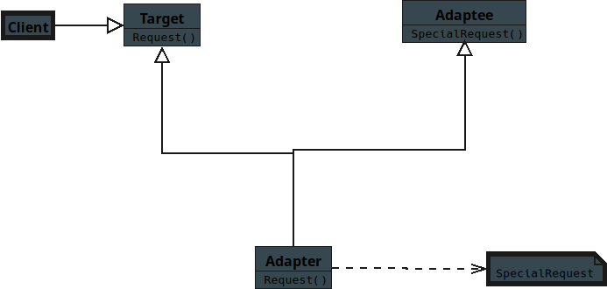
Notes:
(No Sound)

Slide 2
Notes:
Structural Pattern — Adapter for JavaScript Students

Slide 3
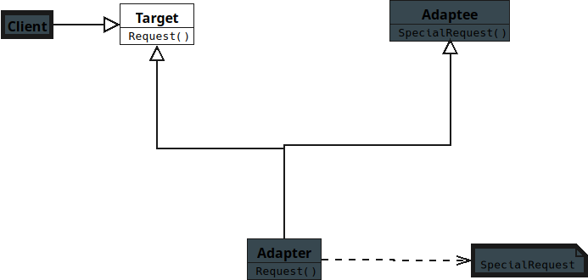
Notes:
Target
Defines the interface the Client expects to use.
Represents the standard way objects should behave.
Used directly by the Client.

Slide 4
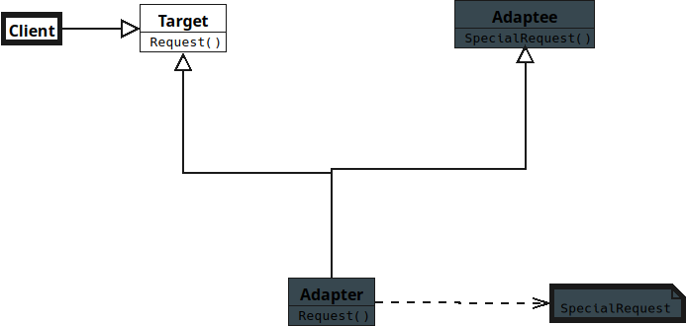
Notes:
Client
Works with objects through the Target interface.
Does not know about Adaptee’s interface.
Uses Adapter to interact with Adaptee.

Slide 5
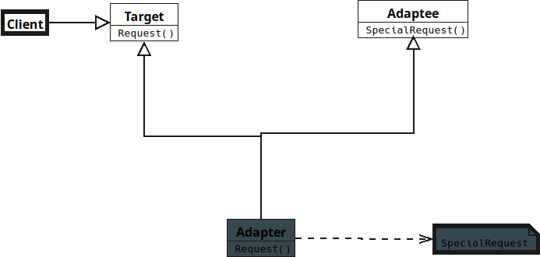
Notes:
Adaptee
Has an existing interface that is incompatible with Target.
Contains useful behavior the Client needs.
Cannot be changed easily.

Slide 6
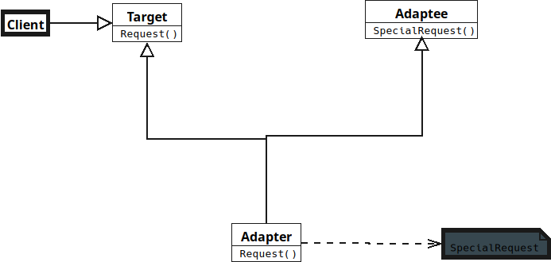
Notes:
Adapter
Implements the Target interface.

Slide 7
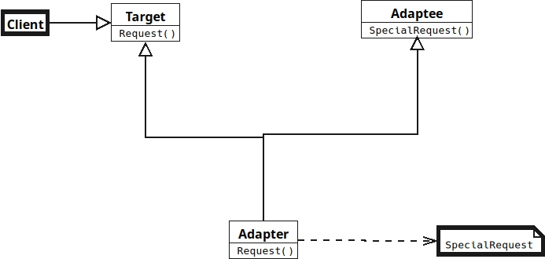
Notes:
Translates Client requests into Adaptee calls.
Connects incompatible interfaces safely.

Slide 8
Notes:
Translates Client requests into Adaptee calls.
Connects incompatible interfaces safely.

