Slide 1

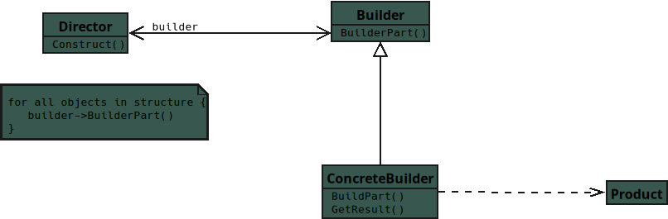
Notes:
Builder — class diagram (for JavaScript Students)

Slide 2
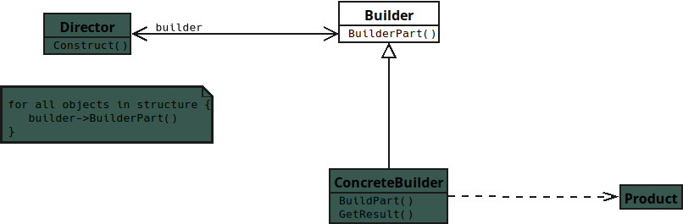
Notes:
Builder
Defines the steps for creating a complex object.
Provides method names that Concrete Builder must implement.
Does not assemble or store the final object.

Slide 3
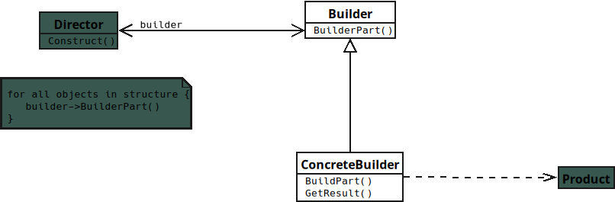
Notes:
Concrete Builder
Implements all building steps defined in Builder.
Actually creates and assembles the product’s parts.
Returns the finished Product at the end.

Slide 4
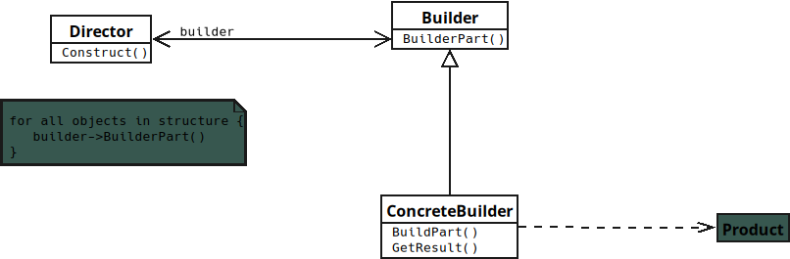
Notes:
Director
Controls the order of building steps.

Slide 5
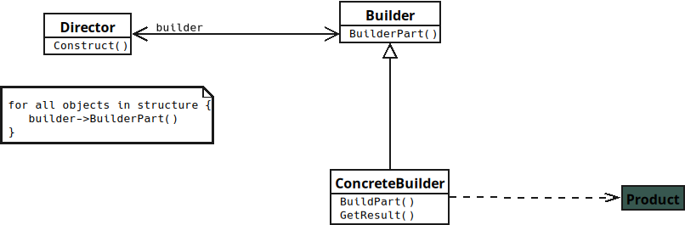
Notes:
Uses a Builder to construct the Product.
Ensures constructions follow a consistent sequence.

Slide 6
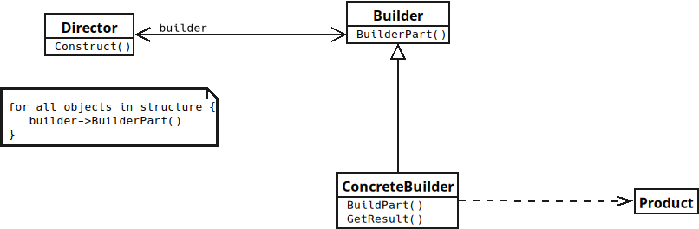
Notes:
Product
The final complex object being built.
Contains many parts assembled by Concrete Builder.
Returned to the Client after construction.

