Slide 1
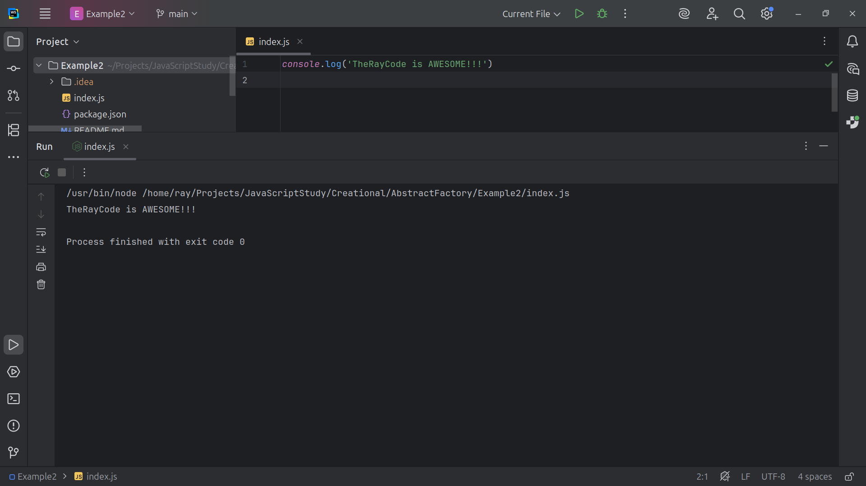
Notes:
Hello, I’m Ray of TheRayCode

Slide 2
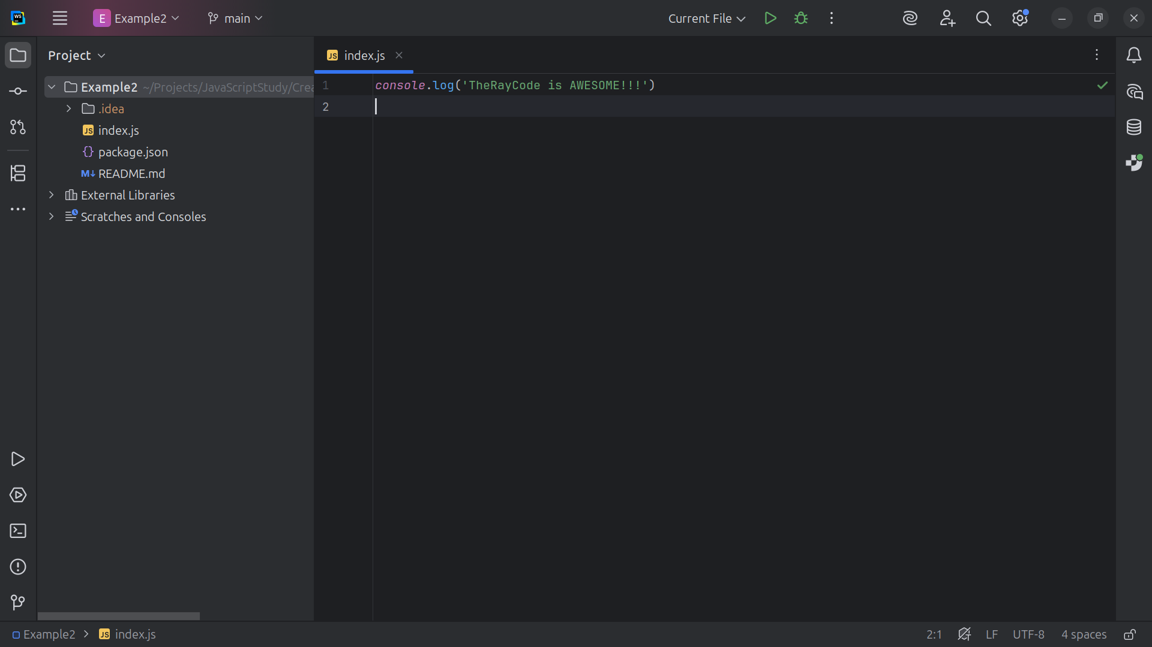
Notes:
In this video I will be giving a presentation of the Abstract Factory and I will be using JavaScriot

Slide 3
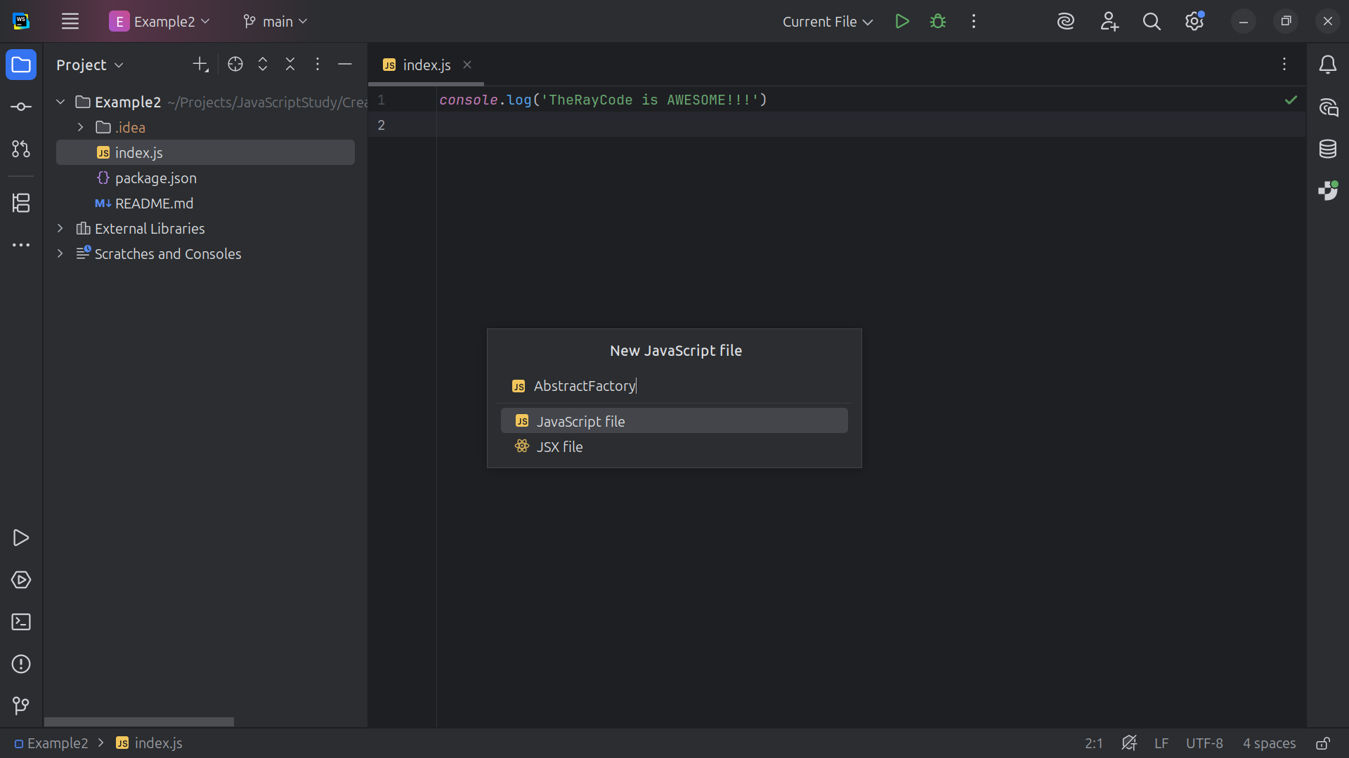
Notes:
We start with our Abstract Factory

Slide 4
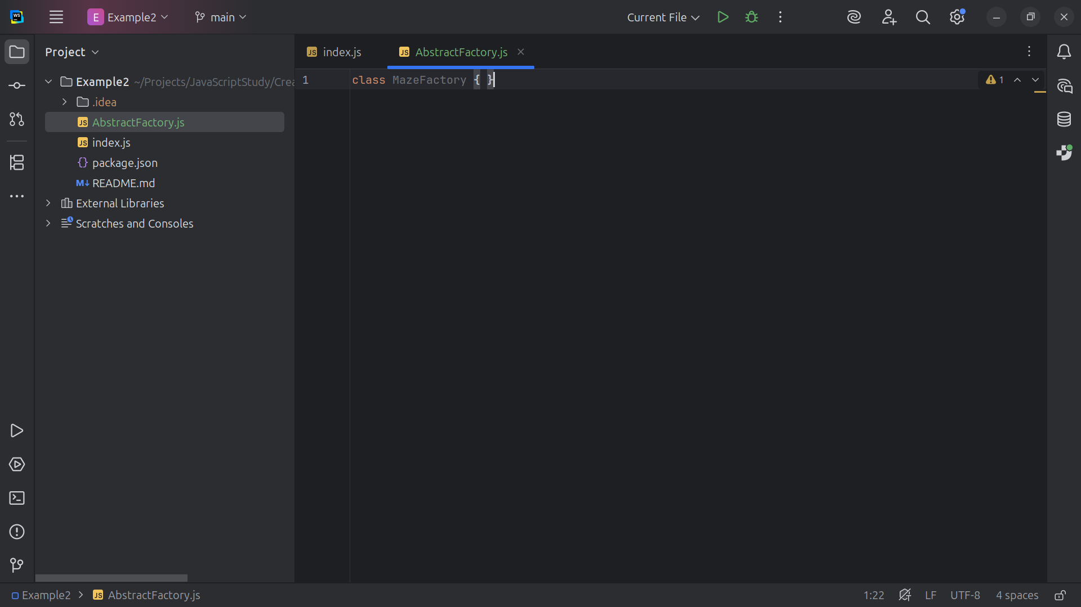
Notes:
Our Abstract Factory will be our Maze Factory for this demo

Slide 5
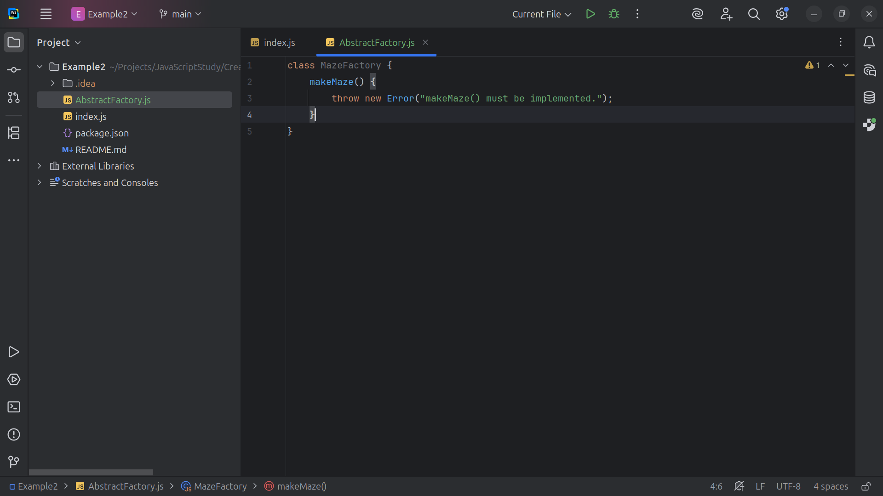
Notes:
Our Maze Factory will be able to make a maze

Slide 6
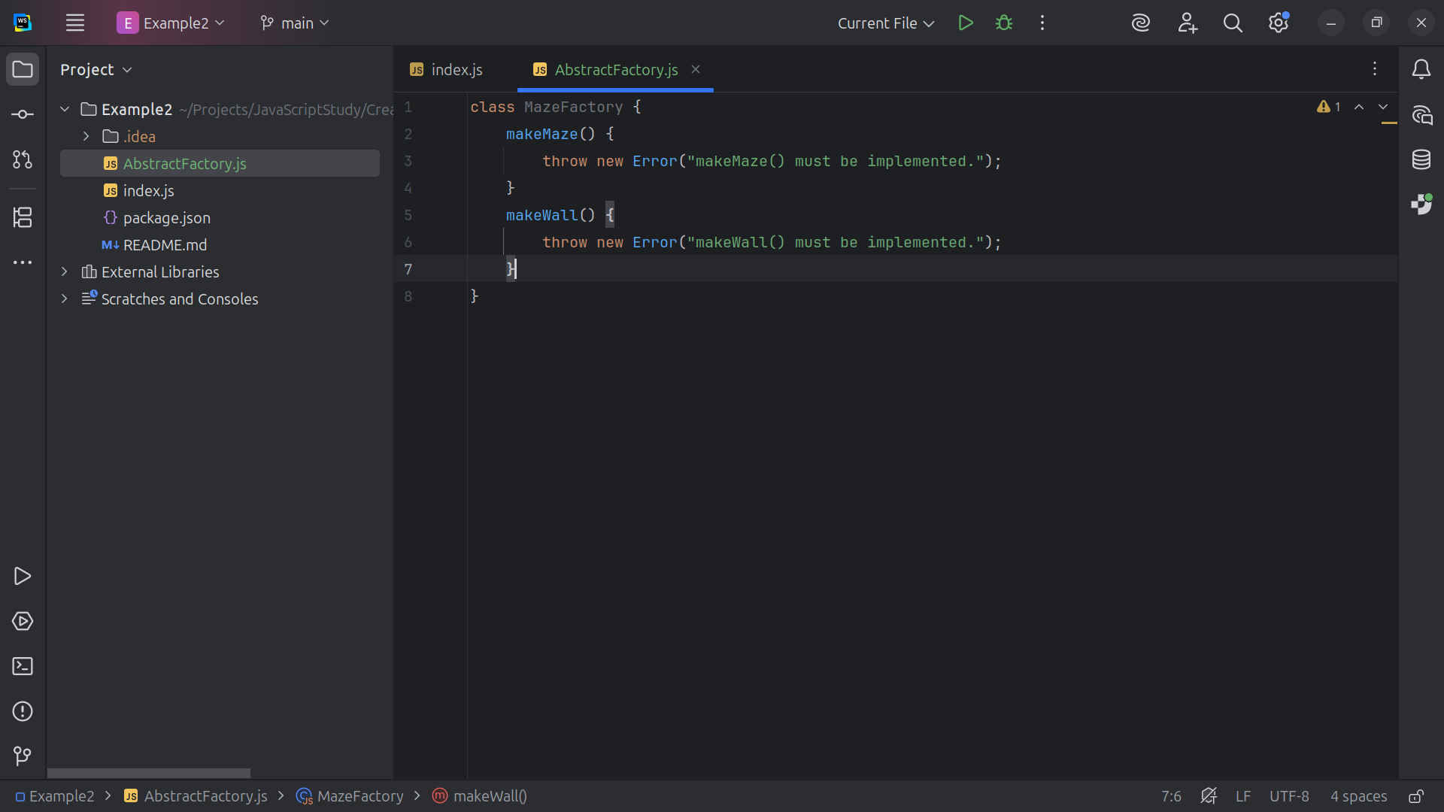
Notes:
Make a wall

Slide 7
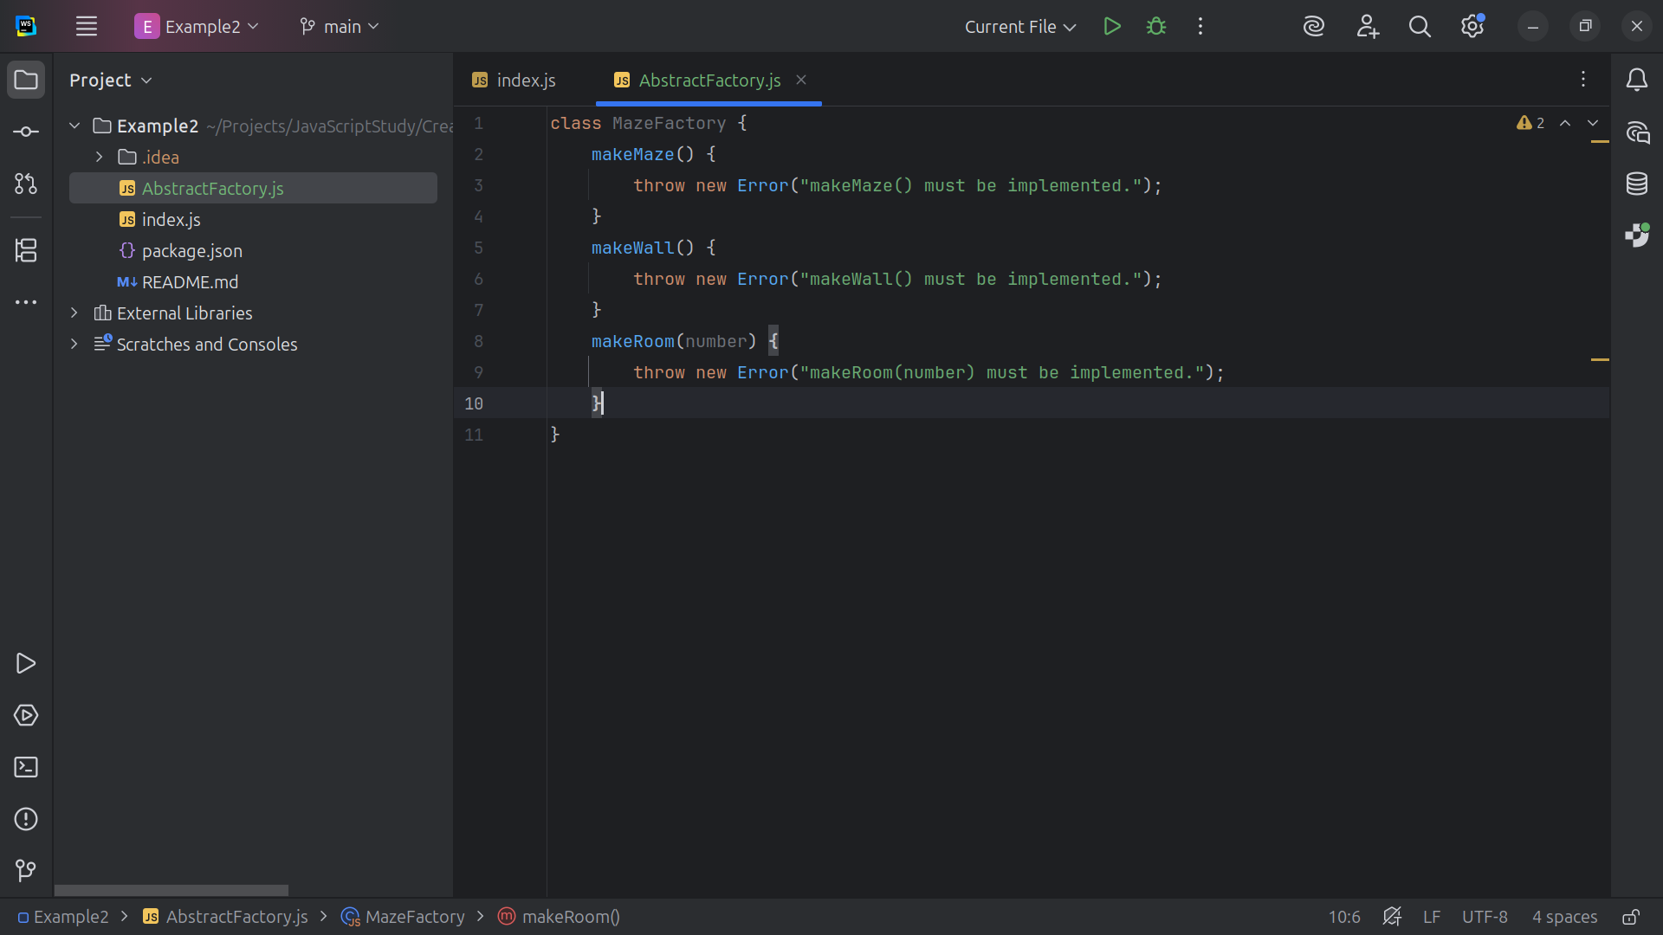
Notes:
Make a room, we will need to pass in the Room number

Slide 8
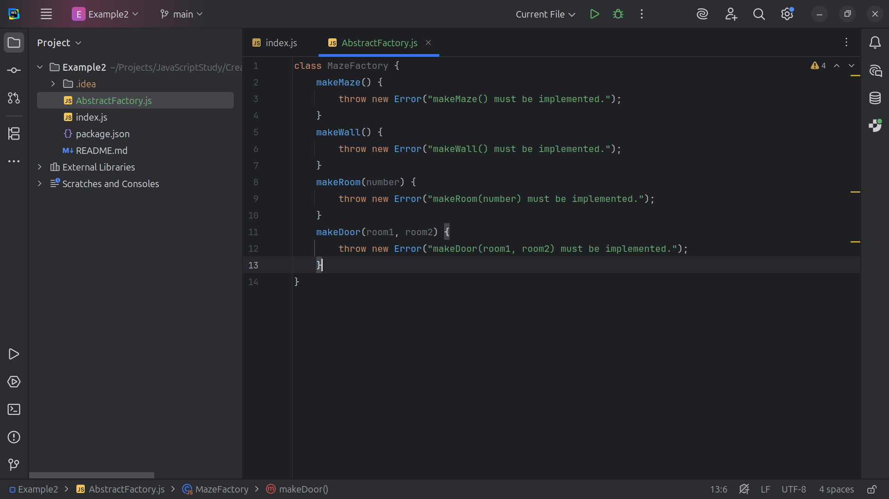
Notes:
And we make make Door which will lead from room 1 to room 2

Slide 9
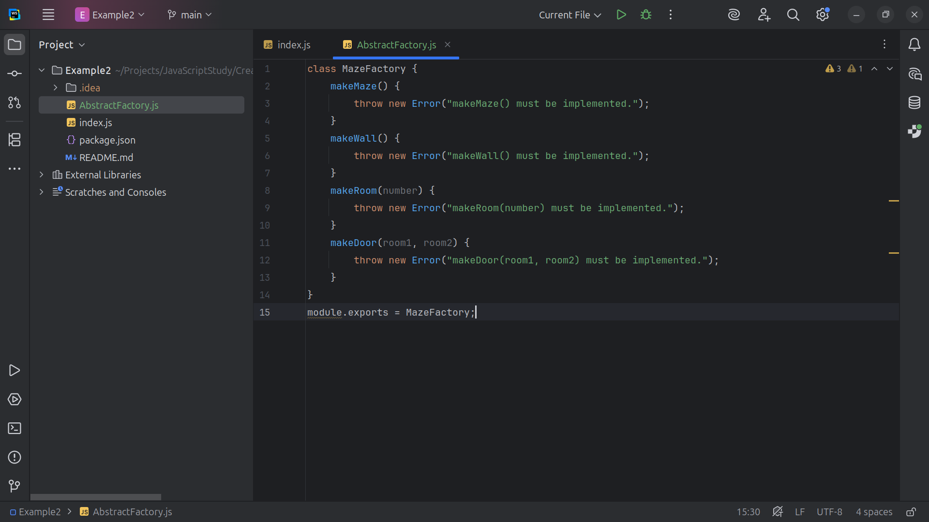
Notes:
And we export the Maze Factory for use I our demo

Slide 10
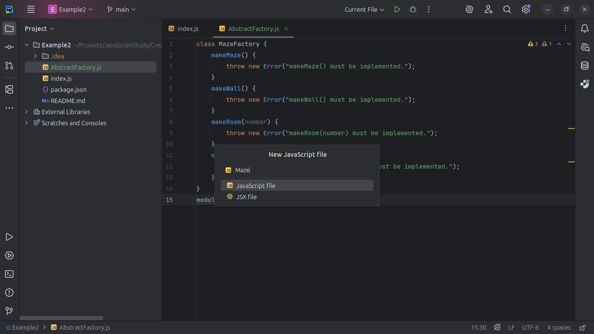
Notes:
Next we create JavaScript Class Maze

Slide 11
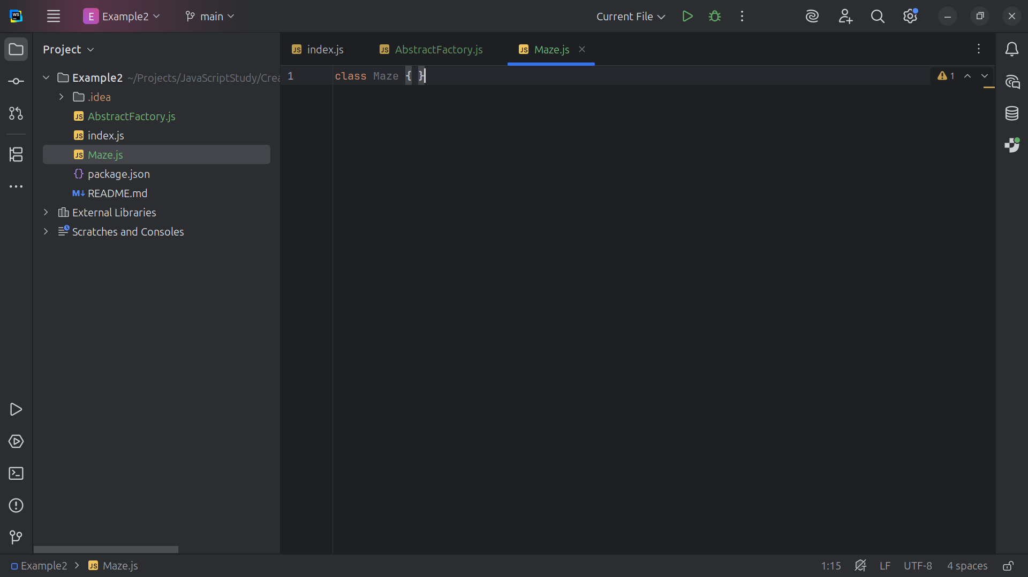
Notes:
Here we have the Maze class structure

Slide 12
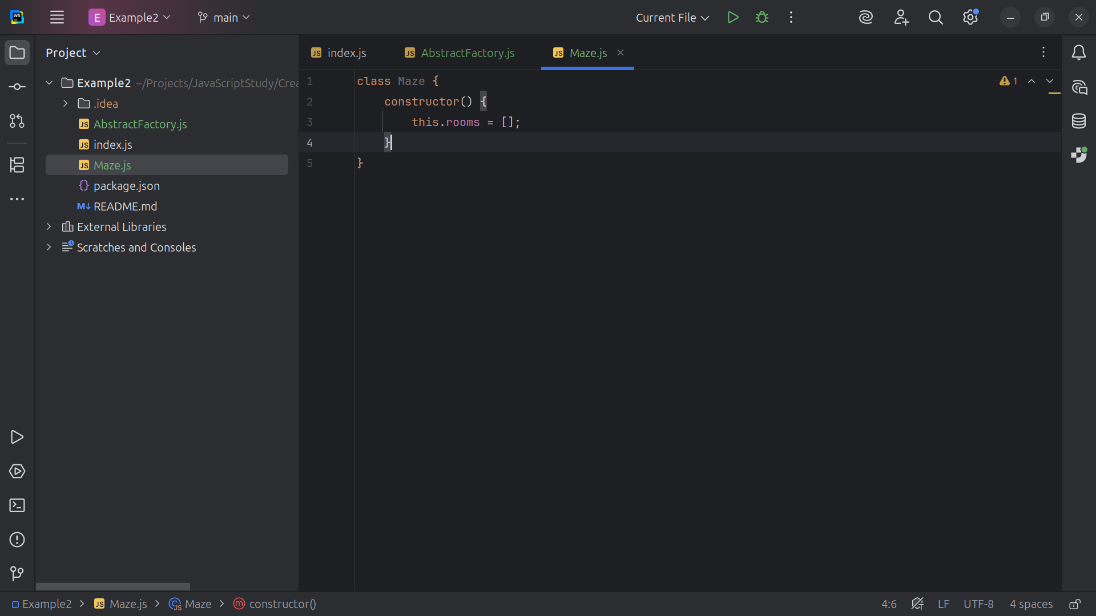
Notes:
We build a constructor that sets this to a array of rooms

Slide 13
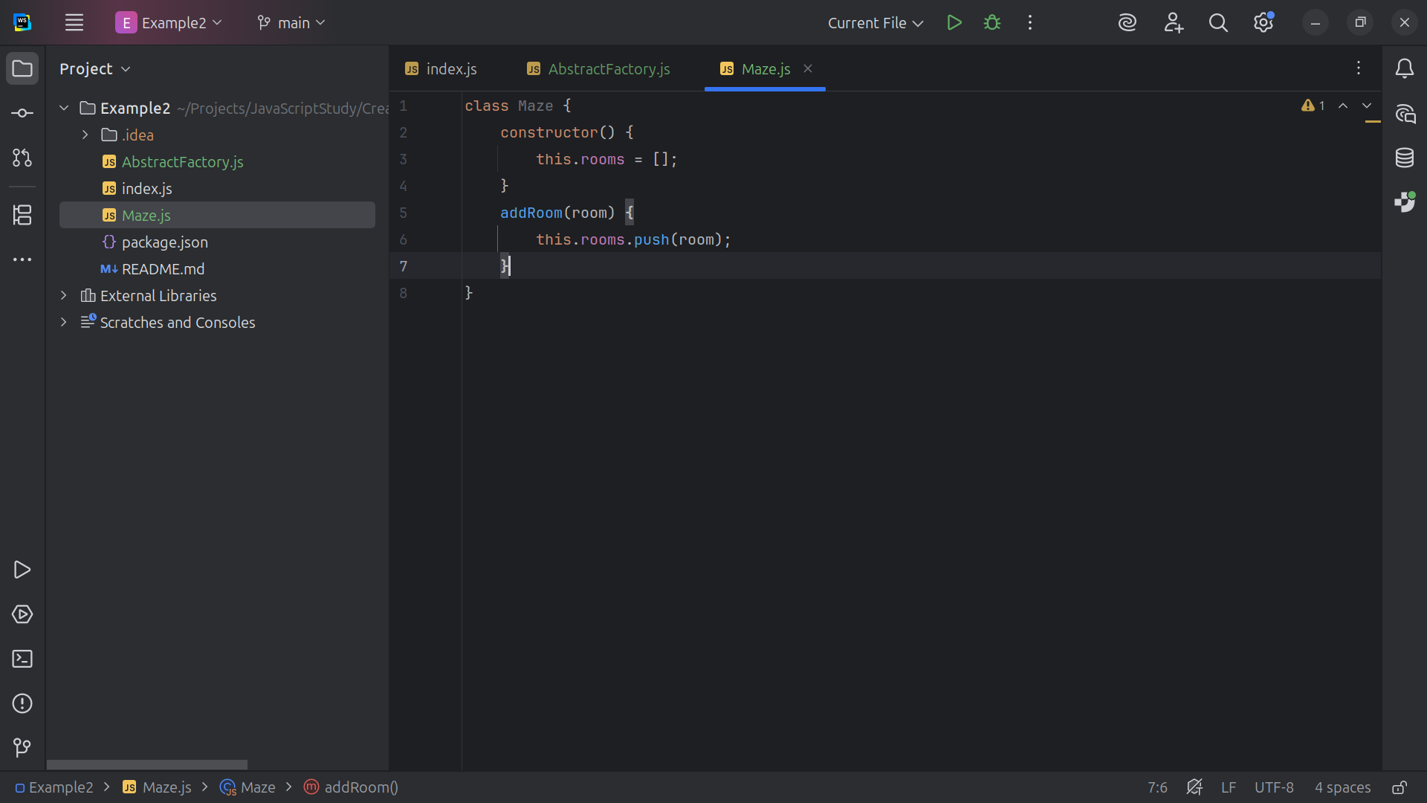
Notes:
We have a method to add room, we push on to the array list stack

Slide 14
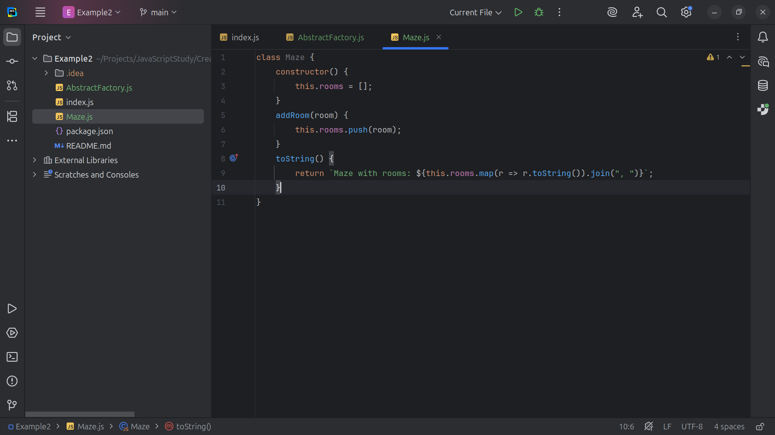
Notes:
And we print to string Maze with rooms, just joined

Slide 15
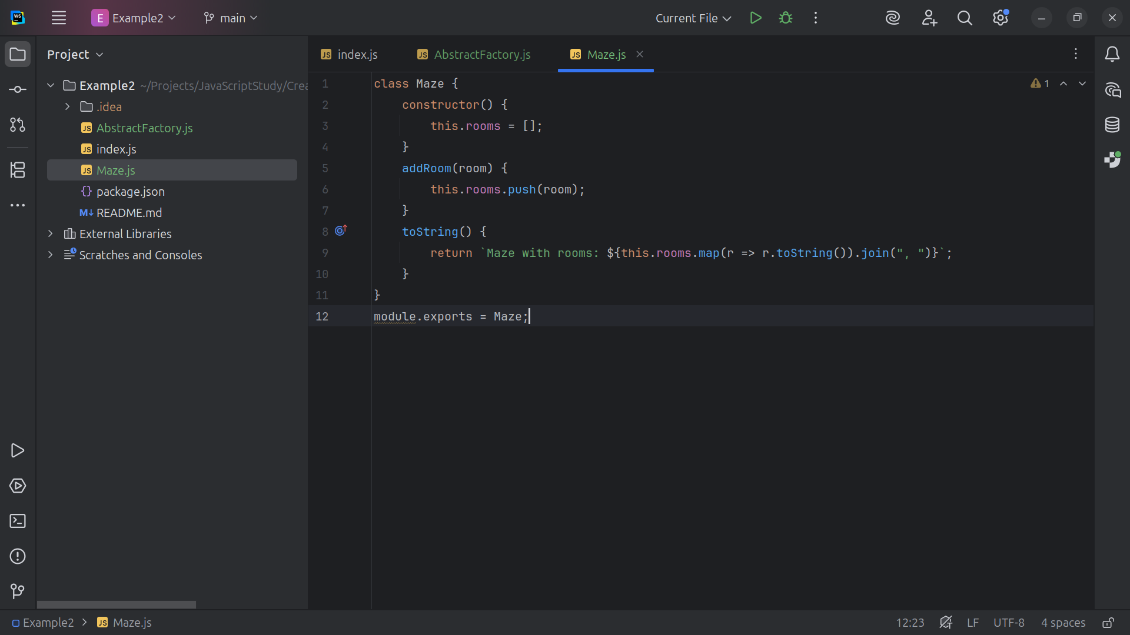
Notes:
And we close the file with a module Export

Slide 16
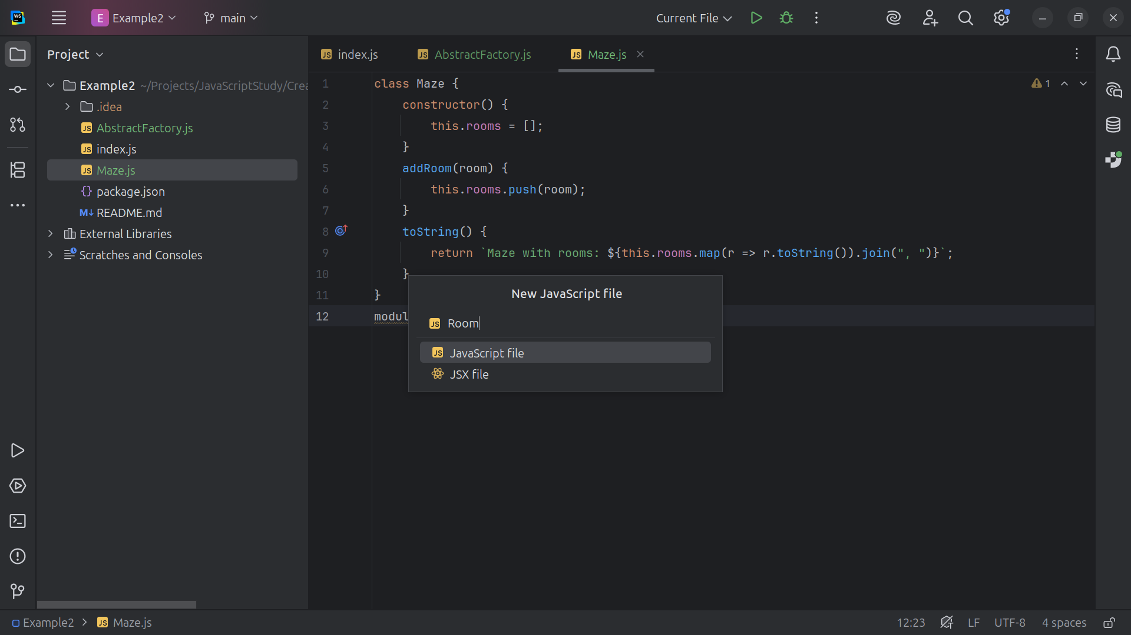
Notes:
Now let’s create a class for Room

Slide 17
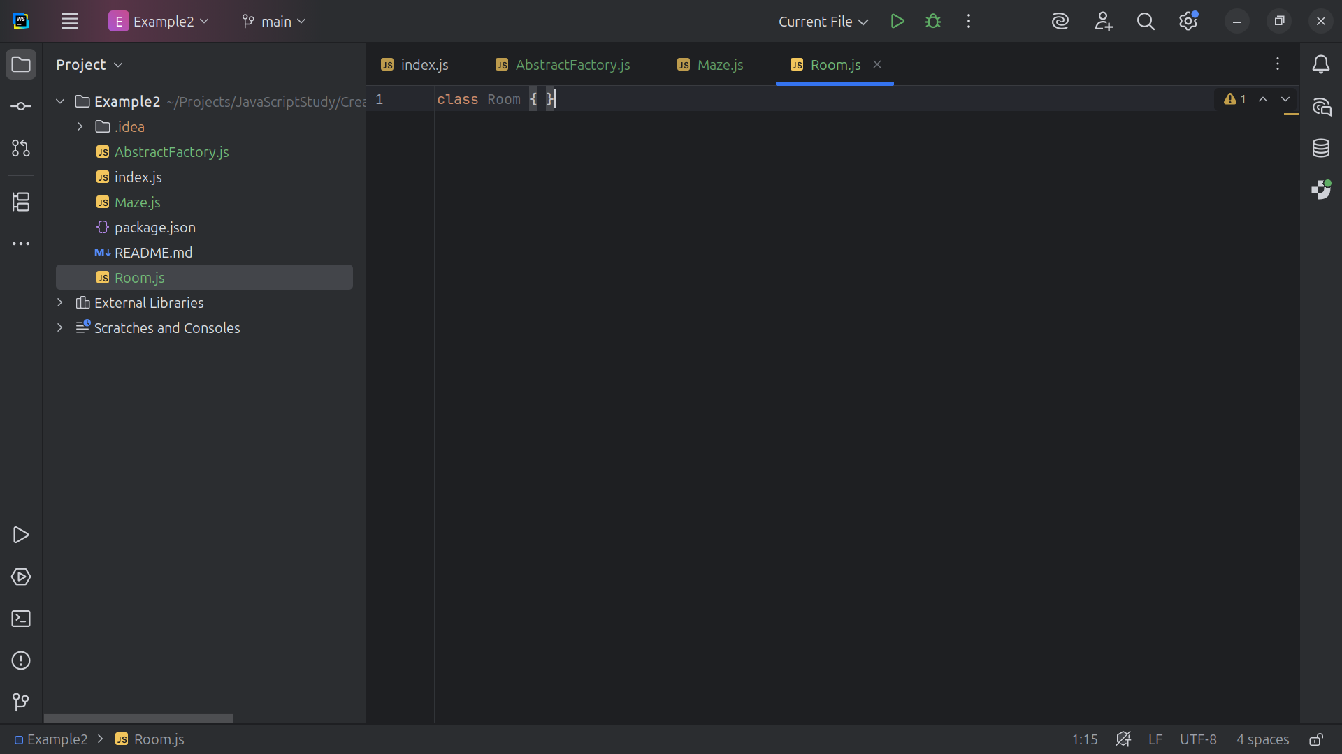
Notes:
Here is the class structure for Room

Slide 18
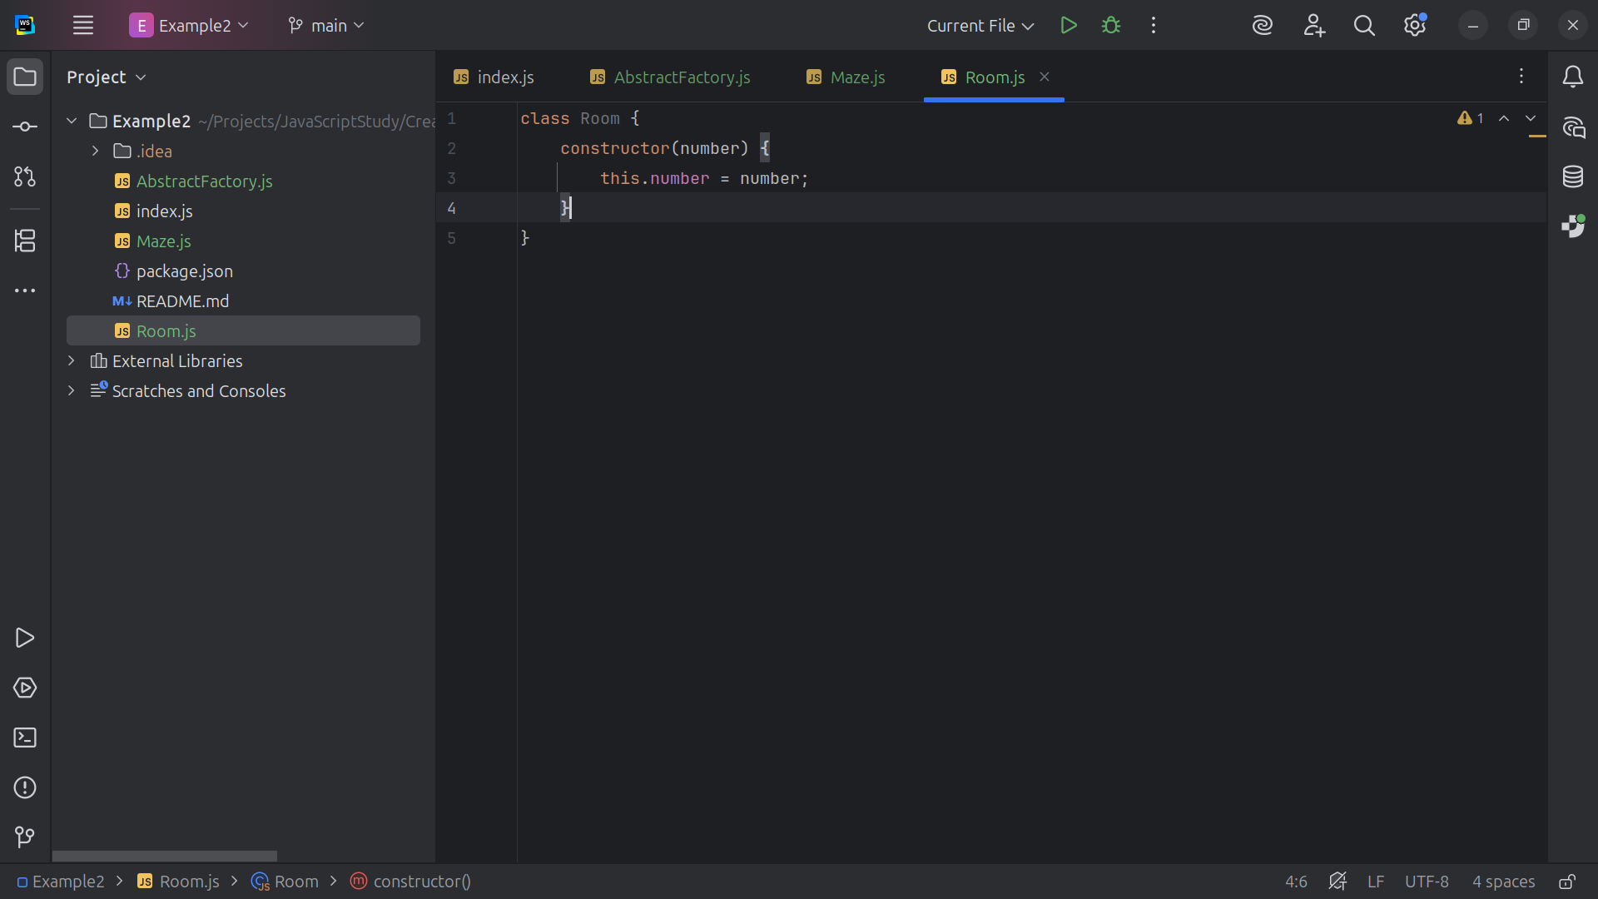
Notes:
We have a constructor that takes a number

Slide 19
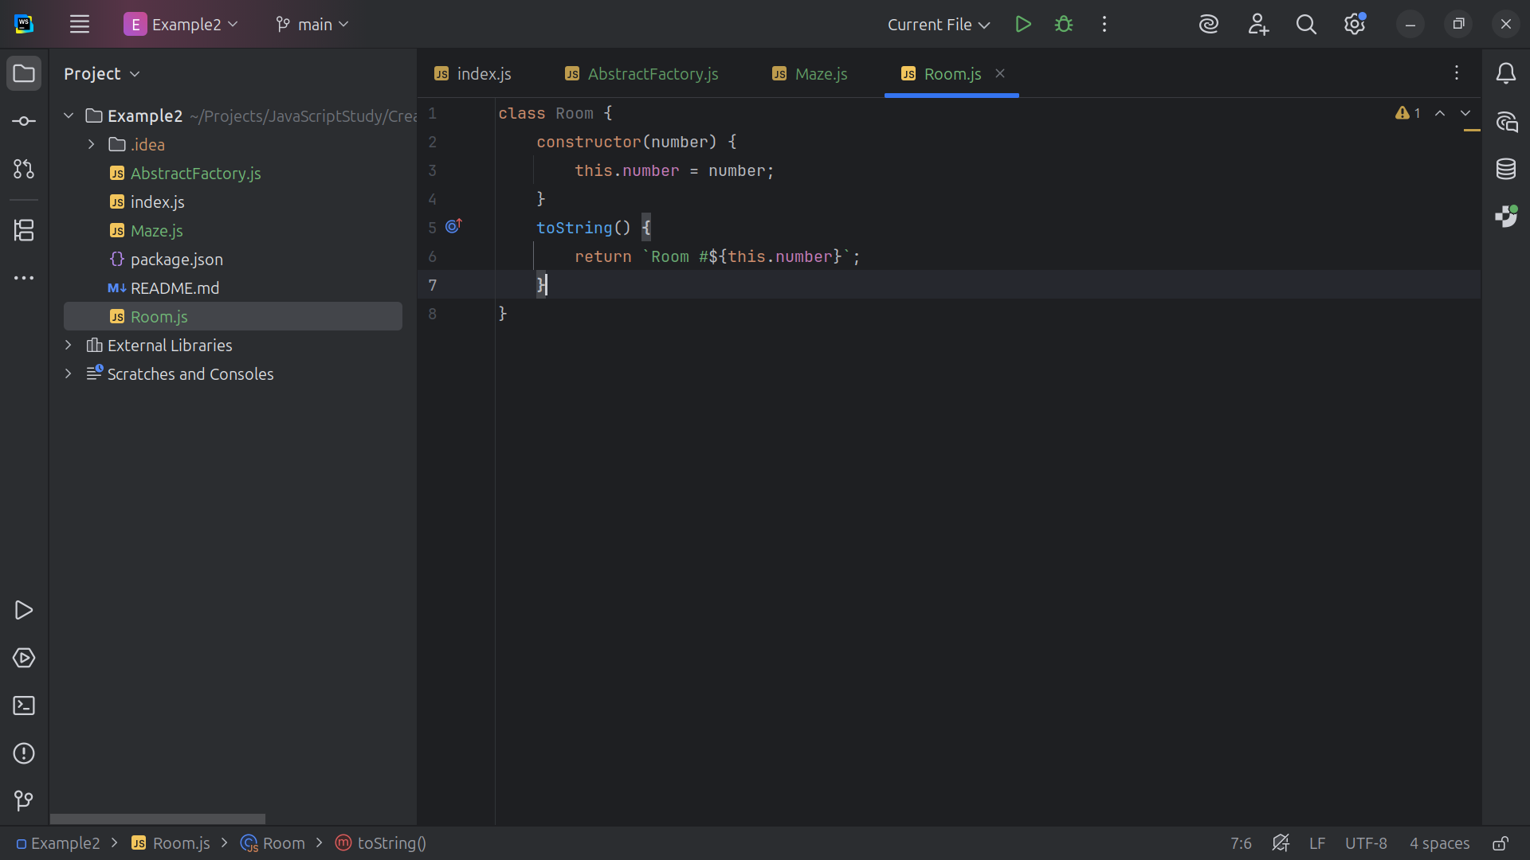
Notes:
We print out Room and the number

Slide 20
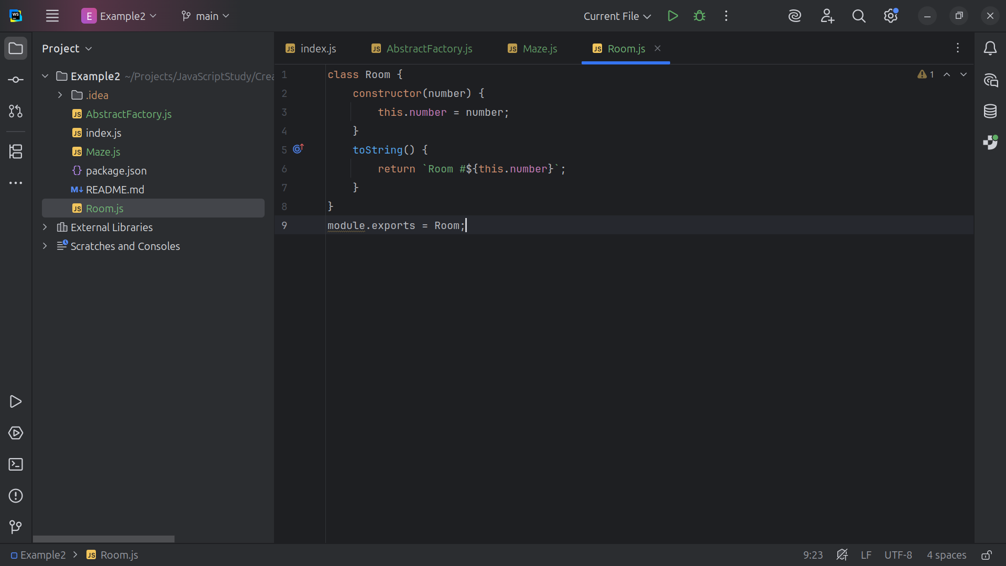
Notes:
And we export this module to use

Slide 21
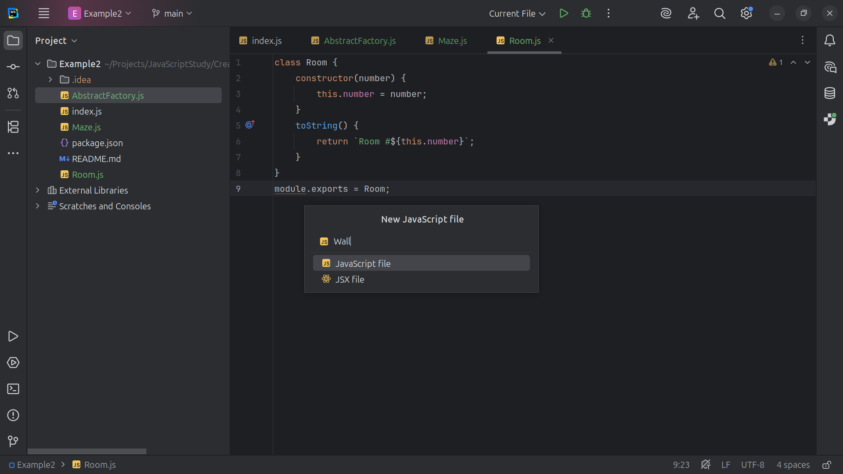
Notes:
Now let’s create a Wall class

Slide 22
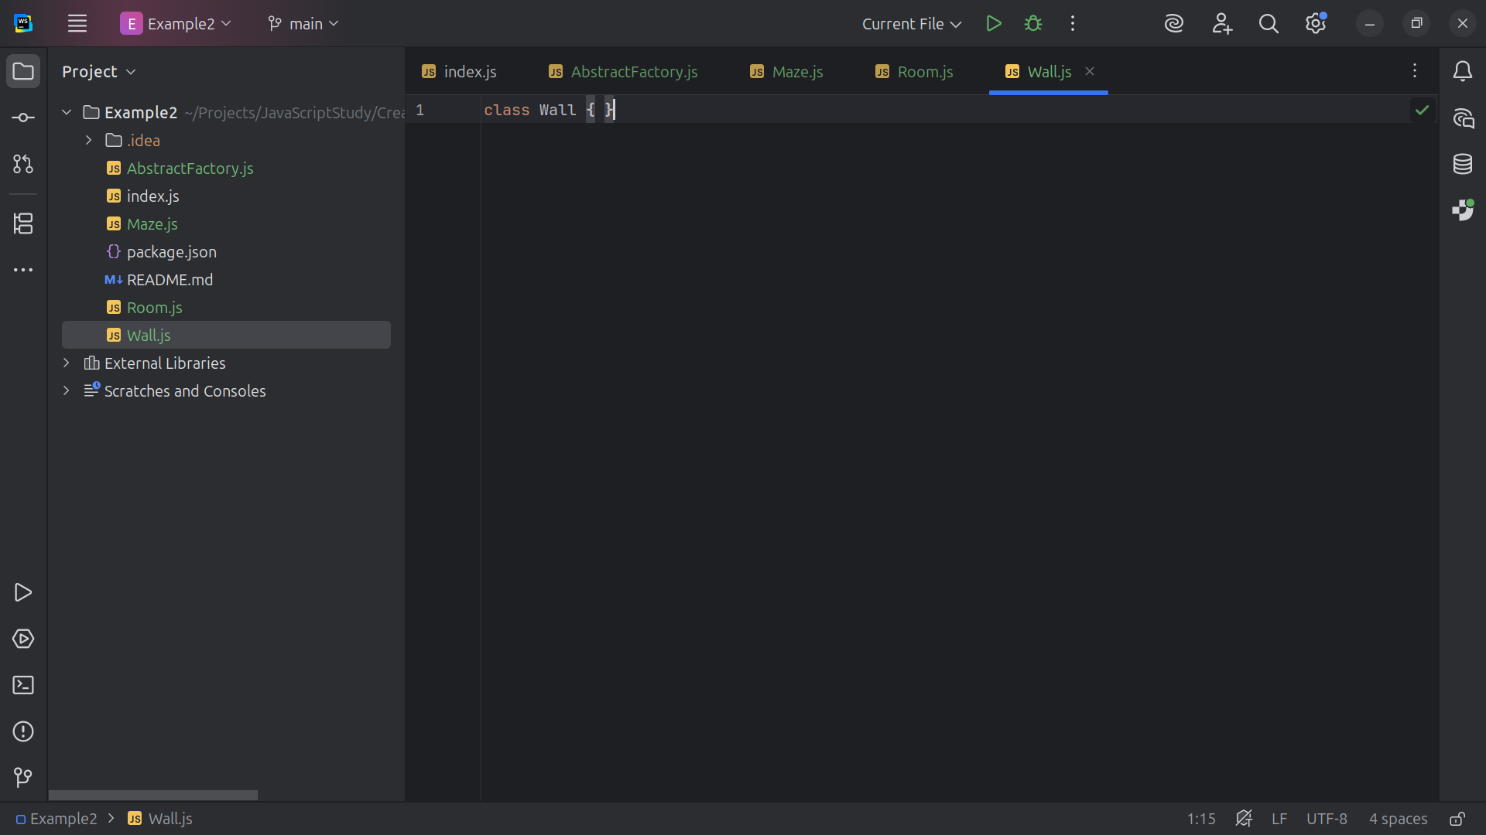
Notes:
The wall decides Rooms

Slide 23
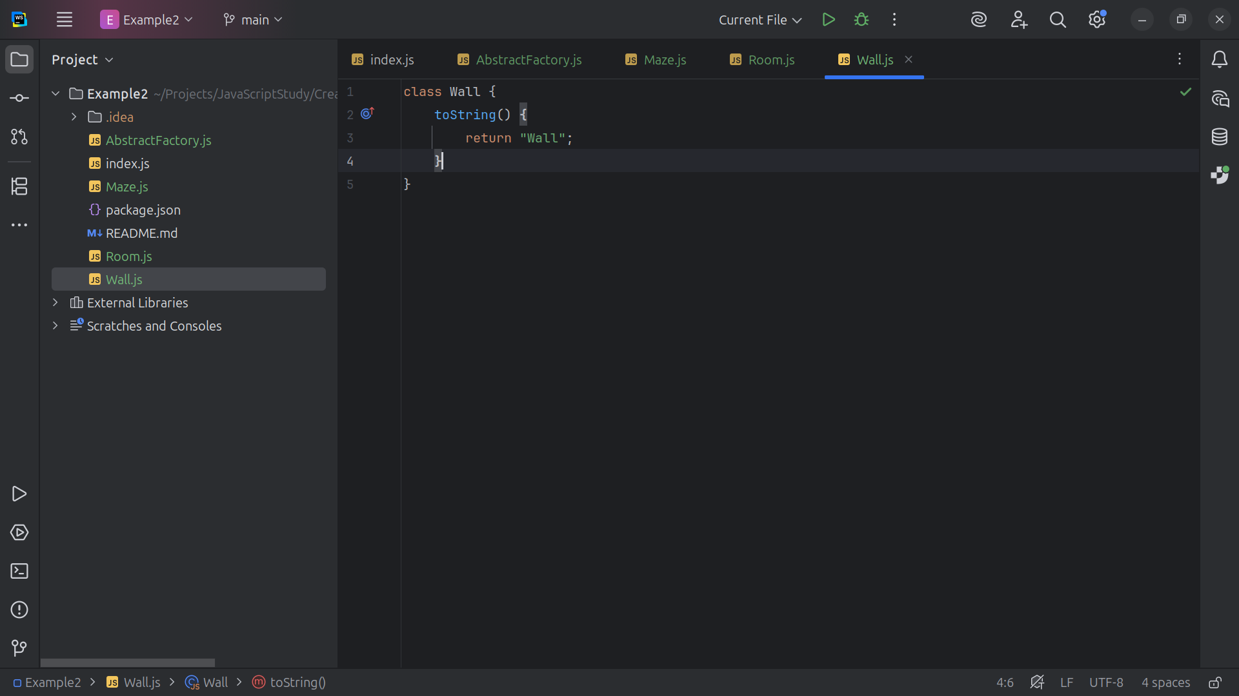
Notes:
So we return the string Wall

Slide 24
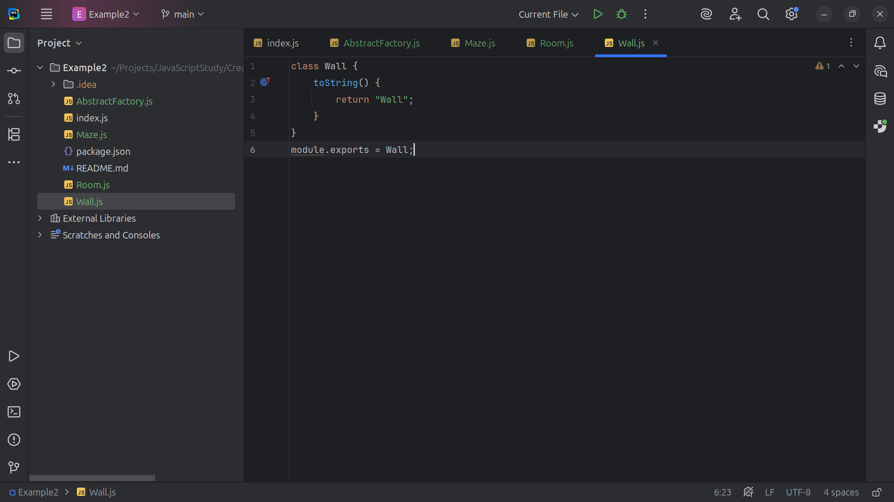
Notes:
And we export the module for use

Slide 25
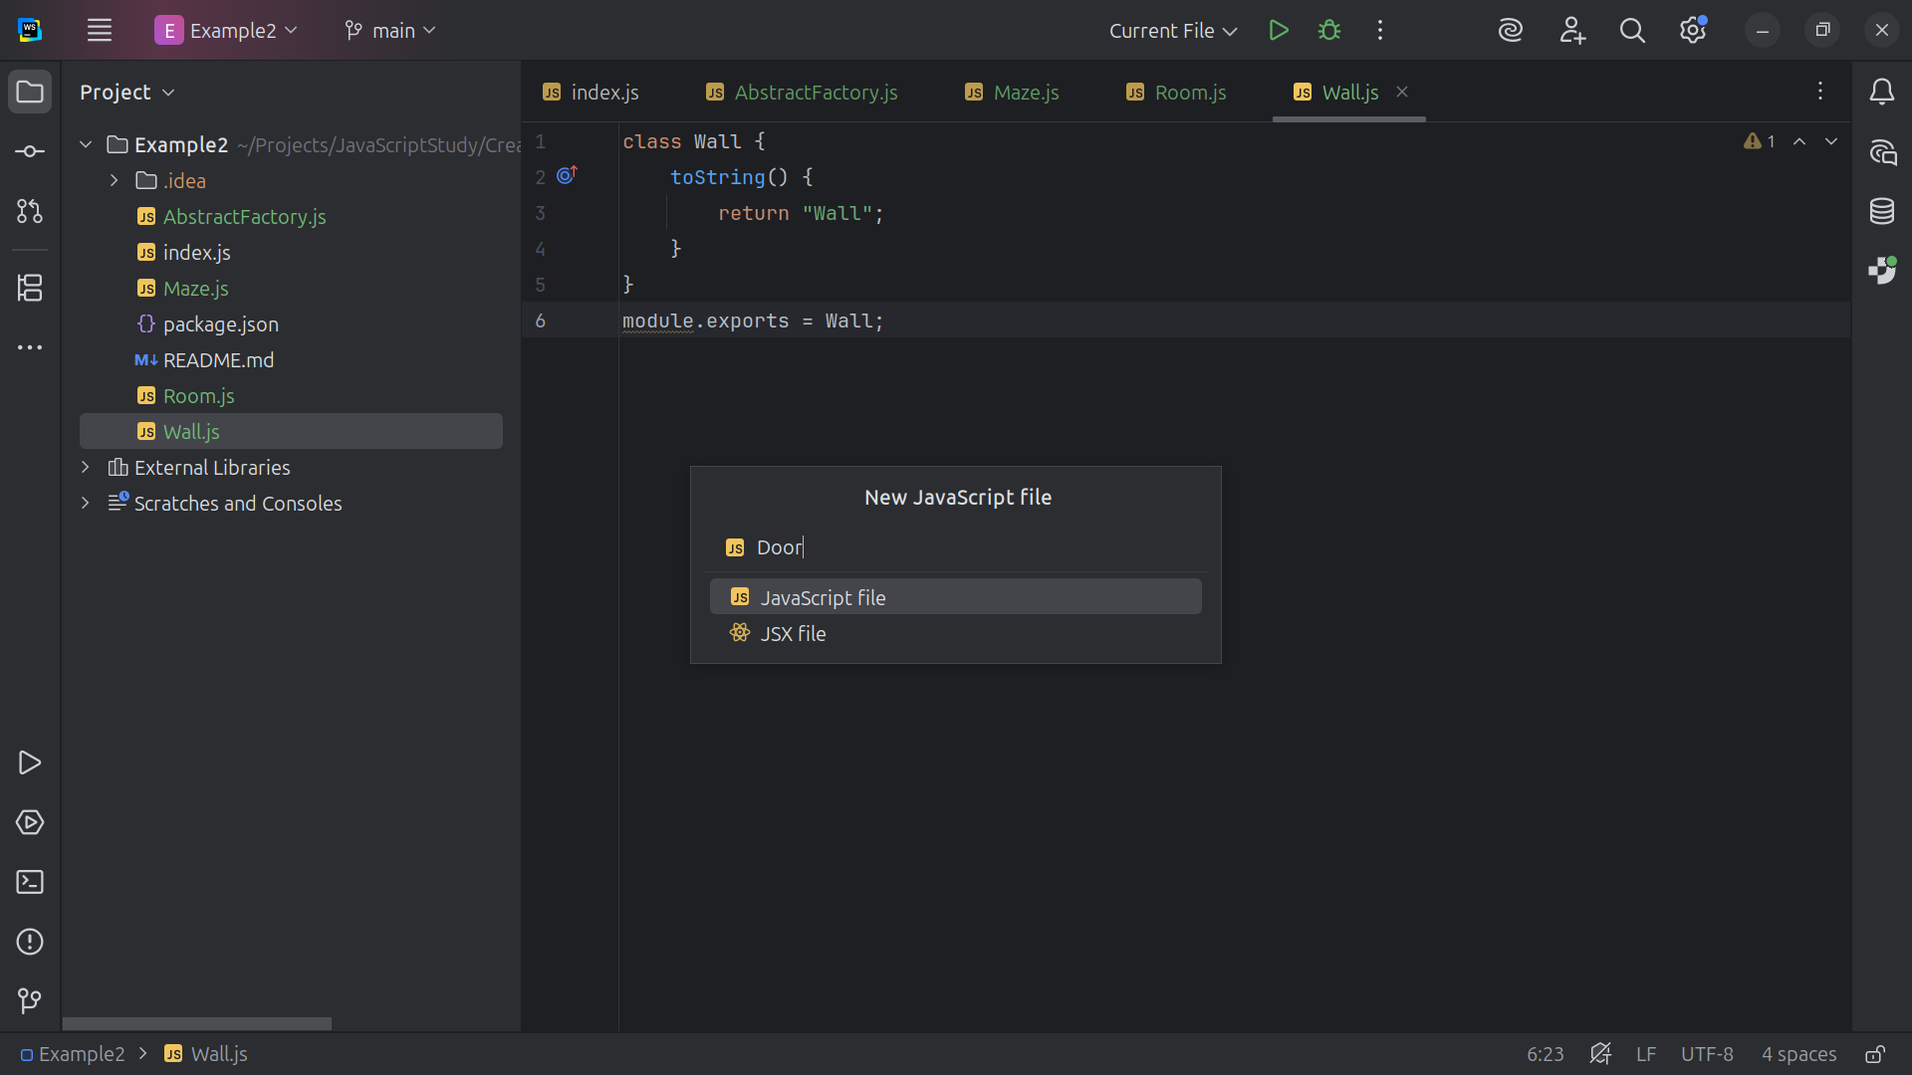
Notes:
Let’s crate a Door

Slide 26
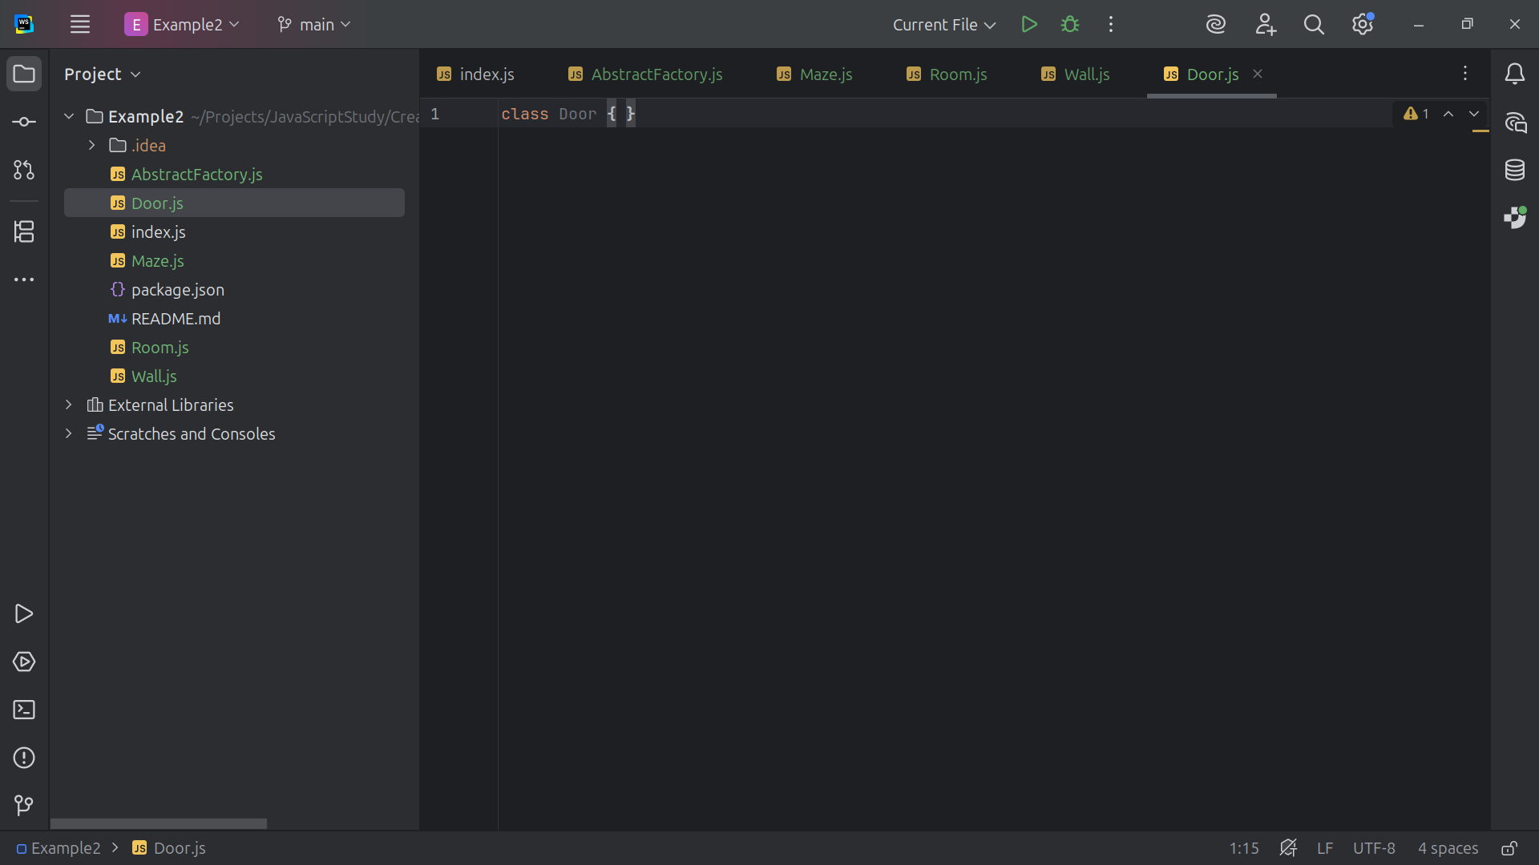
Notes:
A door joins two rooms.

Slide 27
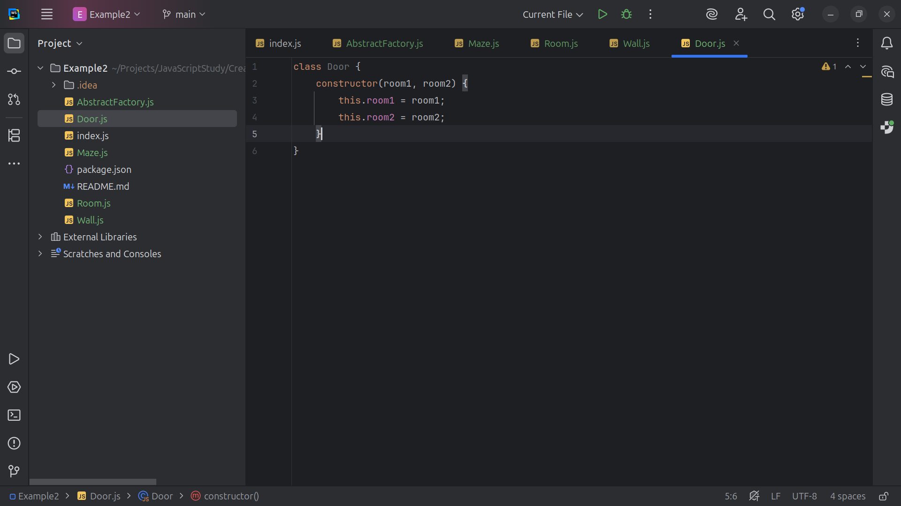
Notes:
This will be a door between two rooms room variable a a room variable two

Slide 28
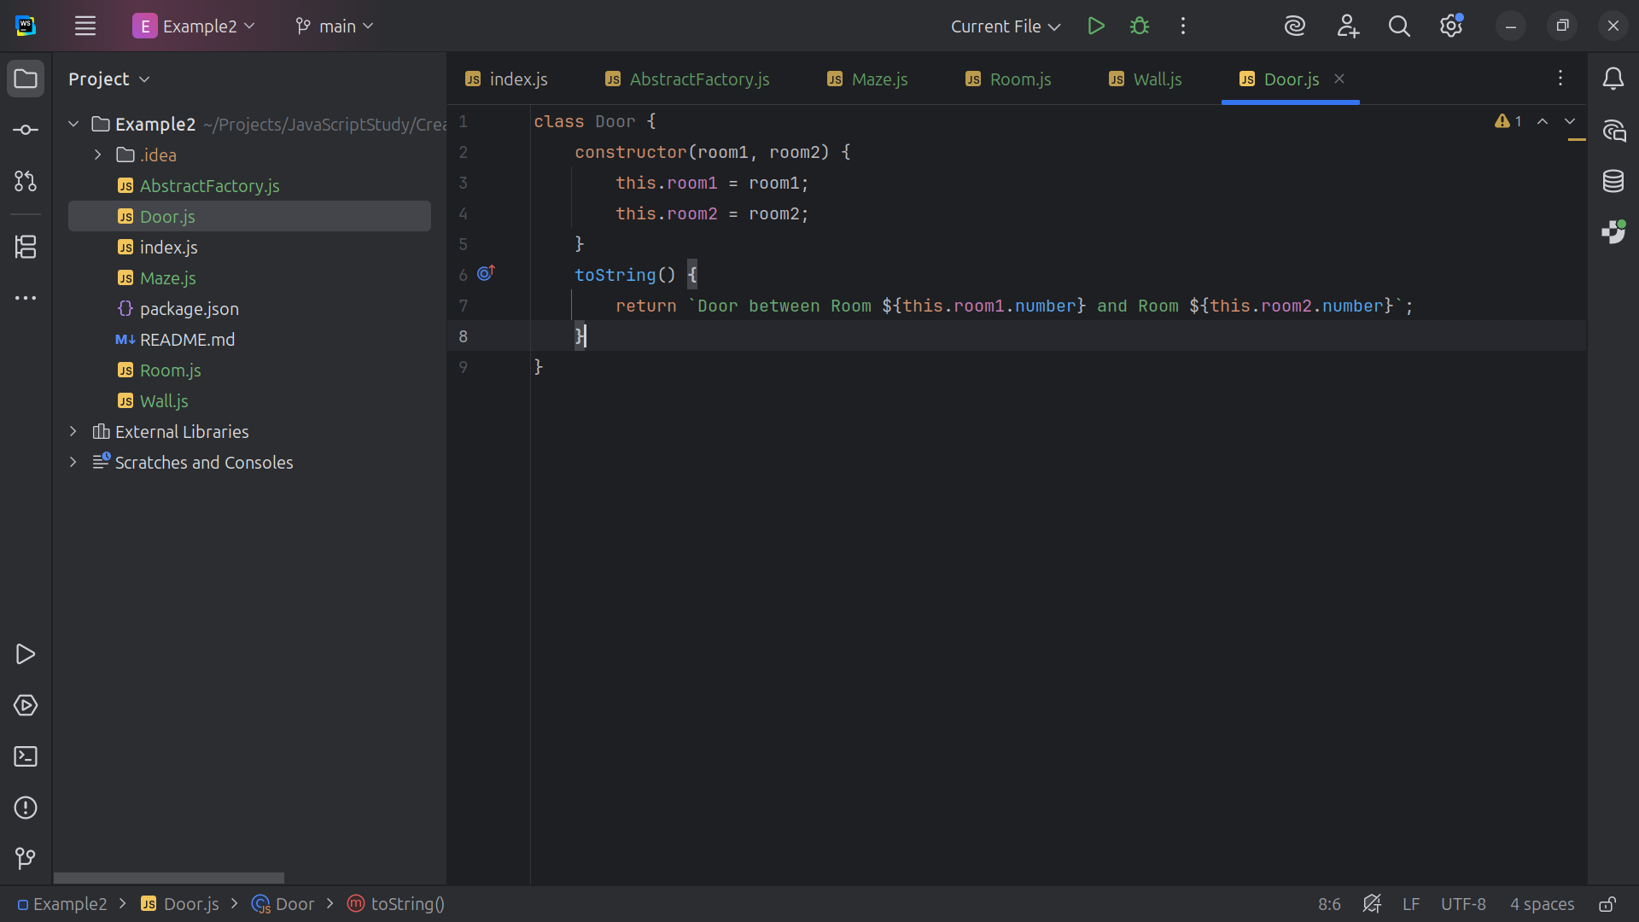
Notes:
We return the string Door between Room room1 and room2

Slide 29
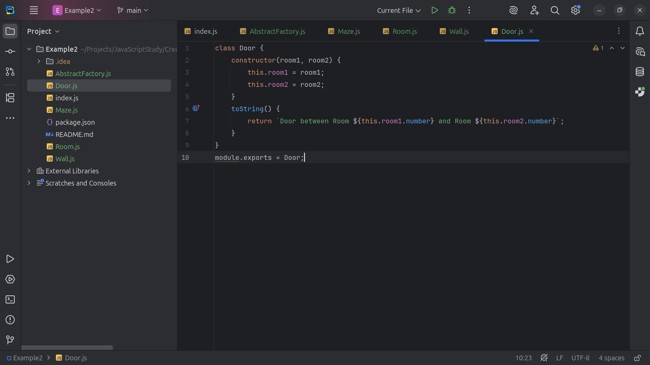
Notes:
And we export this module

Slide 30
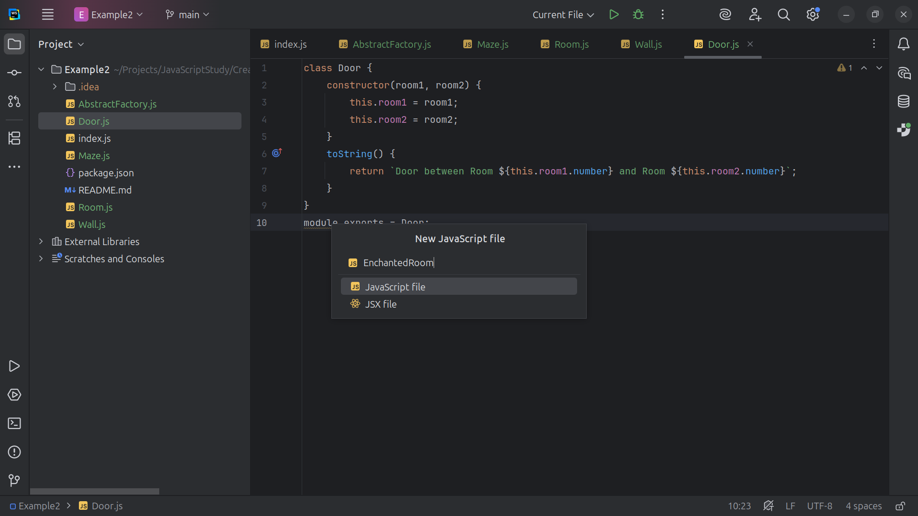
Notes:
Now let’s create the Enchanted Rooms

Slide 31
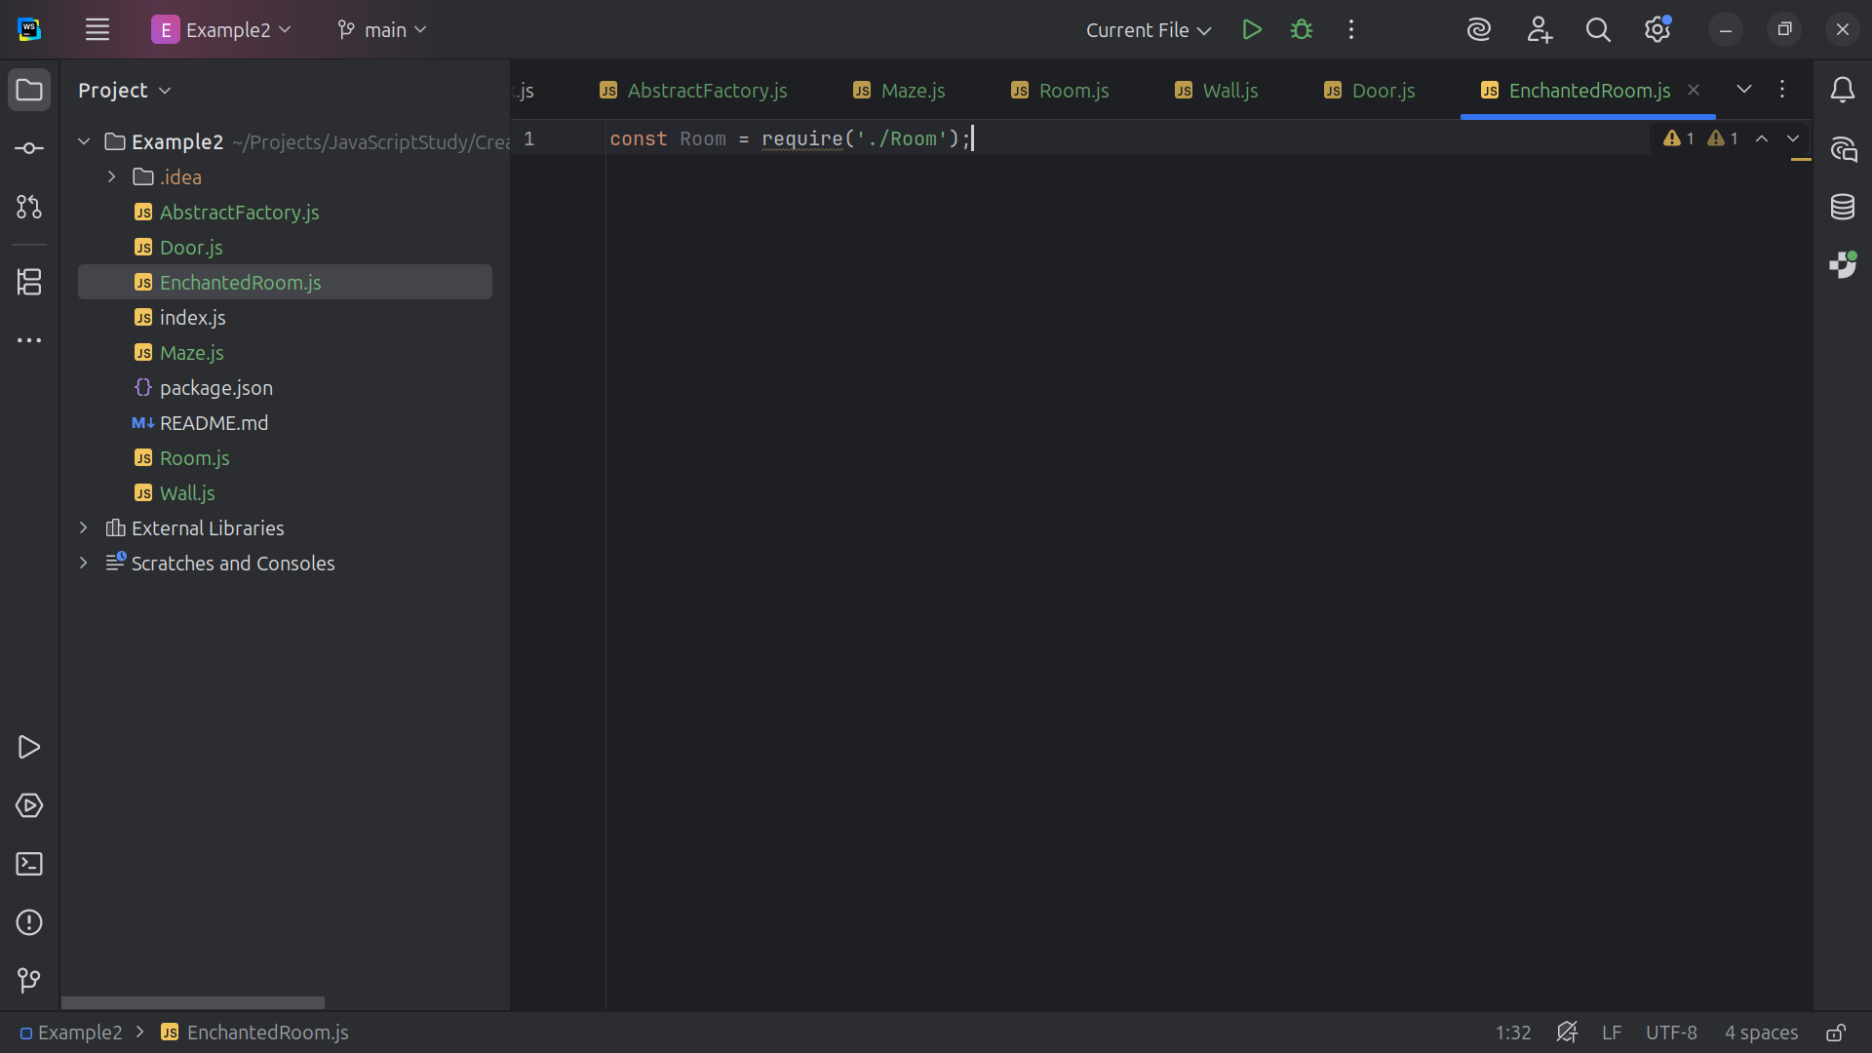
Notes:
The Enchanted Room will require Room

Slide 32
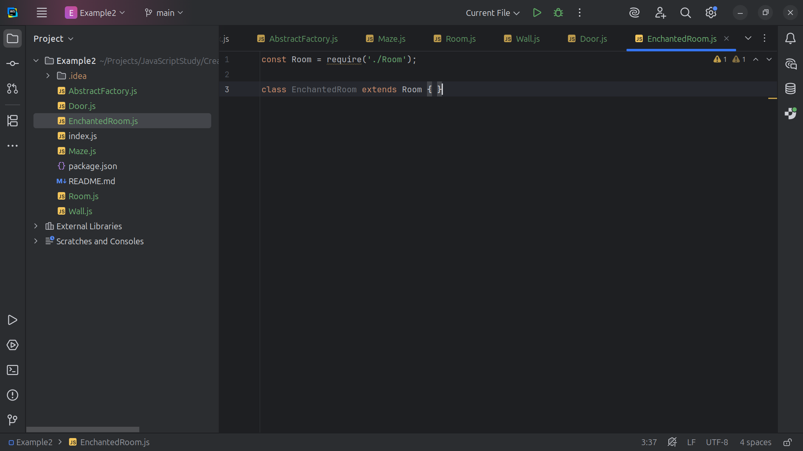
Notes:
Because the Enchanted Room is extended with the Room

Slide 33
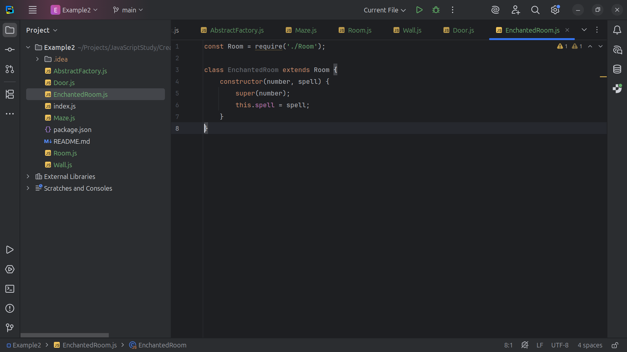
Notes:
And we construct a room with a number and a spell

Slide 34
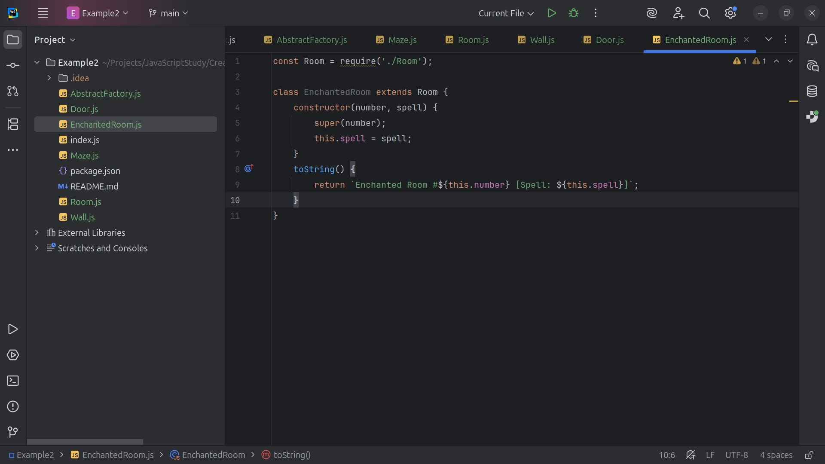
Notes:
And we return the string Enchanted Room given the room number an a spell

Slide 35
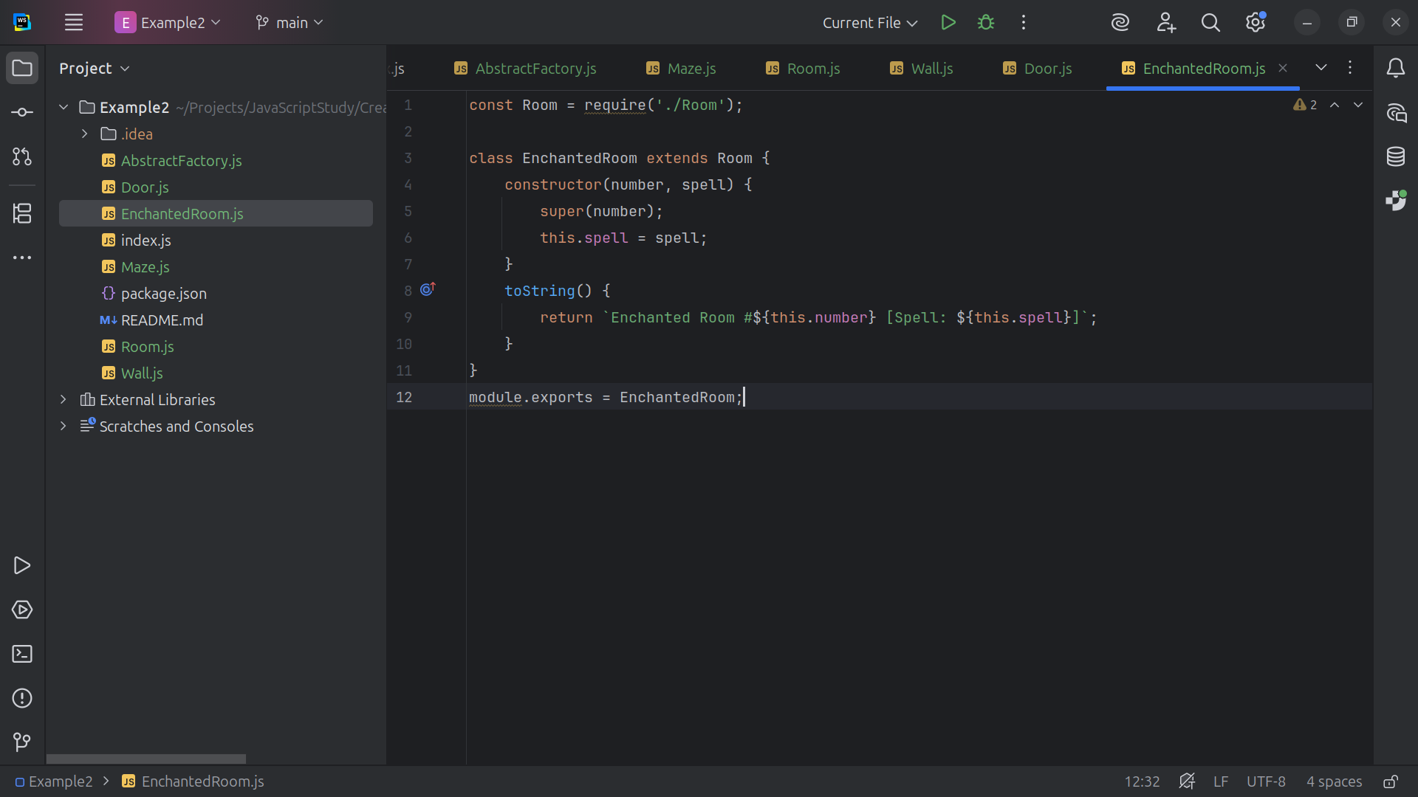
Notes:
And we export this module as Enchanted Room

Slide 36
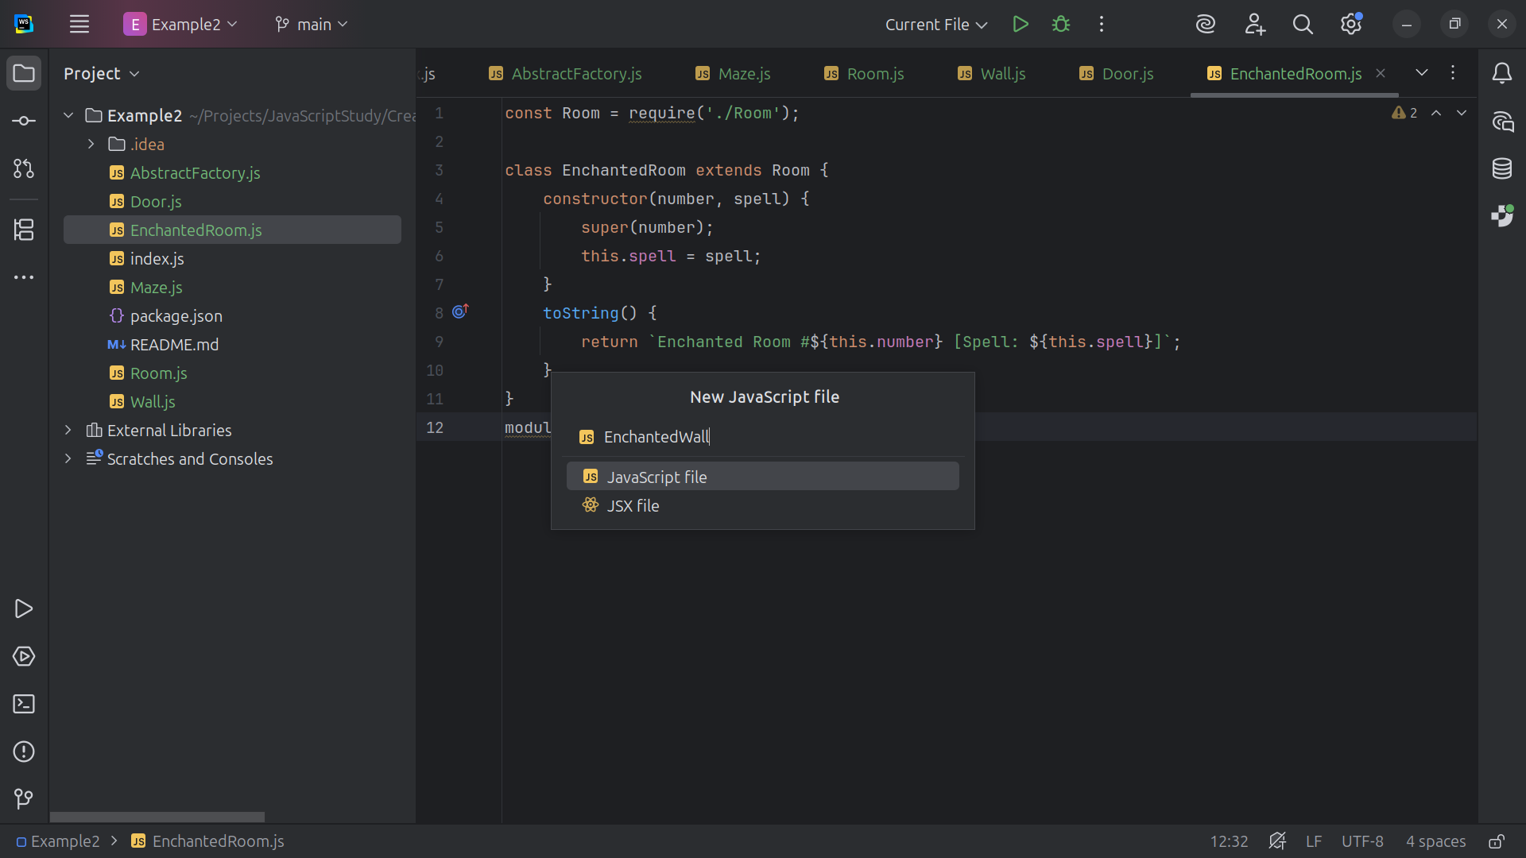
Notes:
Our next Enchanted Variant will be the Enchanted Wall

Slide 37
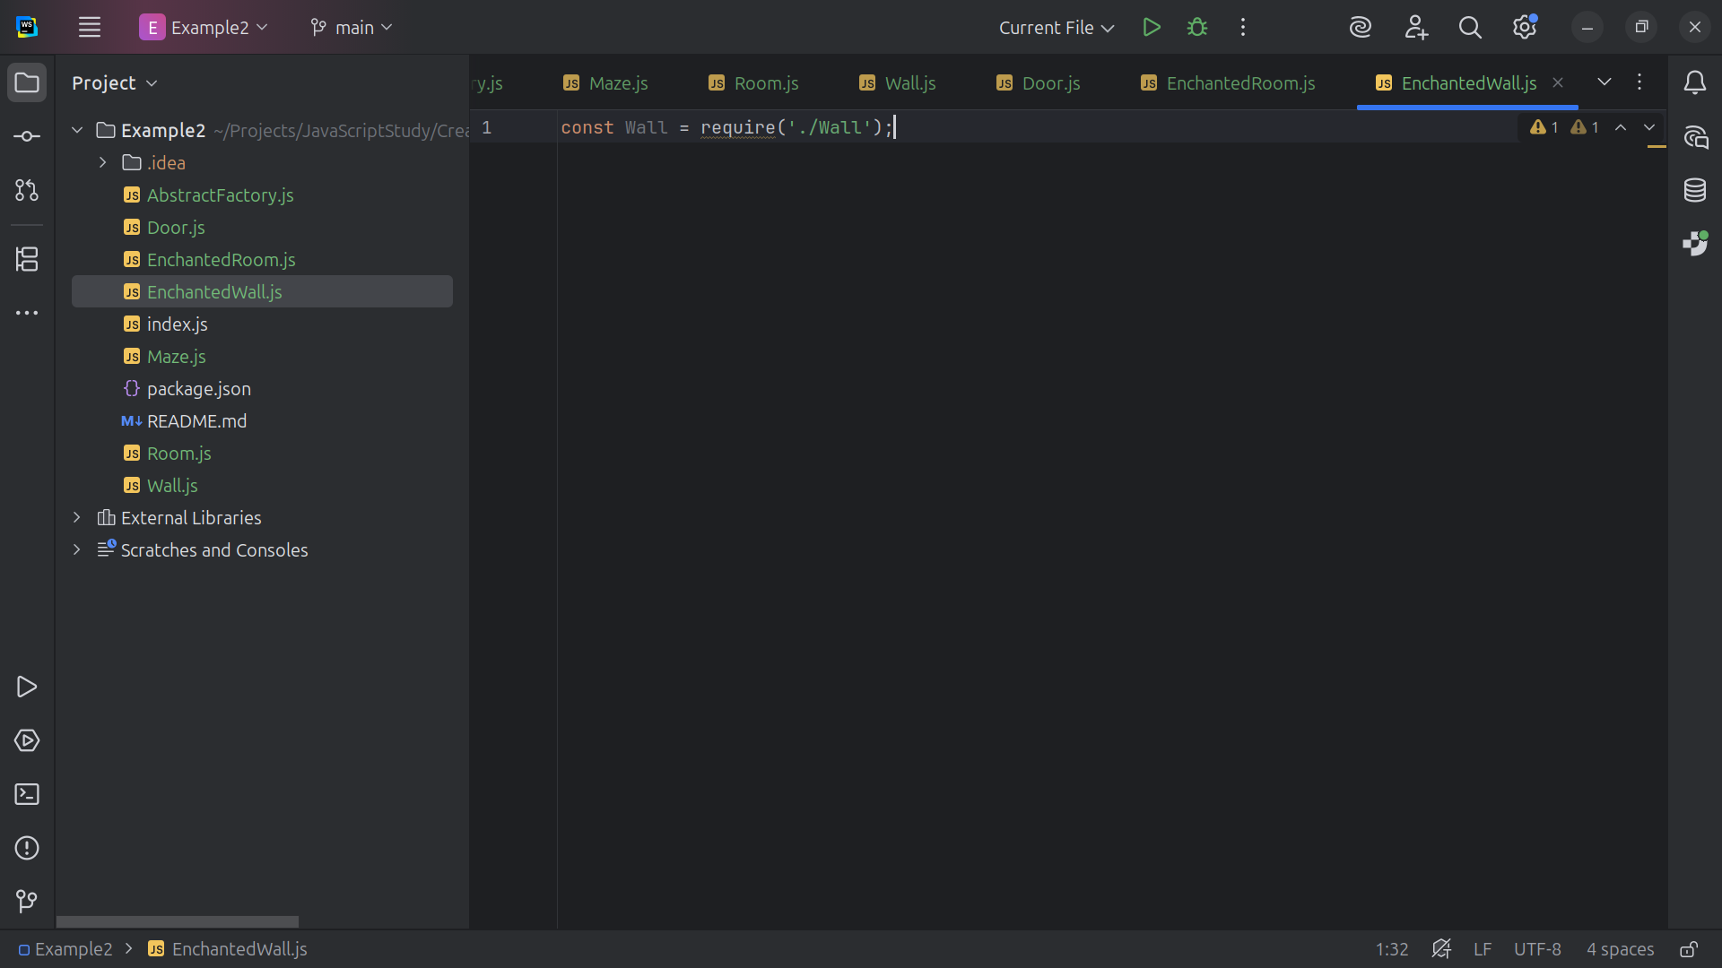
Notes:
Of course the Enchanted Wall will require the Wall inerface

Slide 38
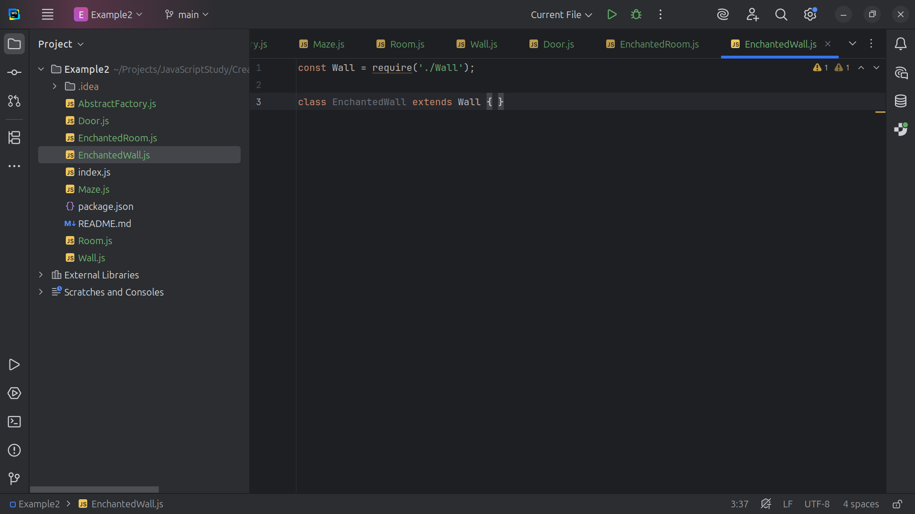
Notes:
So the Enchanted Wall class will be extended by Wall

Slide 39
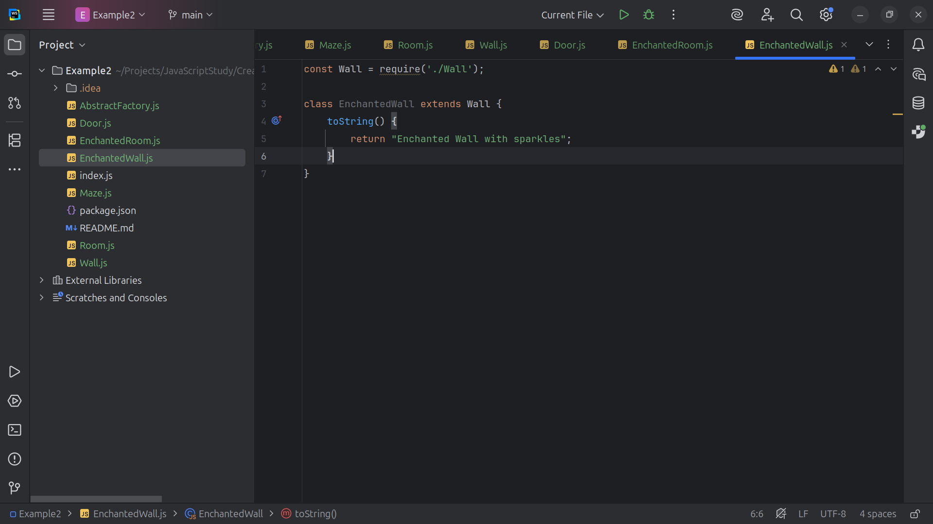
Notes:
And as one enters the room they are greeted with sparkles

Slide 40
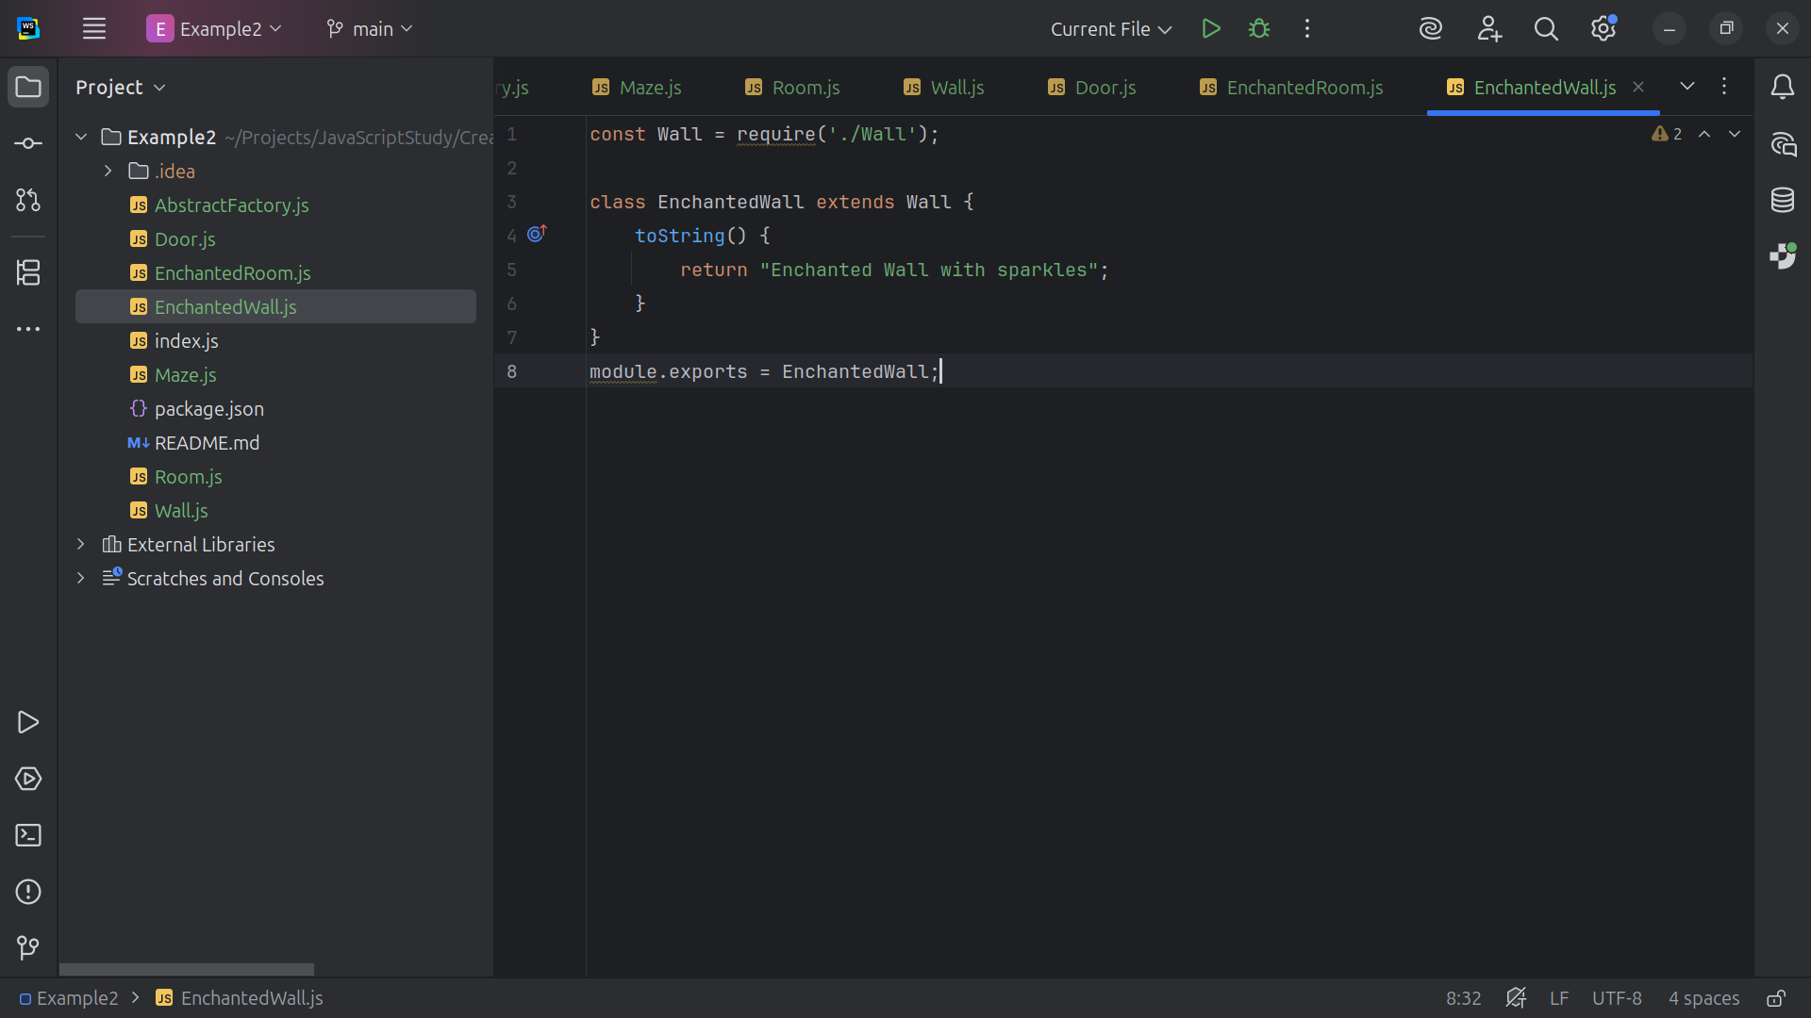
Notes:
And we export this module as the Enchanted Wall

Slide 41
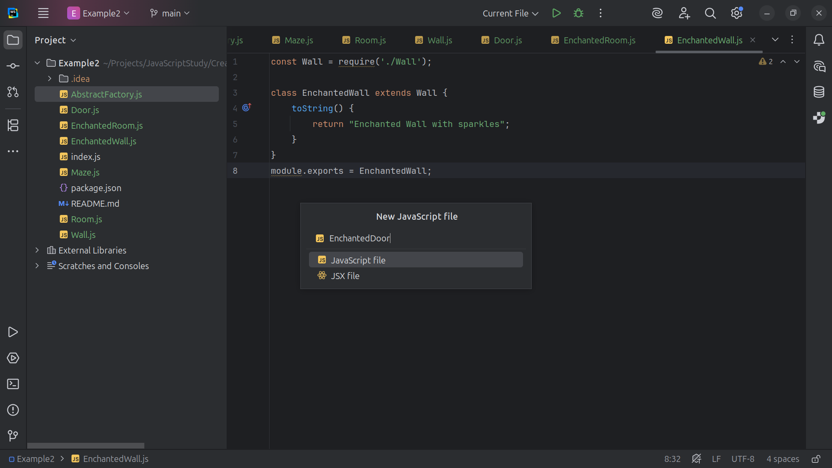

Slide 42
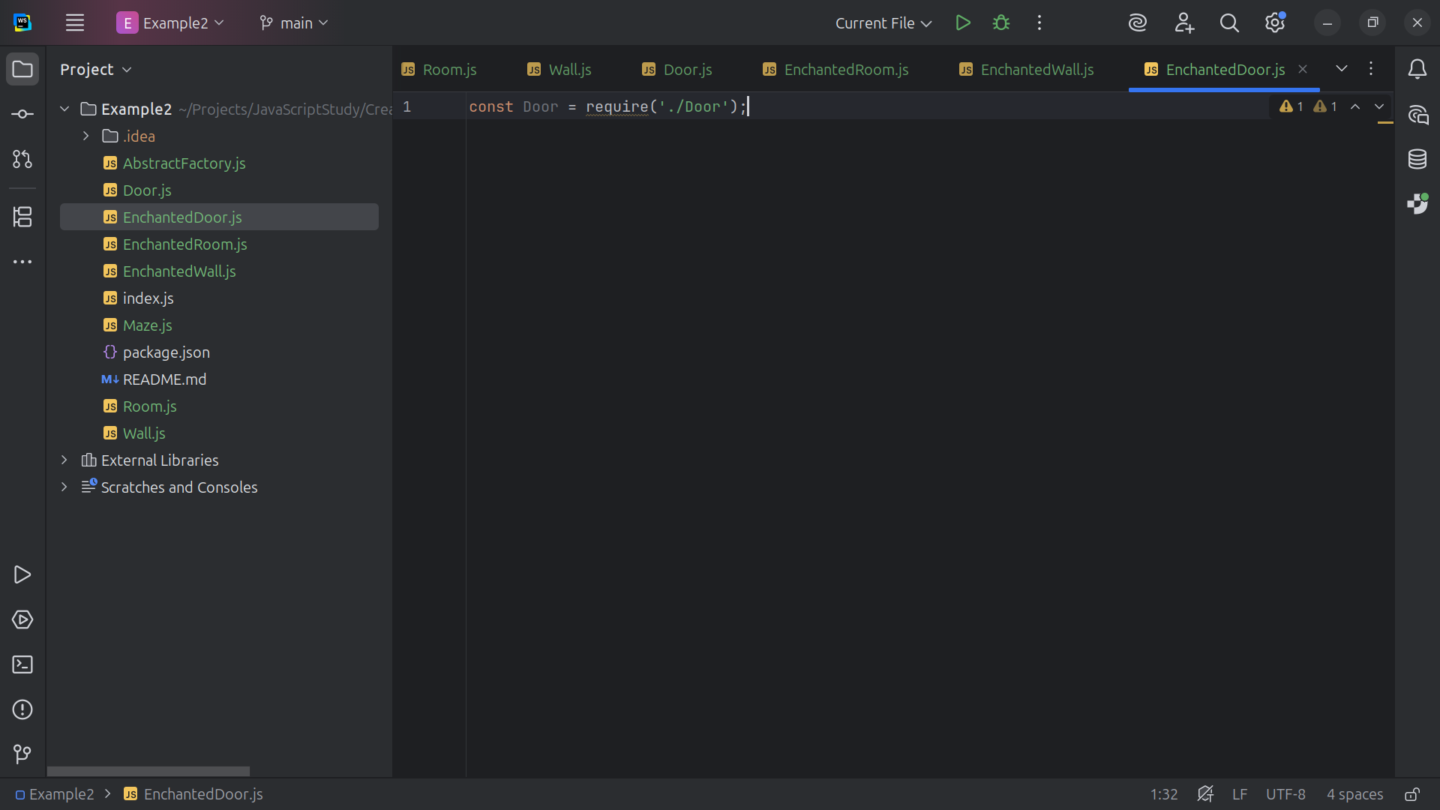

Slide 43
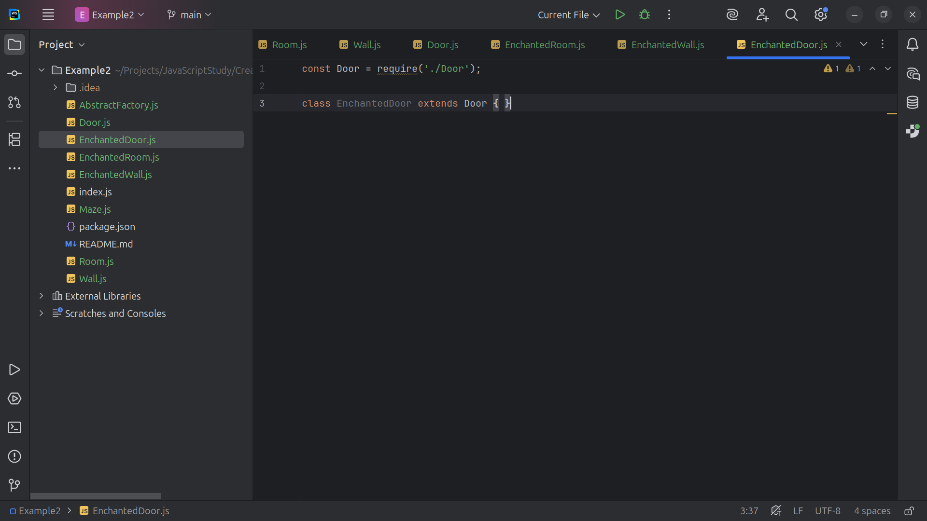

Slide 44
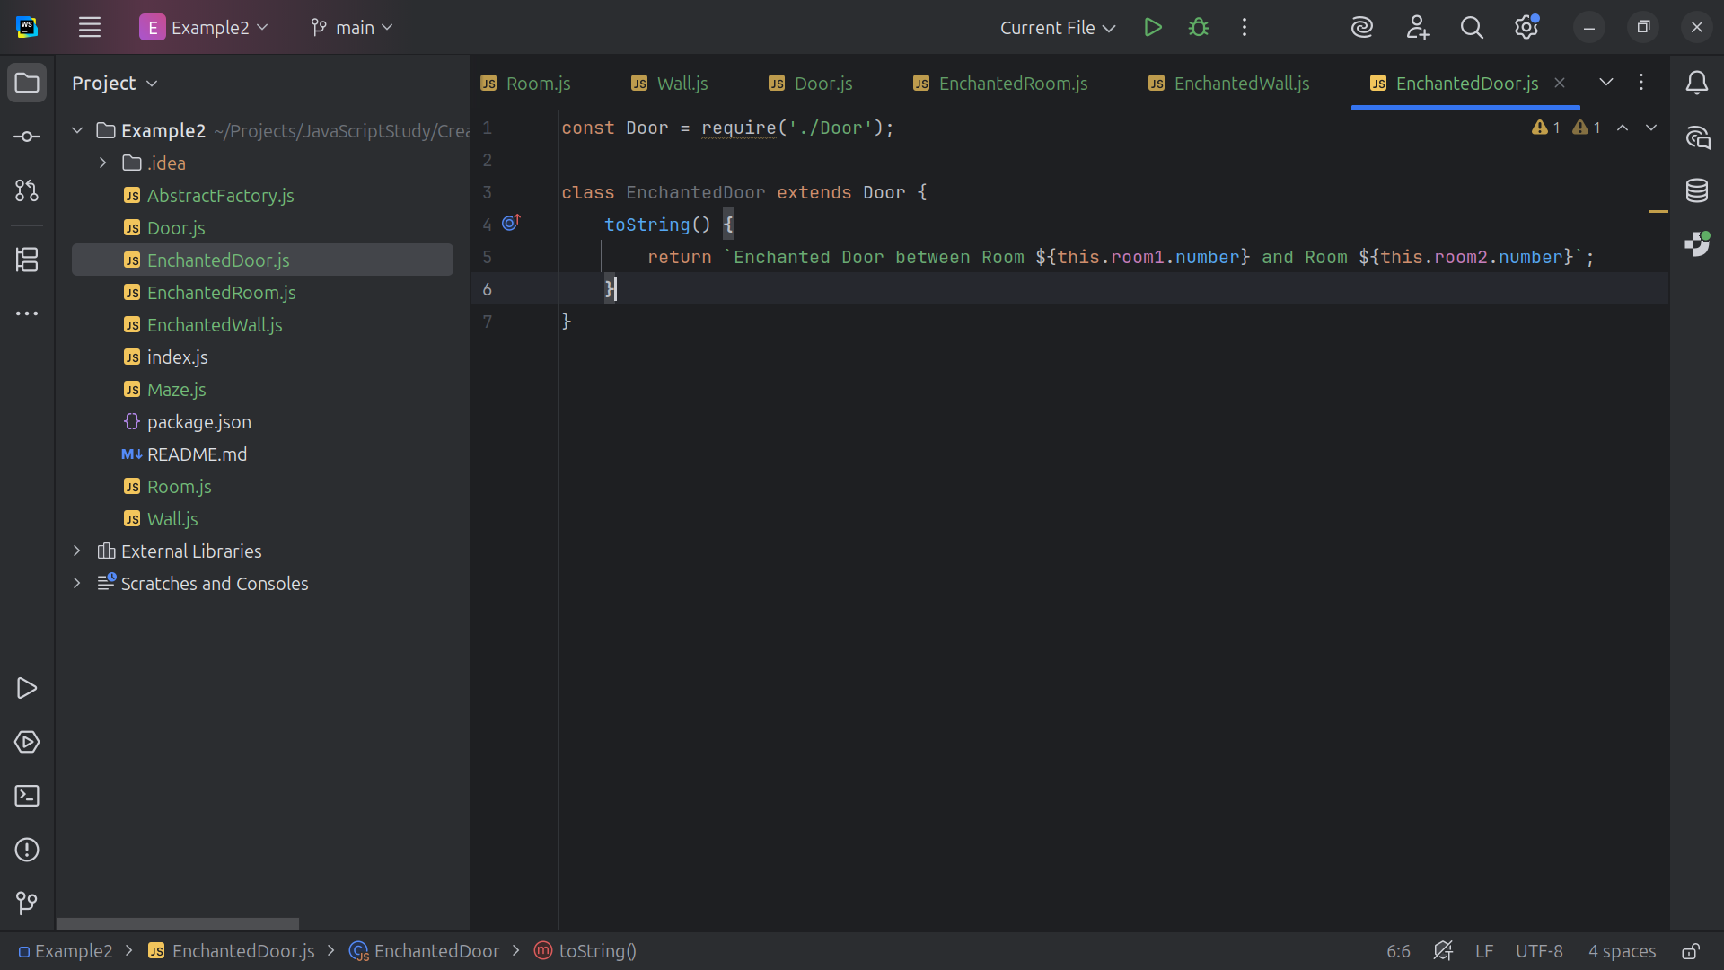

Slide 45
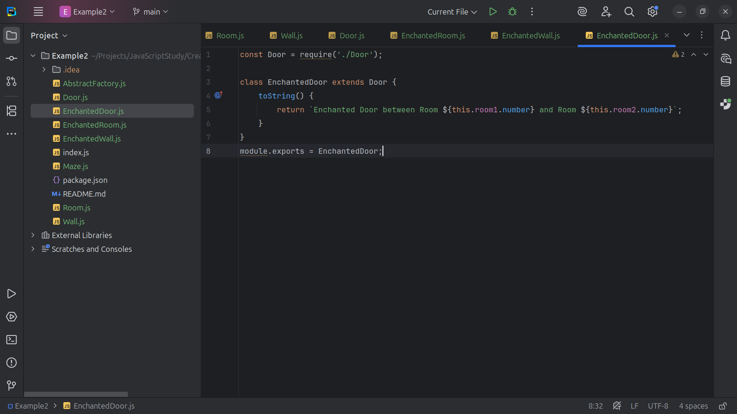

Slide 46
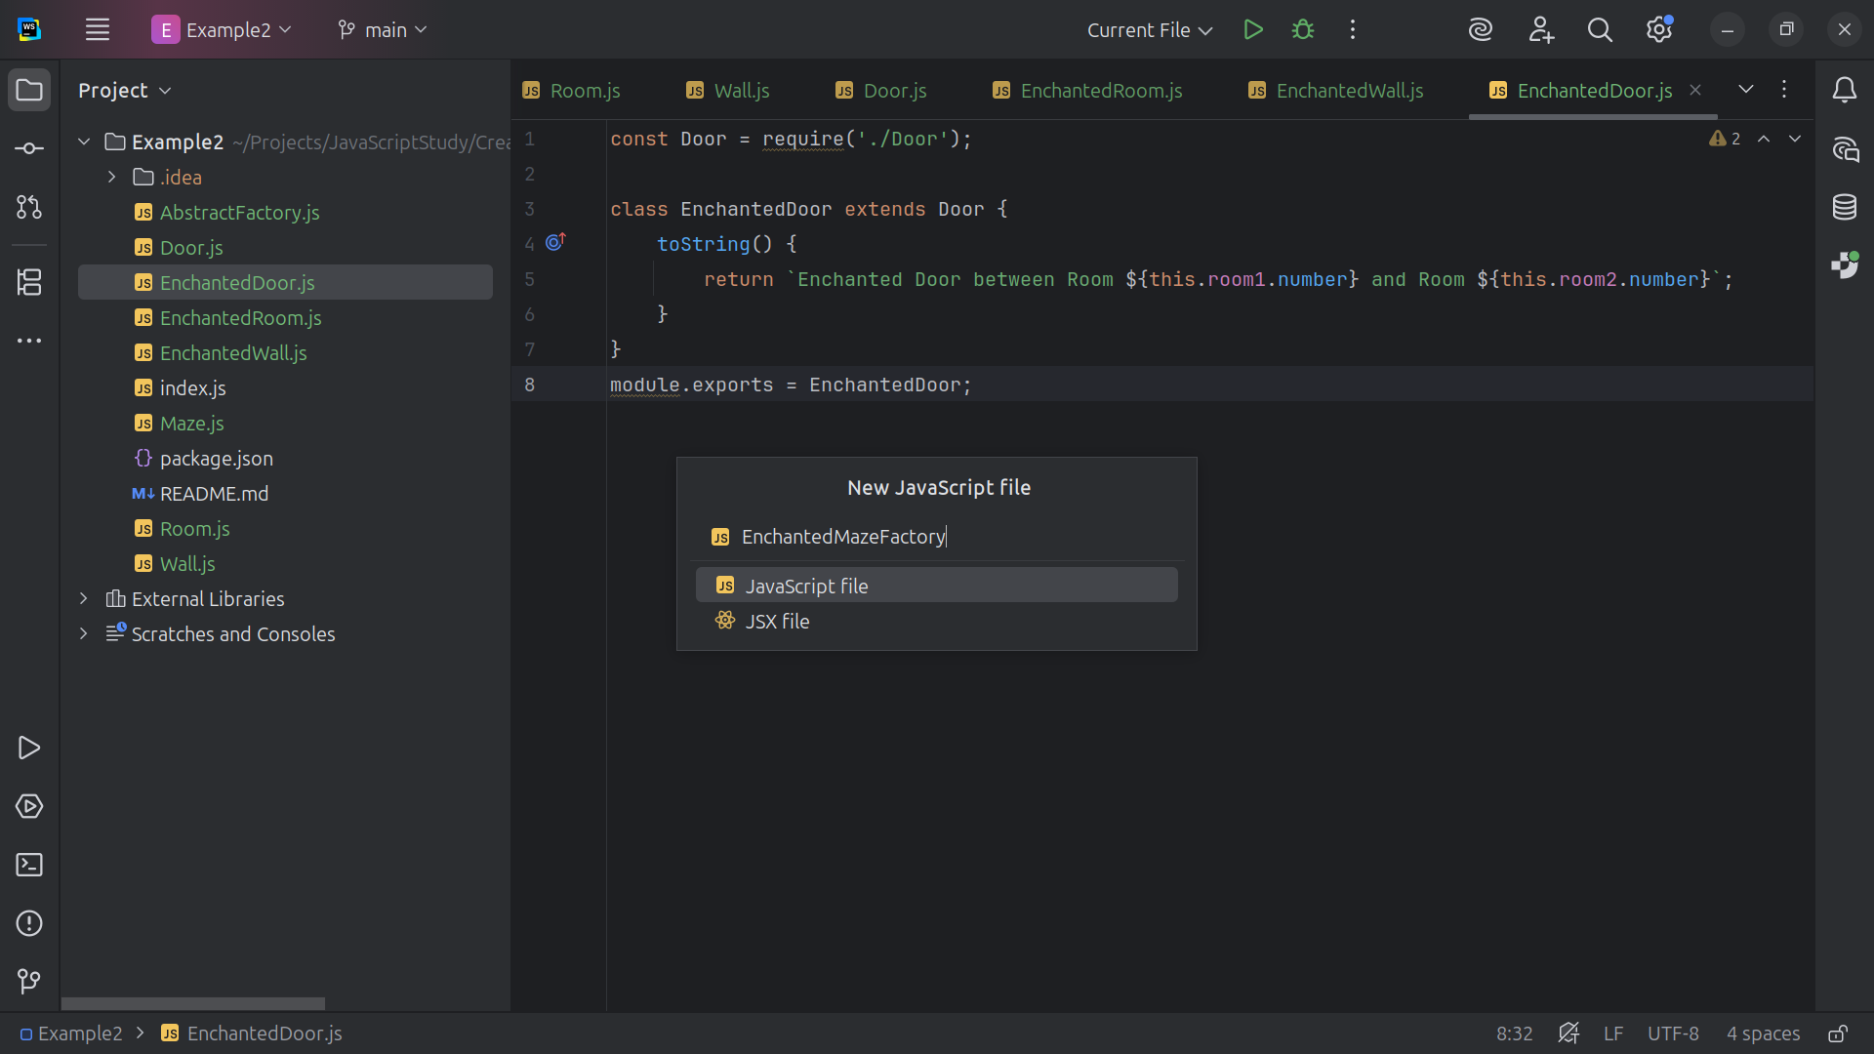

Slide 47
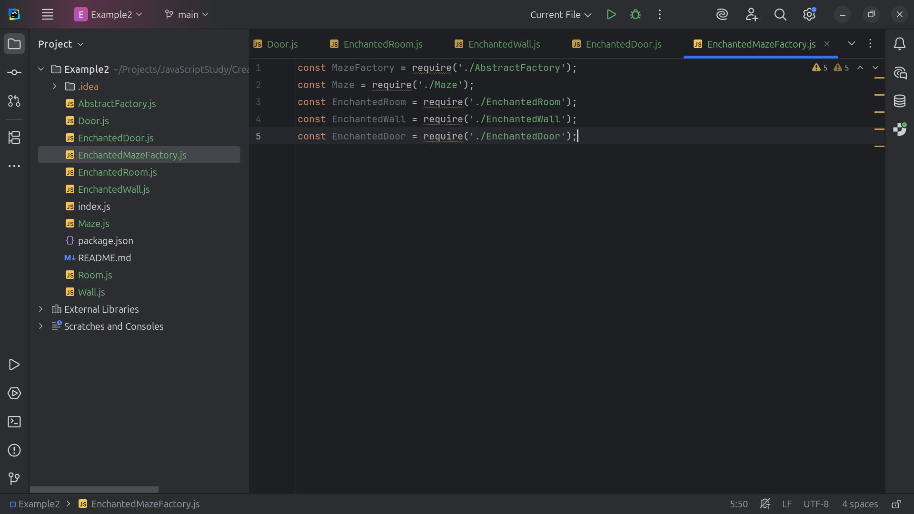

Slide 48
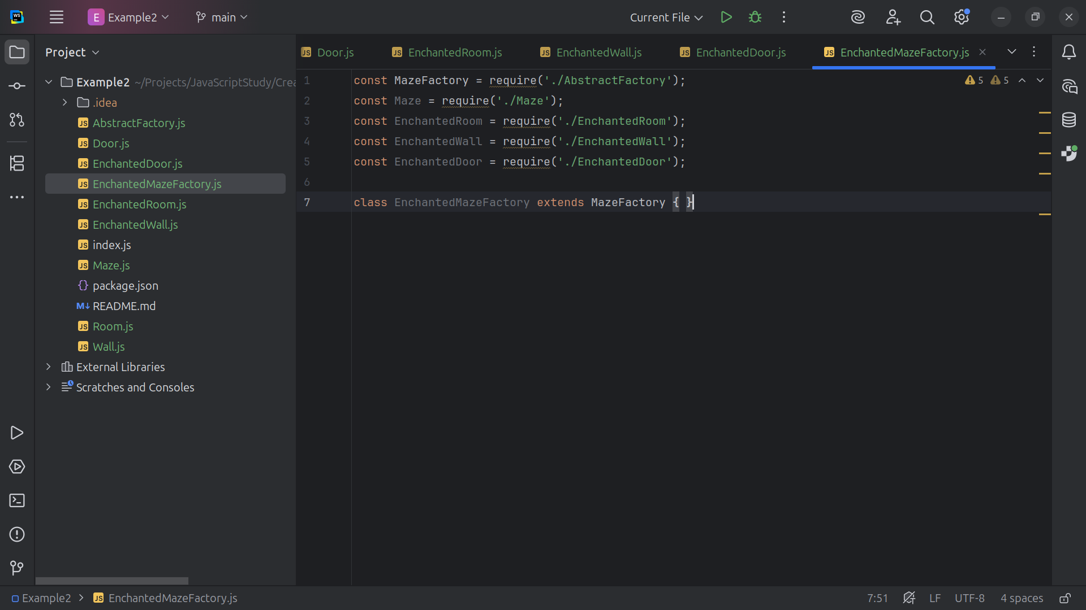

Slide 49
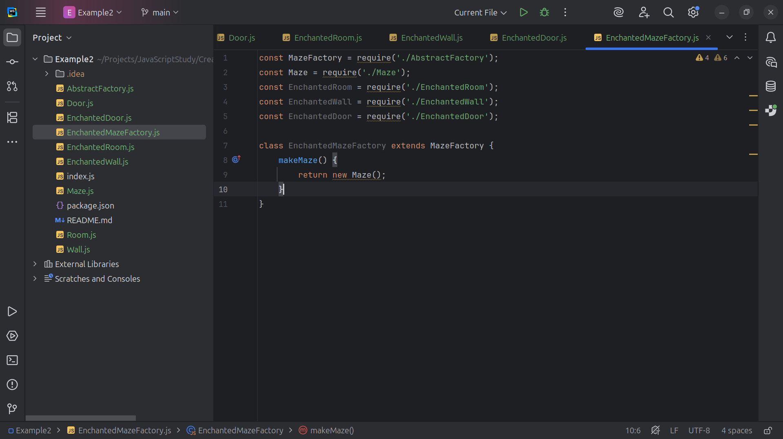

Slide 50
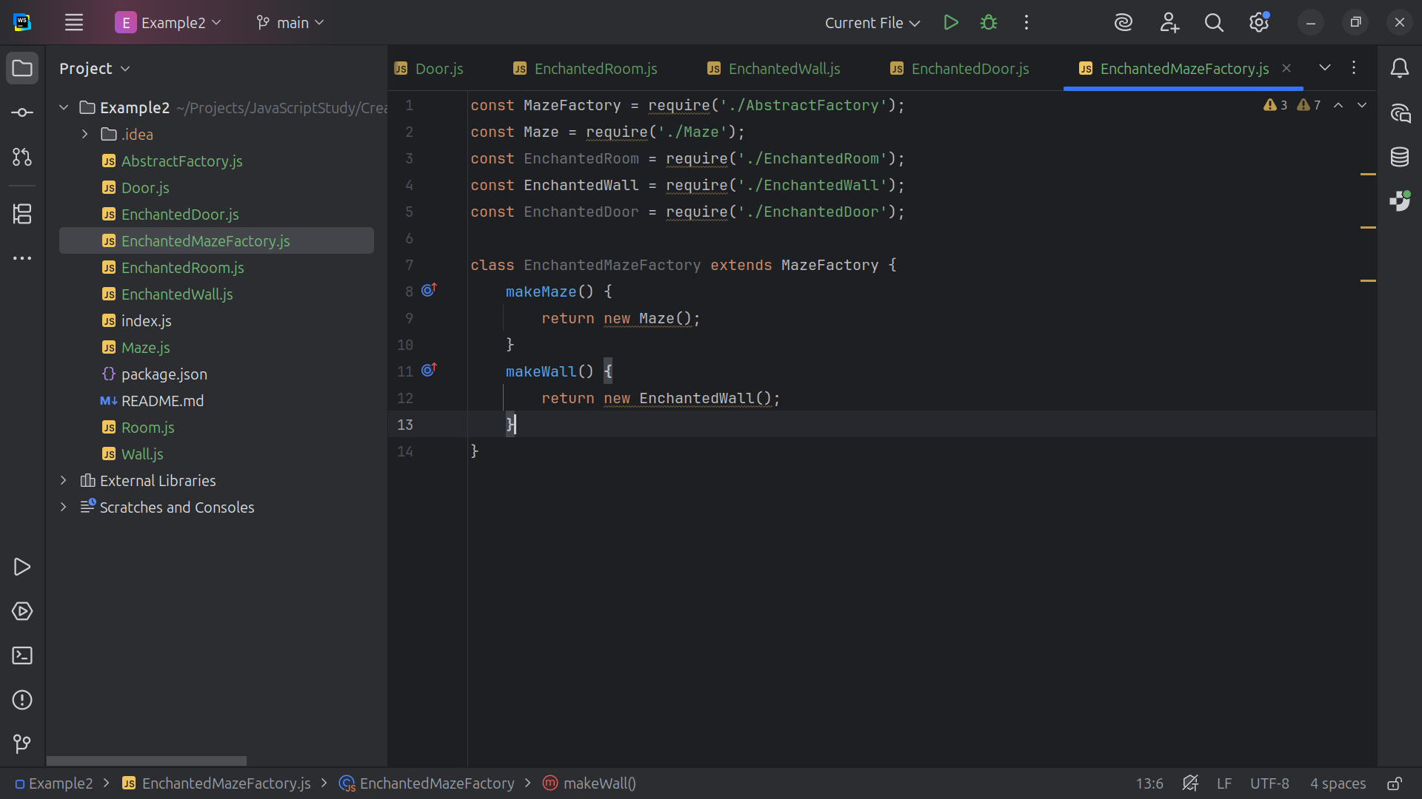

Slide 51


Slide 52


Slide 53


Slide 54


Slide 55


Slide 56


Slide 57


Slide 58


Slide 59


Slide 60


Slide 61


Slide 62


Slide 63


Slide 64


Slide 65


Slide 66


Slide 67


