Slide 1
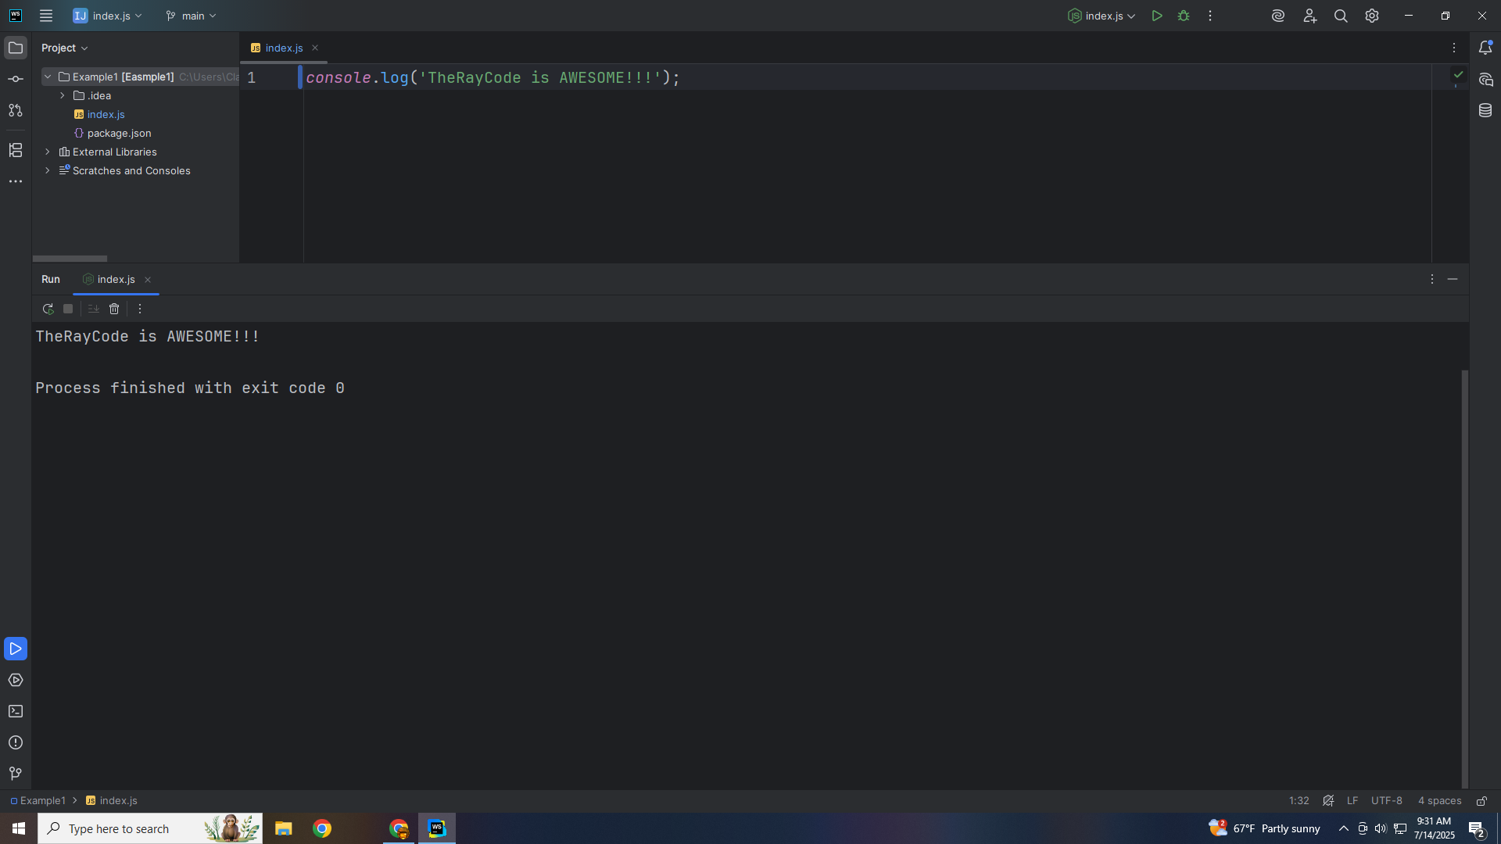
Notes:
Hello I’m Ray of TheRayCode

Slide 2
Notes:
In this show I plan to give a demo of the design pattern know as the Composite Pattern. A Structural pattern I will be using JavaScript

Slide 3
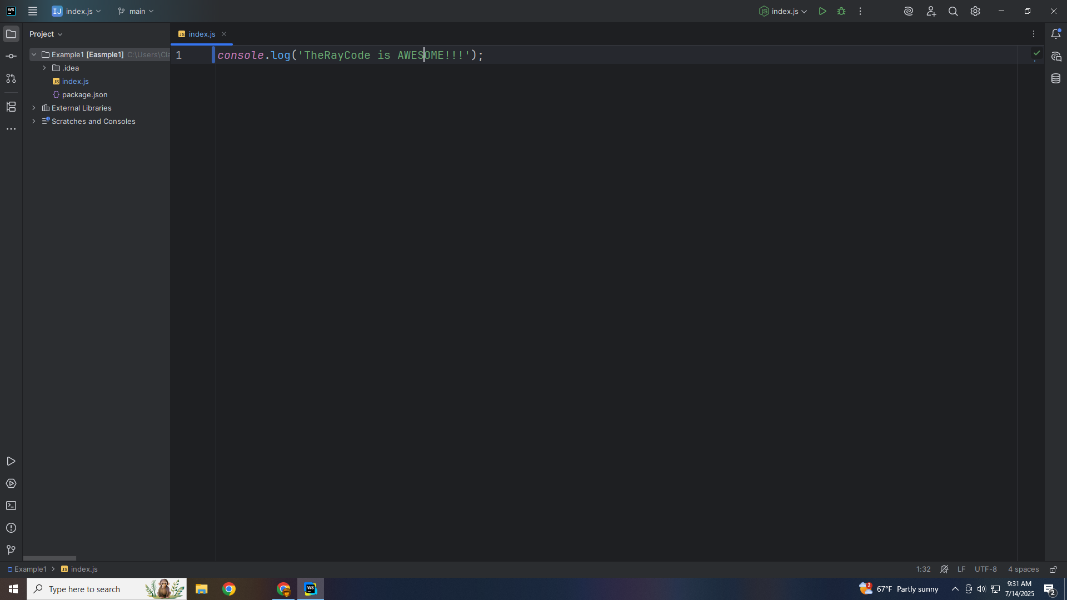
Notes:
I will Stick close to the names that are used in the UML for this section of the Gang of Four Book. We start with the Component

Slide 4
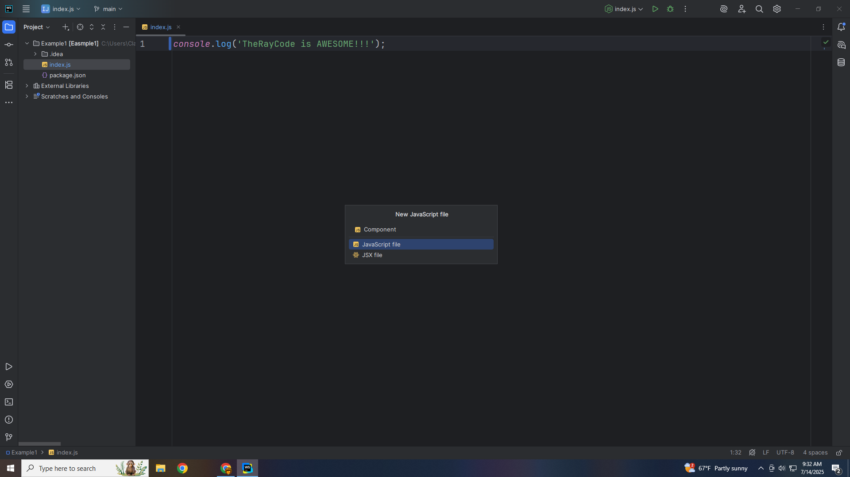
Notes:
The Component defines the interface for all objects in the composition

Slide 5
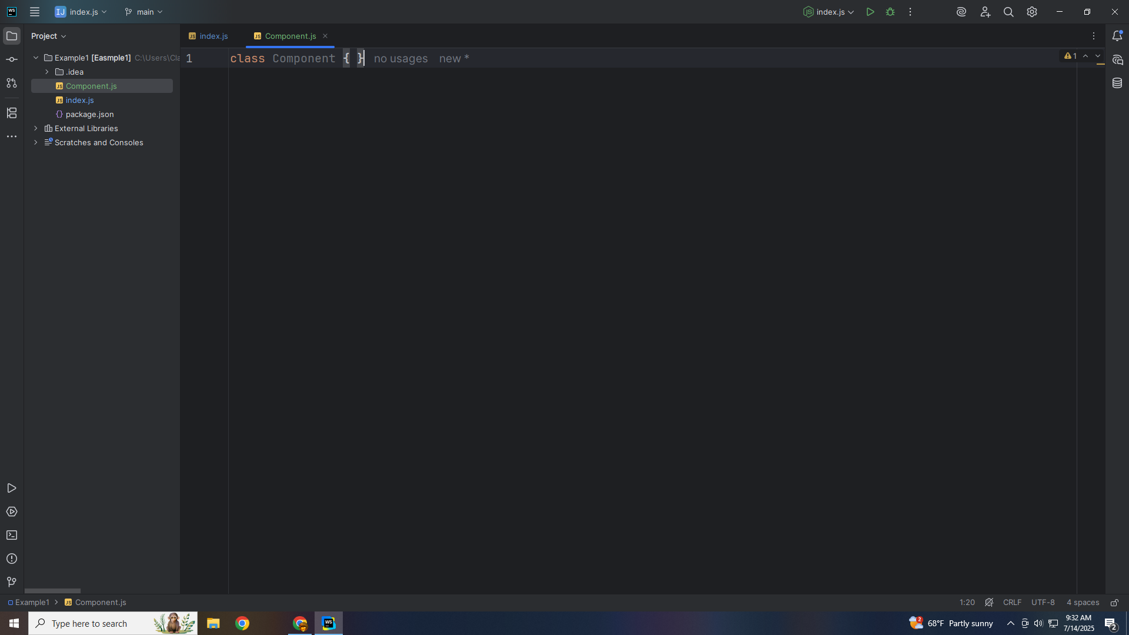
Notes:
This will be the operation method to be implemented by Leaf or Composite

Slide 6
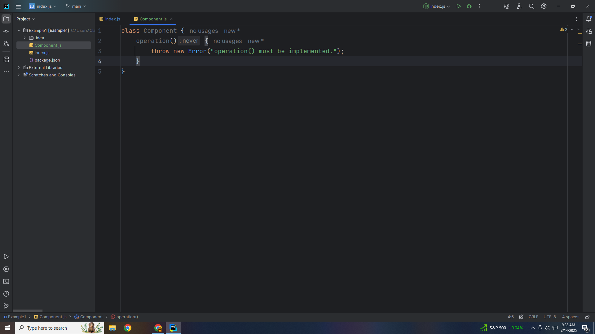
Notes:
We have a method to add components to the Composite

Slide 7
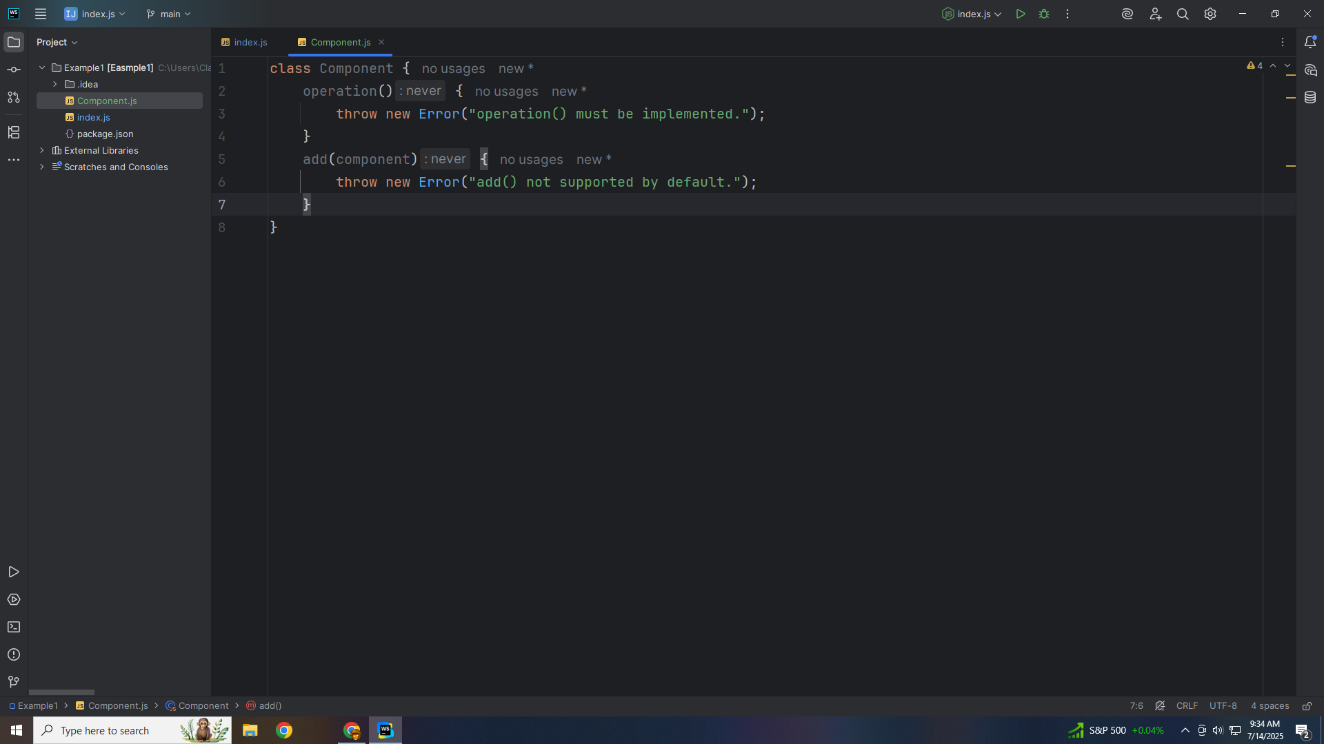
Notes:
And a method to remove components

Slide 8
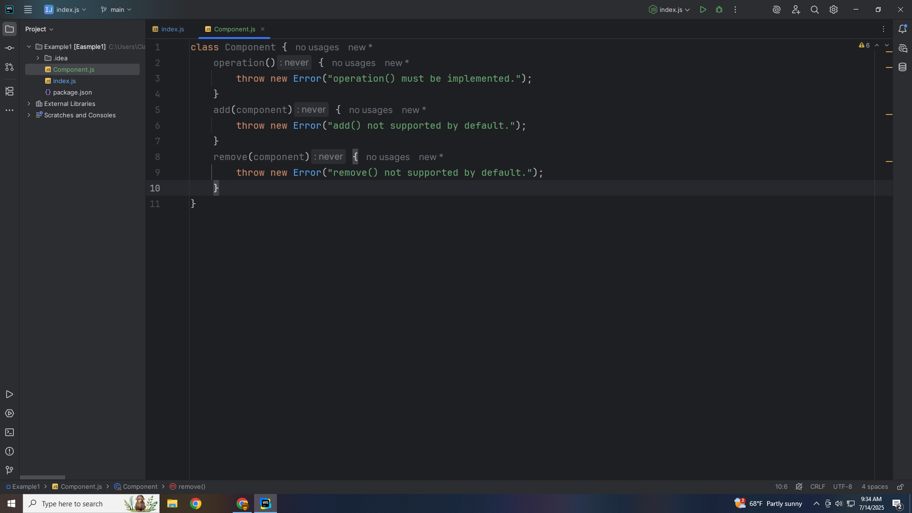
Notes:
And we can get Child by index

Slide 9
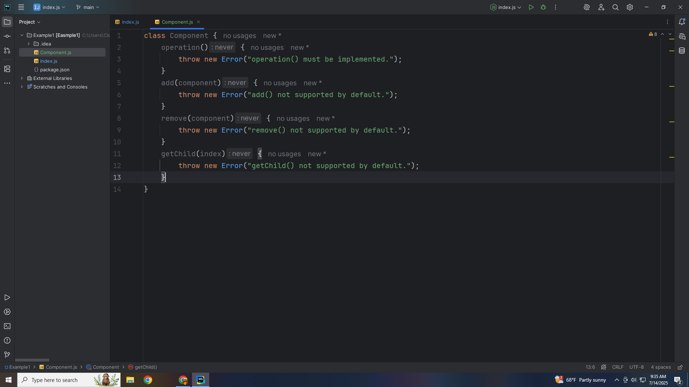
Notes:
Let’s export this module for use in our main demo as Component

Slide 10

Notes:
Now add a class we call Leaf
The Purpose . The Leaf represents individual objects, no children

Slide 11
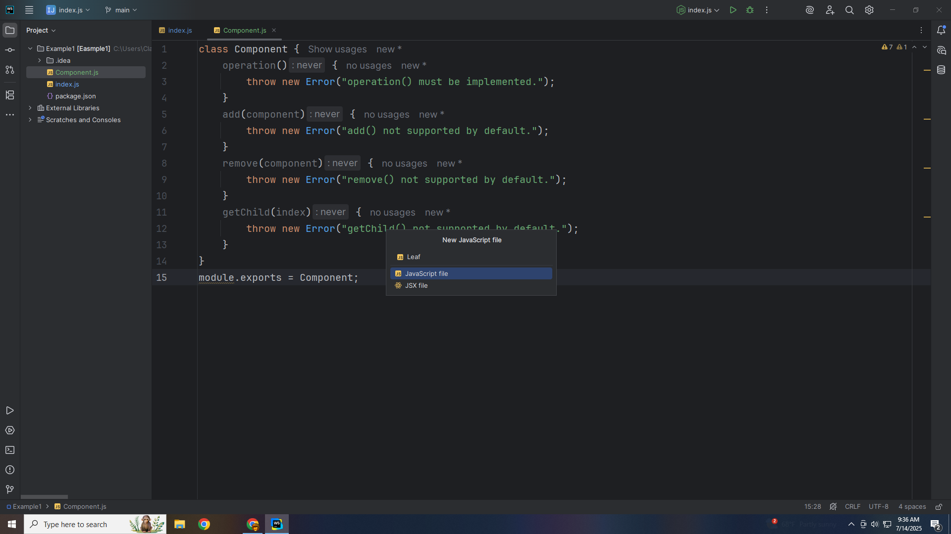
Notes:
At the top we include the Component class

Slide 12

Notes:
The Leaf represents individual objects, and has no children

Slide 13

Notes:
We have the constructor which stores its Name

Slide 14

Notes:
For the operation, we returns its name

Slide 15
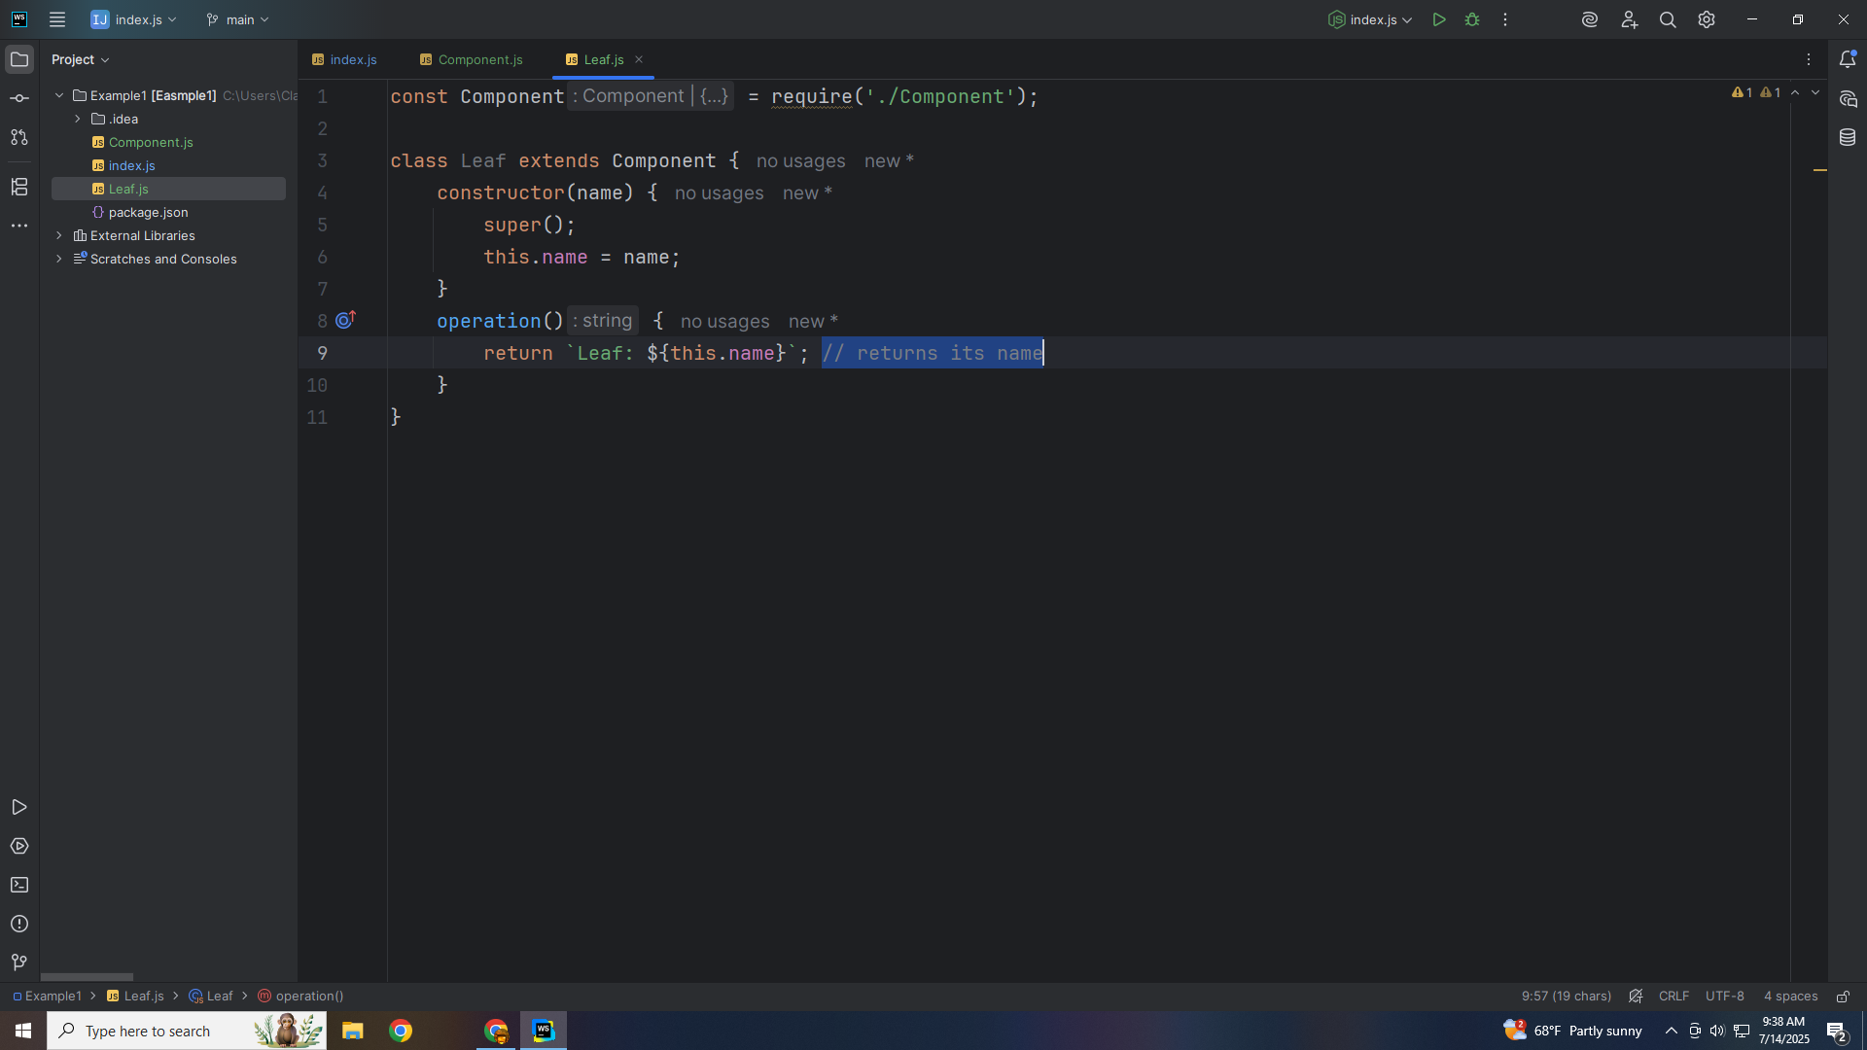
Notes:
Let’s close this class with an export to use in our demo we name Leaf

Slide 16
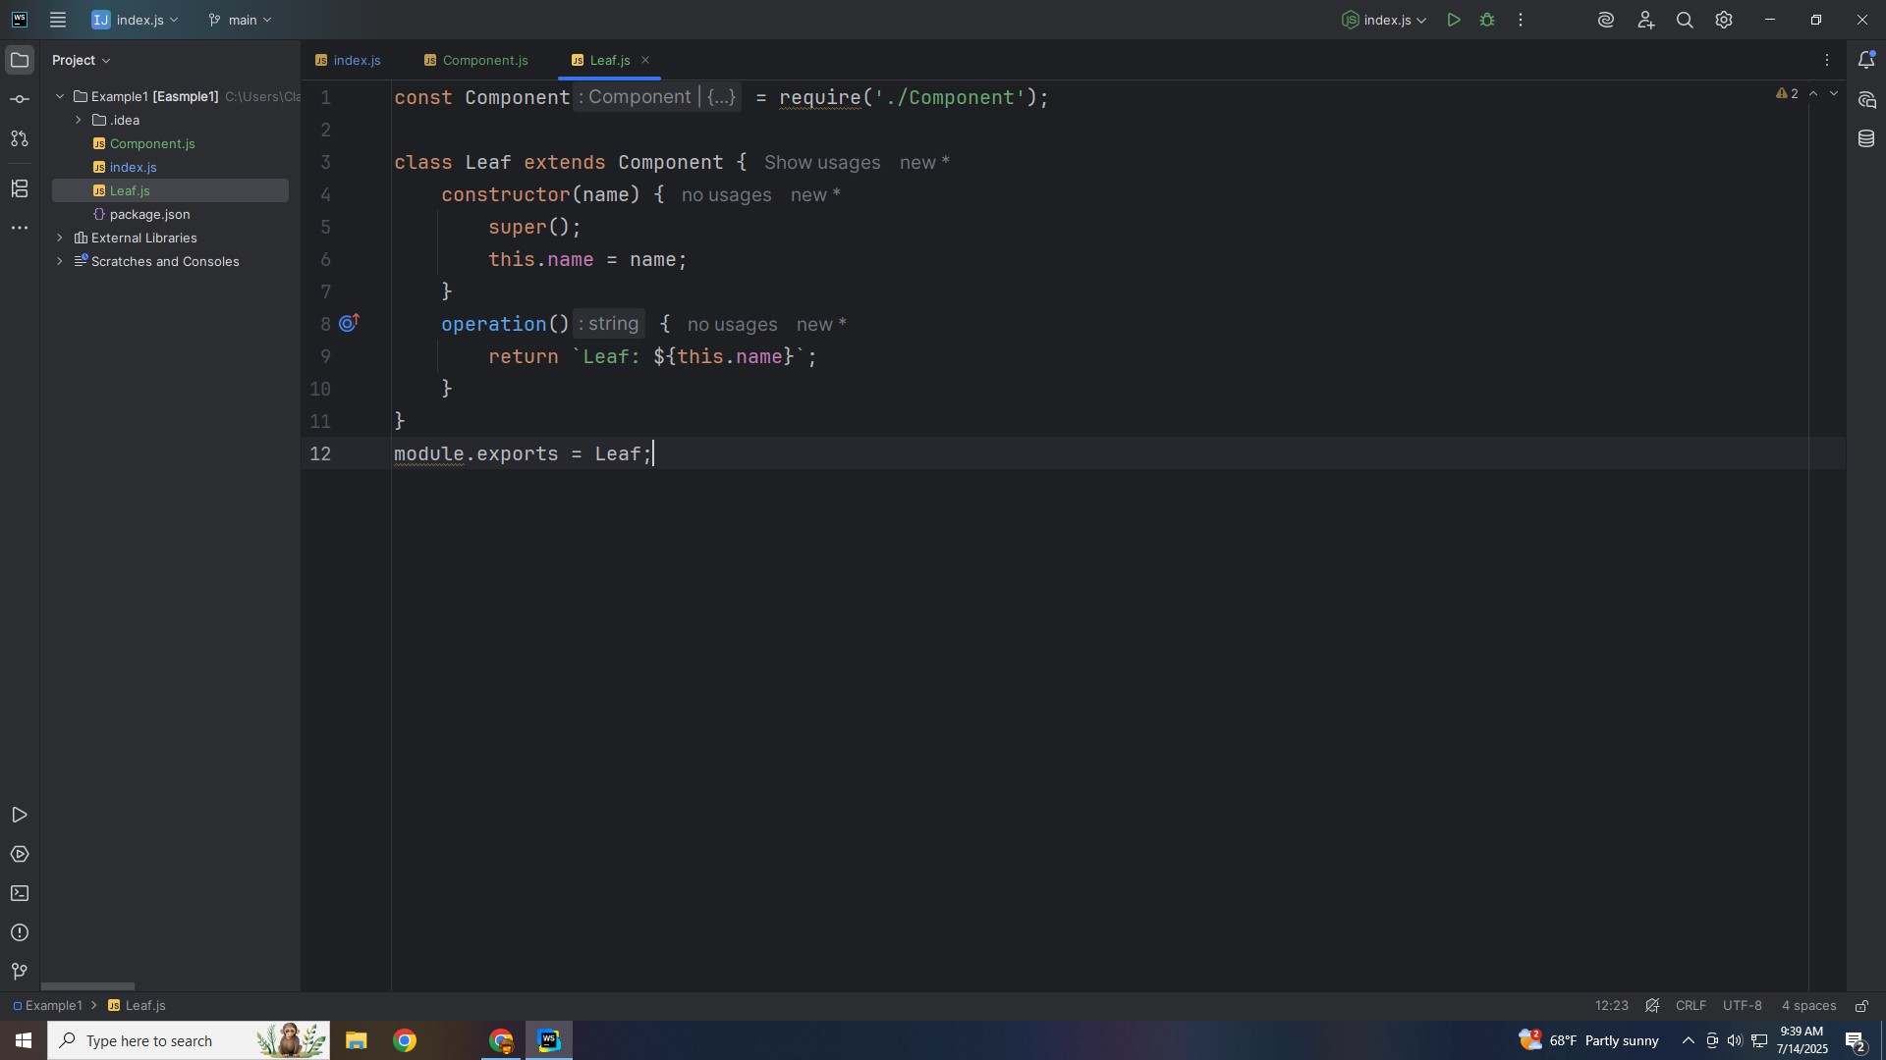
Notes:
Let’s create a Composite class

Slide 17
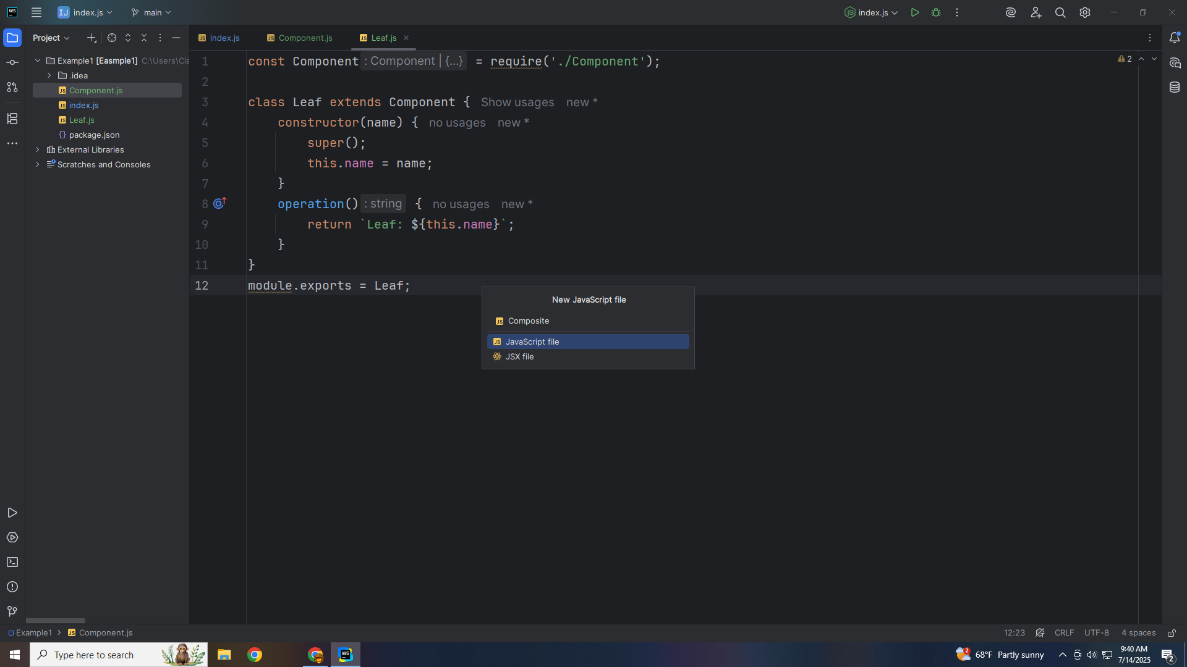
Notes:
Composite stores children and implements the `Component` interface. It delegates `operation()` to its children, so you can treat groups and leaves uniformly AT the tope re require Component

Slide 18
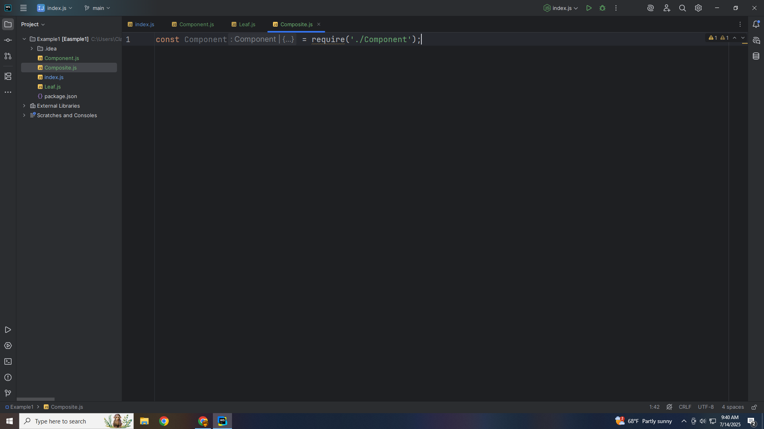
Notes:
We extend the Composite with the Component

Slide 19
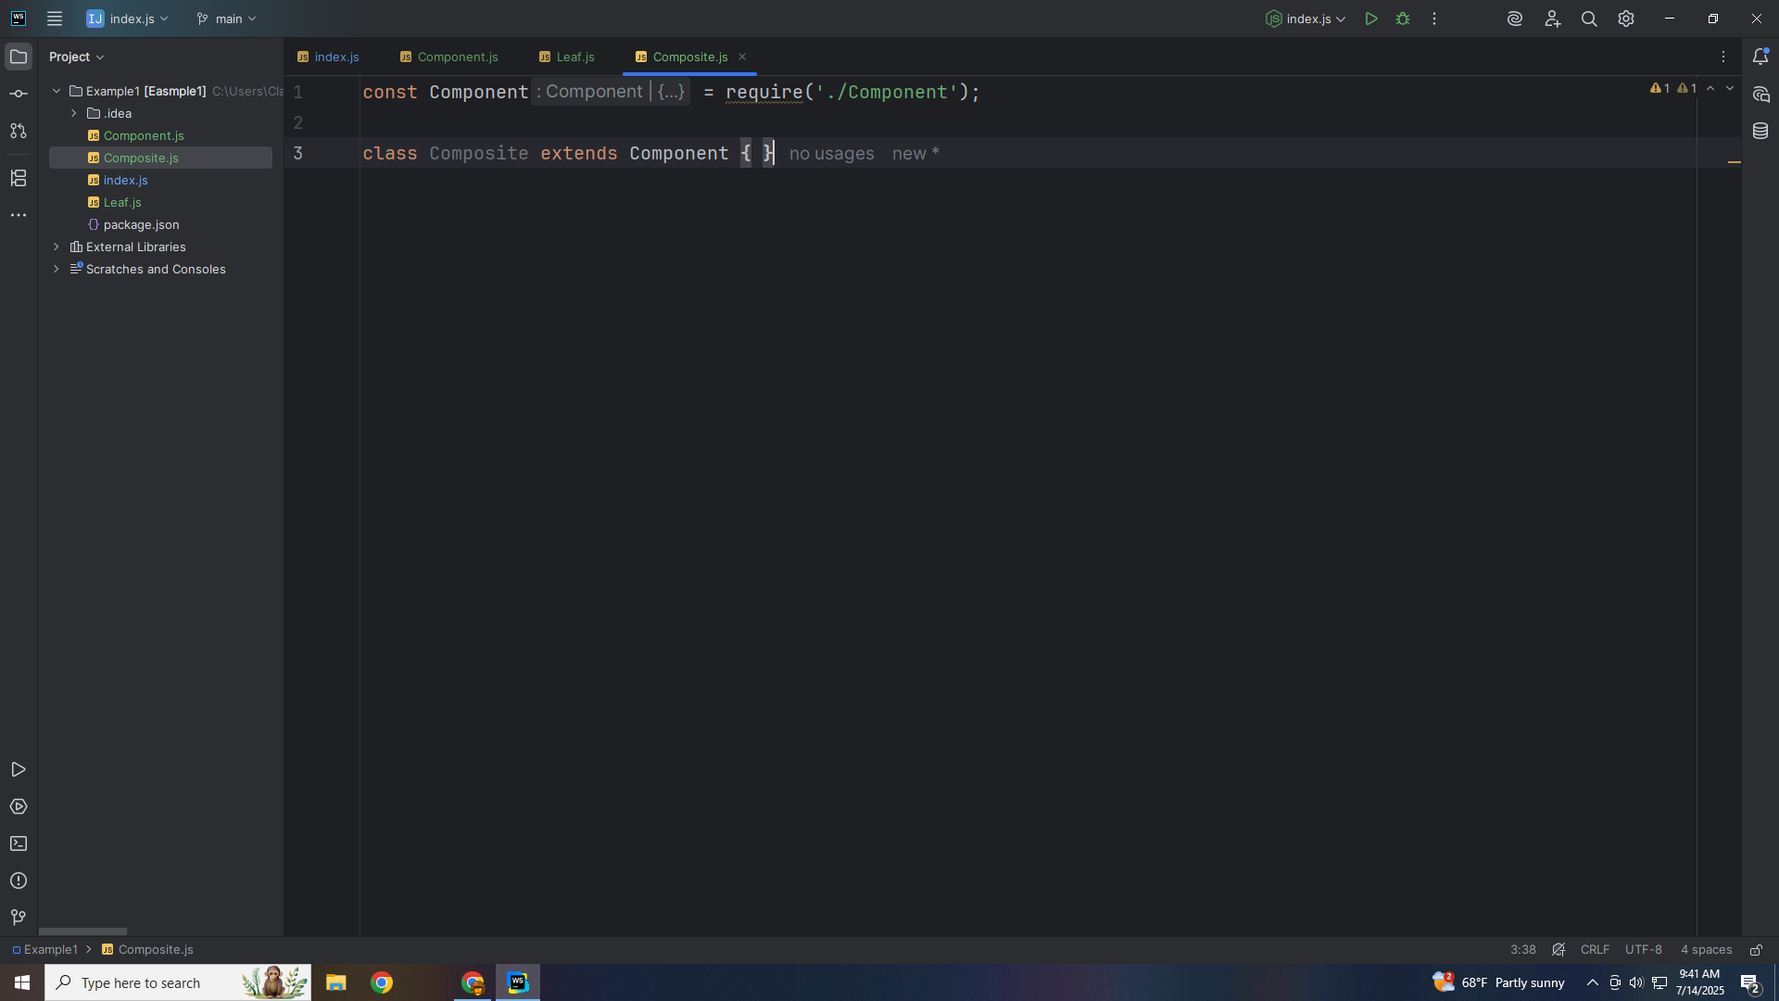
Notes:
A constructor takes a name as parameter

Slide 20

Notes:
and We set this dot children to an array

Slide 21
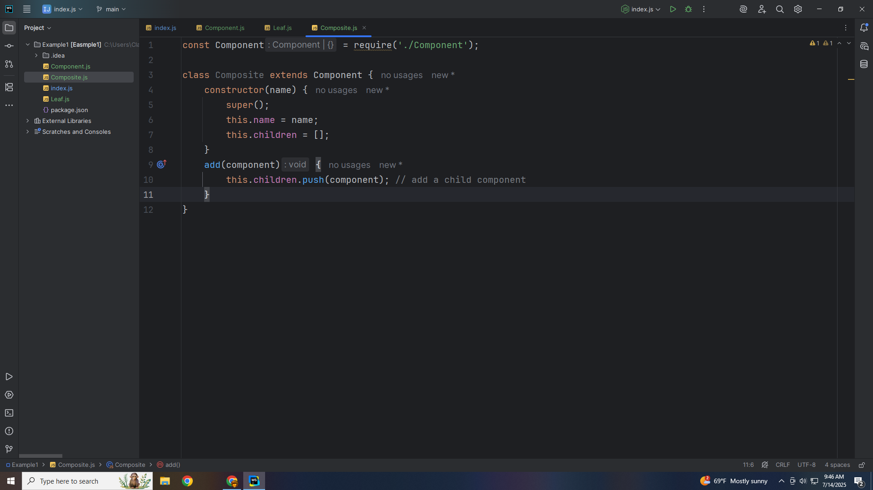
Notes:
And we have a method to add items pushing them onto to the children array

Slide 22
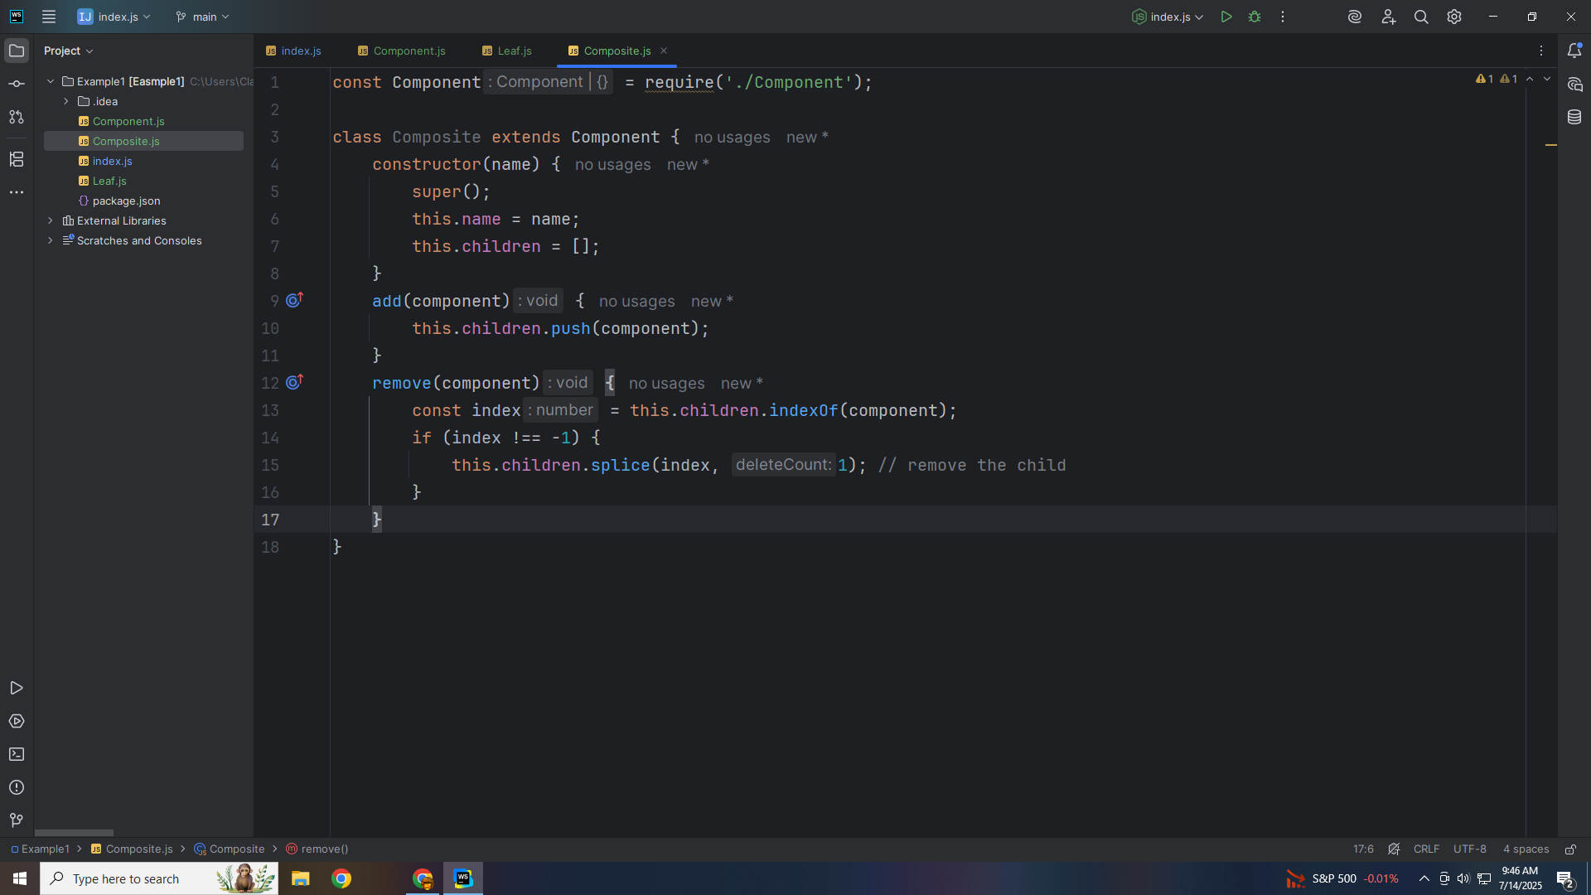
Notes:
Let’s create a method to Remove componrts

Slide 23
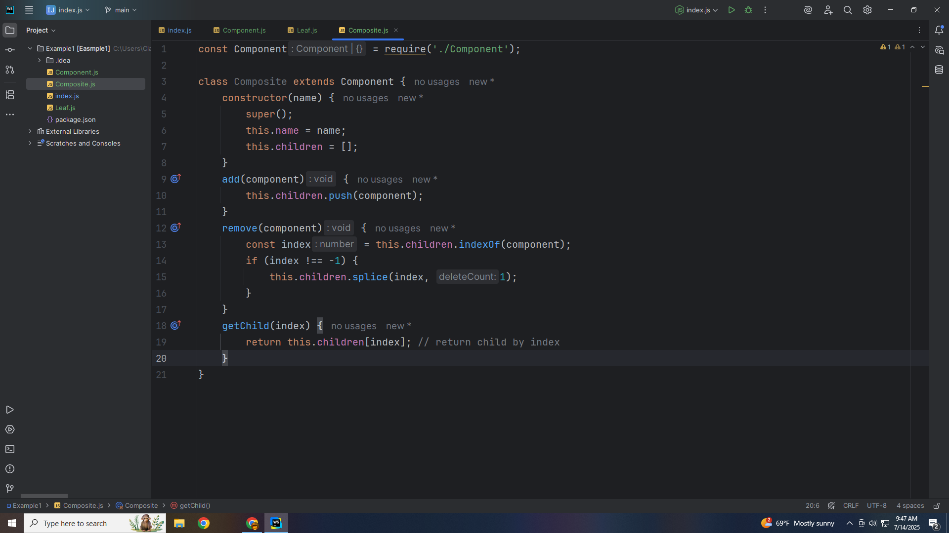
Notes:
We check the index an splice it

Slide 24
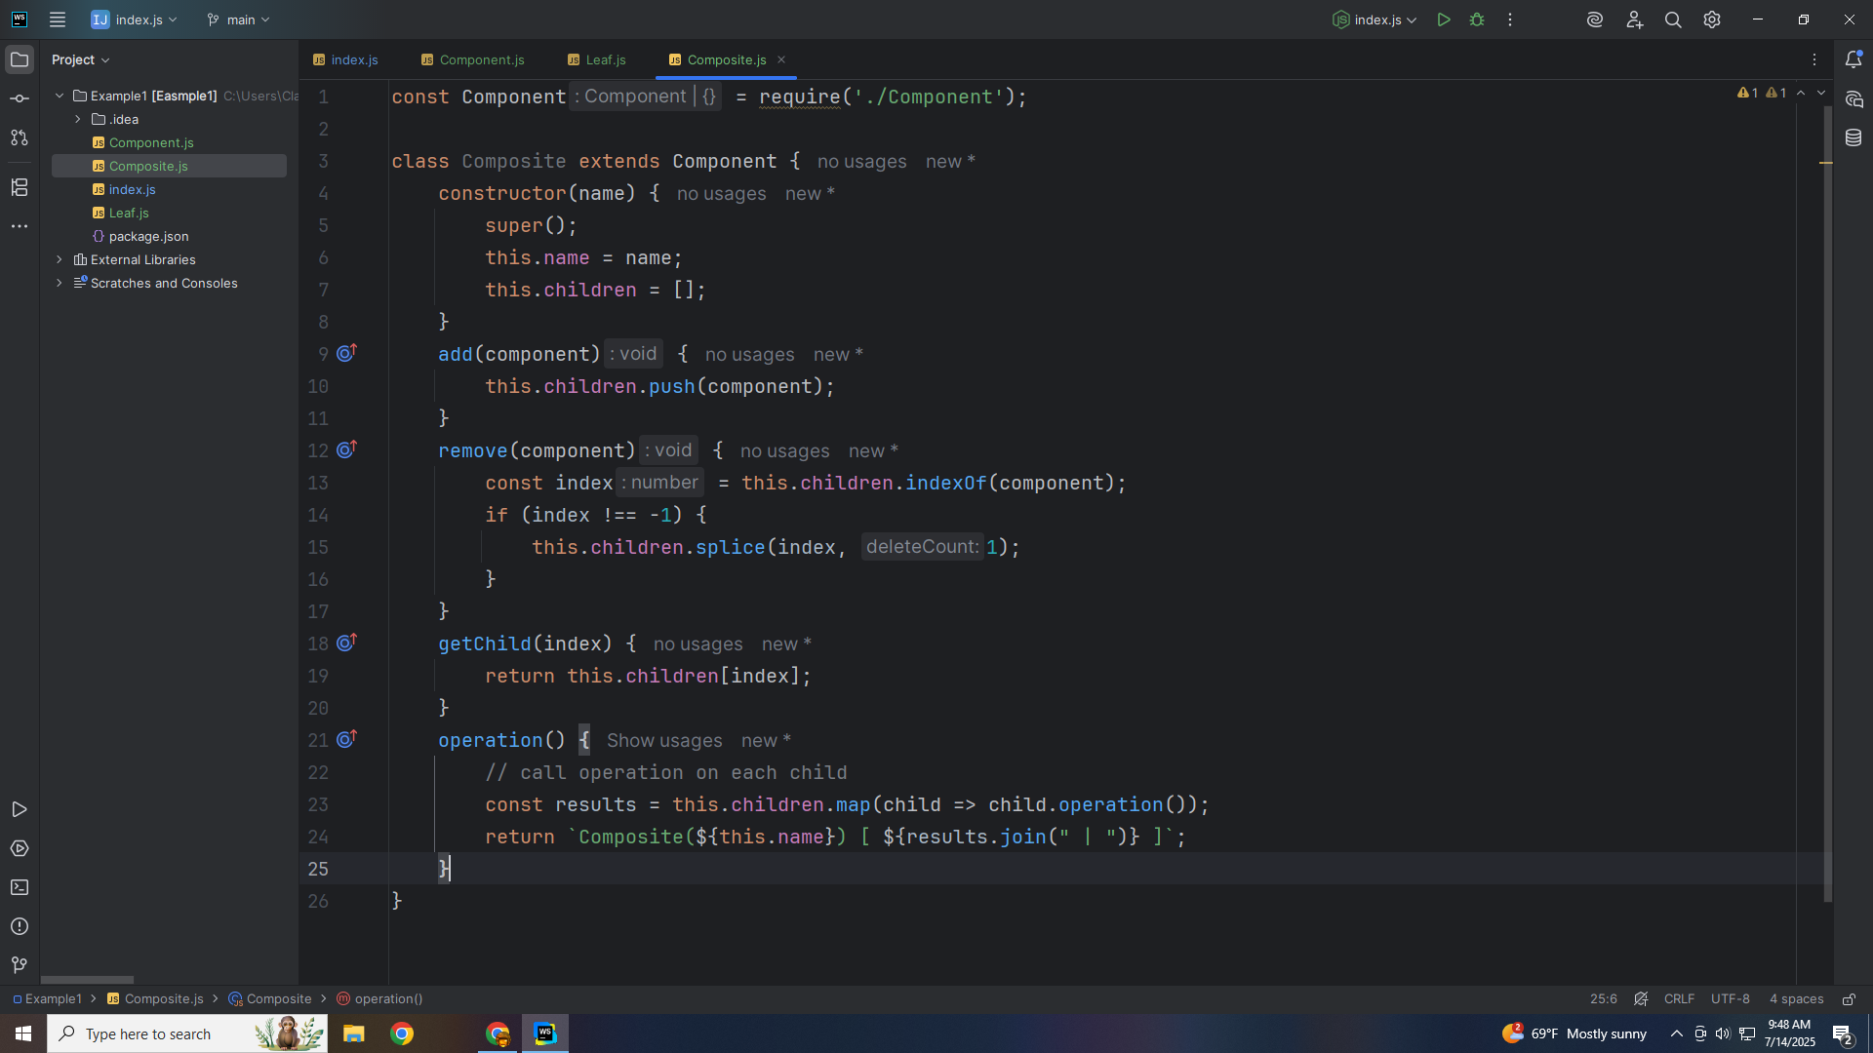
Notes:
And we have a method to get child that take an index as parameter

Slide 25

Notes:
We call the operation on each child

Slide 26
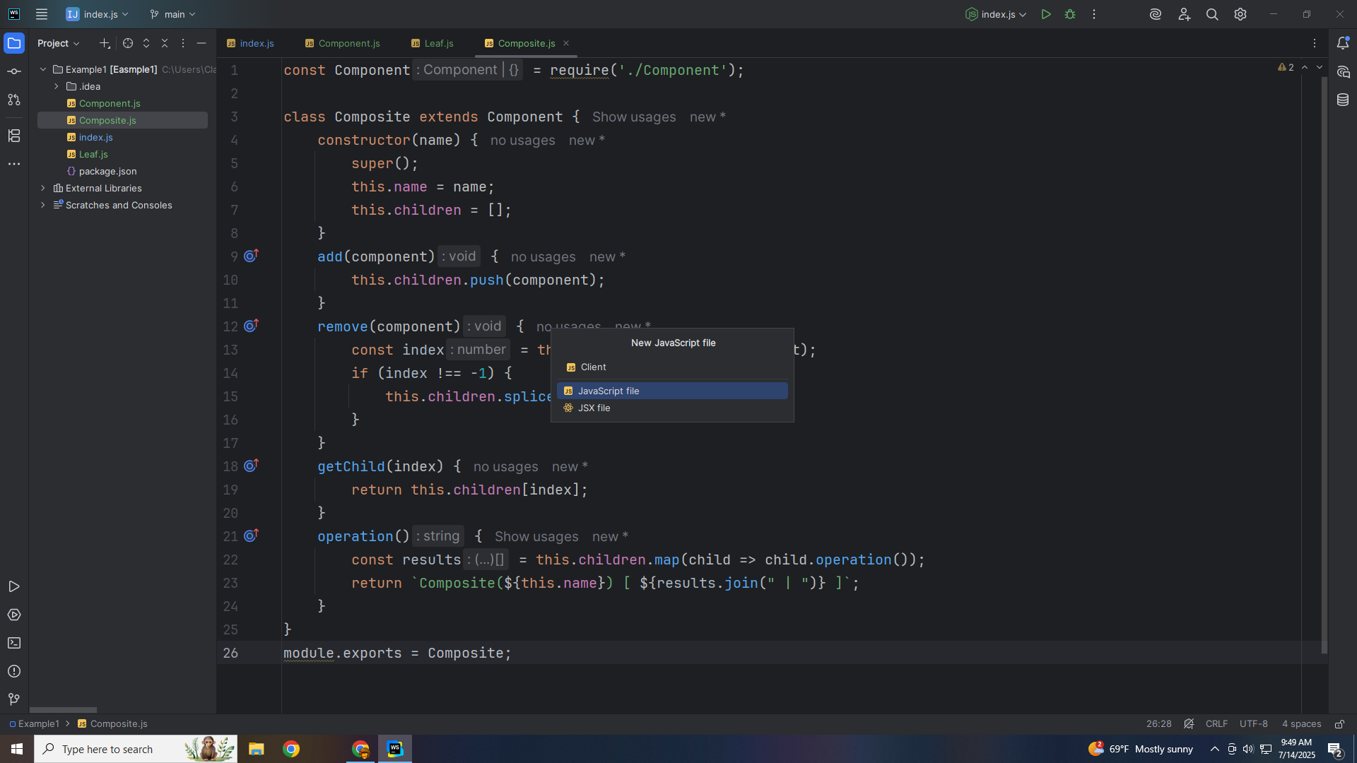
Notes:
Let’s export this module as Composite for use in our demo

Slide 27

Notes:
Let’s now create the Client

Slide 28

Notes:
The Client Uses the Component interface to interact with both `Leaf` and `Composite` objects. It shows how the client sees the entire structure in a uniform way.

Slide 29
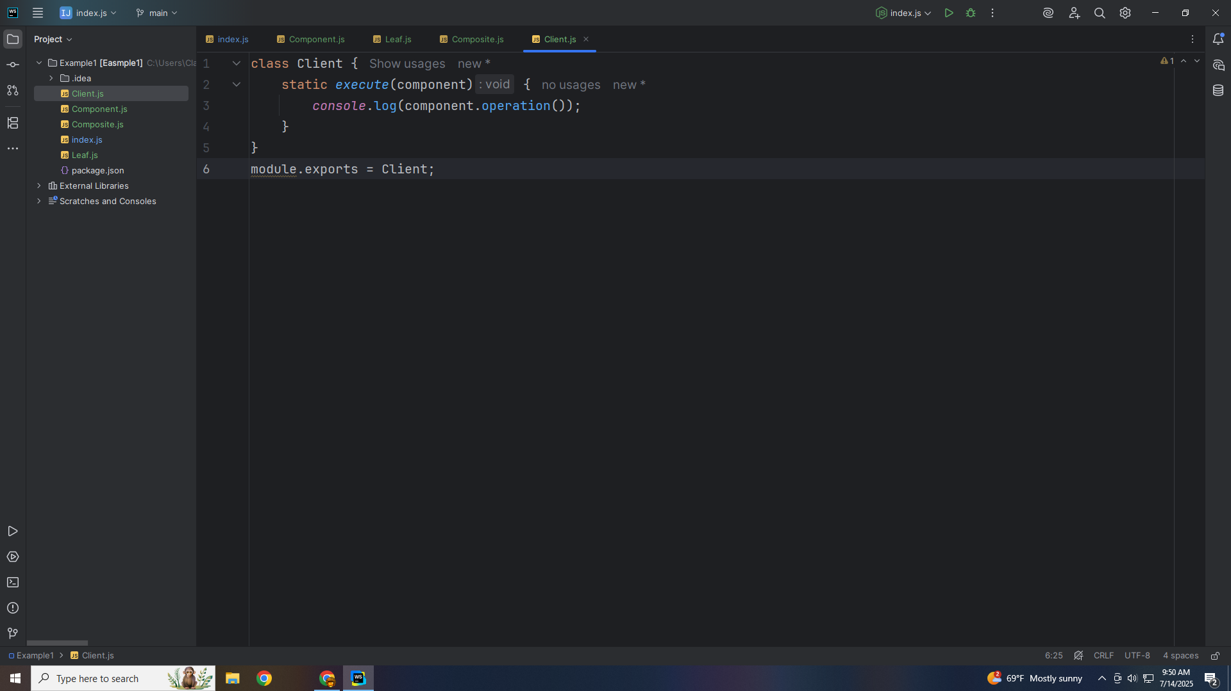
Notes:
We write to the Console the component operation

Slide 30
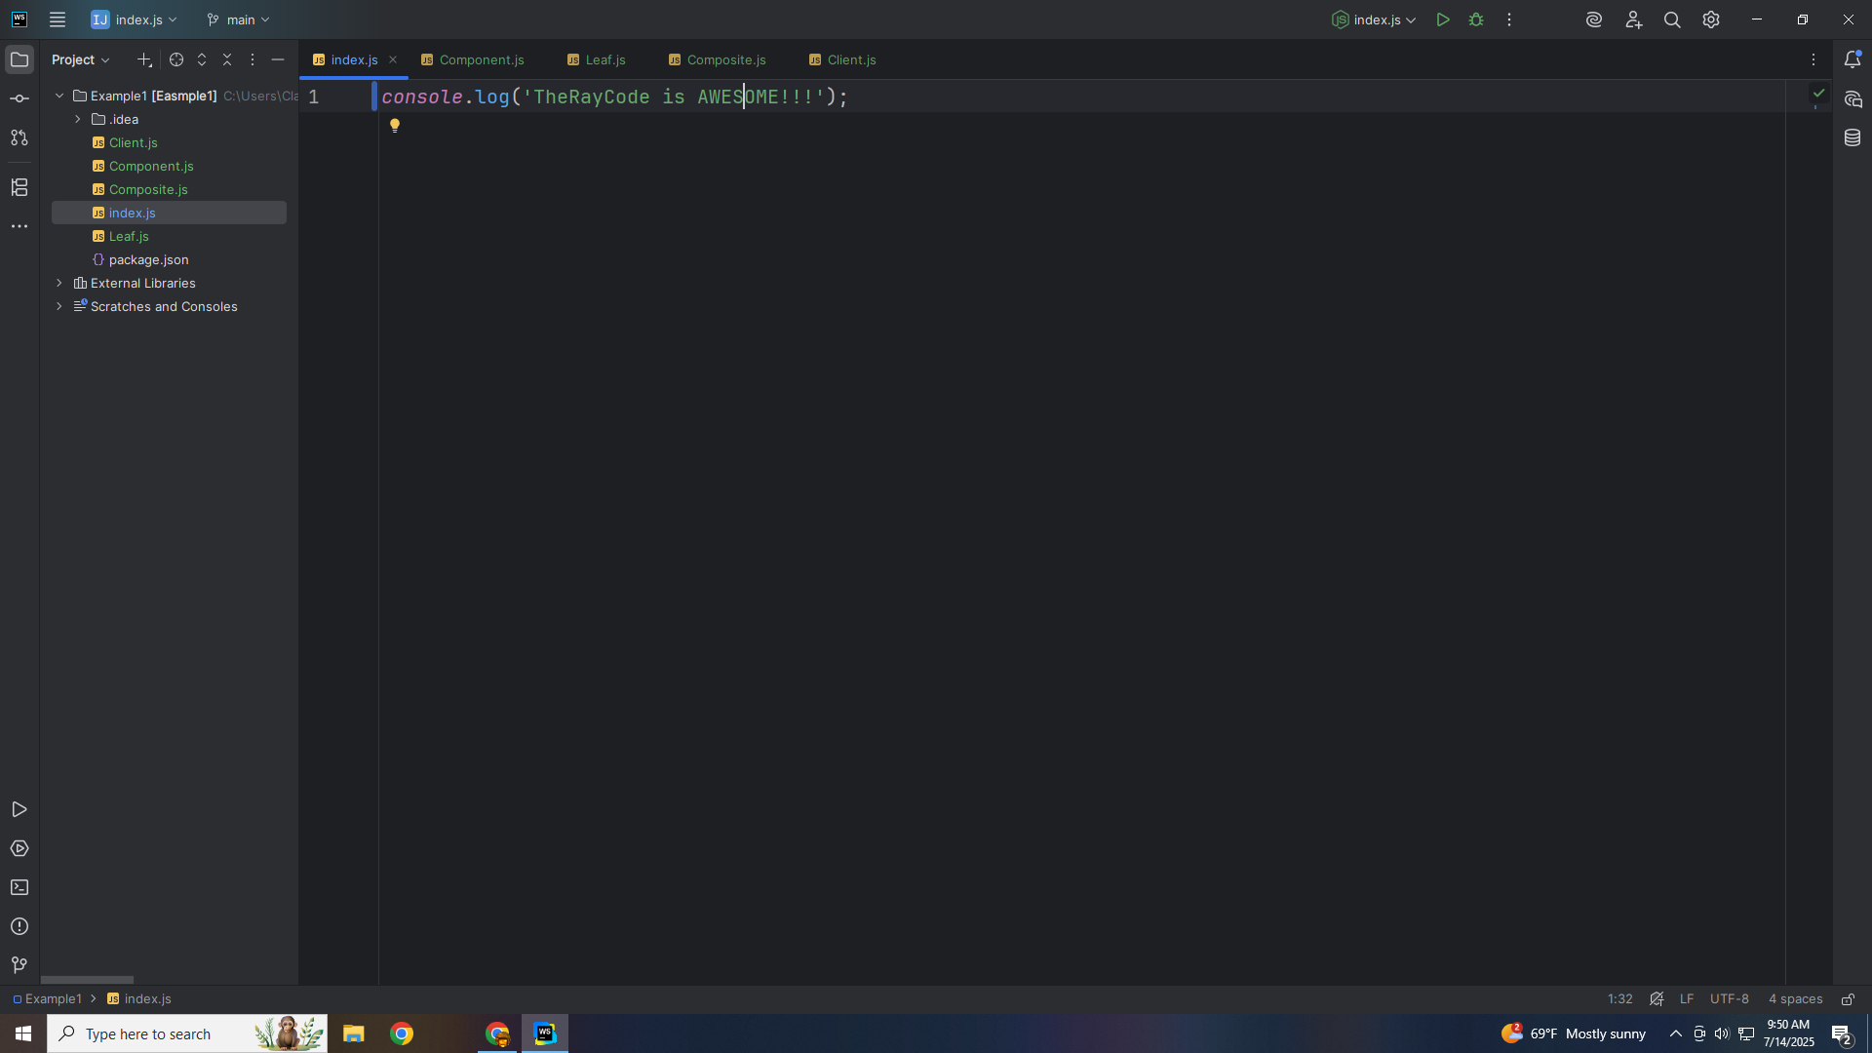
Notes:
Let’s export this for our demo

Slide 31
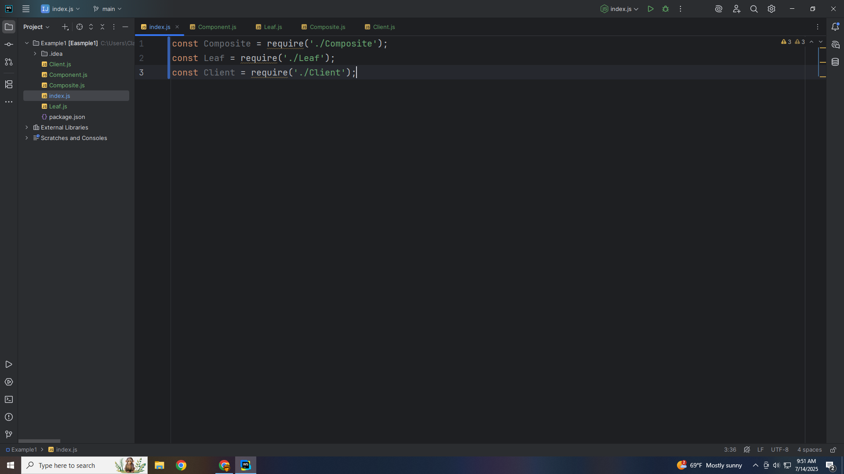
Notes:
Now we go to the index to finish our demo

Slide 32

Notes:
We require the file we created: Composite, Leaf and Client

Slide 33

Notes:
We need a root to add leafs to

Slide 34
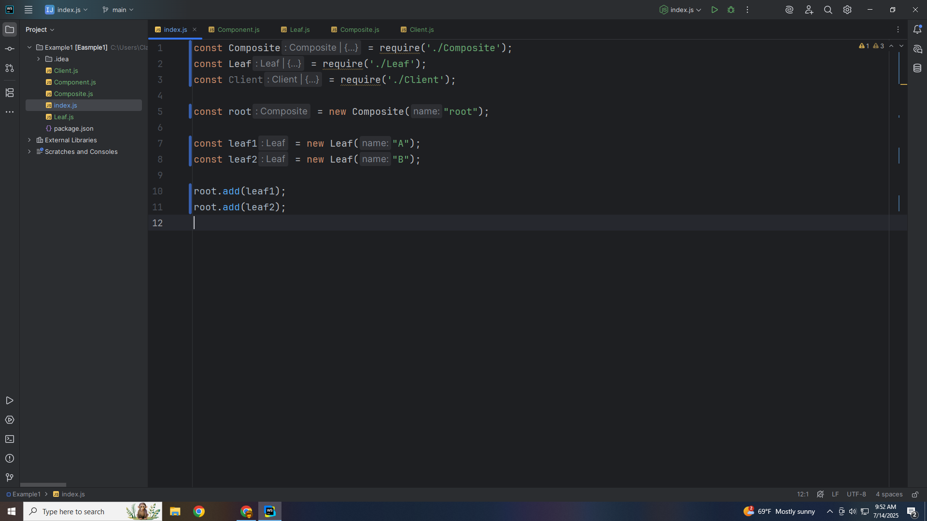
Notes:
We add leaf 1 and add leaf 2

Slide 35
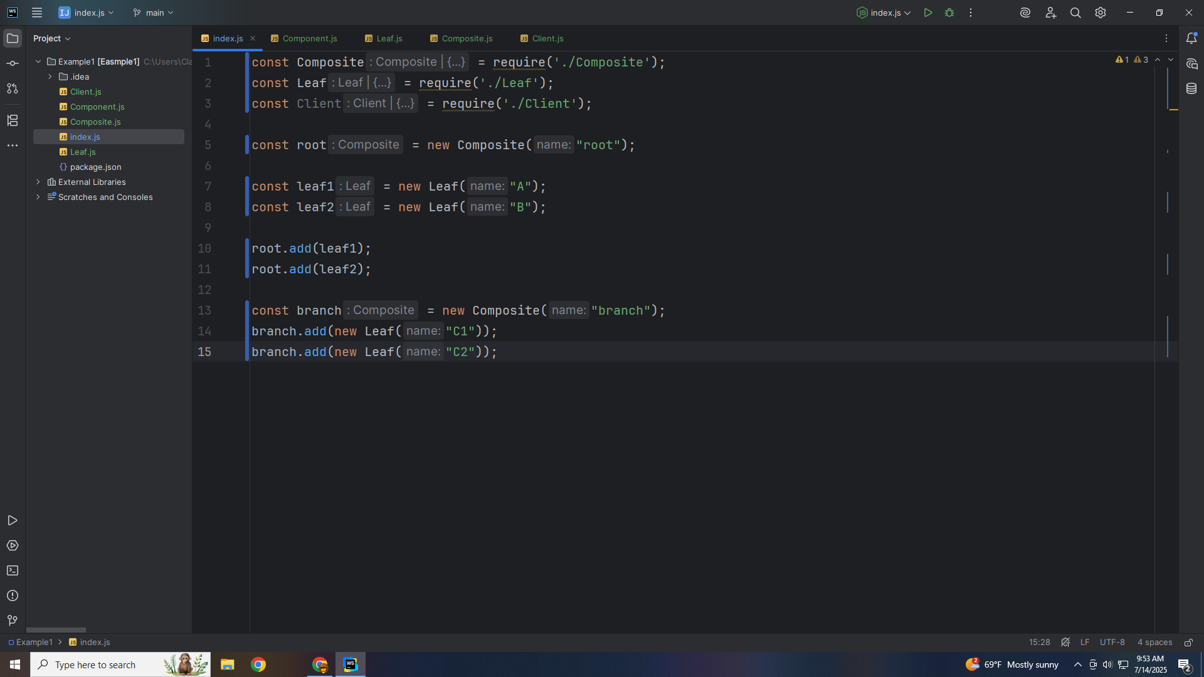
Notes:
We add the leafs to the root
Add a composite child with its own leaves

Slide 36

Notes:
And add it the root

Slide 37
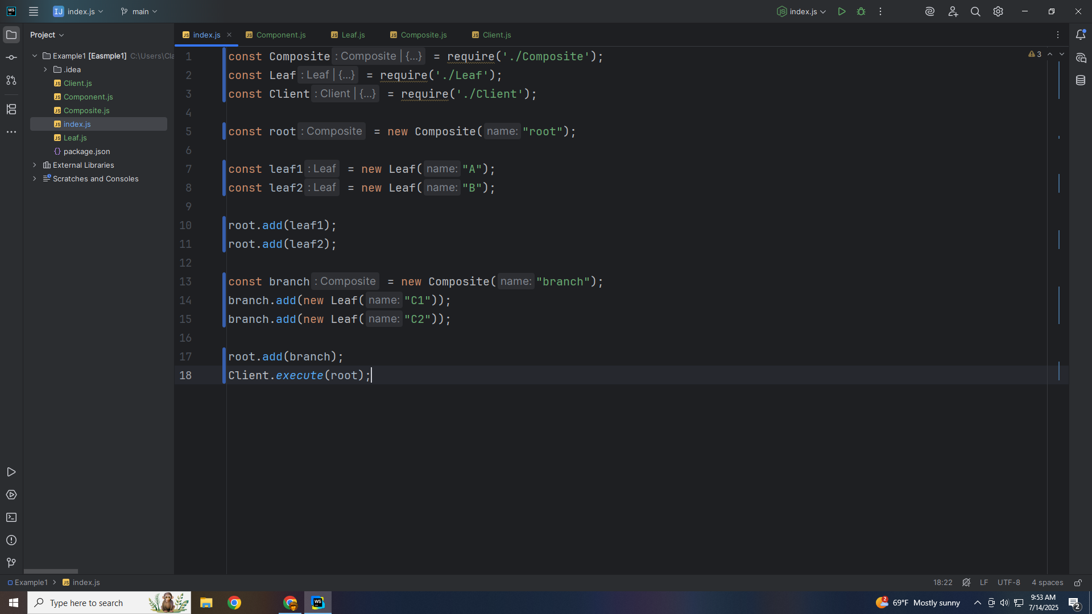
Notes:
We see
Composite(root) [ Leaf: A | Leaf: B | Composite(branch) [ Leaf: C1 | Leaf: C2 ] ]
My name is Ray

Slide 38
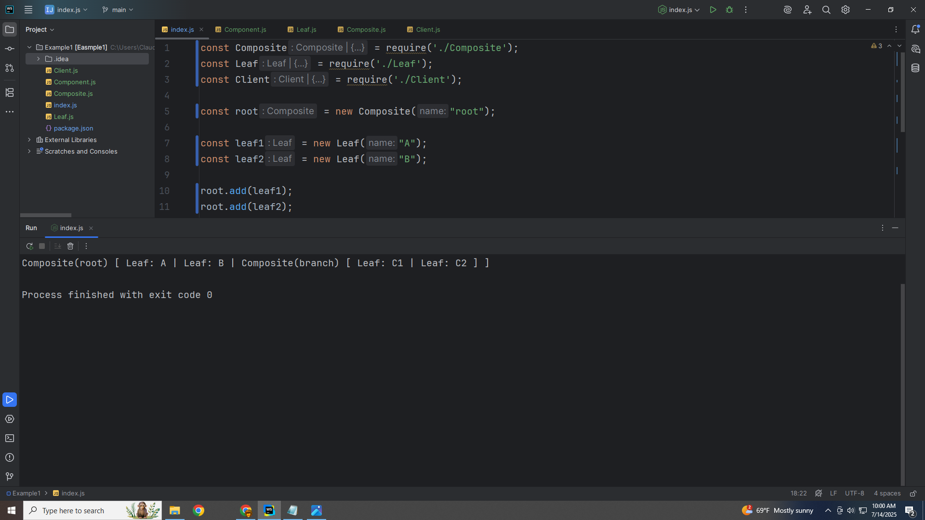
Notes:
Execute the Client with the root); We see

Slide 39
Notes:
We see
Composite(root) [ Leaf: A | Leaf: B | Composite(branch) [ Leaf: C1 | Leaf: C2 ] ]
My name is Ray

