Slide 1
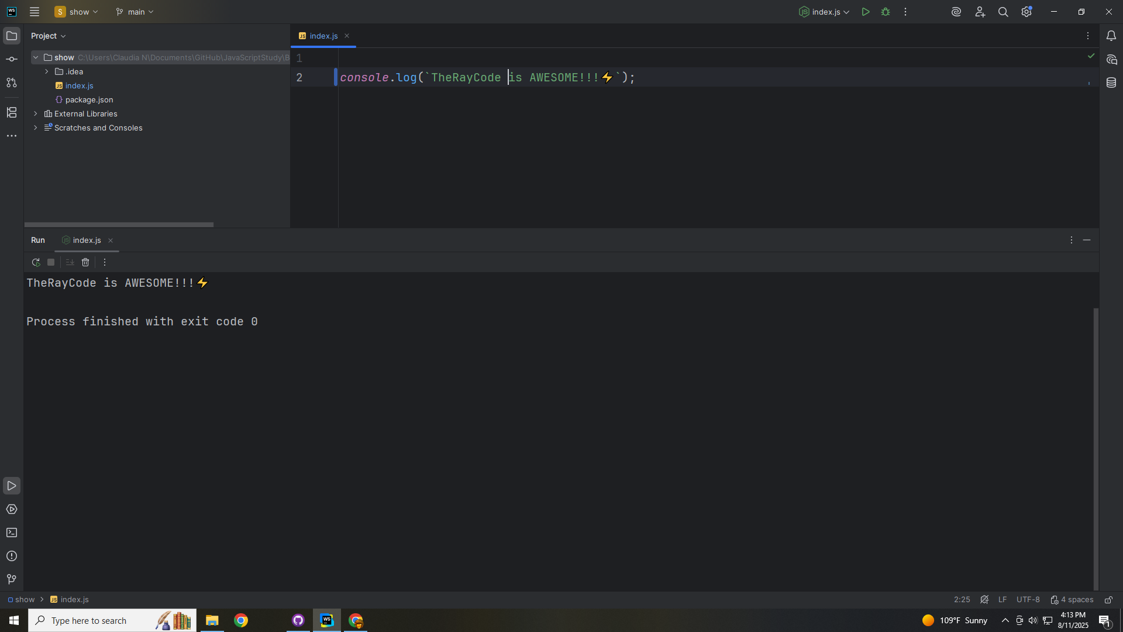
Notes:
Hello, my name is Ray I’m the Ray in TheRayCode

Slide 2

Notes:
In this video I plan to review a Design Pattern called the Iterator
The Iterator is a Behavioral Design pattern as per the Gang of 4

Slide 3
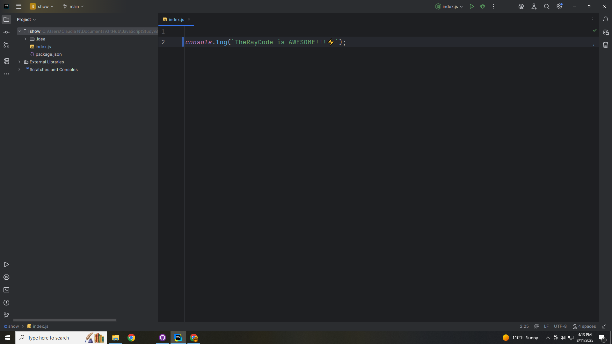
Notes:
I will be using JavaScript
The Iterator Design Pattern provides a systematic way to access elements of a collection without exposing its underlying representation.

Slide 4
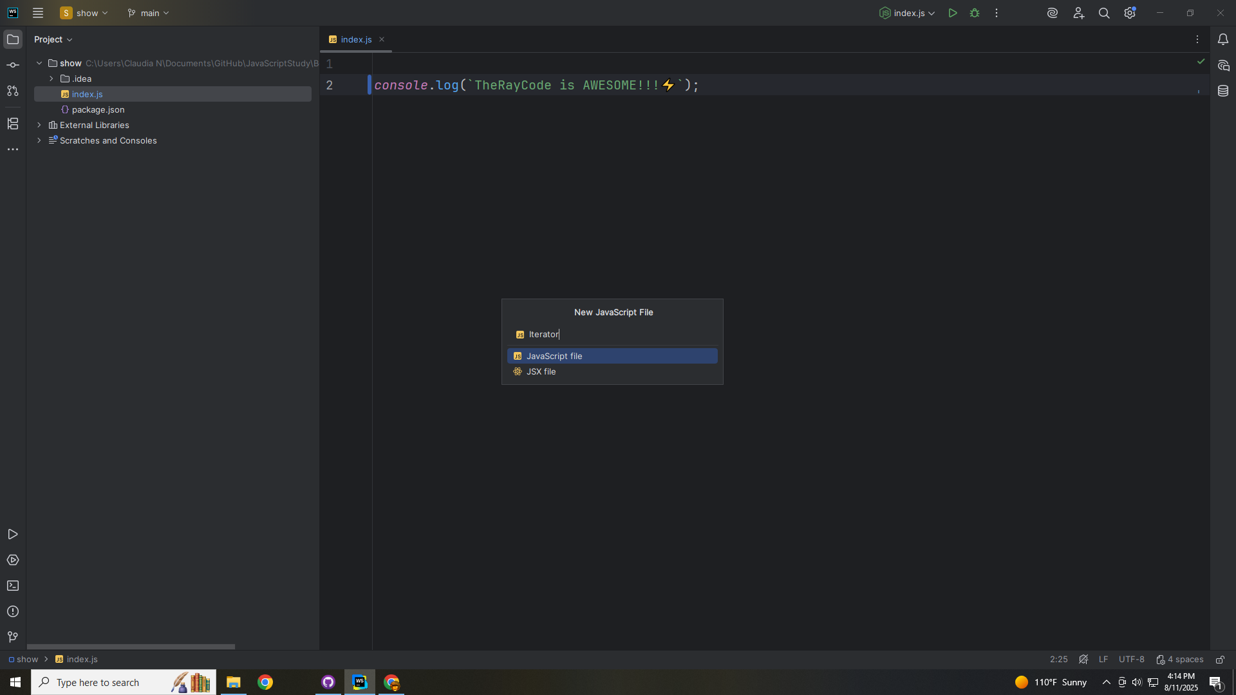
Notes:
We start with the Iterator

Slide 5
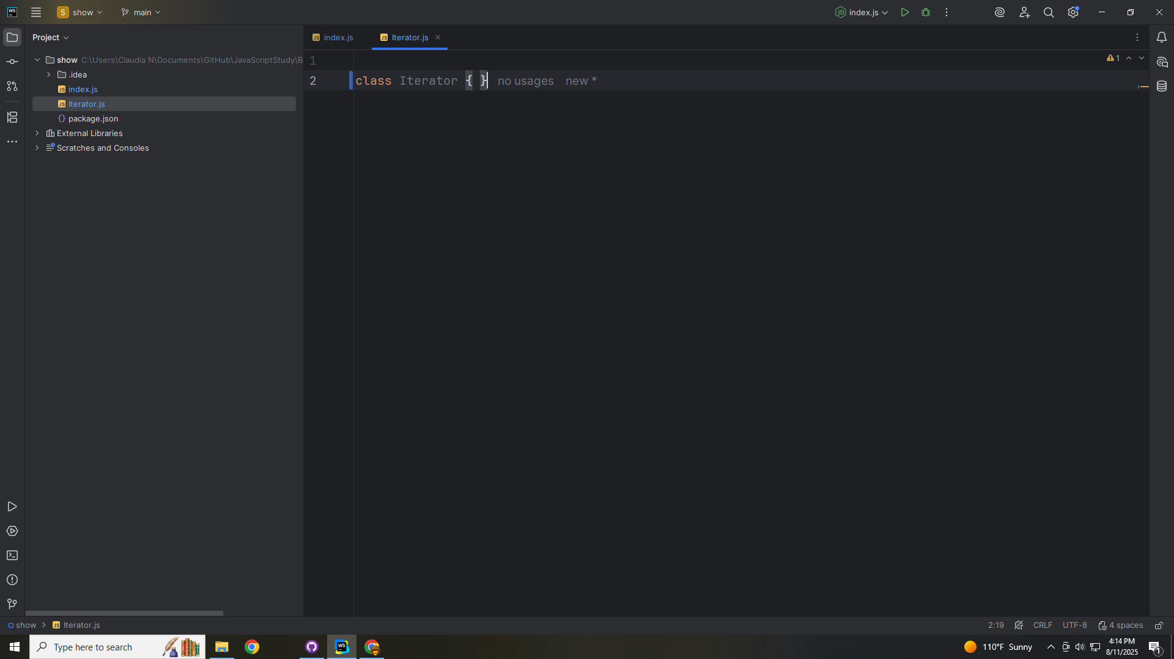
Notes:
The Iterator Defines the traversal interface
The methods
(first, next, isDone, currentItem)
Are all concrete iterators must implement.

Slide 6
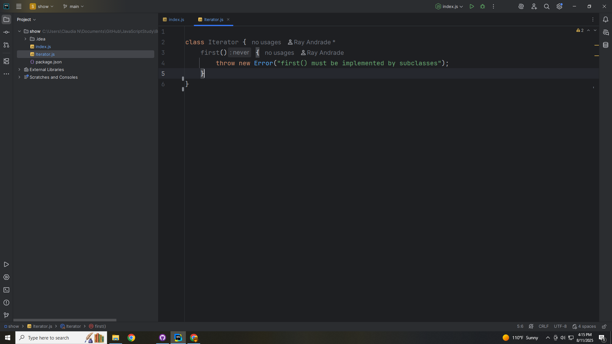
Notes:
first() must be implemented by subclasses

Slide 7
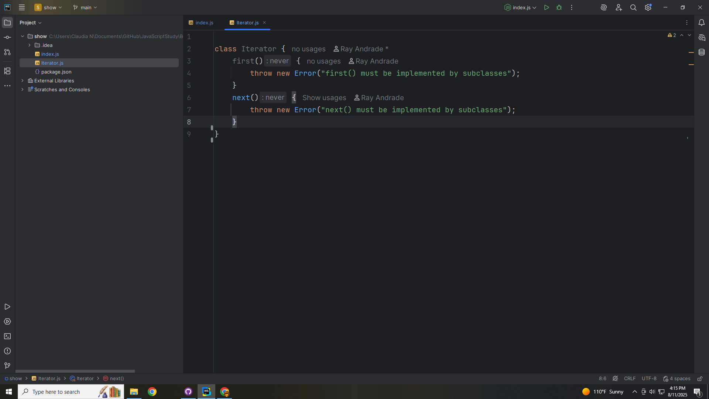
Notes:
And So must next

Slide 8
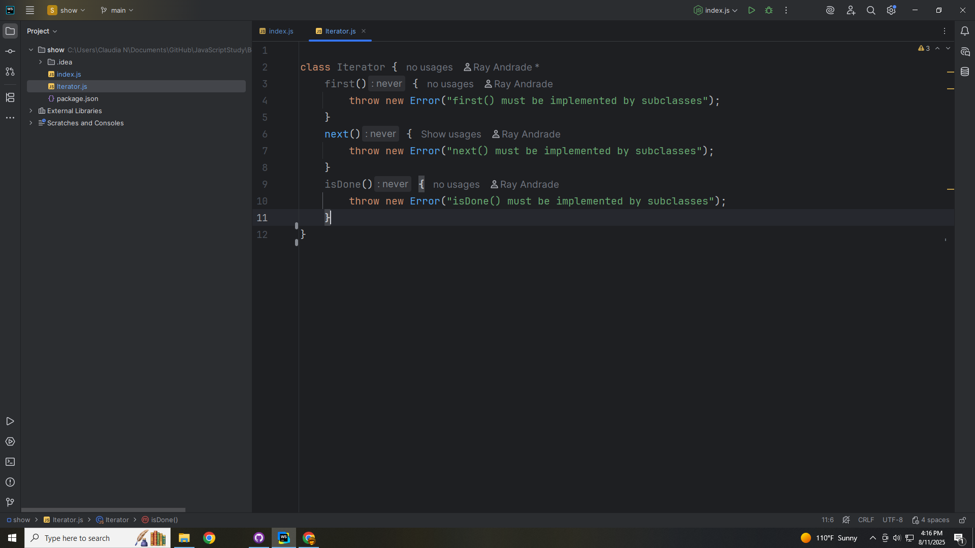
Notes:
And isDone

Slide 9
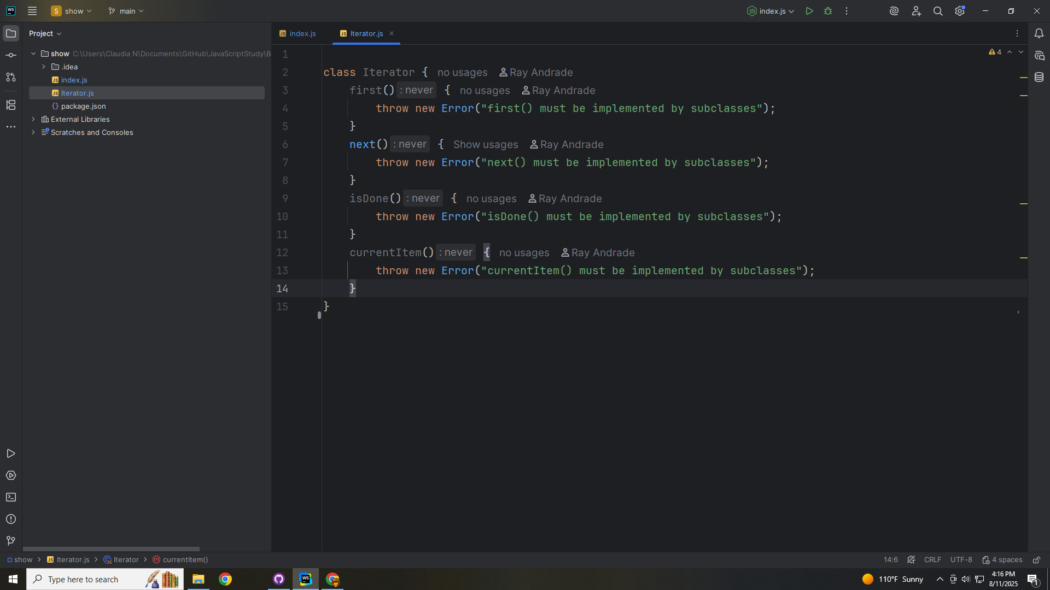
Notes:
And so must the current Item

Slide 10
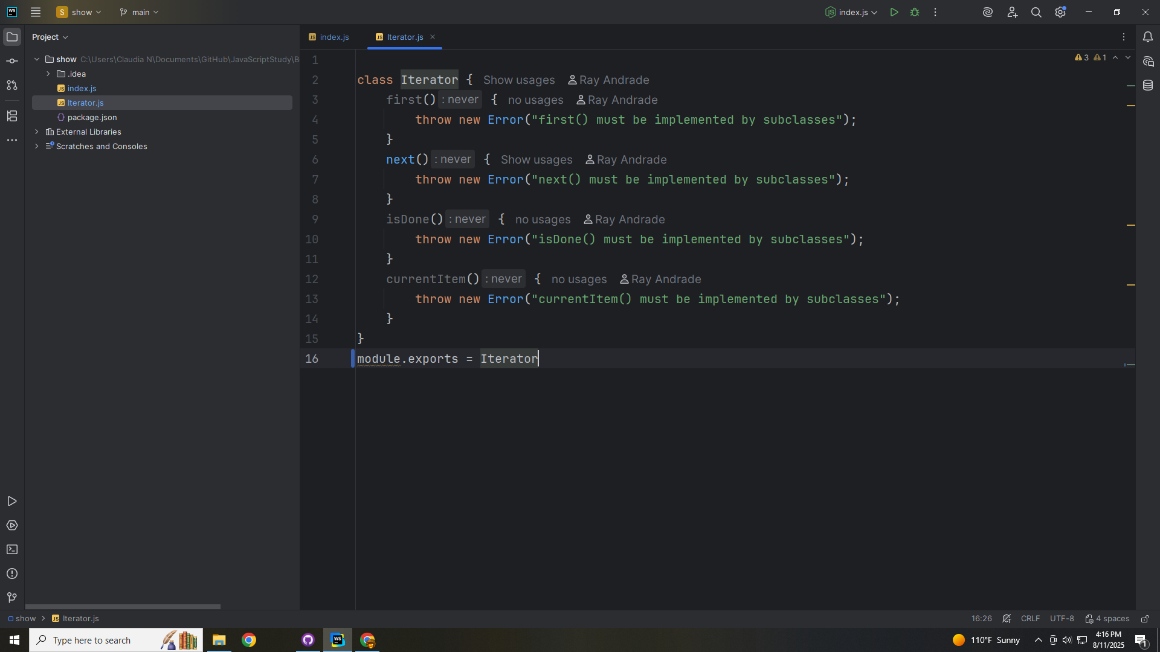
Notes:
We end this module for export as Iterator

Slide 11
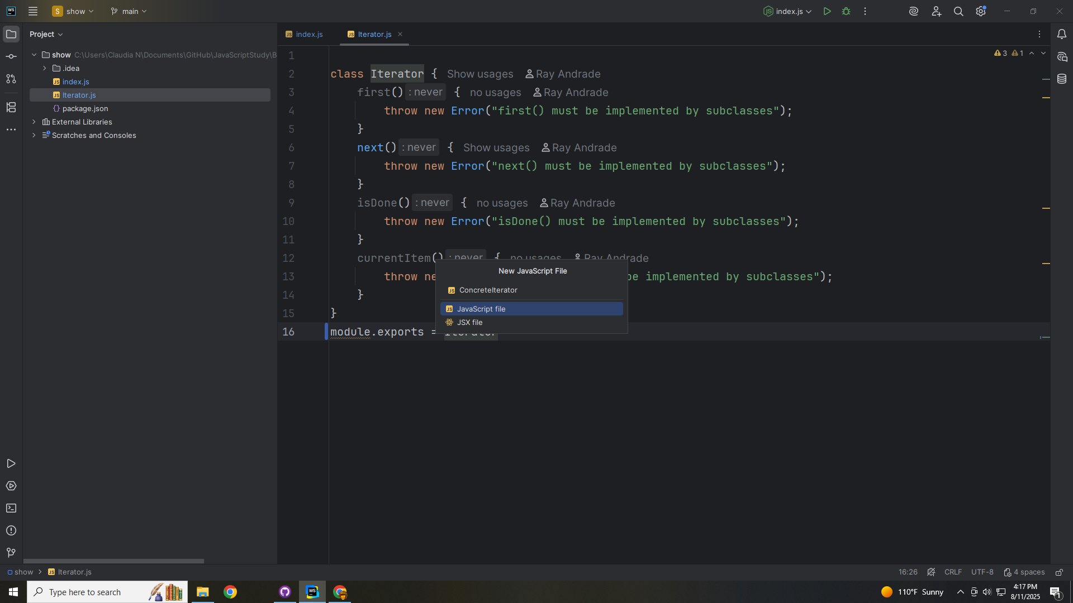
Notes:
Now let’s create a class called Concrete Iterator

Slide 12
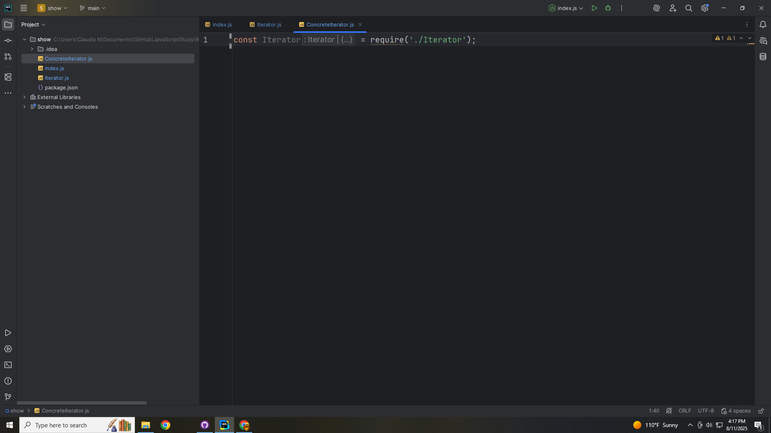
Notes:
We require the Iterator interface

Slide 13
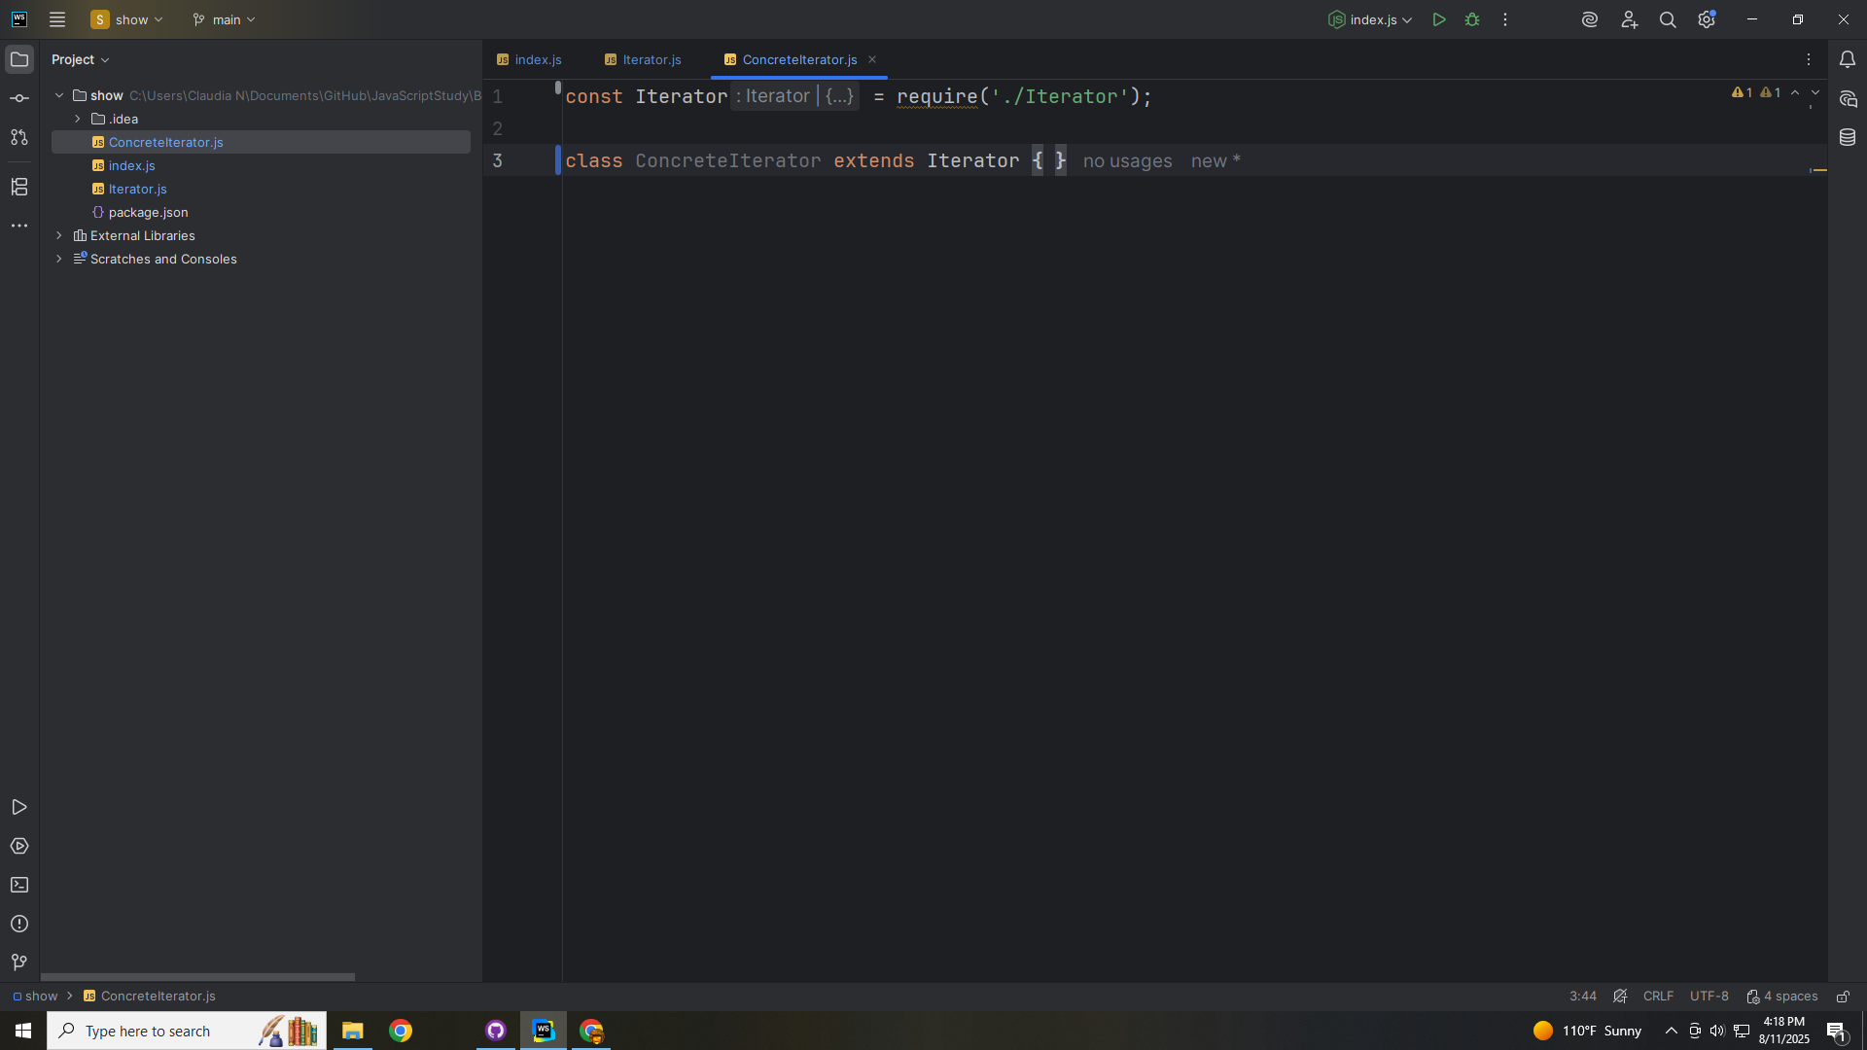
Notes:
So we can extend this class with it.
This will implement the Iterator interface, tracking the current position and iterating over the Concrete Aggregate.

Slide 14
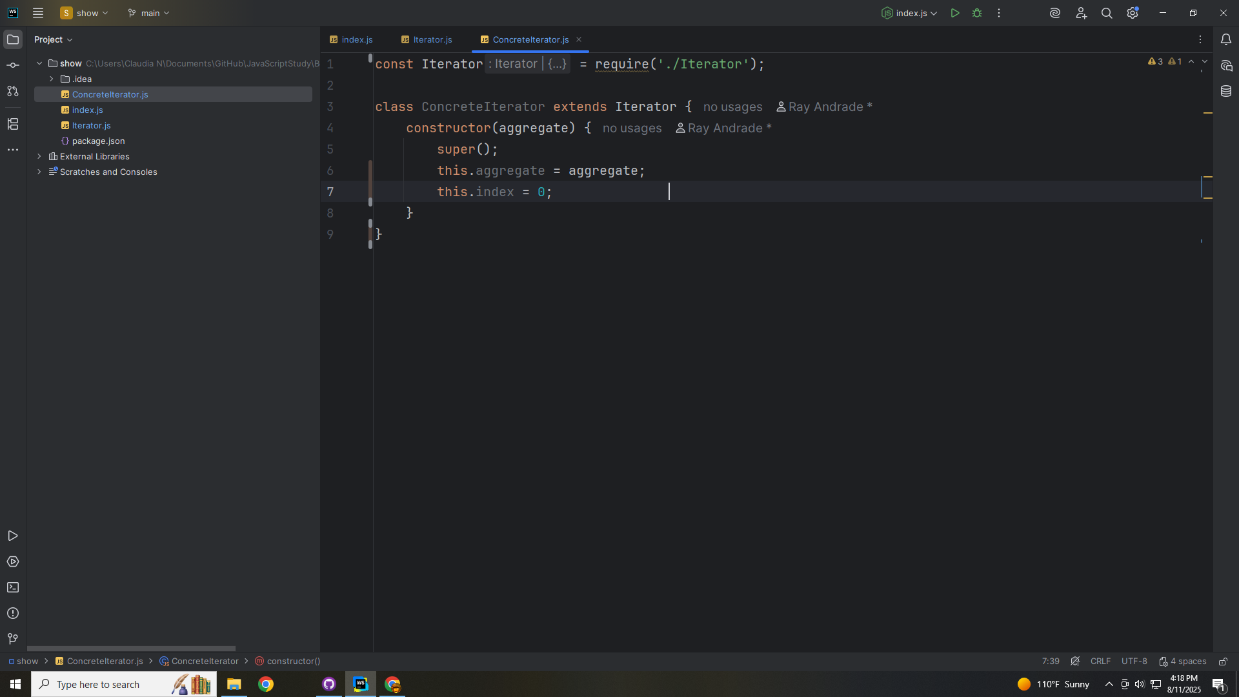

Slide 15
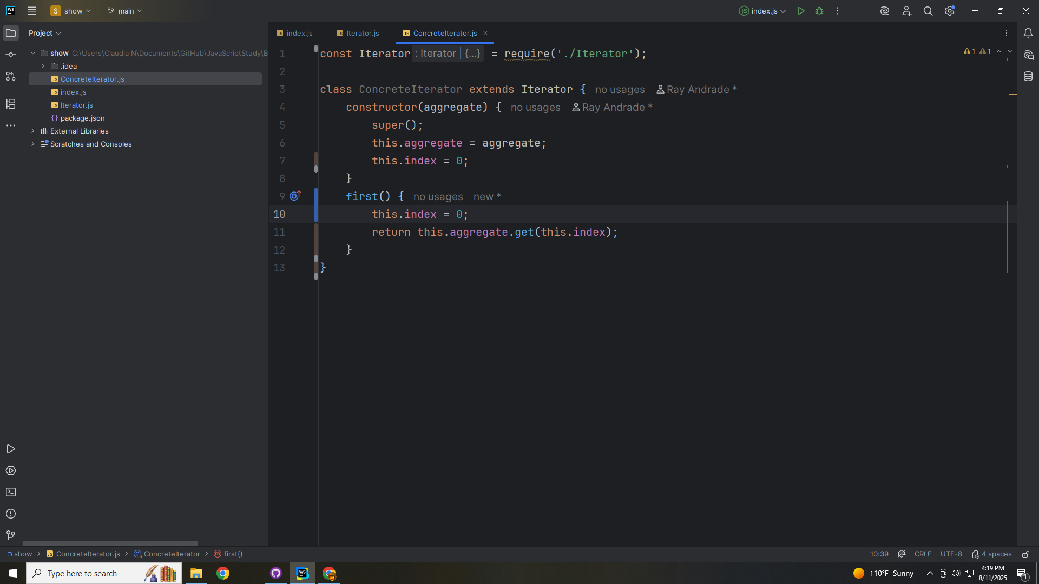

Slide 16
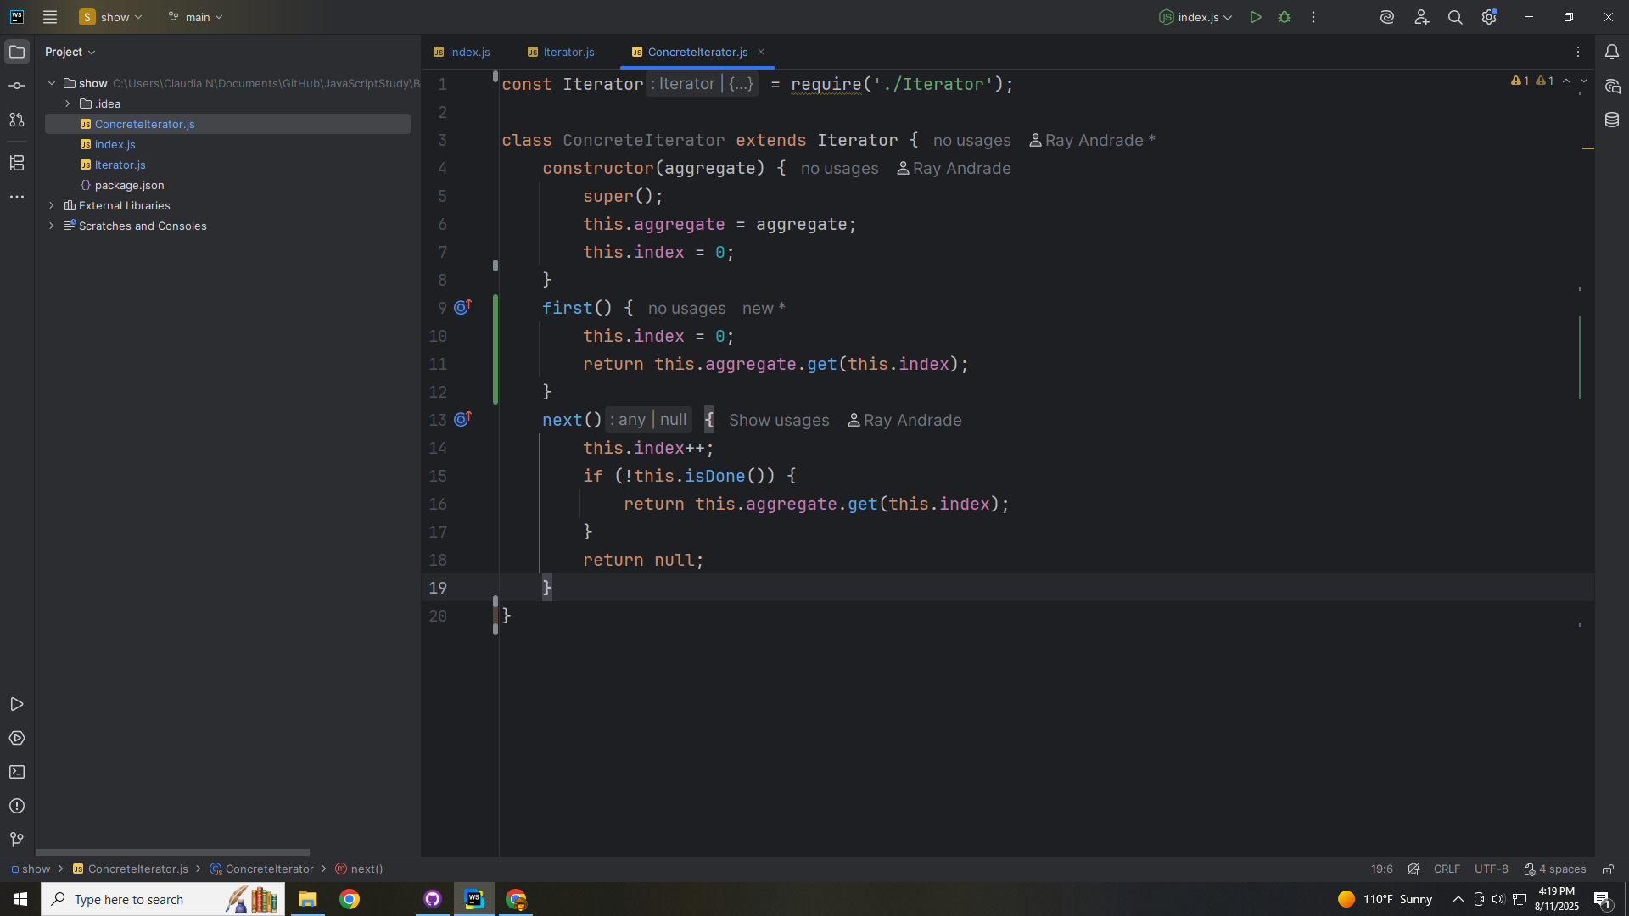

Slide 17
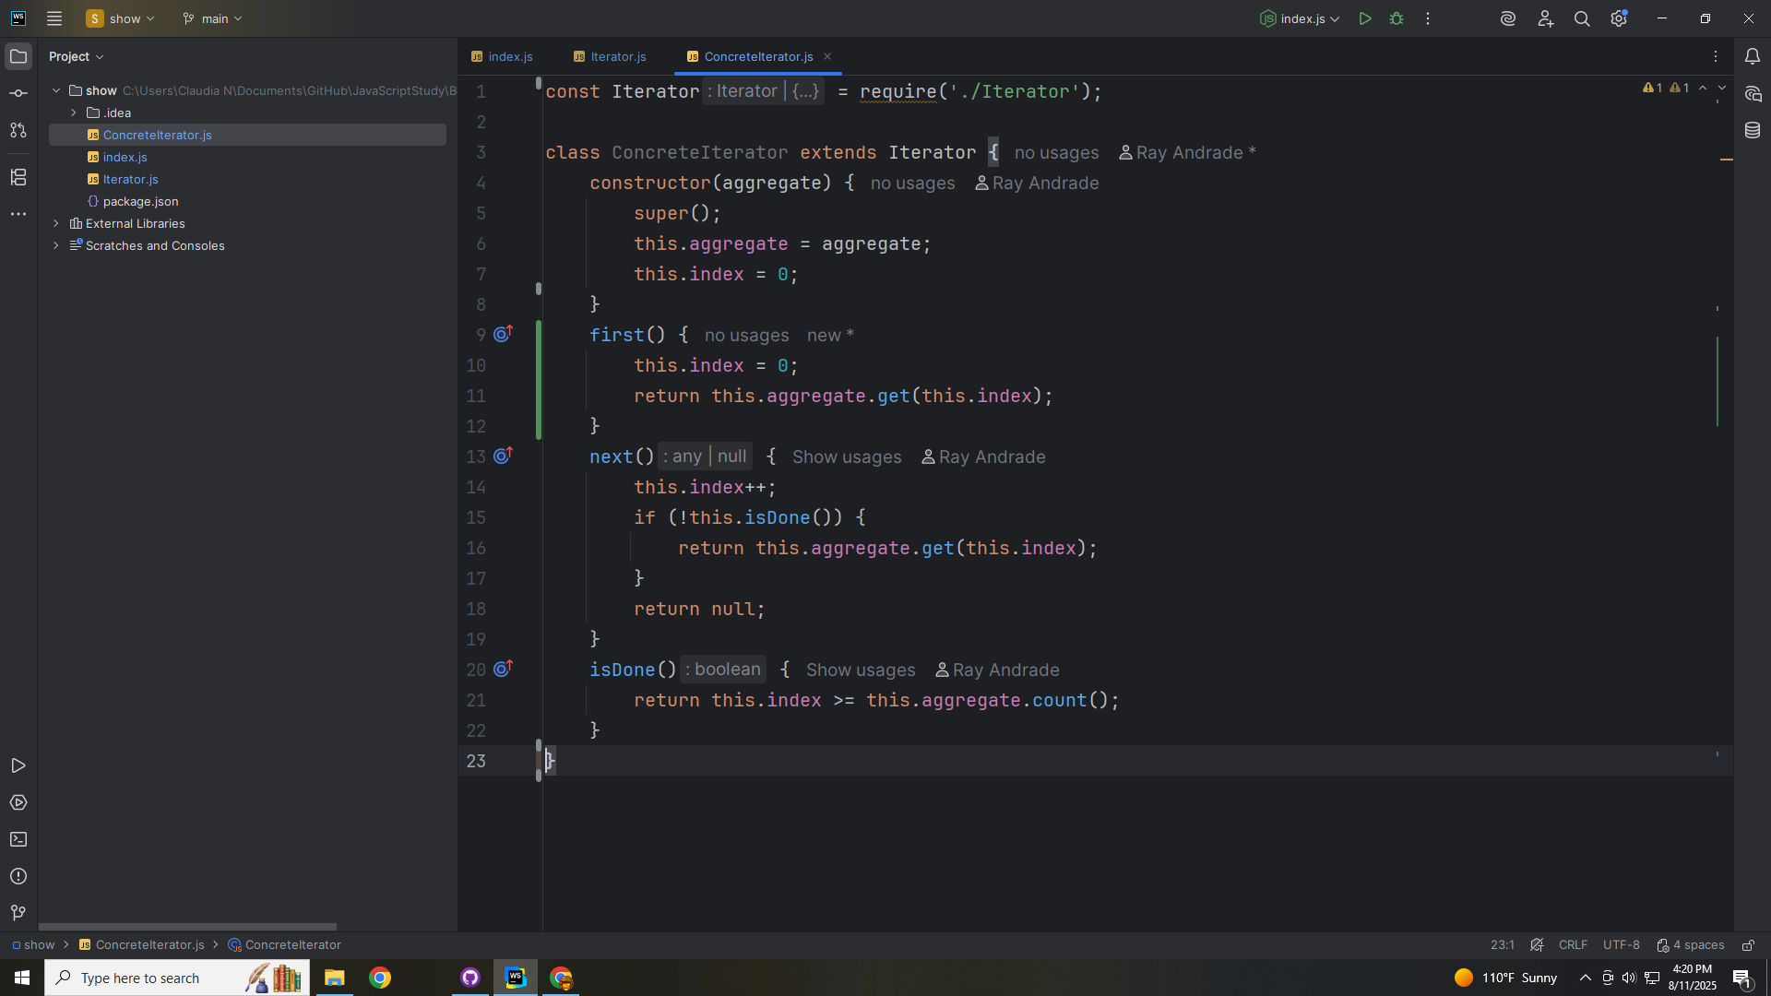

Slide 18
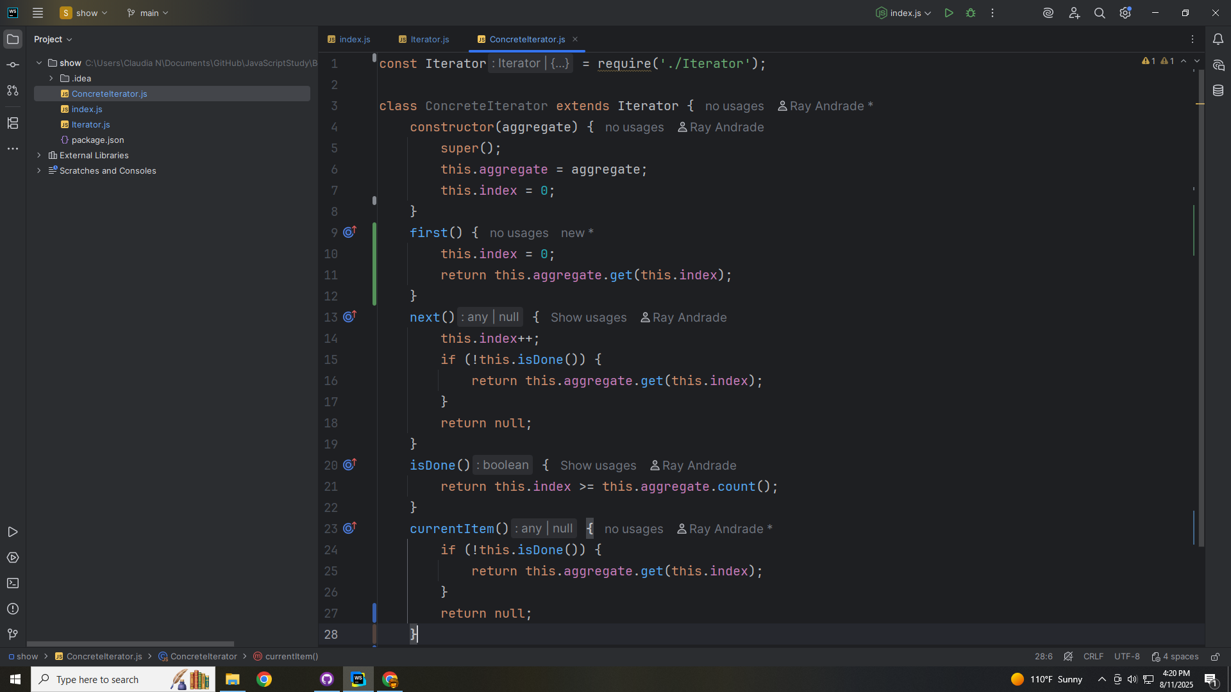

Slide 19
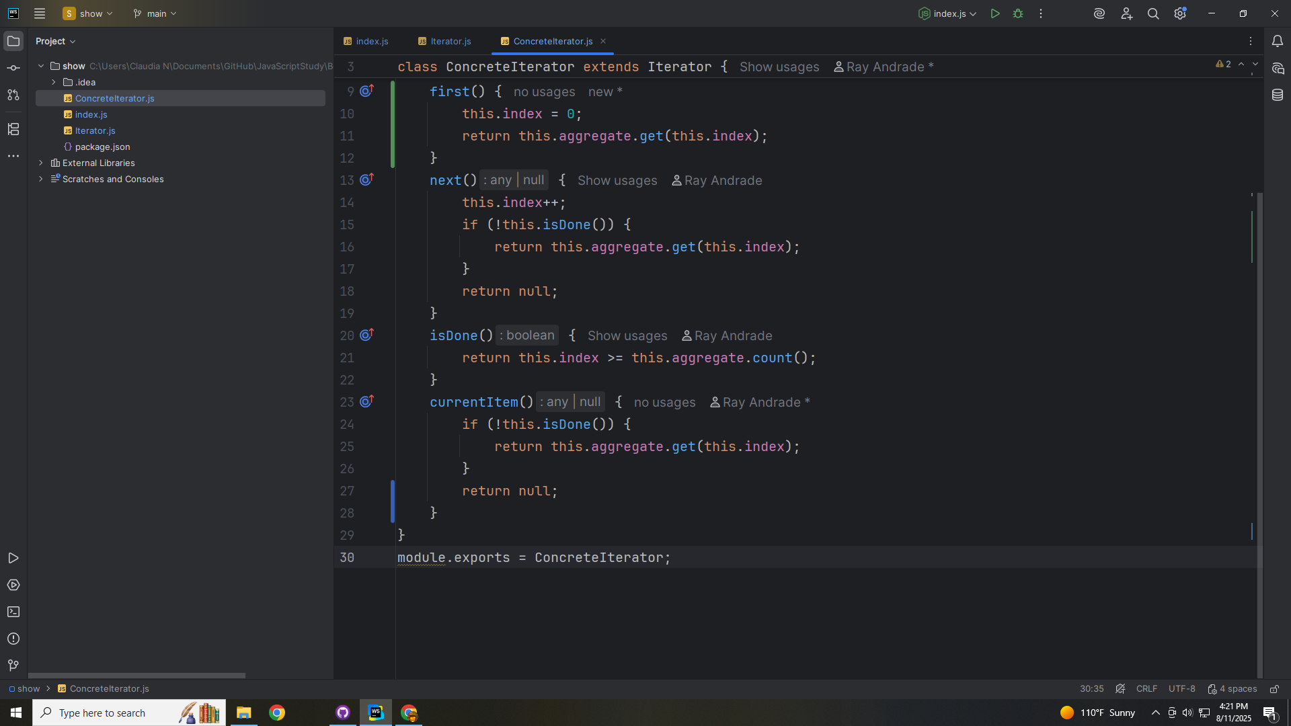

Slide 20
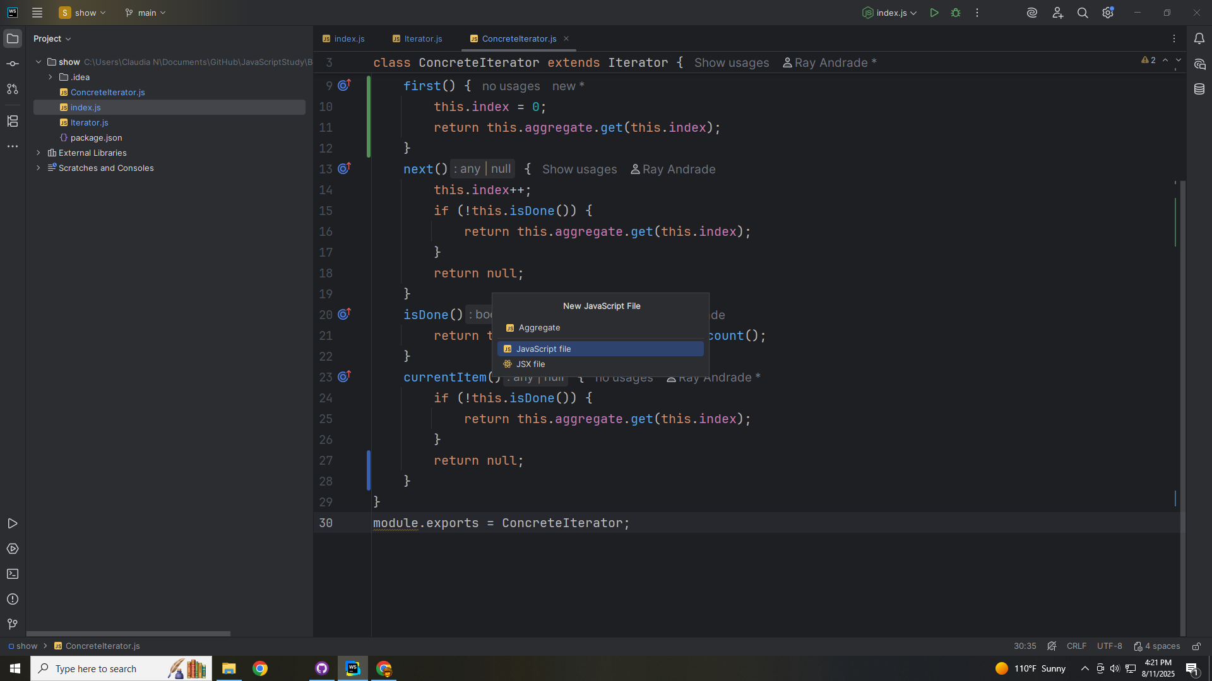

Slide 21
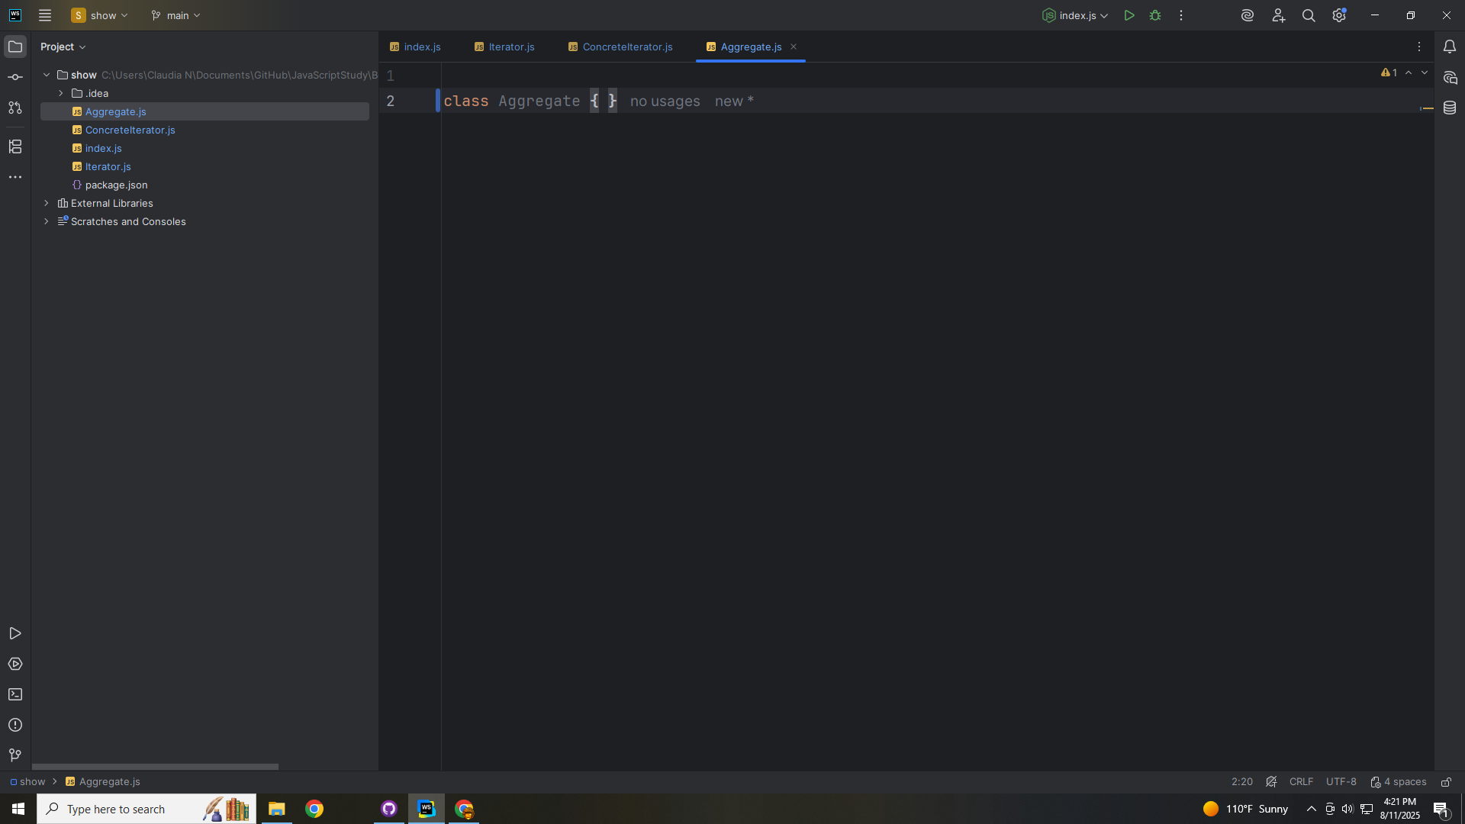

Slide 22
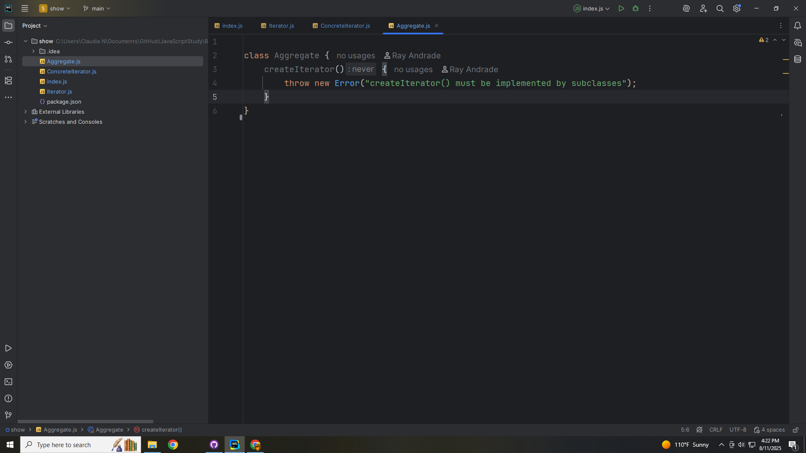

Slide 23
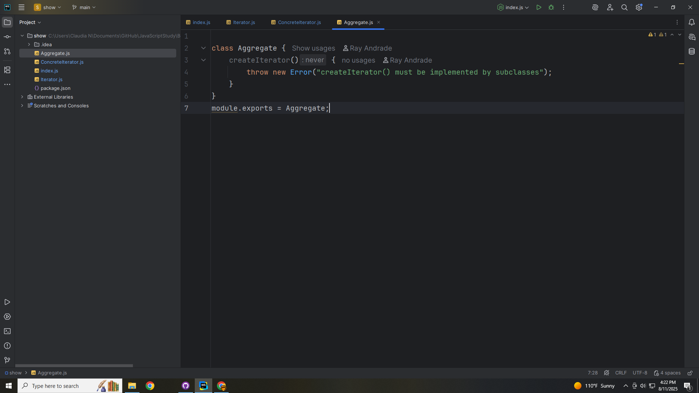

Slide 24
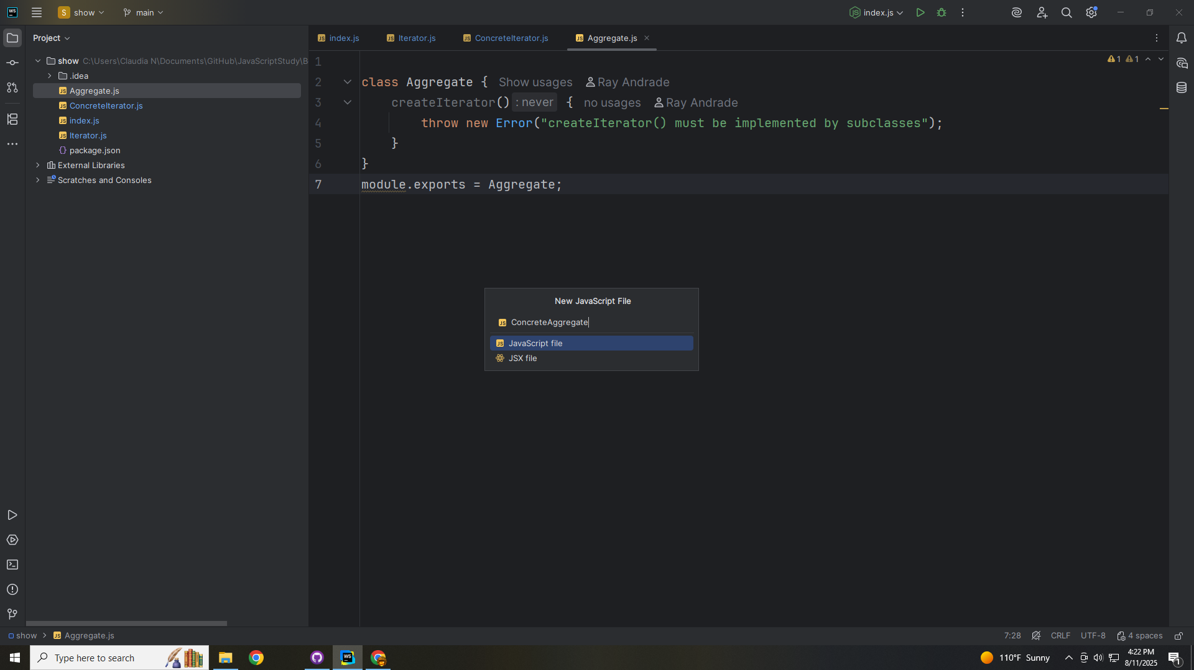

Slide 25
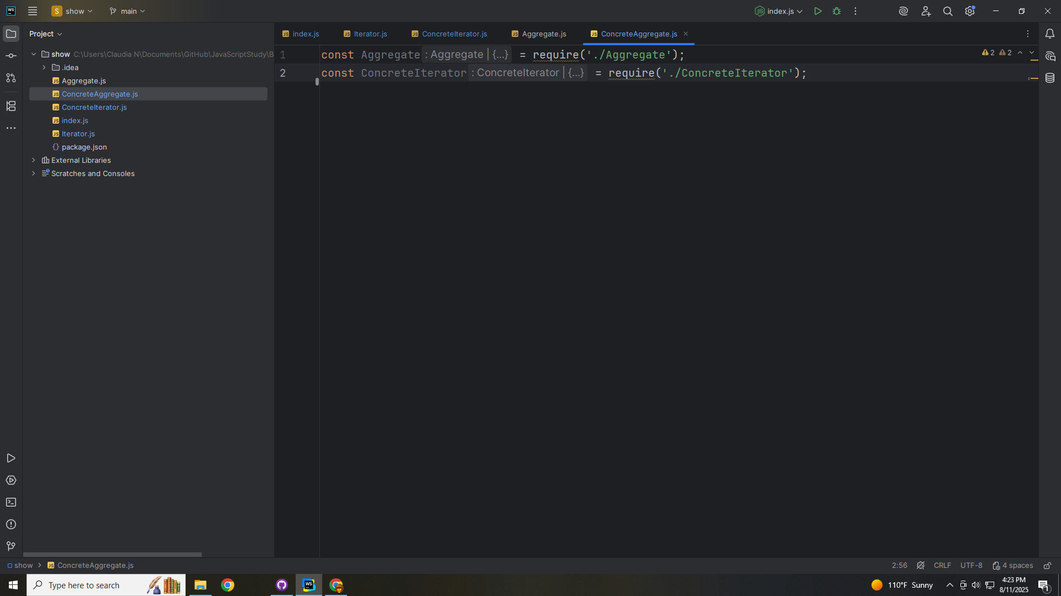

Slide 26
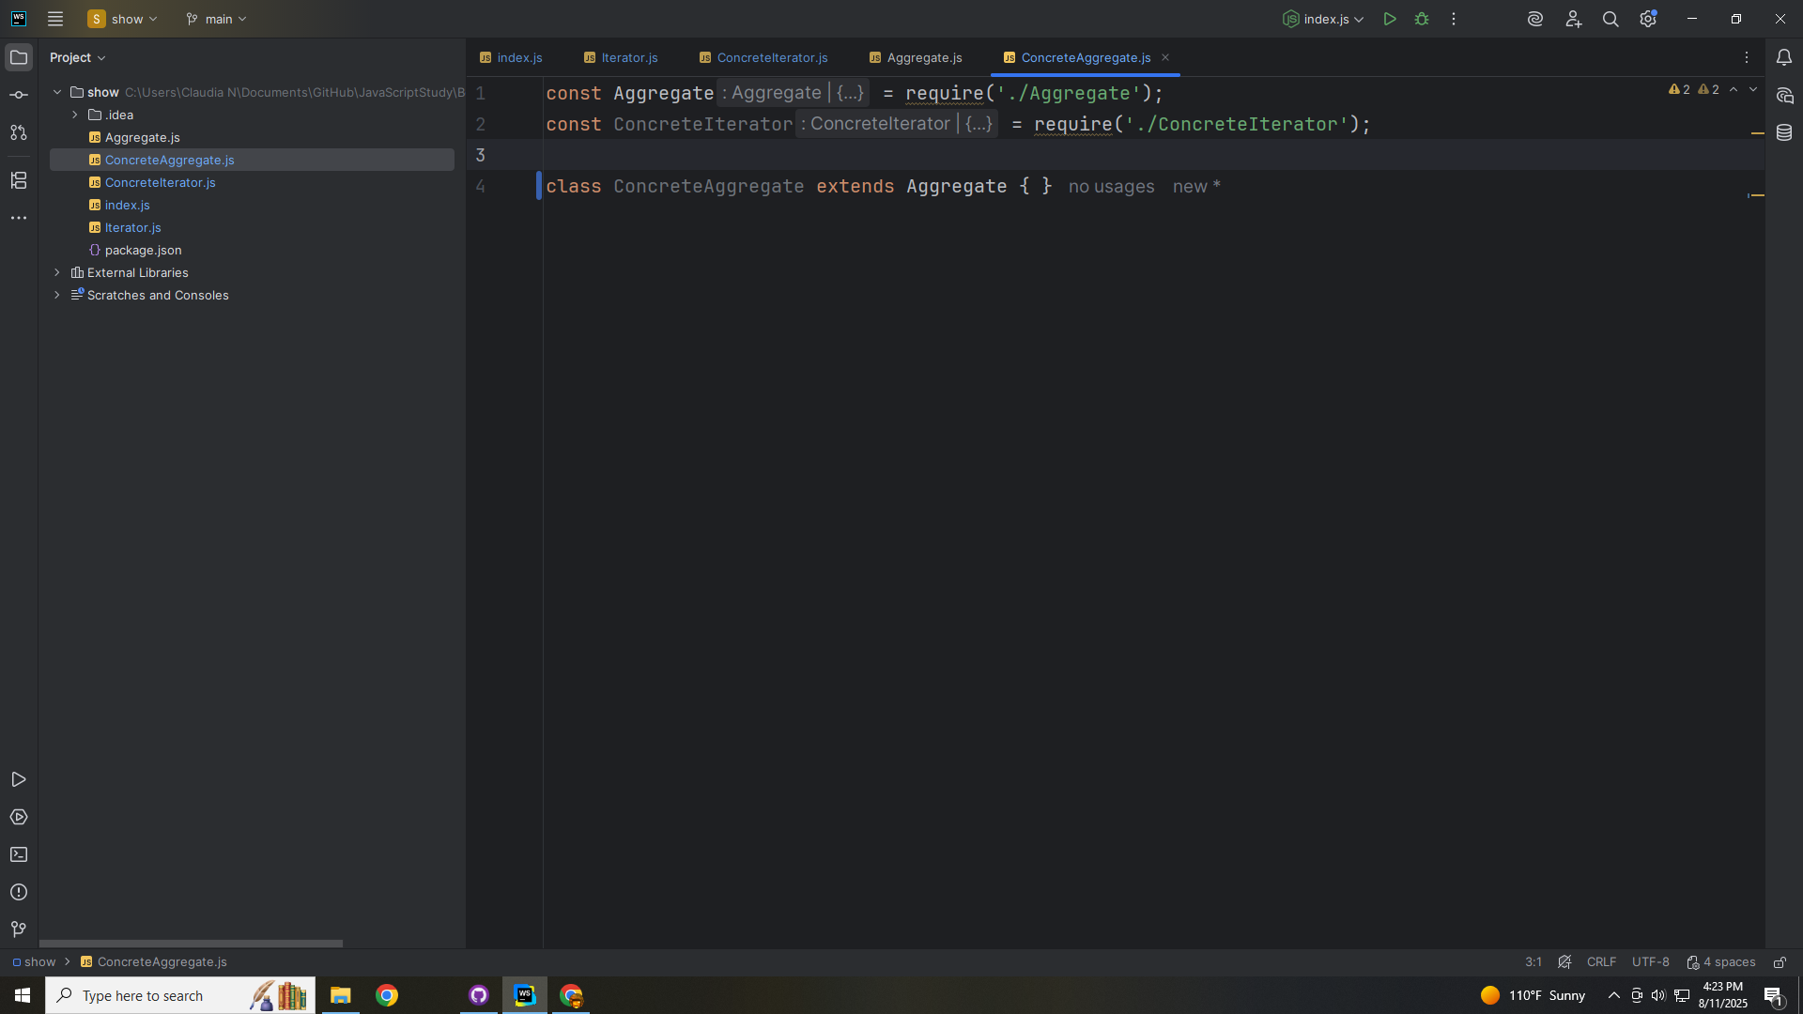

Slide 27
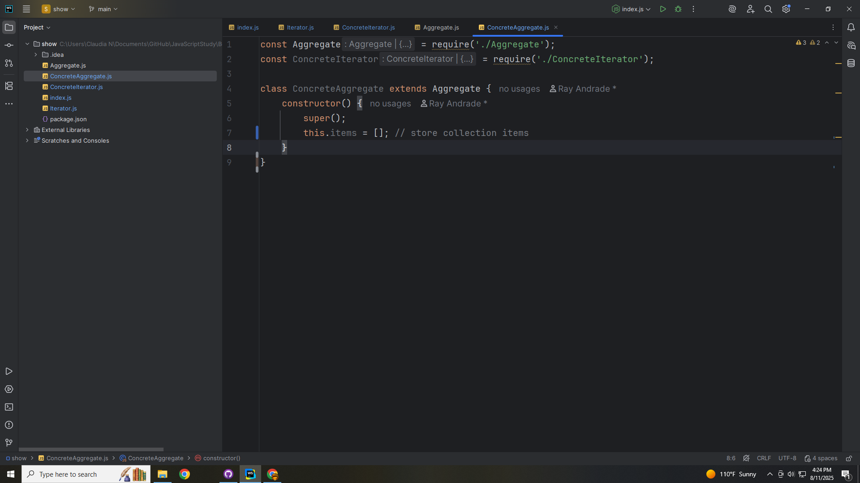

Slide 28
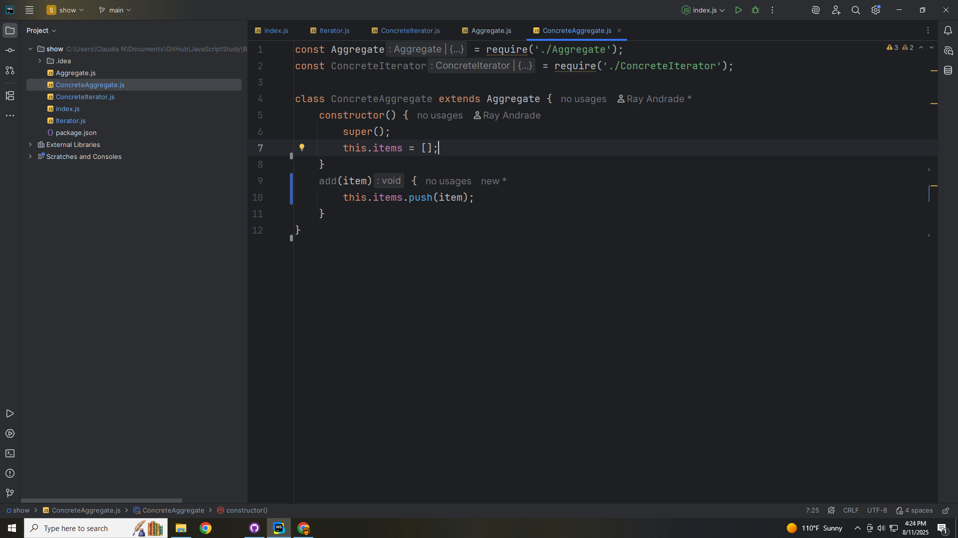

Slide 29
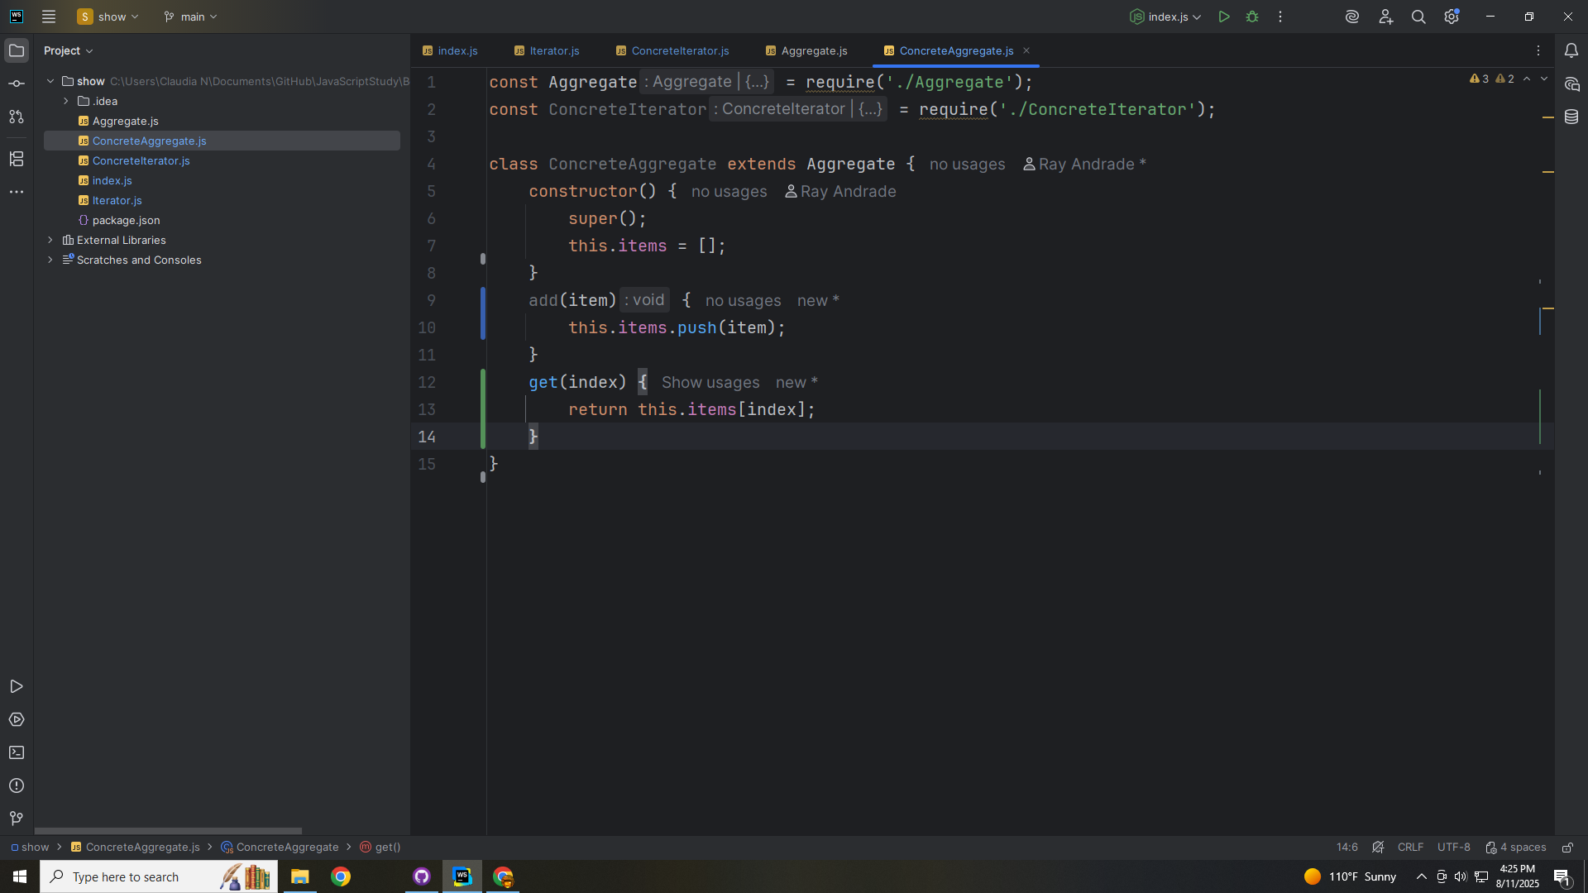

Slide 30
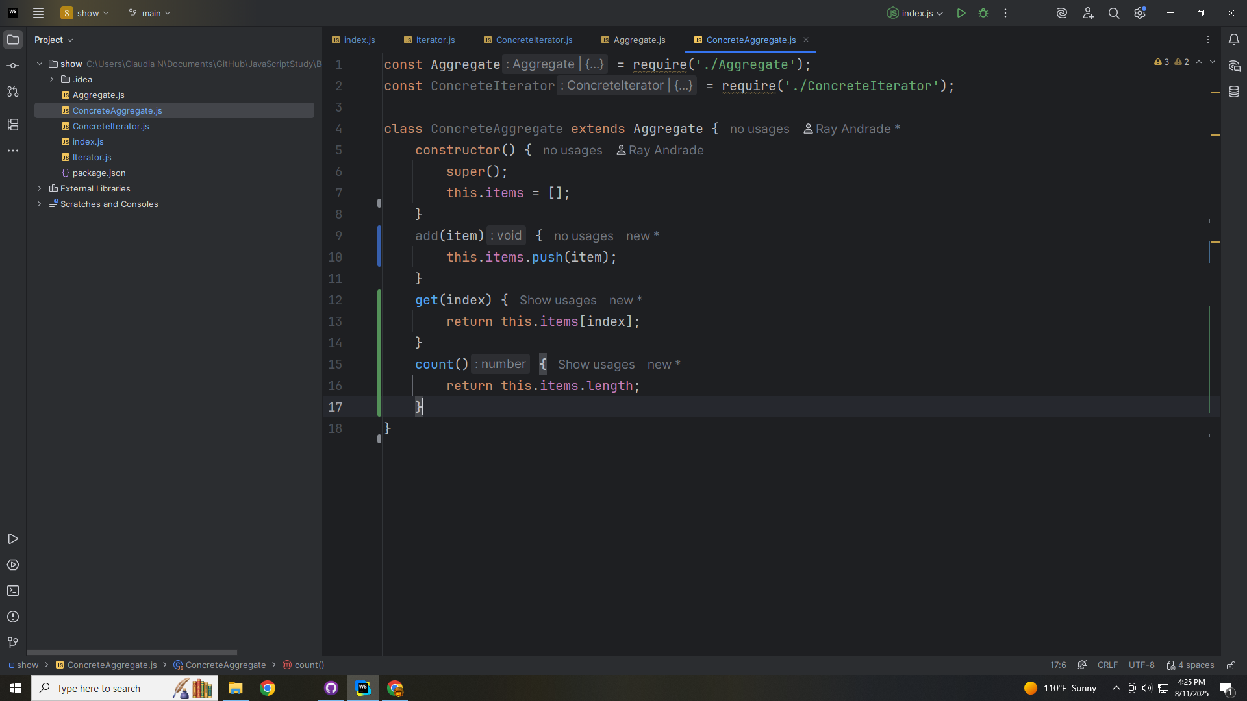

Slide 31
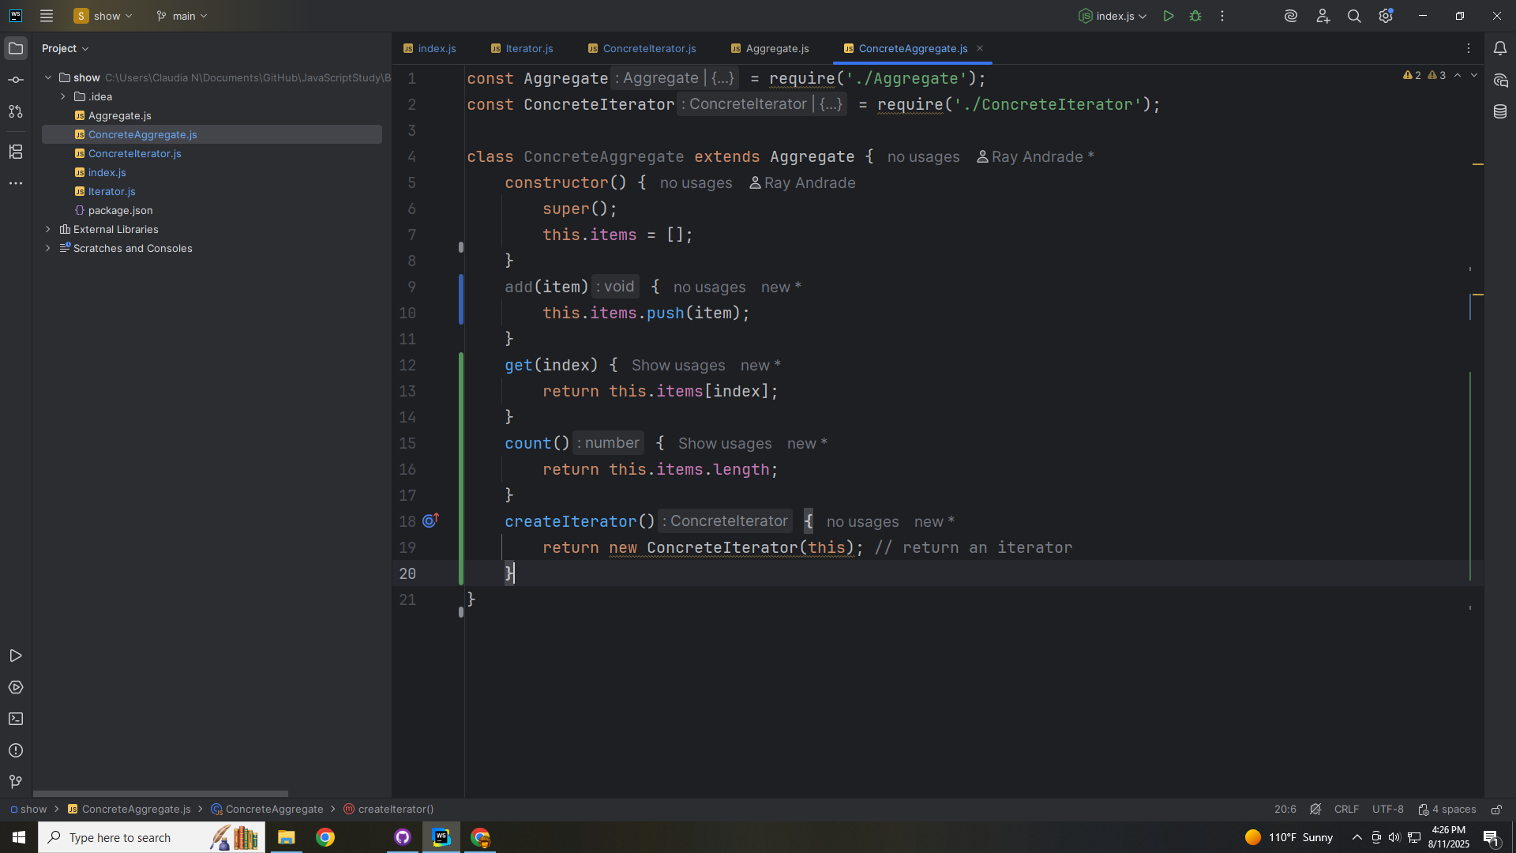

Slide 32
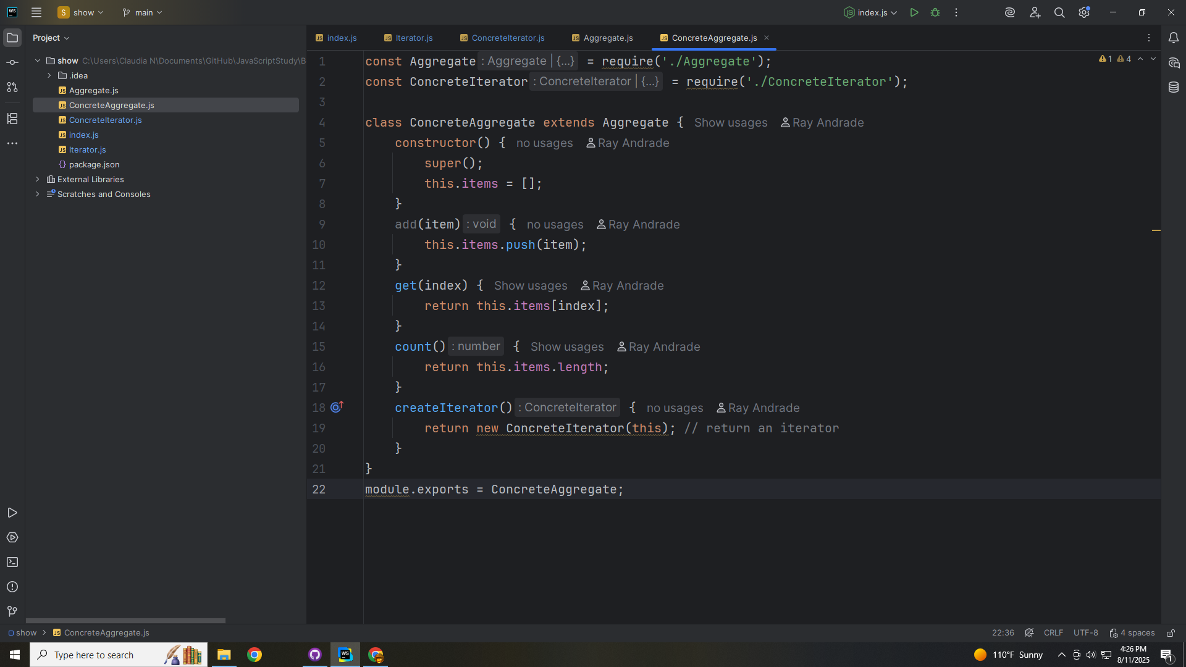

Slide 33
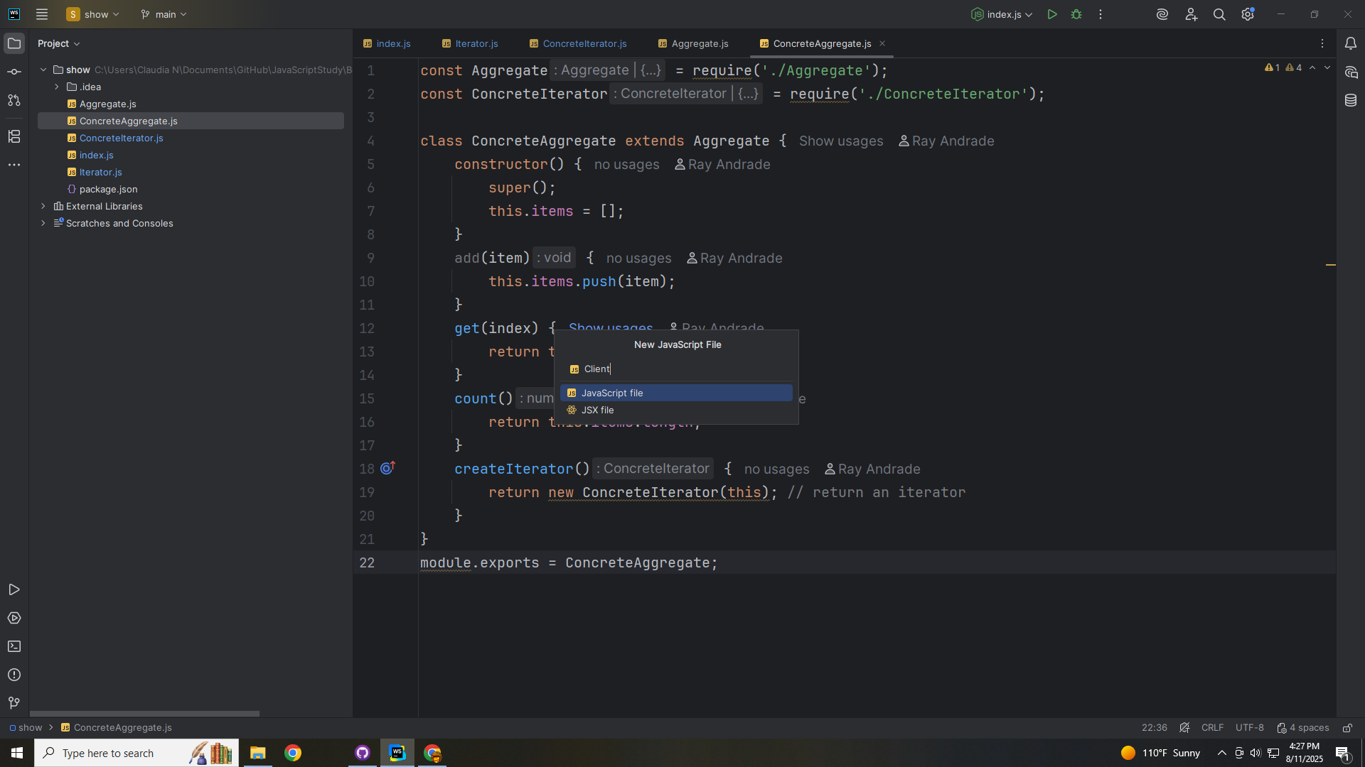

Slide 34
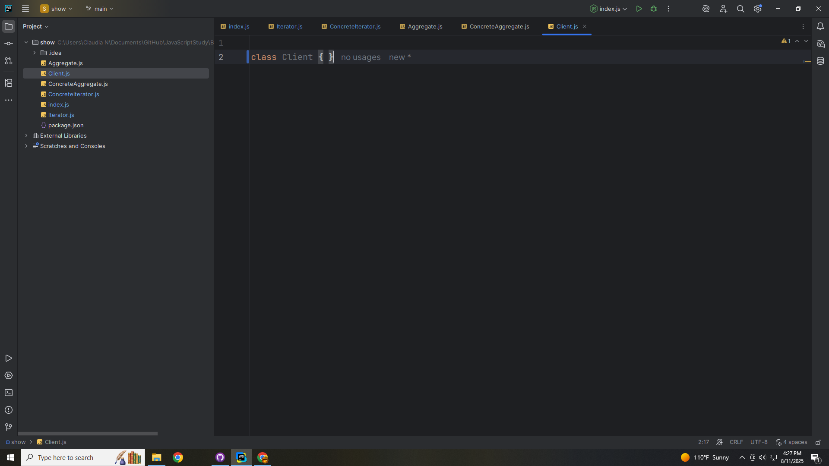

Slide 35
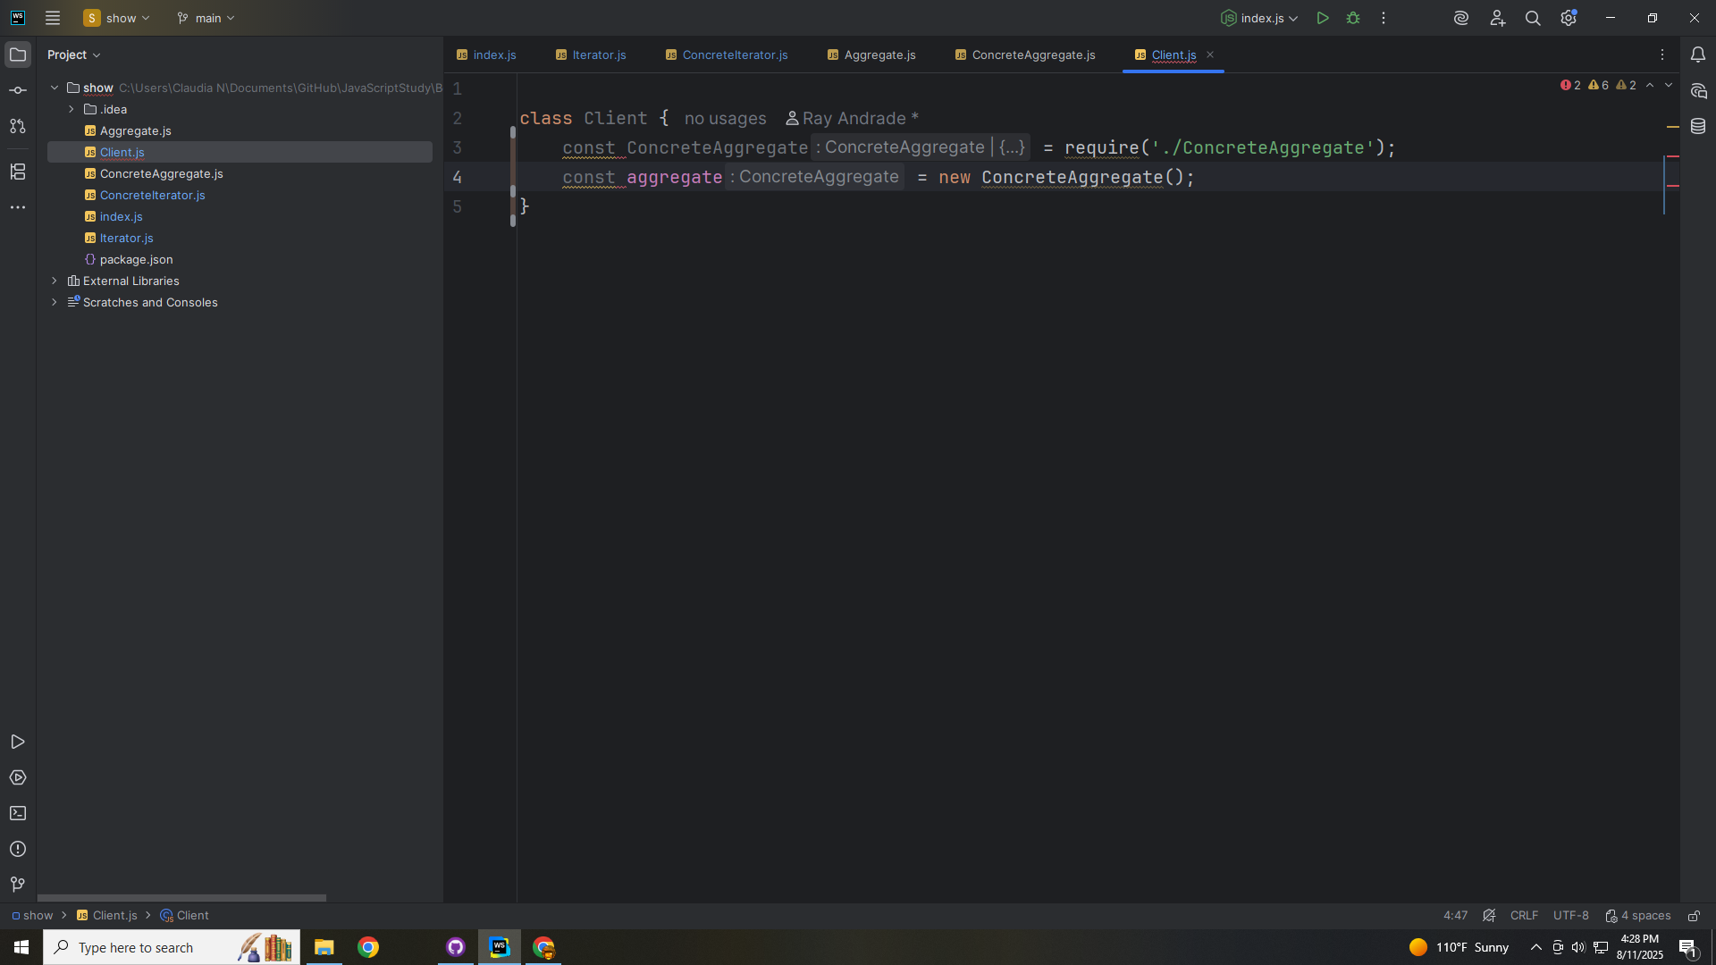

Slide 36
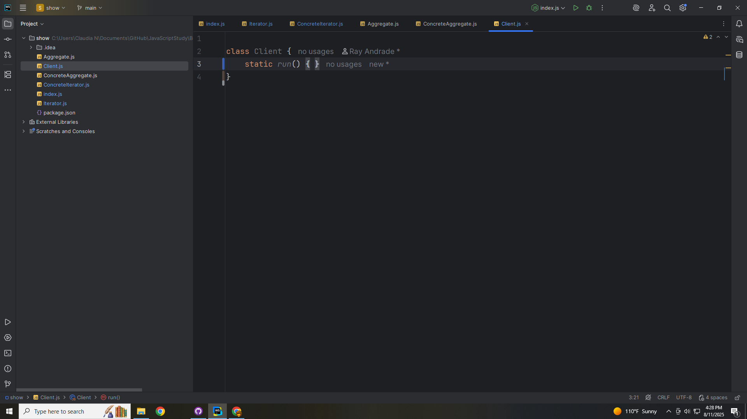

Slide 37
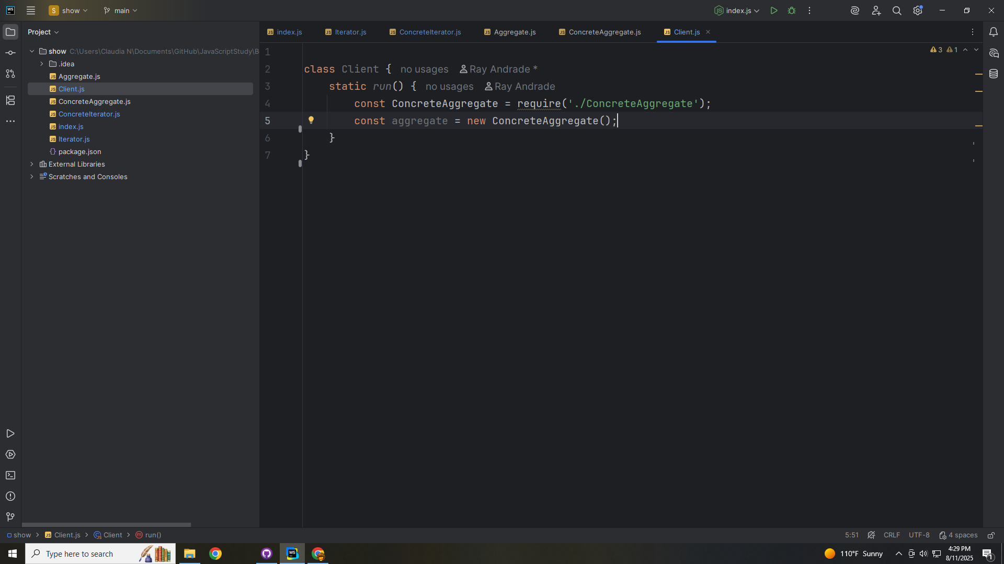

Slide 38
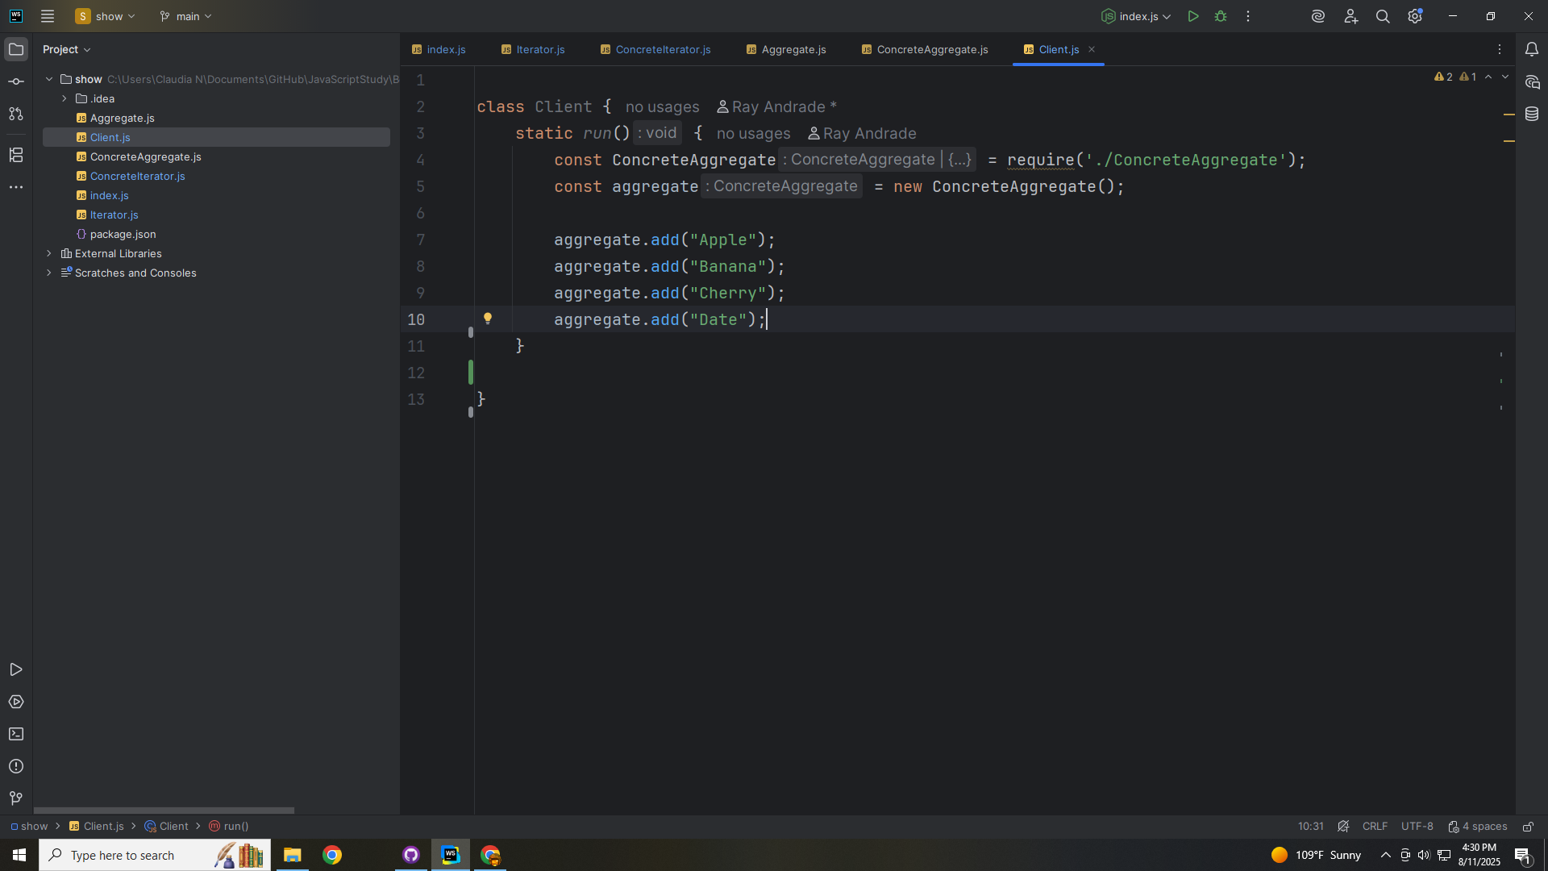

Slide 39
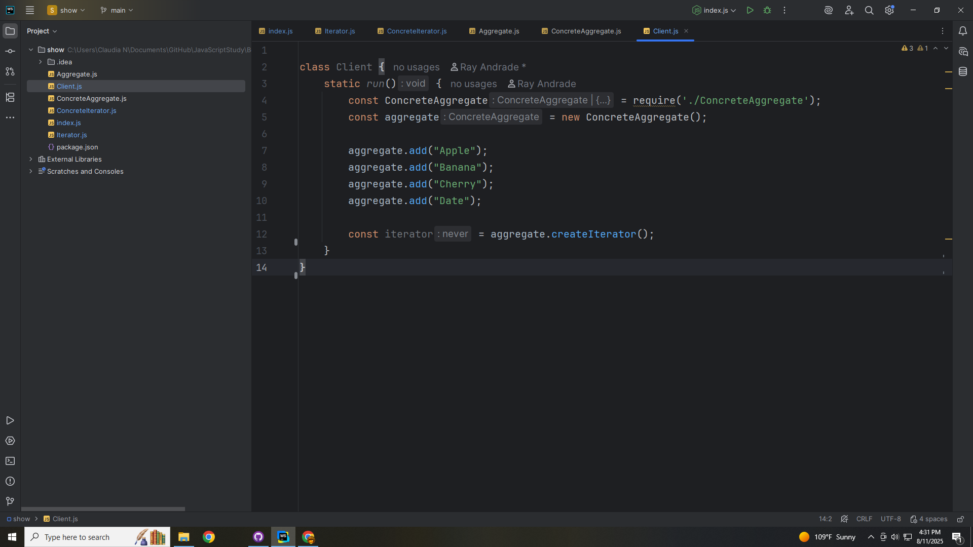

Slide 40
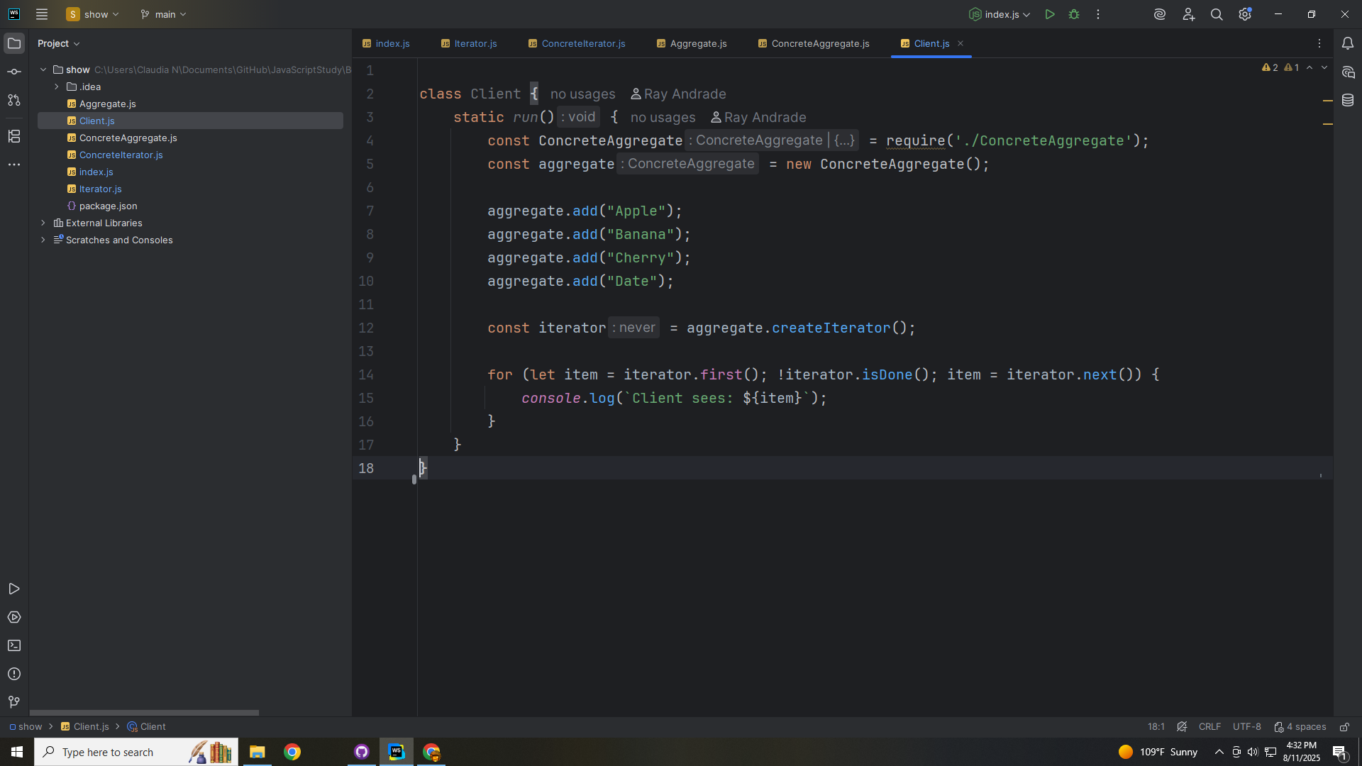

Slide 41
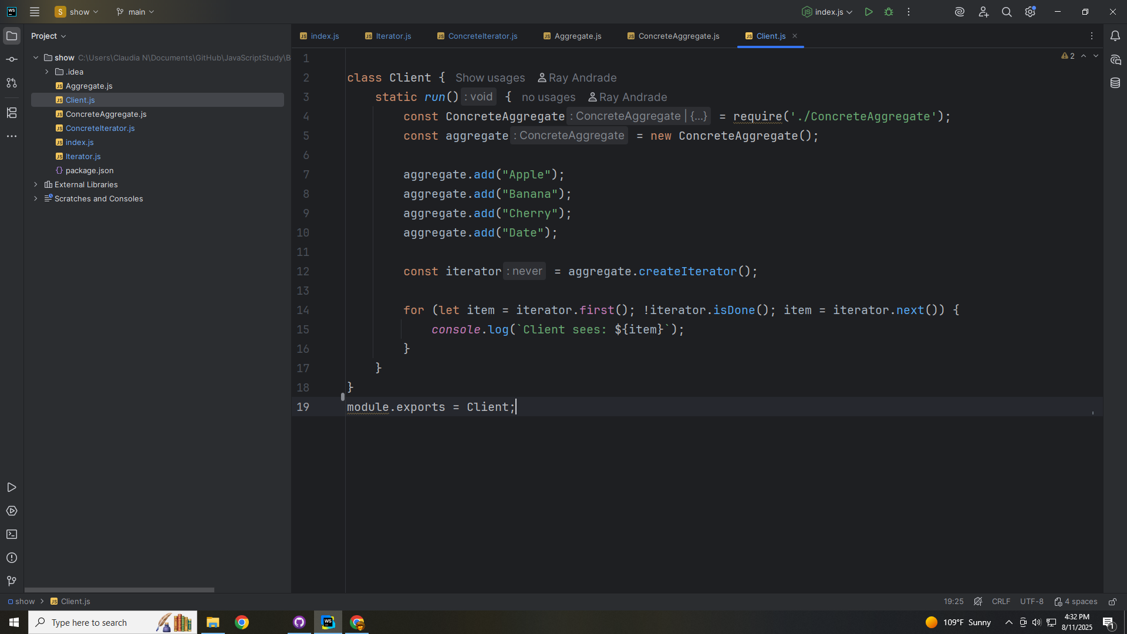

Slide 42
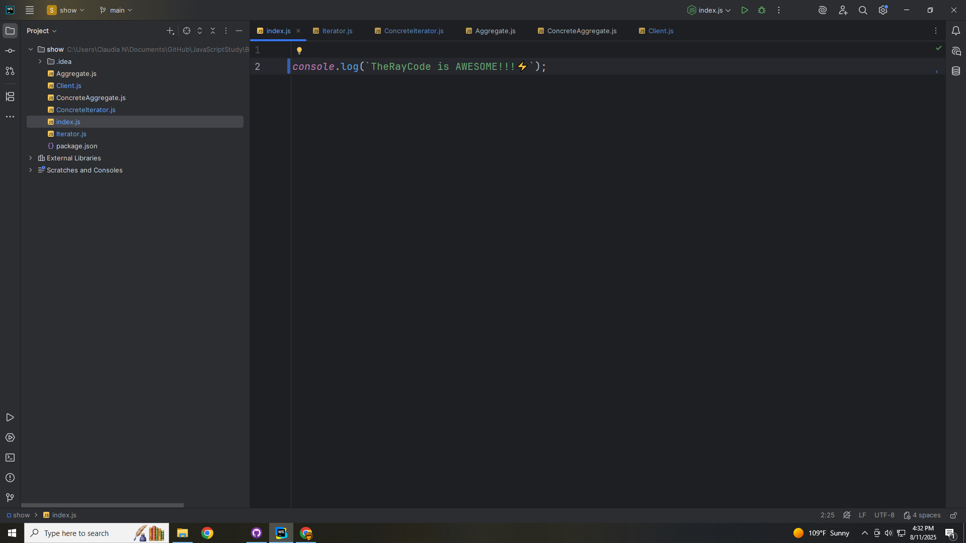

Slide 43


Slide 44
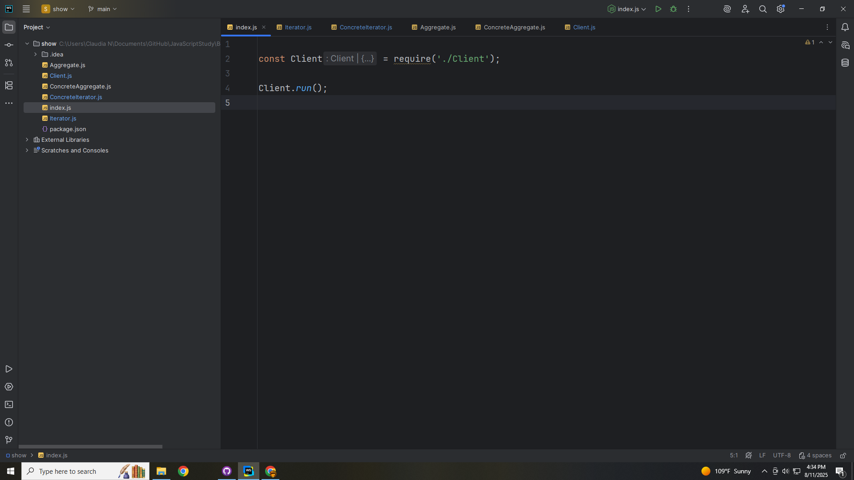

Slide 45
