Slide 1

Notes:
* Controls which Product class gets instantiated.
* Keeps Product creation flexible for the Client

Slide 2
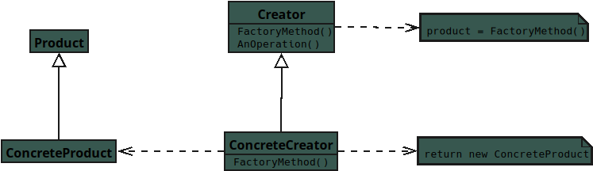
Notes:
# 🌟 Factory Method —
Participants (for JavaScript Students)

Slide 3
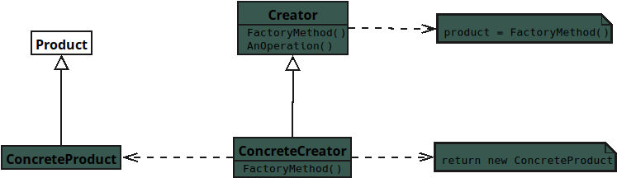
Notes:
## **Product**
* Defines the interface all concrete products must follow.
* Describes behavior expected from any Product.
* Contains no real working code itself.

Slide 4
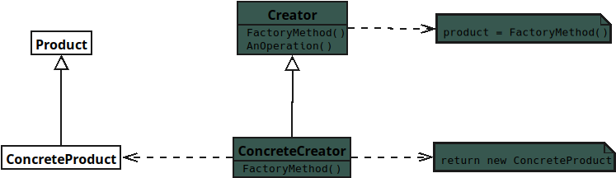
Notes:
## **Concrete Product**
* Actual JavaScript object created by a Concrete Creator.
* Implements all behavior defined in Product.
* Represents one specific Product variation.

Slide 5
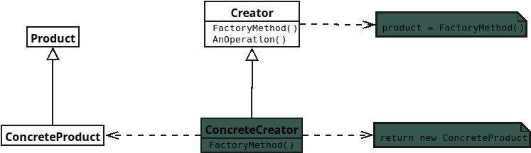
Notes:
## **Creator**
* Declares the Factory Method for creating Products.

Slide 6
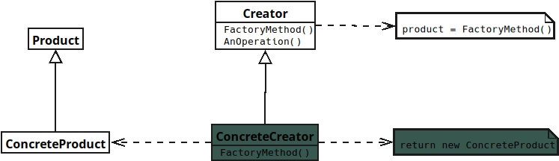
Notes:
* Lets subclasses decide which Concrete Product to return.

Slide 7
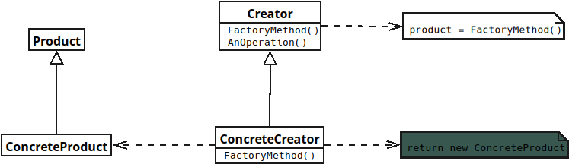
Notes:
## **Concrete Creator**
* Overrides the Factory Method to create a specific Concrete Product.

Slide 8
