Slide 1
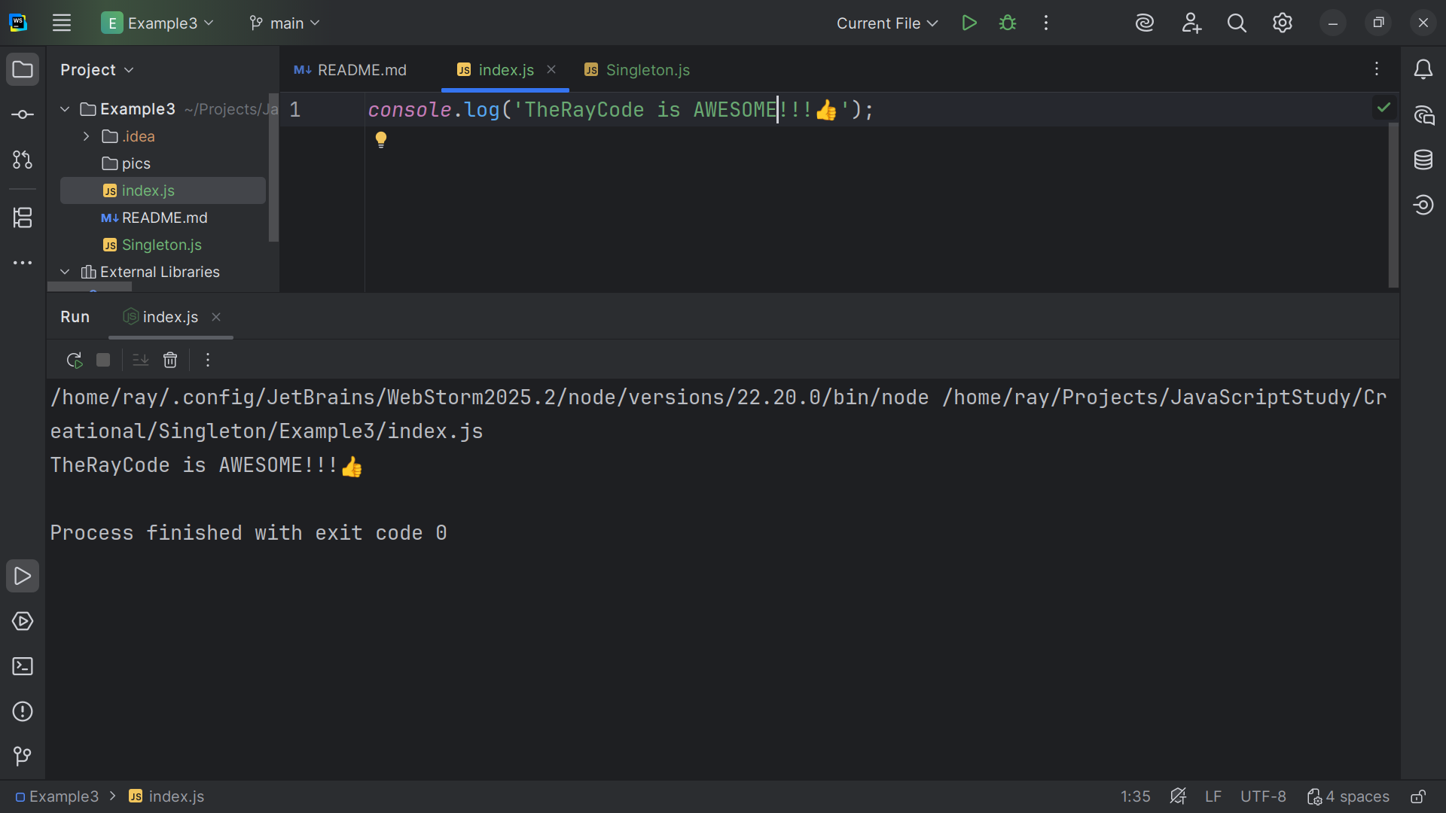
Notes:
Hello, my name is Ray and I’m the Ray in TheRayCode

Slide 2
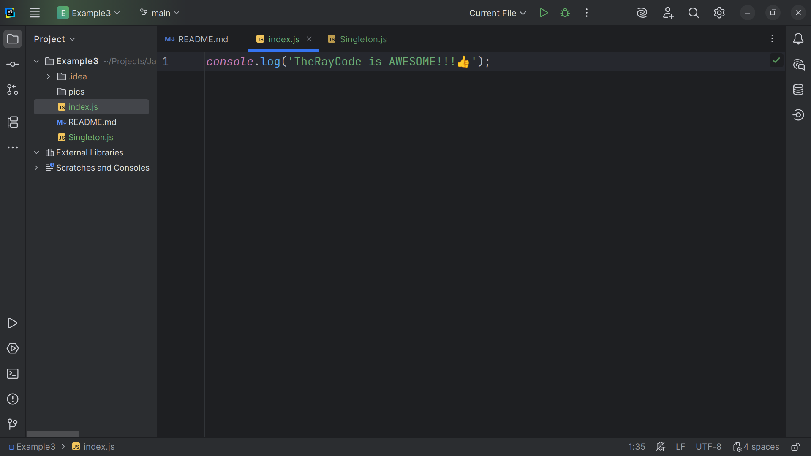
Notes:
In this video I plan to give a presentation of the Design pattern know a the Singleton which is a creational Pattern
I will be using JavaScript in this example

Slide 3
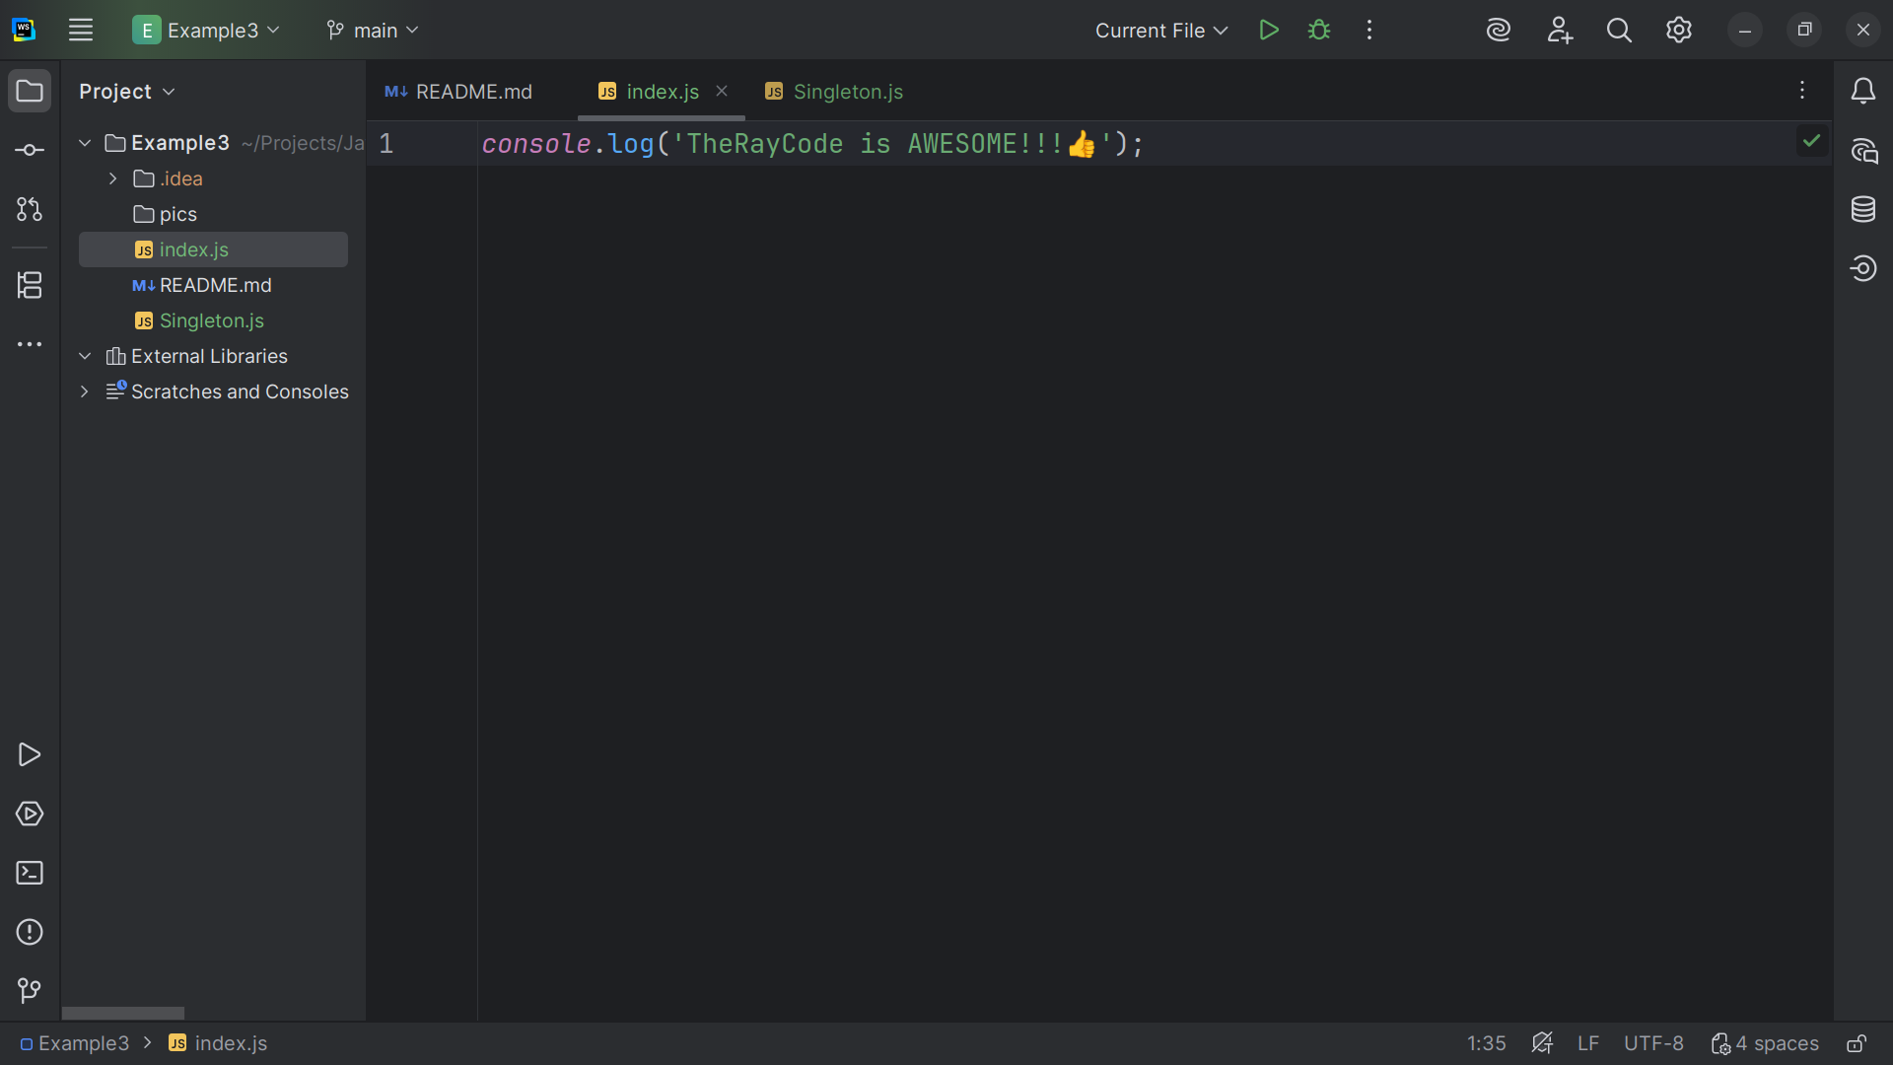
Notes:
The Purpose of the Singleton is to
Ensure there is only one instance of the Singleton in the entire application.
It Provides a global access point for that Instance of the same one object.
It Prevents direct construction via new, so only the method Instance() can create it.
This class is essential when you need a single shared resource, such as for example to a connection to a database

Slide 4
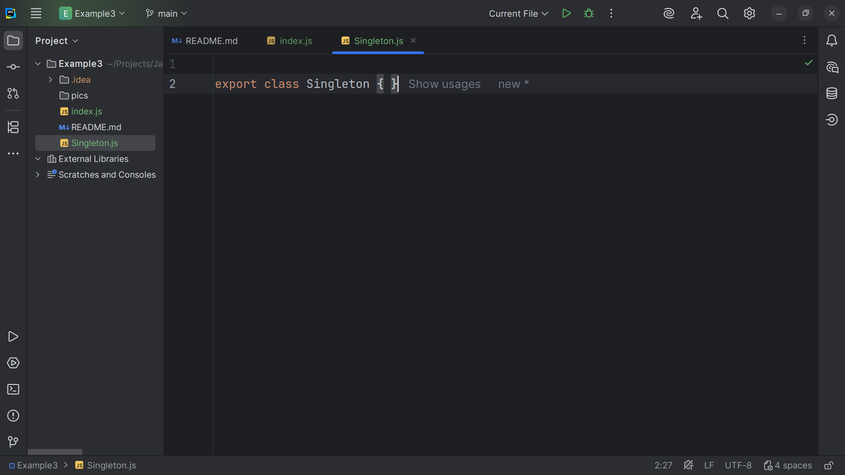
Notes:
We start with the creation of the class called Singleton we will export this class so index dot js can import it.

Slide 5
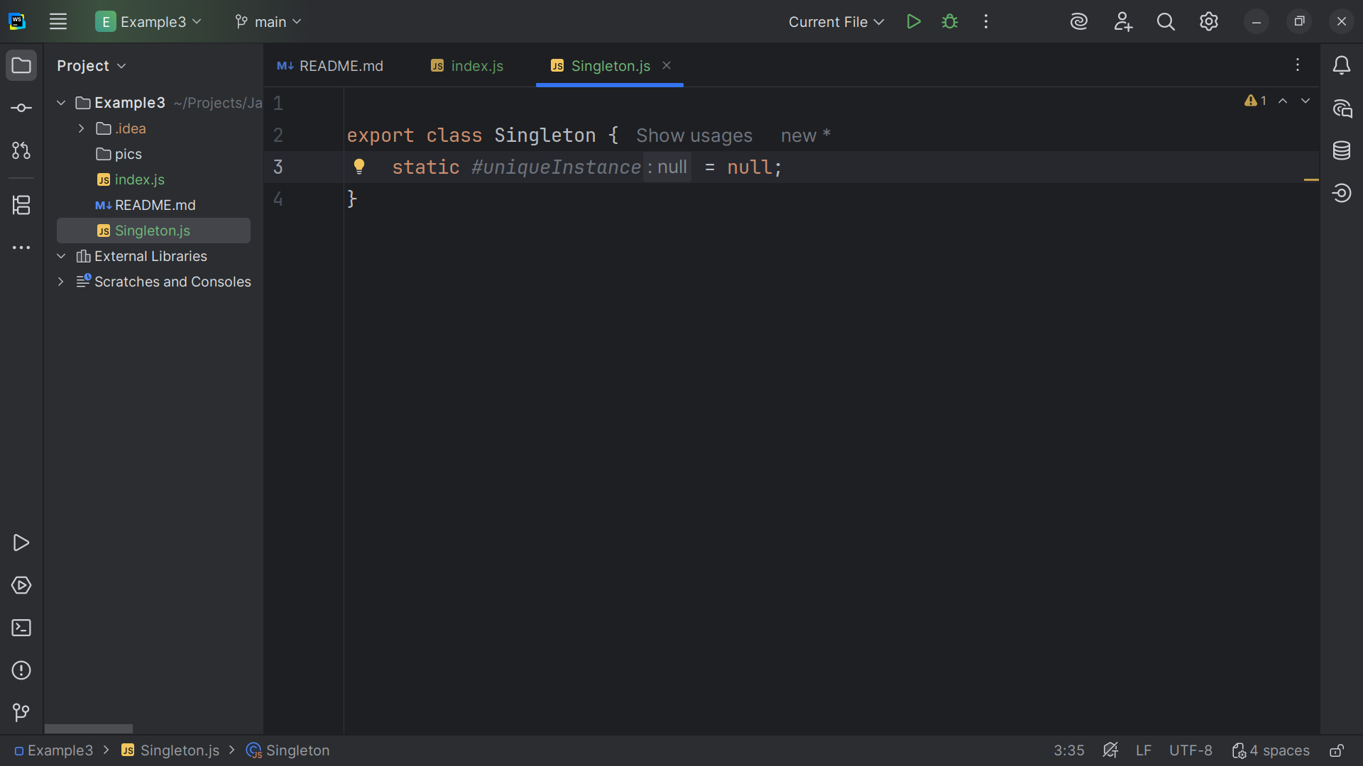
Notes:
Private static field that holds the SINGLE unique Instance

Slide 6
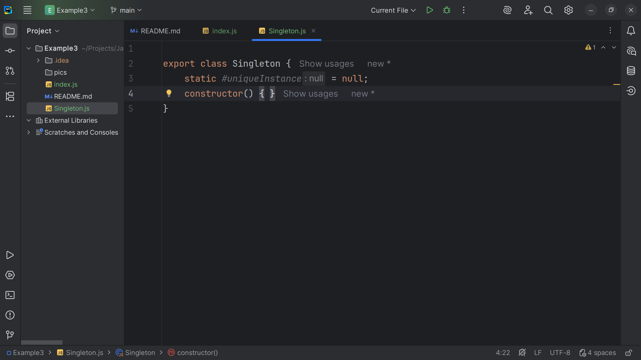
Notes:
Constructor is public in JavaScript, but we enforce access via a static guard
.

Slide 7
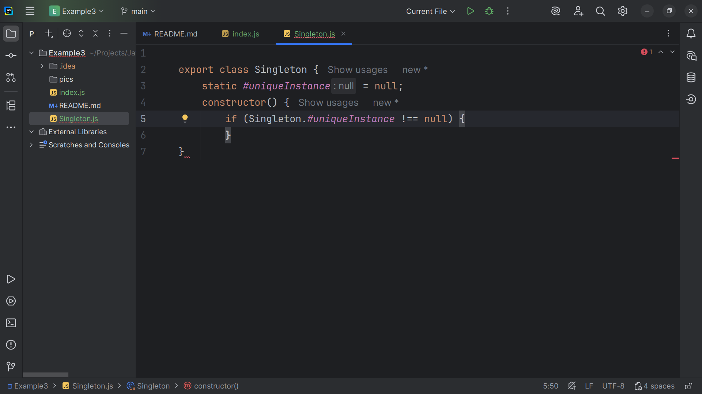
Notes:
If an instance already exists...

Slide 8
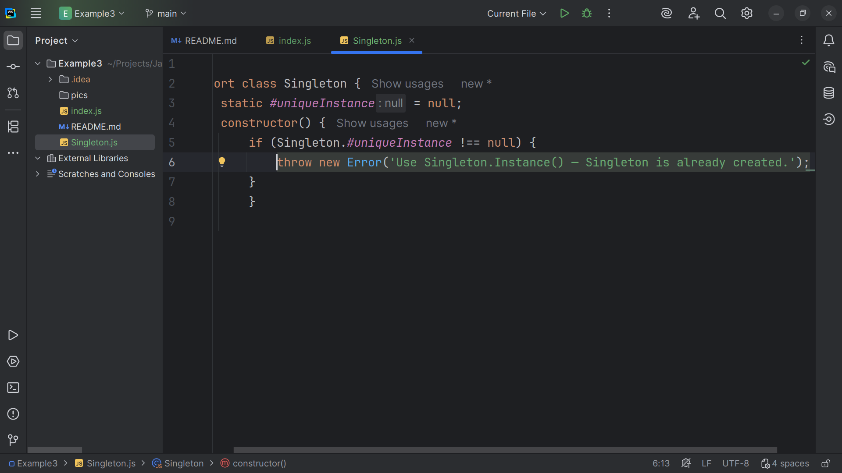
Notes:
we throw an Error to prevent direct construction with new Singleton

Slide 9
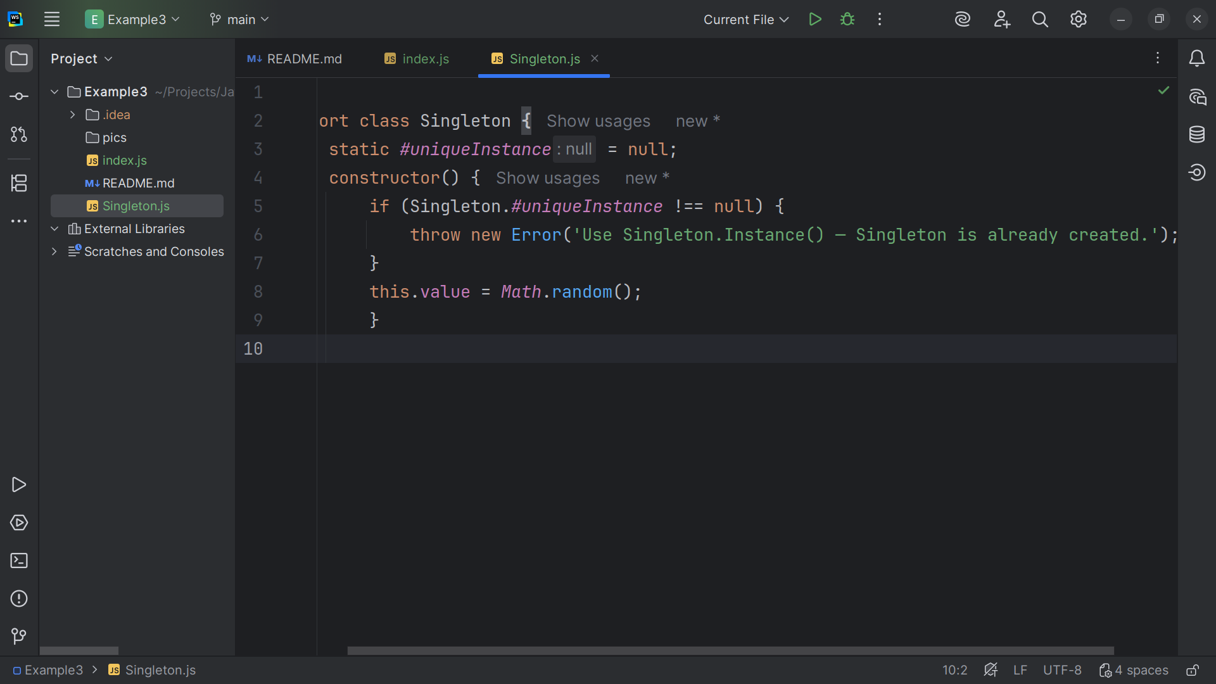
Notes:
A demo the property to a random number to show uniqueness. Each singleton should get only ONE random number.

Slide 10
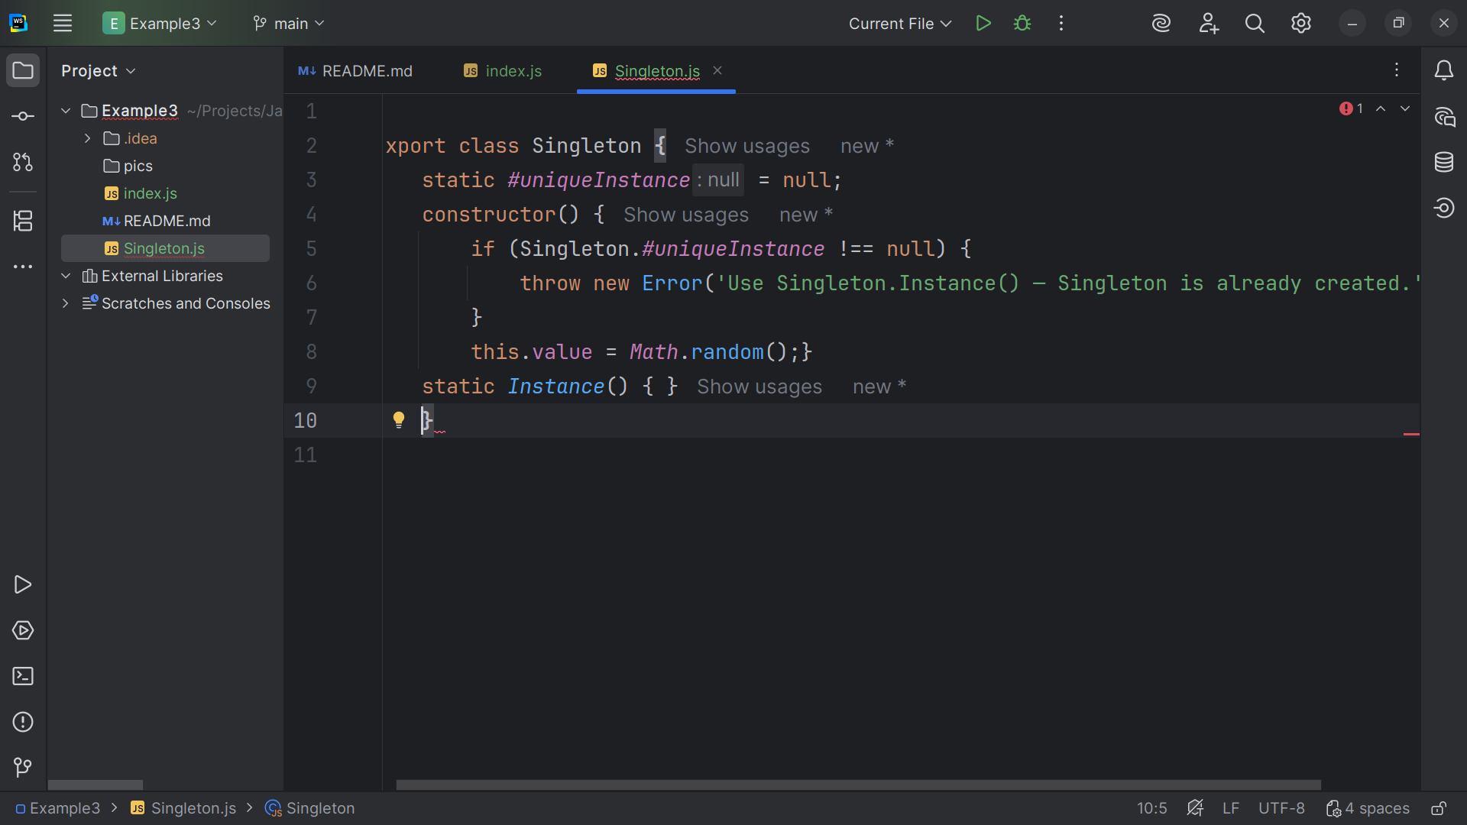
Notes:
create the one and only instance.

Slide 11
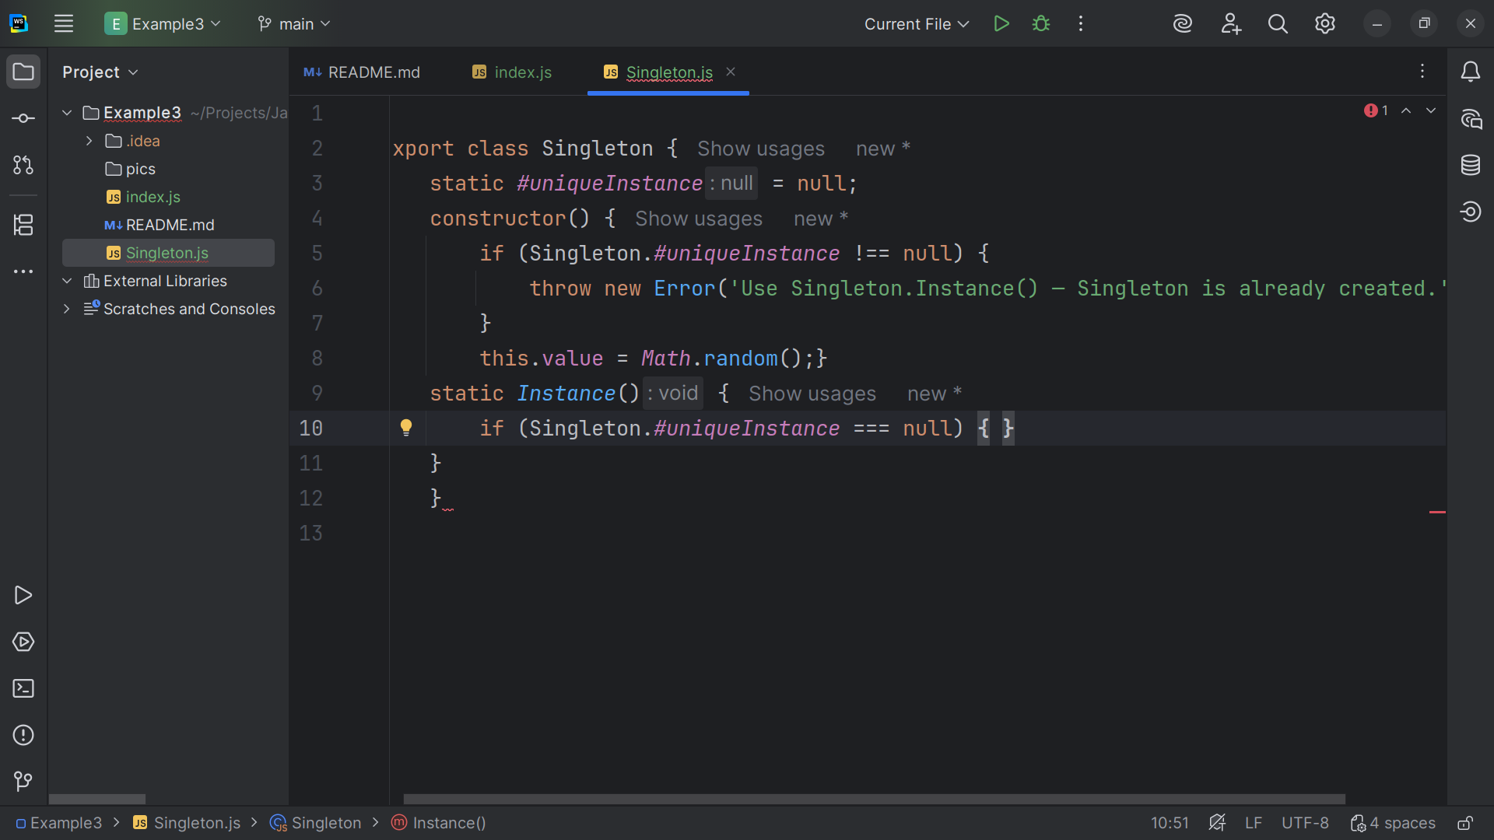
Notes:
If no instance exists yet...

Slide 12
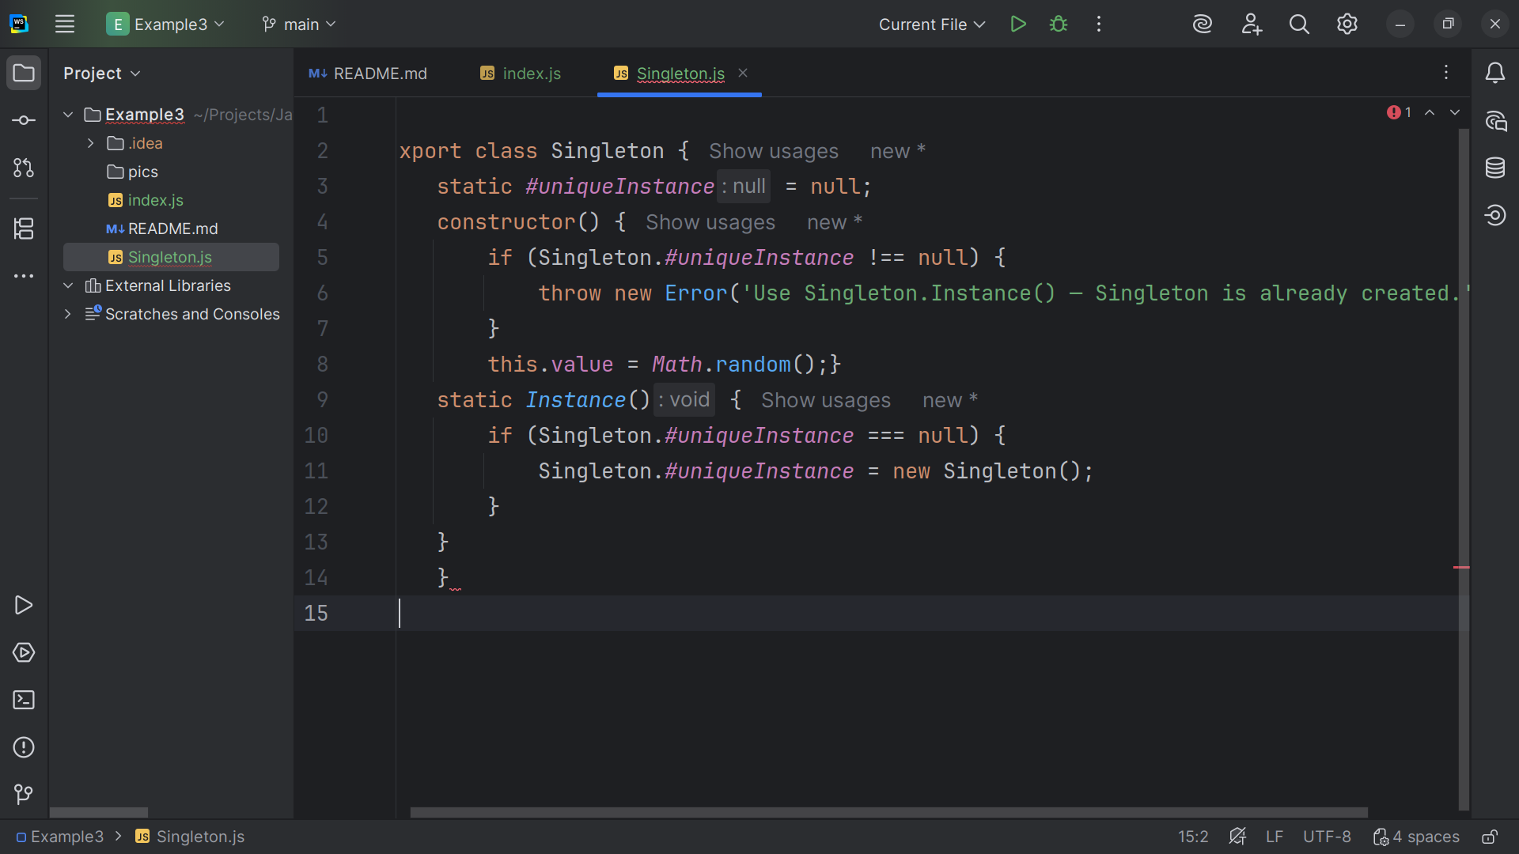
Notes:
We set the instance to a new Singleton

Slide 13
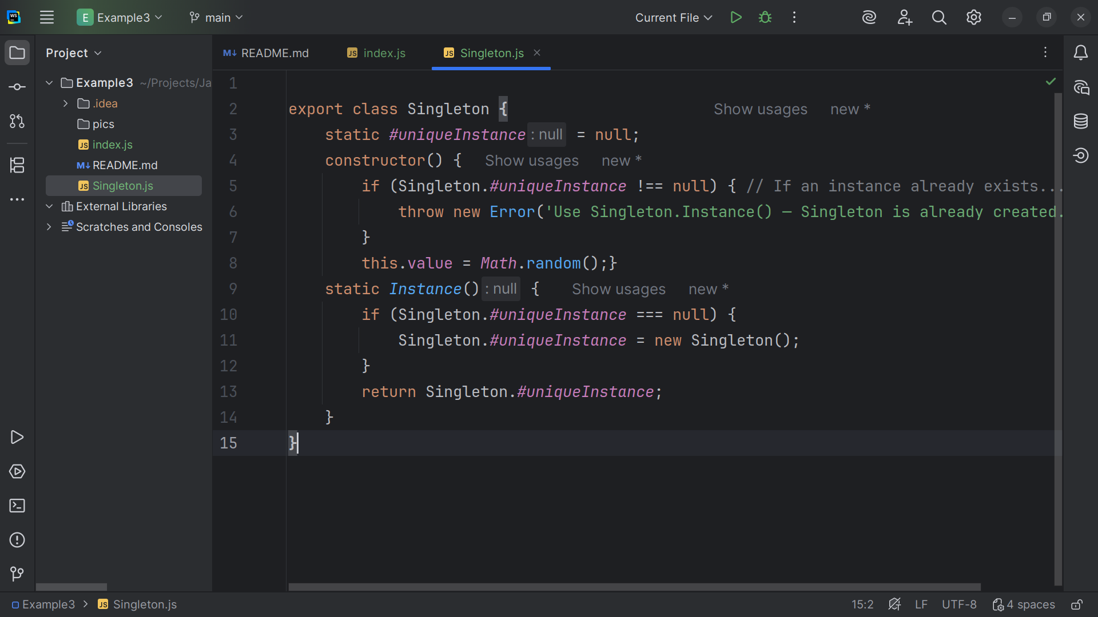
Notes:
And we Return the singleton instance.

Slide 14
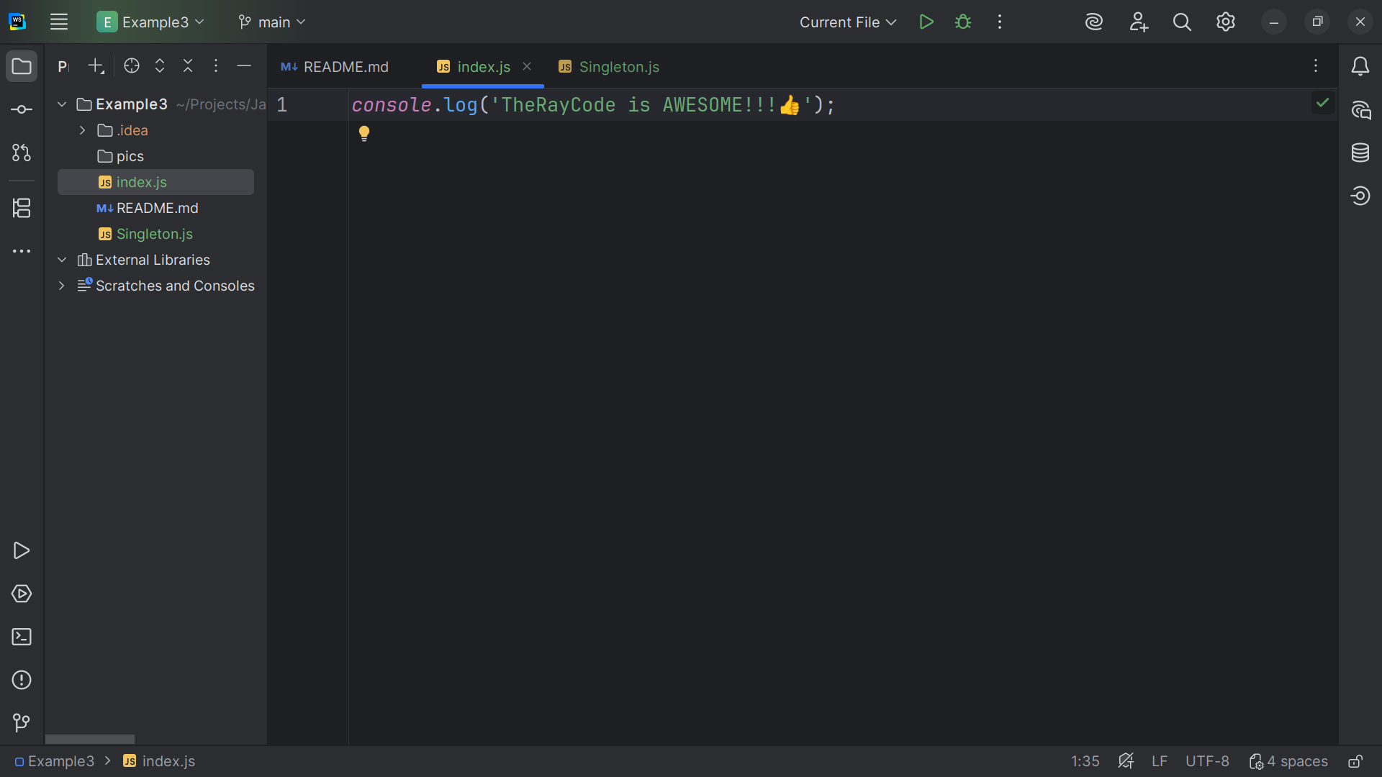
Notes:
Now we move over to the index . Js page

Slide 15
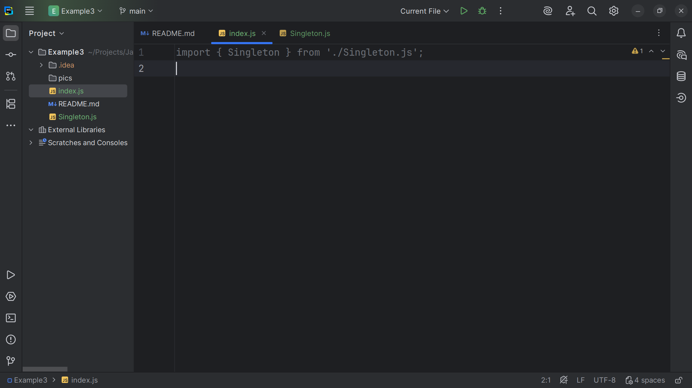
Notes:
We Import the Singleton class from its file.

Slide 16
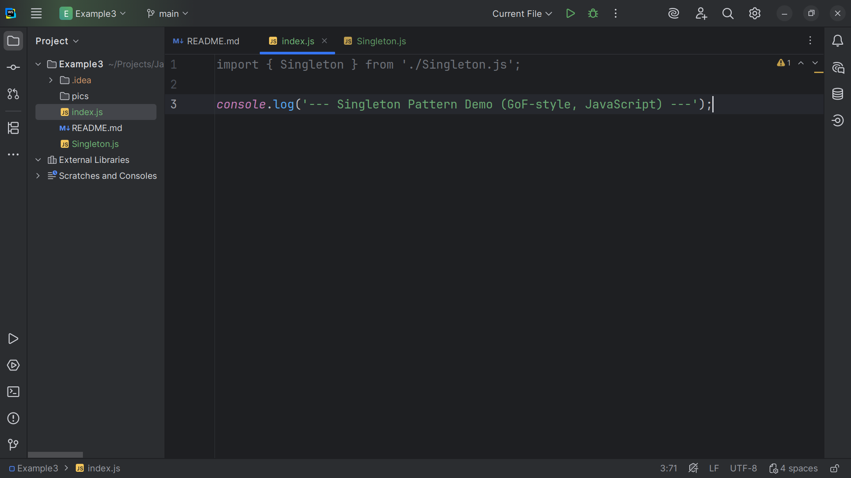
Notes:
I give our demo a title banner

Slide 17
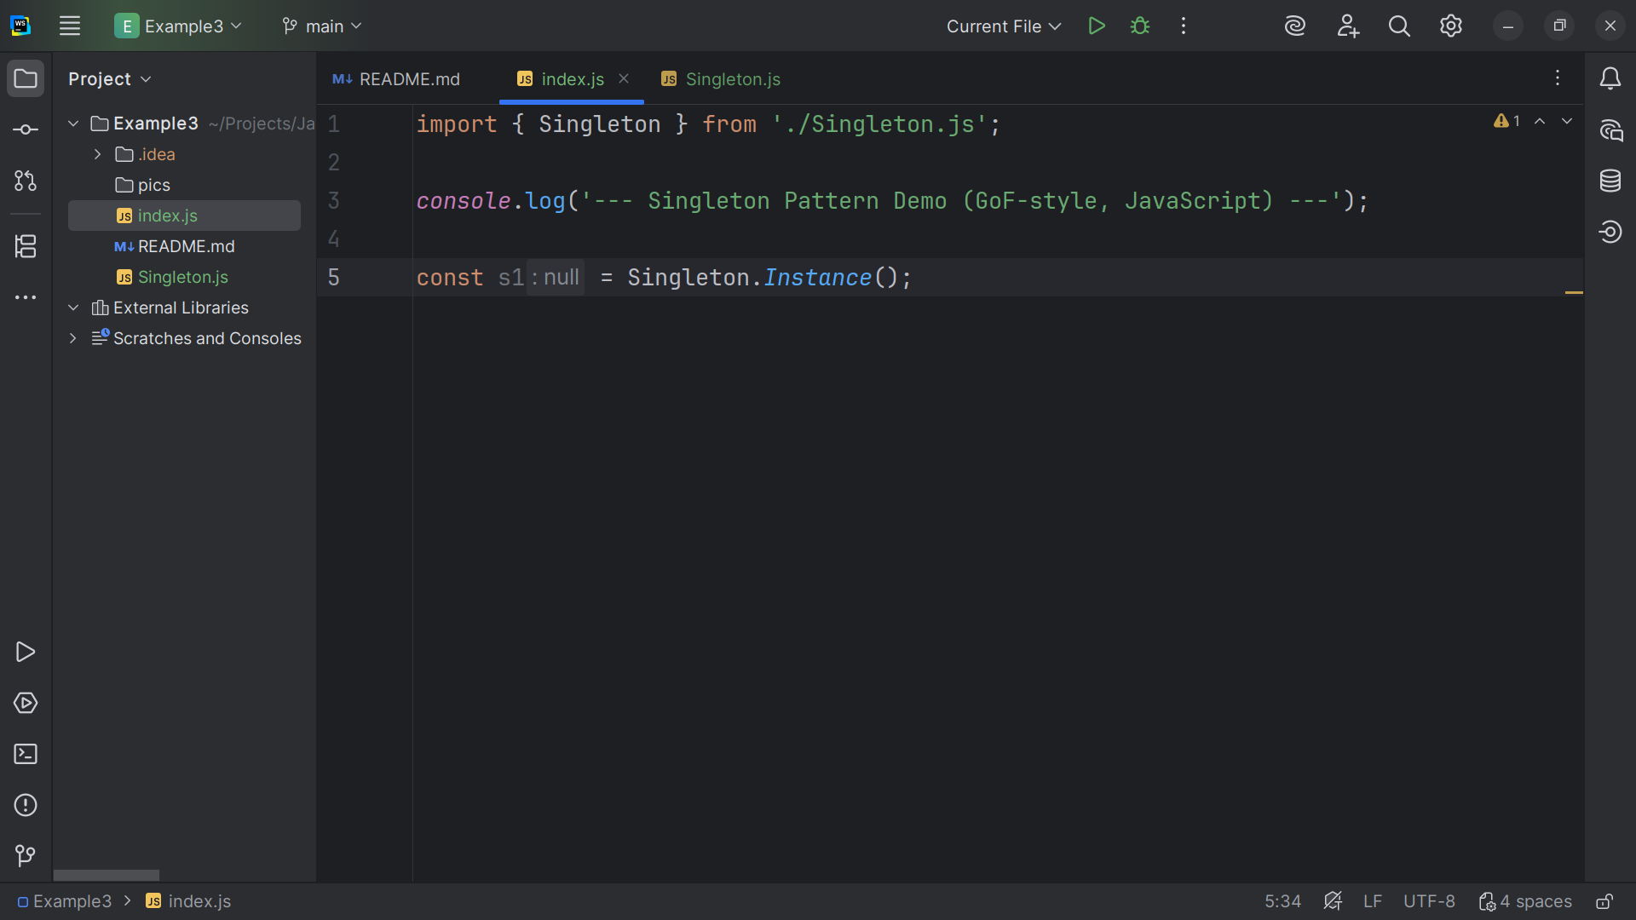
Notes:
We set s1 to a Singleton instance

Slide 18
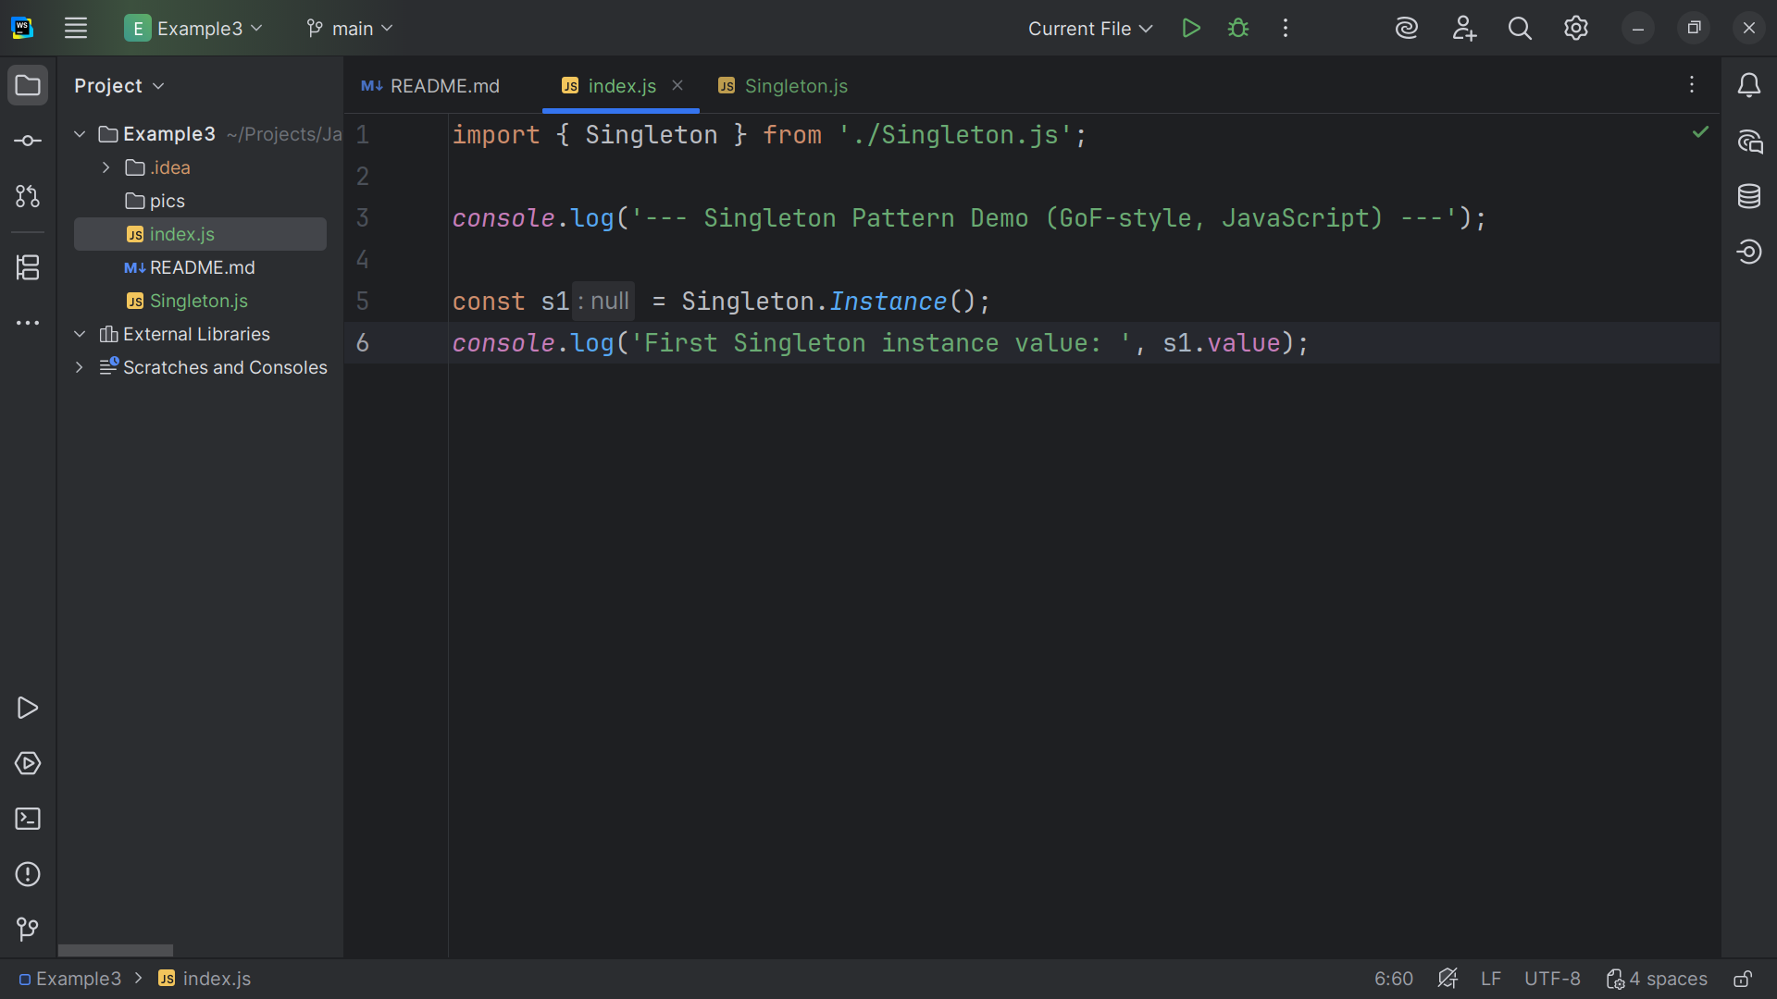
Notes:
And we log to the console s1 dot value

Slide 19
Notes:
(no sound)

Slide 20
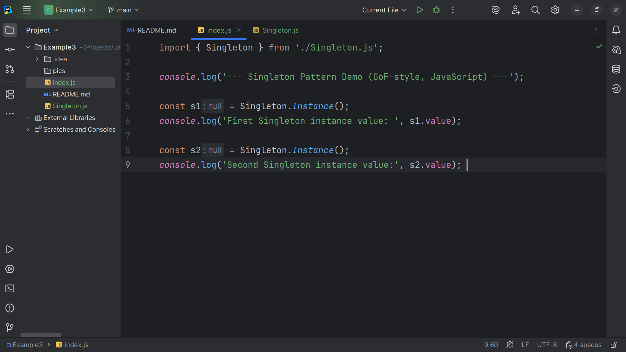
Notes:
And we do the same to another variable we call s2

Slide 21
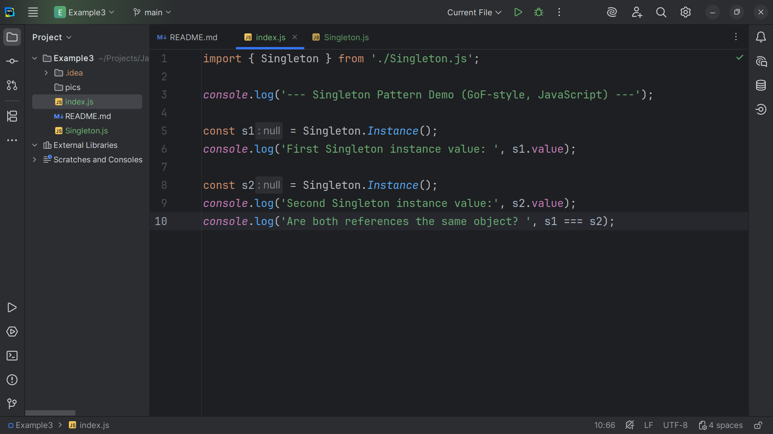
Notes:
And we see if they are exactly equal ie triple equal to each other

Slide 22
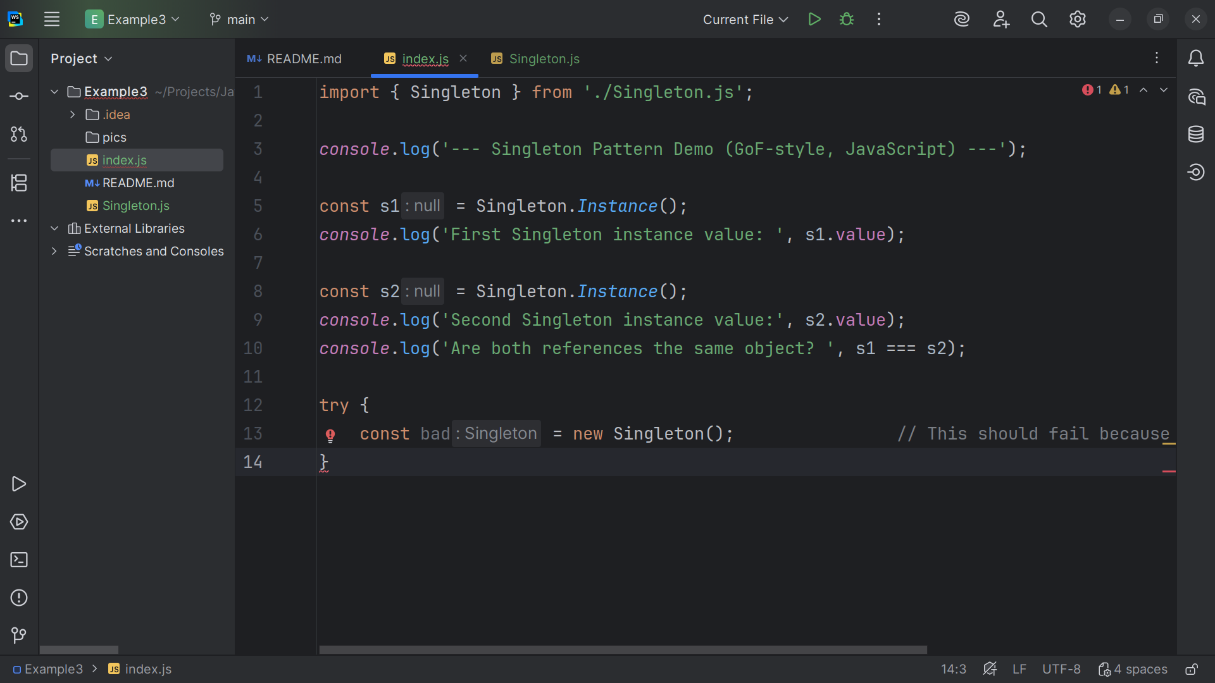
Notes:
We try get get a New singleton rather than access the existing one.. this will give us an error that we will catch

Slide 23
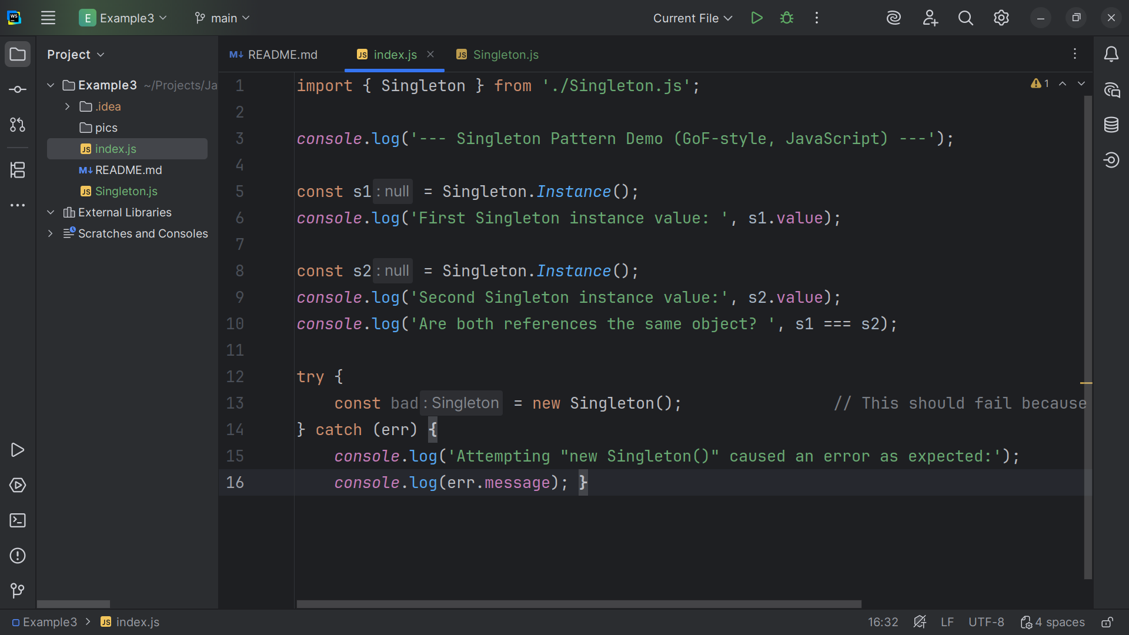
Notes:
And we write to the console if we do get an error
So now let’s take a look at our project

Slide 24
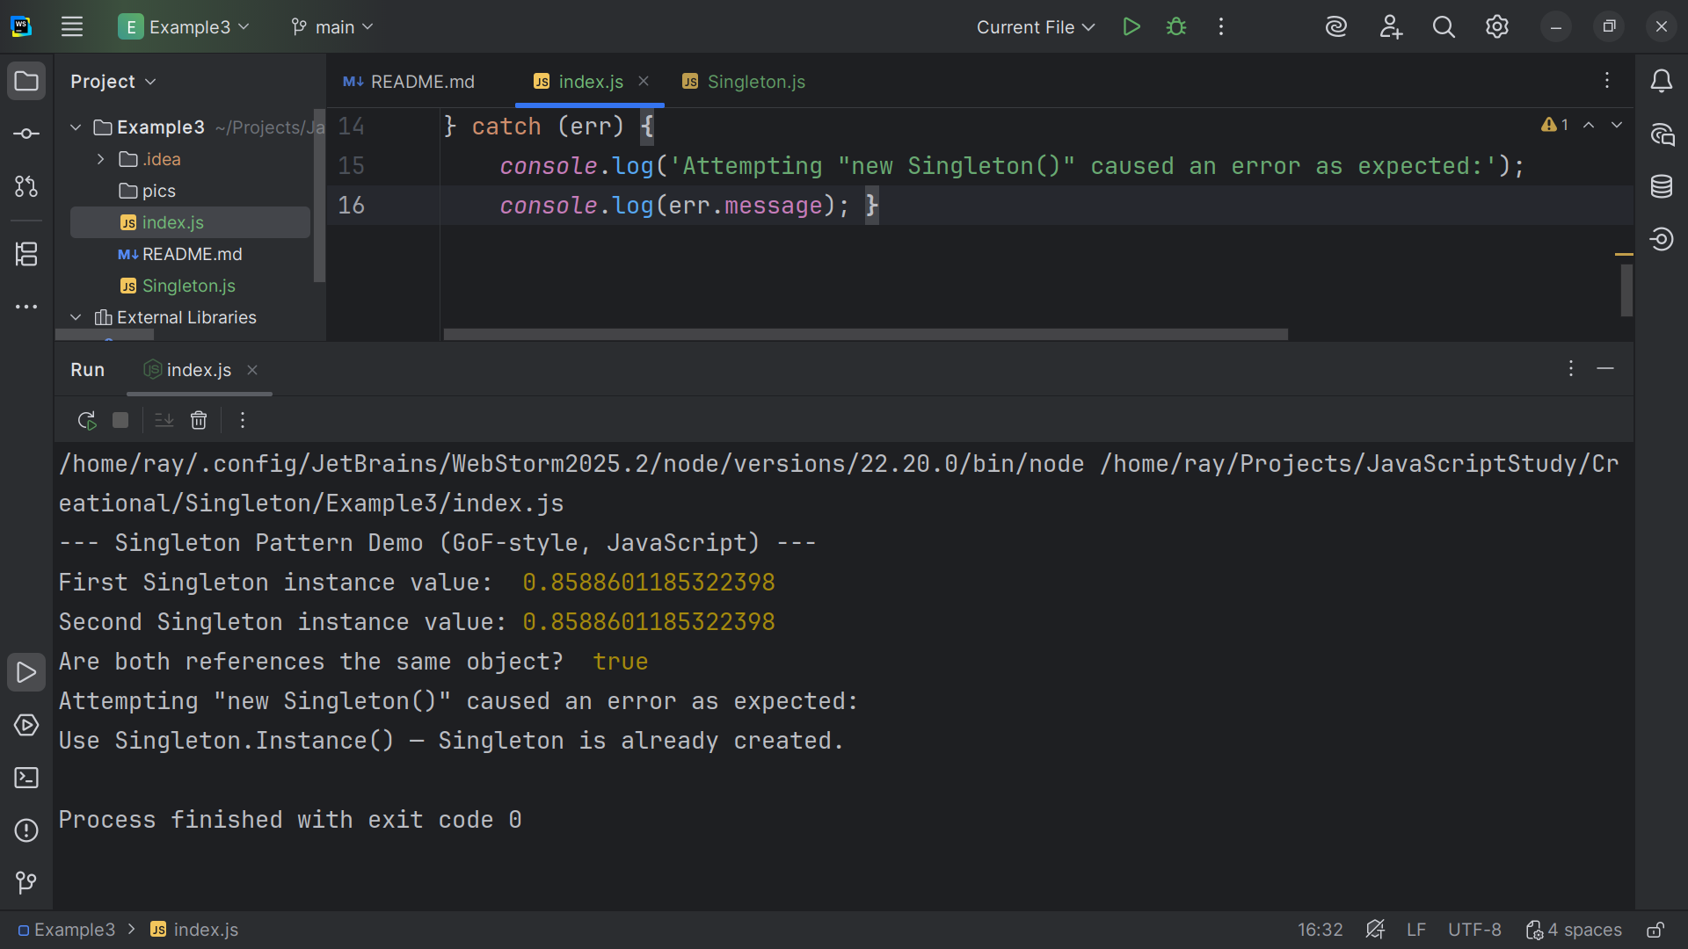
Notes:
We see that the First variable s1 is equal to some random value and we see that s2 is also equal to the same random value so to use that a new singleton was not created
We state both reference are the same
The attempt the create another new Singleton failed
Because it was already created.
My name is Ray Always code with a smile

