Slide 1
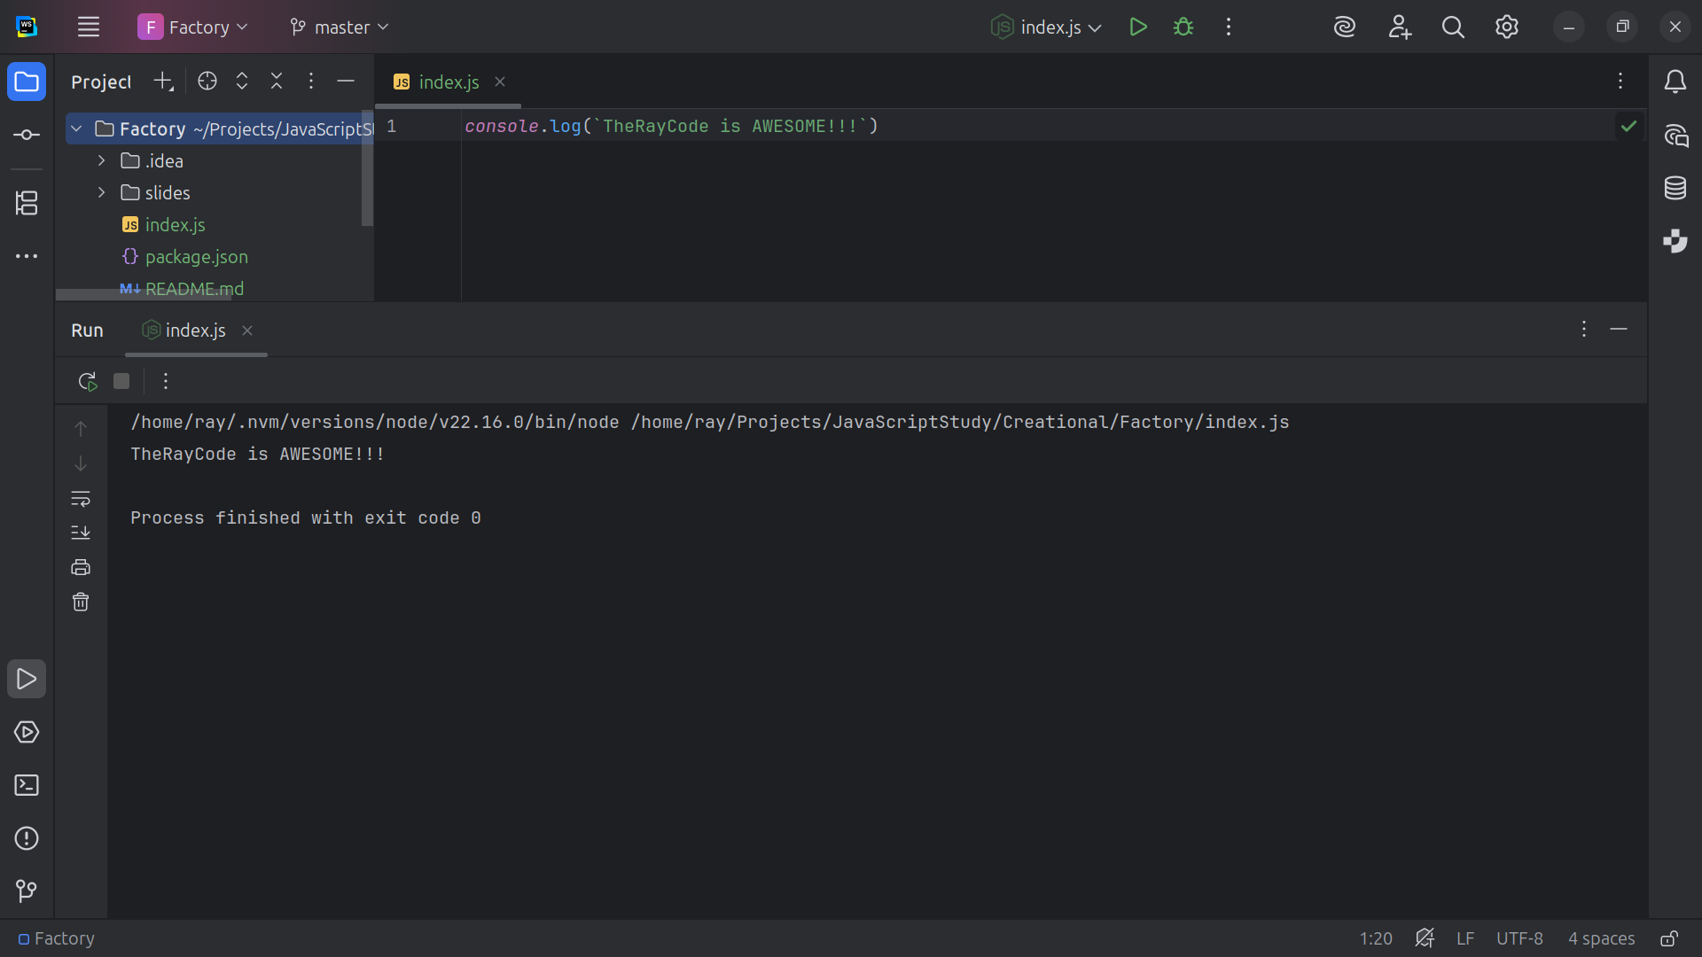
Notes:
Hello, I’m Ray of TheRayCode

Slide 2
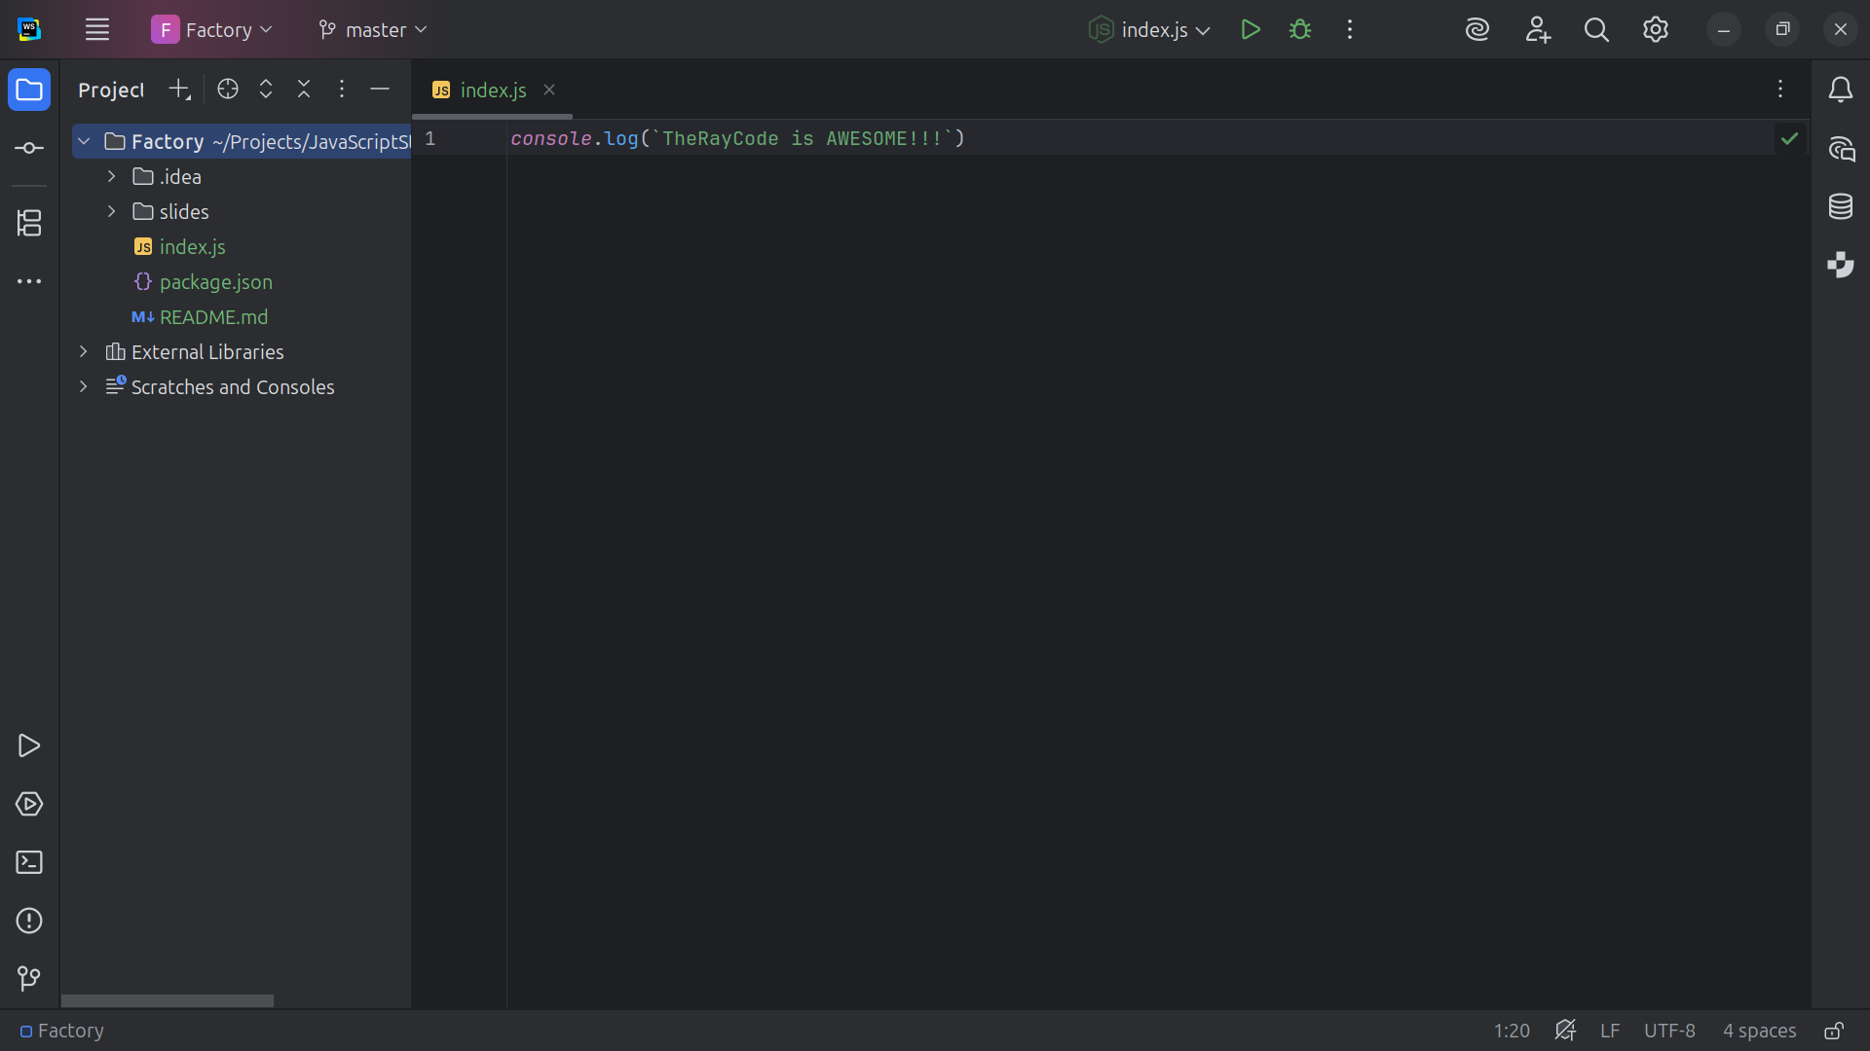
Notes:
In this video I want to give you an example of the Factory design patter
This project demonstrates the Factory Method Pattern from the classic Design Patterns: Elements of Reusable Object-Oriented Software

Slide 3
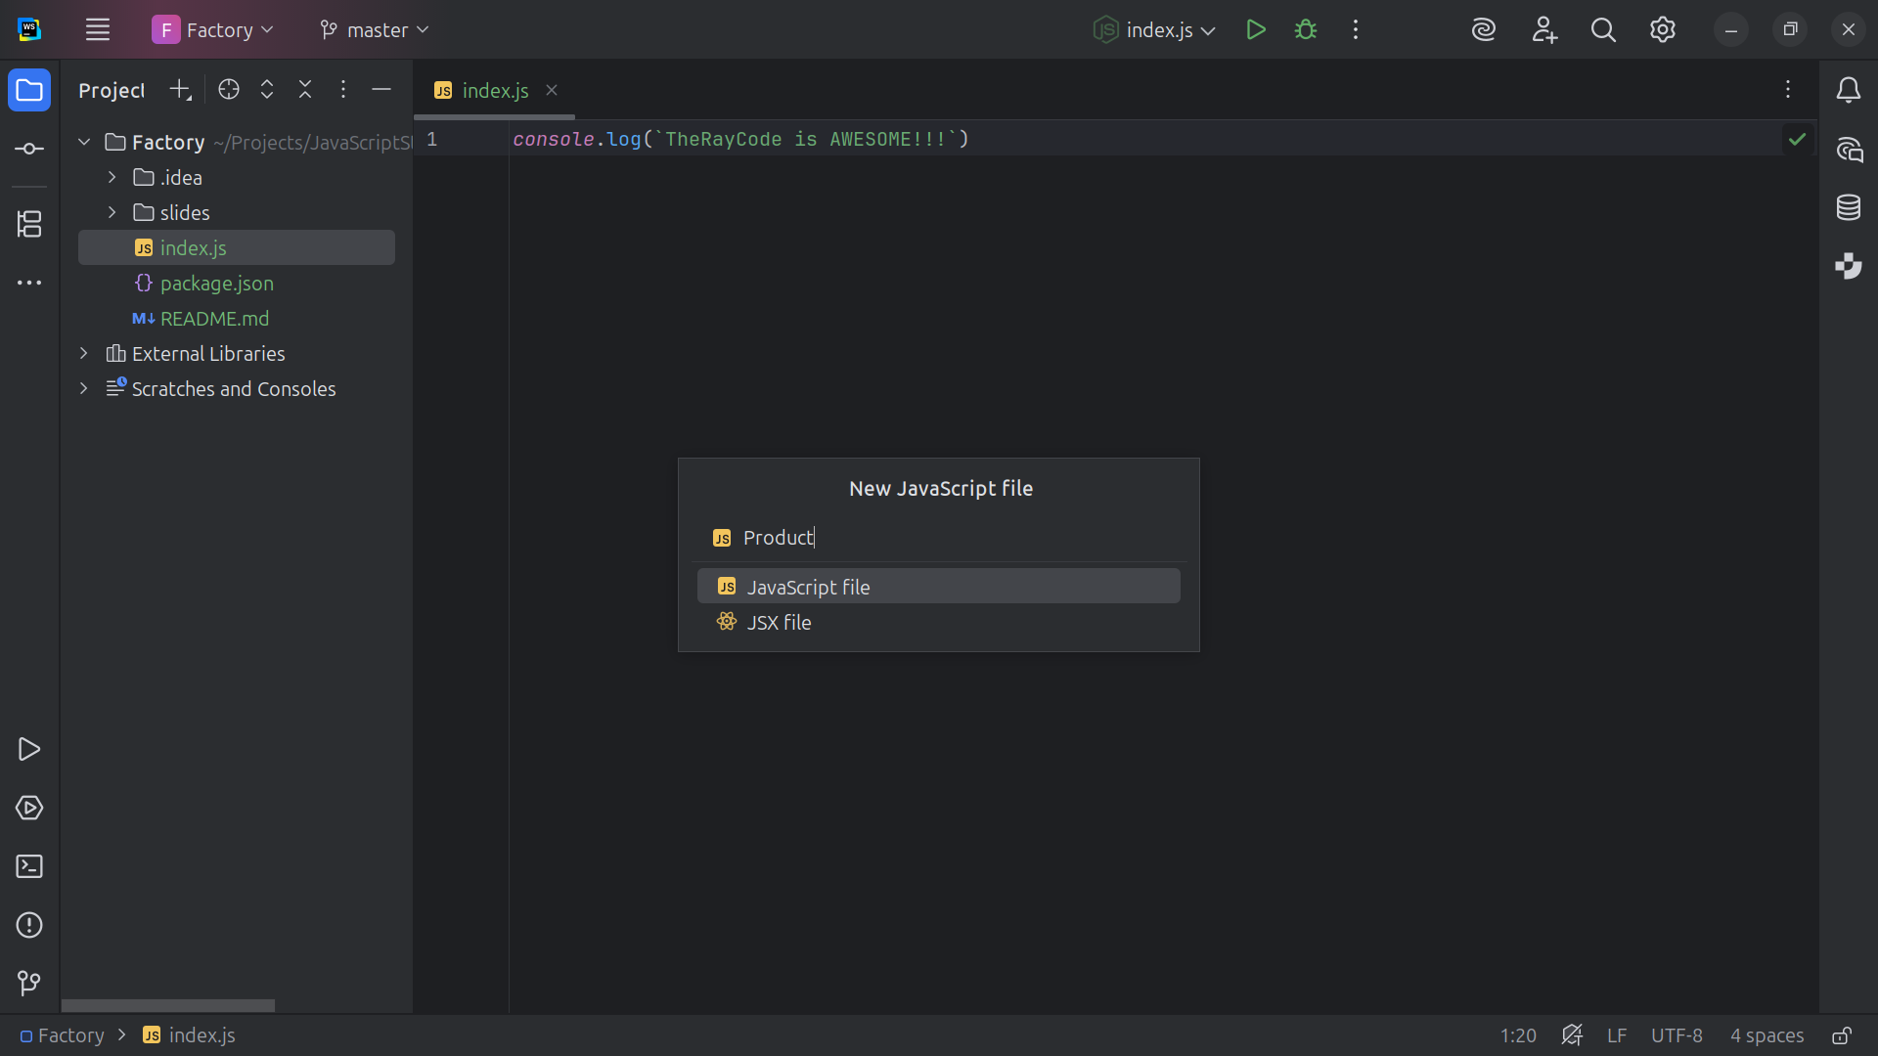
Notes:
I will stick close to the names given in the UML given by the Gang of Four
We start with a class called Product

Slide 4
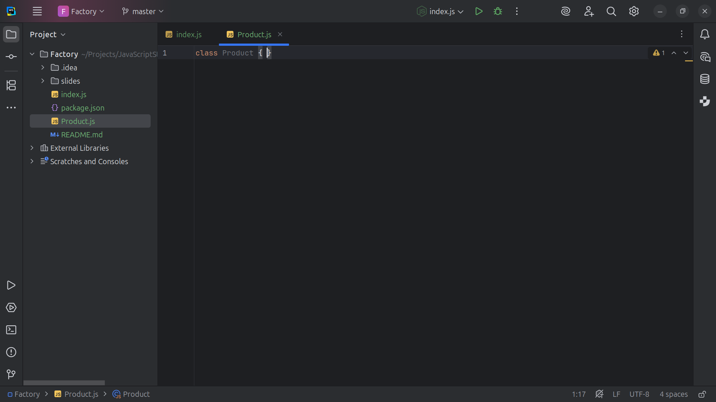
Notes:
Product is an Abstract interface (base class) for all Products

Slide 5
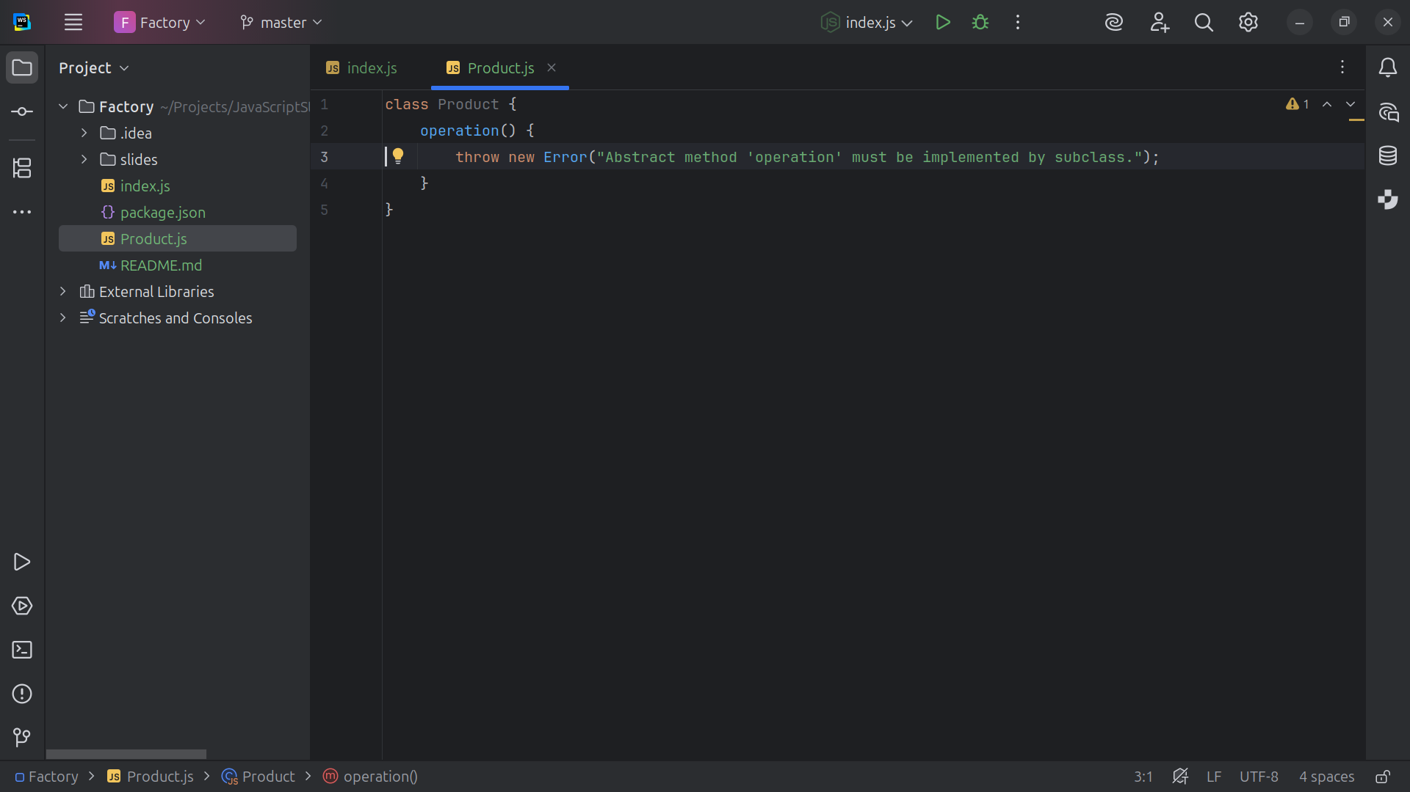
Notes:
Product will have an Abstract method that concrete products must implement

Slide 6
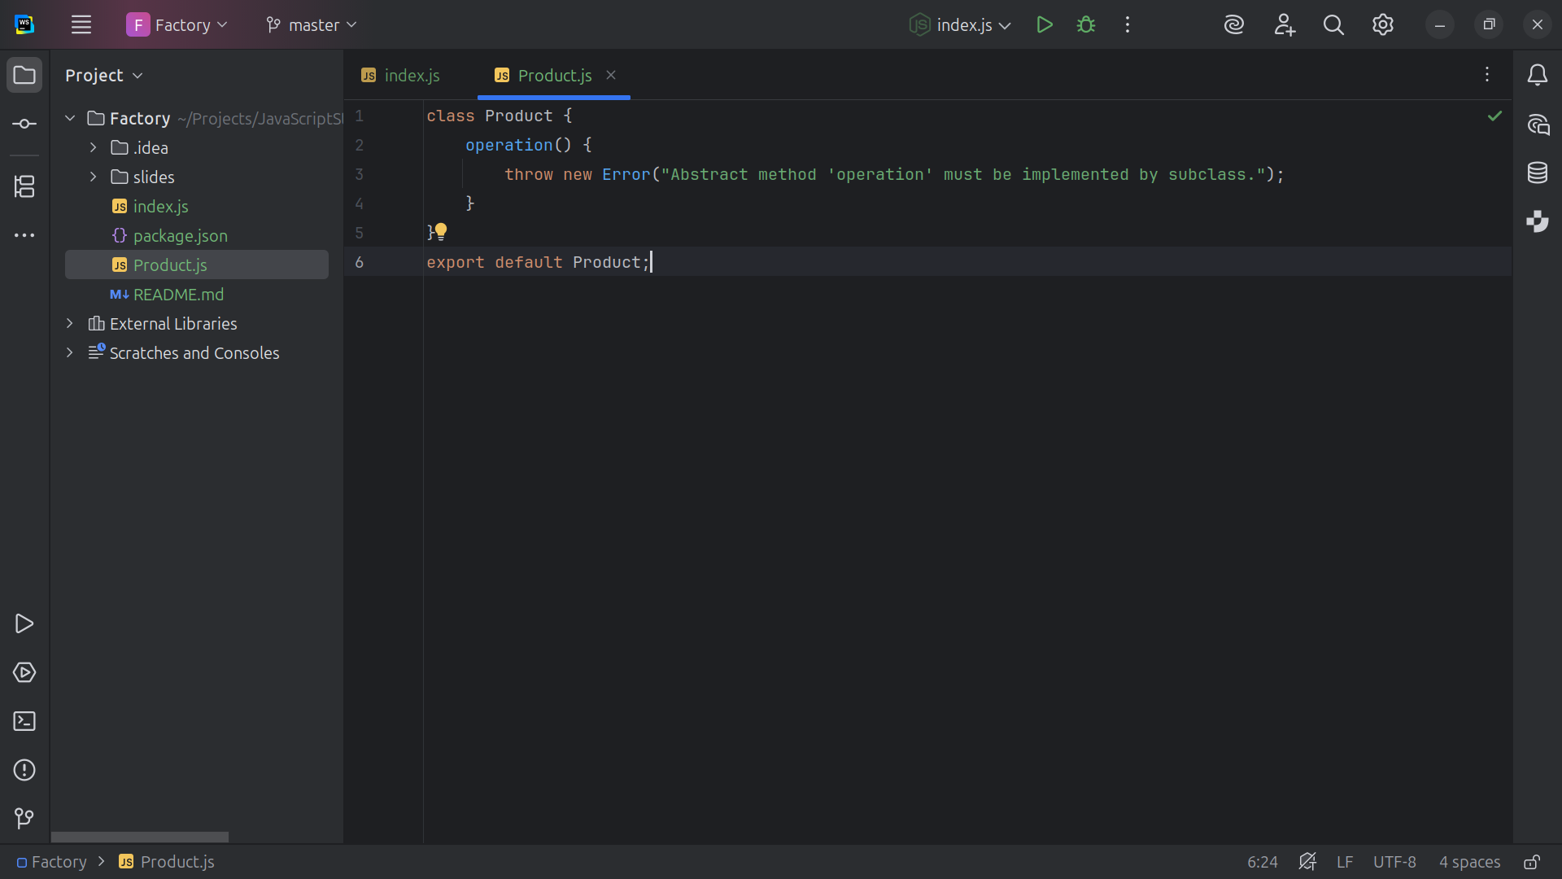
Notes:
And we export Product for our Example

Slide 7
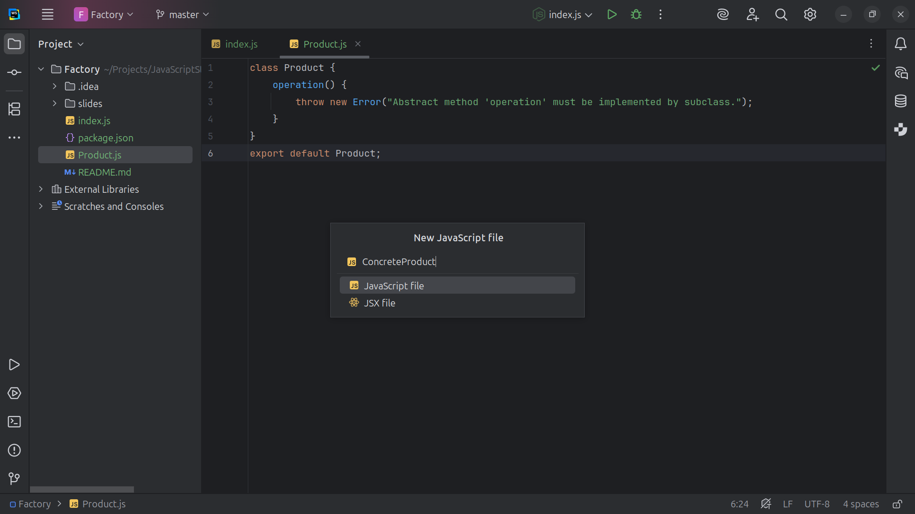
Notes:
Next we create a class called Concrete Product

Slide 8
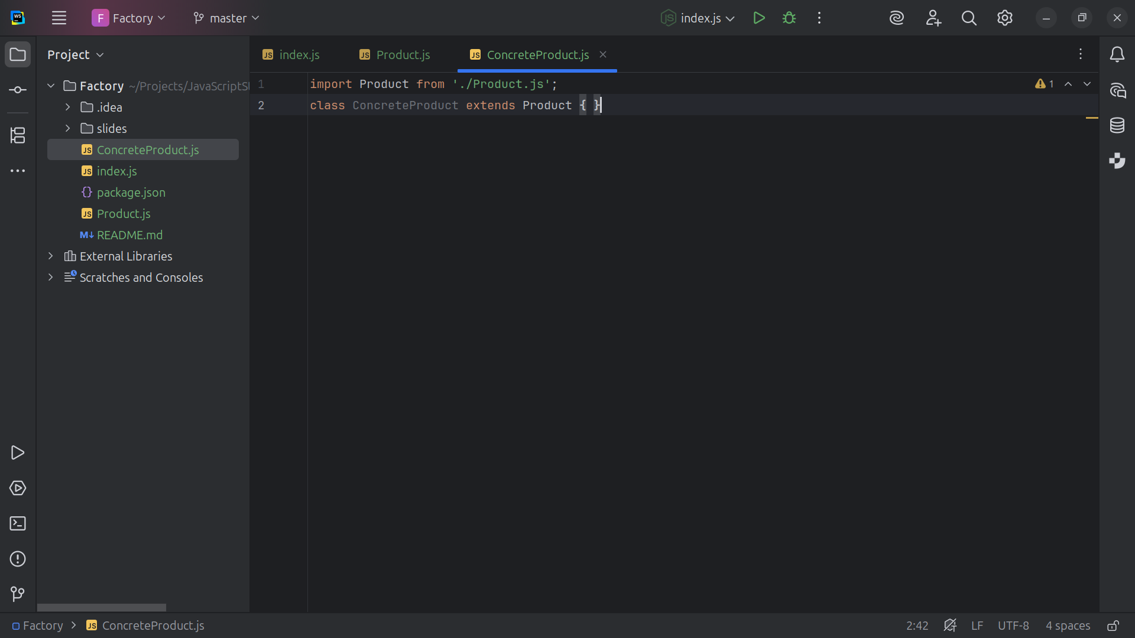
Notes:
We import Product the Concrete implementation of the Product interface

Slide 9
Notes:
The Concrete Product is extended by the Product interface a Concrete implementation of the Product interface

Slide 10
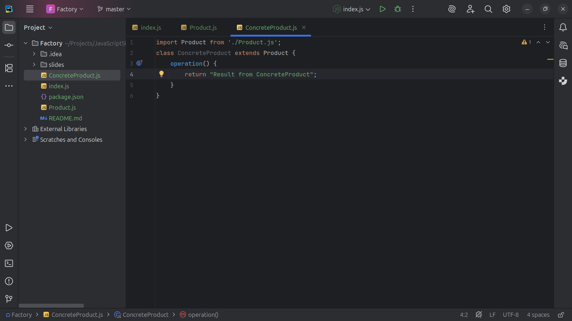
Notes:
Returns a string to simulate product behavior with the message Result from Concrete Product

Slide 11
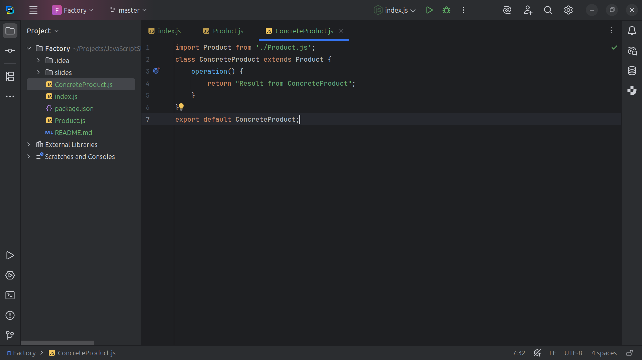
Notes:
. . . and we export this class for our project

Slide 12
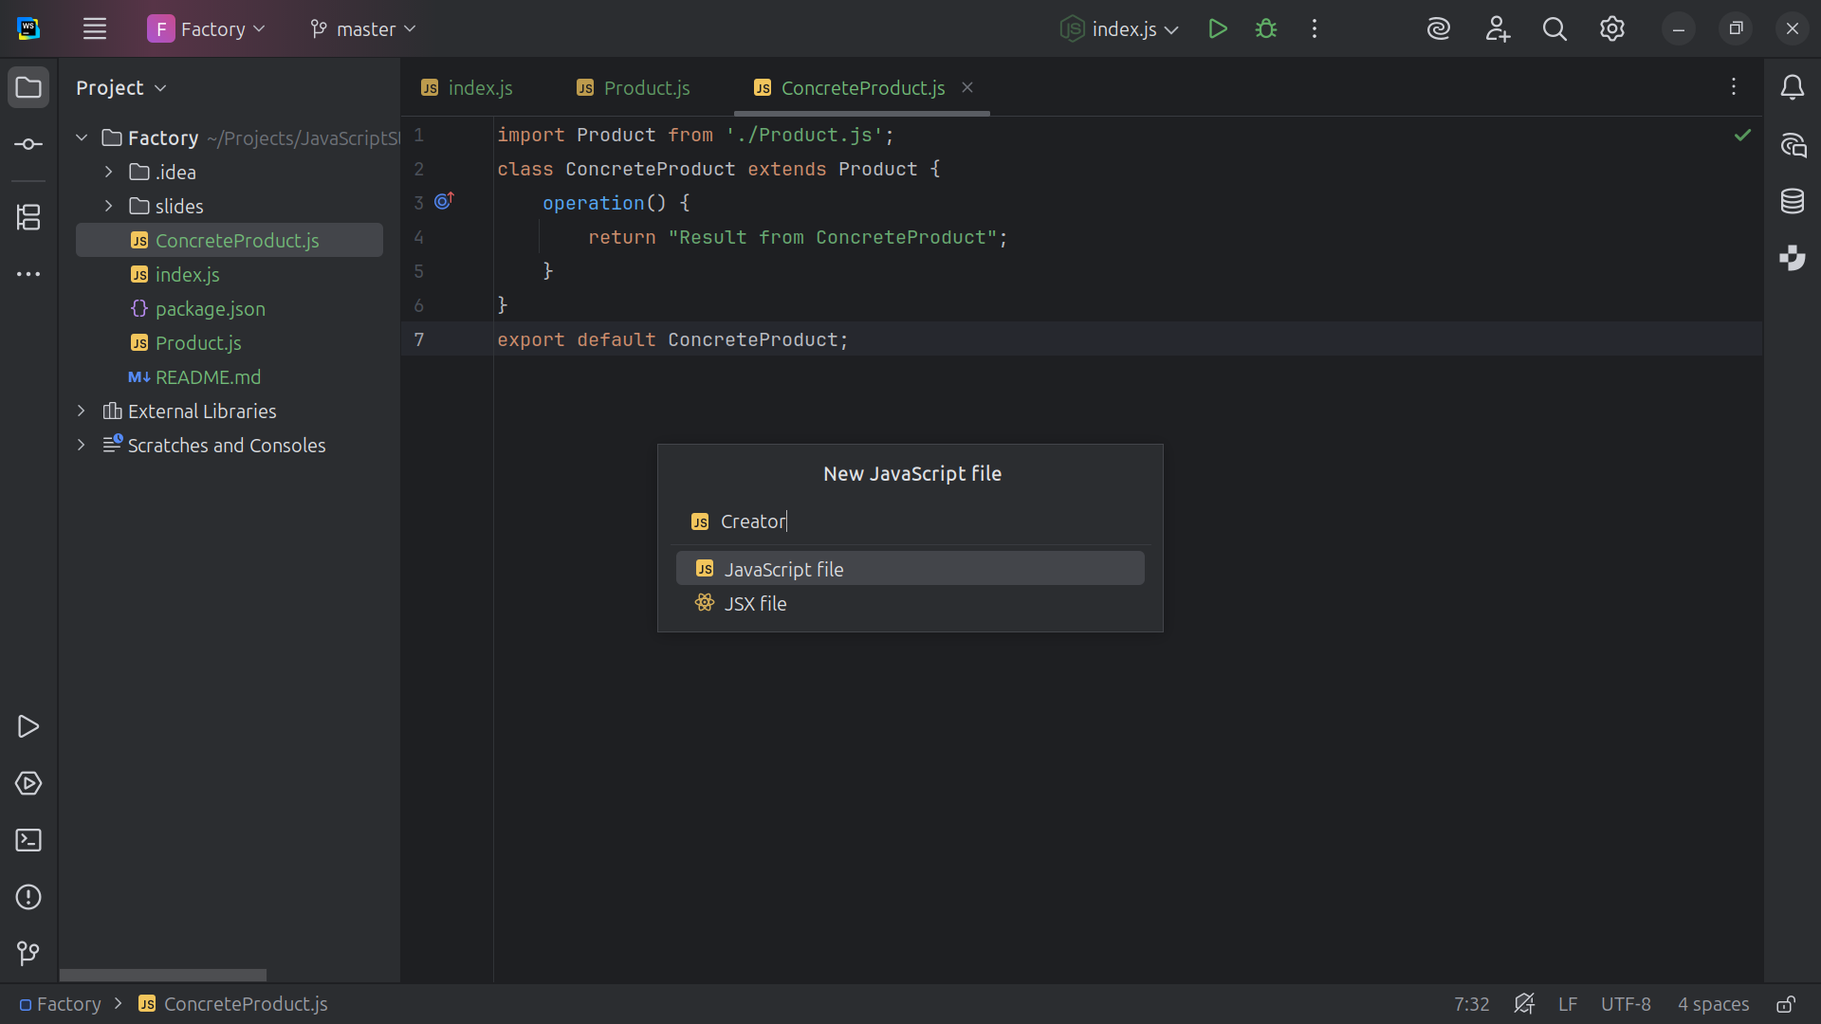
Notes:
Next we create a class called Creator

Slide 13
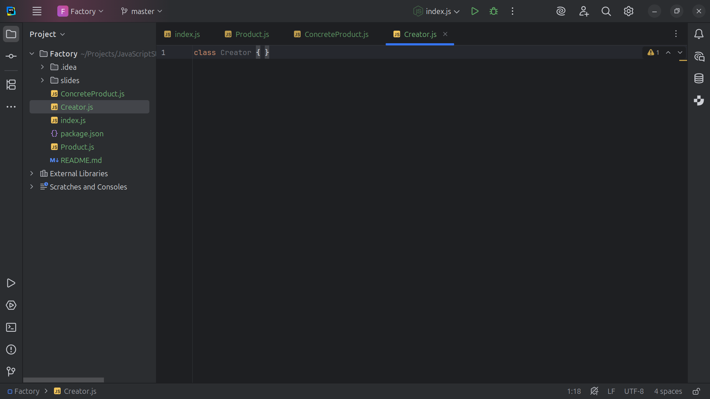
Notes:
The Purpose of “Abstract” Creator is to declare the factory Method() and a template method

Slide 14
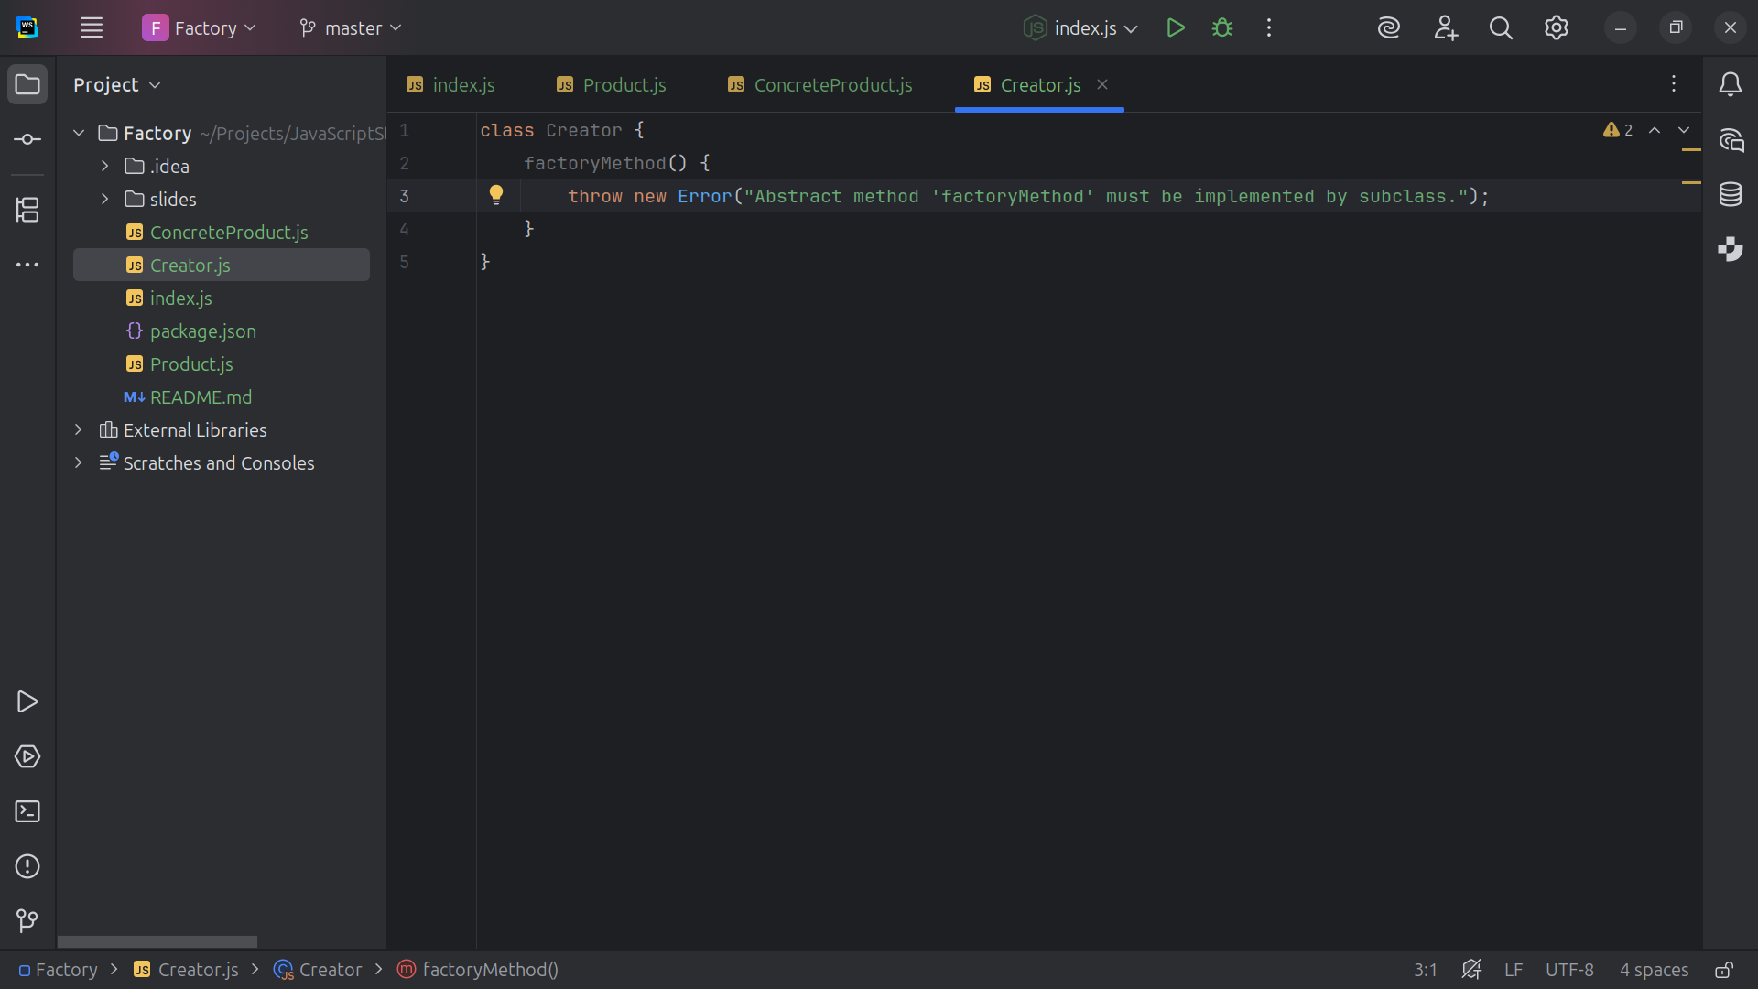
Notes:
We have an Abstract method meant to be overridden by subclasses

Slide 15
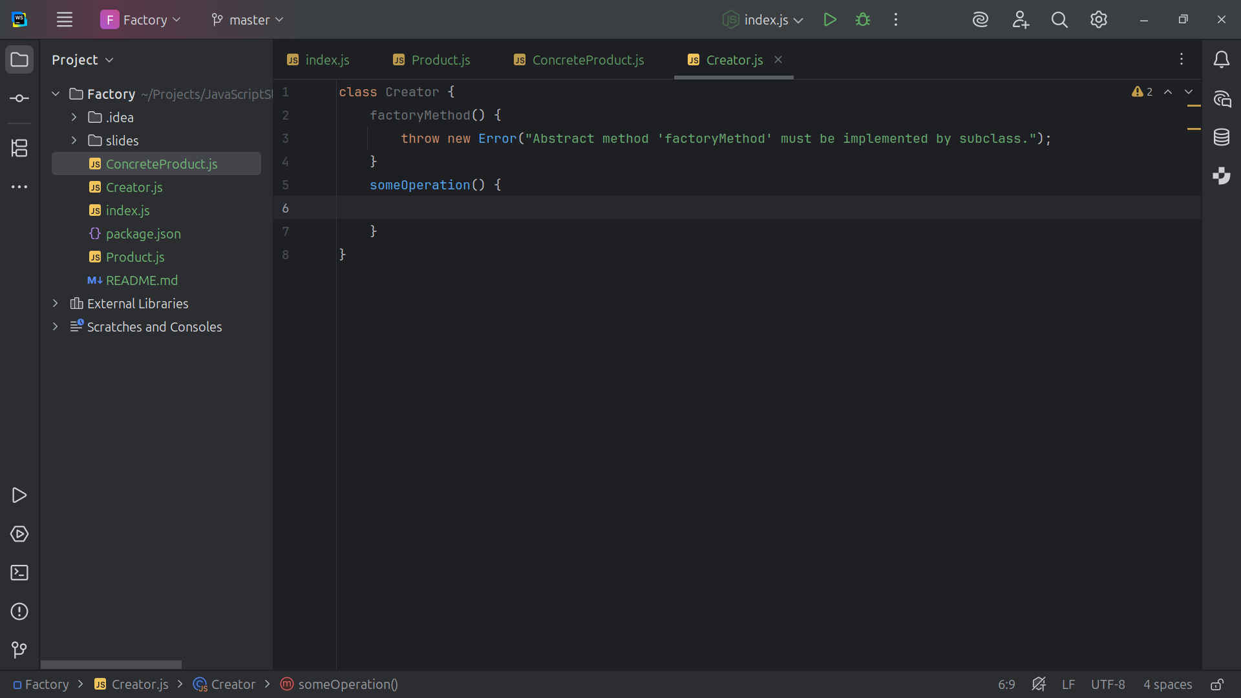
Notes:
Some Operation is a method that .. .

Slide 16
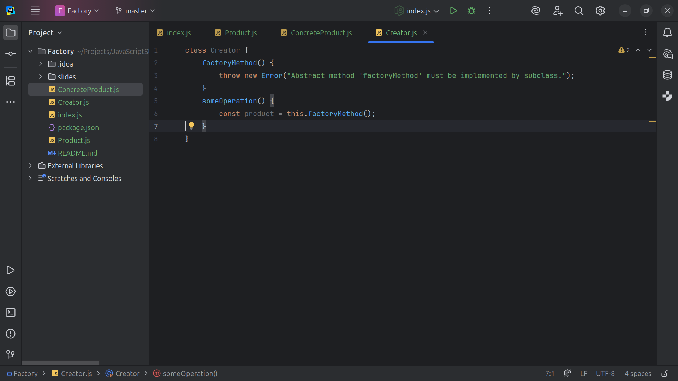
Notes:
… Calls the factory method to create a Product

Slide 17
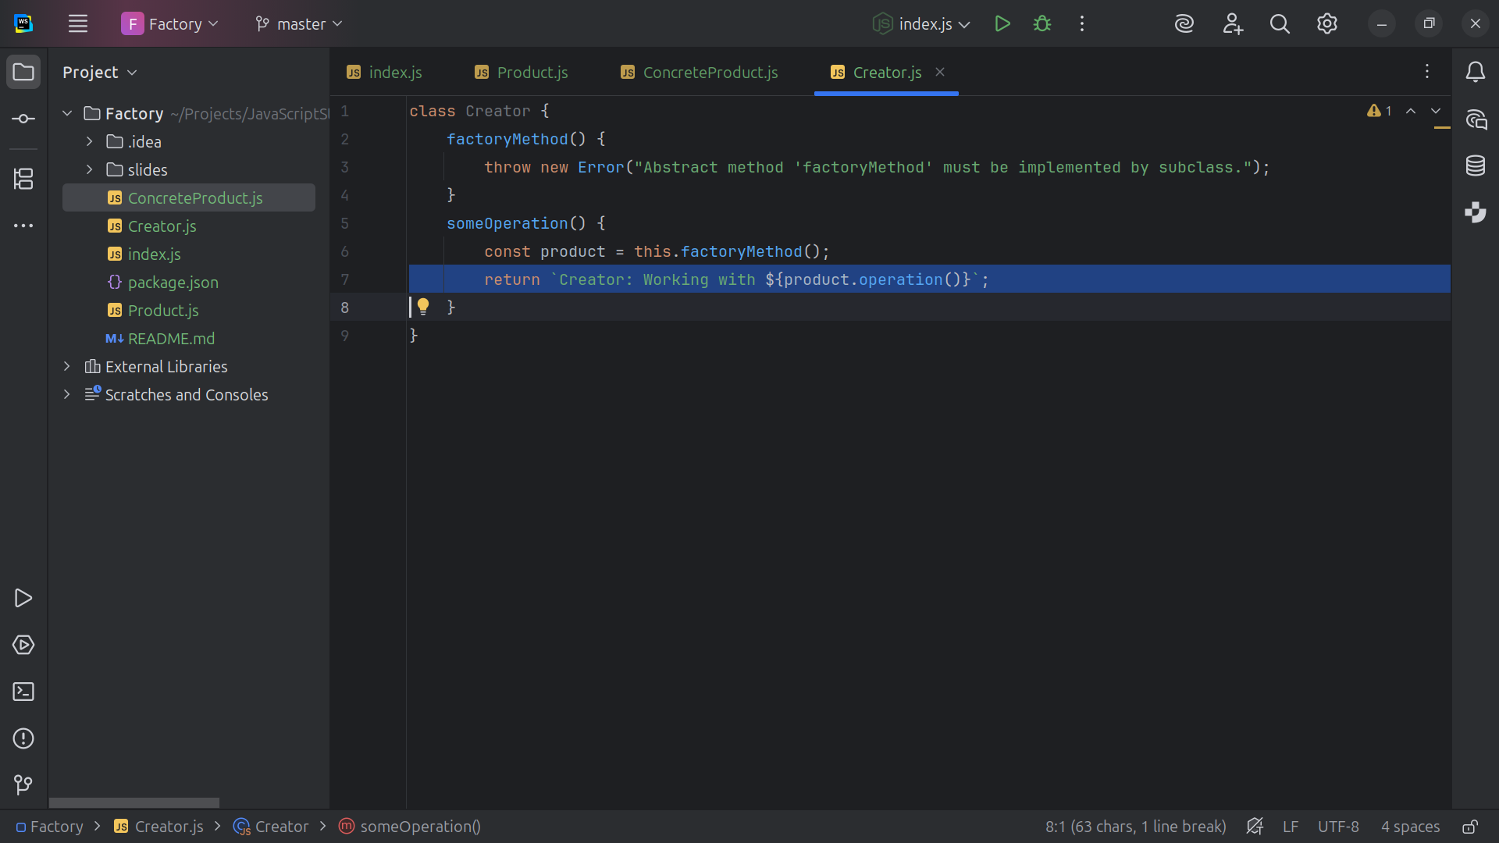
Notes:
We return the message Creator: Working with the Creator: Working with operation

Slide 18
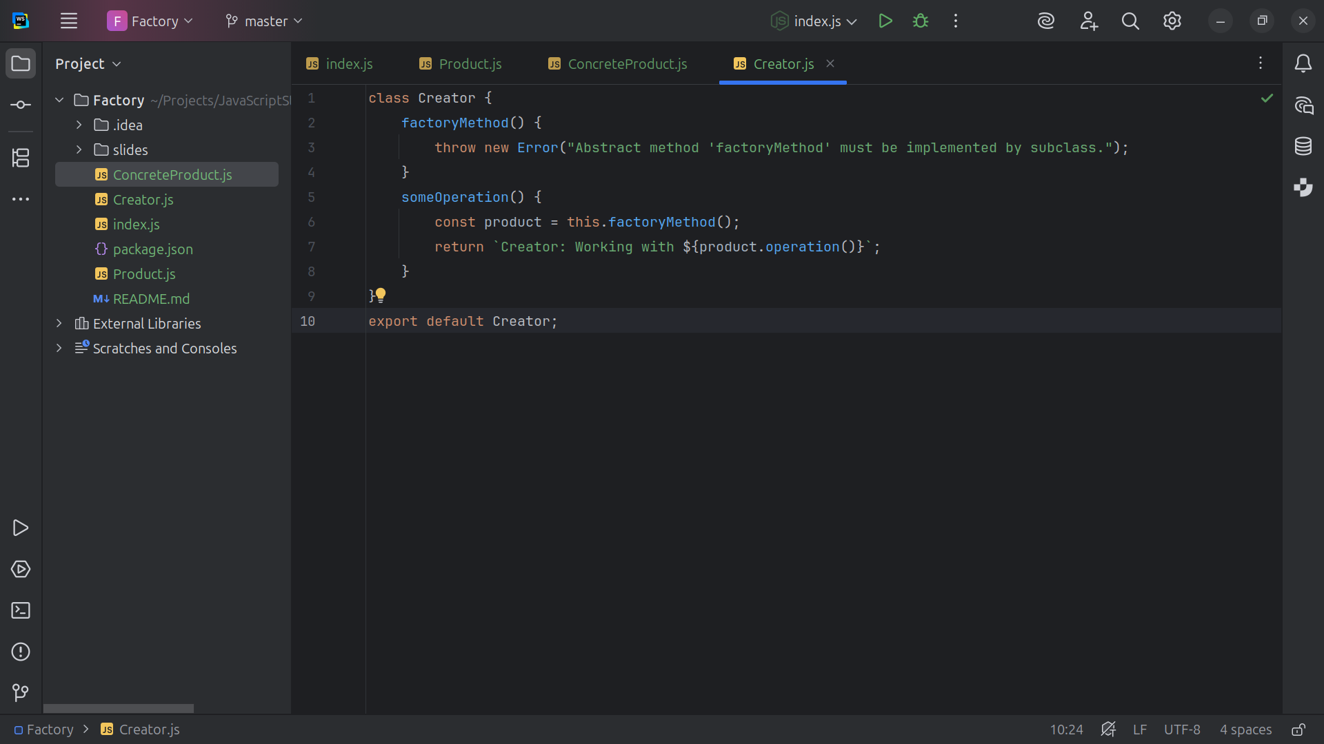
Notes:
An we export this class Creator for our Demo

Slide 19
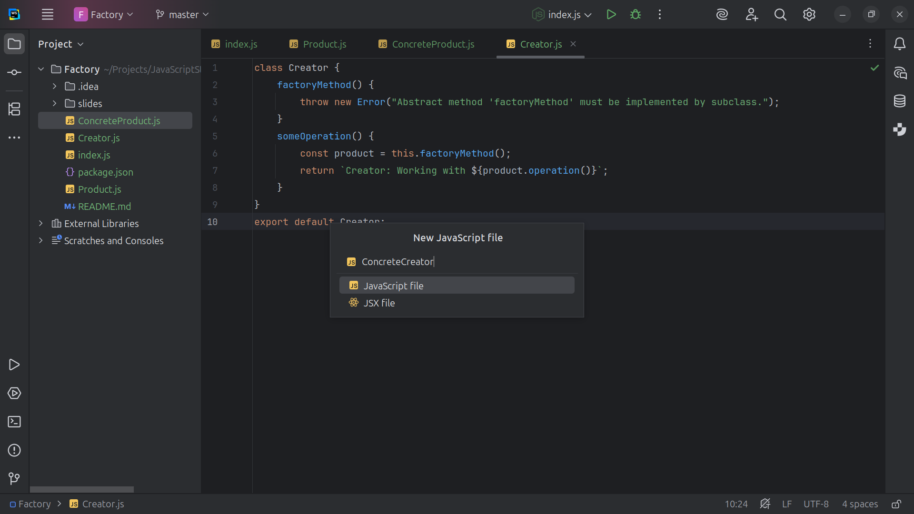
Notes:
Next we create the Concrete Creator

Slide 20
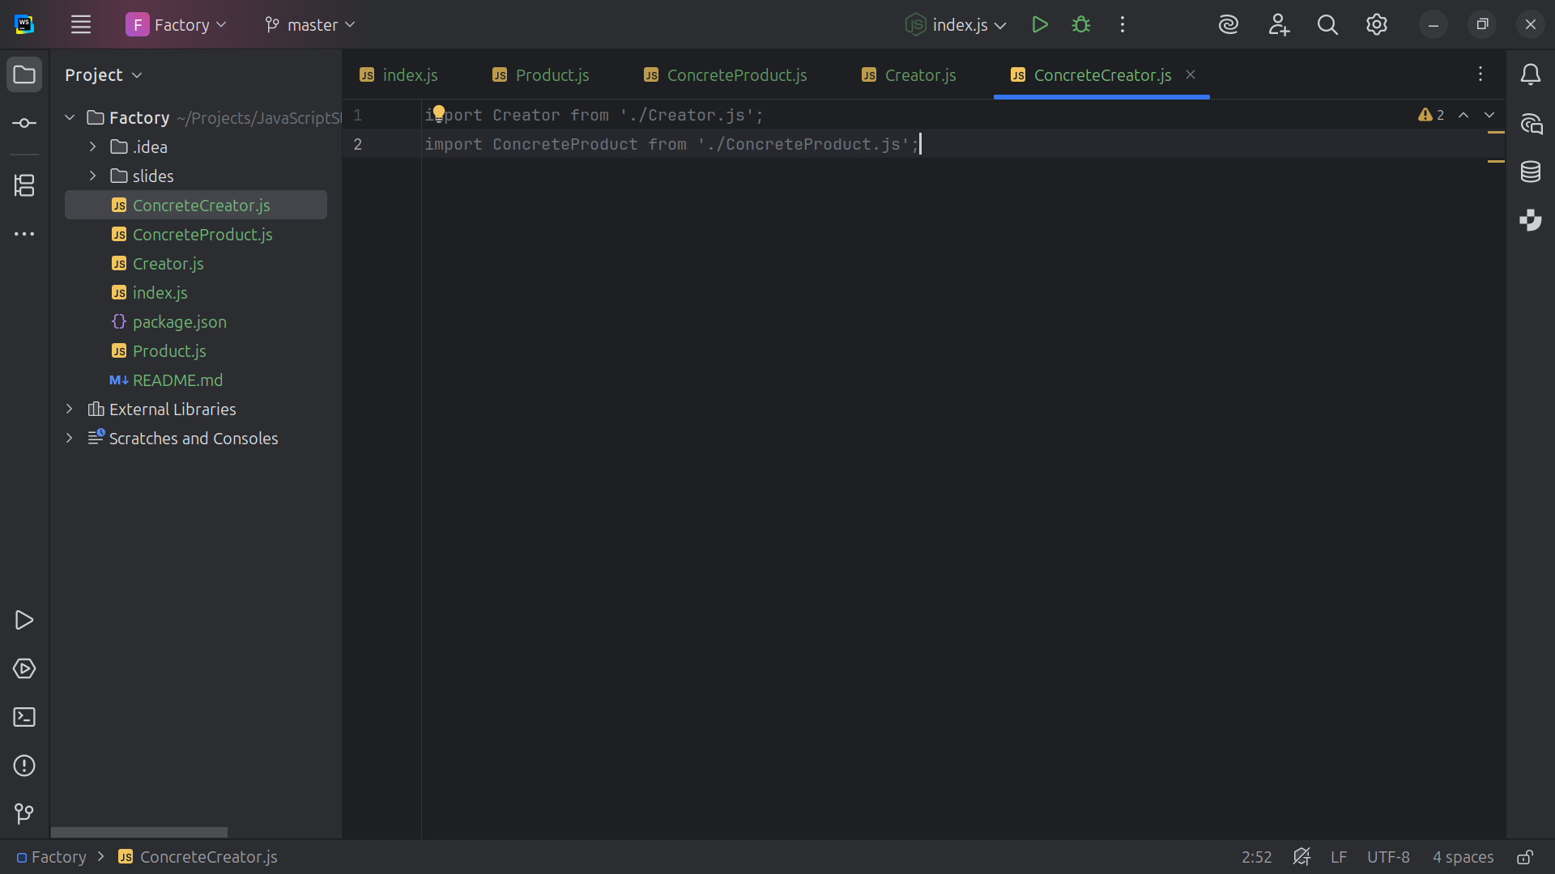
Notes:
The Purpose of the Concrete Creator is that is Implements the factory Method to return a specific Concrete Product
We import the Creator and the Concrete Product at the top

Slide 21
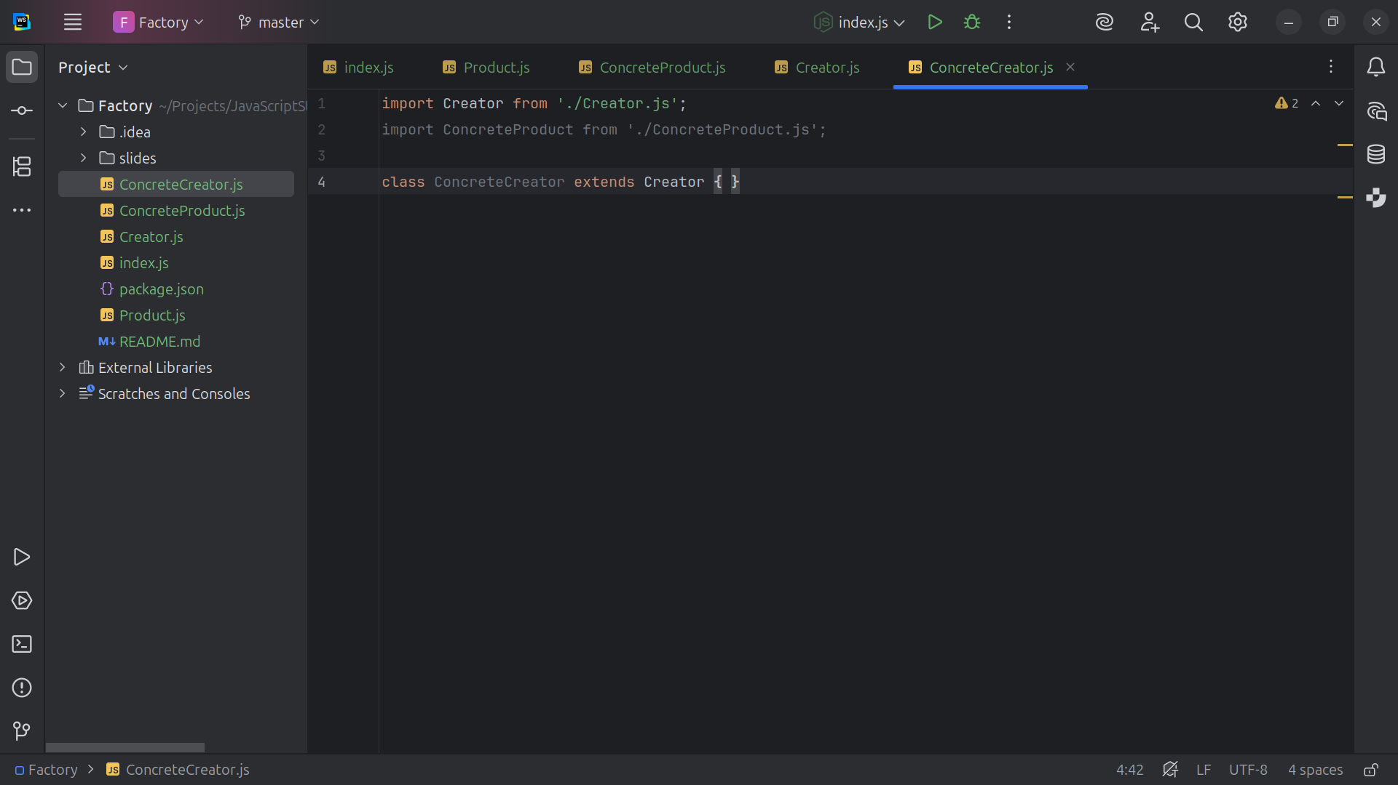
Notes:
The Concrete Creator is extended by the Creator class

Slide 22
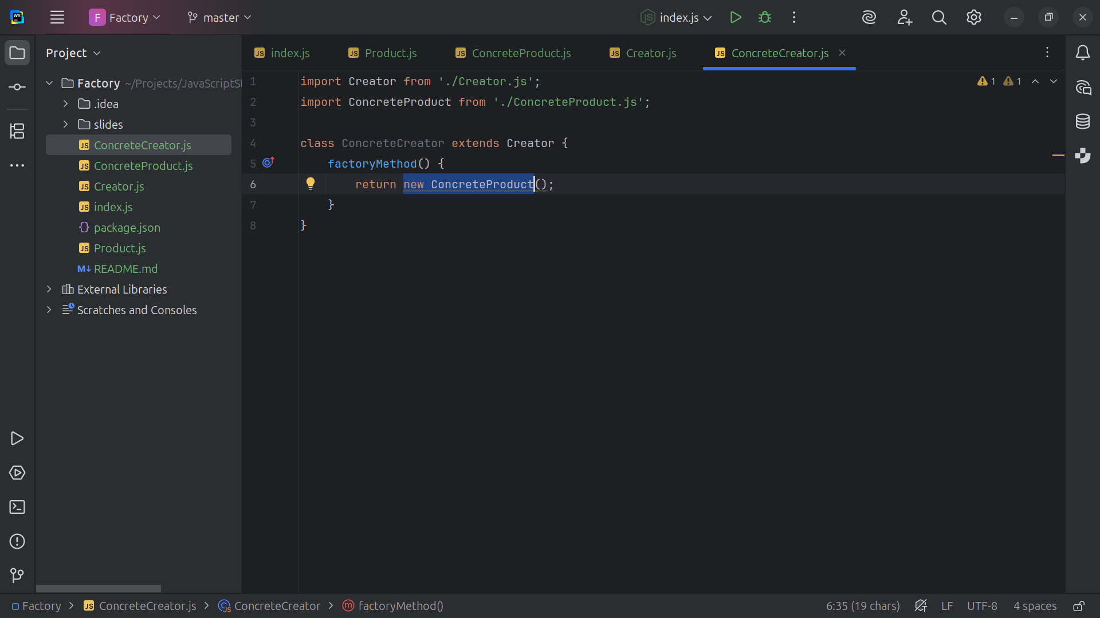
Notes:
Thus we a factory Method that Returns a concrete implementation of the Product

Slide 23
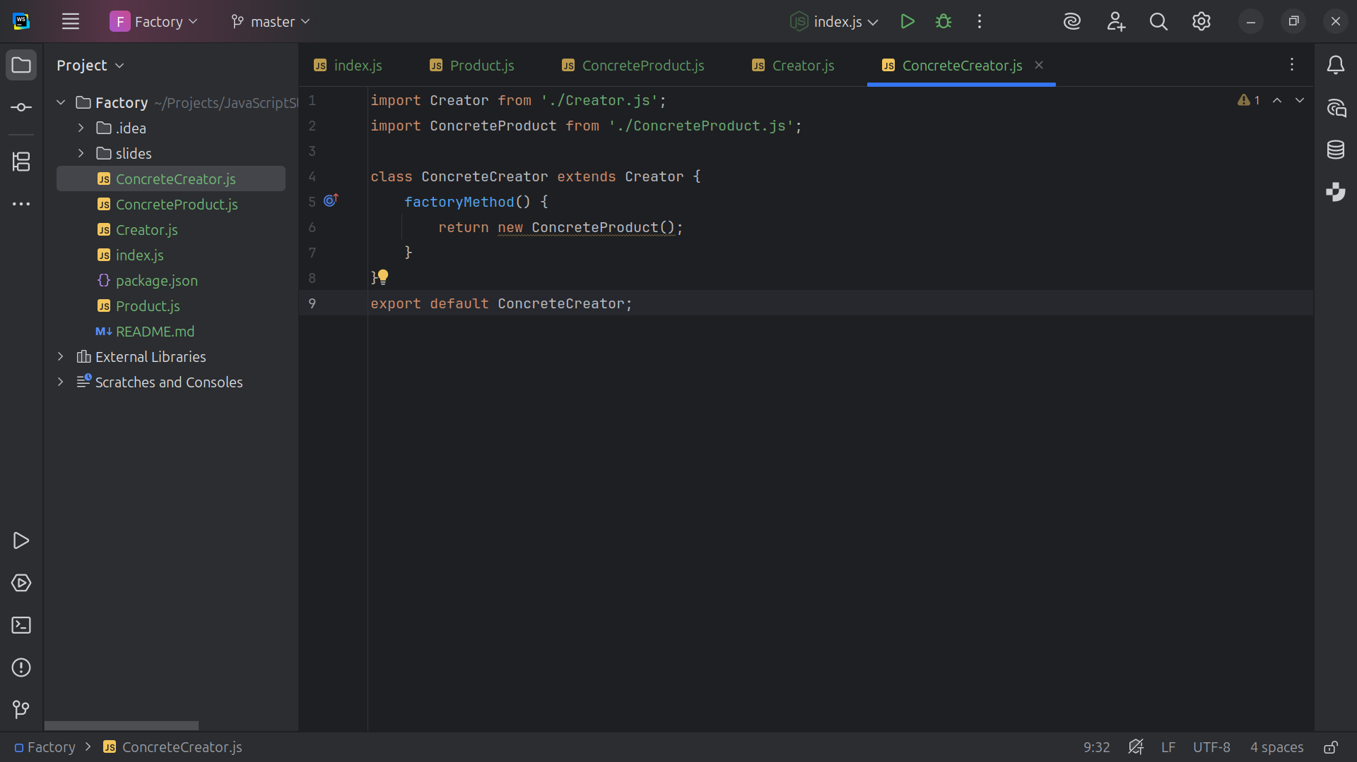
Notes:
And we also export this class for our demo will have at the end

Slide 24
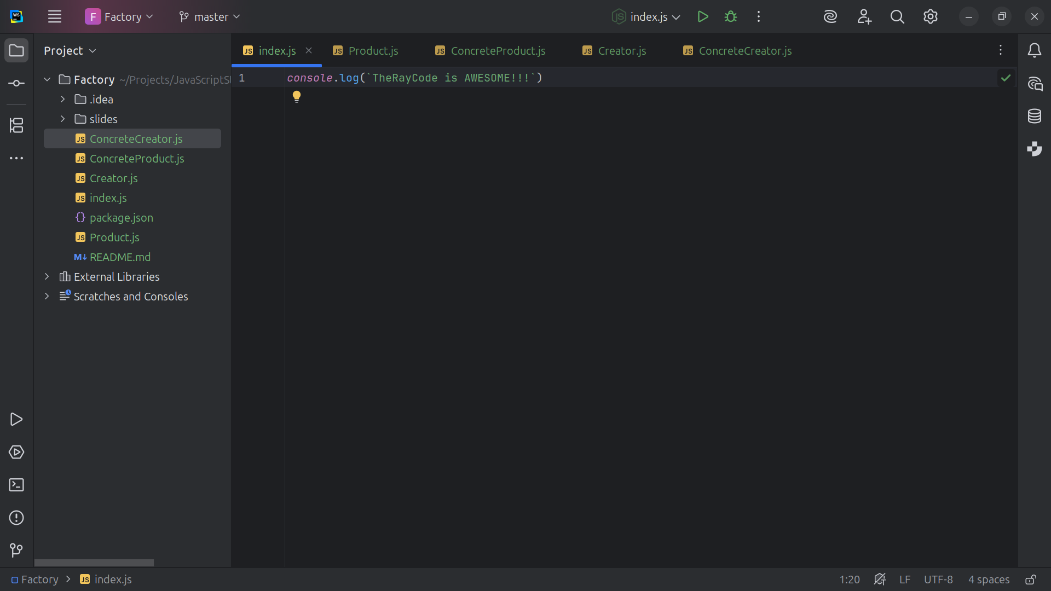
Notes:
Now let’s go to the index.js page for our demo

Slide 25

Notes:
We import the Concrete Creator

Slide 26
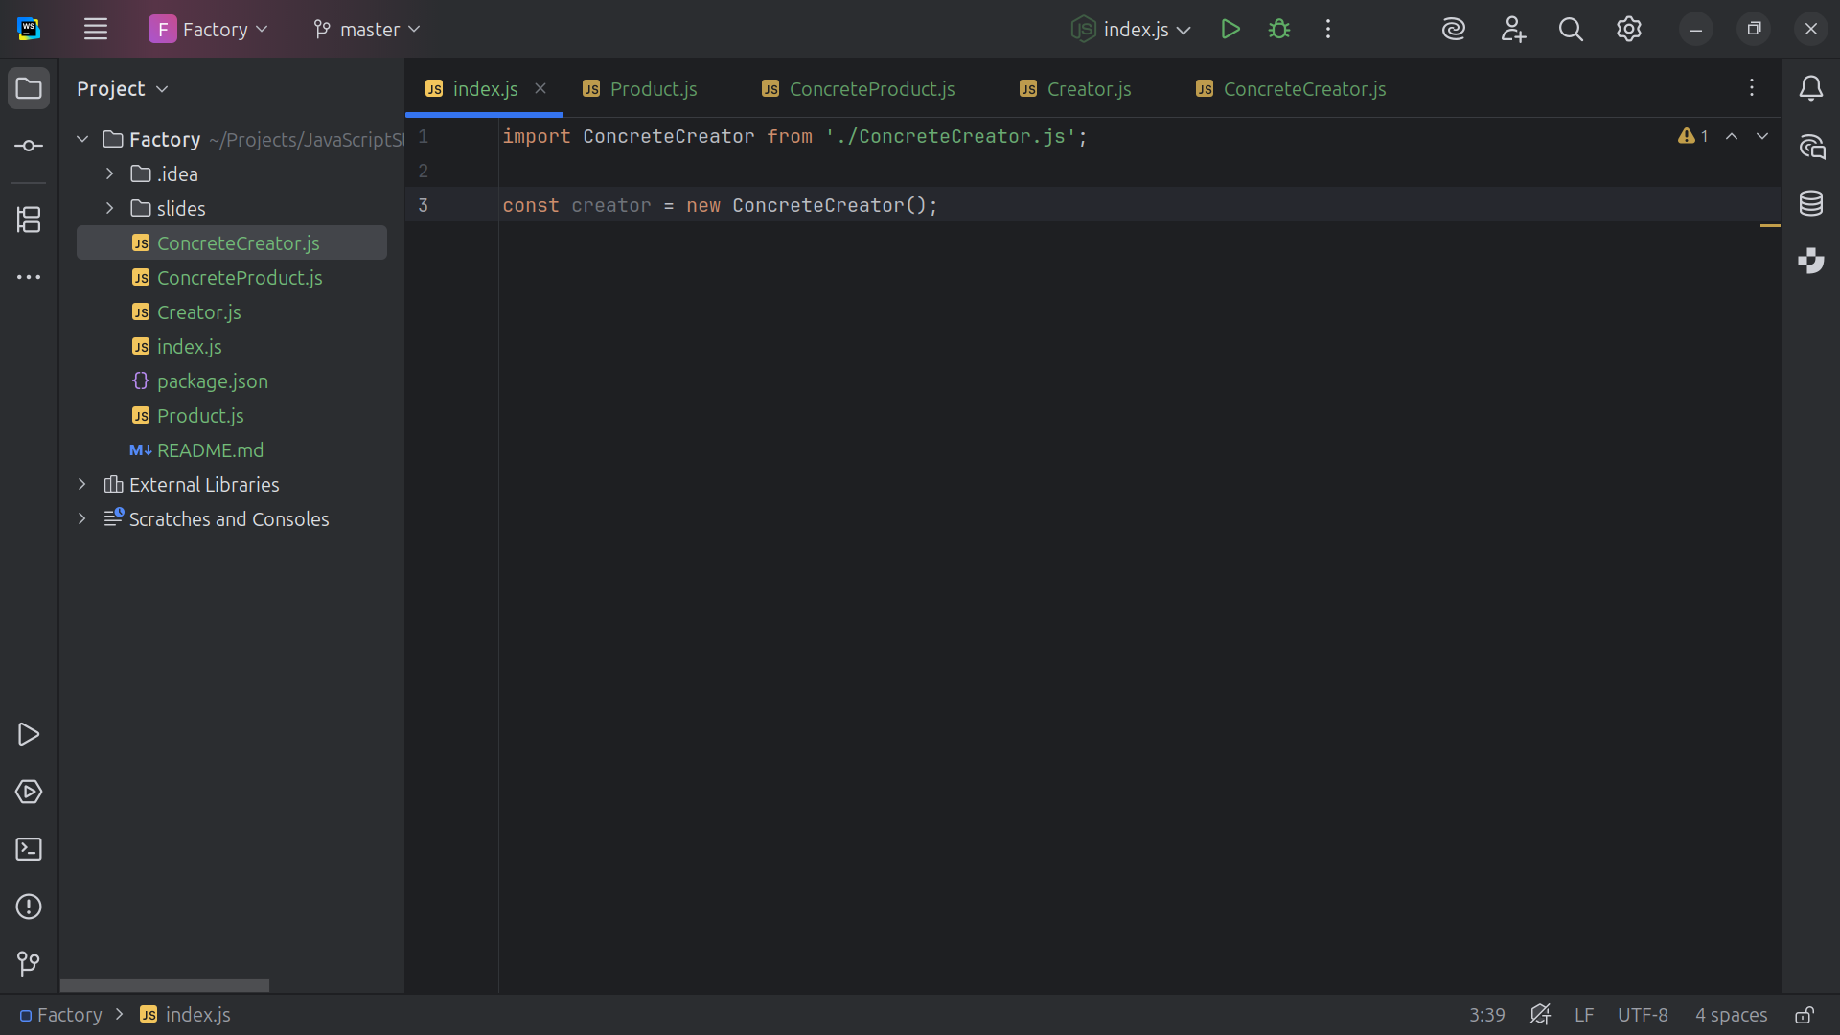
Notes:
We Create an instance of the concrete creator

Slide 27
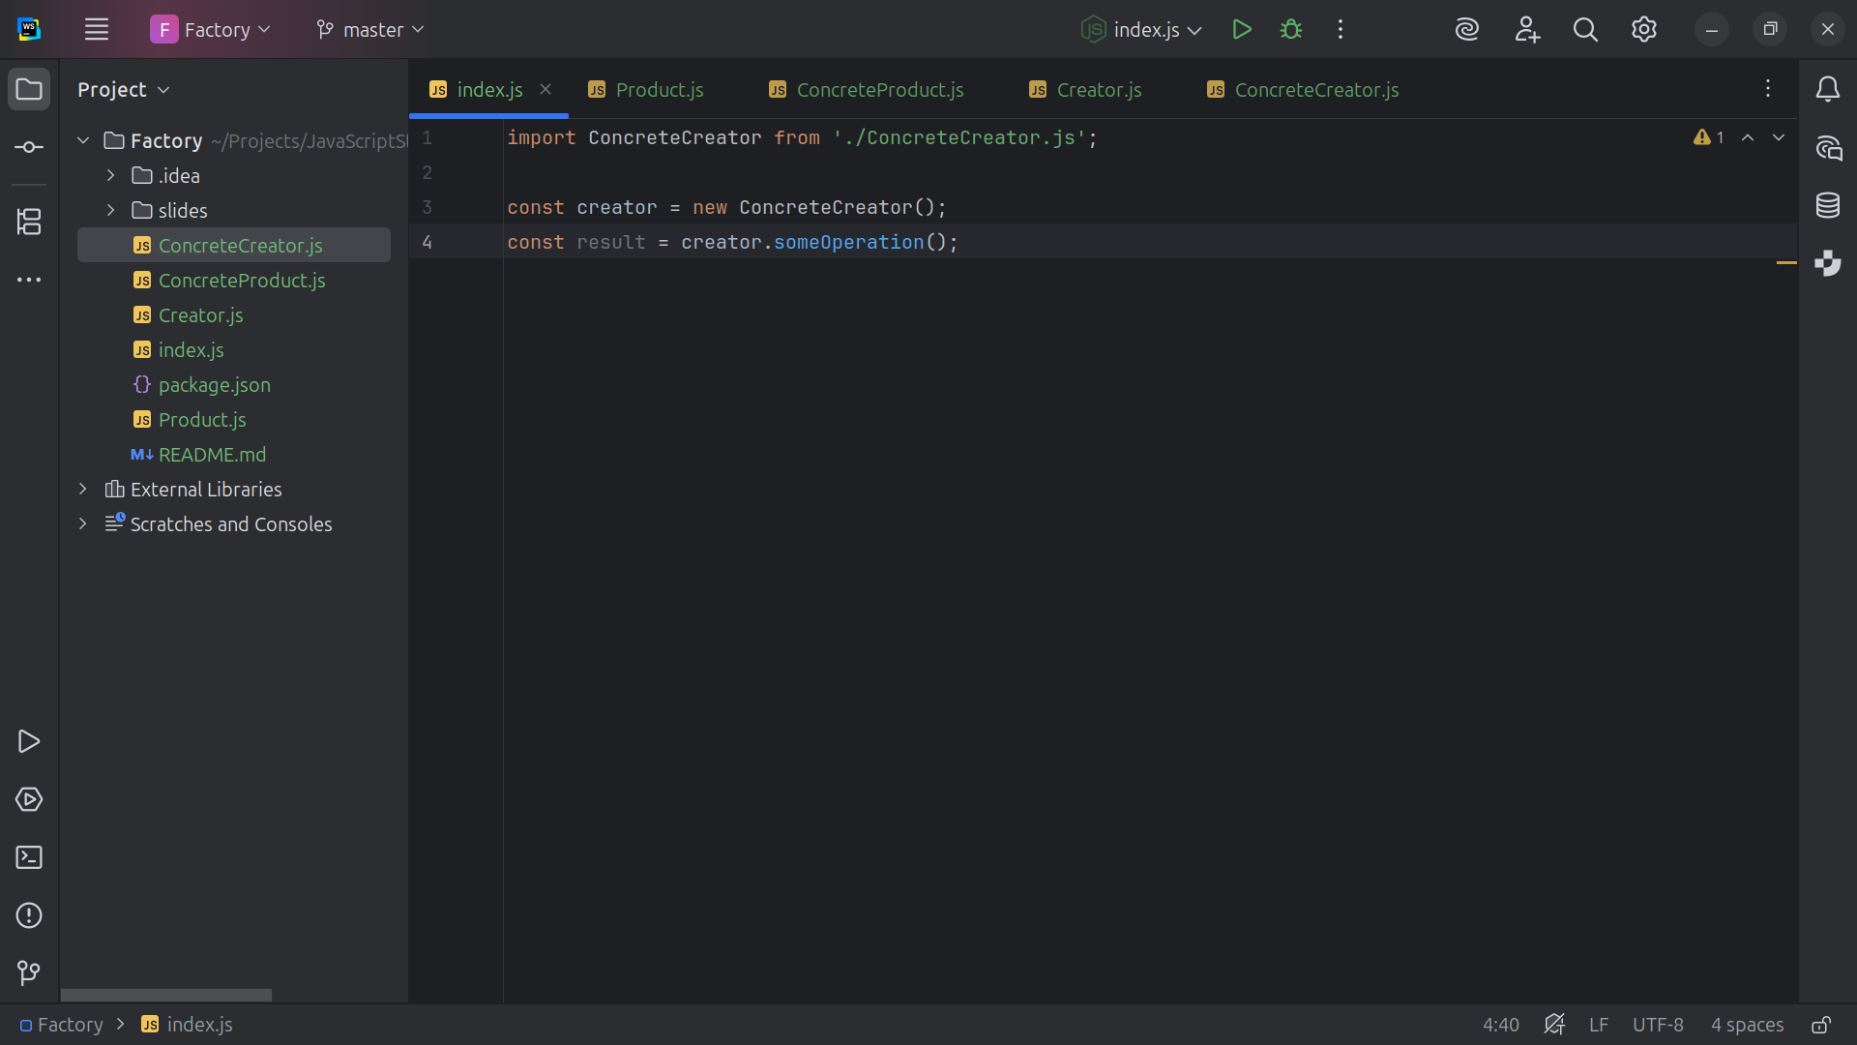
Notes:
And set set result equal some operation on the creator

Slide 28
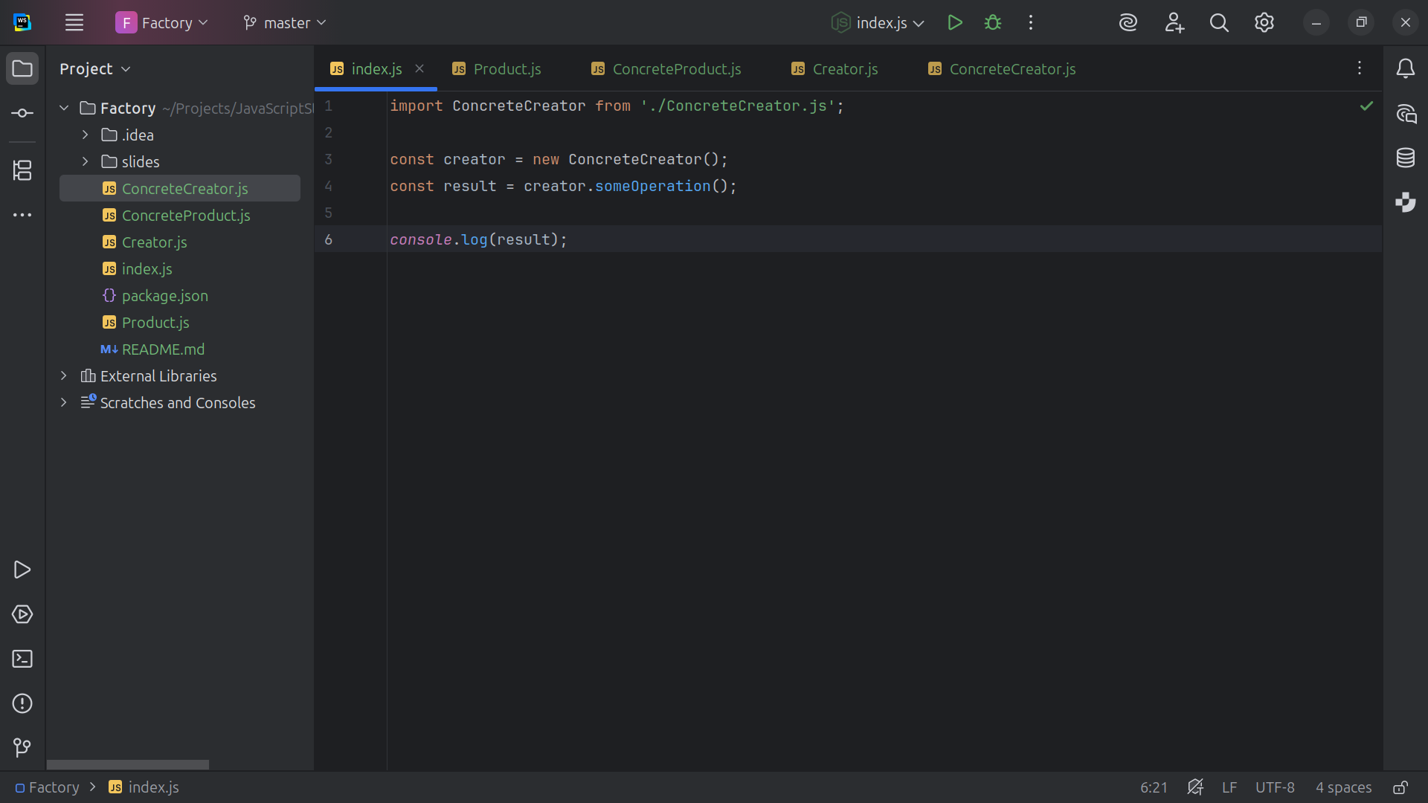
Notes:
We send Output the result to the console

Slide 29
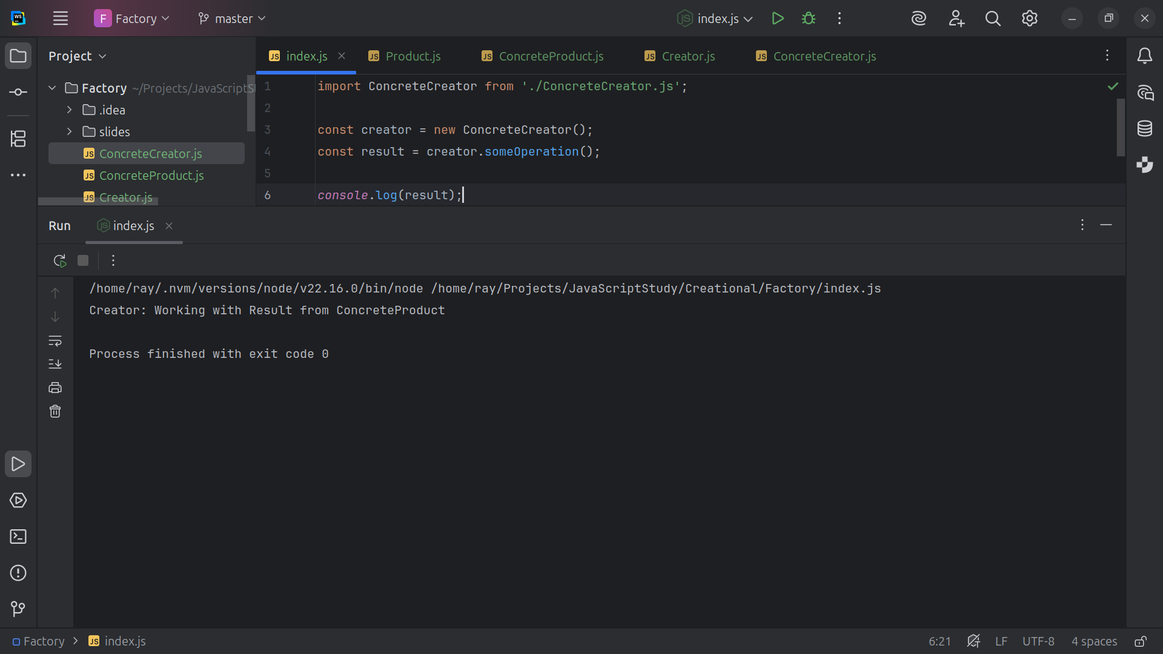
Notes:
And We run and We we get Creator: Working with Result from Concrete Product
This a demo of the Factory design pattern
my name is Ray Always code with a smile

