Slide 1

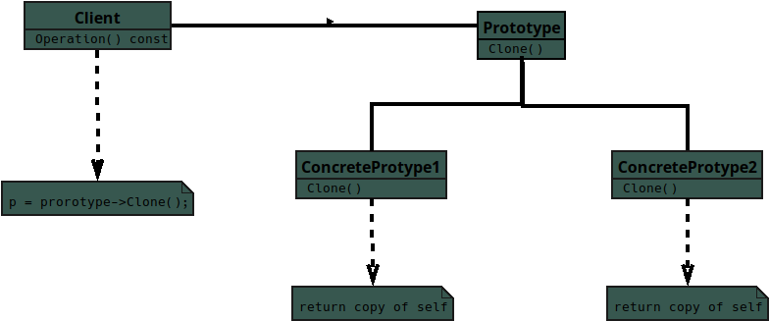

Slide 2
Notes:
Structure UML for the Creational Pattern — Prototype
For the JavaScript student

Slide 3
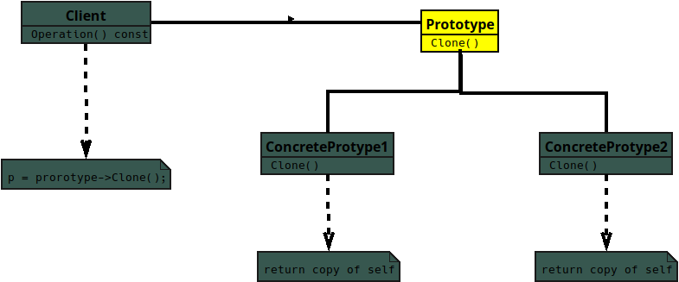
Notes:
Prototype
* Defines the method for cloning itself into a new object.
* Stores the default state shared by its copies.
* Lets objects create new versions without classes.

Slide 4
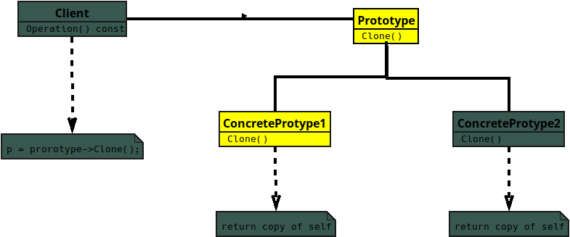
Notes:
The Concrete Prototype

Slide 5
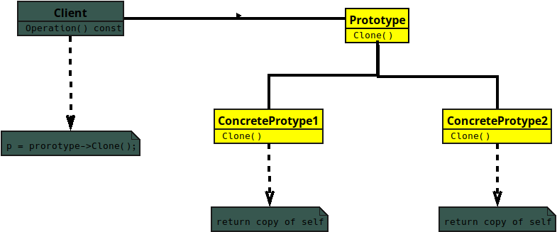
Notes:
Implements the cloning method from Prototype

Slide 6
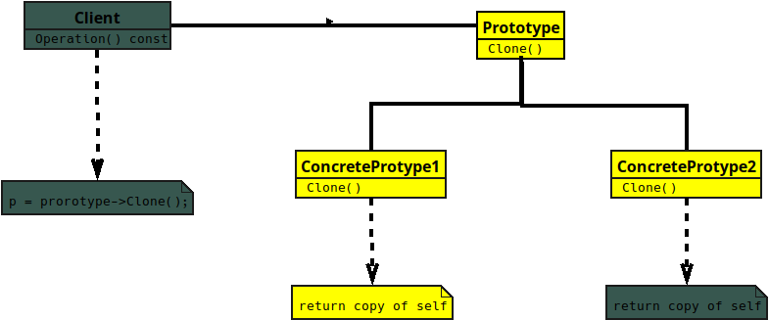
Notes:
Copies its internal state into a new object.

Slide 7
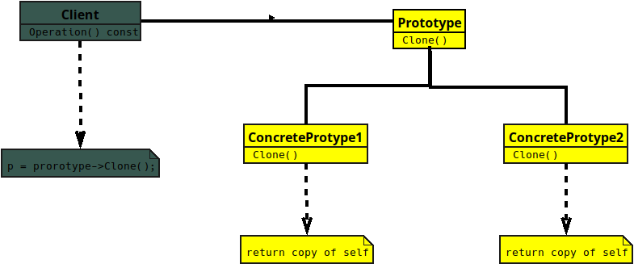
Notes:
* Produces independent duplicates with similar behavior.

Slide 8
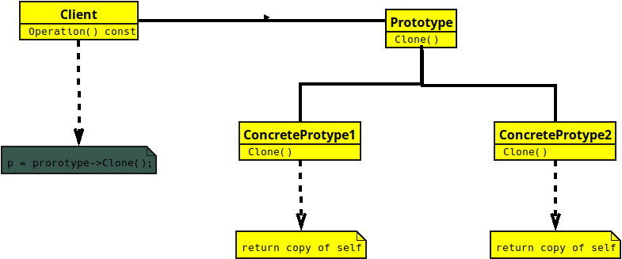
Notes:
**Client**
* Requests new objects by cloning a Prototype.

Slide 9
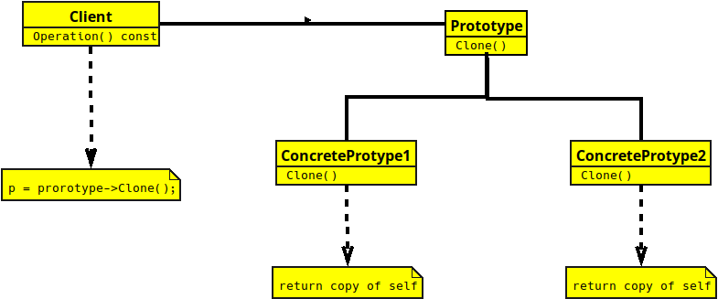
Notes:
* Avoids using `new` to create many similar objects.
* Easily changes which Prototype it clones.

