Slide 1
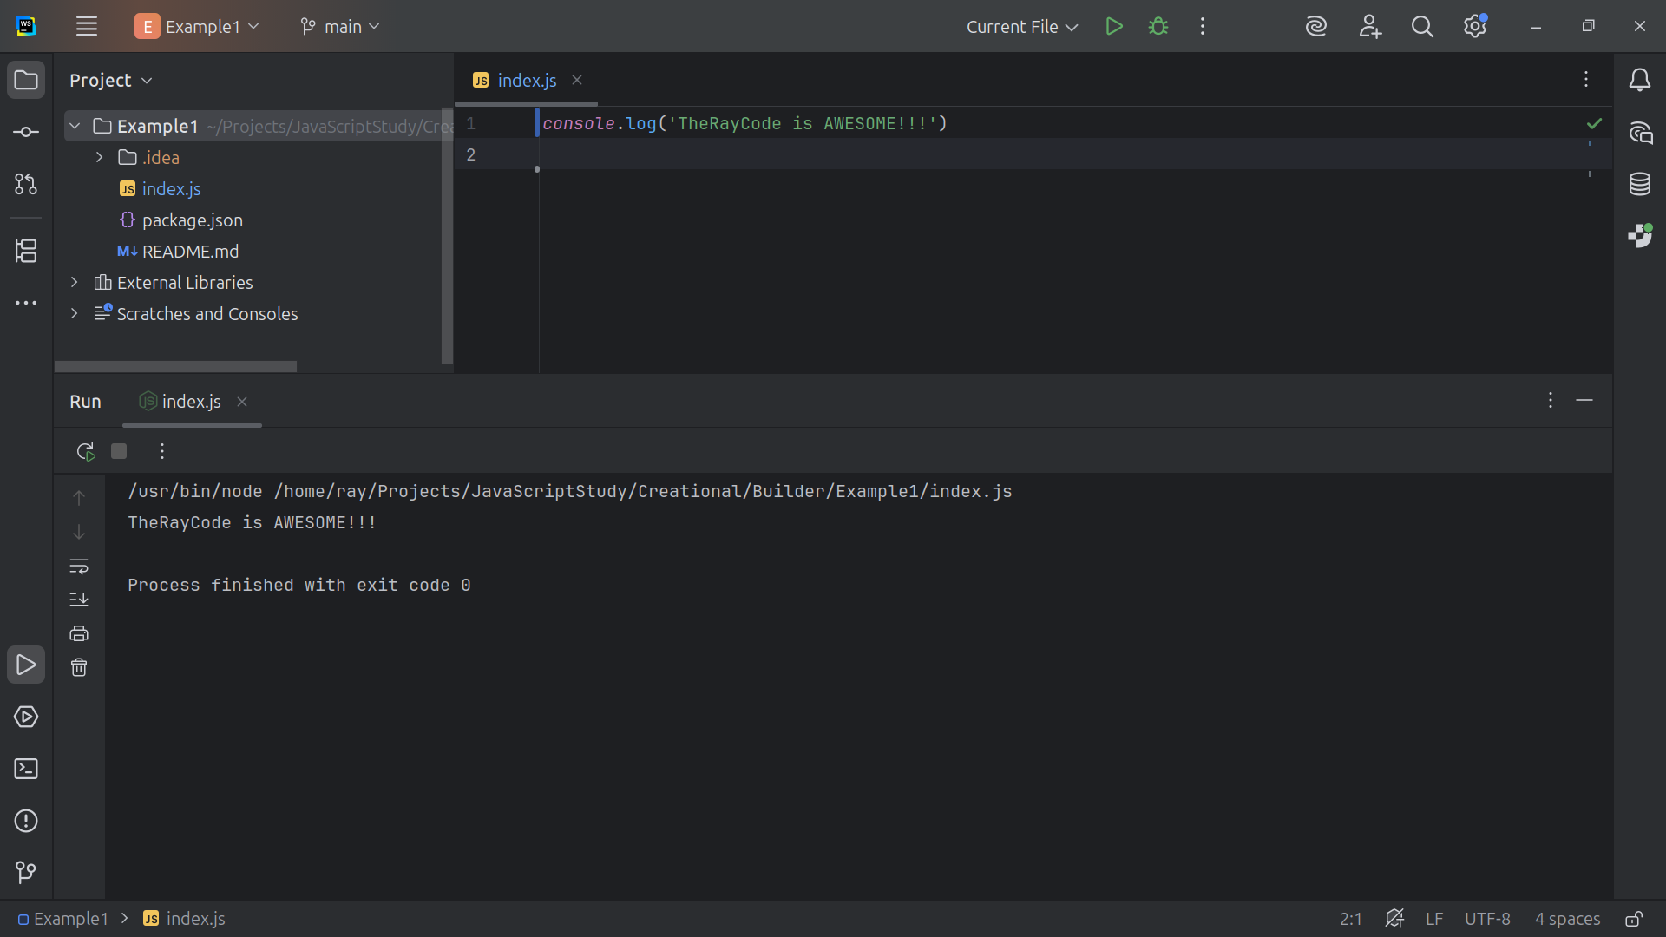
Notes:
Hello I’m Ray of TheRayCode

Slide 2
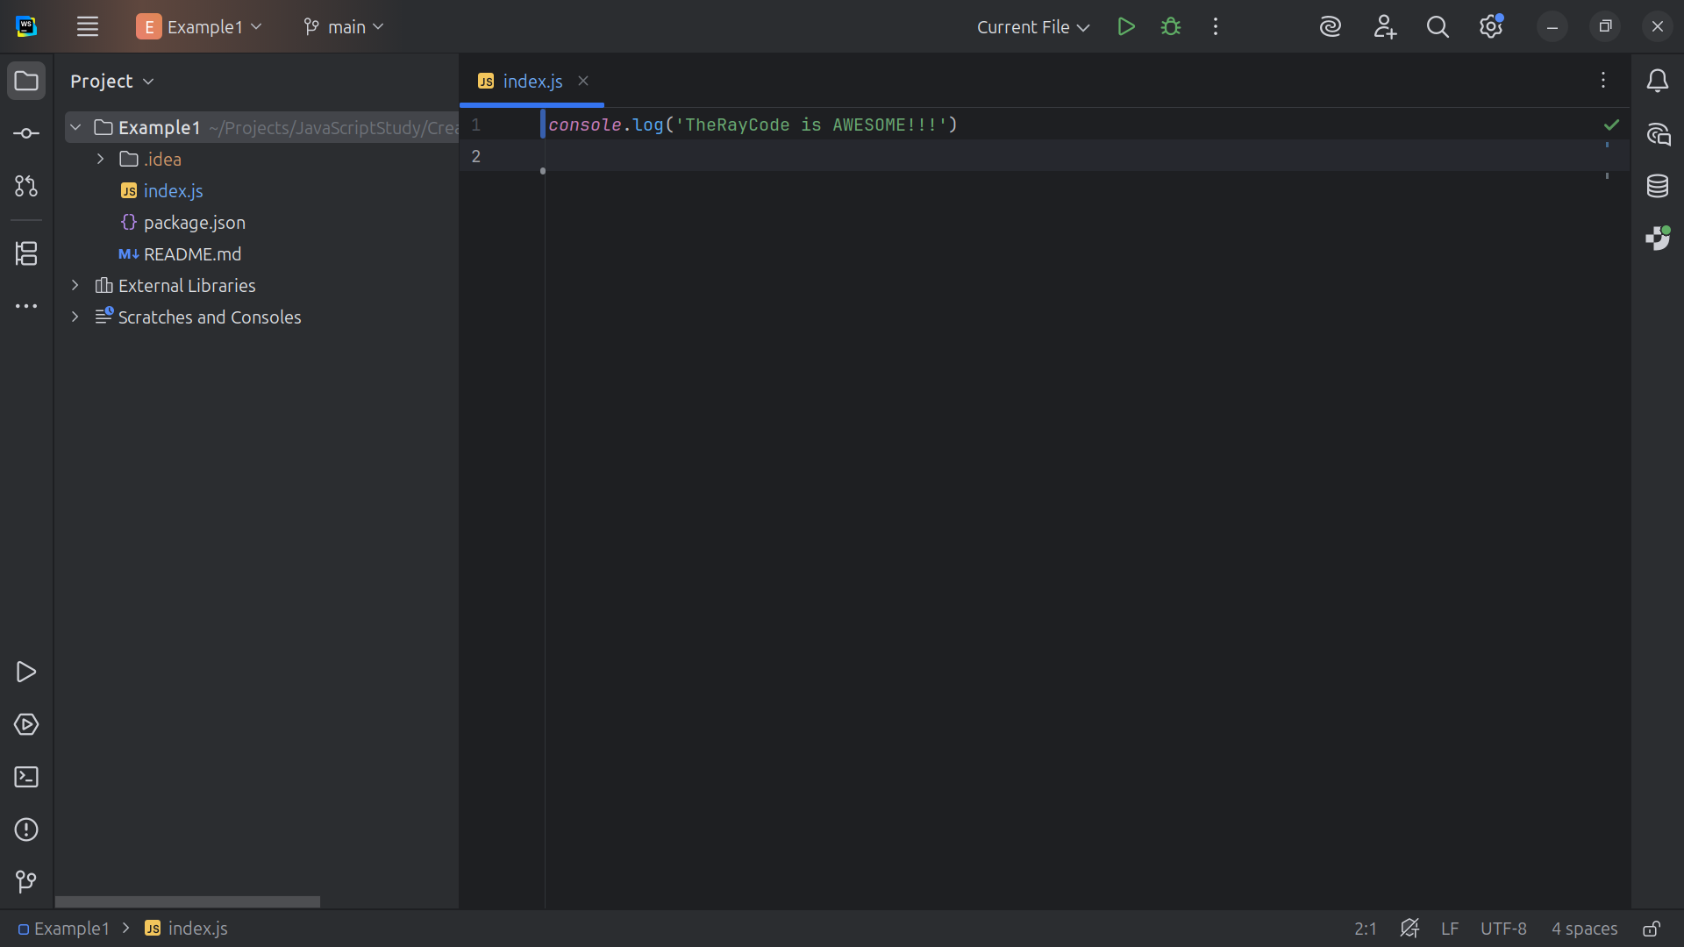
Notes:
In this video I will giving you an example of the design Pattern Builder using JavaScript. The Builder design pattern is a Creational pattern according to the Gang of Four

Slide 3
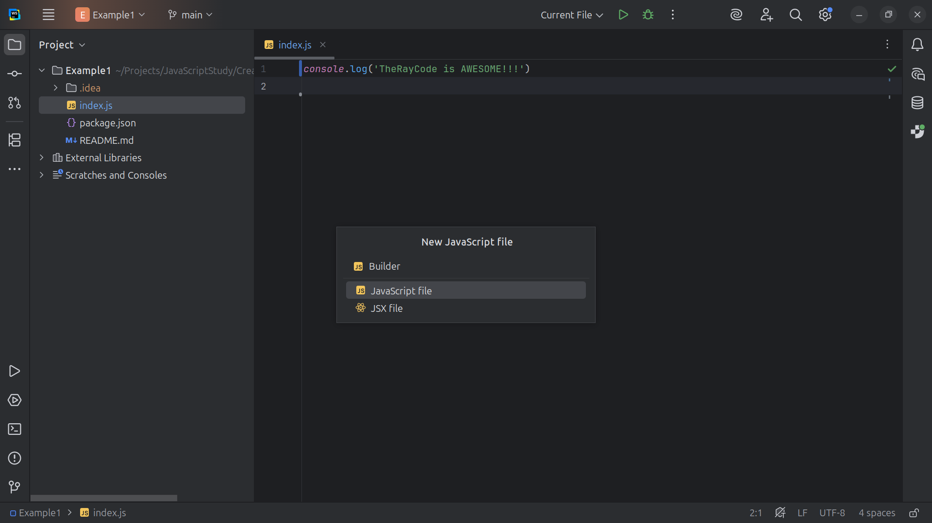
Notes:
We start our project with a class called Builder

Slide 4
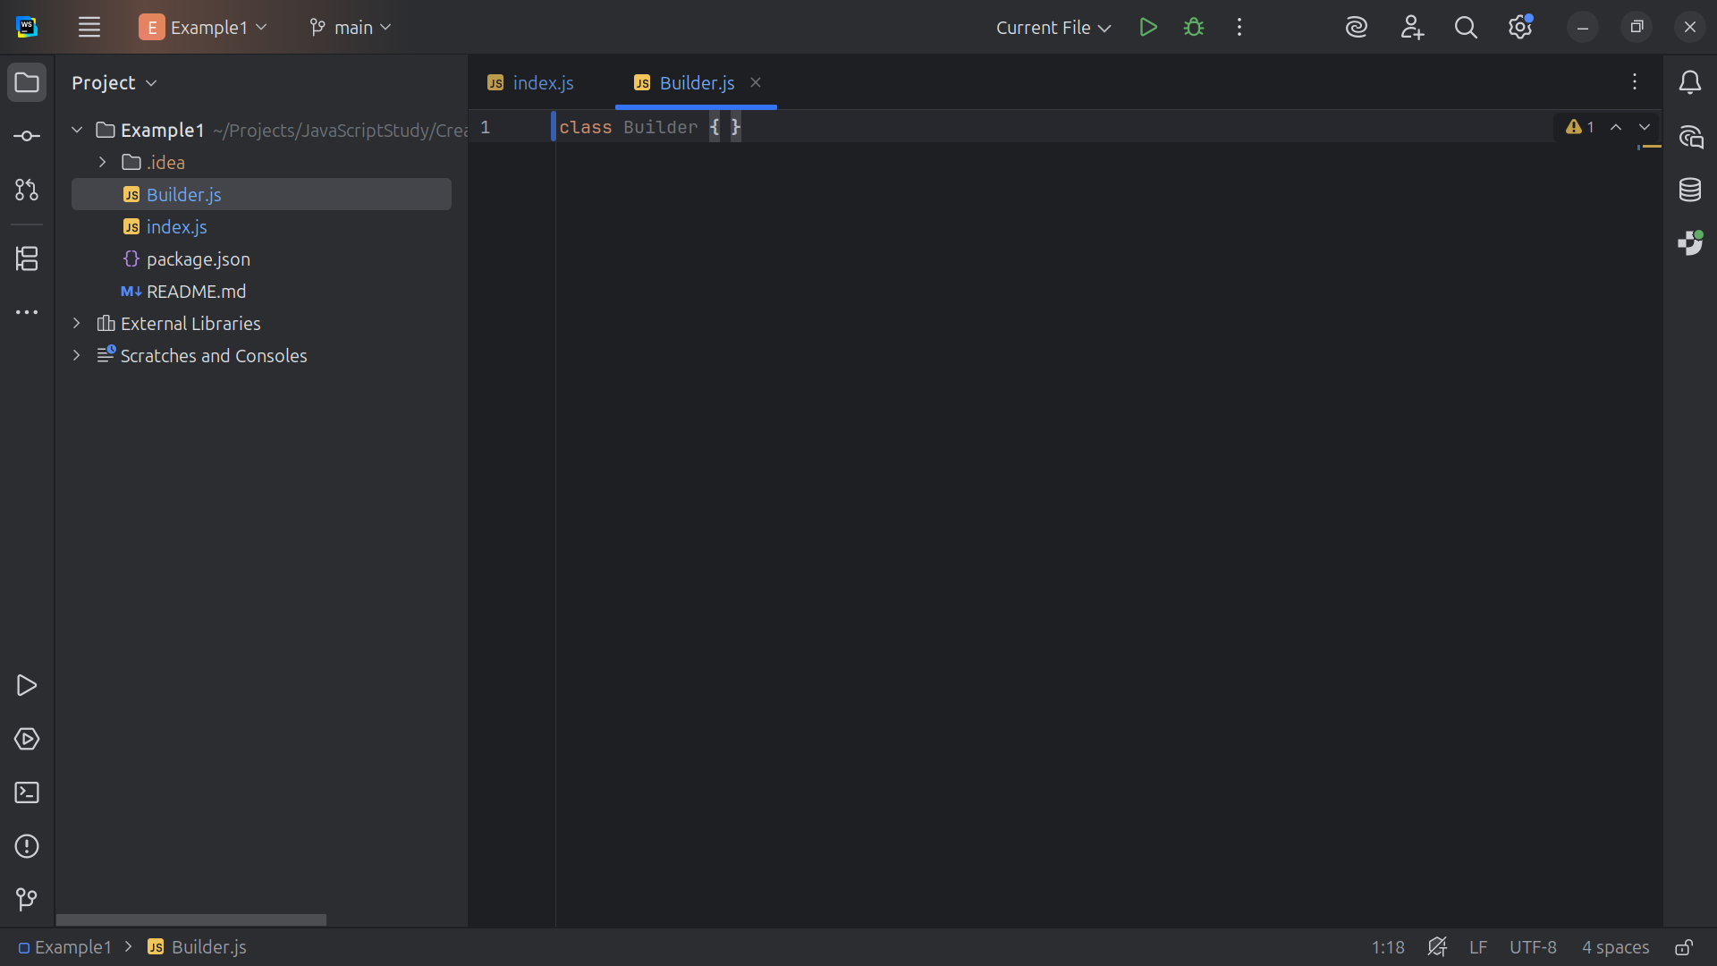
Notes:
Builder Defines the abstract interface for constructing parts of a product and retrieving it.

Slide 5
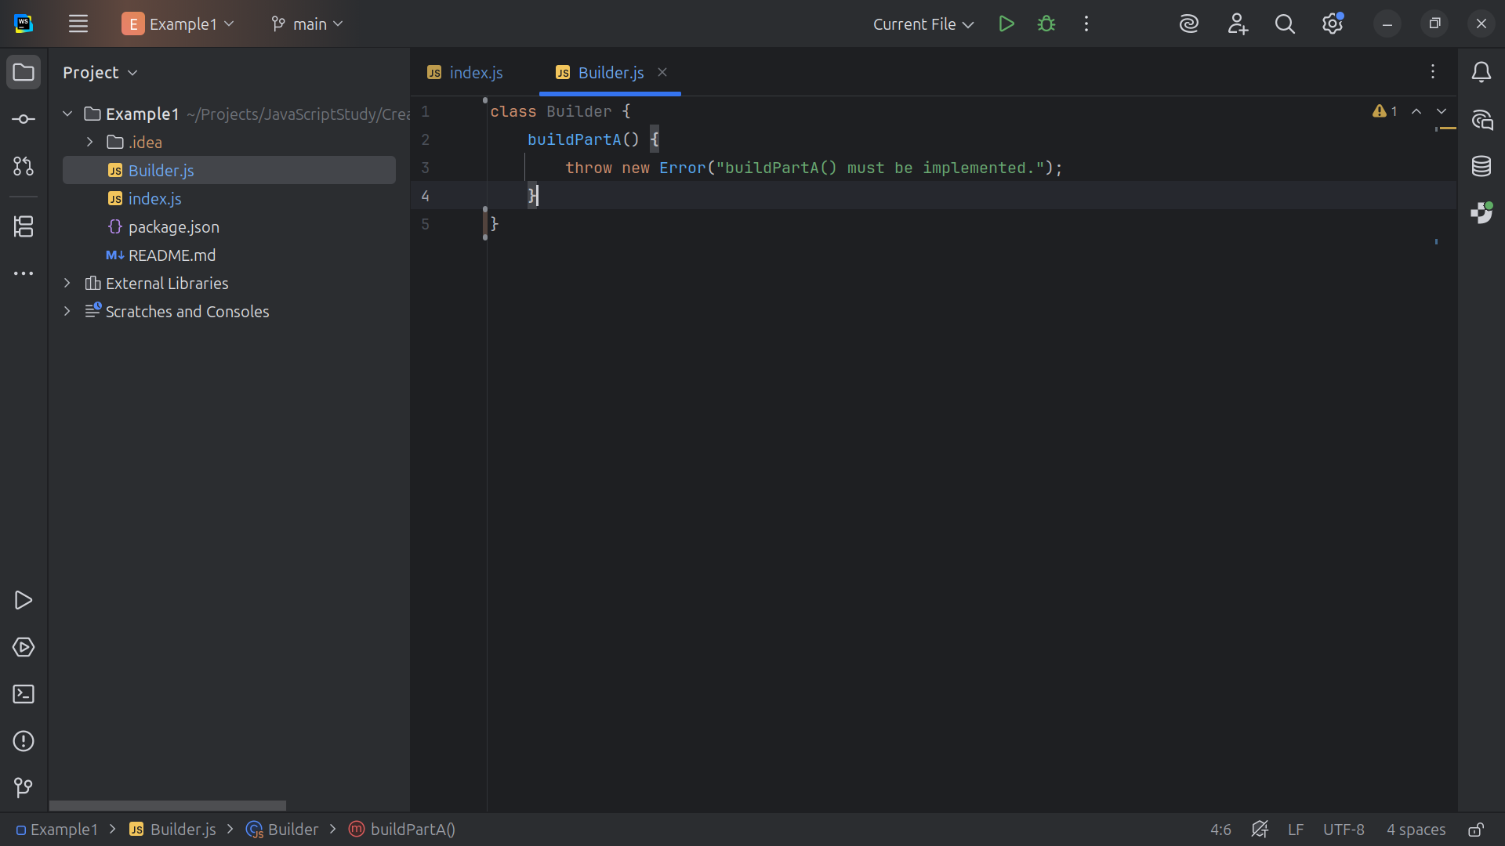
Notes:
We have build Part A which must be implemented

Slide 6
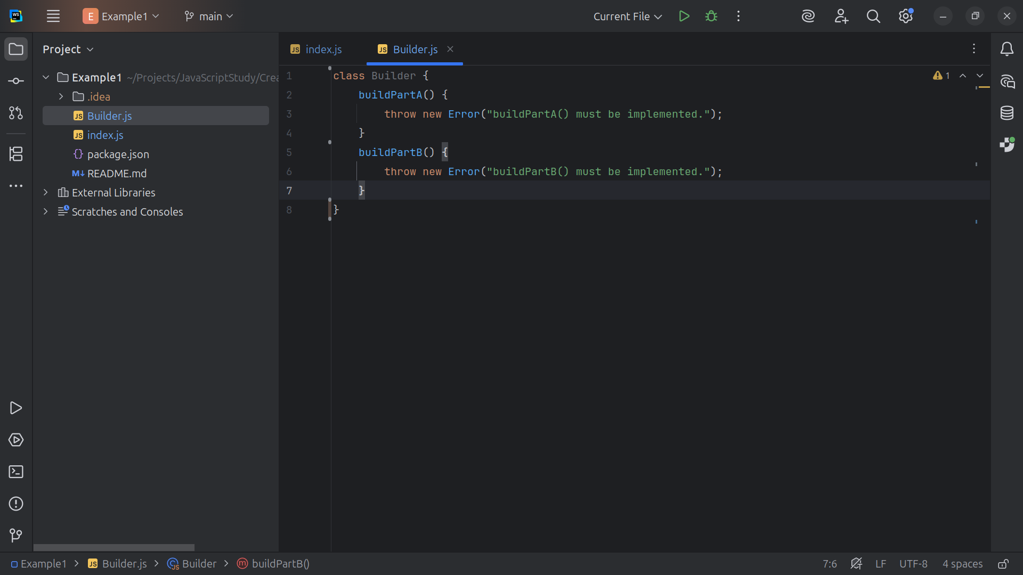
Notes:
And build Part B which too must be implented

Slide 7
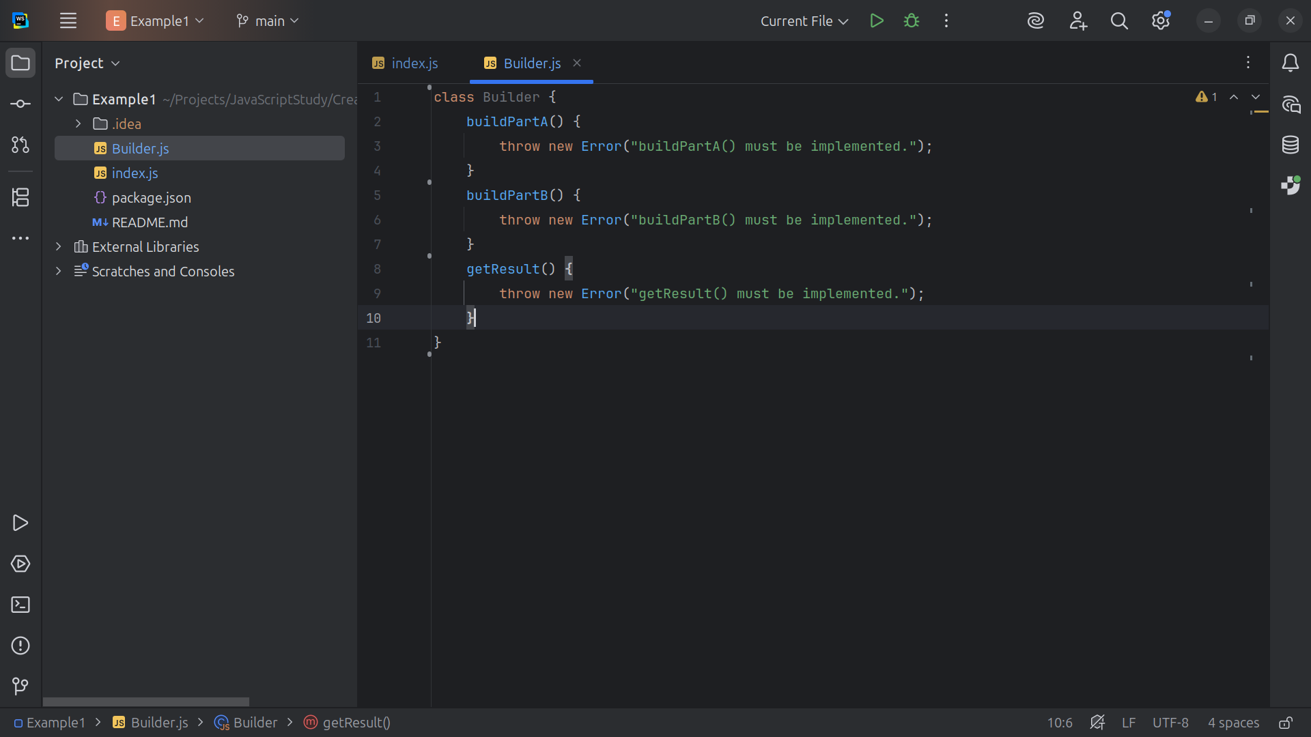
Notes:
And in the end we get the result

Slide 8
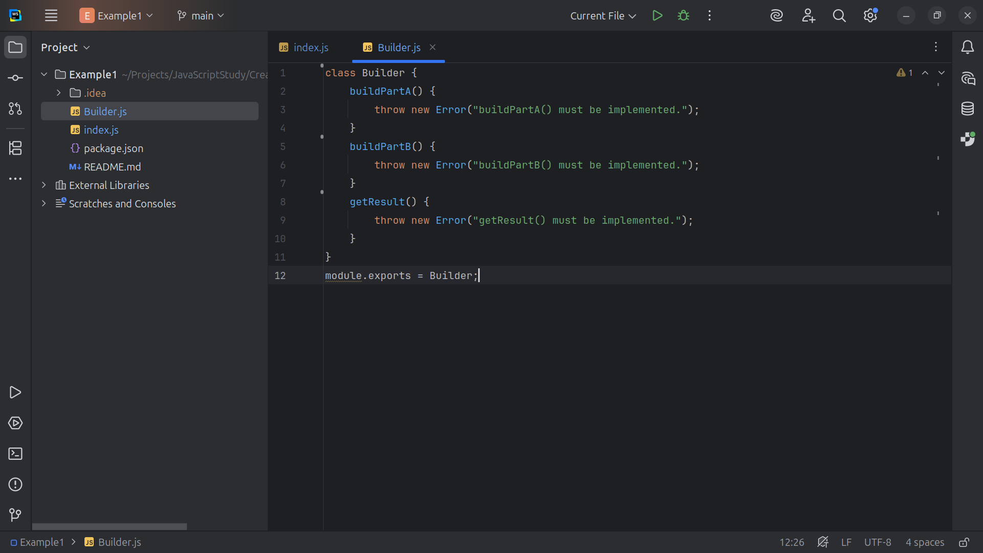
Notes:
Let’s export this module as Builder

Slide 9
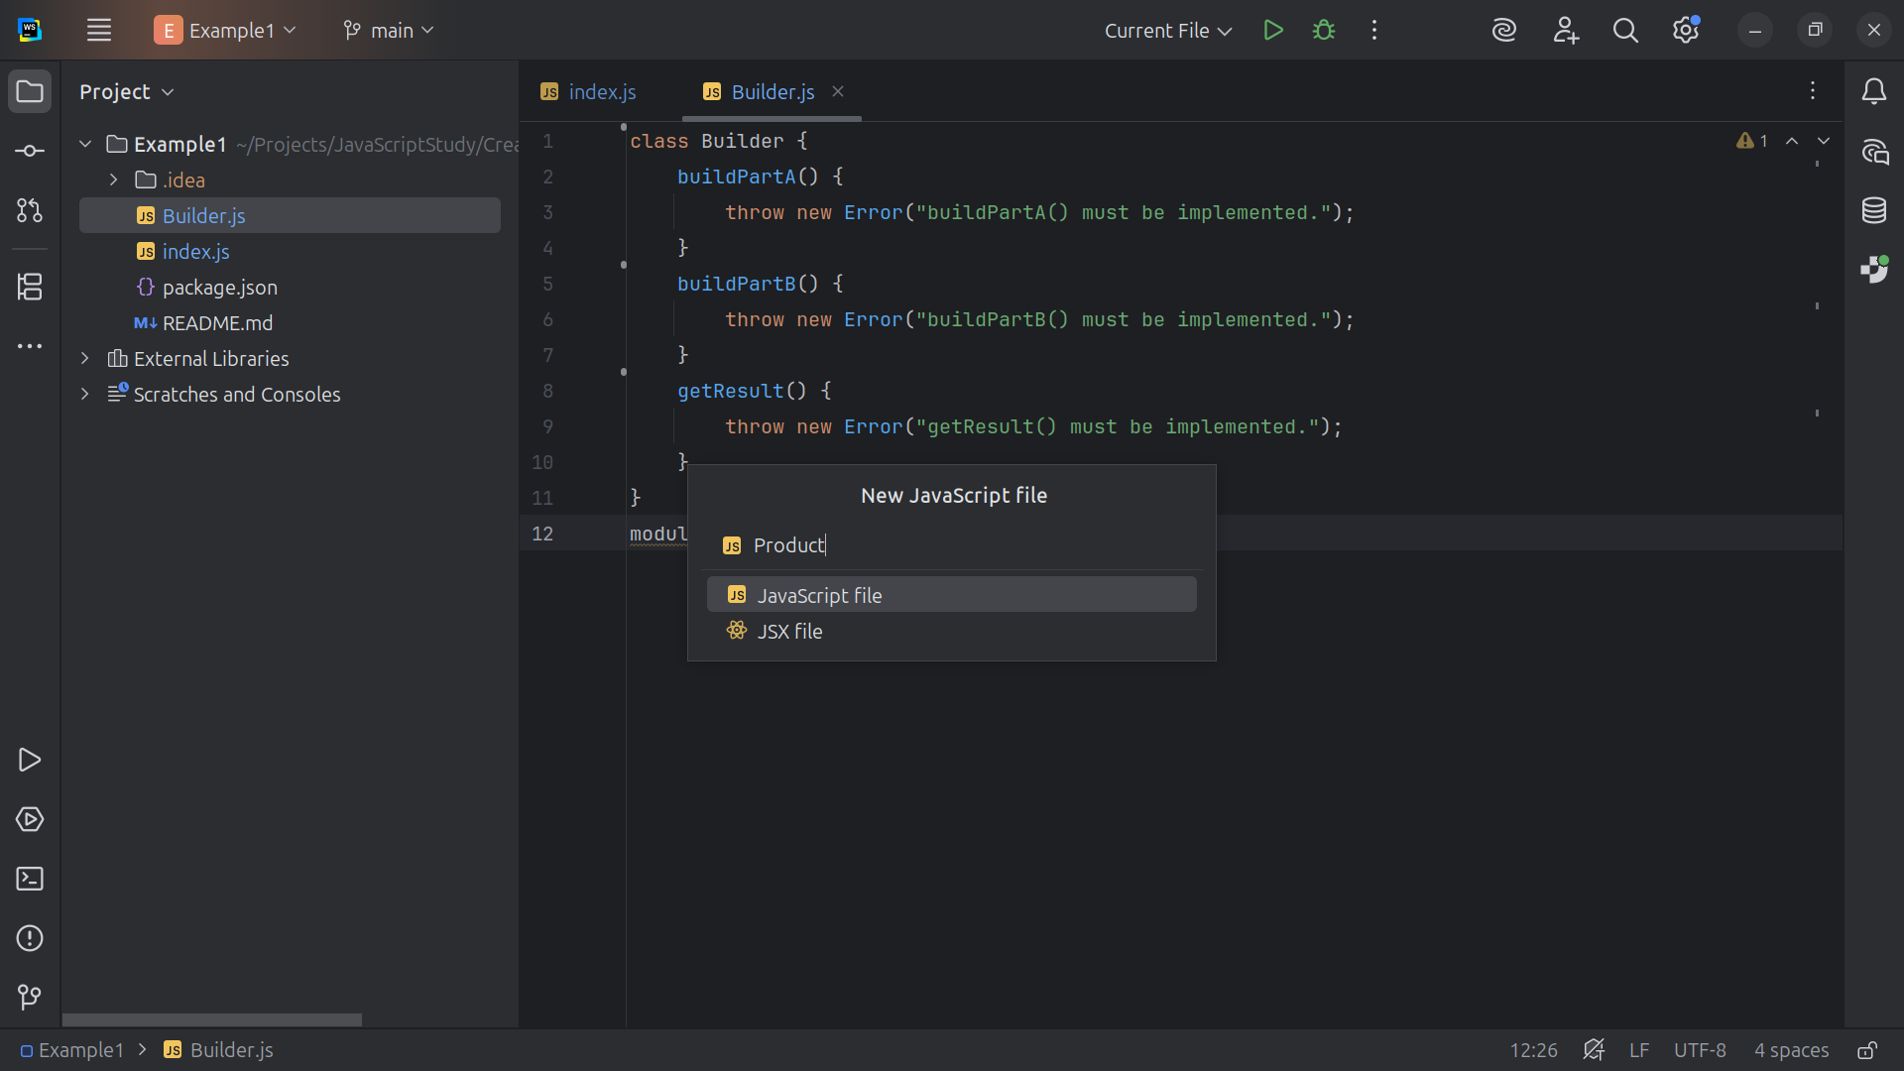
Notes:
Let’s create another class we call Product

Slide 10
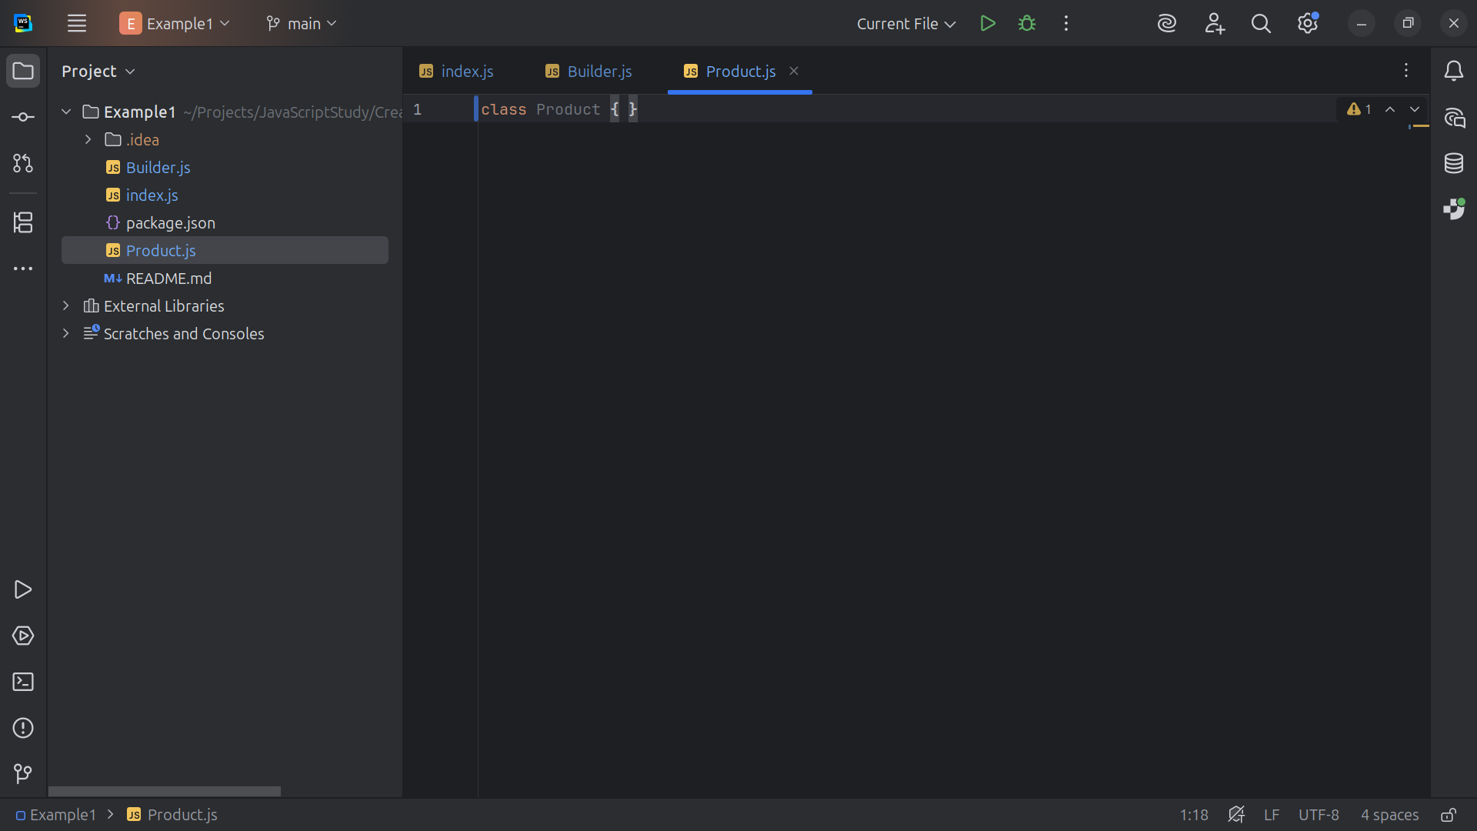
Notes:
Product Represents the complex object being built. It Stores parts and knows how to display itself.

Slide 11
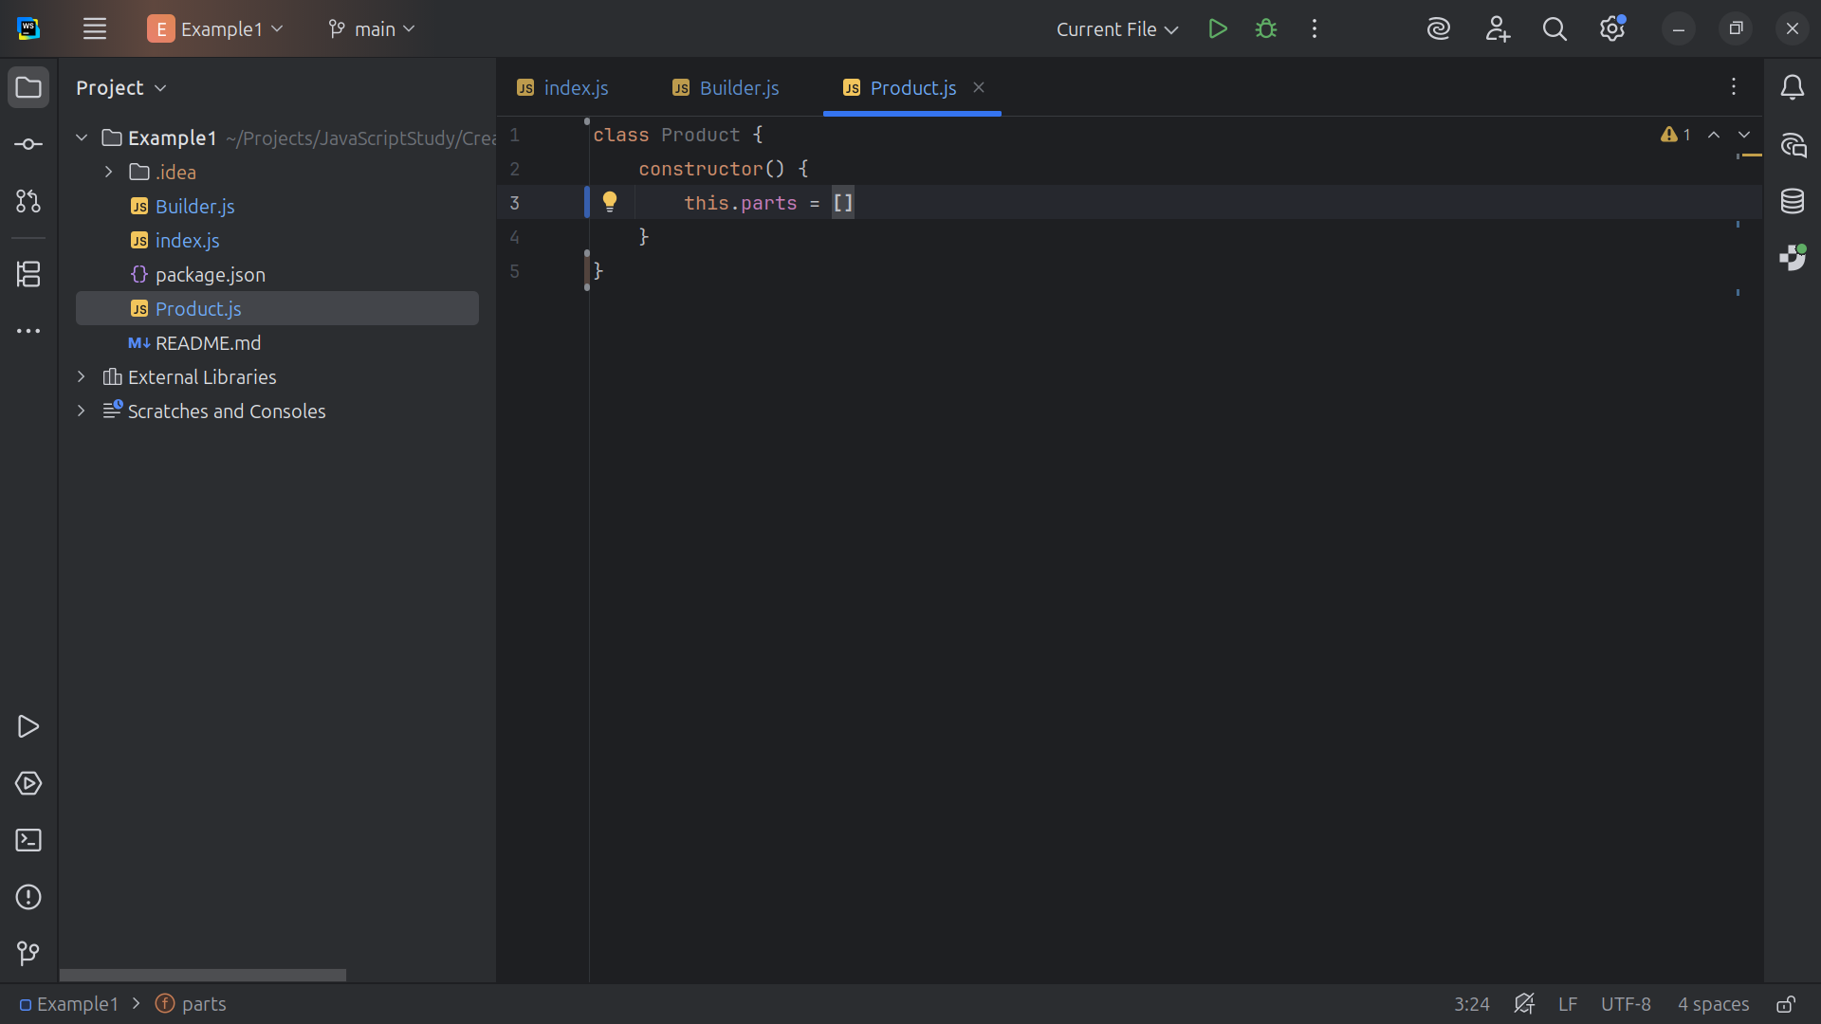
Notes:
We start with a constructor array of parts list

Slide 12
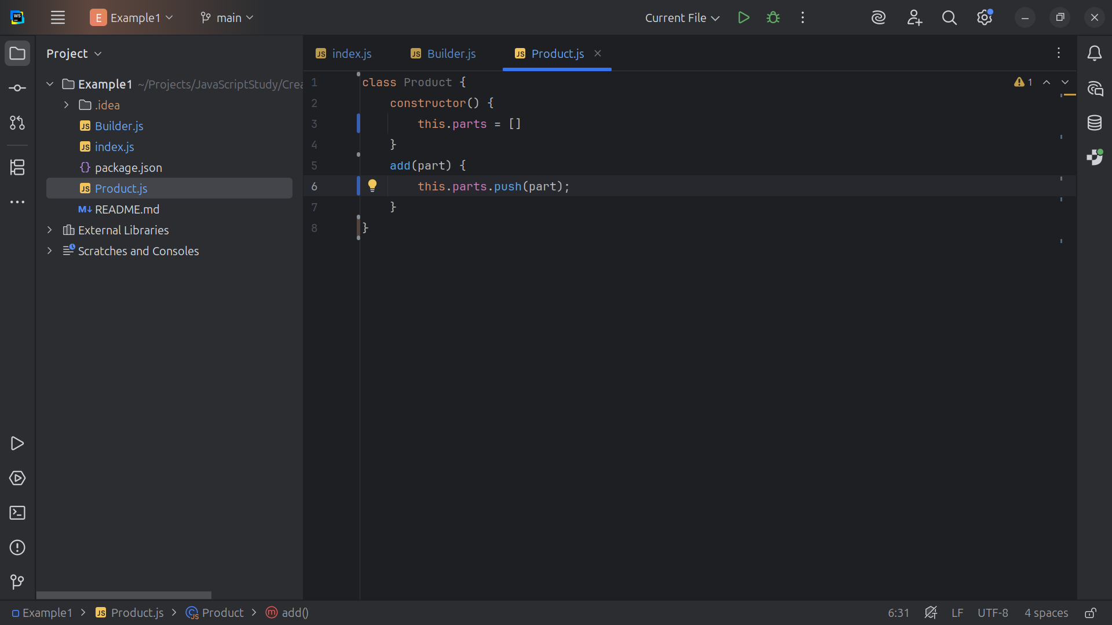
Notes:
And we a have a method to add parts to the list array

Slide 13
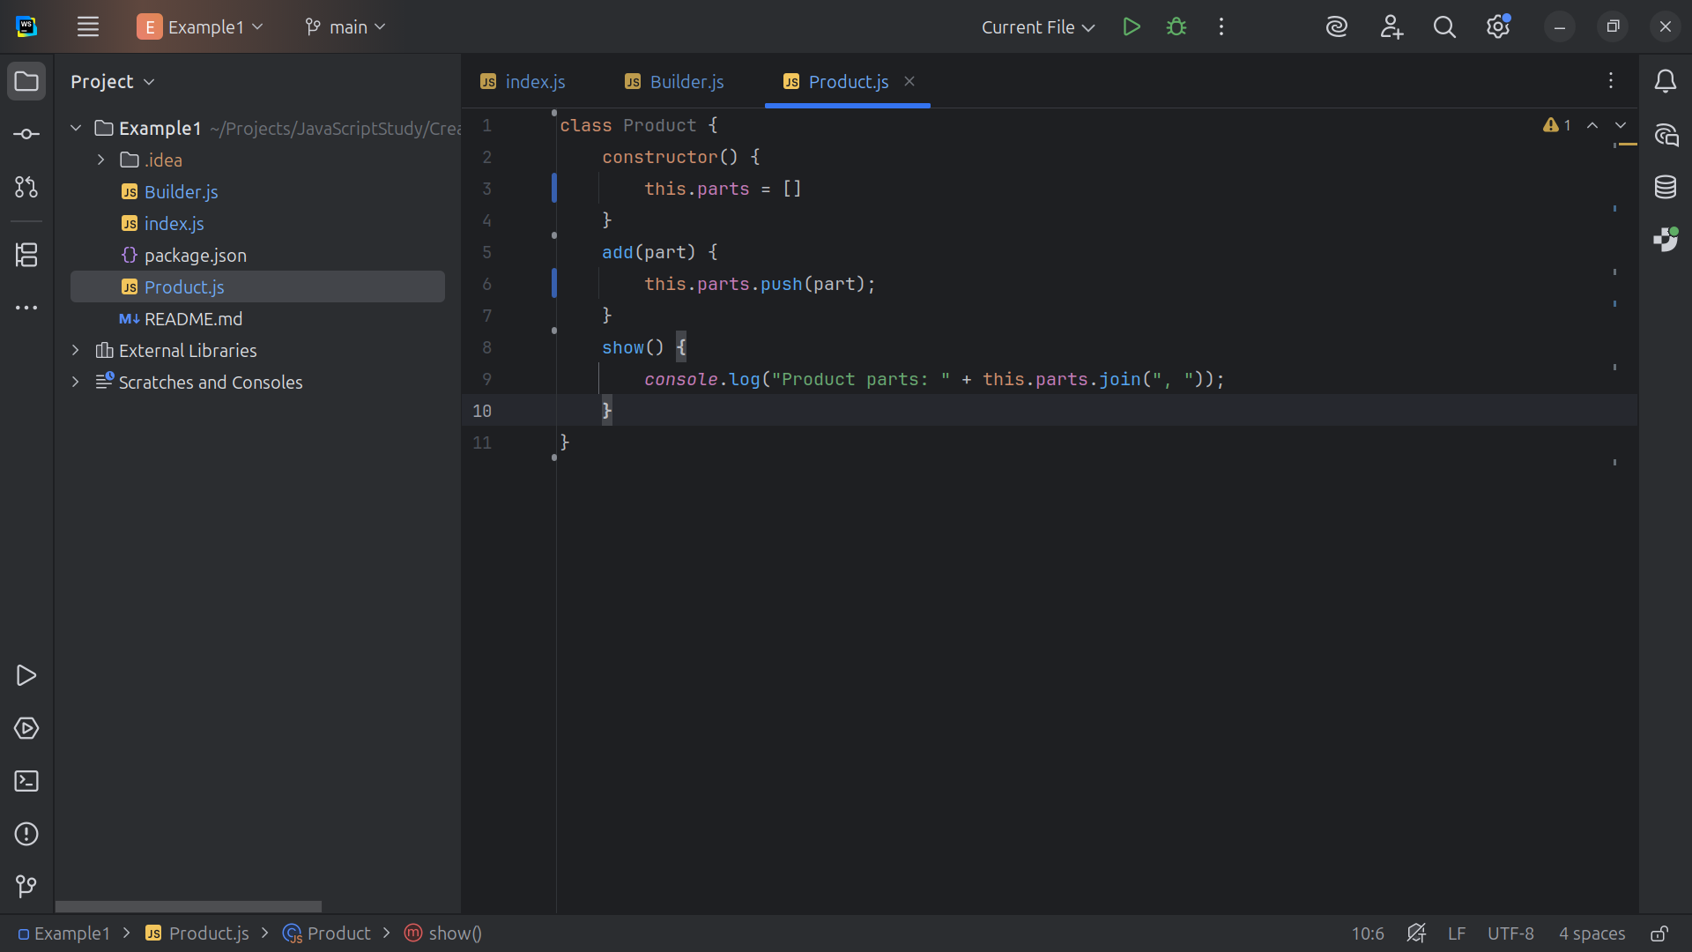
Notes:
We have a show method to display the parts to the console

Slide 14
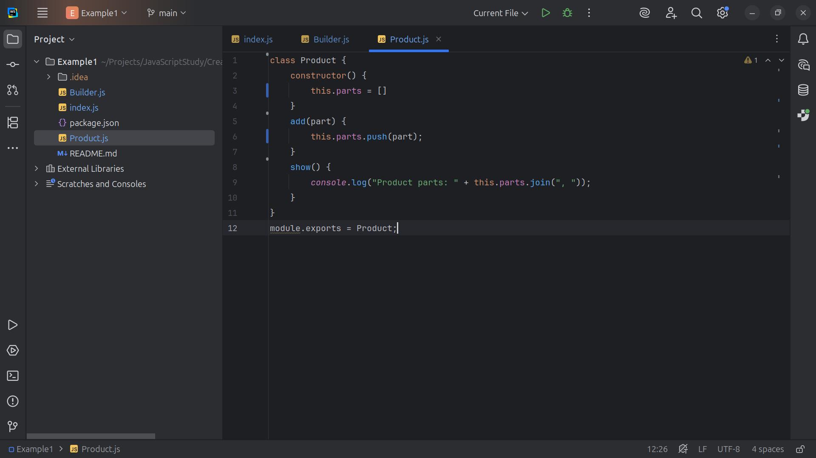
Notes:
And we close this module for export to demonstration

Slide 15
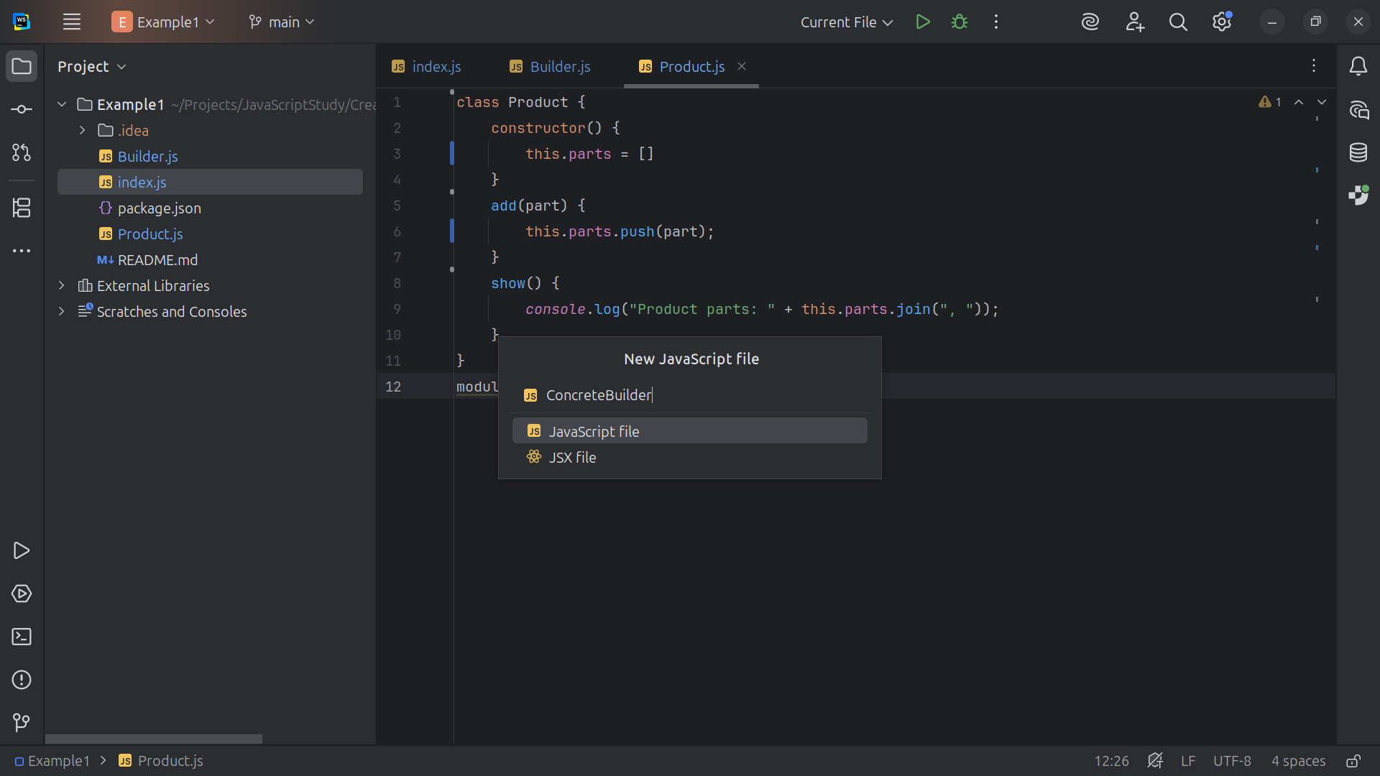
Notes:
The next class I want to create is the Concrete Builder

Slide 16
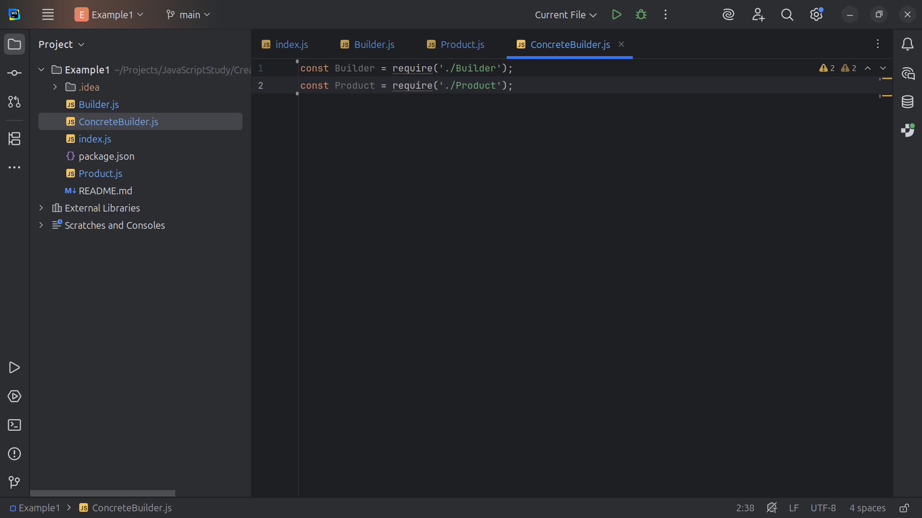
Notes:
At the top we require Builder and Product

Slide 17
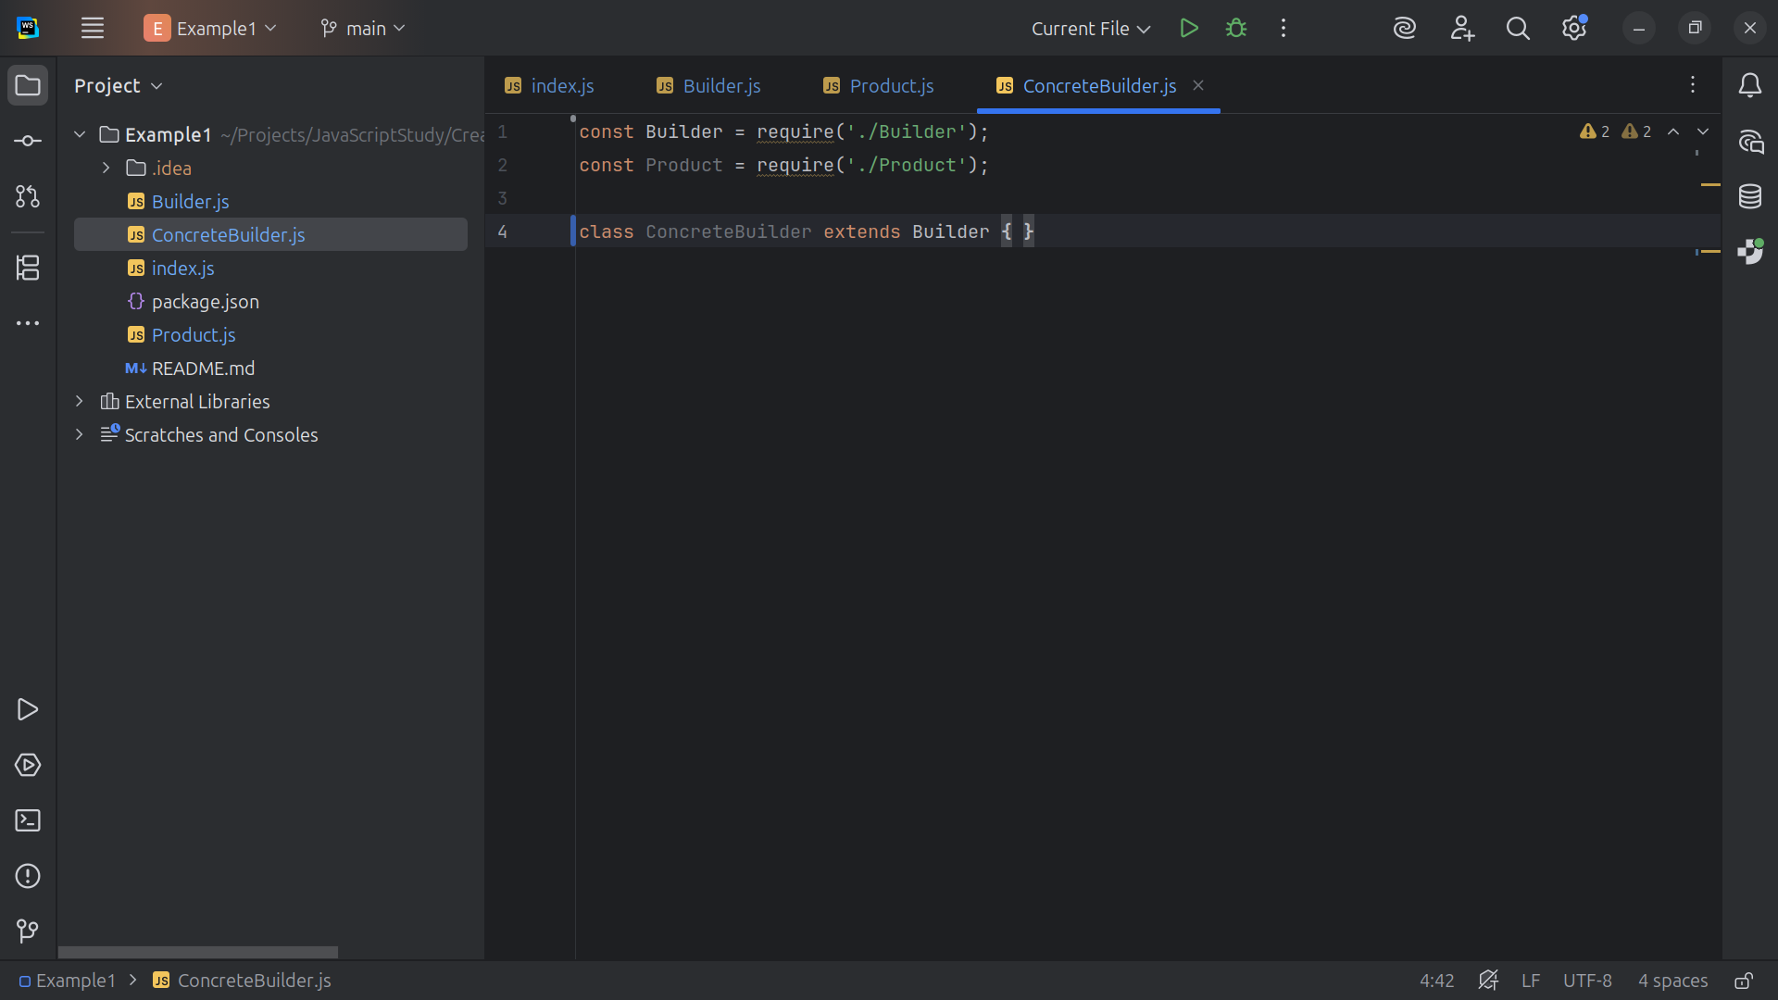
Notes:
We extend this class with the Builder interface

Slide 18
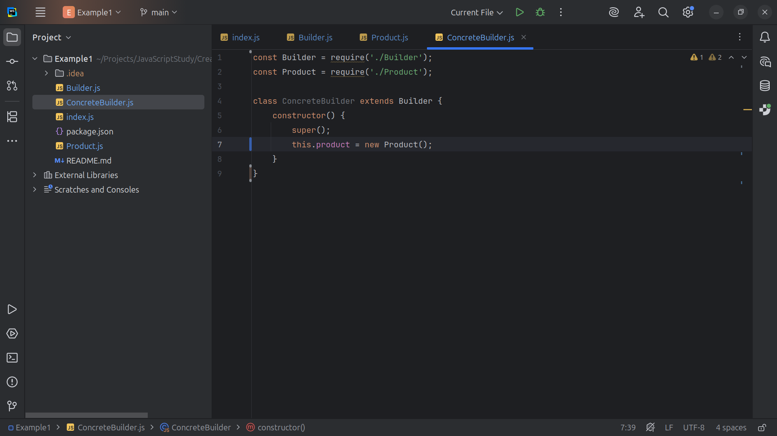
Notes:
For constructor we call super and set this dot product to a new Product

Slide 19
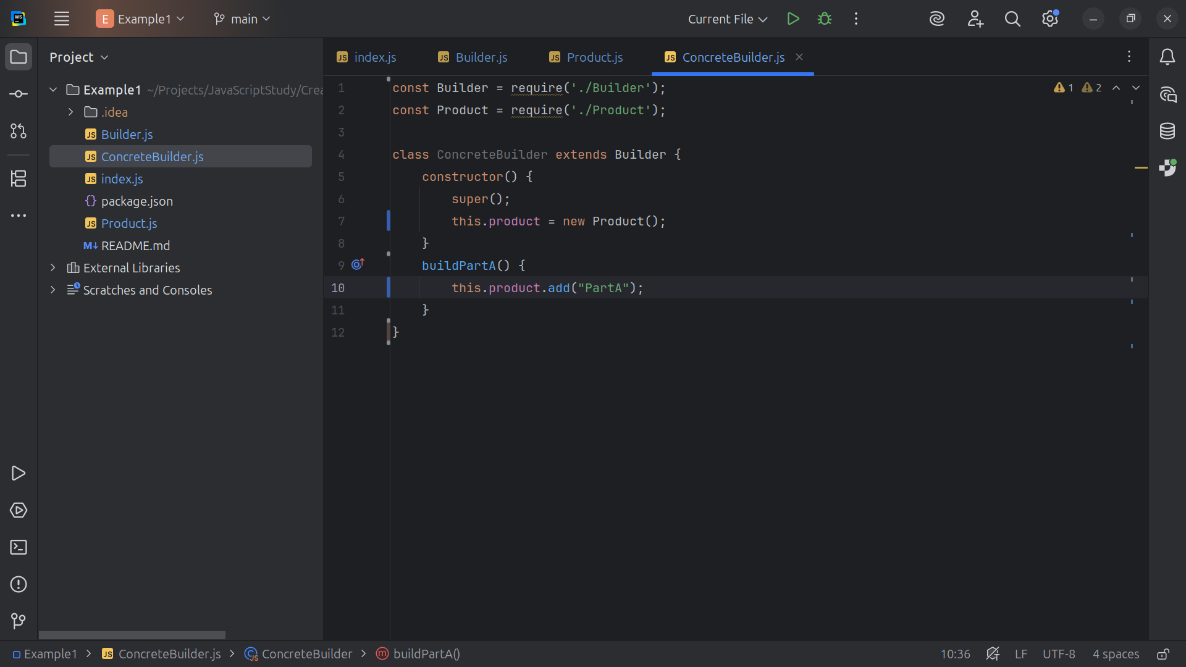
Notes:
We take that product and add Part A to it

Slide 20
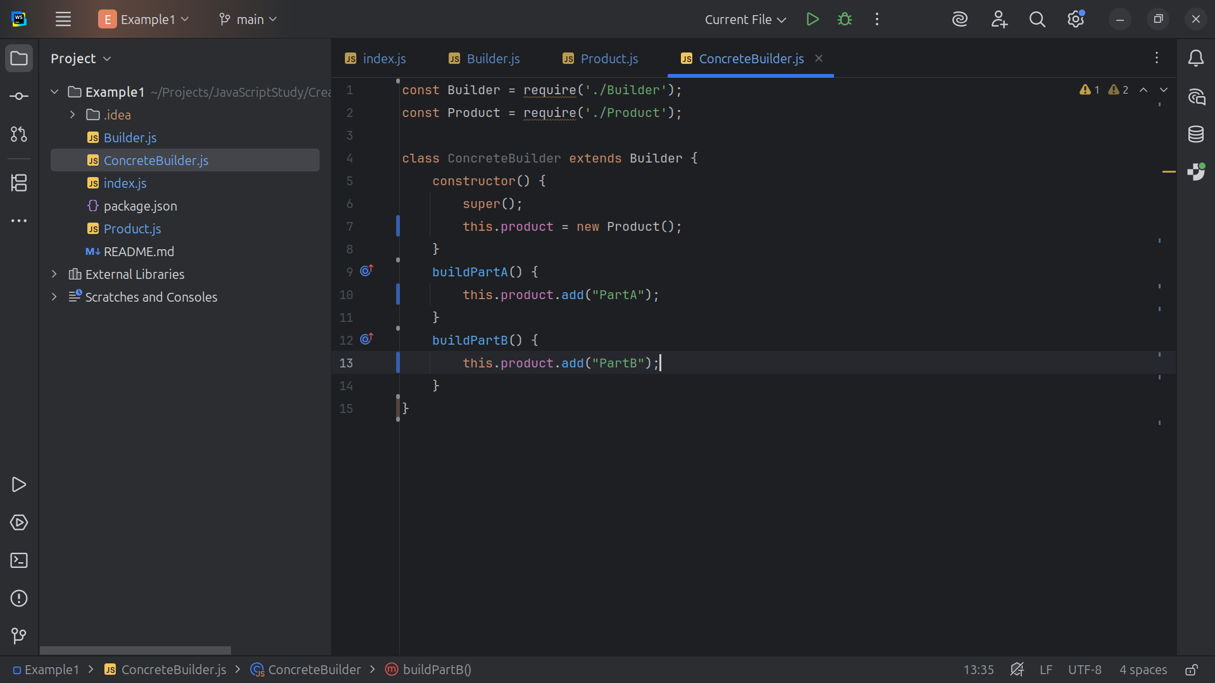
Notes:
And then we add part B to it

Slide 21
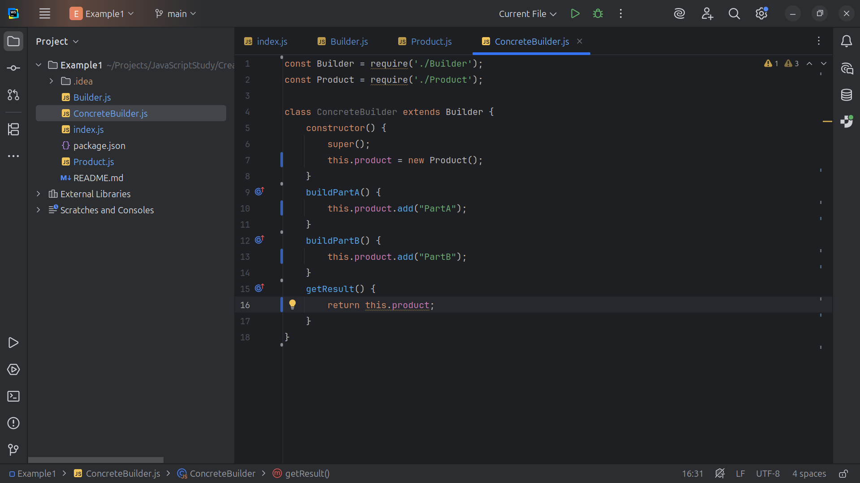
Notes:
And we get result the full product

Slide 22
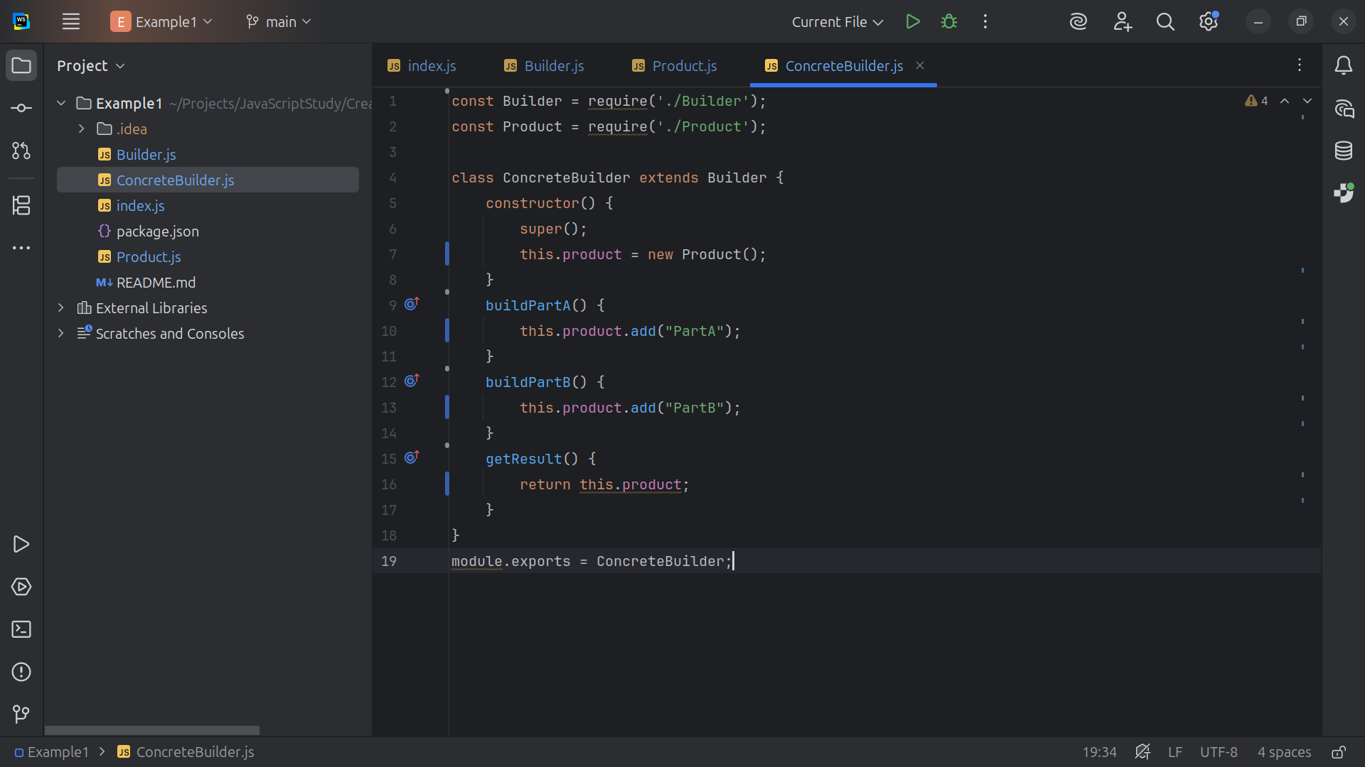
Notes:
And we export this module as Concrete Builder

Slide 23
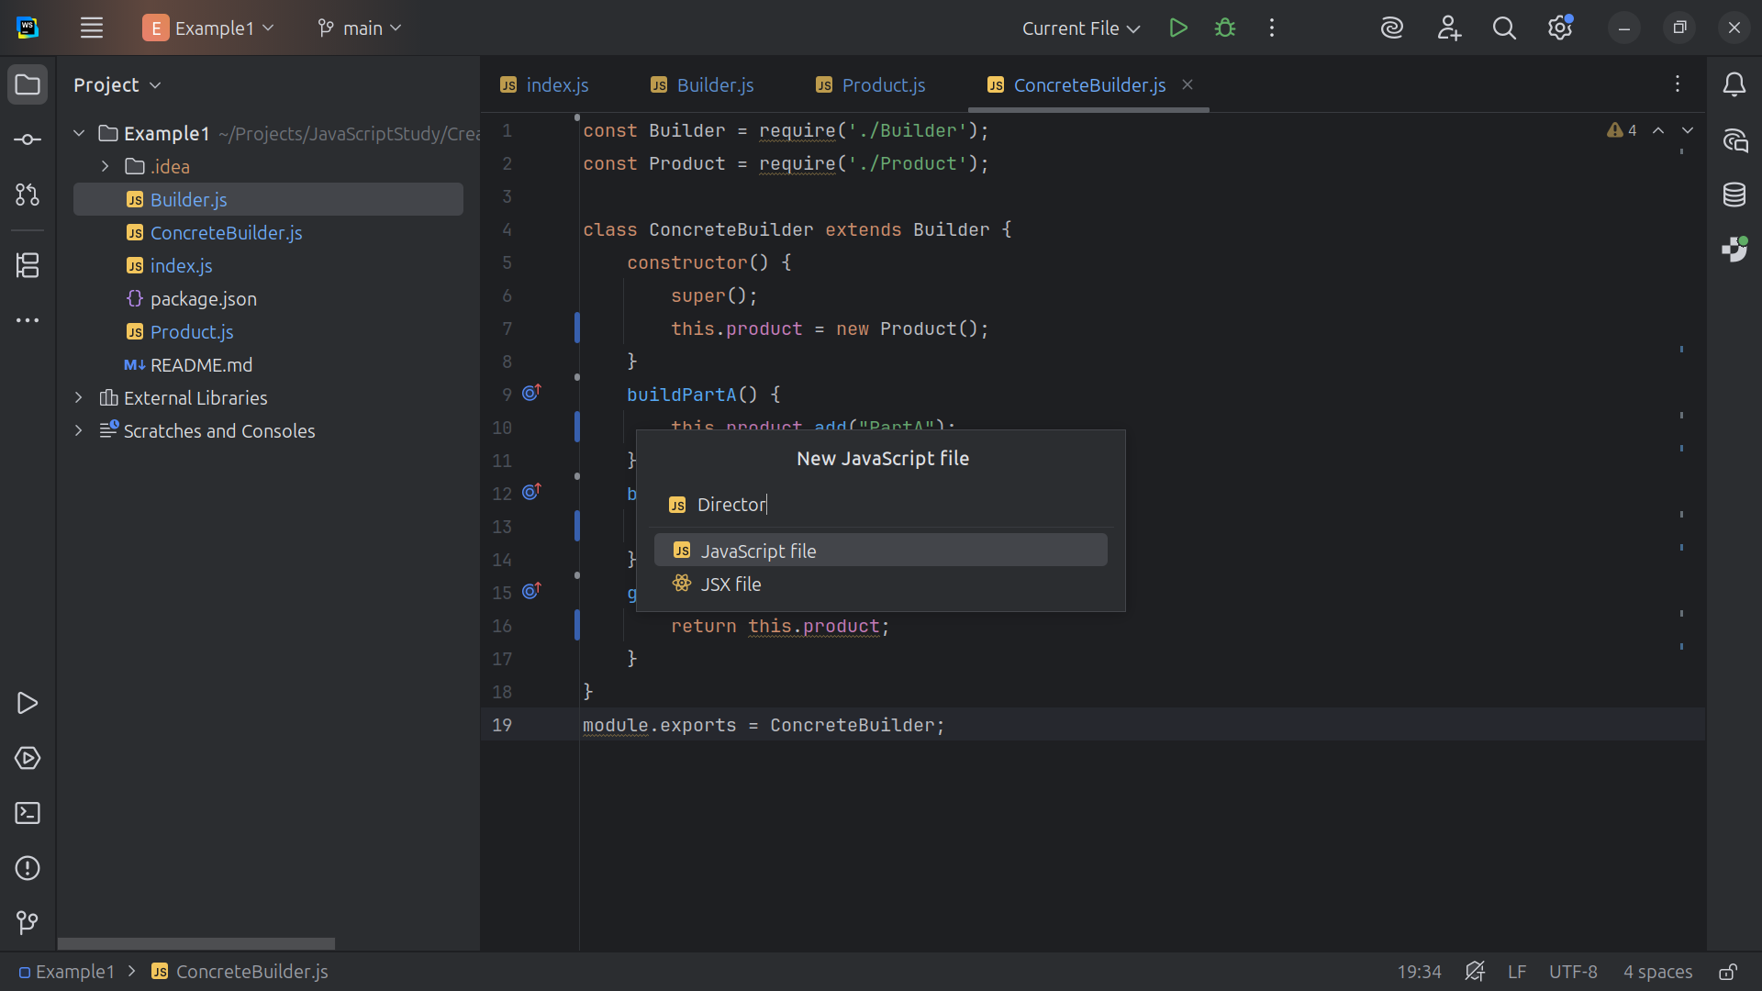
Notes:
Now let’s create a Director class

Slide 24
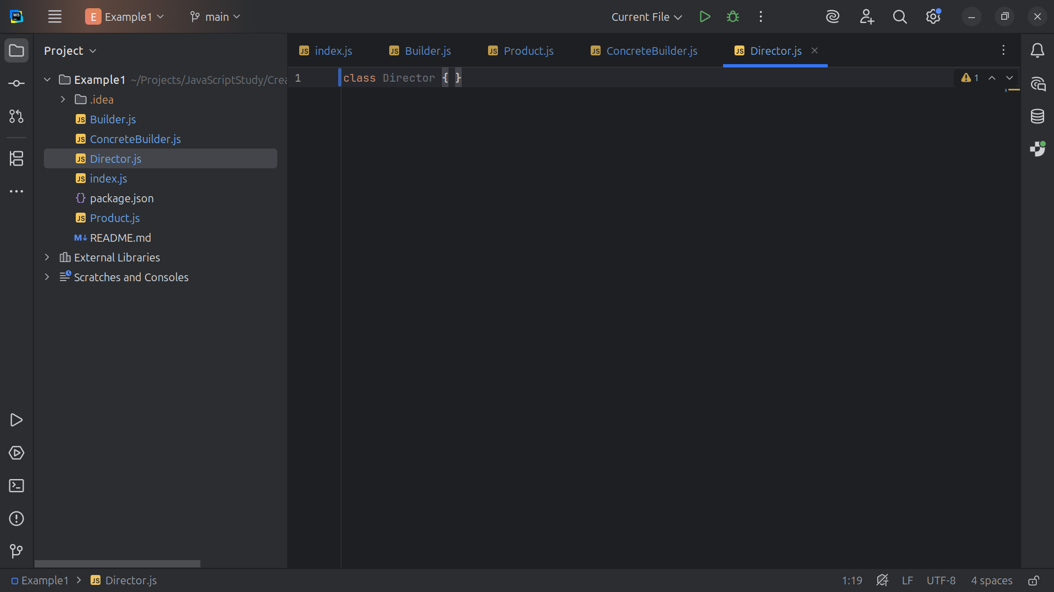
Notes:
The Director class Controls the building process. It doesn't know how the parts are created, it just orchestrates the building steps.

Slide 25
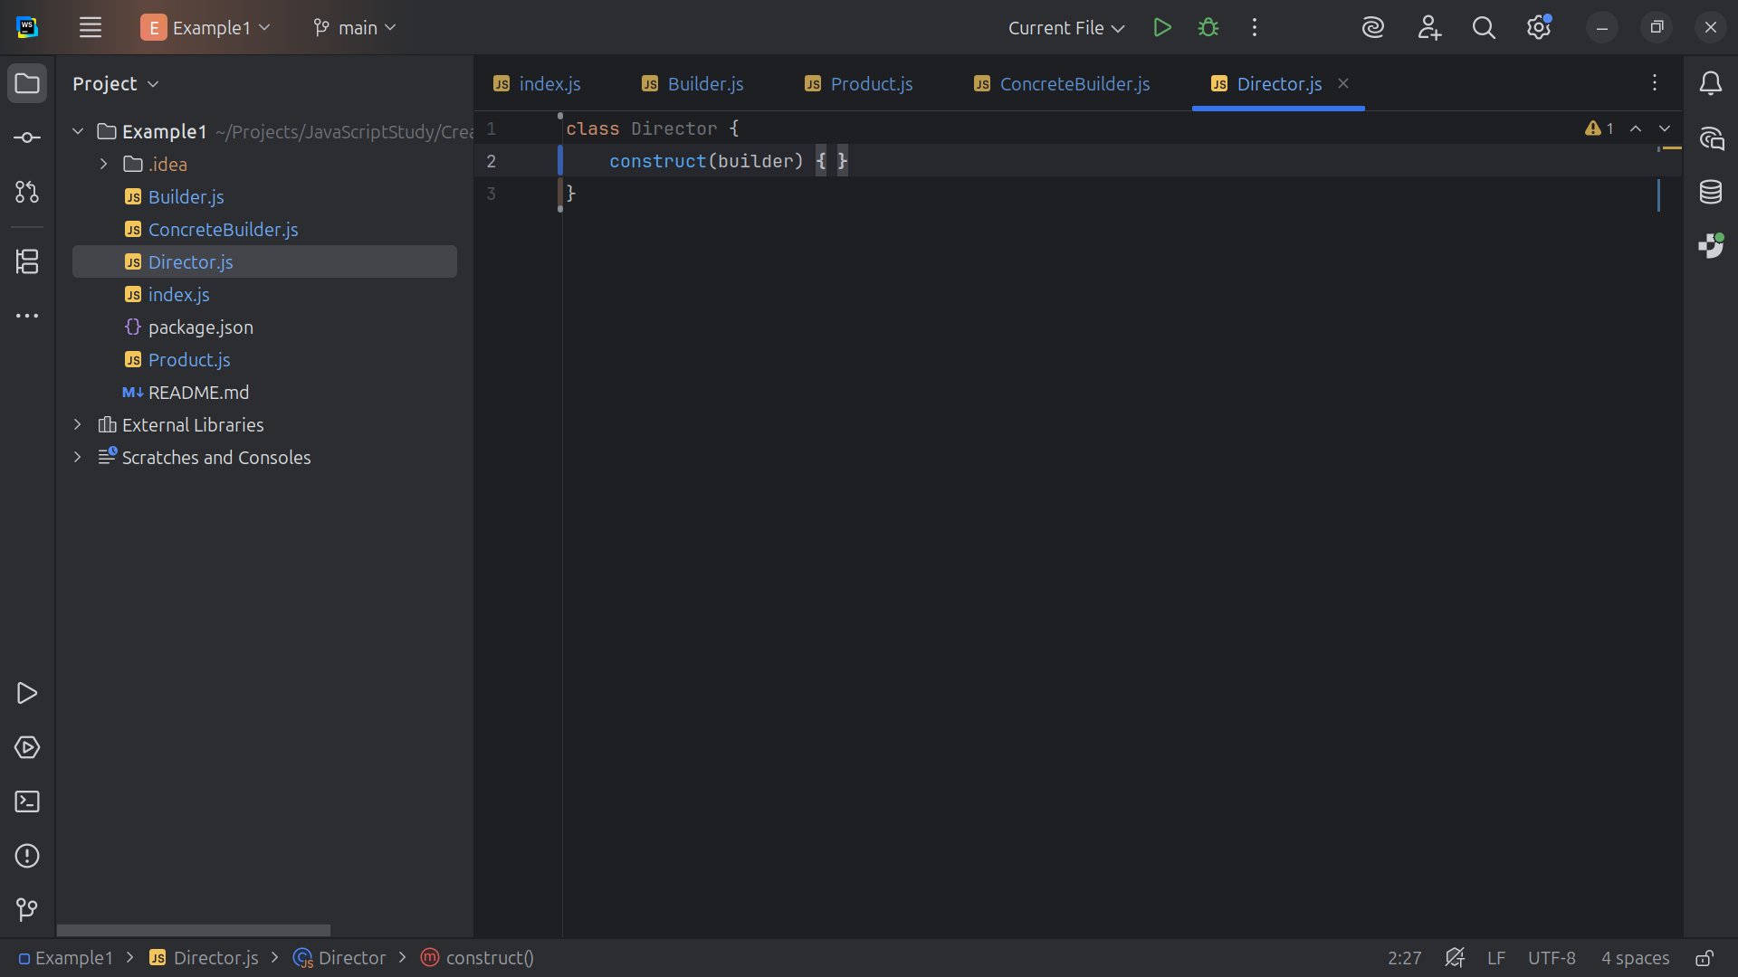
Notes:
We have the construct method which takes a builder object

Slide 26
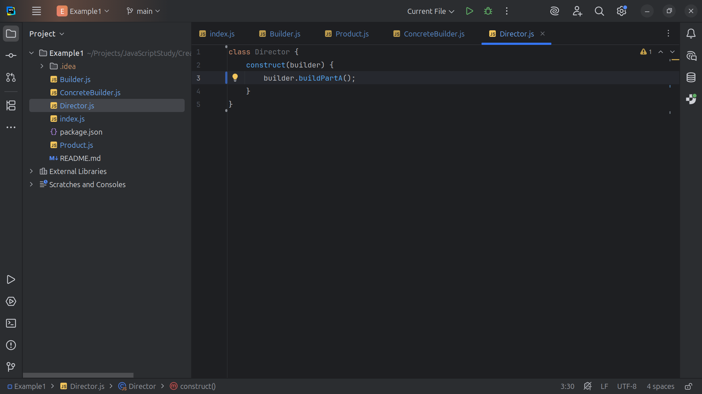
Notes:
With the Build object we Build Part A

Slide 27
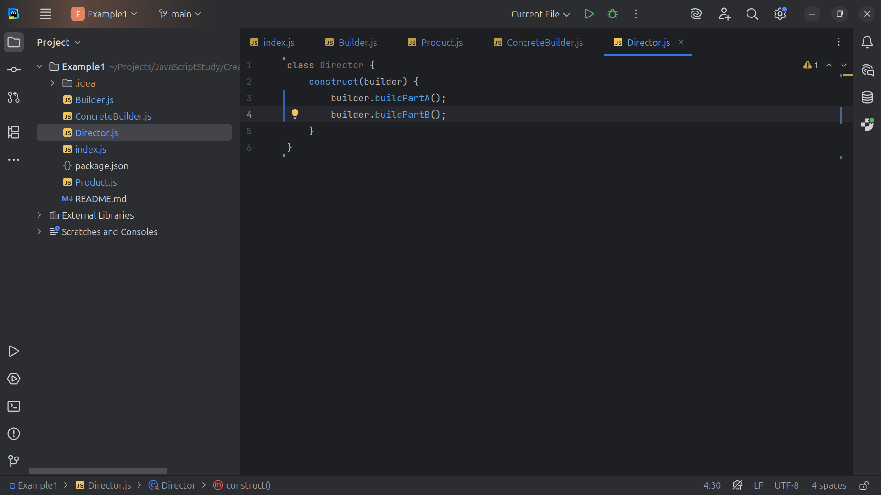
Notes:
And we build Part B

Slide 28
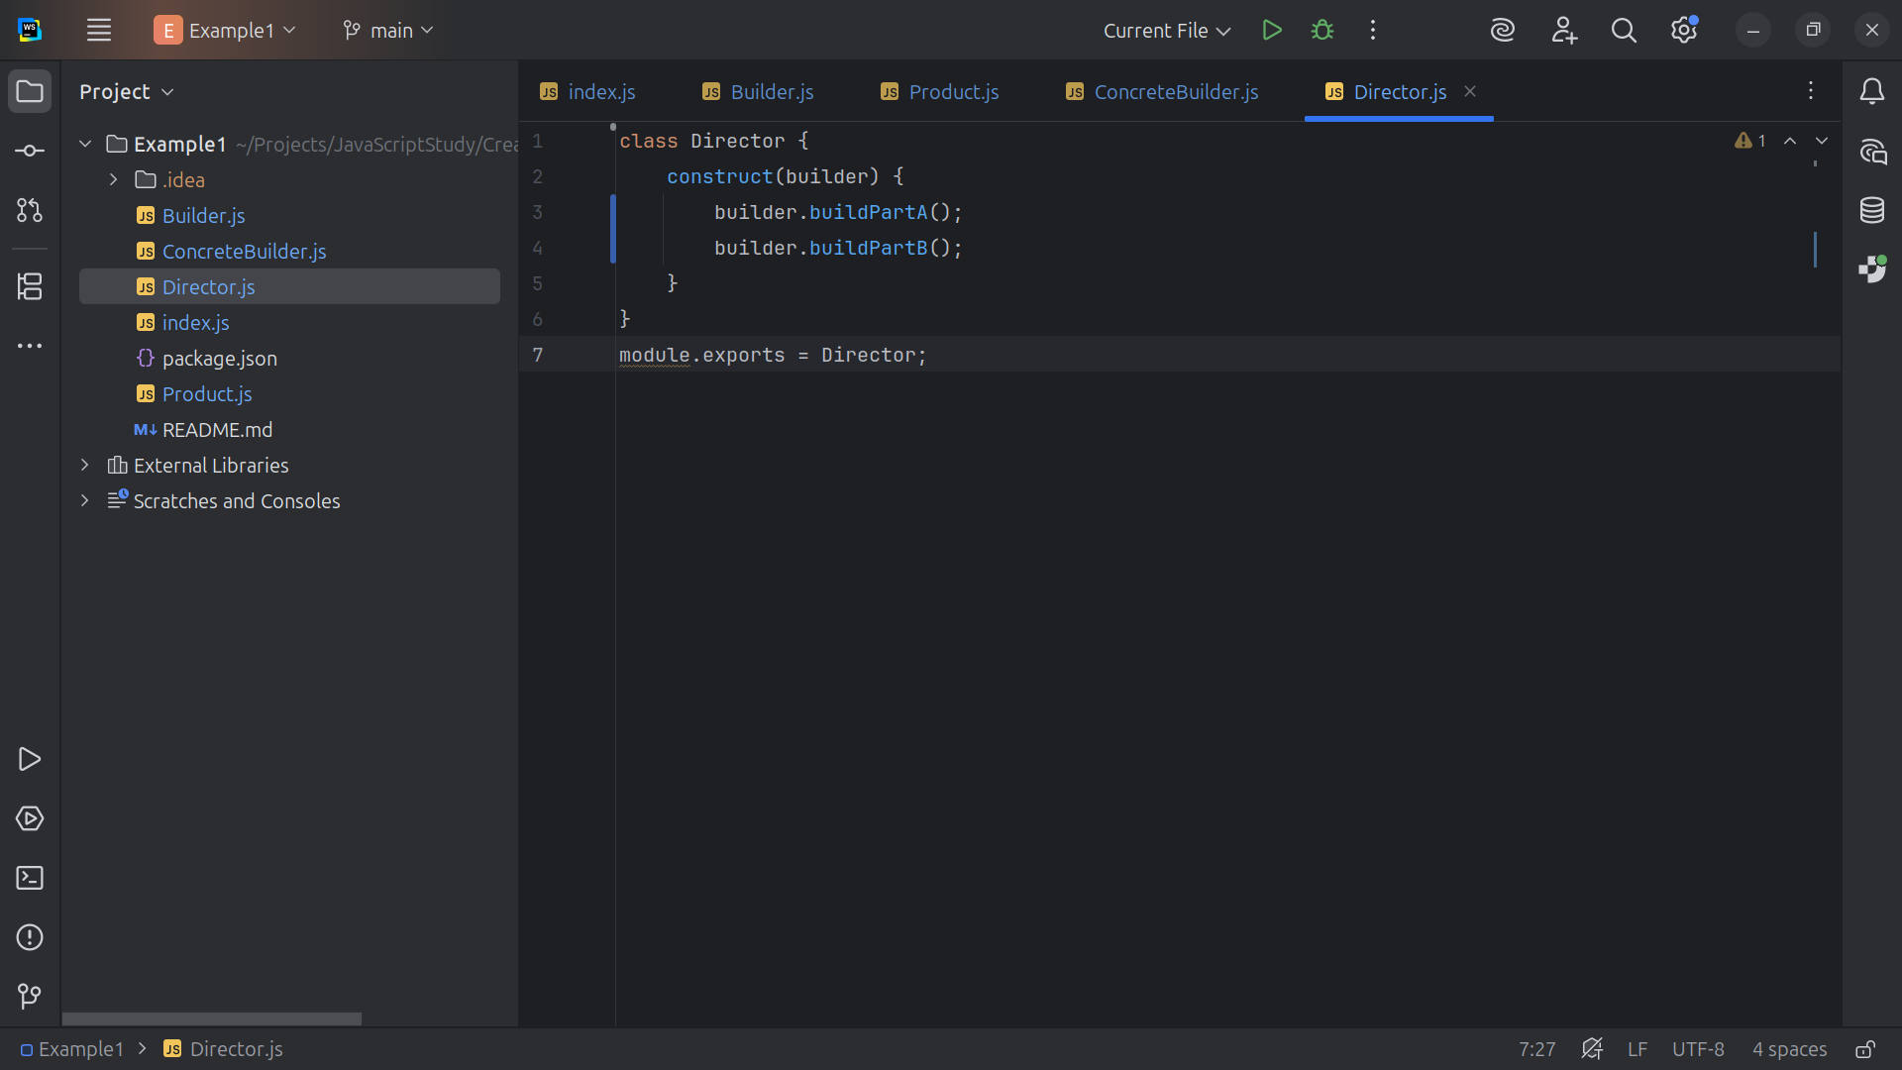
Notes:
Let’s export our module as Director

Slide 29
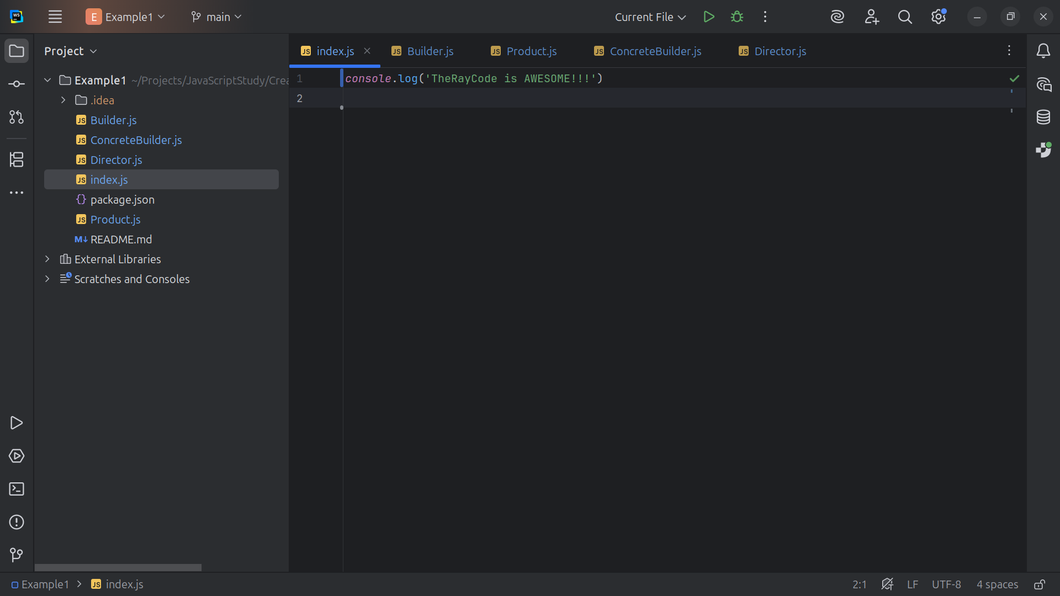
Notes:
Now we are ready for our demo we go to the index page

Slide 30

Notes:
At the top we require the Concrete Builder and the Director

Slide 31
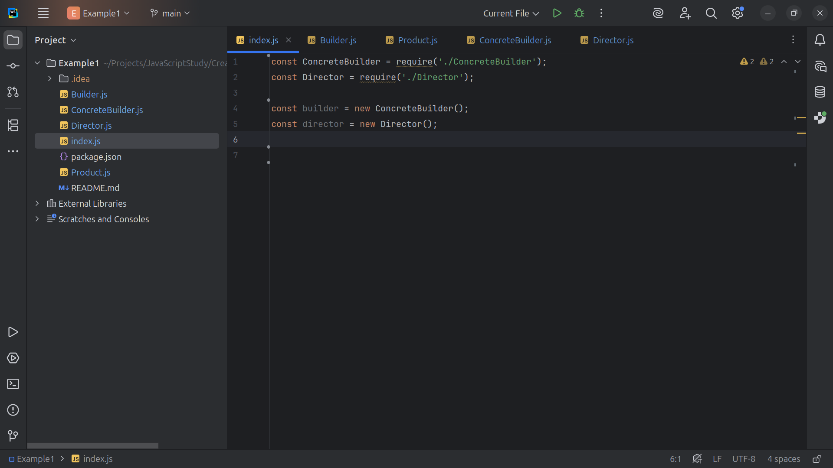
Notes:
We set builder to a new Concrete Builder and director to a new Director

Slide 32
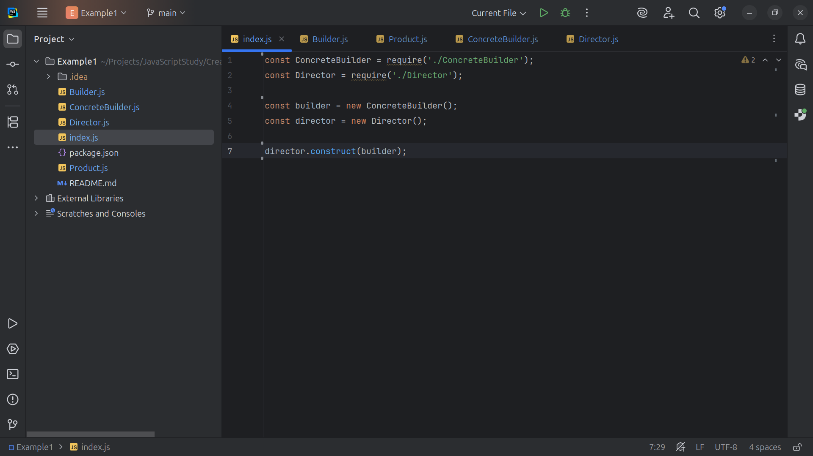
Notes:
The Director builds the product using the builder object

Slide 33
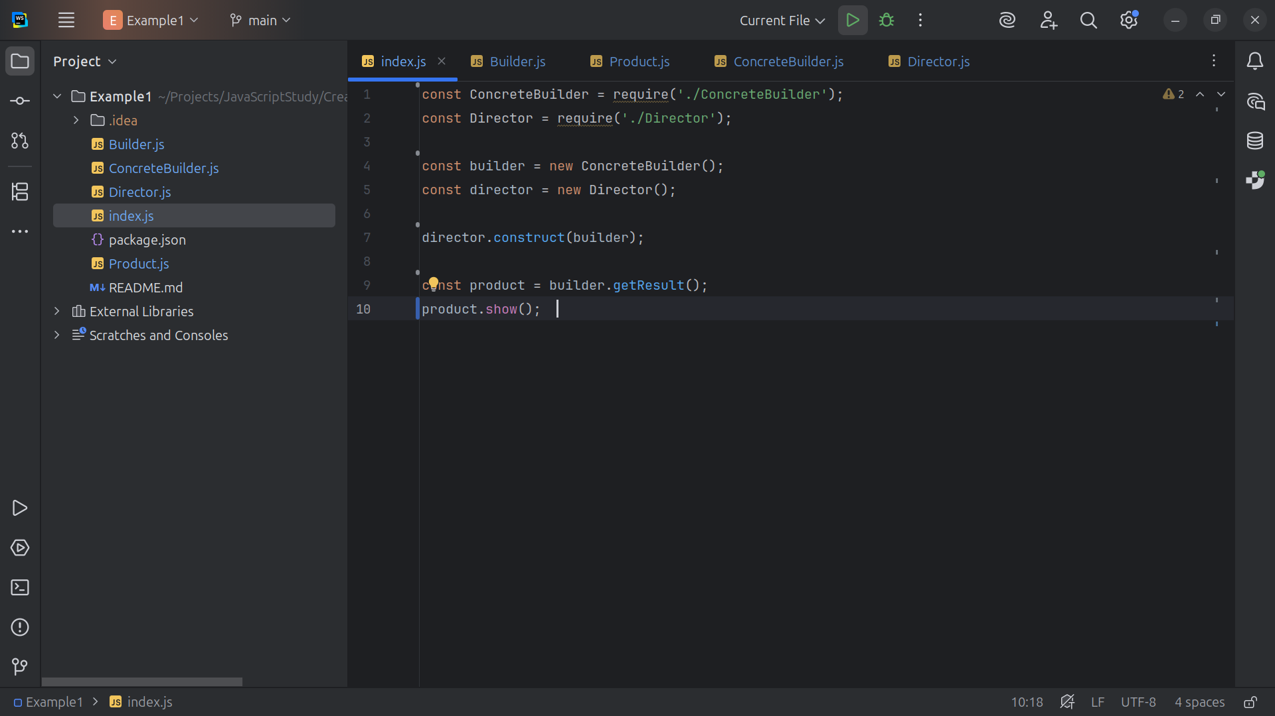
Notes:
We set the product to the builder get Result and we show it.

Slide 34
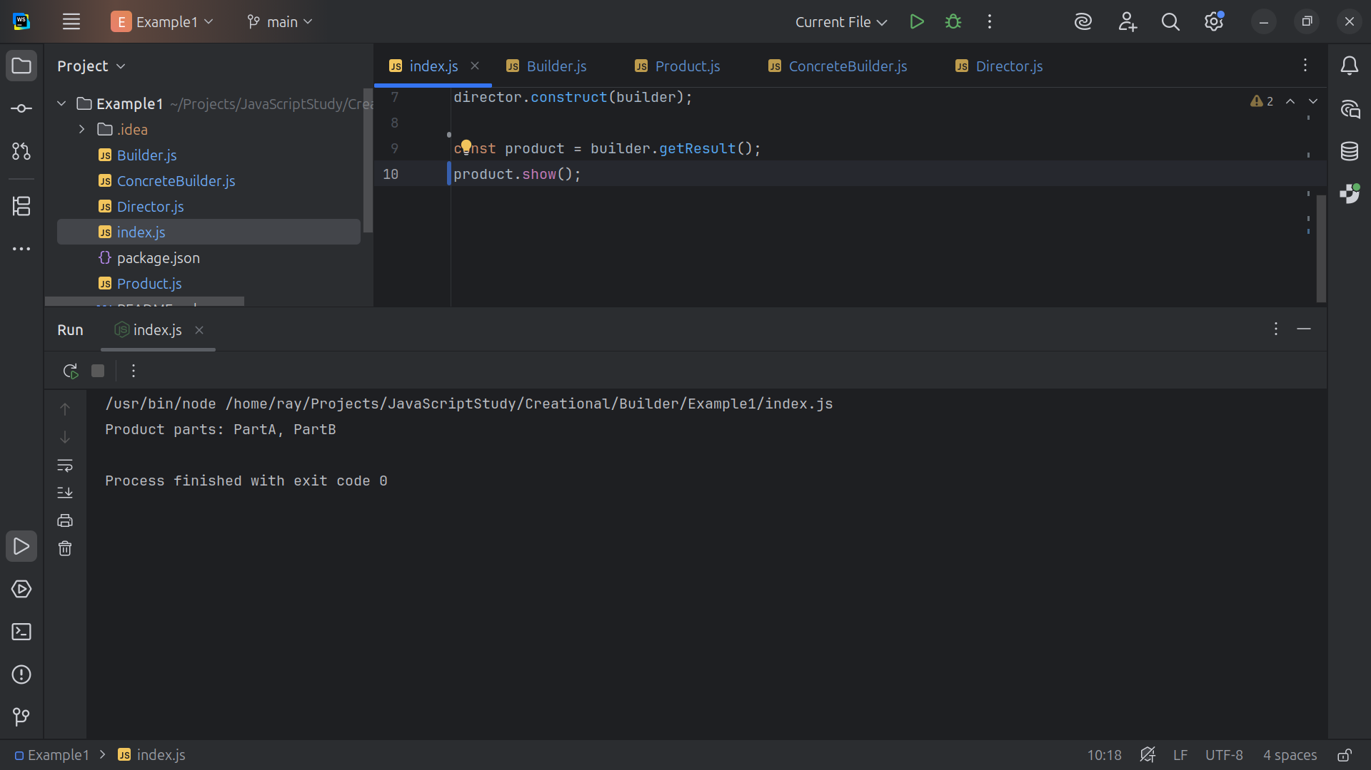
Notes:
Our result is Product parts: Part A, Part B Summary
Each part (PartA and PartB) is optional
—builders can be extended to include more components.
The Director is flexible and it can be used indifferent builders to create variations of the product.
In JavaScript, this pattern is handy for constructing complex object configurations (e.g., building HTML elements or configuring database queries).

