Slide 1

Notes:
(no sound)

Slide 2
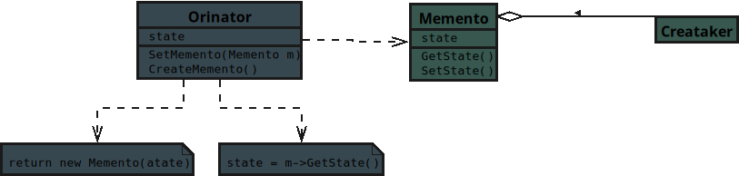
Notes:
The UML diagram for the Behavioral design pattern known as Memento .. JavaScript track

Slide 3
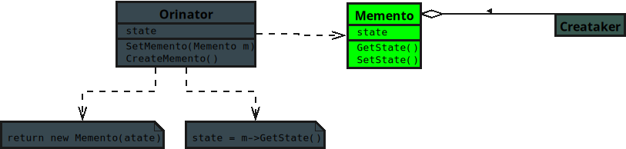
Notes:
**1. Memento**
• Stores the internal state of an object at a specific moment in time.
• Protects that state so it can be restored later without exposing details.
• Think of it like a snapshot that saves your app’s progress so you can roll back if needed.

Slide 4
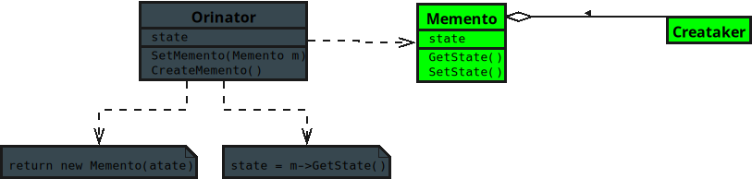
Notes:
**3. Caretaker**
• Keeps track of mementos but never looks inside them.

Slide 5
Notes:
Requests saves and restores from the originator when needed.

Slide 6
Notes:
• It’s like a save manager that stores backups without knowing what’s inside the files.

Slide 7
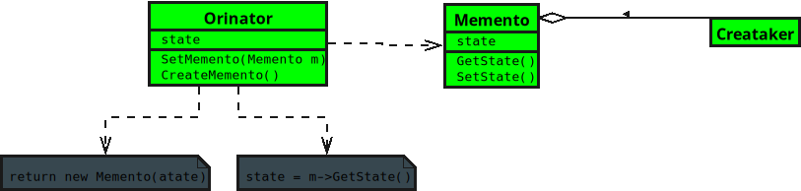
Notes:
No sound

Slide 8
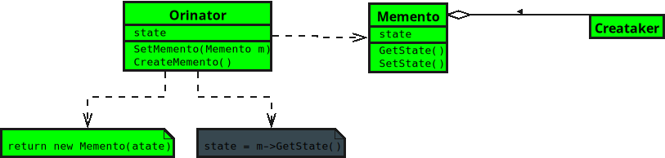
Notes:
No sound

Slide 9
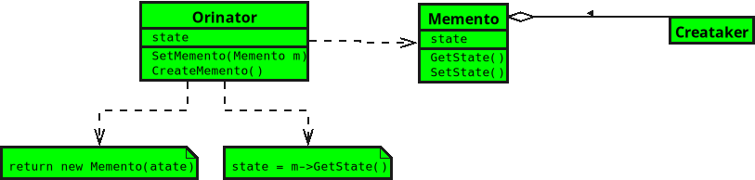
Notes:
**2. Originator**
• Creates a memento containing its current state.
• Can use that memento later to restore itself to a previous state.
• It’s like a text editor that remembers what your document looked like before you hit “undo.”

