Slide 1
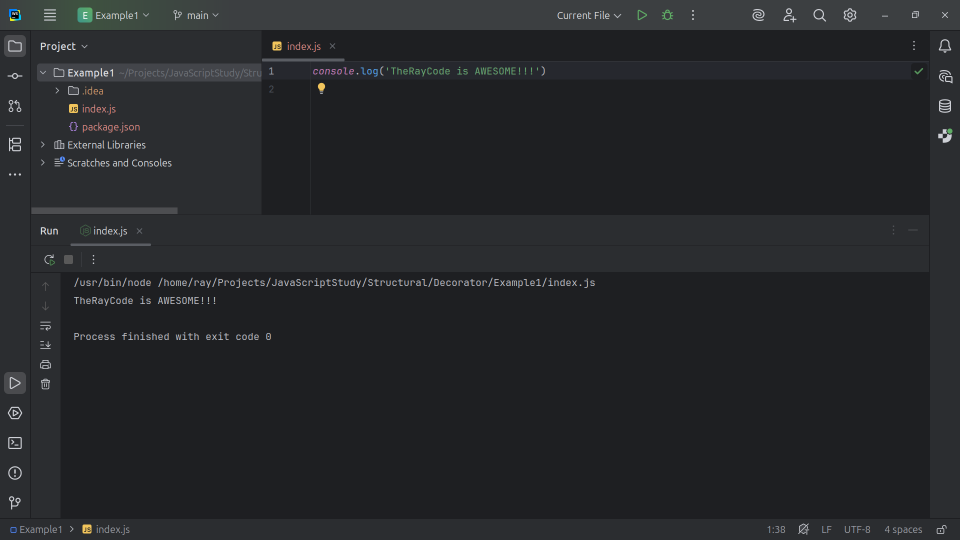
Notes:
Hello my name is Ray, I’m the Ray in TheRayCode

Slide 2
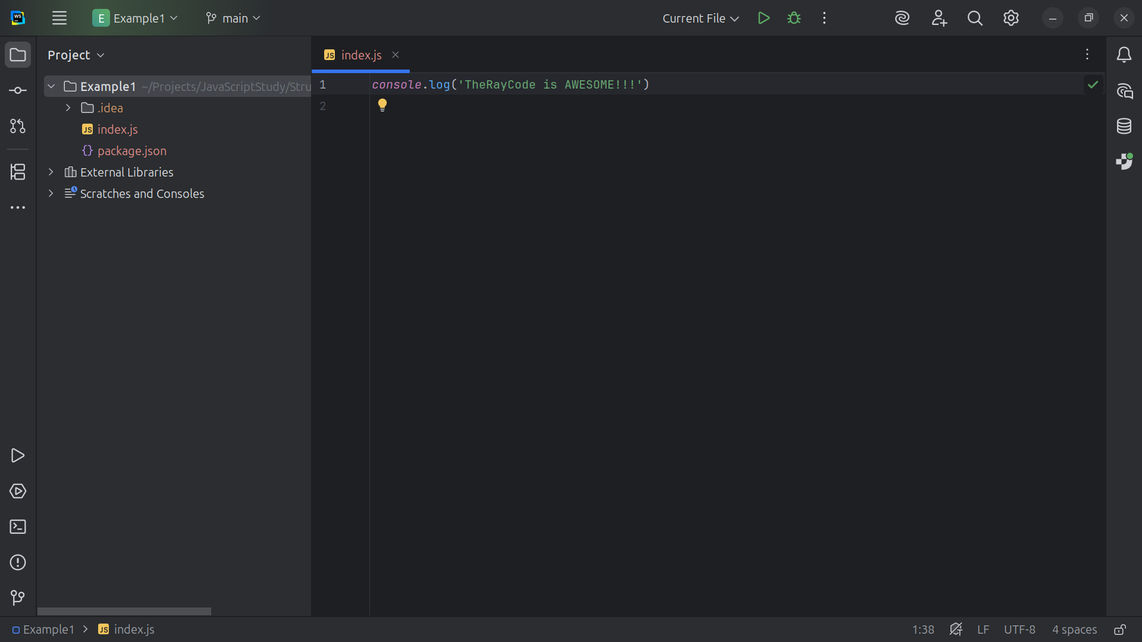
Notes:
In this video I plan to review the Design Pattern know as Decorator. I will be using JavaScript and I will name my classes to mimic those in the Book Design Patterns elements of reusable code

Slide 3
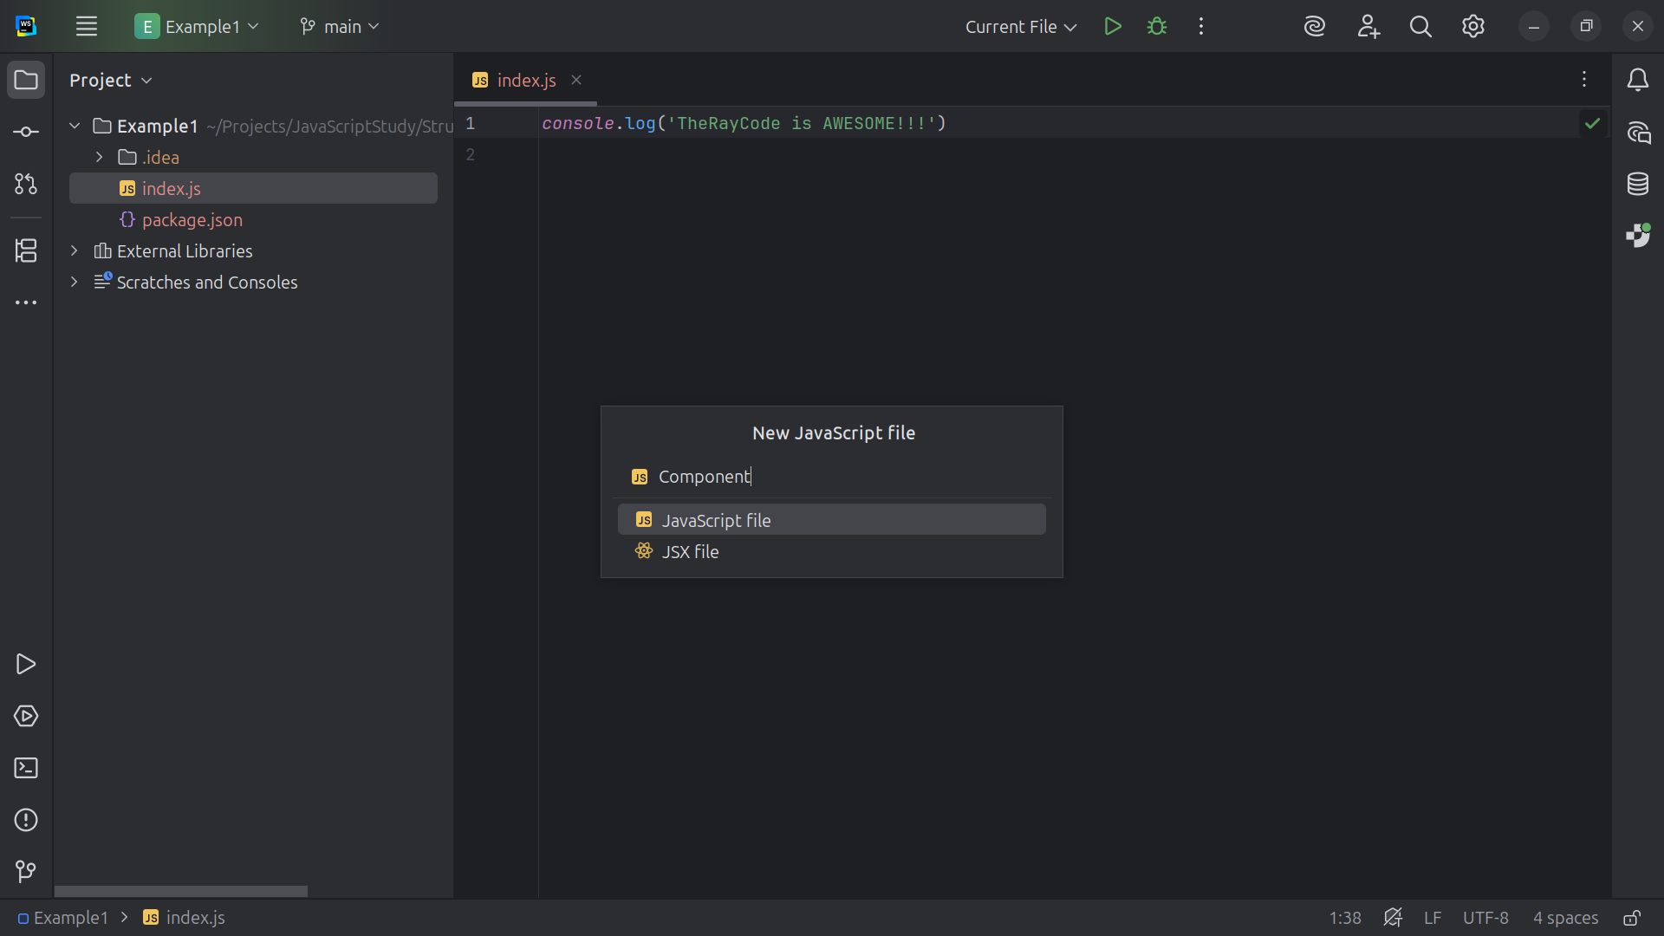
Notes:
We start with a class we call Component. The Component defines the interface for objects that can have responsibilities added to them dynamically.
Both Concrete Component and all decorators must implement this interface.

Slide 4
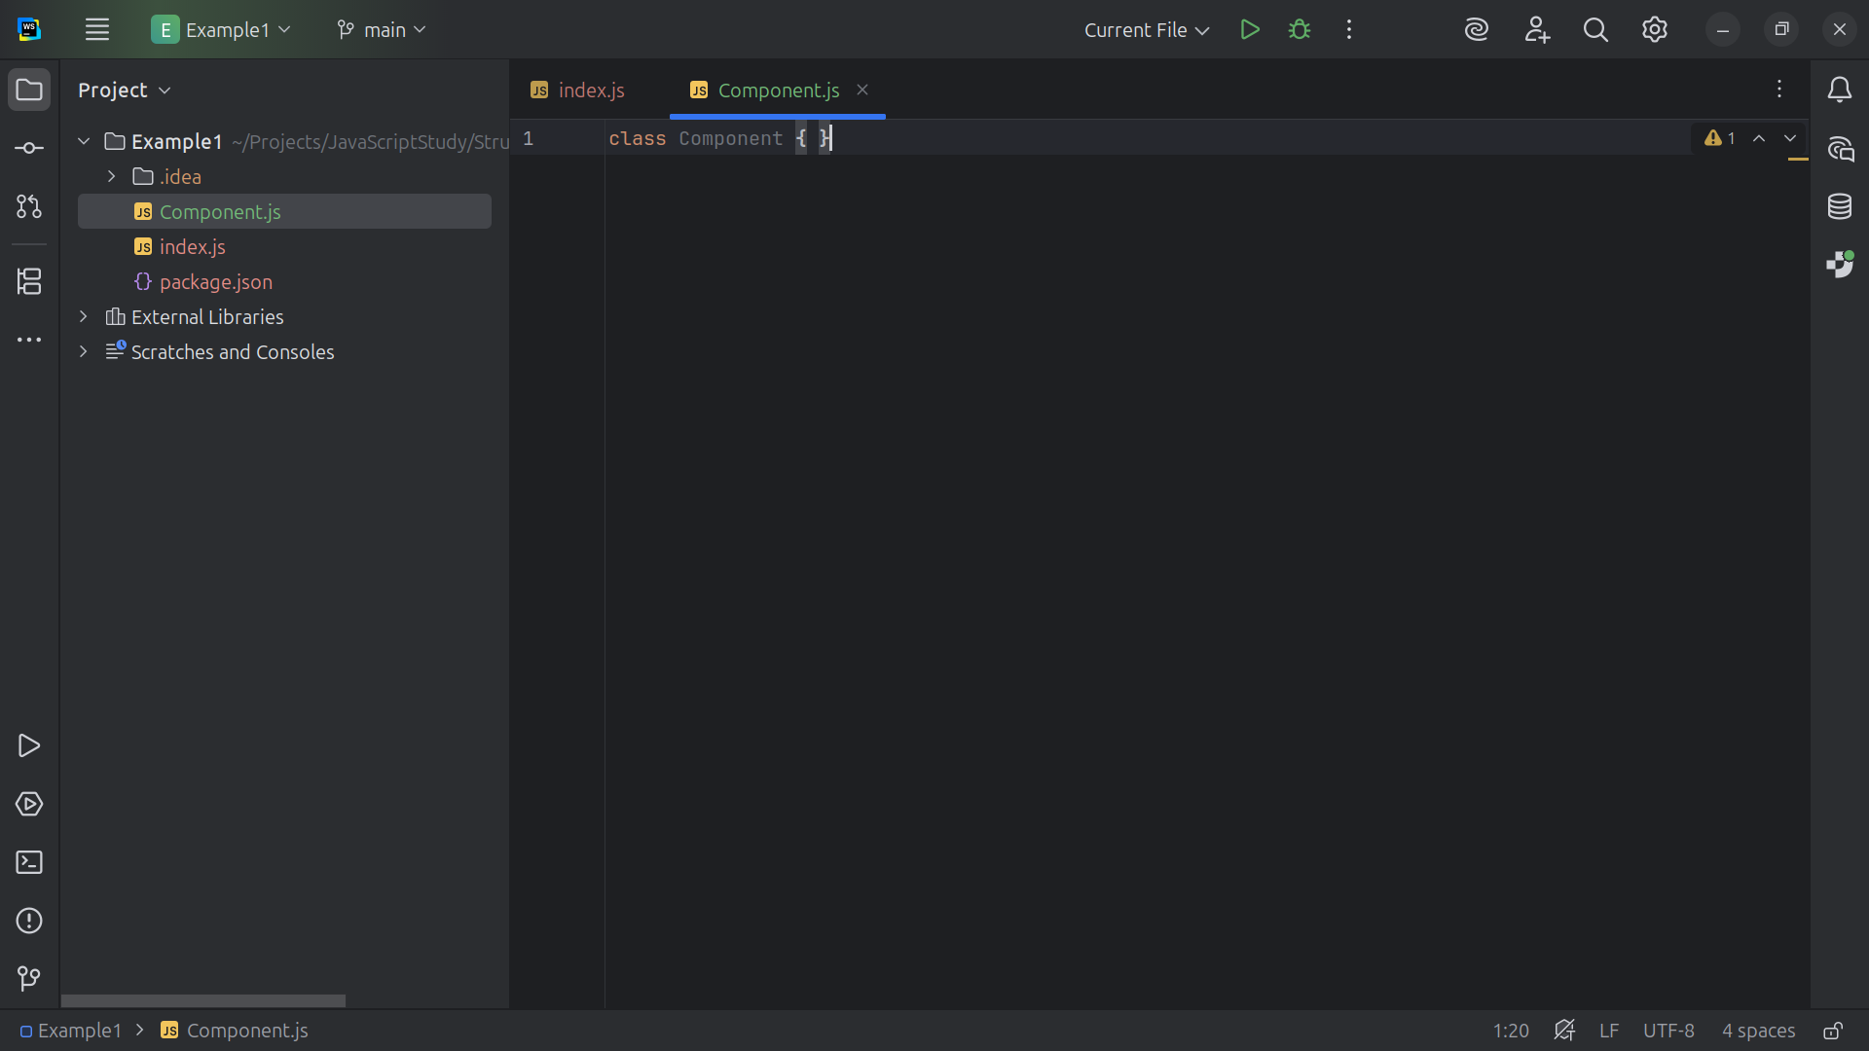
Notes:
The Component defines the interface that can have dynamic behavior added to it

Slide 5
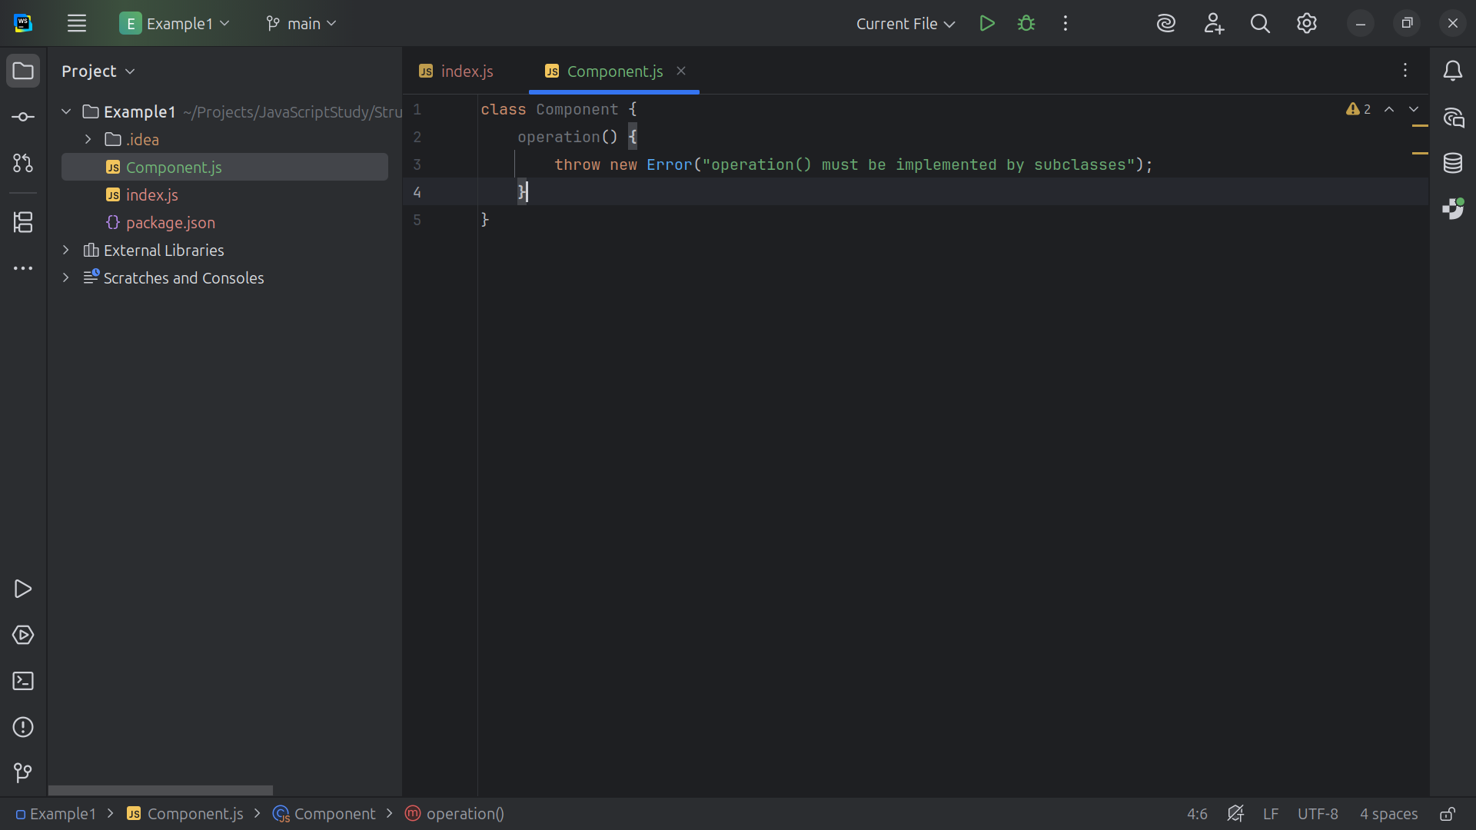
Notes:
We throw an error if operation is not implemented

Slide 6
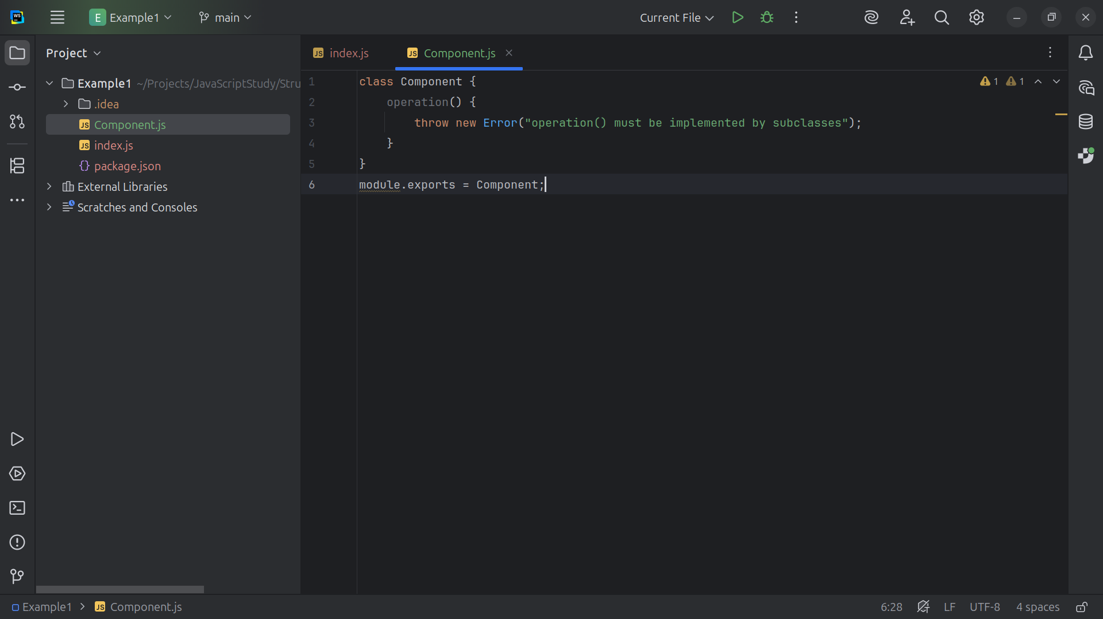
Notes:
We export this module as Component for use in our demonstration

Slide 7
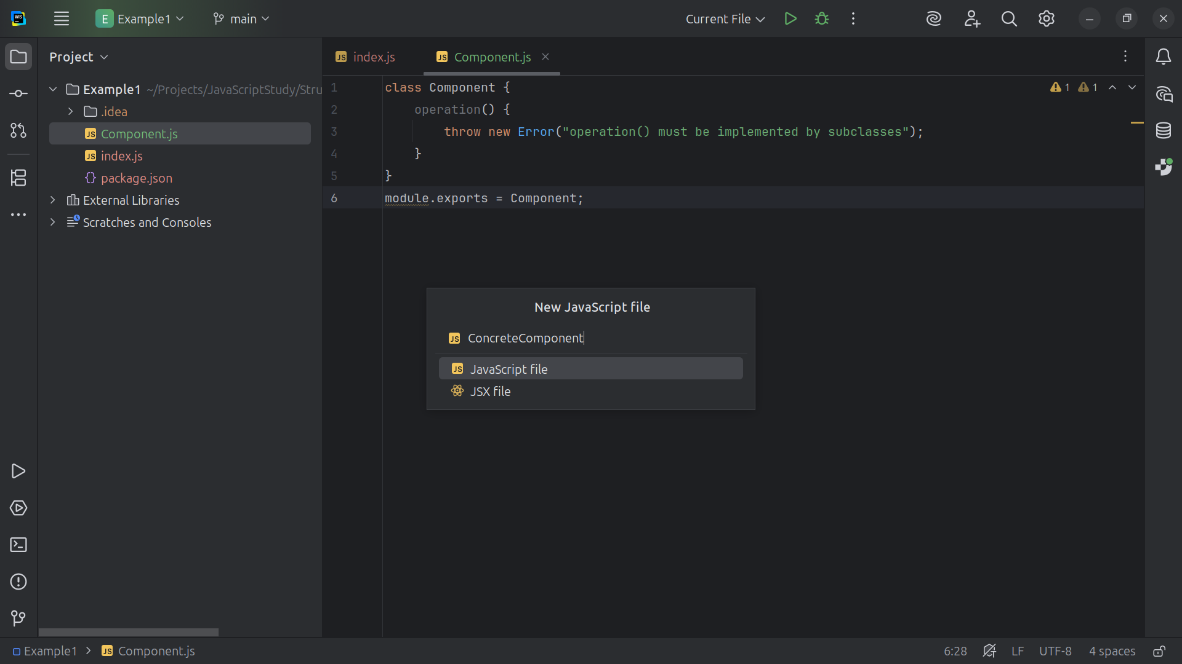
Notes:
Let’s create a class called Concrete Component

Slide 8
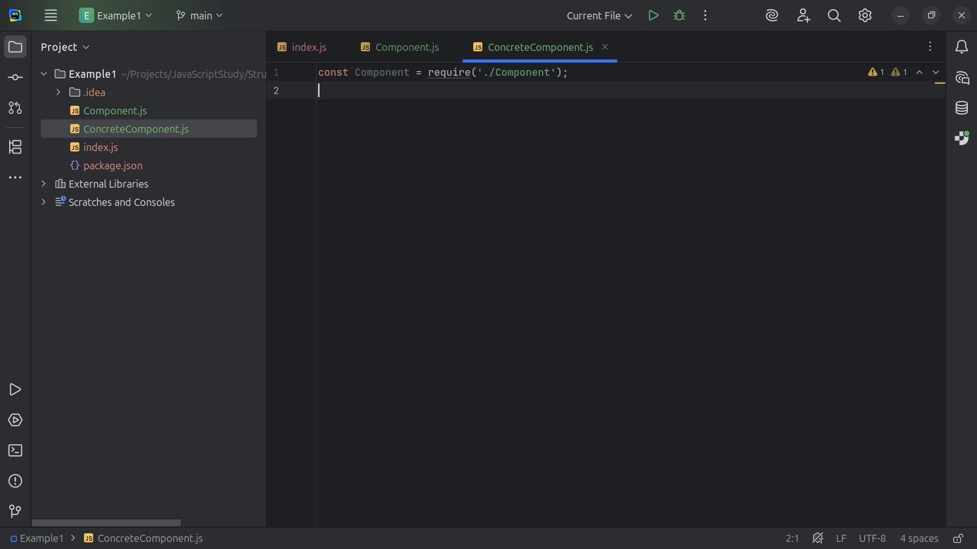
Notes:
We will require the Component at the top

Slide 9

Notes:
So we can use it to extend Concrete Component

Slide 10
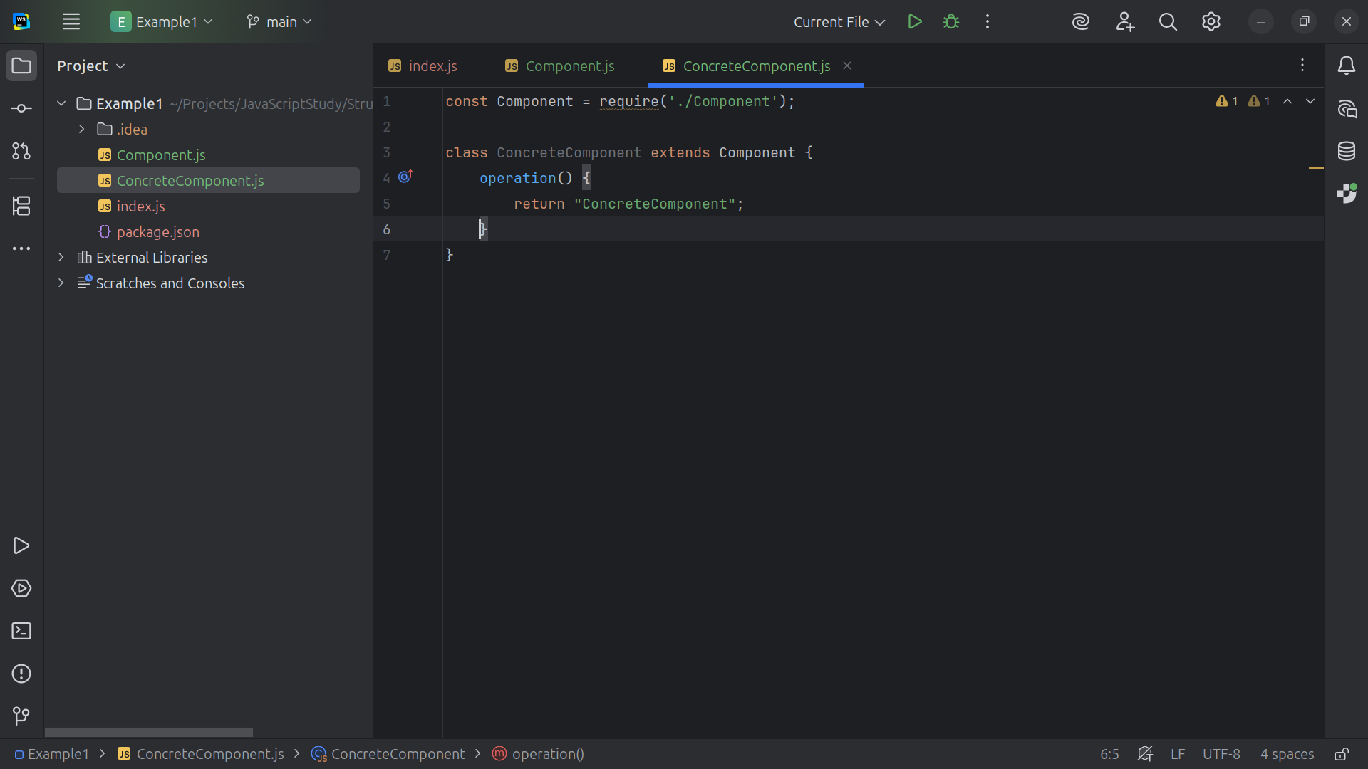
Notes:
This is the object that gets decorated.
It implements the `Component` interface directly.

Slide 11
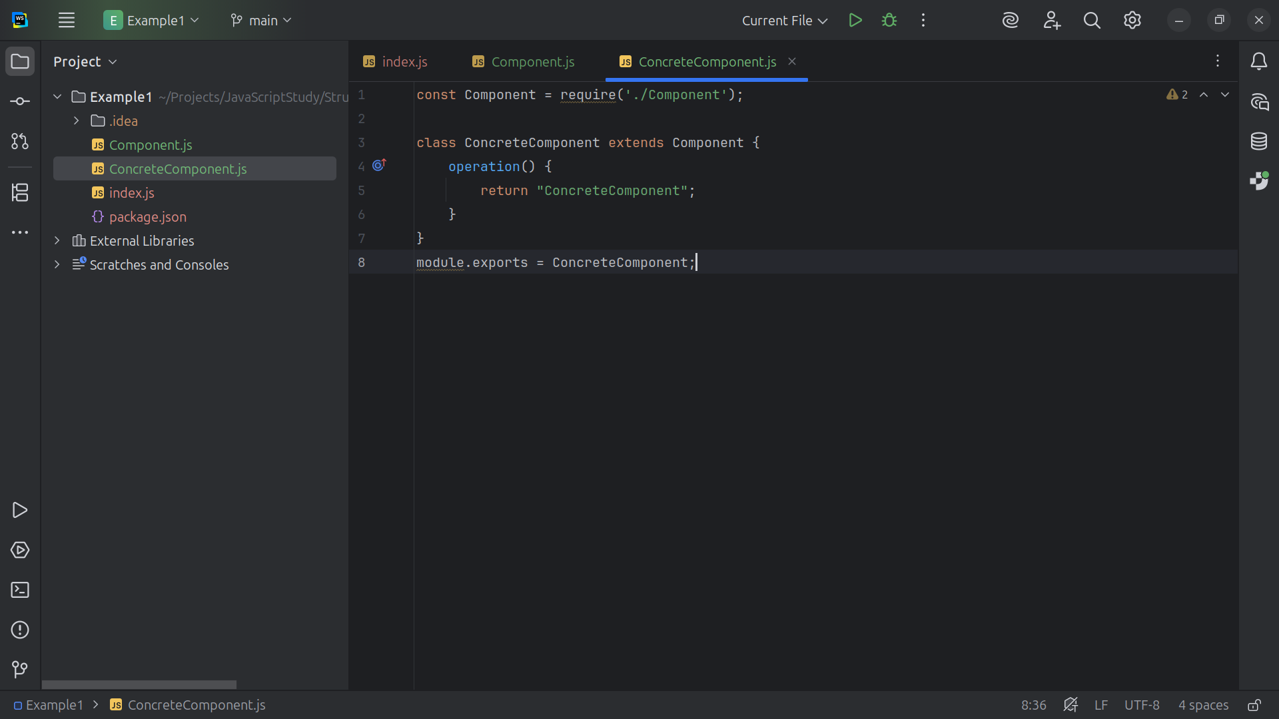
Notes:
We export this class as Concrete Component for use on our demo

Slide 12
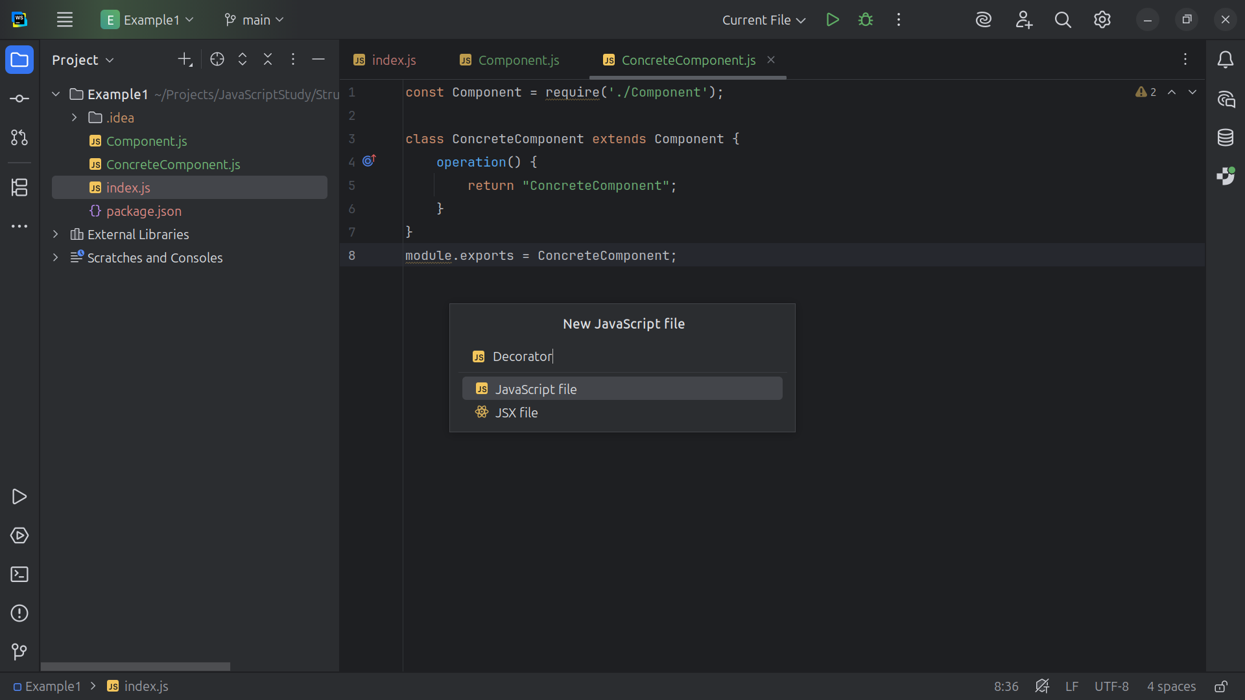
Notes:
Let’s create a class we call Decorator

Slide 13
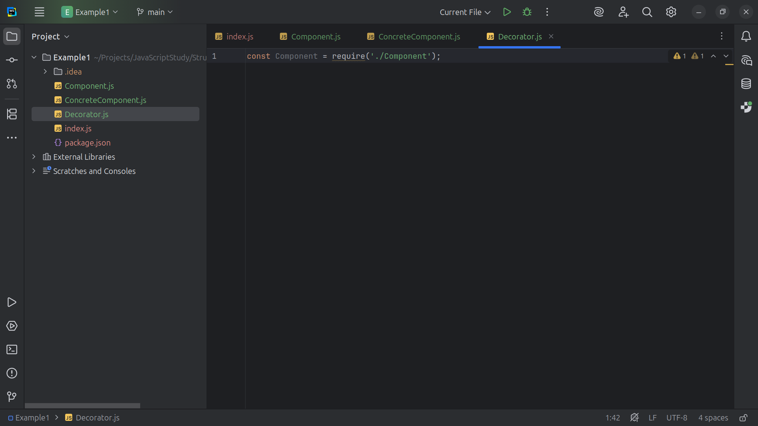
Notes:
We will require Component at the top

Slide 14
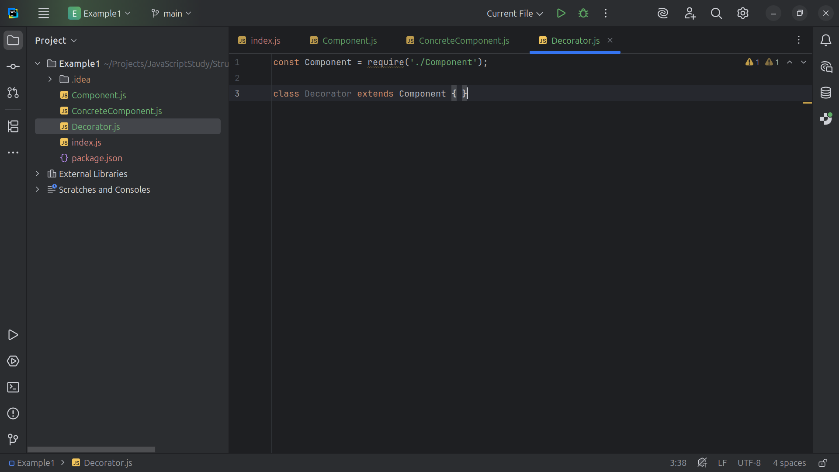
Notes:
The Decorator Defines the base class for all decorators. It holds a reference to a `Component` and forwards operations to it.

Slide 15
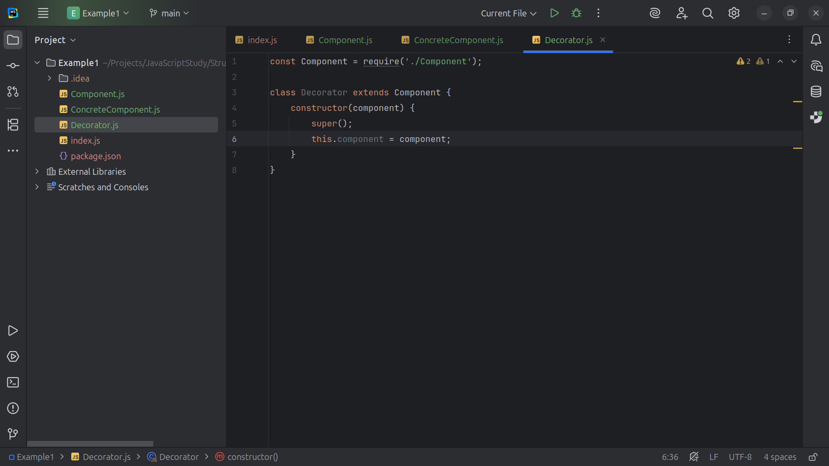
Notes:
The Decorator wraps a component to add behavior dynamically

Slide 16
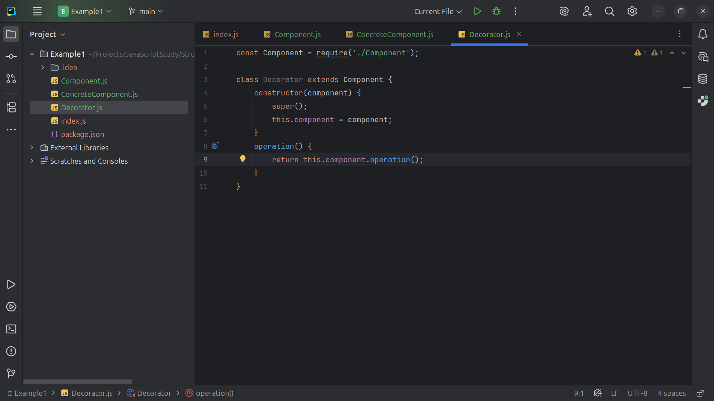

Slide 17
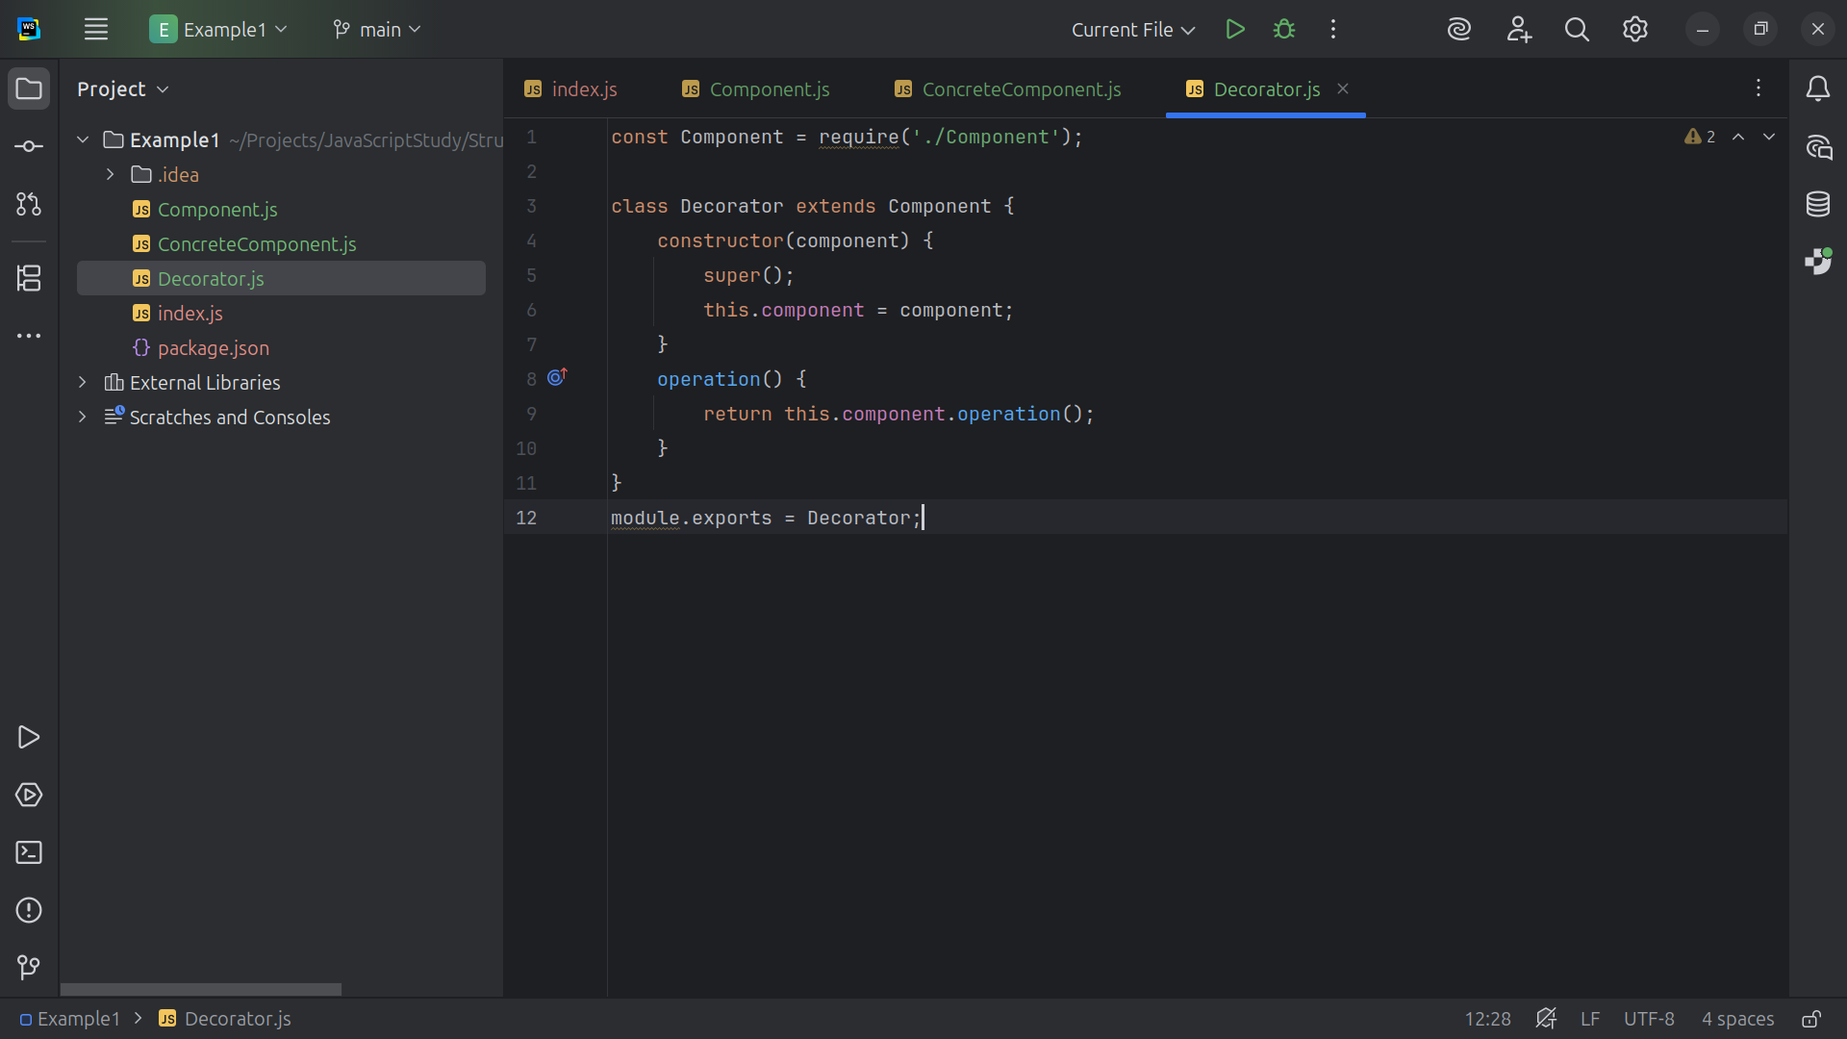

Slide 18
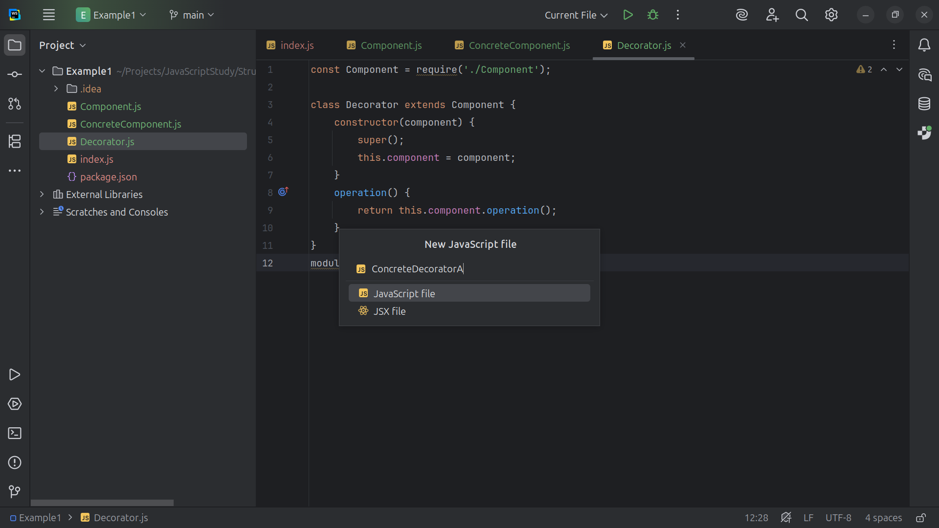

Slide 19
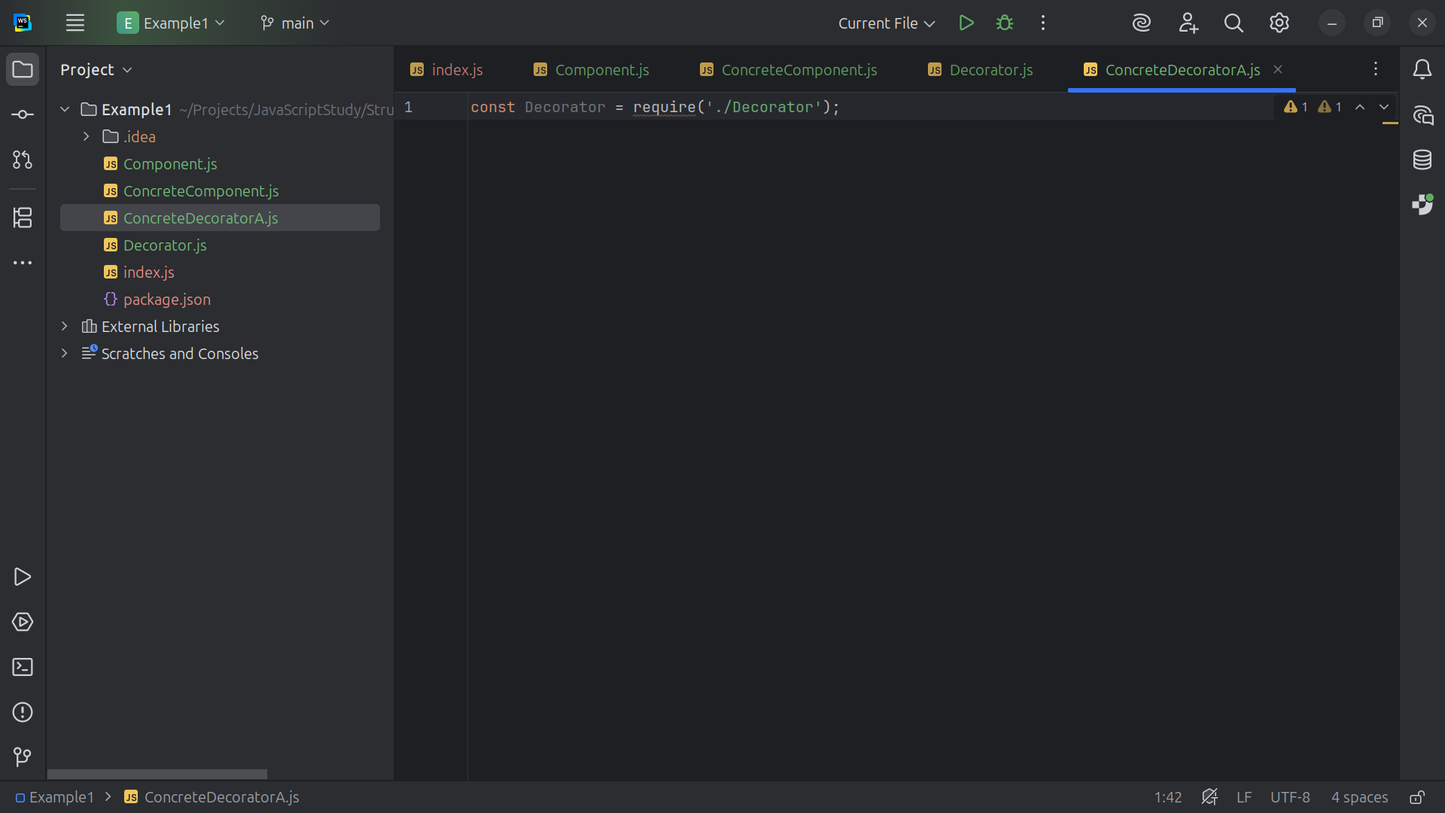

Slide 20
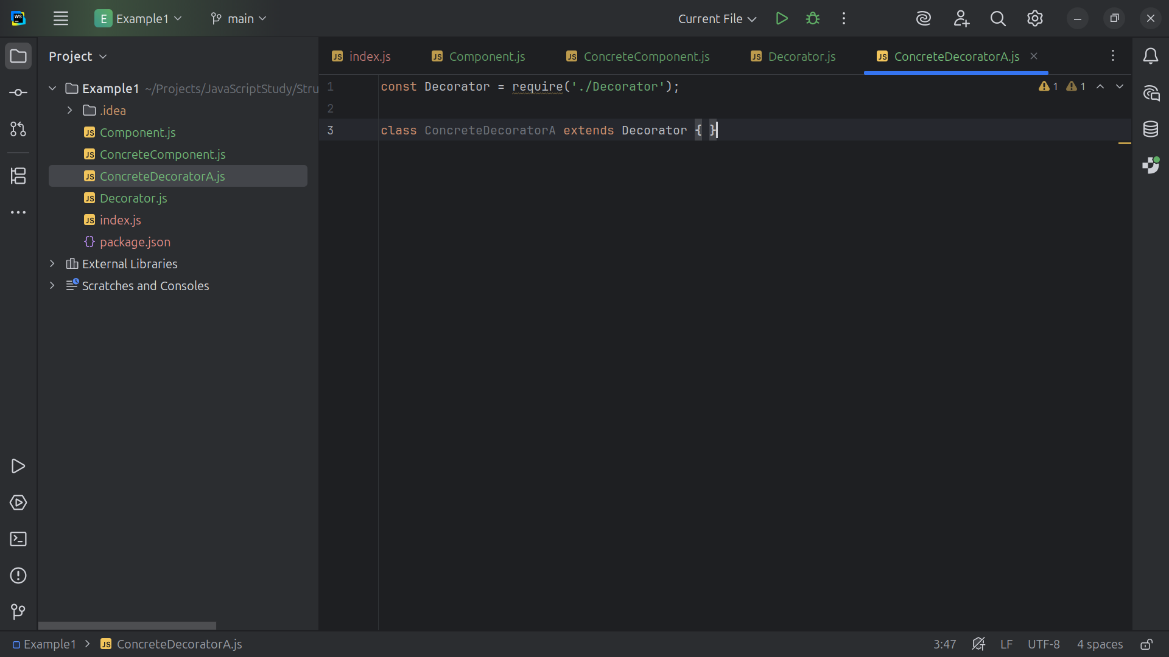

Slide 21
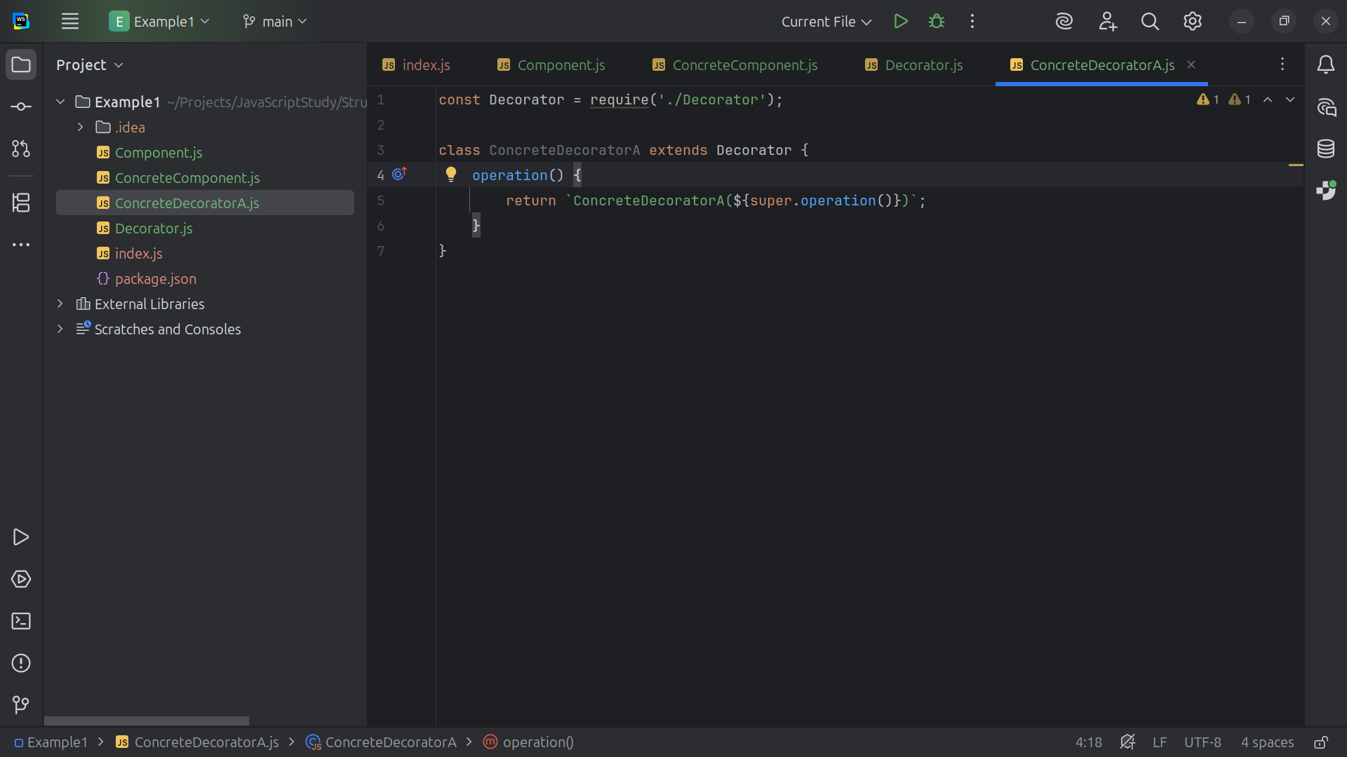

Slide 22
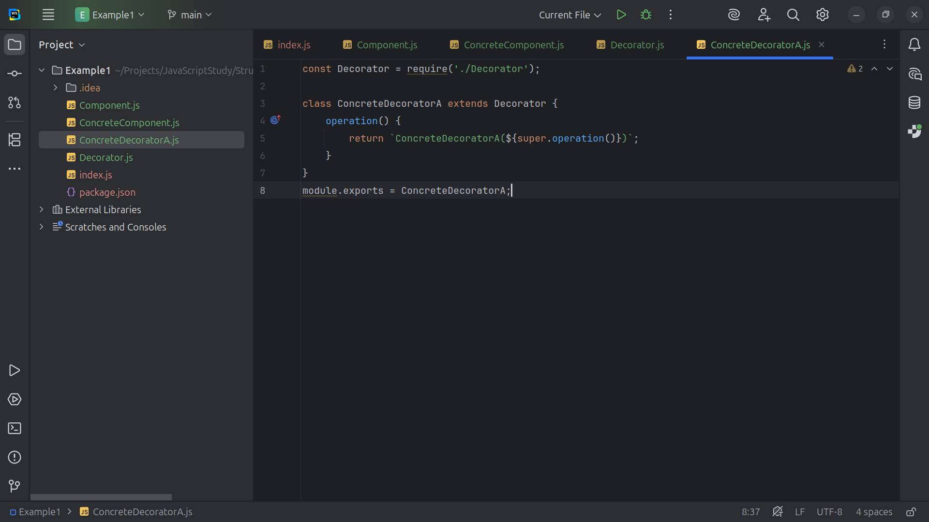

Slide 23
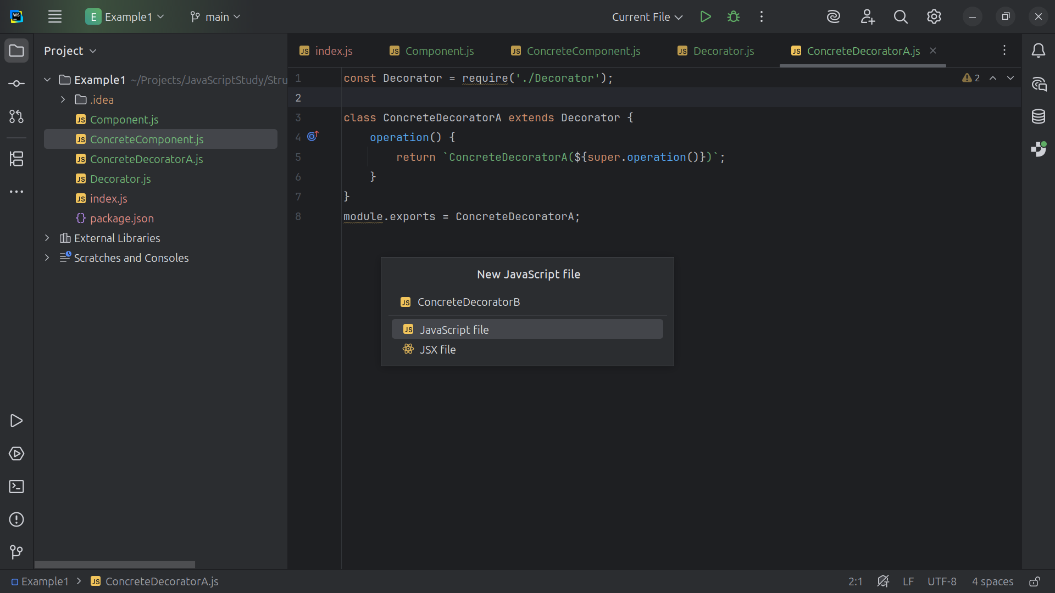

Slide 24
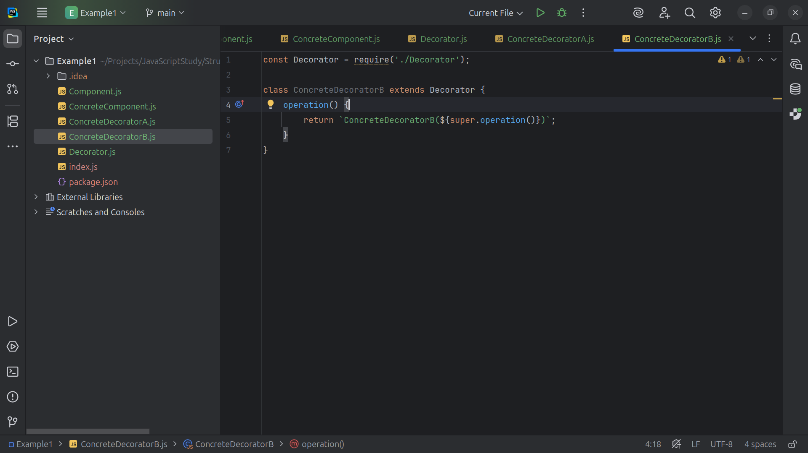

Slide 25
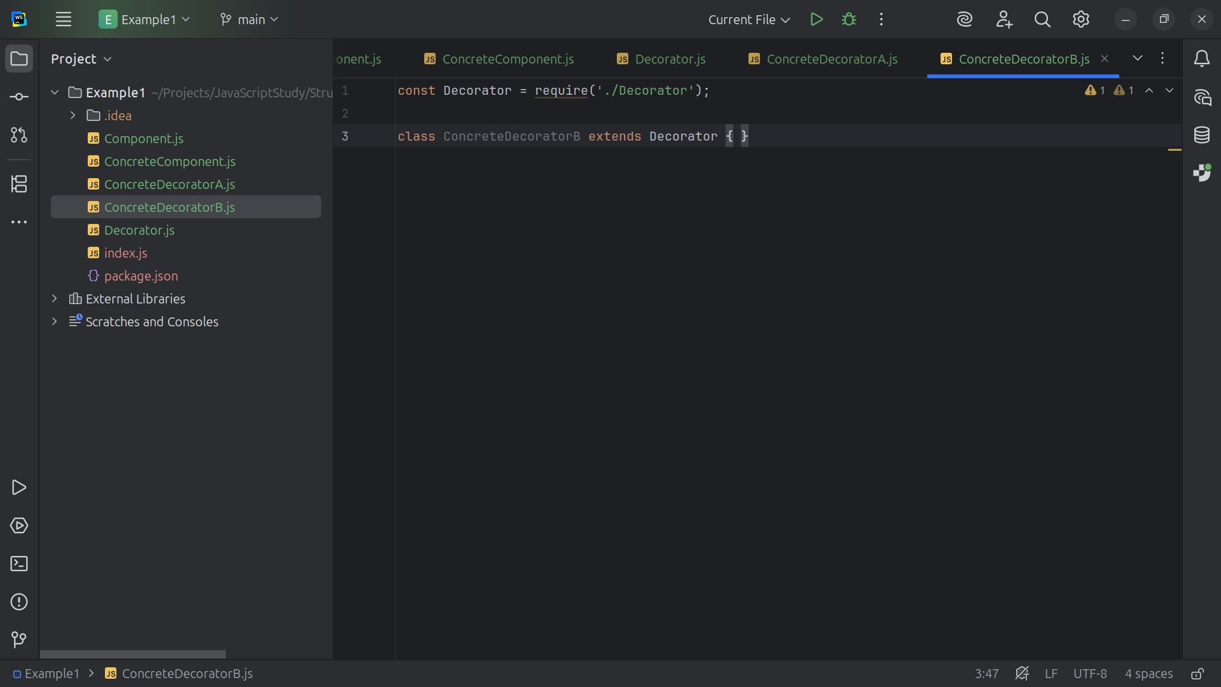

Slide 27
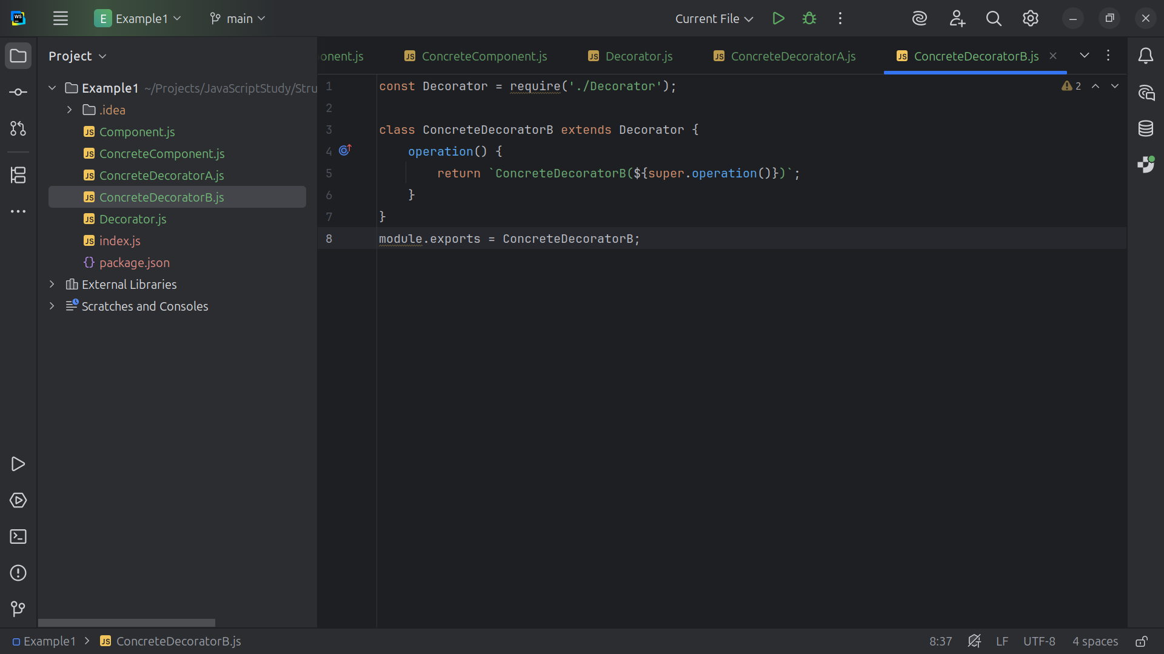

Slide 28
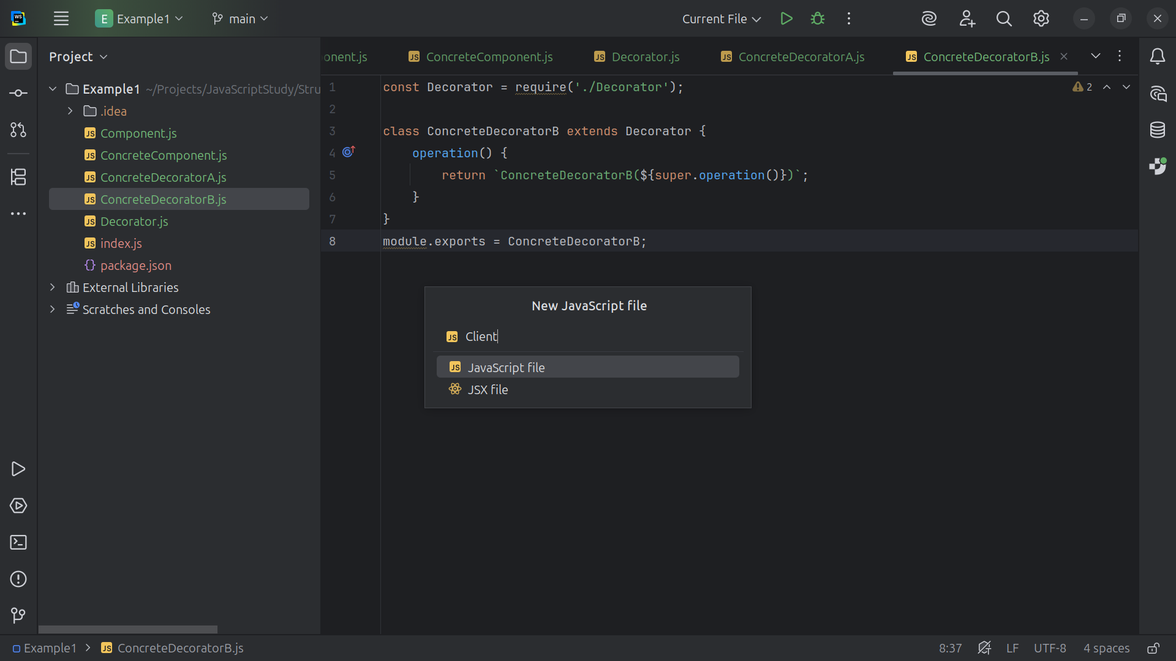

Slide 29
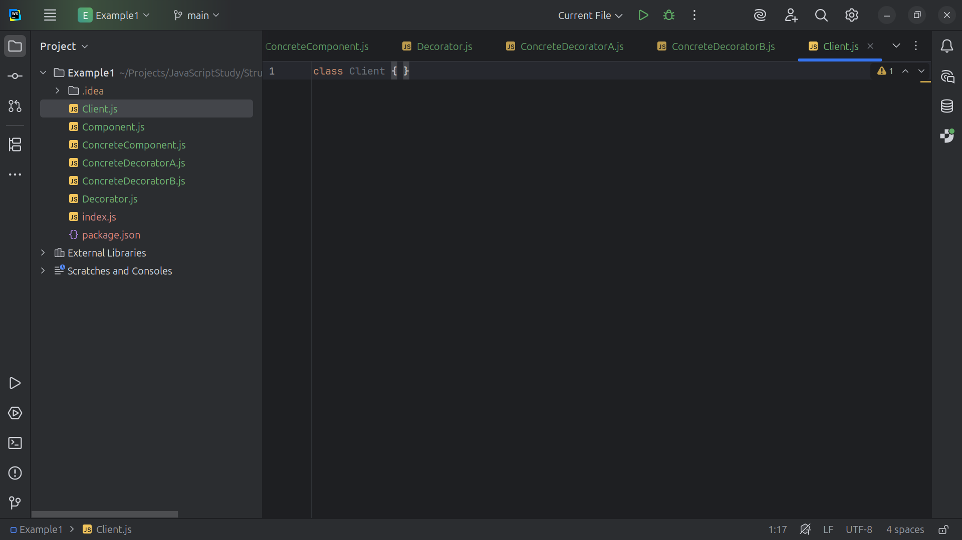

Slide 30
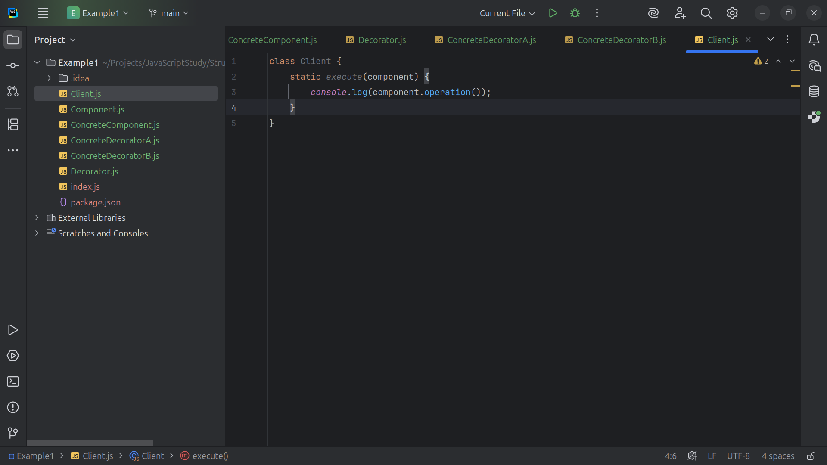

Slide 31
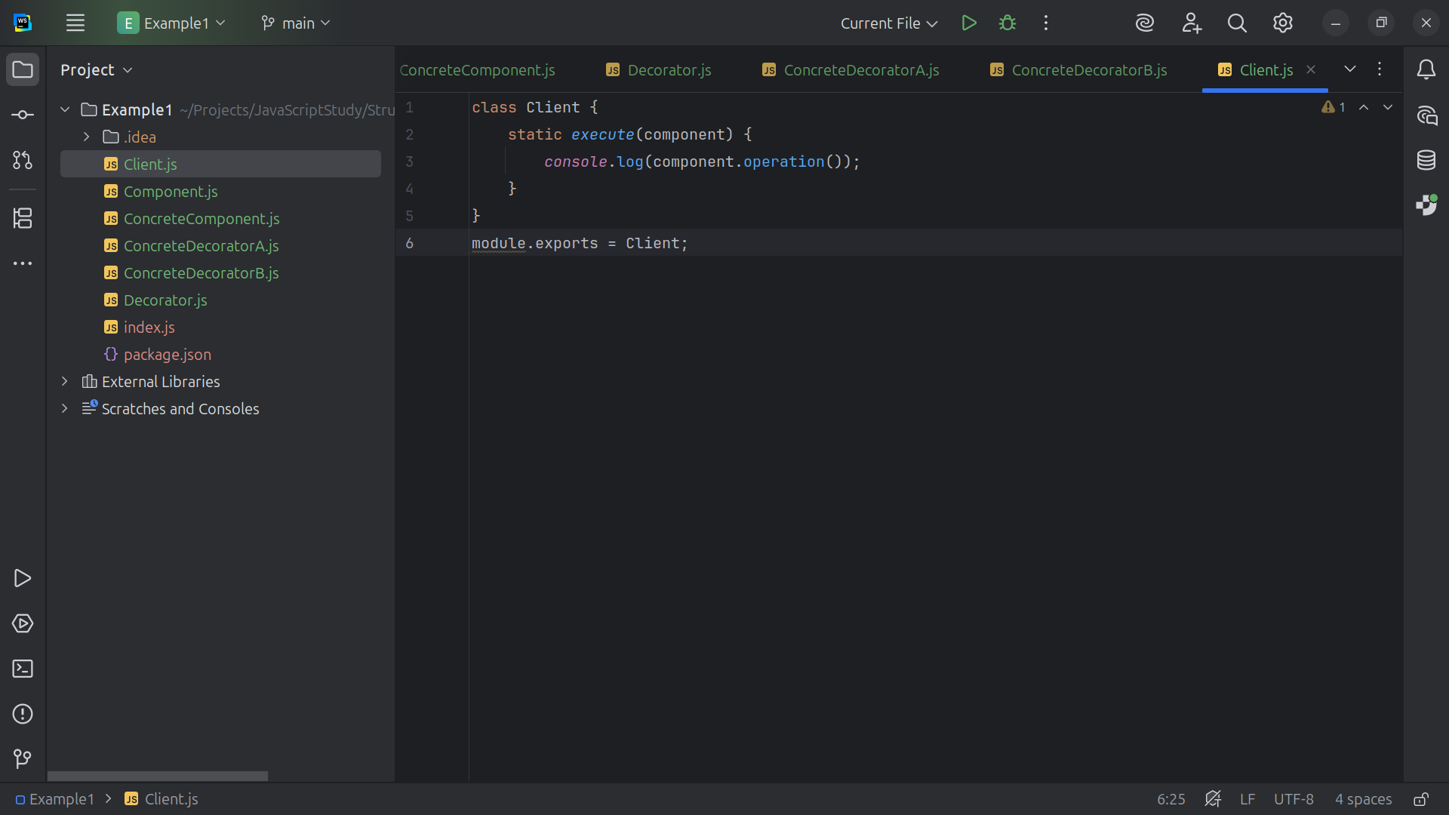

Slide 32
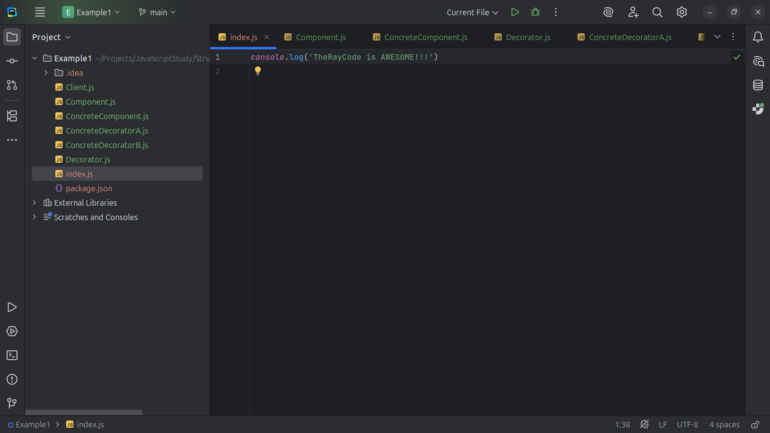

Slide 33
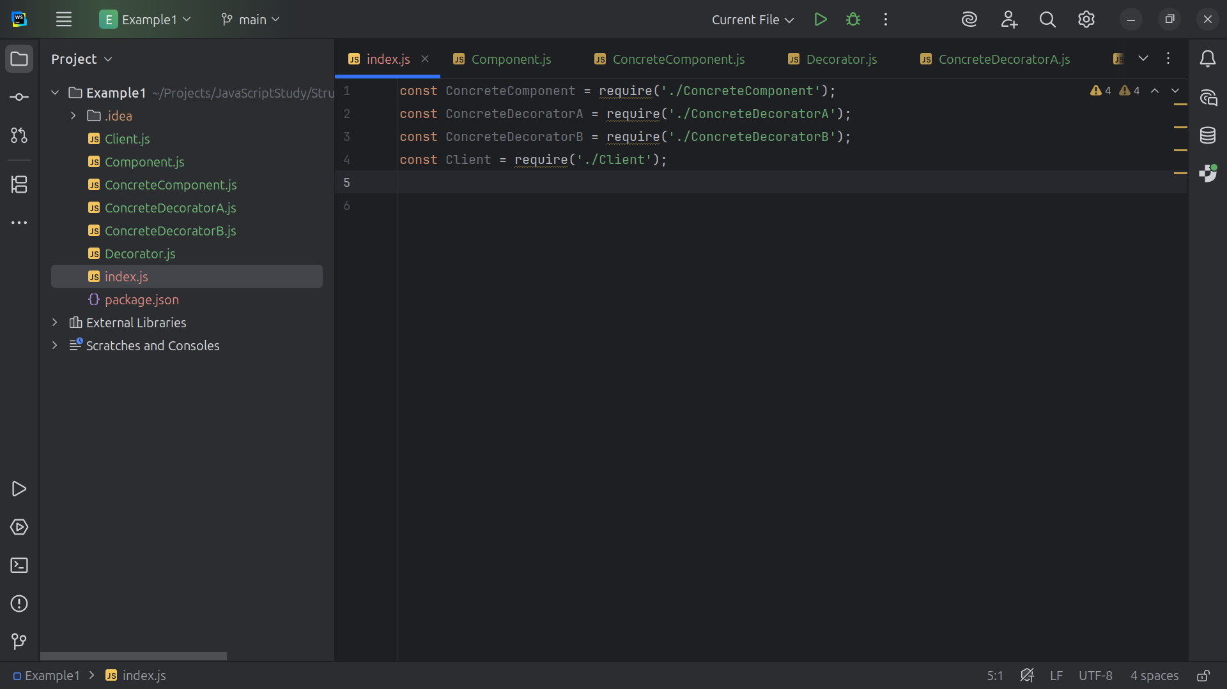

Slide 34
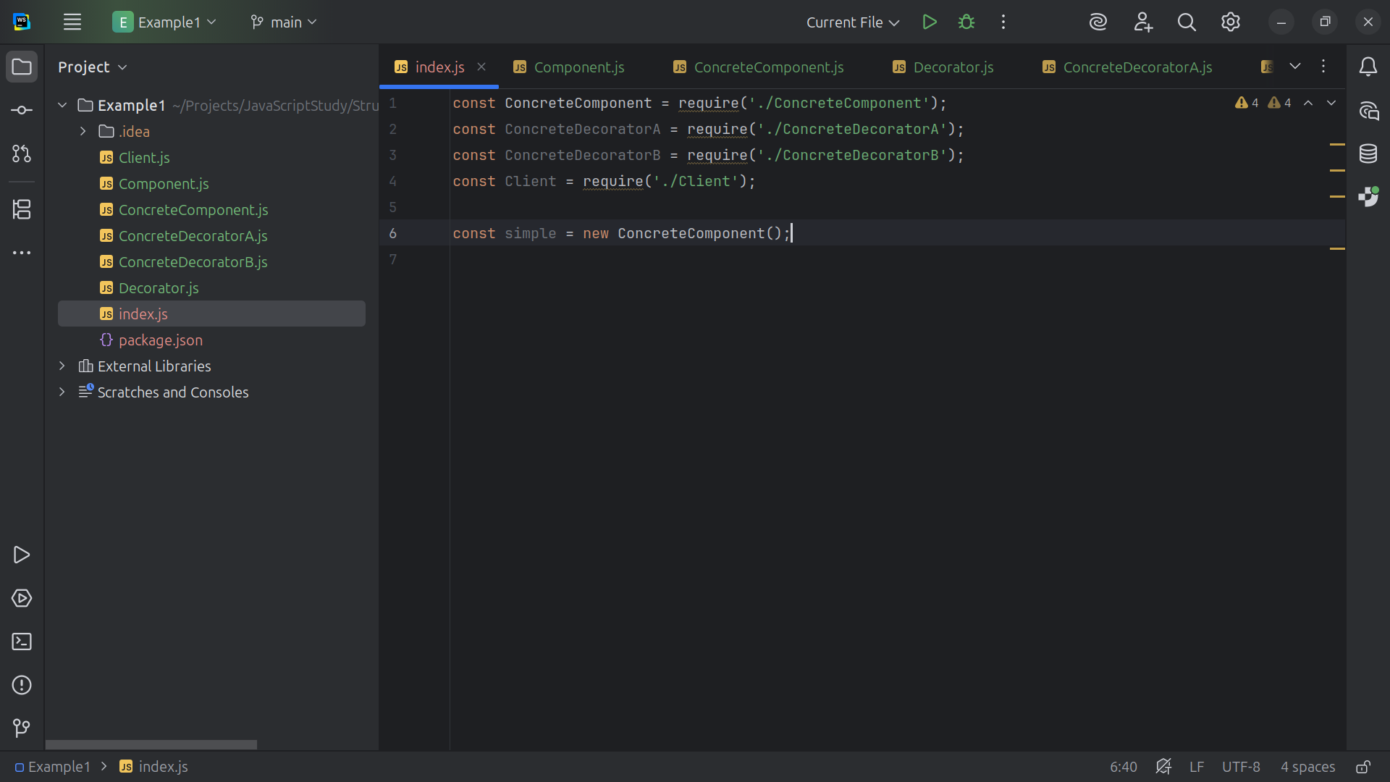

Slide 35
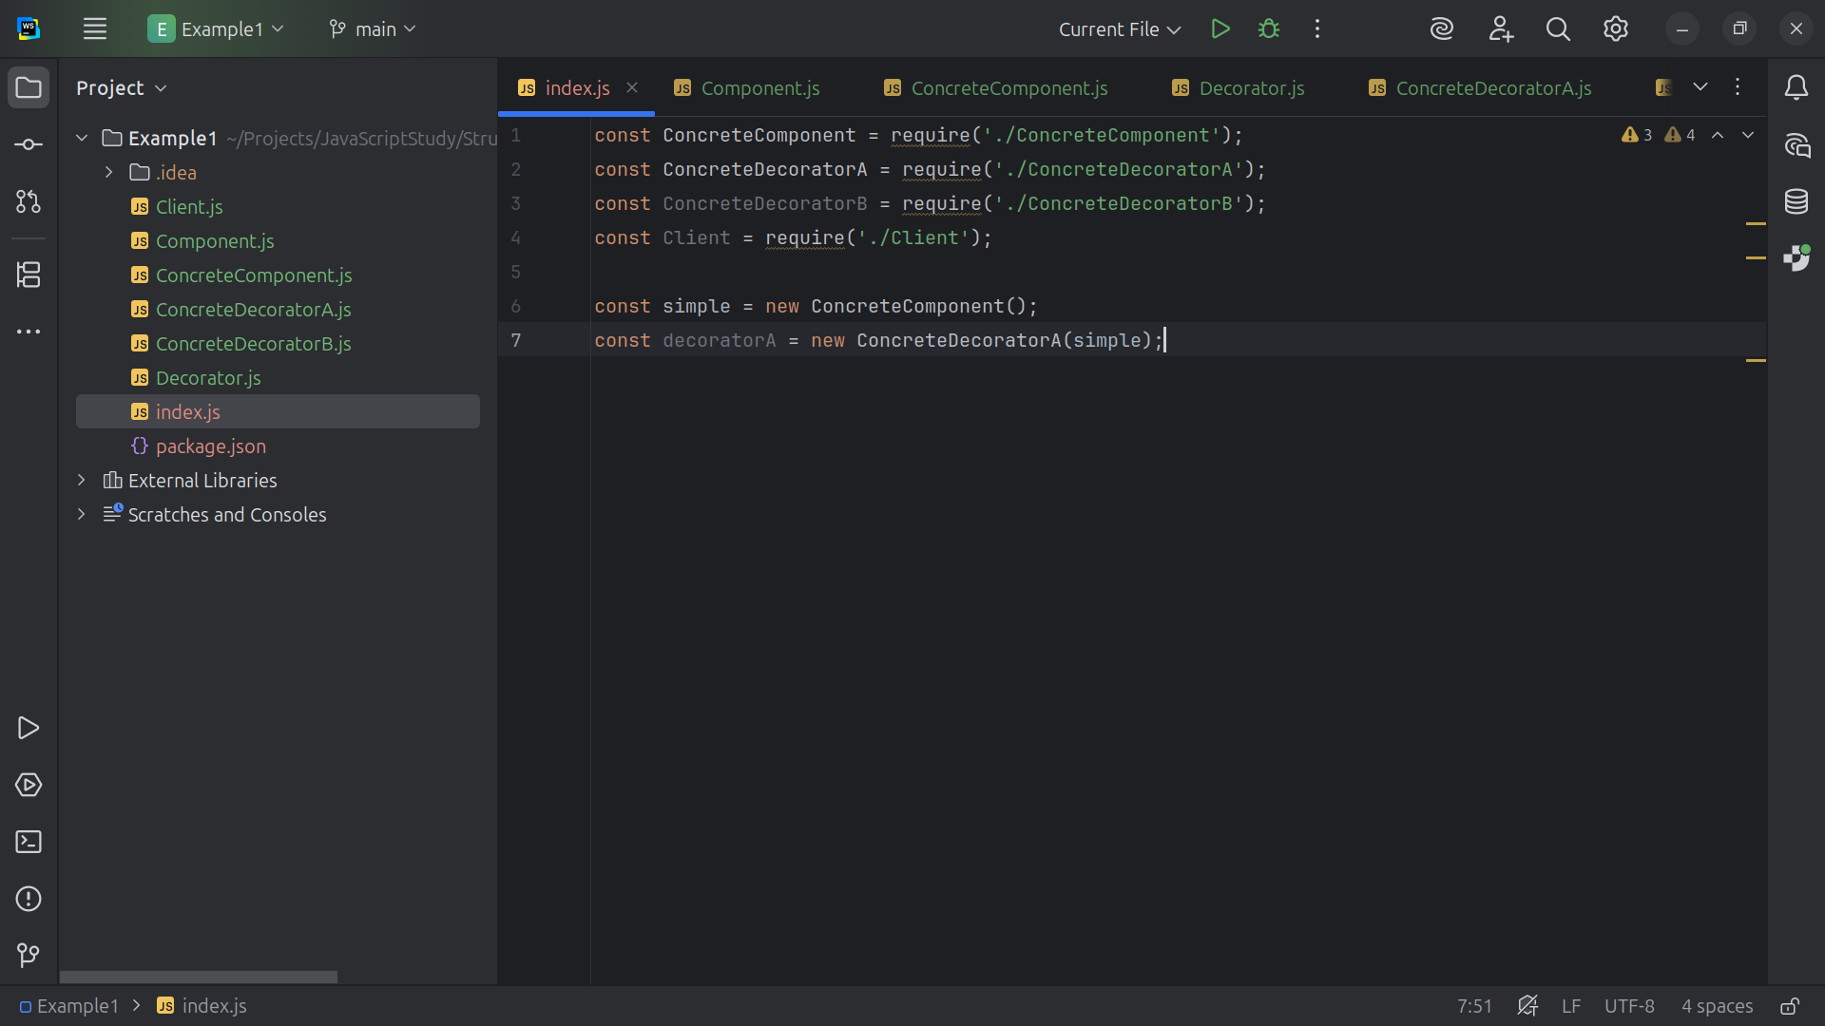

Slide 36
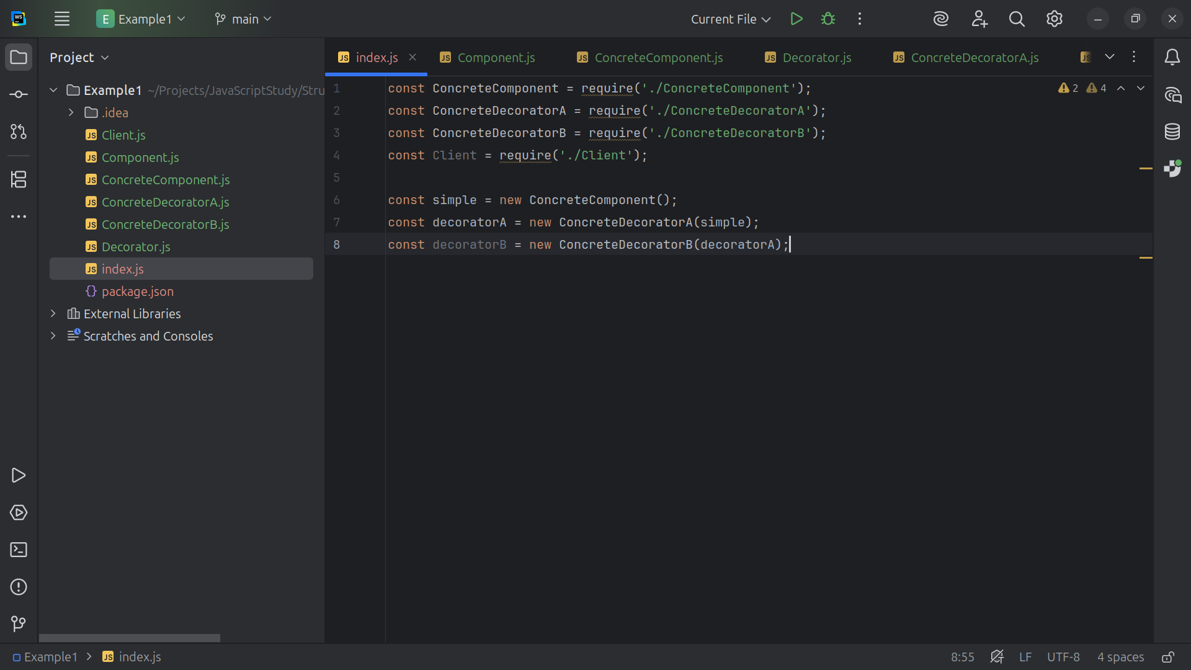

Slide 37
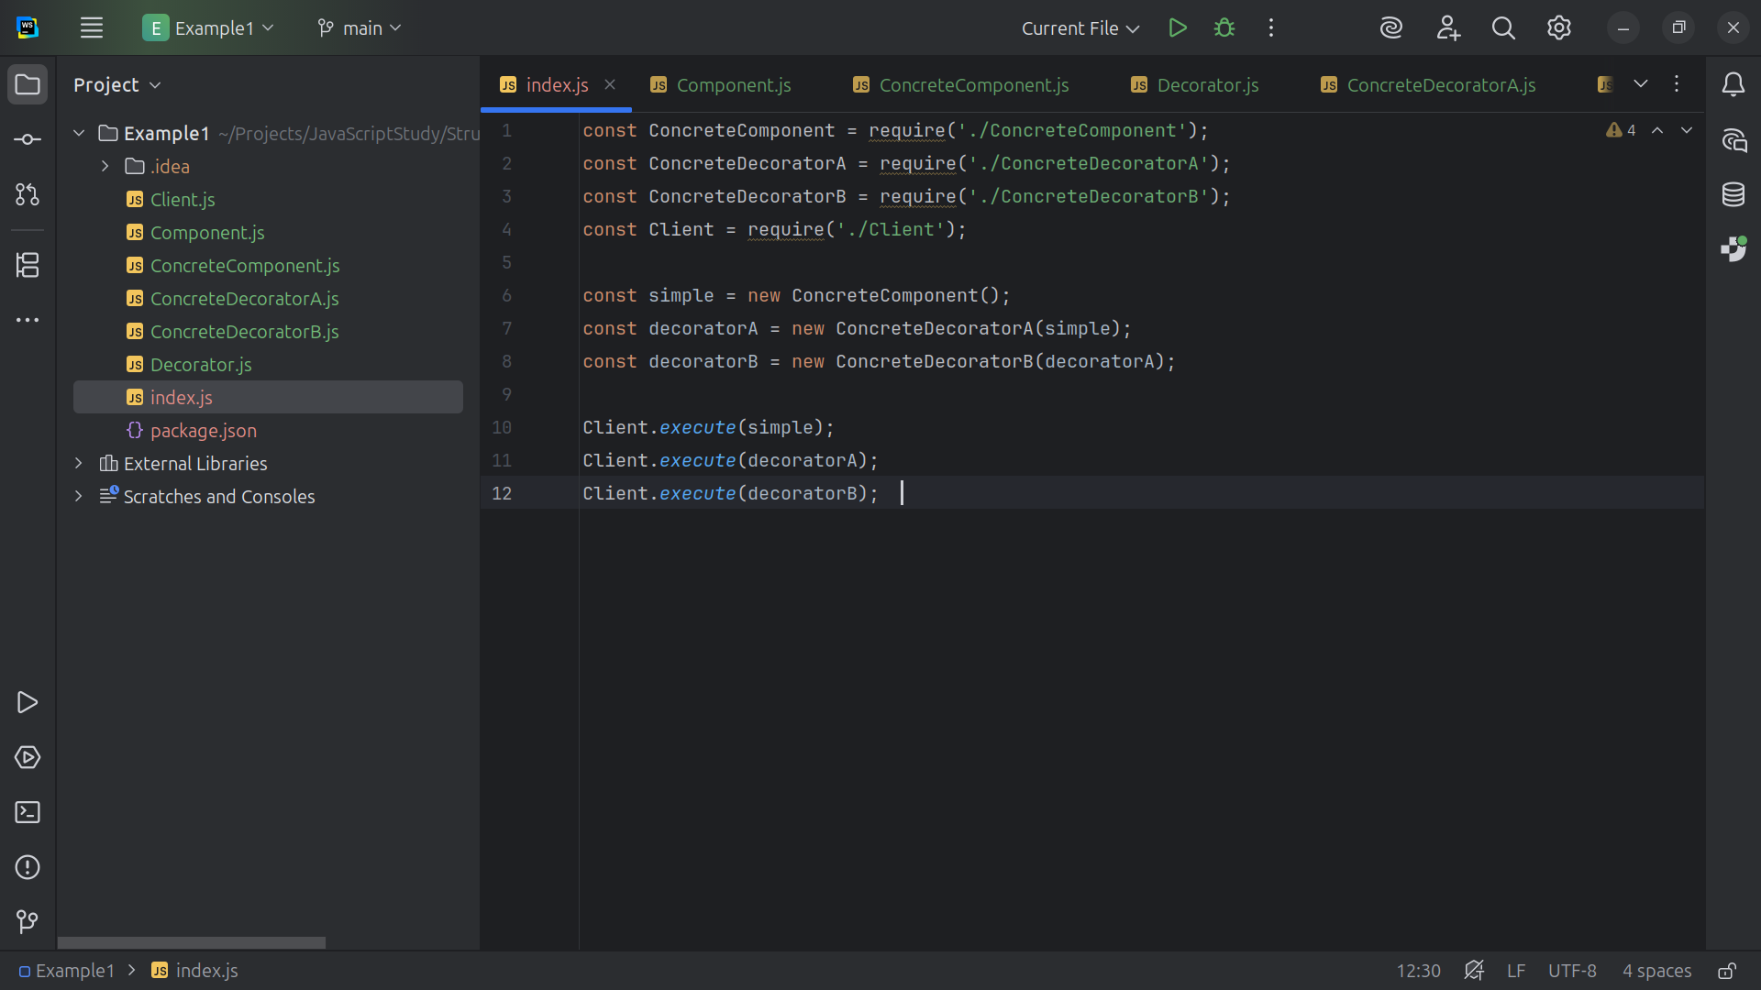

Slide 38


