Slide 1
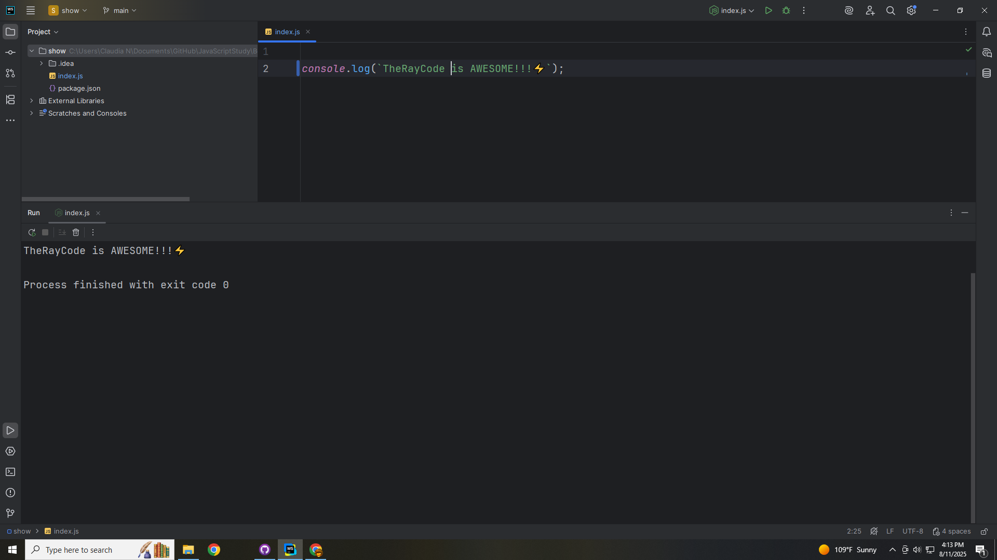
Notes:
Hello, my name is Ray I’m the Ray in TheRayCode

Slide 2

Notes:
In this video I plan to review a Design Pattern called the Iterator
The Iterator is a Behavioral Design pattern as per the Gang of 4

Slide 3
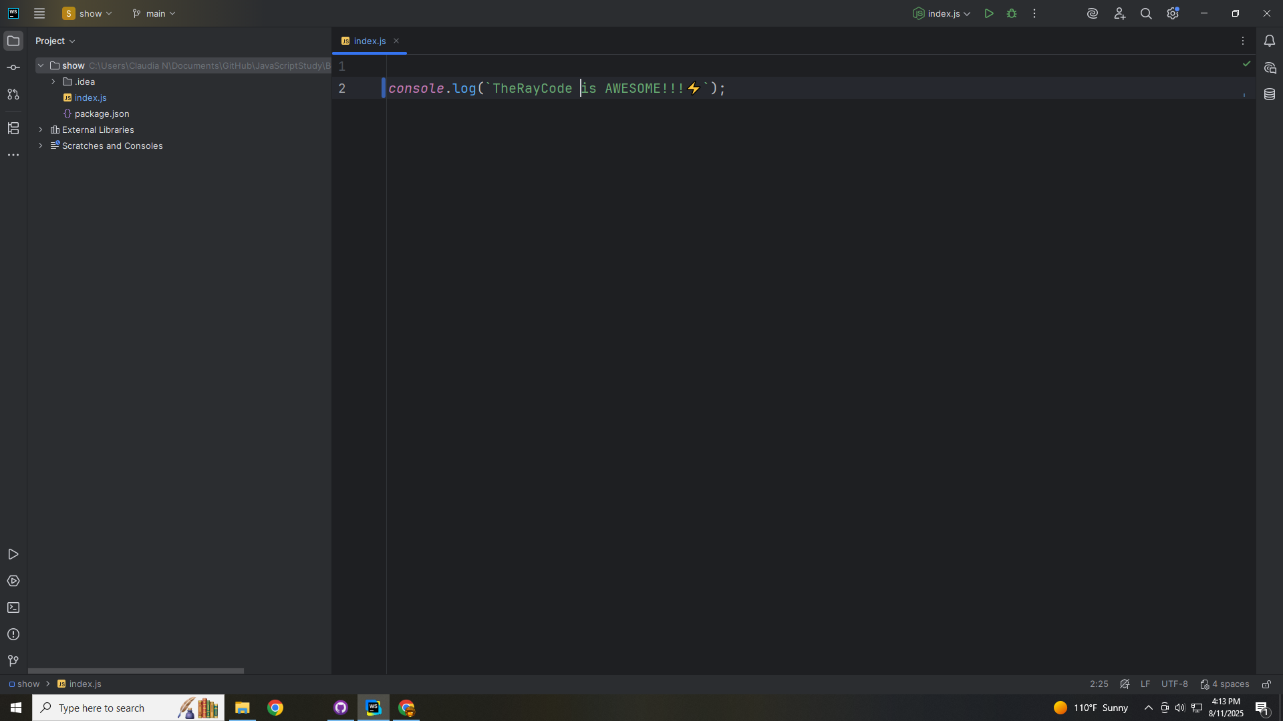
Notes:
I will be using JavaScript
The Iterator Design Pattern provides a systematic way to access elements of a collection without exposing its underlying representation.

Slide 4
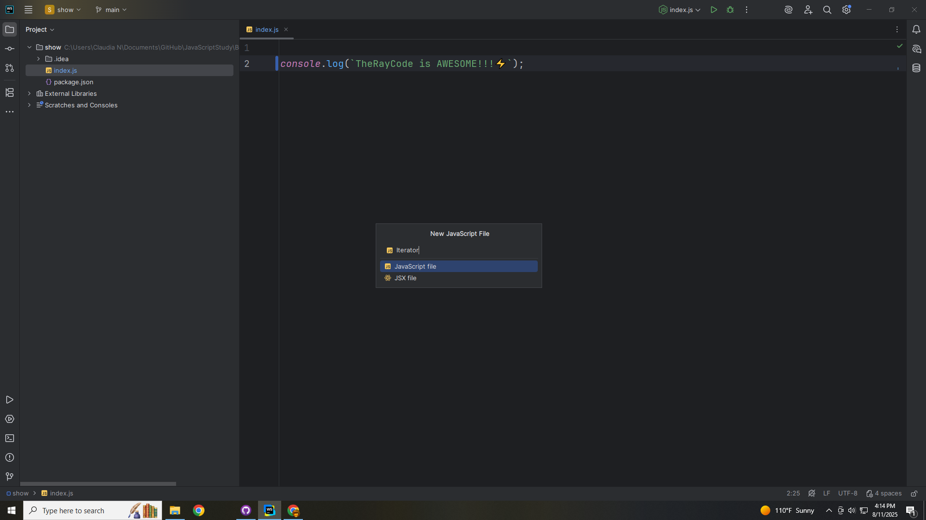
Notes:
We start with the Iterator

Slide 5
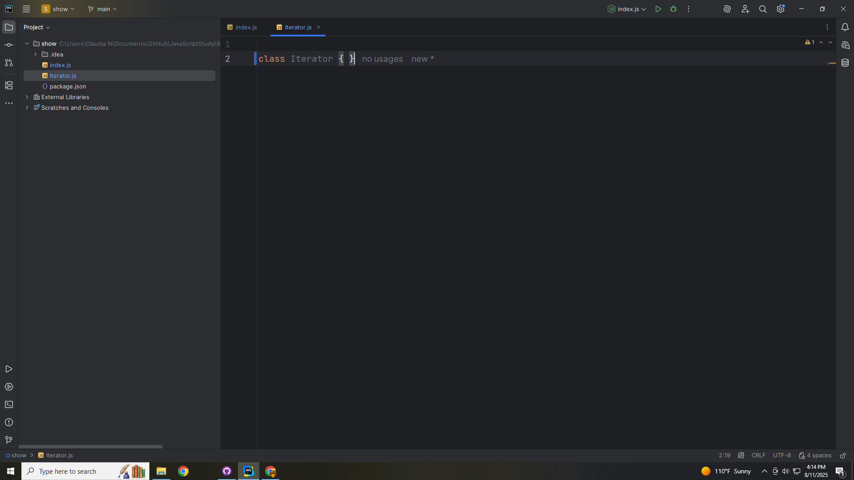
Notes:
The Iterator Defines the traversal interface
The methods required are
(first, next, is Done and current Item)
Are all these methods must be implement.

Slide 6
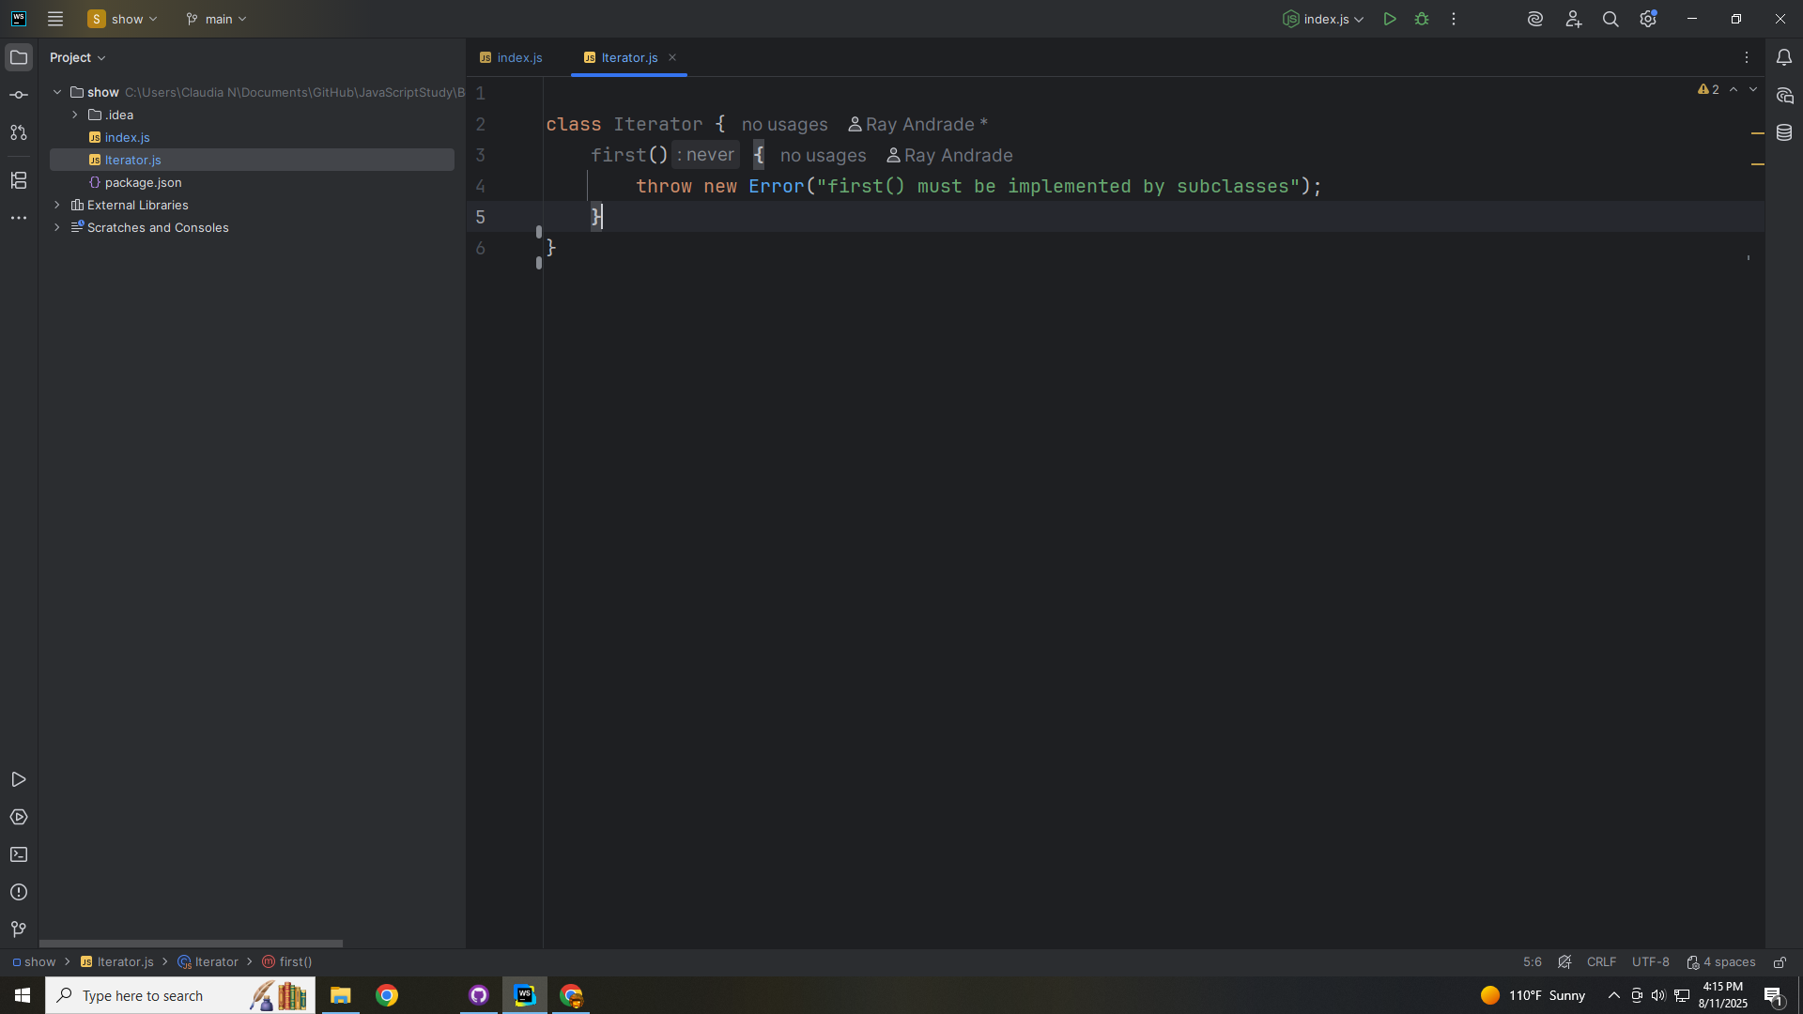
Notes:
first() must be implemented by the sub classes

Slide 7
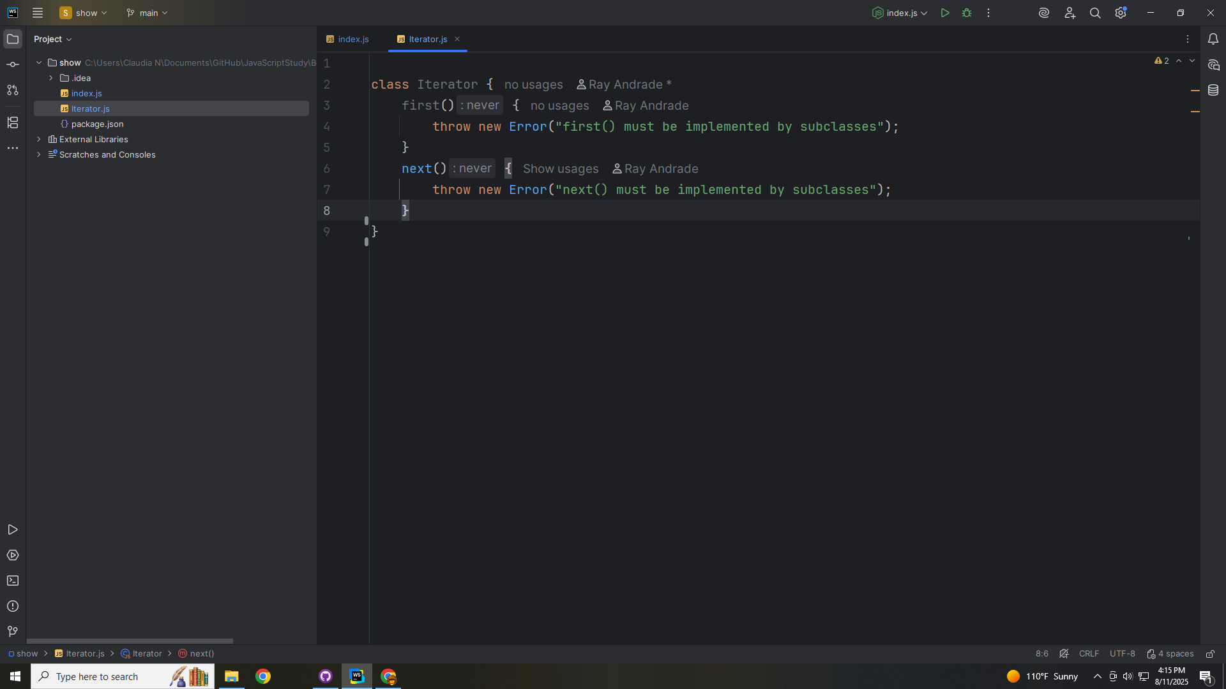
Notes:
And So must the function next

Slide 8
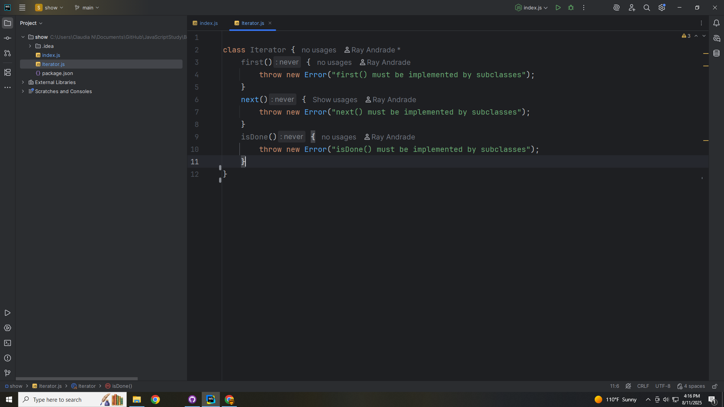
Notes:
And so is Done

Slide 9
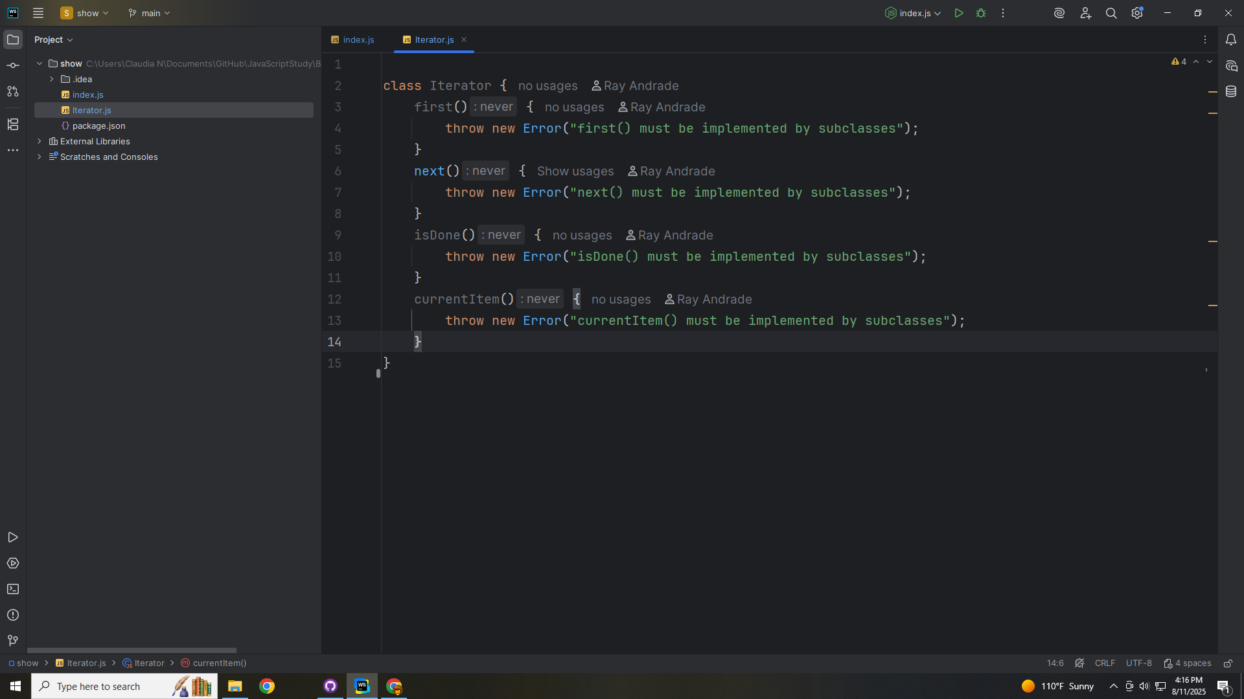
Notes:
And so must the current Item
The current Item must be implemented by sub classes

Slide 10
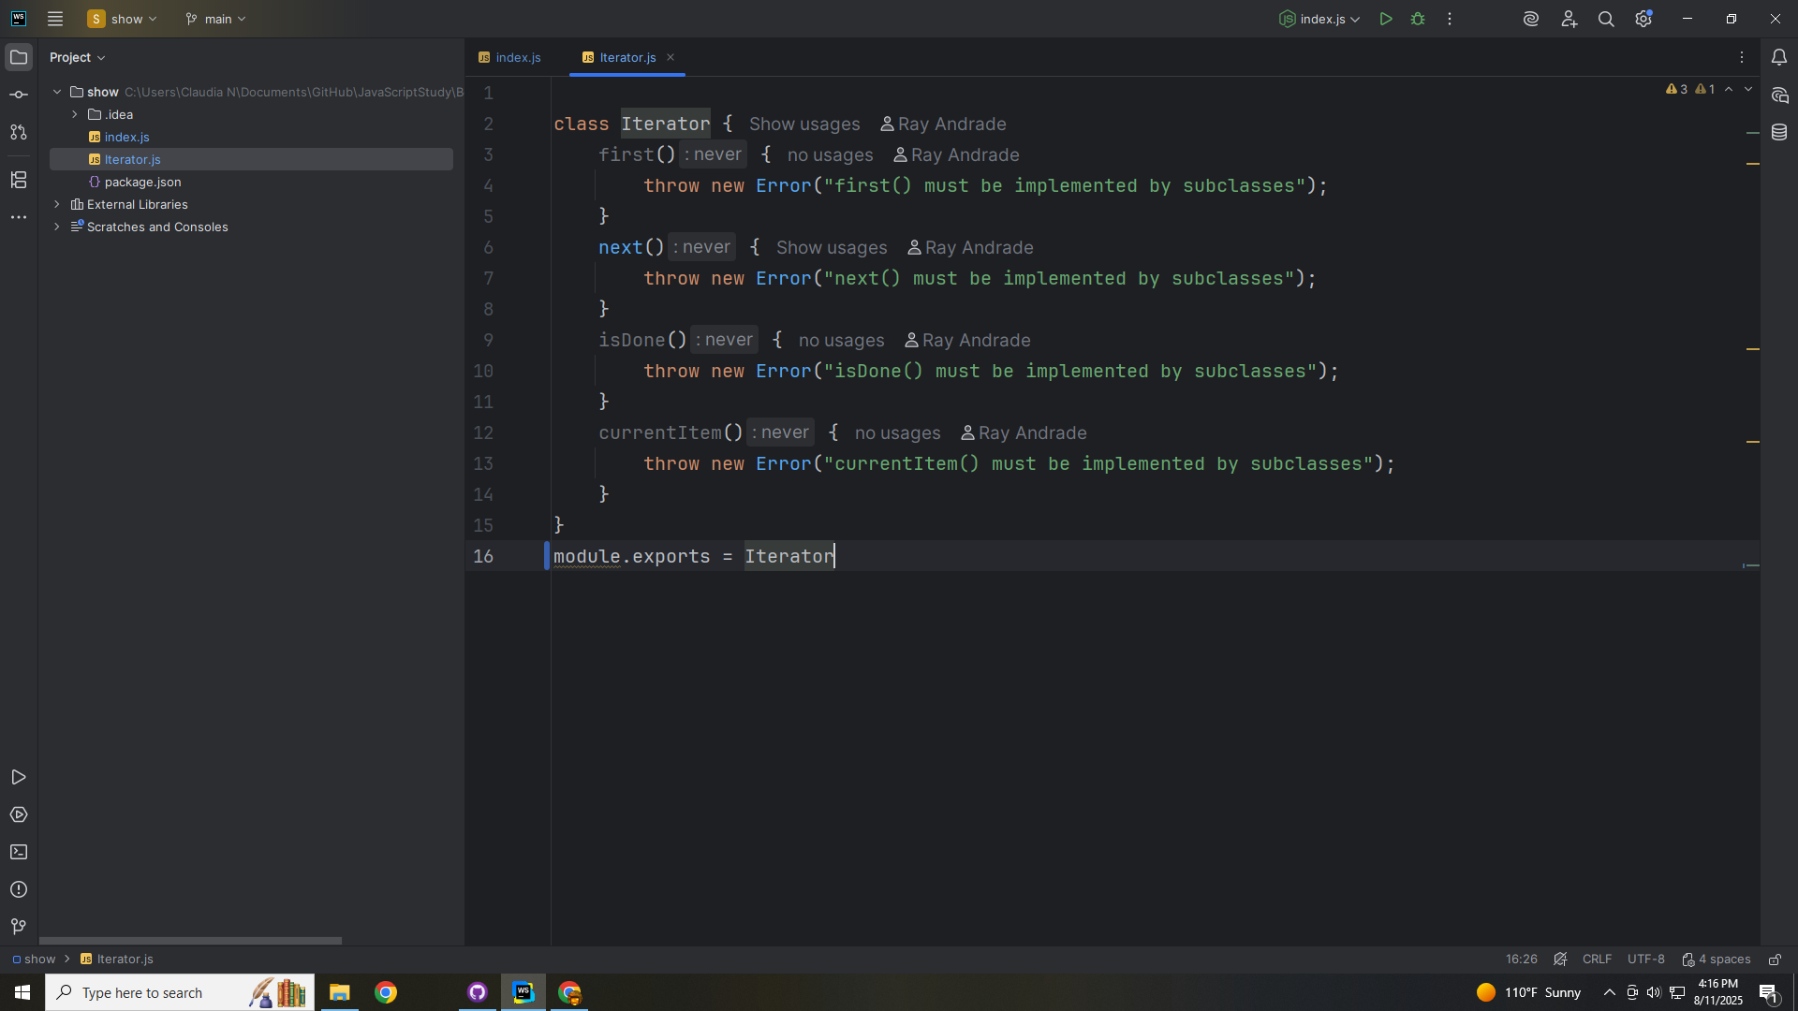
Notes:
We end this module with an export as Iterator

Slide 11
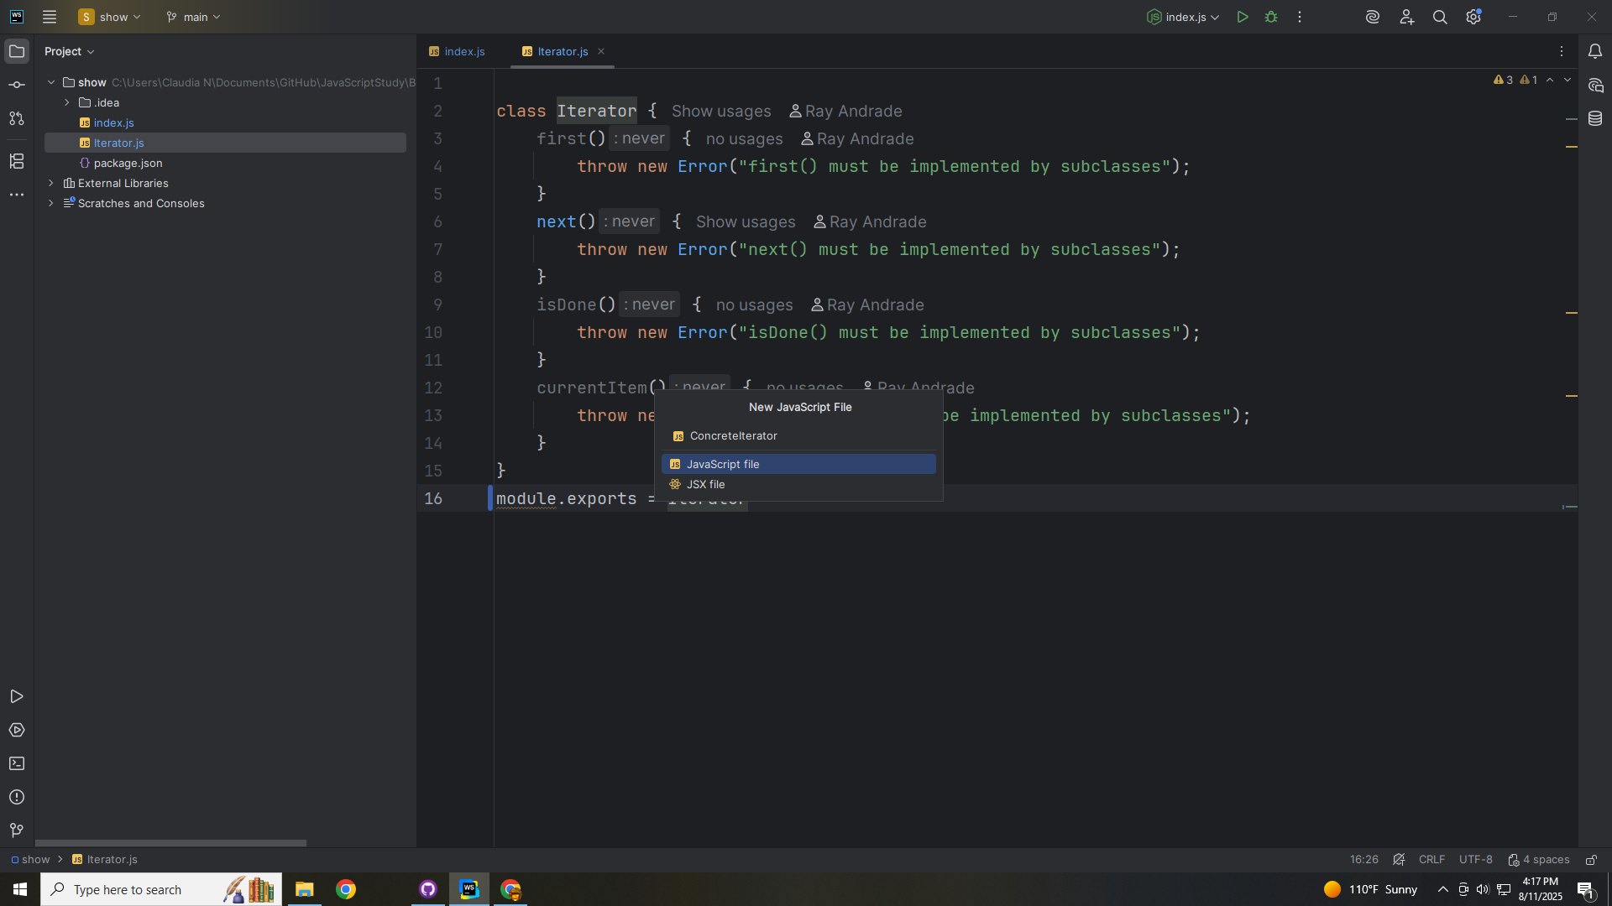
Notes:
Now let’s create a class called Concrete Iterator

Slide 12
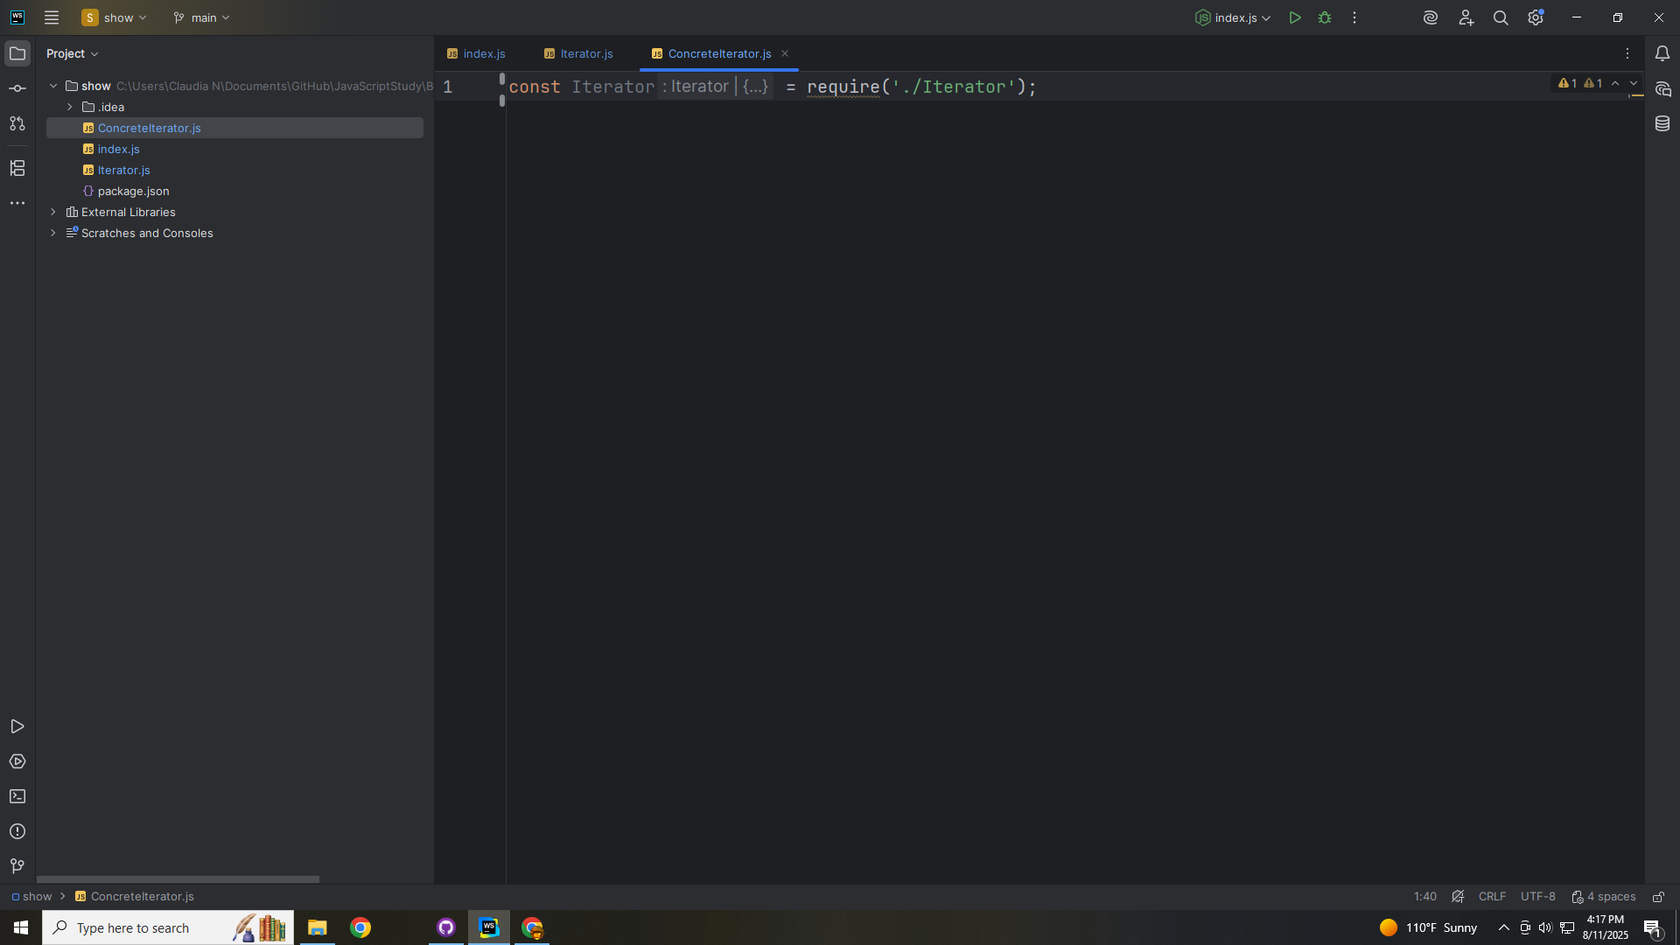
Notes:
We require the Iterator interface at the top

Slide 13
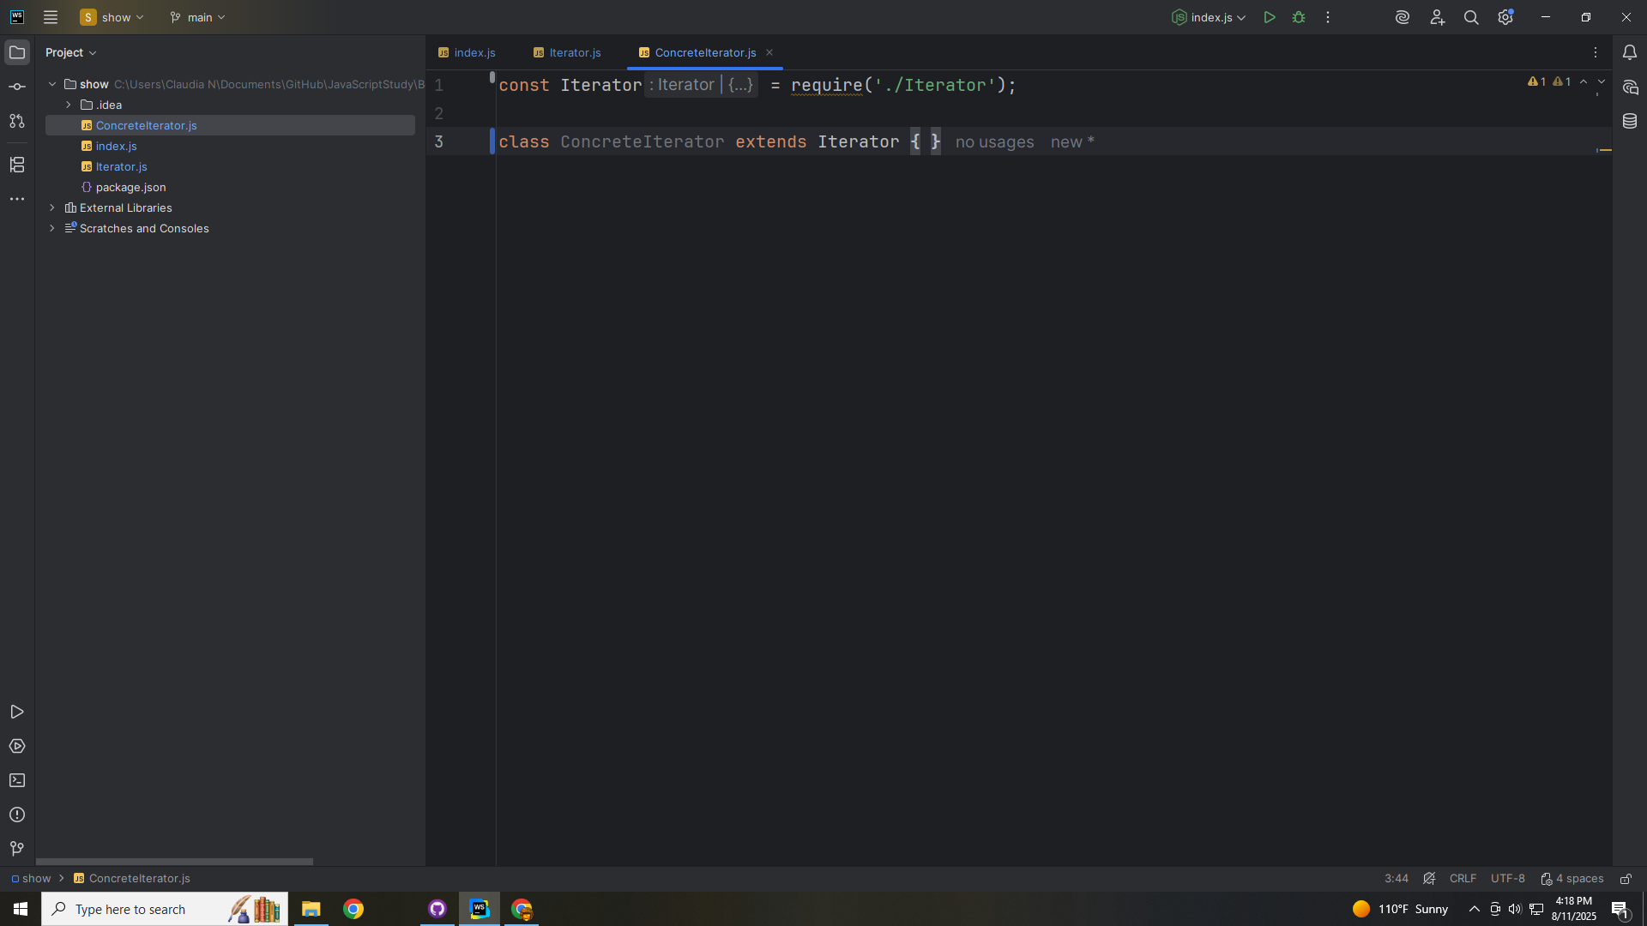
Notes:
This allows us to extend this class with it.
This will implement the Iterator interface, tracking the current position and iterating over the Concrete Aggregate.

Slide 14
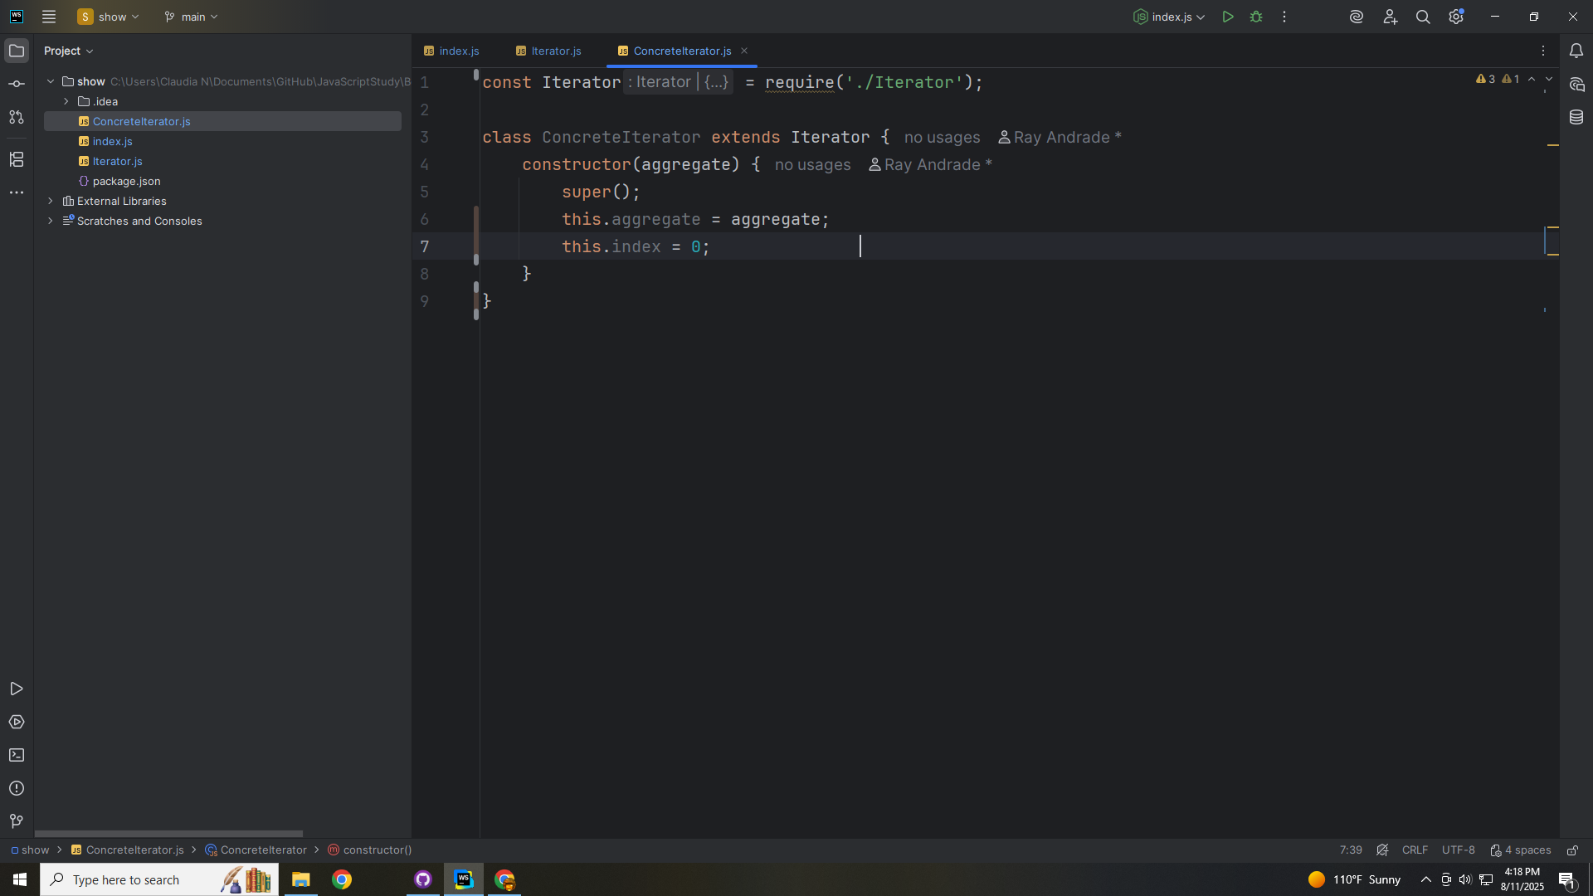
Notes:
We pass in the aggregate object and call super
The we set this dot aggregate to it and we set the index to zero

Slide 15
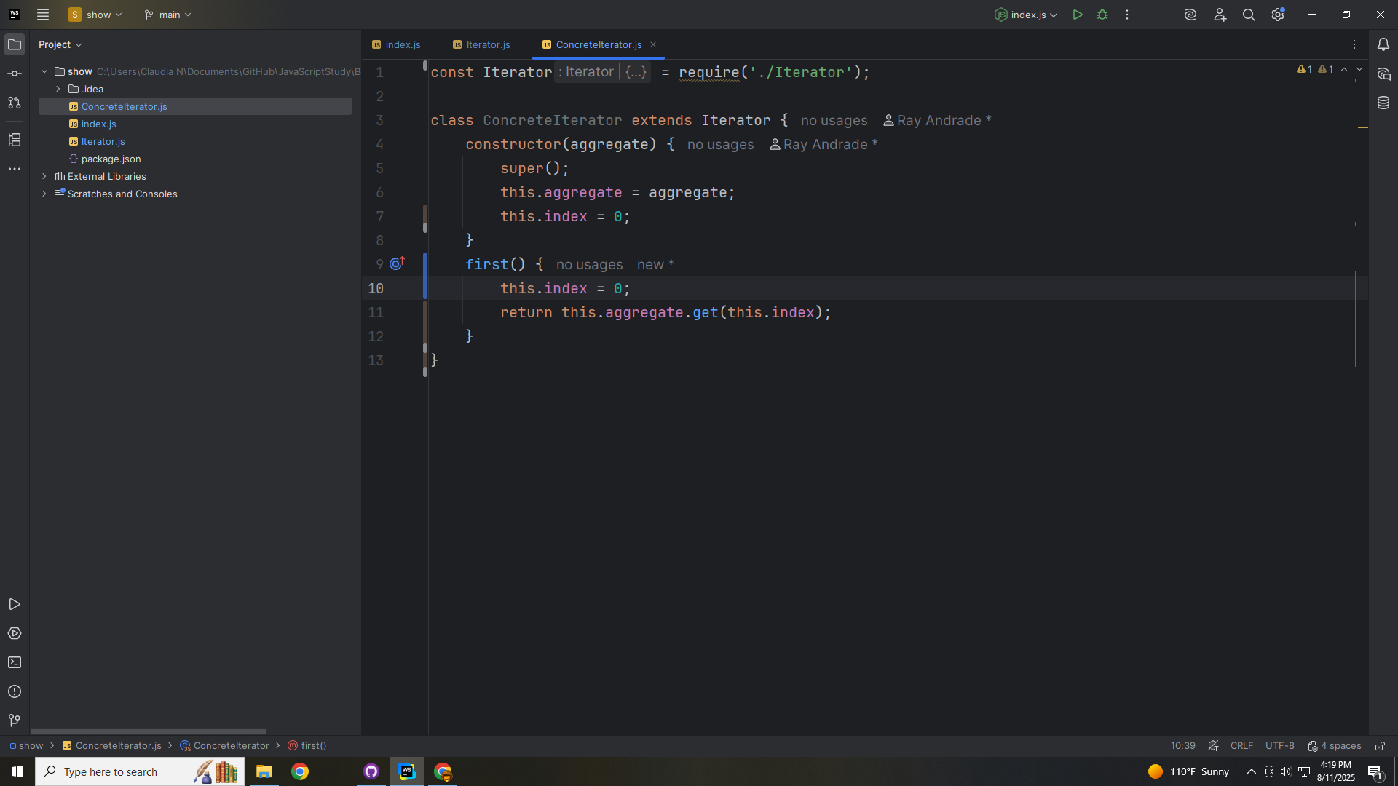
Notes:
We have the first method which sets the index to zero and returns the aggregate
The aggregate is return with the get method for the aggregate at the index

Slide 16
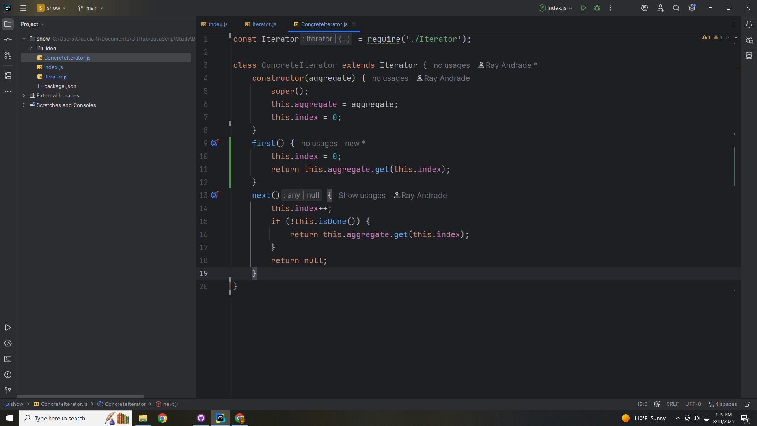
Notes:
The next method increments the index
If this is done then we return the aggregate we get at the index else we return null

Slide 17
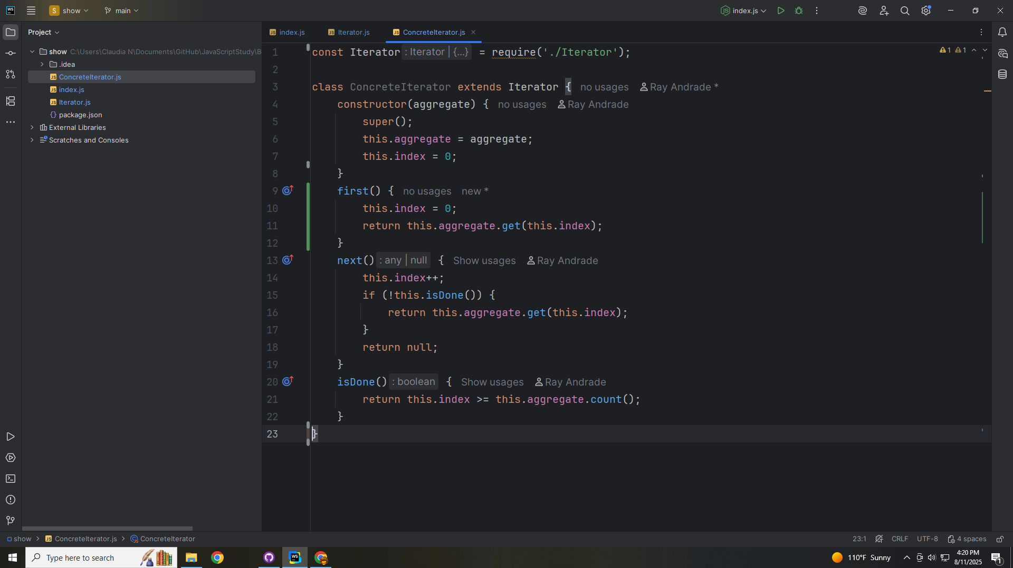
Notes:
At is Done we return the the index is great than or equal to the aggregate count

Slide 18
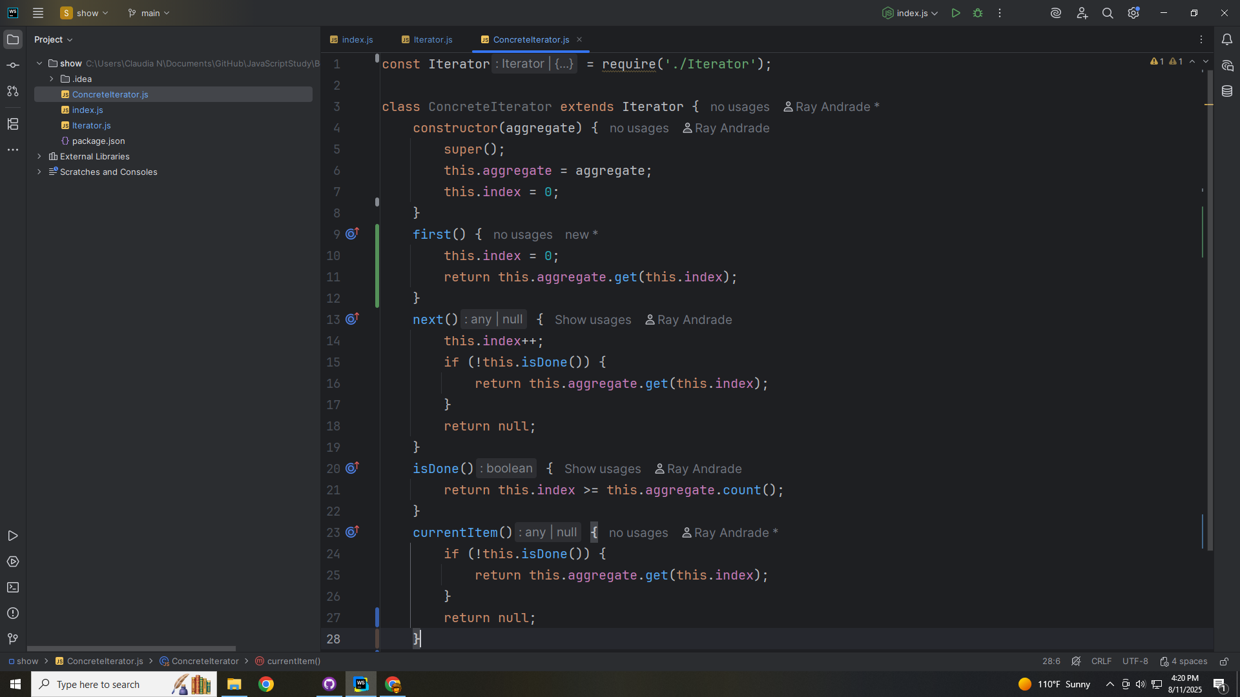
Notes:
For current Item we return if this is done we return the aggregate at the index else we return null

Slide 19
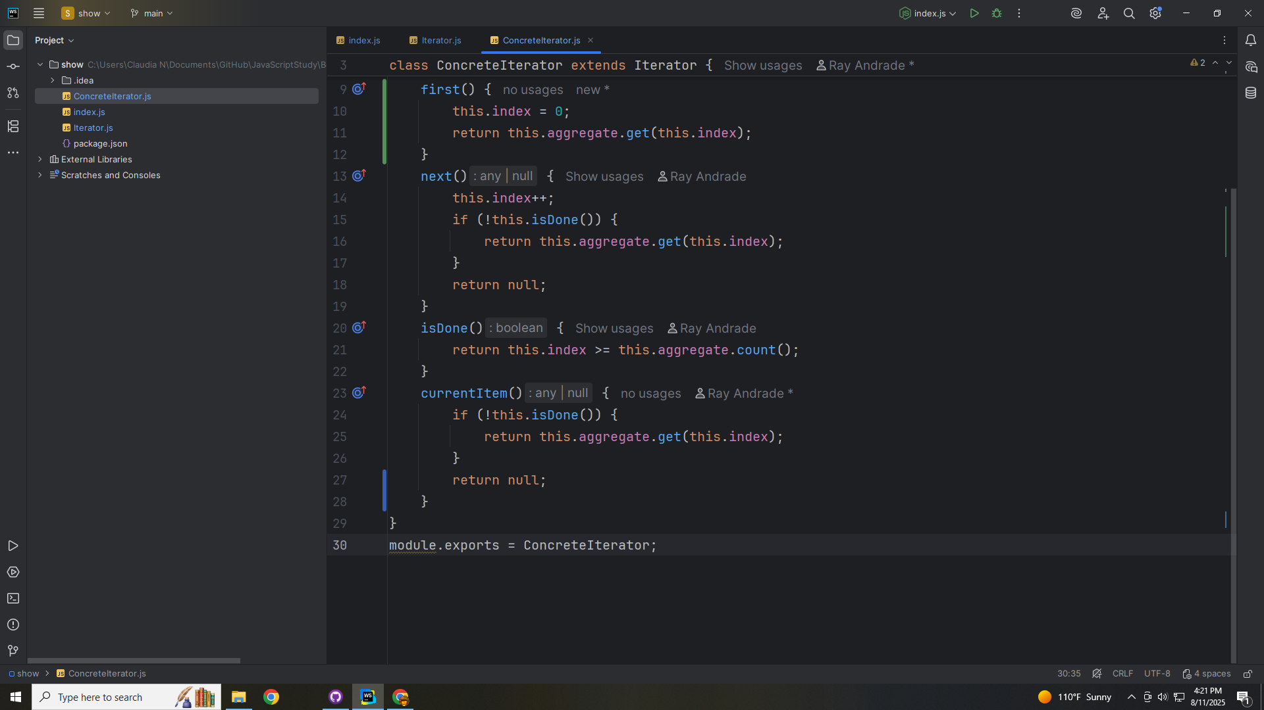
Notes:
We close this module with an export as Concrete Iterator

Slide 20
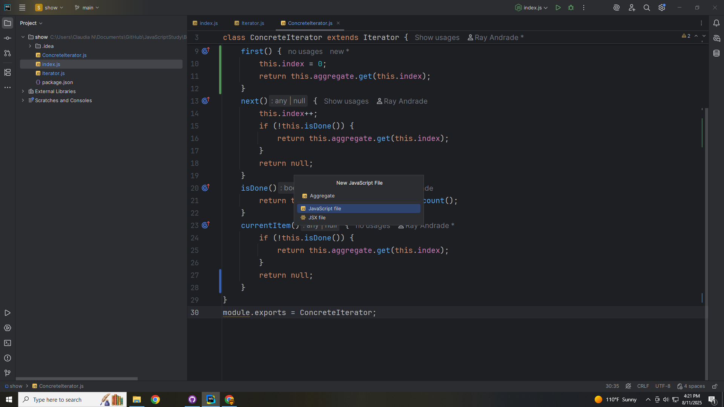
Notes:
And we close this Module to export for use as Concrete Iterator

Slide 21
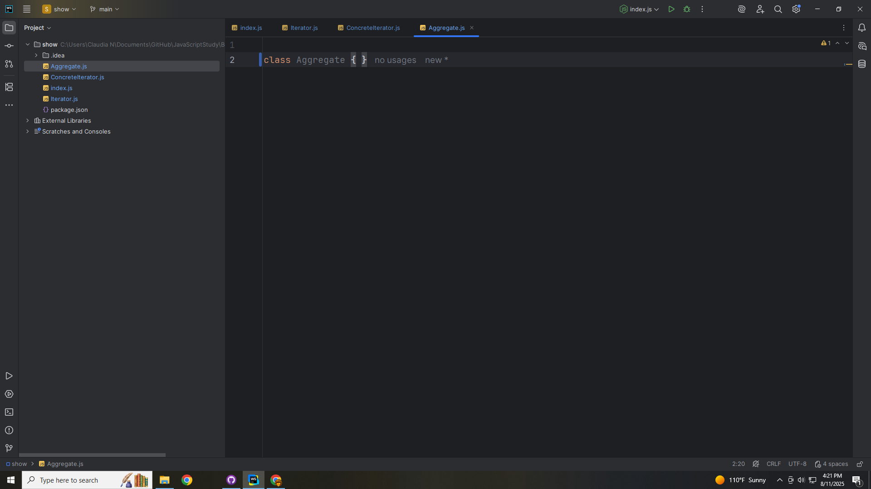
Notes:
Let’s now work on the Aggregate Class this Defines the interface for creating an iterator.

Slide 22
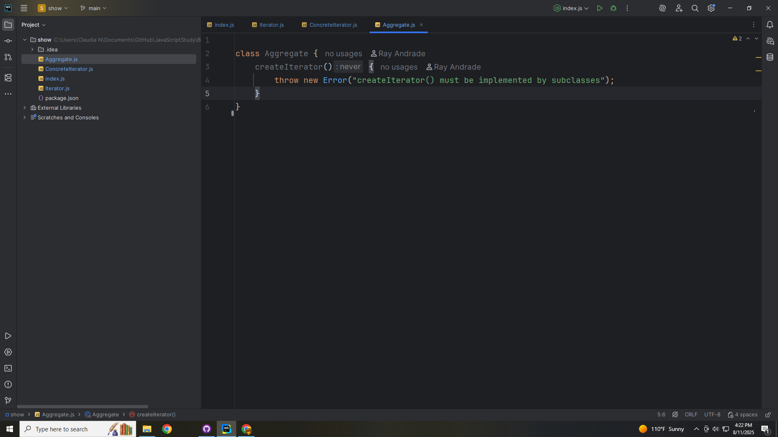
Notes:
We start with a create Iterator method

Slide 23
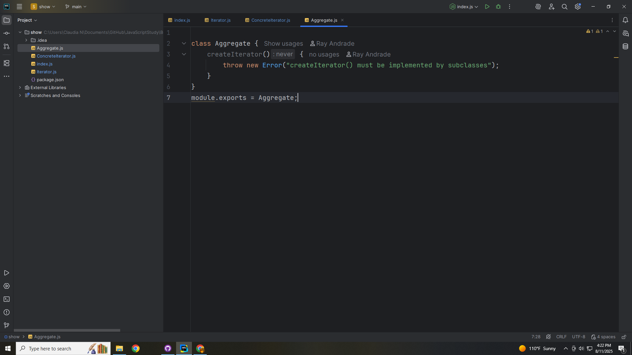
Notes:
And we export this module for use in our demo as Aggregate

Slide 24
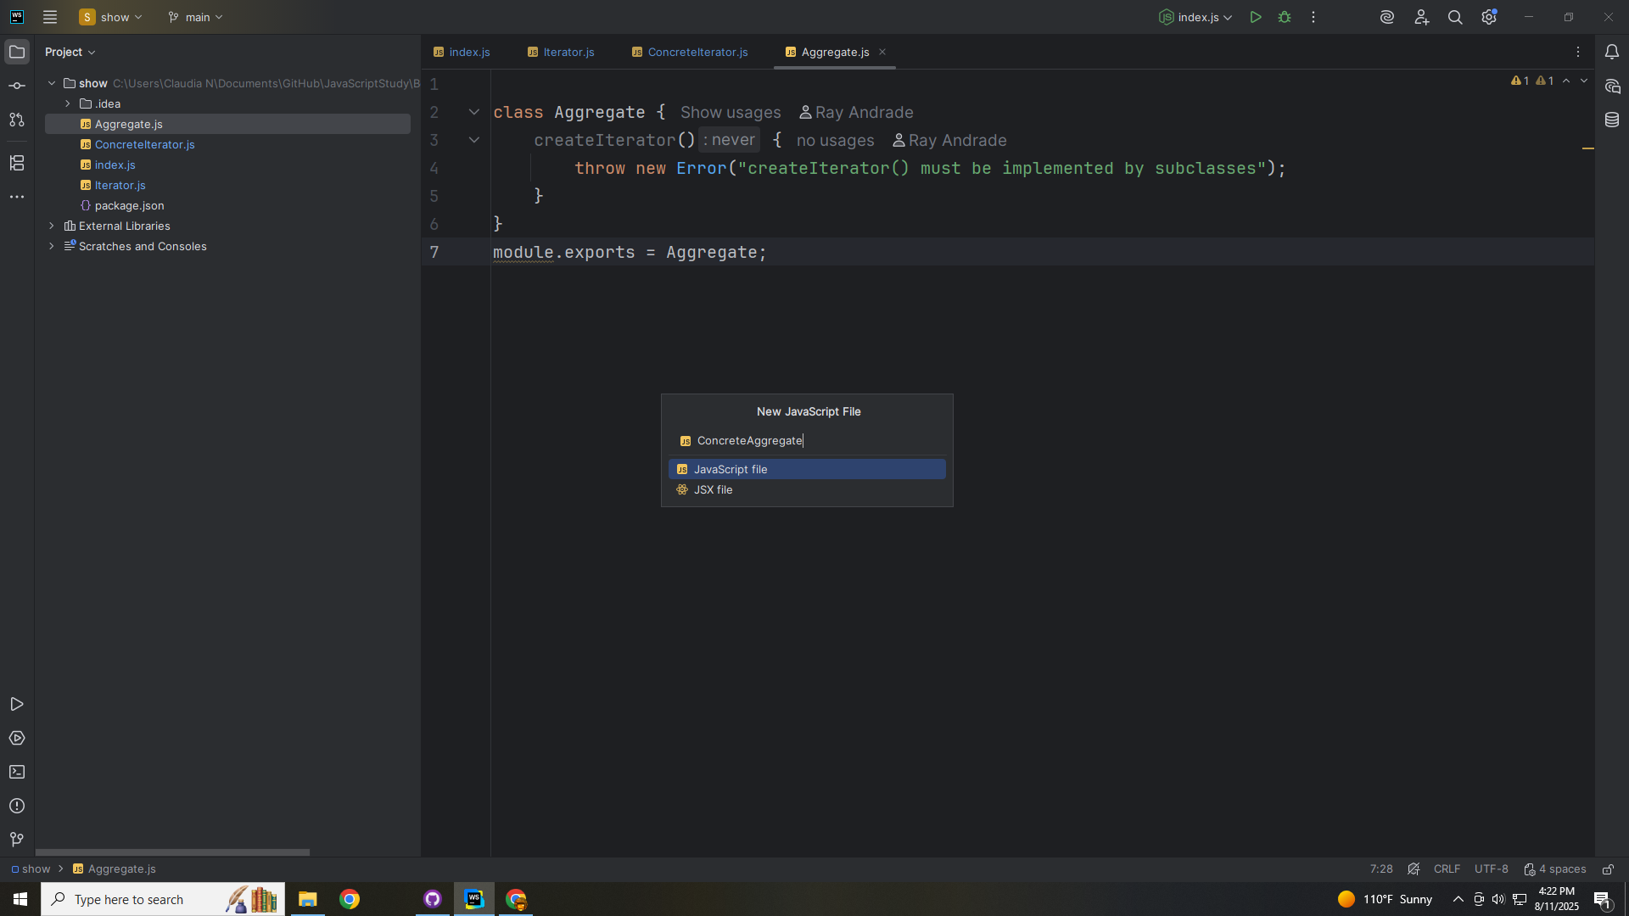
Notes:
Let’s now work on the Concrete Aggregate

Slide 25
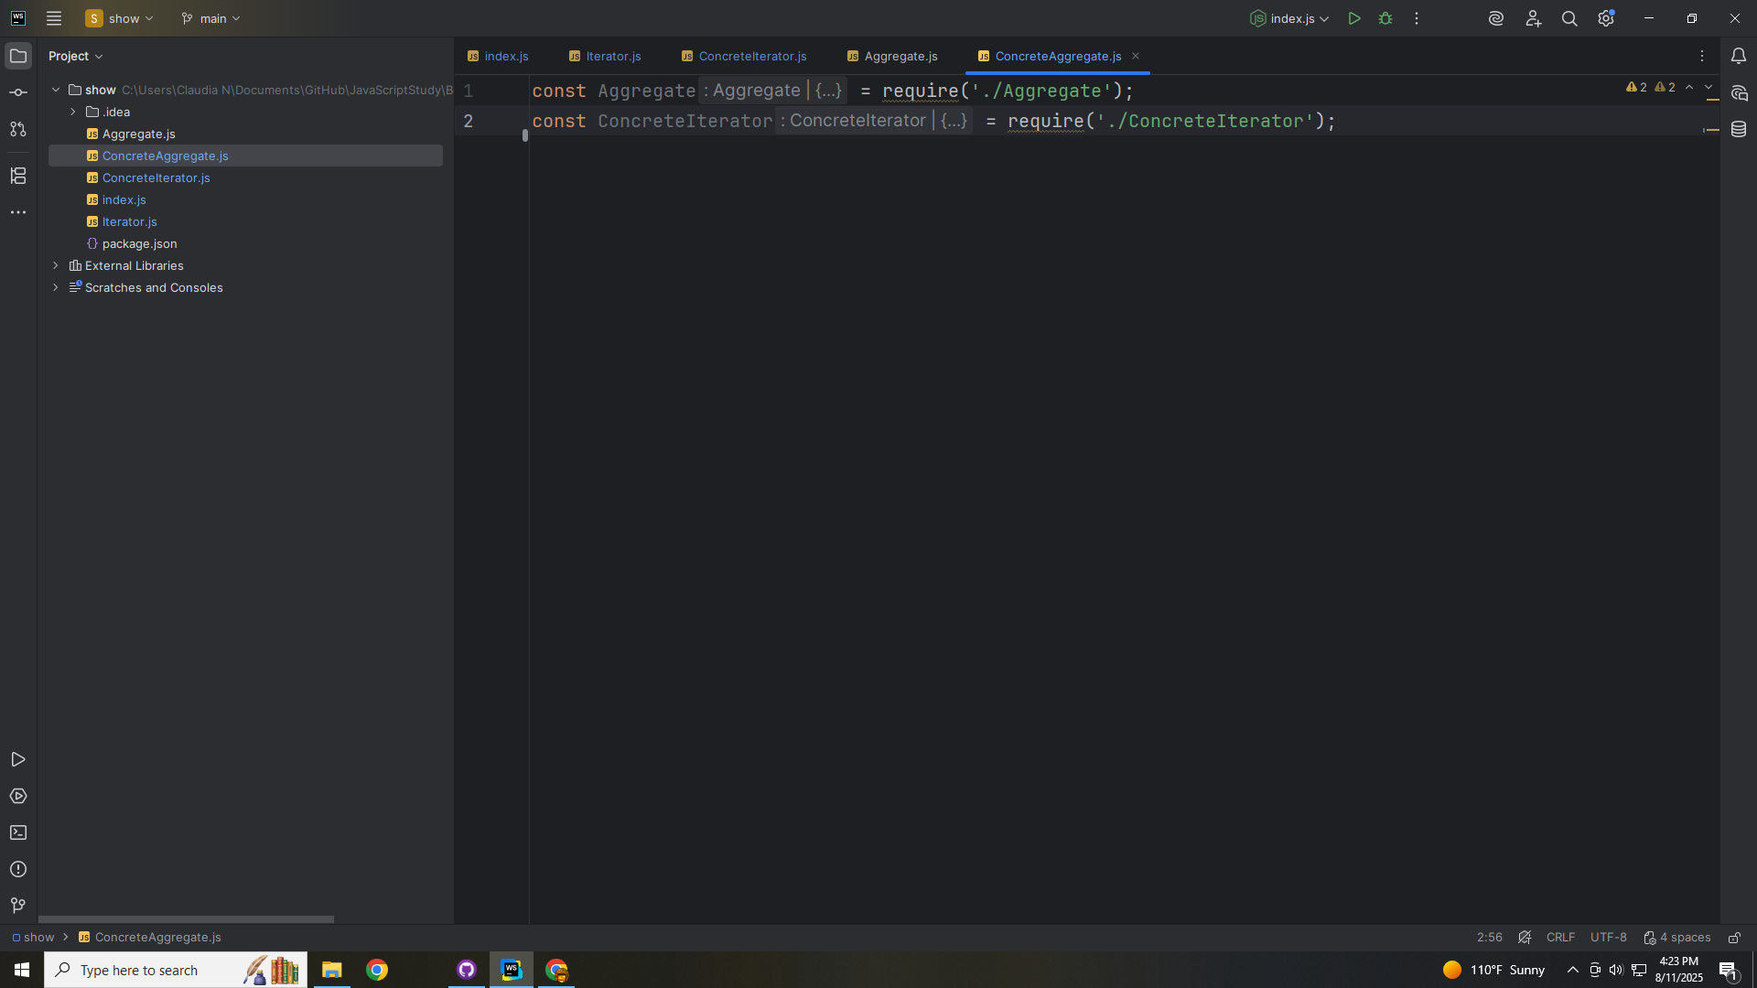
Notes:
The Concrete Aggregate will Implement the Aggregate and stores elements in a List and returns a Concrete Iterator.
At the top we include the Aggregate and the Concrete Iterator

Slide 26
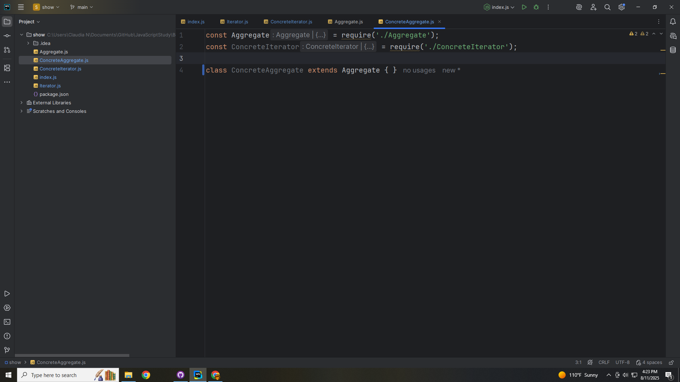
Notes:
We extend THIS class the Concrete Aggregate with the Aggregate

Slide 27
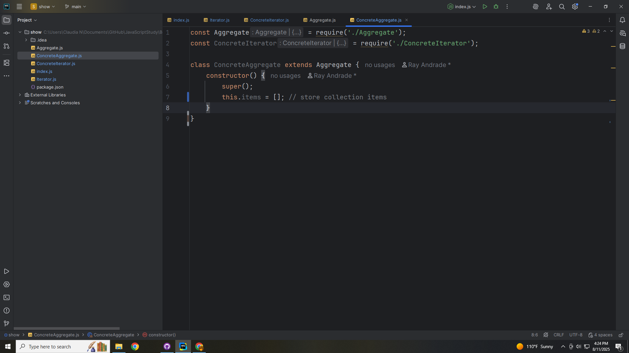
Notes:
We set up our class with a constructor
We initialize our container for our elements

Slide 28
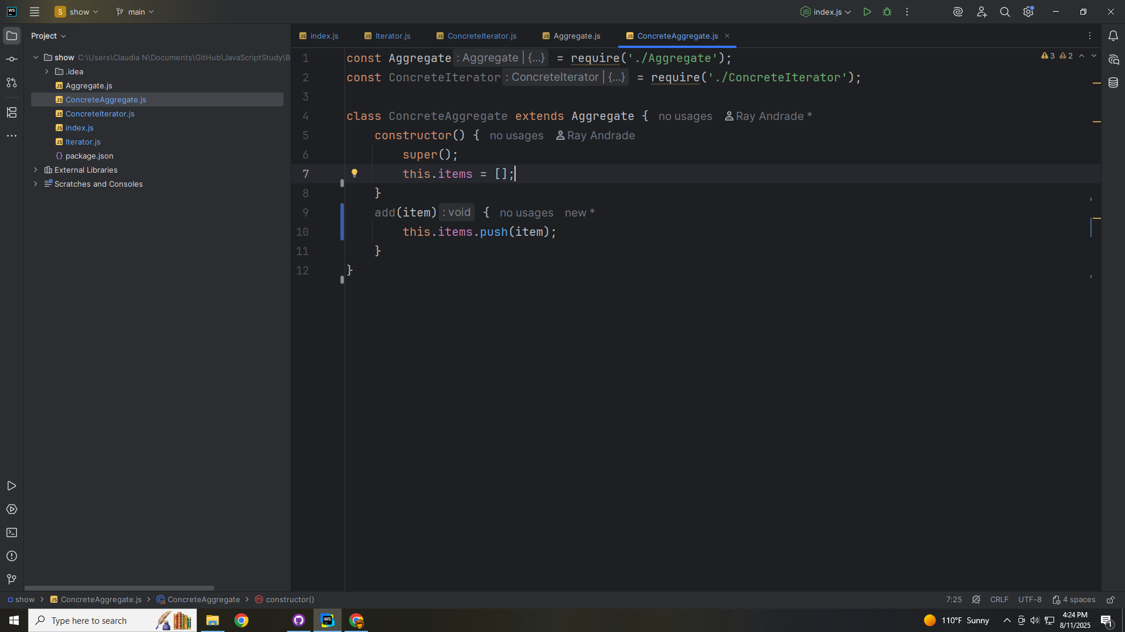
Notes:
We have a method to add items and we push that item onto a stack of items we have created

Slide 29
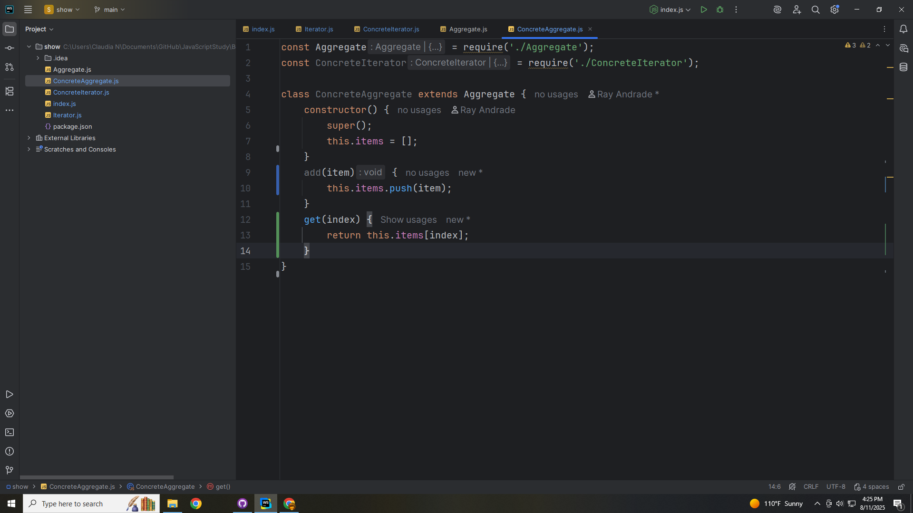
Notes:
We create a method to get items from the stack and it take the index number

Slide 30
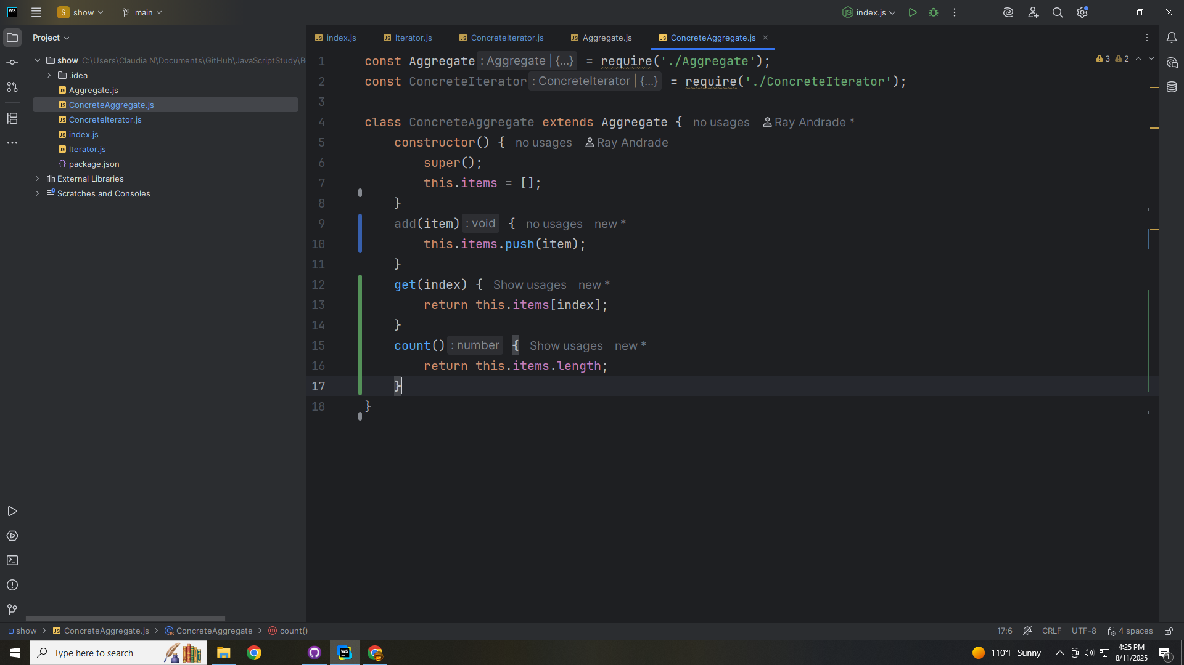
Notes:
We have a count method that returns the length of the array

Slide 31
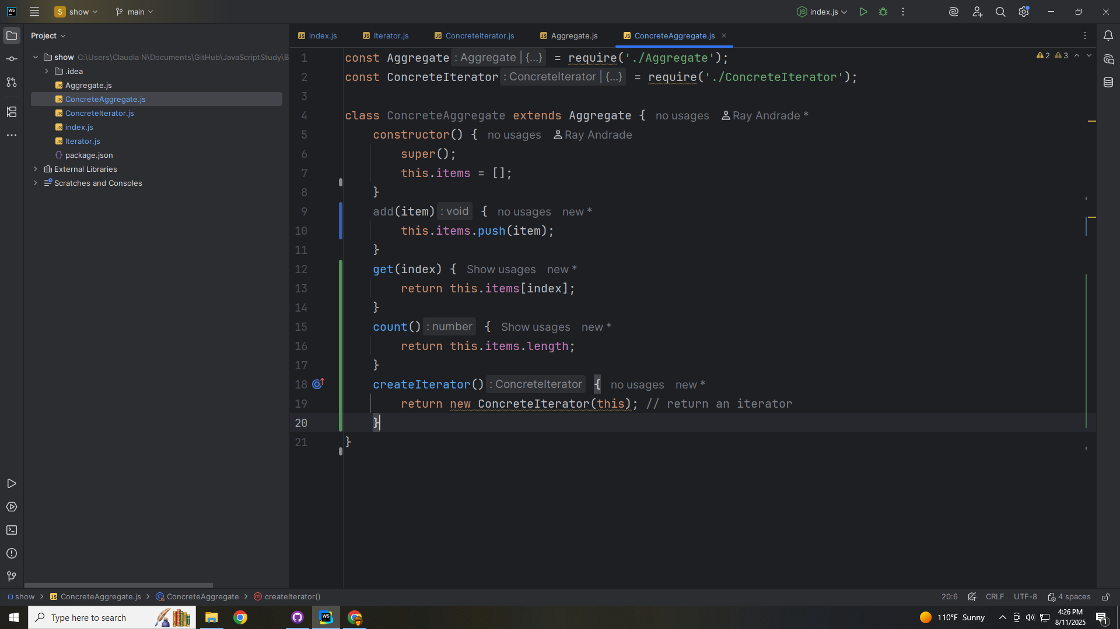
Notes:
We have a method create Iterator that creates a new Concrete Iterator

Slide 32
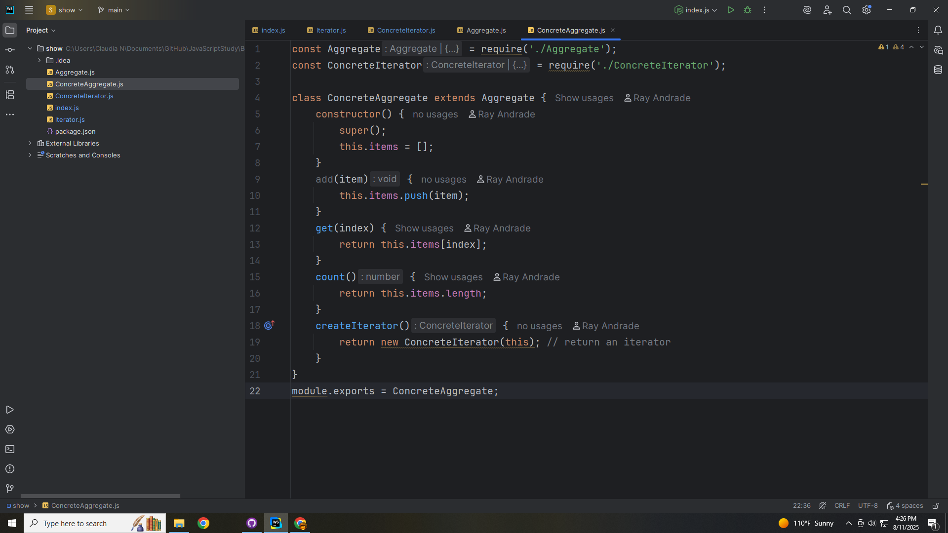
Notes:
We export this Module as Concrete Aggregate for use in our demo

Slide 33
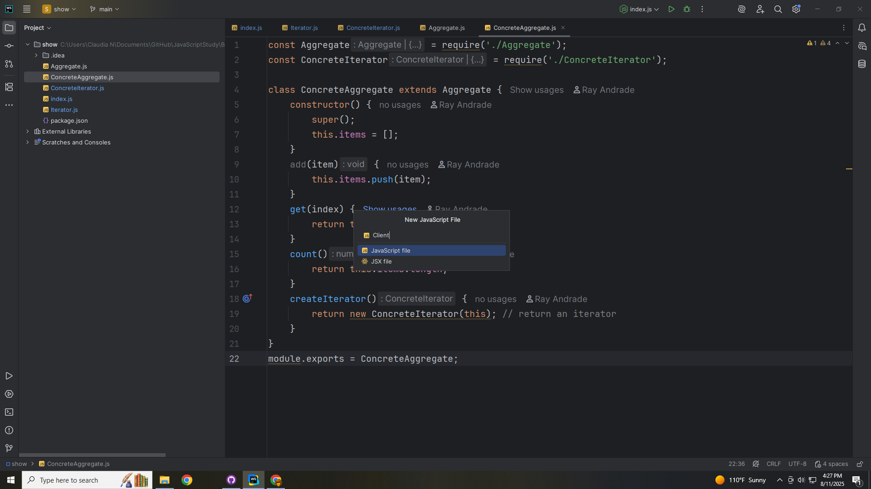
Notes:
Now let’s work on the Client

Slide 34
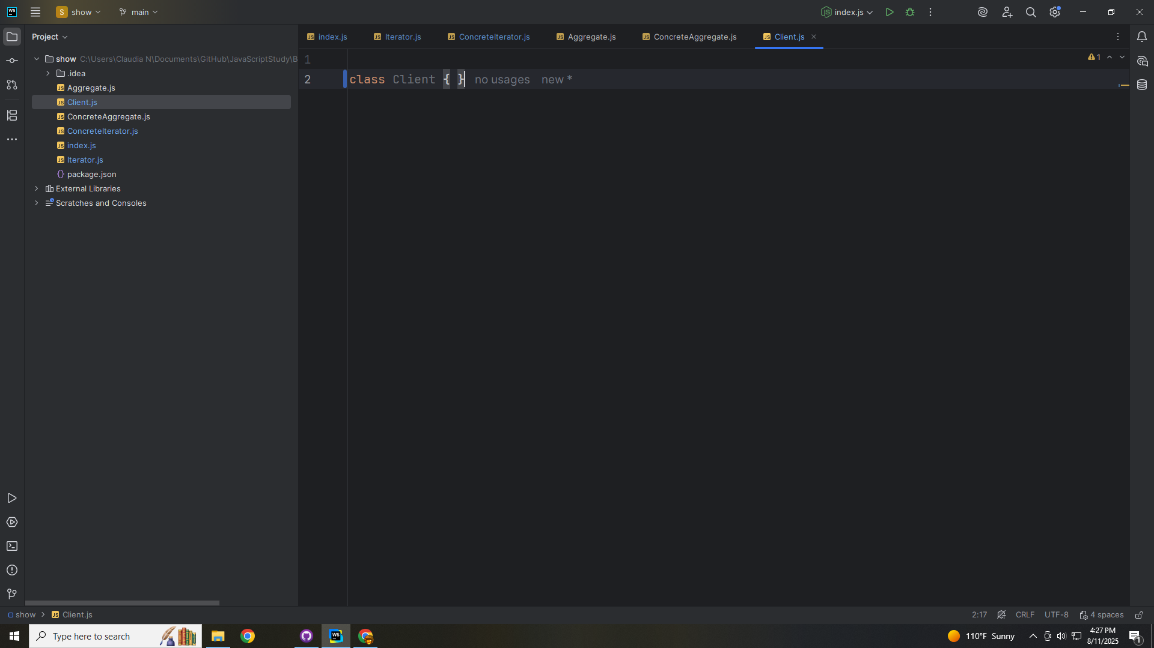
Notes:
We will put all our work in our Client class for a demo

Slide 35
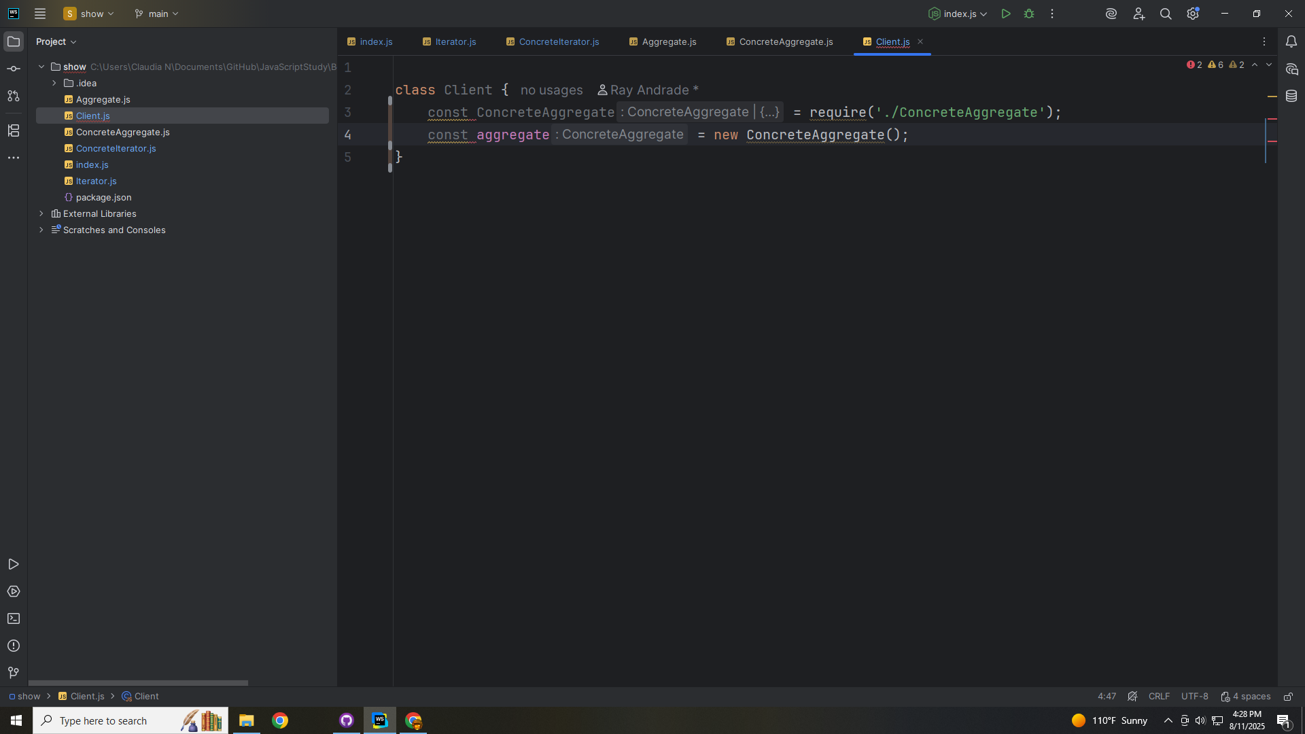
Notes:
(skip this slide)

Slide 36
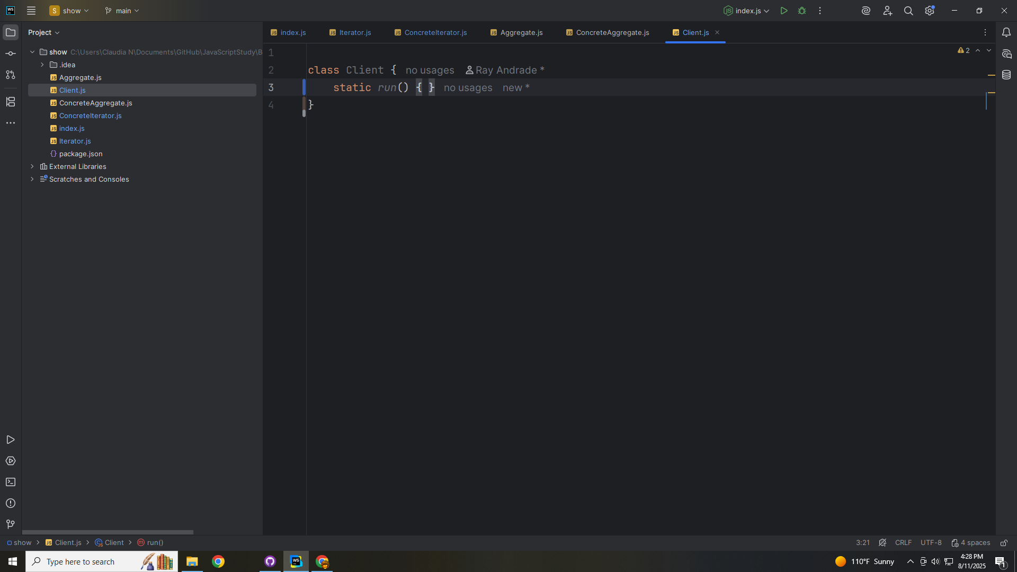
Notes:
The purpose of the client is that it uses an iterator to traverse a collection without knowing its concrete structure.

Slide 37
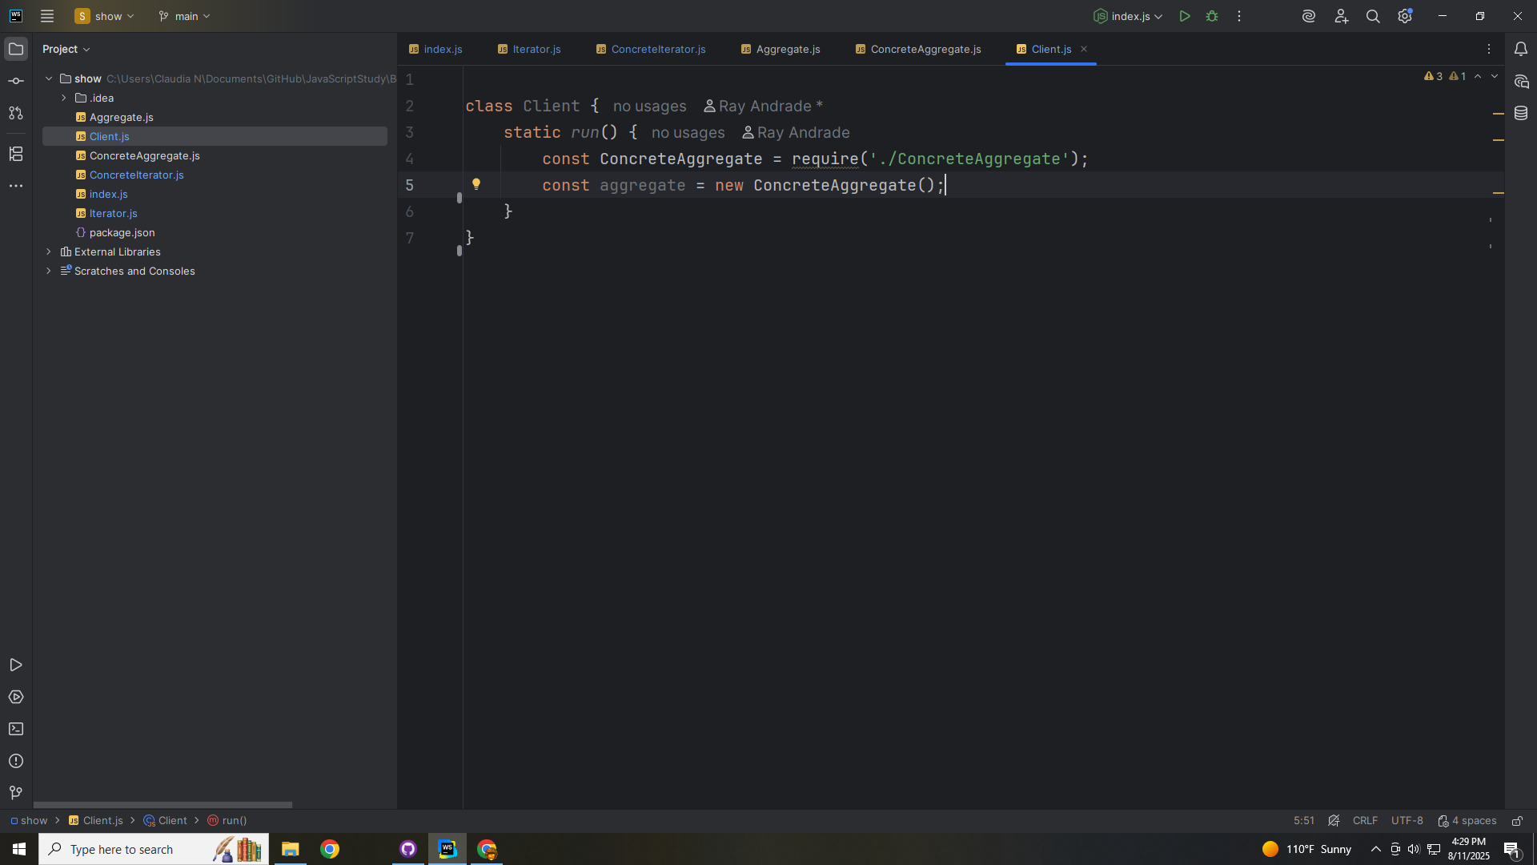
Notes:
In the run method we require the Concrete Aggregate so we can create a new Concrete Aggregate object

Slide 38
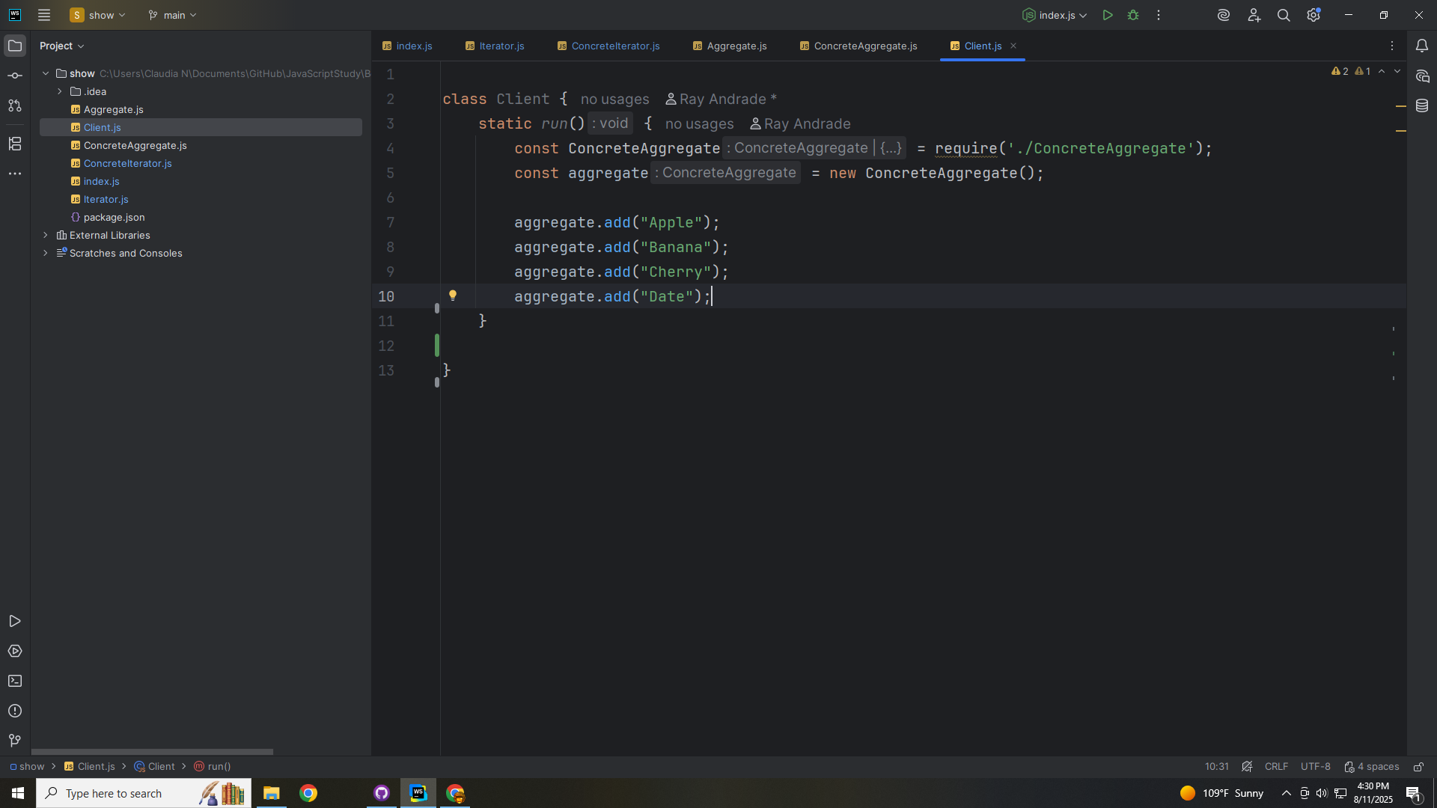
Notes:
And the we add some items to our array
We add Apple, Banana, Cherry and a Date … A, B, C and D

Slide 39
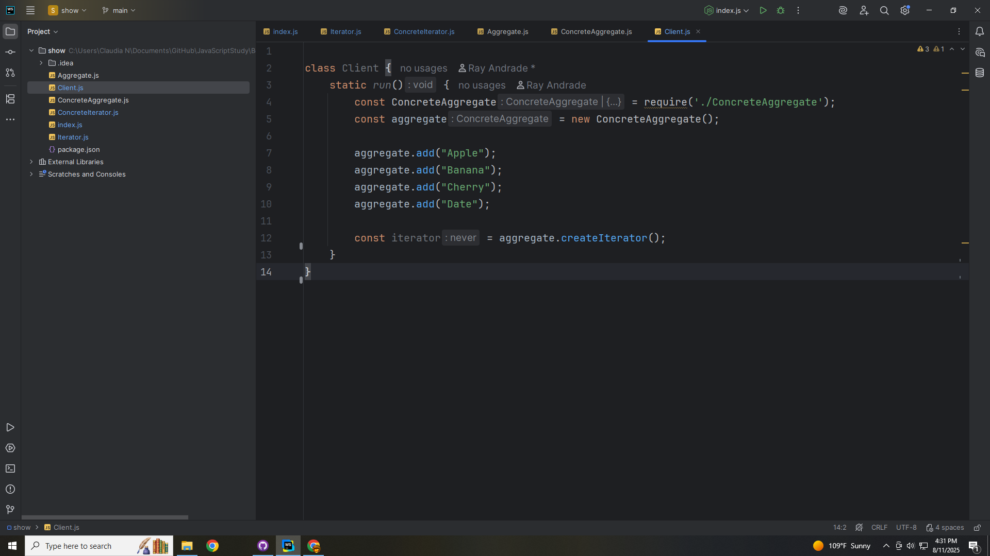
Notes:
With our aggregate we Create Iterator

Slide 40
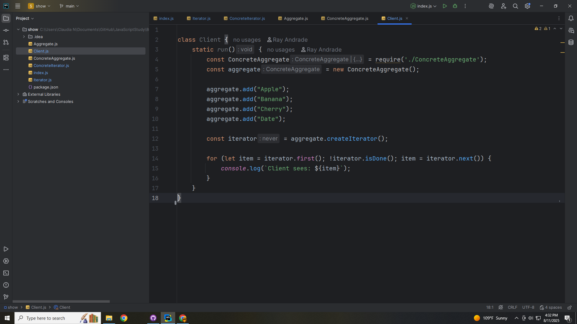
Notes:
And we loop through each item

Slide 41
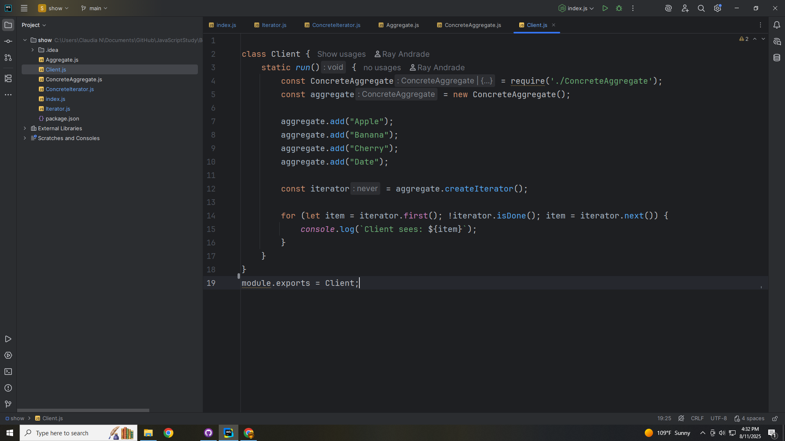
Notes:
Let’s export this module for our demo in the index page

Slide 42
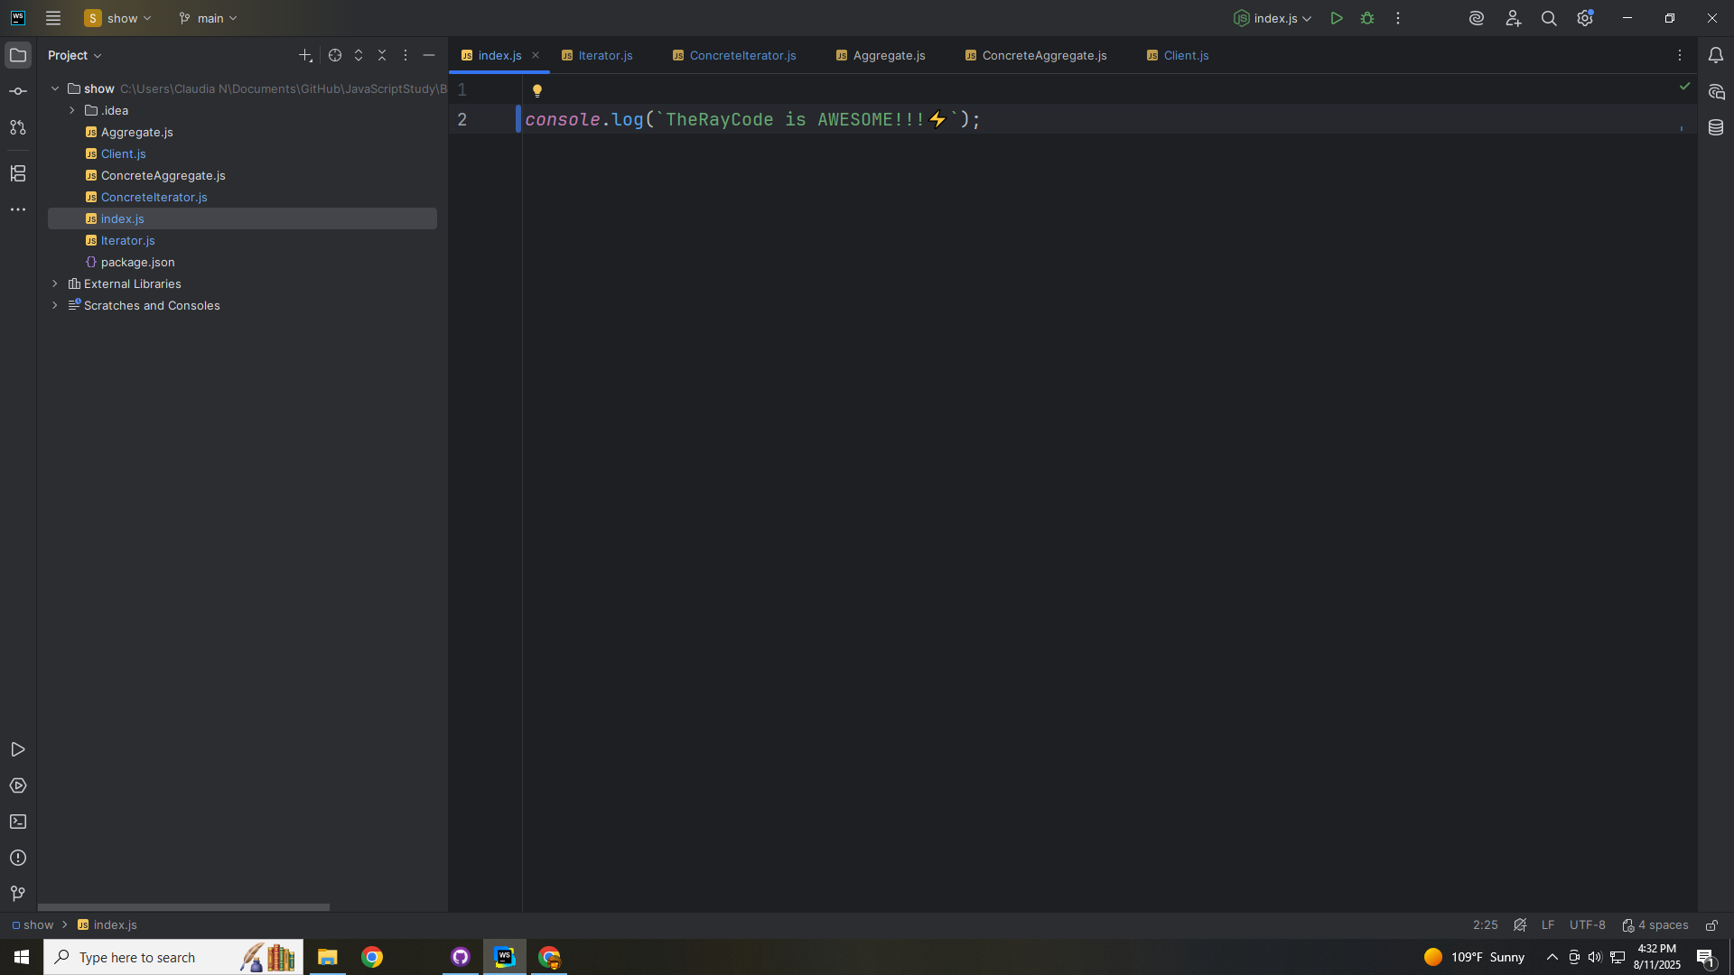
Notes:
At the index

Slide 43

Notes:
We require the Client

Slide 44
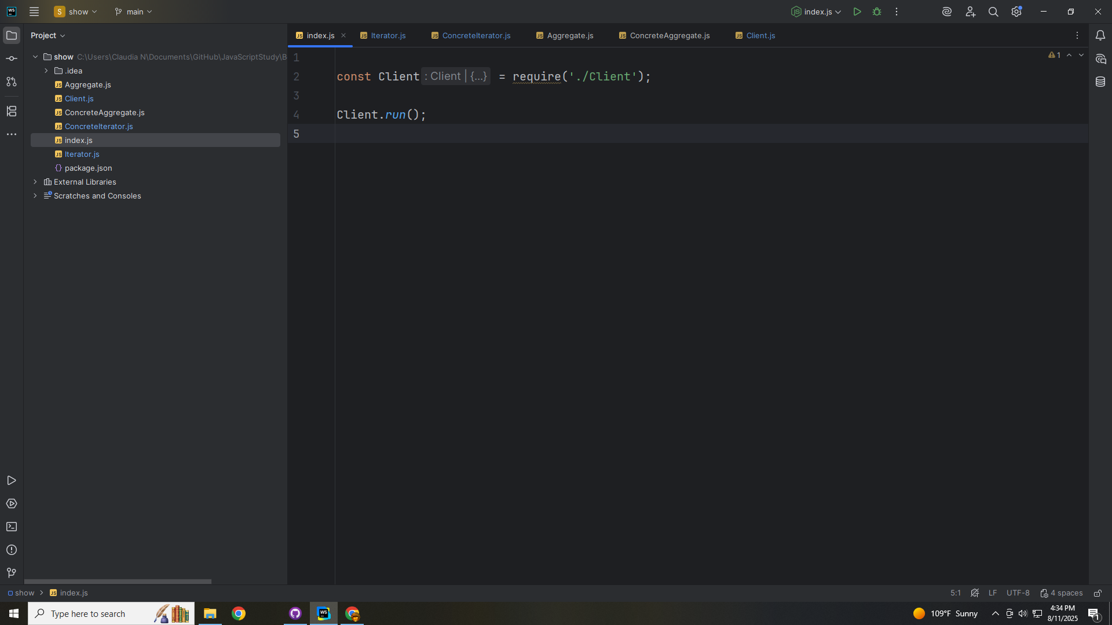
Notes:
And from there we execute the run method and we get

Slide 45
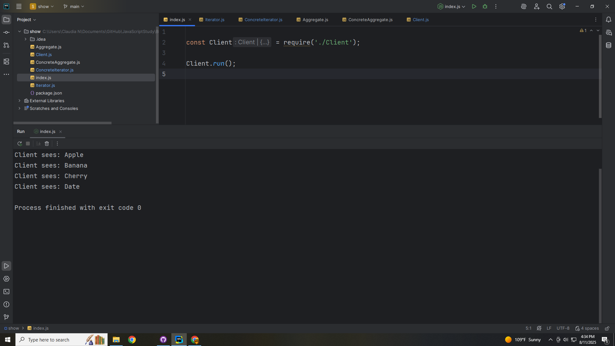
Notes:
Client sees: Apple
Client sees: Banana
Client sees: Cherry
Client sees: Date
Notice that the client never directly indexes the collection
✅ The iterator encapsulates the traversal
✅ Practice extending this to support bidirectional or filtered iterators
My name is Ray continue to code with a smile

