Slide 1
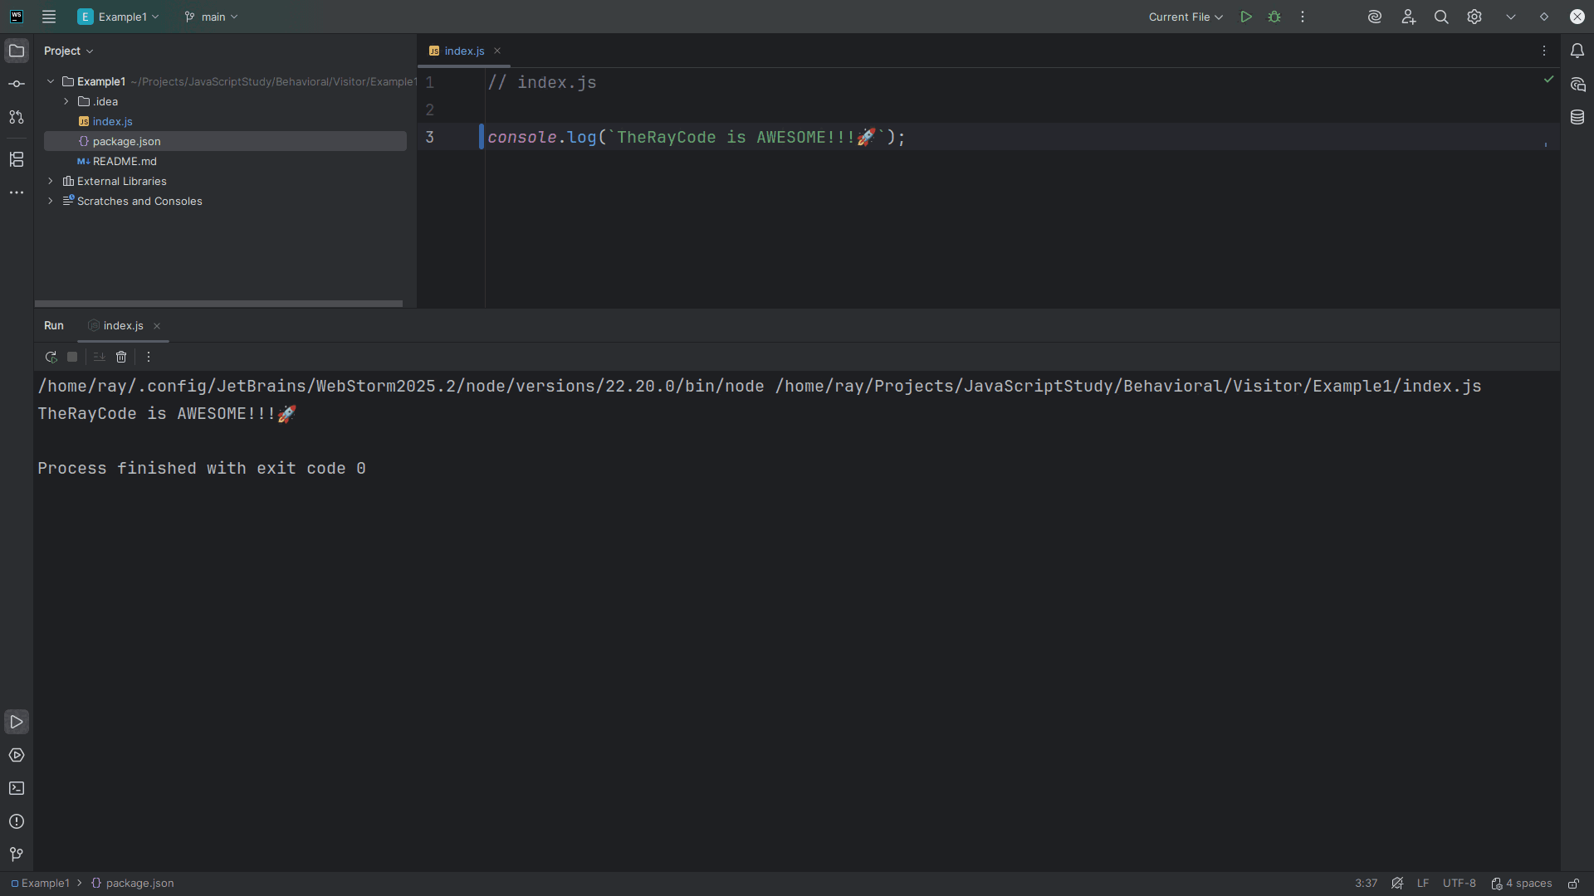
Notes:
(No Sound)

Slide 2
Notes:
Hello, I’m Ray, the Ray in TheRayCode
Today I want to review the design pattern called Visitor.
The Visitor is a behavioral design patten and I will be using JavaScript

Slide 3
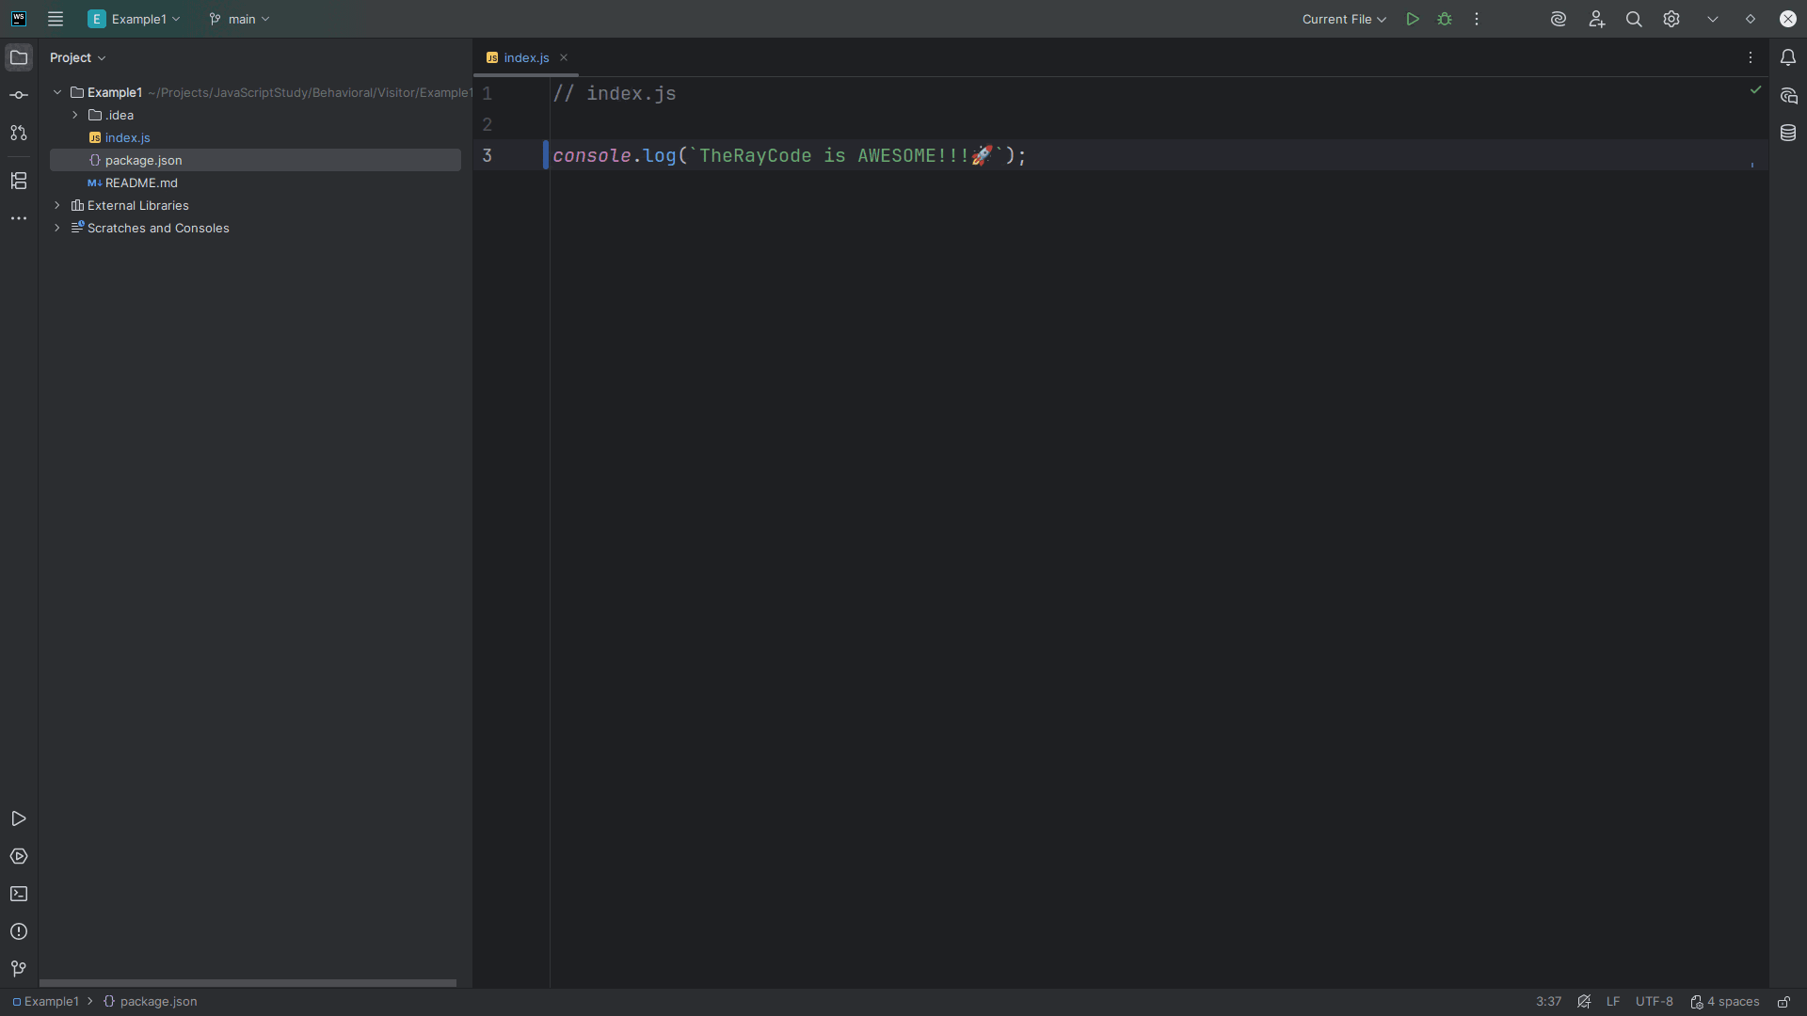
Notes:
The Visitor pattern is a behavioral pattern that lets you add new operations to existing object structures without changing their classes,

Slide 4
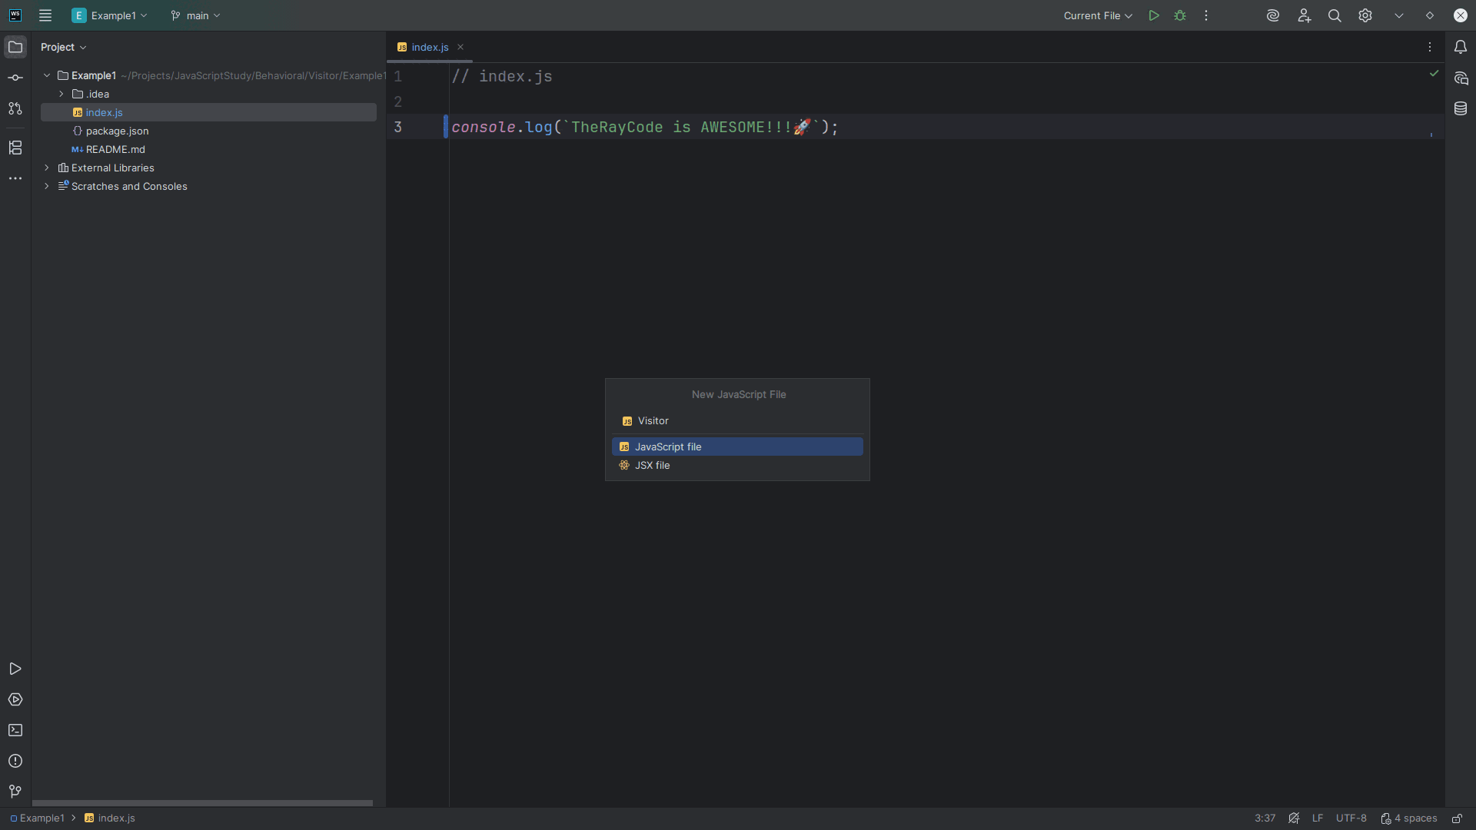
Notes:
We start with a Visitor interface

Slide 5
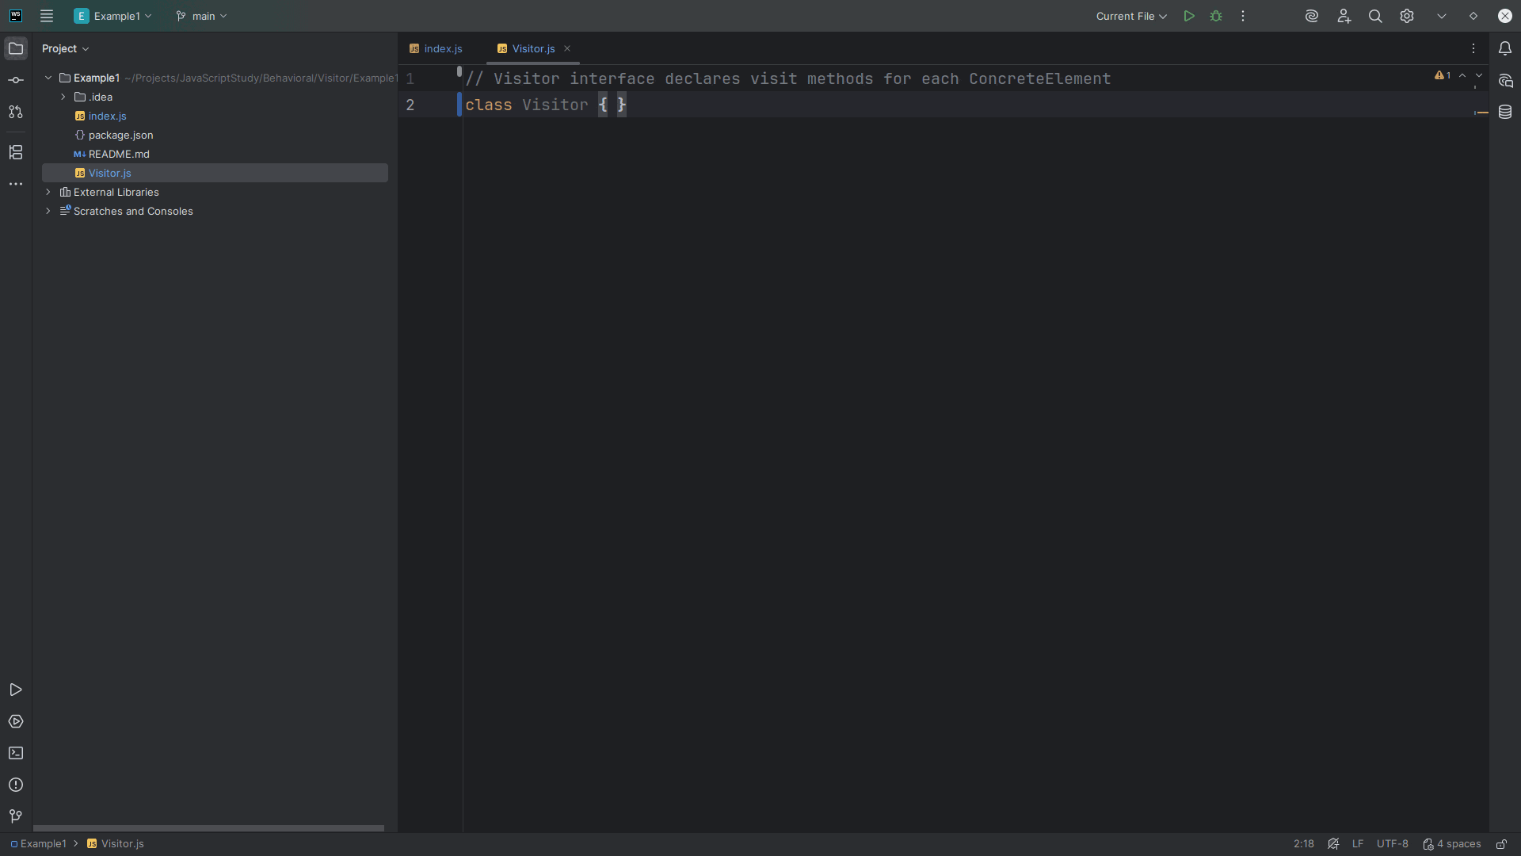
Notes:
The Visitor interface declares visit methods for each Concrete Element

Slide 6
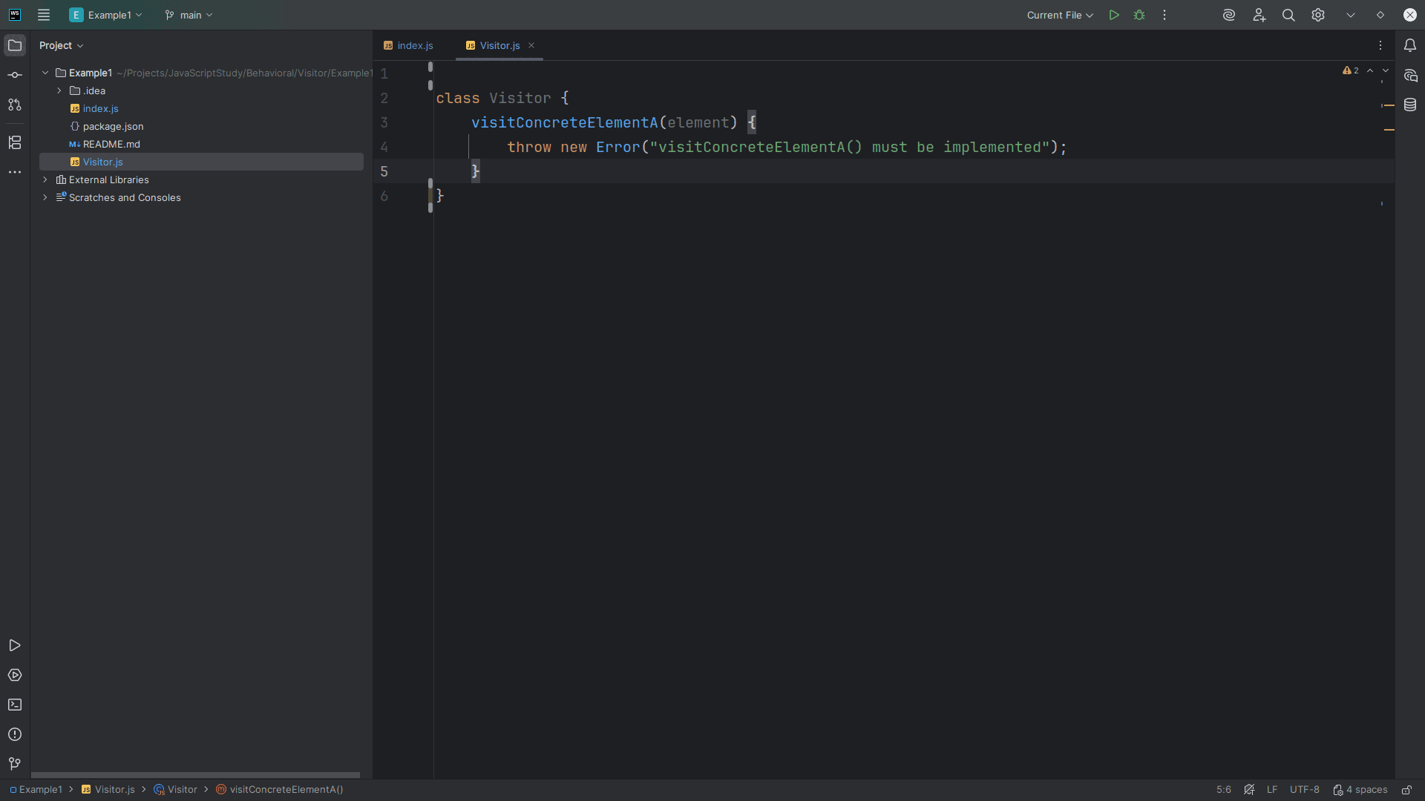
Notes:
We require a visit Concrete Element A method that takes an element object.
We throw an error if this method is not implemented

Slide 7
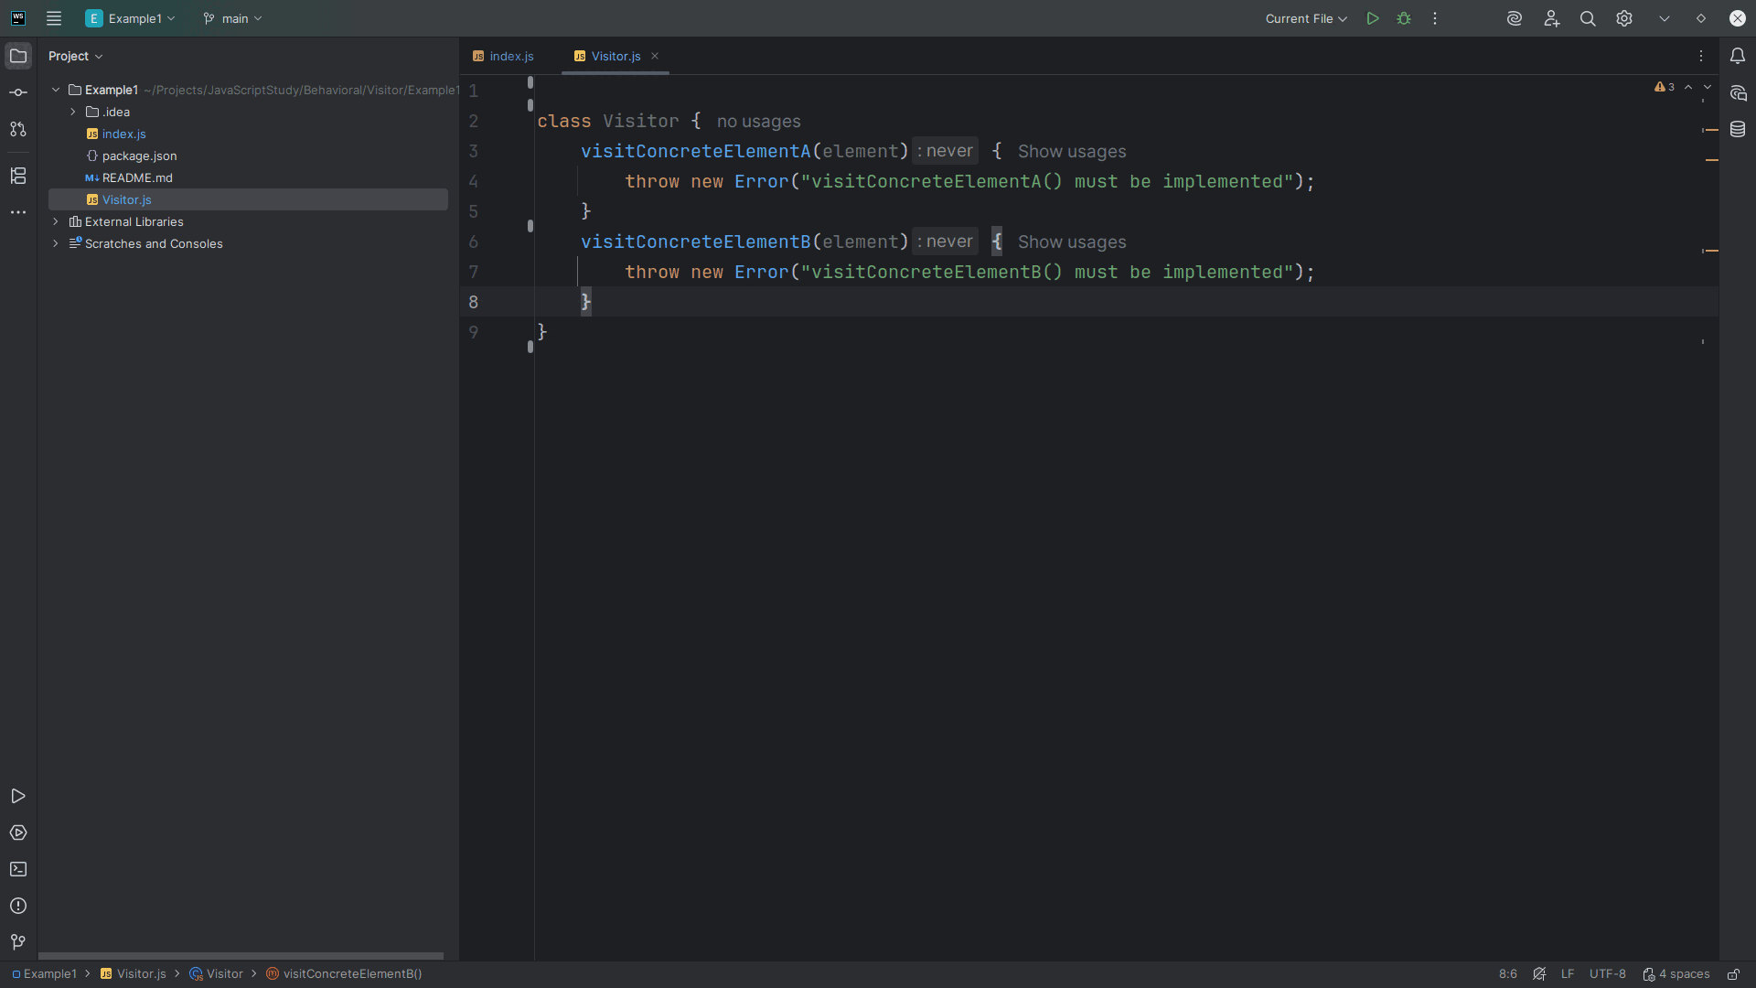
Notes:
We add the requirement for another method we call visit Concrete Element B which takes an element object also
We also throw an error it this too is not implemented

Slide 8
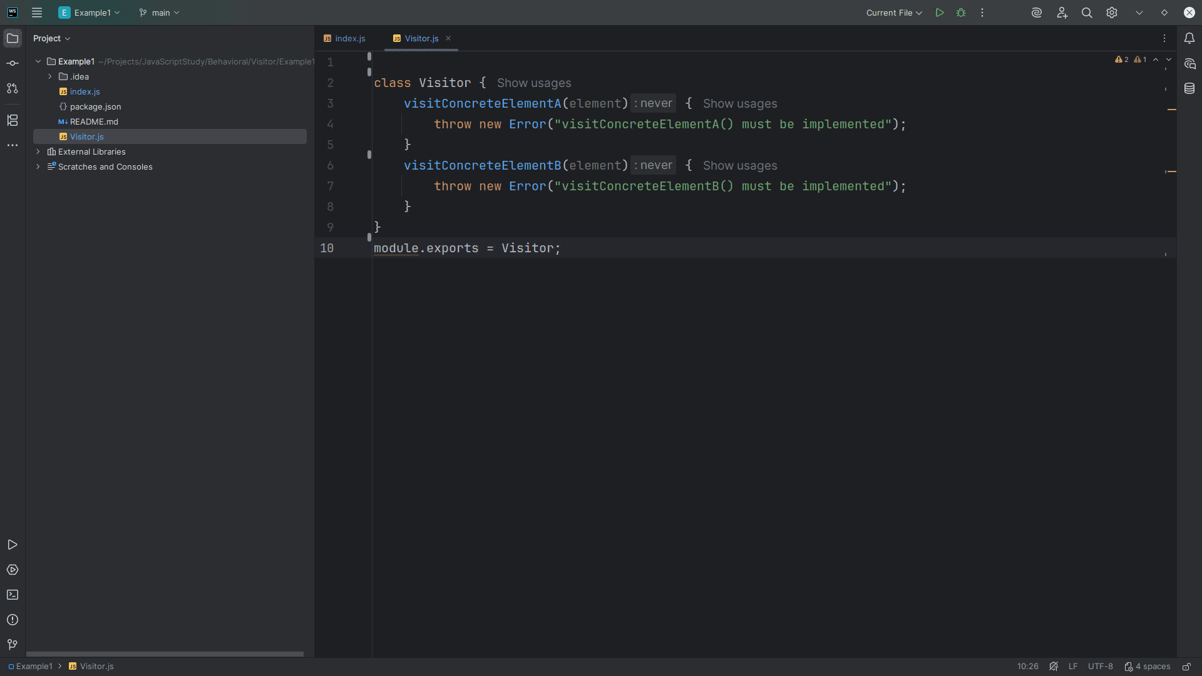
Notes:
We close this module for export in our demonstration we will have at the end

Slide 9
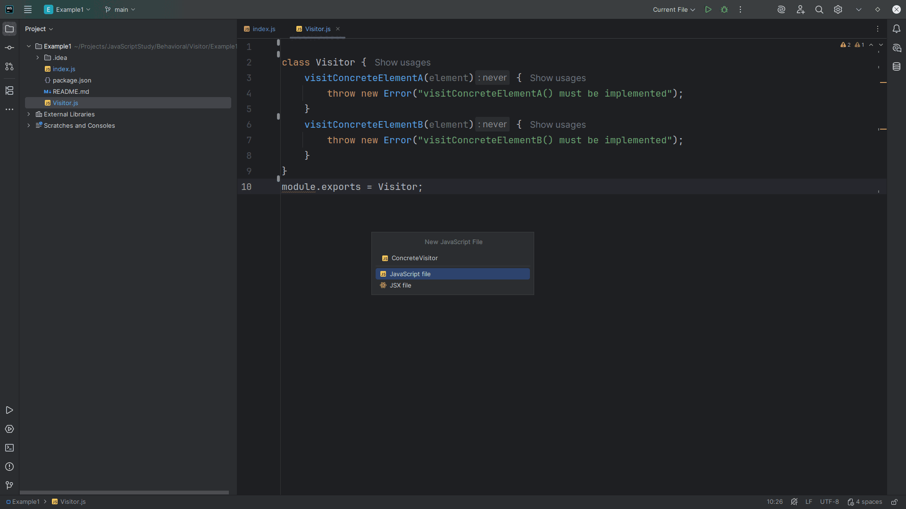
Notes:
Let’s create the Concrete Visitor class

Slide 10
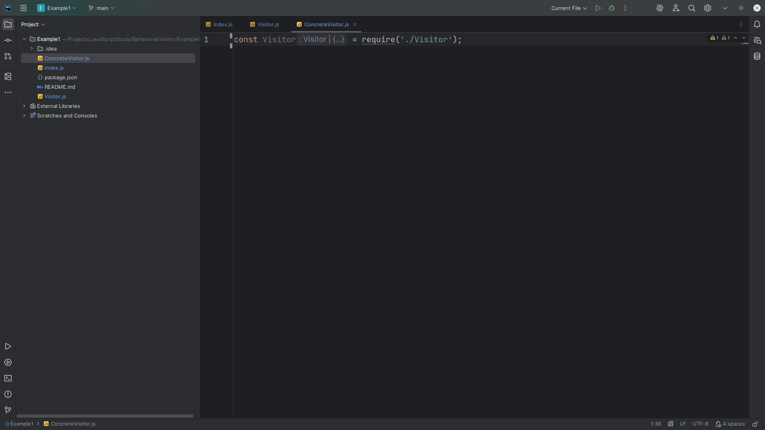
Notes:
The Concrete Visitor Implements the logic that is performed on each element.
We require the Visitor at the top

Slide 11
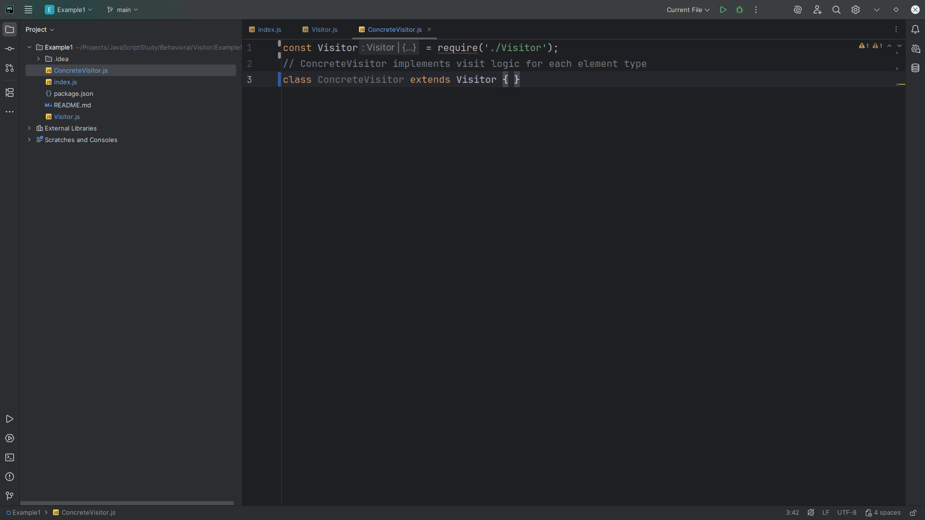
Notes:
We extend our class Concrete Visitor with the Visitor interface

Slide 12
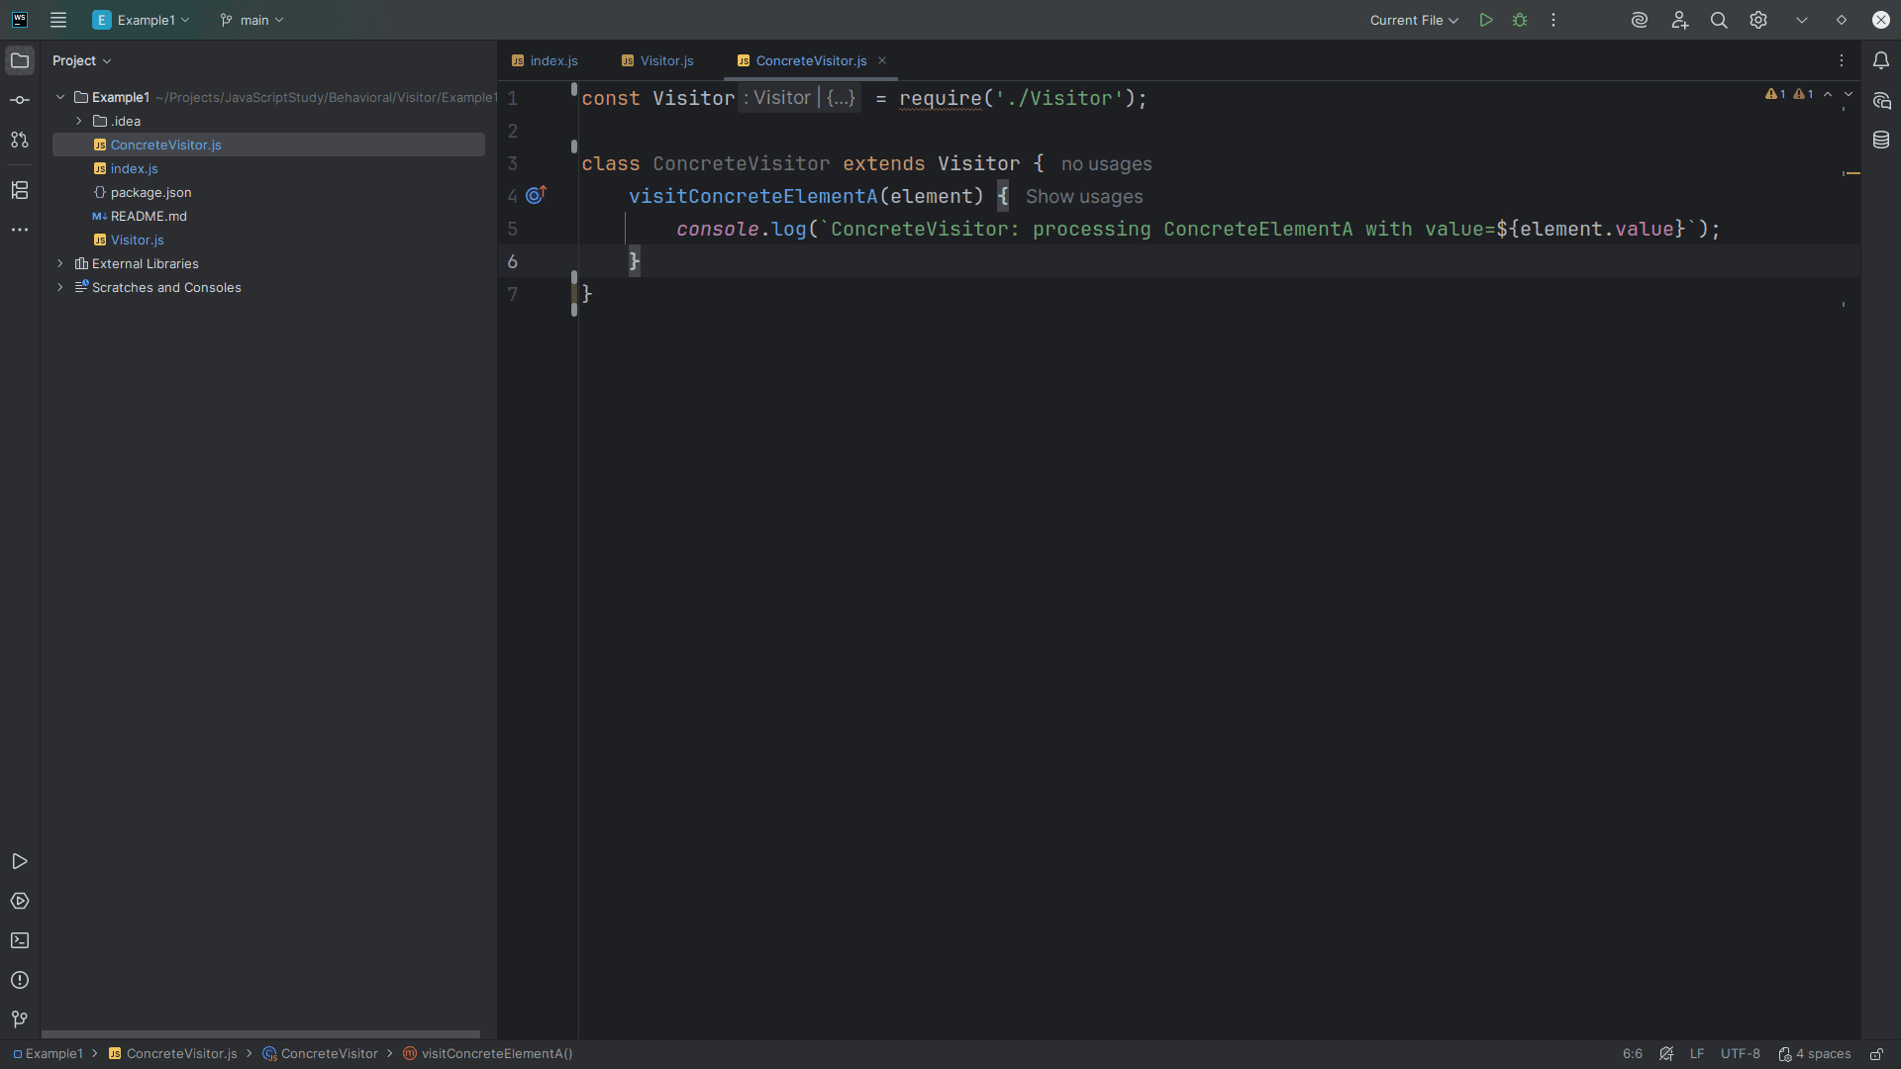
Notes:
Having thus so, we need to implement the visit Concrete Element A method of which we pass into it an element
We will write to the console “Concrete Visitor: processing Concrete Element A with value” and the we’ve passed in

Slide 13
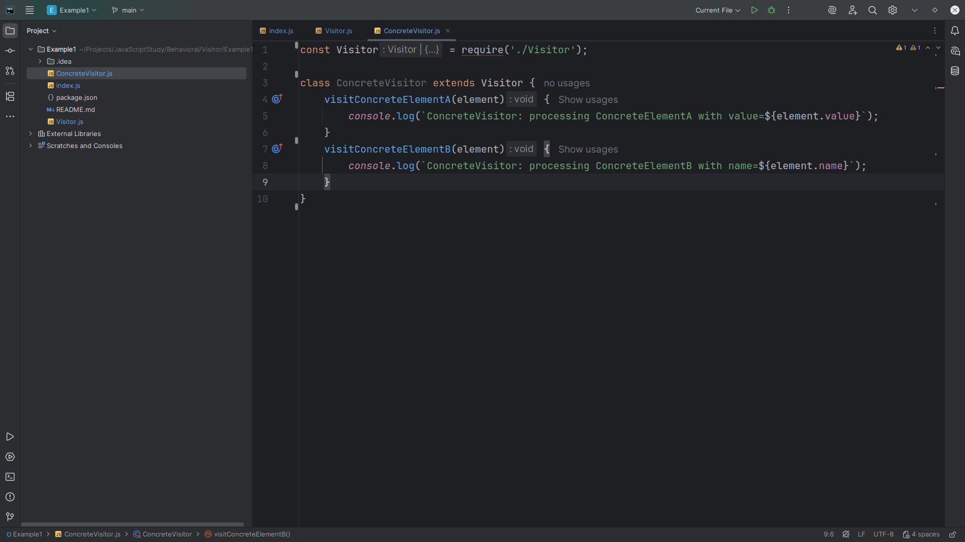
Notes:
We also create a visit Concrete Element B method which takes an element object
From there we write the string:
Concrete Visitor: processing Concrete Element A

Slide 14
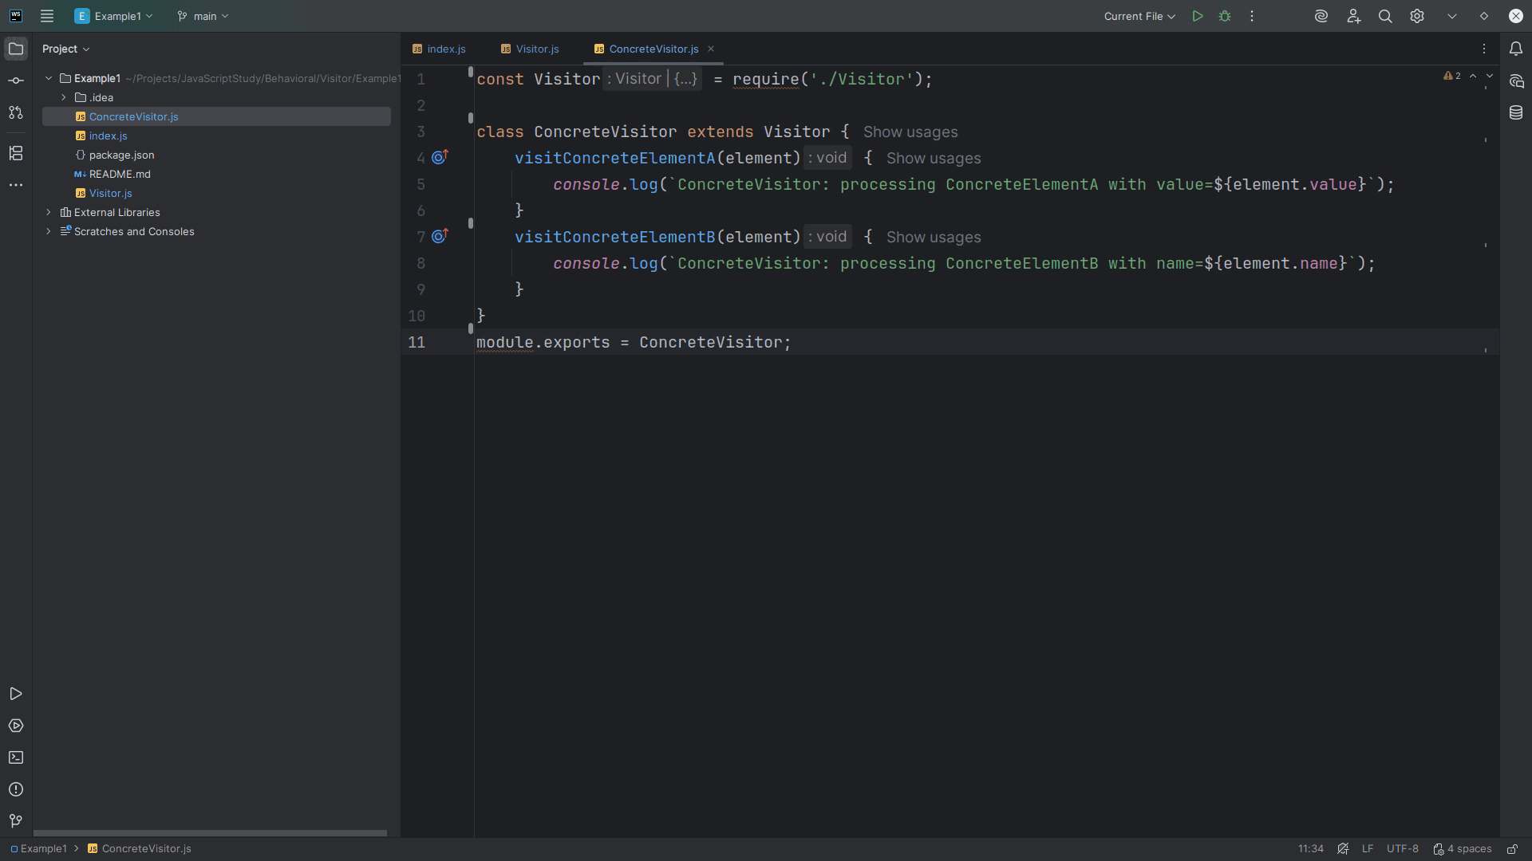
Notes:
And We end this module with an export for use in our demo

Slide 15
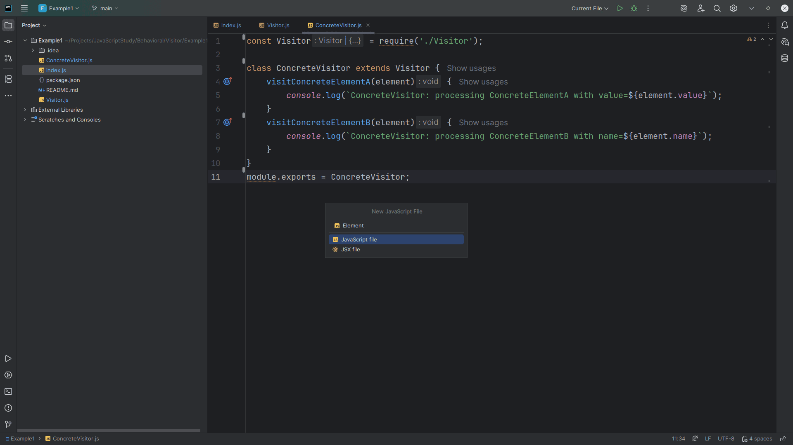
Notes:
Now let’s create an Element interface

Slide 16
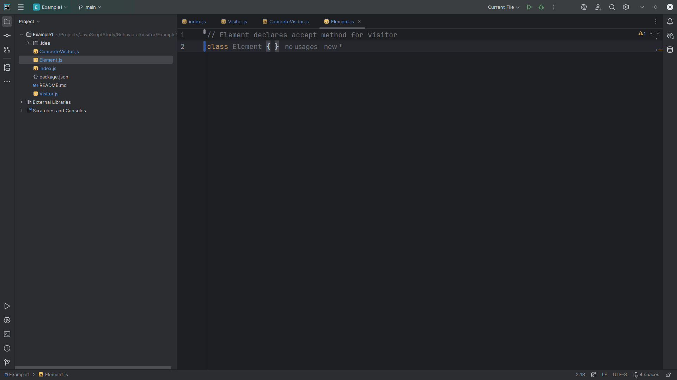
Notes:
The Element will define the interface for elements that can accept a visitor

Slide 17
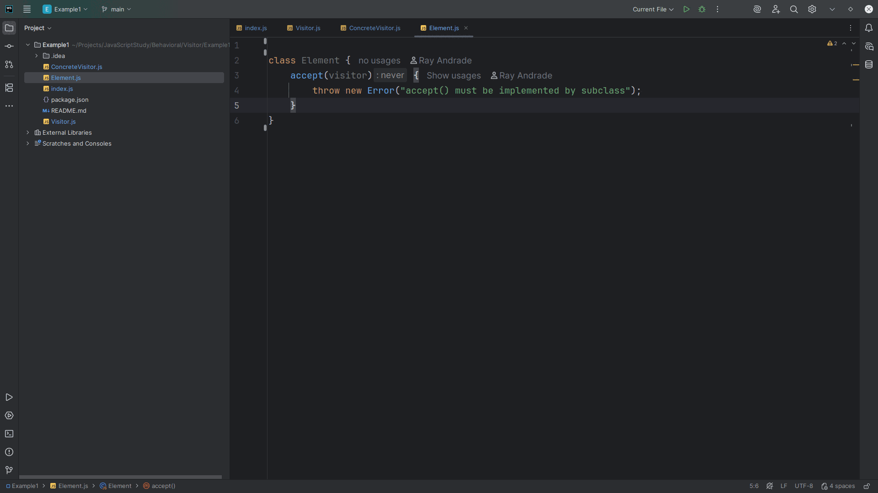
Notes:
We have an accept method which receives a visitor object
It will throw an Error if accept is not implemented by the subclass

Slide 18
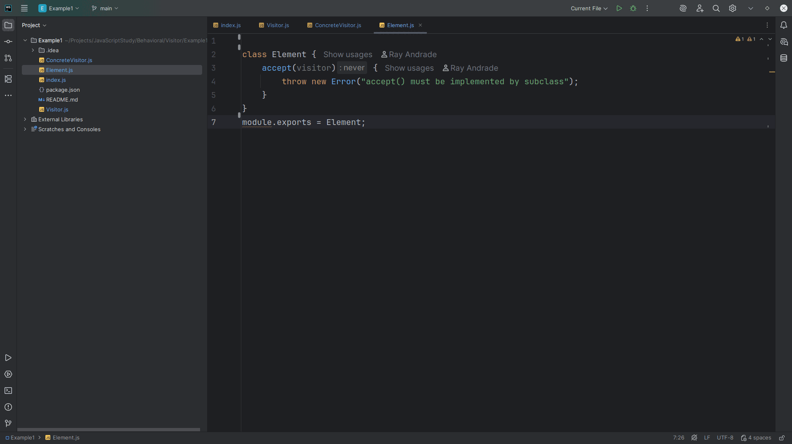
Notes:
We export this module for use in our demo

Slide 19
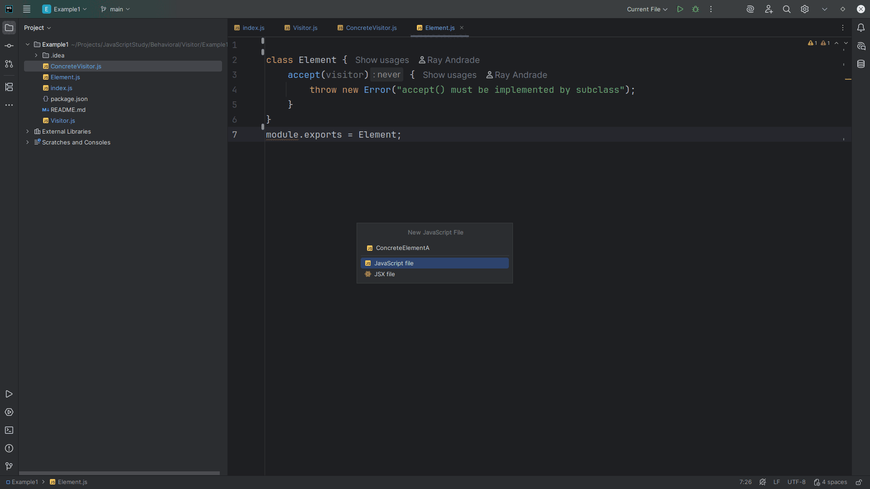
Notes:
The next class I want to create is the Concrete Element

Slide 20
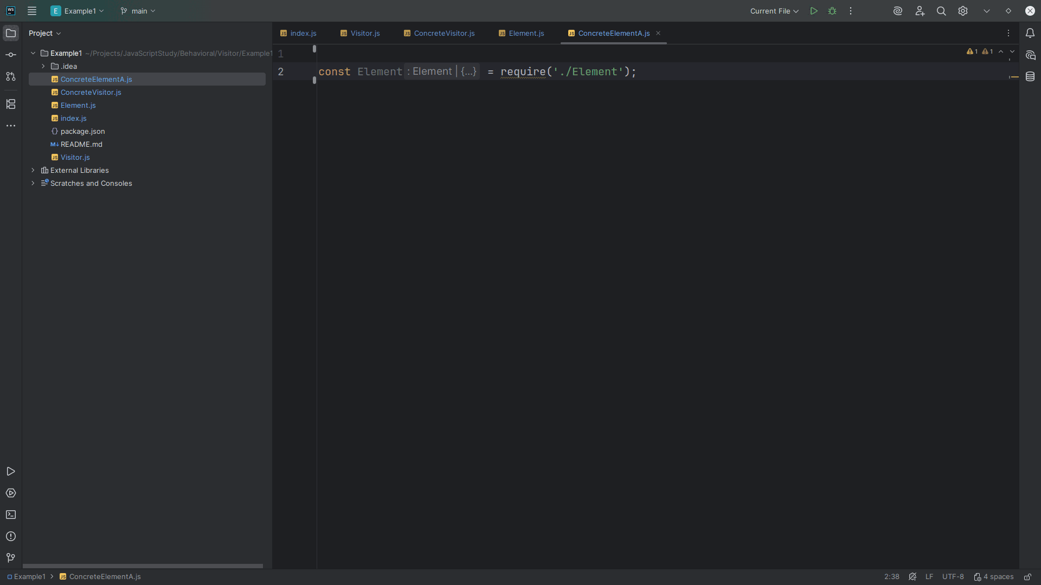
Notes:
We will create two of these class objects.
First we start with a Concrete Element A
At the top we include the Element interface

Slide 21
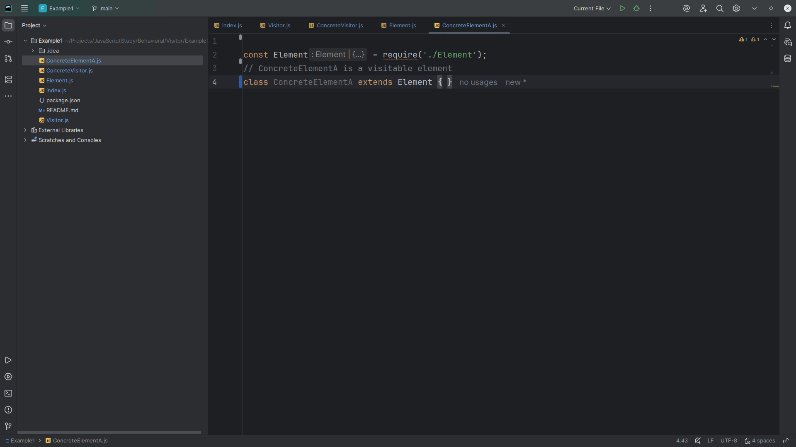
Notes:
Because we will extend this Concrete Element A with the Element interface

Slide 22
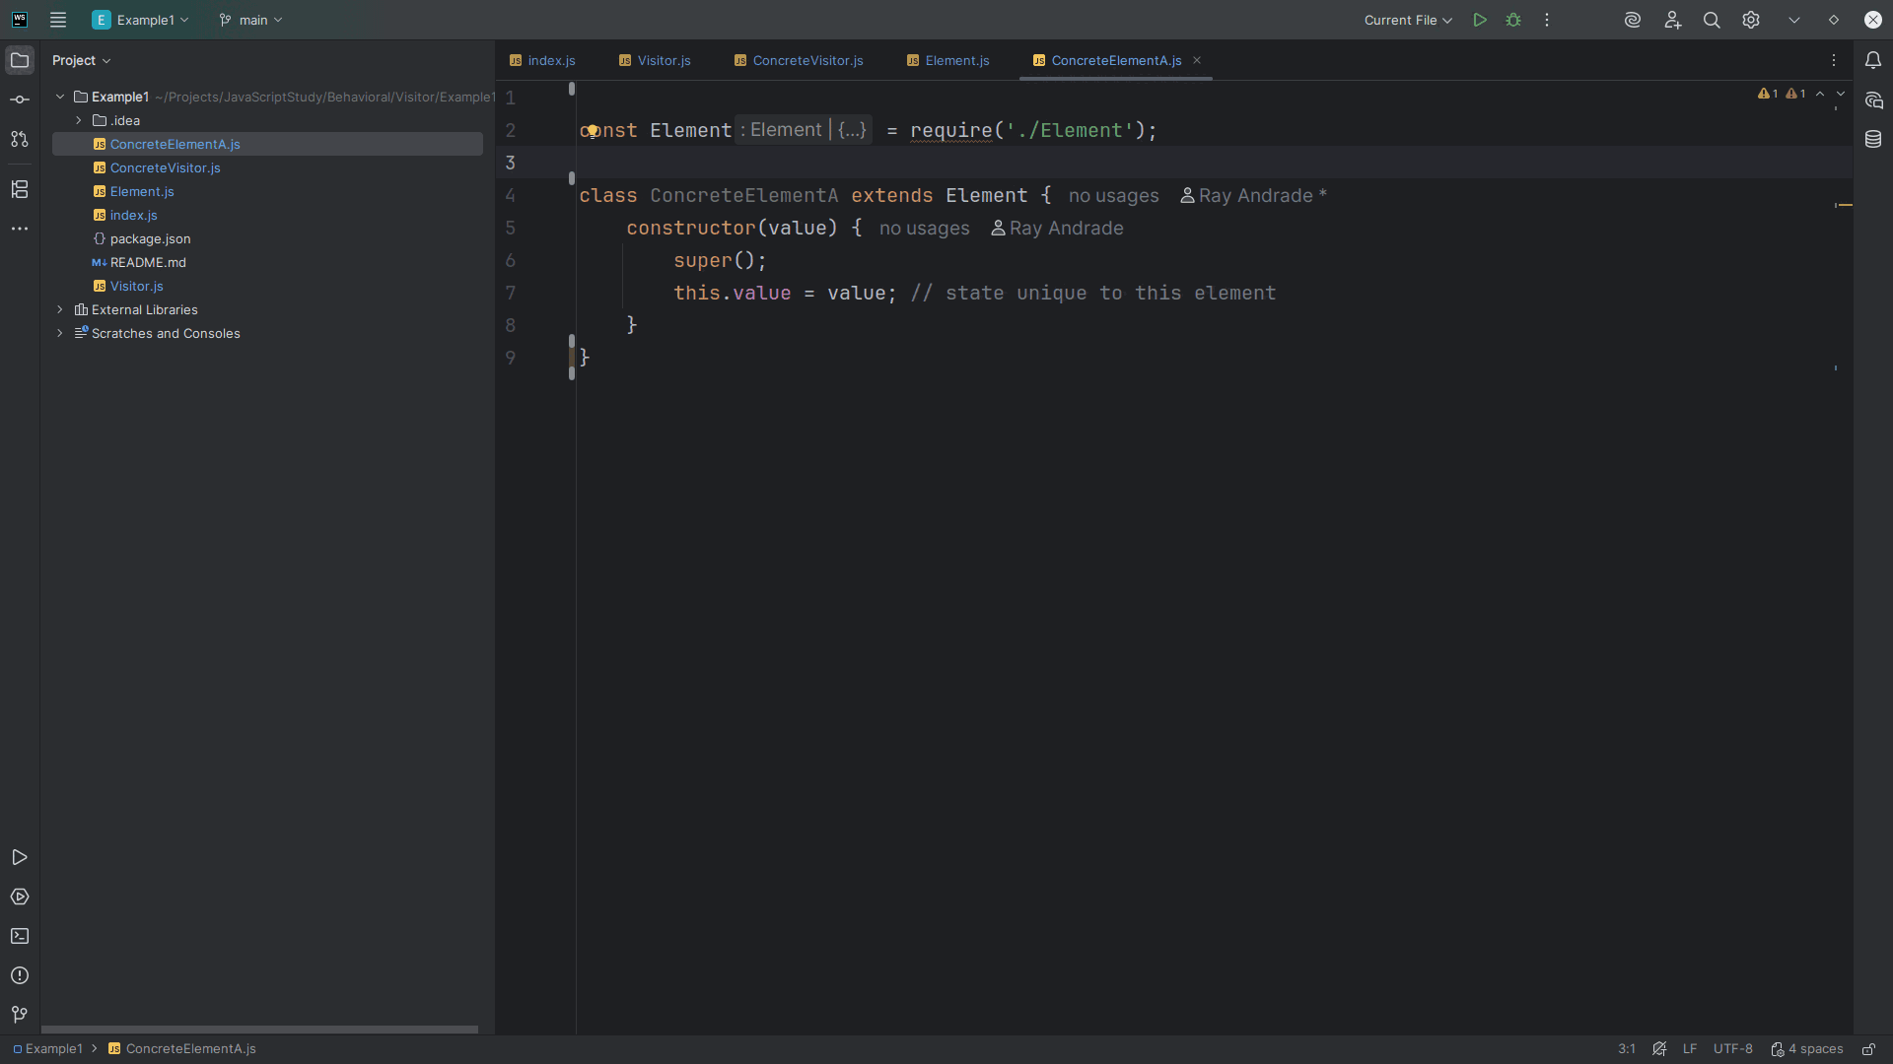
Notes:
We have a constructor which accepts a value
We call super and set this dot value to the value passed in

Slide 23
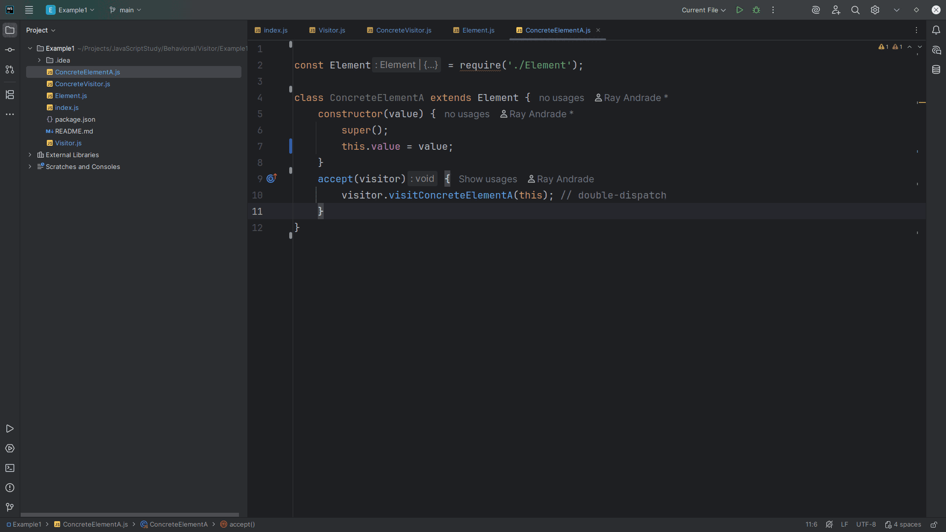
Notes:
We have an accept method that accepts a visitor and does a double-dispatch

Slide 24
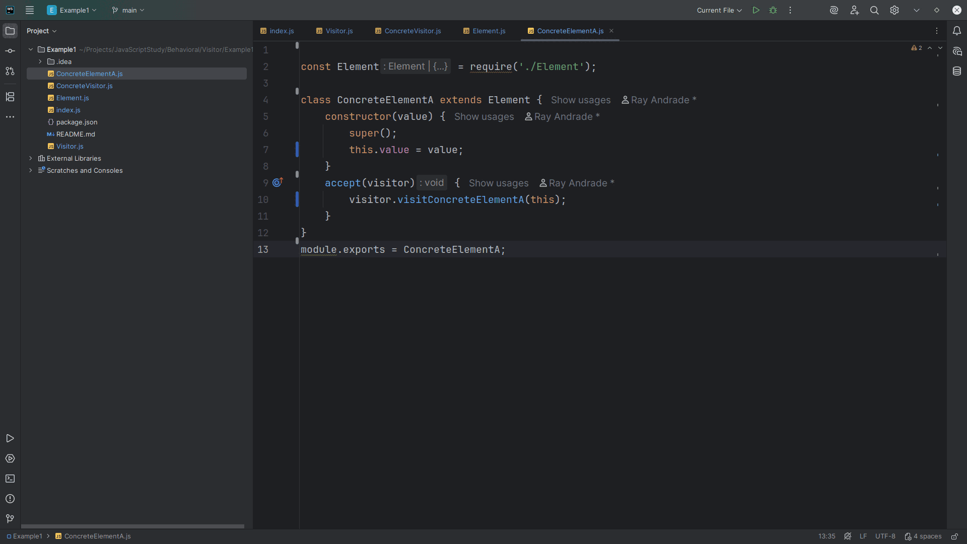
Notes:
We export this module for use in our demo

Slide 25
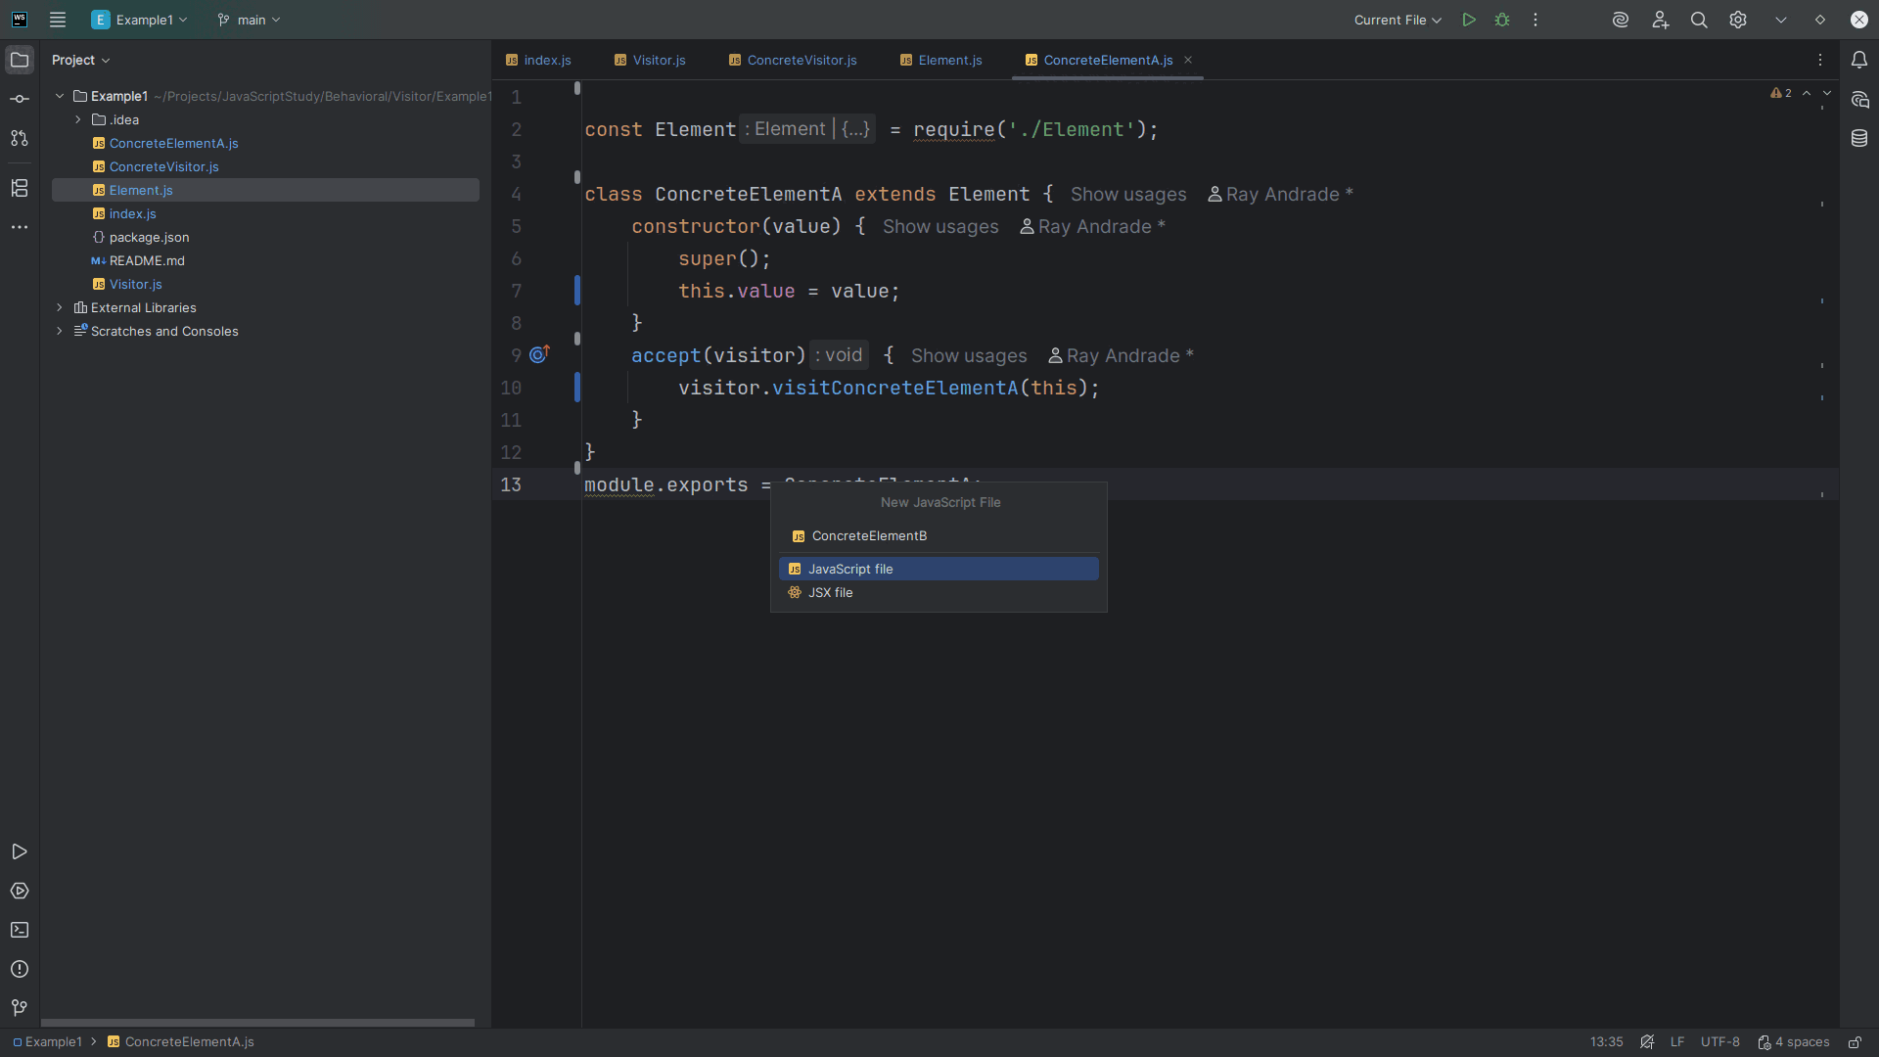
Notes:
Let’s create another Concrete Element we call Concrete Element B

Slide 26
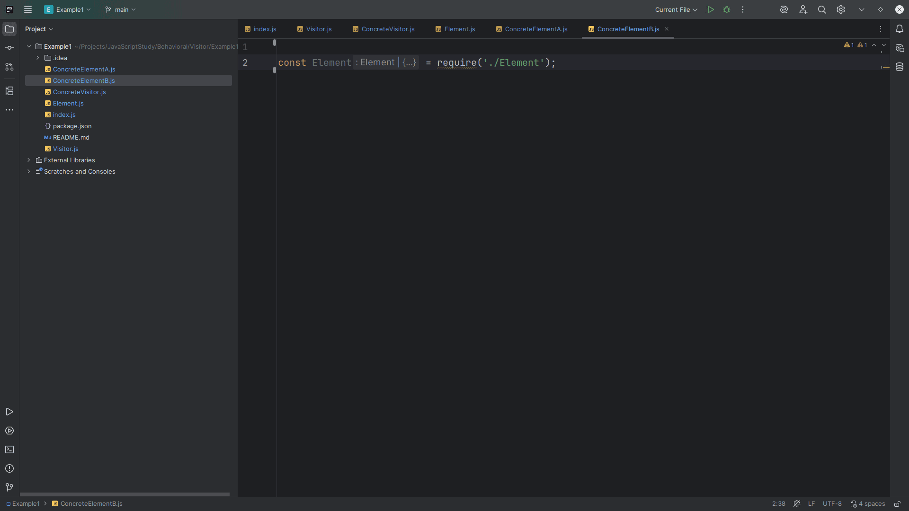
Notes:
Again we require the Element interface

Slide 27
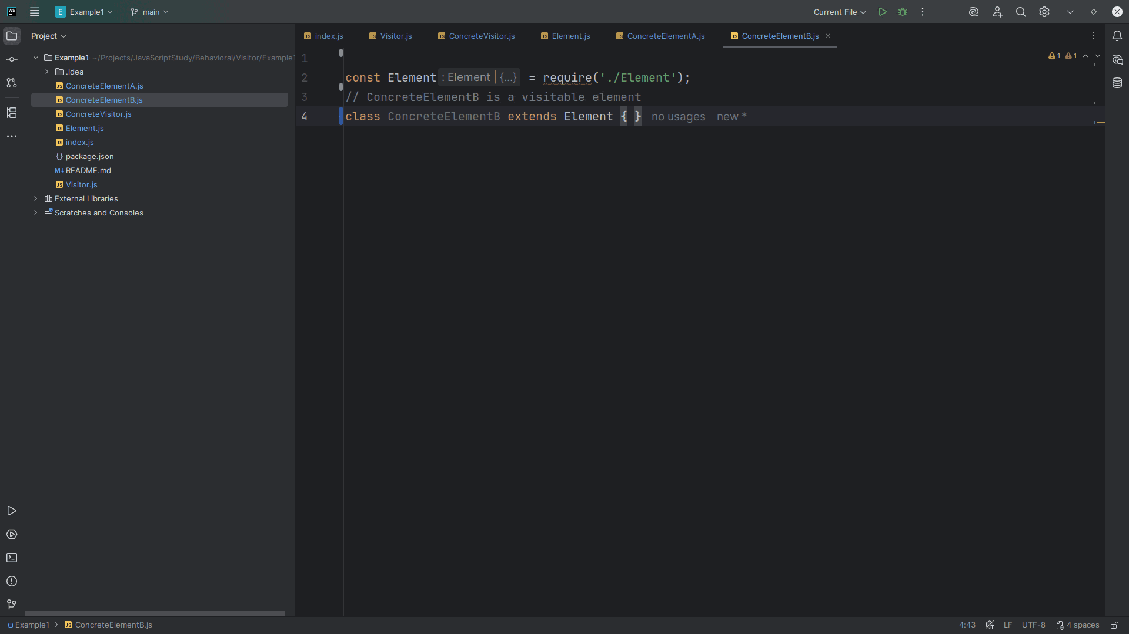
Notes:
Concrete Element B is a visitable element

Slide 28
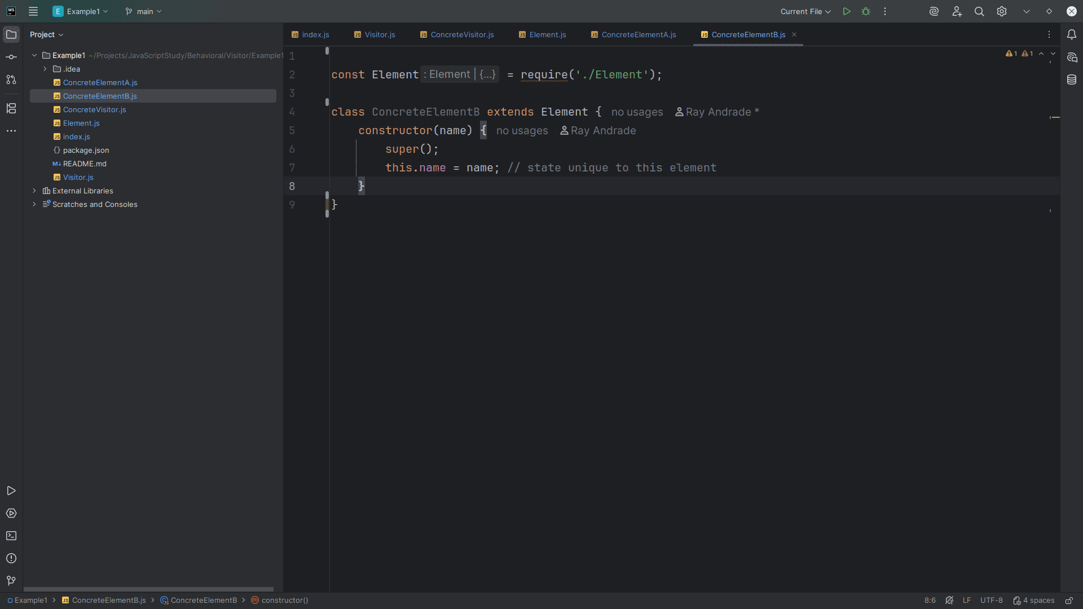
Notes:
With its own constructor and this is state unique to this element

Slide 29
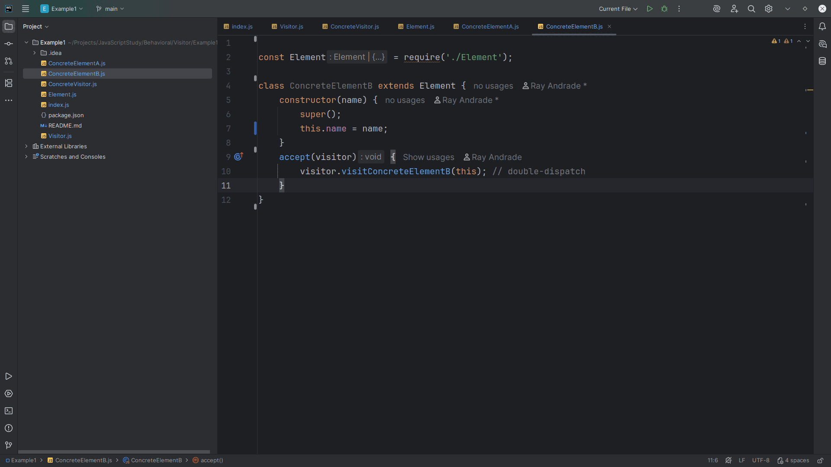
Notes:
This too needs an accept method which accepts a visitor and does a double-dispatch

Slide 30
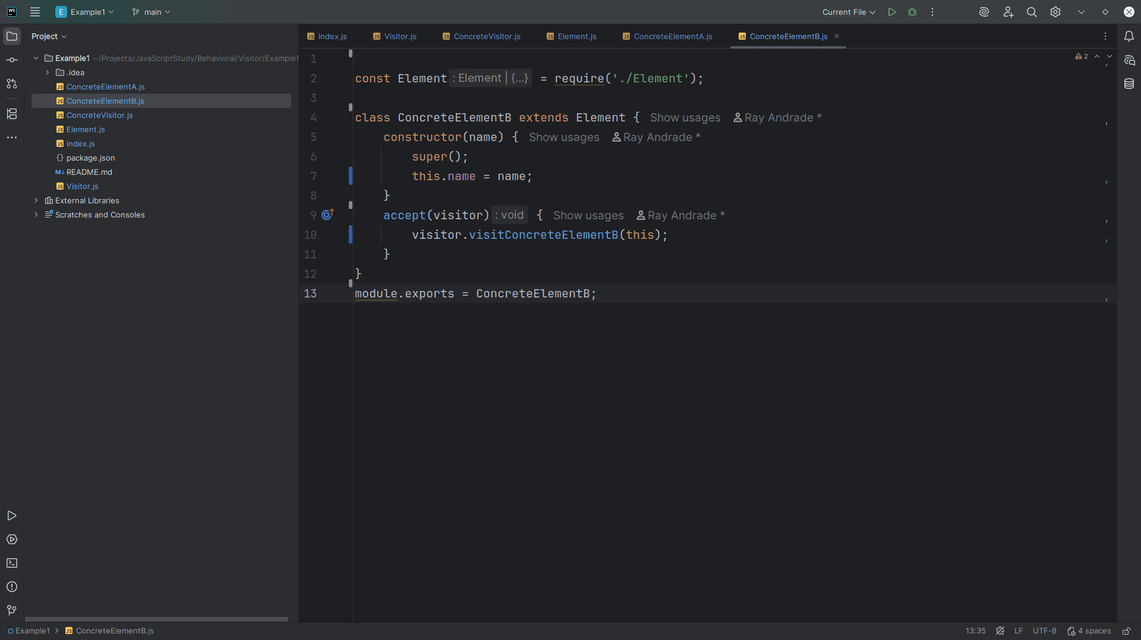
Notes:
We export this module for use in our demo

Slide 31
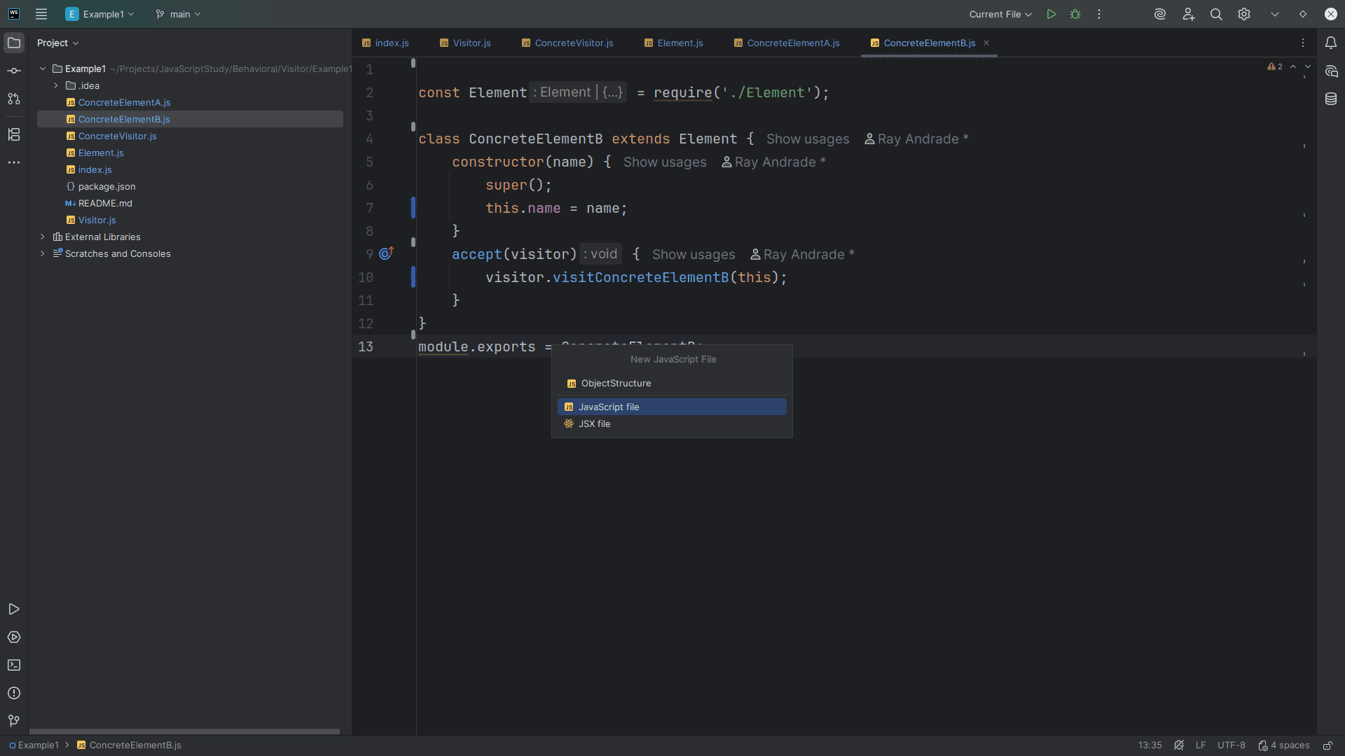
Notes:
Let’s create the Object Structure

Slide 32
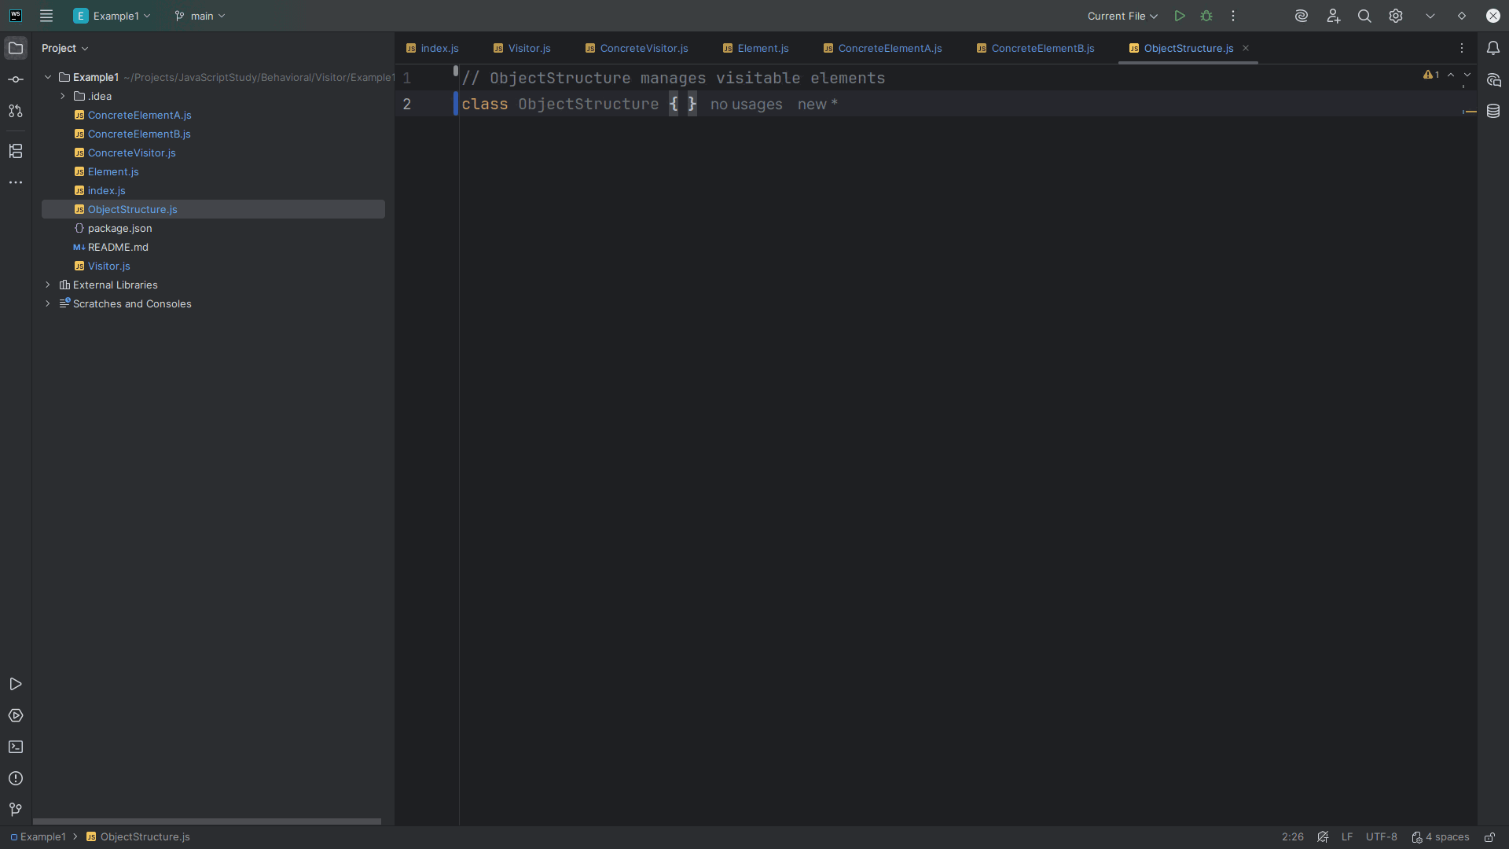
Notes:
The Object Structure will Manage a collection of elements and help apply visitors to them.

Slide 33
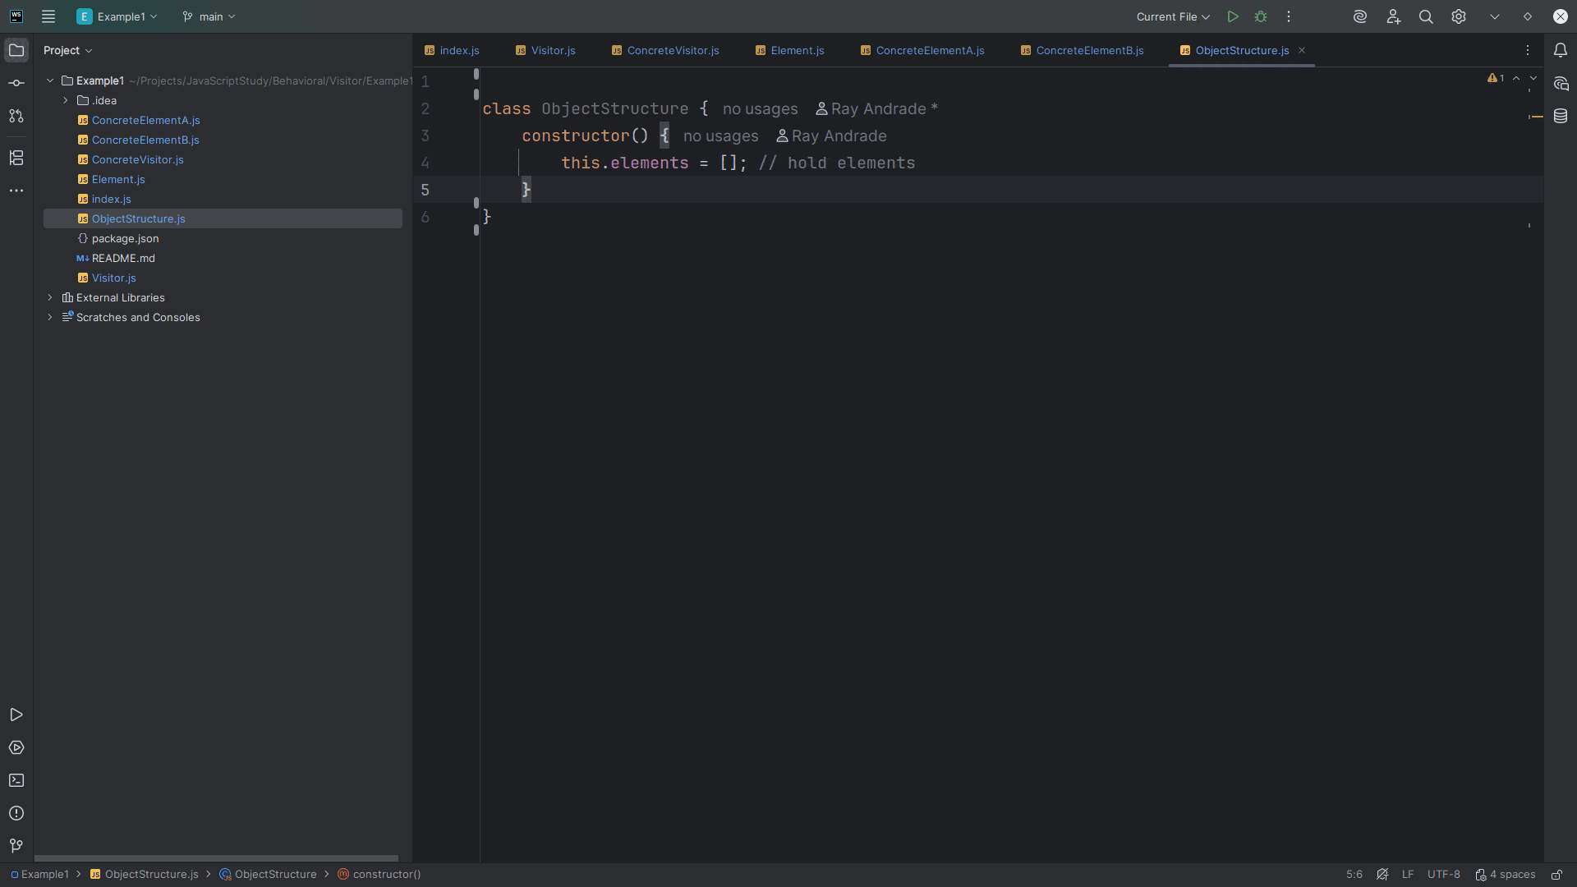
Notes:
We have a constructor that hold elements and places them into an array

Slide 34
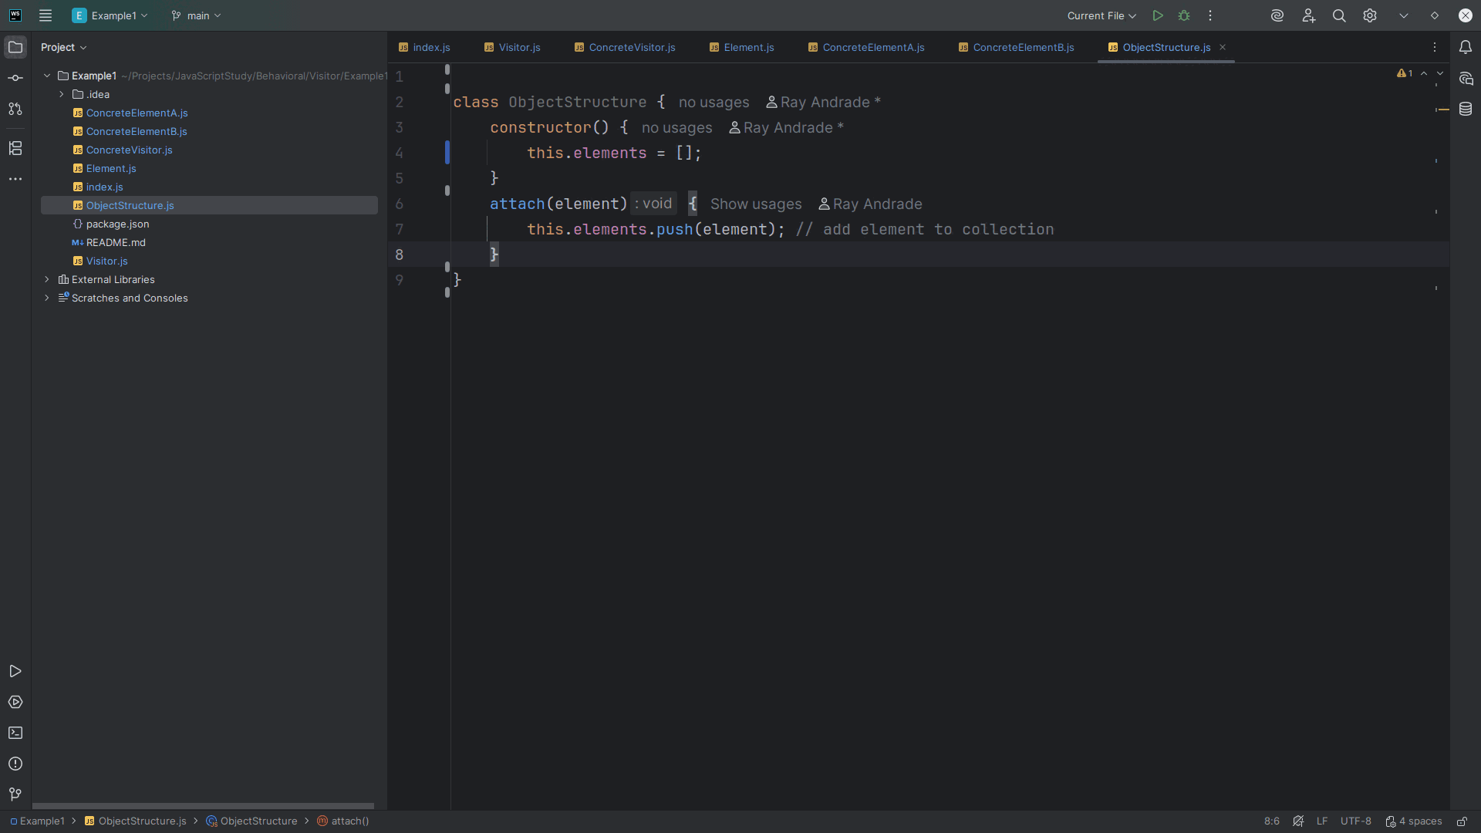
Notes:
We have an attach method that accepts an element and pushes it onto the array
It adds the element to the collection

Slide 35
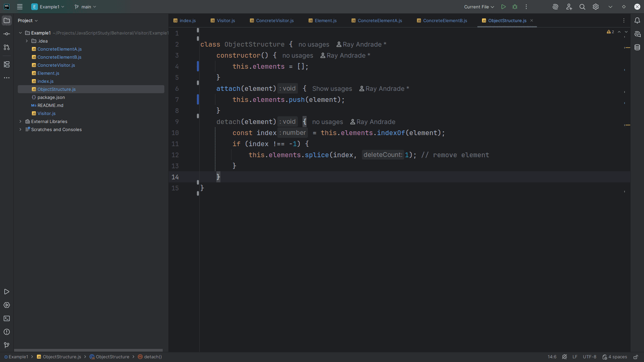
Notes:
We have a detach method which removes the element and maintains the integrity of the array list

Slide 36
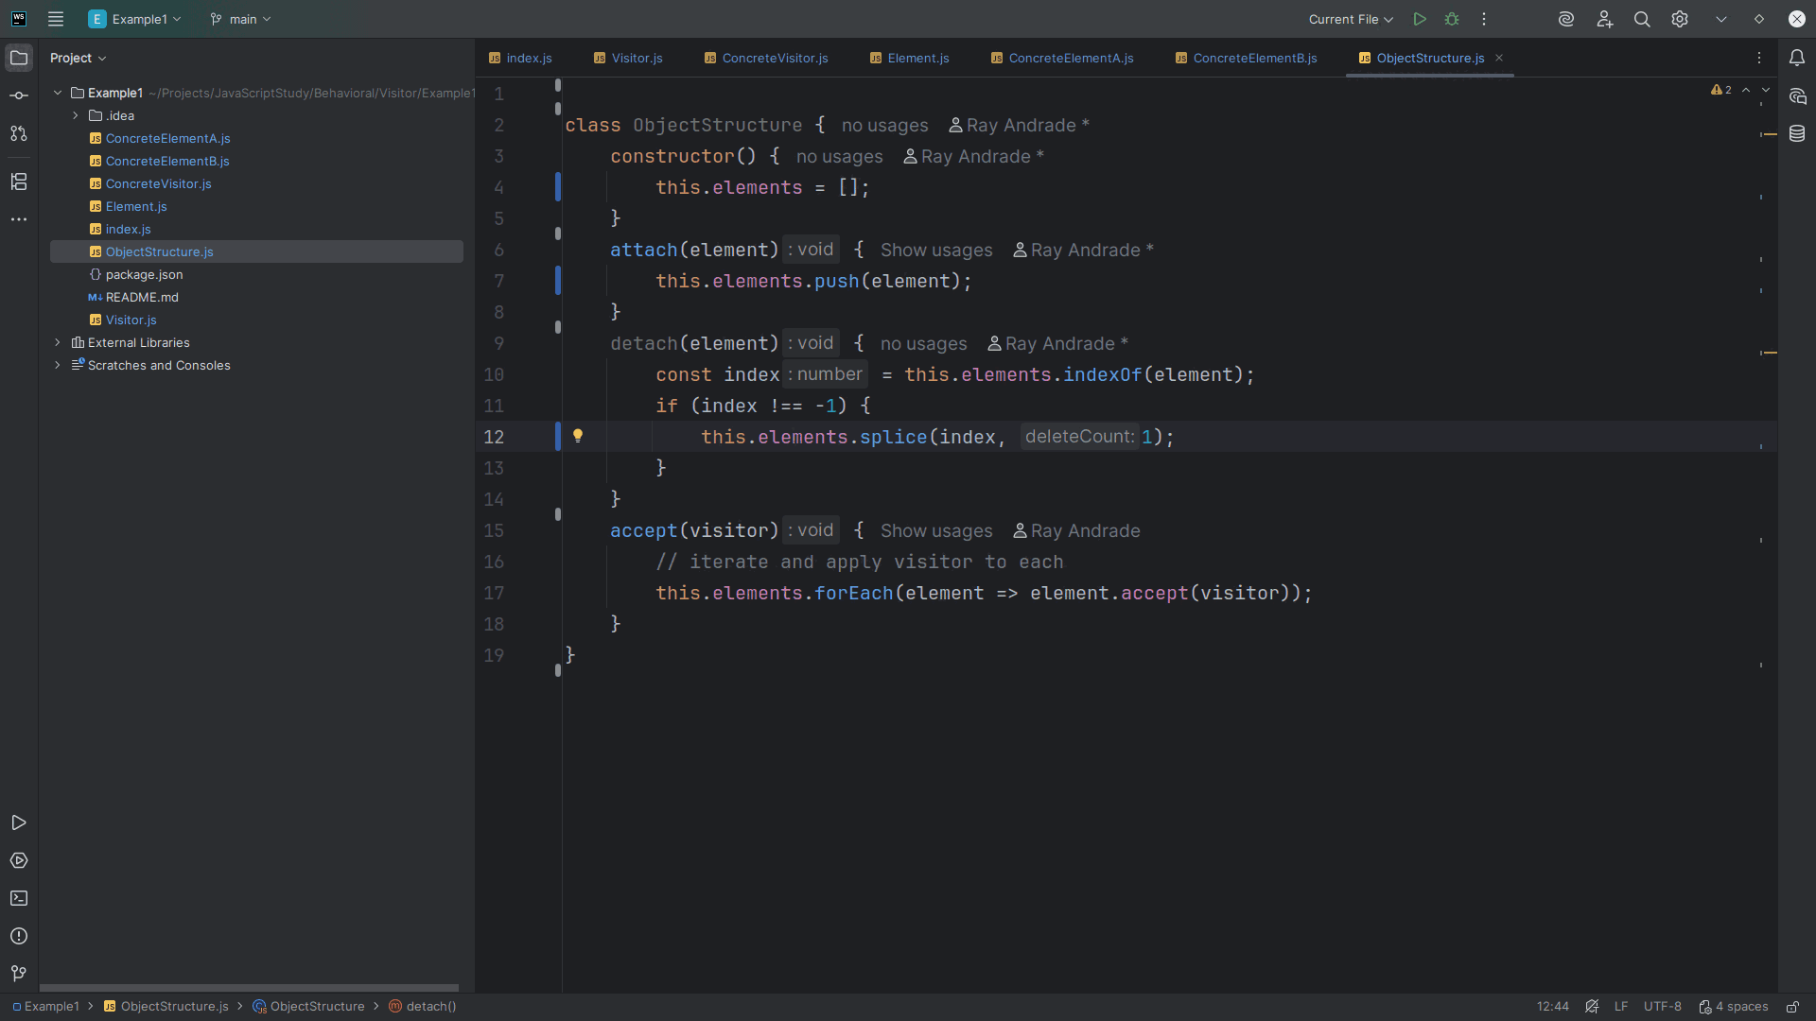
Notes:
We have an accept method which accepts a visitor iterates and apply the visitor to each

Slide 37
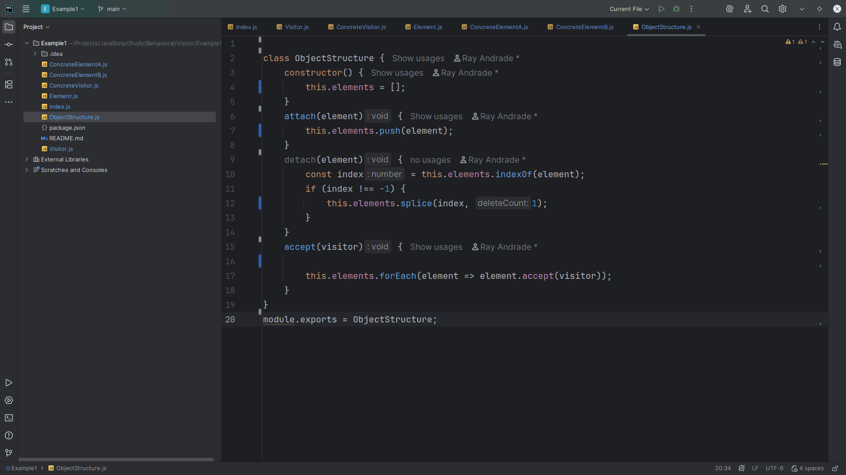
Notes:
We export this module for use in our demo

Slide 38
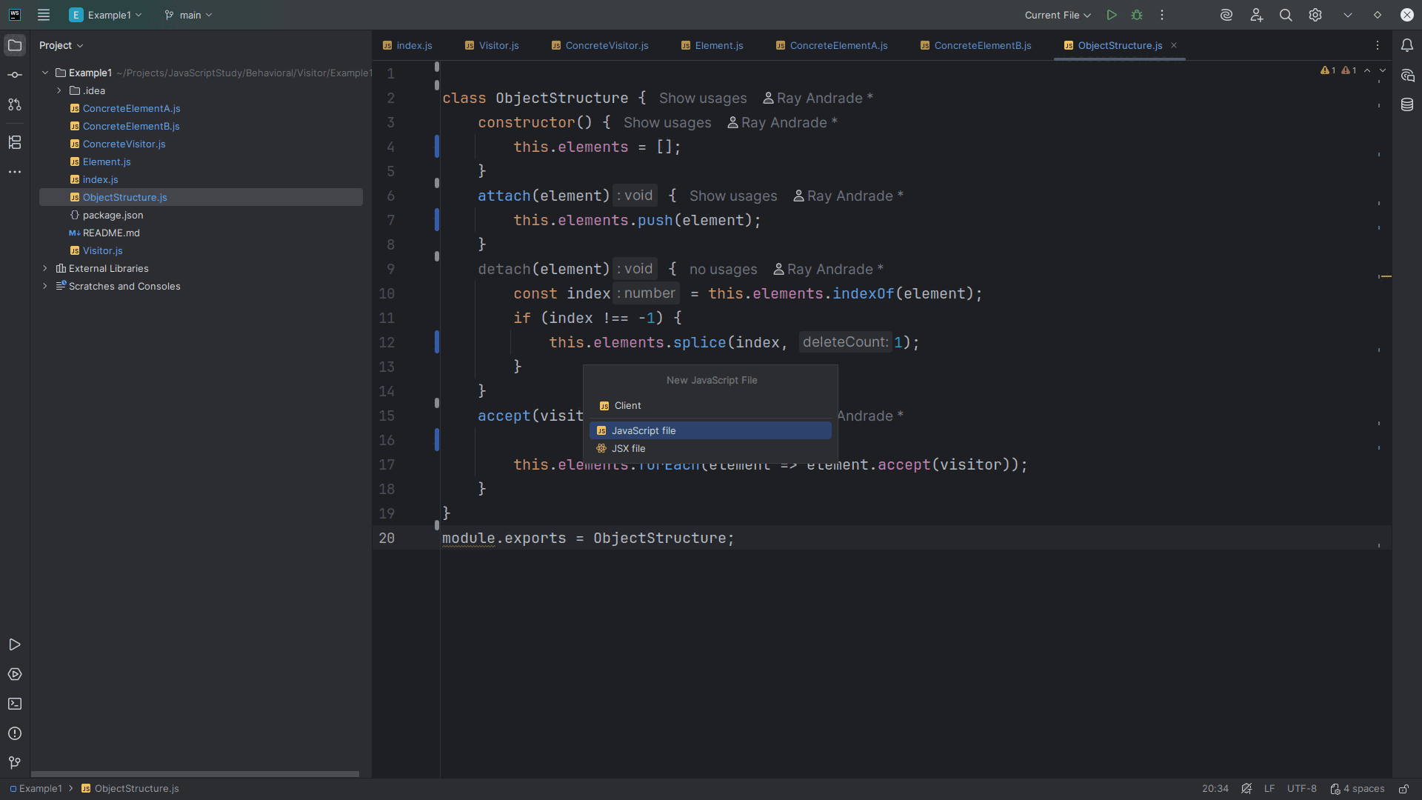
Notes:
Let’s create the Client

Slide 39
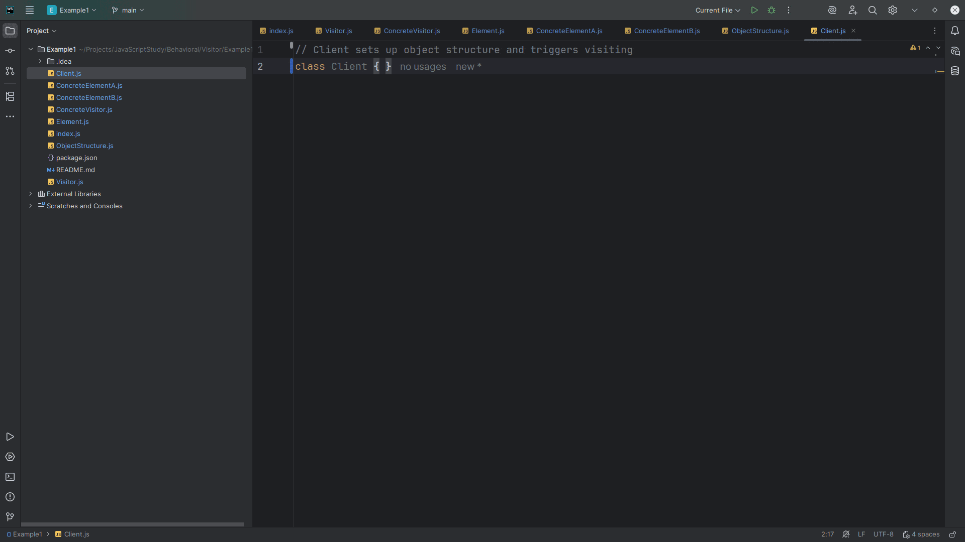
Notes:
The Client Sets up the object structure, creates the visitor, and runs the process.

Slide 40
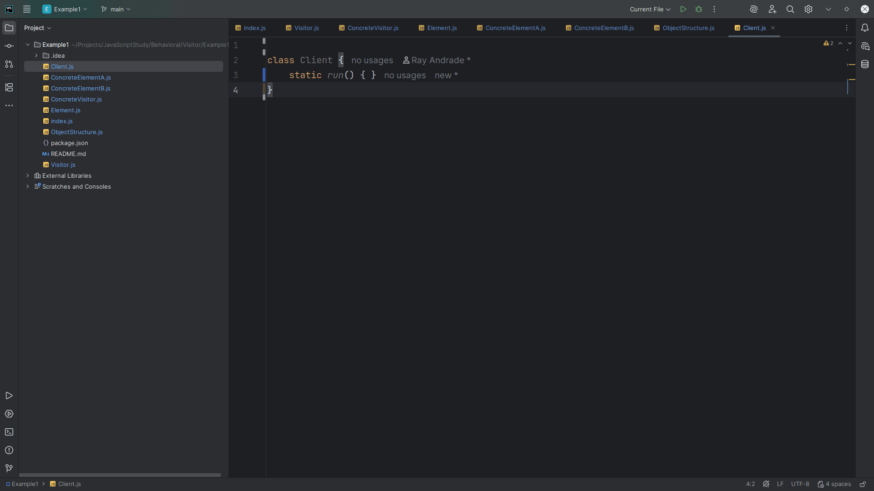
Notes:
We create a run method to our demo

Slide 41
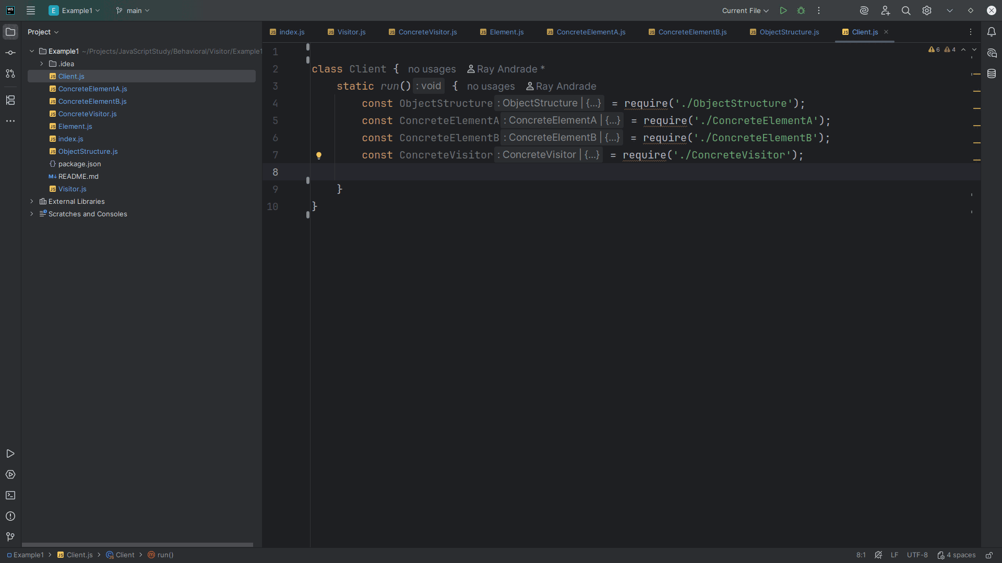
Notes:
Inside of run we require the Object Structure, Both A and B Concrete Elements and the Concrete Visitor

Slide 42
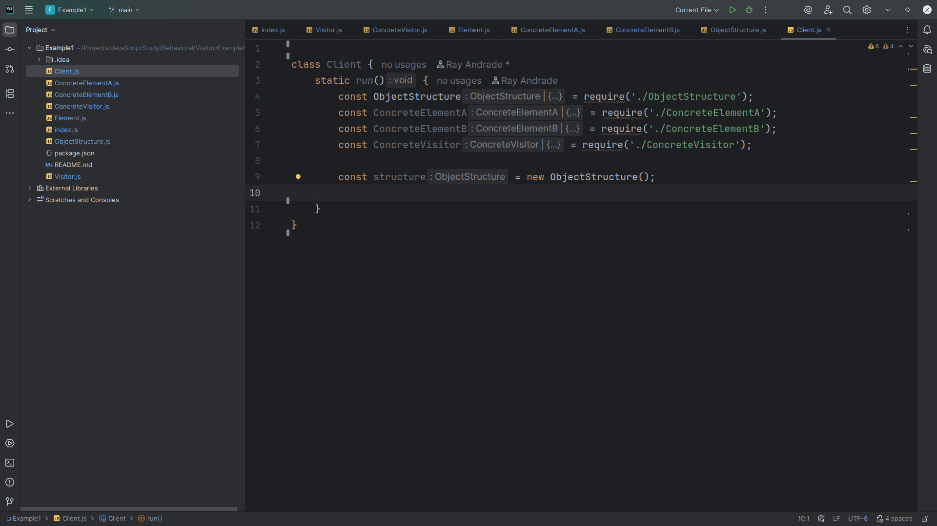
Notes:
We set the structure to a new Object Structure

Slide 43
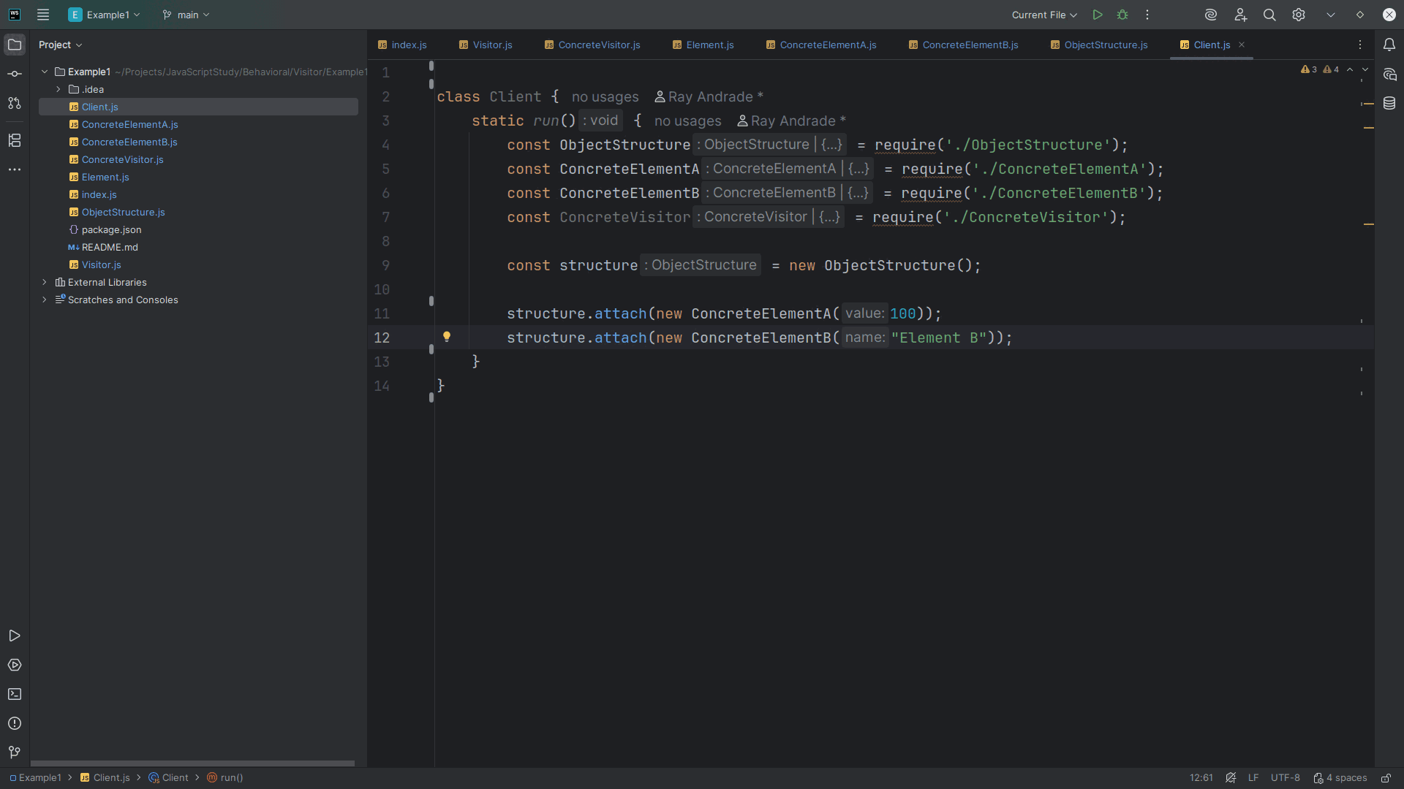
Notes:
We add elements to the structure we add a new Concrete Element A with a value of 100 and a new Concrete Element B with the string Element B

Slide 44
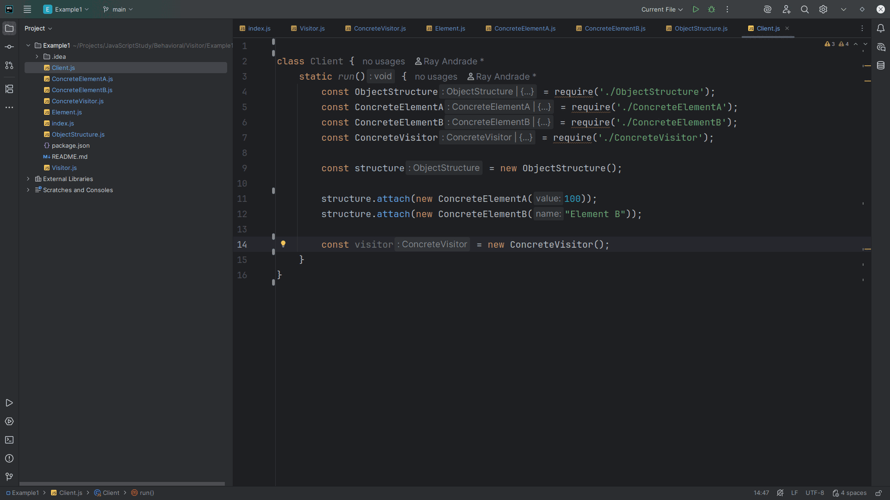
Notes:
We create the visitor

Slide 45
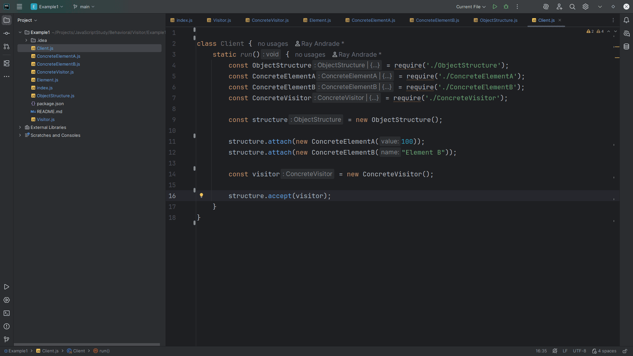
Notes:
And apply visitor to all elements

Slide 46
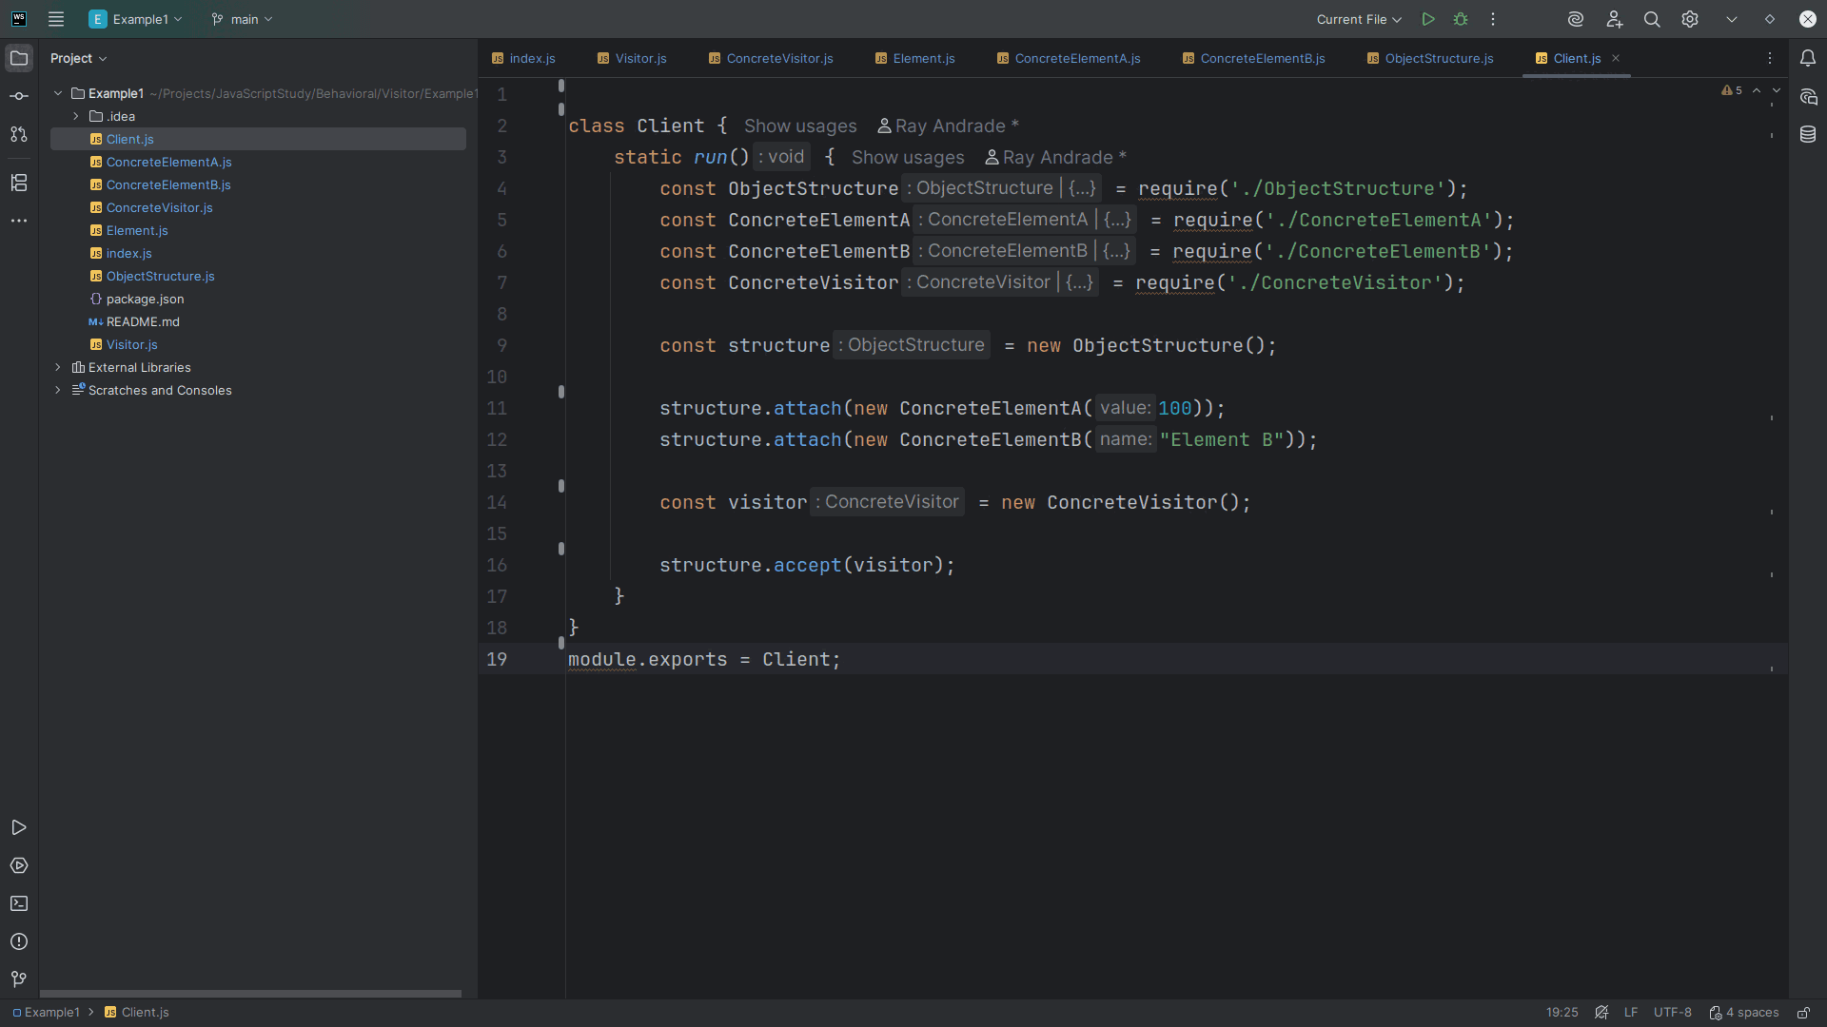
Notes:
We export this module as Client for use in our demo

Slide 47
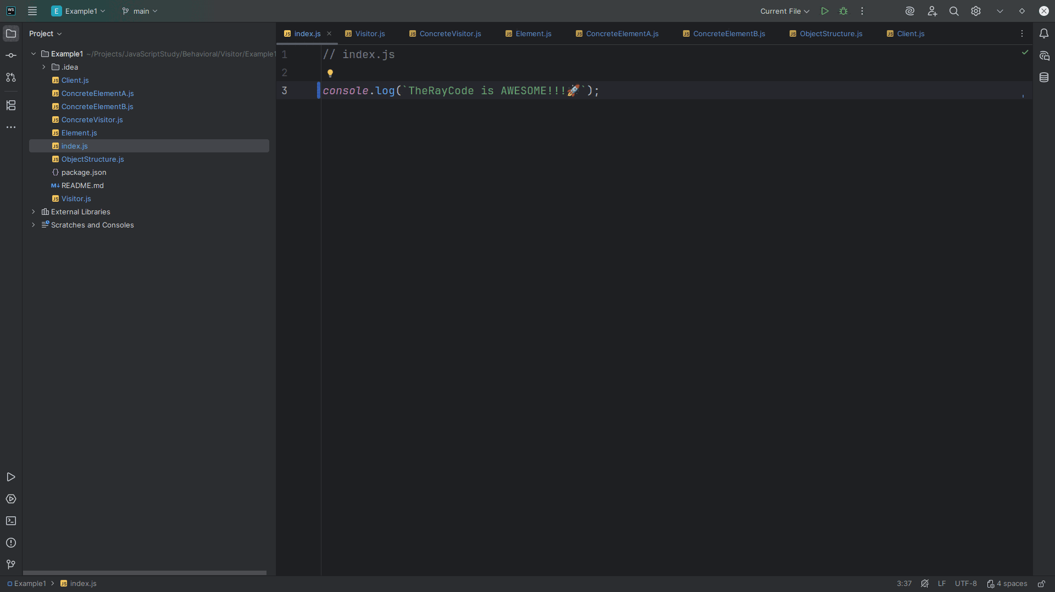
Notes:
Now let’s go to the index page

Slide 48
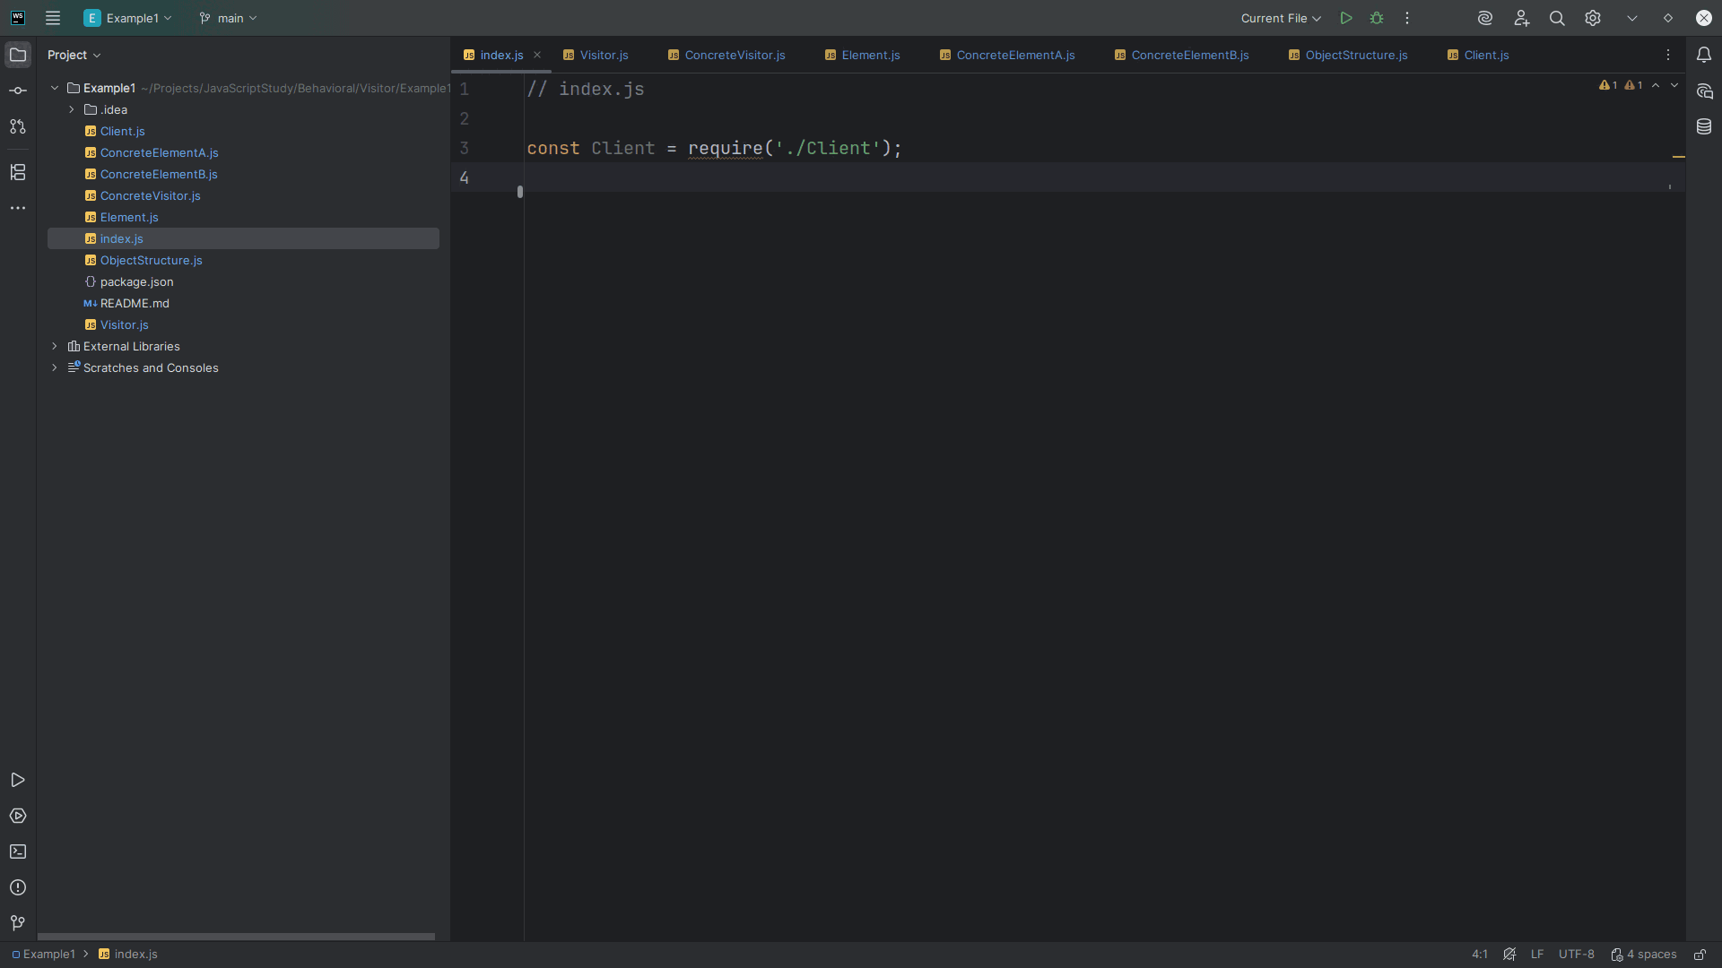
Notes:
There we require at the top

Slide 49
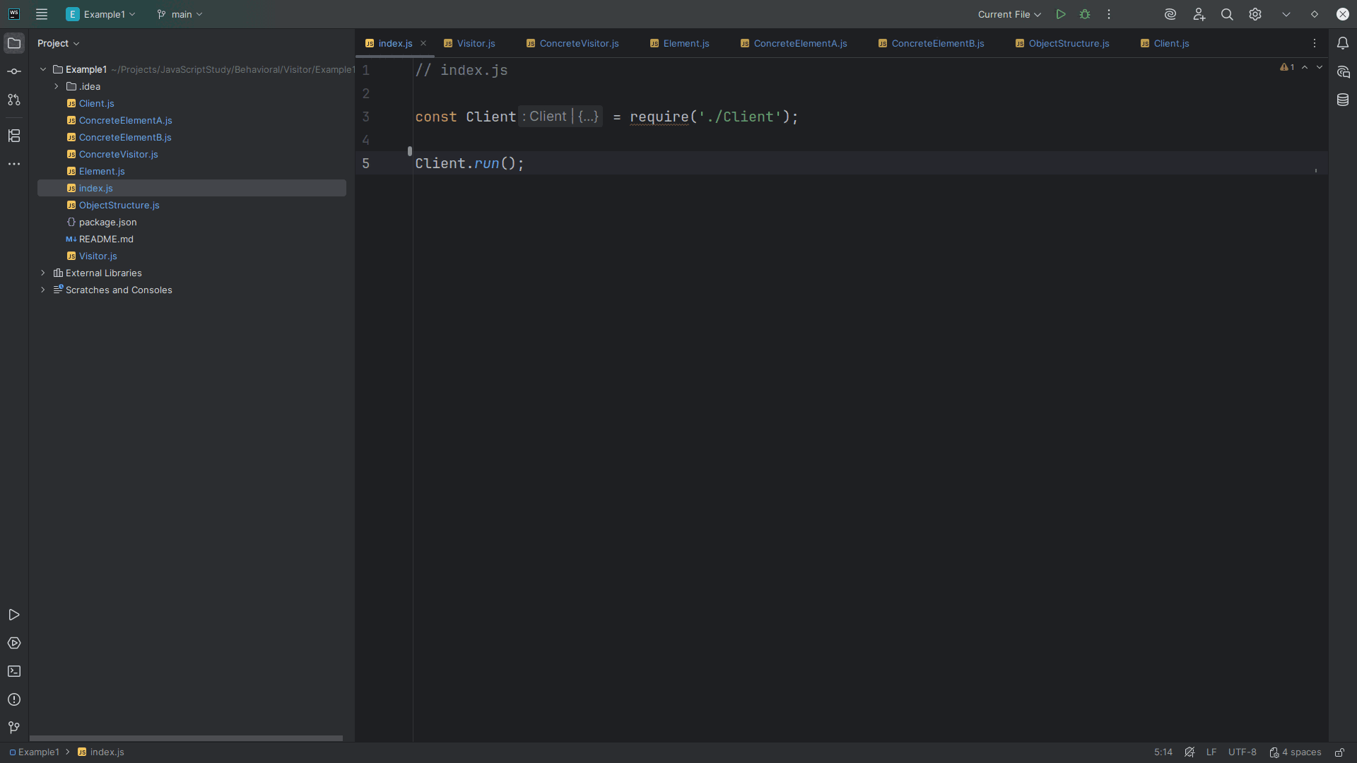
Notes:
And Run the client and we get..

Slide 50
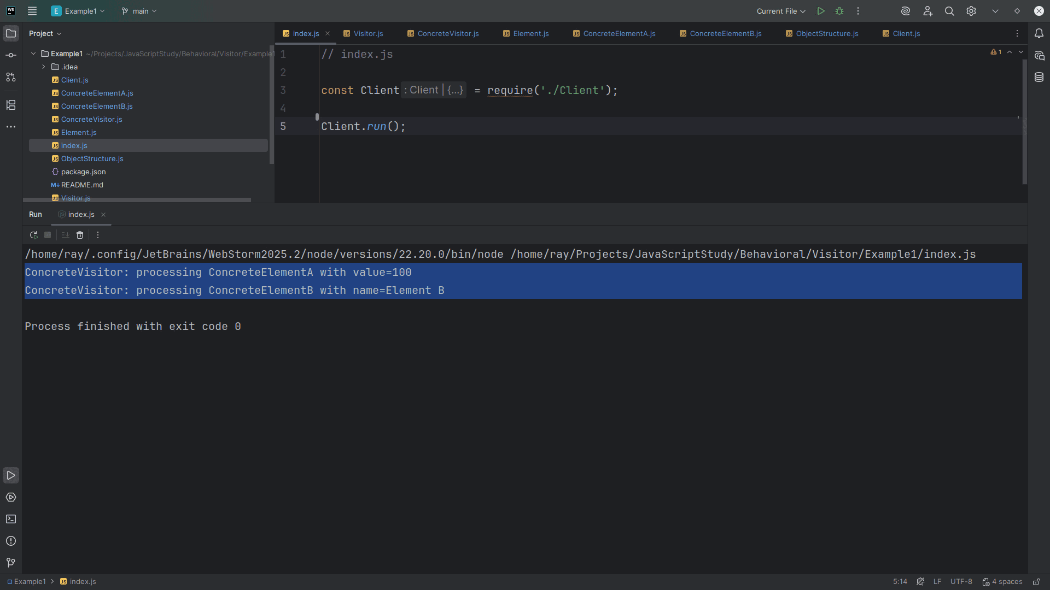
Notes:
Concrete Visitor: processing Concrete Element A with value=100
Concrete Visitor: processing Concrete Element B with name=Element B
My name is Ray always code with a smile

