Slide 1
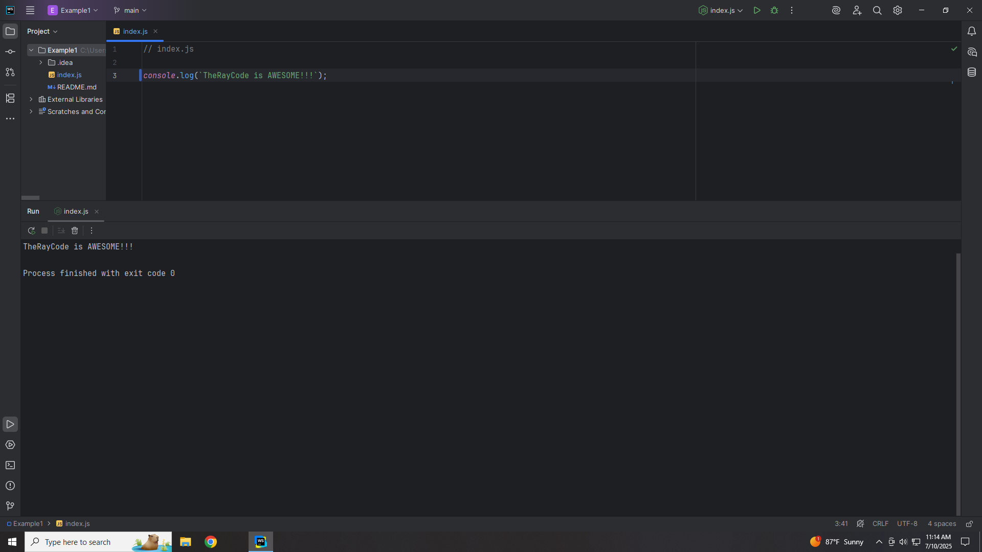
Notes:
(Silent)

Slide 2

Notes:
Hello, I’m Ray of TheRayCode in this show I plan to give you a presentation of the design pattern Chain of Responsibility which happens to be a Creational Pattern according to the Gang of Four

Slide 3
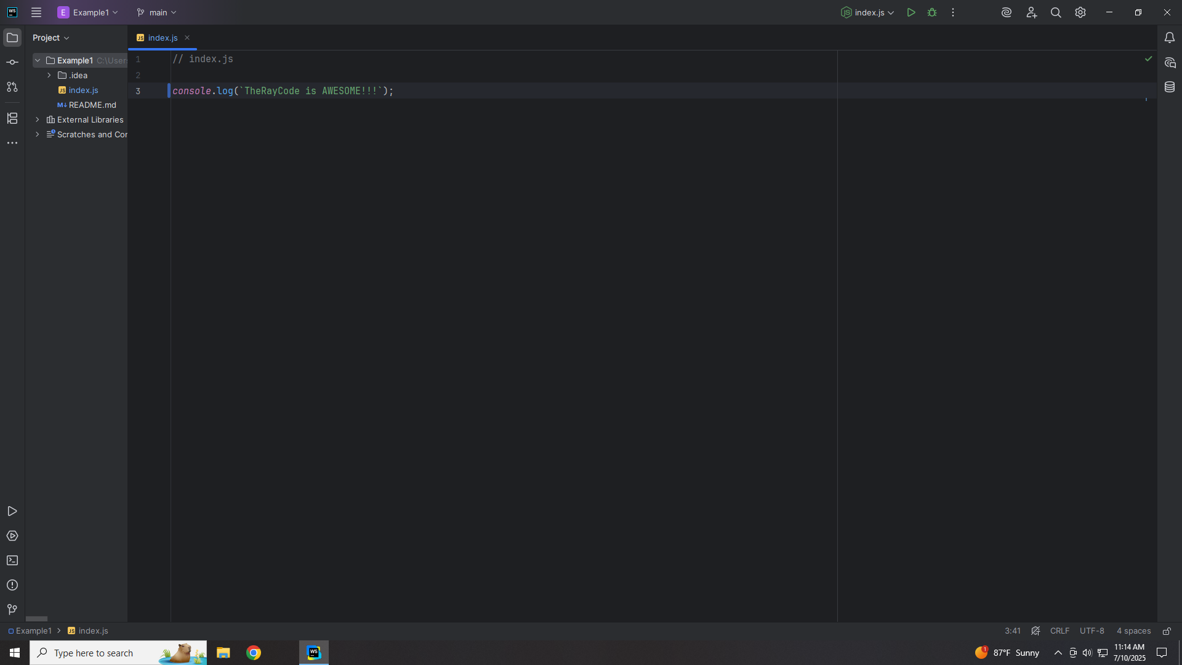
Notes:
In this Demo I will be using the scripting language JavaScript. I will also try to use the same names for the classes that are used in the book by the Gang of Four

Slide 4
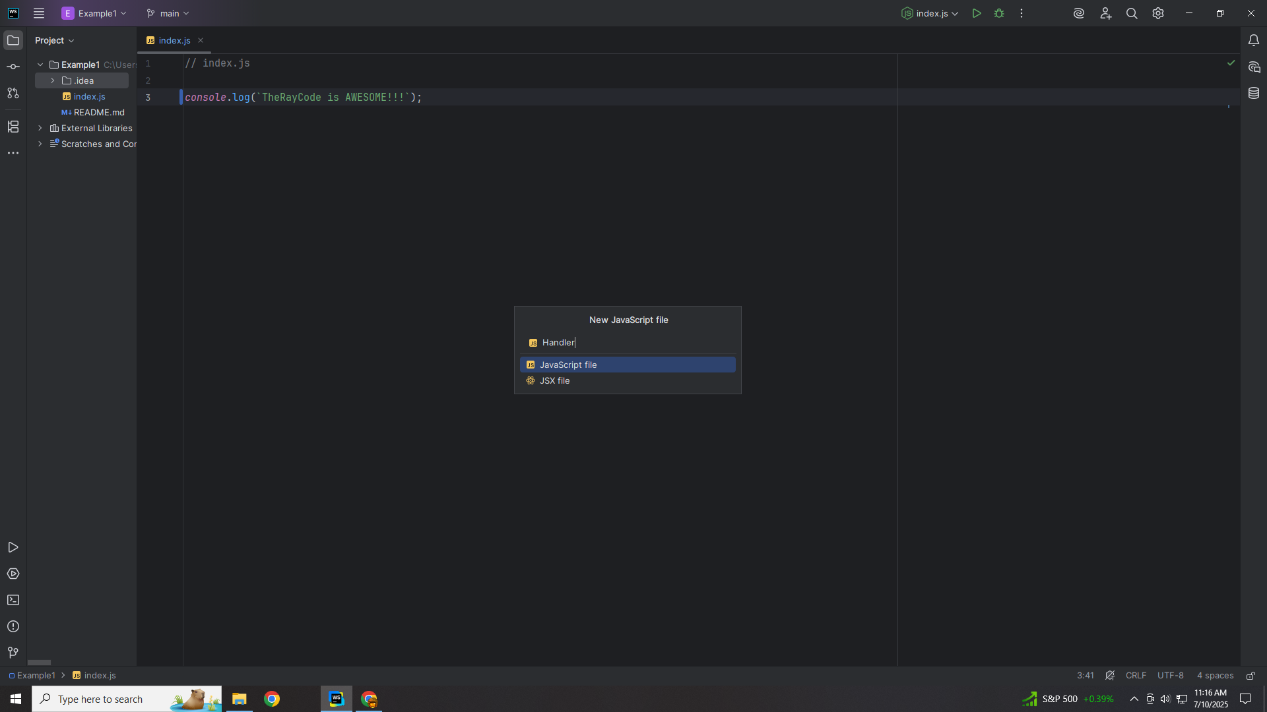
Notes:
We begin with creating an abstract class interface we call Handler

Slide 5
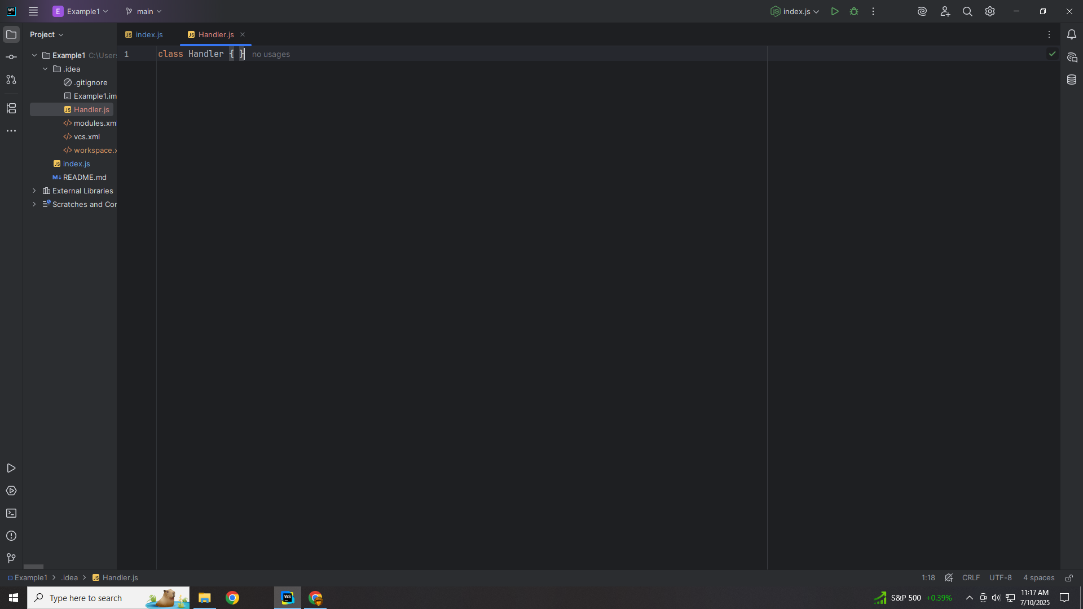
Notes:
Here is the the class structure

Slide 6
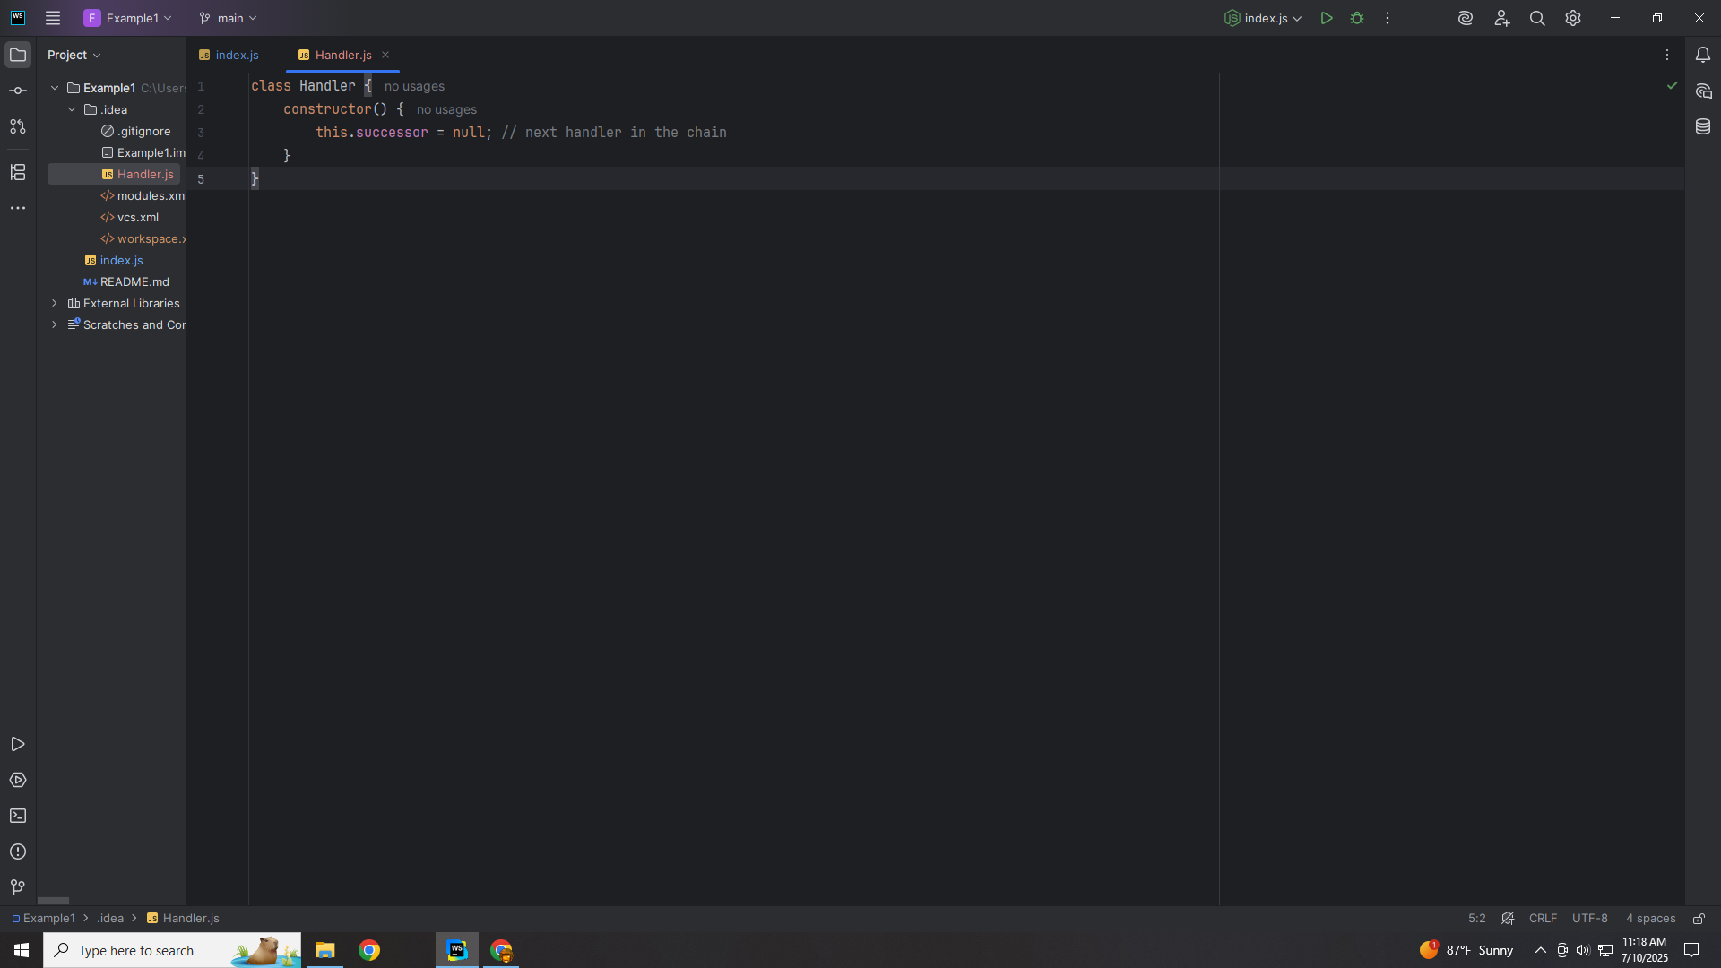
Notes:
We add a constructor that will add the next handler in the chain

Slide 7
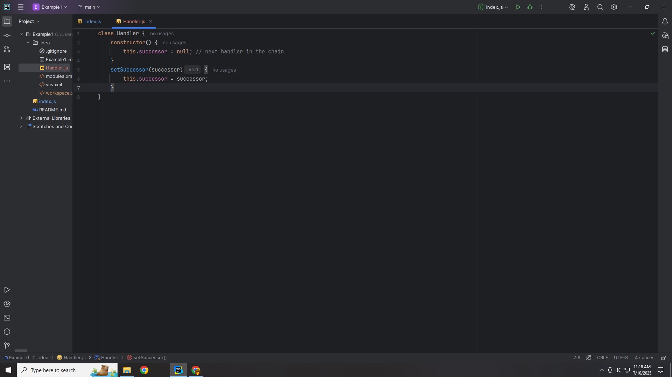
Notes:
We set the Successor of the chain

Slide 8
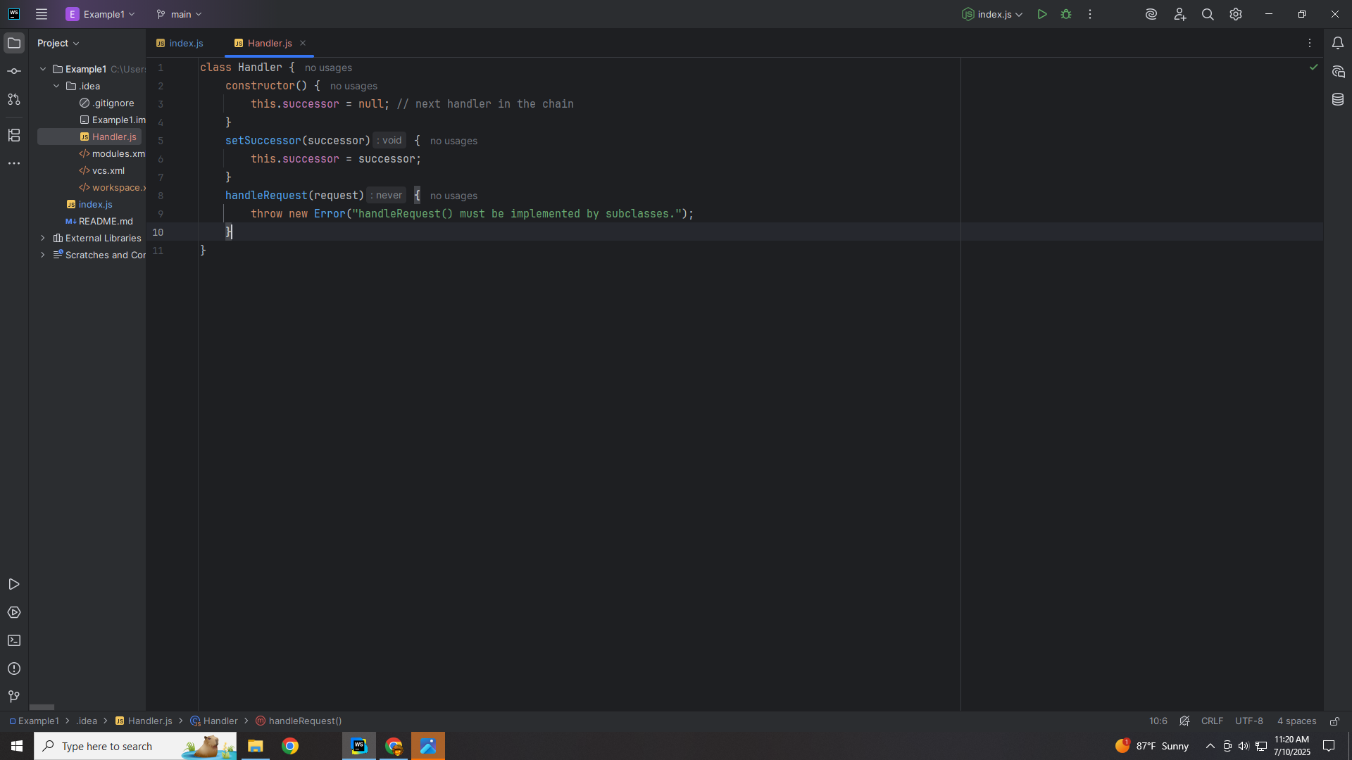
Notes:
And we handled the request

Slide 9
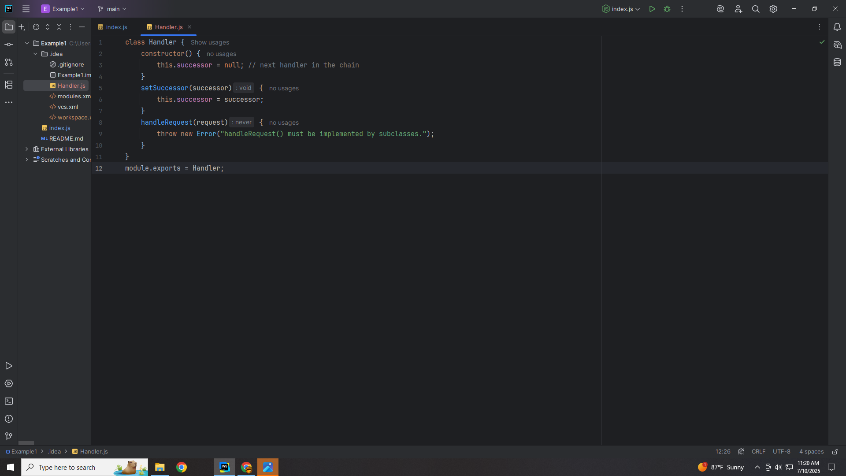
Notes:
We export this module to use in our demo

Slide 10
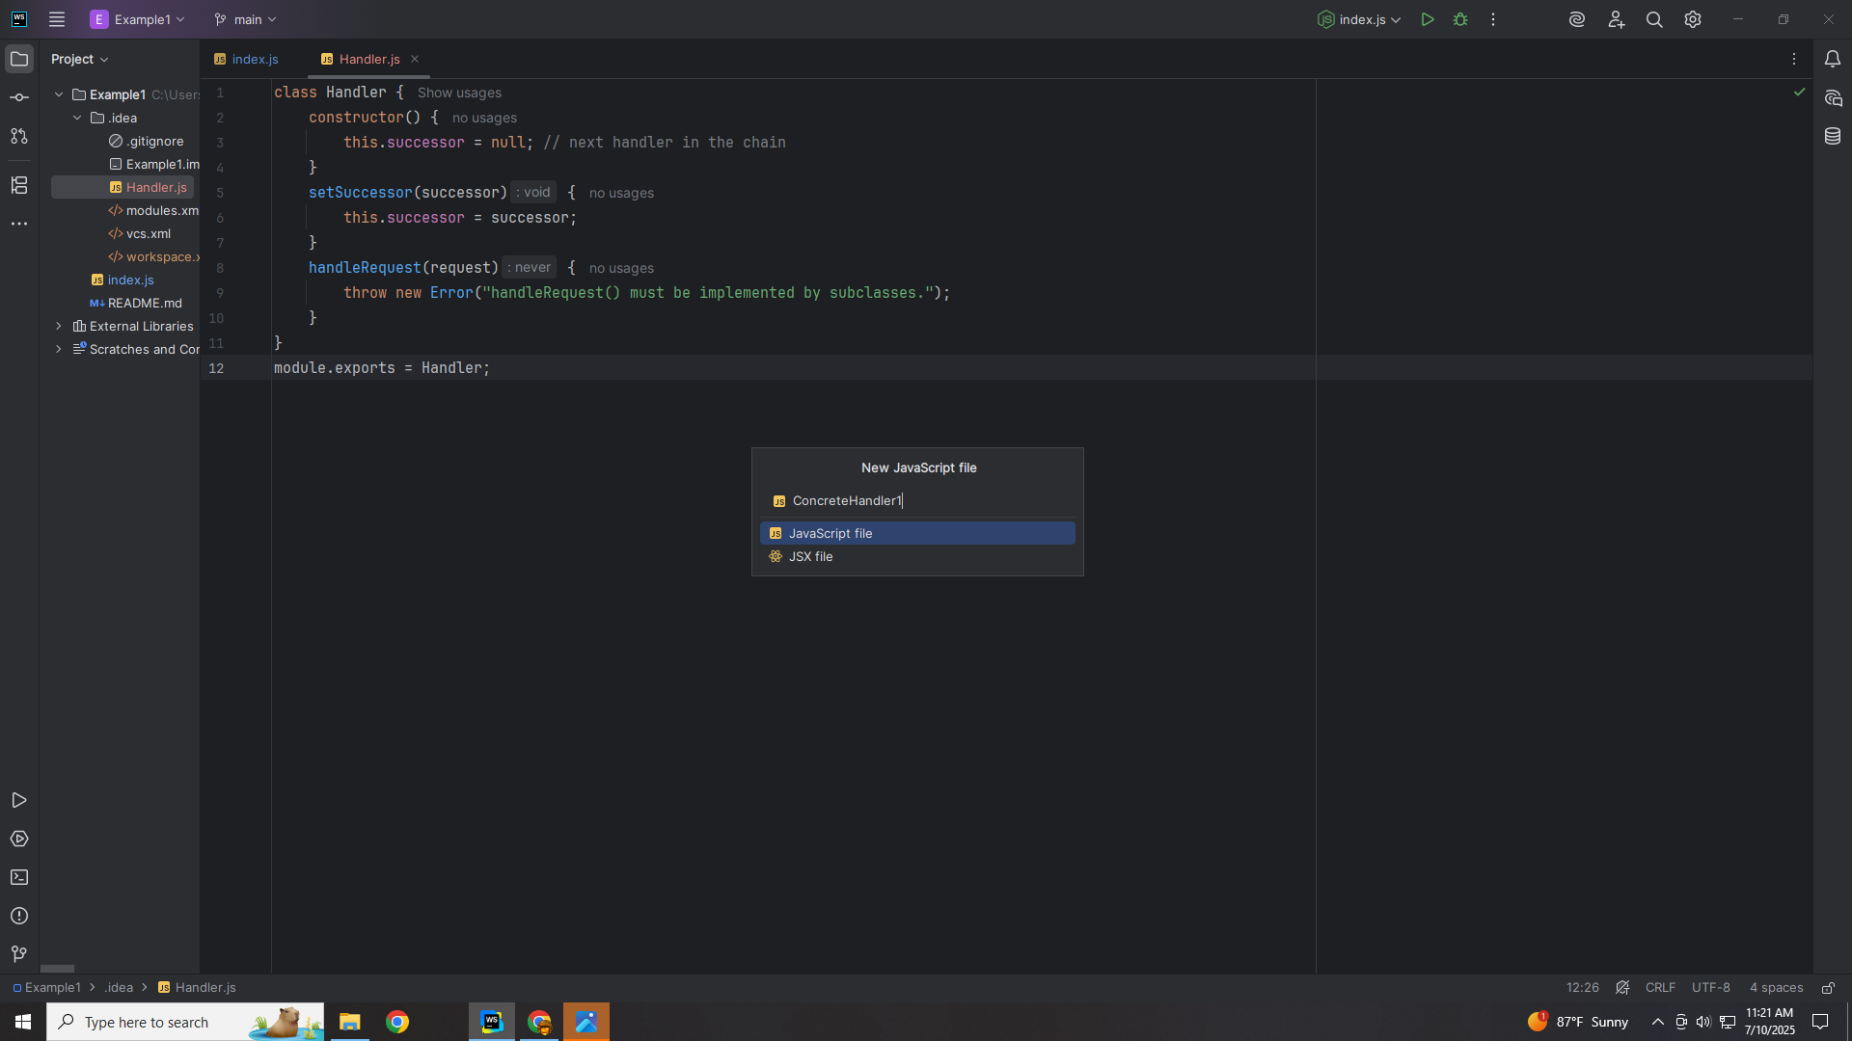
Notes:
Now we will create a class we call Concrete Handler one

Slide 11
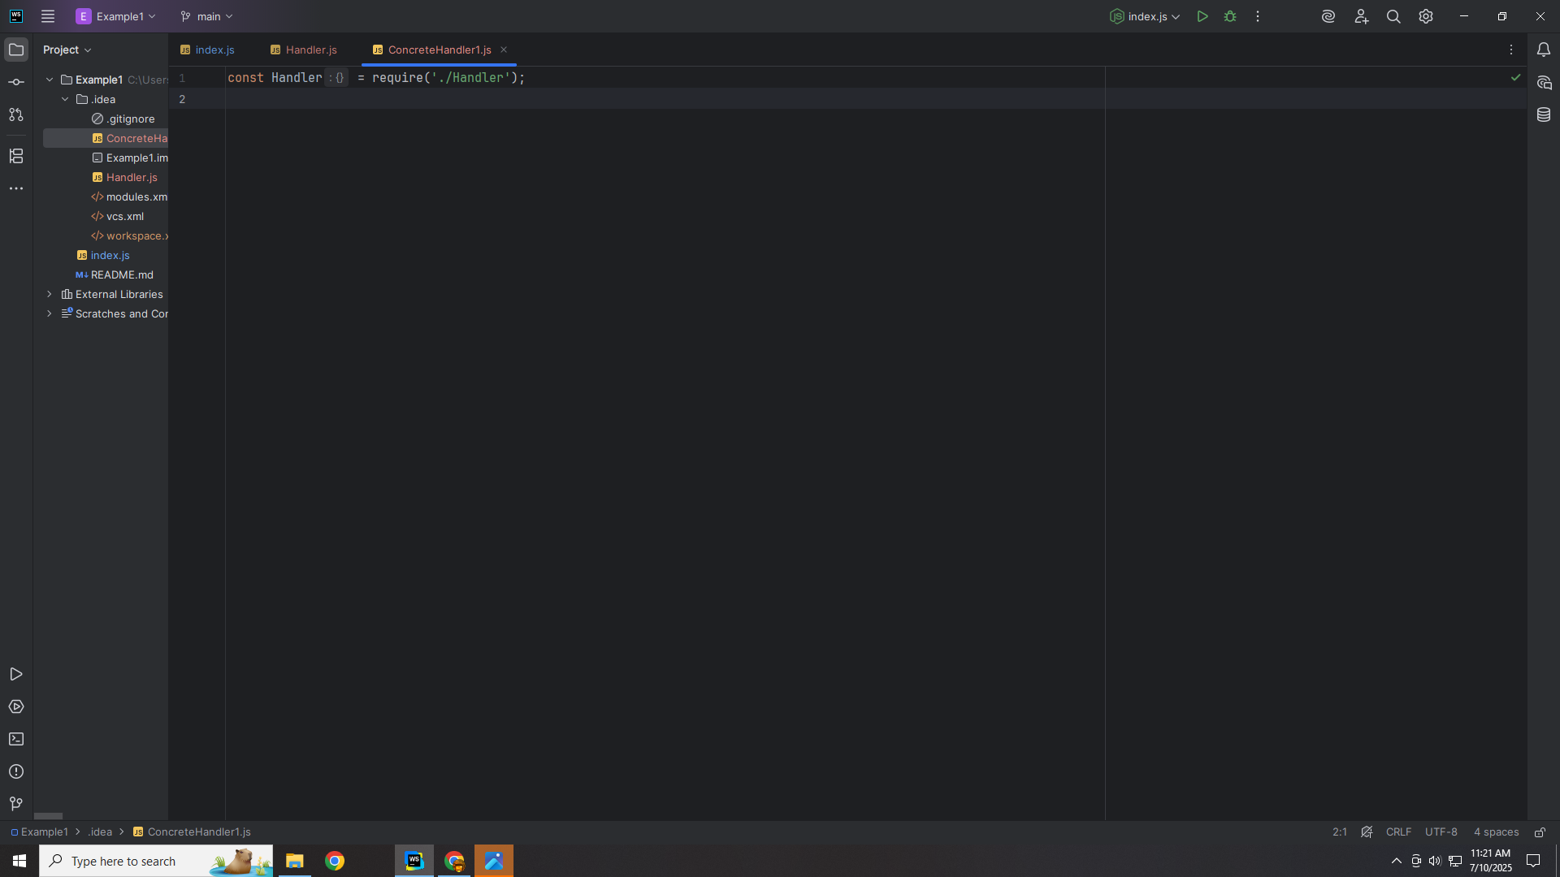
Notes:
We Require the abstract class Handler at the top

Slide 12
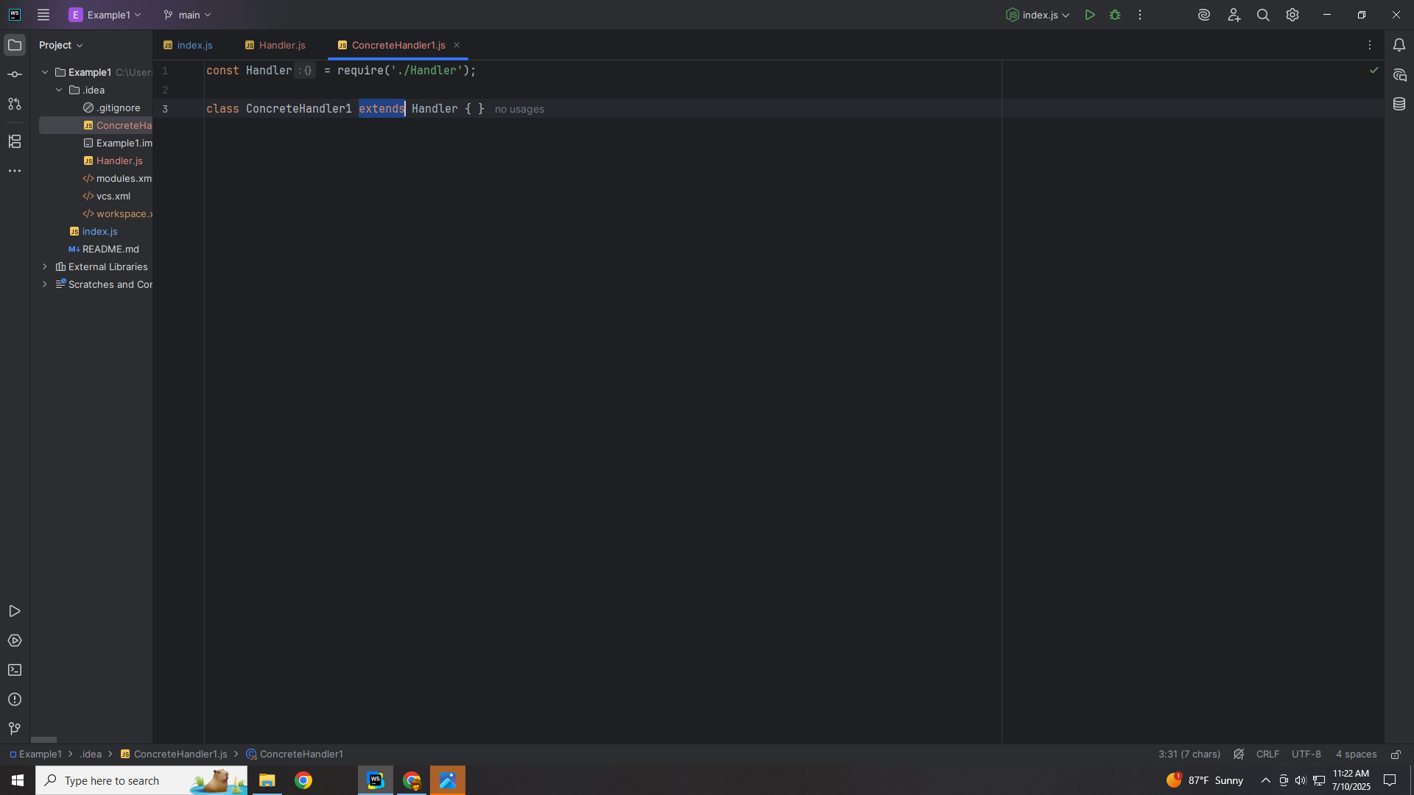
Notes:
Concrete Handler one will be extended with the Handler

Slide 13

Notes:
We pass a request into the handle Request method

Slide 14
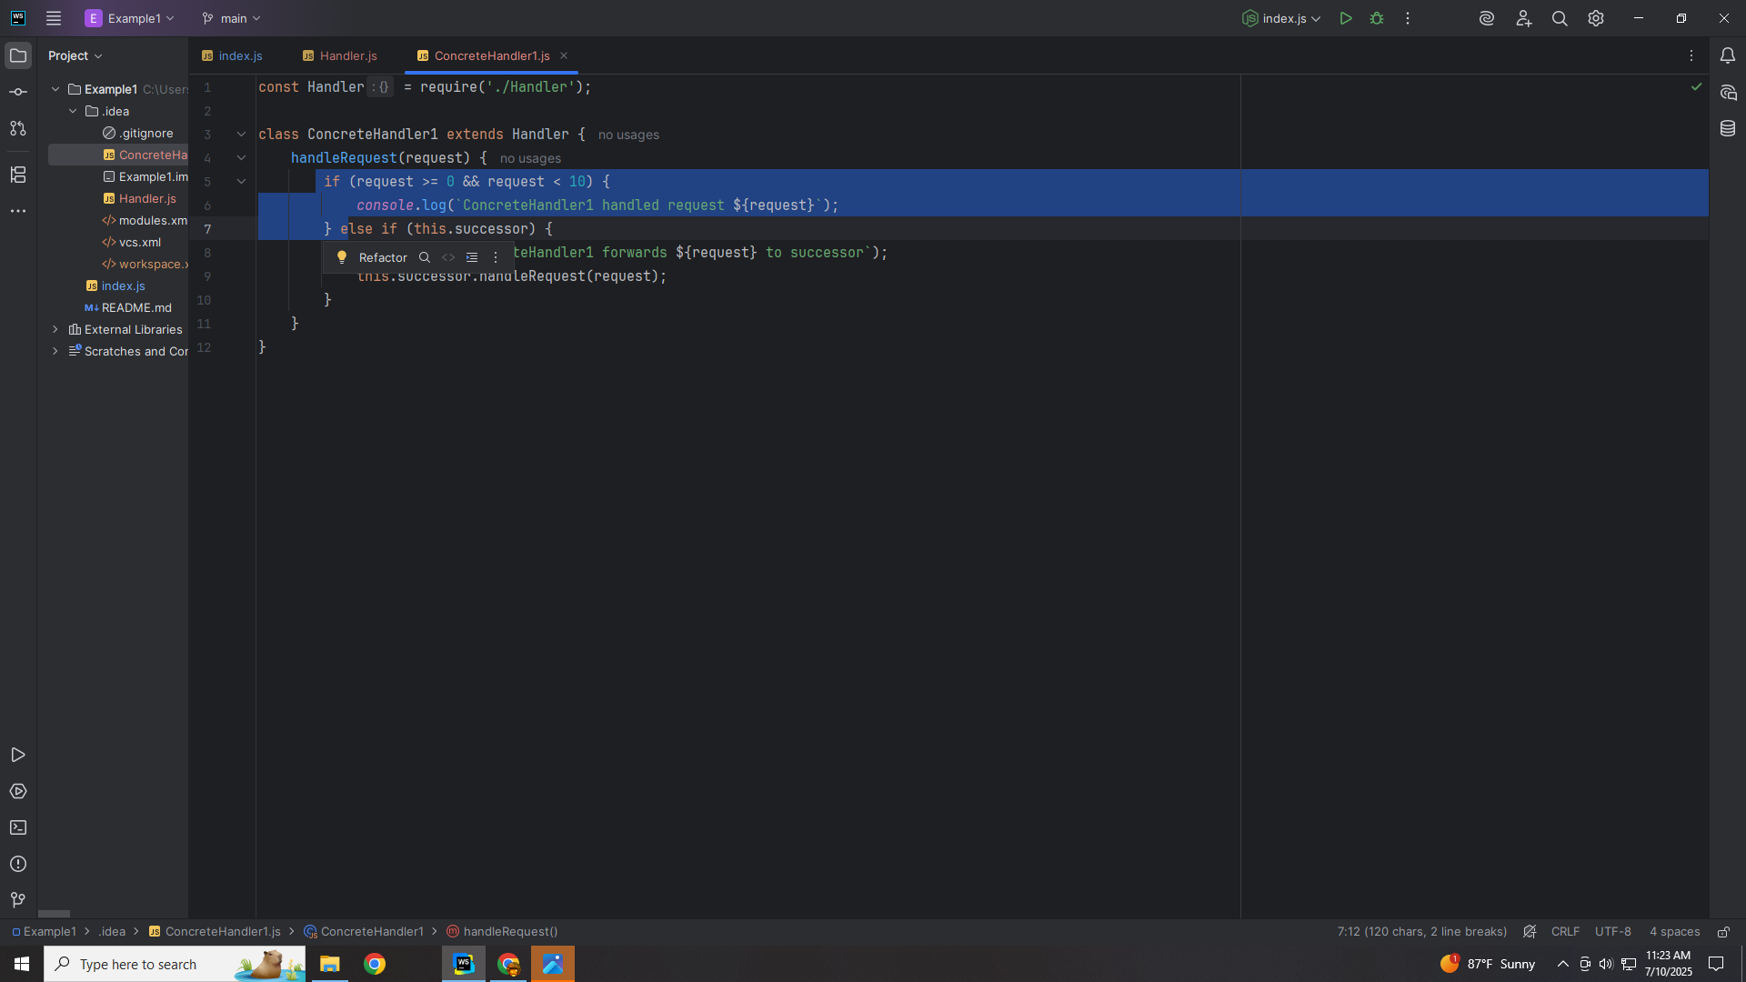
Notes:
If the request is greater than or equal to zero and is less then ten we can use it

Slide 15
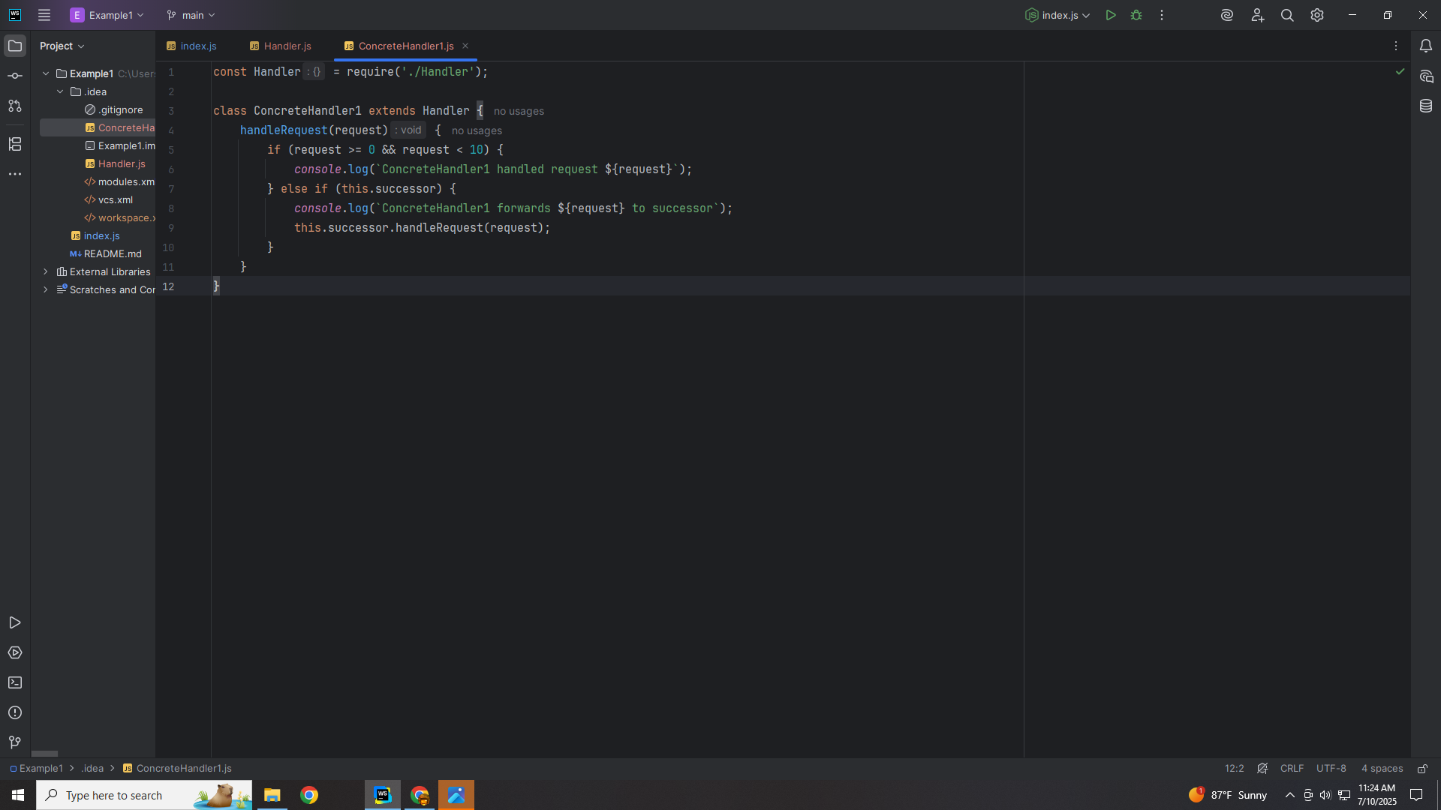
Notes:
But If not we pass the request to the next successor

Slide 16
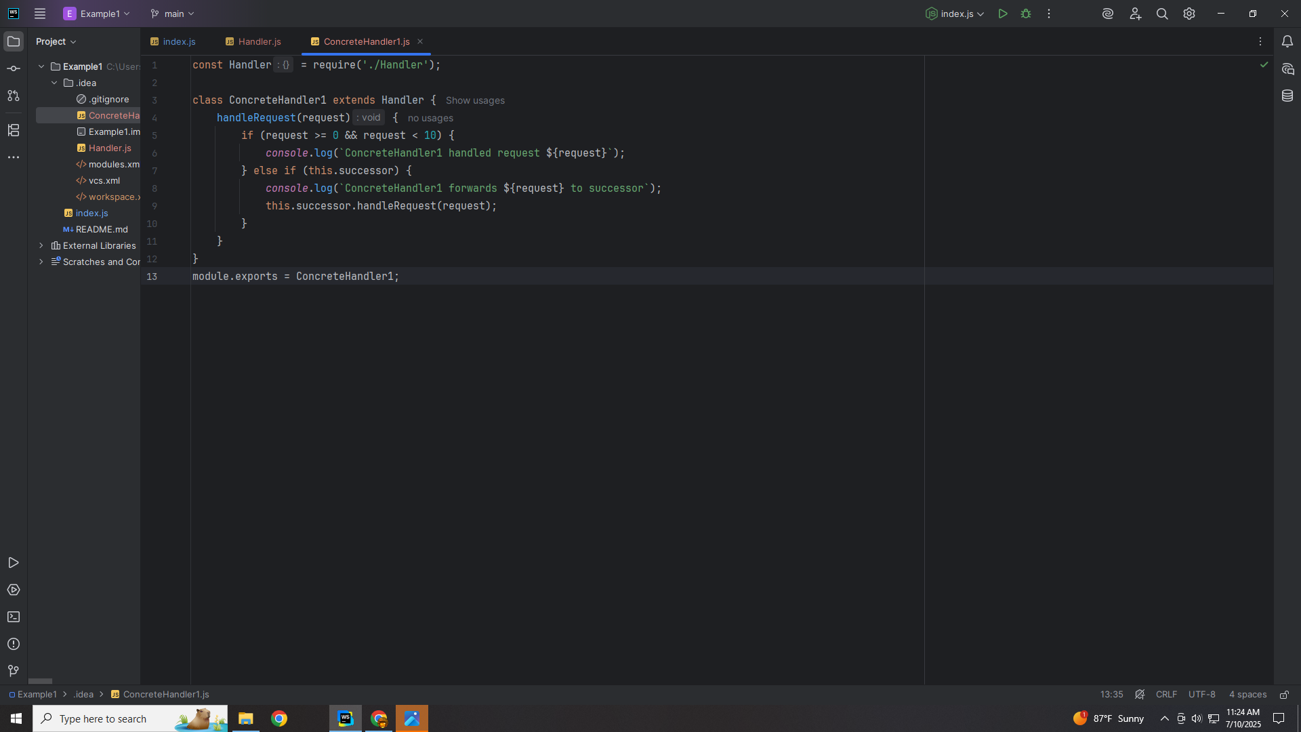
Notes:
We export this module for use in our demo

Slide 17
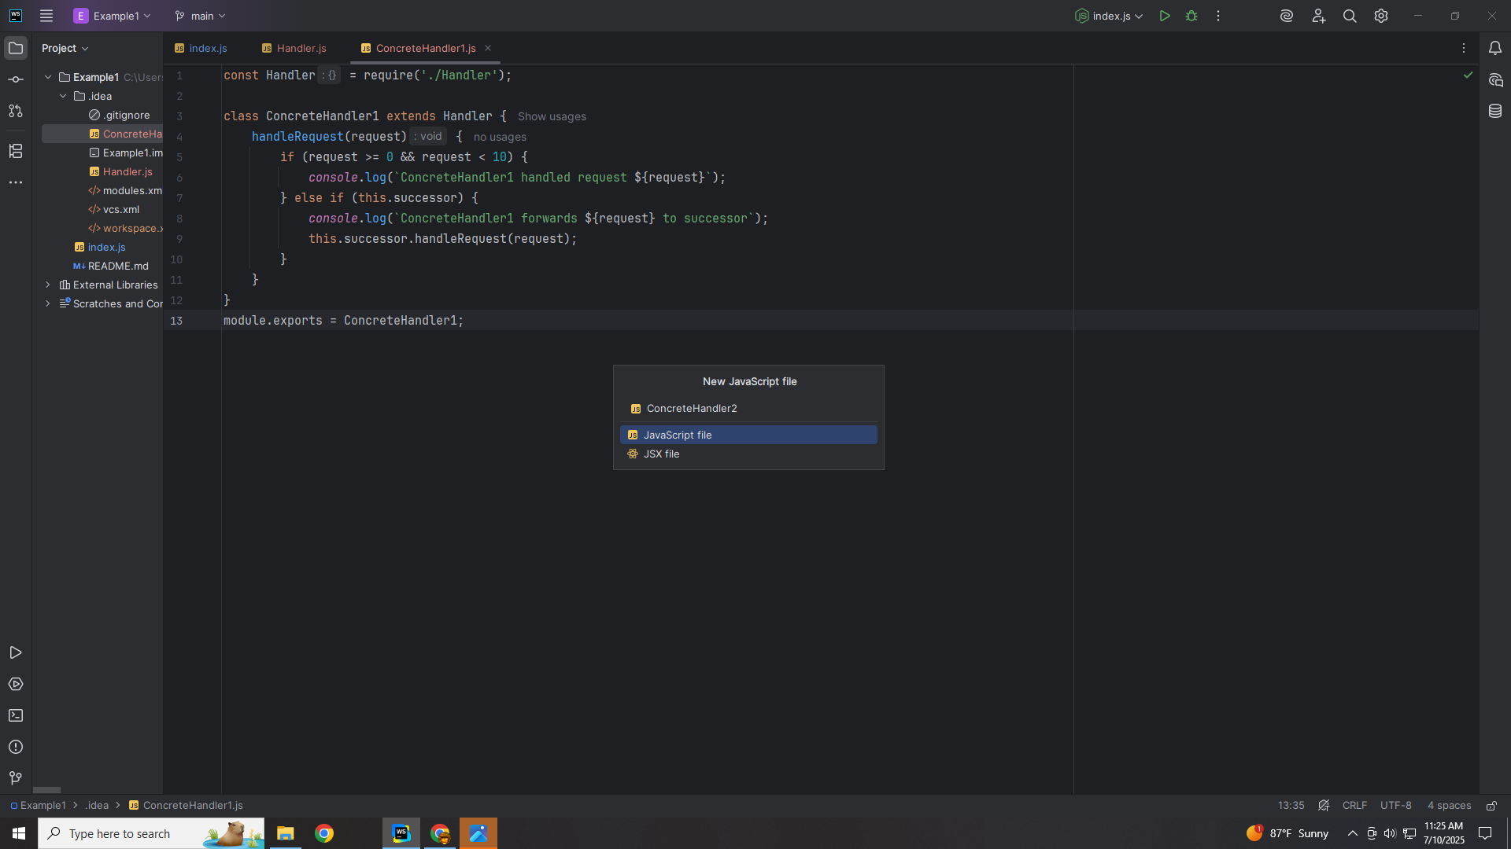
Notes:
Let’s create another class we call Concrete Handler Two

Slide 18
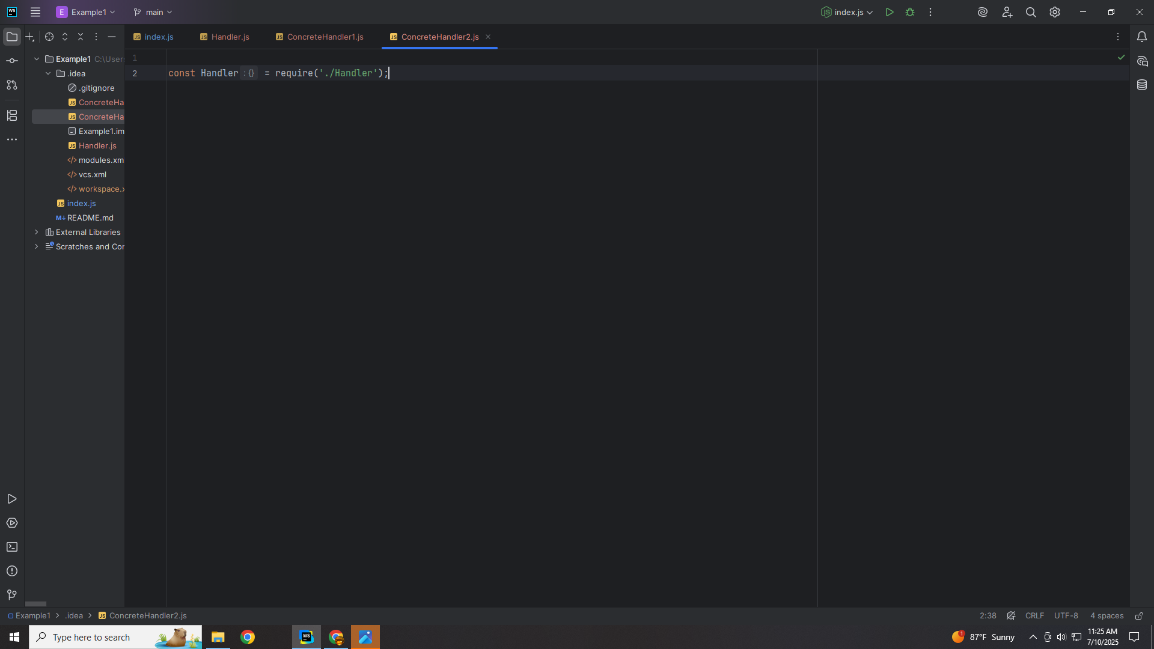
Notes:
At the to we require the Handler abstract class

Slide 19
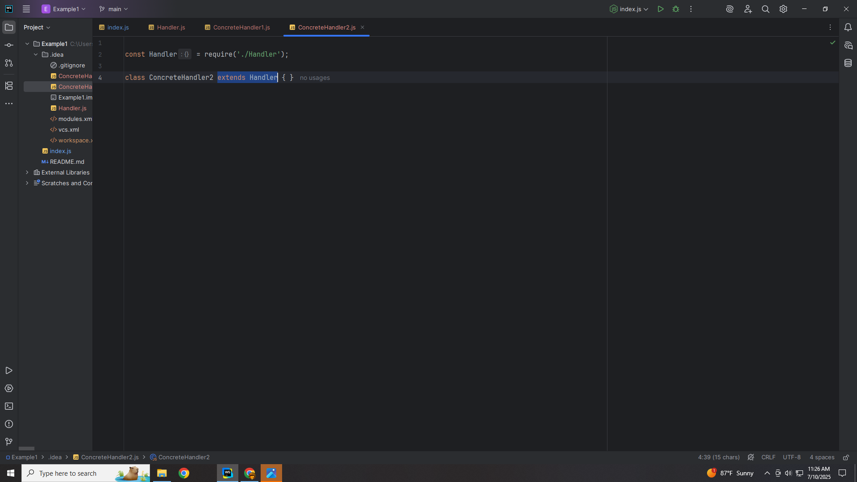
Notes:
Concrete Handler 2 is extended with the Handler class

Slide 20
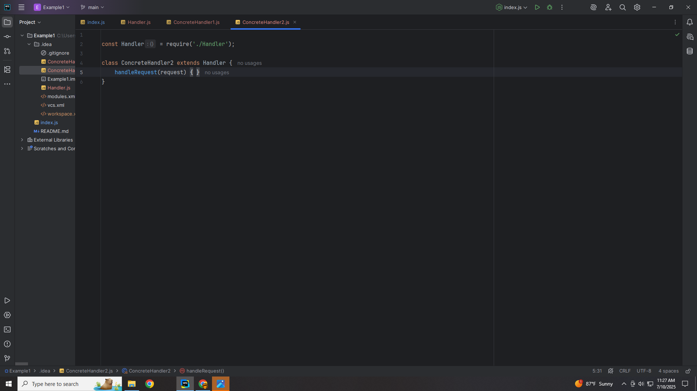
Notes:
We add a handle Request method which accepts a request

Slide 21
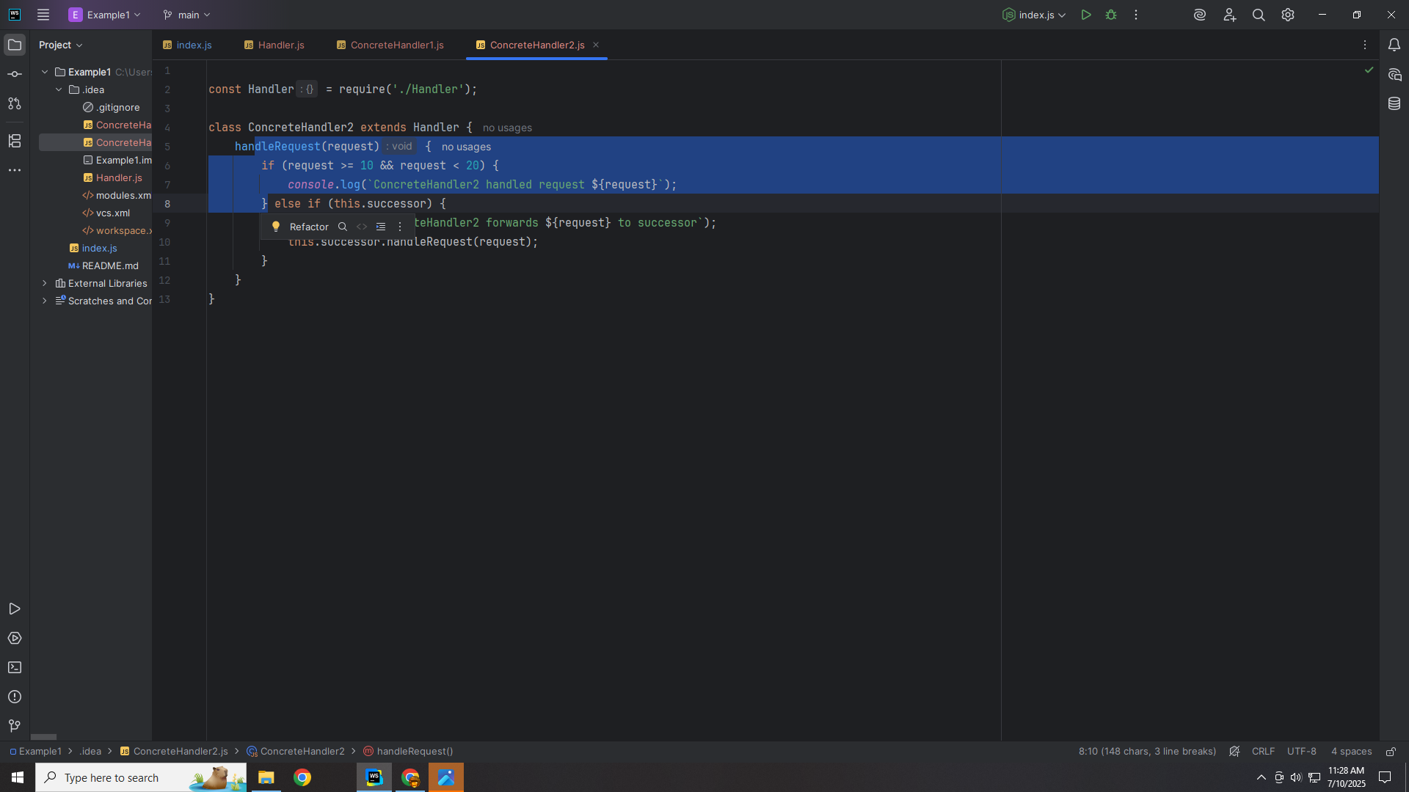
Notes:
If the request is between 10 and 20 it is accepted

Slide 22
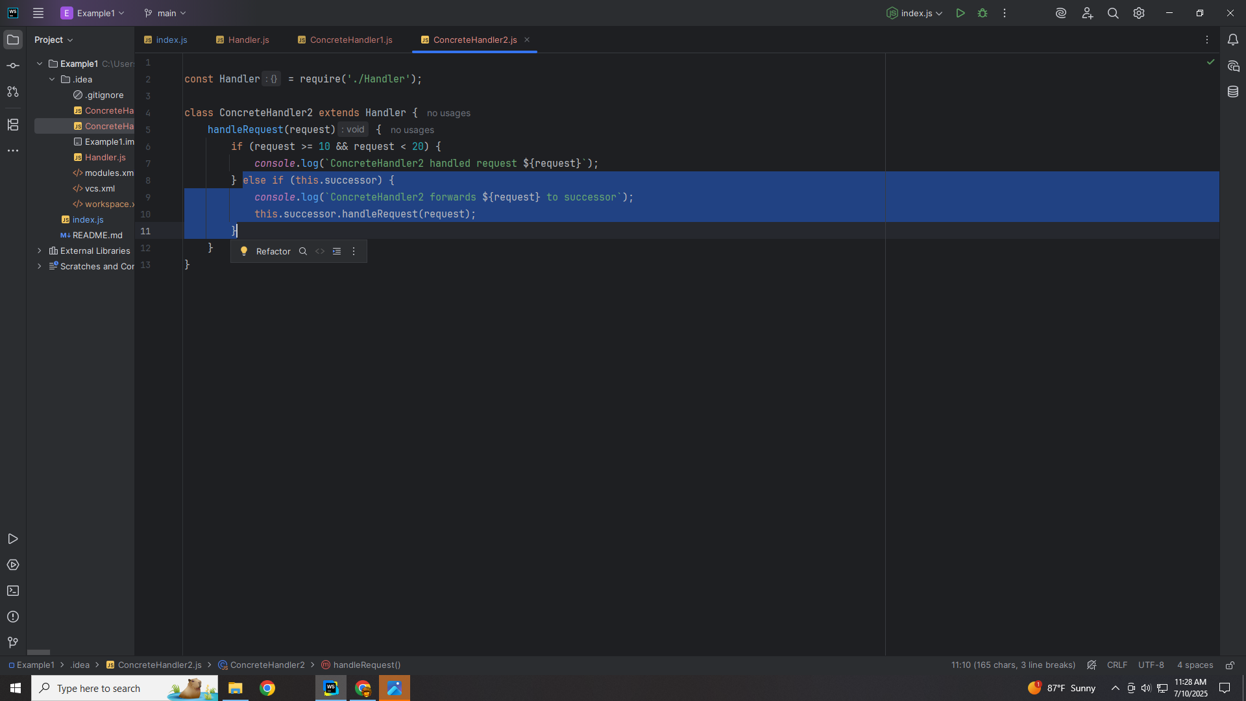
Notes:
Else it is passed to the next Handler

Slide 23
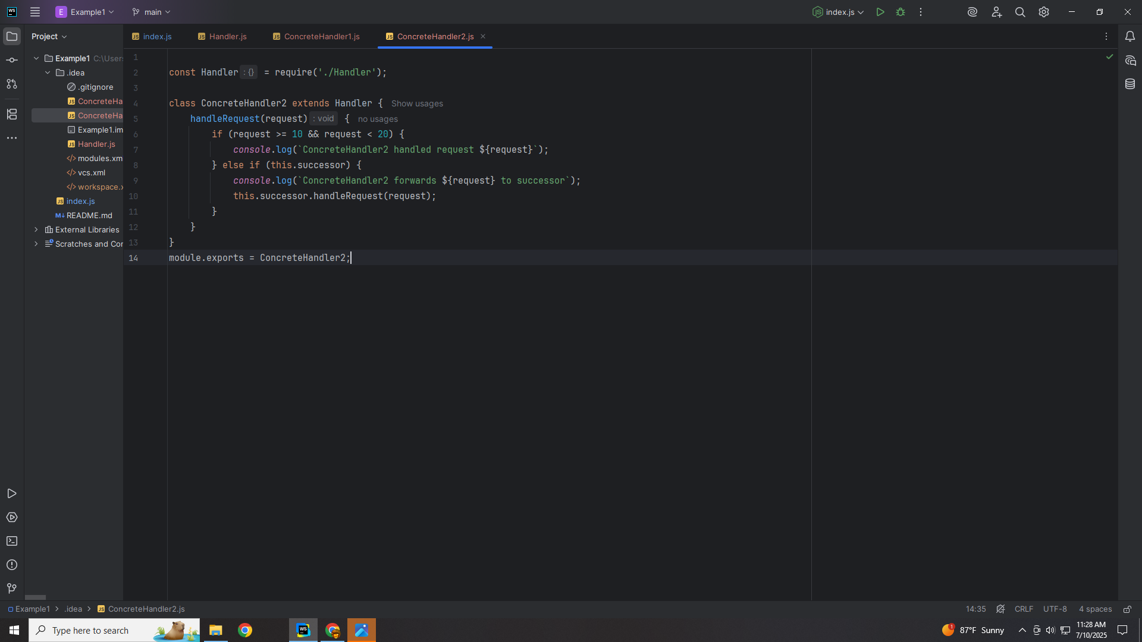
Notes:
And we export this module for use in our demo

Slide 24
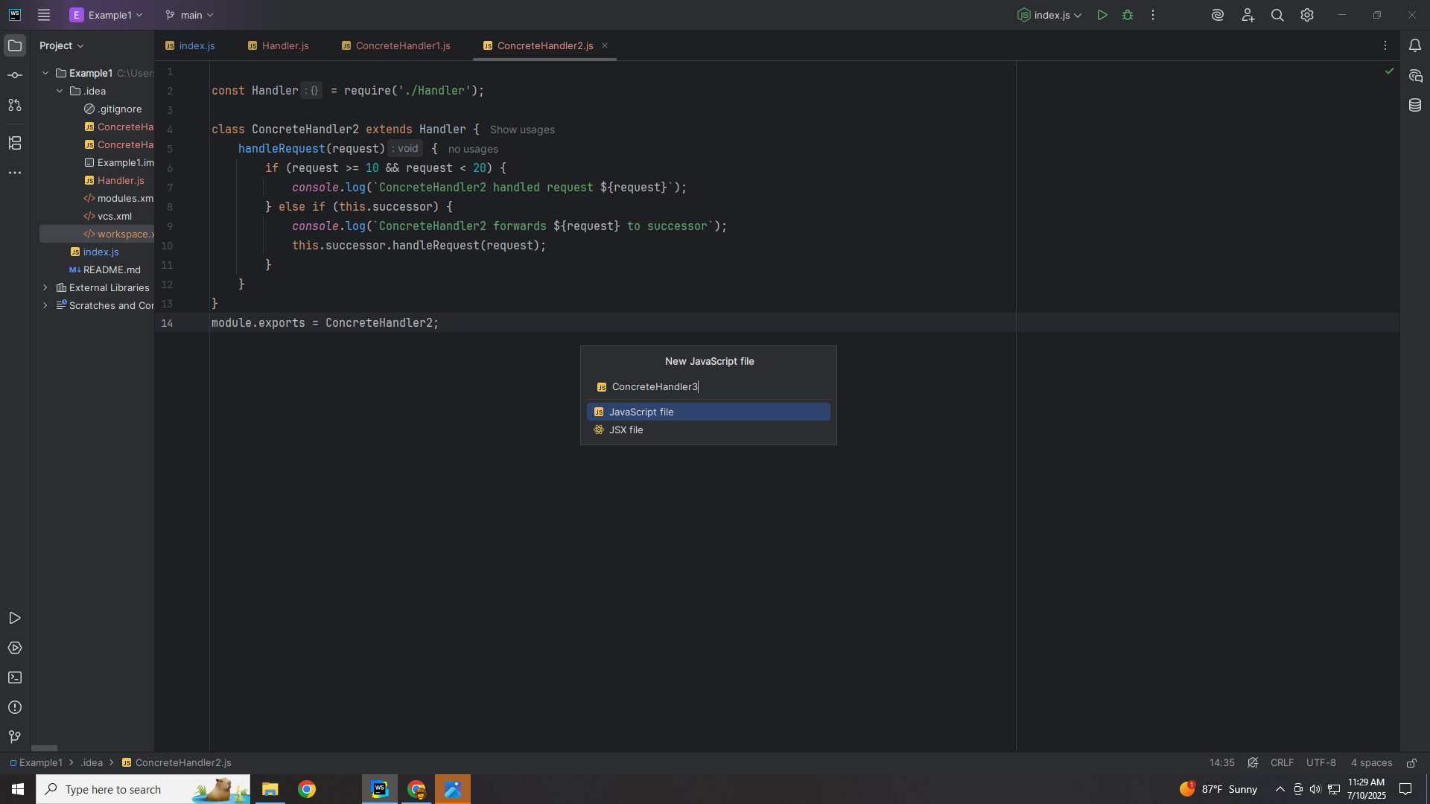
Notes:
Let’s create a Third Concrete Class that is also extended with the Handler

Slide 25
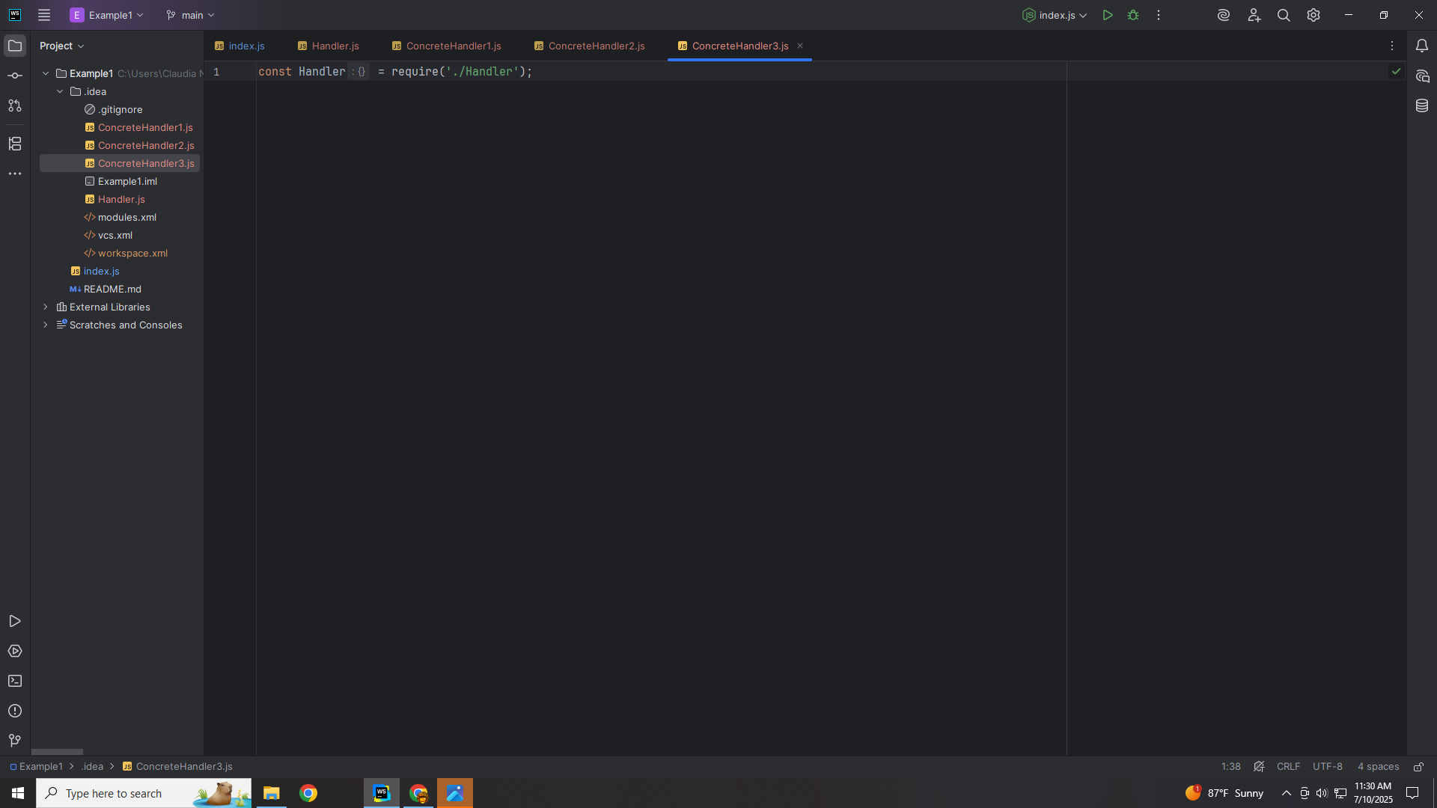
Notes:
At the top we require the Handler

Slide 26
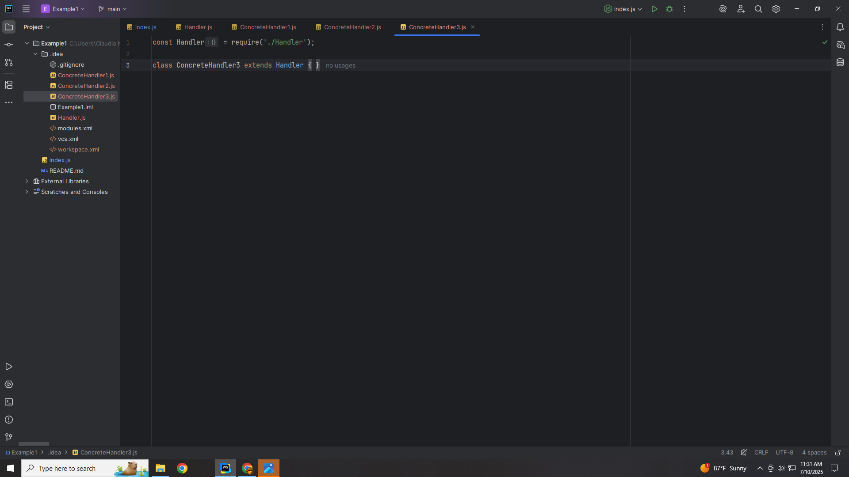
Notes:
So we may extend this class with it

Slide 27

Notes:
We create a method to handle the request that will be past in

Slide 28
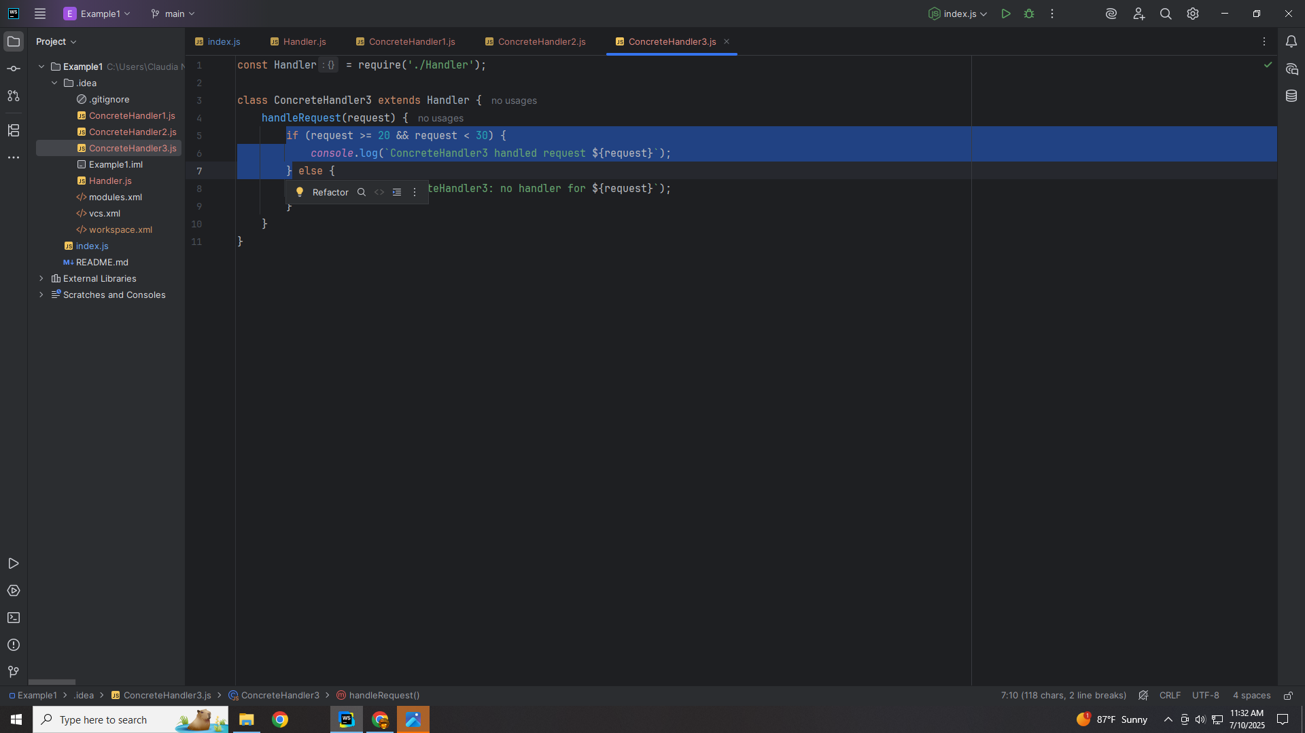
Notes:
We process the request if the value is between 20 and 30 including 20

Slide 29
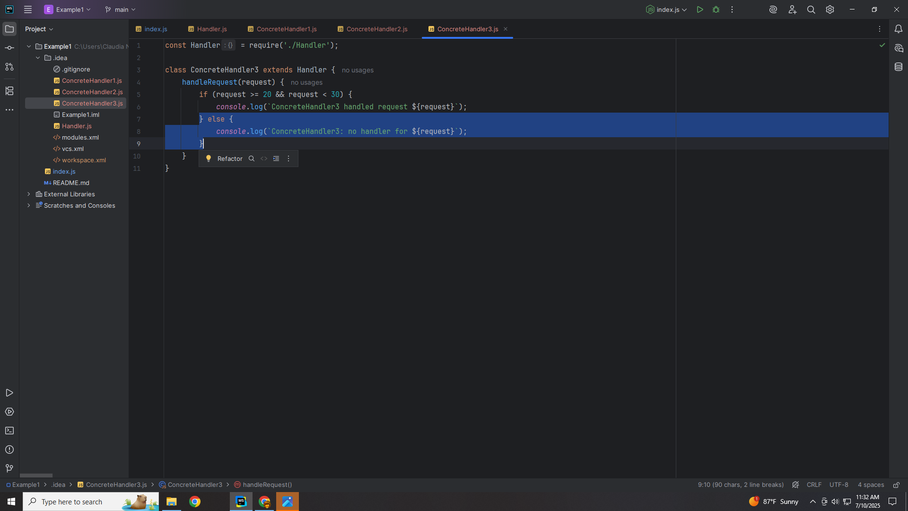
Notes:
else it will be passed the the next handle

Slide 30
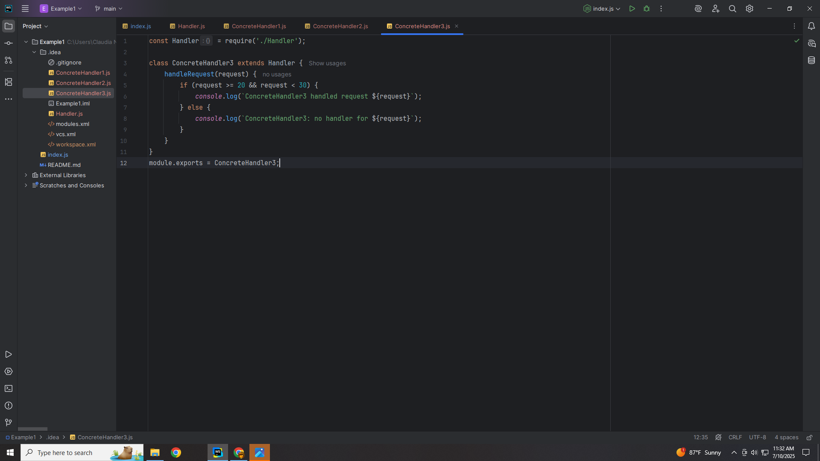
Notes:
We end this Class with an export for our demo

Slide 31
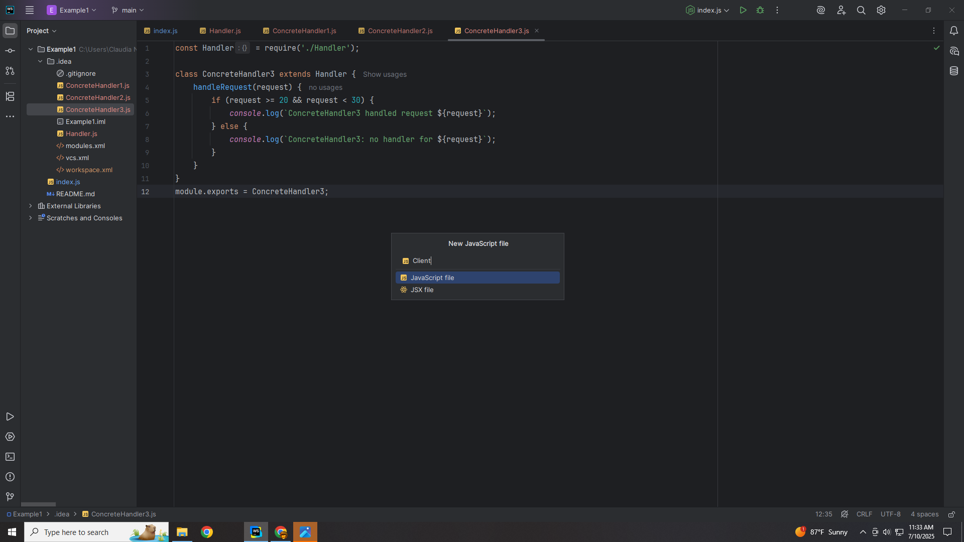
Notes:
Let’s create a Client class

Slide 32
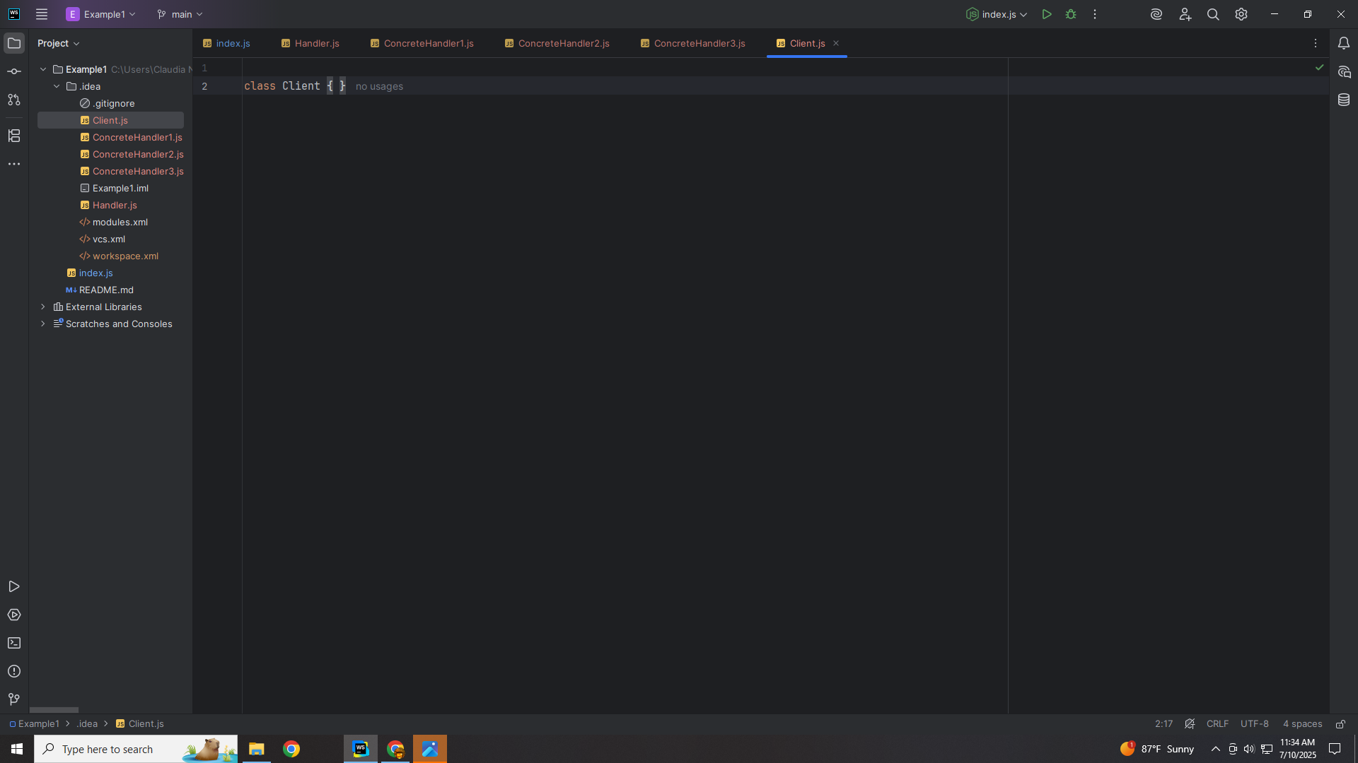
Notes:
The Client is where we will do our demo

Slide 33
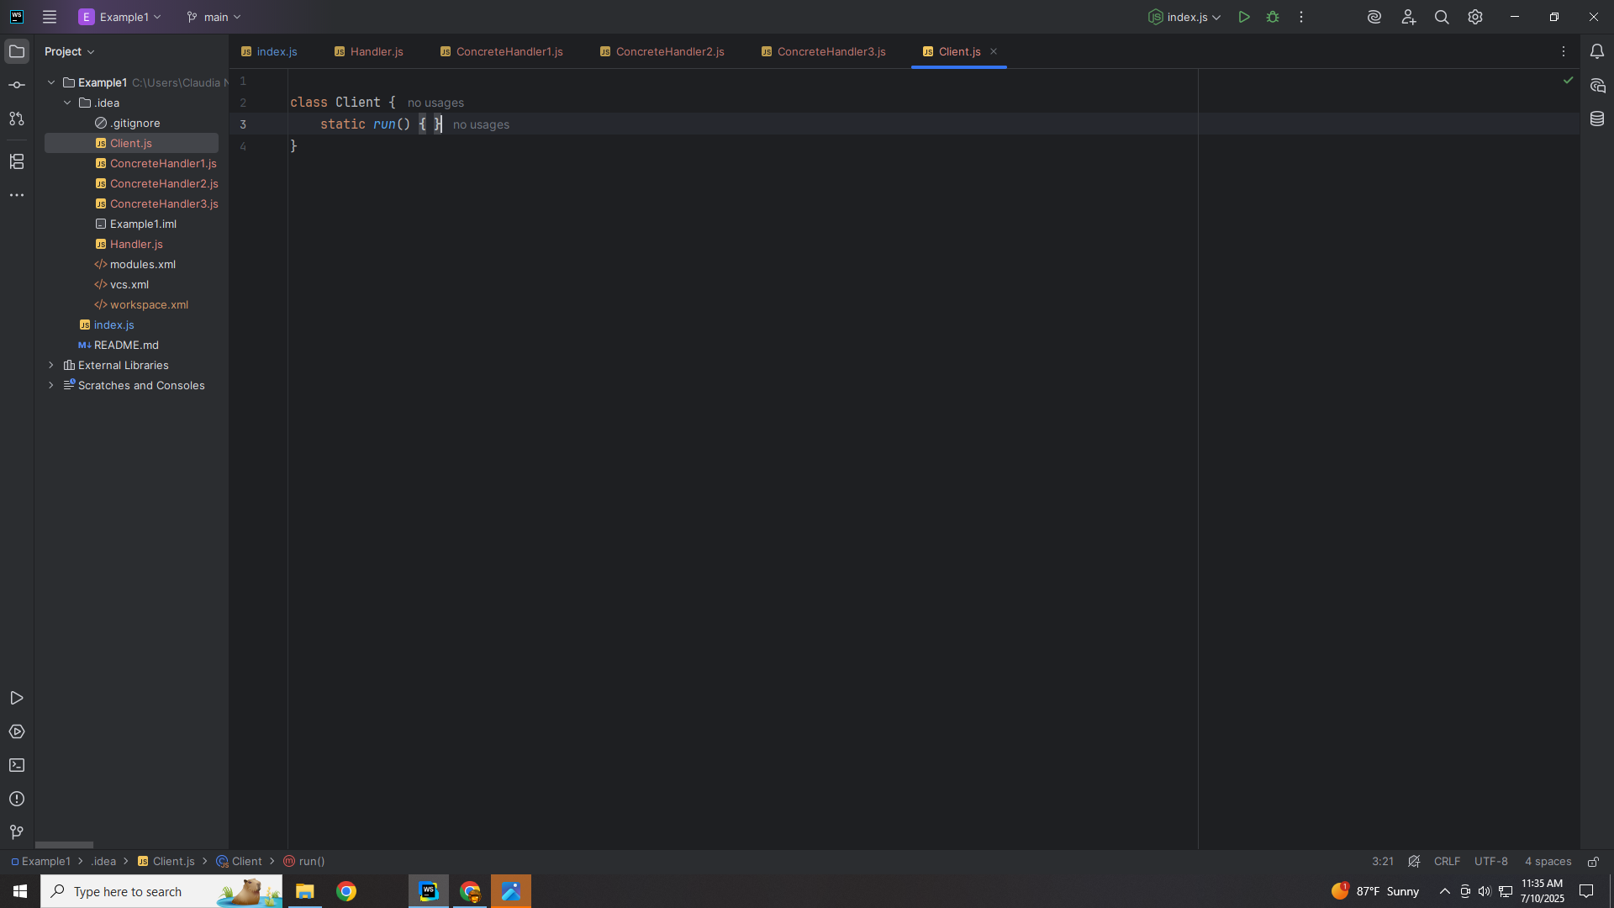
Notes:
We start with a static run

Slide 34
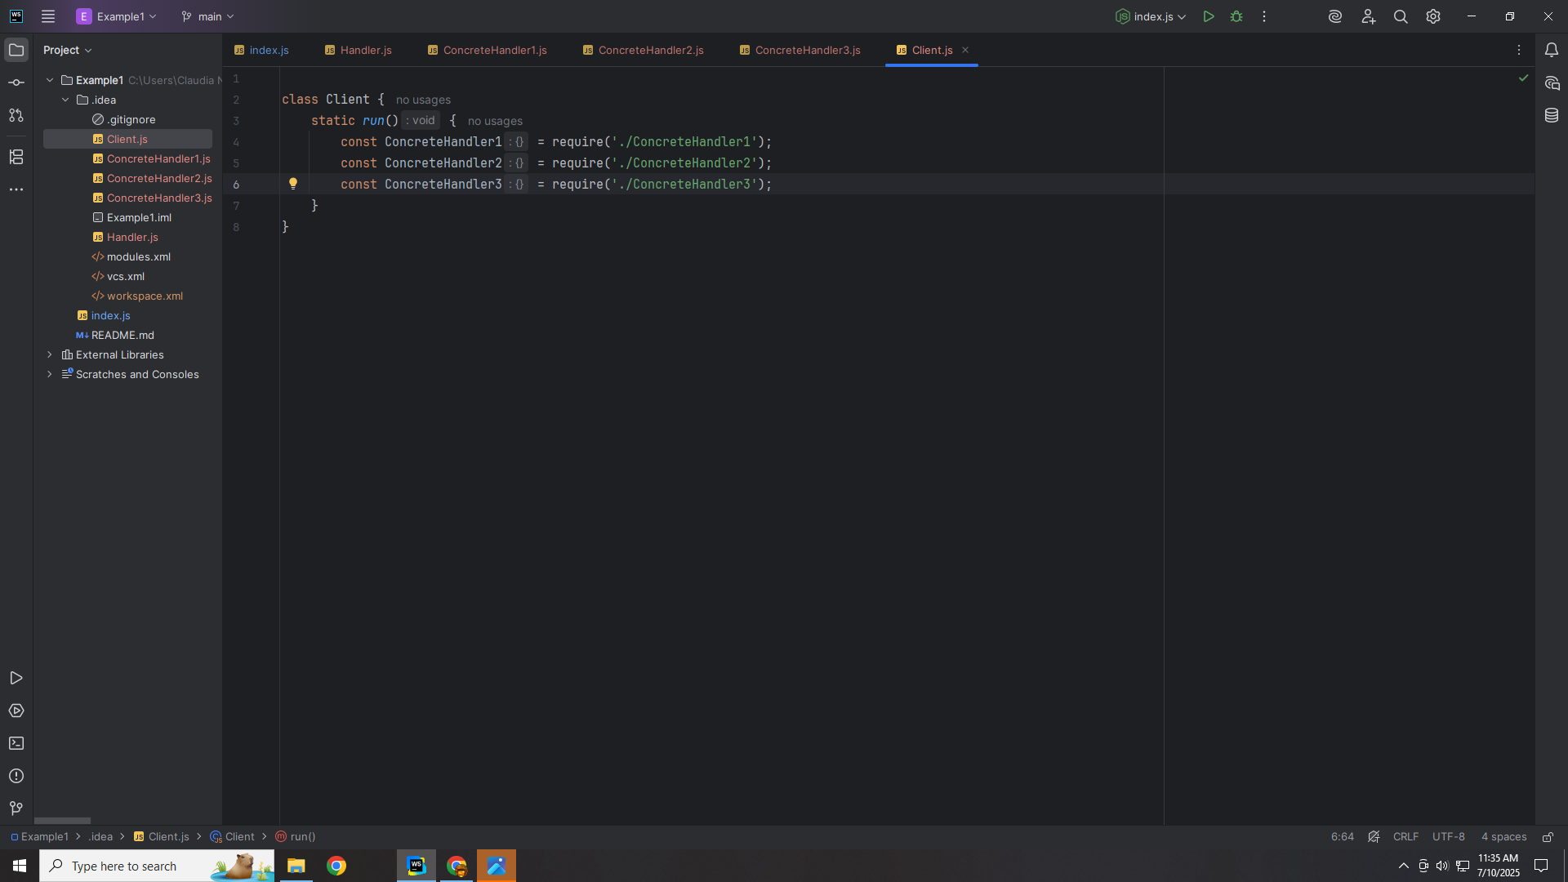
Notes:
We require all three of the Concrete Handlers

Slide 35
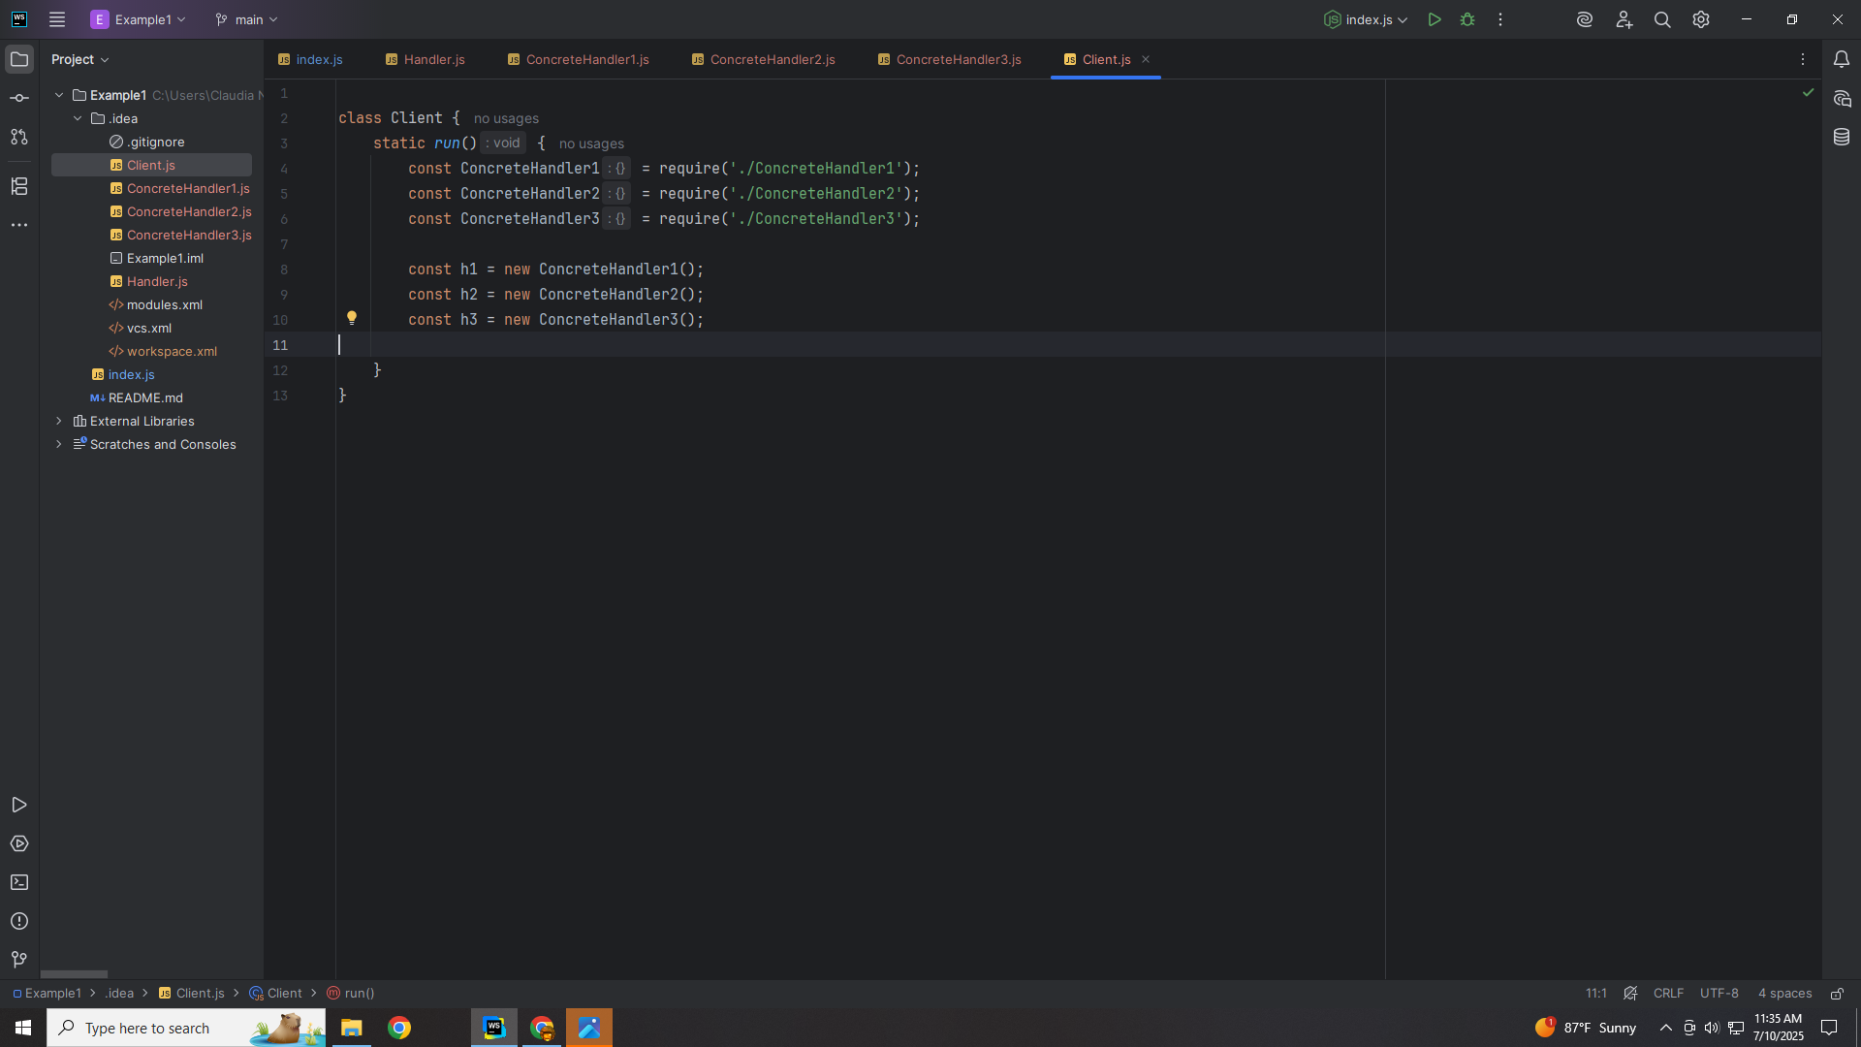
Notes:
We set H one, two and three to respectively new Concentrate Handlers one, two and three

Slide 36
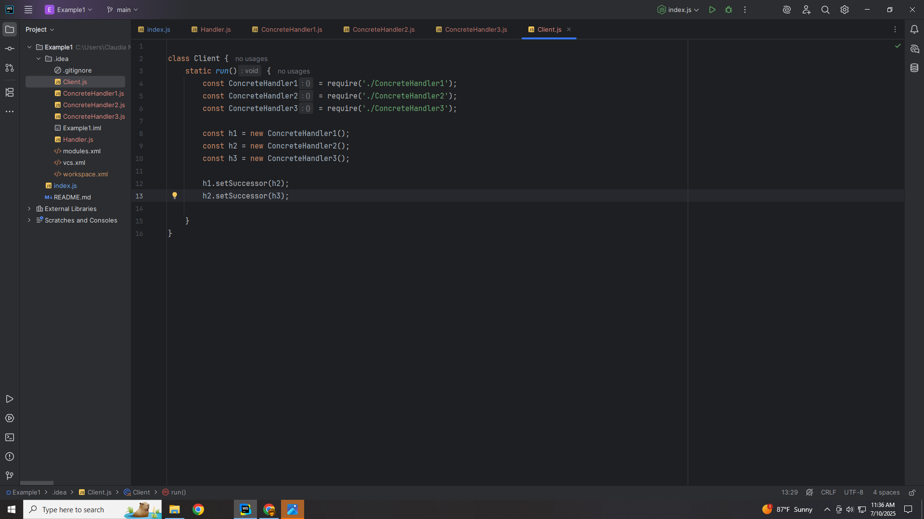
Notes:
We set the successor of h1 to h2 and we set the successor h2 to h3 creating a chain

Slide 37
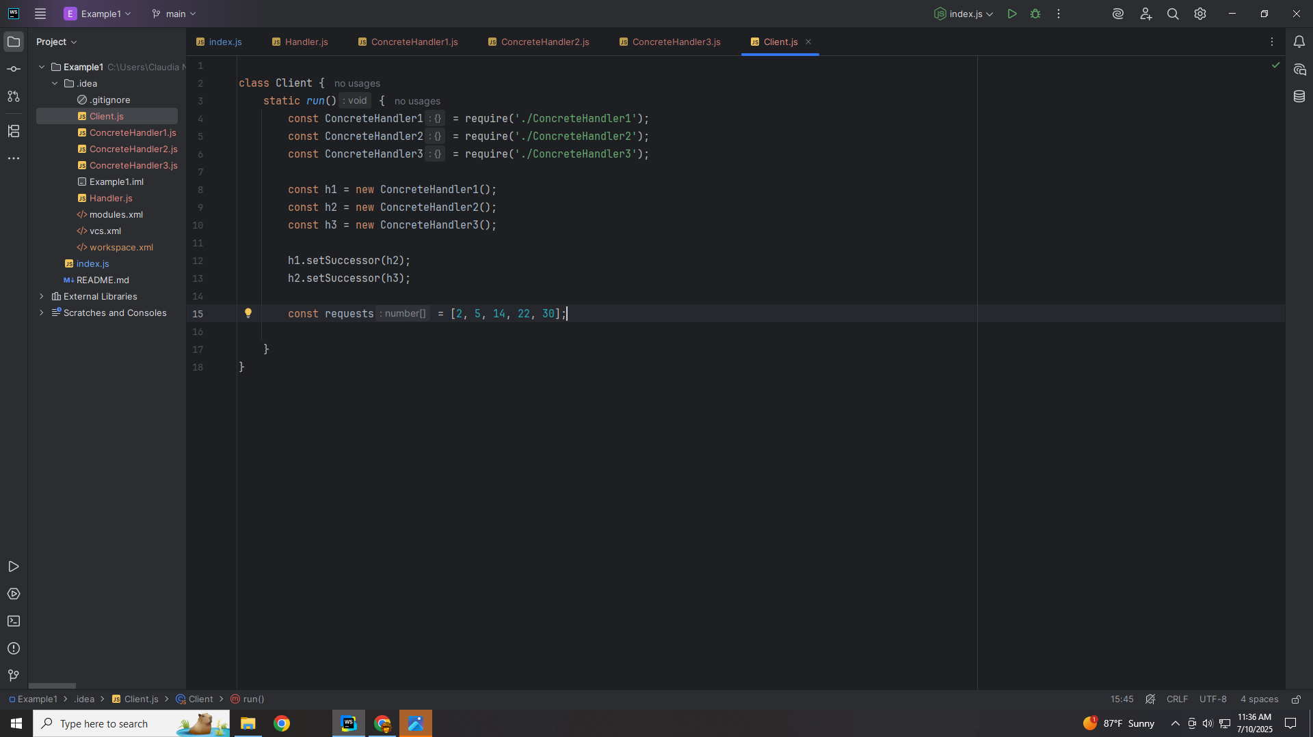
Notes:
We create an array of requests

Slide 38
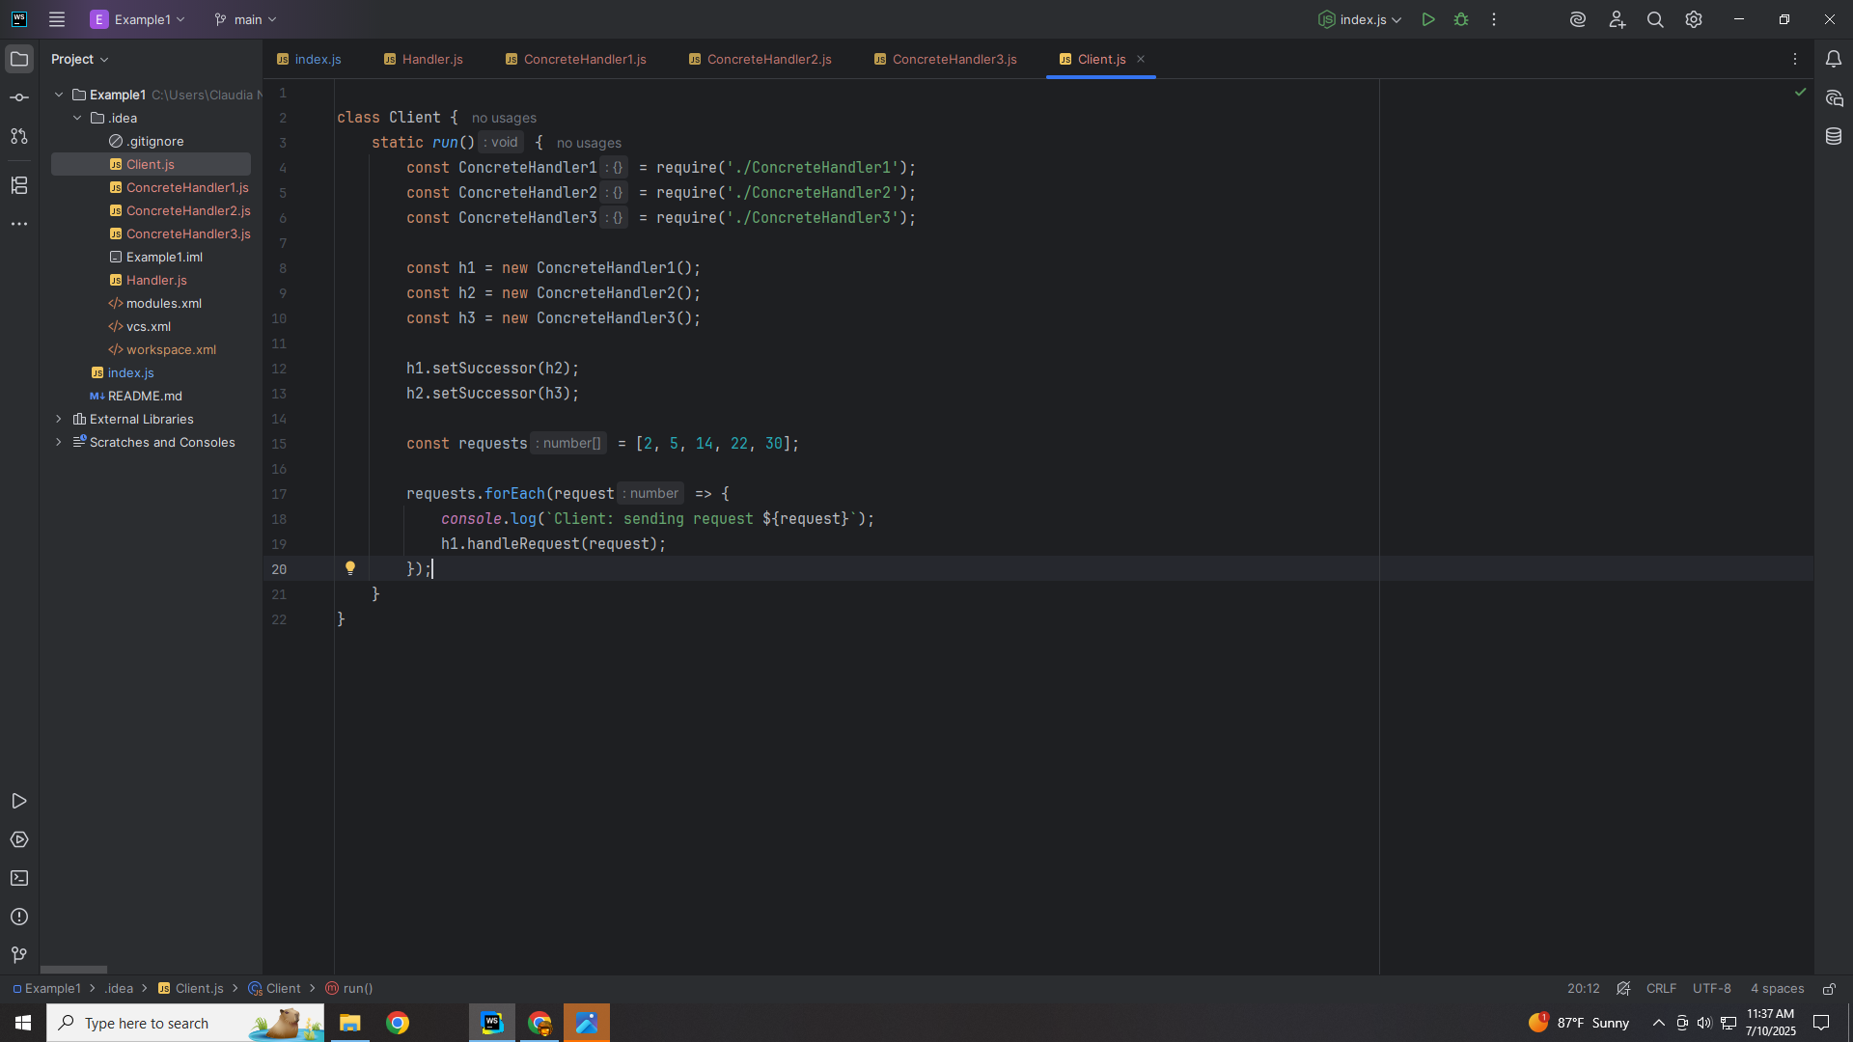
Notes:
And for each request we h1 will handle it starting the chain of requests

Slide 39
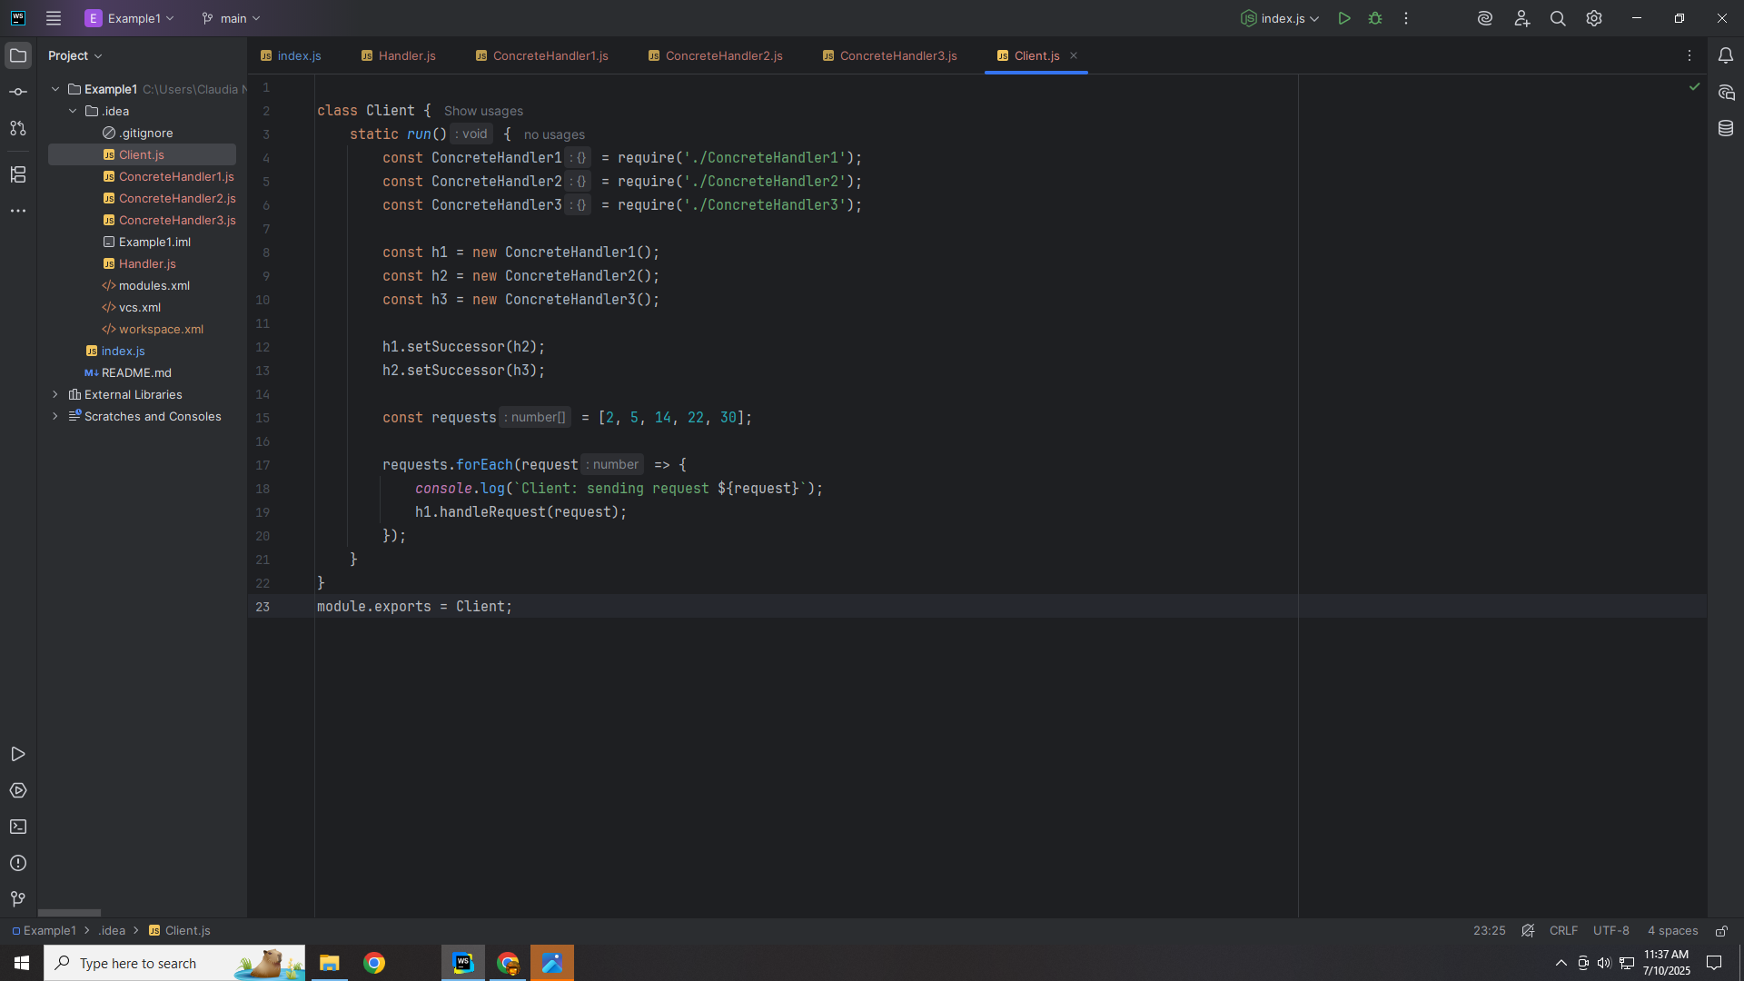
Notes:
And we export this module for use in our demo

Slide 40
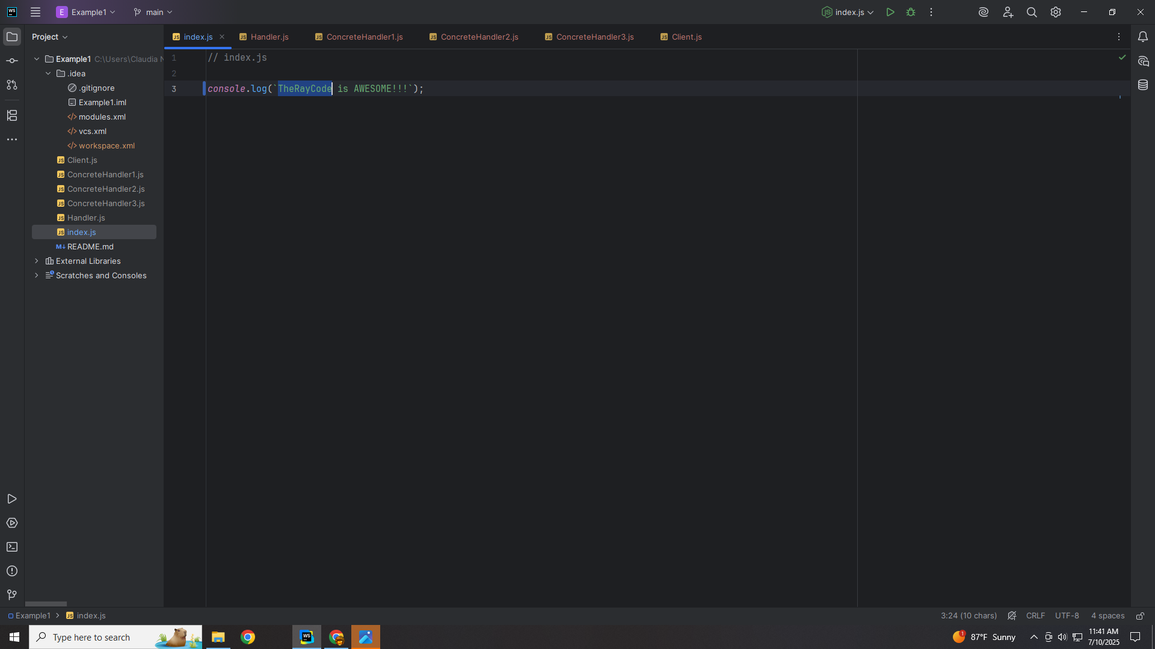
Notes:
So let’s go to the index to compete our demo

Slide 41
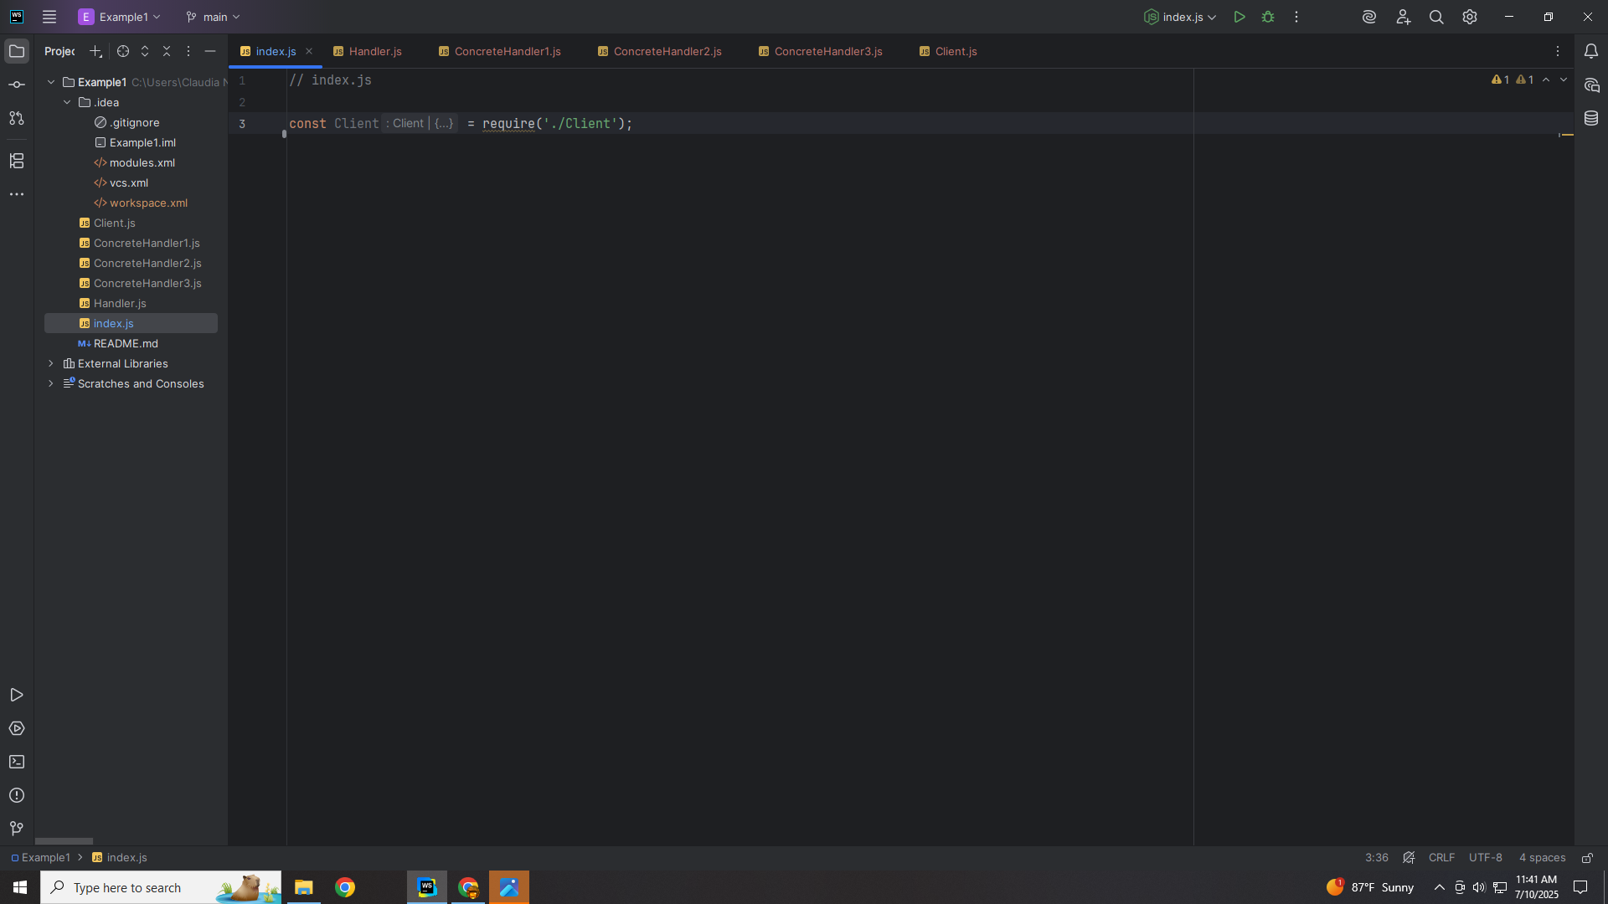
Notes:
We require the Client

Slide 42
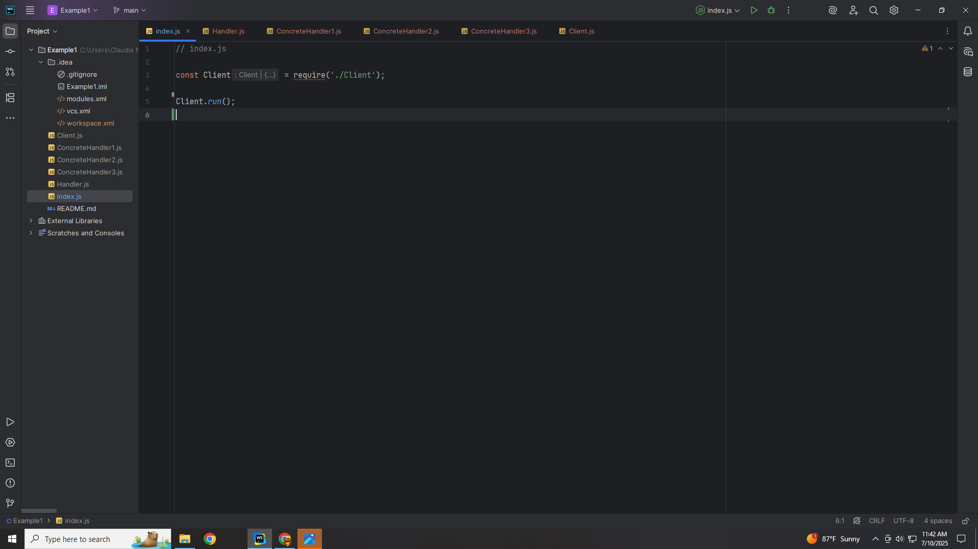
Notes:
And run the Client .. We get

Slide 43
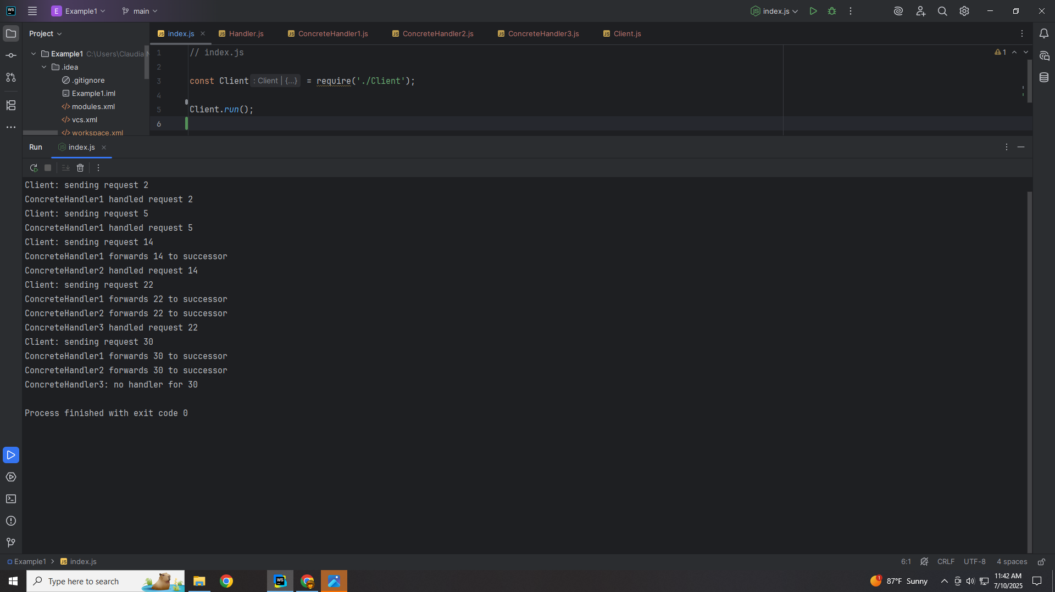
Notes:
XX
My name Is Ray Always code with a smile

