Slide 1
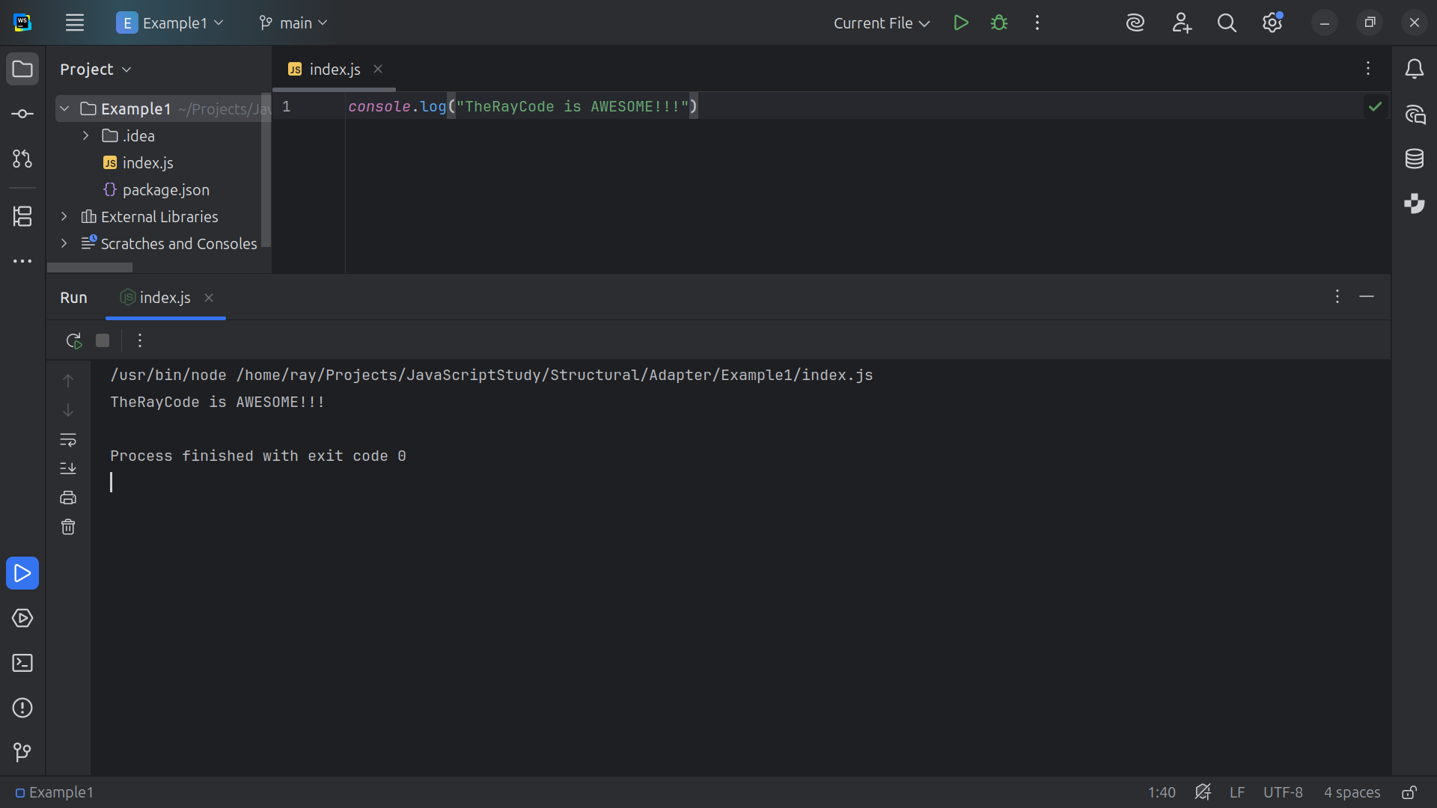
Notes:
Hello I’m Ray of TheRayCode
In this show I plan to review design pattern called the Adapter which is a Structural design pattern

Slide 2
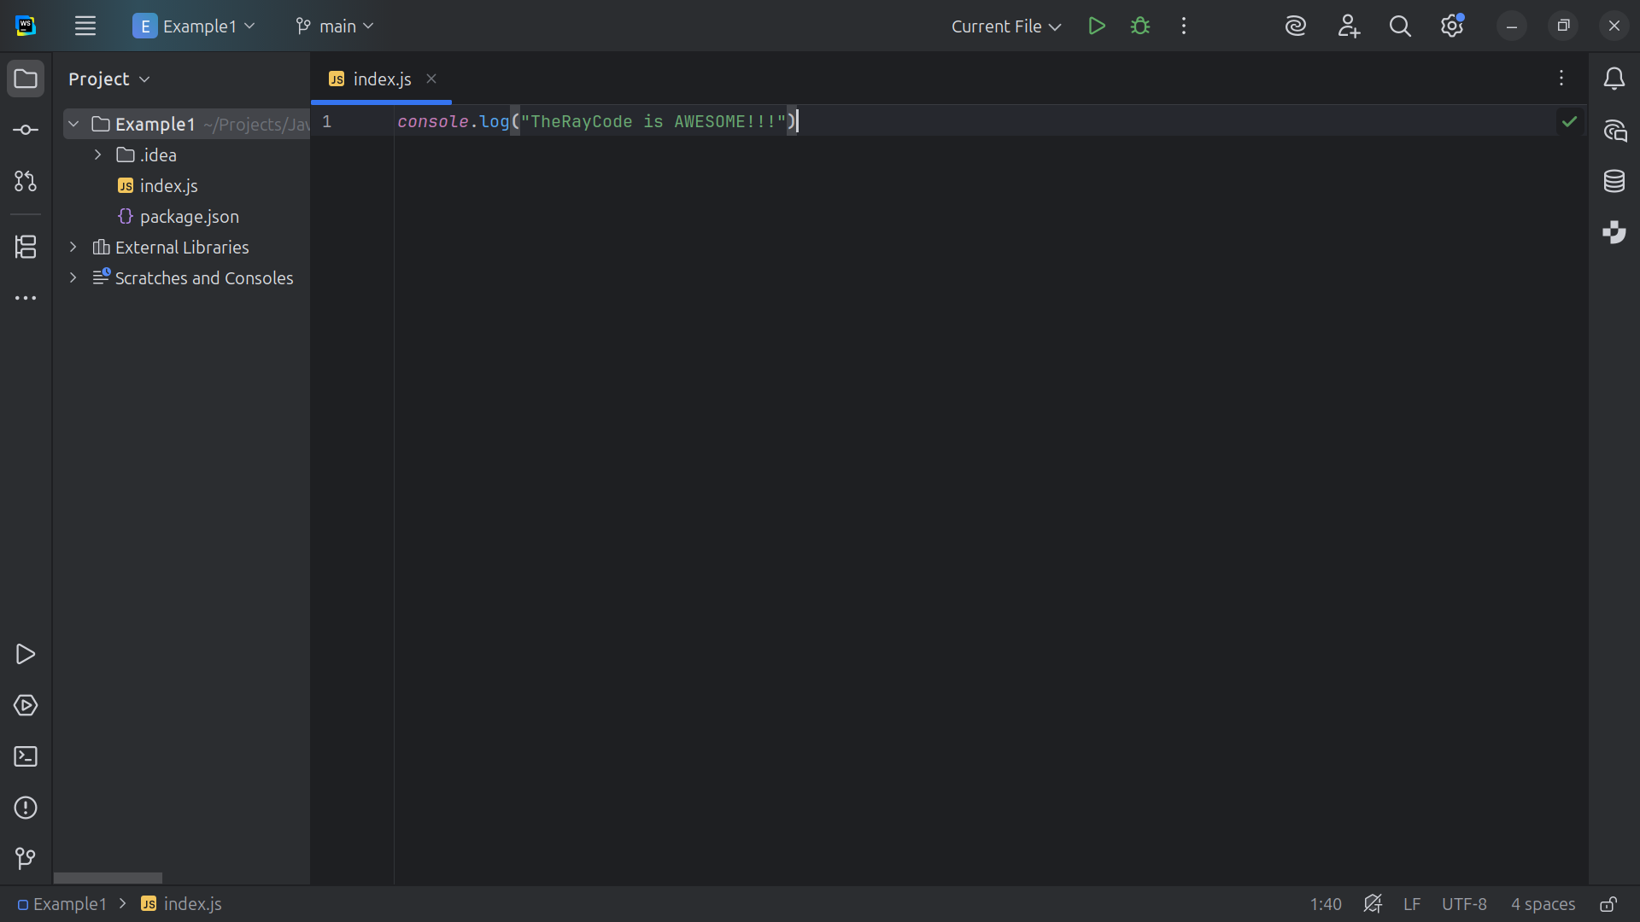
Notes:
I will stick close to using the Class names on the UML that was given By the Gang of Four.. I will be using JavaScript

Slide 3
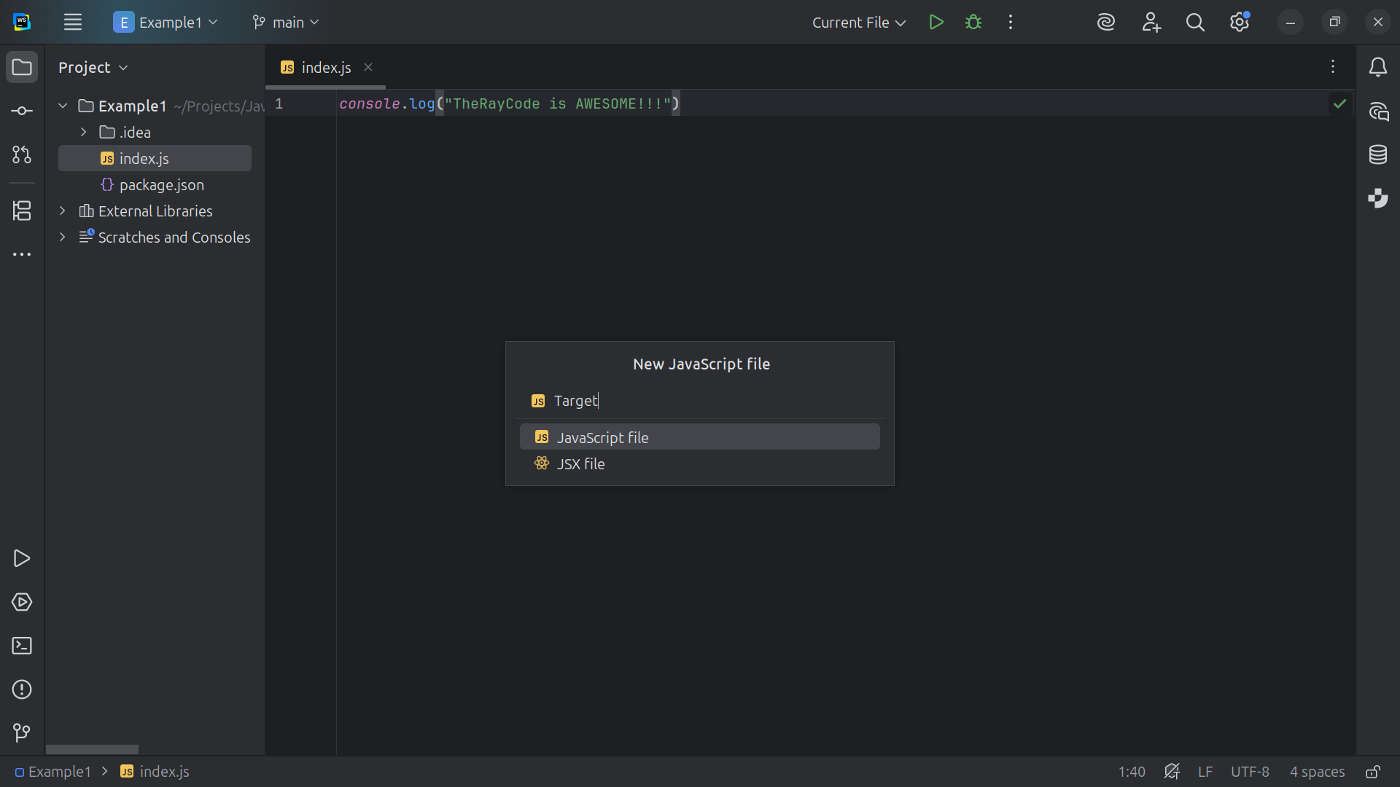
Notes:
We Start our project by creating a class called Target

Slide 4
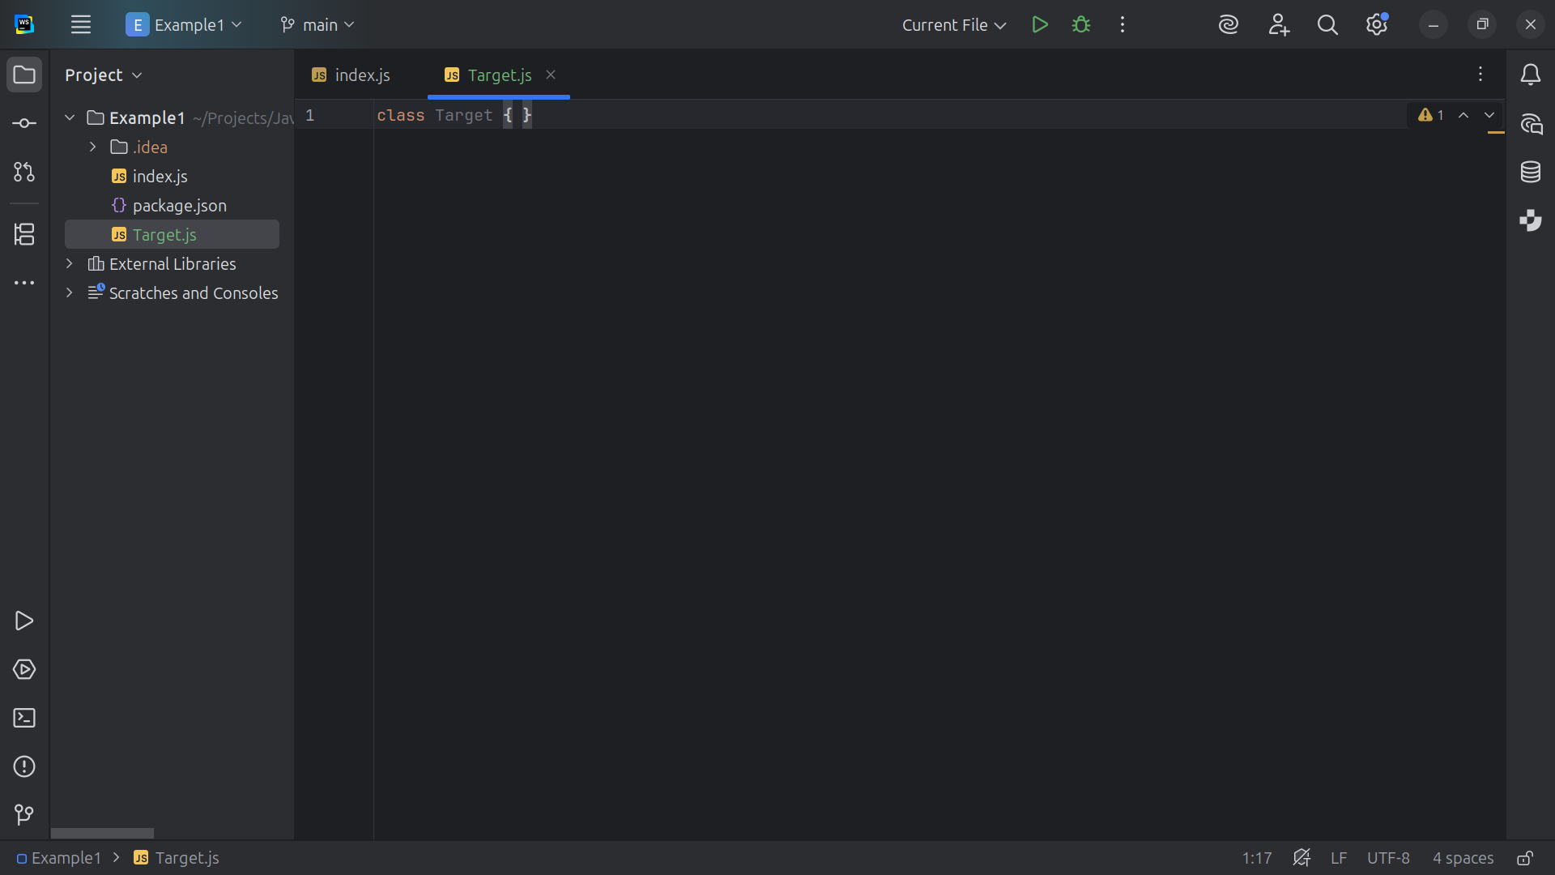
Notes:
Target is The interface that is expected by the client. Any class used by the client must implement this interface.

Slide 5
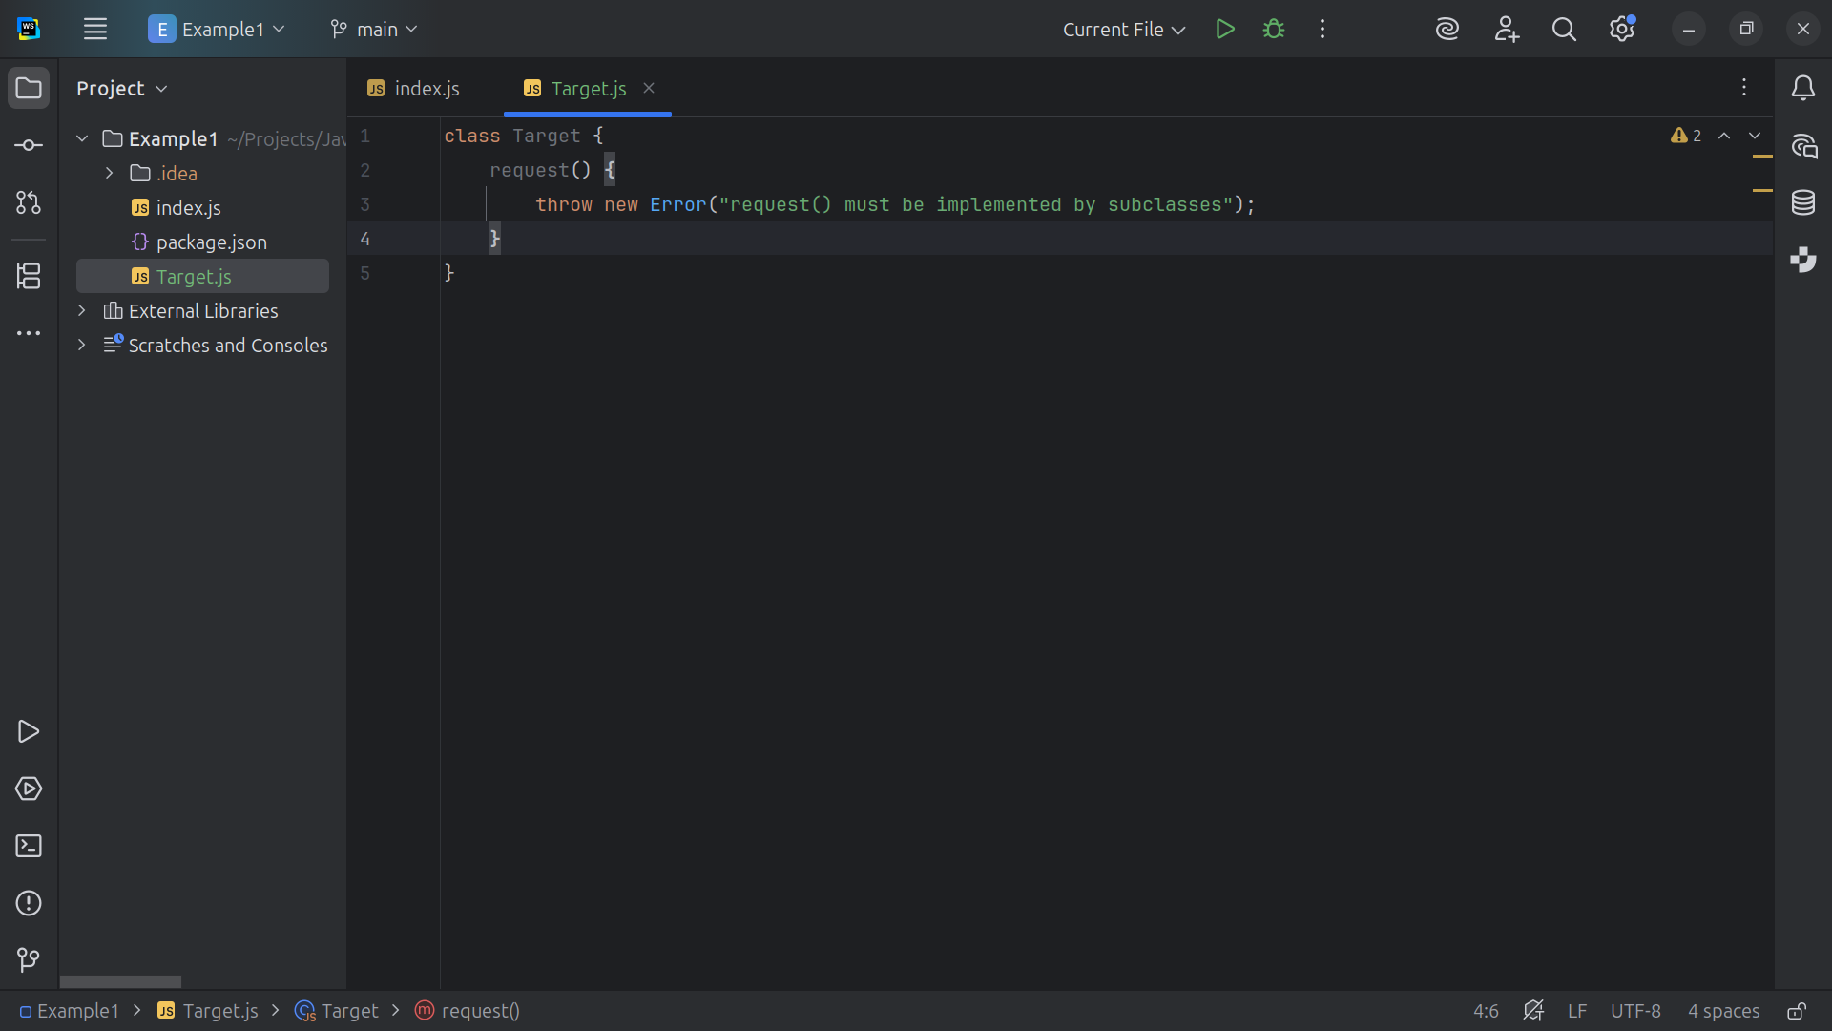
Notes:
The client expects the method must to be implemented by sub classes

Slide 6
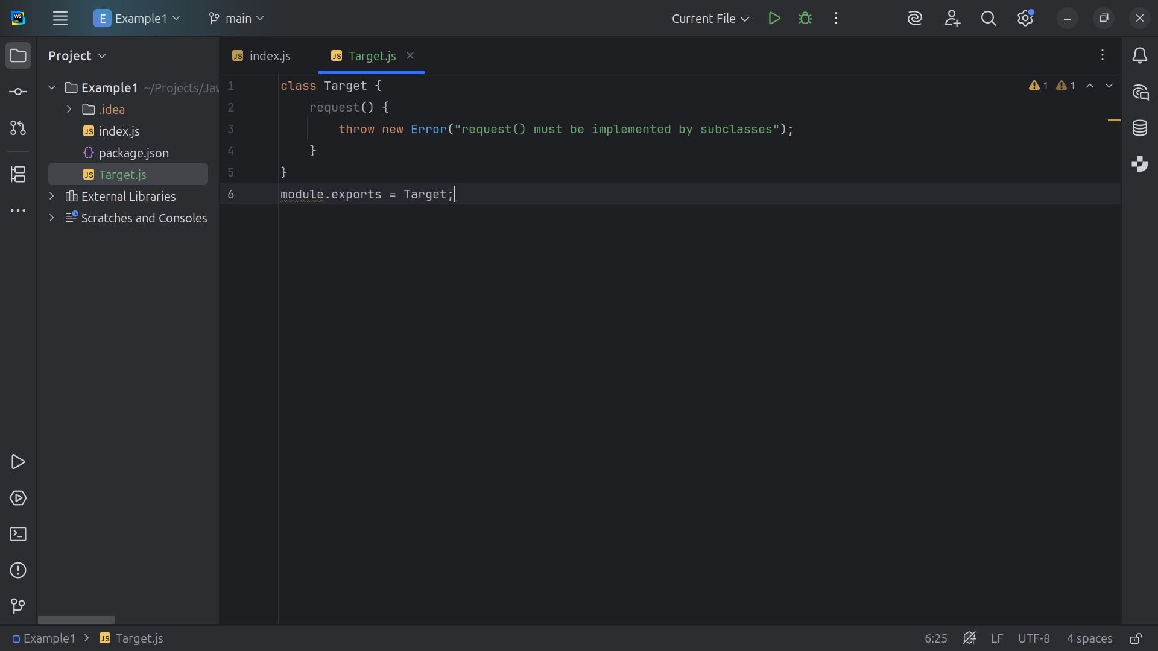
Notes:
We close this module to be exported for our demo

Slide 7
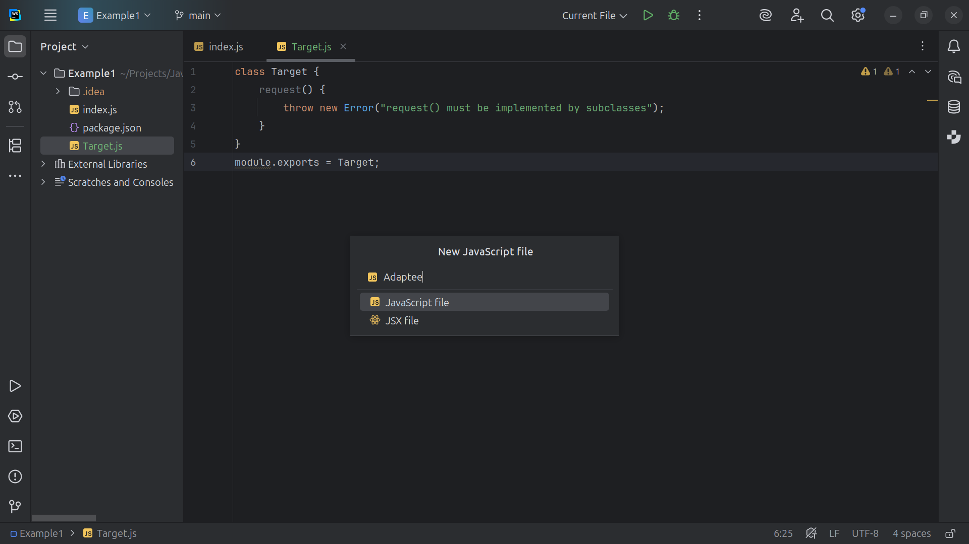
Notes:
Let’s now create a class called Adaptee

Slide 8
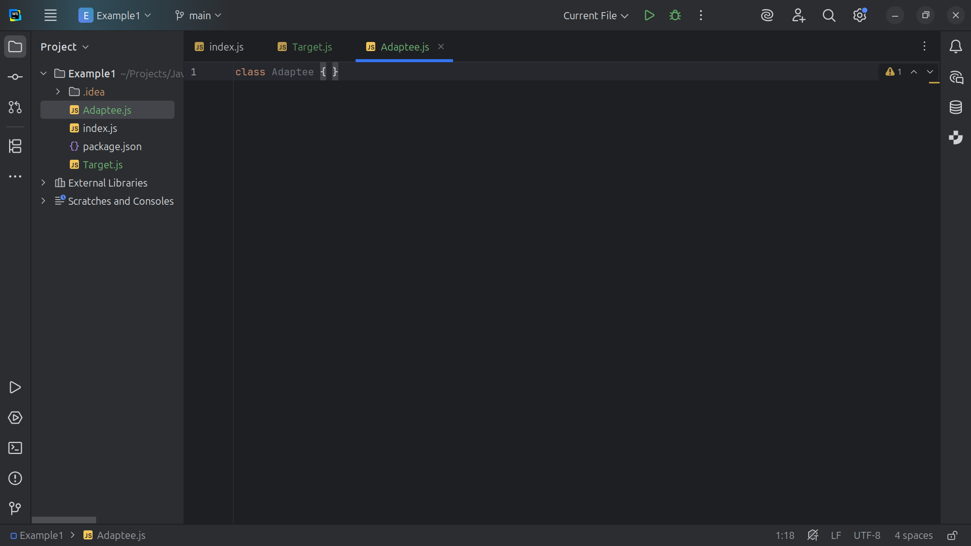
Notes:
The Purpose of the class it to provide An existing class with a useful behavior, but an interface that the client cannot directly use. The Adapter will transform this for our end use

Slide 9
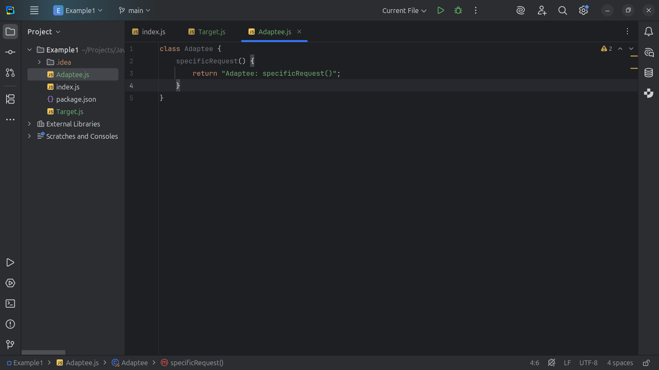
Notes:
In the specific Request we return the string “Adaptee specific Request”

Slide 10
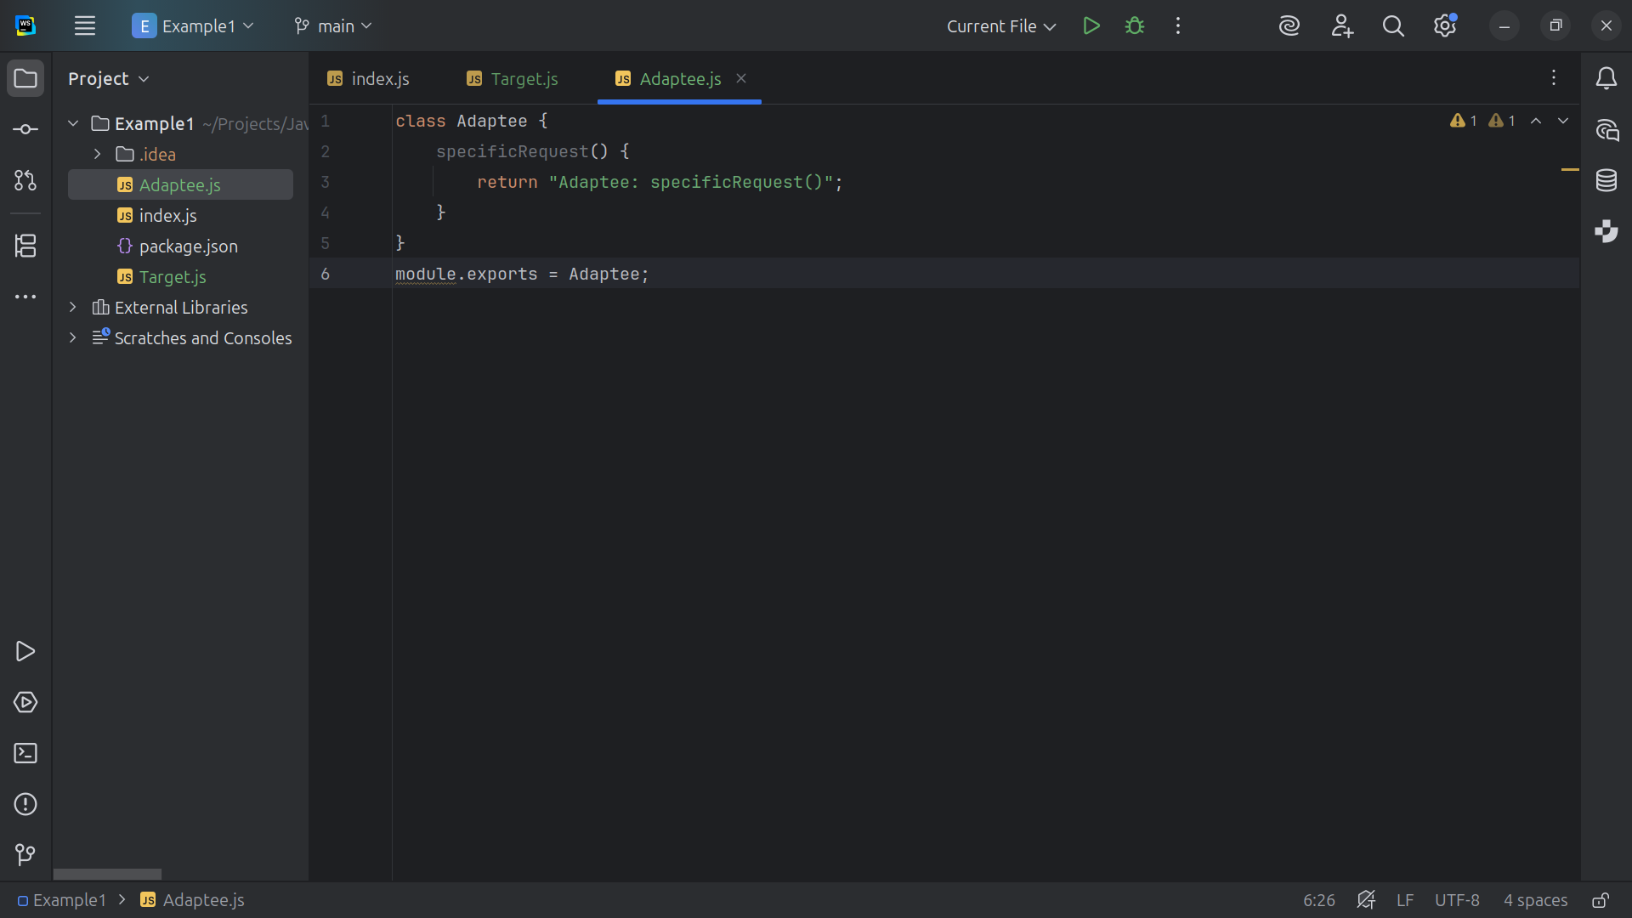
Notes:
And at the bottom of this module we export it for use in our demonstration

Slide 11
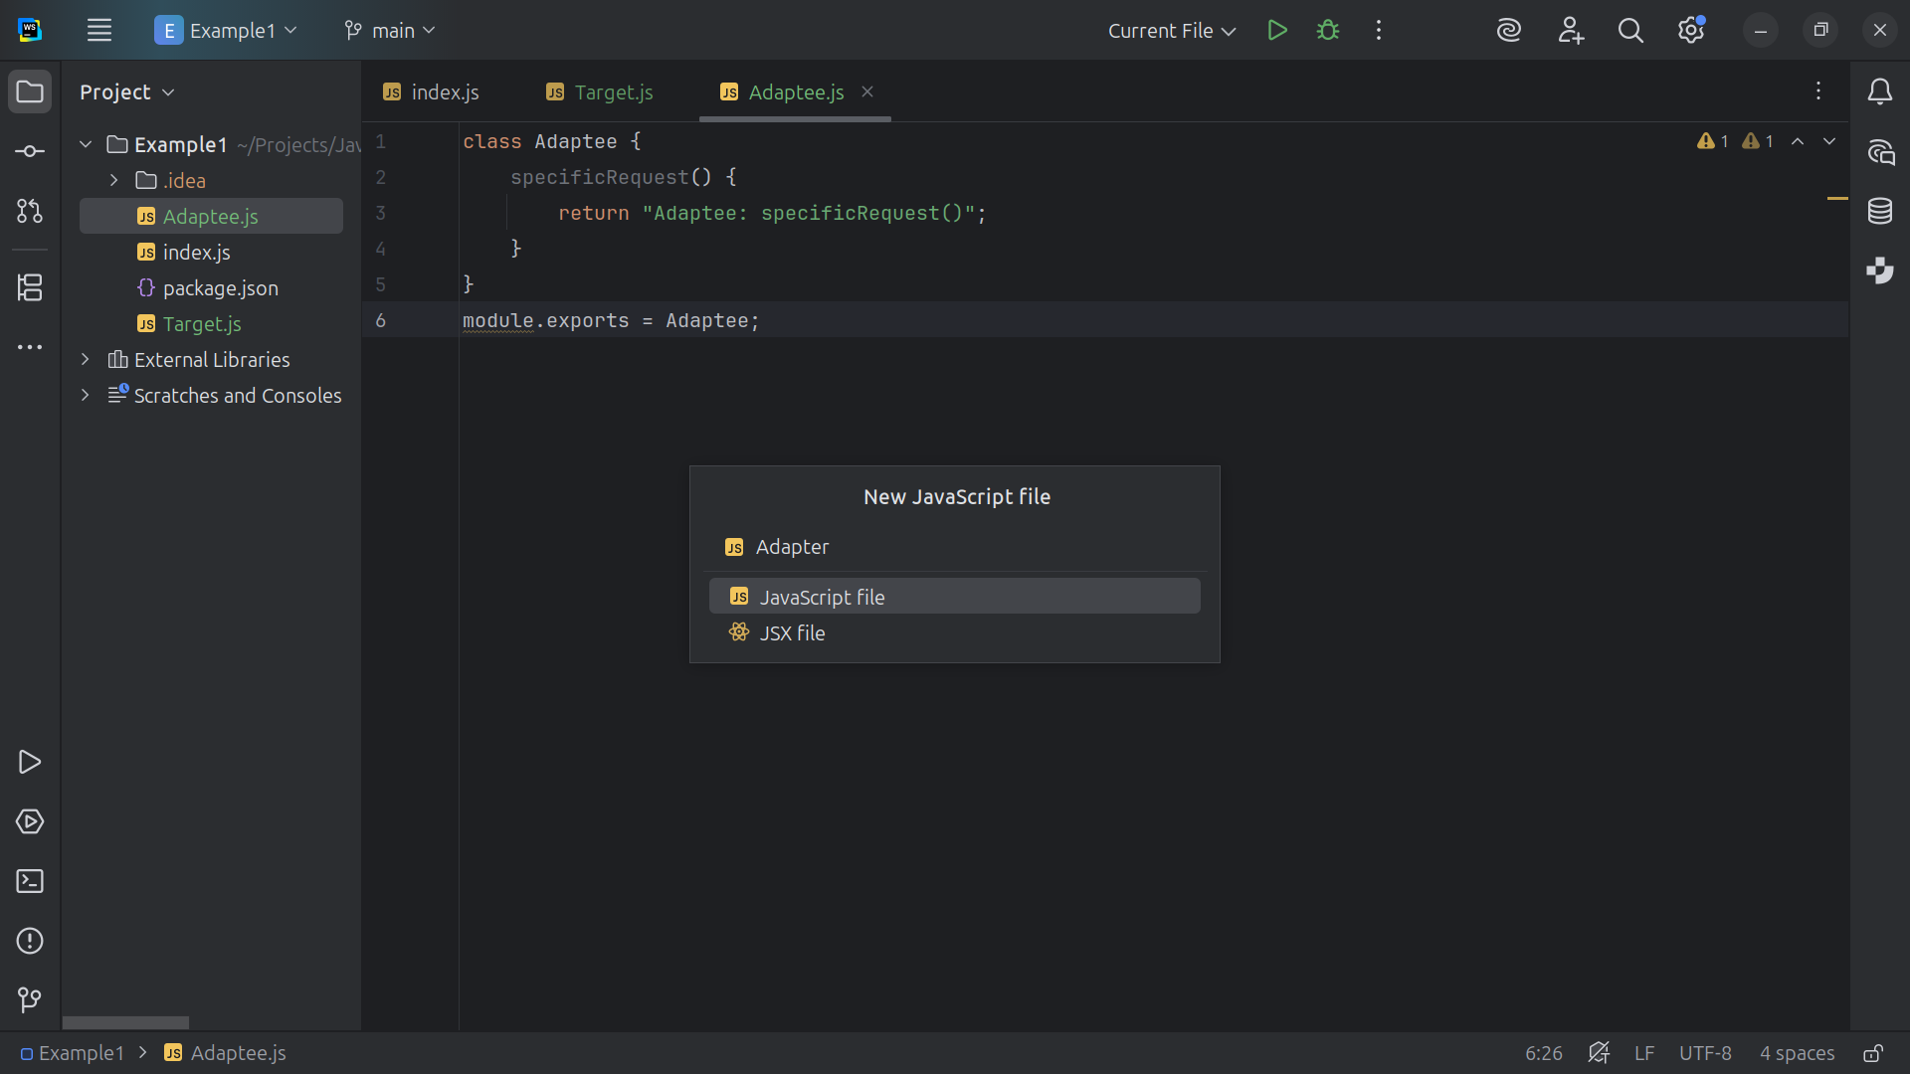
Notes:
Let’s now work on the Adapter

Slide 12
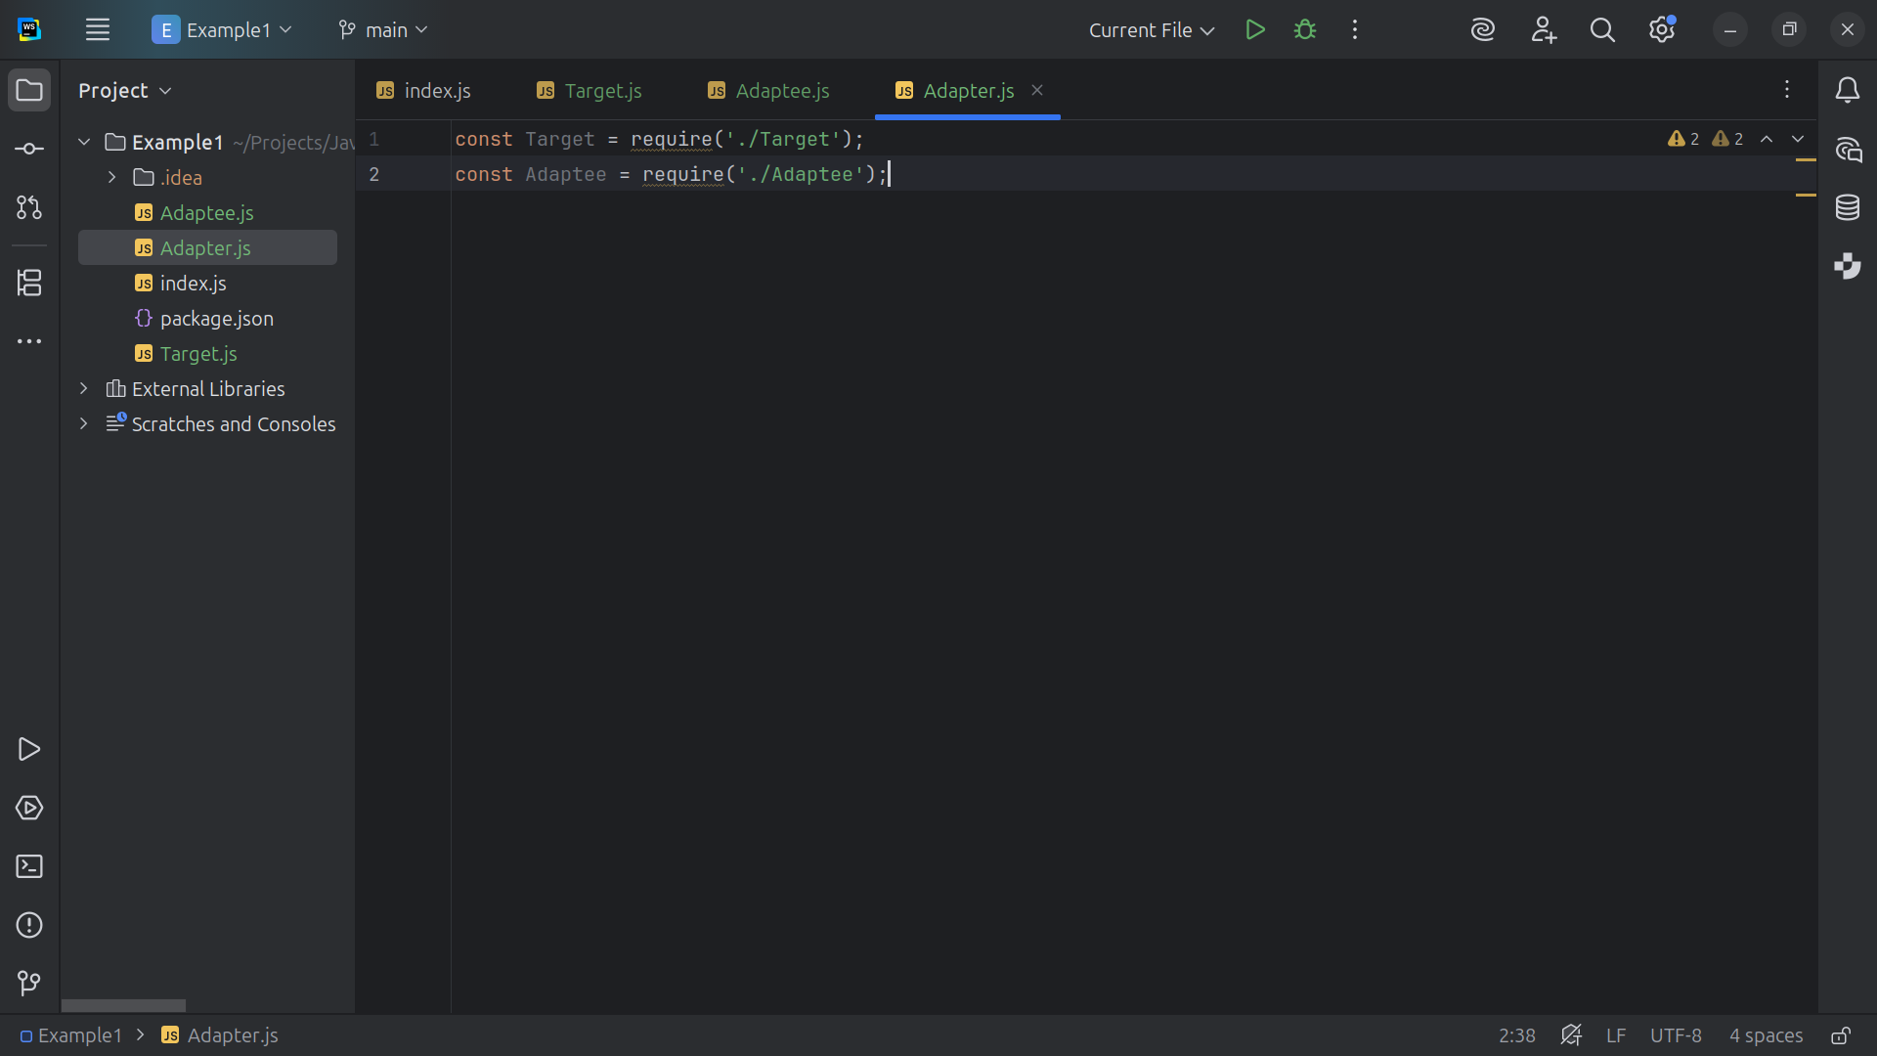
Notes:
The Adapter bridges the Adaptee to the Target

Slide 13
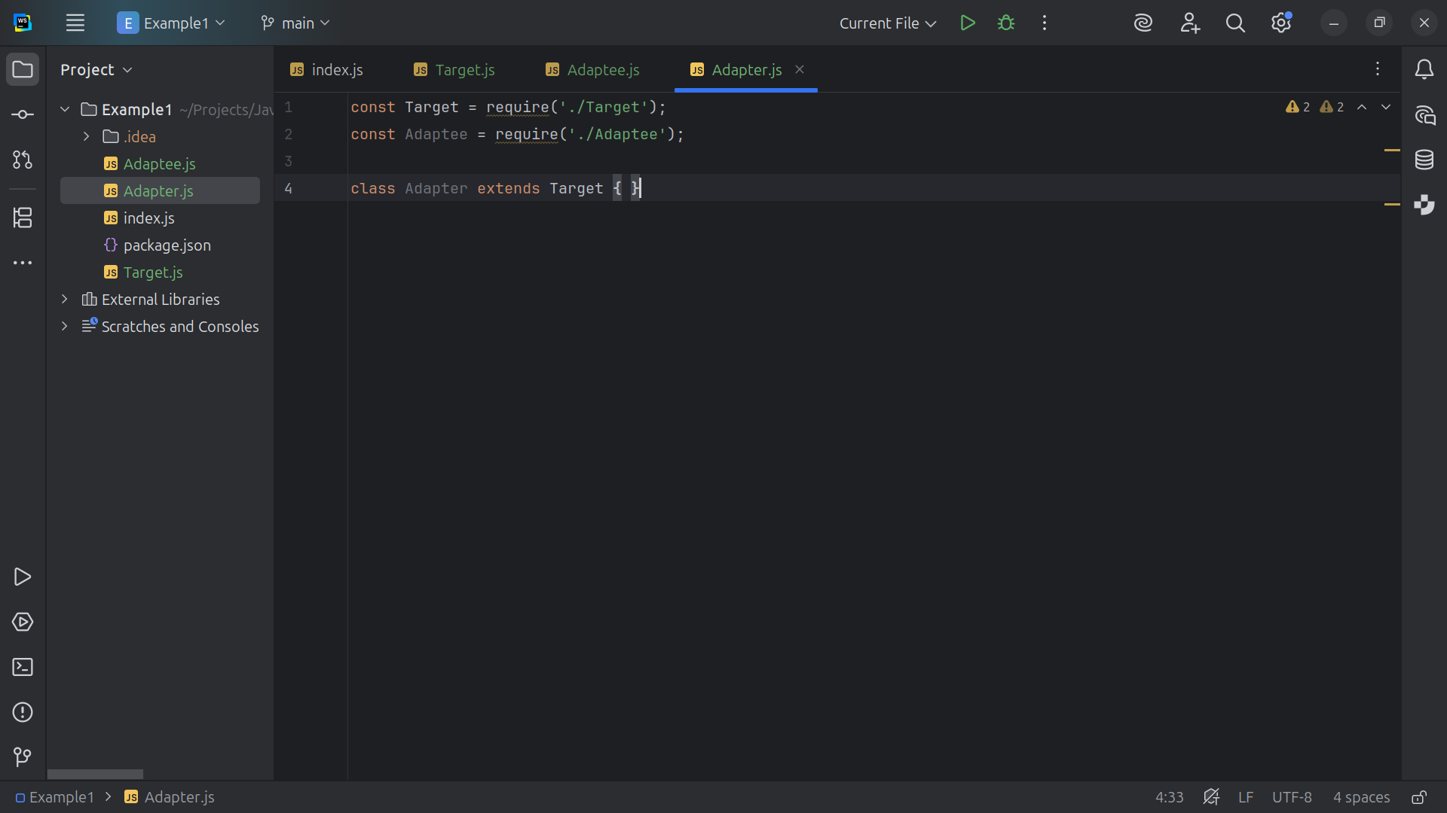
Notes:
Thus we extend this class with Target

Slide 14
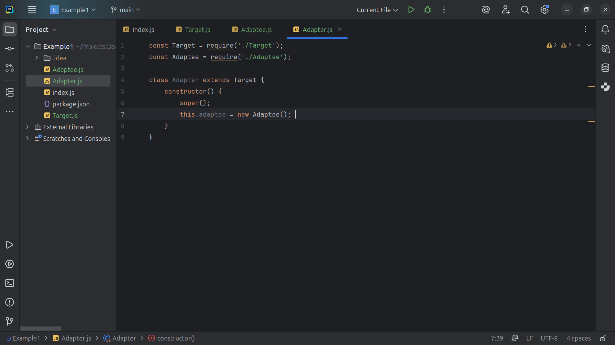
Notes:
We have a constructor A composition to hold the adaptee

Slide 15
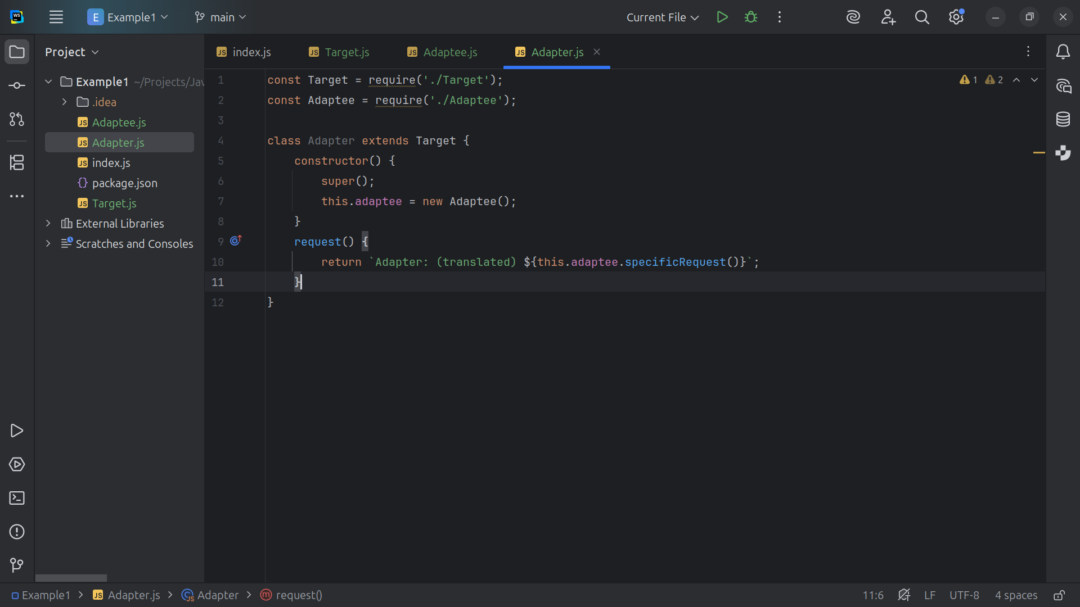
Notes:
We have the Request method the Implements the Target's request but translates to the Adaptee’s specific Request method

Slide 16
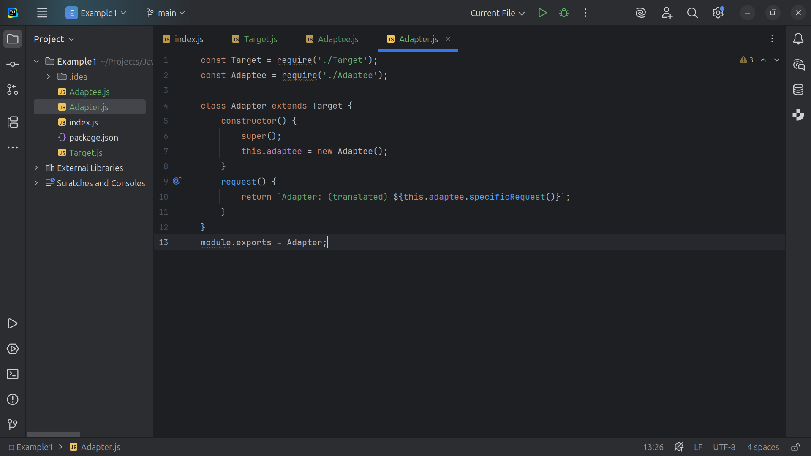
Notes:
And we export this module as Adapter

Slide 17
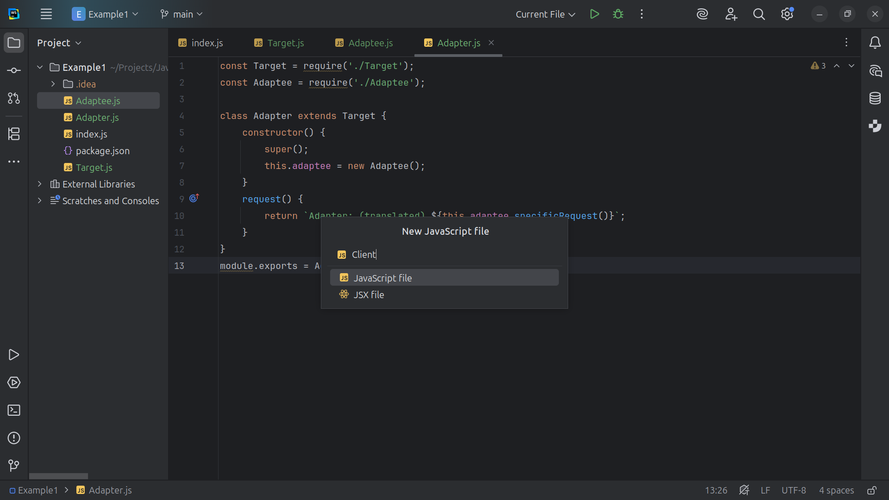
Notes:
Now let’s work on the client where it all comes together

Slide 18
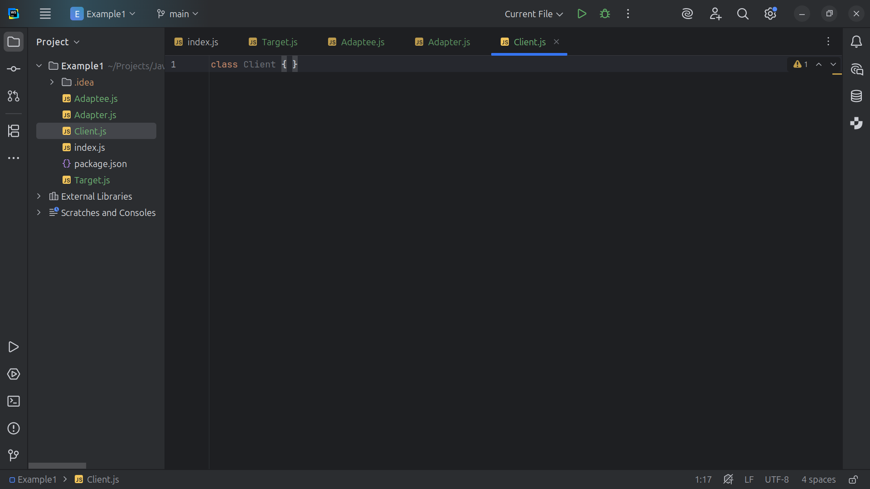
Notes:
The Client only uses the Target interface.

Slide 19
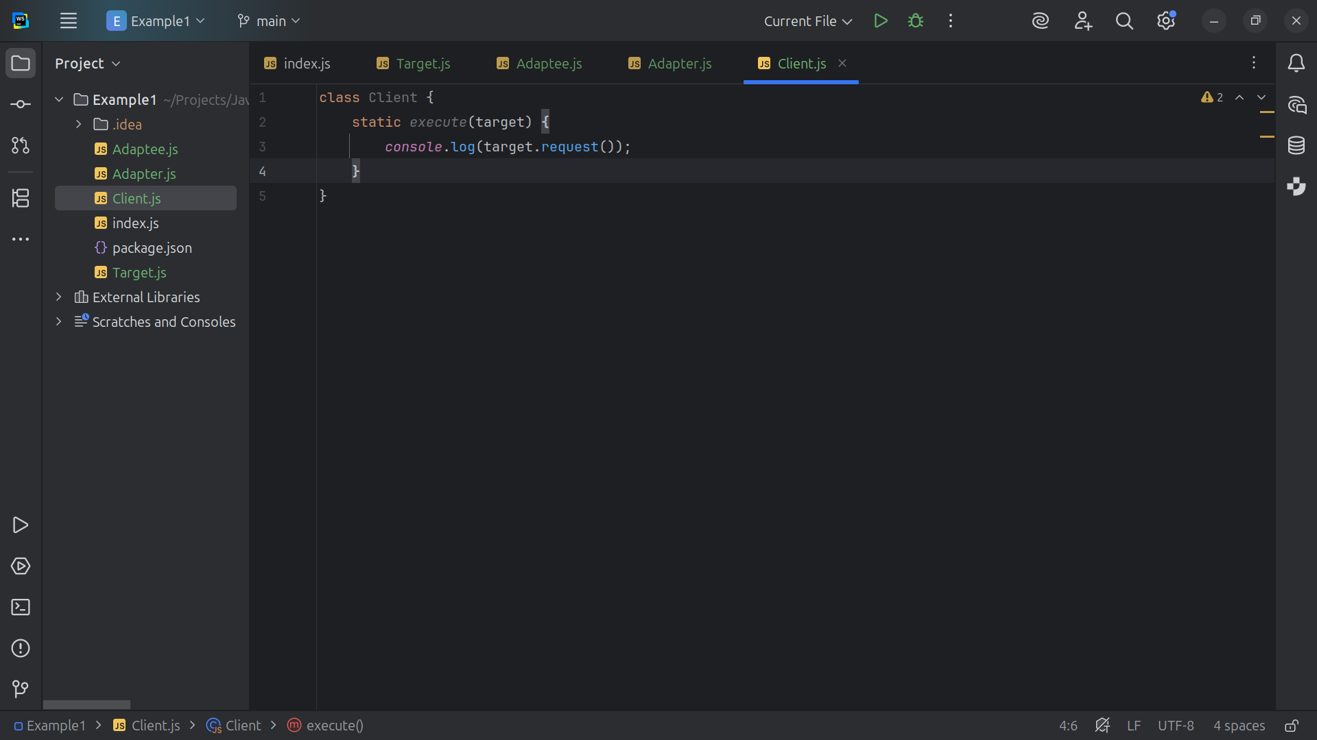
Notes:
We pass the target into the execute where we write the request result to the console

Slide 20
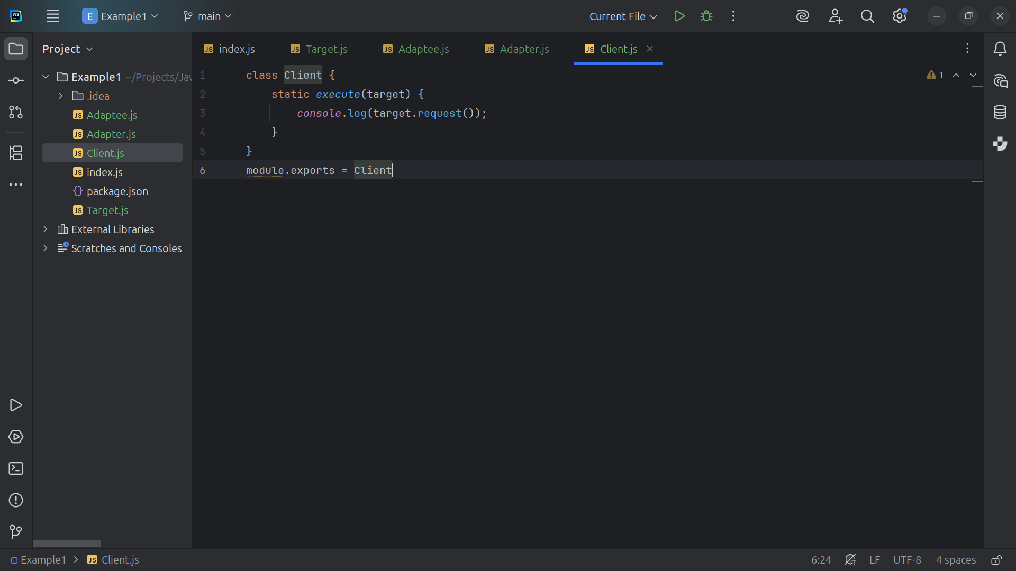
Notes:
And we export this class for use in our demonstration

Slide 21
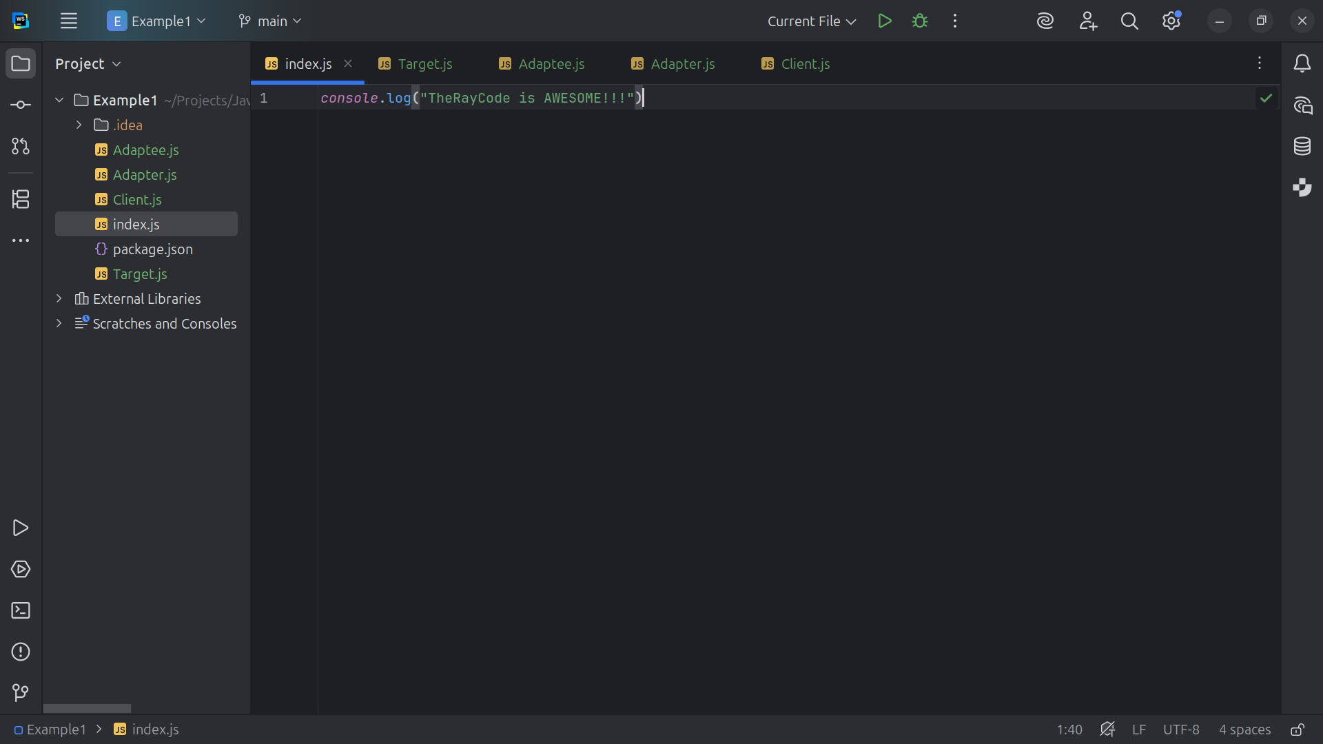
Notes:
So let’s go to the index dot js page

Slide 22
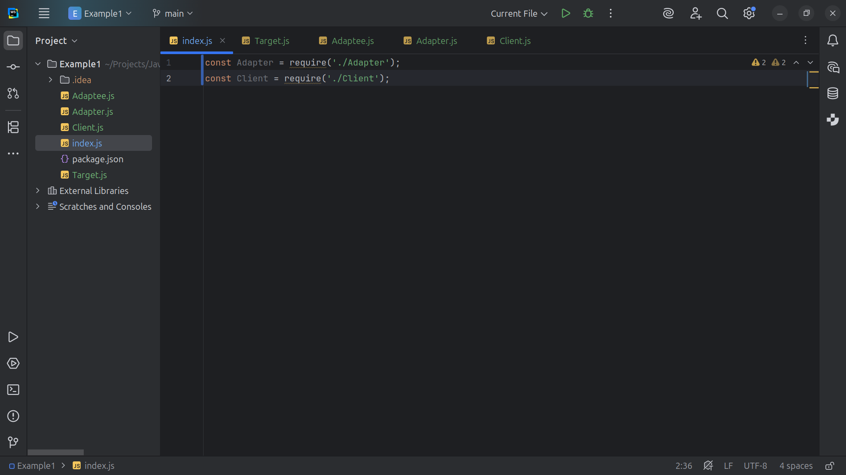
Notes:
We include the Adapter and the Client

Slide 23
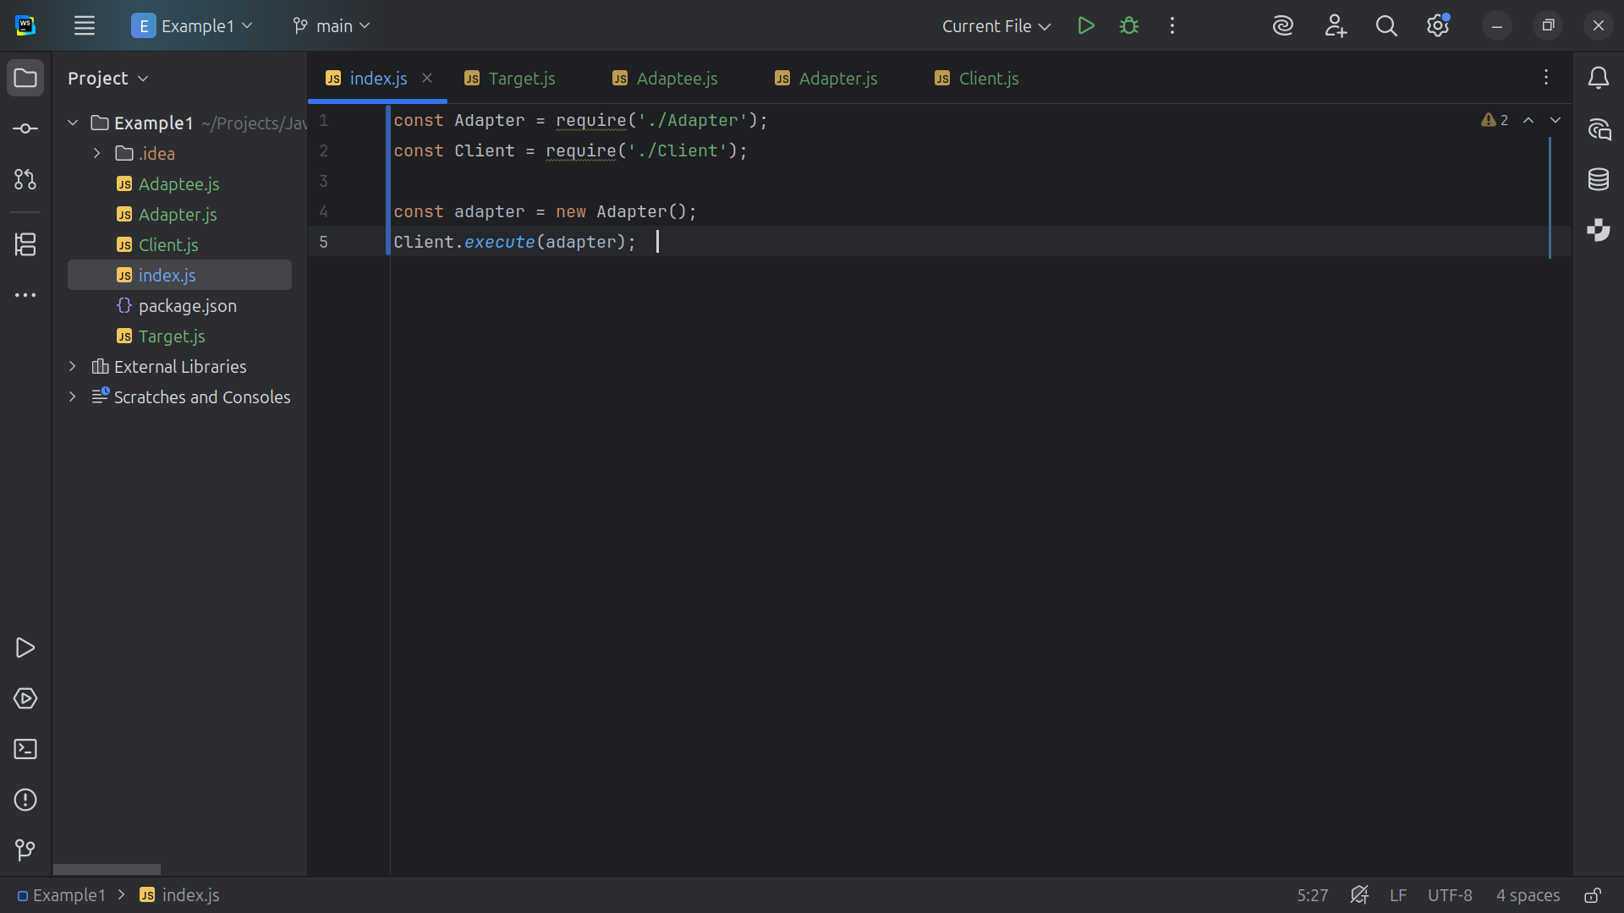
Notes:
We create a new Adapter and pass it in to the execute method of the Client. Now let’s run this and see our results

Slide 24
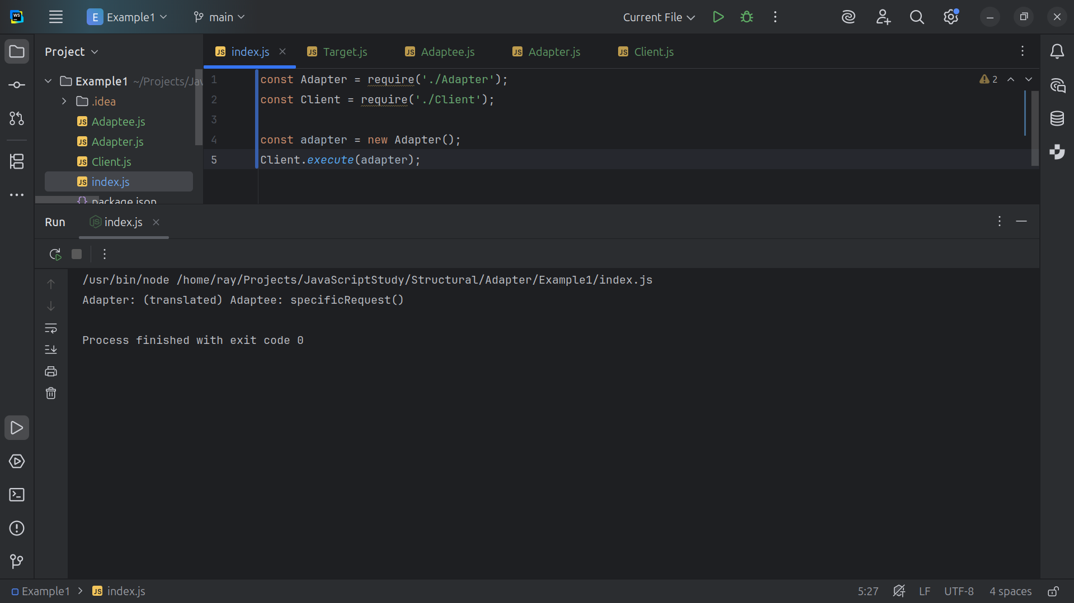
Notes:
We see Adapter: (translated) Adaptee: specific Request()
How it Works
Client expects to call request() on a Target.
Adaptee has specific Request(), which is incompatible.
Adapter implements request() and internally calls specific Request() on an Adaptee instance.
The client remains blissfully unaware that the Adapter is actually talking to the Adaptee behind the scenes.
My name is Ray Keep on coding

