Slide 1
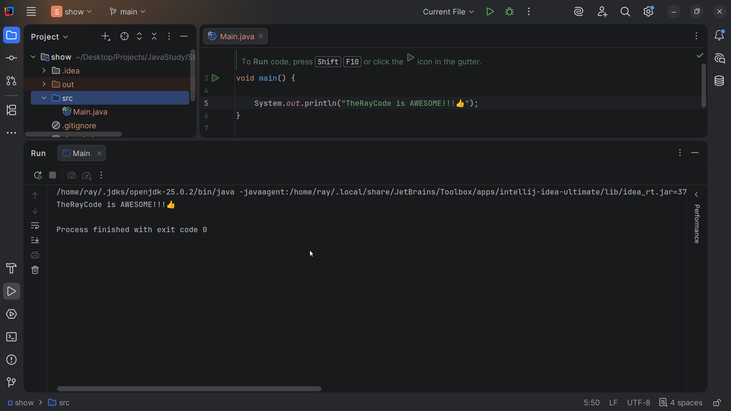

Slide 2
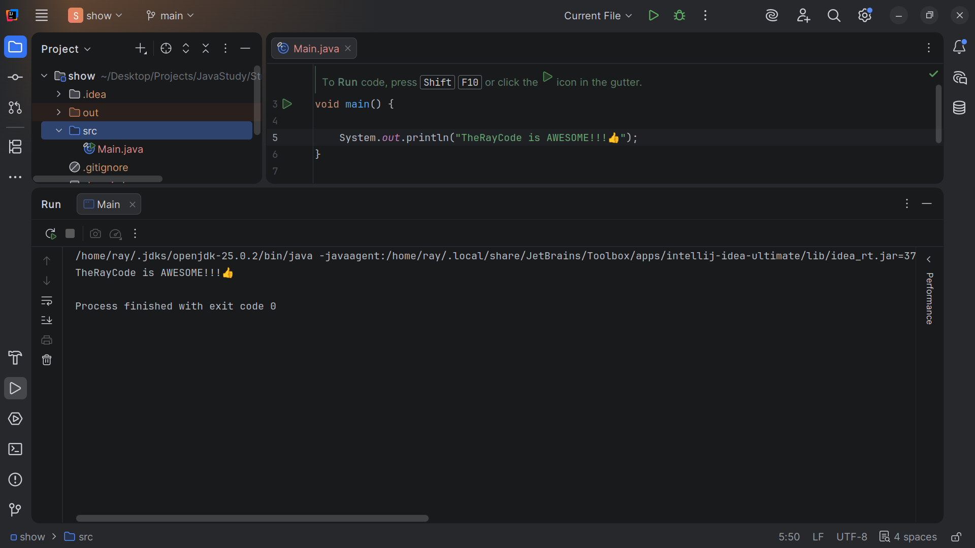
Notes:
Hello. My name is Ray and yes I am the Ray in TheRayCode

Slide 3
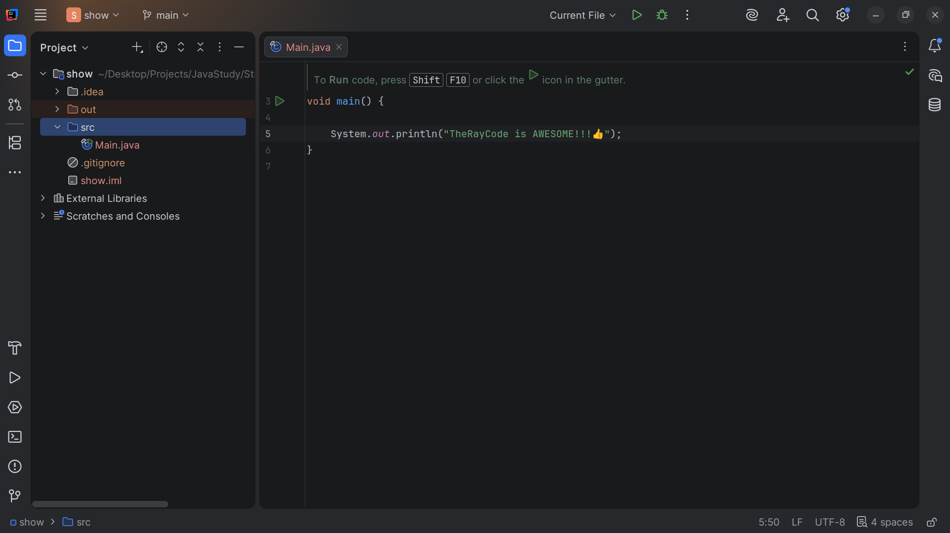
Notes:
In this video I plan to give you an example of the design patterns called Adapter,
I will be using Java
I will also stick close to the naming convention that wax given by the gang of four

Slide 4
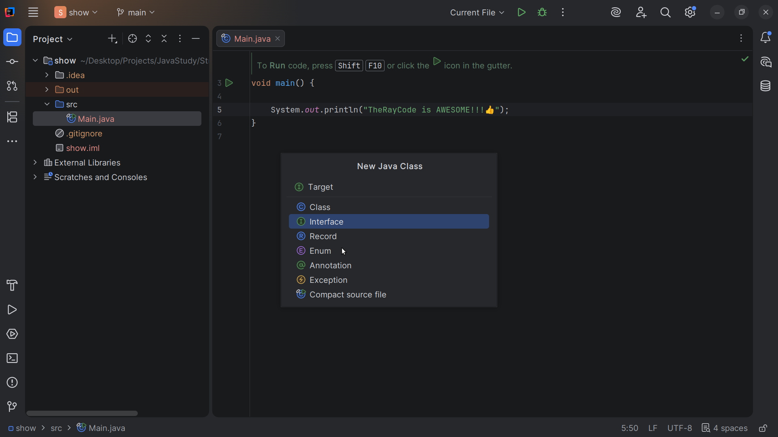
Notes:
We start with an interface we call Target

Slide 5
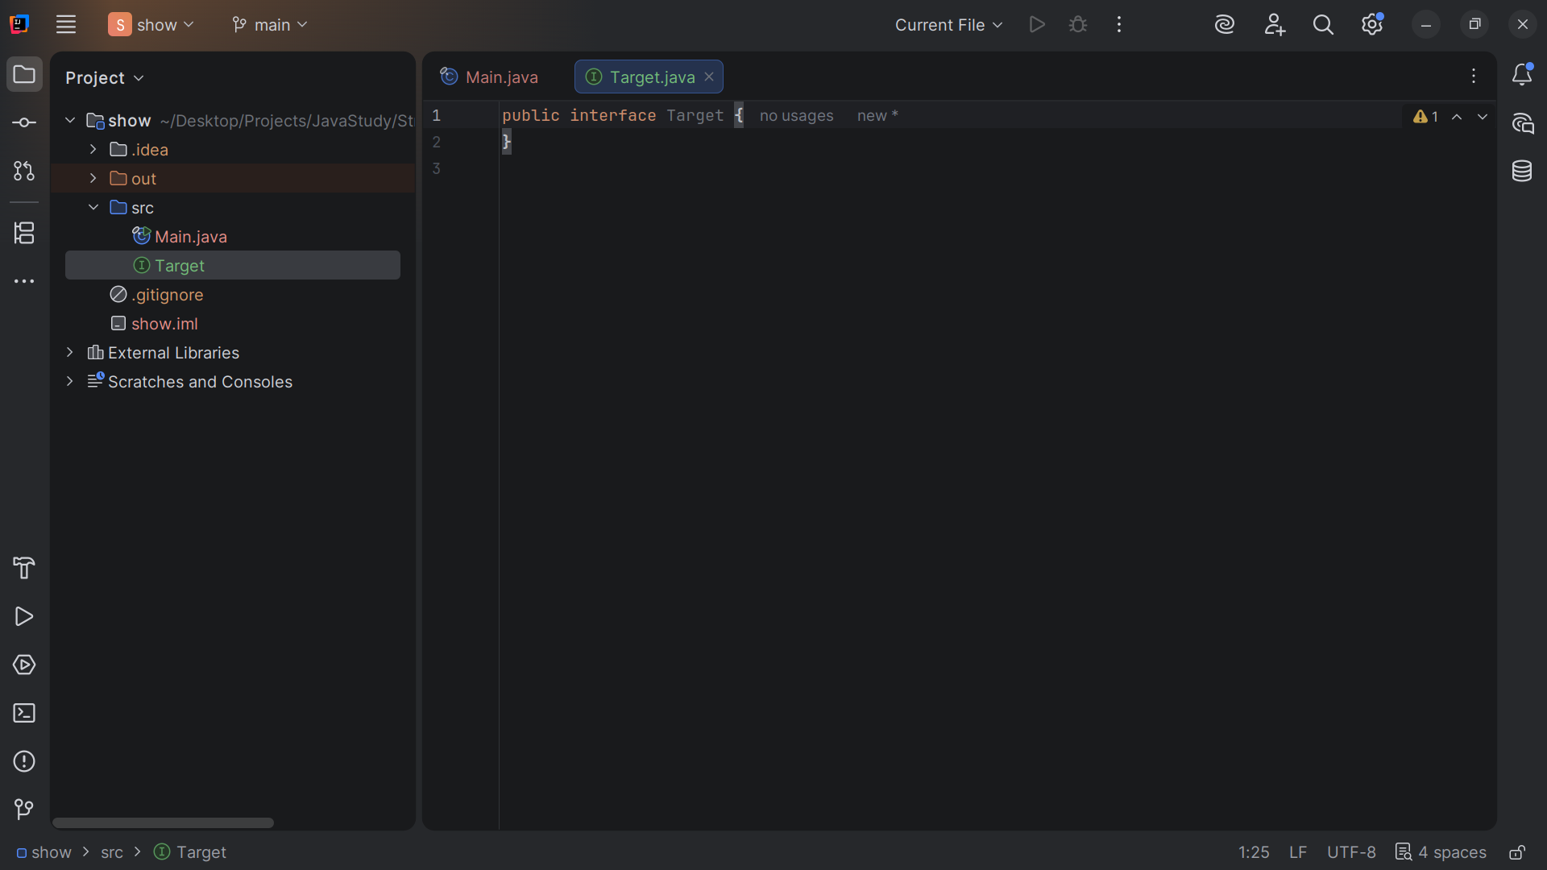
Notes:
Target": is the interface that the Client expects.

Slide 6
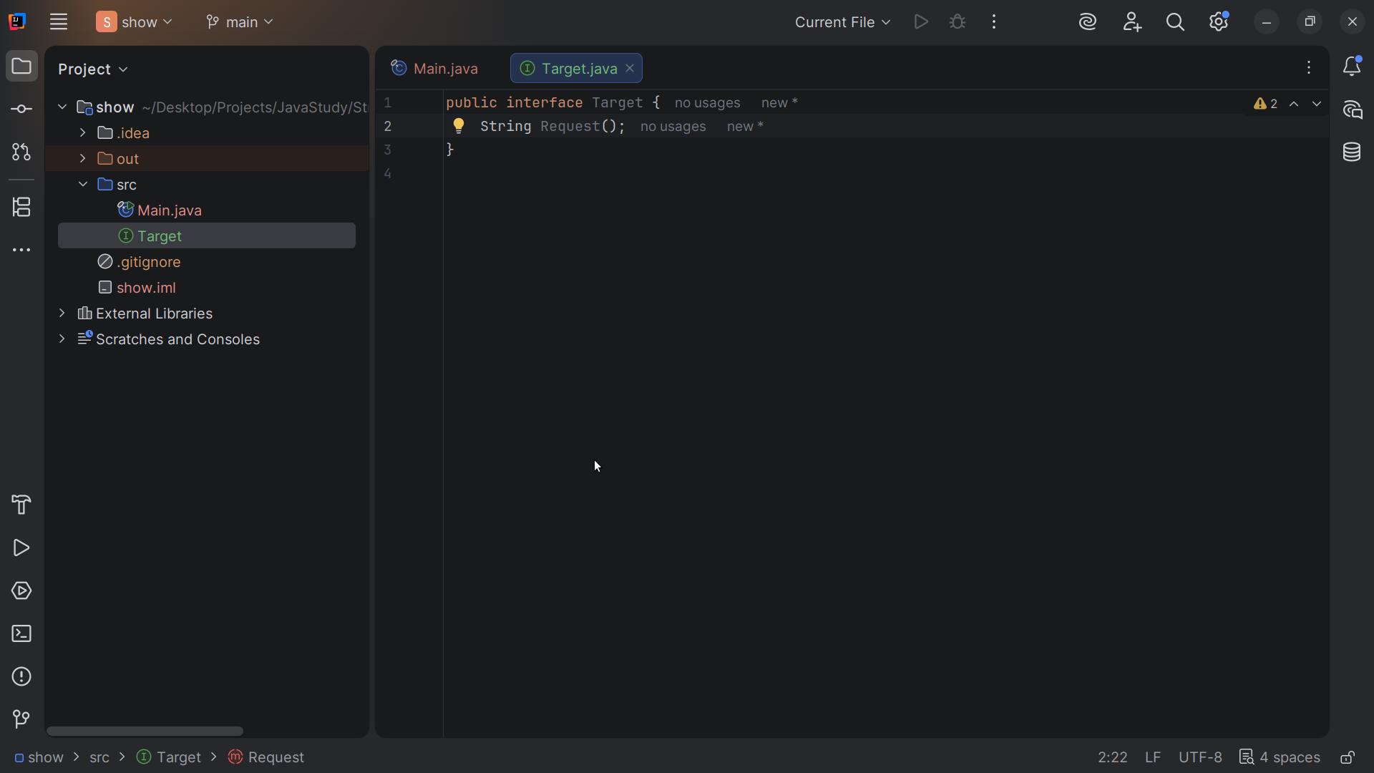
Notes:
When you use this interface you need to have a request method

Slide 7
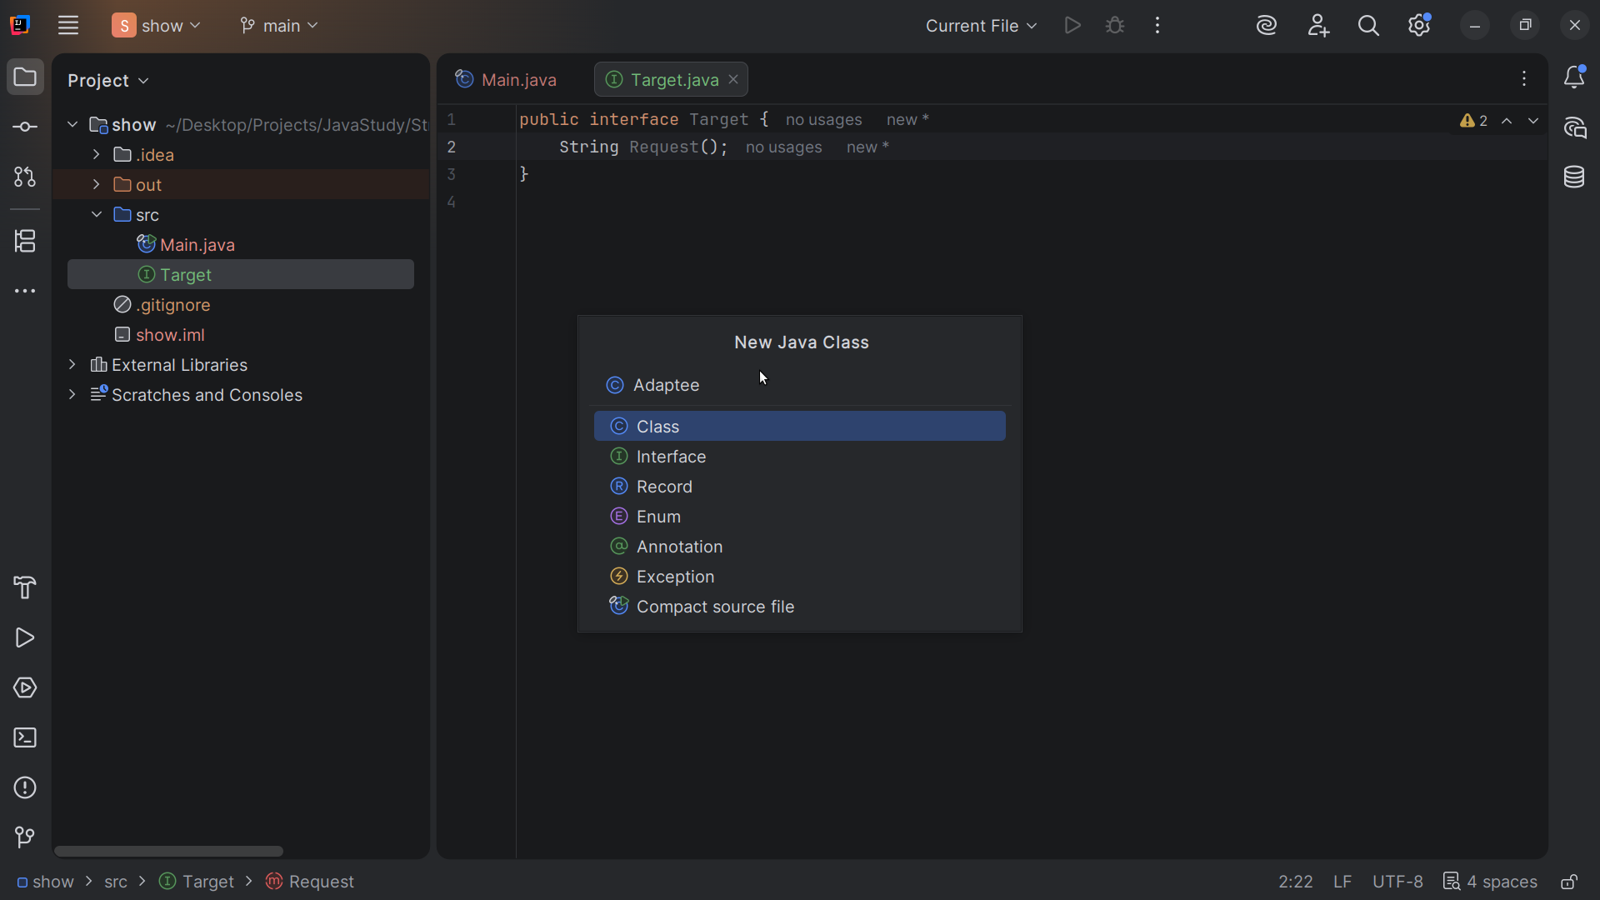
Notes:
Let’s create a class we call Adaptee

Slide 8
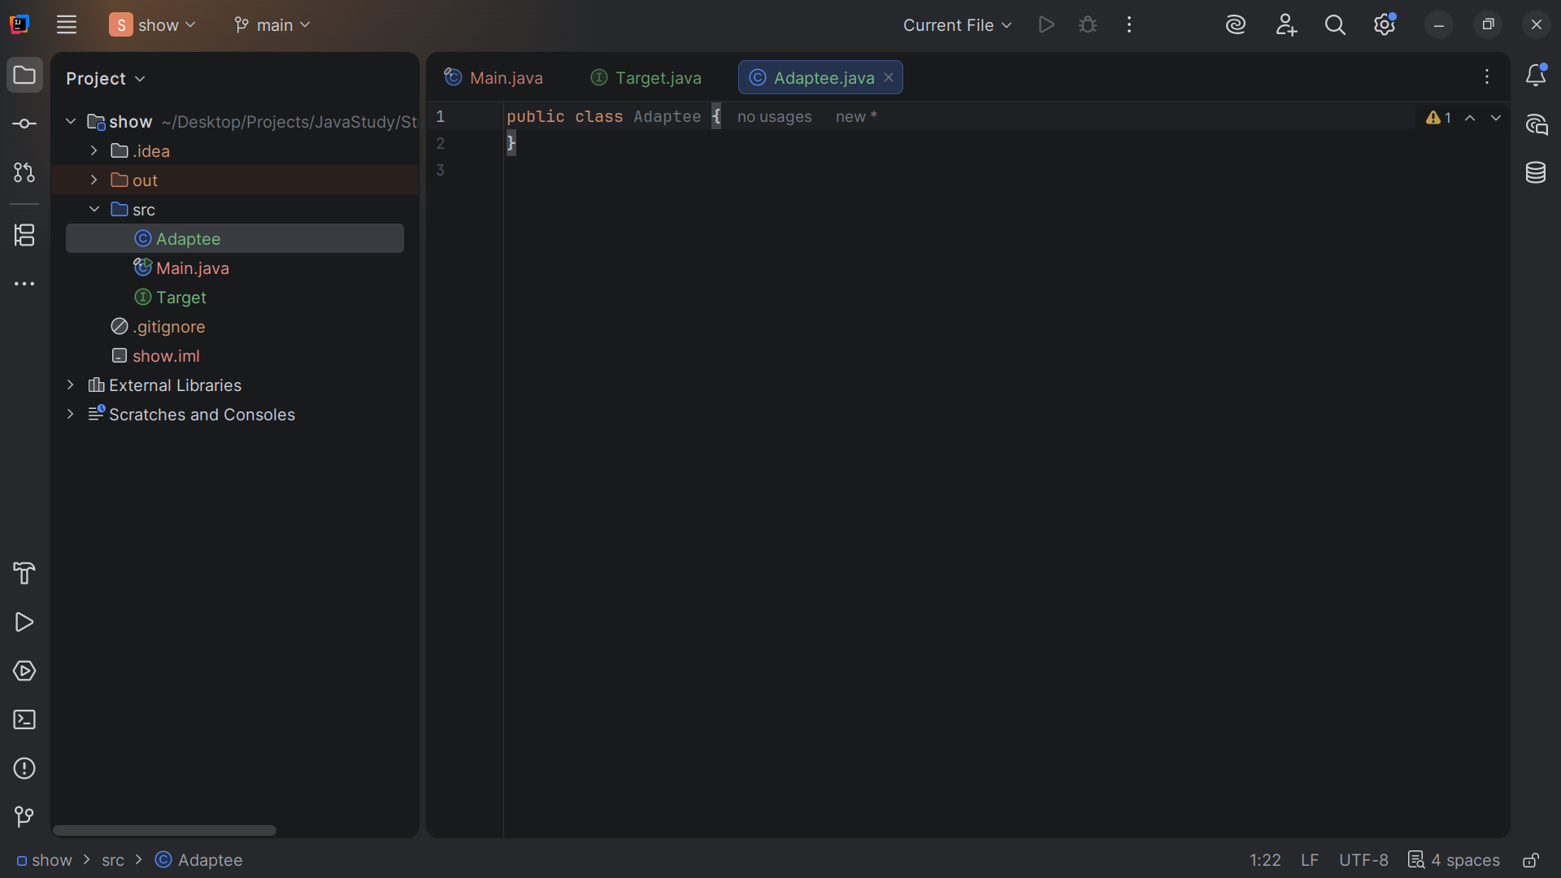
Notes:
The Adaptee will be an existing class with an incompatible interface

Slide 9
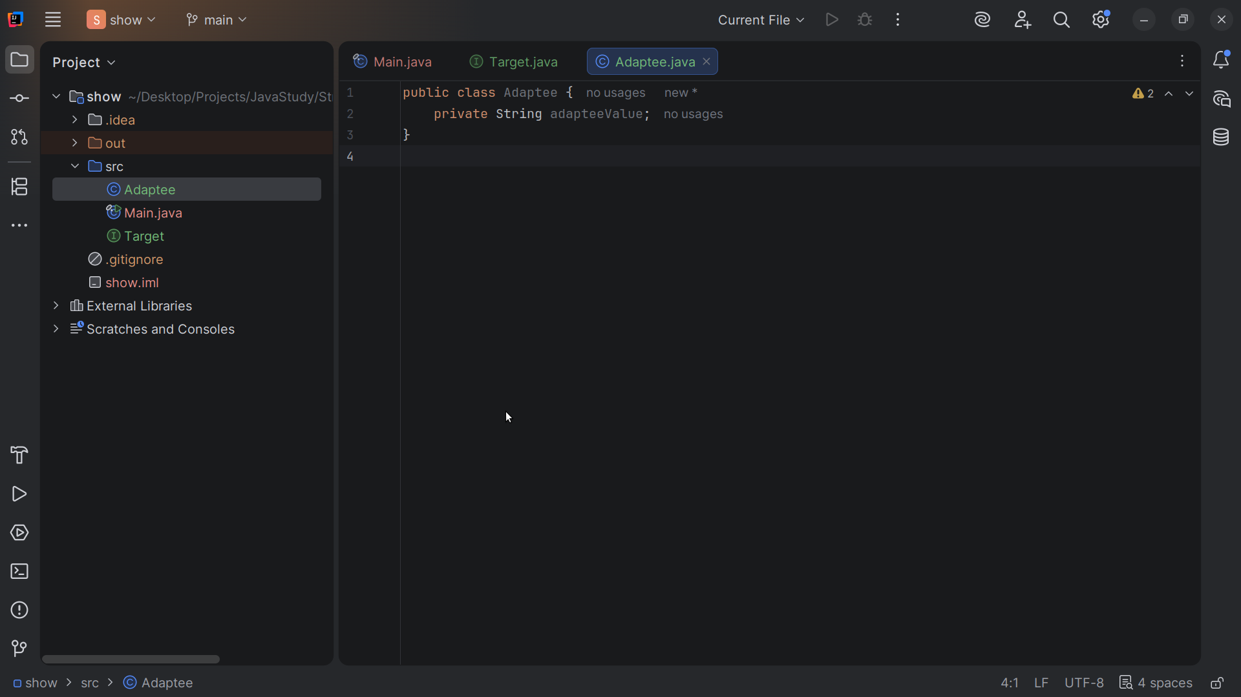
Notes:
We have a private string we call the adapteeValue

Slide 10
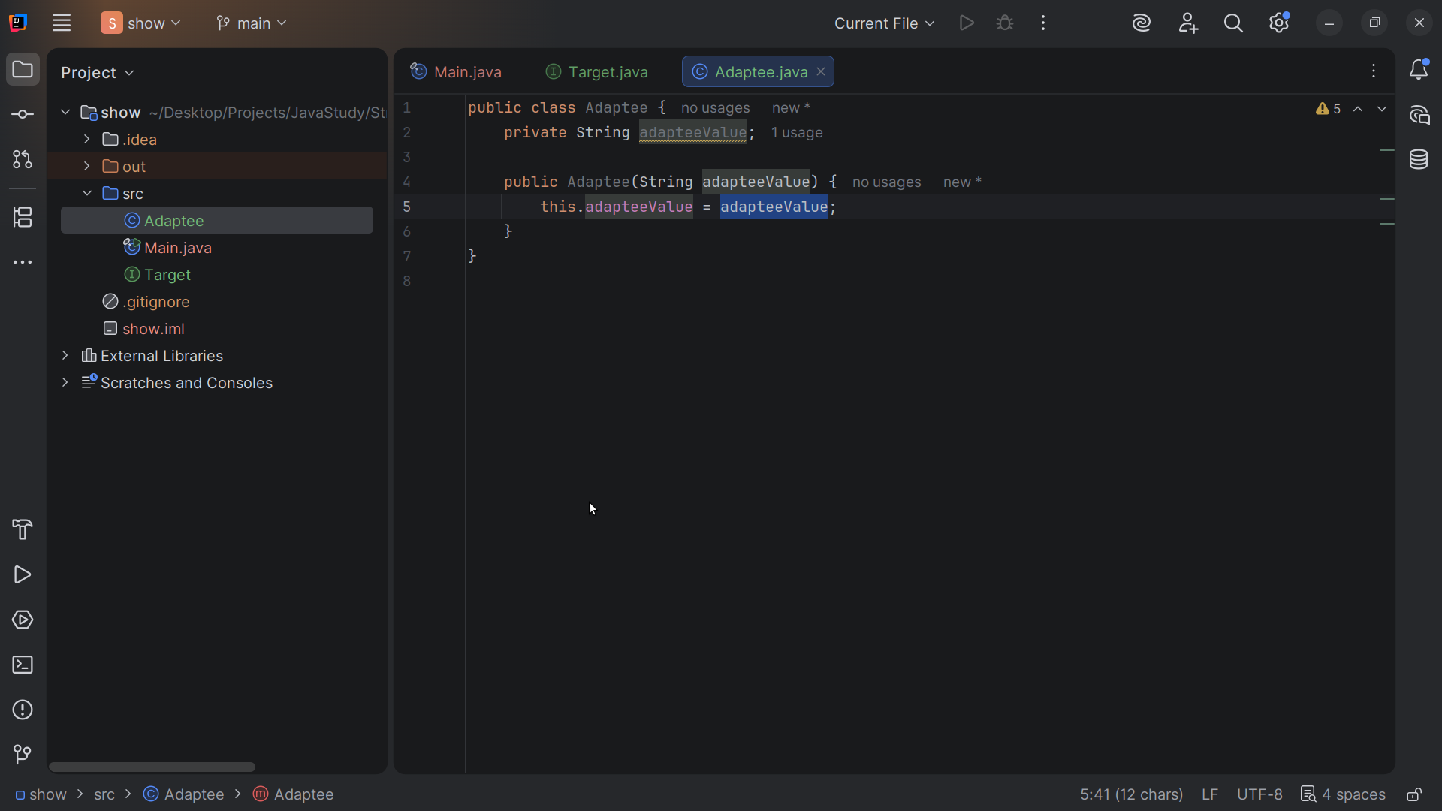
Notes:
Next we have a constructor in which sets this Adaptee value to the value of the Adaptee we just passed in

Slide 11
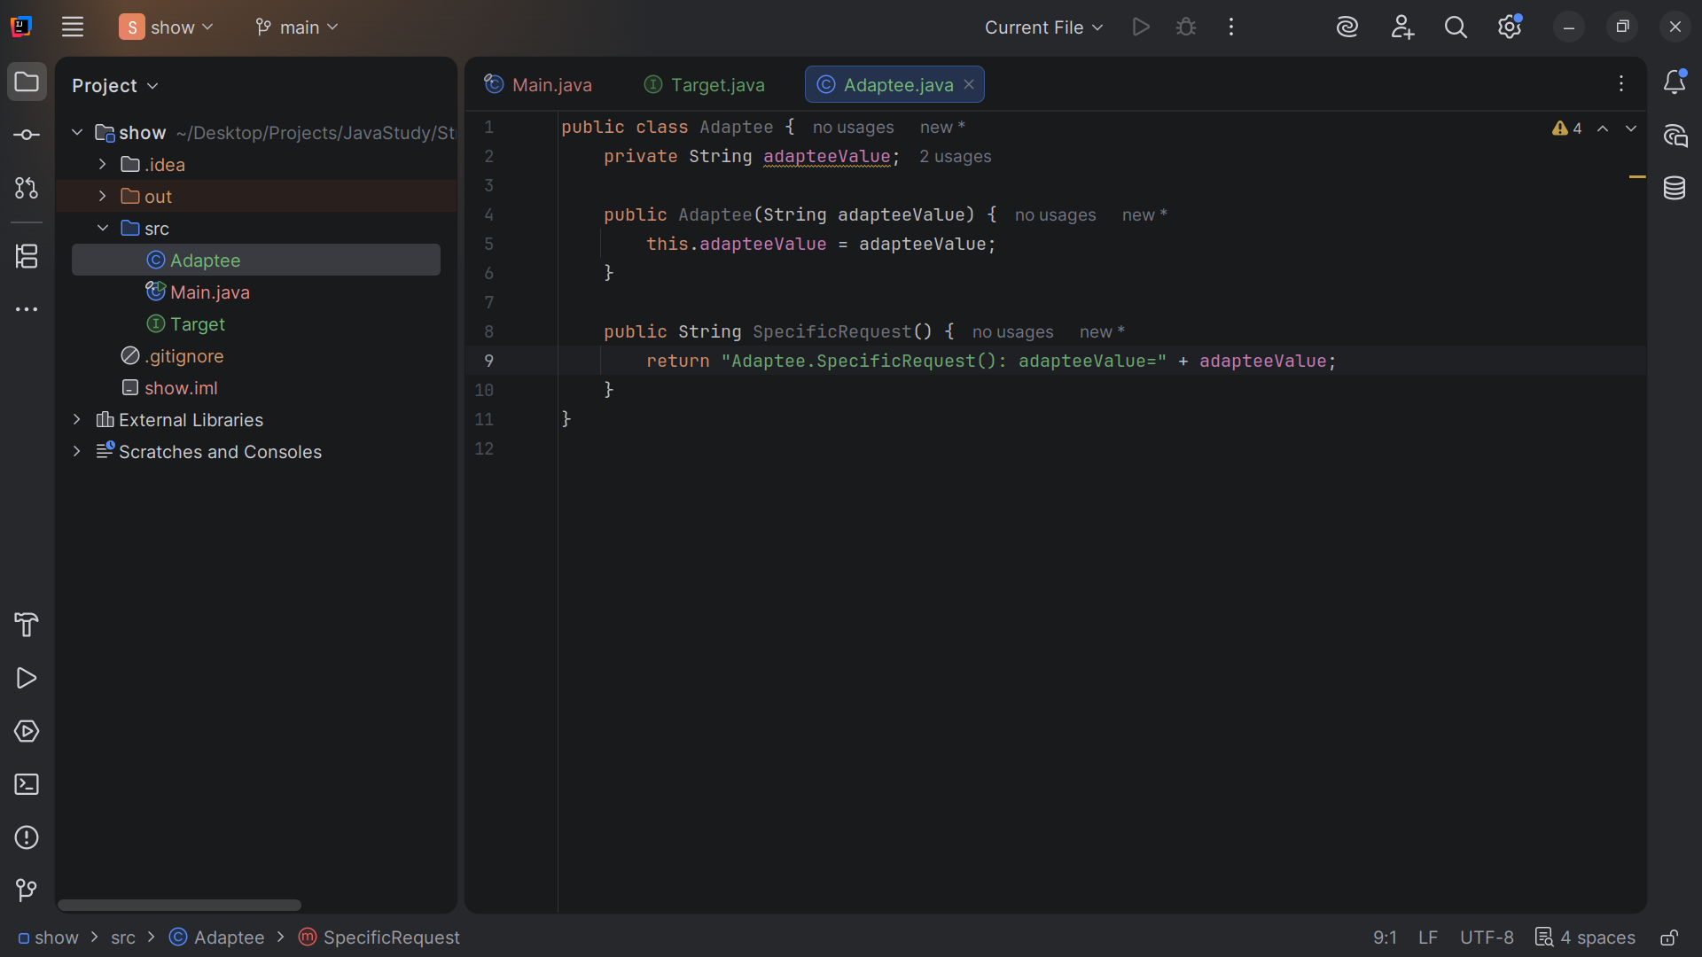
Notes:
WE create the Specific Request from which we return the string: Adaptee dot Specific Request(): adaptee Value = + adaptee Value

Slide 12
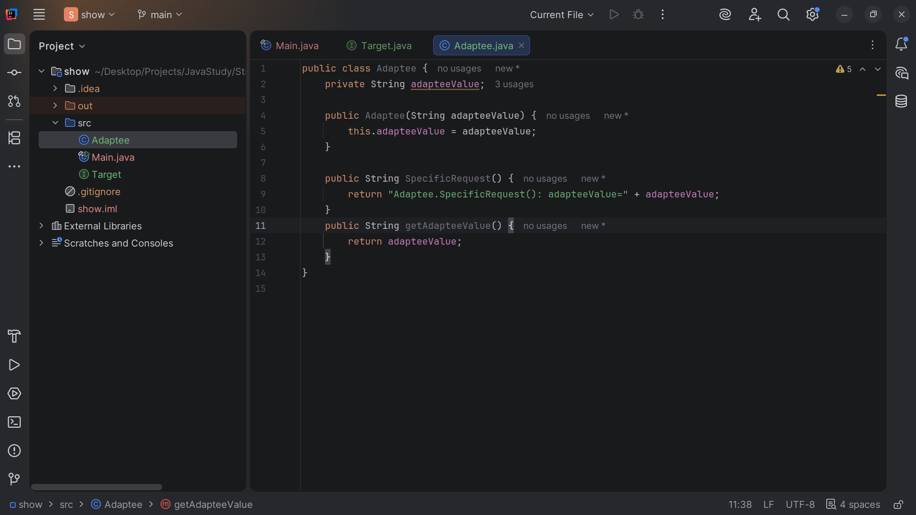
Notes:
And we return the adaptee Value

Slide 13
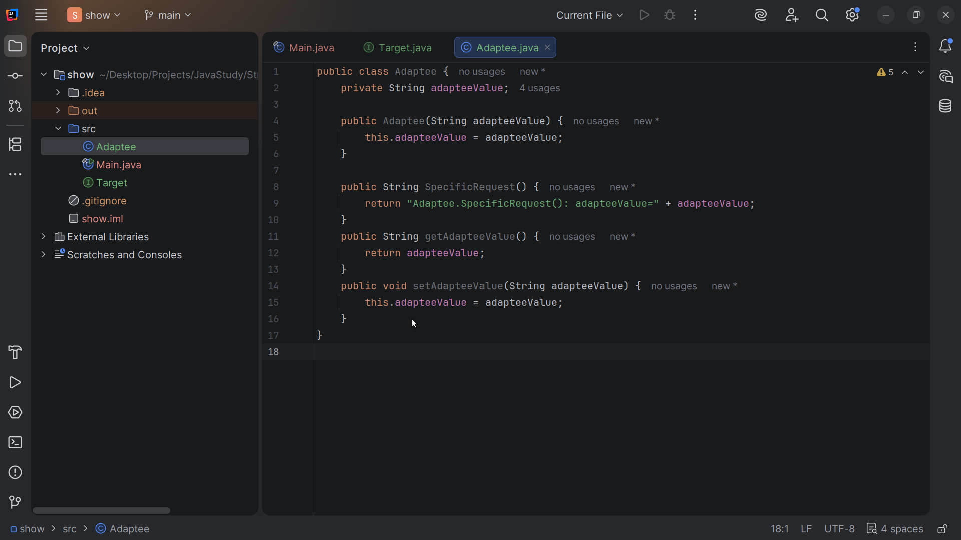
Notes:
And last we set this adaptee Value to the adaptee Value we pass in

Slide 14
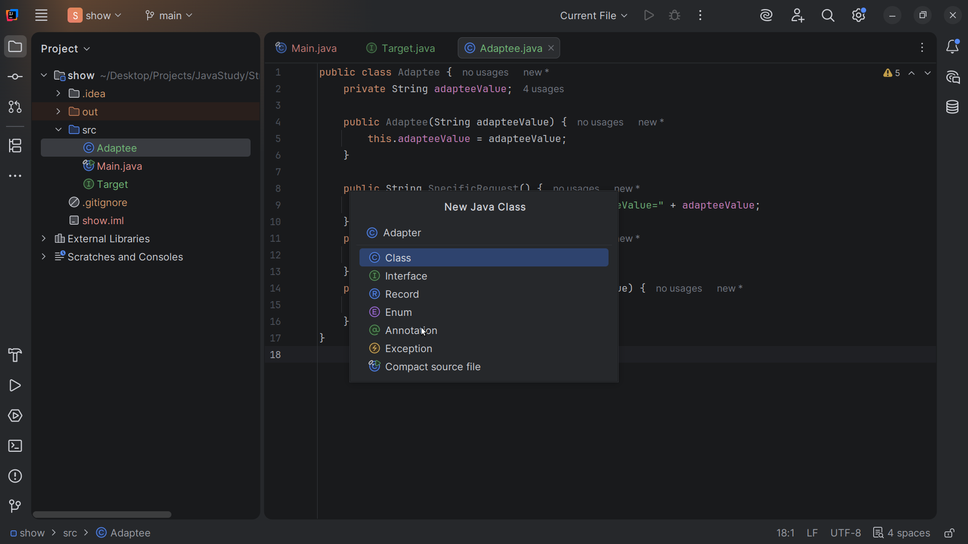
Notes:
Now let’s create a class we call the Adapter

Slide 15
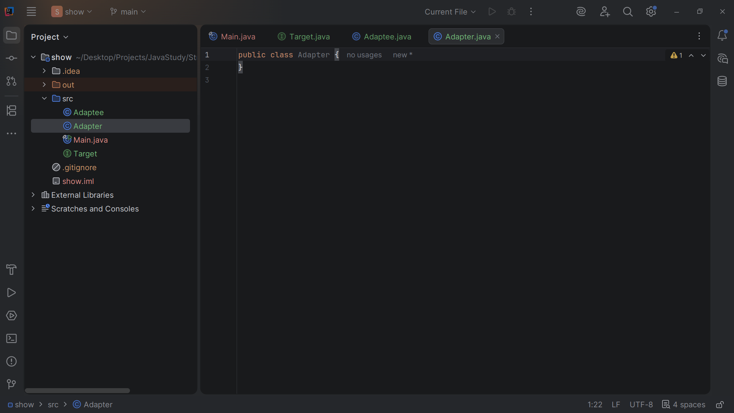
Notes:
The Adapter implements the Target and wraps the Adaptee

Slide 16
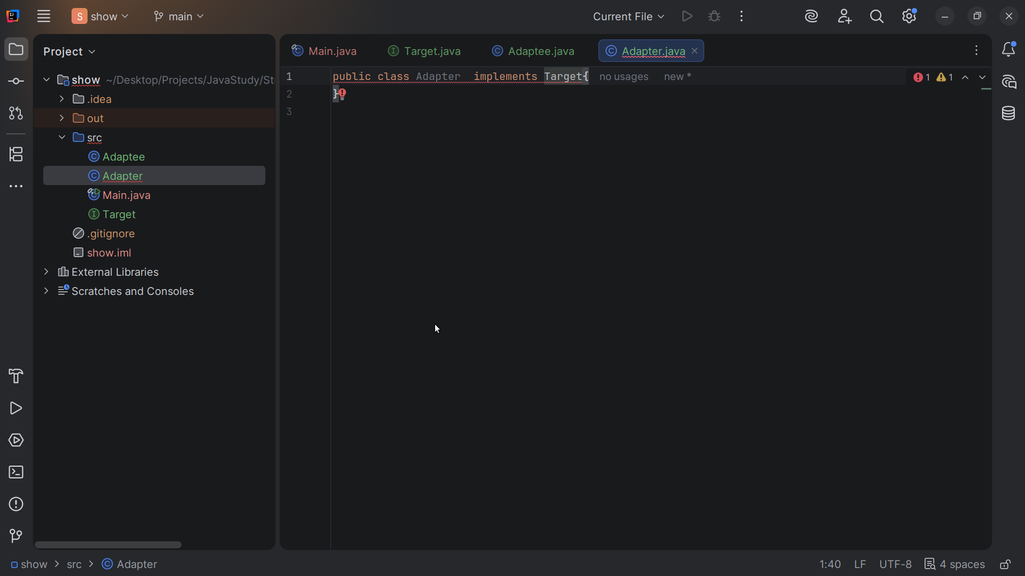
Notes:
The Adapter implements the Target interface

Slide 17
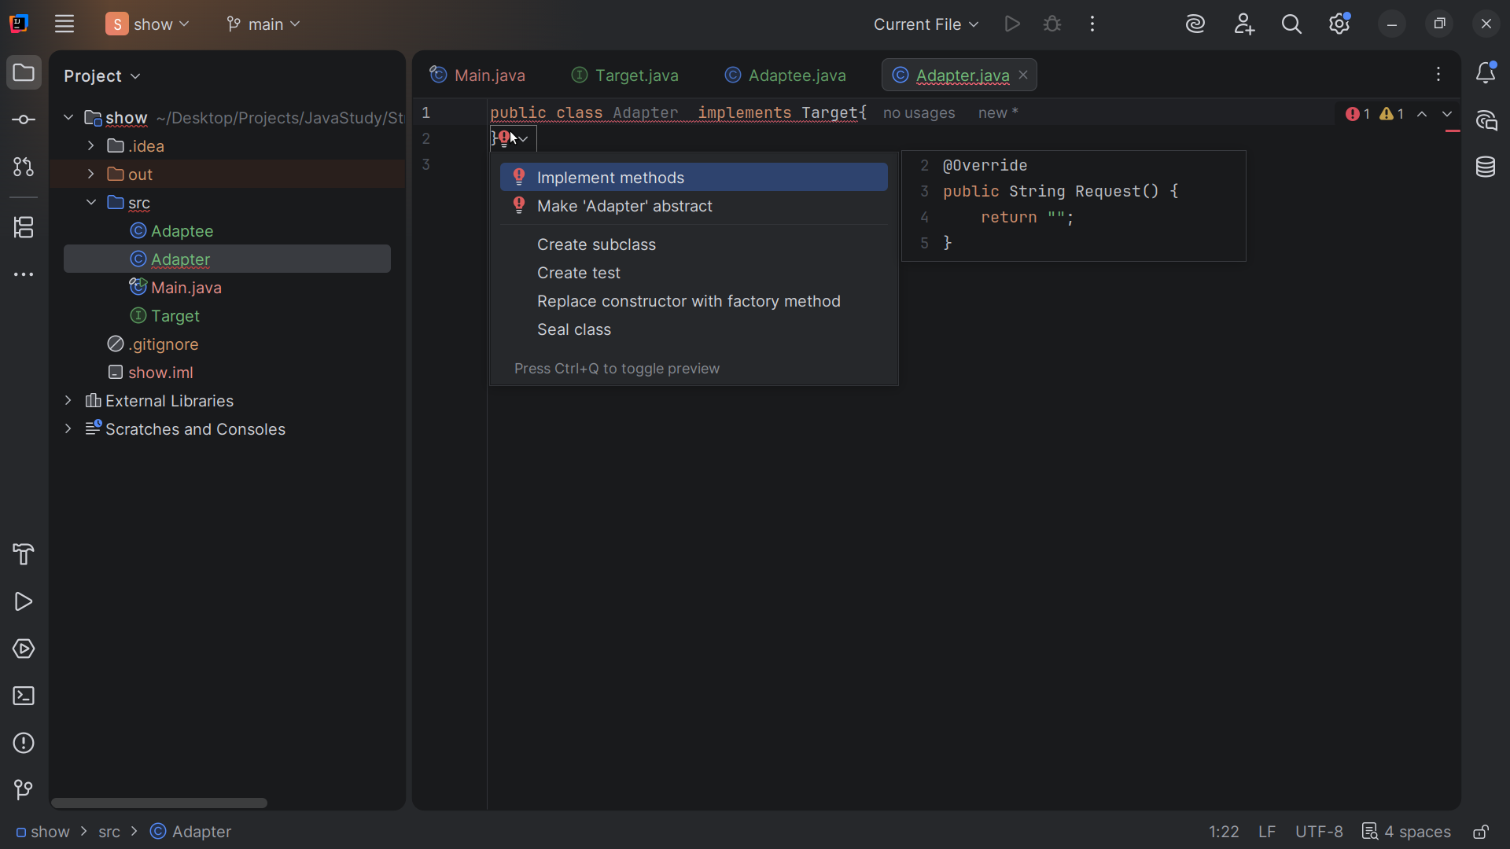
Notes:
The Adapter must implement the methods required by Target

Slide 18
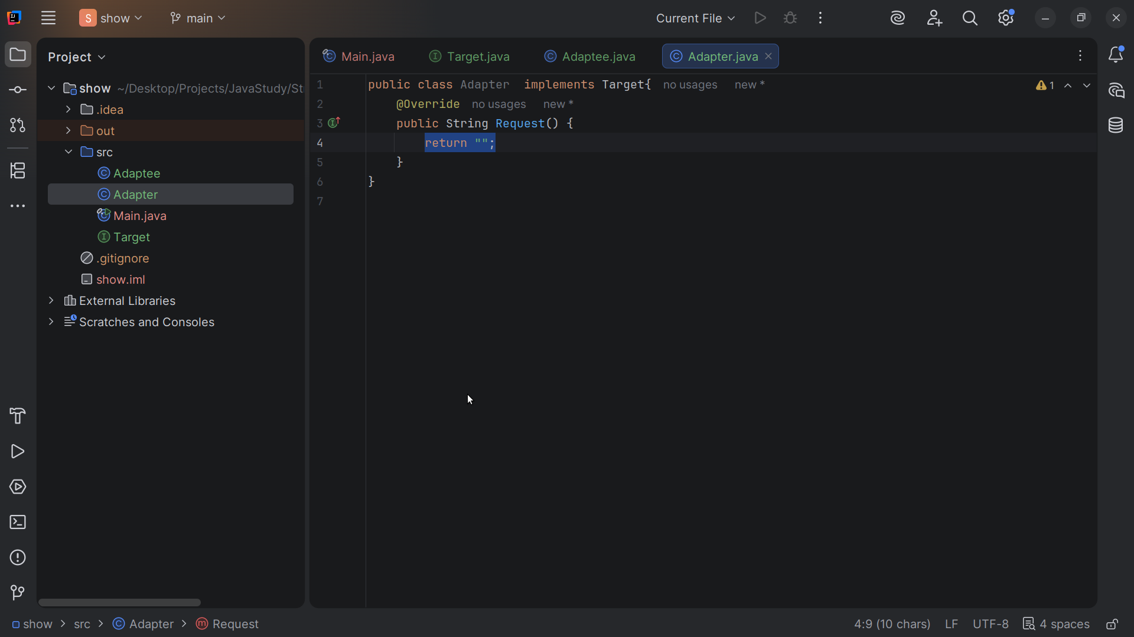
Notes:
Target only requires one method Request so I will have it auto generated

Slide 19
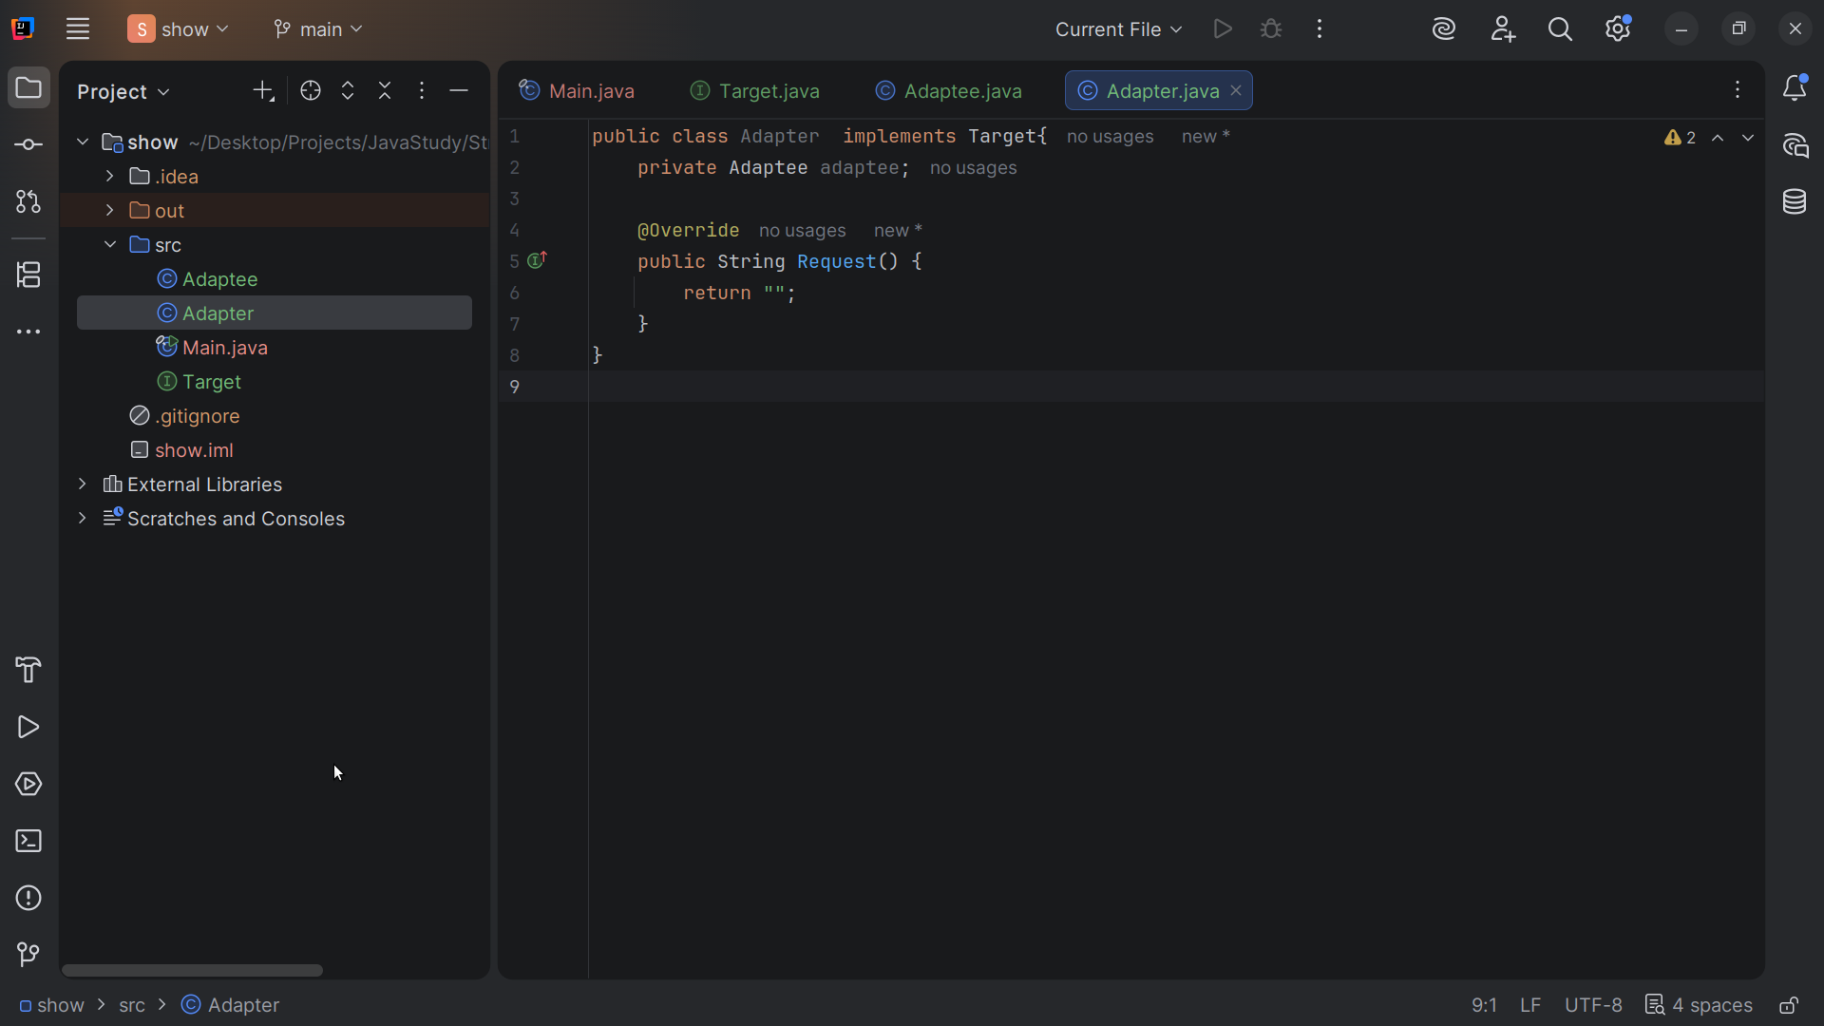
Notes:
Request returns a string

Slide 20
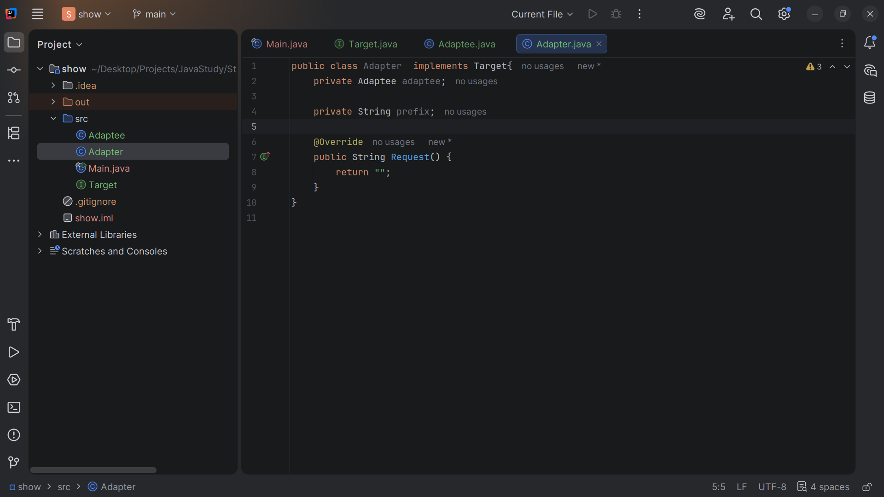
Notes:
So we create a private string variable called prefix

Slide 21
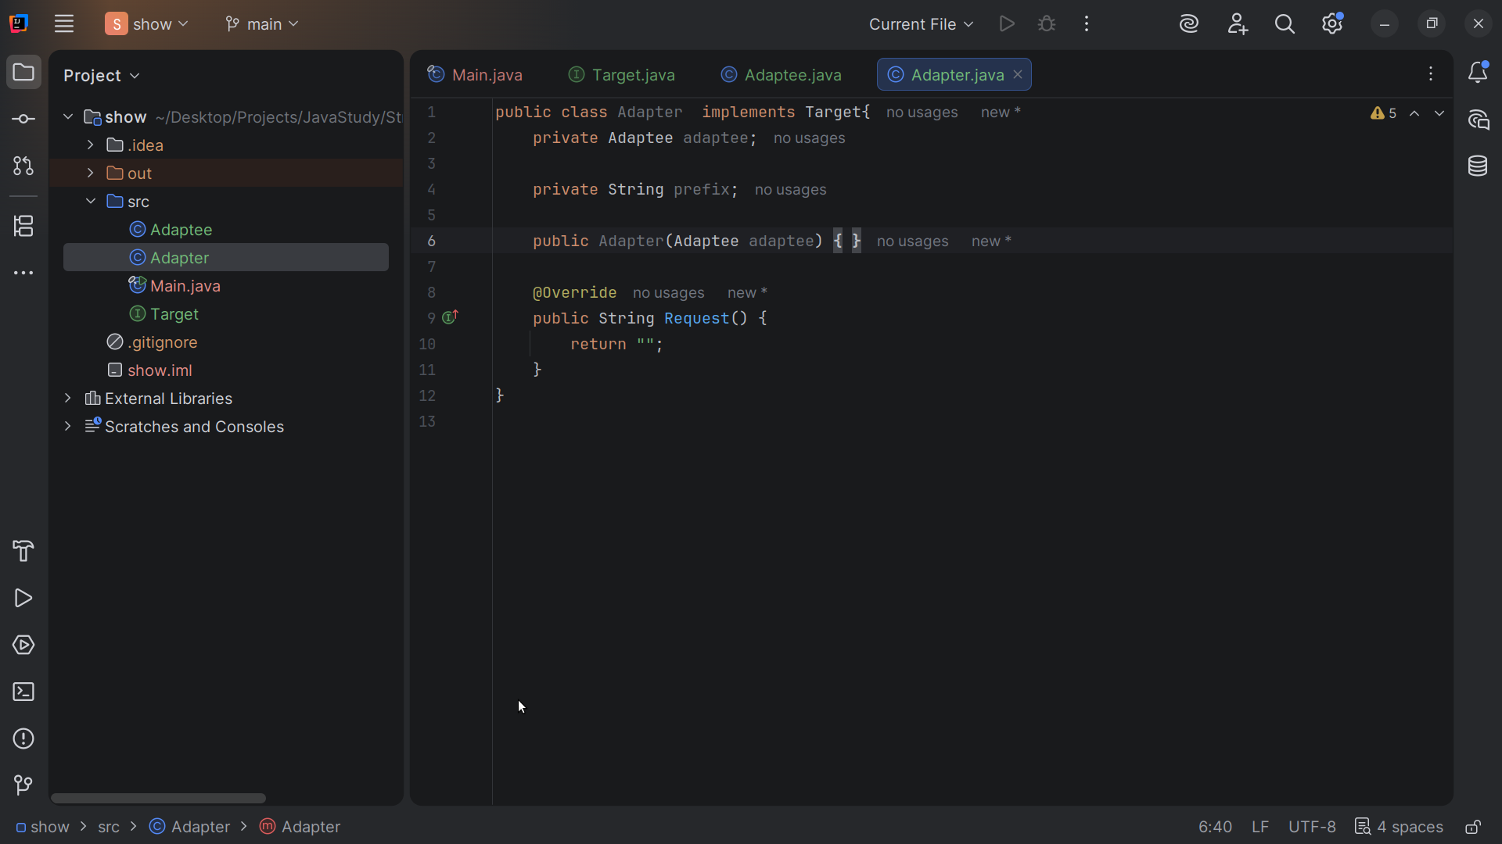
Notes:
We declare the Adapter with the Adaptee we pass in

Slide 22
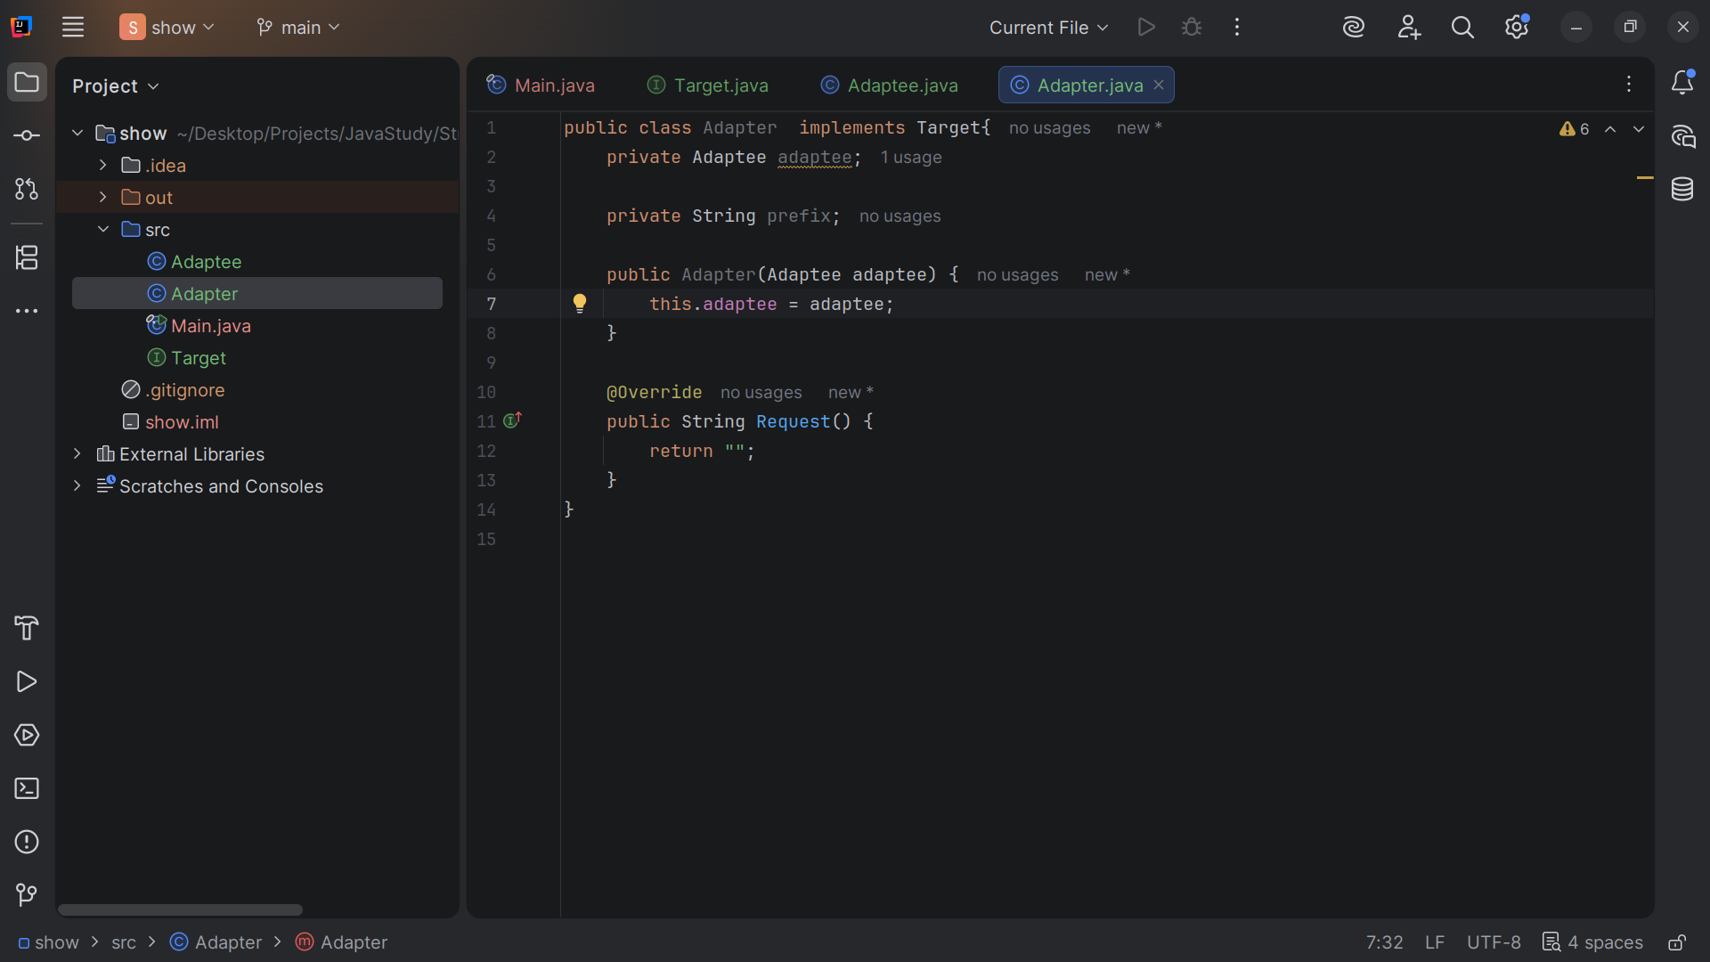
Notes:
We Store the reference so Request() can delegate it to the Specific Request().

Slide 23
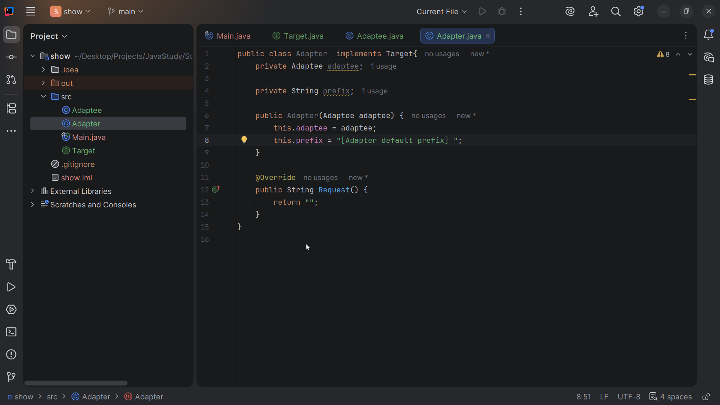
Notes:
We set this dot prefix to Adapter default prefix

Slide 24
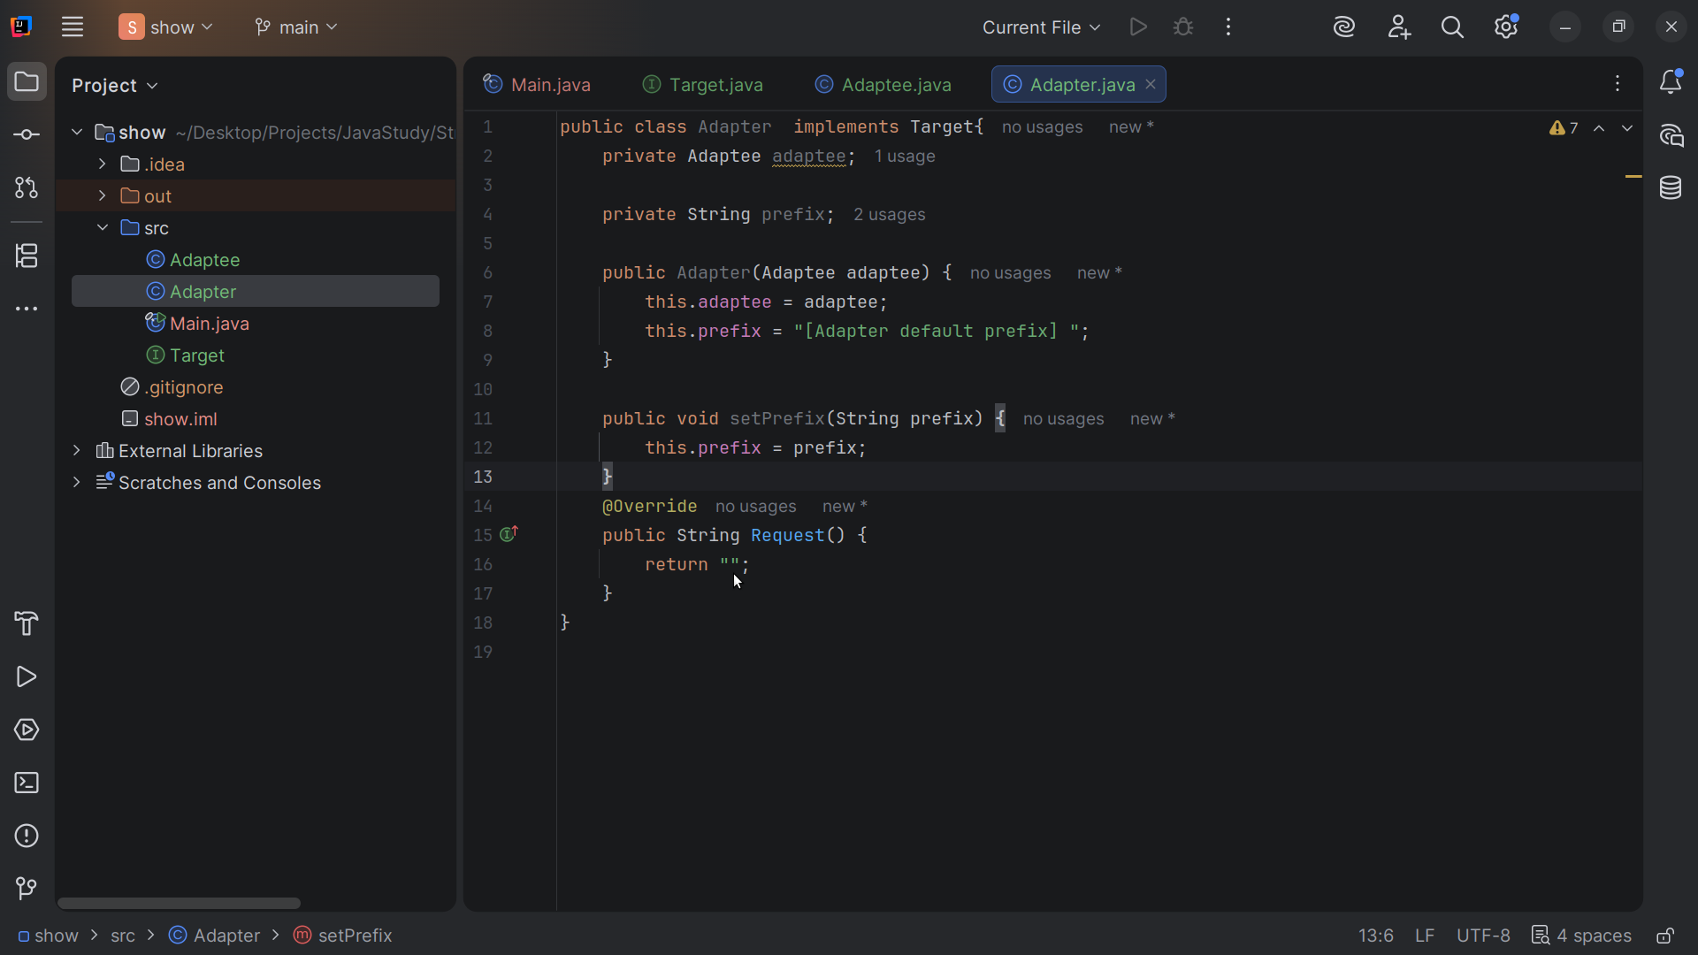
Notes:
We add a set Prefix method which takes a String prefix

Slide 25
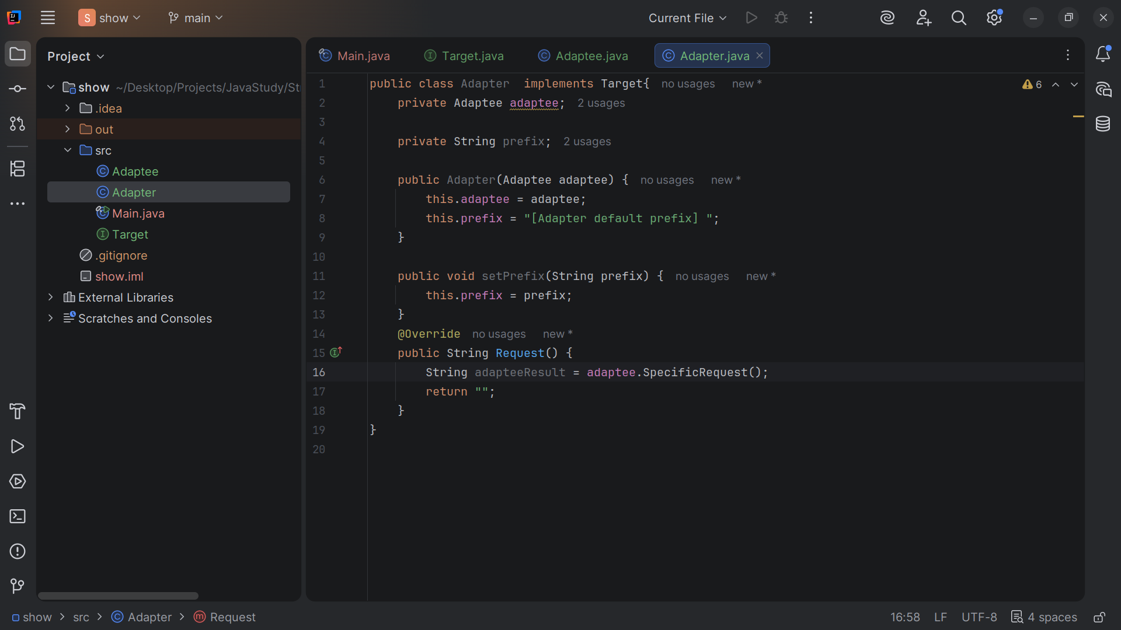
Notes:
Inside of Request we set the adaptee Result to the adaptee Specific Request

Slide 26
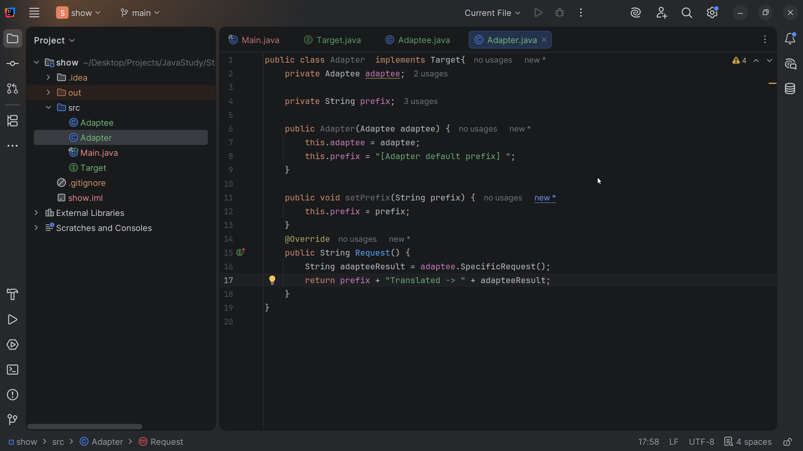
Notes:
And we return prefix + "Translated -> " + adapteeResult;

Slide 27
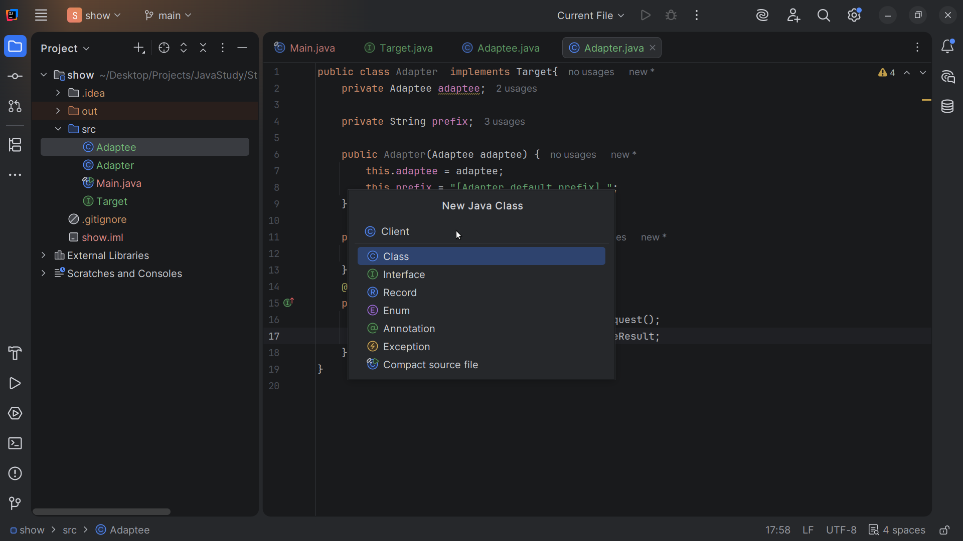
Notes:
Next we create a class we call Target

Slide 28
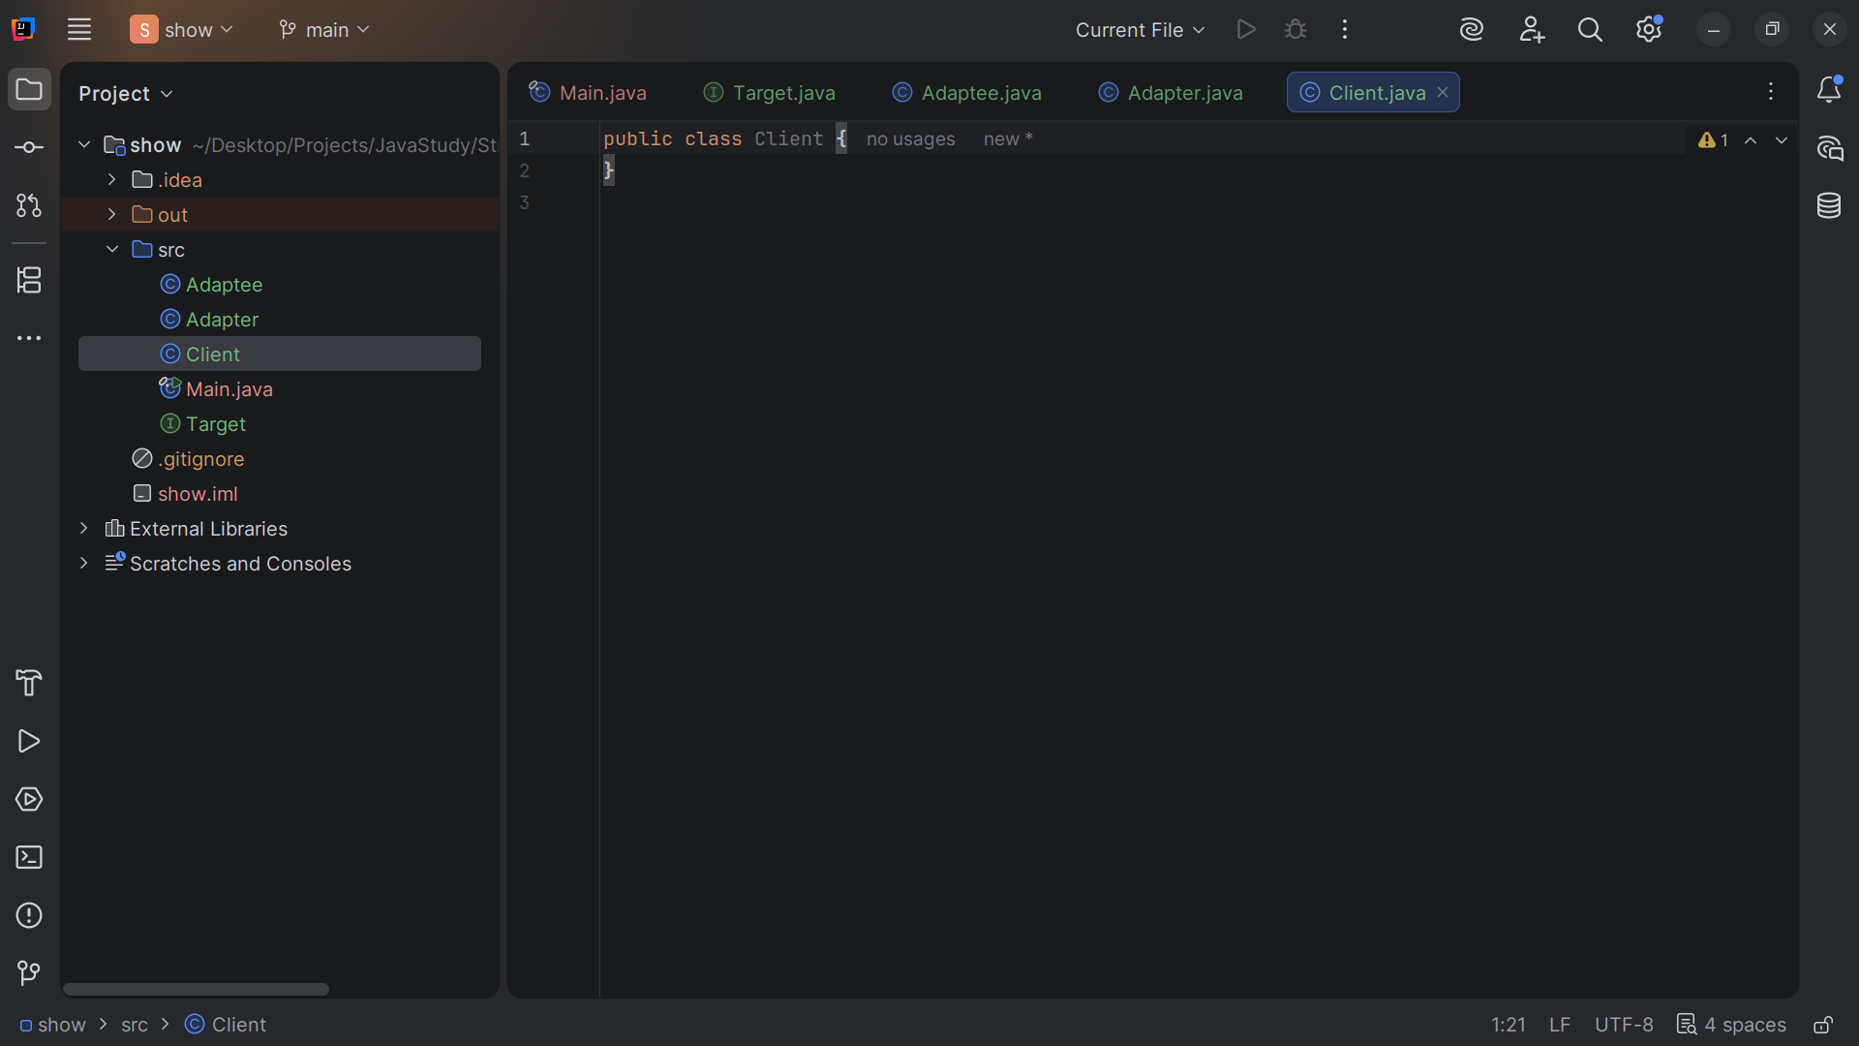
Notes:
Client holds a reference to Target

Slide 29
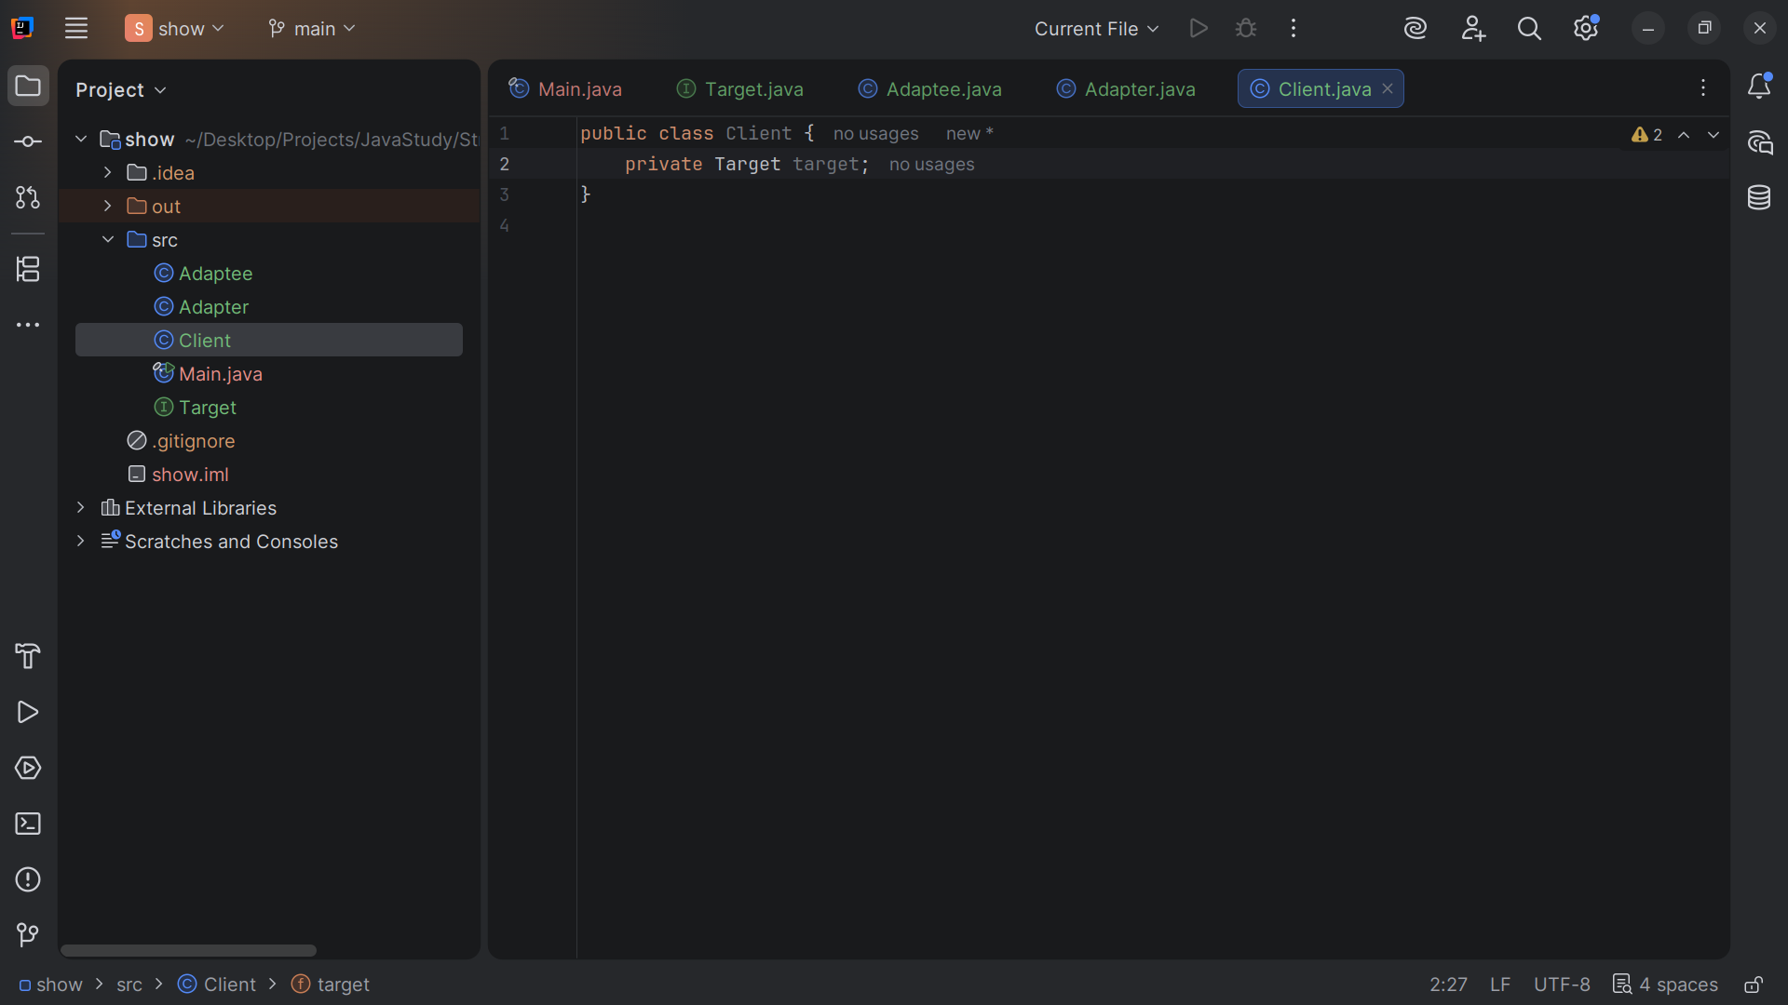
Notes:
So we have a Private variable named Target that we will instantiate

Slide 30
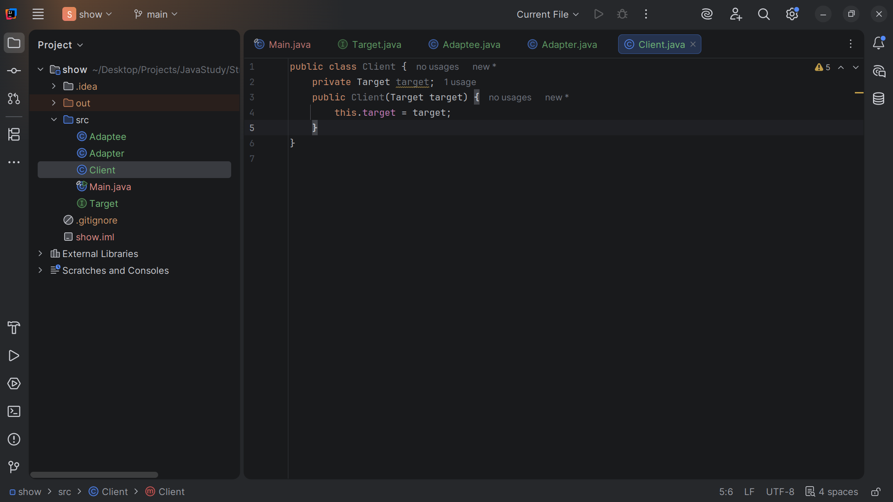
Notes:
For the Client we set this dot target to target

Slide 31
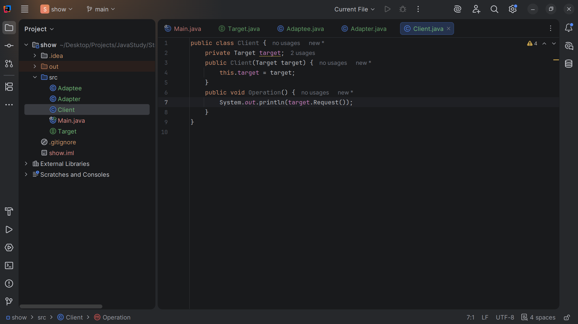
Notes:
We have a method named operation
Operation will Print the result of calling the Target interface

Slide 32
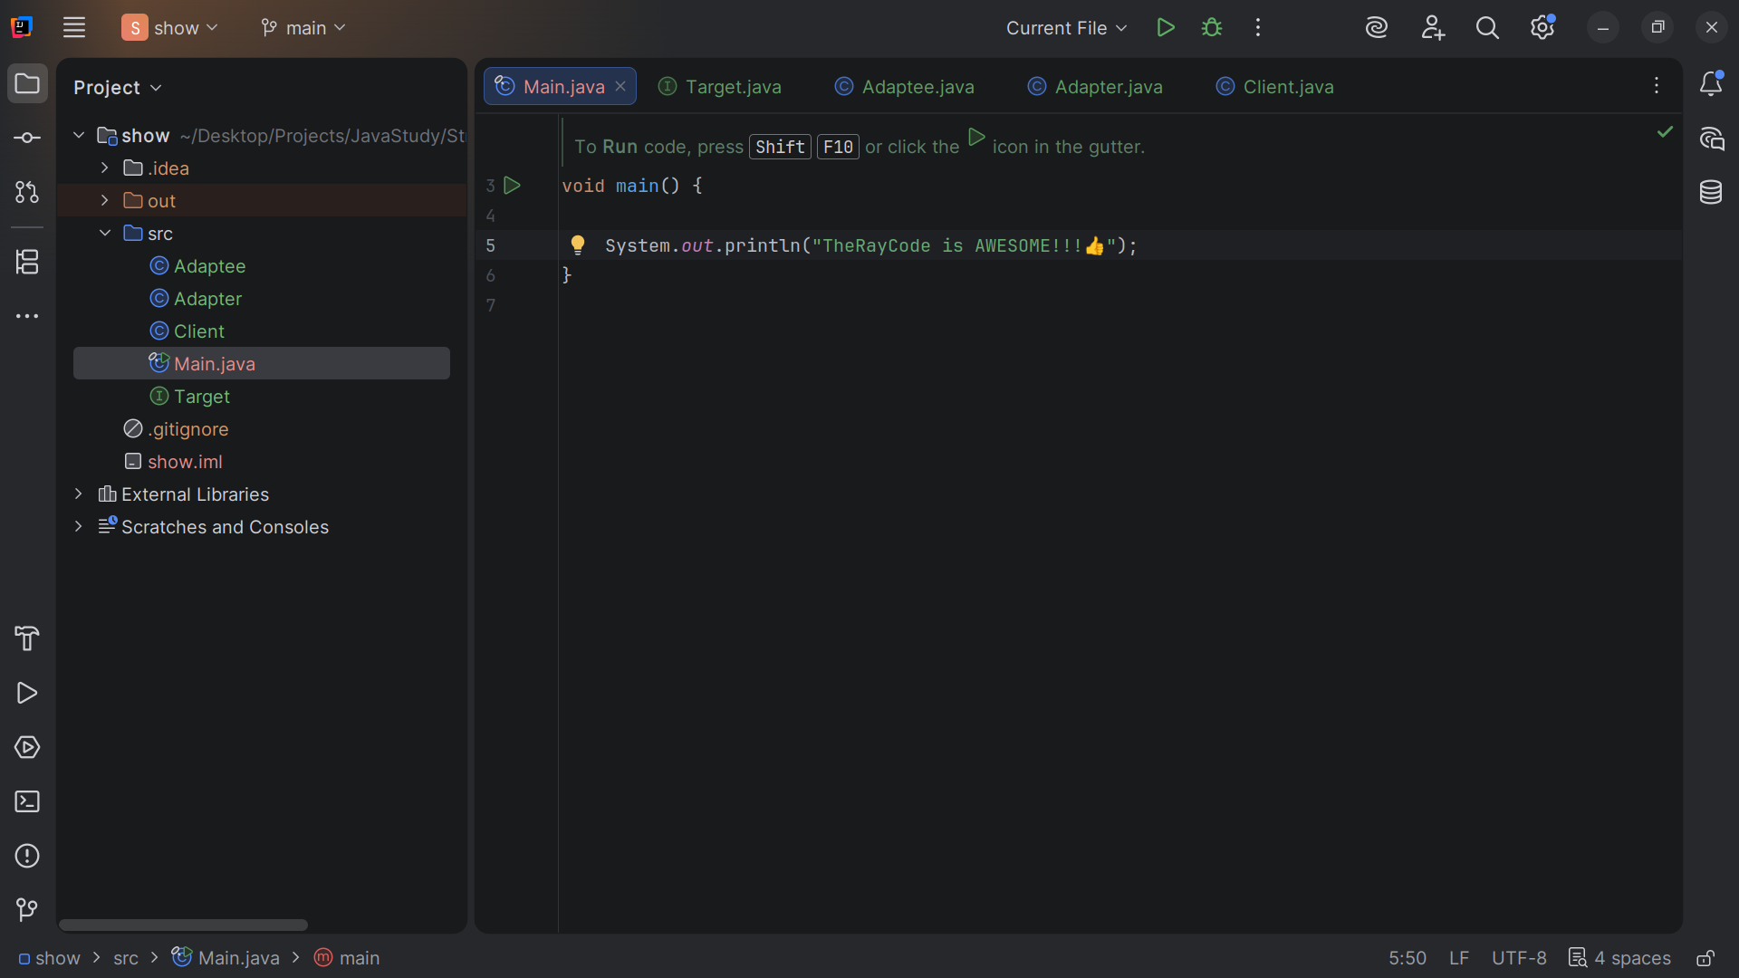
Notes:
Now let’s go to the Main method for our demo

Slide 33
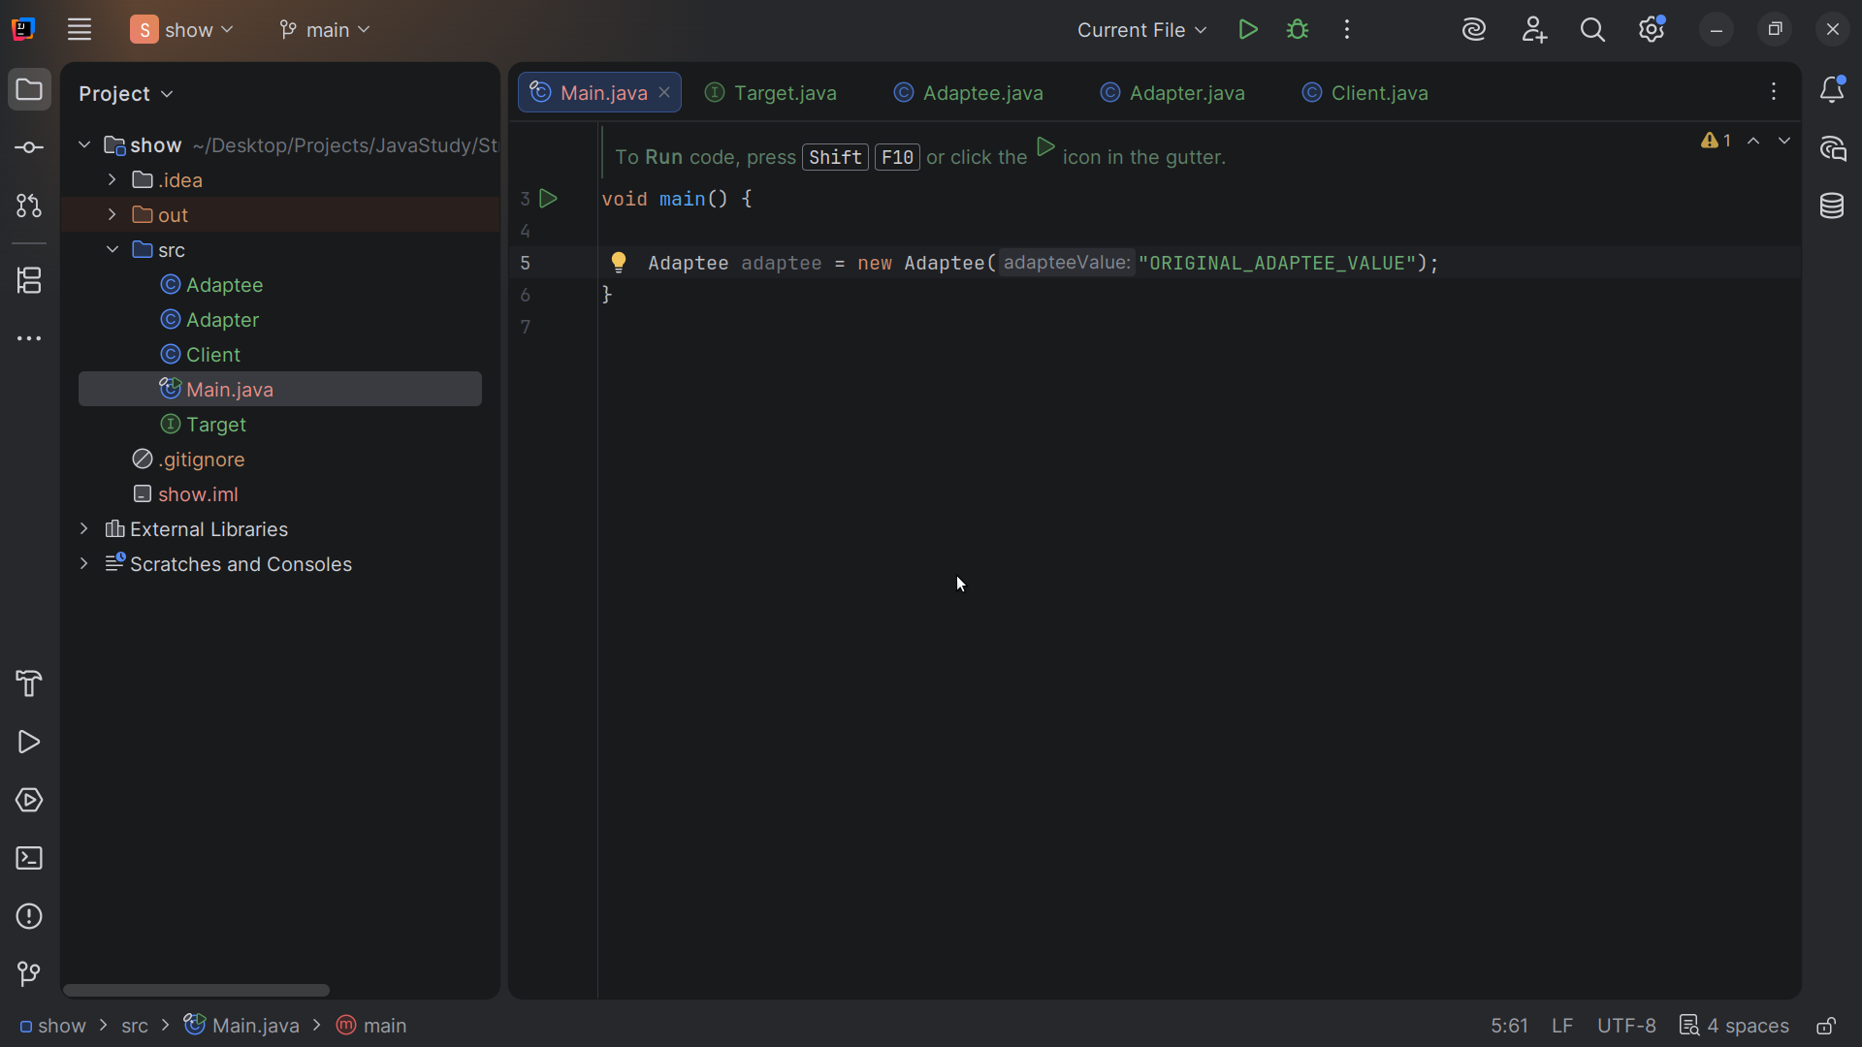
Notes:
We Create the Adaptee with an initial internal value.

Slide 34
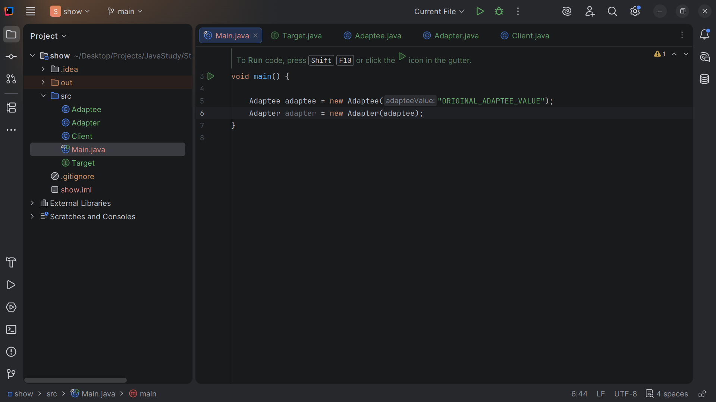
Notes:
Wrap the Adaptee with an Adapter.

Slide 35
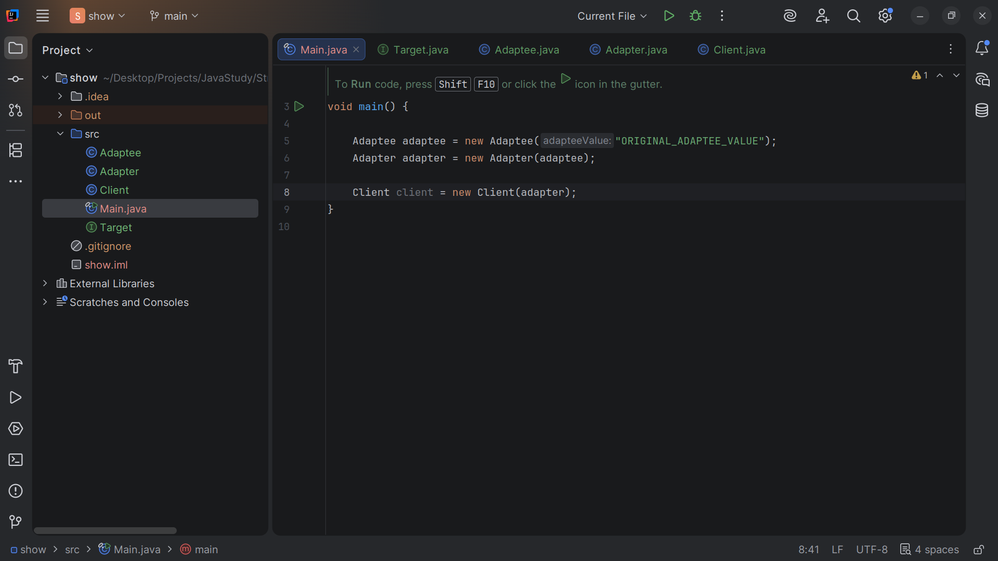
Notes:
Create the Client, depending ONLY on the Target

Slide 36
Notes:
(no sound)

Slide 37
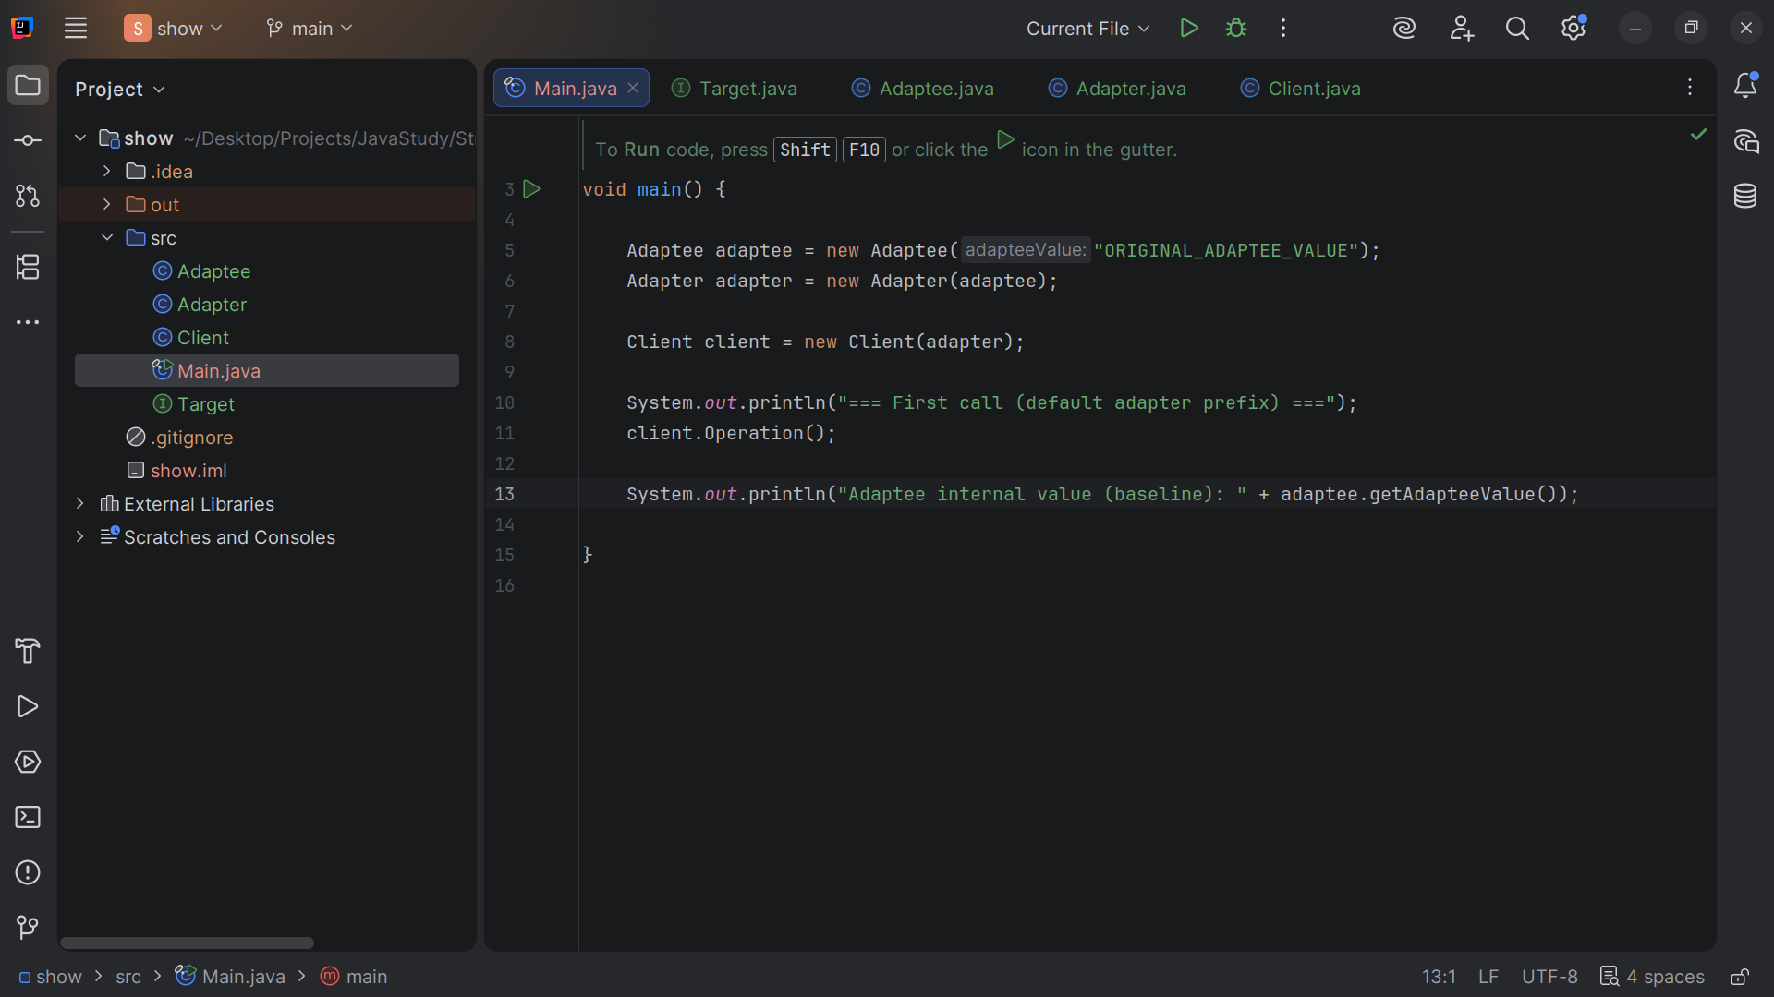
Notes:
We first run the default adapter and we
System out println("Adaptee internal value (baseline): "

Slide 38
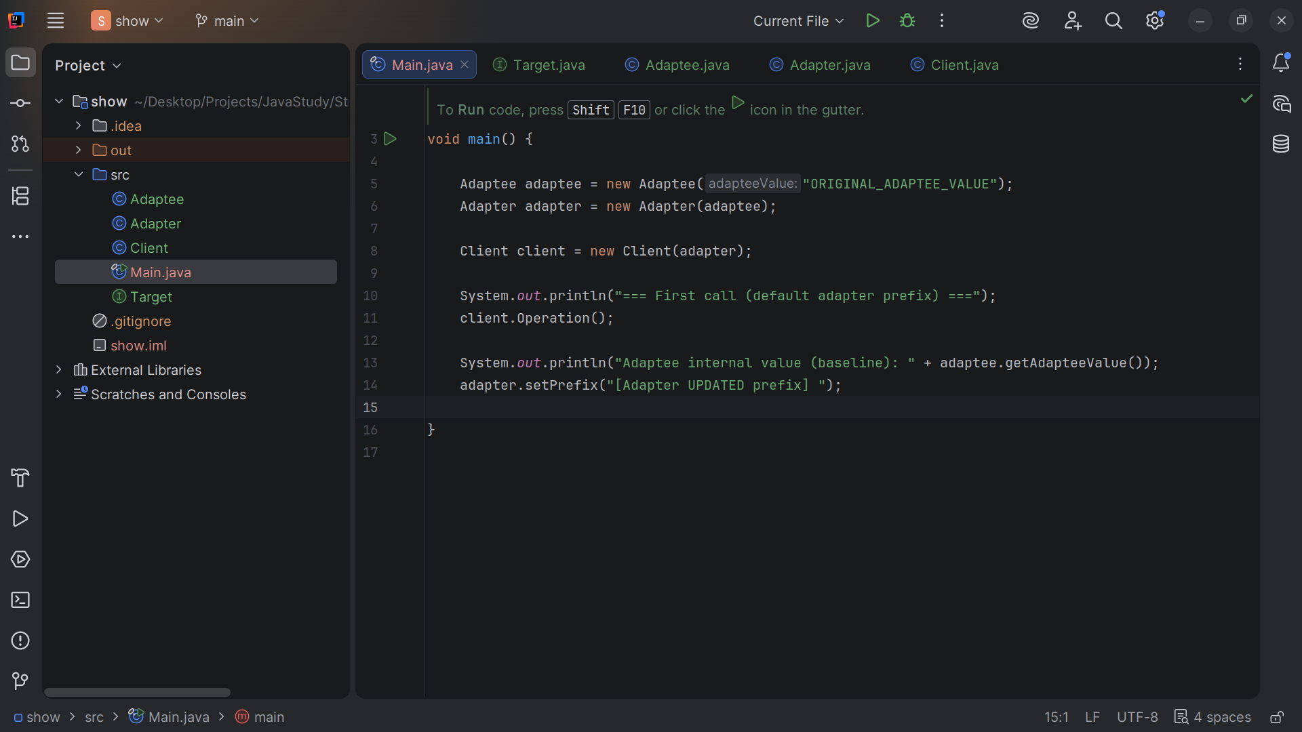
Notes:
We Change a variable on the Adapter with set Adapter set prefix

Slide 39
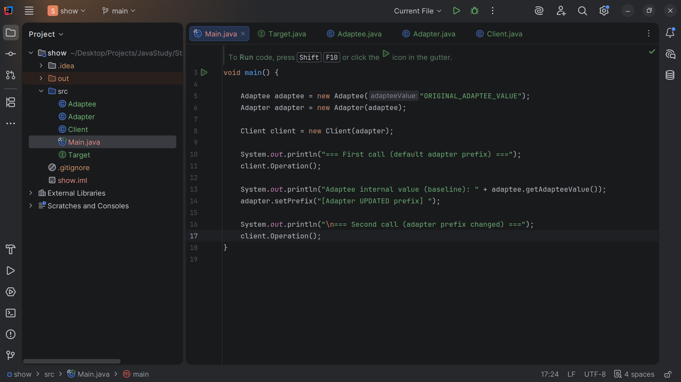
Notes:
Second call adapter prefix changed

Slide 40
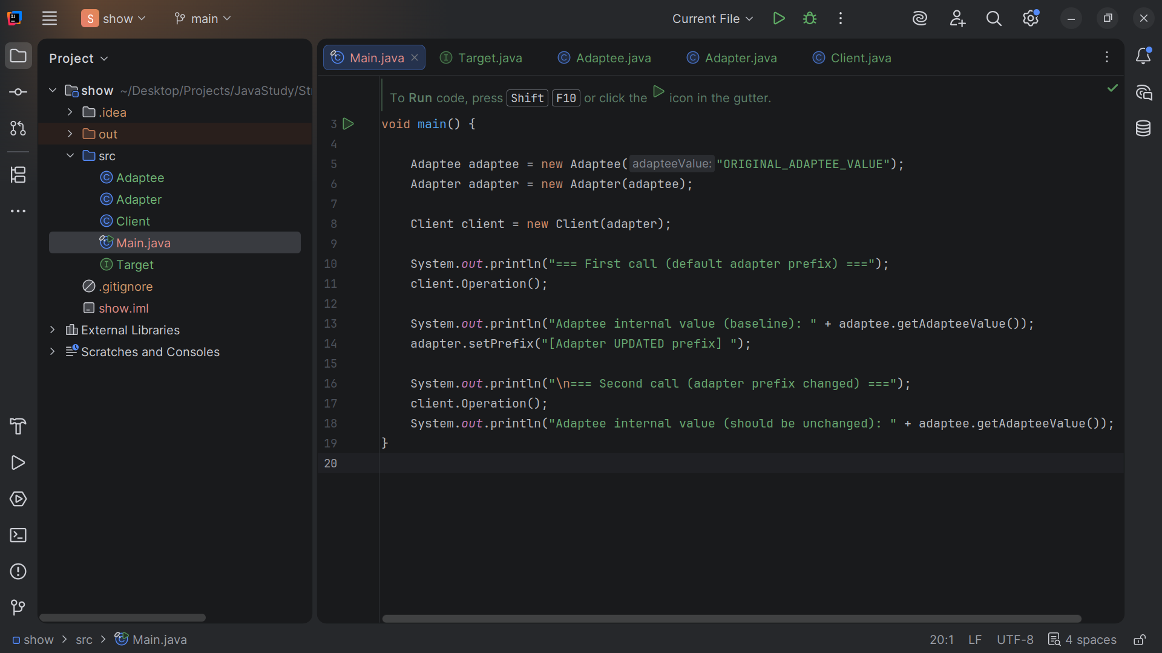
Notes:
Prove Adaptee's internal value is preserved

Slide 41
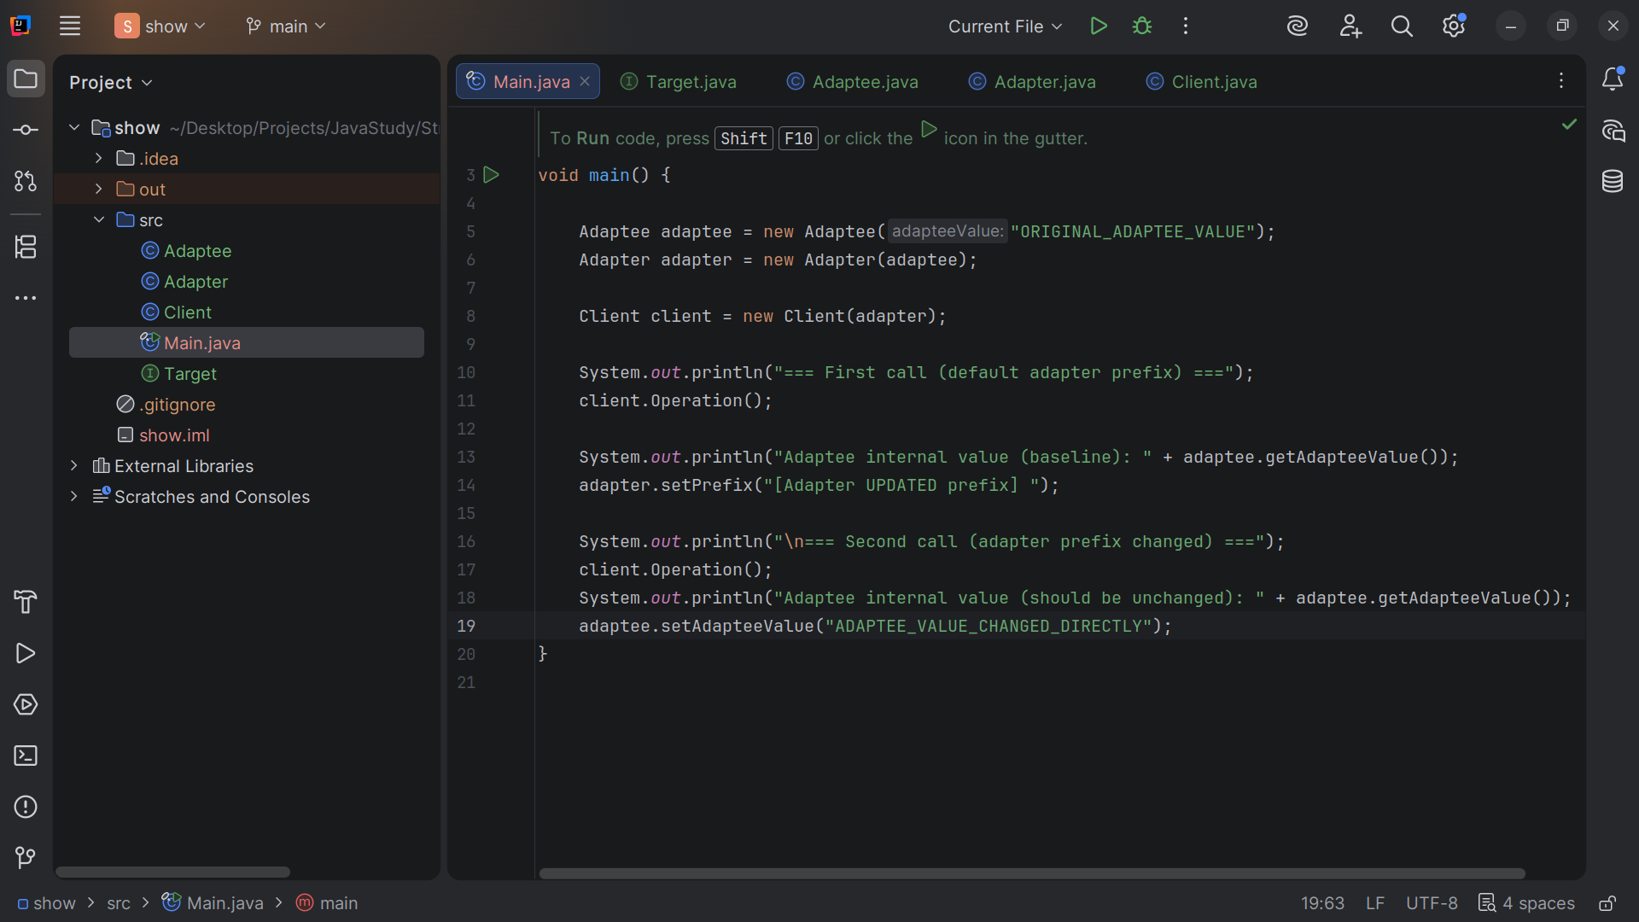
Notes:
We set Adaptee Value ADAPTEE_VALUE_CHANGED_DIRECTLY

Slide 42
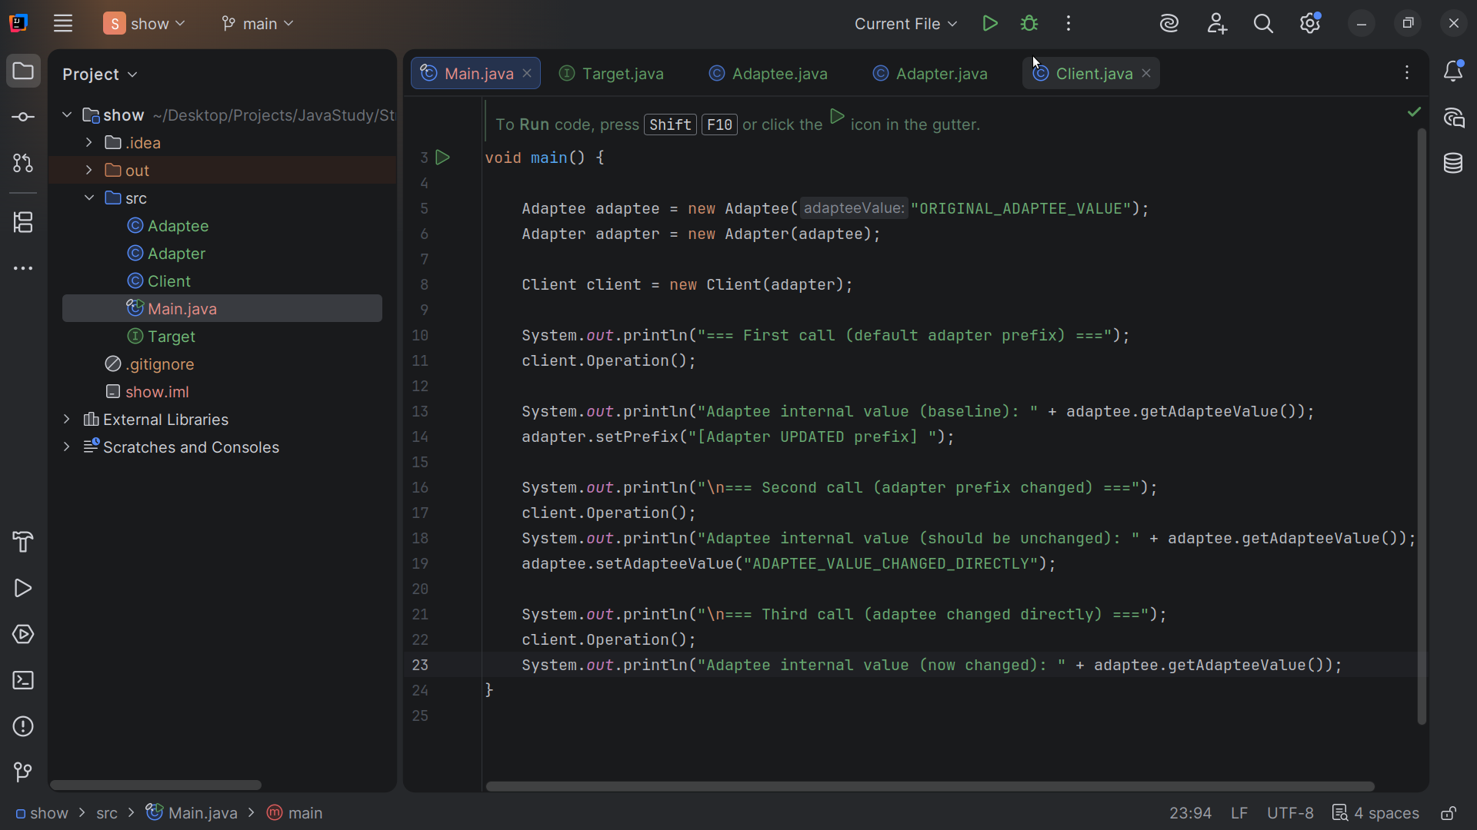
Notes:
Third call adaptee changed directly
Let’s now run

Slide 43
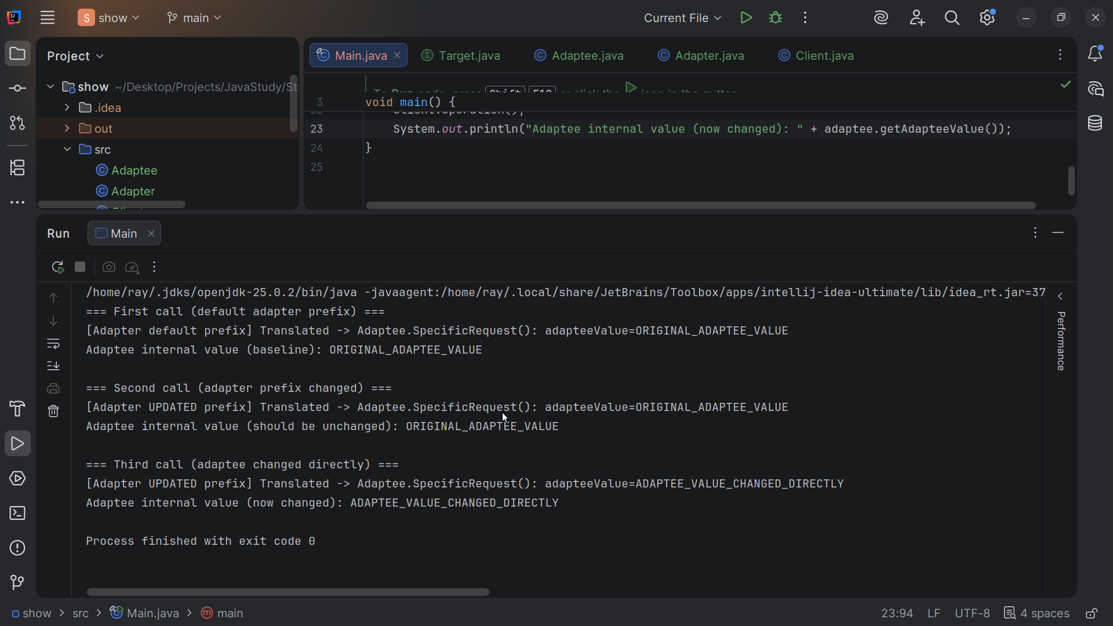
Notes:
We get

Slide 44
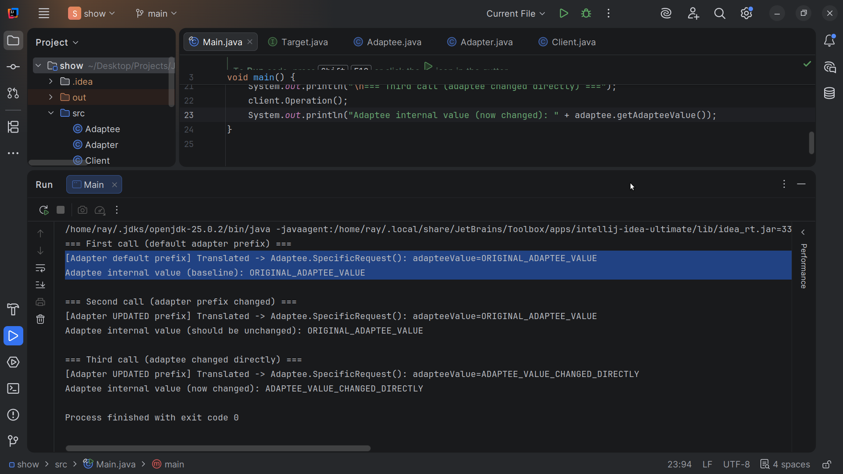
Notes:
[Adapter default prefix] Translated -> Adaptee.SpecificRequest(): adapteeValue=ORIGINAL_ADAPTEE_VALUE
Adaptee internal value (baseline): ORIGINAL_ADAPTEE_VALUE

Slide 45
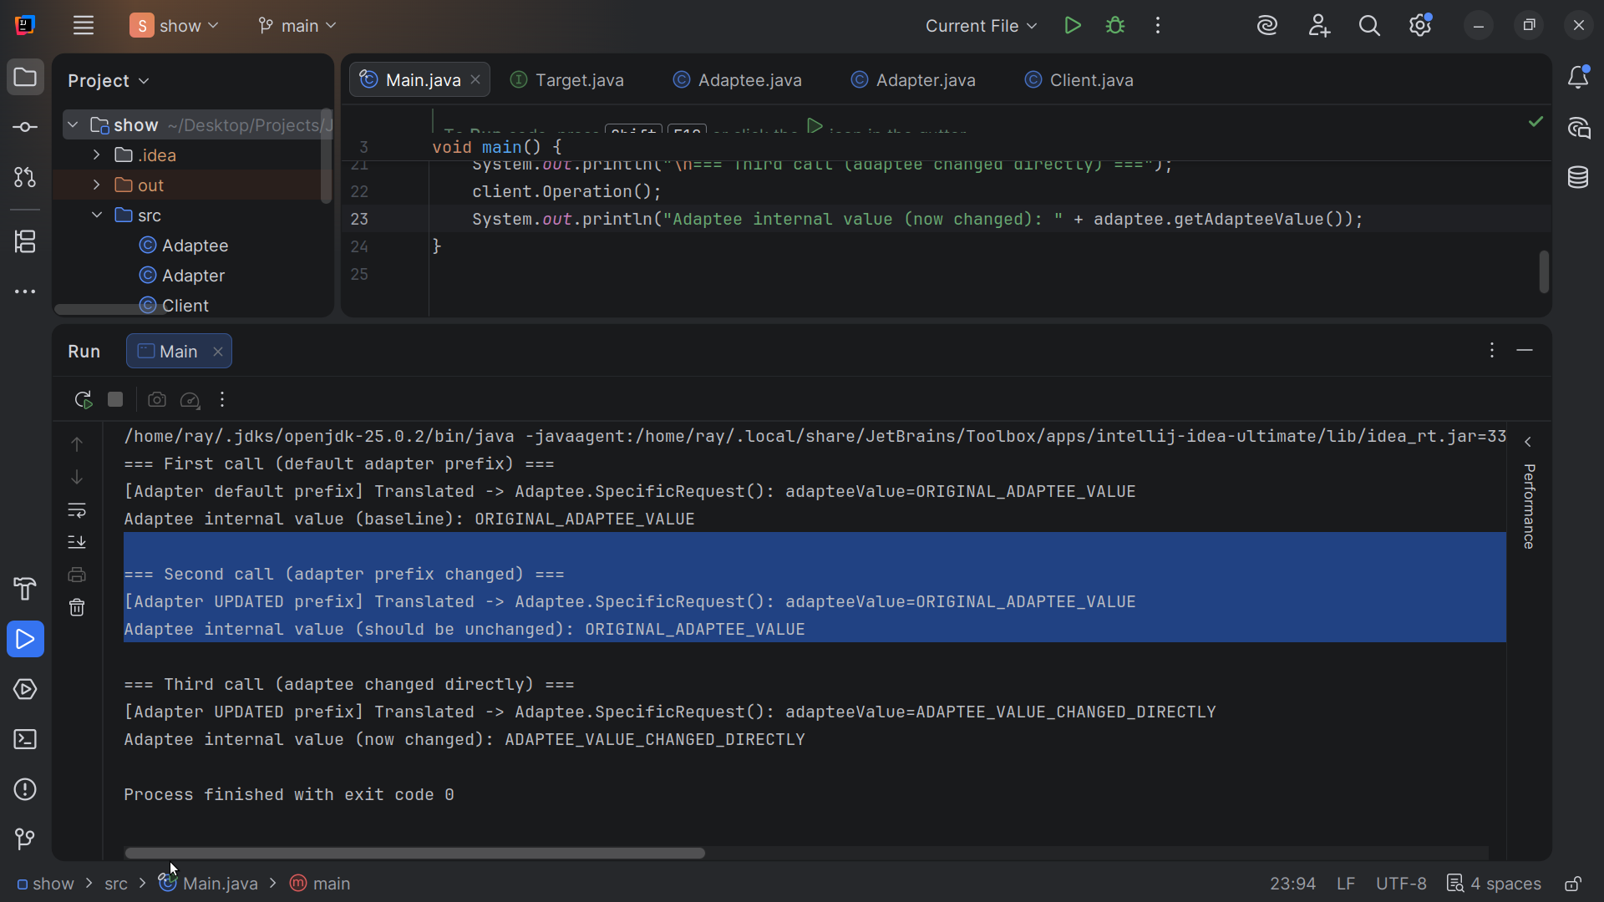
Notes:
=== Second call (adapter prefix changed) ===
[Adapter UPDATED prefix] Translated -> Adaptee.SpecificRequest(): adapteeValue=ORIGINAL_ADAPTEE_VALUE
Adaptee internal value (should be unchanged): ORIGINAL_ADAPTEE_VALUE

Slide 46
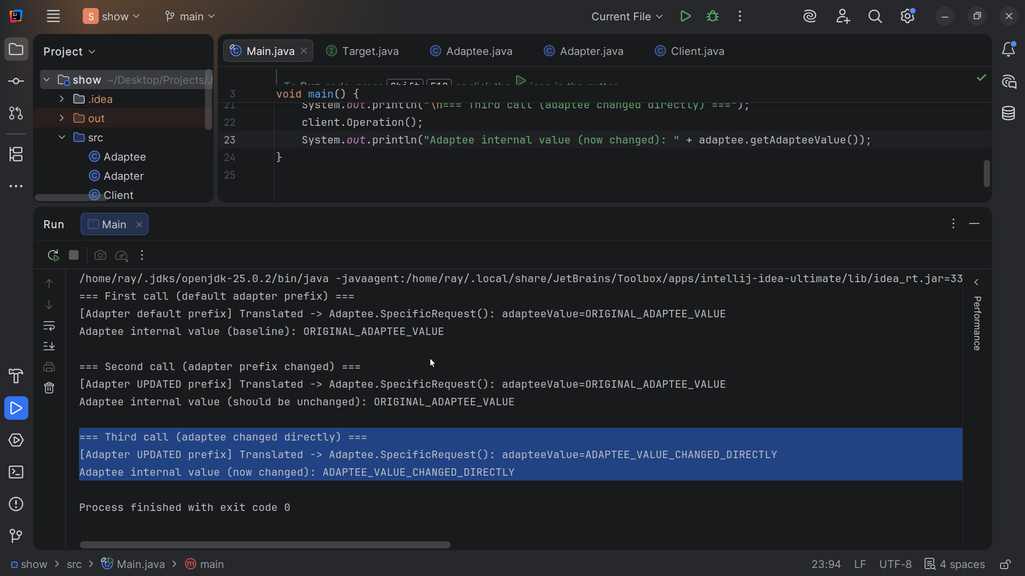
Notes:
=== Third call (adaptee changed directly) ===
[Adapter UPDATED prefix] Translated -> Adaptee.SpecificRequest(): adapteeValue=ADAPTEE_VALUE_CHANGED_DIRECTLY
Adaptee internal value (now changed): ADAPTEE_VALUE_CHANGED_DIRECTLY
My name is Ray Always code with a smile

