Slide 1
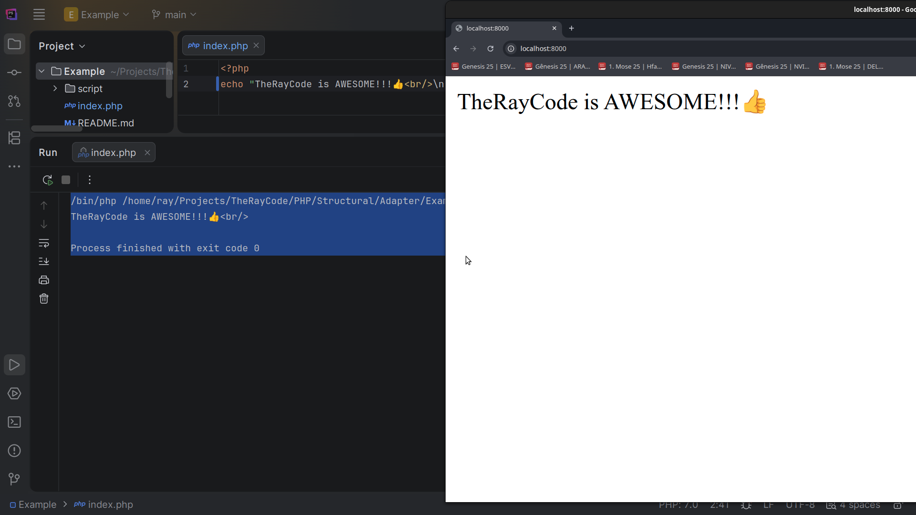
Notes:
Hello, my name is Ray and I’m the “Ray” in TheRayCode

Slide 2
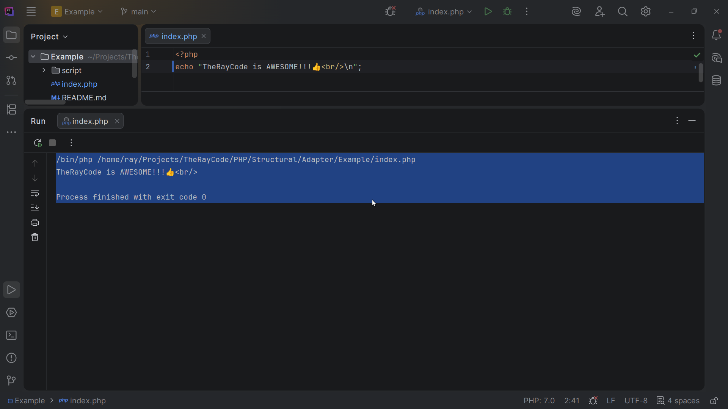
Notes:
In this video I will cover the Adapter design pattern using PHP

Slide 3
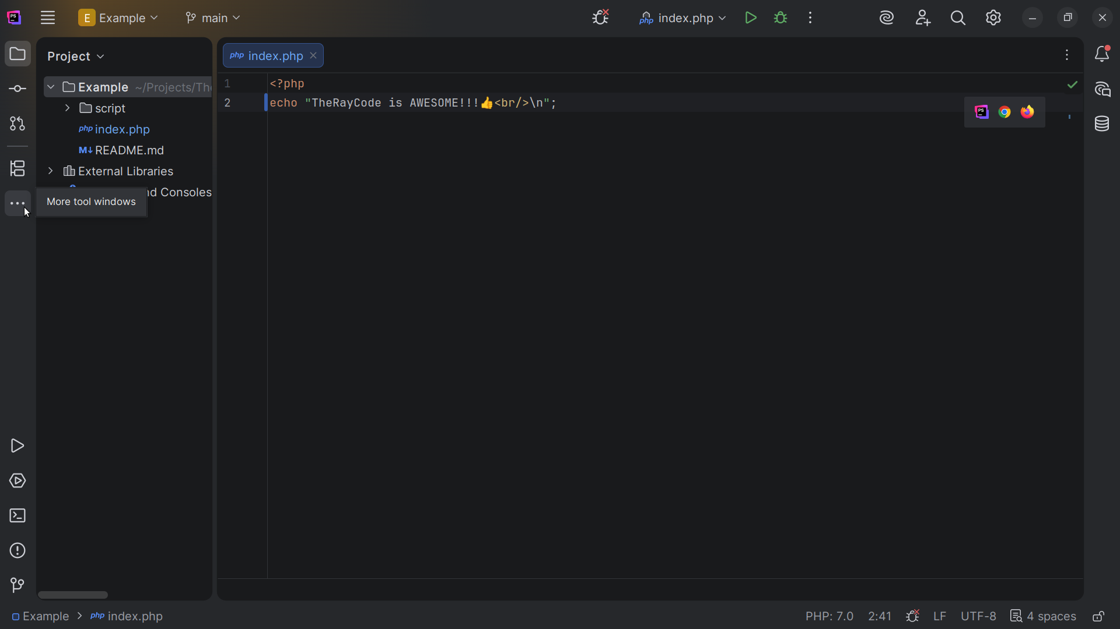
Notes:
I will stick to the naming convention given by the Gang of Four on the UML diagram they gave

Slide 4
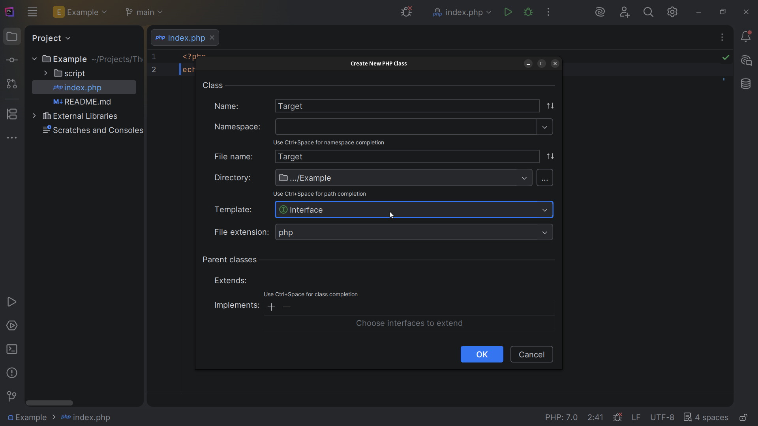
Notes:
We start with an interface we call Target

Slide 5
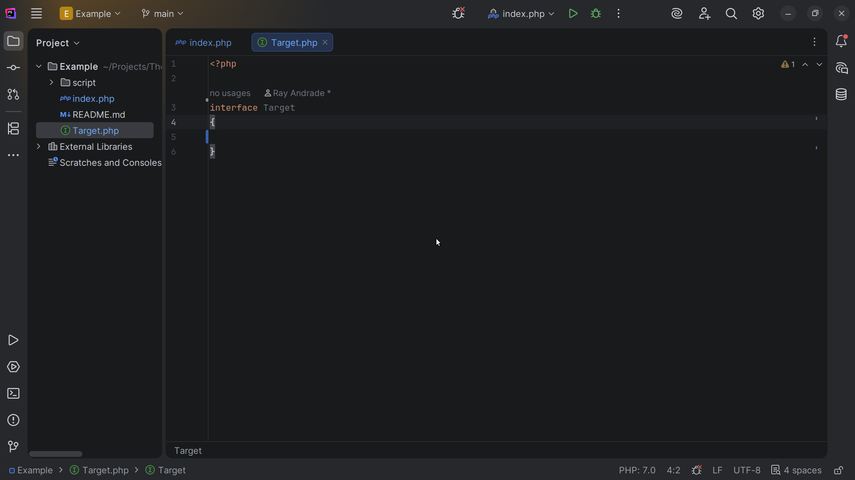
Notes:
This represents the interface that the client expects or needs. In the context of the Adapter Pattern, it defines the domain-specific interface that the system (or client) is expecting.

Slide 6
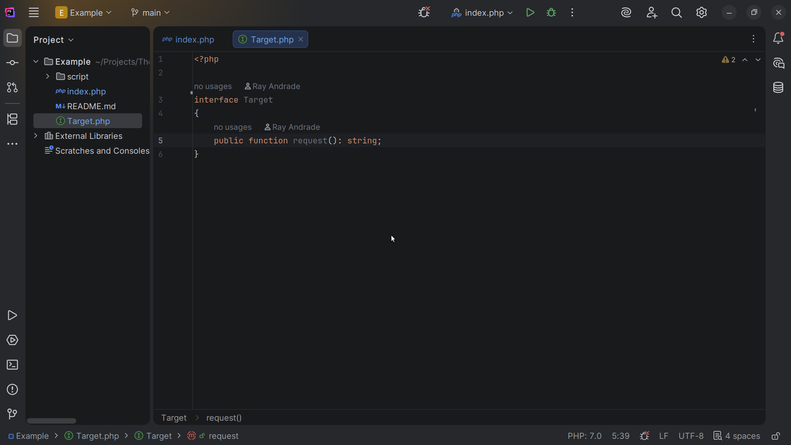
Notes:
We require a request() method that returns a string

Slide 7
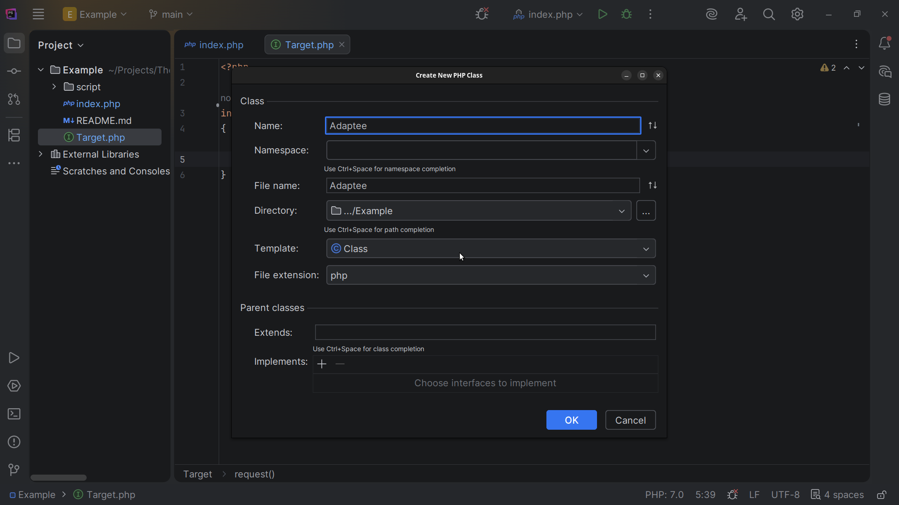
Notes:
Now let’s create the Adaptee class

Slide 8
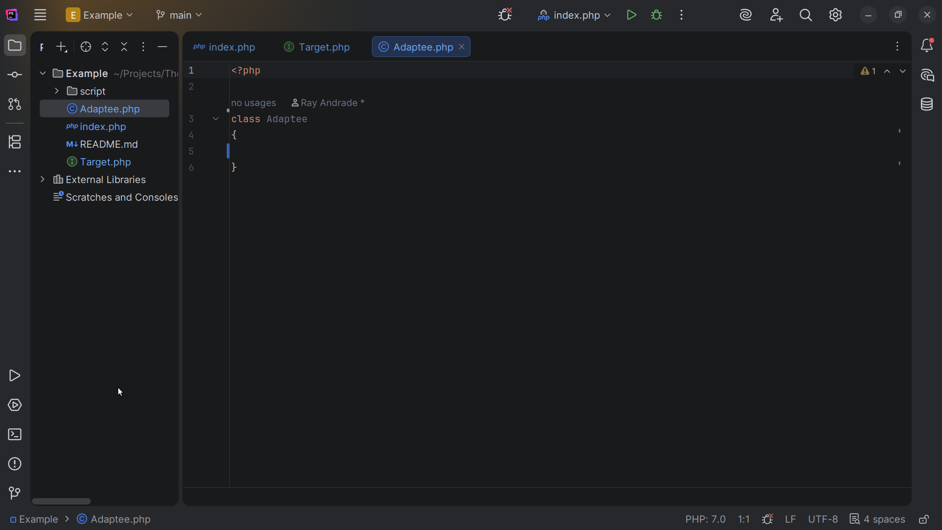
Notes:
This is the class that the client wishes to use, but its interface is incompatible with what the client is expecting.

Slide 9
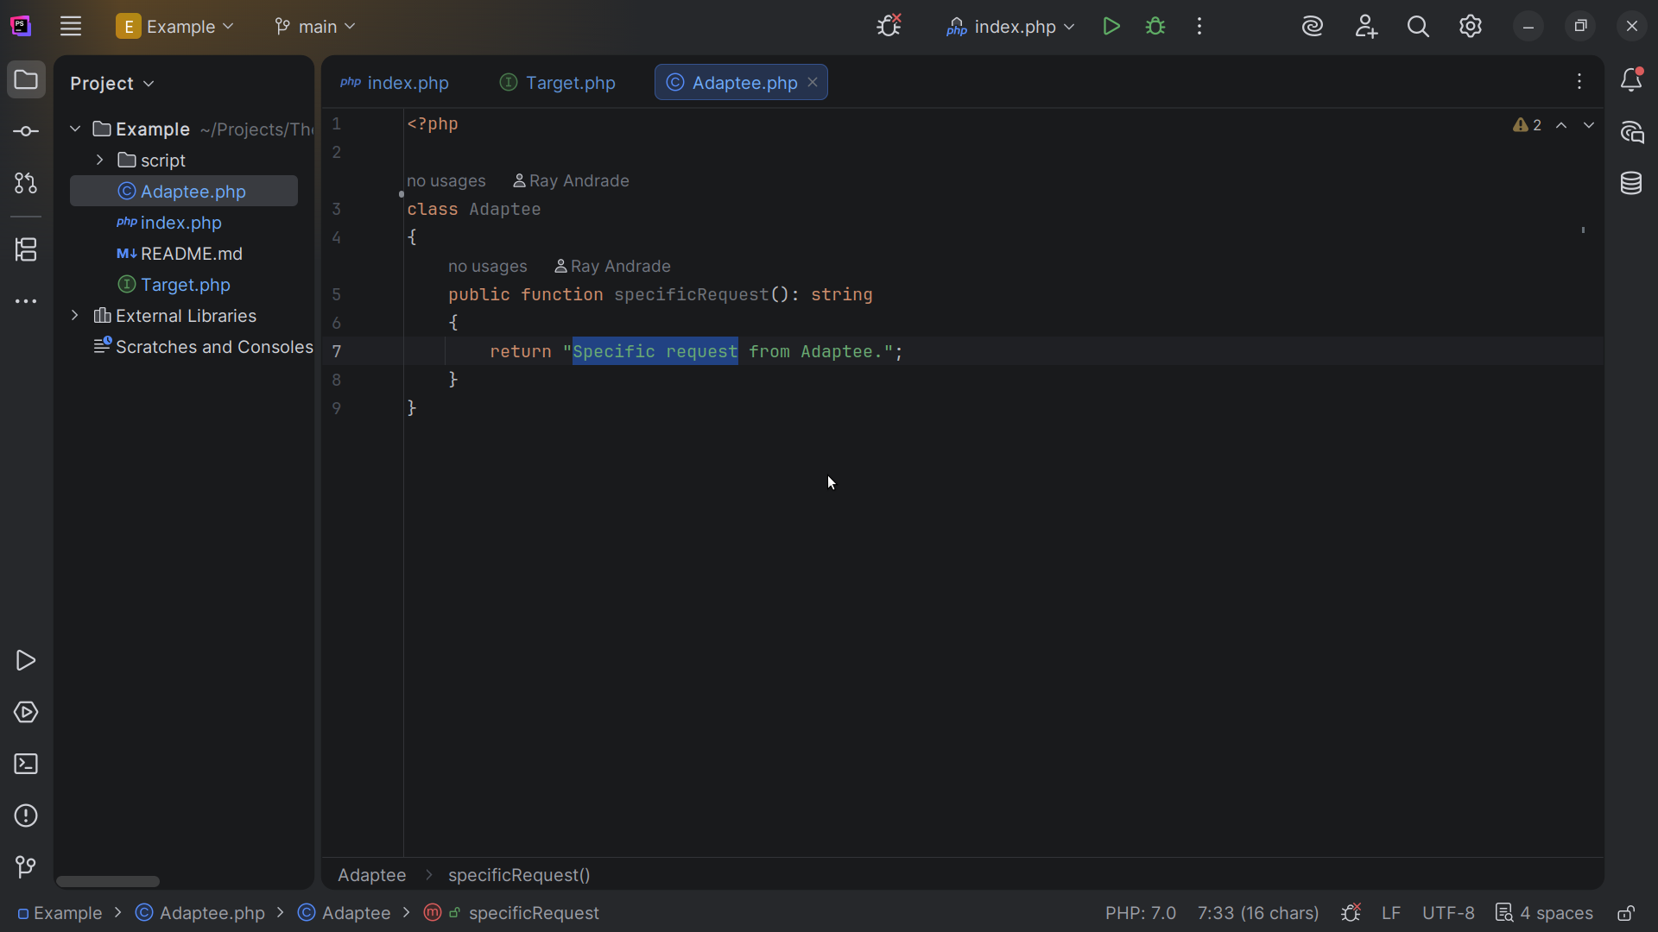
Notes:
From the Specific request method we return the string “Specific request from Adaptee”

Slide 10
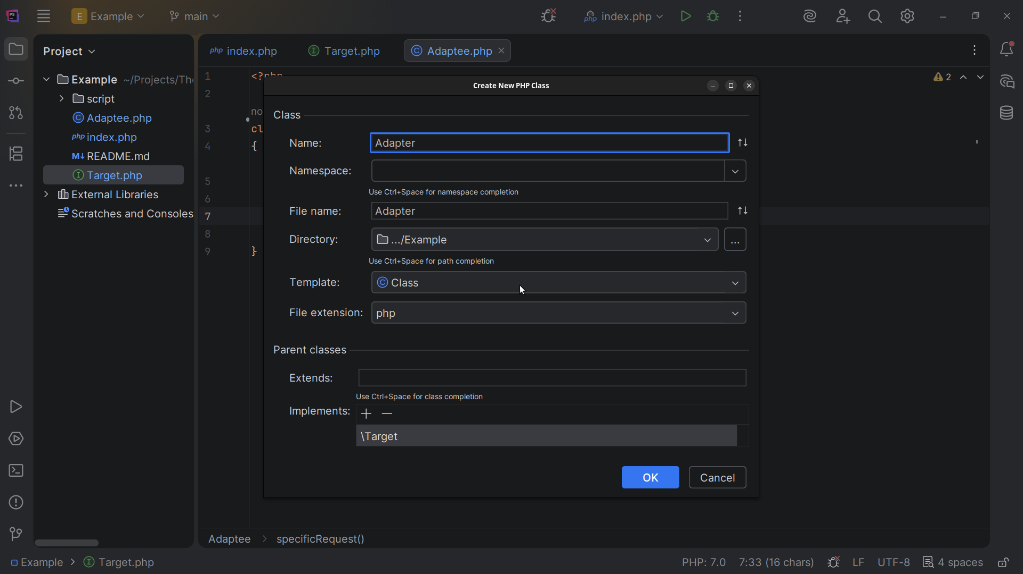
Notes:
Next we create the Adapter class, The Adapter class implements the Target interface

Slide 11
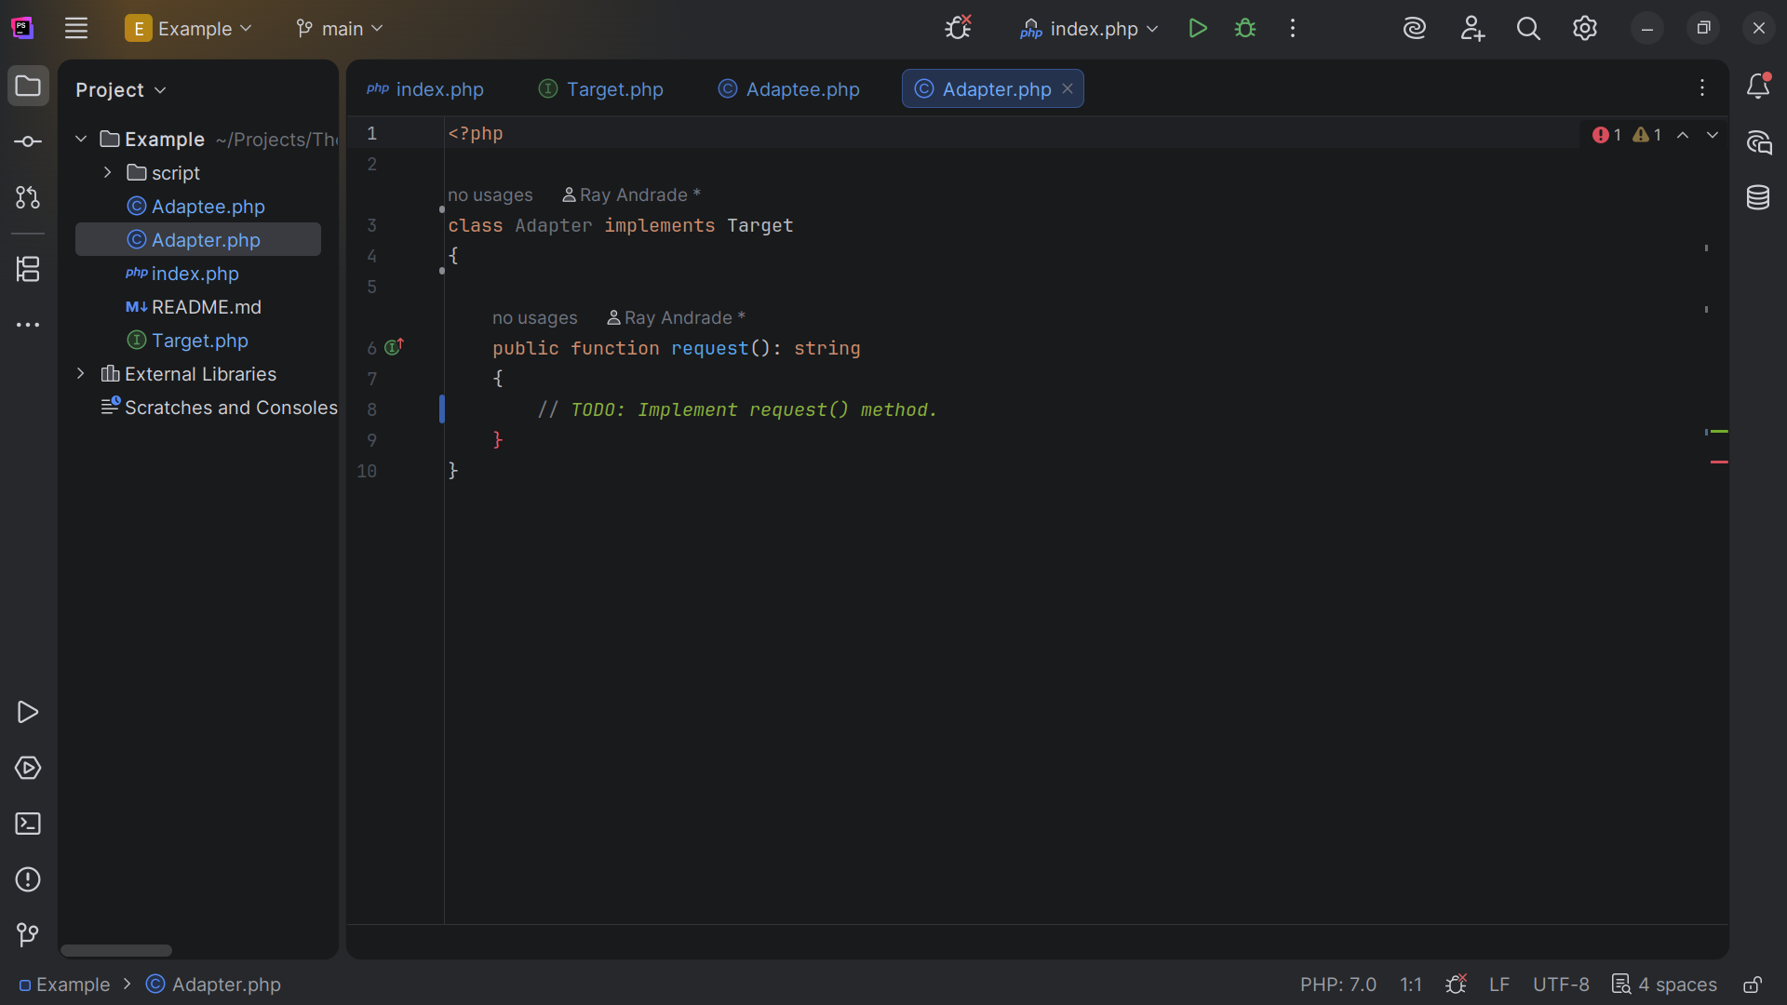
Notes:
The request function is Auto generated to return a string

Slide 12
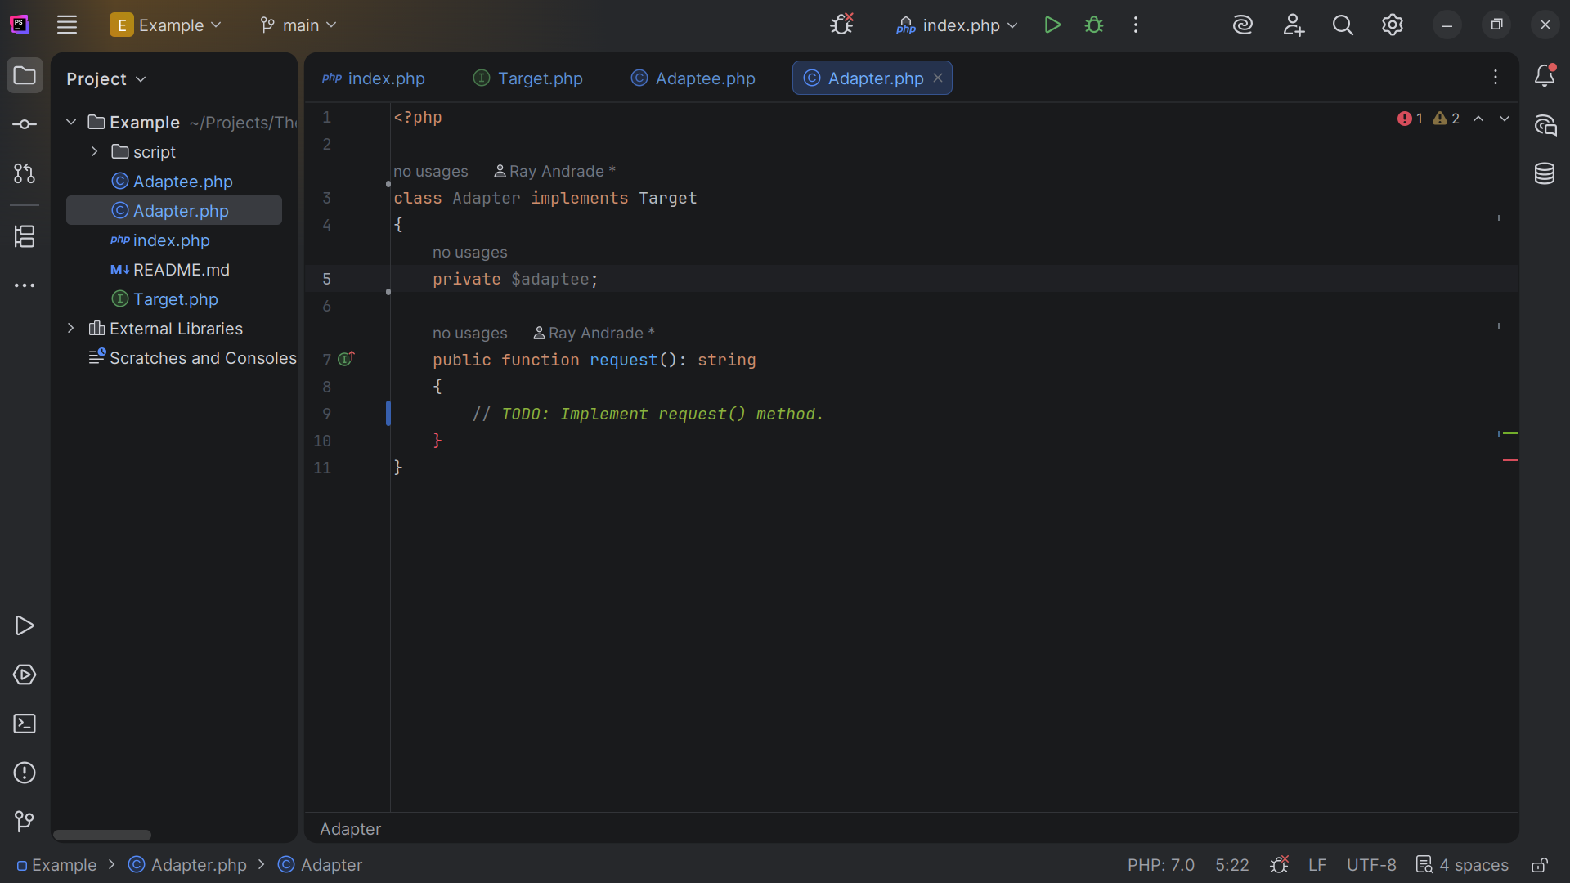
Notes:
But before we do that we declare a variable we label adapter

Slide 13
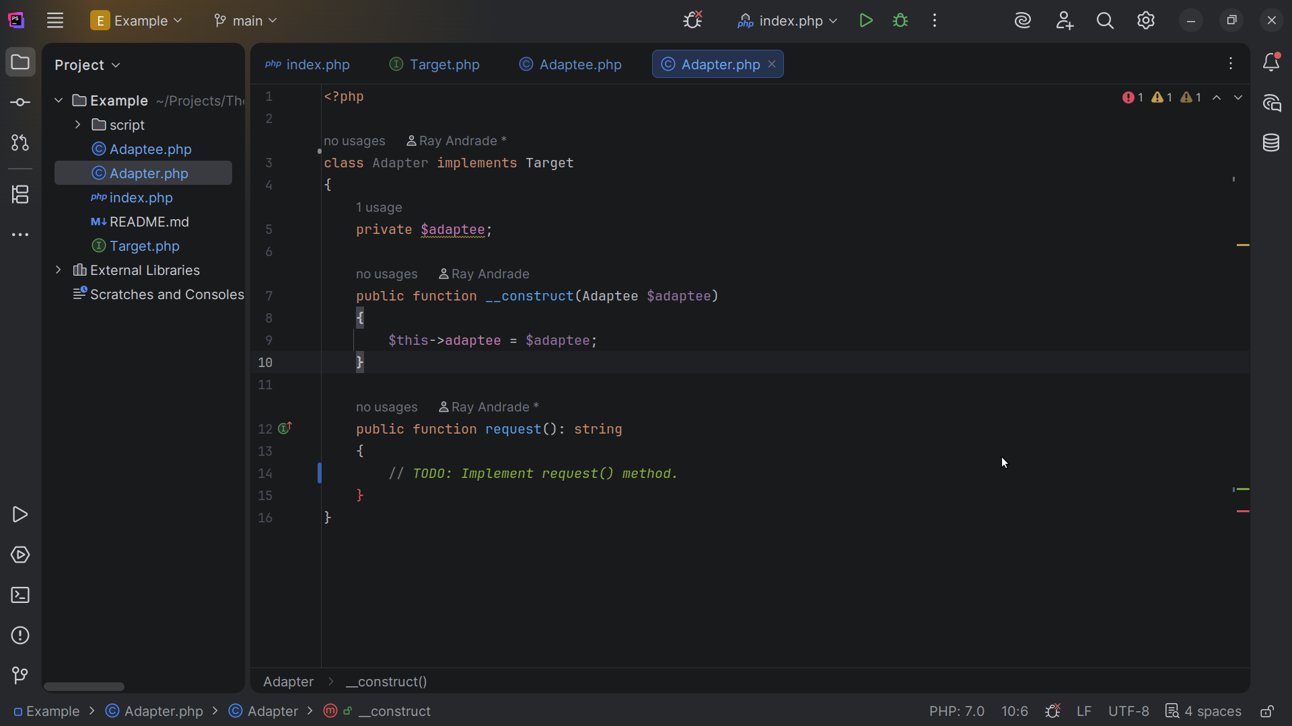
Notes:
We also have a constructor which sets this dot adapee to the adapter

Slide 14
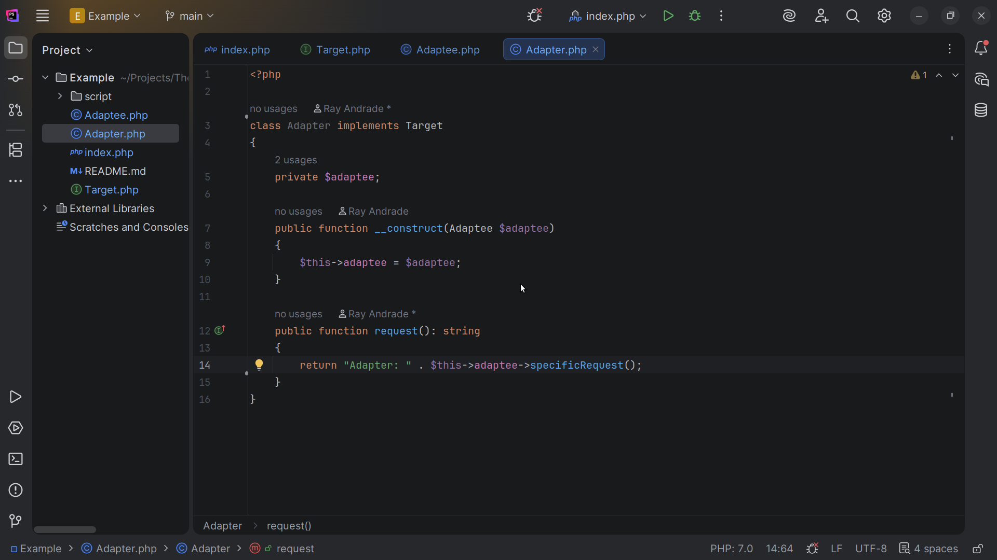
Notes:
And we return the string “Adapter specific request” with this adaptee specific request

Slide 15
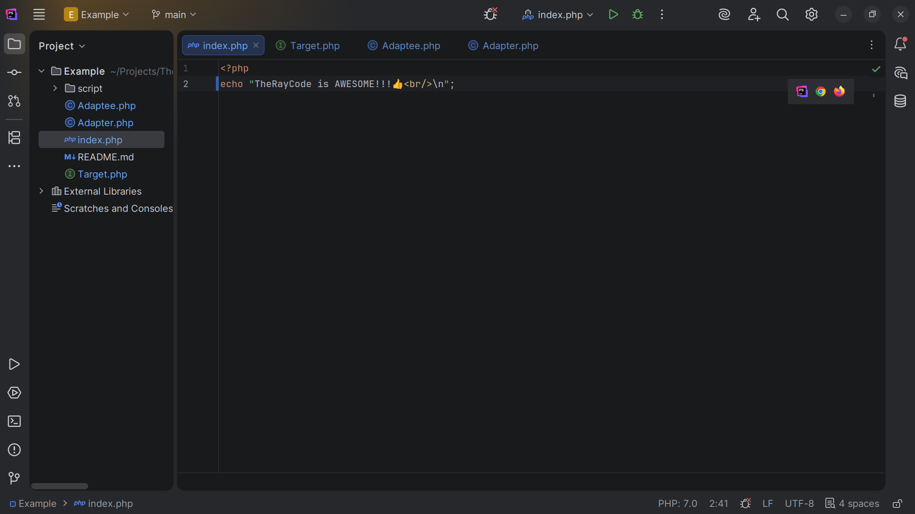
Notes:
Now let’s go to the index for our demo

Slide 16
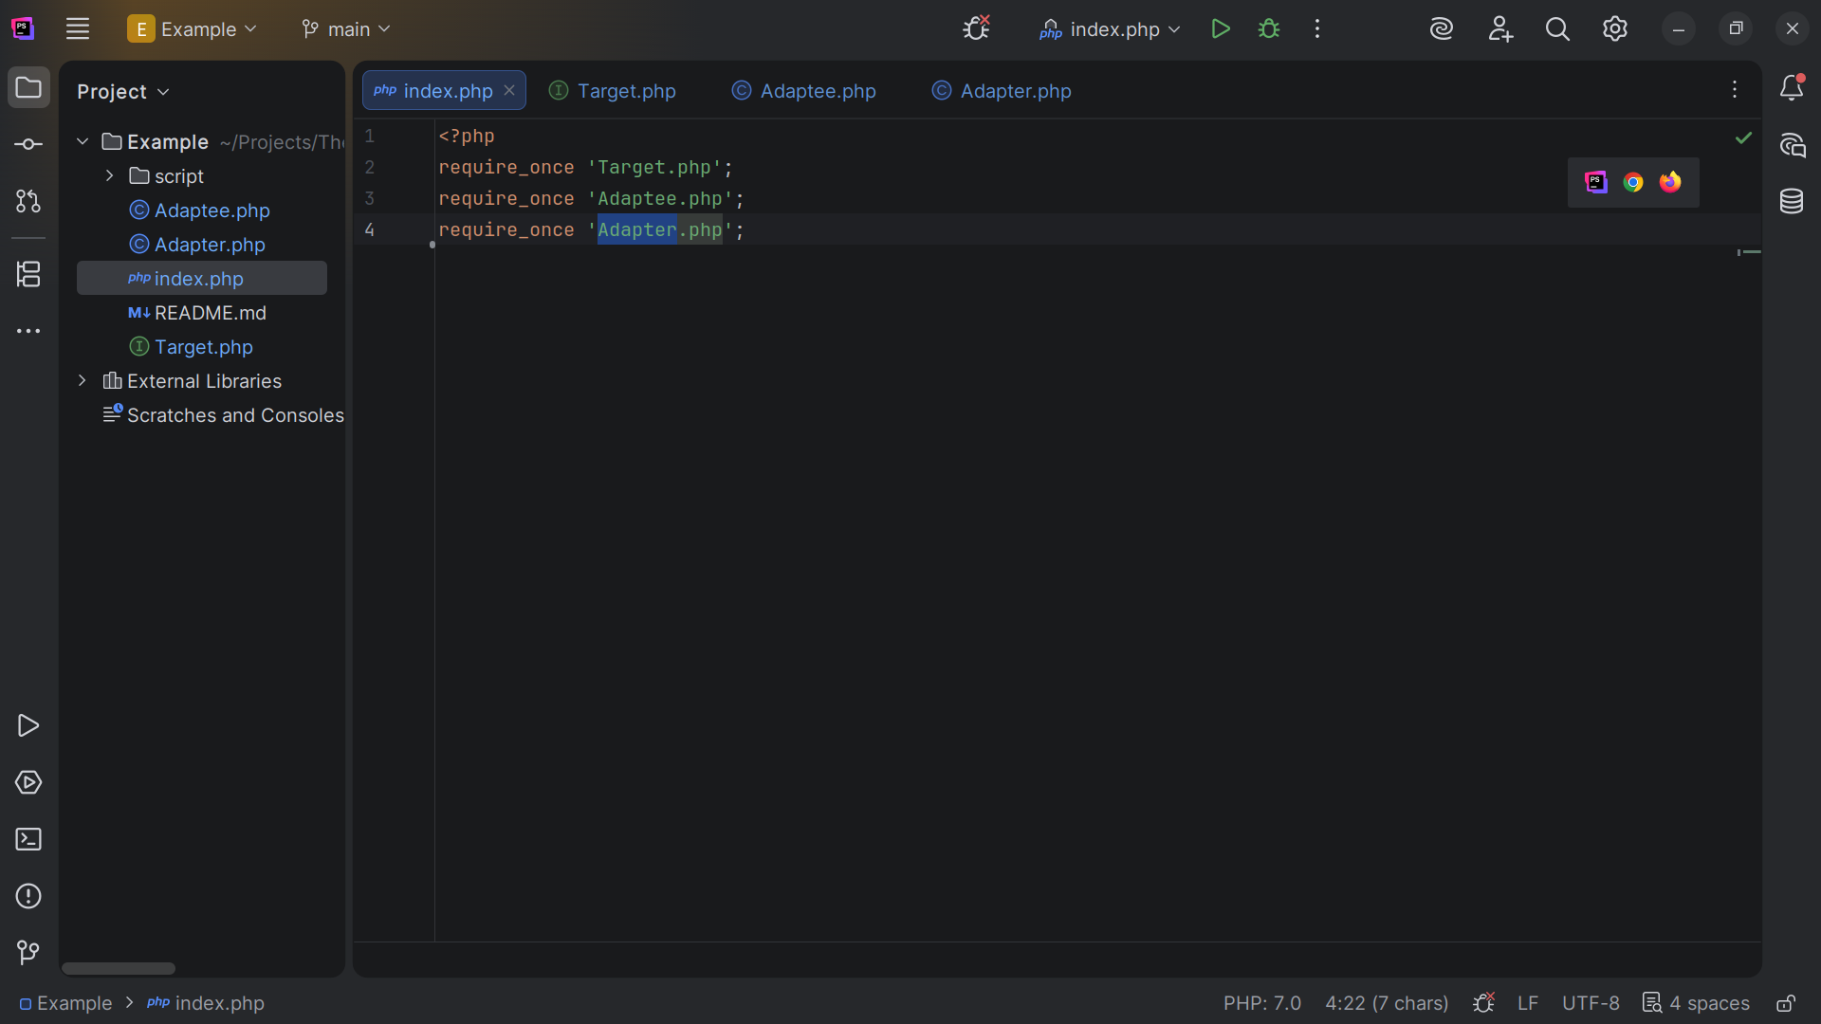
Notes:
At the top we include the files we just created Target, Adaptee and Adapter

Slide 17
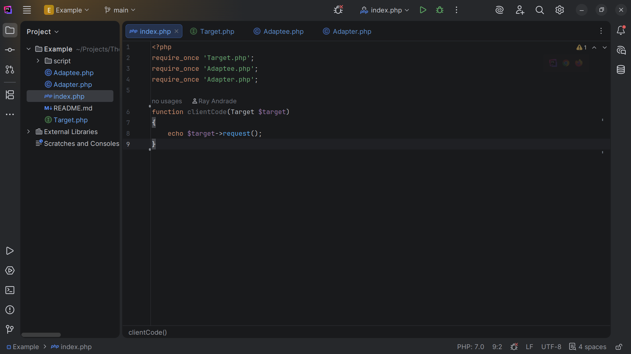
Notes:
We create a client Code method that takes a target

Slide 18
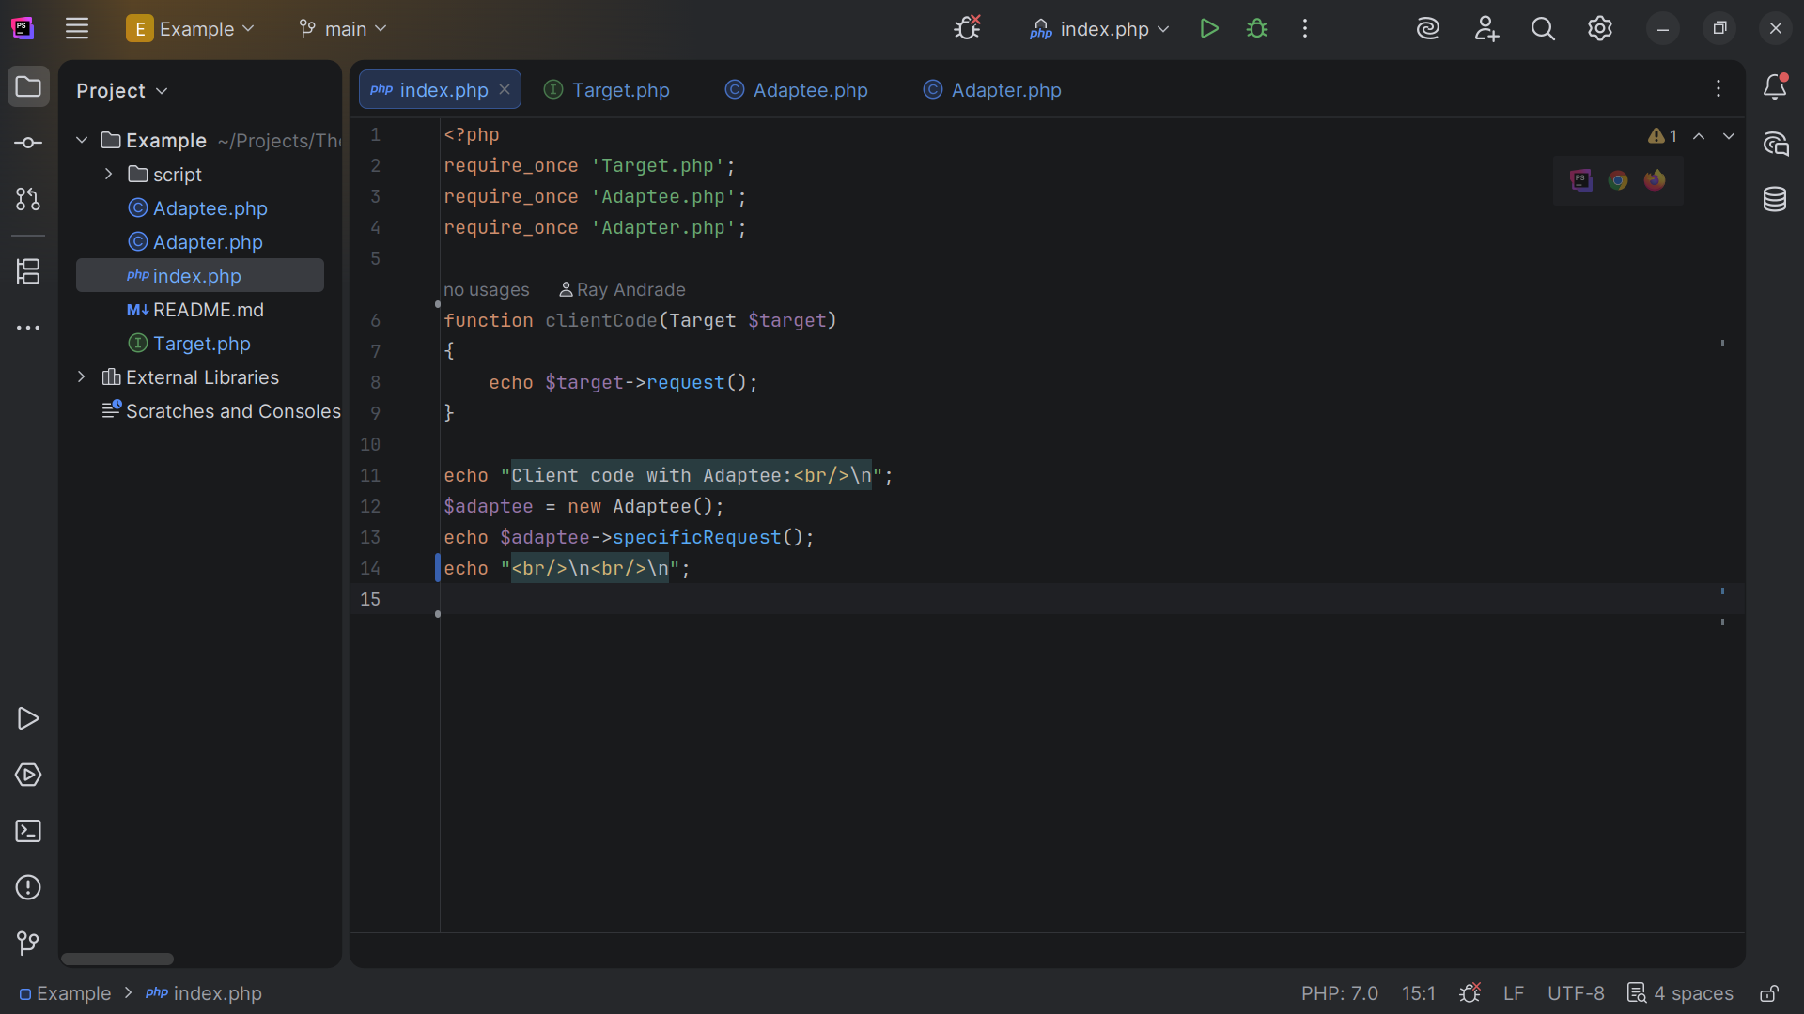
Notes:
We get a new adaptee and echo the specific request

Slide 19
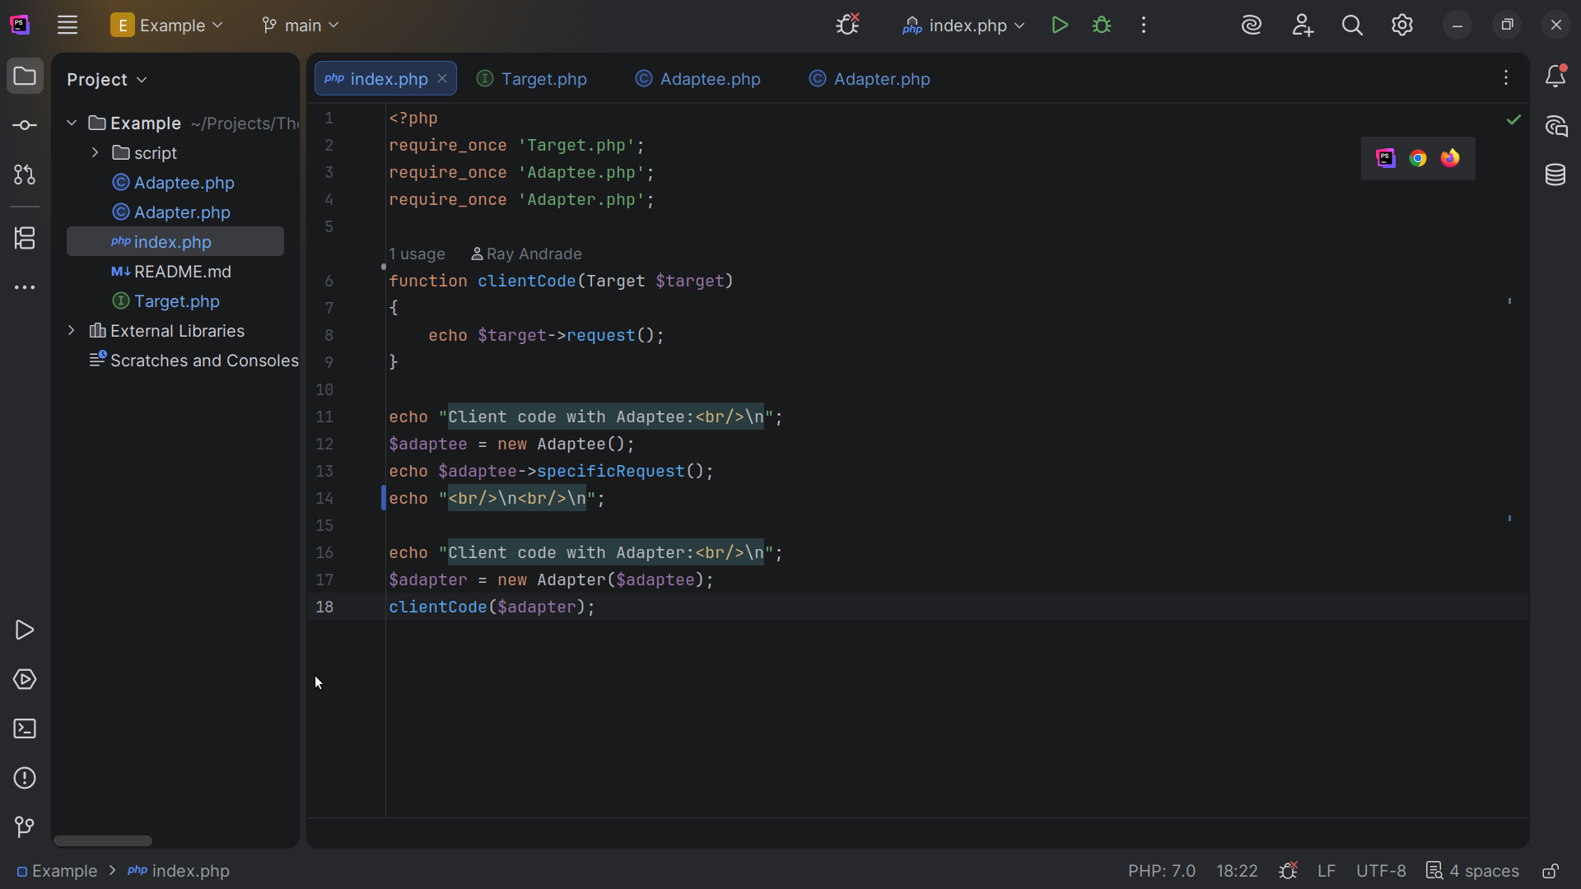
Notes:
We do the client code with the Adapter and we get

Slide 20
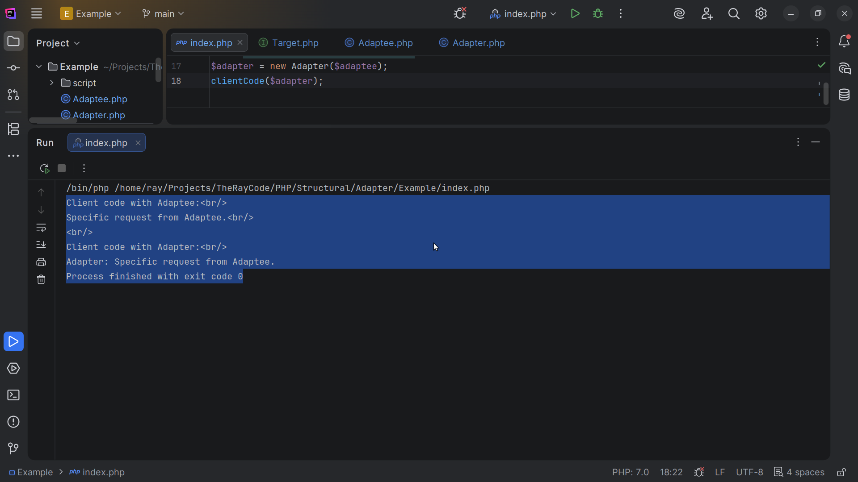
Notes:
Client coed with Adaptee
Specific Request from Adaptee
Client code with Adapter
Adapter Specific Request from Adaptee
We can also view this in the Browser

Slide 21
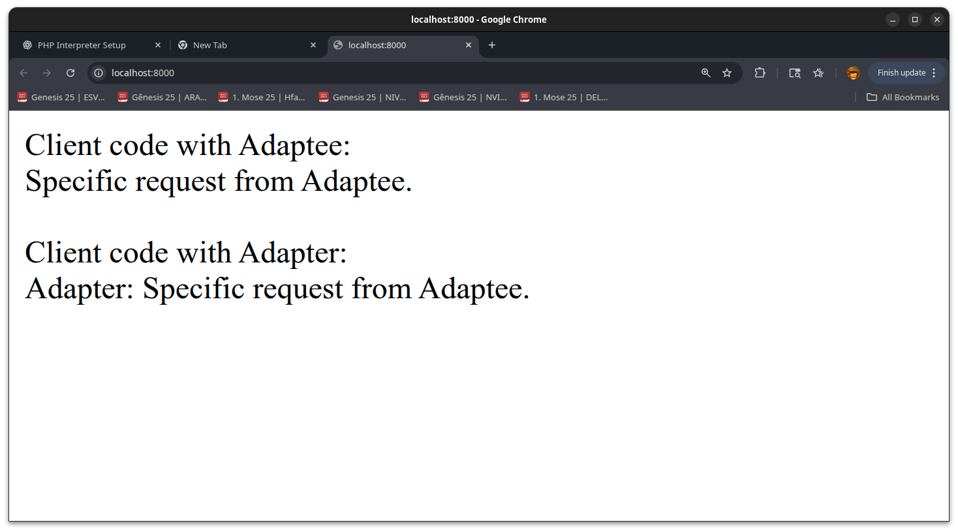
Notes:
Again we have : Client coed with Adaptee
Specific Request from Adaptee
Client code with Adapter
Adapter Specific Request from Adaptee .. without all the br tags
My name is Ray Always code with a smile

