Slide 1
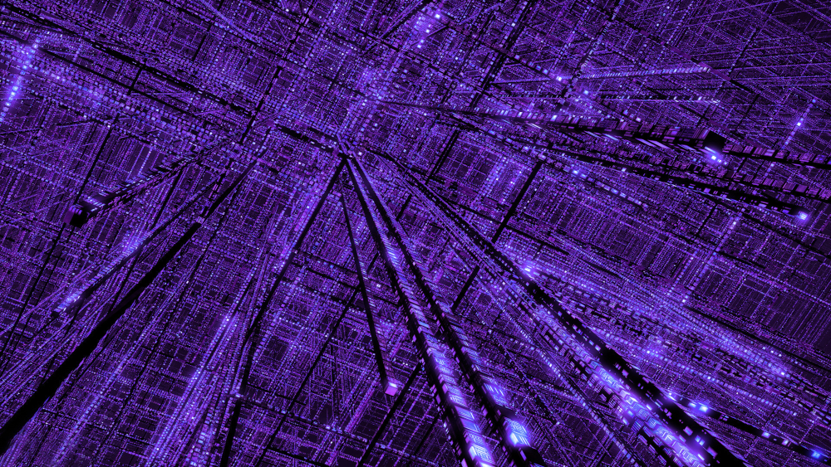
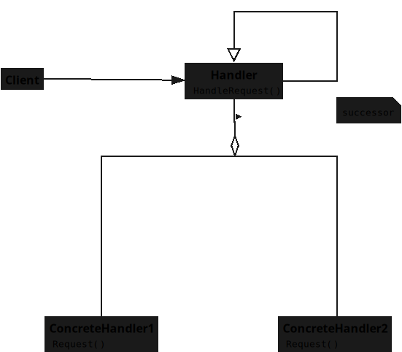

Slide 2
Notes:
Here is **Behavioral Pattern — Chain of Responsibility** rewritten for **PHP students**, following your exact rules:

Slide 3
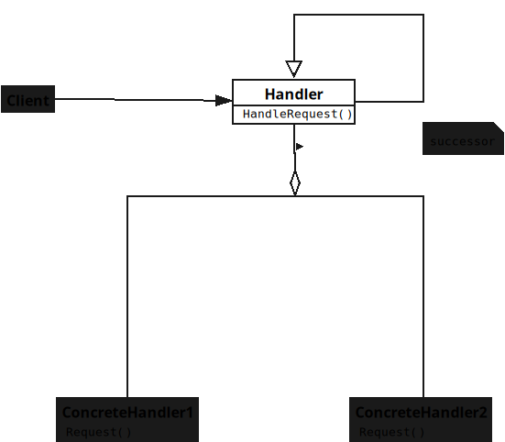
Notes:
## **Handler**
* Defines the interface for handling requests.

Slide 4
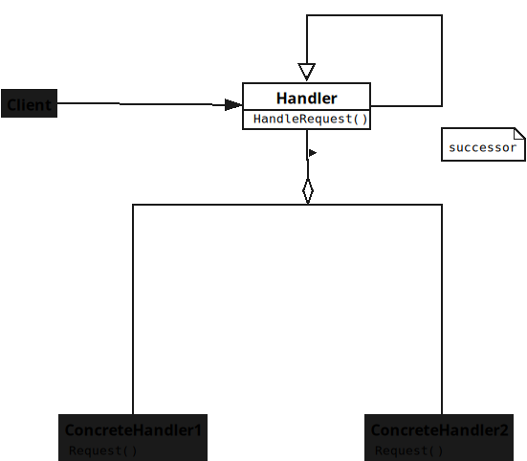
Notes:
* Stores a reference to the next Handler.

Slide 5
Notes:
* Forwards requests if it cannot handle them.

Slide 6
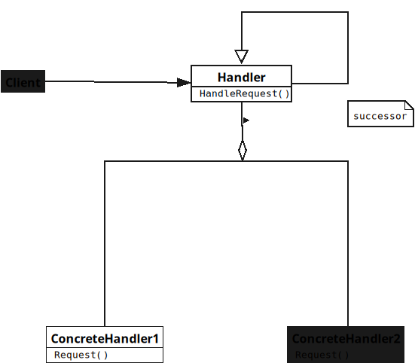
Notes:
## **ConcreteHandler**
* Handles requests it is responsible for.

Slide 7
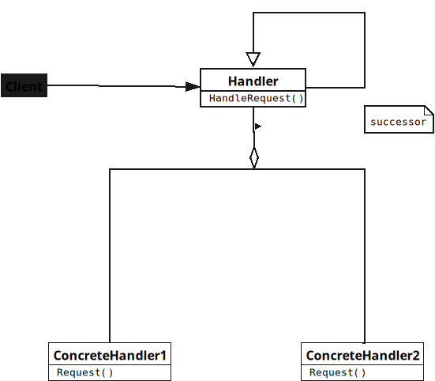
Notes:
* Decides whether to process or forward.

Slide 8
Notes:
* Passes unhandled requests to successor.

Slide 9
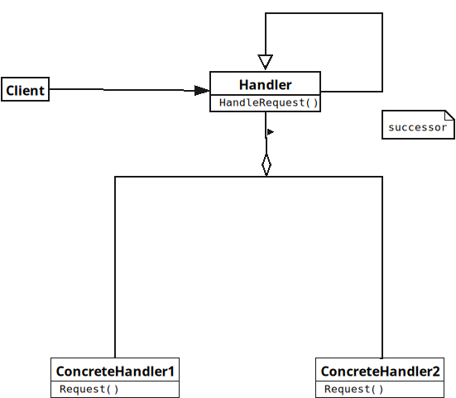

Slide 10
Notes:
## **Client**
* Sends requests to the first Handler.
* Does not know which Handler processes it.
* Relies on the chain for handling.

