Slide 1
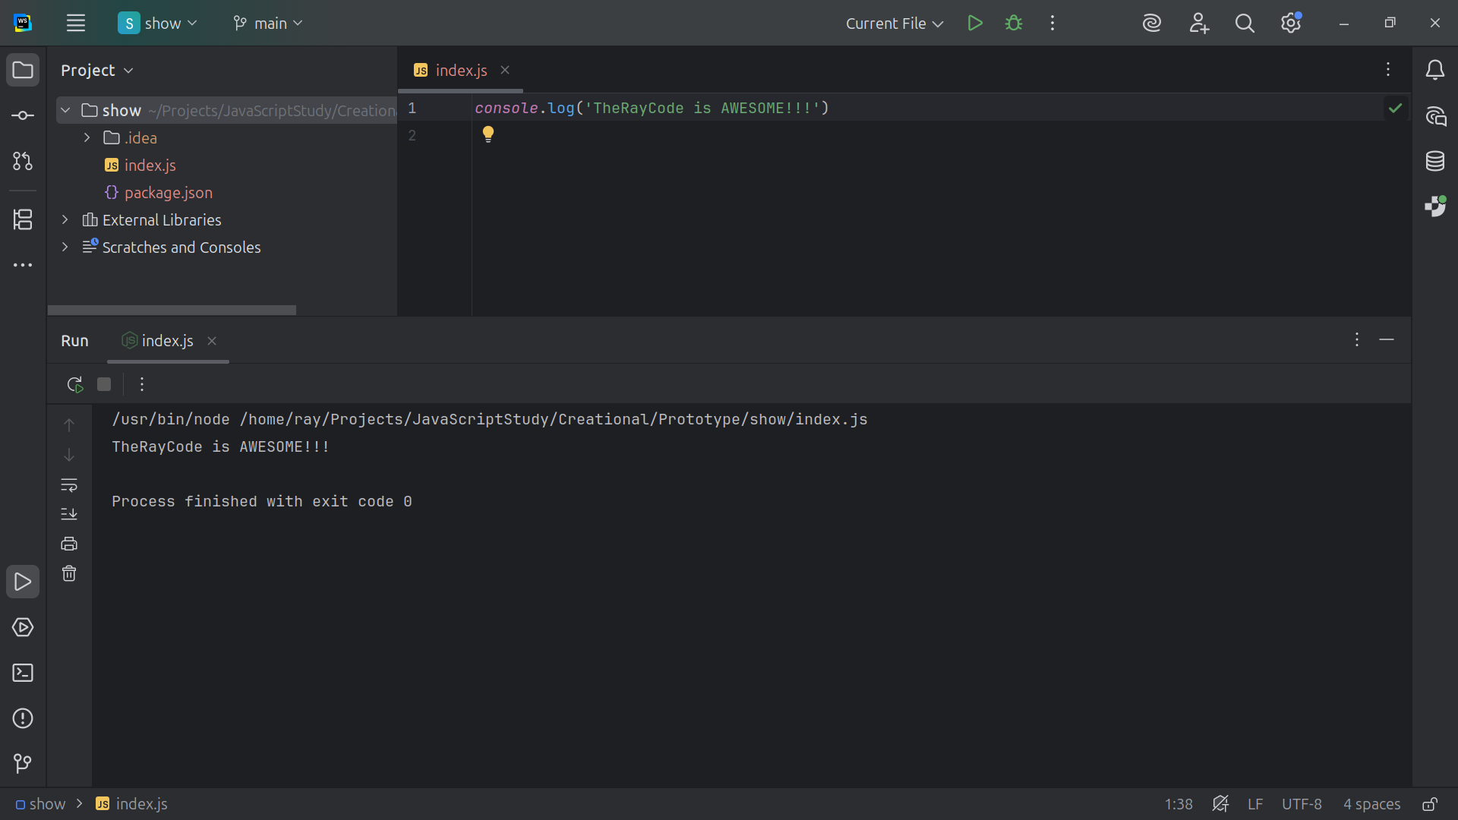
Notes:
Hello I’m Ray from TheRayCode

Slide 2
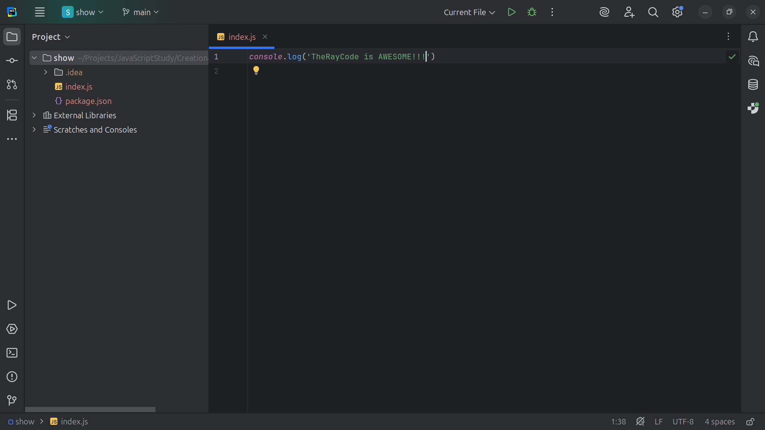
Notes:
In this video I would like to give a demonstration of Prototype design pattern in JavaScript. The Prototype design pattern is a Creational Design patter as noted in the book Design Patterns Element of Reusable Code by the Gang of Four

Slide 3
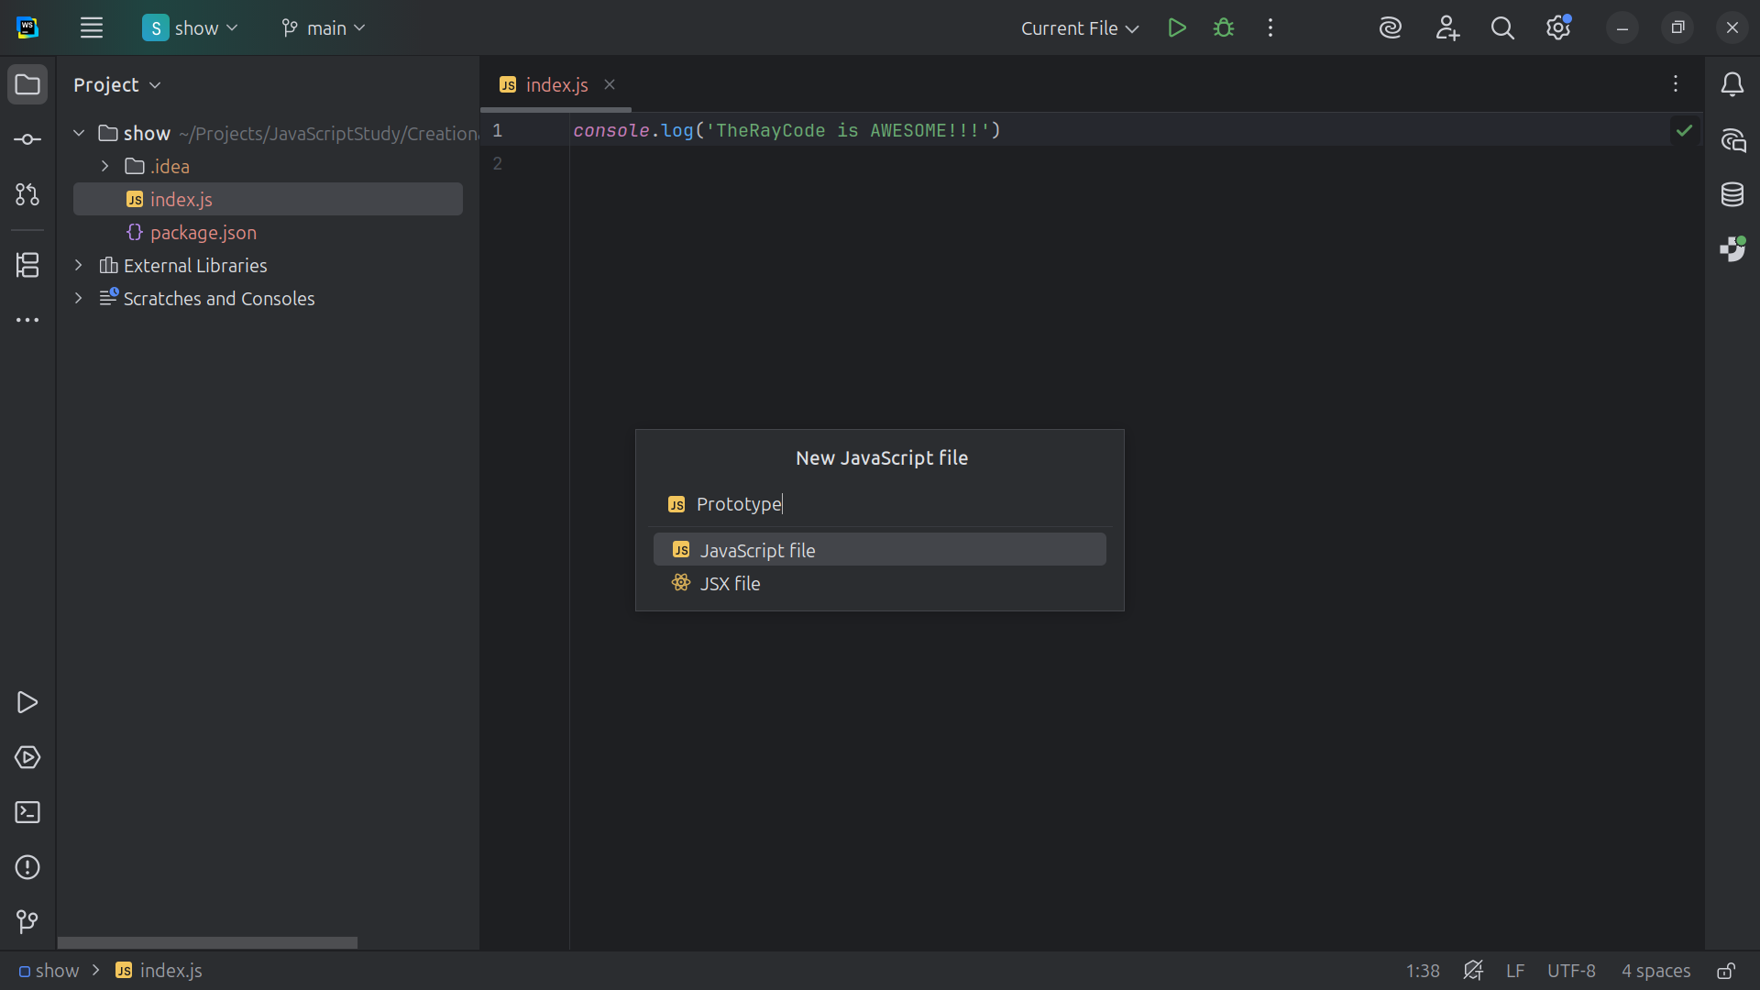
Notes:
Let’s start with a JavaScript class called Prototype

Slide 4
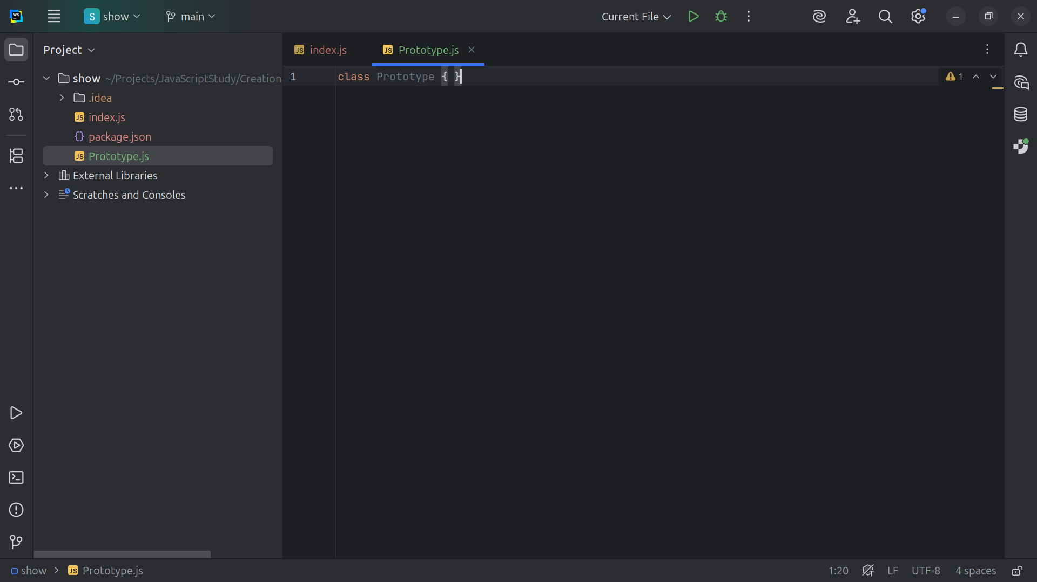
Notes:
The Prototype class will Define the interface for cloning itself

Slide 5
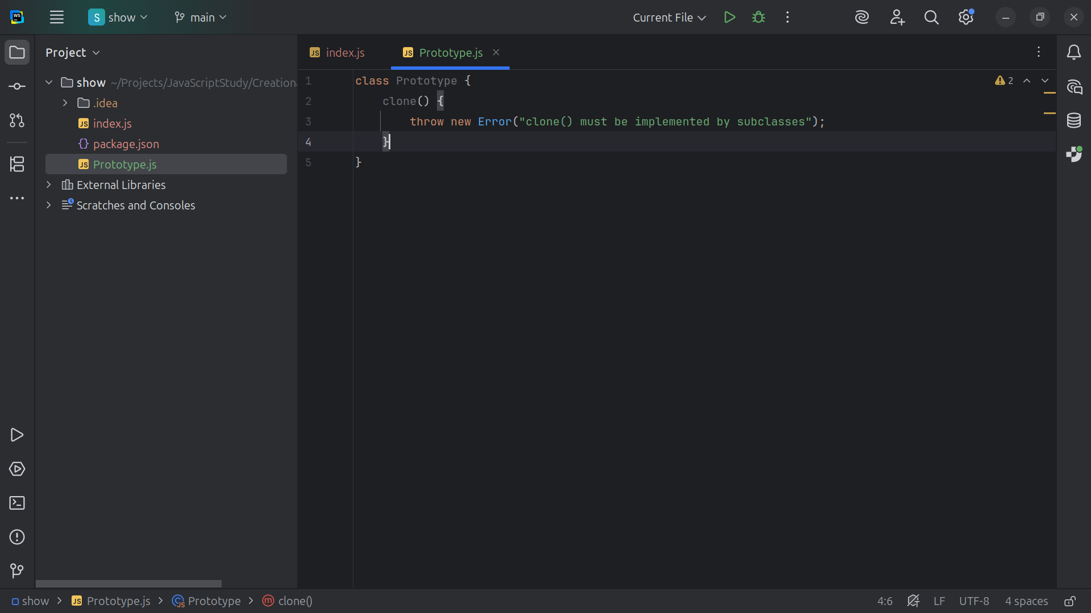
Notes:
So we use the clone method and it must be implemented by subclasses

Slide 6
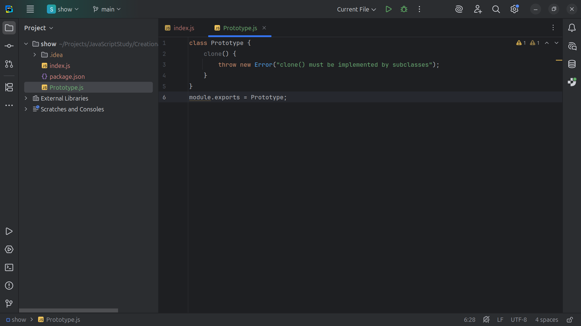
Notes:
And we export this Module for use as Prototype

Slide 7
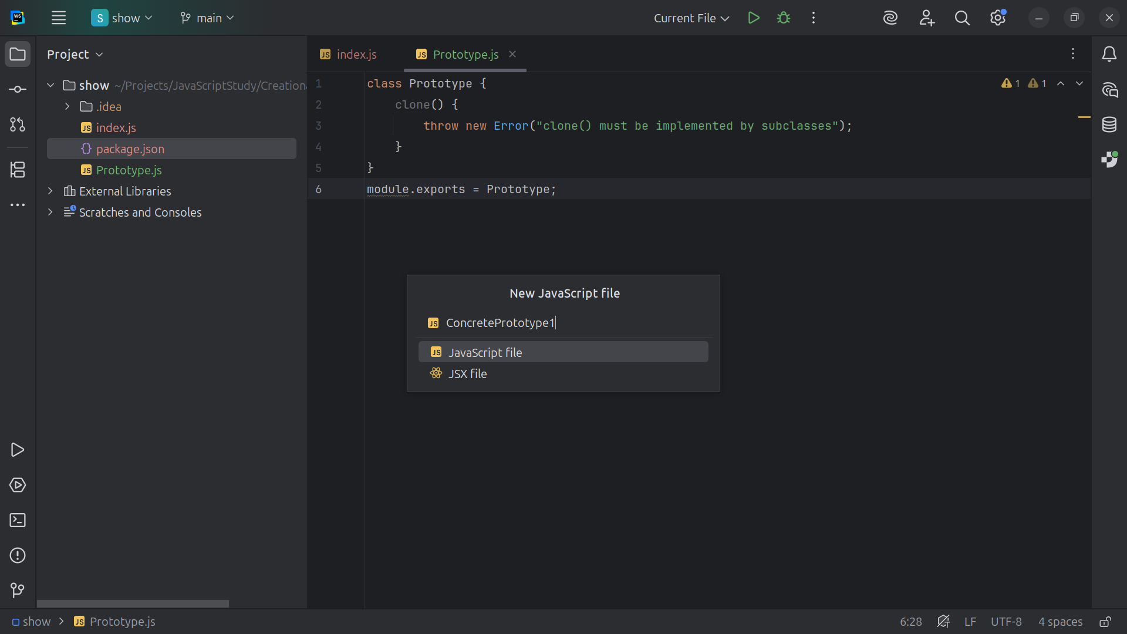
Notes:
Next we create a class called Concrete Prototype 1

Slide 8
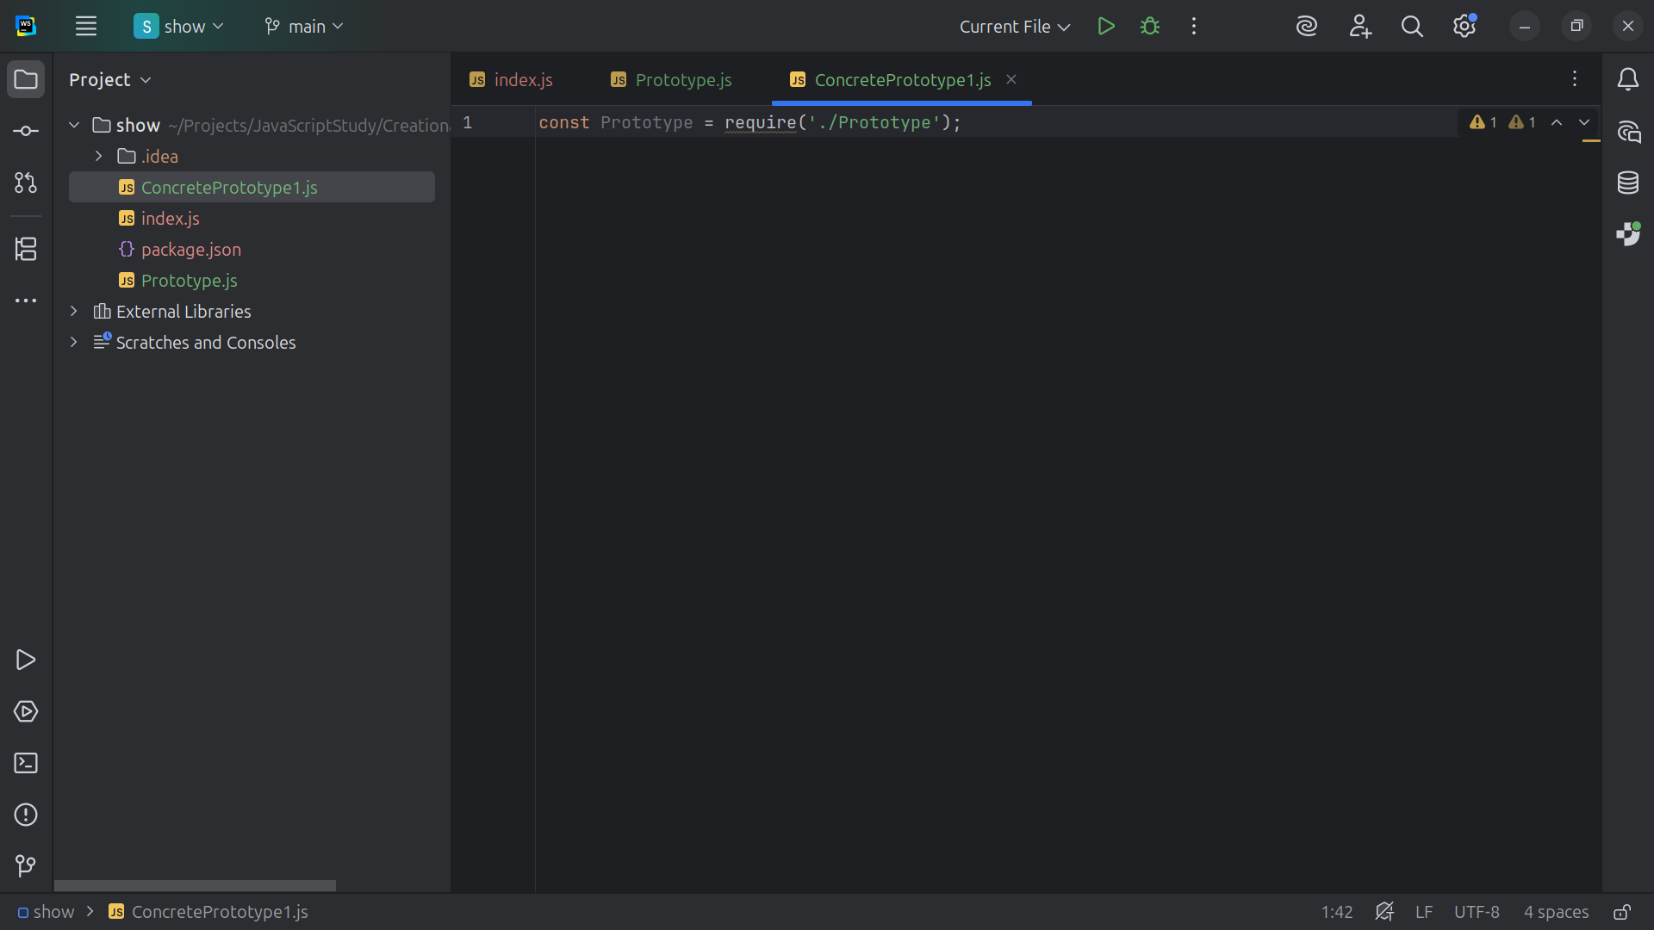

Slide 9
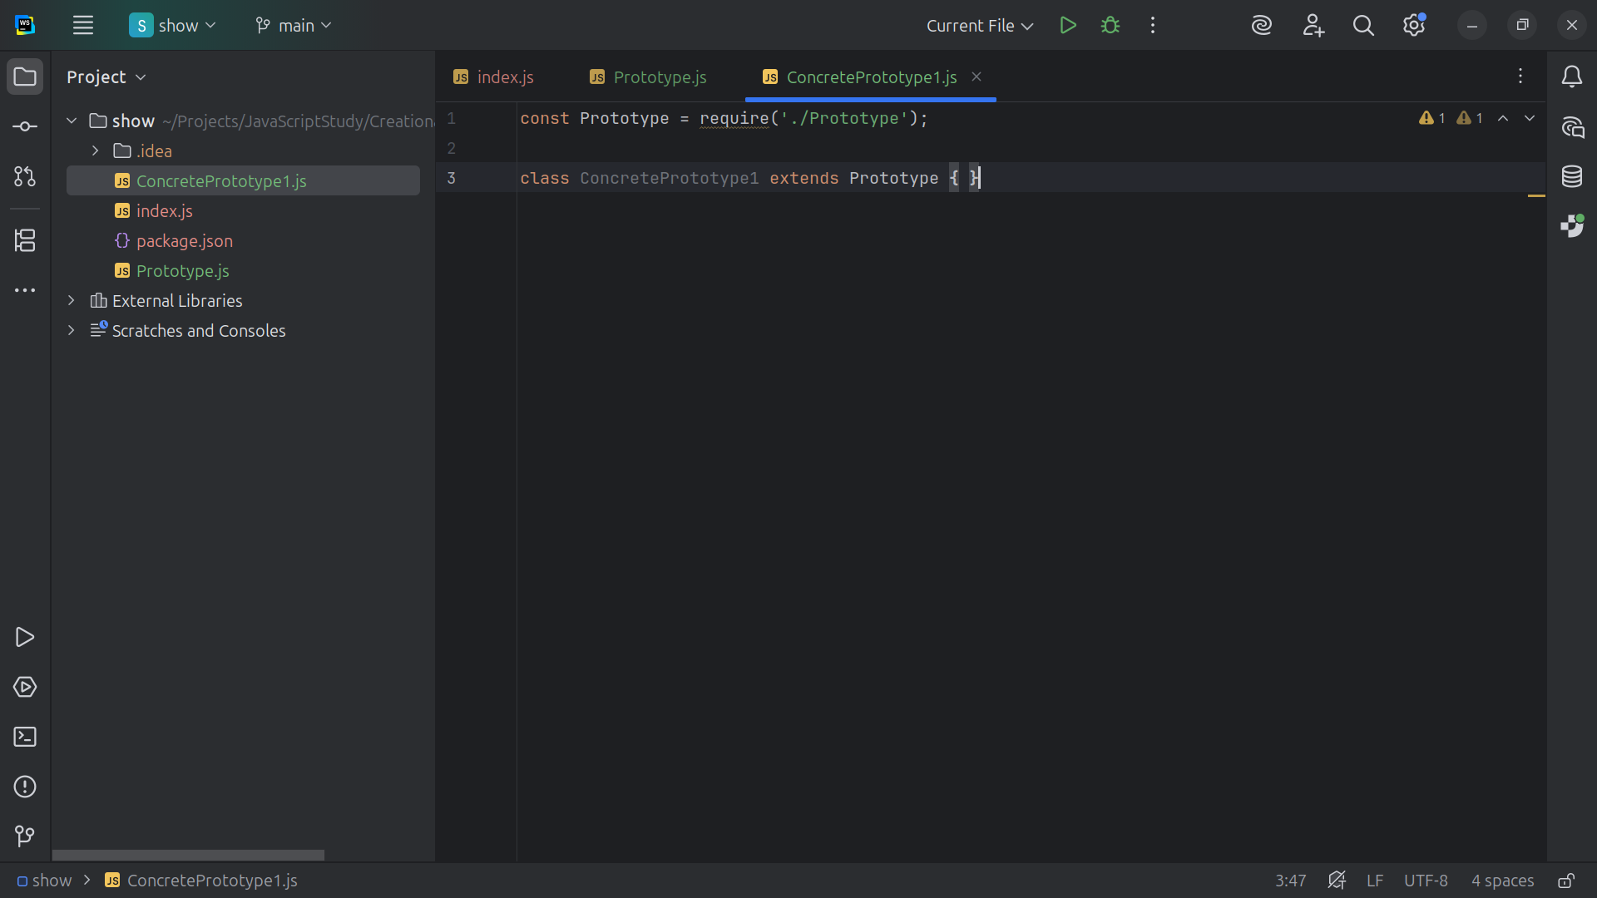
Notes:
Concrete Prototype 1 is a concrete implementation of Prototype that supports cloning so it is extended with Prototype

Slide 10
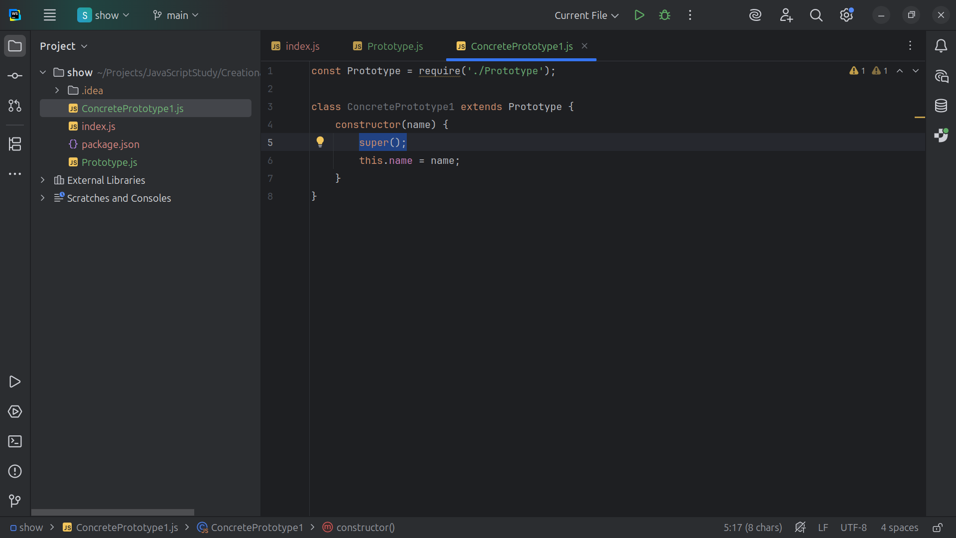
Notes:
Every class that wants to be copyable (cloneable) must have a clone() method, super is a call the parent class and the name property is stored

Slide 11
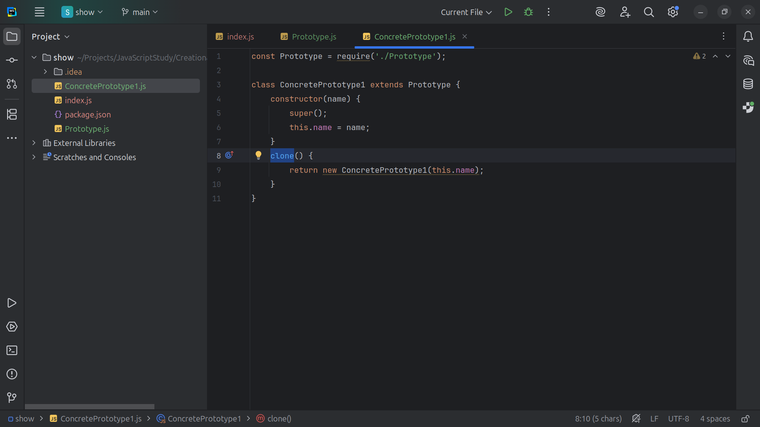
Notes:
The clone method returns a new object with the same name

Slide 12
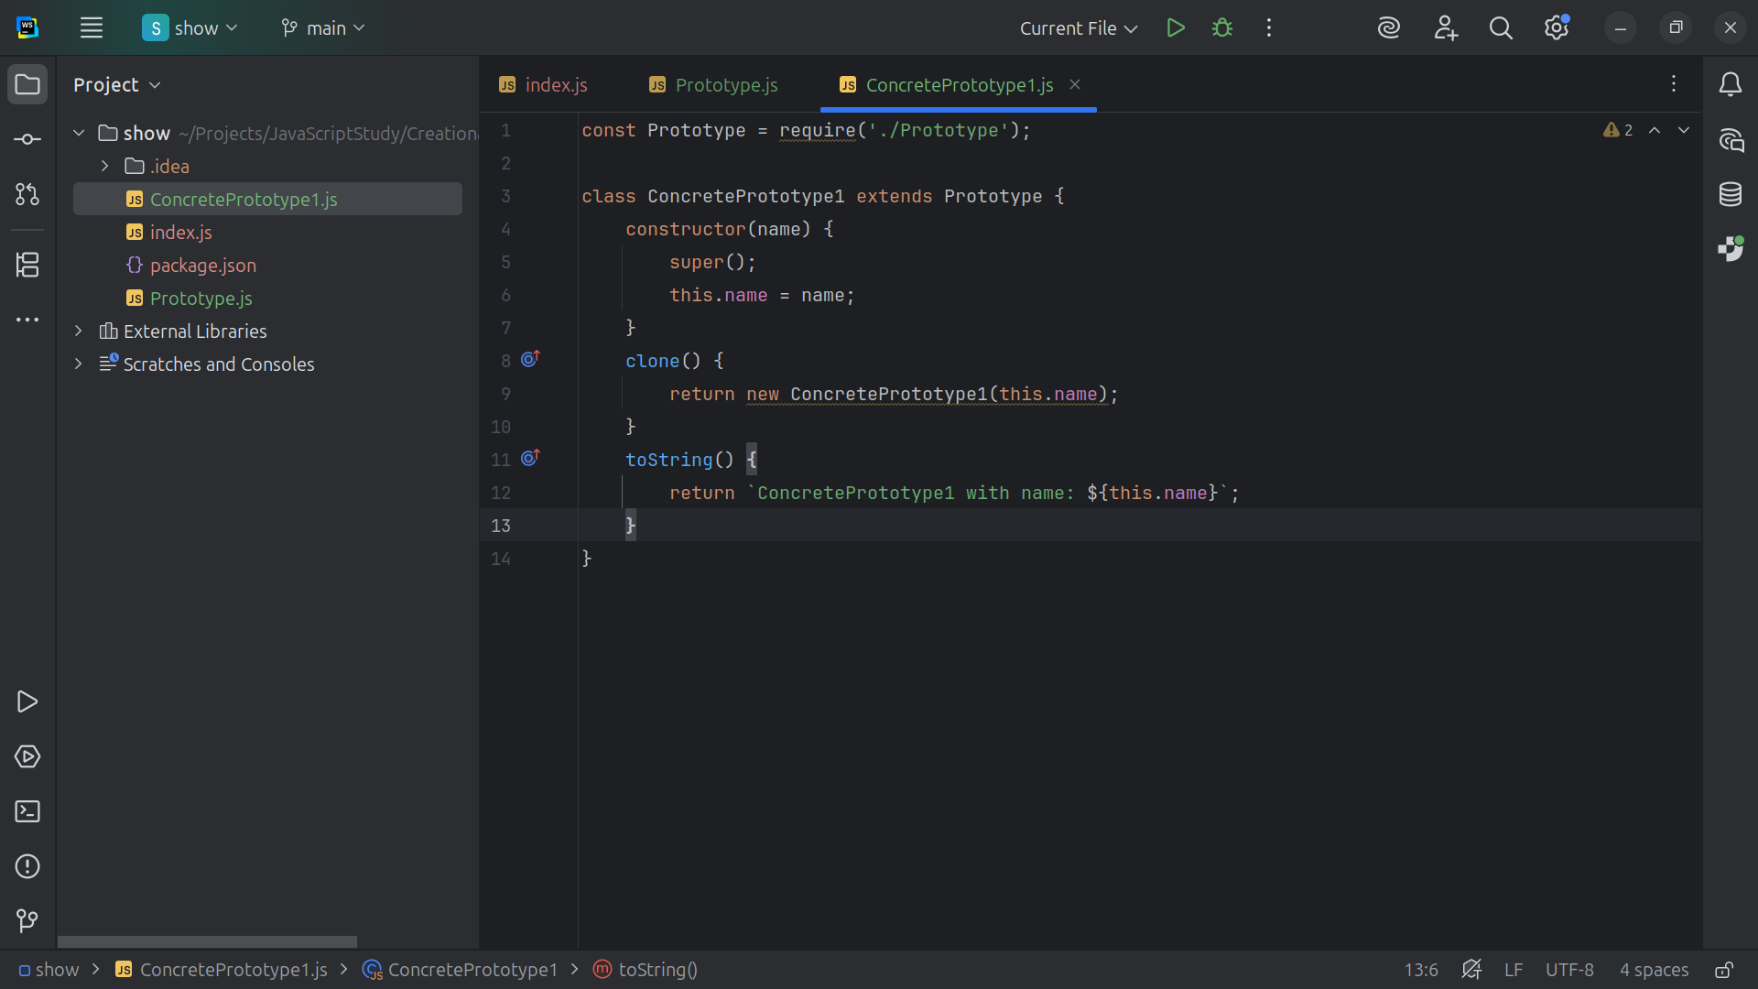
Notes:
And we return to the screen return a new object with the same name that we used

Slide 13
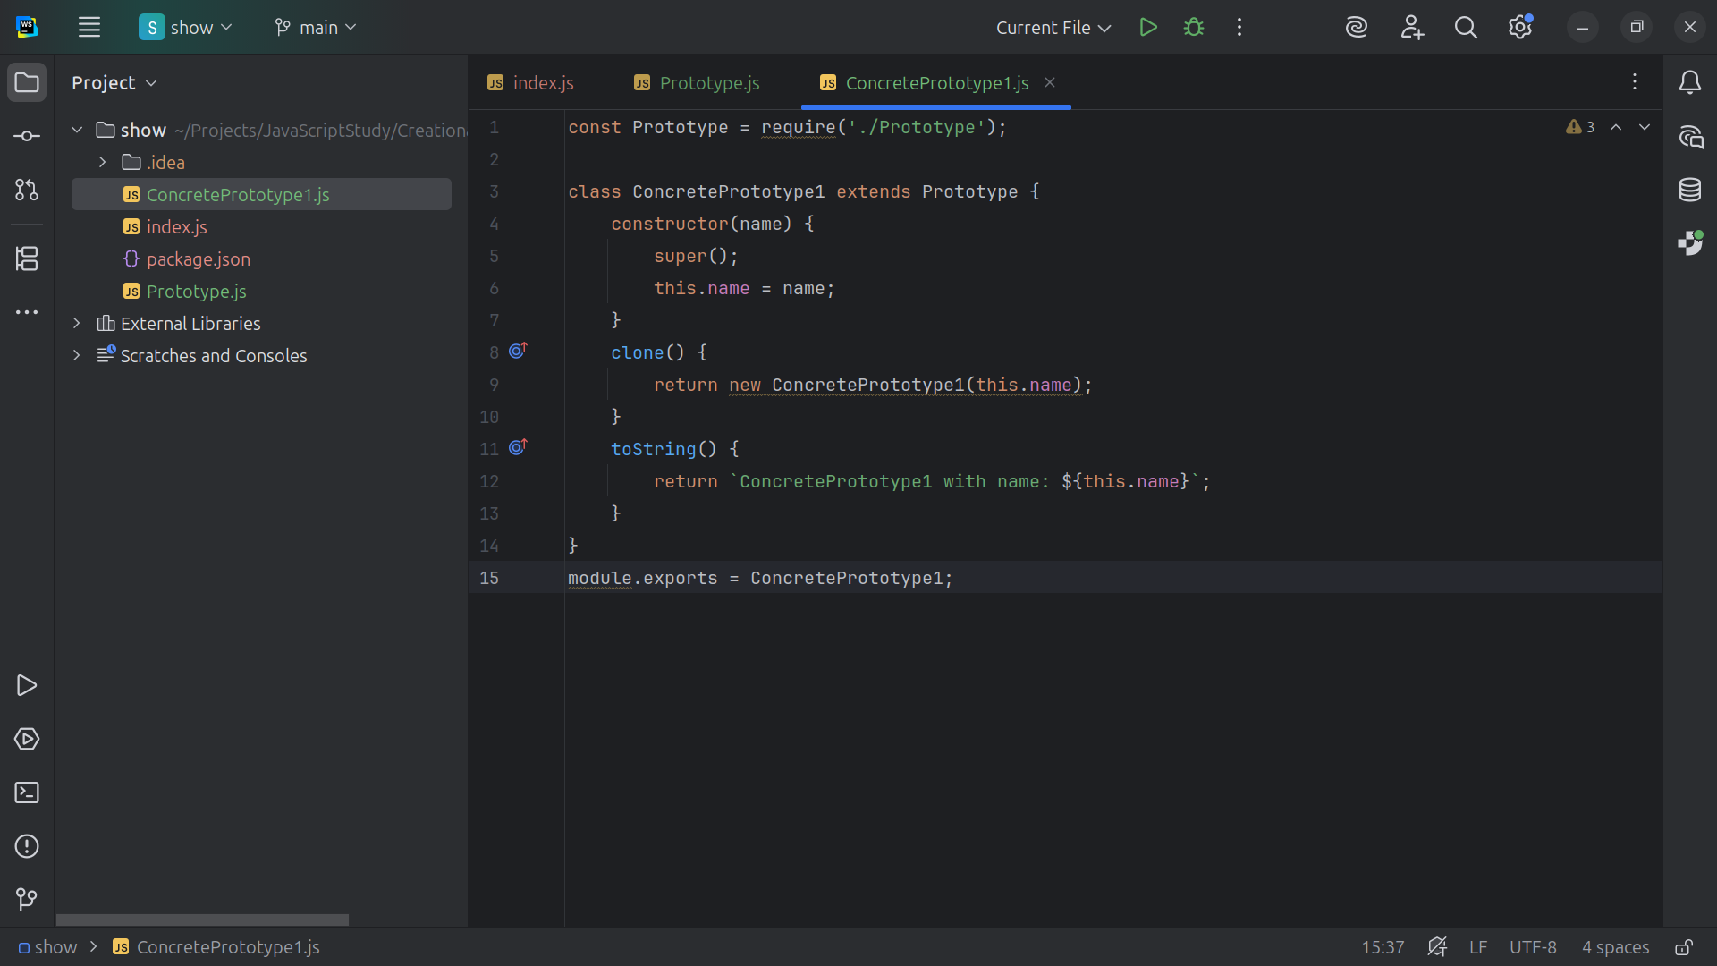
Notes:
So let’s export this module for use as Concrete Prototype 1

Slide 14
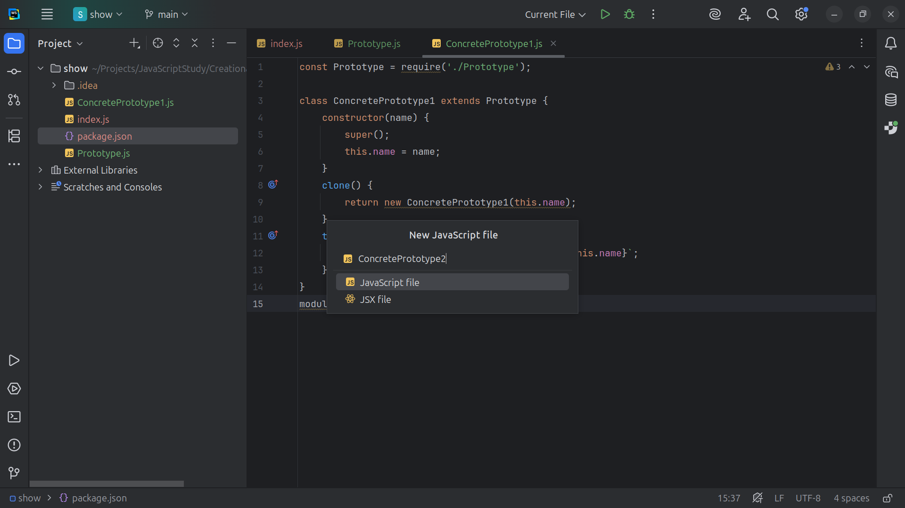
Notes:
Now let’s create another Concrete Prototype this thime we call it Concrete Prototype 2

Slide 15
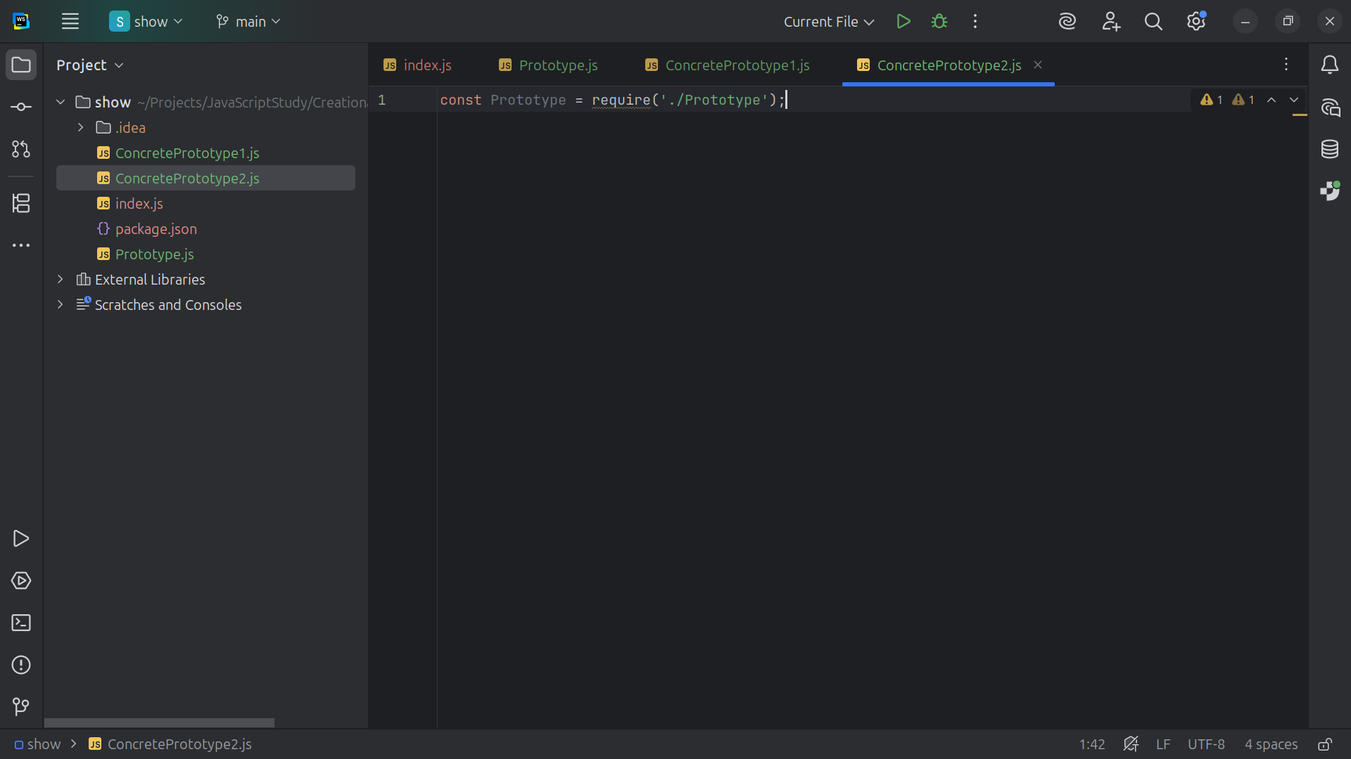
Notes:
At the top we include the Prototype dot js file

Slide 16
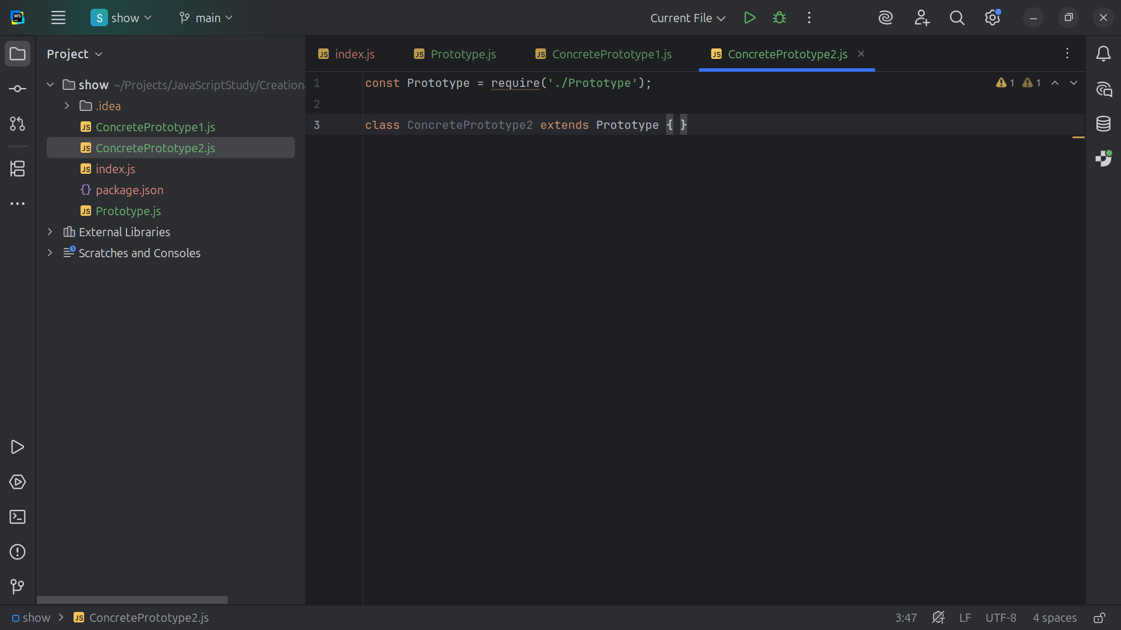
Notes:
We extend Concrete Prototype 2 with the Prototype class this will be Another concrete implementation of Prototype

Slide 17
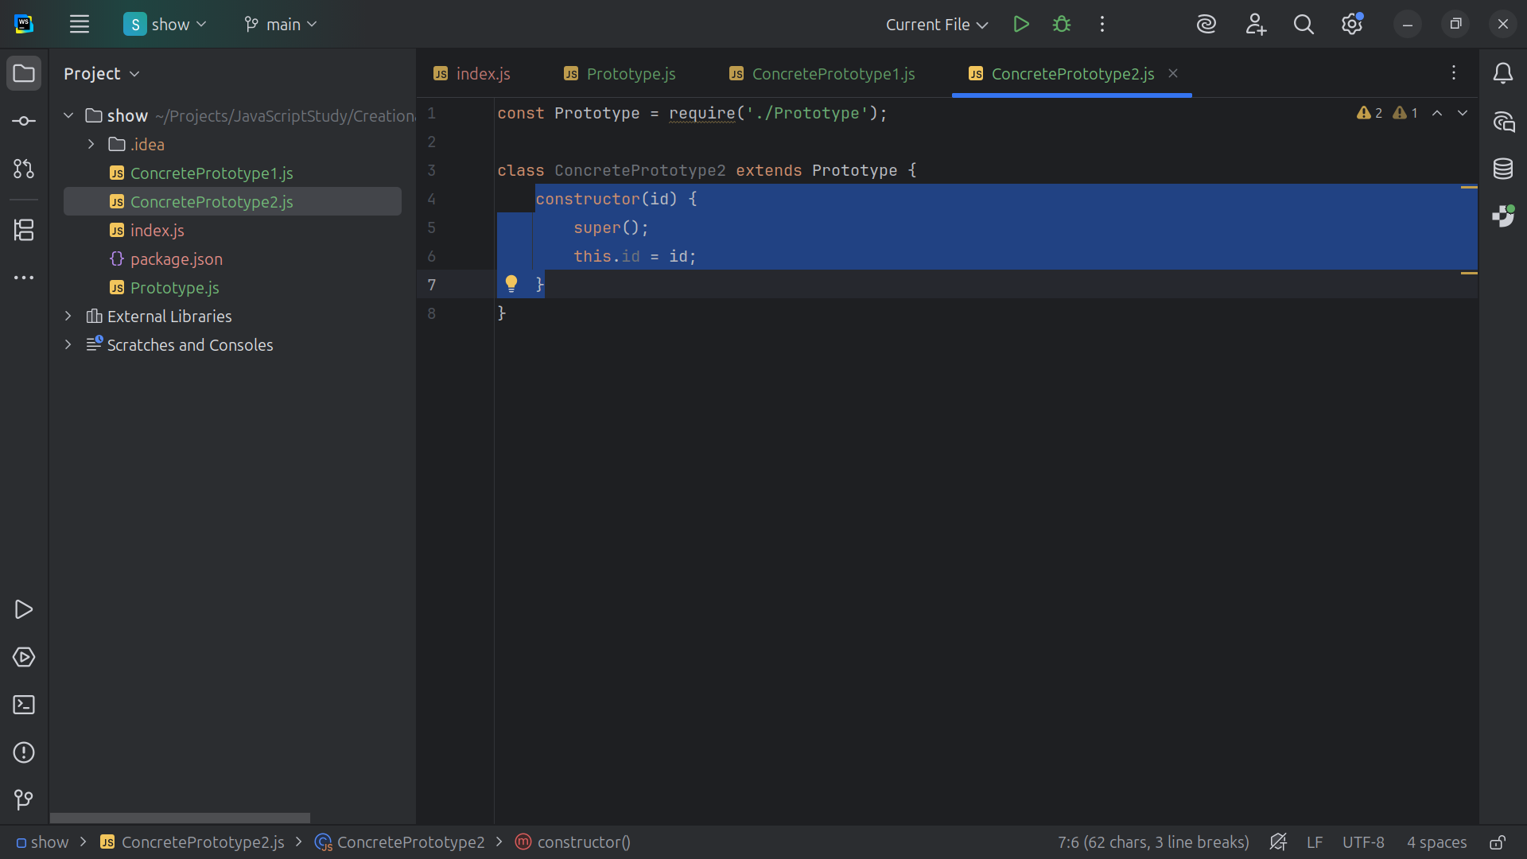
Notes:
It too will have a constructor that takes in an id

Slide 18
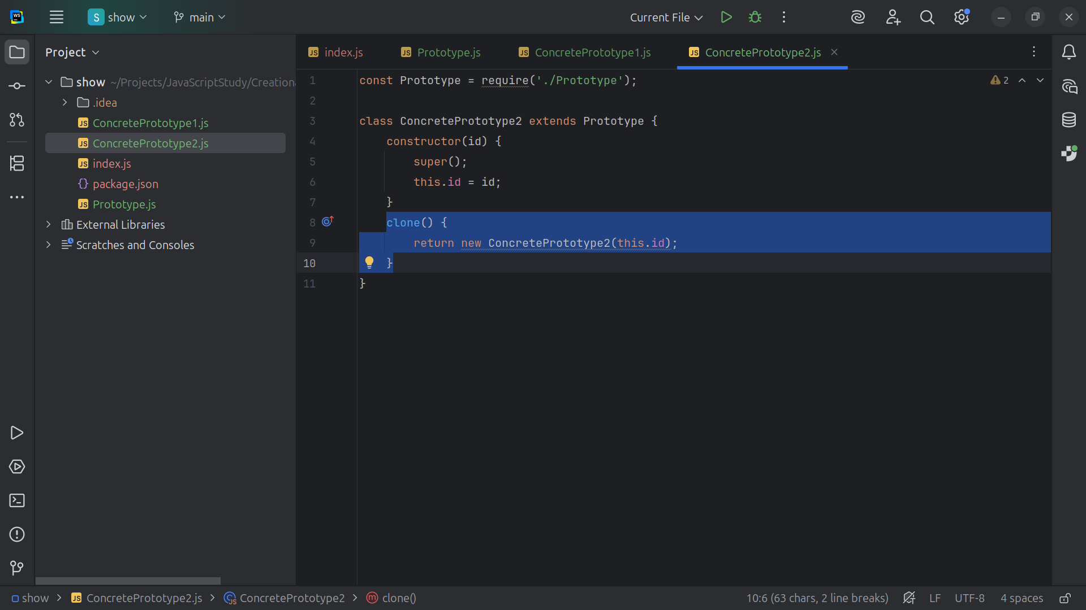
Notes:
And with the clone method we return a new Concrete Prototype 2

Slide 19
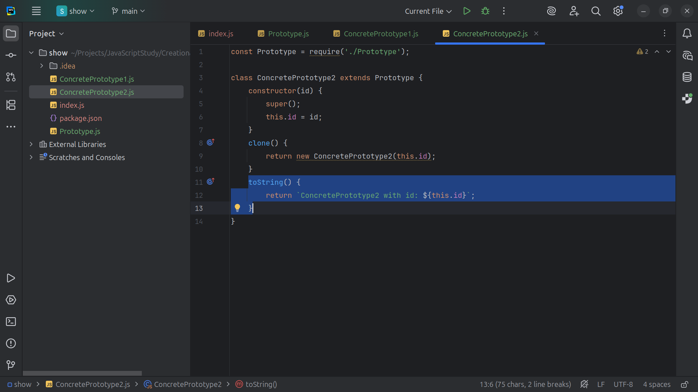
Notes:
And we display its id

Slide 20
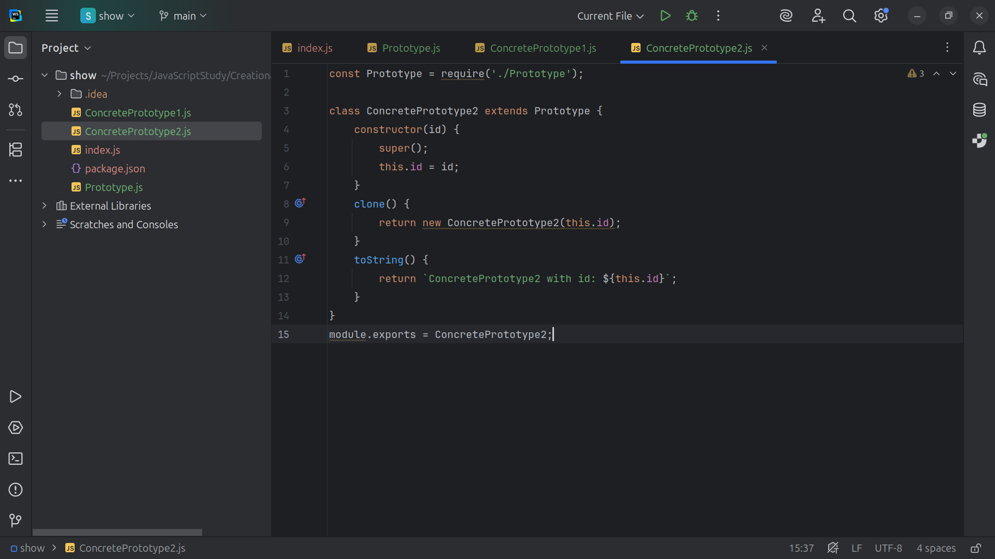
Notes:
Now let’s export this model for use

Slide 21
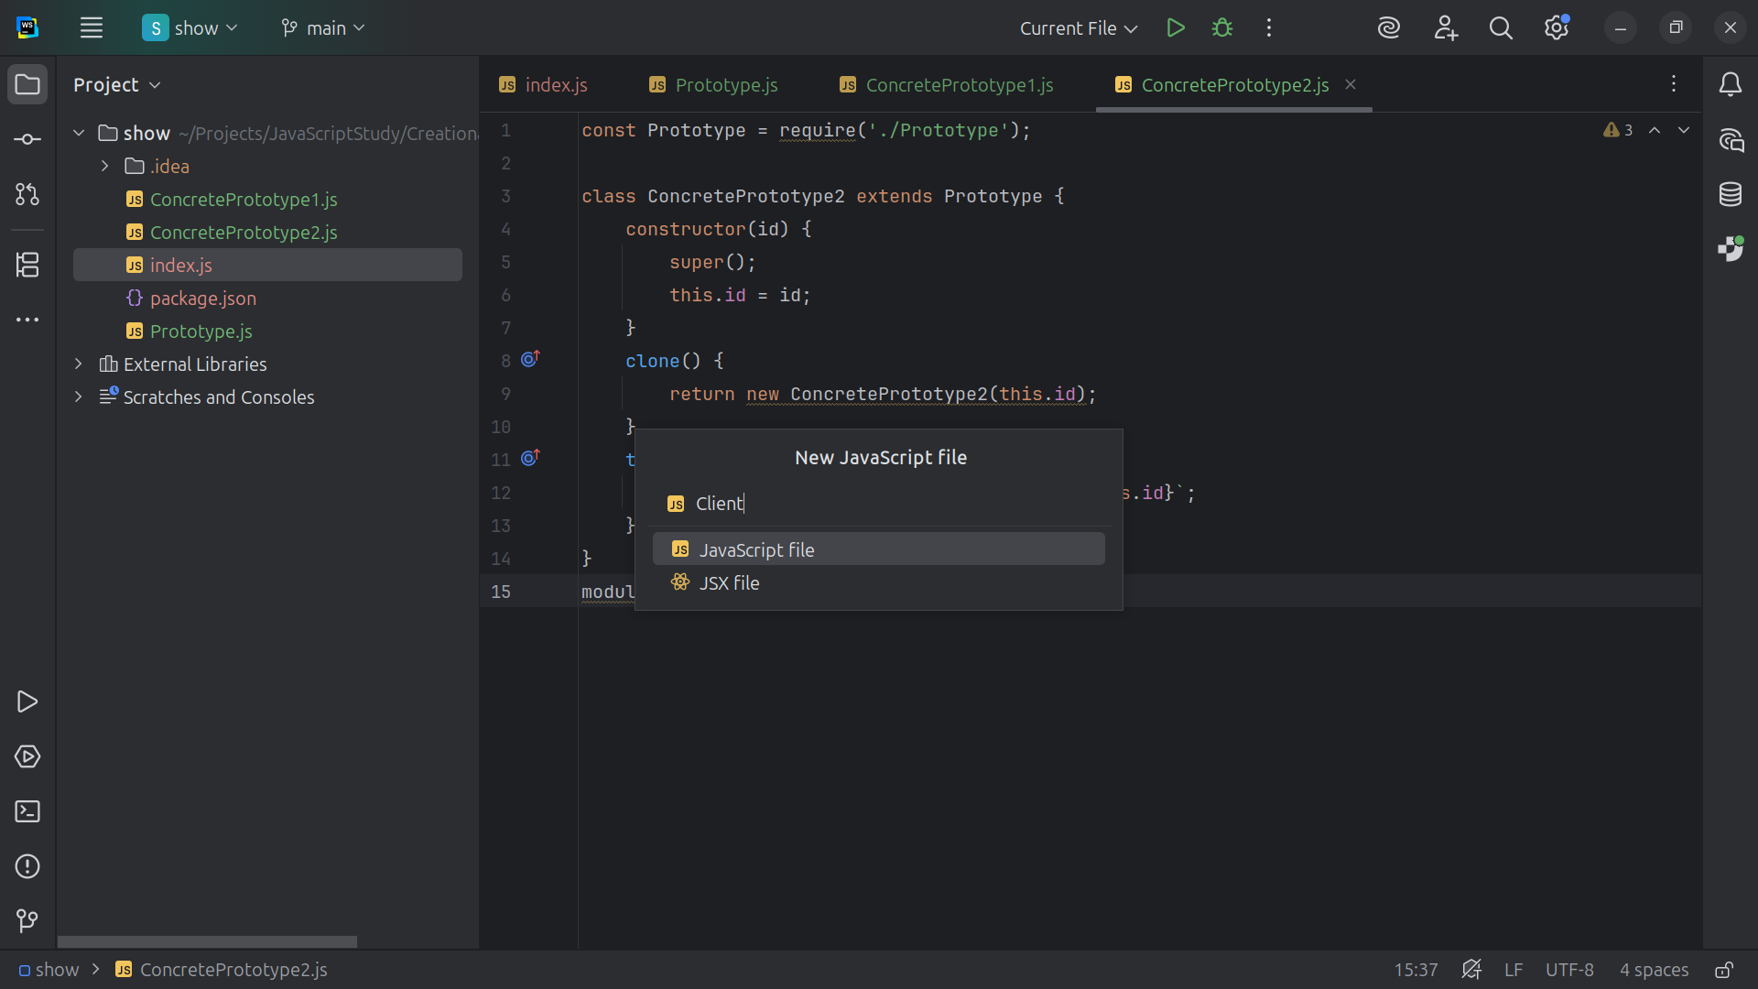
Notes:
Now let’s another class we call Client

Slide 22
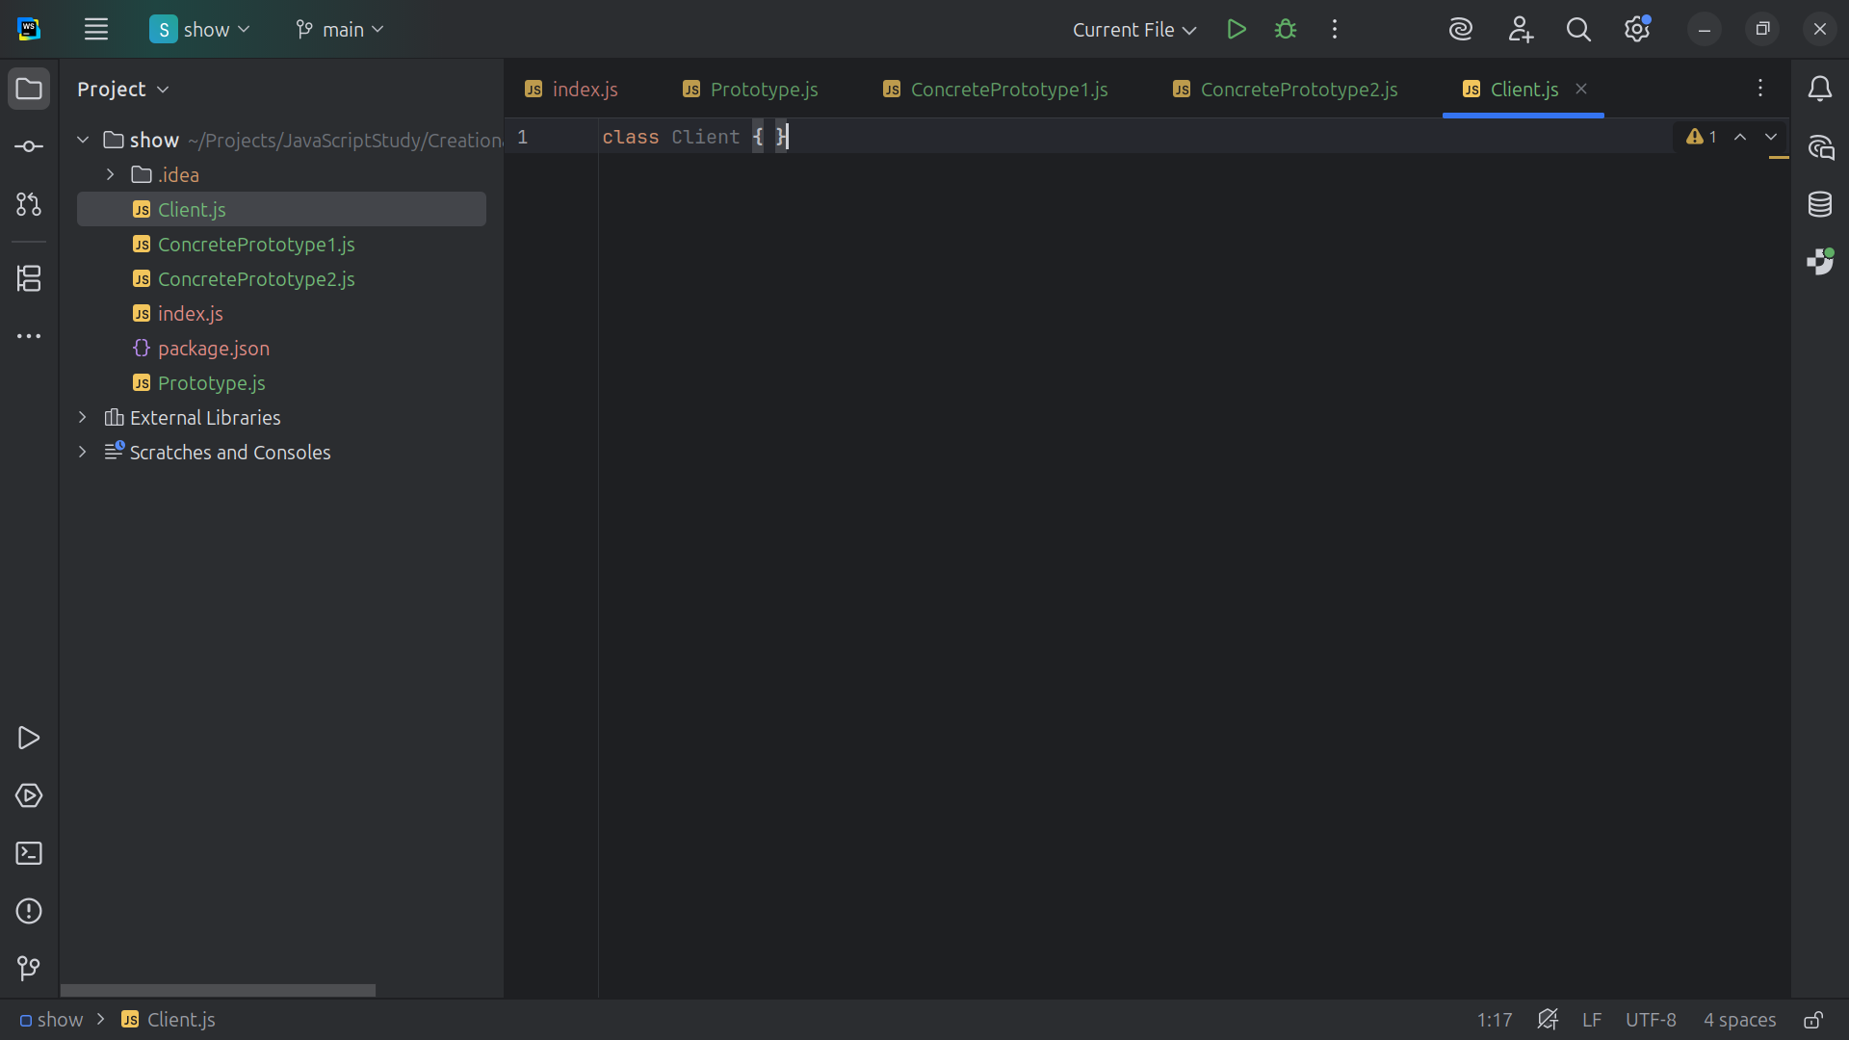
Notes:
Client uses prototypes and does not care about their concrete classes

Slide 23
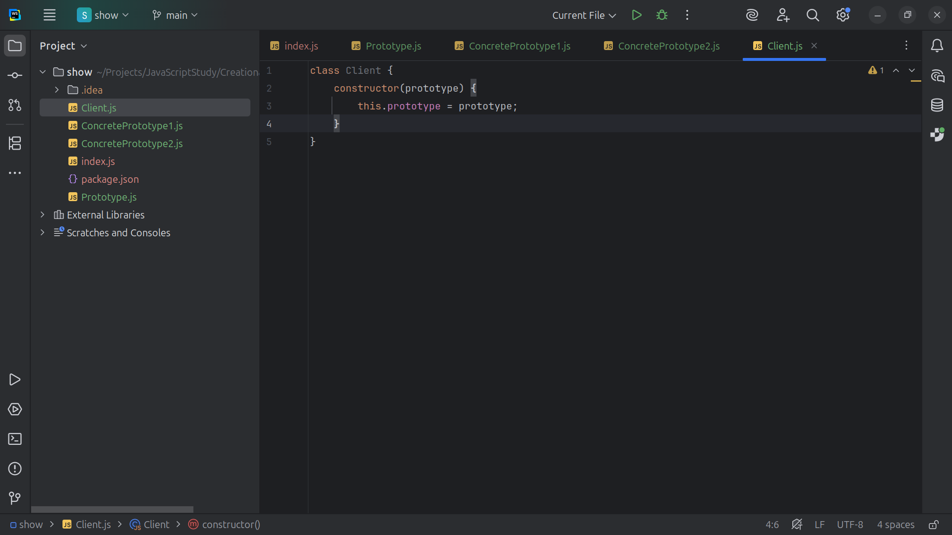
Notes:
We have the construct that takes a prototype and sets it to this prototype .. It Delegates cloning to the prototype instance

Slide 24
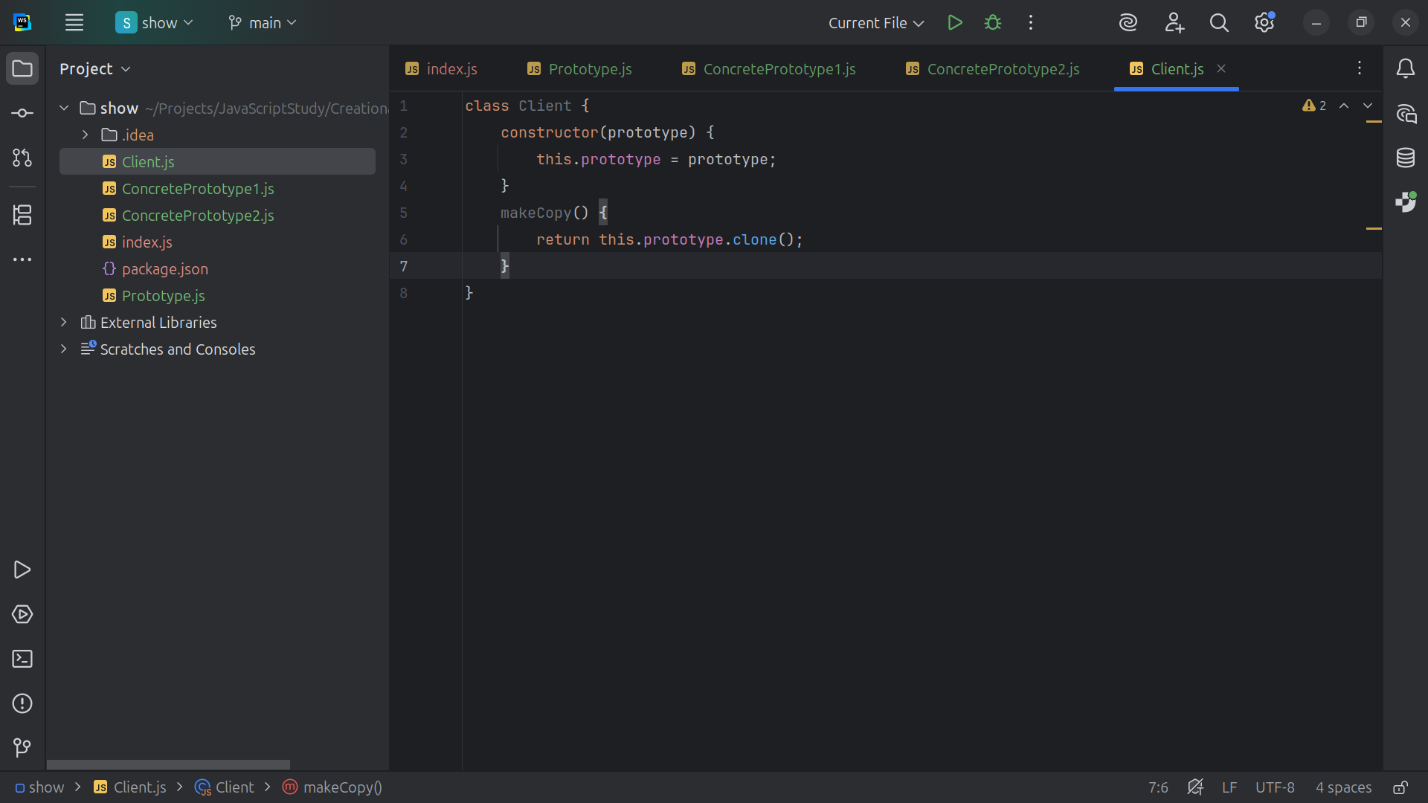
Notes:
And we have make Copy that returns this dot prototype dot clone

Slide 25
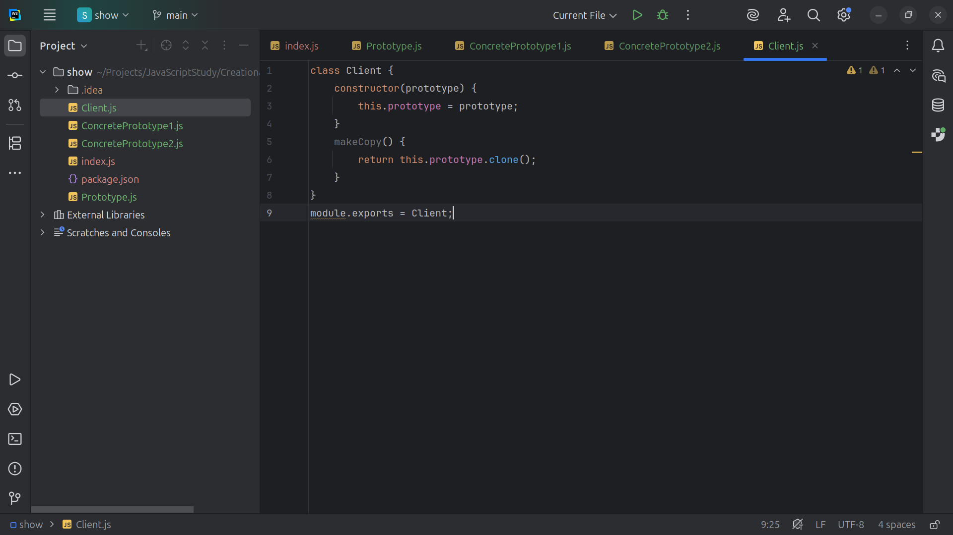
Notes:
And we export this module as Client

Slide 26
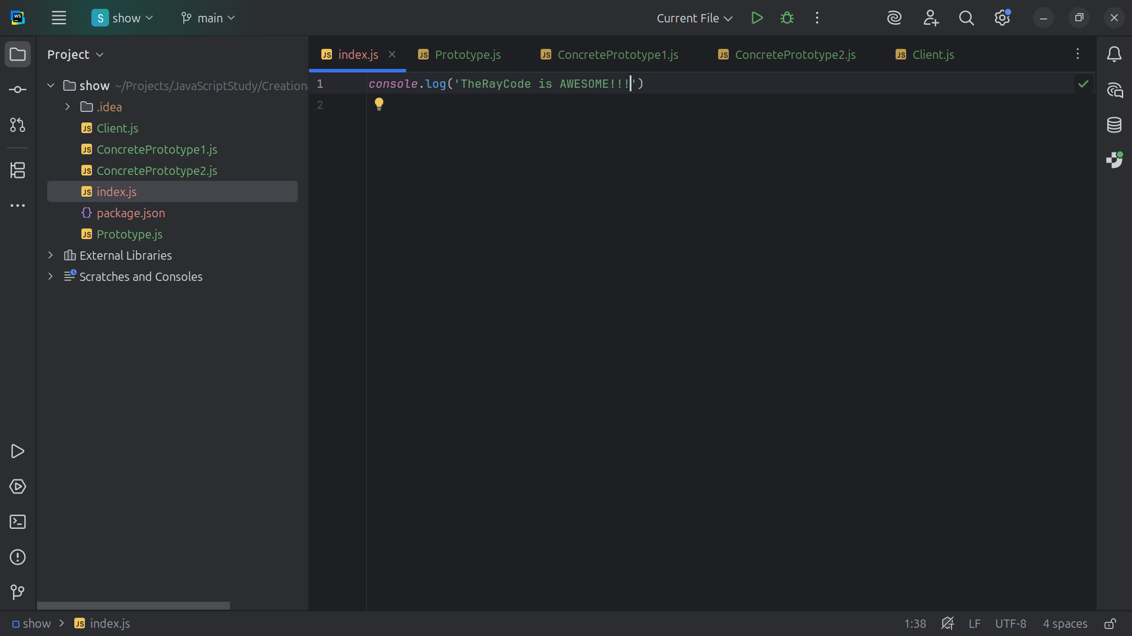
Notes:
No we let’s go to the index for our demo

Slide 27
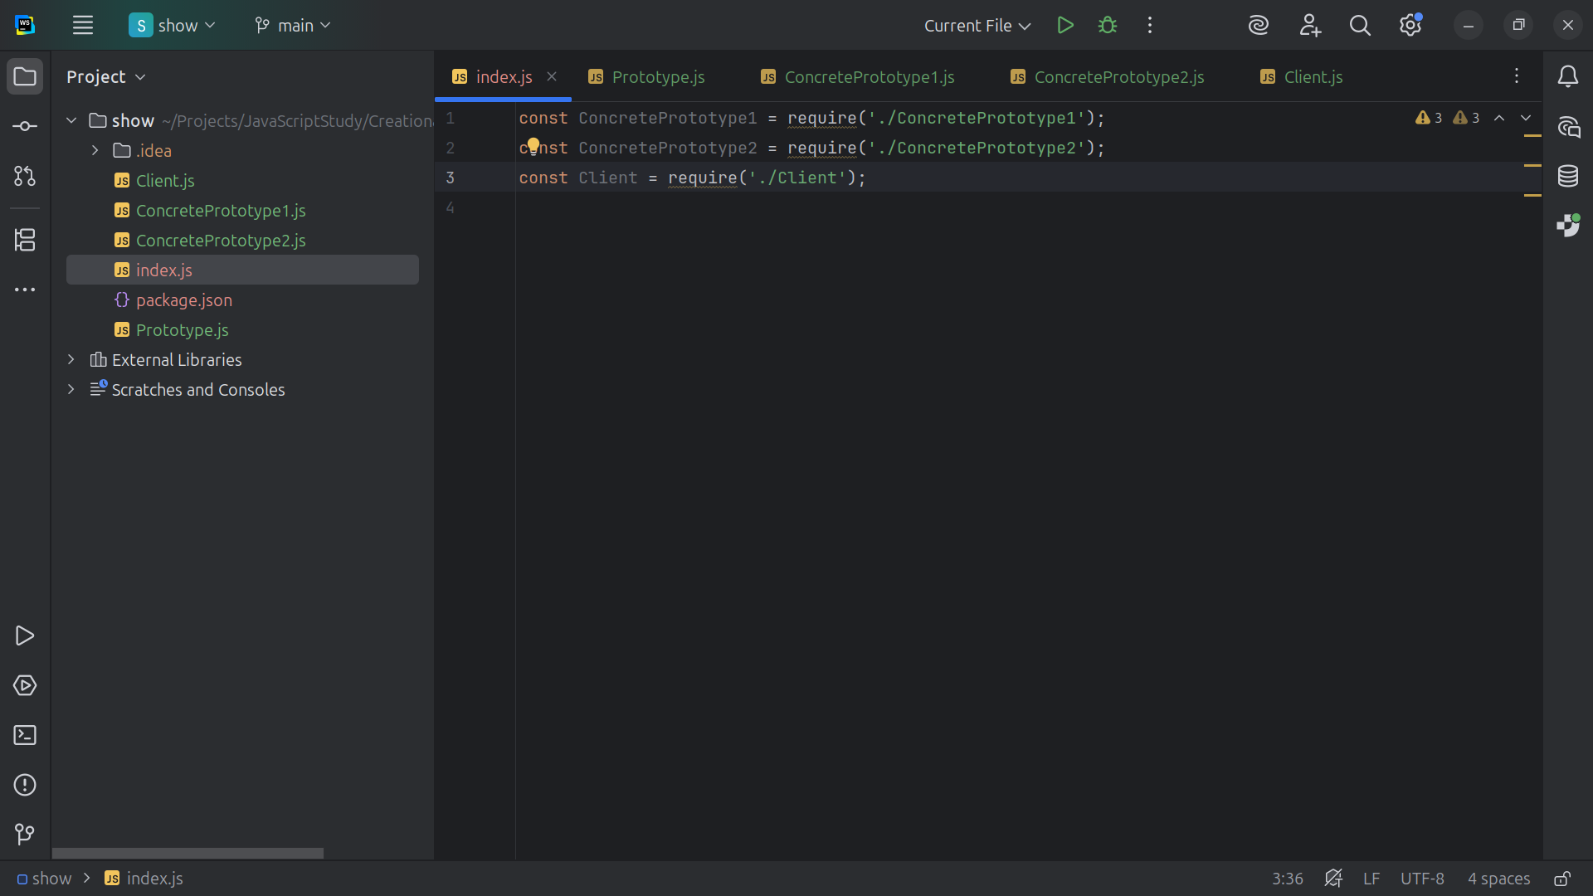
Notes:
At the top we require both Concrete Prototypes and the Client

Slide 28
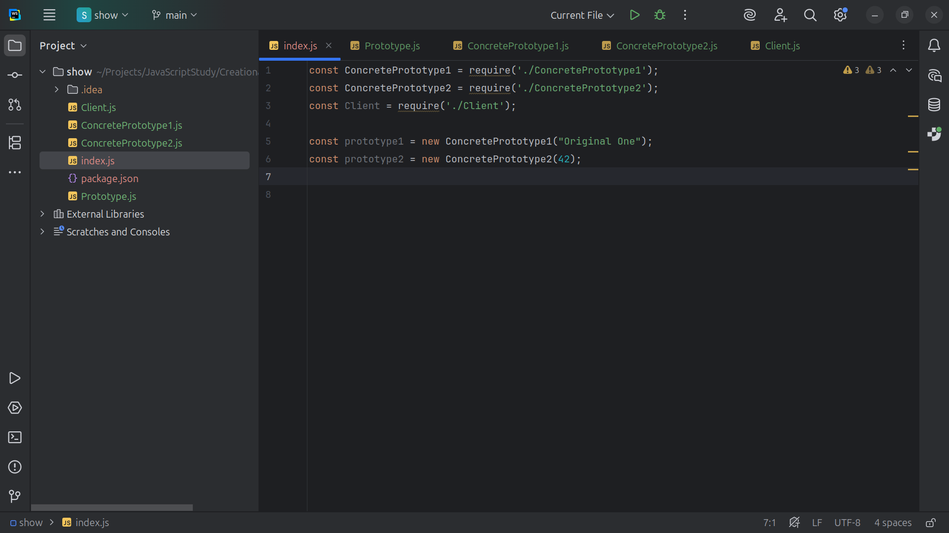
Notes:
We Create the prototype instances in Concrete Prototype 1we pass in the string “Original One” and for prototype 2 we pass in the number 42. the Answer to the Ultimate Question of Life, the Universe, and Everything

Slide 29
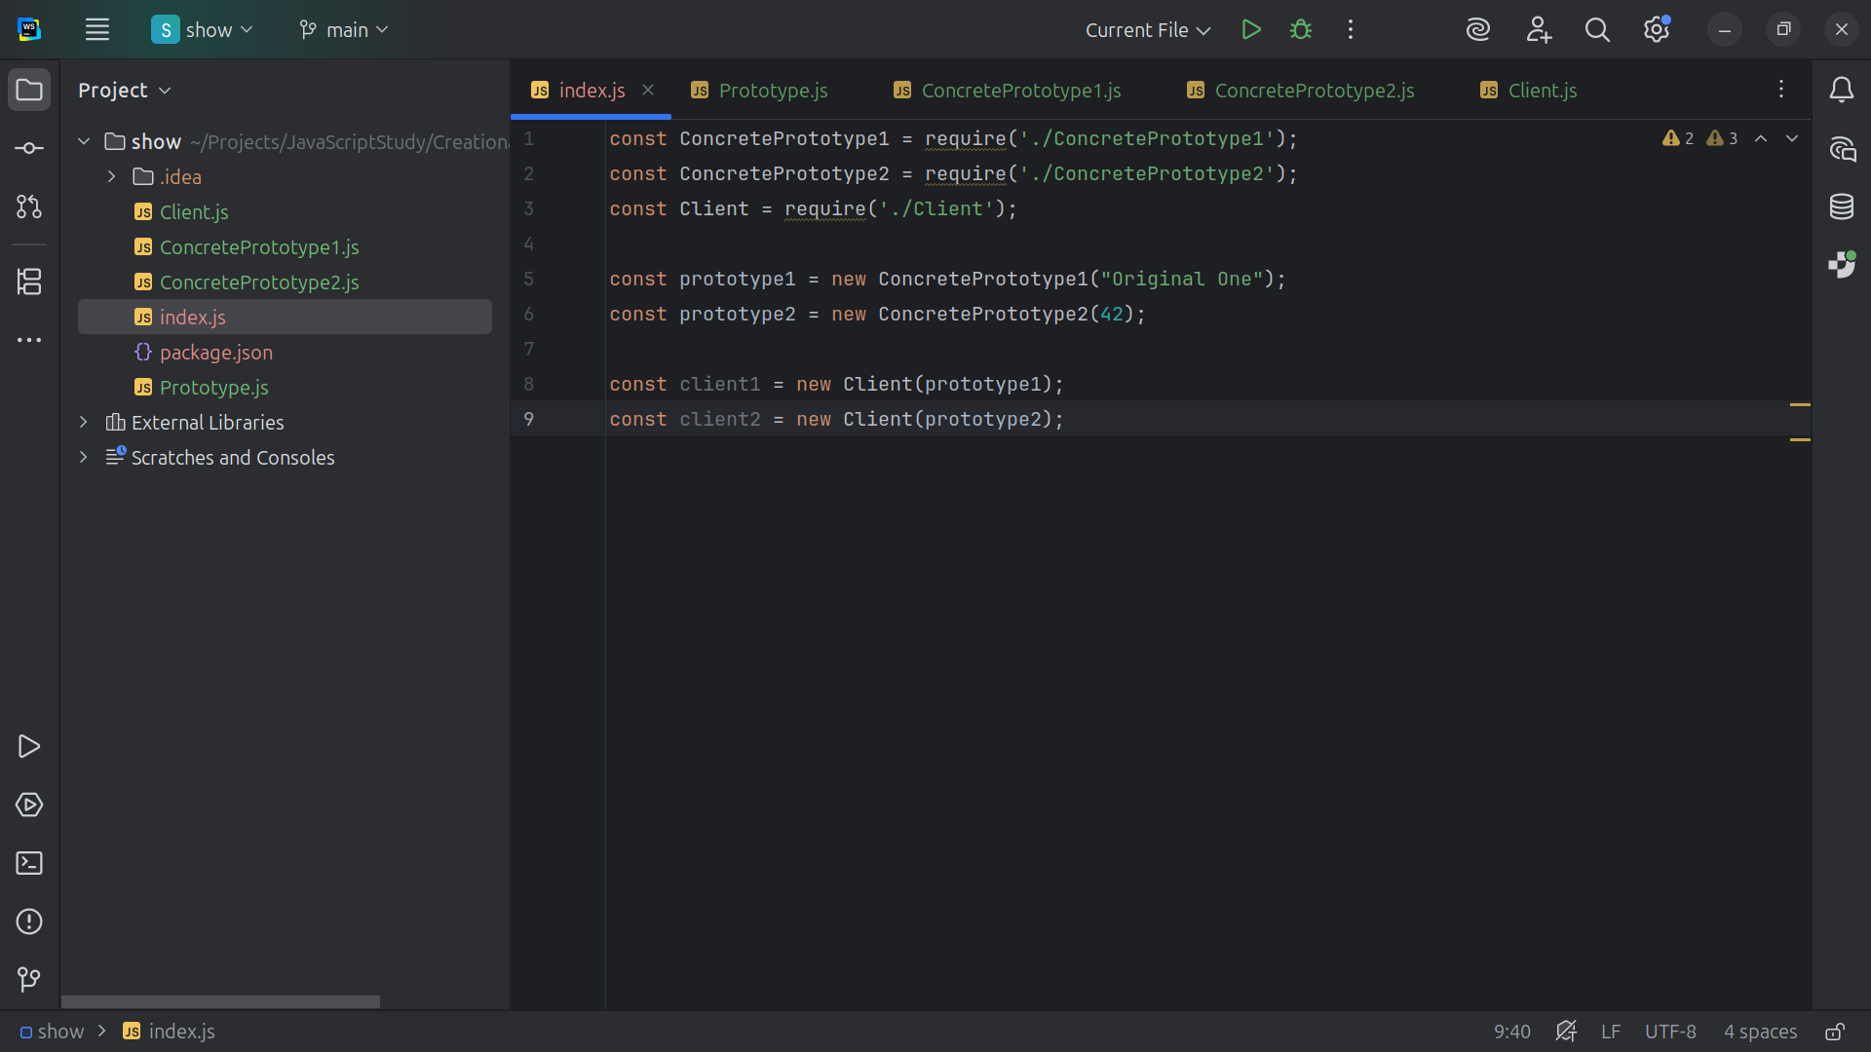
Notes:
Clone 1 is set to client1 and Clone 2 is set to a new client with prototype 2 passed in

Slide 30
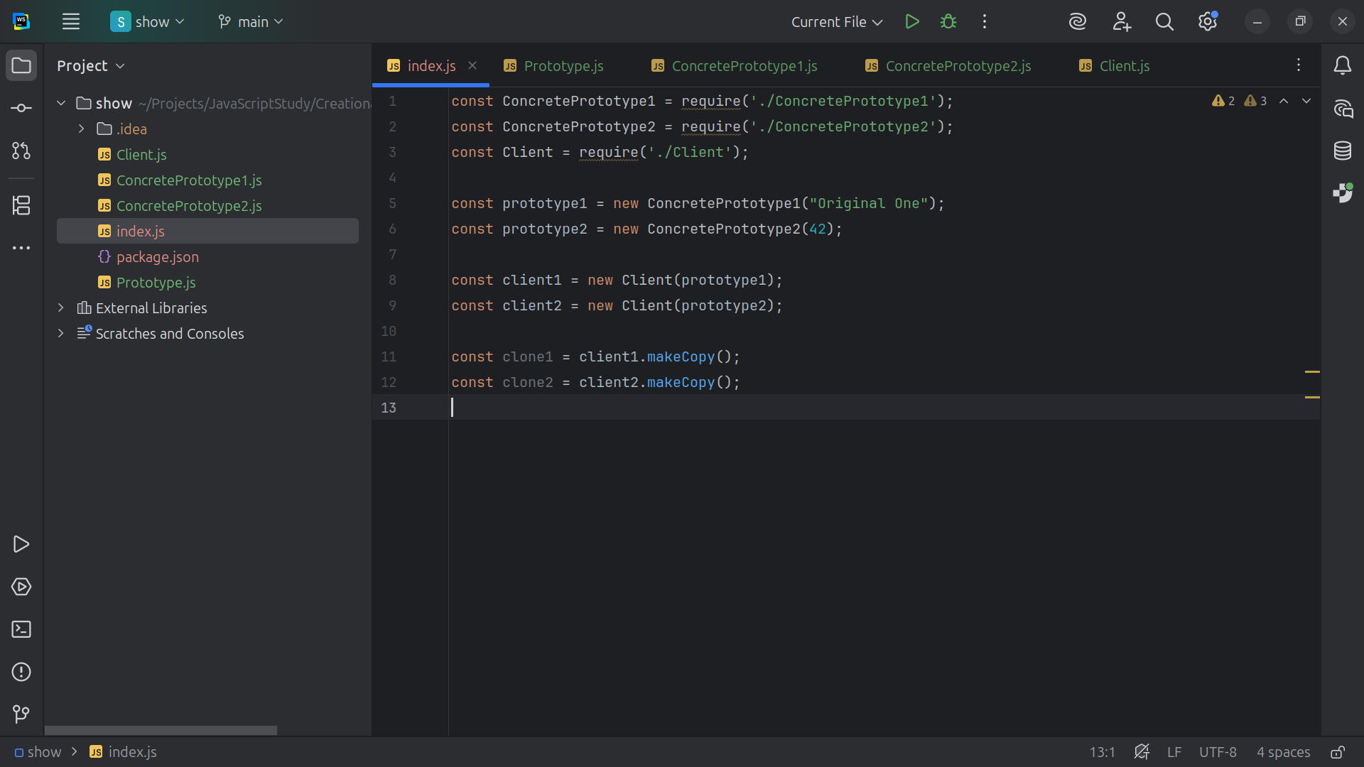
Notes:
We call make copy on client 1 and make copy on client 2

Slide 31
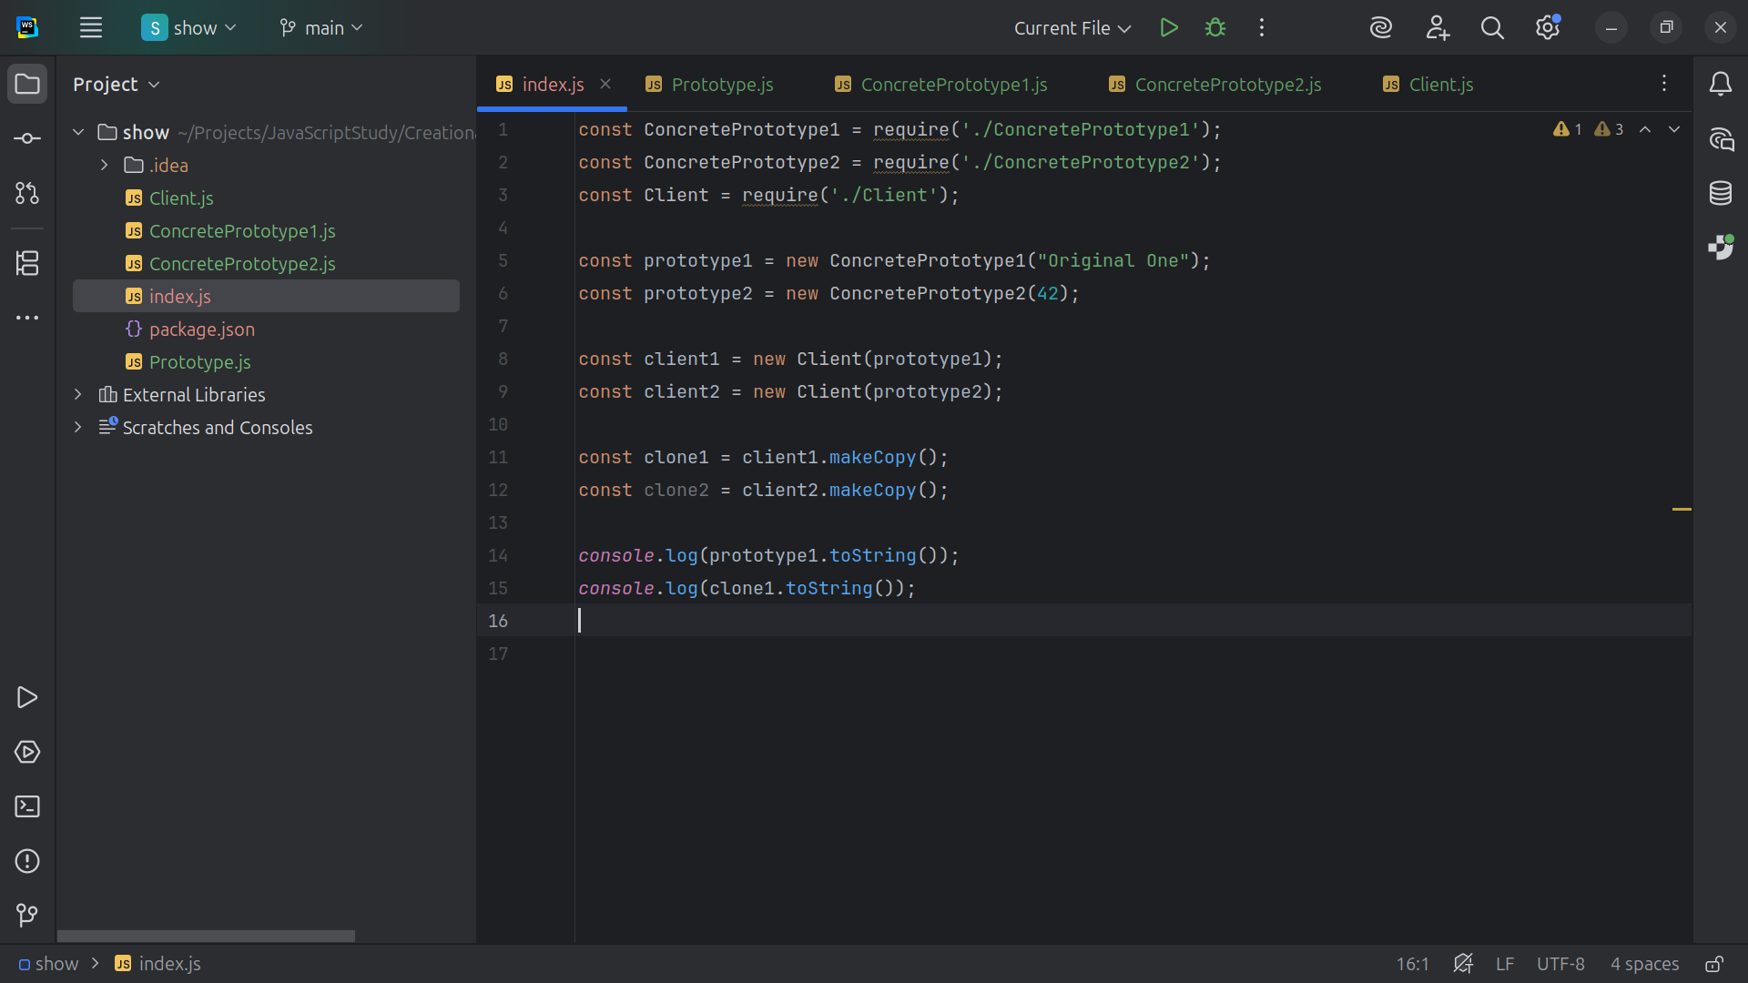
Notes:
And to the console we print prototype 1 and clone 1 to string

Slide 32
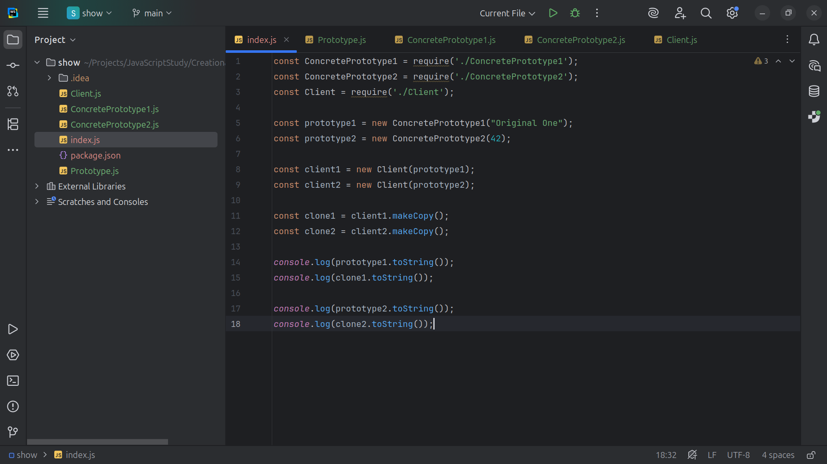
Notes:
And we do the same thing with clone 2 and Let’s now view it in the browser

Slide 33
