Slide 1

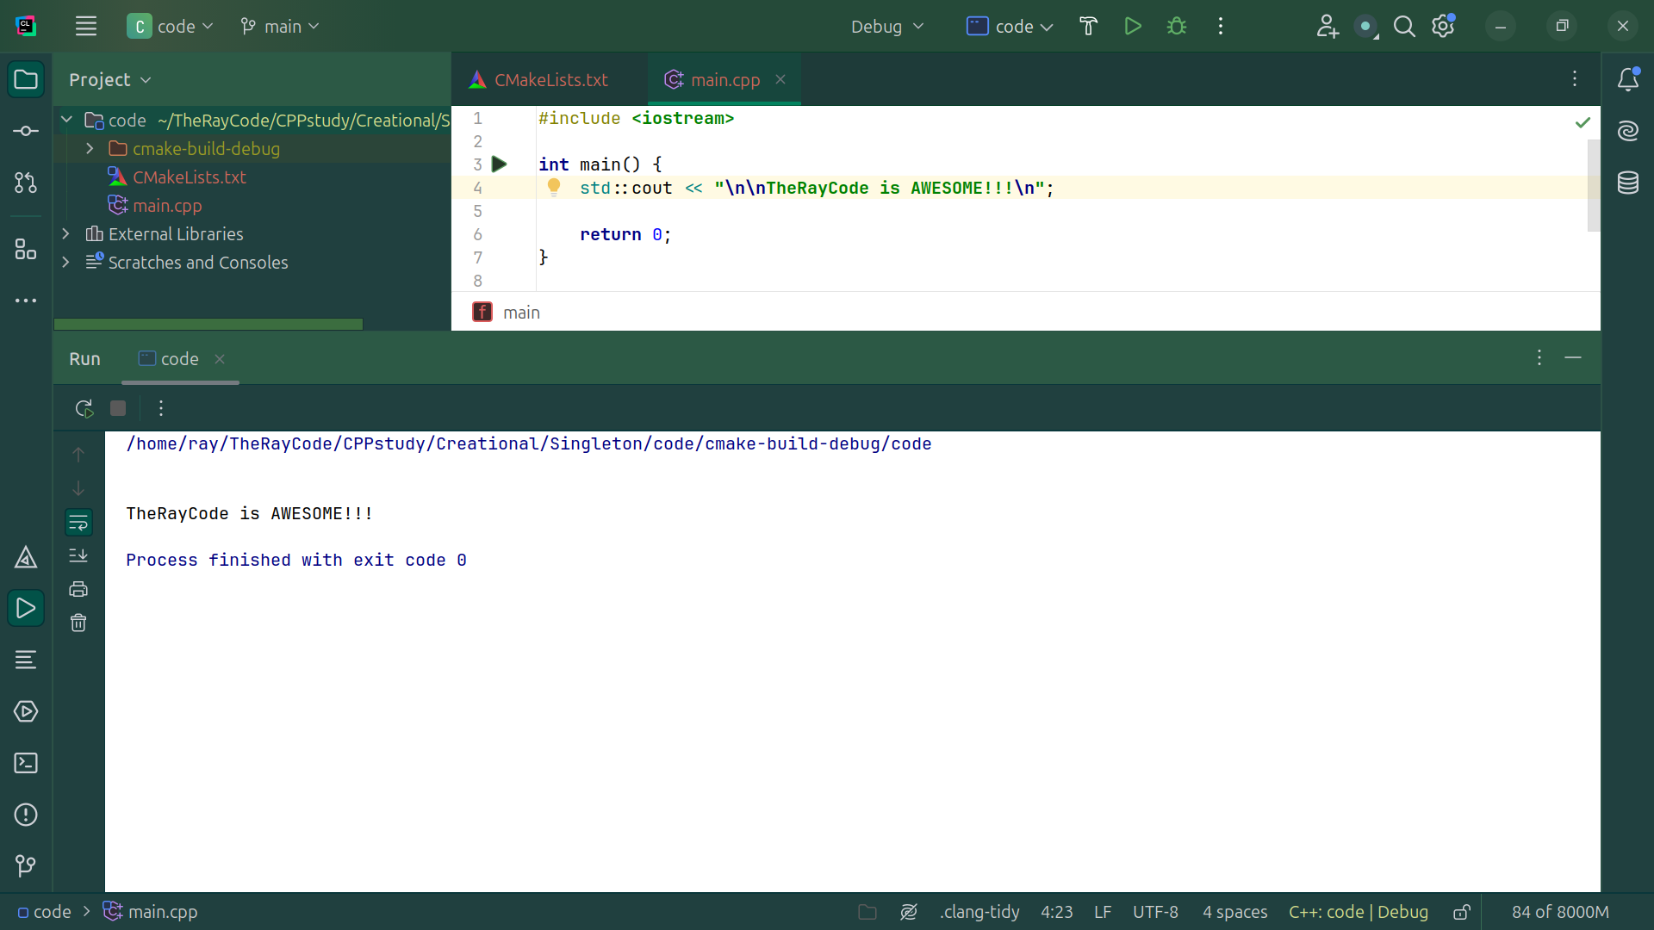
Notes:
No Sound

Slide 2

Notes:
Hello, I am Ray from TheRayCode.
Today I will give a code example of the design pattern Singleton
I will be coding in C++

Slide 3
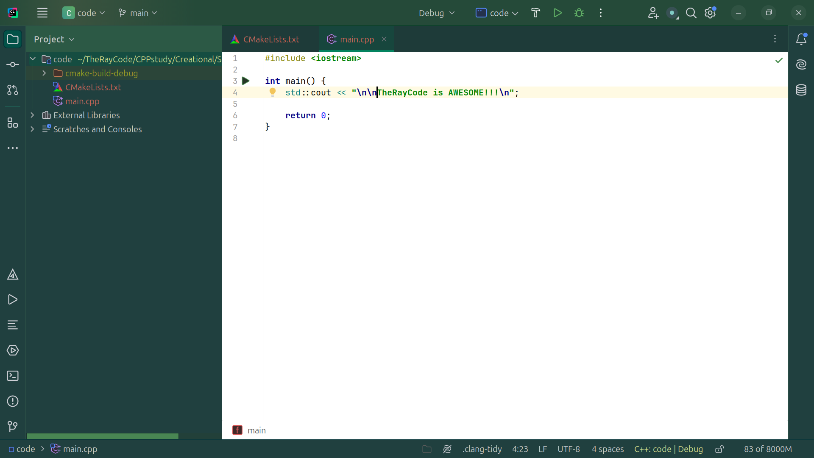
Notes:
Tell your friends TheRayCode is AWESOME!!!

Slide 4
Notes:
No Sound at finish delete this slide not needed

Slide 5
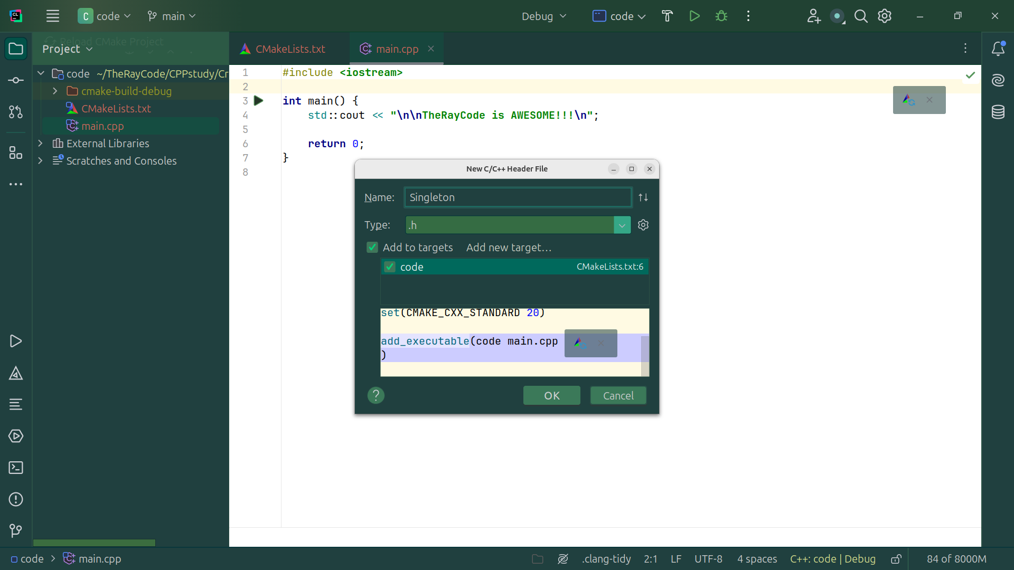
Notes:
Let’s create a class called Singleton
We start with the dot h file

Slide 6
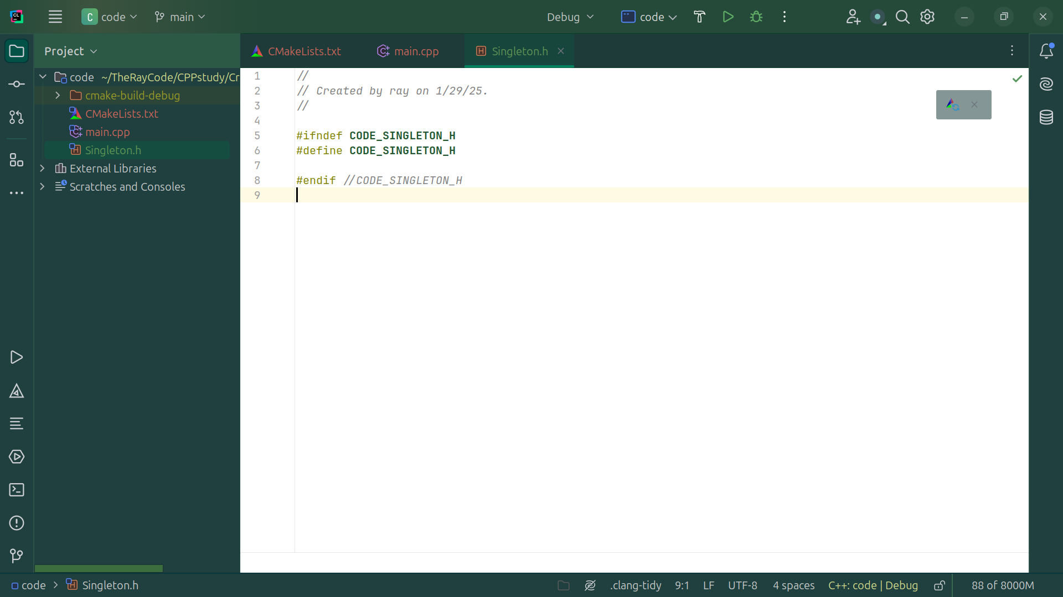
Notes:
We have the defs for this dot h file

Slide 7
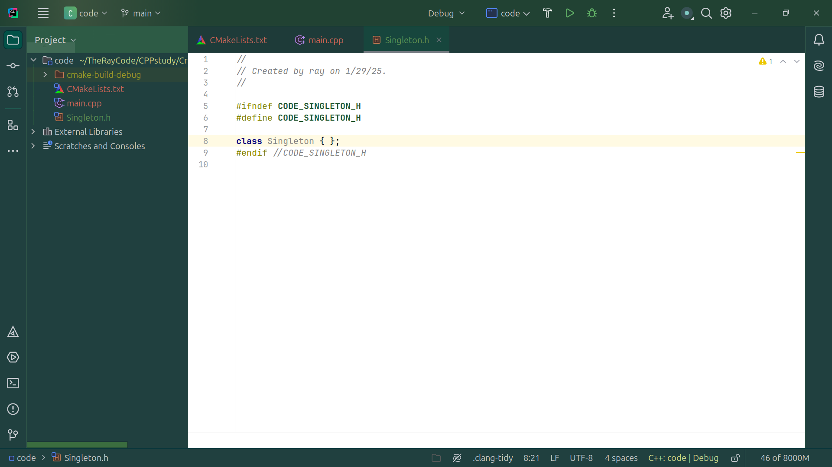
Notes:
We create the class structure

Slide 8

Notes:
We include IO stream at the top

Slide 9

Notes:
We have a Private Static instance pointer

Slide 10
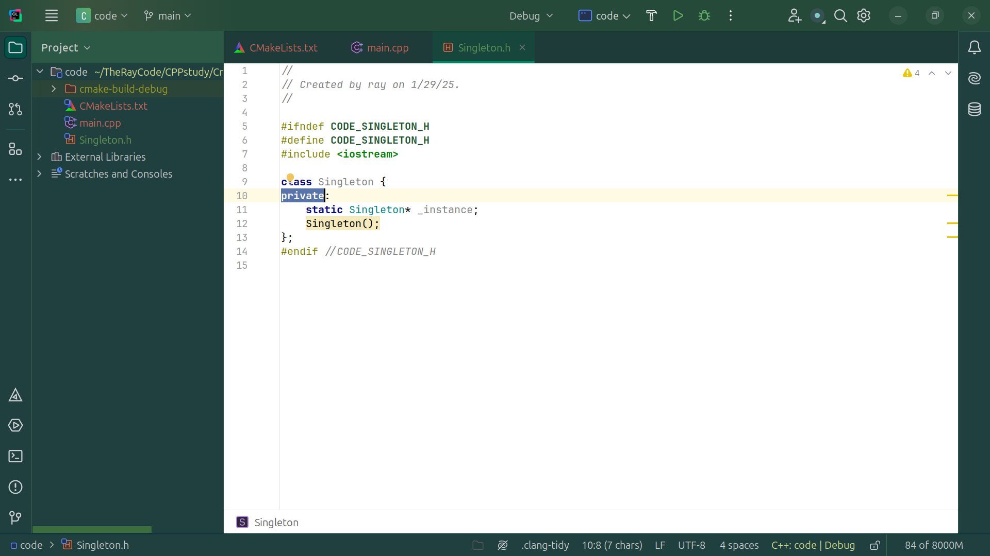
Notes:
And a Private constructor to prevent direct instantiation

Slide 11
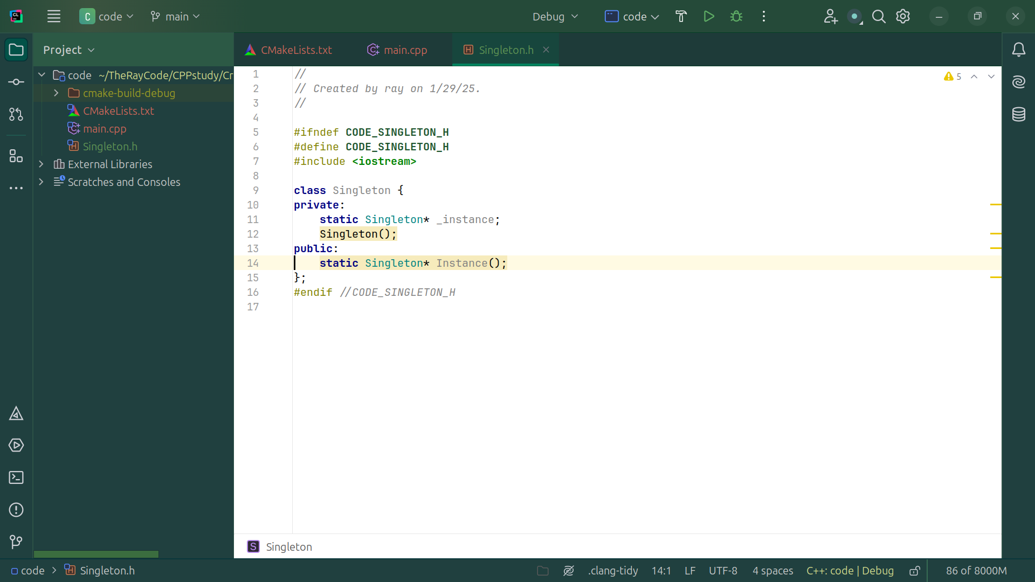
Notes:
We have a Static method to get the single instance

Slide 12
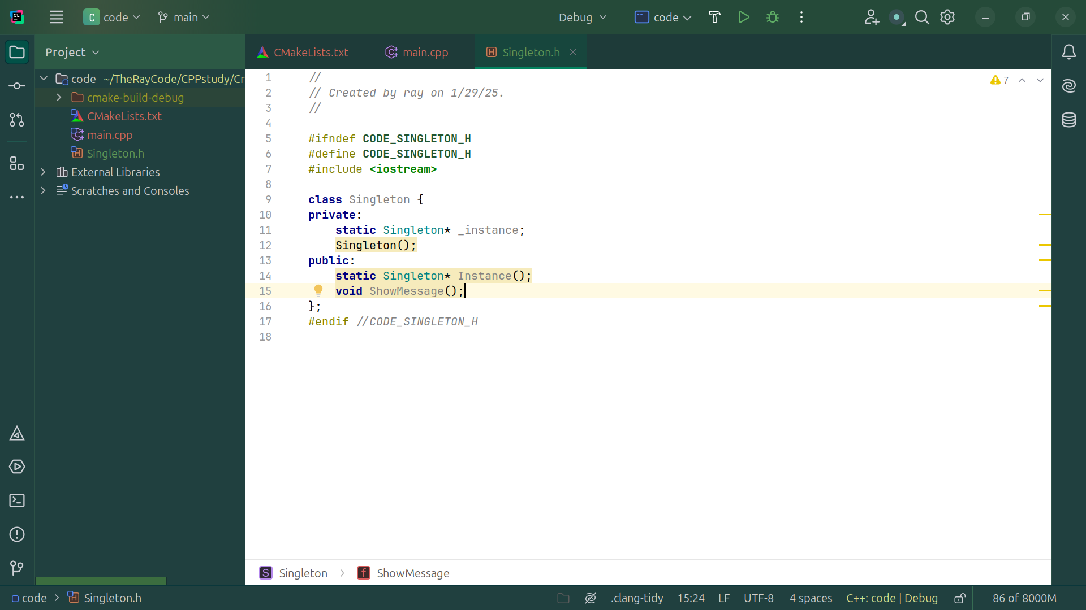
Notes:
Now Let’s have an Example method to demonstrate functionality

Slide 13

Notes:
Now Let’s do some cleanup
Delete copy constructor and assignment operator

Slide 14
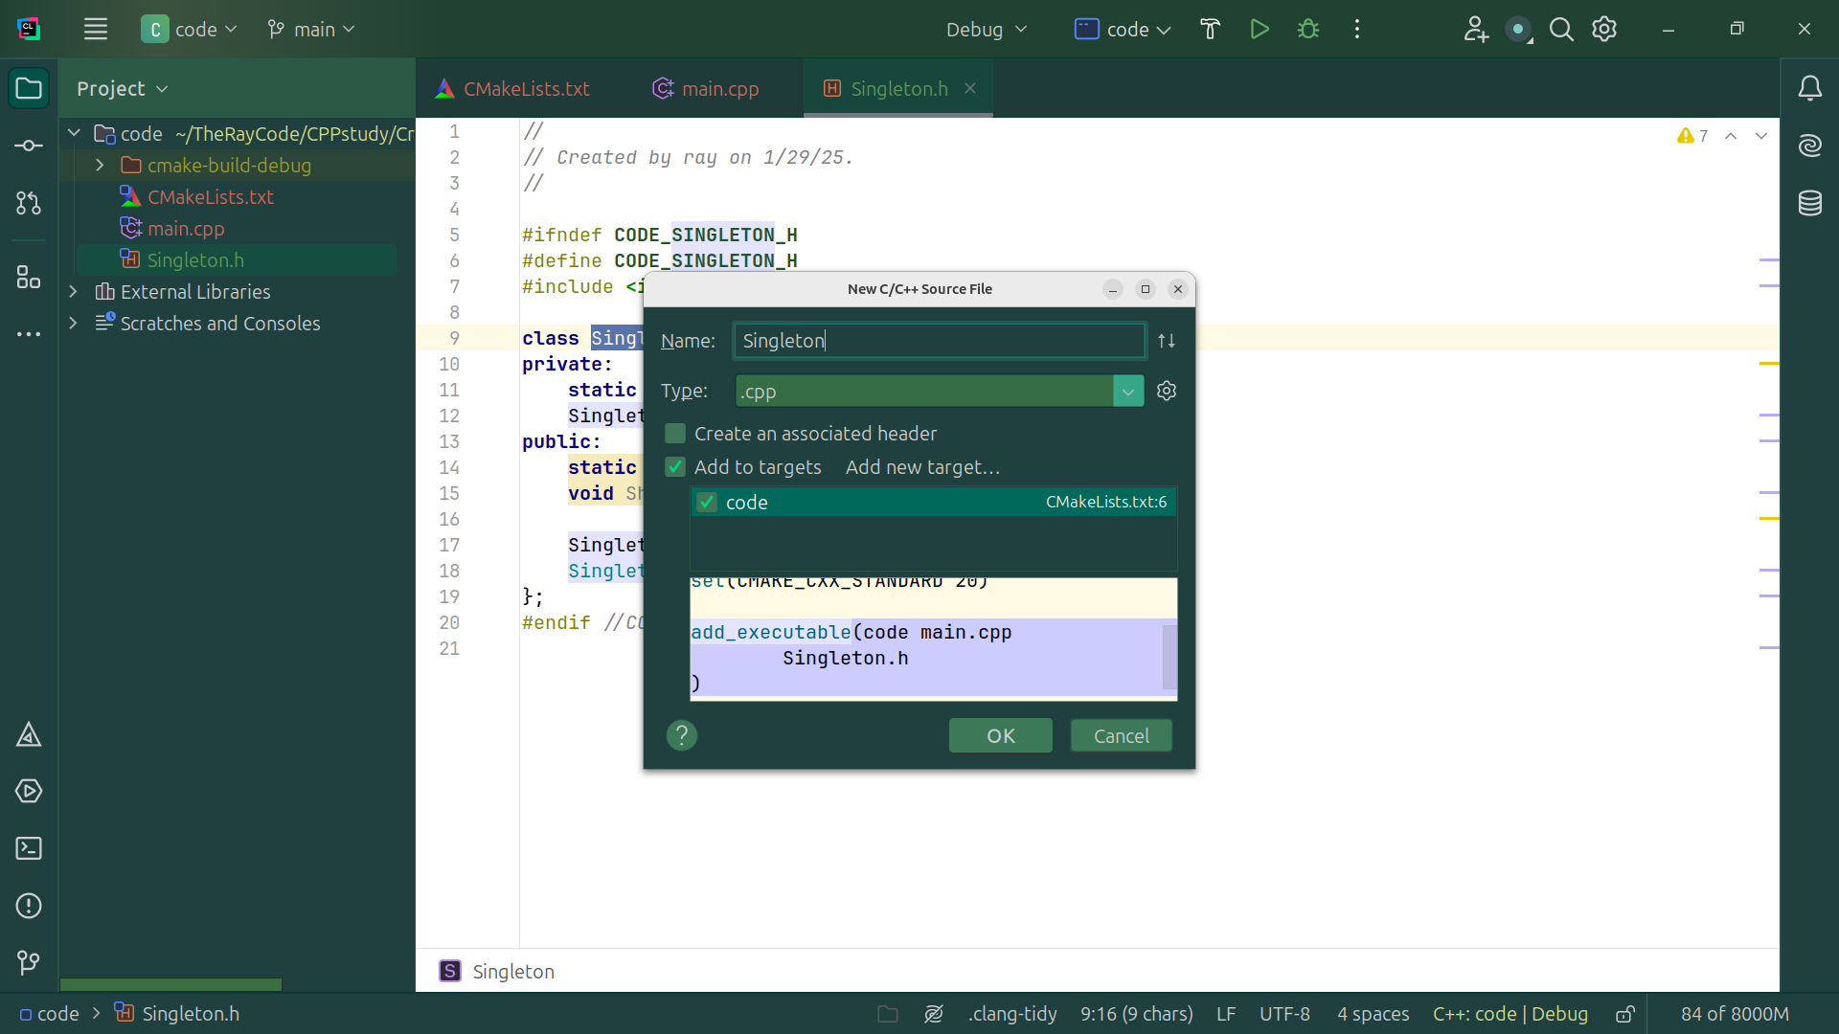
Notes:
Next we go the the cpp side of this Singleton class

Slide 15
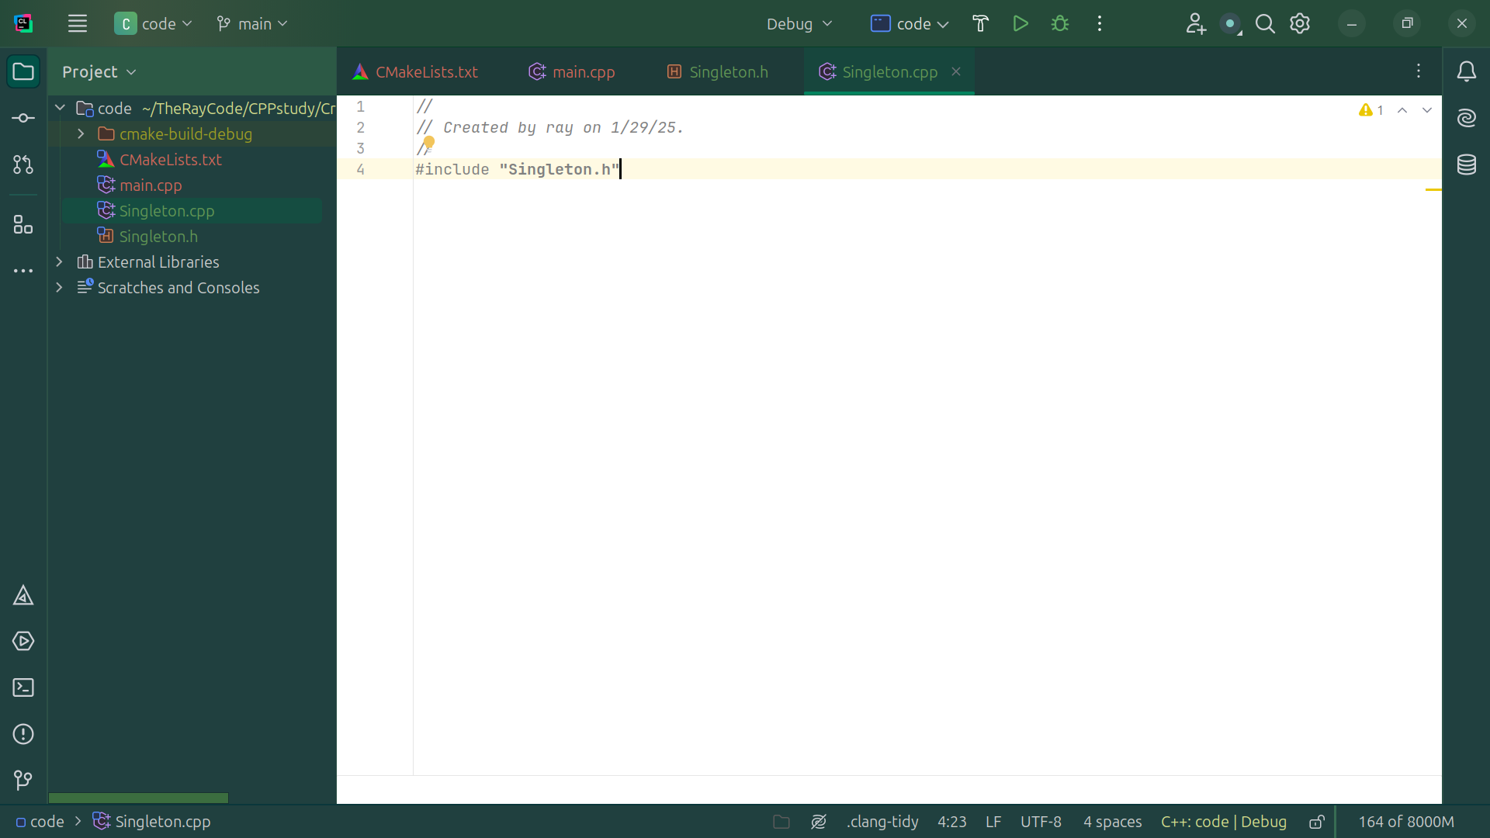
Notes:
In the cpp file we include the dot h file
The Singleton Class Implementation

Slide 16

Notes:
We Initialize the static member

Slide 17
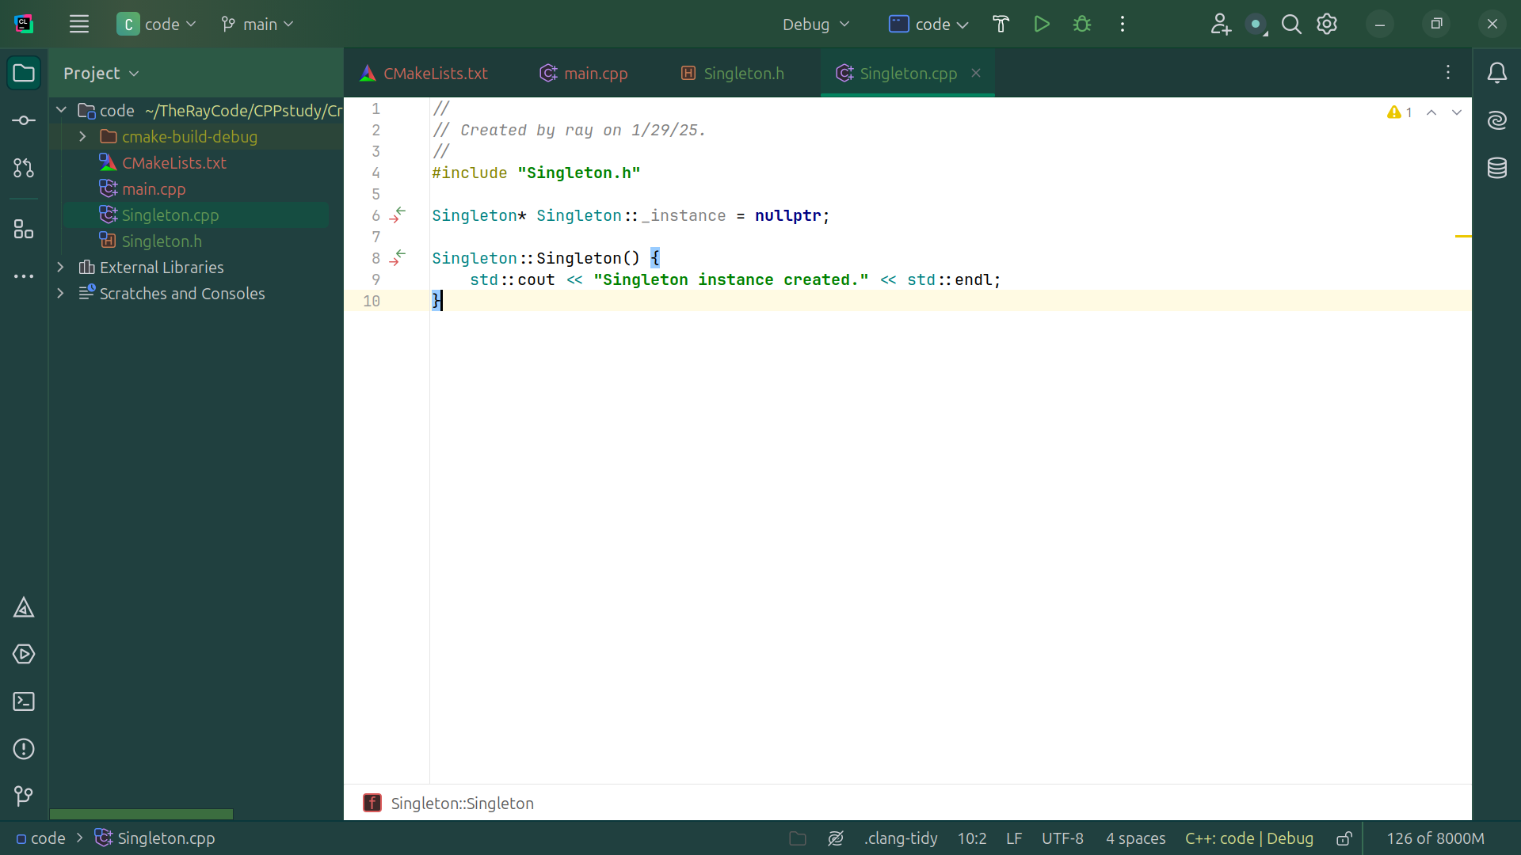
Notes:
And Setup a Private constructor

Slide 18
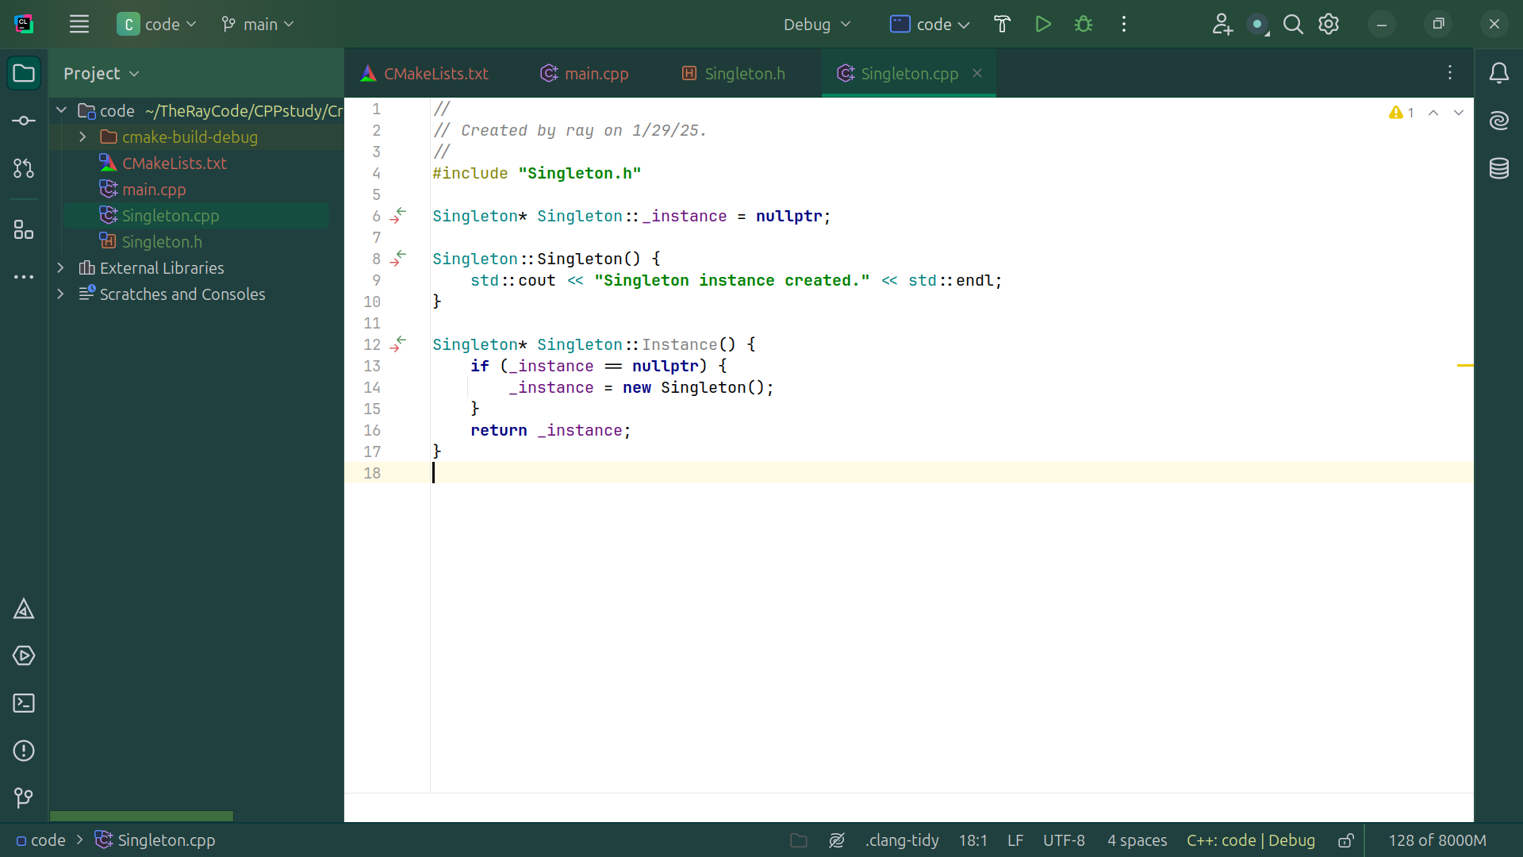
Notes:
And we have a Static method to return the single instance

Slide 19
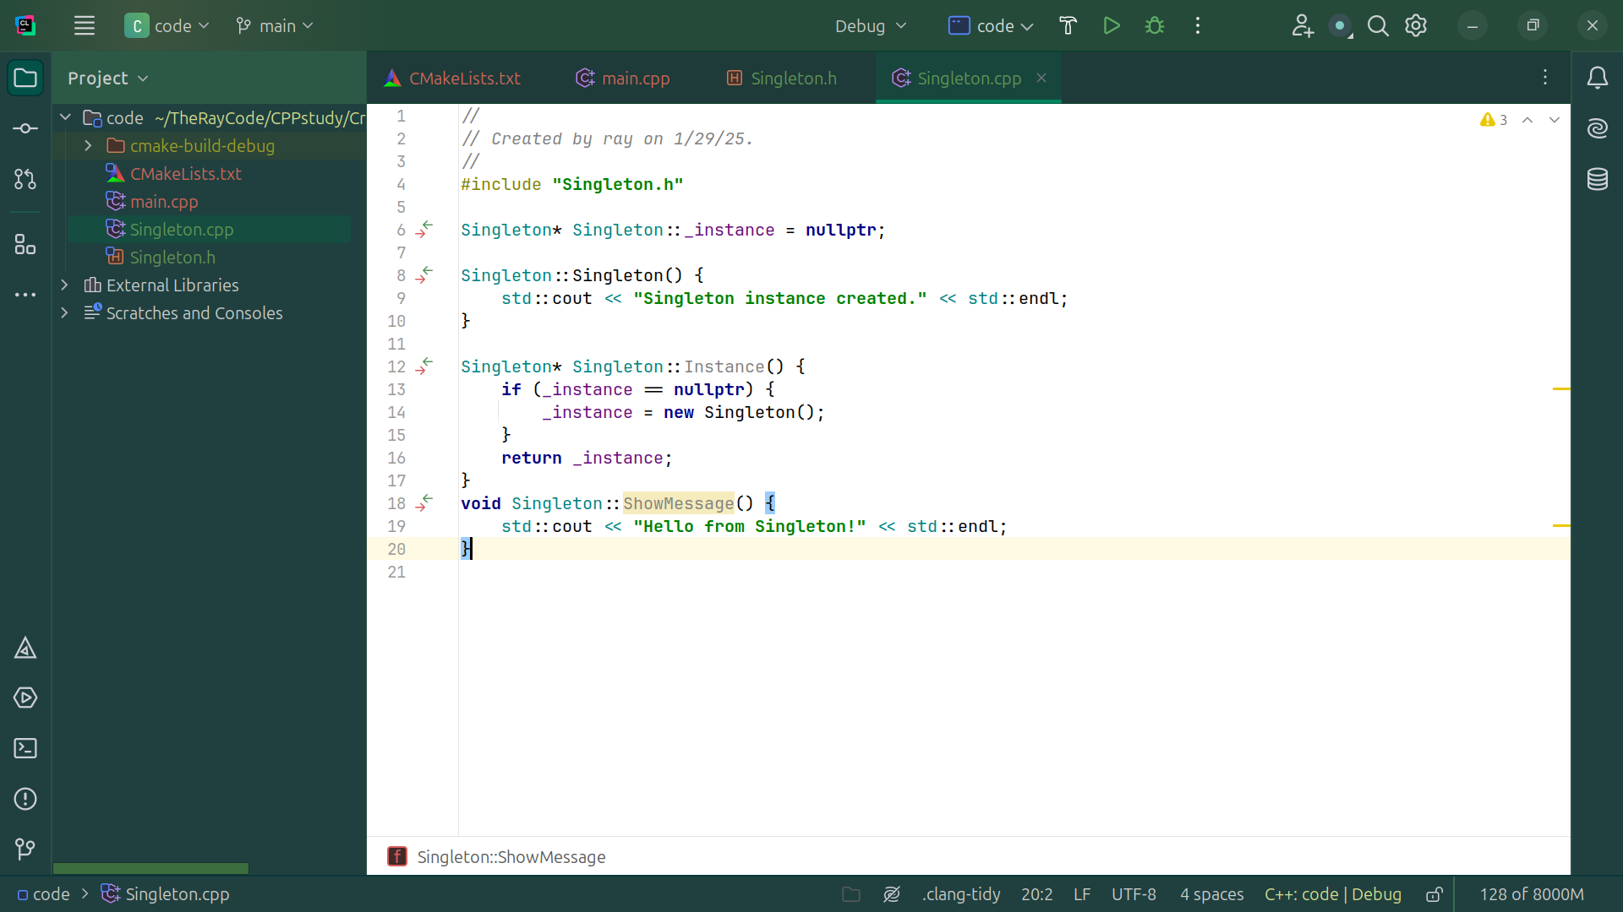
Notes:
We have an Example method implementation

Slide 20
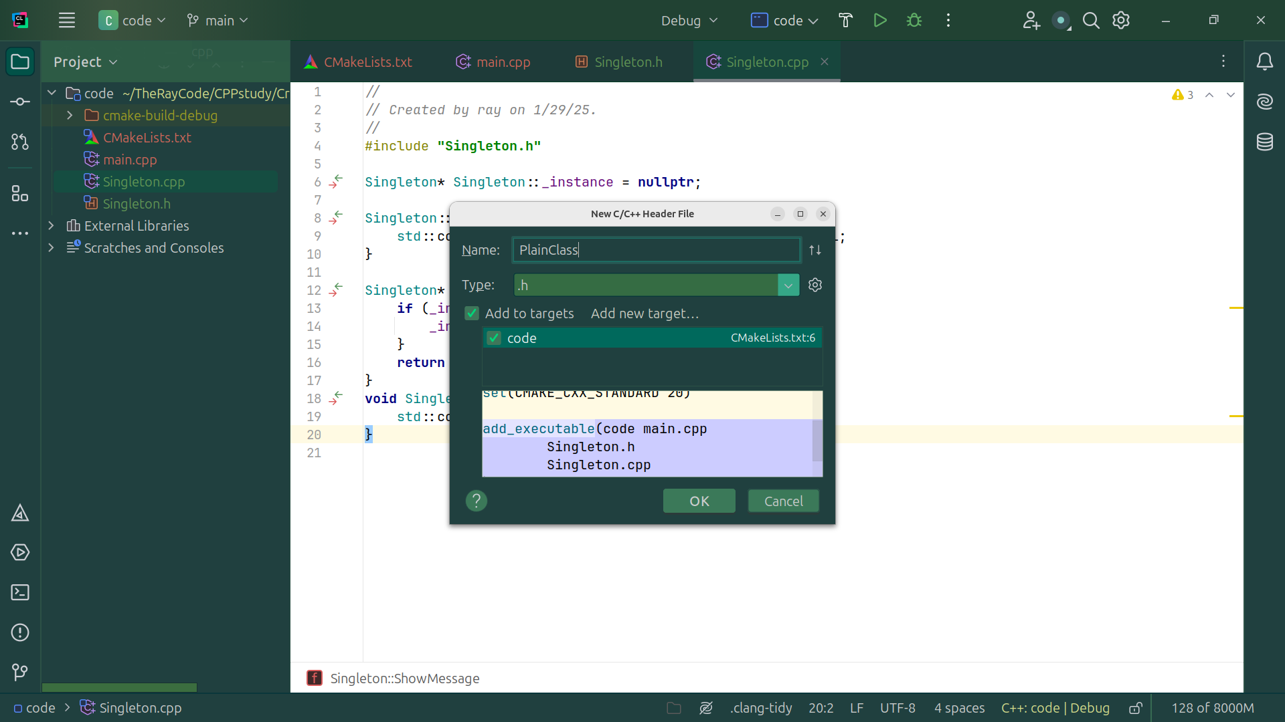
Notes:
So now let’s create a Plain Class

Slide 21
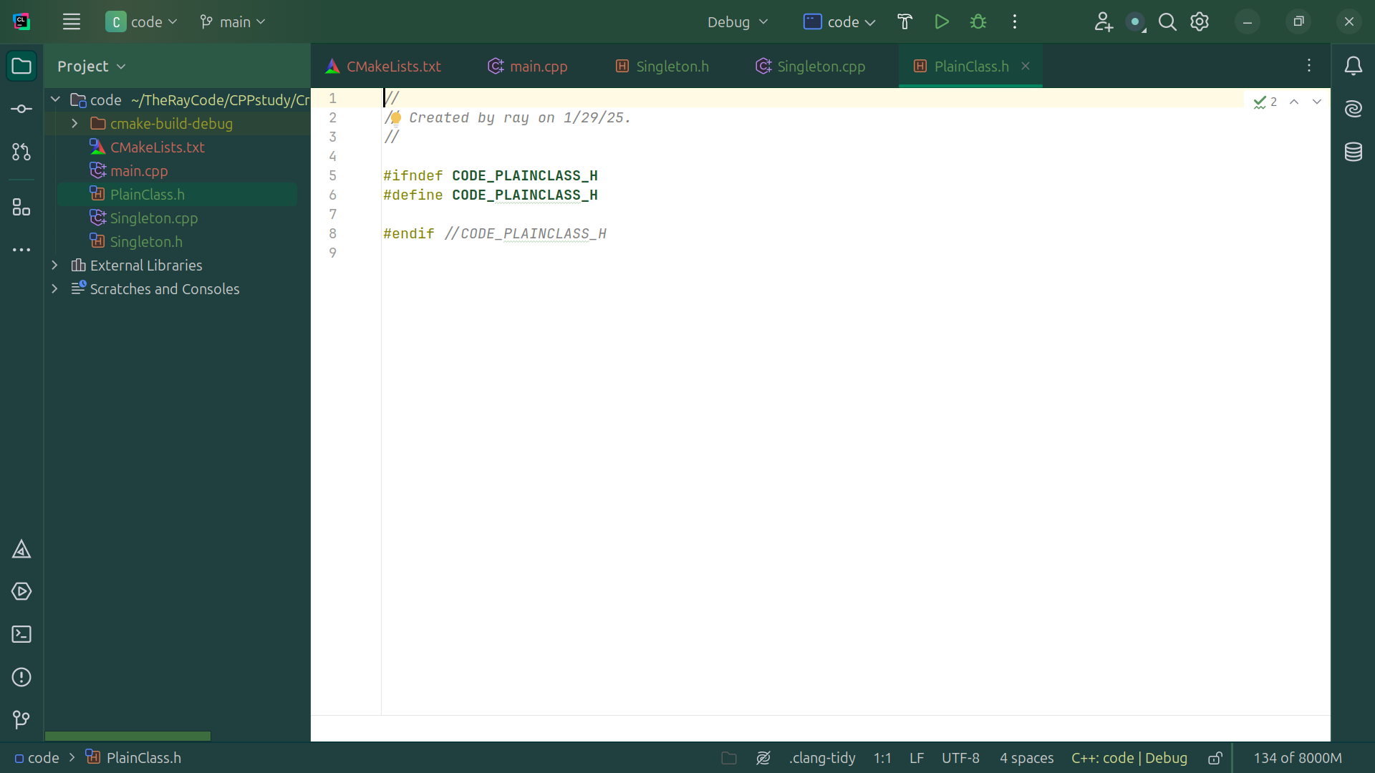
Notes:
We have our traditional define area

Slide 22
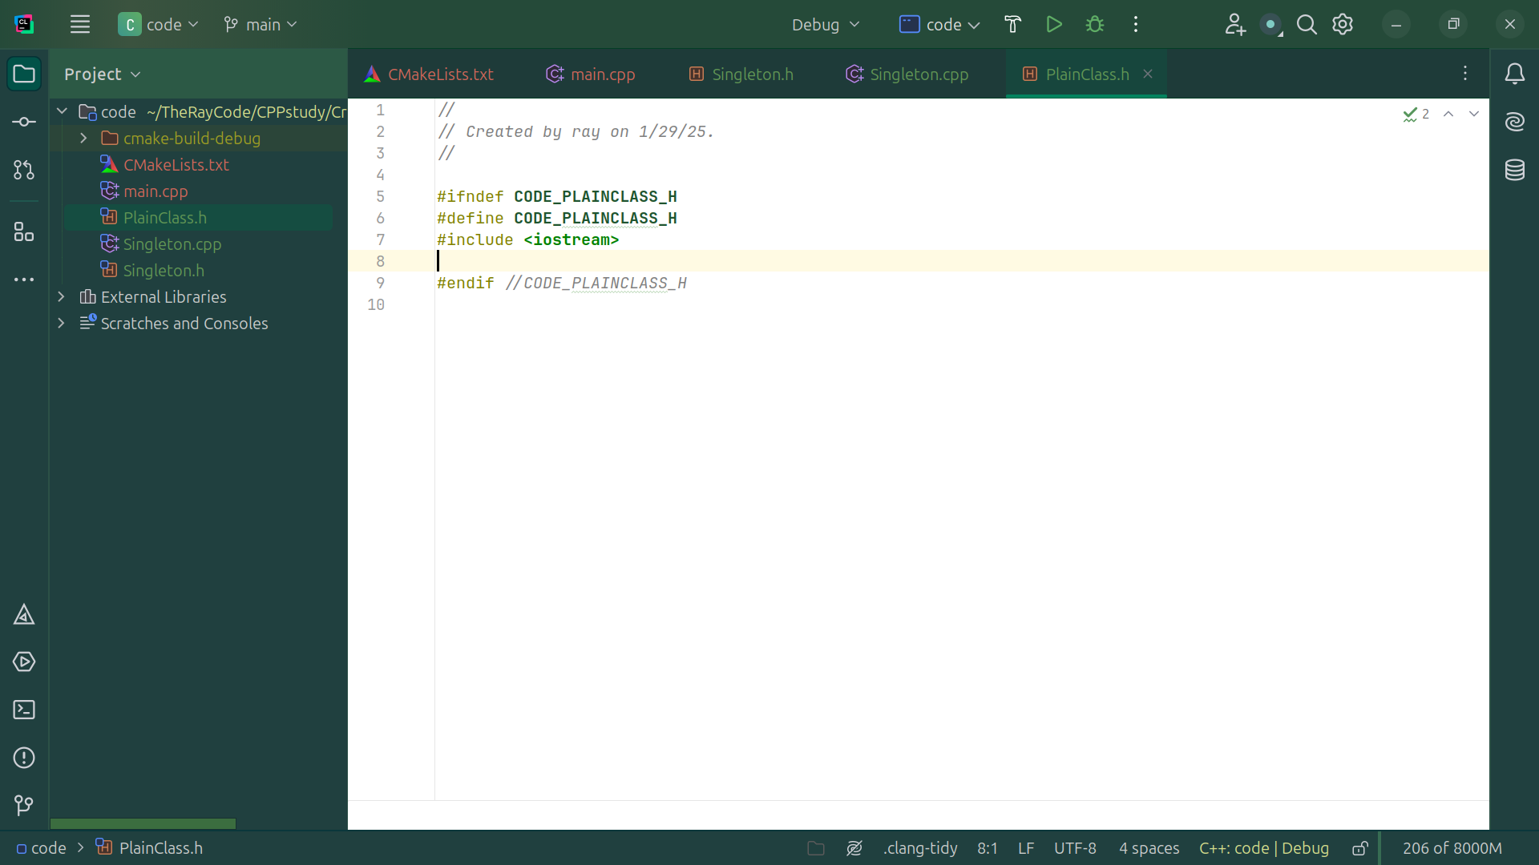
Notes:
We start off with an include for IO stream

Slide 23
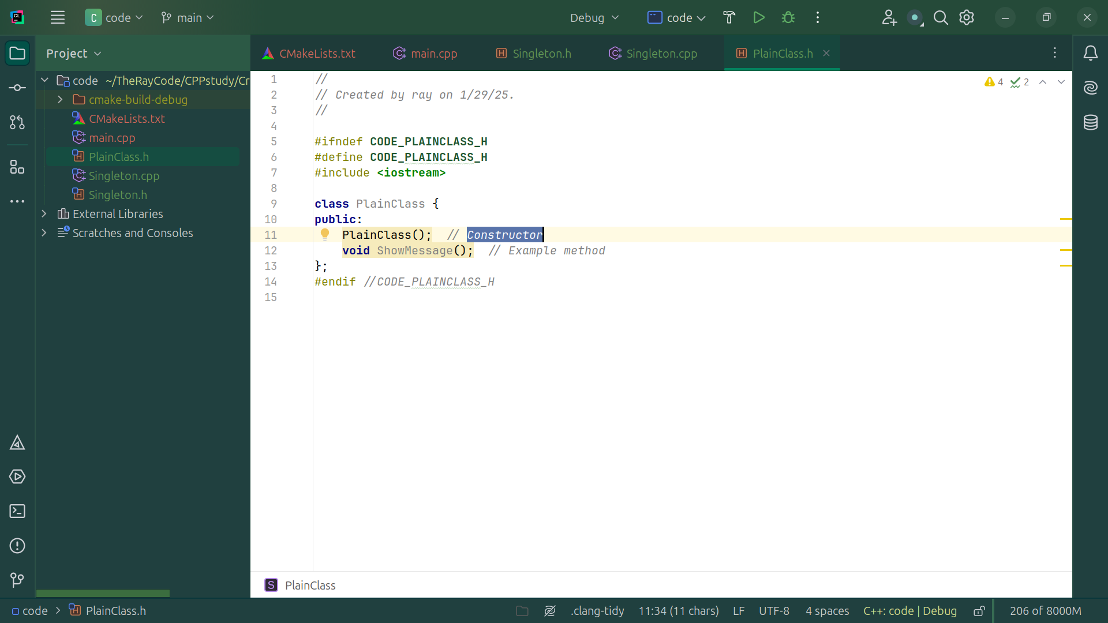
Notes:
And for our Plain Class we Show a simple message

Slide 24

Notes:
Now let’s go over to the cpp side of this Plain Class

Slide 25
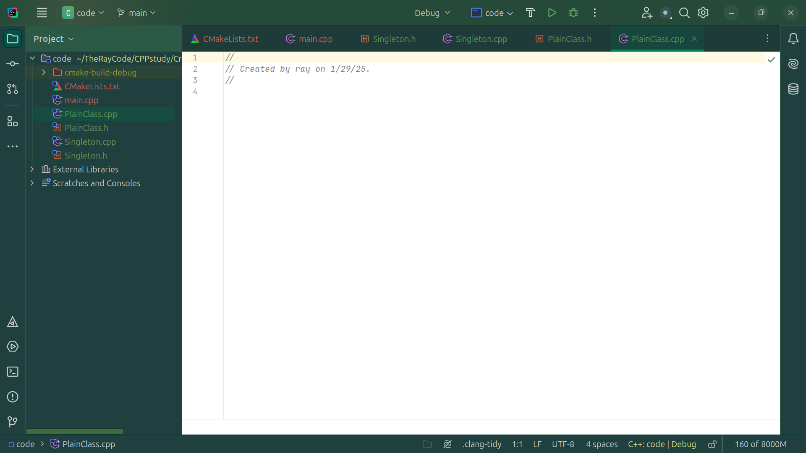
Notes:
In the CPP file

Slide 26

Notes:
We include the Plain Class dot h file

Slide 27
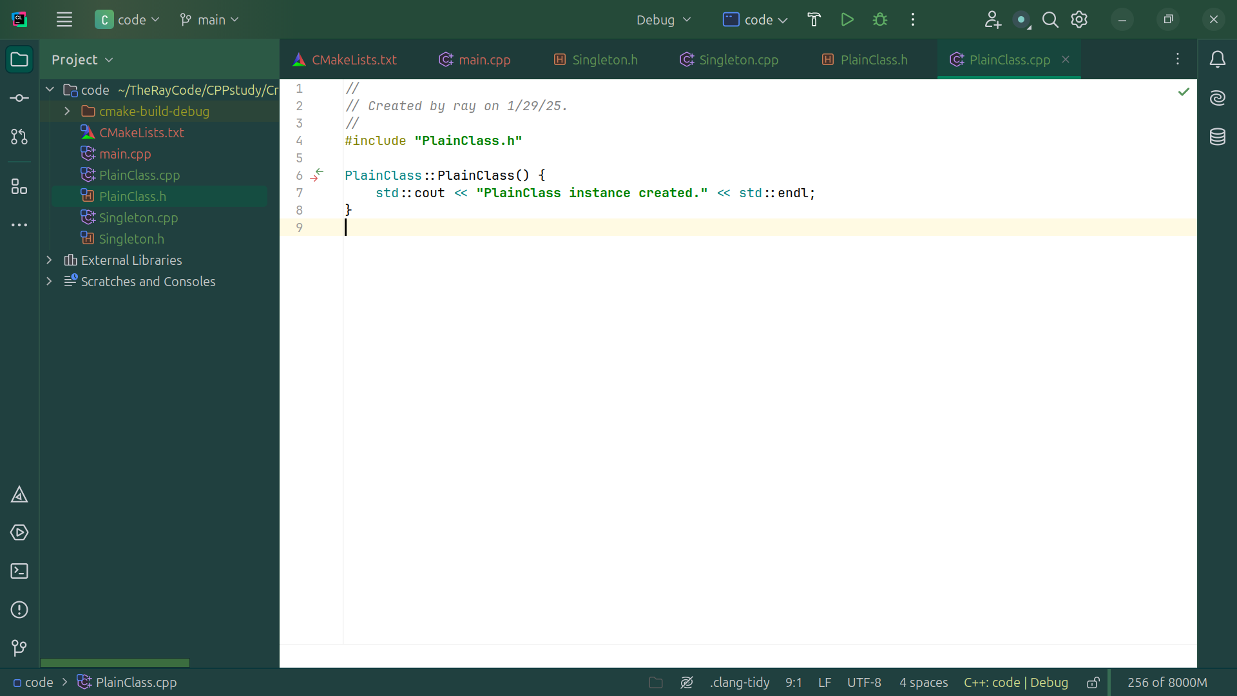
Notes:
And we have a Plain Class created message
The Constructor implementation

Slide 28
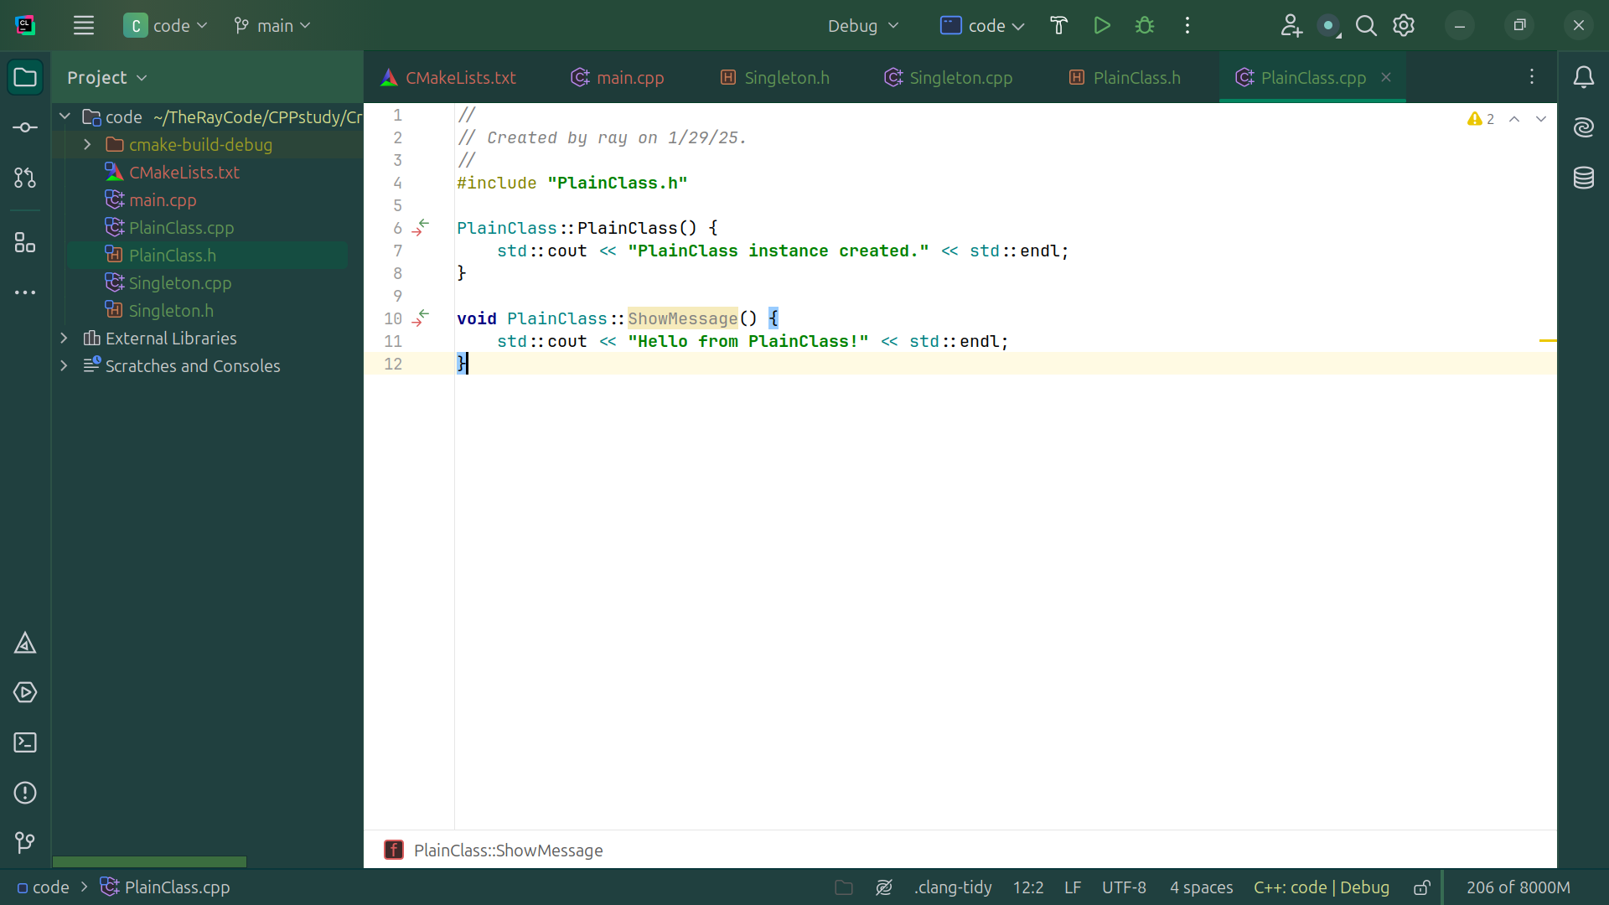
Notes:
Example method implementation

Slide 29
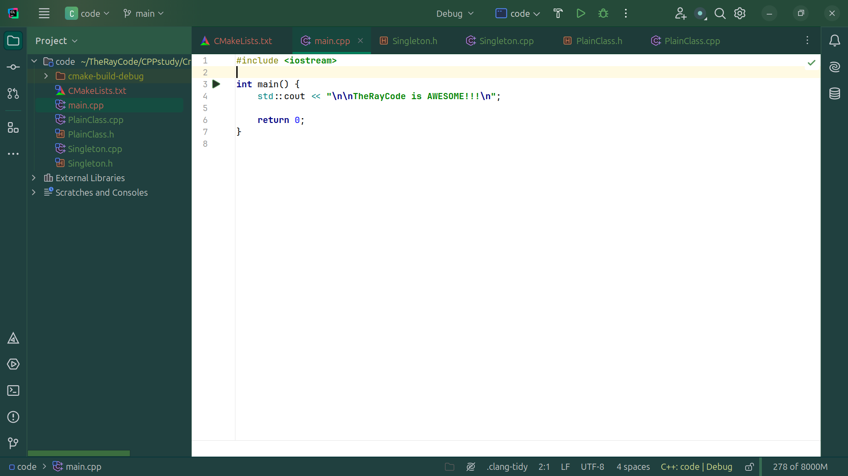
Notes:
Now we go to the main method do our demo
I the main dot cpp

Slide 30

Notes:
At the top we include the dot h files of Singleton and PlainClass

Slide 31

Notes:
We Get the first instance of Singleton

Slide 32

Notes:
We Get another instance of Singleton

Slide 33
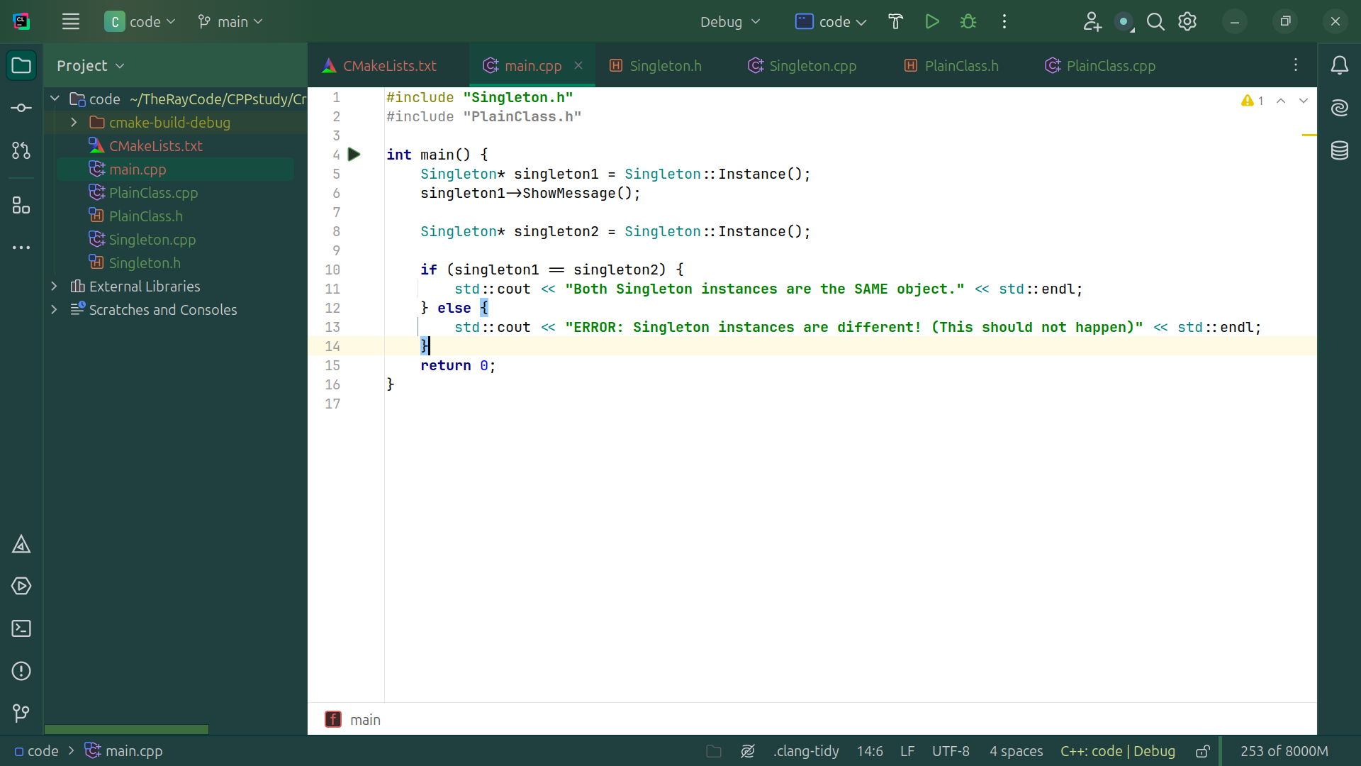
Notes:
We Verify that both Singleton instances are the same

Slide 34

Notes:
We have the message
Creating Plain Class instances

Slide 35
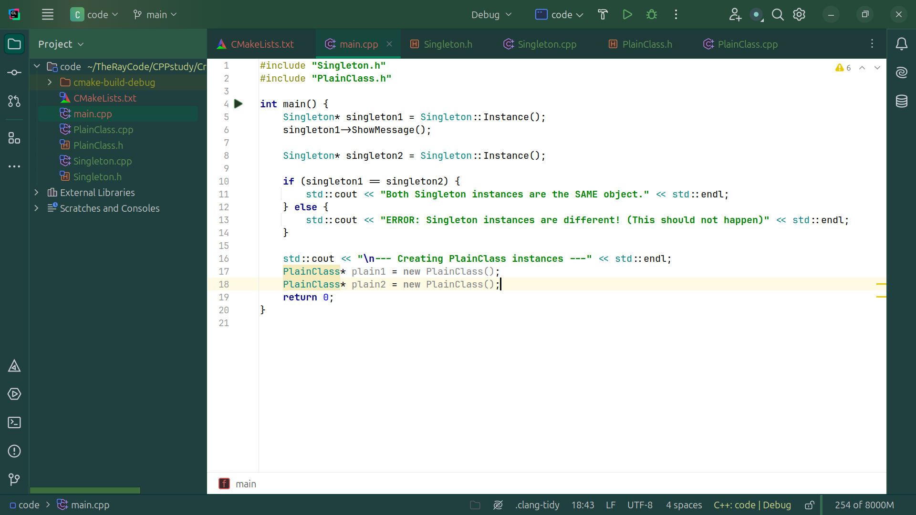
Notes:
we Create two separate instances of PlainClass

Slide 36
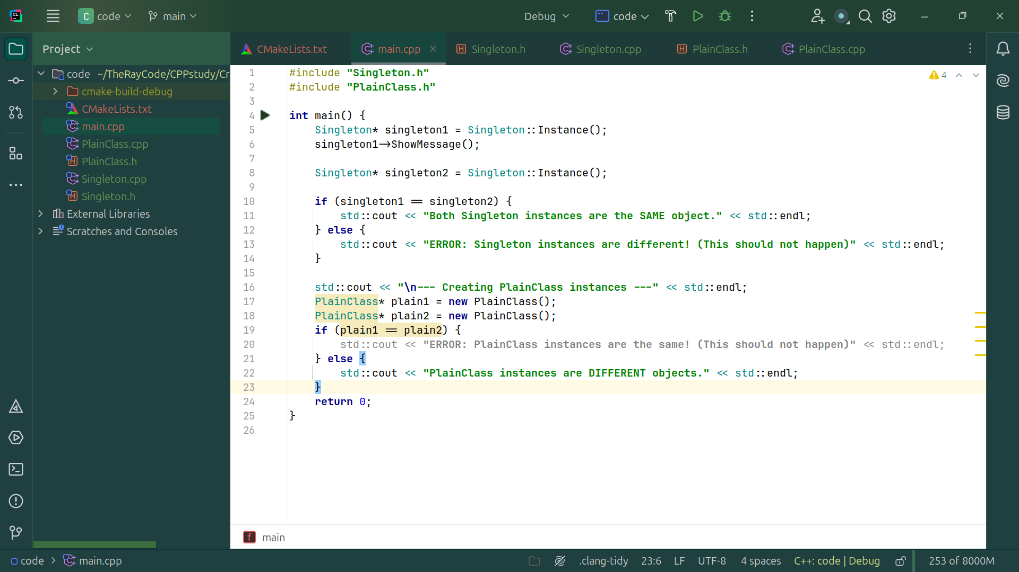
Notes:
Verify that the objects they are different

Slide 37
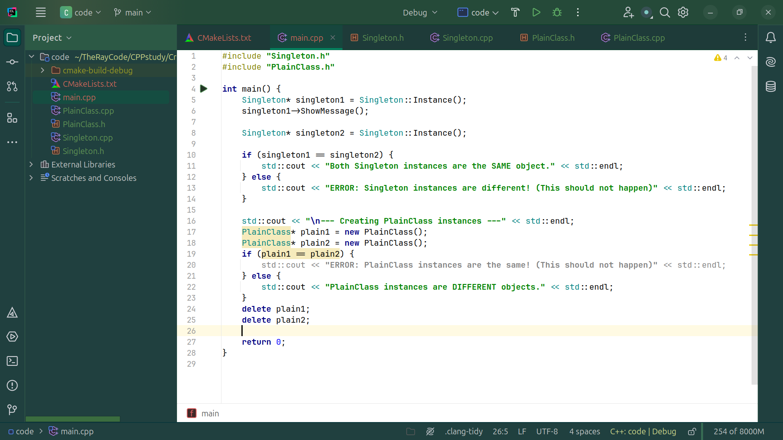
Notes:
Clean up allocated memory
Compile
And We get ...

Slide 38
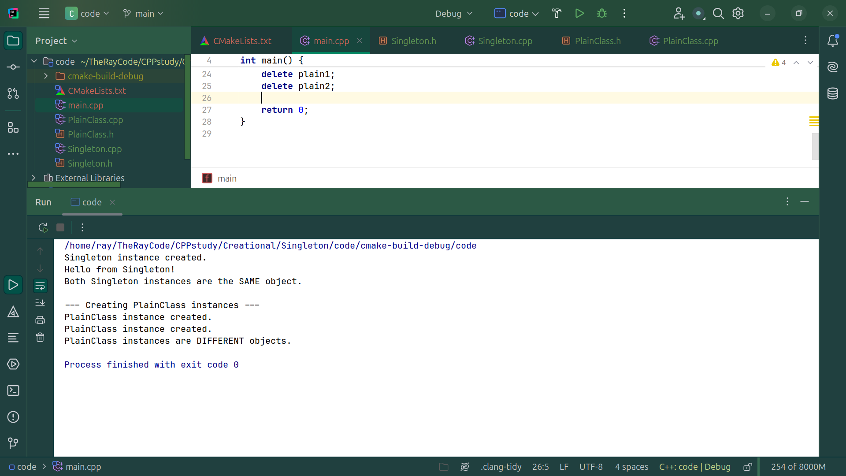
Notes:
Singleton instance created.
Hello from Singleton!
Both Singleton instances are the SAME object.
--- Creating PlainClass instances ---
PlainClass instance created.
PlainClass instance created.
PlainClass instances are DIFFERENT objects
My name is Ray
Keep Code with a smile

Slide 39
Notes:
Singleton instance created.
Hello from Singleton!
Both Singleton instances are the SAME object.
--- Creating PlainClass instances ---
PlainClass instance created.
PlainClass instance created.
PlainClass instances are DIFFERENT objects
My name is Ray
Keep Code with a smile

