Slide 1
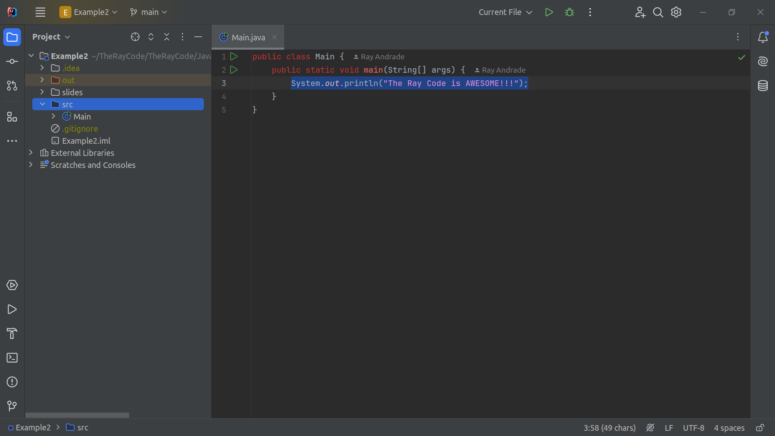
Notes:
In this show I will explore the Abstract Factory design pattern using Java

