Slide 1
Introduction to jQuery
By Raymond Nyaga
github.com/rayauxey

Slide 2
Javascript
HTML is the markup language; describes content
CSS is the styling language; for presentation
Javascript is the scripting language; implements behavior

Slide 3
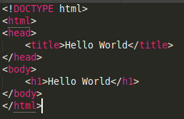
Document Object Model (DOM)
Document (HTML)

Slide 4
Document Object Model (DOM)
Document Object Model
html
head
body
title
h1
“Hello World”
“Hello World”

Slide 5
jQuery
It is a free and open source javascript library
Simplifies the process of writing javascript code
Mainly used to manipulate the DOM
Also used in UI and AJAX calls

Slide 6


Adding jQuery to an HTML page
Either download it and include the downloaded file:
Or use CDN (recommended):
Add jQuery code:

Slide 7




Javascript vs jQuery
Creating an element:
Removing an element:

Slide 8
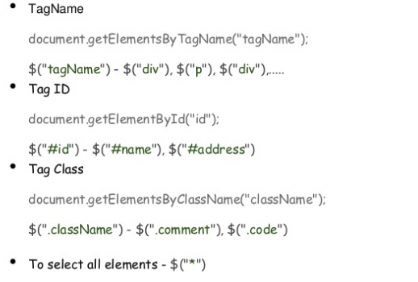
Basic Selectors

Slide 9
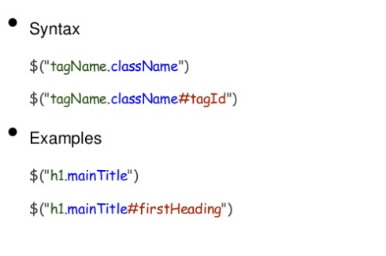
Selectors Combined

Slide 10
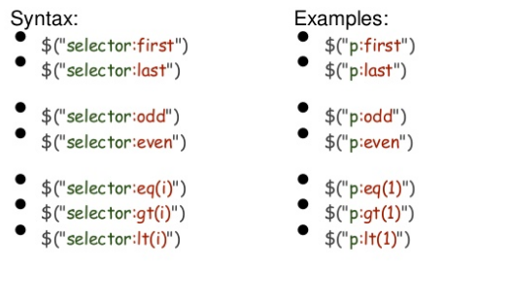
Index Filters

Slide 11
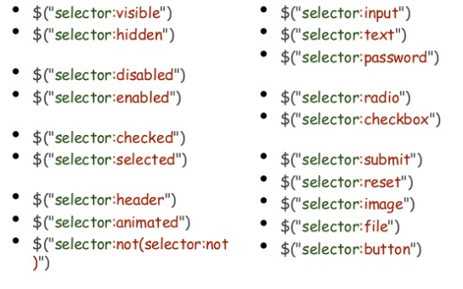
Condition Filters- Form Filters

Slide 12
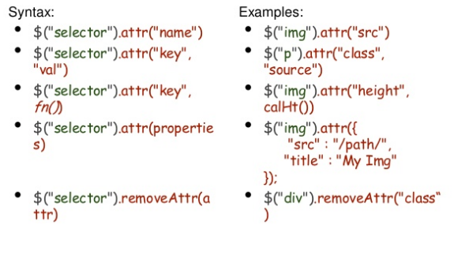
Retrieve, Set and Remove attributes

Slide 13
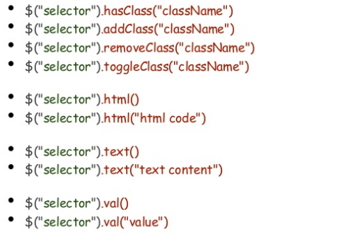
Class, HTML, Text, Value

Slide 14
Animations
show()
hide()
fadeIn()
fadeOut()
slideIn()
slideOut()

Slide 15
Thank You!

