Slide 1

Strategies for Landing Data Jobs at
Yu-Jui Chen
Notes:
Hi, I am Yu-Jui Chen. Today I am going to introduce‘Strategies for landing data jobs at amazon’

Slide 2

INTRODUCTION
Features
Title
Location
Posting date
Description
Basic Qualifications
Preferred Qualifications
3493 x 7
Notes:
And there is the dataset I analyzed. Features includes title of job, locations, overall description. Minimum Qualifications for the job, and prefer requirements for the job.

Slide 3
Best Time to Apply
Notes:
First strategy is for time. When will be the best time for applying?

Slide 4
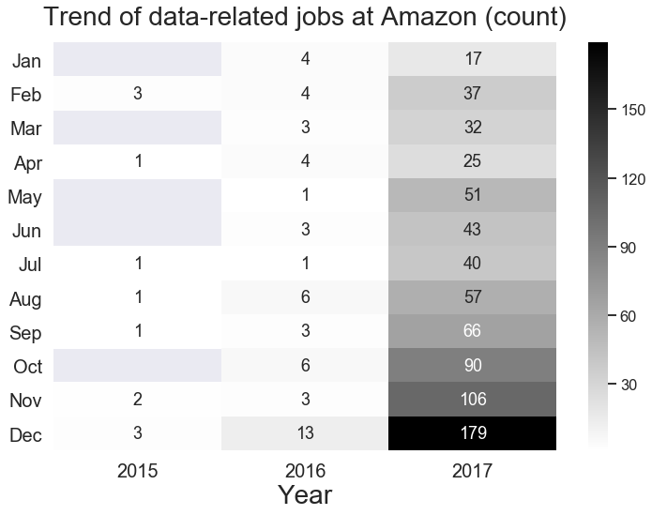
The Q4
is the best,
especially in December
Notes:
From this graph, we know two things:
1. Data jobs posted was growing from 2015 to 2017.
2. The fourth quarter is the best chance to apply Amazon data-related jobs especially in December. December got the maximum of posted jobs from 2015 to 2017.

Slide 5
Skill Set
Notes:
Second strategy is related to skills, I really want to answer What kind of Skills you better have for applying Amazon’s job.

Slide 6
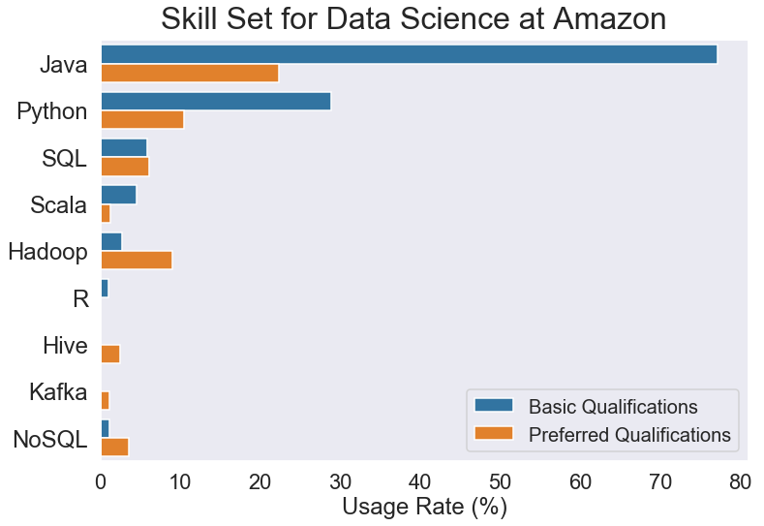
Skills,
such as
Hadoop,
Hive,
Kafka,
NoSQL,
make you be a stronger applicant.
Notes:
There are some interesting insights in skills:
1. Java is dominated language of data jobs at Amazon.
2. R wouldn't make you be a strong applicant for jobs at Amazon. It don’t take important role at Amazon.
3. Languages, such as Hadoop, Hive, Kafka, NoSQL, increased a lot from Basic requirement to preferred requirement, which means that Amazon hopes talents can handle large-scale data.
If you want to landing jobs at Amazon, prepare-well for Java and languages related to big data will make you be a stronger applicant.

Slide 7
Culture Fit
Notes:
Finally. What kind of Personalities
you need to highlight in your resume?

Slide 8
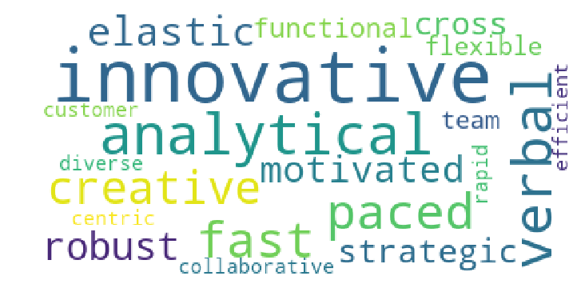
Highlight
characteristics,
Including
Innovative,
creative,
fast paced,
communicative,
flexible
team player
in your resume
Notes:
To better understand personalities that Amazon wants to have, I extract the words about personality by using natural language processing.
The ideal data person of Amazon is a person who are Innovative, creative, fast paced, communicative, flexible and also a team player.
Highlight those characteristics with your previous working experieces in resume will help to fit Amazon’s expectation.

Slide 9
Thank You ☺

