Slide 1
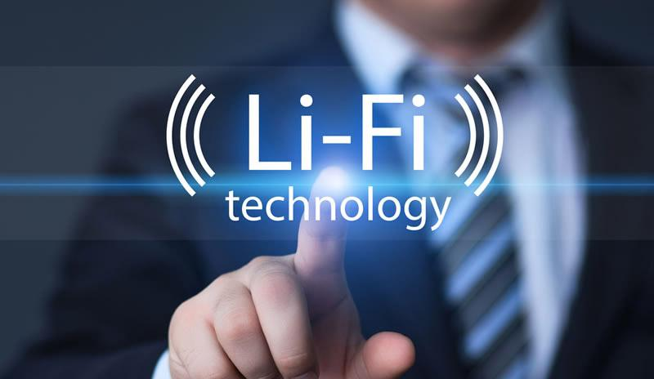

Slide 2
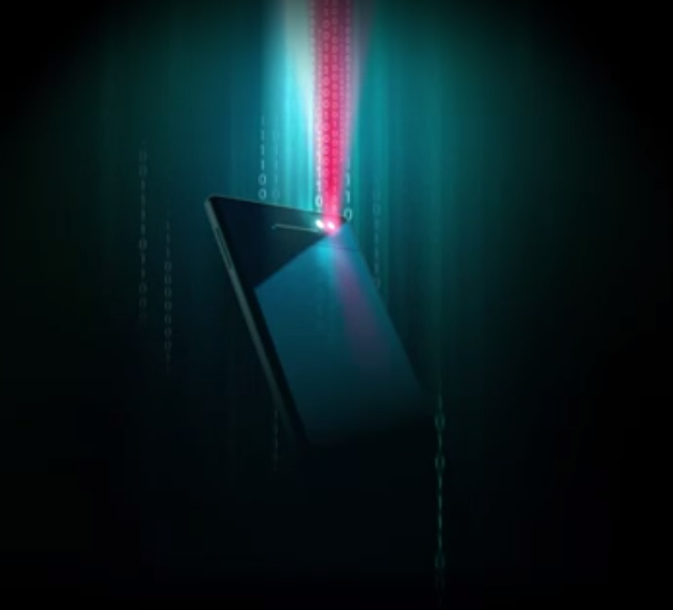
LiFi : Light Fidelity
Lifi is transmission of data through illumination, that varies in intensity faster than human eye can follow
WHAT IS LI-FI?

Slide 3
Lifi can be thought of as a light based wifi. That is, it uses light instead of radio waves to transmit information
And instead of lifi modems, lifi would use transceiver-fitted LED lamps that can light a room as well as transmit and receive information.
OVERVIEW

Slide 4
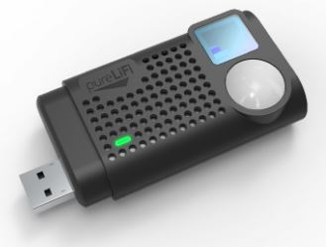
FIRST LI-FI DONGLE
A USB dongle like many other wifi dongles, that you can connect into any USB device and connect wirelessly to any li fi enabled light .

Slide 5
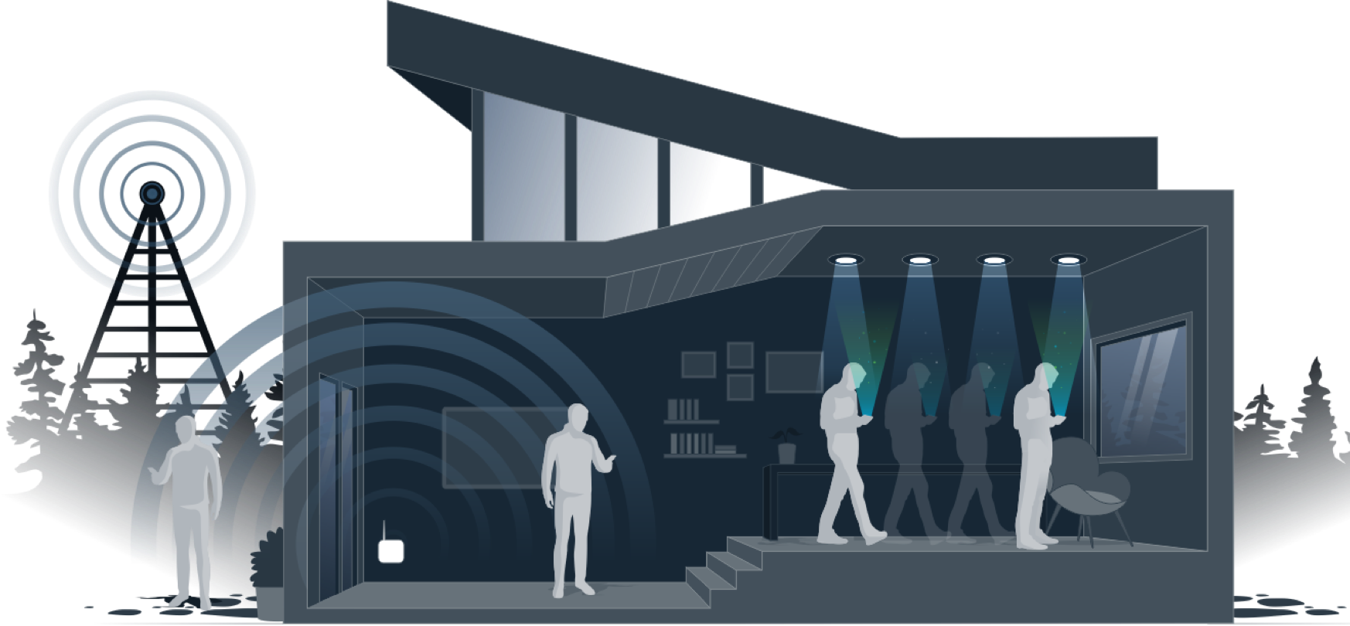

Slide 6
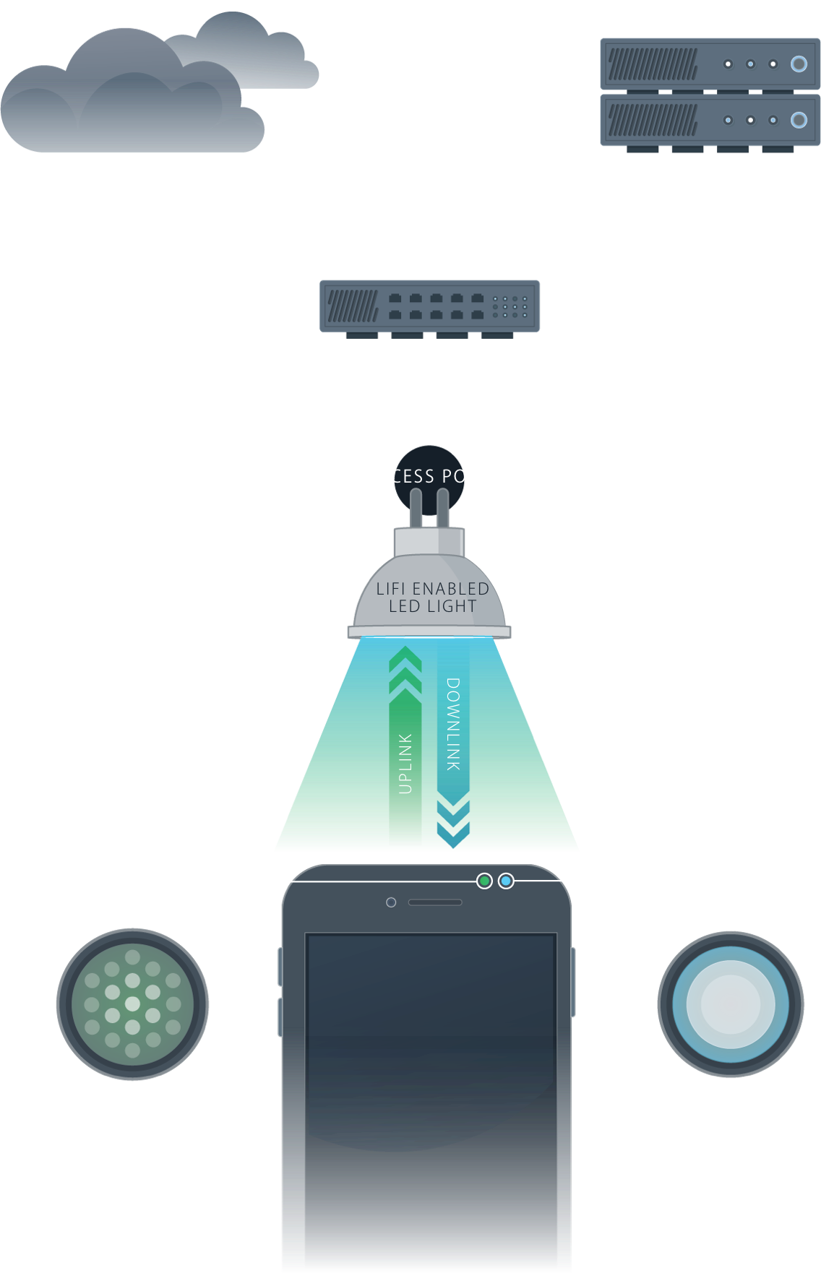
How does it work

Slide 7
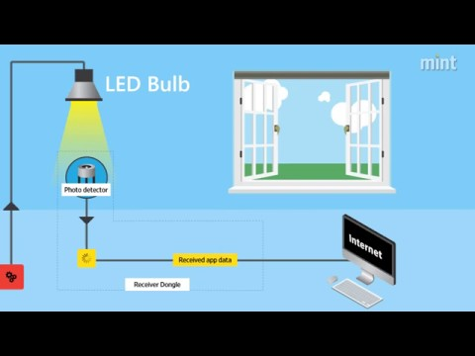
HOW DOES IT WORK

Slide 8

HISTORY
The technology truly began during the 1990s in countries like germany , korea , and japan where they discovered LED’s could be retrofitted to send information ,
Harald Haas to continued to wow the world with the potential of use light as a tool for communication and data sharing
HARALD HASS (inventor of lifi)

Slide 9
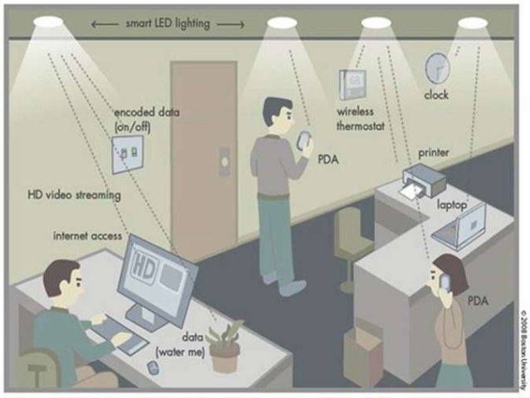
A world where every LED light is an internet access point

Slide 10
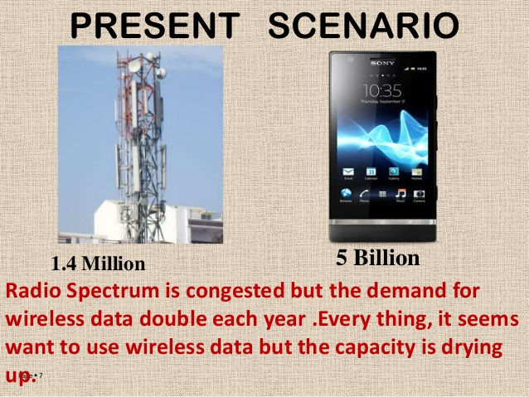
Why we need this new idea ?
Radio spectrum is congested but the demand for wireless data doubles each other.
Everything it seems want to use wireless data but the capacity is drying up.

Slide 11


Good bye wi-fi, hello li-fi!
Uses Light
LED transfers data
Uses radio waves
WiFi router transfers data
No Interference Issue
Cannot pass opaque objects
Interference by nearby routers
Passes opaque objects
Used in:
Airlines, undersea explorations, OT in hospitals, office/home
Used in:
Every possible area
Can work in high network density environment due to a large spectrum (or bandwidth) option.
Spectrum choices will eventually end in nearby future

Slide 12
PROS & CONS
Solved problems related to the insufficiency of radio frequency bandwidth as this technology uses Visible light spectrum.
High data transmission rates of up to 10Gbps.
Since light cannot penetrate walls, it provides privacy and security that Wi-Fi cannot.
Li-Fi has low implementation and maintenance costs.
Can be used in RF restricted environments.
By not using radio and serving same use case, it eases out interference and congestion of highly occupied radio bands i.e. ISM band used popularly in WPAN technologies.
Light can't pass through objects.
Interference from external light sources like sun, light, normal bulbs, opaque materials.
Area coverage is limited and indoor mostly.

Slide 13
WHO IS INVESTING ON LI-FI?
Li fi pioneer
pureLIFI : li flame ceiling unit, li flame desktop unit
Lucibel
A new space for business
Wealth of opportunities
Du and zero1
iOS 9 with lifi capabilities

Slide 14
APPLICATIONS
Traffic lights
In RF restricted environment
Airlines
Hospitals
Ocean beds
Street lamps

Slide 15
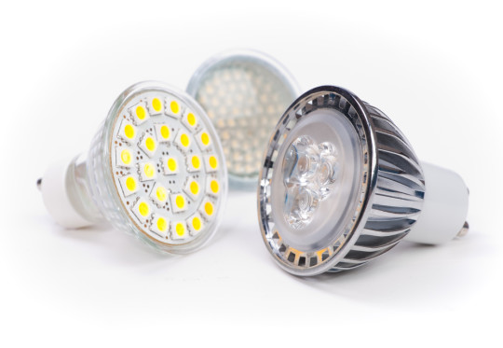
CONCLUSION
The possibilities are numerous and can be explored further .
If this technology can be put into practical use,
Then every bulb can be used something like wifi hotspot to transmit wireless data.

Slide 16


Resources
http://www.purelifi.com
http://www.youtube.com

Slide 17

US

