Slide 1

DriverPass System Analysis
Ray Cooke

Slide 2

System Requirements
Functional Requirements Include:
System validates users at sign in
System provides ability to reset passwords for all users {on their own account} and admins can reset all passwords.
Non-Functional requirements include:
System shall be hosted in the cloud
System shall have the ability to update subscription offerings
Notes:
Validating users at sign in is an essential step to ensure security. The client has requested that all users can reset their own passwords. Admins can reset all passwords and modify user access. Per client request, the system was designed to be hosted in the cloud. Client can also modify their subscription packages.

Slide 3
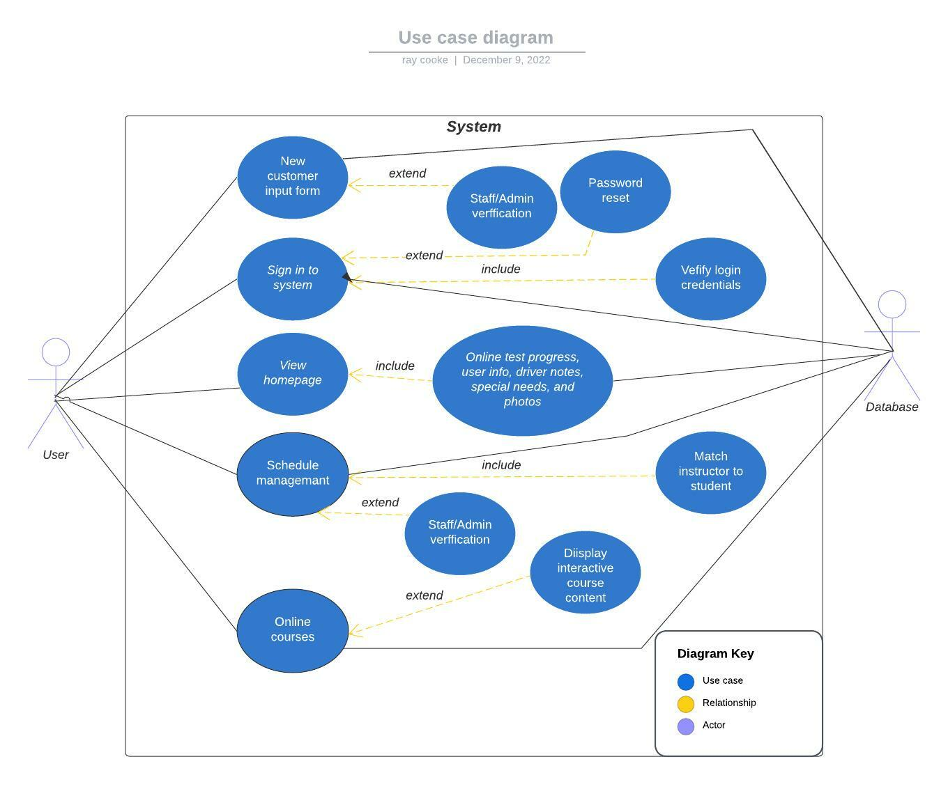
Use Case Diagram
[Insert your use case diagram here.]
Notes:
The actors involved in the use case diagram include students, admins, DriverPass staff, and the database. This diagram underscores the ability to intake new students, sign in, display the homepage, manage schedules, and interact with online courses. The needs of DriverPass are met by letting staff and admins act as a liaison between the user and database, which will maintain data and system integrity.

Slide 4
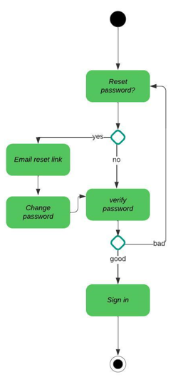
Activity Diagram
Notes:
This activity diagram breaks down the password reset use case. As a user goes to the log in page, there will be an option to reset their password. After resetting, the new password is verified and the user is granted access to the system.

Slide 5
Security
System design addresses security by:
Using exclusive usernames paired with passwords
Verifying login credentials
Using a RESTful API and DropWizard to link the client and server side securely
“UserRESTController” class provides admins the means to modify user access tiers and provide the least amount of access that users require
Notes:
Security is addressed by using personal usernames and passwords. The system verifies this before granting access. A secure medium will be used to link information from the cloud to the user. Users with admin level access will be able to create, update, and delete users in the system. This system was designed with the principal of least access in mind which reenforces its security.

Slide 6
System Limitations
This project has a three-month timeline towards completion
Budget
Members of the development team may not be familiar with serverless hosting requirements
Notes:
Three months should be enough time to build the system as requested. There may not be enough time for the client to request new features. I strongly recommend assigning developers that are familiar with API’s to the development of this system.

