Slide 1

帳務管理 > 發票清單管理
系統代號:
往來種類:
查詢
建立發票開立清單
 | 廠商統編 | 廠商 名稱 | 發票開立 編號 | 發票 金額 | 發票類別 | 課稅別 | 往來 註記
 | 02750963 | 工研院
 | 02750963 | 廠商A
 | 02750963 | 廠商B
Notes:
1.系統代號與往來種類讀取來源
系統代號:[mrlpub].[dbo].[syscd]
往來種類:[mrlpub].[dbo].[fgitri]
2.代號與查詢種類必須選擇，PowerBuilder按下查詢時T-SQL為
SELECT ia.ia_mfrno ,mfr.mfr_inm ,ia.ia_refno ,ia.ia_pyat ,ia.ia_fgitri ,ia.ia_invcd ,ia.ia_taxtp ,ia.ia_status ,ia.ia_iasdate ,ia.ia_iasseq ,ia.ia_iaitem ,ia.ia_syscd ,ia.ia_iano
FROM ia ,mfr
WHERE ( ia.ia_mfrno = mfr.mfr_mfrno ) and( ( ia.ia_status = ' ' ) and( dbo.ia.ia_syscd = :ra_syscd ) and( ia.ia_fgitri = :ra_fgitri ) )
ORDER BY ia.ia_iano ASC
3.未處理發票之邏輯 ia.ia_status = ' '
4.顯示之清單可以提供做為開立發票清單使用，按下”開立發票清單”後繼續處理
(1)取得目前年月 格式為yyyyMM ，用於做ias.ias_iasdate的比對 ，powerBuilder語法為
SELECT max(ias.ias_iasseq)
into :ls_seq
FROM ias
WHERE ( ias.ias_syscd = :ins_syscd ) AND
( ias.ias_iasdate = :yyyymm )
GROUP BY ias.ias_syscd,
ias.ias_iasdate
(2)定義seq序號，由系統代號判斷 T-SQL為
if ins_syscd = "C1" then
li_seq = 11000
else
if ins_syscd = "C2" then
li_seq = 12000
else
if ins_syscd = "C3" then
li_seq = 14000
else
if ins_syscd = "C4" then
li_seq = 16000
end if
新的發票開立單序號為目前各分類最大序號+1，格式必須為五碼數字固定
(3)將值塞入 ias 中，即建立一張新的發票開立單 T-SQL
INSERT INTO ias ( ias_syscd, ias_iasdate, ias_iasseq, ias_toitem,
ias_cancel, ias_trans_sap,
ias_createdate, ias_createmen, ias_fgitri )
VALUES ( :ins_syscd, :yyyymm, :ls_seq, '', '0', '0', :english_date,
:g_id, :ins_itriflag )
值說明
ias_syscd 即系統代號
ias_iasdate 即yyyyMM六碼年月
ias_iasseq 即ias中同類 seq最大值+1
ias_toitem 即此次備更新的發票單數量(被勾選的)
ias_createdate 即getdate 格式 yyyyMMdd
ias_fgitri :即往來種類
4.接著，再更新 ia ，被選的資料可能有多筆，所以這邊可能為批次更新
更新的目標即為2.的查詢結果中被勾選的資料
更新欄位為
dw_1.setitem(i,"ia_ia_iasdate", english_date)
dw_1.setitem(i,"ia_ia_iasseq", ls_seq)
dw_1.setitem(i,"ia_ia_iaitem", ls_iaitem)
其中， ls_iaitem為此次更新的資料由1開始起算，每筆加1，格式需為固定3碼數字
5.最後顯示一行訊息
messagebox("HELLO!!!請注意記注以下資訊!!!" , ls_msg)
ls_msg = "系統代號為：" + ins_syscd + " 轉檔年~月~：" + yyyymm + " 批次為：" + ls_seq

Slide 2
帳務管理 > 發票列印與回復
系統代號:
轉檔年月:
批次:
查詢
列印發票開立清單
列印發票開立單
列印發票郵寄單
發票開立清單回復
手動取回發票
 | 系統 代號 | 轉檔日期 | 批次 | 開立 單數 | 產生日 | 建立者 | 是否轉SAP | 是否 註銷
 | C1 | 201204 | 11101 | 1 | 20120501 | 葉瑞鳳 | 是 | 否
 | C1 | 201204 | 11102 | 2 | 20120502 | 葉瑞鳳 | 是 | 否
 | C1 | 201204 | 11103 | 3 | 20120503 | 葉瑞鳳 | 是 | 否
Notes:
1.透過系統代號與轉檔年月進行查詢 T-SQL
SELECT "ias"."ias_syscd" ,"ias"."ias_iasdate" ,"ias"."ias_iasseq" ,"ias"."ias_toitem" ,"ias"."ias_cancel" ,"ias"."ias_trans_sap" ,"ias"."ias_createdate" ,"ias"."ias_createmen" ,"ias"."ias_fgitri" ,"srspn"."srspn_cname"
FROM {oj "ias" LEFT OUTER JOIN "srspn" ON "ias"."ias_createmen" = "srspn"."srspn_empno"}
WHERE ( ias.ias_trans_sap = '0' )
2.根據所選擇的資料，按下”發票開立清單回復”，則進行以下T-SQL
UPDATE ia
SET ia_iasdate = '',
ia_iasseq = '',
ia_iaitem = '',
ia_status = ''
WHERE ( ia.ia_syscd = :sle_syscd.text ) AND
( ia.ia_iasdate = :sle_iasdate.text ) AND
( ia.ia_iasseq = :sle_seq.text ) ;
DELETE ias
WHERE ias_syscd =:sle_syscd.text and
ias_iasdate =:sle_iasdate.text and
ias_iasseq =:sle_seq.text
3.列印功能均參考P4~P7
4.發票開立清單回復
一次只能選擇一筆資料做回復，按下按鈕後執行下列DB更新
T-SQL:
UPDATE ia
SET ia_iasdate = '',
ia_iasseq = '',
ia_iaitem = '',
ia_status = ''
WHERE ( ia.ia_syscd = :sle_syscd.text ) AND
( ia.ia_iasdate = :sle_iasdate.text ) AND
( ia.ia_iasseq = :sle_seq.text ) ;
DELETE ias
WHERE ias_syscd =:sle_syscd.text and
ias_iasdate =:sle_iasdate.text and
ias_iasseq =:sle_seq.text
5.手動取回發票
直接執行store procedure sp_from_sap_001
使用try catch
若成功則顯示”發票號碼已取回”
若有任何意外狀況，則顯示”執行sp_to_sap_001失敗，未成功取回”
會議中紀錄:
回復與取回發票動作時需提供confirm message
已轉SAP之資料，勾選後按下回復時，會提示訊息“已轉SAP不可回復，請連繫會計”

Slide 3
發票開立清單
系統代號:C1
轉檔年月: 201204
批次: 11101
列印發票開立單
項次 | 發票開立 編號 | 廠商統編 | 廠商 名稱 | 發票號碼 | 發票 日期 | 往來 種類 | 人工產 生註記 | 系統代號 | 轉檔年月 | 批次
Notes:
單一筆發票開立清單中，逐筆列出所屬的發票開立單
此畫面為p2點選任一筆清單資料Lnik，顯示的Detail清單
T-SQL為
SELECT "ia"."ia_iaitem" ,"ia"."ia_refno" ,"ia"."ia_mfrno" ,"mfr"."mfr_inm" ,"ia"."ia_invno" ,"ia"."ia_invdate" ,"ia"."ia_fgitri"
,"ia"."ia_fgnonauto" ,"ia"."ia_syscd" ,"ia"."ia_iasdate" ,"ia"."ia_iasseq"
FROM "ia" ,"mfr"
WHERE ( "ia"."ia_mfrno" = "mfr"."mfr_mfrno" ) and ( ( ia.ia_syscd = :ra_syscd ) and ( ia.ia_iasdate = :ra_iasdate ) and ( ia.ia_iasseq = :ra_iasseq ) )
可以直接列印，列印時直接把畫面欄位產生出來即可

Slide 4
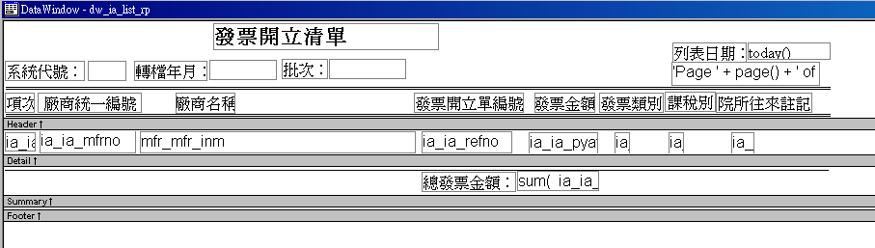
Notes:
列印發票開立清單
T-SQL
SELECT "ia"."ia_mfrno" ,"mfr"."mfr_inm" ,"ia"."ia_refno" ,"ia"."ia_pyat" ,"ia"."ia_fgitri" ,"ia"."ia_invcd" ,"ia"."ia_taxtp" ,
"ia"."ia_status" ,"ia"."ia_iasdate" ,"ia"."ia_iasseq" ,"ia"."ia_iaitem"
FROM "ia" ,"mfr"
WHERE ( "ia"."ia_mfrno" = "mfr"."mfr_mfrno" ) and ( ( ia.ia_syscd = :ra_syscd ) and ( ia.ia_iasdate = :ra_yyyymm ) and ( ia.ia_iasseq = :ra_seq ) )

Slide 5
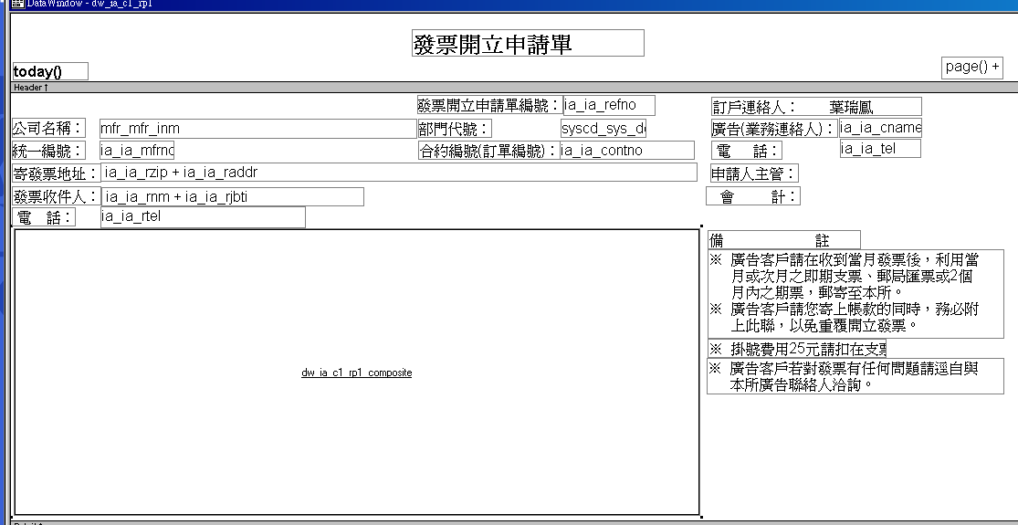
Notes:
列印發票開立申請單
T-SQL:
SELECT "mfr"."mfr_inm" ,"ia"."ia_mfrno" ,"ia"."ia_rzip" ,"ia"."ia_raddr" ,"ia"."ia_rnm" ,"ia"."ia_rjbti" ,"ia"."ia_rtel" ,"ia"."ia_refno" ,
"ia"."ia_syscd" ,"ia"."ia_iano" ,"ia"."ia_cname" ,"ia"."ia_tel" ,"ia"."ia_contno" ,"syscd"."sys_deptcd"
FROM "ia" ,"mfr" ,"syscd"
WHERE ( "ia"."ia_mfrno" = "mfr"."mfr_mfrno" ) and ( "ia"."ia_syscd" = "syscd"."sys_syscd" ) and
( ( ia.ia_syscd = :ra_syscd ) and ( ia.ia_iasdate = :ra_iasdate ) and ( ia.ia_iasseq = :ra_iasseq ) )

Slide 6
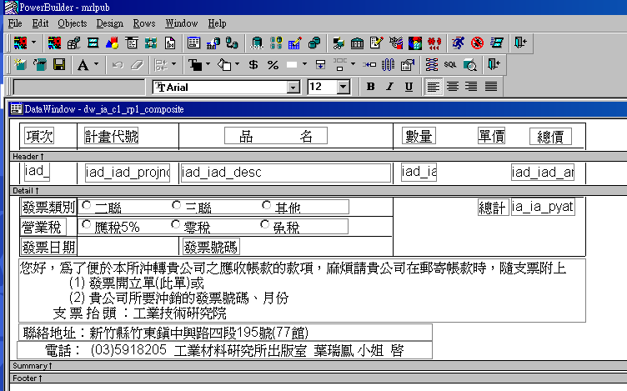
Notes:
列印發票開立申請單(續)-前一頁左下角空白方塊區域
T-SQL
SELECT "iad"."iad_iaditem" ,"iad"."iad_projno" ,"iad"."iad_desc" ,"iad"."iad_qty" ,"iad"."iad_uprice" ,"ia"."ia_syscd" ,"ia"."ia_iano" ,"ia"."ia_invcd“
,"ia"."ia_taxtp" ,"ia"."ia_pyat" ,"iad"."iad_amt"
FROM "ia" ,"iad"
WHERE ( "ia"."ia_syscd" = "iad"."iad_syscd" ) and ( "ia"."ia_iano" = "iad"."iad_iano" ) and ( ( ia.ia_syscd = :ra_syscd ) and ( ia.ia_iano = :ra_iano ) )
ORDER BY "ia"."ia_syscd" ASC,"ia"."ia_iano" ASC,"iad"."iad_iaditem" ASC,"iad"."iad_projno" ASC

Slide 7
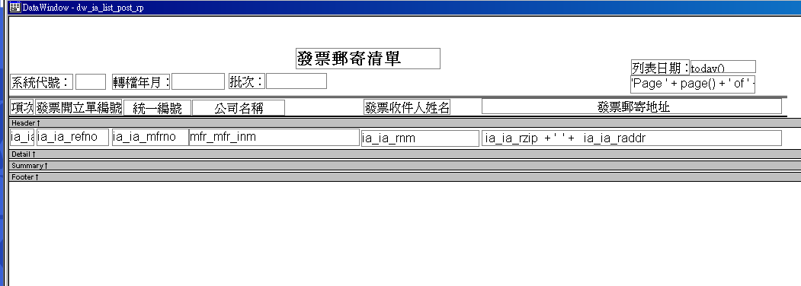
Notes:
列印發票郵寄單
SELECT "ia"."ia_mfrno" ,"mfr"."mfr_inm" ,"ia"."ia_refno" ,"ia"."ia_invcd" ,"ia"."ia_taxtp" ,"ia"."ia_status" ,"ia"."ia_iasdate" ,
"ia"."ia_iasseq" ,"ia"."ia_iaitem" ,"ia"."ia_rnm" ,"ia"."ia_rzip" ,"ia"."ia_raddr"
FROM "ia" ,"mfr"
WHERE ( "ia"."ia_mfrno" = "mfr"."mfr_mfrno" ) and ( ( ia.ia_syscd = :ra_syscd ) and ( ia.ia_iasdate = :ra_yyyymm ) and ( ia.ia_iasseq = :ra_seq ) )

Slide 8
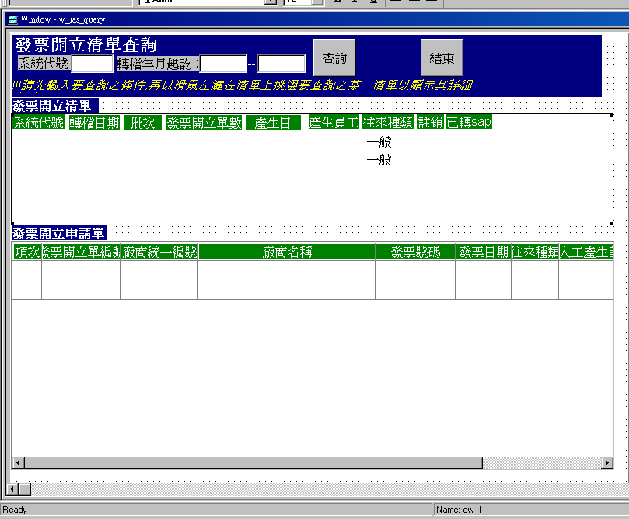
Notes:
查詢發票開立清單
T-SQL
SELECT ias.ias_syscd , ias.ias_iasdate , ias.ias_iasseq , ias.ias_toitem , ias.ias_cancel , ias.ias_trans_sap , ias.ias_createdate , ias.ias_createmen , ias.ias_fgitri , srspn.srspn_cname
FROM ias , srspn
WHERE ( ias.ias_createmen *= srspn.srspn_empno)
發票開立申請單資料
T-SQL
SELECT "ia"."ia_iaitem" ,"ia"."ia_refno" ,"ia"."ia_mfrno" ,"mfr"."mfr_inm" ,"ia"."ia_invno" ,"ia"."ia_invdate" ,"ia"."ia_fgitri" ,"ia"."ia_fgnonauto" ,"ia"."ia_syscd" ,"ia"."ia_iasdate" ,"ia"."ia_iasseq"
FROM "ia" ,"mfr"
WHERE ( "ia"."ia_mfrno" = "mfr"."mfr_mfrno" ) and ( ( ia.ia_syscd = :ra_syscd ) and ( ia.ia_iasdate = :ra_iasdate ) and ( ia.ia_iasseq = :ra_iasseq ) )

