Slide 1
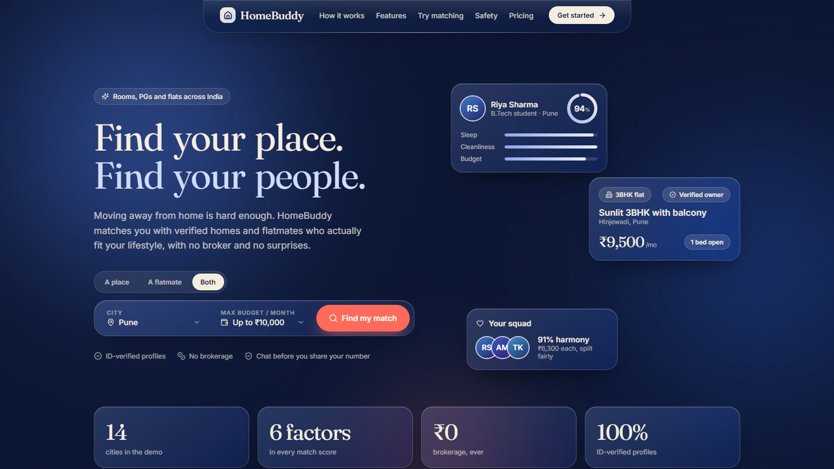
TEAM PROJECT
HomeBuddy
Find your place. Find your people.
A platform that matches people living away from home with compatible flatmates and verified rooms, PGs and flats across India. No broker.
Jatin · Shivansh · Ajay
Notes:
JATIN: Greet the class. HomeBuddy helps anyone who has moved away from home find a place and the right people to share it with. Today: the problem, our solution, a live demo of the working prototype, the business model, and our plan.

Slide 2
THE PROBLEM
Moving away is hard. Finding a home is harder.
01
02
03
A month of rent, gone
Strangers, not flatmates
Scattered and risky search
Brokers usually charge about one month of rent before you have even unpacked. For a student or an intern this is a huge hit.
Sleep time, cleanliness, food, guests, smoking. One mismatch and the flat stops feeling like home.
Group chats, social posts and listing apps. No way to know who is real, and no way to know who you would live with.
Existing apps list properties, or list people. None does both.
HomeBuddy
2
Notes:
JATIN: Tell a short story. Think of a first-year student or a first-job intern arriving in a new city with a suitcase. Three things go wrong: broker fees, bad flatmate matches, and a scattered, risky search.

Slide 3
HOW MANY PEOPLE
Millions live, study and work away from home.
4.33 crore
4.14 crore
15 days to 1 month
students enrolled in higher education in India
inter-State migrant workers counted in India
of rent: what brokers commonly charge tenants in big cities
AISHE 2021-22, via Indian Express
Census 2011, Rajya Sabha reply
Times of India; Housing.com
What it means for one person: on a Rs 10,000 room, a one-month broker fee is Rs 10,000, about 8% of a year of rent, paid before you have lived there a day.
These numbers show how big the group is. No official count says how many struggle to find a compatible home, so we will measure that with a class survey.
HomeBuddy
3
Notes:
JATIN: These are official or published numbers. They show how large the group is that moves away from home. Be honest: no official statistic counts how many of them struggle to find a safe, compatible home. That is why we plan a short class survey. Sources are listed at the bottom of the slide.

Slide 4
WHY IT MATTERS
A bad housing match does not end after a month.
RIGHT AWAY
EVERY NIGHT
OVER A SEMESTER
OVER THE YEARS
Money
Sleep and focus
Mood and grades
Studies and career
Brokerage every time you move, plus money tied up in deposits. Move twice in a year on a Rs 10,000 room and fees alone are Rs 20,000.
Poor sleep hurts concentration, memory and academic performance in college students.
In a study of college roommates, low mood and low grades spread between close roommates. As symptoms spread, the roommate's GPA fell.
Students who start with depressive symptoms tend to get lower grades and are more likely to drop out in the first two years.
Illustrative, one-month brokerage
NIH PMC review, 2025
PLOS ONE, 2023
PLOS ONE, 2023, citing earlier work
Most research is on college roommates abroad. It shows the pattern, not an Indian measurement. Good matching is prevention.
HomeBuddy
4
Notes:
JATIN: Connect the problem to the long term. Money goes first. Then sleep and focus, then mood and grades, then bigger risks like falling behind or dropping out. Be clear that the research is mostly on college roommates abroad: it shows the pattern, not an Indian measurement. This is why matching people well is prevention, not a nice-to-have.

Slide 5
WHO IT IS FOR
Everyone who moves away from home.
Seekers (demand)
Owners (supply)
School and college students, including out-of-state
Interns and trainees
First-job working professionals
People relocating for a new job
Exam aspirants in coaching cities
PG owners and hostel operators
Landlords with flats to fill
Tenants with a spare bed or room
Partners: tiffin, furniture rental, movers, Wi-Fi
Two sides, one platform: owners fill beds faster, seekers find a safe home and compatible people.
HomeBuddy
5
Notes:
JATIN: Two sides of one marketplace. People who need a place and a flatmate, and owners with empty beds who want reliable tenants. Not only students: also interns, first-job workers, people switching cities and exam aspirants in coaching cities.

Slide 6
OUR SOLUTION
HomeBuddy matches people and places together.
Take a two-minute lifestyle quiz. Get verified flatmates and homes ranked by a transparent compatibility score. Team up to rent a bigger flat for less.
1
2
3
4
Lifestyle quiz
Verified profiles
Place + people
Squad Up
Sleep, cleanliness, food, habits, guests, noise and budget in nine quick questions.
College ID, office email or government ID badges for people and owners.
Homes ranked by fit with the people already living there. People ranked by fit with you.
Matched people rent a bigger flat together, see group harmony and split rent fairly.
Plus add-ons: tiffin, furniture rental, movers and Wi-Fi setup.
HomeBuddy
6
Notes:
JATIN: One sentence pitch, then the four pillars. The key difference from every other app is that we match the people AND the place, and we show why a match works.

Slide 7
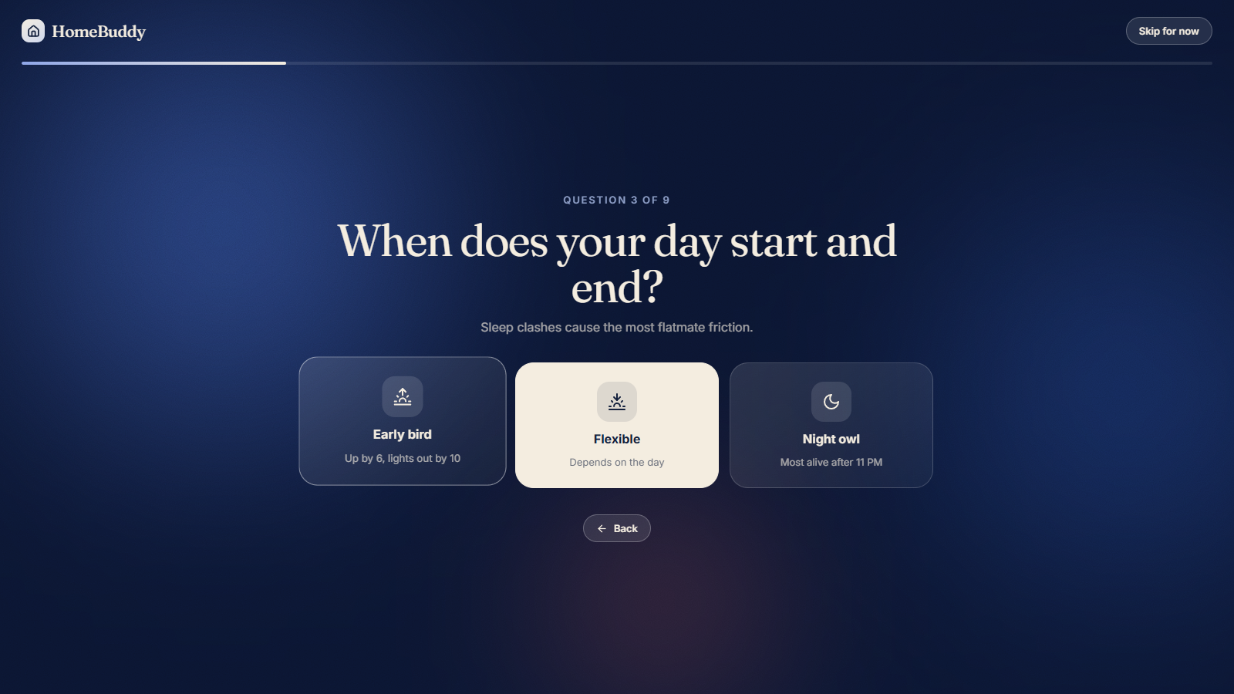
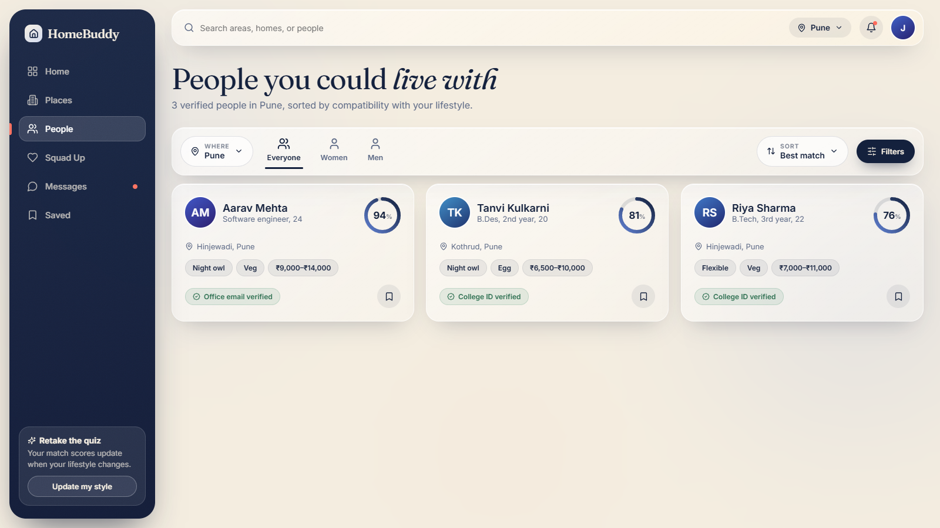
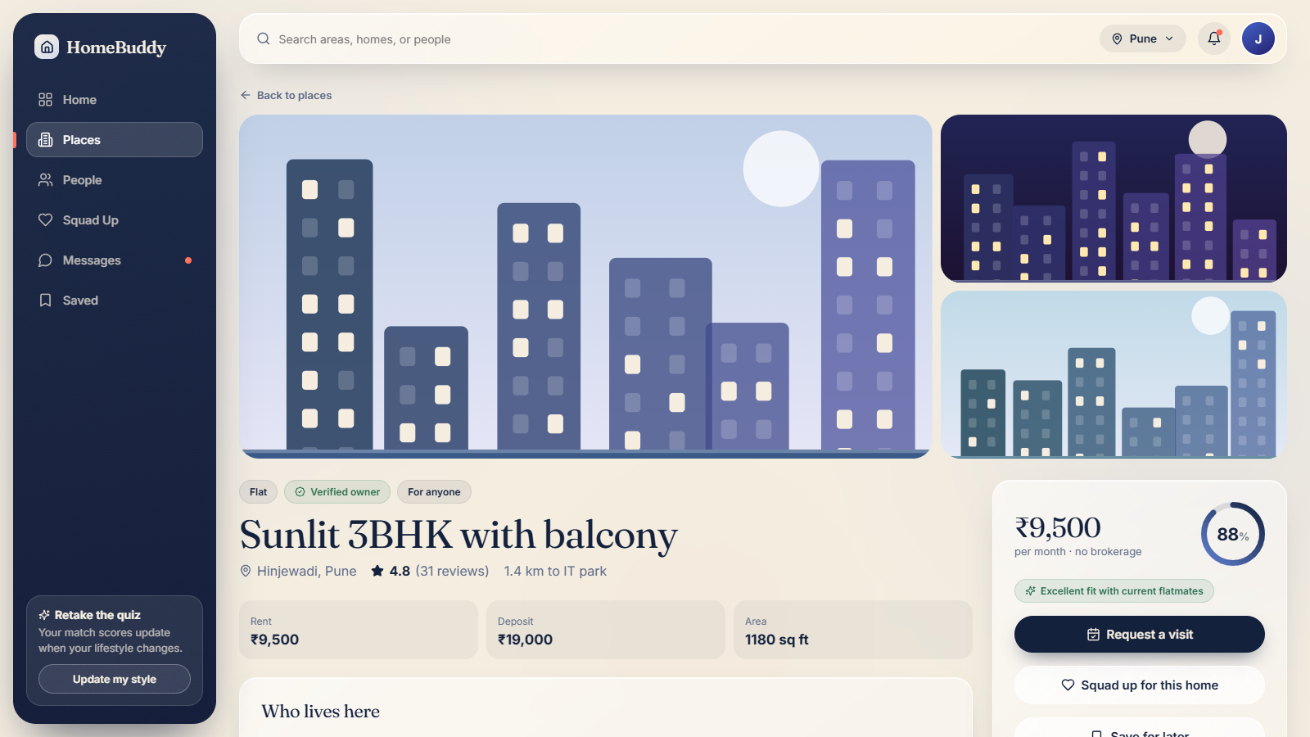
HOW IT WORKS
Three steps from new city to new home.
1
Tell us how you live
2
Meet your matches
3
Move in with confidence
A two-minute quiz.
Ranked by a clear score.
Chat, squad up, split rent.
HomeBuddy
7
Notes:
JATIN: Walk through the three steps while pointing at the screenshots. These are real screens from our prototype.

Slide 8
THE MATCHING ENGINE
A compatibility score you can see and trust.
Six factors, each scored 0 to 100 and explained in words.
Weights reflect which clashes cause the most conflict: cleanliness and sleep rhythm count most.
Homes get a fit score too: the average match with current residents.
Group harmony for Squad Up is the average of every pair.
Weight of each factor
Cleanliness
22%
Sleep rhythm
20%
Guests and noise
16%
Budget overlap
16%
Smoking and drinking
14%
Food habits
12%
HomeBuddy
8
Notes:
JATIN: This is real logic in the prototype, not a mock number. Six factors, each weighted by how often it causes flatmate conflict. Every score comes with plain-language reasons, so users know why someone is a good match.

Slide 9
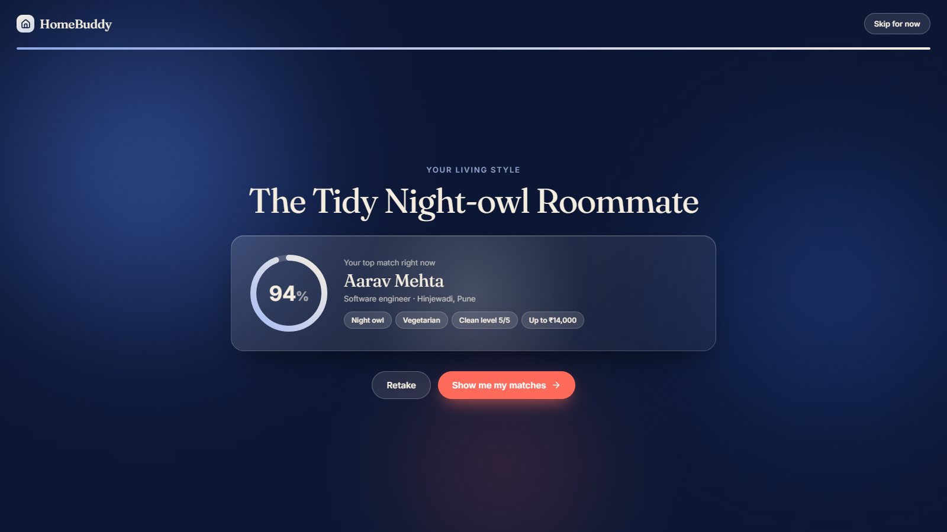
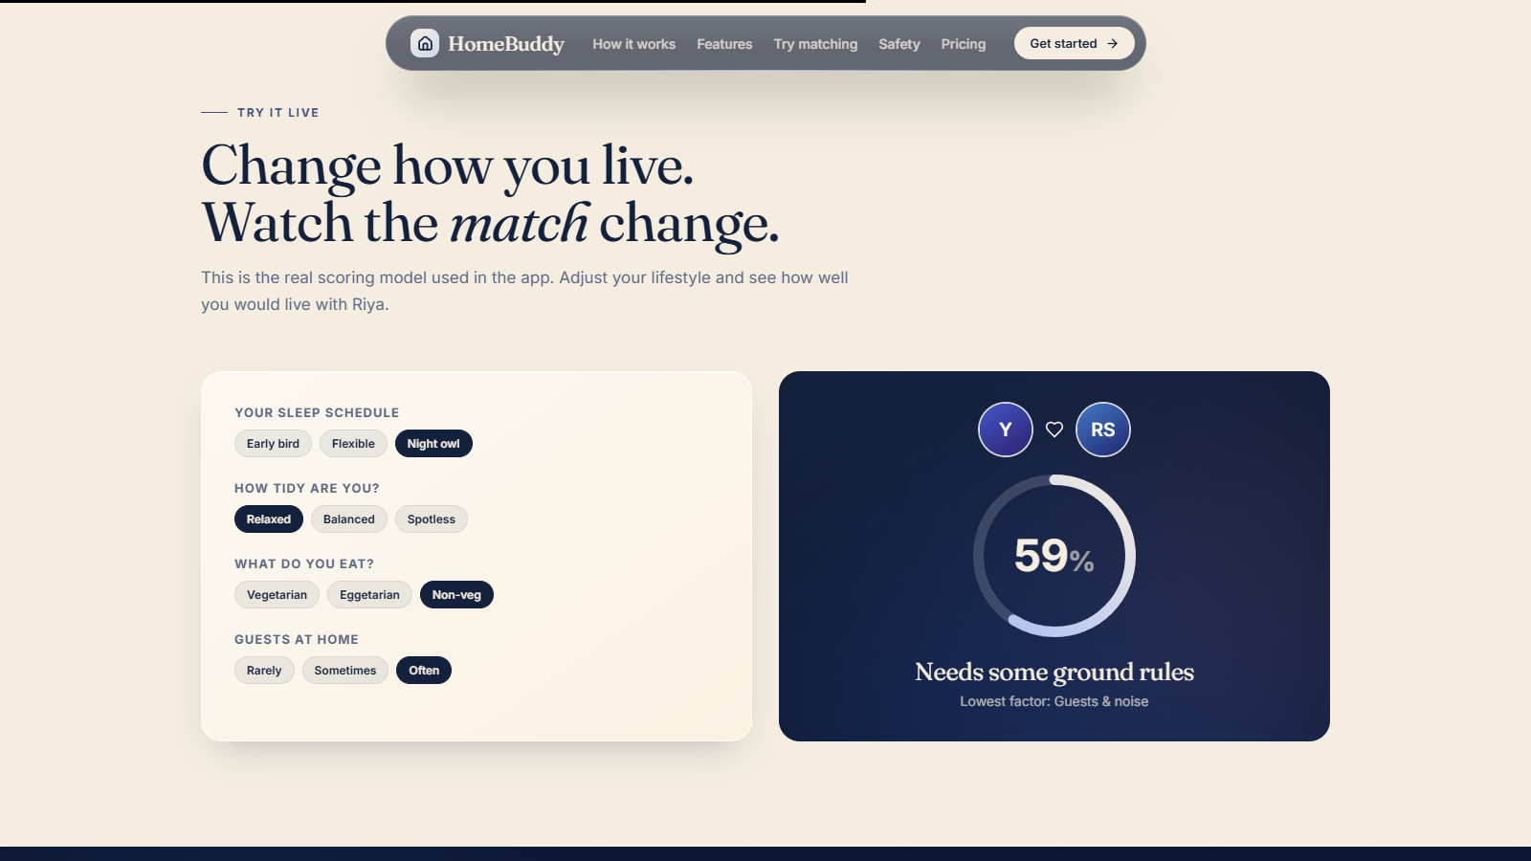
LIVE DEMO
Landing page and lifestyle quiz
Animated landing page with a city picker covering India
Nine-question quiz ends with your living style and a top match
"Try it live" lets anyone change habits and watch the score move
HomeBuddy
9
Notes:
JATIN (open the prototype on screen): Show the landing page, scroll a little to show the navbar morph, then take the quiz live. Finish on the living-style result. Then show the "Try it live" widget.

Slide 10
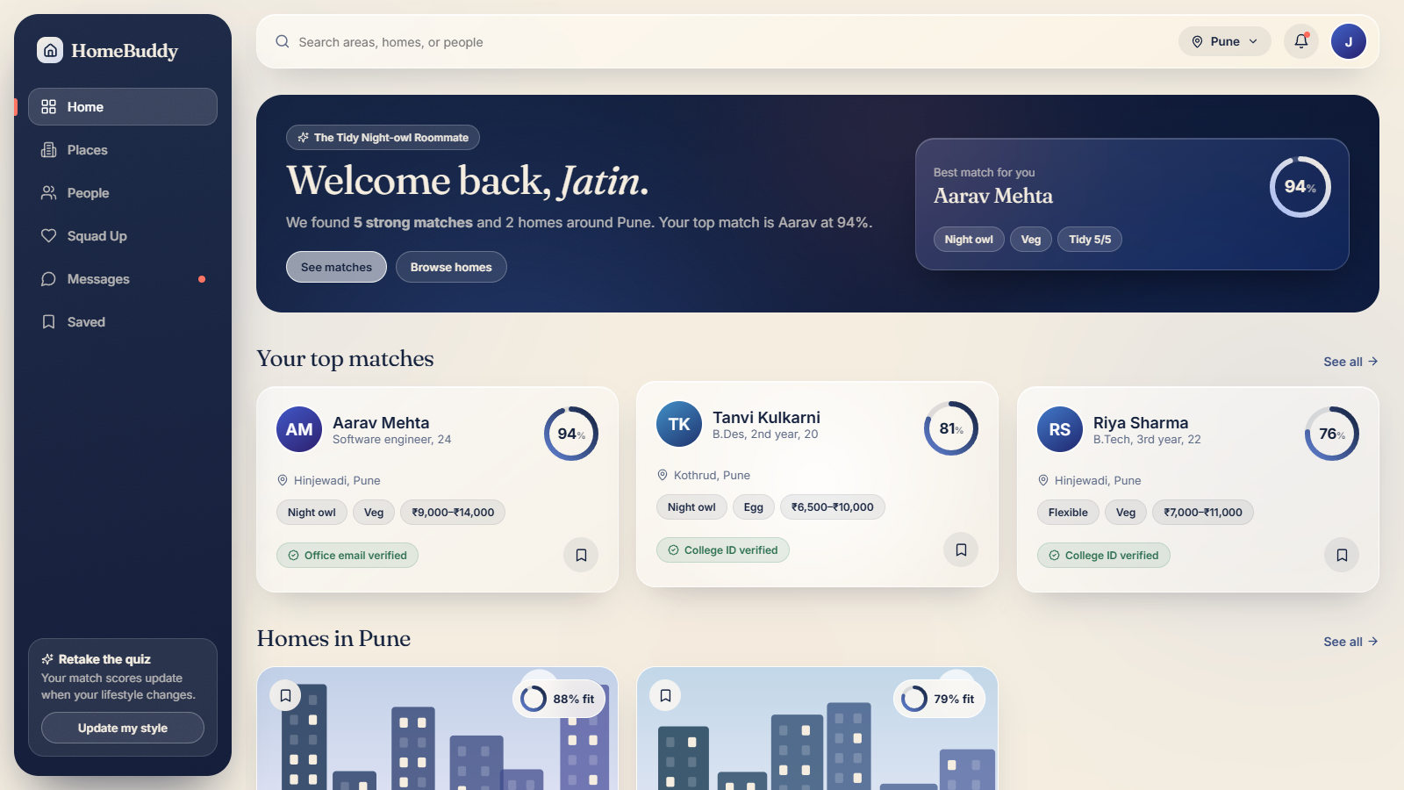
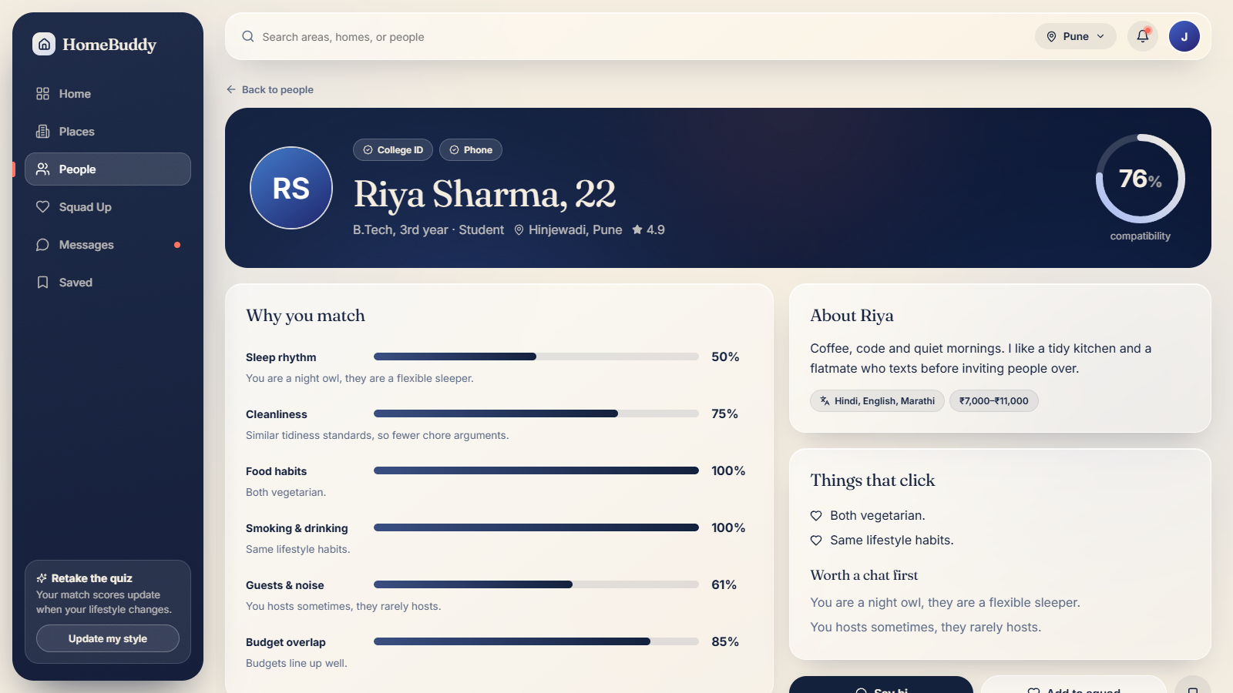
LIVE DEMO
Your dashboard and match profiles
Top matches, homes, and a suggested squad in one view
A profile explains exactly why you match, factor by factor
People page filters by gender, diet, life stage and minimum match
HomeBuddy
10
Notes:
JATIN: Open a profile and point at the breakdown bars. Say: "This is why we are not a normal listing app: we tell you who you would be living with and why it works."

Slide 11
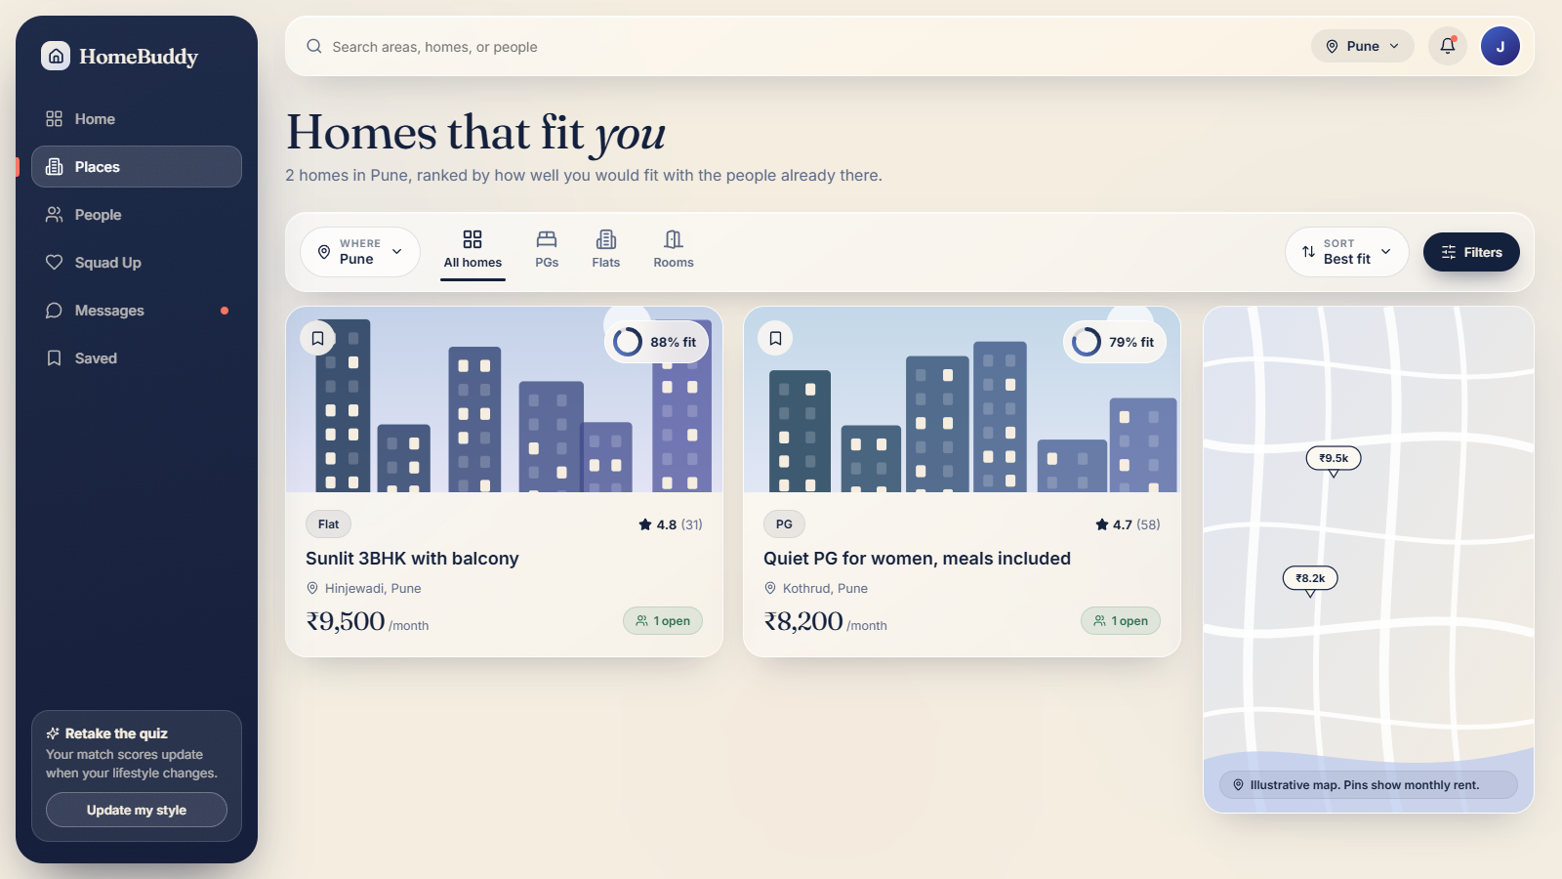
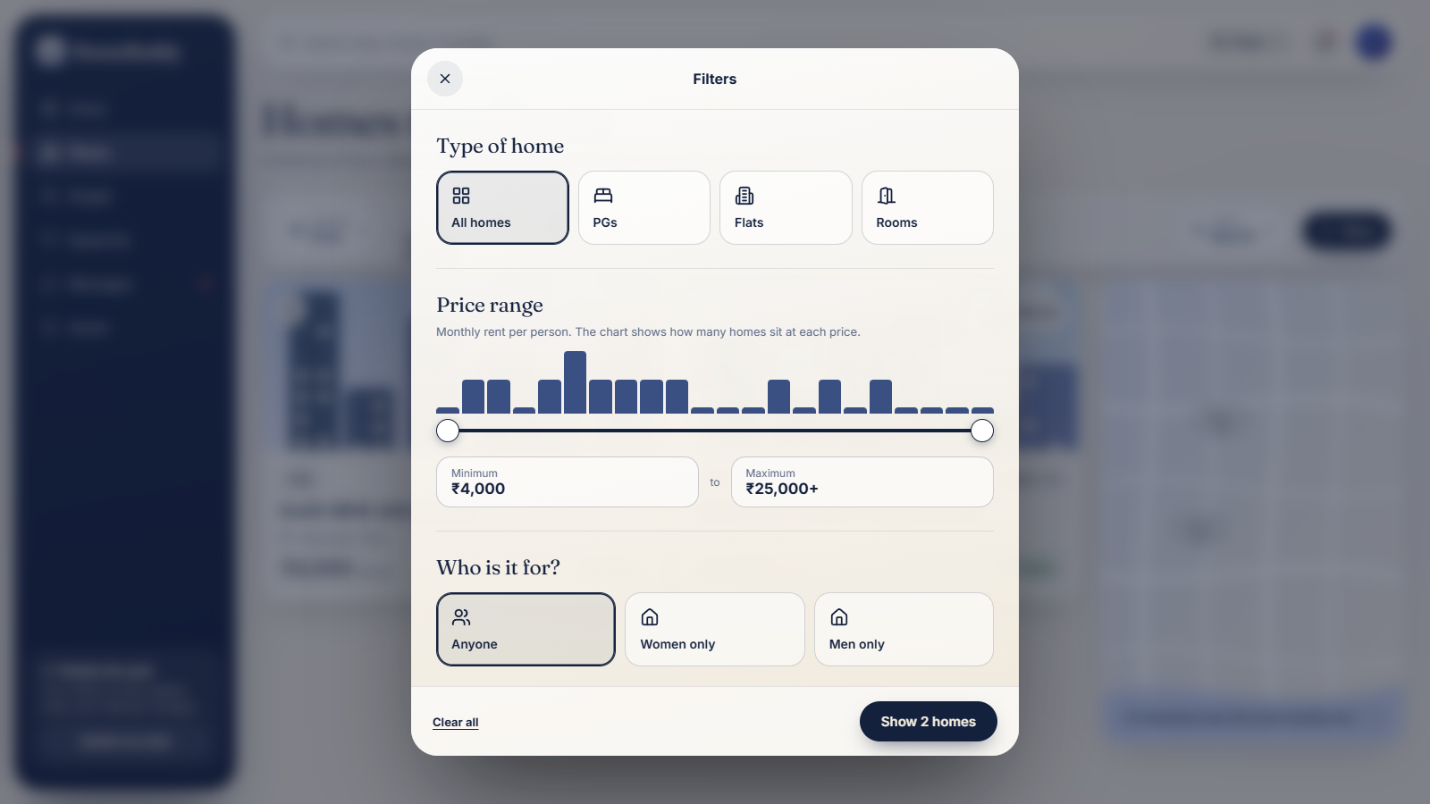
LIVE DEMO
Search homes the Airbnb way
Location search, type tabs, sort, and a full filters sheet with a live result count and price histogram
Each home shows how well you fit with current residents
HomeBuddy
11
Notes:
JATIN: Open the Filters sheet, drag the price slider and show the "Show N homes" count updating. Then open a home to show who lives there and your fit with each person.

Slide 12
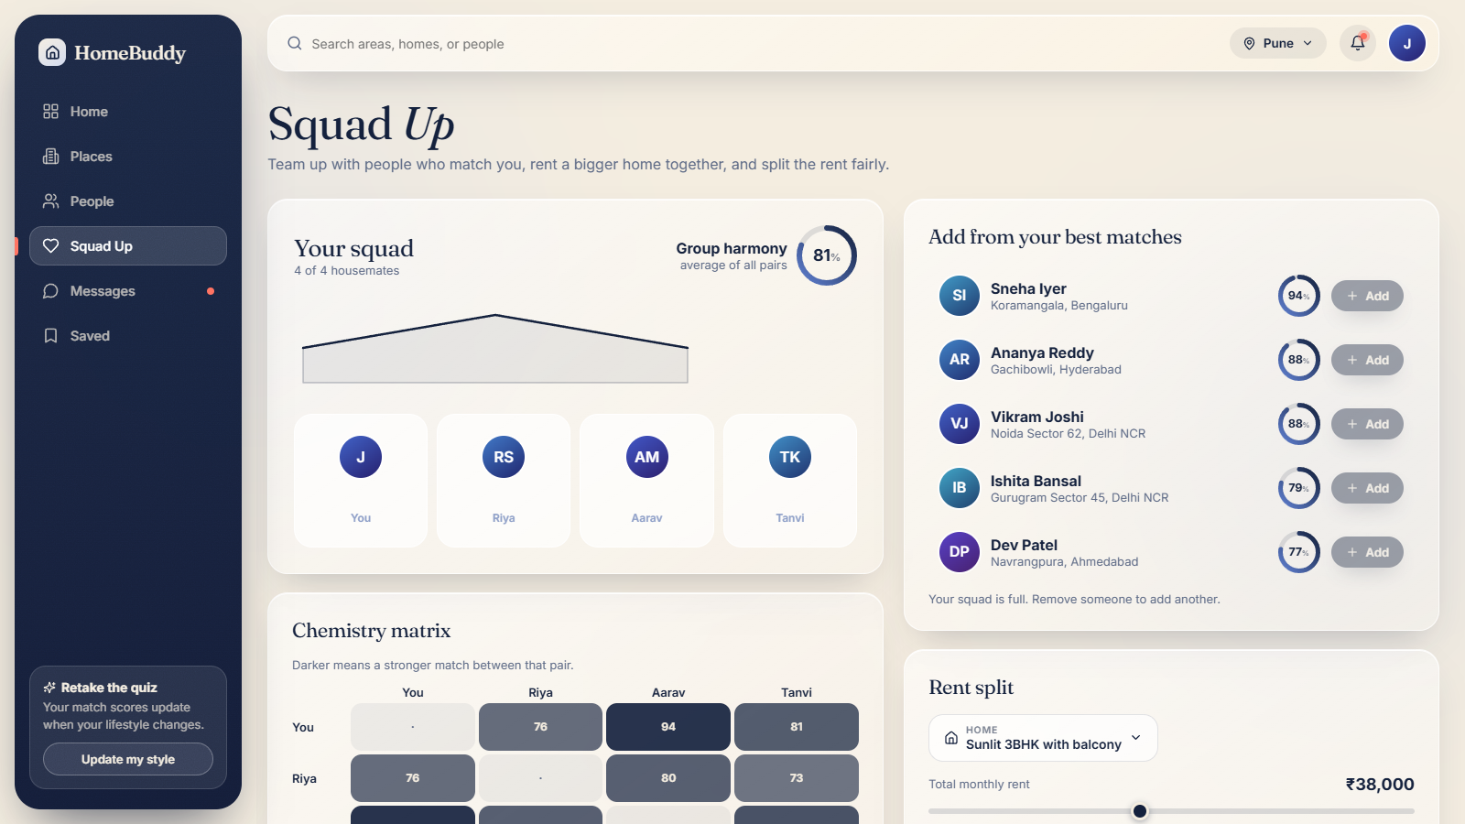
LIVE DEMO
Squad Up: rent together, split fairly
Group harmony: the average match across every pair in the squad.
Chemistry matrix: see who fits with whom at a glance.
Fair split: bigger or attached-bath rooms pay more, small rooms pay less.
Pick a home, set the rent, and invite housemates.
Sharing a bigger flat can cost less per person than renting separate rooms.
HomeBuddy
12
Notes:
JATIN: This is our group-renting feature. Add matches to a squad, see the group harmony ring and the chemistry matrix, then change a room type and watch the rent split update. Hand over to Shivansh for the market after this slide.

Slide 13
MARKET
A large group that moves every year.
College and school students
How we size it (illustrative)
Move for hostels and PGs every academic year
People who move for study or work
x share who rent shared housing
x share who close through us
x success fee per rental
Interns and trainees
Short stays, small budgets, urgent need
First-job professionals
New city, new salary, no local contacts
Relocating professionals
Example: 1,000 rentals a month at a Rs 750 fee is Rs 7.5 lakh a month from success fees alone.
Job switches, transfers, higher budgets
Exam aspirants
Coaching cities, long stays, need for quiet
Assumptions, to be validated by survey.
HomeBuddy
13
Notes:
SHIVANSH: Do not quote exact national numbers unless you have checked a source. Say we sized the market bottom-up: how many people move, how many rentals close, what we earn per rental. The numbers on the right are illustrative assumptions we plan to validate with a class survey.

Slide 14
COMPETITION
Nobody matches people and places together.
 | Lists homes | Matches flatmates | Verified people | Group renting | Add-on services
Property portals | Yes | No | Owners | No | No
Social media groups | Posts | By hand | No | No | No
Co-living brands | Own stock | No | Partly | No | Yes
HomeBuddy | Yes | Scored | Yes | Squad Up | Yes
Our edge: one app for the place and the people, with a score that explains itself.
Generalised from our research of typical features. Individual products differ.
HomeBuddy
14
Notes:
SHIVANSH: Be fair to competitors. Property portals are great at listings. Social groups are great for finding flatmates but unsafe. Co-living brands are managed and pricier. Our edge is the combination plus the transparent score. Double-check these generalisations before presenting.

Slide 15
BUSINESS MODEL
Free to match. We earn when homes get filled.
Revenue stream | Who pays | How
Vacancy listing fee | Owners and PGs | Per vacancy or monthly plan
Success fee | Owner or seeker | Small one-time fee when a rental closes
HomeBuddy Plus | Seekers | Monthly plan: priority matching, more chats
Featured listings | Owners | Pay for higher placement
Partner commissions | Service partners | Percentage on tiffin, furniture, movers, Wi-Fi
Starting assumptions
Success fee: Rs 500 to Rs 1,000 per closed rental
Plus plan: about Rs 149 a month
Add-on commission: 10 to 15%
Searching and matching stay free
Costs: development, hosting, ID verification, support, marketing.
HomeBuddy
15
Notes:
SHIVANSH: Seekers search and match for free, so we grow quickly. We earn from owners who fill beds, a small success fee when a rental closes, an optional Plus plan, and partner commissions. All prices are assumptions to test.

Slide 16
COMPETITORS
Who we compete with, and why we are better.
Competitor
What they provide
What HomeBuddy provides
Why we are better
Property portals
Search listings, filter by price, contact owners or agents
Listings plus people matching, with a fit score for current residents
You see who you would live with, not just the room
NoBroker, Housing.com, MagicBricks
Social media groups
Free posts to find rooms and flatmates
Verified profiles, in-app chat and reviews
Fewer scams, and no digging through endless posts
Facebook and WhatsApp groups
Co-living brands
Managed rooms with services, at set prices
Many homes to choose from, plus flatmate matching
More choice and lower-cost options, and you pick your people
Zolo, Stanza Living
Local brokers
Show homes in person, for a fee
Free matching, and a small fee only when a rental closes
Far below the usual 15 days to one month of rent
Agents in every neighbourhood
Competitor descriptions are generalised from public information. Individual products differ.
HomeBuddy
16
Notes:
SHIVANSH: Go row by row. Each row is one kind of competitor: what they give people today, what HomeBuddy gives instead, and why that is better. Be fair: property portals are strong at listings, social groups are free, co-living brands are convenient. Our edge is matching people and places together, with trust built in. Double-check the competitor descriptions before presenting.

Slide 17
RISKS AND TRUST
The risks we know about, and our answers.
Risk | How we handle it
Safety and fraud | ID checks for people and owners, reports, reviews, chat before sharing numbers
Cold start: no users and no listings | Launch in one locality, onboard owners by hand first
Users skip the platform to avoid fees | Keep value after matching: house rules, rent split, add-ons, reviews
Score is not trusted | Show the reasons behind every score and improve with feedback
Privacy and legal | Collect little data, ask consent, follow tenancy and data rules
Social impact: lower costs for people on tight budgets, safer shared living (especially for women), steady income for owners.
HomeBuddy
17
Notes:
AJAY: Judges like honesty about risk. Safety and the cold start are the two biggest. Mention that we collect minimal data and follow local rules.

Slide 18
Thank you
Your next home is waiting. So is your next flatmate.
Questions and feedback welcome.
Notes:
AJAY: Close with the one-line pitch, thank the class, and invite questions. Each of us can answer: Jatin on the product, Shivansh on money and market, Ajay on launch and risks.

