Slide 1
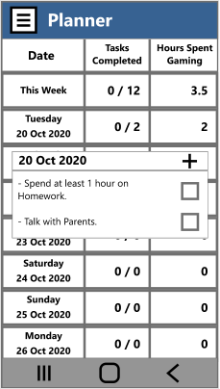
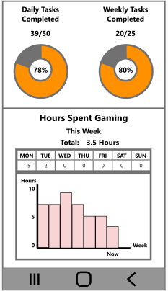
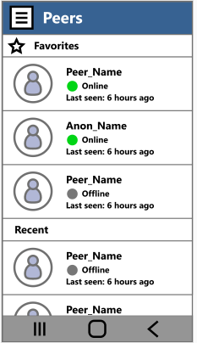
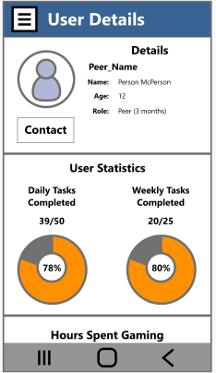
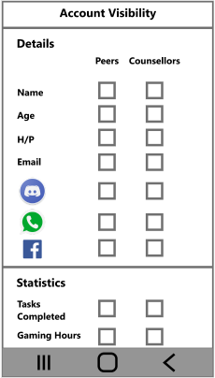
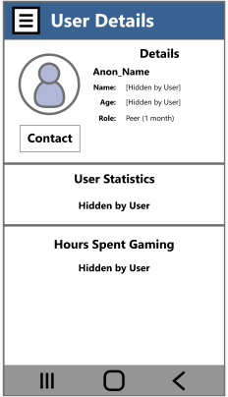
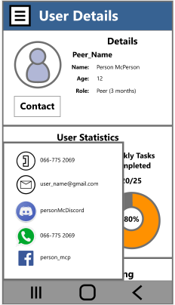
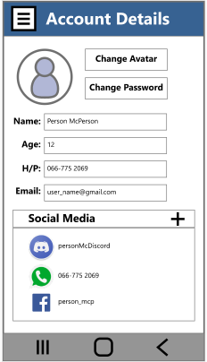
HabitTrimmer Videogame Addiction Aid App As part of a DECO3500 Assignment
Track of your Progress:
Record your own personalized Tasks, and hours spent gaming. See this data displayed in an easily-read format.
Connect with Support Groups:
Facilitates building connections among Peers & Counsellors within Support Groups. Find like-minded individuals who can help.
Stay Comfortable, Stay Anonymous:
User Details and Statistics can be hidden on-demand. No need to compare yourself to others.
Link your favorite Social Media:
HabitTrimmer allows you to continue using your existing Social Media as normal, no need to constantly check yet another app. Just link and start finding Peers & Counsellors.
Suitable for Ages 15 - 26
Available for Mobile Platforms

