Slide 1
CMSC451
Project outline

Slide 2
Technical components
Reading the publications
there’s a python package for downloading abstracts from PubMed (an archive of medical publications)
Finding the relations
Machine learning model: neural network for text input (python, pytorch)

Slide 3
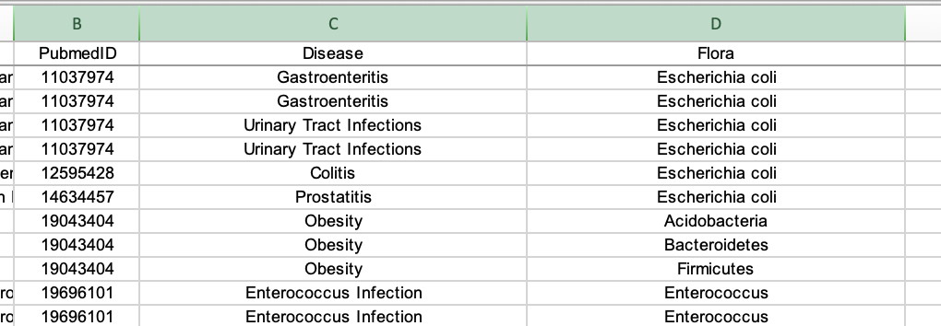
Building the training set for machine learning
A database of publication – disease – bacteria associations
Go to: http://gift2disease.net/GIFTED/download.jsp
Download “01All associations of microbiota and human diseases.”
Should produce a file GIFTED.xlsx
Focus on columns PubmedID, Disease, Flora

Slide 4
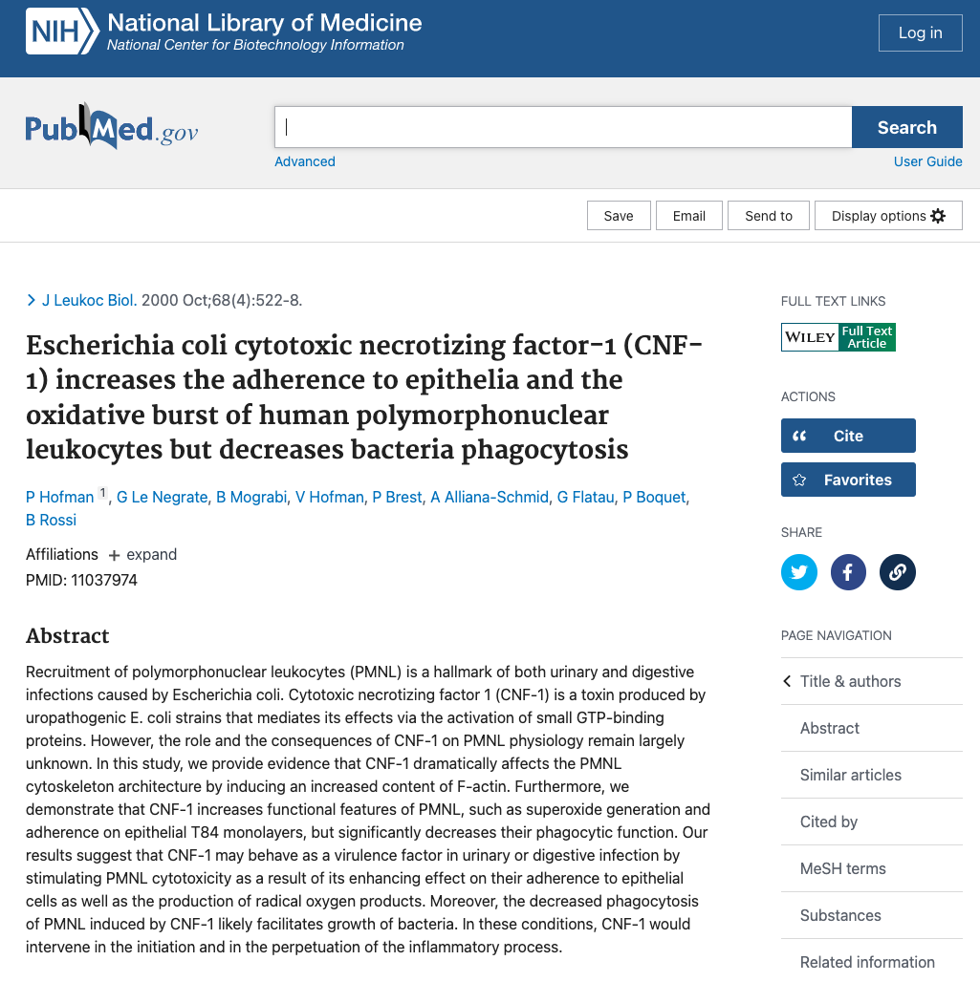
PubMed page
We are interested in this:
We are interested in this:

Slide 5
Building the training set for machine learning
Task: download text of abstracts of all the publications mentioned in column B (PubmedID)
Pubmed is a database of medical literature maintained by National Institutes of Health
Desired output: 4 items per article [pubmedID, title, abstract text, text length in characters incl. spaces]
Please figure out the best way to store it (text file, python pickle, …)
It’s about 1000 publications, each abstract is on the order of 1000-2000 characters, so it’s not a huge database
We will need to read it using pubmedID as the key

Slide 6
Building the training set for machine learning
Starting points:
Option 1: biopython
Option 2: pymed https://github.com/gijswobben/pymed
﻿#pip install biopython
from Bio.Entrez import efetch
from Bio import Entrez
Entrez.email = 'some@example.com'
def print_abstract(pmid):
handle = efetch(db='pubmed', id=pmid, retmode='text', rettype='abstract')
print(handle.read())
print_abstract(11037974)
### looks like it may take some work to isolate title and abstract
﻿#pip install pymed
from pymed import PubMed
### this might be better, it seems their examples folder shows how to get the abstract and separately the title

