Slide 1

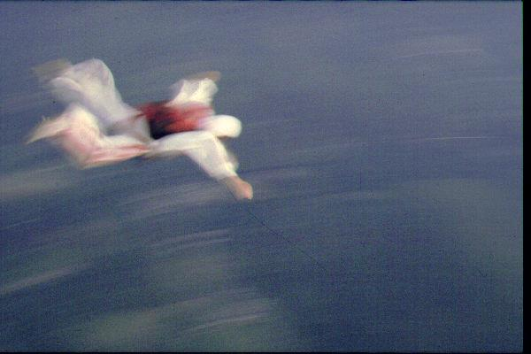
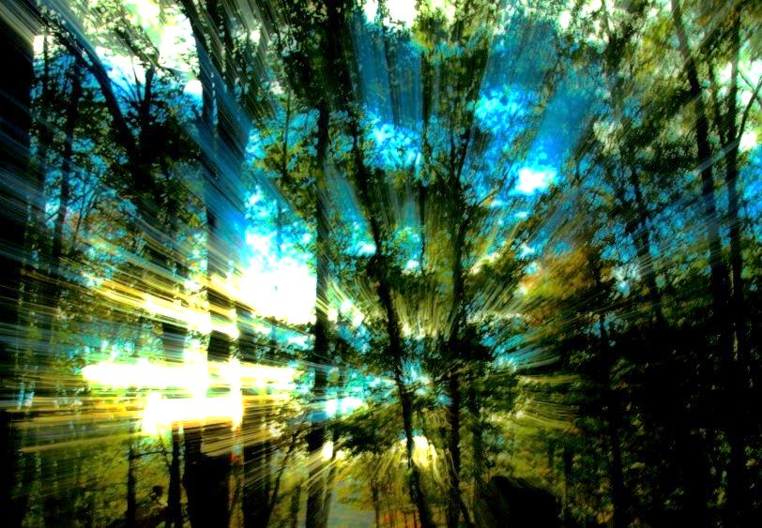
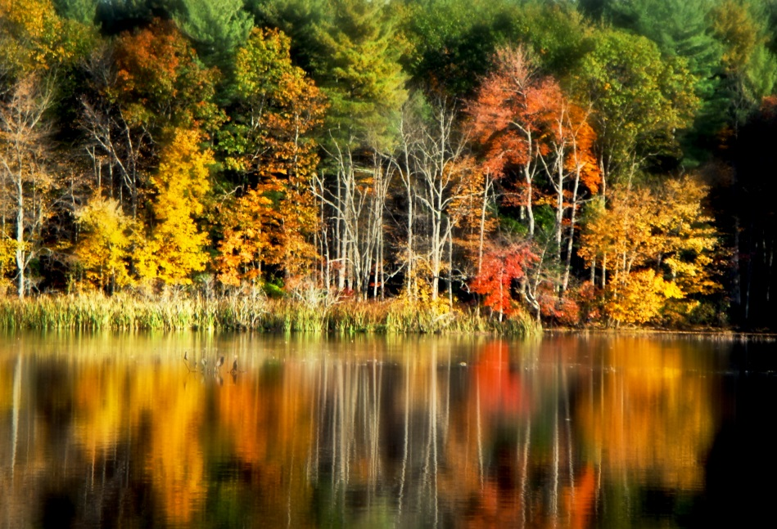
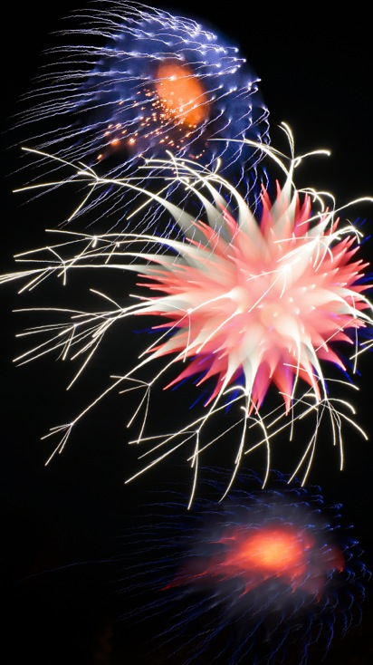
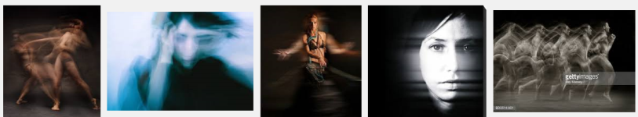

Digital Technique for October 8 Competition
Motion During Exposure
Intentional Motion During Exposure -
This highly flexible technique involves panning, rotating, zooming or racking your focus ring during a moderately long exposure. This can result in some really interesting shots.
Set your camera on Arpeture Priority and stop down all the way to f22. Then using a tripod for as long and exposure as you choose, you can get some interesting results by panning or zooming or changing focus as the exposure is happening. A neutral density filter can slow things down even further for you for more dramatic results. The amount of blur is purely subjective. Experiment with shutter speeds (generally ¼ second or more) as well as the speed of the movement. Try lots of variations until you get some you like.
You can get some other ideas by googling Long exposure motion blur. Have fun!
Step 5: Lighten and enhance as desired
Since Multiply blend mode darkened the image, now is the time to lighten it. You can add a Levels or Curves adjustment layer to lighten the resulting montage or simply take it back into Camera Raw to play with the exposure sliders.

