Slide 1
Sainsbury's vs Tesco
Which supermarket offers better value across common product categories?
Price and value-for-money comparison
We compare overall prices, average category prices, and a simple value index.
Group Member: Xurui Wang
Xuanya Pei
Chu Zhang
Data Source: Time Series UK Supermarket Data, Kaggle.
Notes:
Open by saying: Today I compare Sainsbury's and Tesco using three views: overall prices, common category averages, and value for money. The goal is not to prove one supermarket is always cheaper, but to identify where each one performs better. I will finish with practical findings for shoppers and for supermarket category strategy.

Slide 2
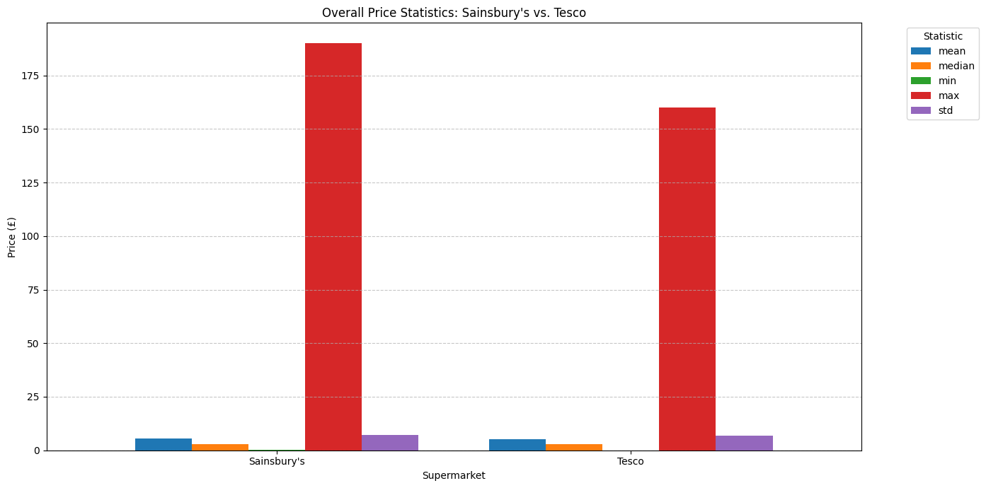
1. Overall price statistics
Both supermarkets have similar mean and median prices, so the typical basket price level is close.
Sainsbury's has a higher maximum price, suggesting more expensive premium or large-size items.
Standard deviation is close, so price dispersion is broadly comparable across the two datasets.
Notes:
This first chart compares mean, median, minimum, maximum and standard deviation. The mean and median are close, so we should not say one supermarket is much cheaper overall. However, Sainsbury's has the higher maximum price, which may reflect more premium or larger products. This motivates the next step: compare common categories directly.

Slide 3
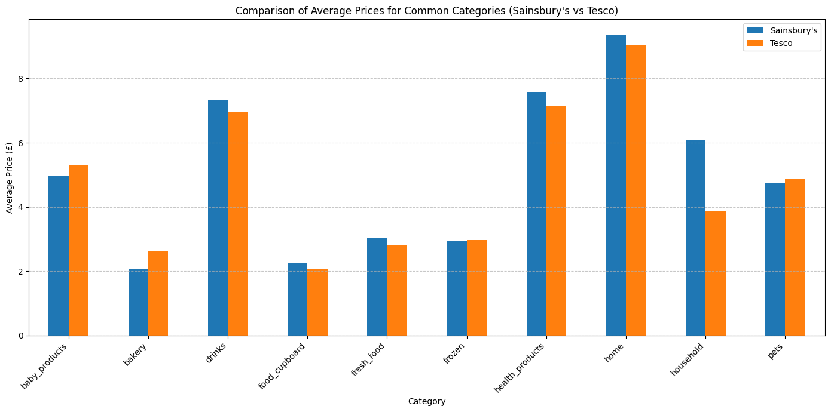
2. Average prices by common category
Category findings
Sainsbury's cheaper in:
baby_products, bakery, frozen, pets
Tesco cheaper in:
drinks, food_cupboard, fresh_food, health_products, home, household
Largest gap: household
Sainsbury's £6.07 vs Tesco £3.87
Notes:
This chart only uses the ten categories found in both supermarkets. Sainsbury's is slightly cheaper in baby products, bakery, frozen, and pets. Tesco is cheaper in six categories, especially household products, where the gap is large. For customers, the cheapest supermarket depends strongly on what they buy most often.

Slide 4
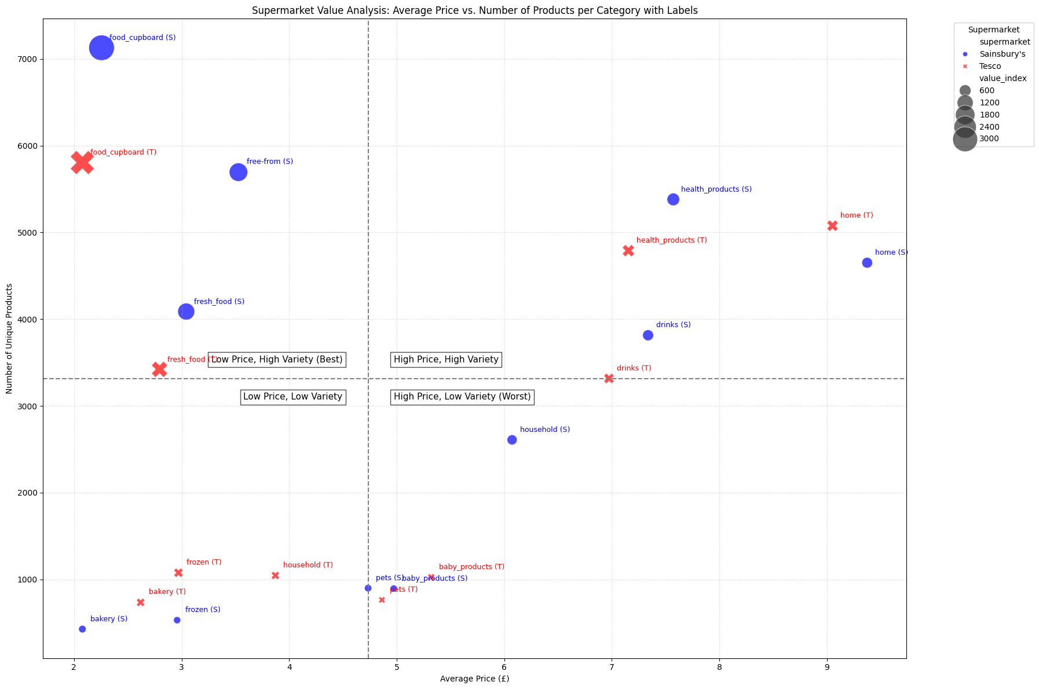
3. Value-for-money analysis
Value Index = Number of Products / Average Price
Best zone
Low price + high variety is the strongest value position. Food cupboard and fresh food perform well here.
Premium zone
Home, health products and drinks have high average prices but also high variety.
Weak zone
High price + low variety is the weakest value position and needs category attention.
Notes:
The bubble chart combines two dimensions: price on the x-axis and number of products on the y-axis. The value index is number of products divided by average price. Higher means more variety for each pound of average price. The best area is low price and high variety; the weakest area is high price and low variety. This gives a more practical view than price alone because shoppers also care about choice.

Slide 5
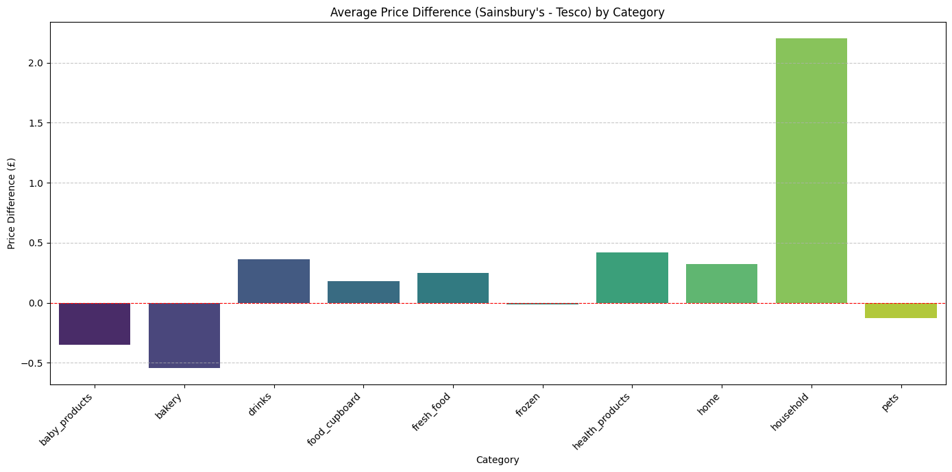
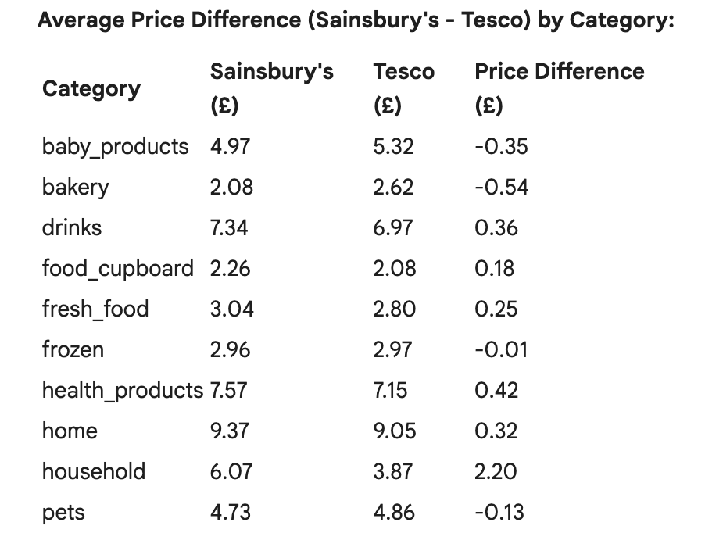
4. Average Price Difference by Category
Price difference = Sainsbury's average price - Tesco's average price

Slide 6
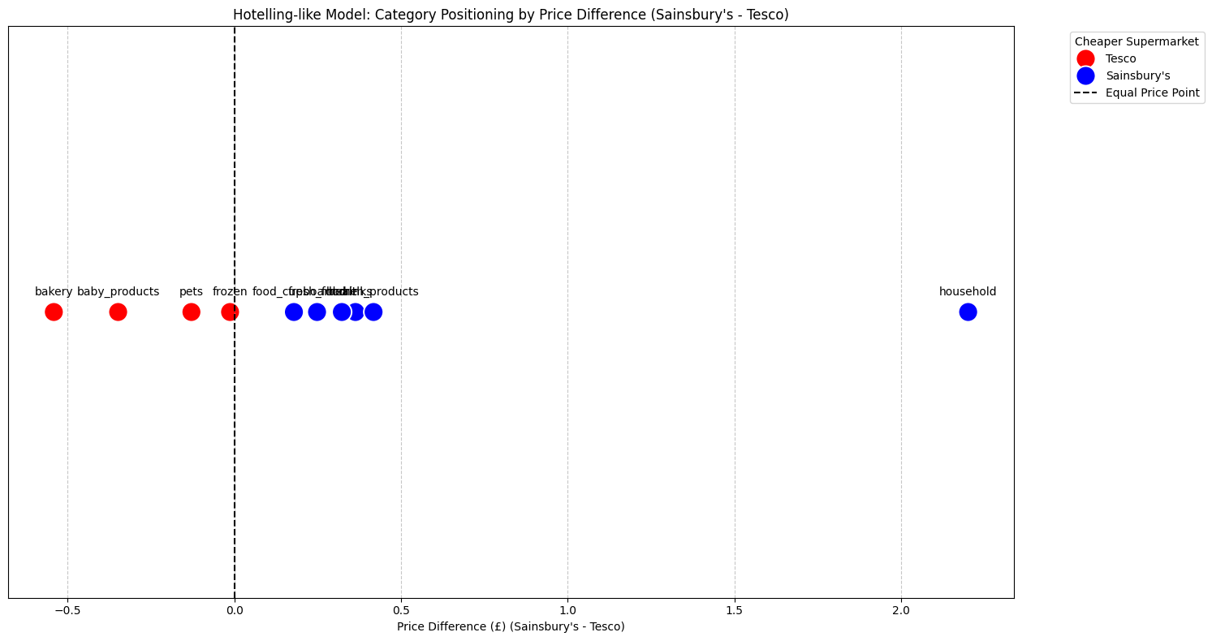
5. Category Positioning by Price Difference
Hotelling-like model: positioning categories by price difference (Sainsbury's - Tesco).
Interpretation of the plot:
Red points (to the left of 0): These categories are cheaper at Tesco.
Blue points (to the right of 0): These categories are cheaper at Sainsbury's.
Grey point (at 0, if any): Indicates categories where prices are equal.

Slide 7
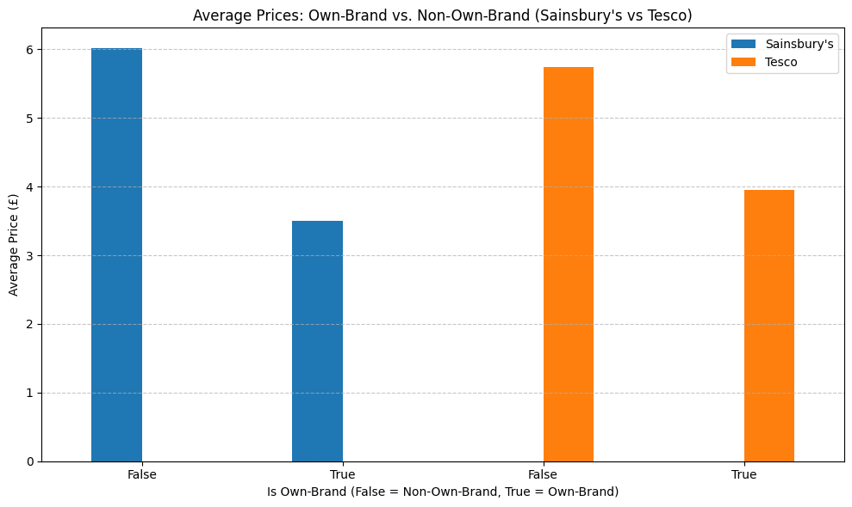
6. Own-Brand vs. Non-Own-Brand Price Comparison
Average prices for own-brand and non-own-brand products in Sainsbury's and Tesco.

Slide 8
Conclusion: no single winner overall
.
Three takeaways
1. Overall prices are close
2. Tesco wins more categories
3. Value also needs variety
Mean and median prices are similar, so the broad price level is not dramatically different.
Tesco has lower average prices in 6 of 10 common categories, with a clear advantage in household.
A lower price is not always better if customers face fewer choices. The value index captures this trade-off.
Final message: Tesco appears more price-competitive in more categories, while Sainsbury's still performs strongly in selected categories and may offer broader value in some product areas.
Notes:
Summarise the presentation clearly: Overall prices are quite close. Tesco is cheaper in more common categories, especially household products. But price is not the whole story: value also depends on variety, which is why the value index is useful. A good extension would be to build example baskets and compare final basket prices.

