Slide 1
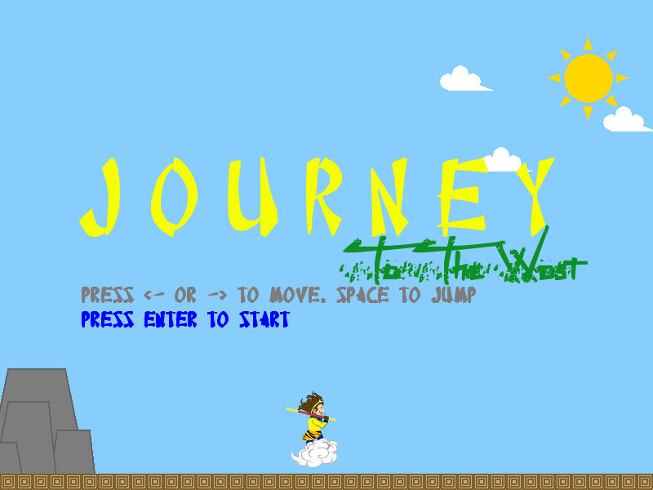

Slide 2
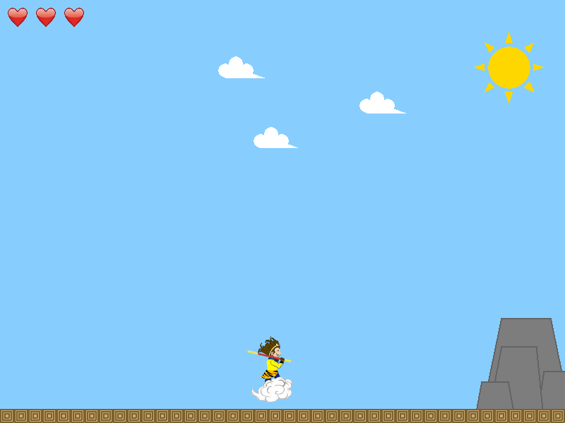
Movement
Press and hold “->” key to go right

Slide 3
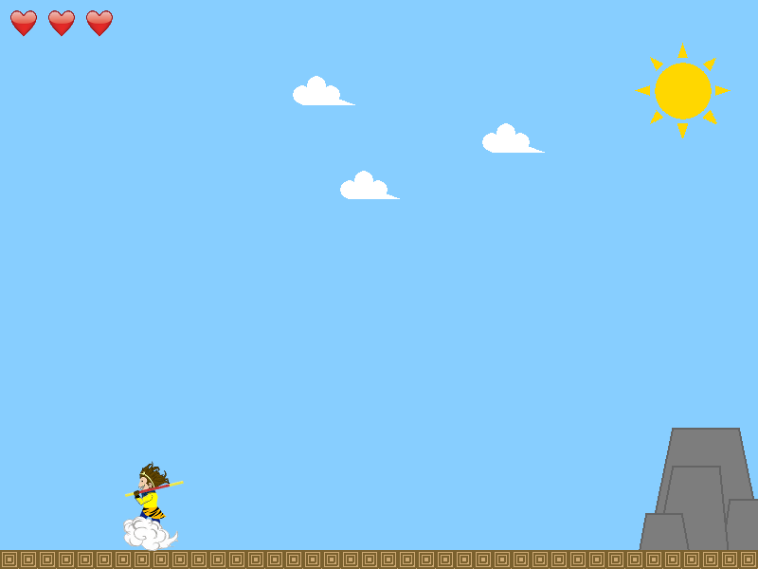
Movement
Press and hold “<-” key to go left

Slide 4
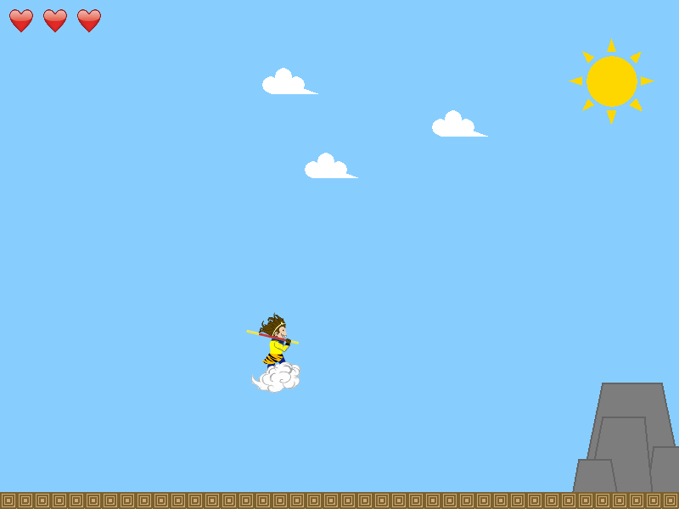
Movement
Press space bar to jump

Slide 5
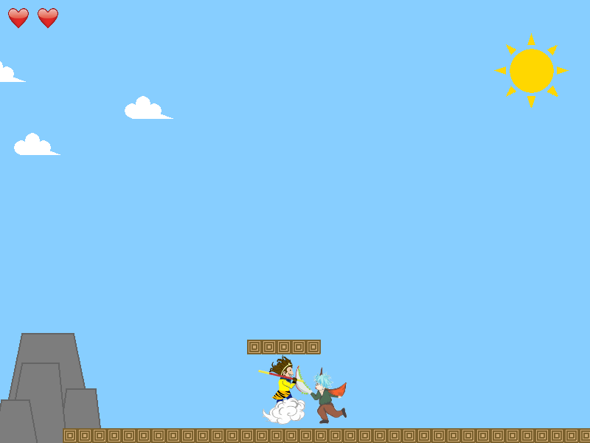
Enemy Encounter
You will lose health if you take the enemy head on

Slide 6
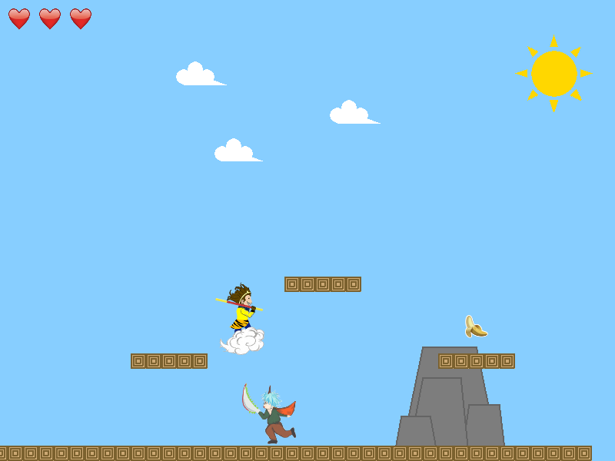
Enemy Encounter
Bounce on their head to inflect damage instead

Slide 7
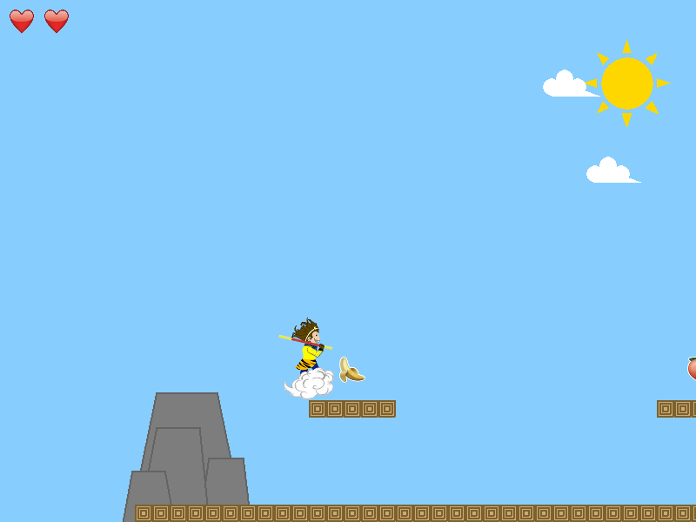
Enemy Encounter
Eating a fruit will replenish lost health

Slide 8
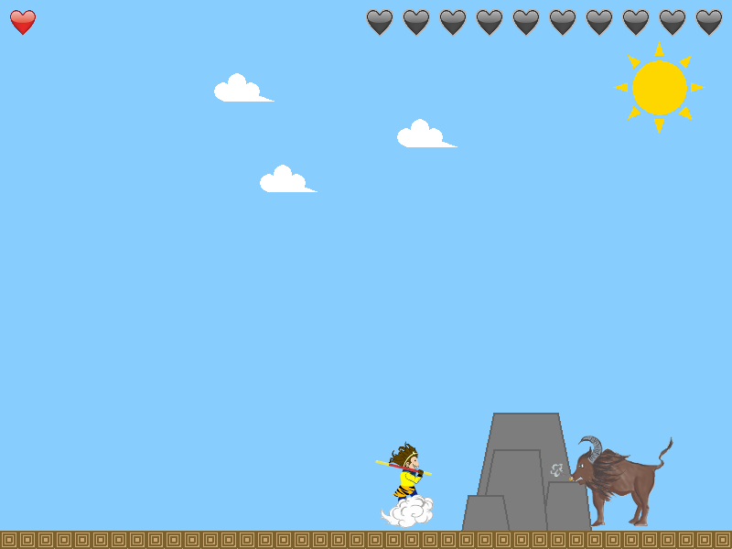
Enemy Encounter
Boss has more health then regular enemies. Killing him would require multiple bounces

Slide 9
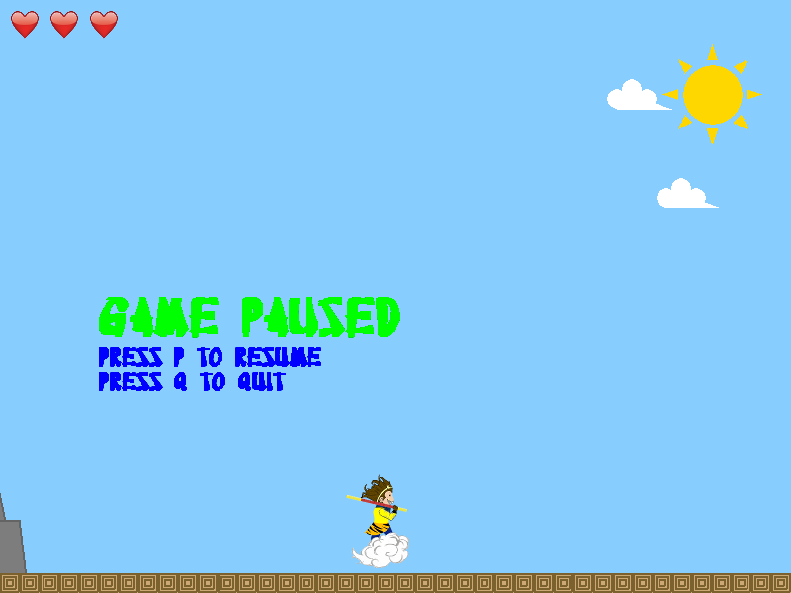
Game Control
Press “P” during any stages of the game to pause.

Slide 10
Game Control
Press “Q” at the pause screen to quit.

