Slide 1
Title
Play
Settings
Quit

Slide 2

Character Selection
Character Selection
Character Image/Ability Showcase
Abilities
Abilities Description

Slide 3

Level Selection
Level Number Level Name Difficulty
Tutorial Downtown Mall
Waves: 4
Enemies: 100
Level 1 City Hall
Level 2 Night Club
Level 3 Distillery
Level 4 Factory
Level 5 Lower Neighborhood-1
Level 6 Lower Neighborhood-2
Level 7 Community Center
Stage Picture/Map
Begin Level

Slide 4
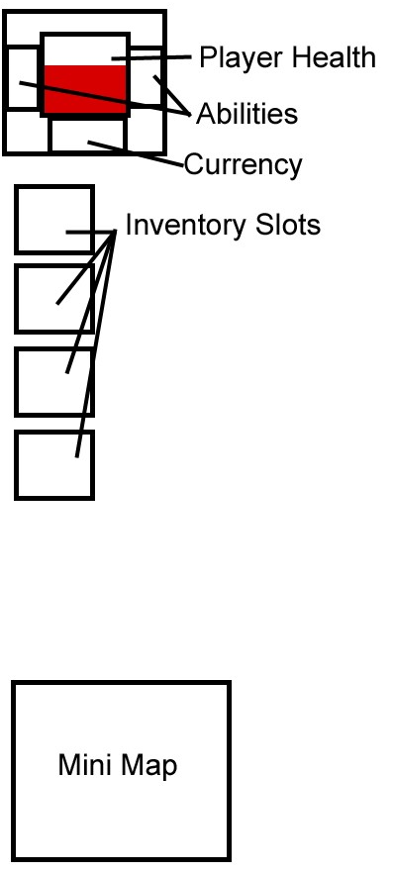
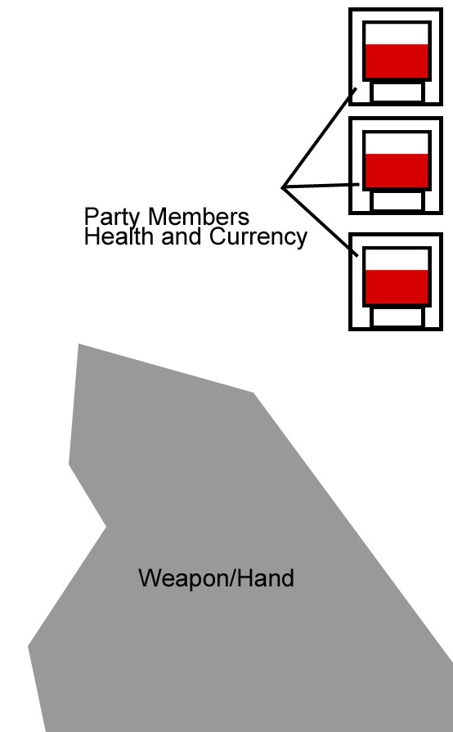
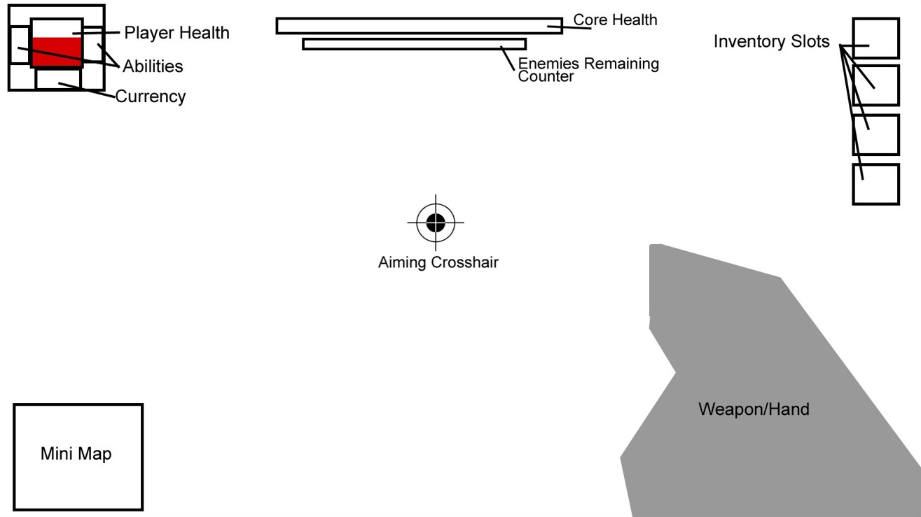
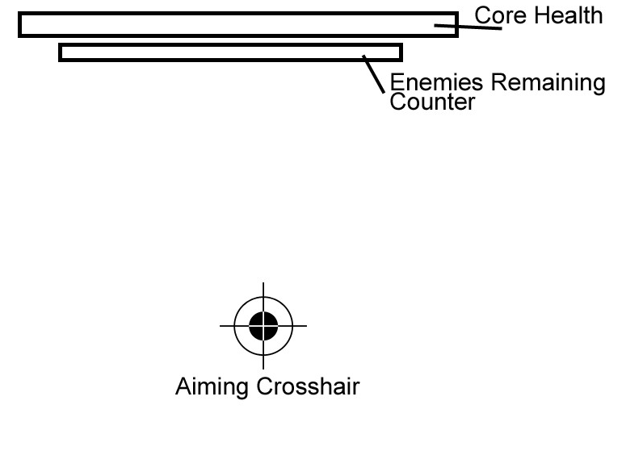

Slide 5


Map
Shop
Inventory
Settings
Restart
Quit
Map (Larger)
Fluffy flavor text/description
Press ESC to Resume

Slide 6
Map
Shop
Inventory
Settings
Restart
Quit
Traps
Weapons
Player Currency
Trap Preview
Trap Description
Buy Blueprint
Fluffy flavor text/description
Press ESC to Resume

Slide 7
Map
Shop
Inventory
Settings
Restart
Quit
Traps
Weapons
Player Currency
Weapon Preview
Weapon Description
Buy Blueprint
Fluffy flavor text/description
Press ESC to Resume

Slide 8
Map
Shop
Inventory
Settings
Restart
Quit
Key Bind
Key Bind
Key Bind
Key Bind
Item Preview
Item Description
Fluffy flavor text/description
Press ESC to Resume

Slide 9
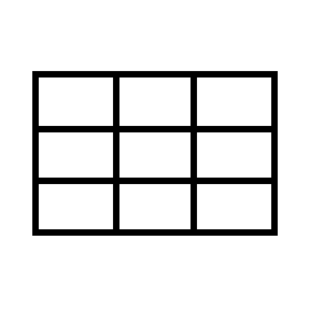
Map
Shop
Inventory
Settings
Restart
Quit
Game Settings
Video Settings
Audio Settings
Fluffy flavor text/description
Press ESC to Resume

Slide 10
Map
Shop
Inventory
Settings
Restart
Quit
Are you sure you want to restart?
Yes
No
Fluffy flavor text/description
Press ESC to Resume

Slide 11
Map
Shop
Inventory
Settings
Restart
Quit
Are you sure you want to quit?
Yes
No
Fluffy flavor text/description
Press ESC to Resume

