Slide 1
Click-Through Rate Prediction
Team 7:
Po-Han Yen, Shih-Siang Lin, Hsin-Yu Tsai, Yun-Jung Fan, Shu-Ping Chen

Slide 2
Agenda
01
02
03
04
05
06
Introduction
Data
Research Question
- Motivation
- Workflow
- Description
- Challenges
Methodology
Results & Findings
Conclusion

Slide 3
Introduction - Motivation
Online advertisements have a significant influence on the success of a business
Click-through rate (CTR) is commonly used to evaluate ad performance

Slide 4
Introduction - Workflow
Evaluation
Accuracy, Sensitivity, Specificity, AUC
Gathering data
Kaggle
04
01
03
Pre-processing
Downsampling, Partitioning, Recategorizing
Training & testing models
Ensemble, Random Forest, Boosting, Naive Bayes, Prune classification tree, Logistic Regression, and KNN
02

Slide 5
Data - Description
Data source: Kaggle CTR prediction contest
Observations: 45 million records
Variables: 23 in total
dependent variable: click

Slide 6



Data - Challenges
Big data
Anonymized features
Imbalanced classes of
the dependent variable
1
0

Slide 7
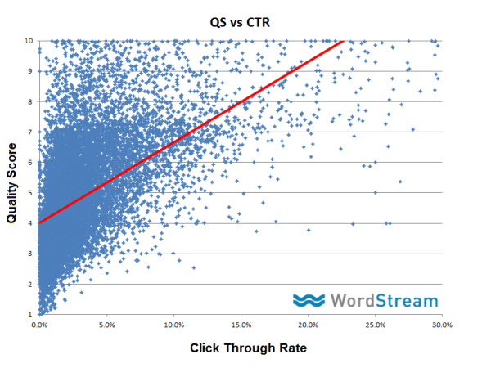
Research Question - 1
There is a positive relationship between Click Through Rate and Quality Scores.
Is it possible to predict whether an ad would be clicked by viewers or not based on historical data? Furthermore, is it possible to successfully identify both clicked ads and non-clicked ads?

Slide 8

Research Question - 2
The challenge of the humongous data sets : Is it possible to drive values from the data in an efficient way under constraints?

Slide 9
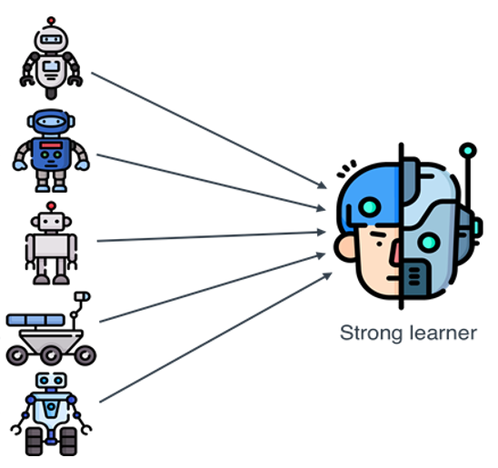

Methodology
Anonymized features
Big data
Imbalanced classes
Feature Category
Group Mean CTR vs Total Mean CTR
Very Low, Low, Median, High, Very High
Weights
Synthetic
Downsample
https://livebook.manning.com/concept/machine-learning/ensemble-method

Slide 10
Auto modeling
Reprocess (if needed)
Tree
Big data
Sample
Data
Cleaned data
NB
Ensemble
Results
45M
100K
Downsample
LR
Evaluation
Preprocess

Slide 11
Our Ensemble Algorithm
Randomly choose a subset of data & 2-6 features
Build NaiveBayes, Logistic Regression or Classification Tree
Choose proper prediction method based on input model
Average the predictive probabilities to get final result

Slide 12
Results & Findings
Stage I | Accuracy | Sensitivity | Specificity
NaiveBayes | 0.637 | 0.271 | 0.894
KNN | 0.636 | 0.609 | 0.641
Prune Tree | 0.608 | 0.267 | 0.907
Bagging | 0.591 | 0.666 | 0.575
Gradient Boosting | 0.562 | 0.216 | 0.863
XGB | 0.635 | 0.402 | 0.684
Random Forest | 0.627 | 0.775 | 0.595

Slide 13
Results & Findings
Stage II | Accuracy | Sensitivity | Specificity
125 Tree | 0.651 | 0.638 | 0.653
125 NB | 0.598 | 0.706 | 0.575
125 LR | 0.609 | 0.695 | 0.59
125 Tree + 125 NB | 0.623 | 0.666 | 0.613
125 Tree + 125 LR | 0.64 | 0.666 | 0.634
125 NB + 125 LR | 0.604 | 0.683 | 0.587
125 Tree + 125 NB + 125 LR | 0.628 | 0.666 | 0.619
375 Tree | 0.652 | 0.638 | 0.655

Slide 14
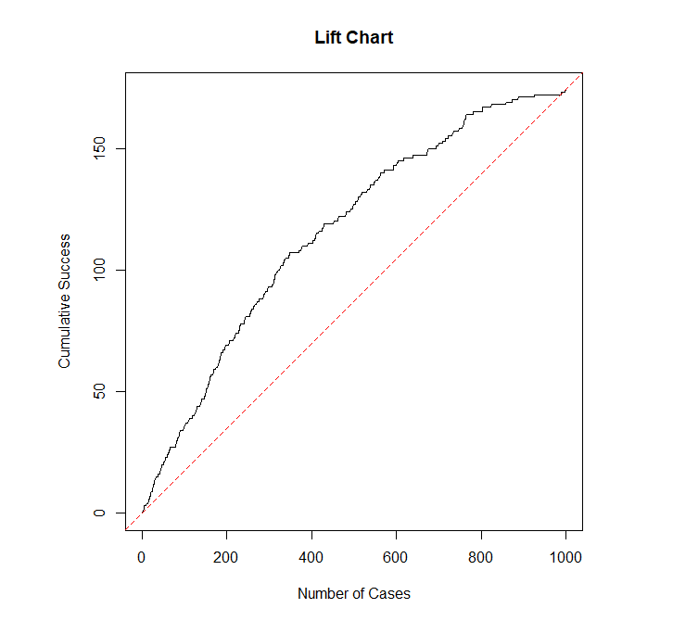
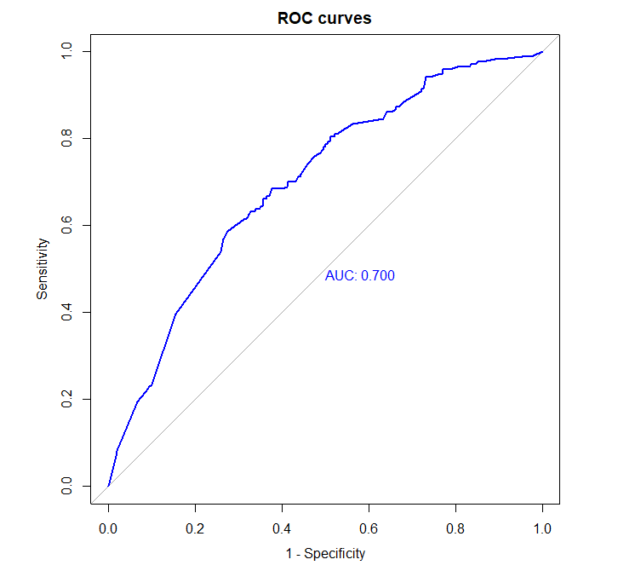
Results & Findings

Slide 15
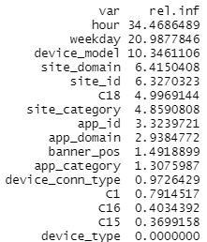
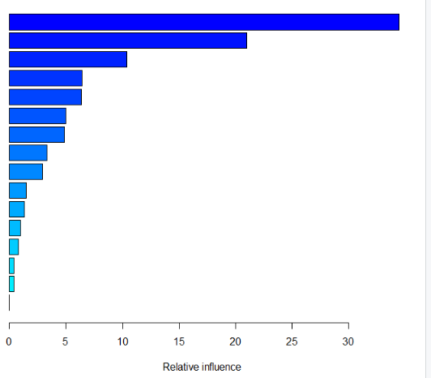
Conclusion

Slide 16
Conclusion
Recommended prediction model:
Self-build ensemble tree-based model
Accuracy: 65.2%
Sensitivity: 63.79%
Specificity: 65.5%
AUC: 70%
Future works:
More data and models
Deep learning algorithms
Process data on big data platforms
Hadoop and Spark

Slide 17
Thank You!
Team 7

