Slide 1
Business Analytics Consultant Project for
UMD Alumni Association

Slide 2
Team Information
Team 4 (Project_0506_04) Red Turtle
Adarsh Challa
George Puthean
Po-Han Yen (Team Leader)
Yi-Wei Sun
Dec. 3, 2021

Slide 3
Mission Statements
Help the UMD alumni association find ways to attract more first time attendees and major prospects.
Predict the percentage of first time attendees and major prospects based on the characteristics of the event that is going to be held.

Slide 4
Mission Objectives
When do the events have higher percentage first time attendees or major prospects?
What types of events have higher percentage first time attendees or major prospects?
Which locations of the events have higher percentage first time attendees or major prospects?

Slide 5
Methods - Outlines
Step 1: Divide the data based on the target value we want to analyze
Step 2: Perform exploratory data analysis respectively on numerical data, categorical data and time series data.
Step 3: Aggregate categorical data into smaller groups and analyze them.
Step 4: Identify relevant data, preprocess and split them for model training and evaluating.
Step 5: Build, train, test and evaluate the predictive model.

Slide 6
Methods - details
Split the data into two, one for analyzing PFTA the other for PMP.
PFTA one does not include the first year 2013.
Adding month, year and weekday columns for time series analysis.
Group by month, year, weekday, group code and location code respectively, and perform aggregate calculations.
Further group location, group and activity into smaller groups based on similarities.

Slide 7
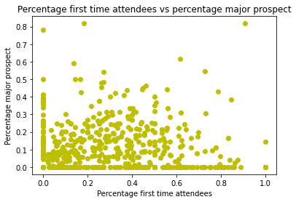
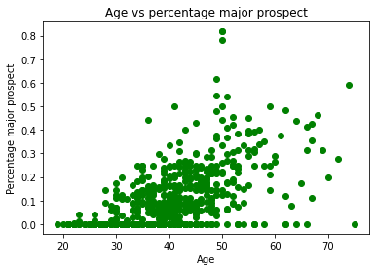
Findings - Numerical data
Percentage major prospect & percentage first time attendees does not highly correlated.
linear relationship between Average Age and percentage major prospect.

Slide 8
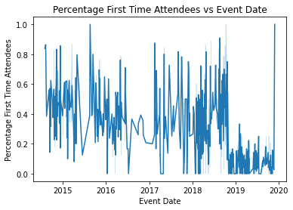
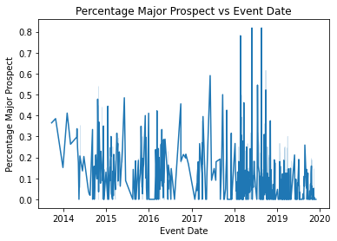
Findings - Time Series data
Lots of events with low PFTA occur during 19-20
Events with the highest PMP occur during 18-19

Slide 9
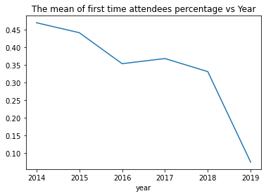
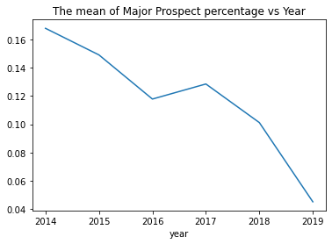
Findings - Time Series data
Concerning downward trend.
Concerning downward trend.

Slide 10
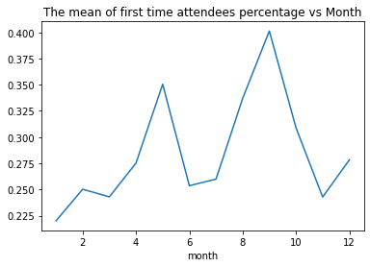
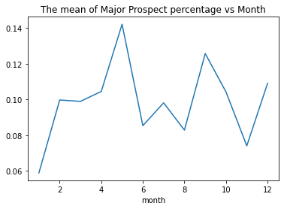
Findings - Time Series data
May and September have the highest percentage first time attendees!
January, March and November have the lowest percentage first time attendees!
The difference is over 10% which is significant.
May and September also have the highest percentage major prospect!
January and November have the lowest percentage major prospect!
The difference is about 8%.

Slide 11
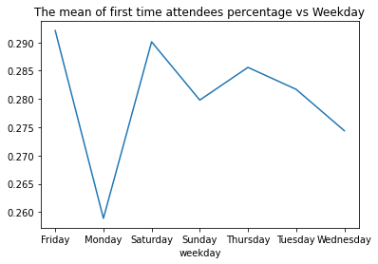
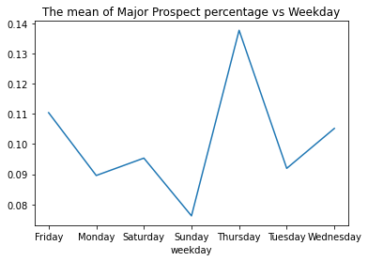
Findings - Time Series data
Friday and Saturday have the highest percentage first time attendees!
Monday has the lowest percentage first time attendees!
But the difference is only 3% which is not significant.
Thursday has the highest percentage major prospect!
Sunday has the lowest percentage major prospect!
The difference is about 6%.

Slide 12
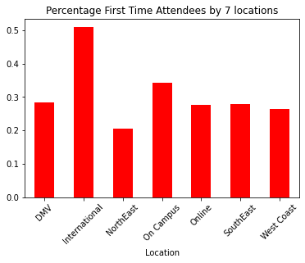
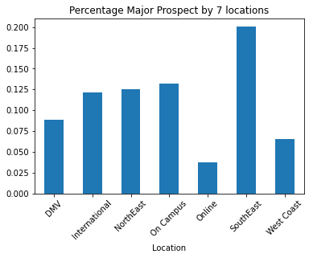
Findings - Categorical data I

Slide 13
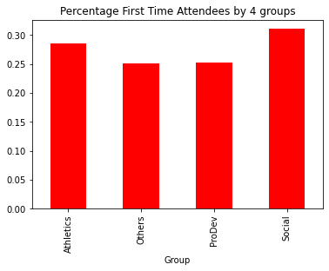
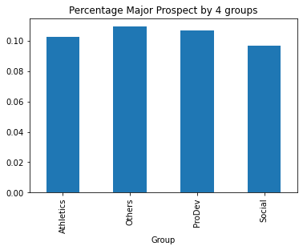
Findings - Categorical data II

Slide 14
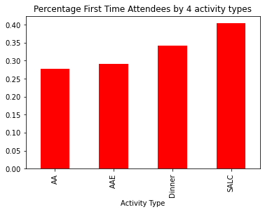
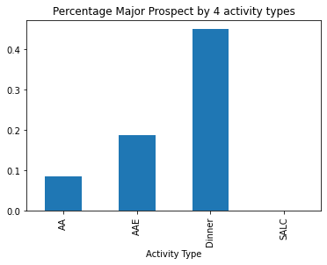
Findings - Categorical data III

Slide 15
Recommendations
To increase percentage first time attendees:
Events should be held on May, August, September and October.
Preferable locations are international and on campus.
Preferable types are social and athletics.
Preferable activity -- SALC.

Slide 16
Recommendations
To increase percentage major prospect:
Events should be held on May and September, preferably Thursday.
Try hold at South East region and prevent online events.
Try to attract alumni with higher age.
Preferable activity -- Dinner. Unpreferable -- SALC, AA.

Slide 17
Linear Regression model
Identify the attributes that are highly correlated to our target value PFTA or PMP.
Convert categorical data into dummy variables.
Build and train two linear models respectively.
Evaluate models based on MAE.
PFTA model :
['Participated', 'Average Age', 'year']
['Location', 'Group', 'month', 'Activity Type']
MAE: 16.09%
PMP model :
['Participated', 'Average Age', 'year']
['Location', 'month', 'weekday', 'Activity Type']
MAE: 7.12%
PMP model works better but both have potential improvements.

Slide 18
Future Work
Group activity codes into smaller groups based on similarities and domain knowledge.
If relevant, use them to improve the model performance.
Try different models to find the one with higher prediction accuracy.
Construct pipelines to simplify data cleansing and model training processes.

Slide 19
Thank you!
Questions?

