Slide 1
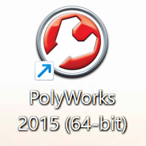
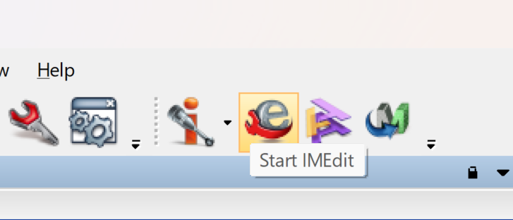
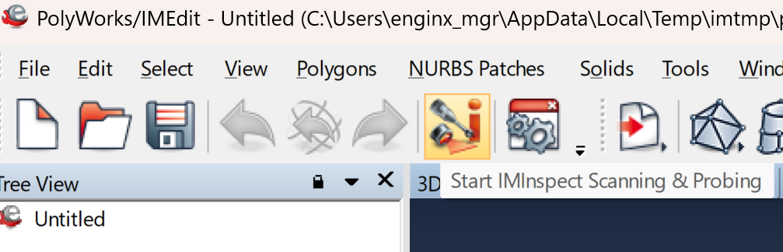
Launch Polyworks/IMInspect
Launch Polyworks by clicking Polyworks on desktop
From the Polyworks workspace, click Start IMEdit to launch IMEdit
From IMEdit, click Start IMInspect Scanning to launch Inspect for scan

Slide 2
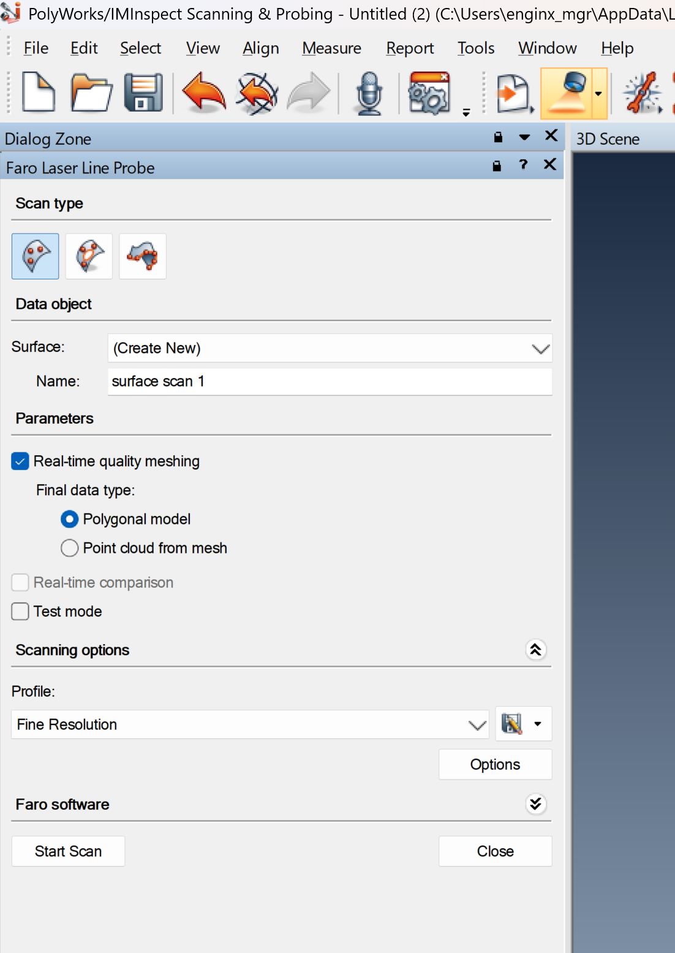
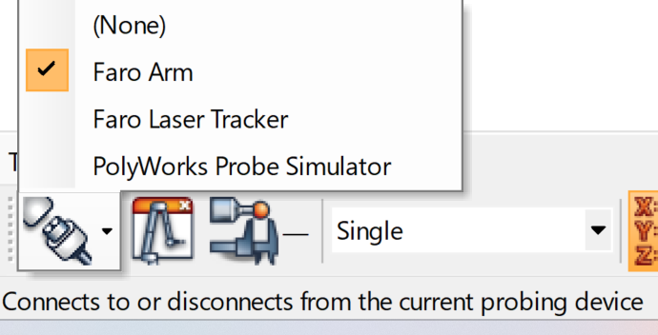
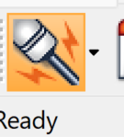
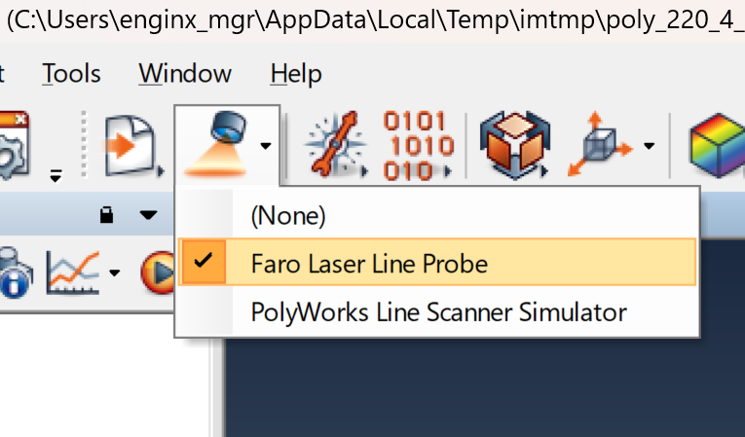
Setup laser scanner
At the bottom of the Inspect Scanning window, link to Faro Arm, then click connect to establish connection, a ready icon should exist when it is connected
At the top tool bar, select Faro laser line probe, then click the scan to launch laser scan

Slide 3
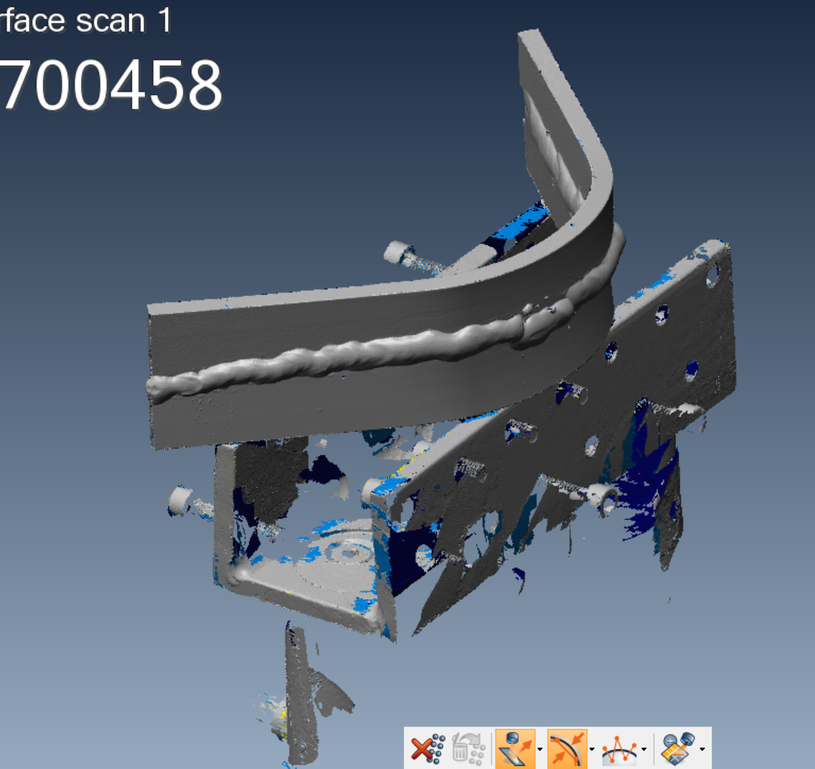
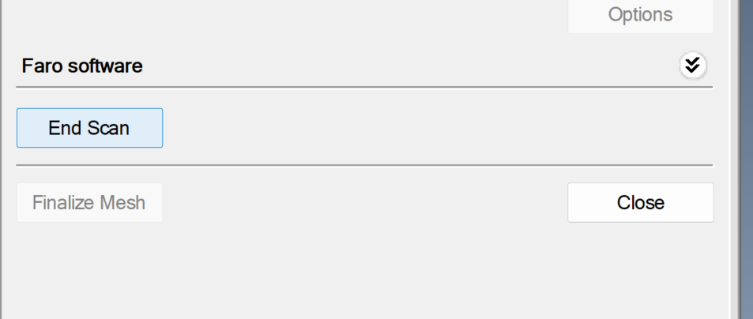
Start laser scan
Use the laser probe to Start Scan the sample, then End Scan and Finalize Mesh.

Slide 4
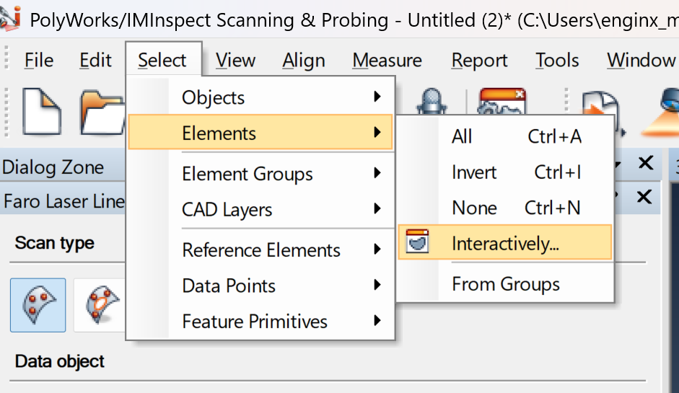
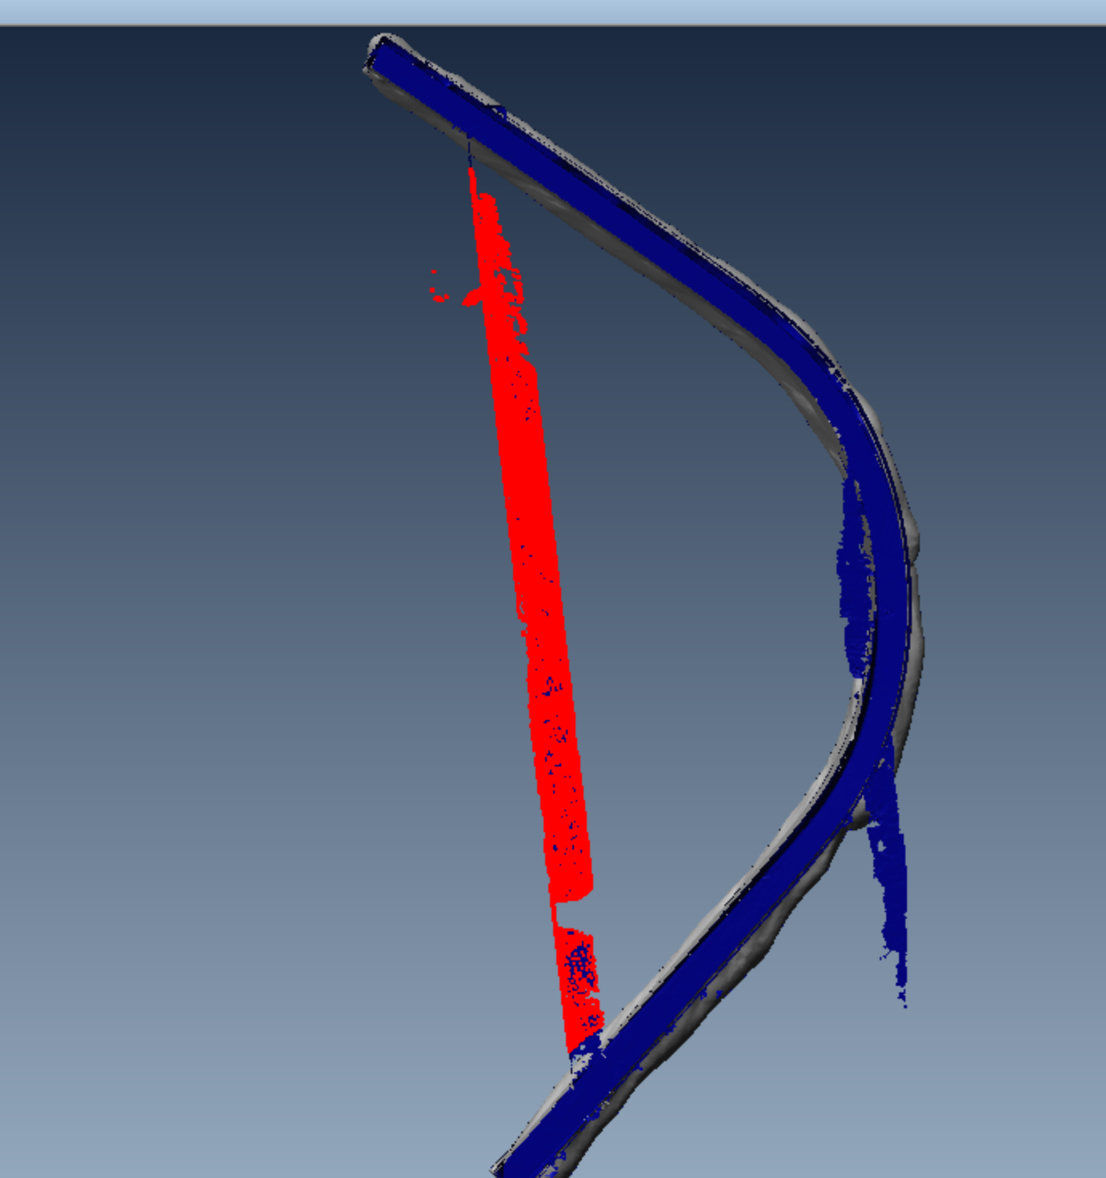
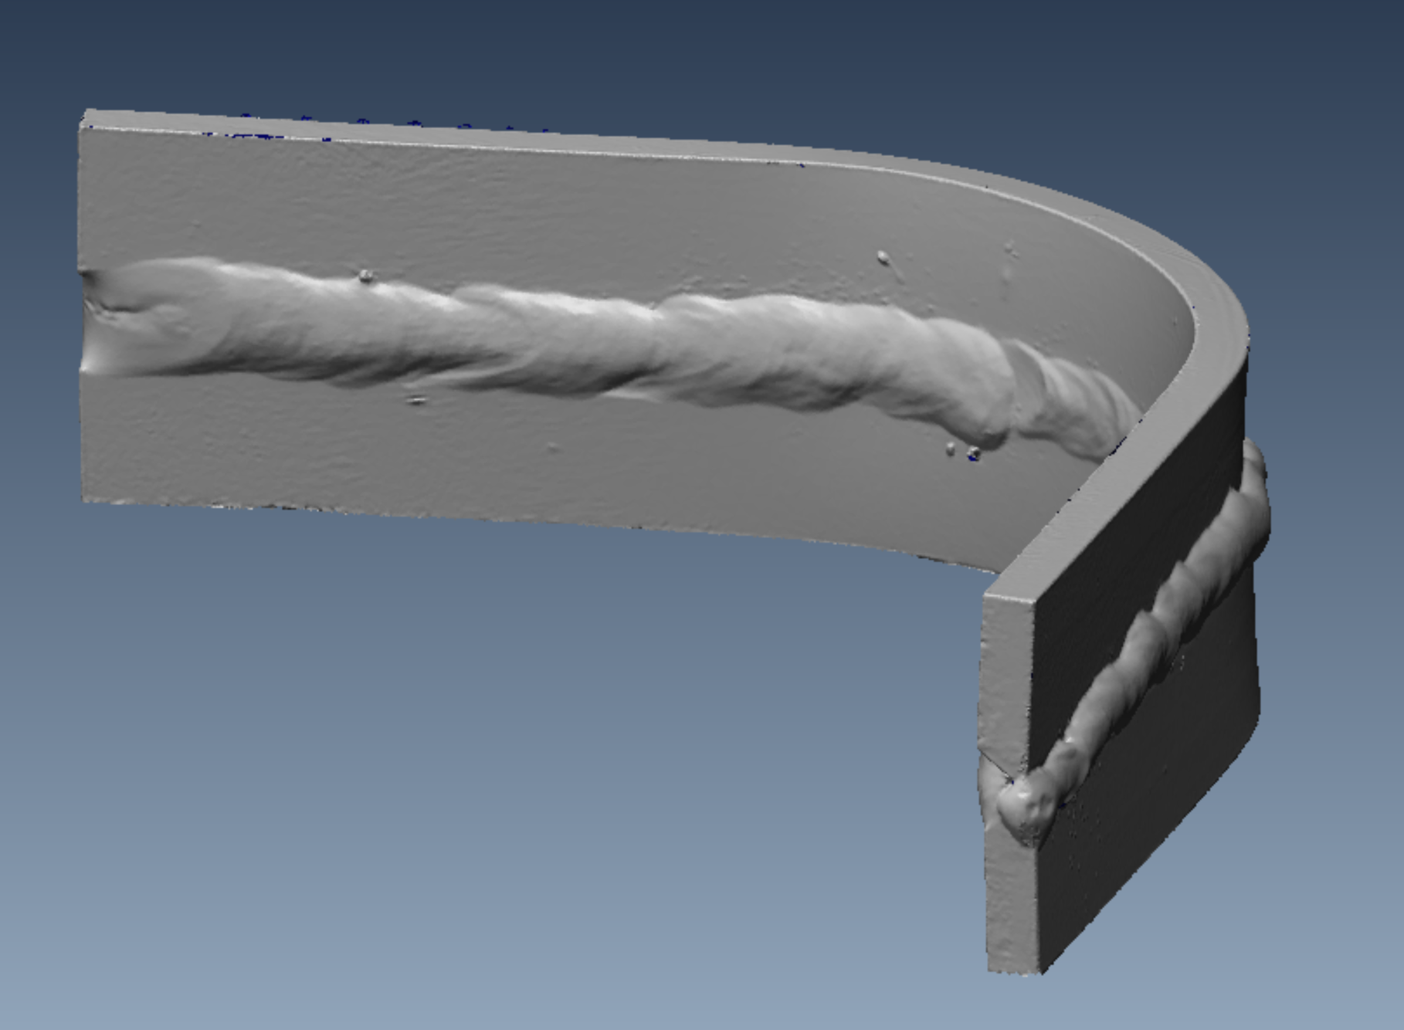
Clean the model
From Select, Elements, Interactively to select parts want, then press Delete button on keyboard to delete.

Slide 5
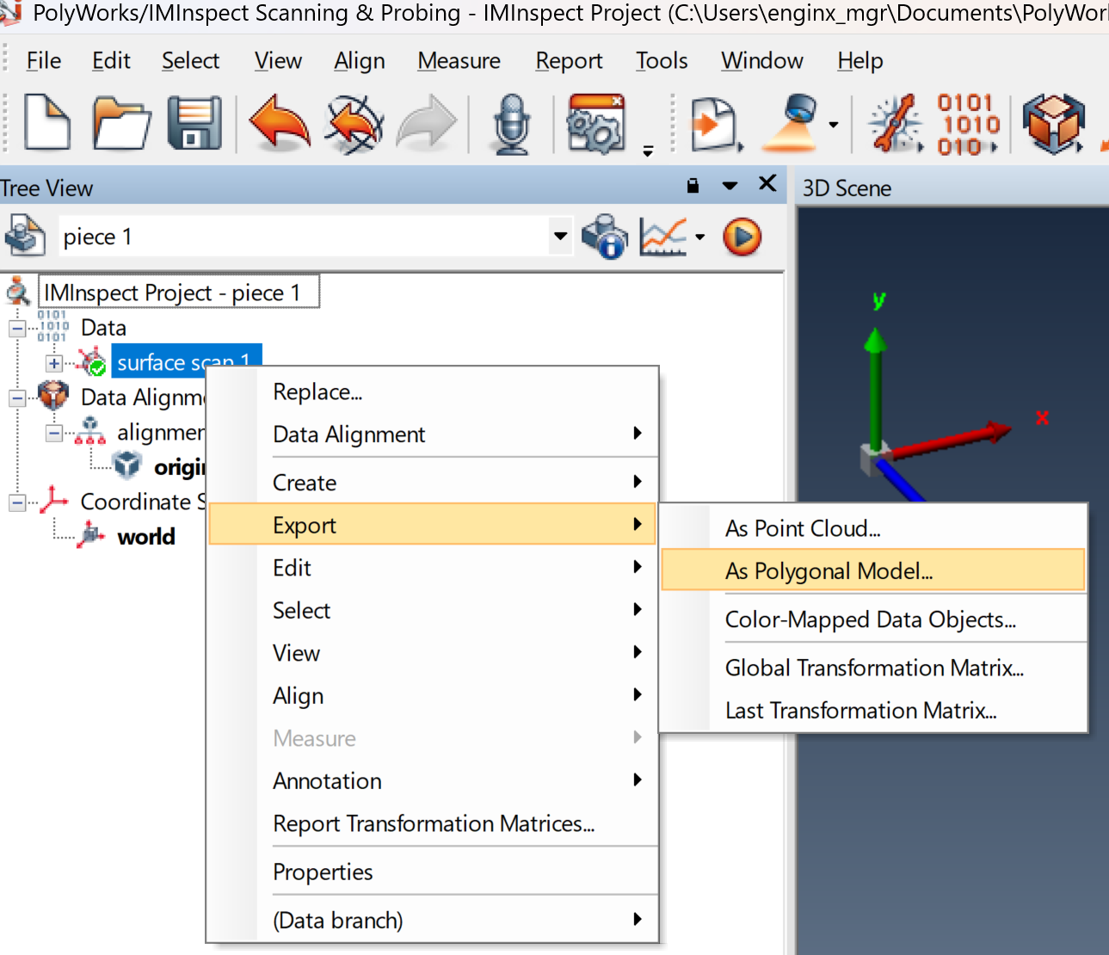
Save model
Go to treeview (bottom), select surface scan and right click
Export -> As Polygonal Model to save as .stl file.

Slide 6
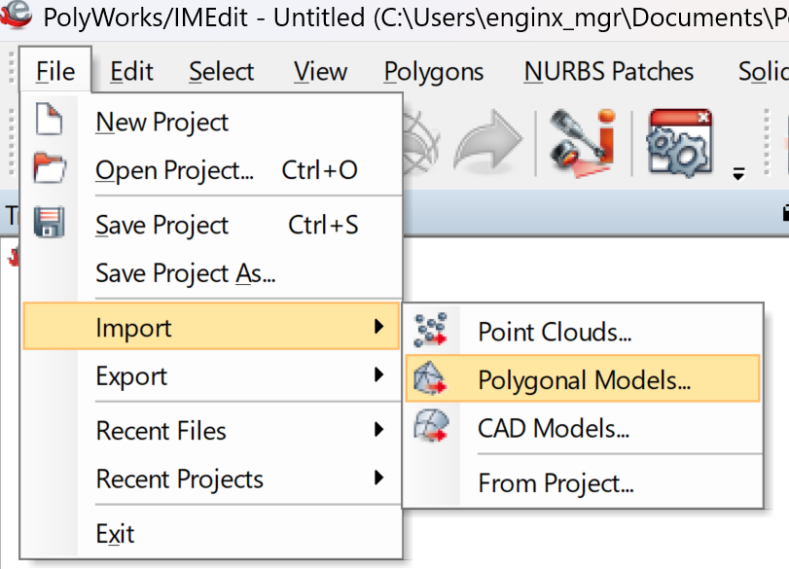
Import model to IMEdit
Open Polyworks/IMEdit
Import -> Polygonal Models to import the saved model.

Slide 7
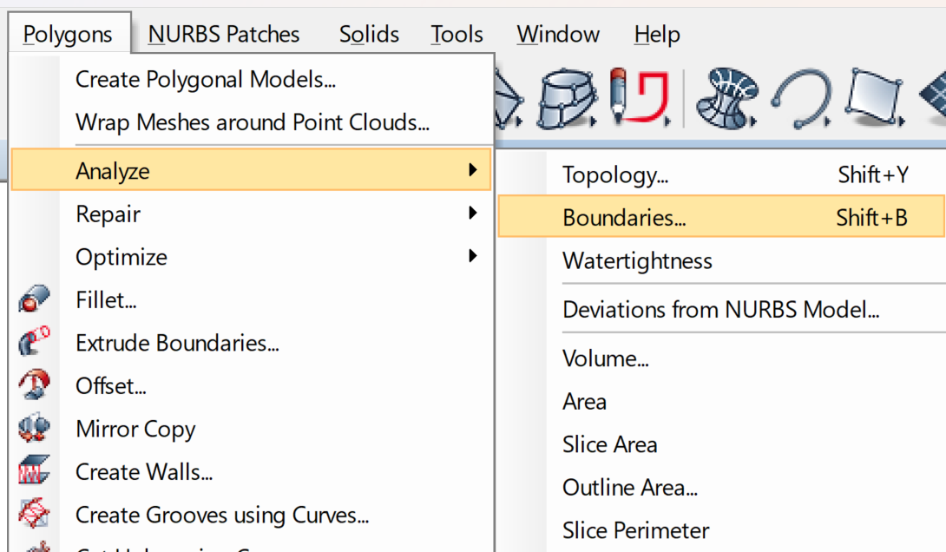
Analyze model
3. Analyze boundaries and Watertightness to check if there are open boundaries.

Slide 8
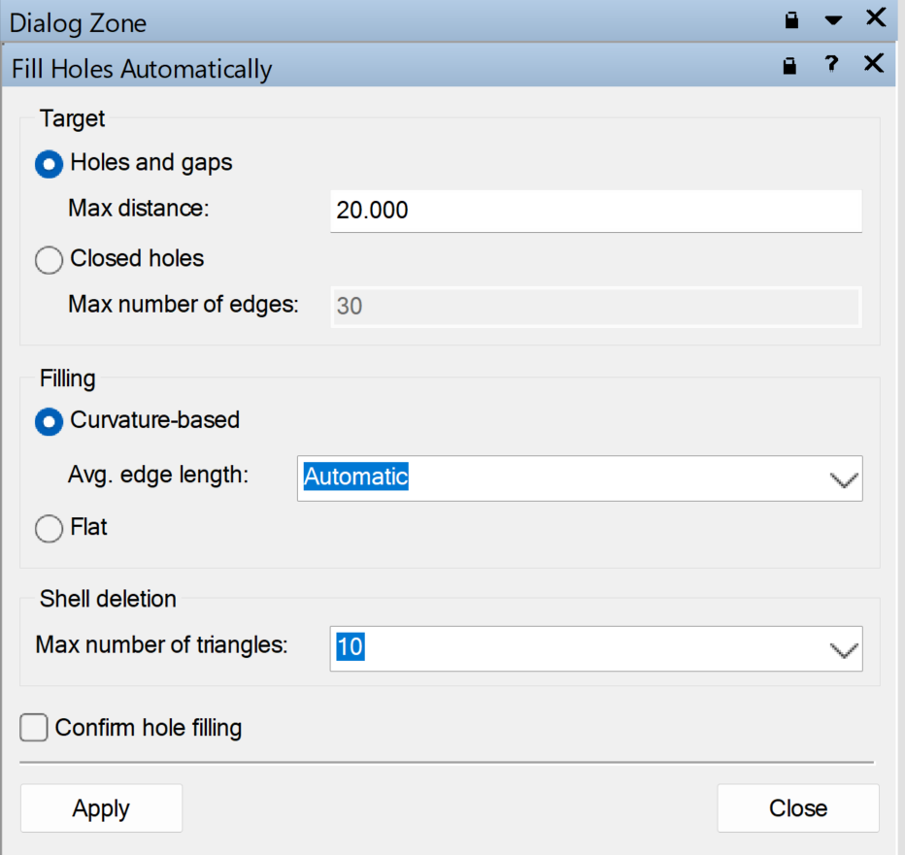
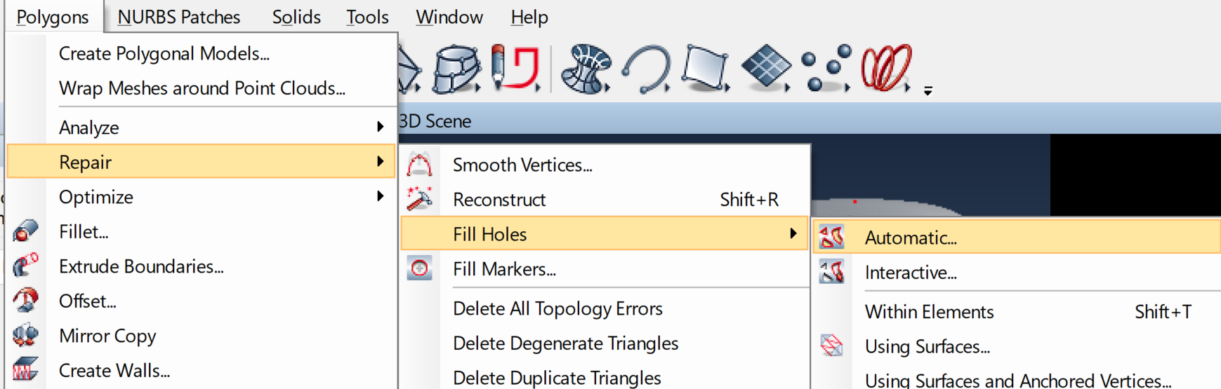
Repair model
4. If there are open boundaries and the model is not watertight, Repair -> Fill Holes to close all the holes until there are no open boundaries and the model is watertight.

Slide 9
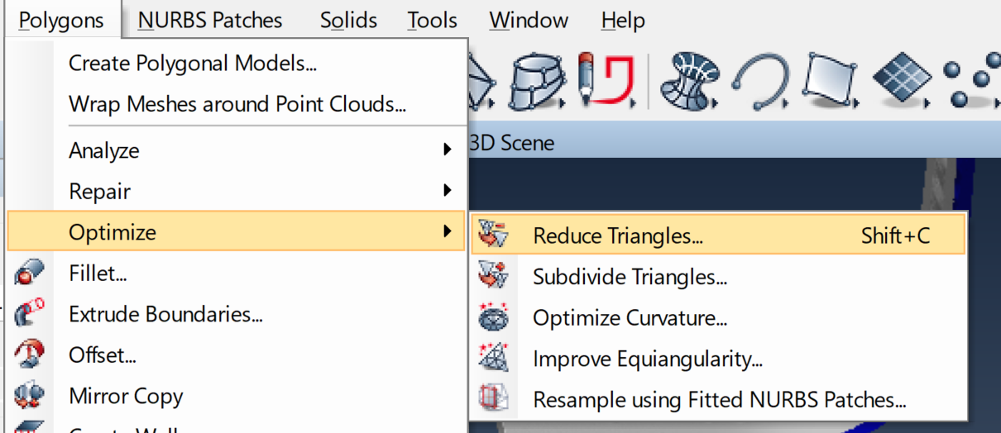
Optimize and save
5. Optimize -> Reduce Triangles to reduce number of mesh.
6. Then Export the model as stl file.

