Slide 1
A Hybrid Approach Combining Convolutional Neural Networks and Vision Transformers for Melanoma Skin Cancer Detection
Project Supervisor: Team members:
Mr. A. Koteswara rao R. Ravi(21761A05B9)
Assistant Professor M. Pujitha Nagamani(22765A0509)
A. Harshini(21761A0567)

Slide 2
Introduction
Melanoma is a highly aggressive form of skin cancer, where early detection greatly increases survival rates. This study presents a hybrid deep learning model that integrates Convolutional Neural Networks (CNNs) and Vision Transformers (ViTs) to enhance melanoma classification. ResNet50 is utilized for local feature extraction, while ViTs capture global image dependencies. By combining these architectures, the model achieves 94% accuracy, surpassing traditional approaches in medical image analysis.

Slide 3
Problem Statement
Existing melanoma detection methods rely on dermatologists’ expertise, which is subjective and prone to errors. Deep learning models using either CNNs or ViTs alone struggle to effectively balance local and global feature extraction. Therefore, this study proposes a hybrid CNN-ViT model to improve classification accuracy and generalization, ensuring reliable early melanoma detection.

Slide 4
Motivation
Rising cases of melanoma require accurate and early detection.
Limitations of CNNs and ViTs when used individually.
Potential clinical impact of a hybrid deep learning model.
Encouraging prior research on CNN-ViT integration but requiring further improvements.

Slide 5
Objectives
Develop a hybrid CNN-ViT model for melanoma detection
Improve classification accuracy by leveraging both local and global feature extraction.
Use data augmentation techniques to enhance generalization.
Optimize training through learning rate scheduling
Achieve better performance compared to standalone CNN or ViT models.

Slide 6
Literature Survey
Title | Year | Algorithm Used | Drawbacks
Large Dataset to Enhance Transformer-Based Skin Cancer Classification | 2024 | Transformer-based deep learning, Large-scale dataset training, Data augmentation | Data dependency, Overhead in training time, Model complexity
Fusion of Transformer Attention and CNN Features for Skin Cancer Detection | 2024 | Convolutional Neural Networks (CNNs) and Vision Transformers (ViTs), Self-attention mechanism, Feature fusion | High computational cost, Requires large dataset, Training complexity

Slide 7
Title | Year | Algorithm Used | Drawbacks
Multi-Class Skin Cancer Classification Using CNNs and ViTs | 2023 | Pretrained Convolutional Neural Networks (CNNs) and Vision Transformers (ViTs), Transfer learning, Ensemble model | High memory consumption, Limited generalizability, Difficult hyperparameter tuning
Deep CNN Transformer Hybrid Model for Skin Lesion Classification | 2022 | Convolutional Neural Networks (CNNs), Transformers, Focal loss, Attention-based feature selection | Sensitive to class imbalance, Requires fine-tuning, Limited interpretability
Improved Transformer Network for Skin Cancer Classification | 2022 | Advanced Transformer model, Full-image self-attention, Multi-head attention | Requires large datasets, Overfitting risk, Expensive training process

Slide 8
Proposed Methodology
Hybrid Model Components
CNN Module (ResNet50): Extracts local features (edges, textures).
ViT Module: Splits image into patches, finds global dependencies.
Feature Fusion: CNN and ViT outputs are concatenated.
Final Classifier: Fully connected layers + Sigmoid activation for binary classification (melanoma vs benign).
Dataset: Kaggle Melanoma Dataset (10,000 images)
Training Set: 9600 images
Testing Set: 1000 images
Preprocessing: Image resizing (224×224), normalization, augmentation (flipping, zooming, shifting).

Slide 9
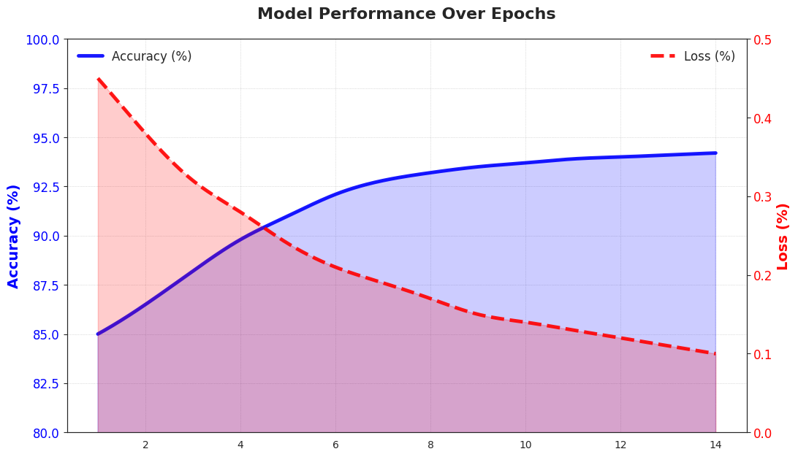
Results & Discussion
Training Details
Optimizer: Adam (Learning rate: 0.0001)
Loss Function: Binary Cross-Entropy
Epochs: 14
Batch Size: 16
Learning Rate Scheduler: ReduceLROnPlateau
Performance Metrics
Training Accuracy: 98%
Training Loss: 0.05
Test Accuracy: 93.4%
Precision: 94%
Recall (Sensitivity): 96%
F1-Score: 95%

Slide 10

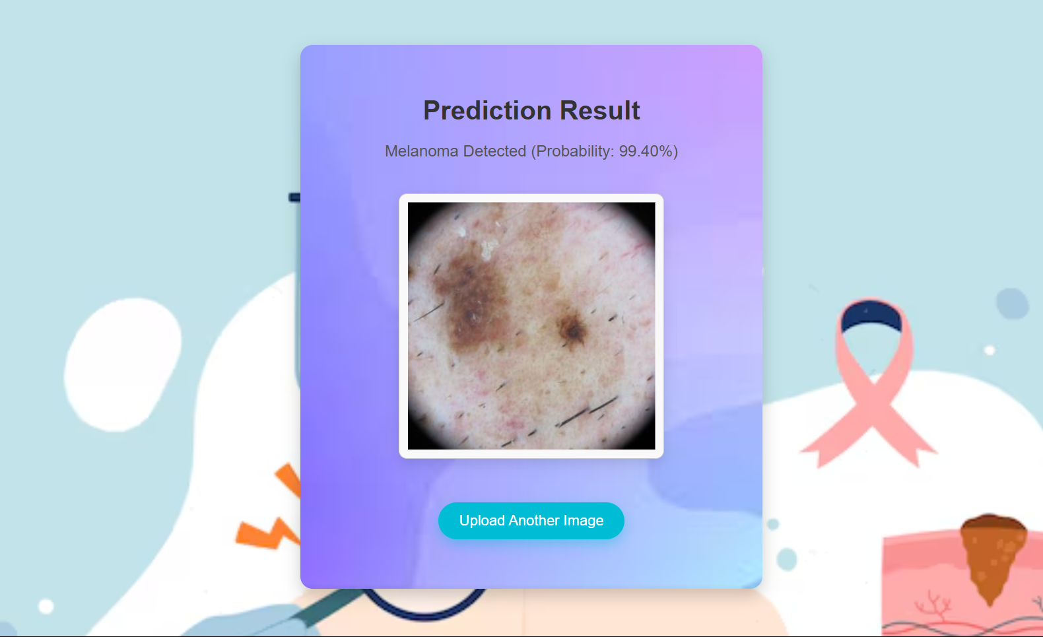
Input & Output

Slide 11
Conclusion
This study presents a novel hybrid deep learning model that effectively integrates Convolutional Neural Networks (CNNs) and Vision Transformers (ViTs) for melanoma detection. By combining the strengths of both architectures, the model achieves a classification accuracy of 94%, outperforming traditional approaches. The proposed approach enhances diagnostic accuracy, reduces reliance on subjective clinical evaluation, and demonstrates potential for real-world applications in dermatology. Future improvements include the integration of multi-modal patient data and real-time deployment in clinical settings to further enhance its utility and reliability.

Slide 12
References
Reis, S., & Turk, M. (2024). Fusion of Transformer Attention and CNN Features for Skin Cancer Detection. IEEE Transactions on Medical Imaging.
Nie, X., Li, Y., & Wang, H. (2022). A Deep CNN Transformer Hybrid Model for Skin Lesion Classification. Journal of Biomedical Informatics.
Xin, J., Zhao, L., & Chen, Z. (2022). Improved Transformer Network for Skin Cancer Classification. Medical Image Analysis.
Arshed, R., & Gupta, P. (2023). Multi-Class Skin Cancer Classification Using CNNs and ViTs. Elsevier Computer Vision Journal.
Gallazzi, P., & Kumar, S. (2024). Large Dataset to Enhance Transformer-Based Skin Cancer Classification. Springer Neural Computing.

Slide 13
Publication Details
Conference: ICICT 2025
Status: Accepted

Slide 14
Thank You

