Slide 1
Sales Performance Dashboard
Data Analyst Internship – Task 3 | Power BI Dashboard Summary

Slide 2
Dashboard Objective
Provide business stakeholders with a clear view of sales, profit and growth performance.
Enable interactive analysis using date, category, state, payment mode and other filters.
Highlight trends and areas that may require management attention.

Slide 3
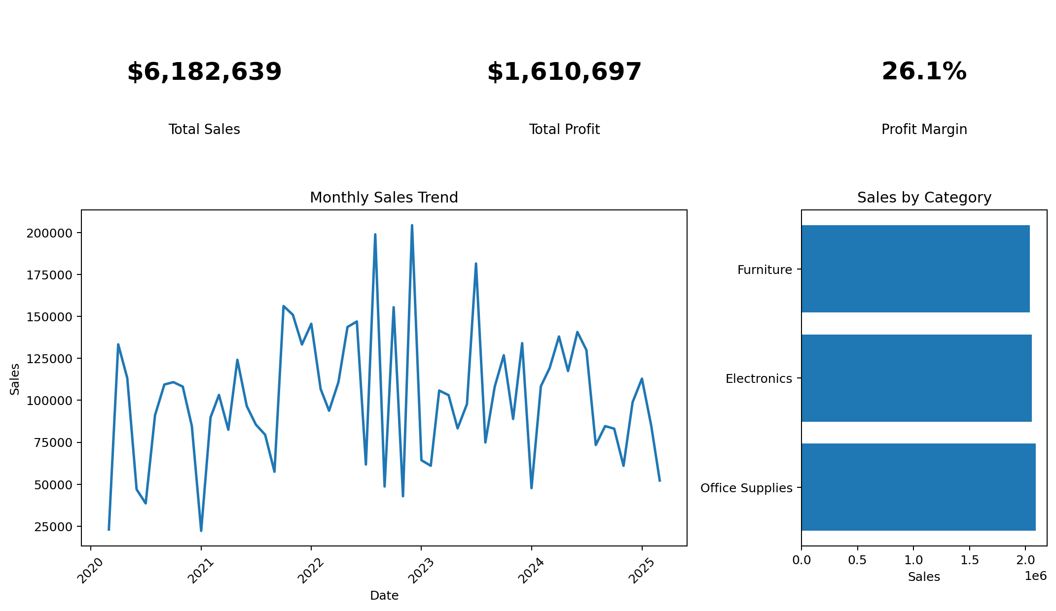
Dashboard Design Preview

Slide 4
Key Business Insights
Total sales in the dataset are $6,182,639, with total profit of $1,610,697.
Overall profit margin is approximately 26.1%.
The dataset contains 547 unique orders and 12,745 units/items.
Office Supplies is the highest-sales category based on the supplied data.
New York is the highest-sales state based on the supplied data.

Slide 5
Recommended Power BI Visuals & Filters
KPI Cards: Total Sales, Total Profit, Profit Margin %, Quantity and Unique Orders.
Line chart: Monthly Sales and Profit trend.
Bar chart: Sales by Category and Sub-Category.
Map or bar chart: Sales and Profit by State/City.
Donut/bar chart: Sales by Payment Mode.
Slicers: Year, Month, Category, Sub-Category, State, City and Payment Mode.

Slide 6
Conclusion
The dashboard is designed to support fast business decision-making.
Interactive filters allow stakeholders to drill from overall performance into products, locations and time periods.
The Power BI-ready workbook contains the cleaned dataset and supporting summary tables.

