Slide 1






BEYOND HACK 2.0 · TEAM LOCKIN
A/C 5021 0034 7781 9920
PAATTI
IFSC HDFC0001234
The AI grandmother who makes scammers hand over their mule accounts.
B2B
Banks
Telcos
Cyber cells
UPI officer@okaxis
₹4,50,000
Notes:
Paatti is an AI honeypot for India's digital arrest scams, sold to banks and telcos. She takes over scam calls and gets the scammer to confirm their own mule account, before any victim pays. Live dashboard: paatti-app.vercel.app

Slide 2


The mule account is the choke point
LOST TO DIGITAL ARREST SCAMS
MONEY RECOVERED
₹4,057 cr
70–80%
15–20%
2022 to May 2026 · 2.98 lakh complaints
within 2 h
later
~30 min
13 layers of mule accounts
and the money is gone
Everyone finds the account after the victim pays. Paatti finds it before.
Notes:
I4C/MHA data via The420 (2026). Recovery is 70 to 80 percent if 1930 is reached within 2 hours, 15 to 20 percent later. One Maharashtra case had 13 layers and 6,500+ mule accounts.

Slide 3







Proposed solution
PAATTI
Believable victim
An AI grandmother who answers the scam call, plays along, and gets the scammer to confirm their own mule account before anyone pays.
A slow, frightened, eager-to-pay grandparent in the caller's own language keeps the scammer talking.
Scammer confirms the account
She reads the digits back; only what the scammer confirms in their own words is locked.
Evidence, ready to act on
12 personas
10 languages
Report in 1 click
A Mule Intel Report with quotes, hashes and NCRP fields goes to the bank or 1930 within the golden hour.
Problem: banks learn about the mule after the money is gone. Solution: get the account from the scammer first.
Notes:
Our solution is Paatti: an AI grandmother who takes over a scam call. She sounds real, in the caller's own language, keeps them talking, and gets them to read out and then confirm the mule account. That becomes a Mule Intel Report a bank fraud desk or 1930 can act on inside the golden hour.

Slide 4









Technical approach and technologies
VOICE LOOP
INTEL PIPELINE
Scammer's call
Rules + Gemini extract
PAATTI
Sarvam speech-to-text
Quote + read-back gate
Gemini persona
SQLite mule registry
Sarvam Tamil voice
Report + dispatch
React
FastAPI
Python
Gemini
Sarvam AI
SQLite
Twilio
ReportLab
Vercel
Notes:
Reply ladder: code read-back, prepared intent replies, reply cache, Gemini, then script. The Gemini pool rotates models and keys with local rate limits. Fillers like 'Aiyo, oru nimisham kanna' cover the 2 to 5 second Gemini delay. Speech-to-text 0.37 s; 8 s of Tamil voice in 1.4 s.

Slide 5






System architecture
CHANNELS
FASTAPI BACKEND · WEBSOCKETS
OUTPUTS
Twilio phone line
Voice pipeline
SQLite mule registry
inbound or ring a phone
VAD → Sarvam speech-to-text → Sarvam voice (10 languages)
calls, turns, intel, repeat sightings
Persona engine
Read-back → script → prepared lines → cache → Gemini, behind an output guard
Browser phone
Mule Intel Report
judge scans a QR code
Intel extraction
PDF + JSON, SHA-256 hashes
Rules + Gemini, kept only if the quote is verbatim and the read-back is confirmed
Operator dashboard
Live hub
Bank / 1930 dispatch
type or speak as scammer
Every turn and intel card pushed to phone and laptop in real time
inside the 2-hour golden hour
Runs on: React dashboard (Vercel) · FastAPI on Render or laptop + Cloudflare tunnel · Gemini · Sarvam AI
Notes:
A call reaches Paatti three ways: a real Twilio number, a judge's phone via QR, or the dashboard. All three go through one FastAPI backend. The voice pipeline turns speech into text and back in the persona's language. The persona engine answers from the cheapest safe source first: code read-back, demo script, prepared lines, cache, then Gemini behind an output guard. Extraction keeps a finding only if its quote is verbatim from the scammer and, for accounts, the scammer confirmed the read-back. A live hub pushes everything to the phone and laptop. Results land in the SQLite mule registry, the Mule Intel Report, and the dispatch to a bank or 1930.

Slide 6
Features implemented and development progress
FEATURES
236
93%
Live dashboard: transcript, scam-stage tracker, intel cards
Done
Browser phone via QR, auto-reconnect, live laptop sync
Done
automated tests passing
backend code coverage
12 grandparent personas in 10 Indian languages
Done
Read-back gate and verbatim-quote evidence check
Done
Rules + Gemini extraction of account, IFSC, UPI, phone
Done
288/288
8
Mule Intel Report (PDF + JSON, SHA-256) and mule registry
Done
Real phone line via Twilio
Built, not live-tested
key fields across all 12 personas
scam scripts, 3 of them adversarial
Hand-off to bank fraud desk / 1930
Mock
Progress: working end to end on laptop and phone; real phone line and live dispatch are next.
Notes:
Everything marked Done works end to end today on a laptop and a phone. The Twilio phone line is built but not yet tested on a live number, and the bank and 1930 hand-off is a mock that records exactly what would be sent. Quality: 236 automated tests, 93% coverage, and every scam script passes for all 12 personas.

Slide 7
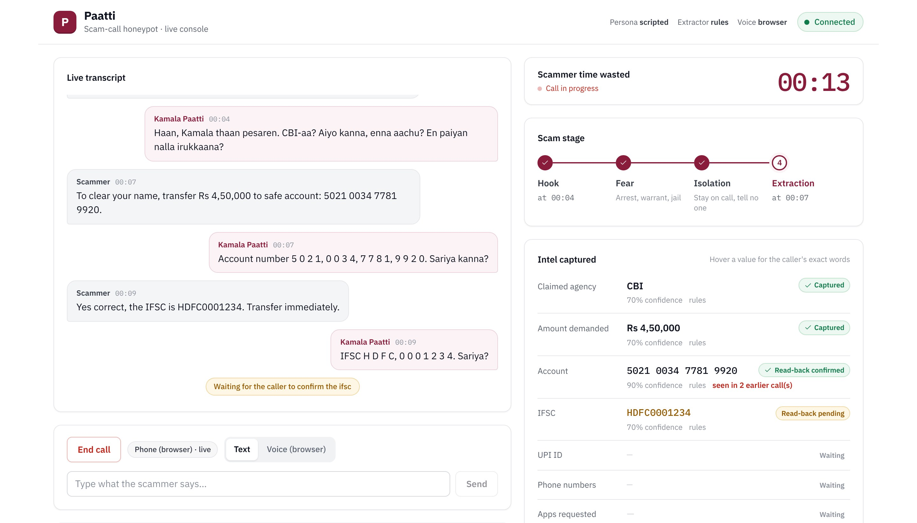
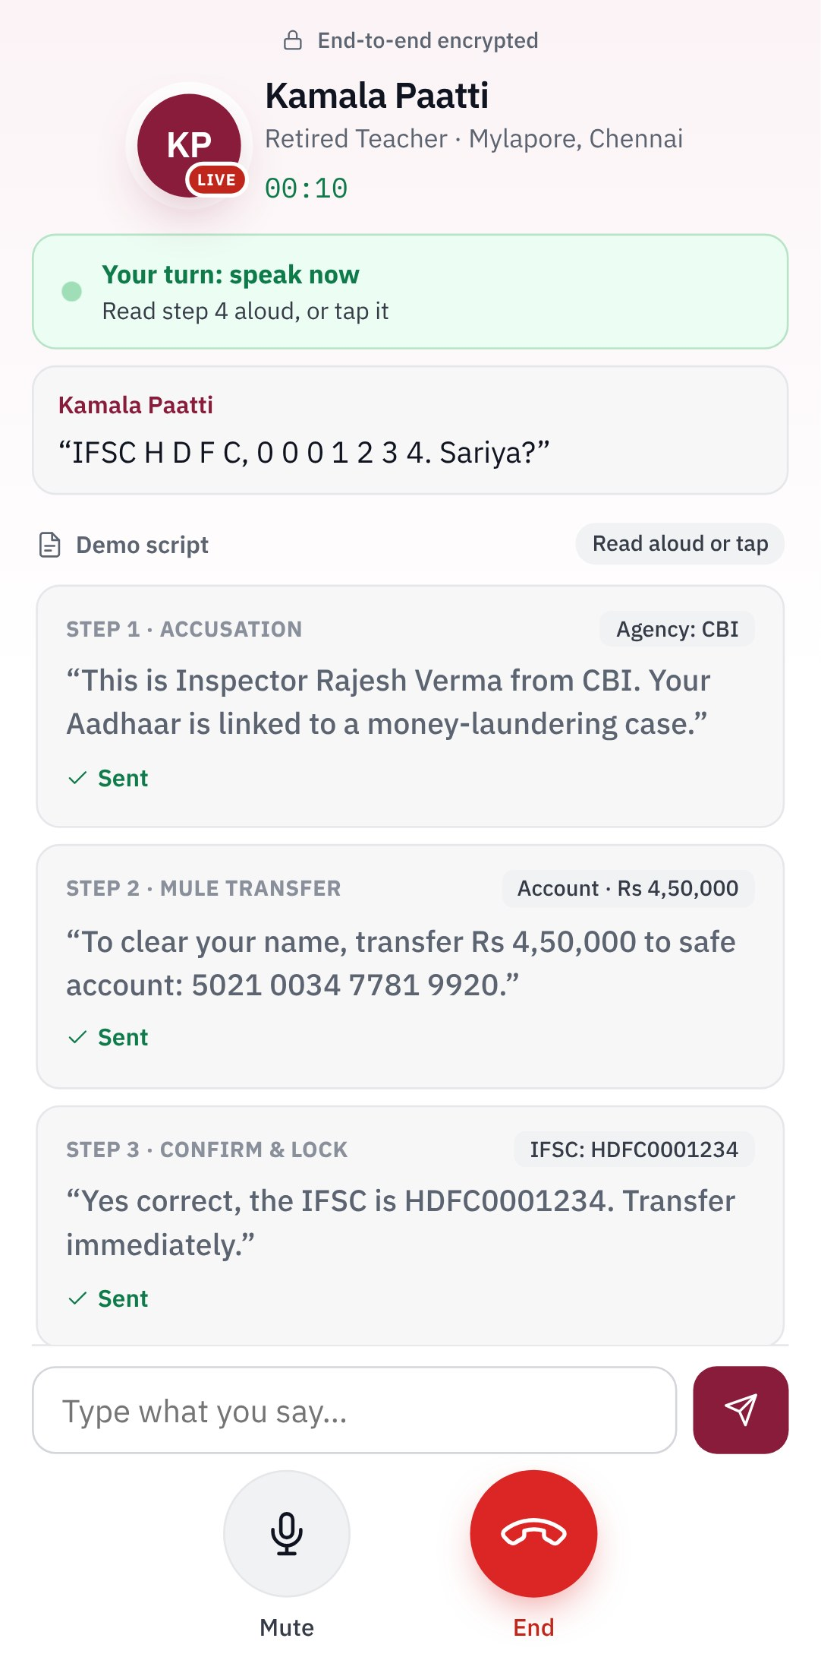
Project screenshots
Laptop
Live transcript, scam stage and intel cards as the call happens
Locked
Account confirmed by read-back, flagged as seen in an earlier call
Phone
The scammer's side: Paatti reads the IFSC back digit by digit
Real screenshots of one call: phone and laptop stay in sync, turn by turn.
Notes:
These are real screenshots of one demo call. On the phone, the judge plays the scammer and Paatti reads the IFSC back. On the laptop, the same call appears live: the transcript, the scam reaching the extraction stage, and the account number confirmed by read-back, already flagged as seen in an earlier call.

Slide 8




Potential applications
Bank fraud desks
Cyber cells and 1930
Telcos
Freeze or watch mule accounts before the money moves.
Evidence-grade leads already in NCRP format.
Send flagged scam calls to Paatti instead of just blocking them.
UPI apps and wallets
Families and seniors
Training and awareness
Block scammer UPI IDs across apps through a shared feed.
"Hand it to Paatti": forward a suspicious call to her number.
Real scam transcripts to train police, bank staff and the public.
One engine, many buyers: every call it takes protects the next victim.
Notes:
The same engine serves many users: bank fraud desks and UPI apps act on the mule accounts, cyber cells and 1930 get evidence-grade leads, telcos reroute scam calls to Paatti, families can forward a suspicious call to her, and the transcripts become training material for police and bank staff.

Slide 9








Future scope
NEXT 3 MONTHS
6 MONTHS
12 MONTHS
Real phone lines
Plug into the system
National scale
Live Twilio / telco numbers (built, needs a number)
Bank fraud-desk API, cross-checked with MuleHunter
Telco honeypot numbers seeded on scam lists
"Hand it to Paatti": forward any suspicious call
Real NCRP / 1930 hand-off (mock today)
More languages: Odia, Assamese, Urdu, dialects
Operator login and audit trail
Mule network graph across calls
Multi-agency cloud deployment
Working today: dashboard, QR phone call, Twilio-ready line, 12 personas, mule registry.
Notes:
Today Paatti runs on the dashboard and a browser phone via QR; the Twilio line is built but not tested live. Next: real numbers anyone can forward a scam call to. Then connect the reports to bank fraud desks and NCRP, and link mule accounts across calls. At scale, telcos host thousands of honeypot numbers seeded onto scammer lists.

