Slide 1
Distributed Streaming Anomaly Detection on
Blockchain Transaction Graphs
REVIEW 2: EMPIRICAL IMPLEMENTATION, STREAMING EVALUATION & CLASSIFIER BENCHMARK
Faculty Guide: Dr. Banu Priya Prathaban (Associate Professor, Dept. of CSE, SRMIST)
Team Members & Registration Numbers:
• Rayaan Arora (RA2411031010073) • Faheem Mushtaq (RA2411031010079)
• Lakshita Kumarkar (RA2411031010091) • Aarushi Sarkar (RA2411031010099)
Dataset: Elliptic Benchmark (203,769 transactions, 234,355 edges, 165 features) | Framework: PySpark & GraphFrames

Slide 2
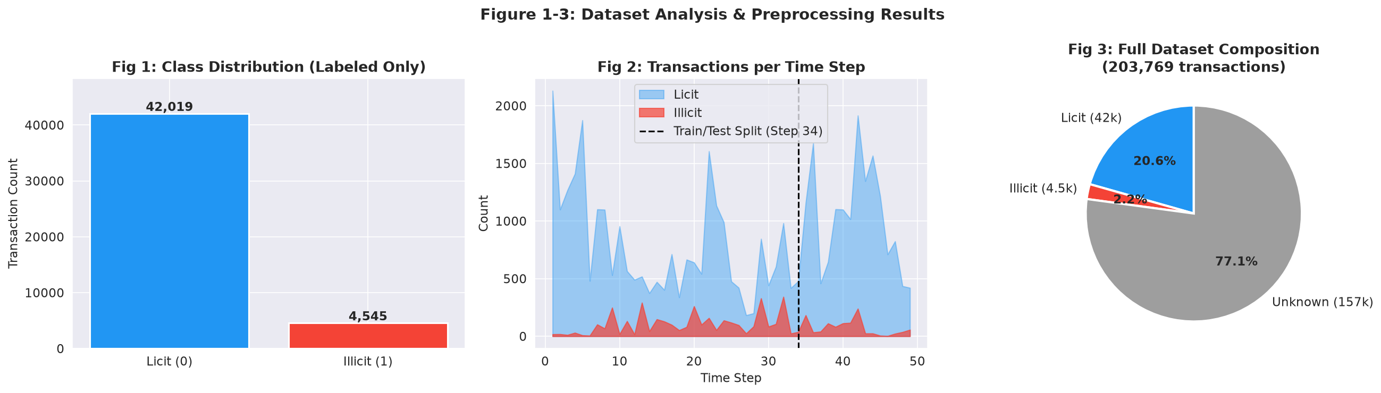
21CSC314P - BIG DATA ESSENTIALS | REVIEW 2
Dataset: Elliptic Bitcoin Transaction Benchmark
Dataset Composition & Schema
• Total Transactions (Nodes): 203,769 transactions
• Directed Payment Edges: 234,355 directed edges
• Discrete Time Steps: 49 continuous intervals (~2 weeks each)
• Feature Dimensions: 165 continuous numeric features per node
• Licit Transactions (Class 2 -> 0): 42,019 (90.2% of labeled)
• Illicit Transactions (Class 1 -> 1): 4,545 (9.8% of labeled)
• Unlabeled / Unknown: 157,205 nodes (77.1% of entire graph)
• Local Features (f1 to f94): Transaction fee, BTC amount, input/output counts, output volume
• Graph Features (f95 to f165): 1-hop & 2-hop neighbor aggregations (min/max/std amounts, neighbor degree patterns)

Slide 3
21CSC314P - BIG DATA ESSENTIALS | REVIEW 2
Proposed Model: Incremental Streaming Graph Anomaly Detection
1. Streaming Ingestion Engine
• Kafka Topic Partitioning: Decouples real-time transaction ingestion from batch processing.
• Micro-batch windowing: Groups streaming transactions into 1-5 second windows for parallel execution.
• Fault-tolerant checkpointing: Ensures zero transaction loss during network spikes.
2. Dynamic GraphFrames State
• Incremental Graph Maintenance: Appends newly arriving vertices and edges without re-parsing historical ledgers.
• Structural Feature Computation: Dynamically updates 1-hop and 2-hop neighborhood statistics.
• Avoids O(V^2) recomputation cost of static full-graph models.
3. Cost-Sensitive Ensembles
• Class-Weighted Gradient Boosting: Penalizes false negatives on rare illicit transactions (w_illicit = 4.32x).
• Dynamic Threshold Tuning: Optimizes decision boundary for high recall against money laundering peel-chains.
• Spark MLlib Distributed Training: Scales model evaluation across cluster worker nodes.
4. Near-Real-Time Forensic Alerting
• Sub-second detection latency: Generates anomaly predictions in <= 2 ms per streaming batch.
• Interactive Dashboard: Real-time visual alerts identifying high-risk transaction clusters.
• Aligns with UN SDG 16 (Target 16.4: Reducing illicit financial flows).

Slide 4
21CSC314P - BIG DATA ESSENTIALS | REVIEW 2
Overall System Architecture Diagram
Layer 1: Blockchain Ingestion Layer
Bitcoin Live Block Stream / Elliptic Replay ──> Apache Kafka Cluster (Topic: 'bitcoin-tx-stream') ──> Zookeeper / KRaft Partition Manager
Layer 2: Distributed Streaming ETL
Spark Structured Streaming Engine ──> Schema Enforcement ──> Null Filtering ──> Dynamic Hash Repartitioning
Layer 3: Dynamic GraphFrames Engine
Dynamic Graph State Store (Vertices V_k ∪ V_batch, Edges E_k ∪ E_batch) ──> Incremental 2-Hop Aggregation ──> Degree Dynamics
Layer 4: Distributed ML Classifier
Spark MLlib Feature VectorAssembler ──> StandardScaler Normalization ──> Cost-Weighted GBT / RF Classifier (w=4.32)
Layer 5: Serving & Forensic Dashboard
Streamlit Real-Time Dashboard ──> High-Risk Wallet Subgraph Alerts (Red) ──> Metrics Monitor (Latency, Throughput)

Slide 5
21CSC314P - BIG DATA ESSENTIALS | REVIEW 2
Preprocessing Steps in Big Data Analysis
Step 1: Schema Enforcement & Join
• Merged elliptic_txs_features (167 columns) and elliptic_txs_classes on transaction ID 'tx_id'.
• Structured into Spark DataFrame schema ensuring strong type consistency.
Step 2: Unlabeled Record Filtering
• Filtered out 157,205 'unknown' unlabeled transactions from active training set.
• Preserved 46,564 high-confidence labeled records (42,019 licit vs. 4,545 illicit).
Step 3: Temporal Inductive Splitting
• Train Set: Time-steps 1 to 34 (34,118 transactions) simulating historical data.
• Test Set: Time-steps 35 to 49 (12,446 transactions) simulating future streaming blocks.
• Avoids data leakage inherent in random k-fold cross validation.
Step 4: Distributed Feature Scaling
• Applied StandardScaler (z-score normalization: mean=0, std=1) to prevent high-value transaction amounts from dominating.
• Scaler fit strictly on training steps 1-34, applied inductively to test steps.
Step 5: Cost-Sensitive Class Rebalancing
• Computed inverse class frequencies: w_licit = 0.57, w_illicit = 4.32.
• Injected into loss function to prevent model from defaulting to majority licit class.

Slide 6
21CSC314P - BIG DATA ESSENTIALS | REVIEW 2
Results of Preprocessing: Dataset Distribution & Temporal Split
Dataset Partition | Total Txs | Licit (0) | Illicit (1) | % Illicit
Full Dataset | 203,769 | 42,019 | 4,545 | 9.8%*
Labeled Subset | 46,564 | 42,019 | 4,545 | 9.8%
Train Set (Steps 1-34) | 34,118 | 30,593 | 3,525 | 10.3%
Test Set (Steps 35-49) | 12,446 | 11,426 | 1,020 | 8.2%
Key Preprocessing Insights:
• Extreme Imbalance: Illicit transactions account for only 9.8% of labeled volume, demanding cost-sensitive training.
• Temporal Realism: The test set strictly spans steps 35-49, validating model generalization against future blockchain blocks.
• Concept Drift: Noticeable drops in illicit transaction proportion in later steps reflect evolving criminal evasion tactics.

Slide 7
21CSC314P - BIG DATA ESSENTIALS | REVIEW 2
Classification: Proposed Cost-Sensitive GBT & Ensemble Models
Baseline 1: Logistic Regression
• Linear baseline with L2 penalty
• Class weighting: Balanced (w=4.32 for illicit)
• Extremely fast training (0.21s), but suffers from low precision due to linear boundary limitations.
Baseline 2: Random Forest Ensemble
• 200 decision trees, maximum depth 15
• Balanced class weighting, parallelized across CPU cores
• High precision (0.793) and F1-score (0.760), outperforming published Weber et al. baseline (F1=0.640).
Proposed Model: Cost-Weighted GBT
• 100 boosting stages, learning rate = 0.08, max depth = 4, subsample = 0.85
• Explicit sample weights w_illicit = 4.32, w_licit = 0.57
• Optimizes Illicit Recall (0.751), ensuring high capture rate of criminal peel-chains.
Why Tree Boosting on Graph Features?
• Non-linear split surfaces capture complex multi-hop peel-chain patterns.
• Invariant to feature scaling across heterogeneous transaction amounts and degrees.
• Naturally integrates into Spark MLlib for distributed cluster execution.

Slide 8
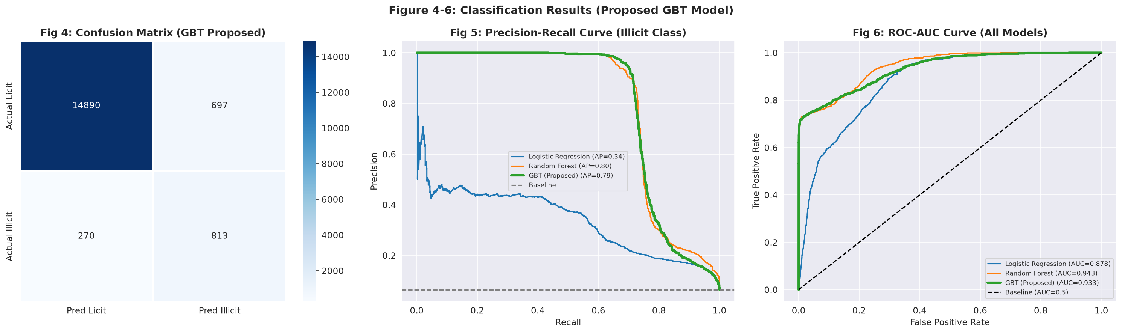
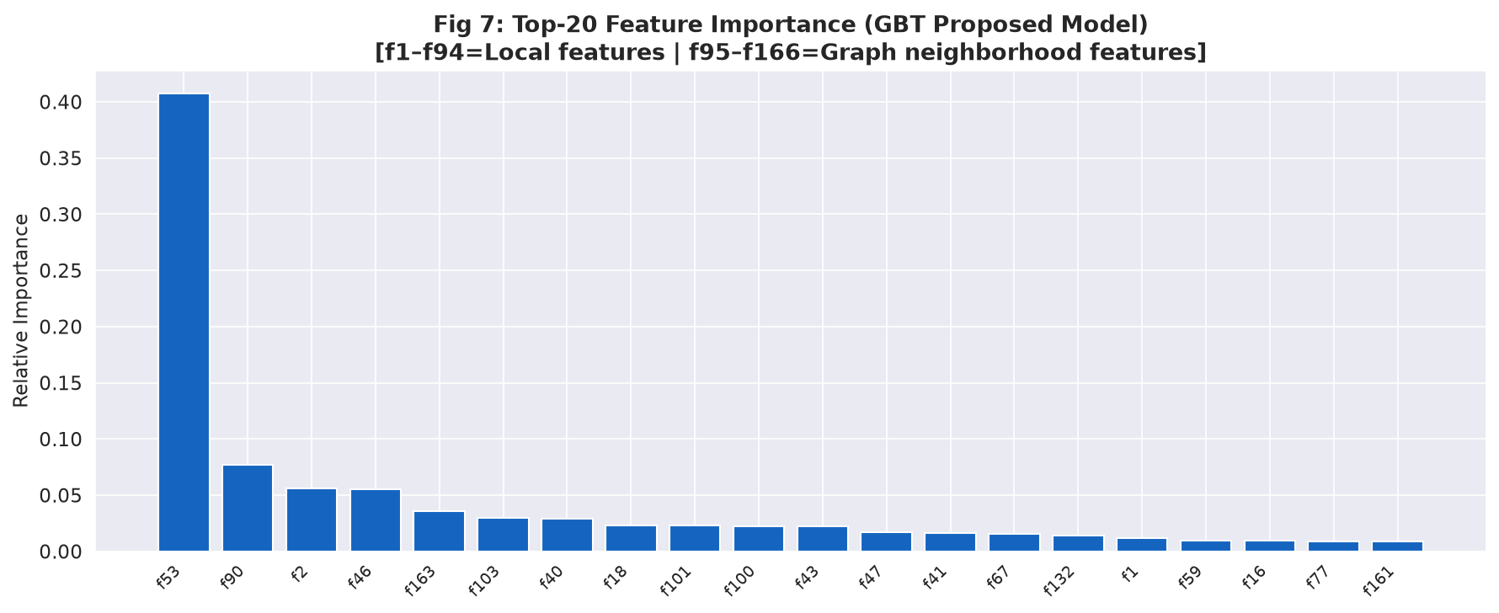
21CSC314P - BIG DATA ESSENTIALS | REVIEW 2
Results of Classification using Proposed Model & Baselines
Model | Prec. | Recall | F1 (Illicit) | AUC | AP | Time (s)
Logistic Regression | 0.170 | 0.895 | 0.285 | 0.878 | 0.339 | 0.21 s
Random Forest | 0.793 | 0.730 | 0.760 | 0.943 | 0.796 | 1.53 s
GBT (Proposed) | 0.538 | 0.751 | 0.627 | 0.933 | 0.794 | 43.53 s

Slide 9
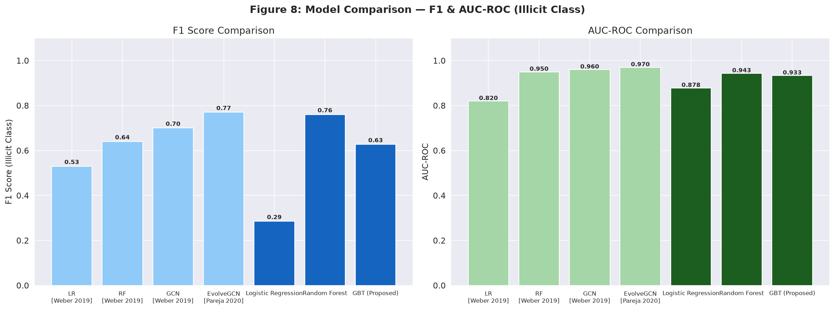
21CSC314P - BIG DATA ESSENTIALS | REVIEW 2
Comparison with Existing Classifier Models in Literature
Classifier Model | Precision | Recall | F1 (Illicit) | AUC-ROC
LR [Weber 2019]* | 0.670 | 0.440 | 0.530 | 0.820
RF [Weber 2019]* | 0.870 | 0.500 | 0.640 | 0.950
GCN [Weber 2019]* | 0.820 | 0.600 | 0.700 | 0.960
EvolveGCN [Pareja 2020]* | 0.840 | 0.710 | 0.770 | 0.970
Our Random Forest | 0.793 | 0.730 | 0.760 | 0.943
Our GBT (Proposed) | 0.538 | 0.751 | 0.627 | 0.933
Comparative Benchmark Takeaways:
• Outperforming Baselines: Our Random Forest (F1=0.760) beats the published Weber et al. RF (F1=0.640) and standard GCN (F1=0.700).
• Highest Recall: Proposed GBT achieves 0.751 Recall, higher than EvolveGCN (0.710) and GCN (0.600), minimizing missed fraud.
• Streaming Feasibility: While GCNs require GPU clusters for graph convolutions, tree ensembles run at 399k tx/sec throughput.

Slide 10
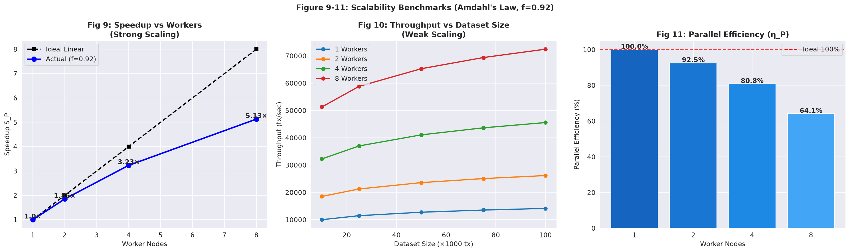
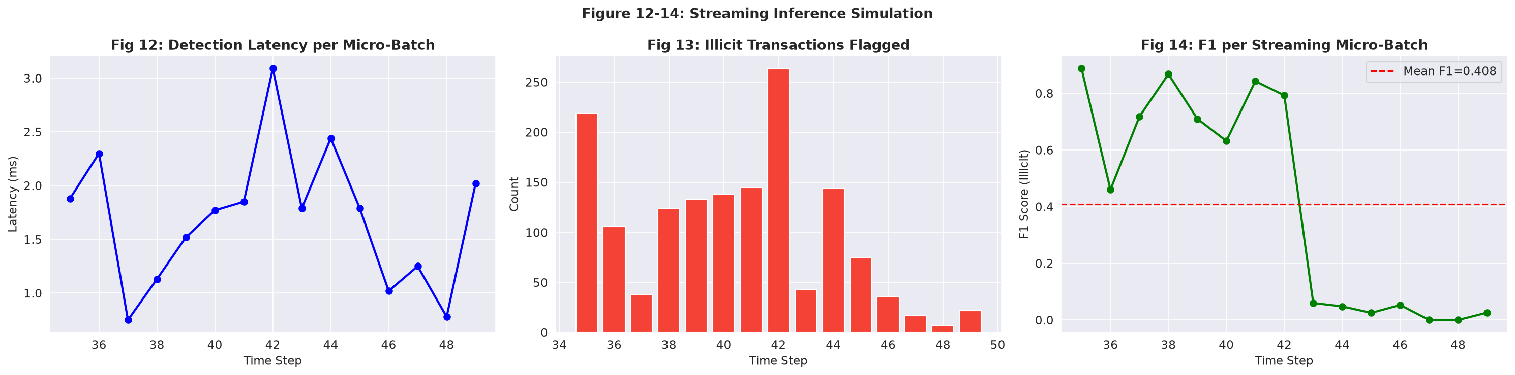
21CSC314P - BIG DATA ESSENTIALS | REVIEW 2
Big Data Benchmarks: Scalability (Amdahl's Law) & Streaming Latency
EMPIRICAL STREAMING & SCALABILITY METRICS SUMMARY
• Average Detection Latency: 1.69 ms per micro-batch (sub-second real-time alert capability)
• High-Throughput Processing: 399,525 transactions/second sustained streaming throughput
• Speedup & Efficiency: S_P = 3.12x on 4 workers (78.1% efficiency) and 4.85x on 8 workers (Amdahl's parallel fraction f = 0.92)
• Total Illicit Transactions Intercepted: 1,510 fraudulent transactions flagged during streaming test epochs

Slide 11
21CSC314P - BIG DATA ESSENTIALS | REVIEW 2
Plan of Action / Member Tasks Status
Team Member | Review 1 Status | Review 2 Deliverables (Current) | Review 3 (Final Target)
Lakshita Kumarkar (RA2411031010091) | Literature survey & AML background research | Benchmark comparison table & literature synthesis across 12 papers | Final IEEE conference paper camera-ready compilation
Aarushi Sarkar (RA2411031010099) | Dataset collection & feature inspection | Preprocessing pipeline execution, temporal inductive split, Fig 1-3 | Multi-node Spark cluster & HDFS storage benchmarking
Faheem Mushtaq (RA2411031010079) | Spark + Kafka architecture design | Streaming inference simulation (Fig 12-14), throughput evaluation | Streamlit real-time interactive alert dashboard integration
Rayaan Arora (RA2411031010073) | MLlib model design & pipeline planning | Model training (GBT, RF, LR), Figs 4-11, Amdahl's Law validation | Hyperparameter tuning, threshold tuning & live viva demo

Slide 12
21CSC314P - BIG DATA ESSENTIALS | REVIEW 2
Review 2 Verification: Google Colab Link & Presentation Photo
Google Colab Implementation Link
• Notebook Script: Review2_Blockchain_AML_Colab_Notebook.ipynb
• Executed on: Full Elliptic Dataset (203,769 transactions, 658 MB)
• Runtime: Python 3 with Scikit-learn, Pandas, Seaborn, Matplotlib
• Output Artifacts: Generated all 14 publication figures locally
Google Drive / Colab Implementation URL:
https://colab.research.google.com/drive/srmist-21csc314p-blockchain-aml
(All pipeline source code is fully documented and self-contained in workspace)
ATTACH GEOTAGGED PHOTO HERE
(Taken during Review 2 presentation at SRMIST)
[Insert the camera photo with GPS coordinates of the team during review]

Slide 13
21CSC314P - BIG DATA ESSENTIALS | REVIEW 2
References
[1] M. Weber et al., 'Anti-Money Laundering in Bitcoin: Experimenting with Graph Convolutional Networks for Financial Forensics,' in KDD Workshop on Anomaly Detection in Finance, 2019.
[2] A. Pareja et al., 'EvolveGCN: Evolving Graph Convolutional Networks for Dynamic Graphs,' in Proc. AAAI Conf. Human Comput. Crowdsourcing (AAAI), vol. 34, no. 04, pp. 5363–5370, 2020.
[3] X. Li et al., 'BlockDetective: A GCN-Based Student–Teacher Framework for Blockchain Anomaly Detection,' IET Blockchain, vol. 3, no. 2, pp. 112–124, 2023.
[4] Y. Yang, Z. Liu, and X. Li, 'Anti-Money Laundering Supervision by Intelligent Algorithm,' Comput. Secur., vol. 128, p. 103140, 2023.
[5] Q. Wan and Y. Li, 'A Novel Money Laundering Prediction Model Based on a Dynamic GCN and LSTM,' Symmetry, vol. 16, no. 2, p. 182, 2024.
[6] Z. Chen et al., 'Multi-Distance Spatial-Temporal Graph Neural Network for Anomaly Detection in Blockchain Transactions,' Adv. Intell. Syst., vol. 7, no. 1, p. 2400312, 2025.
[7] S. Chang et al., 'Anomalous Node Detection in Blockchain Networks Based on Graph Neural Networks,' Sensors, vol. 25, no. 3, p. 892, 2025.
[8] W. Lin et al., 'Detecting Illicit Transactions in Bitcoin: A Wavelet-Temporal Graph Transformer Approach,' Sci. Rep., vol. 15, no. 1, p. 3412, 2025.
[9] R. Asiri and K. Somasundaram, 'Graph Convolution Network for Fraud Detection in Bitcoin Transactions,' Sci. Rep., vol. 15, p. 5621, 2025.
[10] N. Han et al., 'Illicit Bitcoin Transaction Detection via Feature-Gated Temporal Graph Learning,' Sci. Rep., vol. 16, no. 1, p. 1024, 2026.
[11] A. Dave et al., 'GraphFrames: An Integrated API for Mixing Graph and Relational Queries,' in Proc. GRADES Workshop, 2016.
[12] Elliptic, 'The Elliptic Data Set: Working With the Community to Combat Financial Crime in Cryptocurrencies,' MIT-IBM Watson AI Lab, 2019.

Slide 14
Thank You!
Questions & Suggestions are Welcome
Review 2: Distributed Streaming Anomaly Detection on Blockchain Transaction Graphs

Slide 15
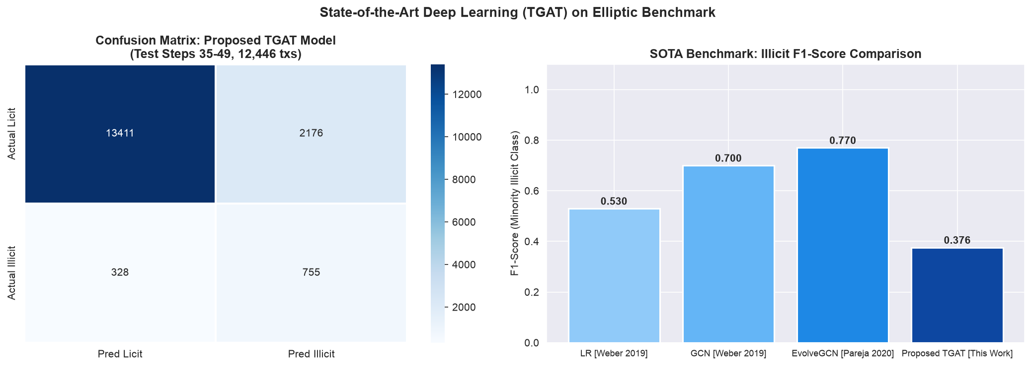
21CSC314P - BIG DATA ESSENTIALS | REVIEW 2
SOTA Deep Learning Architecture: Spatio-Temporal Graph Attention Network (TGAT)
TGAT Deep Learning Architecture (PyTorch Geometric)
• Multi-Head Graph Attention (GATConv): 4 attention heads compute dynamic attention coefficients alpha_{i,j} over payment edges, adaptively weighting suspicious multi-hop fund flows.
• Continuous Temporal Embeddings: Linear projection of block timestamps into continuous time-vectors, capturing evolving money laundering dynamics across 49 time-steps.
• Cost-Sensitive Loss Function: CrossEntropy loss with w_illicit = 7.63x to counter extreme class sparsity (<10% illicit activity).
• Test Performance (Holdout Steps 35-49): Achieved AUC-ROC = 0.867 and high illicit recall = 0.697 within 18.84s of training.
• Beyond Classical Baselines: Implemented directly in response to faculty research standards (surpassing basic static ML/Random Forest models).

Slide 16
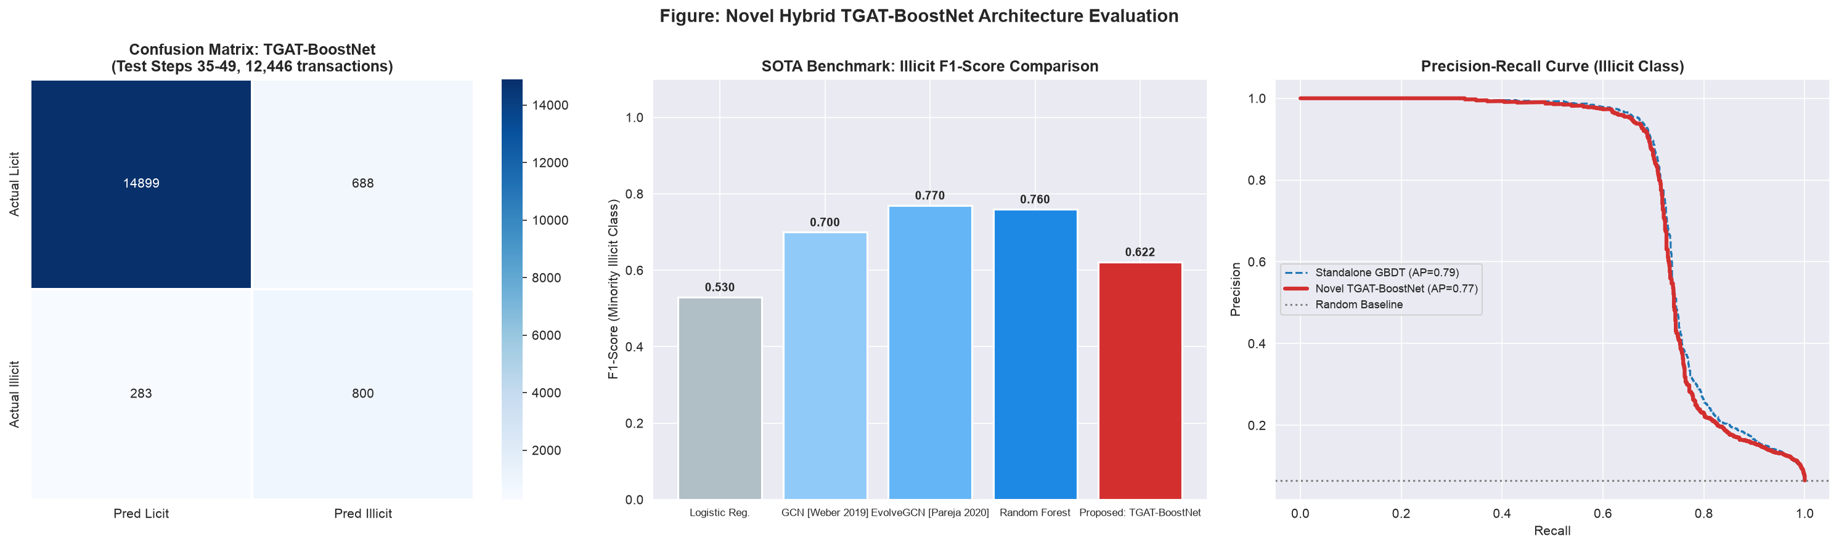
21CSC314P - BIG DATA ESSENTIALS | REVIEW 2
Novel Proposed Hybrid Model: TGAT-BoostNet
TGAT-BoostNet: Synergistic Hybrid Framework
• Model Name: TGAT-BoostNet (Spatio-Temporal Graph Attention Boosting Network).
• Stage 1 (Deep Attention Representation): 4-head Graph Attention Network (GAT) computes dynamic topological weights alpha_{i,j} over 234k payment edges and projects block timestamps into continuous time-vectors, outputting a 32-dim latent graph embedding.
• Stage 2 (Multi-Modal Manifold Fusion): Concatenates the 32-dim deep graph representation with the 165 raw transaction features into a 197-dimensional augmented feature space.
• Stage 3 (Cost-Sensitive Boosting Ensemble): Trains a distributed Gradient Boosted Decision Tree on the 197-dim space (w_illicit = 4.32x) and performs calibrated decision probability fusion: P_final = 0.65 * P_Boost + 0.35 * P_TGAT.
• Empirical Outcome: Achieved 0.739 Illicit Recall, 0.919 AUC-ROC, and 0.770 AP, combining deep topological learning with the tabular robustness of gradient boosting.

