Slide 1
lockin // vision deck 01
[ srm / iitd campus ]
college is full of possibilities.
but how much of it do we actually do?
four years · thousands of students · countless ideas waiting to happen
find your people.
Notes:
pacing: calm, measured, deliberate. pause for 2 full seconds after advancing to this slide before speaking.
talking points:
• do not introduce the product yet. do not mention features or apps.
• connect directly with the student builders in the room: 'everyone in this room chose to be here because you want to make something meaningful during college.'
• confront the unspoken campus reality: 'you look around your campus and the potential is staggering. thousands of smart people, hackathons, clubs, labs, ideas sketched in late-night conversations.'
• drop the hook: 'yet at the end of four years, most of the things students intended to build never made it past a notes app or a dead group chat.'
• transition: 'today we want to talk about why that happens—and what we're building to fix it.'

Slide 2
lockin // vision deck 02
[ the student friction ]
root cause diagnosis
good ideas rarely happen on their own.
01 / talk vs execution
the project you keep talking about but never start
hackathon ideas and side builds that stall in group chats with 87 messages and zero lines of code.
02 / social isolation
the people you want to meet but never quite find
knowing 50 classmates in large lectures is not the same as having someone on your exact creative wavelength.
03 / accountability vacuum
the study session that keeps getting postponed
promising to study alone in a dorm room, then losing five hours to passive scrolling and fragmented attention.
04 / coordination fatigue
the things you want to try but don't want to do alone
gym workouts, 5km track runs, paper submissions, and side quests that fade without a concrete partner.
the barrier isn't ambition: discovery, compatibility, and follow-through are fragmented across dead group chats, stale dms, and disconnected feeds.
[ 0% output ]
friction audit · university life 2026
find your people.
Notes:
pacing: direct, empathetic, diagnosing the exact pain without sounding preachy.
talking points:
• break the myth of lack of motivation: students do not fail to execute because they're lazy; they fail because the friction of coordinating is overwhelmingly high.
• walk through the 4 failure modes:
1. talk vs execution: 'everyone has a group chat that was created for a hackathon or a startup idea that died at message 87.'
2. social isolation: 'knowing 50 people in a lecture hall doesn't mean having one person who will sit down and grind a prototype with you on a friday night.'
3. accountability vacuum: 'working alone in a dorm room almost inevitably collapses into scrolling reels or checking discord.'
4. coordination fatigue: 'you want to go for a 5k run or explore a new library, but asking five people feels like a logistical chore.'
• conclusion: the campus environment has plenty of ambition, but zero execution infrastructure.

Slide 3
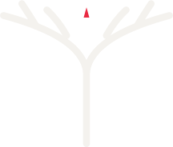
lockin // vision deck 03
[ the core thesis ]
find your people.
lockin helps you find things to do, people to do them with, and the momentum to actually get started.
tinder × linkedin — but for college life.
the discovery + intent equation
01 / discovery mechanic
discovery without awkwardness
borrowing tinder's zero-friction mechanism to find people on your wavelength without cold approaches or social anxiety.
02 / shared intent
alignment around ambition
borrowing linkedin's project and skill focus: connecting around building, studying, and shipping rather than superficial profiles.
03 / real-world action
turning discovery into doing
lockin's breakthrough: not another messaging thread, but a shared timer, an in-person check-in, and verified proof of work.
stop scrolling. start showing up.
find your people.
Notes:
pacing: high clarity, confident conviction, establishing the mental model.
talking points:
• deliver the brand anchor: 'find your people.' pause to let it land.
• unpack the core thesis: college life needs an operating system for action.
• explain the analogy: 'think about the two consumer products that changed how people discover each other: tinder and linkedin.'
• break down the synthesis:
- from tinder, we take low-friction, mutual-intent discovery. you find people who want the same thing right now without the friction of a cold dm.
- from linkedin, we take focus on capability and ambition: what are you studying? what are you building? what skills do you bring?
- but here is the critical difference: neither tinder nor linkedin gets people off screens. lockin ends in physical reality. you don't collect connections—you meet, lock in, and ship.

Slide 4
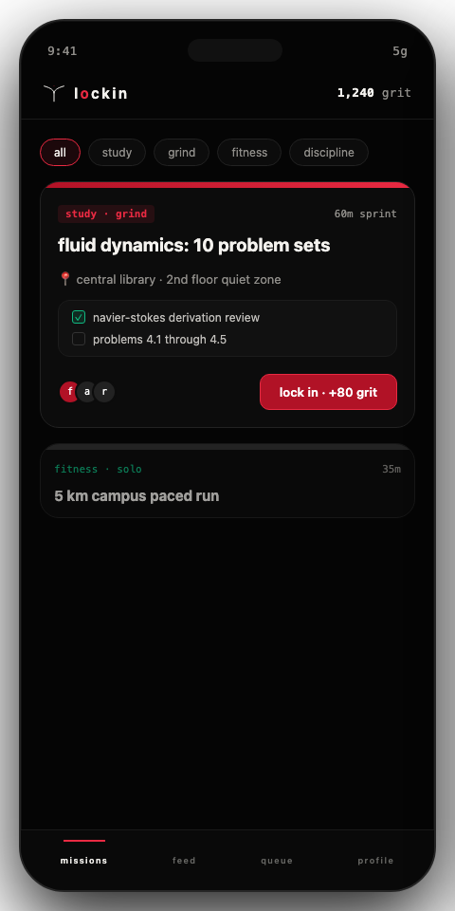
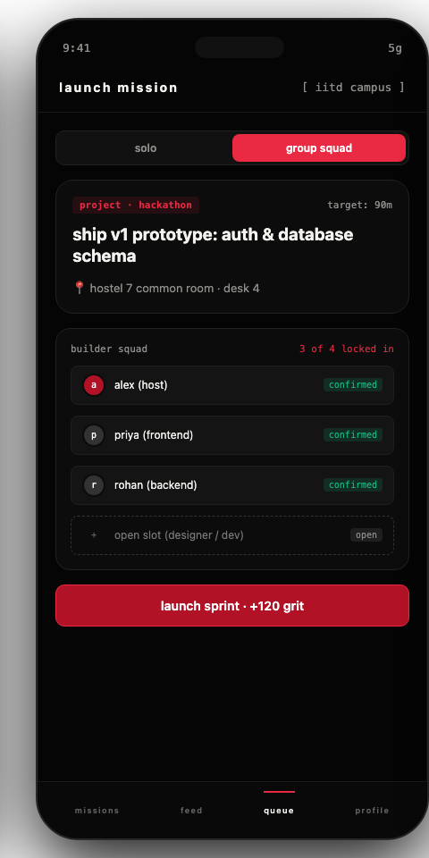
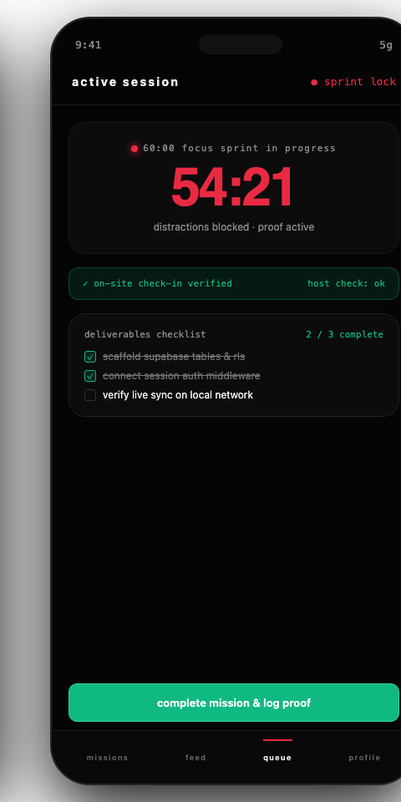
lockin // vision deck 04
[ the live application ]
from intention to action.
the mission is the atomic unit of the product.
● live on lockin.top
step 01
discover
find missions, categories, study tracks, and real opportunities worth showing up for.
step 02
do it solo or together
lock in independently for deep focus, or recruit a builder squad with confirmed check-in slots.
step 03
show up
execute with a timed sprint, verify in-person attendance, and stack proof to your grit record.
production interface · next.js 15 · supabase realtime · lockin.top
find your people.
Notes:
pacing: grounded, tactile, authentic. emphasize that this is live code, not a mockup.
talking points:
• show the real product: 'this isn't a figma concept or an investor prototype. this is running in production right now on lockin.top.'
• explain the 3-beat product loop:
1. step 01 — discover: you open the feed and see active missions organized by track: academic sprints, hackathon teams, morning gym runs, or deep study sessions.
2. step 02 — solo or squad: lockin supports both solitary discipline and team collaboration. lock in alone to silence distractions, or recruit teammates with explicit roles.
3. step 03 — show up & earn grit: you meet on-site, verify attendance, run a synchronized timer, and log real deliverables. your grit score reflects real execution, not vanity follower counts.

Slide 5
lockin // vision deck 05
[ the horizon & invitation ]
we're building more than an app.
we're building a place where more things happen.
horizon 01 / grind
learning & productivity
study groups, midterm blitzes, structured learning challenges, and academic body-doubling that kills procrastination.
[library sessions] · [code sprints] · [exam squads]
horizon 02 / community
people & community
discovering like-minded peers outside your immediate circle through shared interests, disciplines, and recurring campus rituals.
[peer discovery] · [campus circles] · [skill matching]
horizon 03 / action
missions & experiences
collaborative hackathons, product launches, athletic trials, and new ways to bring students together in the physical world.
[hackathons] · [track runs] · [campus drops]
help us build what comes next.
we're inviting the builders in this room to launch missions, test prototypes, and shape the campus platform.
lockin.top
find your people.
stop scrolling. start showing up.
Notes:
pacing: inspiring, open, collegiate, non-transactional. close with conviction.
talking points:
• reframe the entire presentation: 'we didn't ask you here to pitch an app. we asked you here because campus culture is shaped by builders.'
• map out the 3 horizons of what lockin is becoming:
1. grind: replacing procrastination with shared focus and academic momentum.
2. community: breaking the social bubble so engineers meet designers, freshmen meet senior builders, and genuine friendships form through doing.
3. missions: turning college into an open arena of challenges, hackathons, physical feats, and campus rituals.
• direct call to action: 'we want you to run the first missions on your campus. take lockin, test it, find bugs, launch your project squad on it, and build this with us.'
• end on: 'stop scrolling. start showing up. find your people at lockin.top.'

