Slide 1
Capstone Project
University Success Analysis

Slide 2
Problem Statement
Compare university rankings across different systems, assess the impact of ranking criteria on university positions, and analyze changes in university metrics over time. Utilize SQL and Excel for data aggregation and for EDA. Create a Power BI dashboard to provide a comprehensive view of university rankings.

Slide 3
MECE BREAKDOWN
Category 1: University Information Analysis
What are the names of the universities in the dataset?
What are the names of the countries and how many countries represented in the dataset?
Can you provide the university ID for a specific university?
What universities are located in a particular country?2
Category 2: Ranking Information Analysis
Name of the rankings , count of ranking systems and how they are included in the dataset?
What are the criteria’s used by these ranking systems?
Can you provide the criteria name for a specific ranking criteria ID?
For a particular ranking system what is the ranking system ID?

Slide 4
Category 3: Yearly Data Analysis
What are the years for which we have data in the dataset?
What is the ranking score for a specific university in a given year?
What percentage of international students does a specific university have in a given year
How many students does a specific university have in a particular year?
What is the student-staff ratio for a specific university in a particular year?
percentage of female students does a specific university have in a given year?

Slide 5
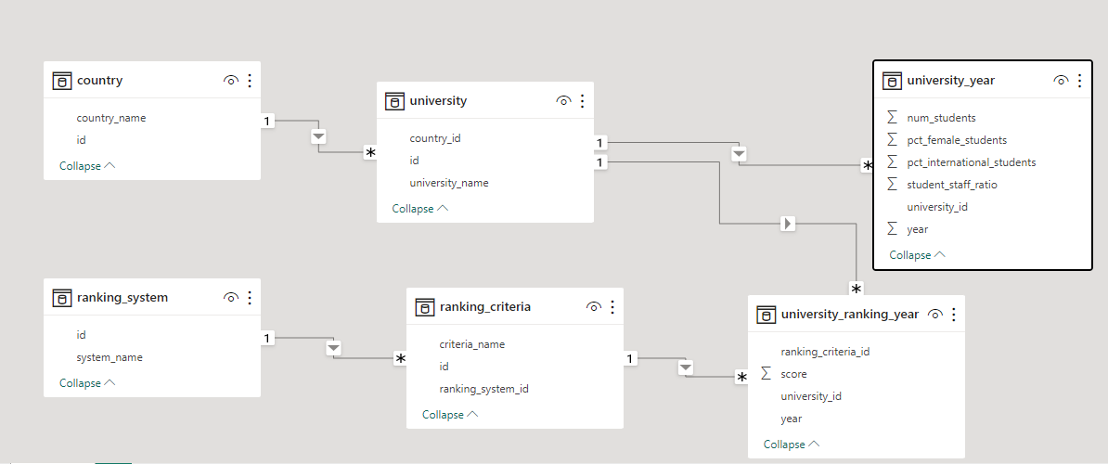
ER Diagram

