Slide 1

CS 522: Selected Topics in Computer Science
Securing LLM-Powered Code
Assistants Against Prompt
Injection Attacks Using
Machine Learning
Final Project Presentation
Section 1 | Team 7
Instructor: Dr. Yasir Alguwaifli
Imam Abdulrahman Bin Faisal University • College of Computer Science and Information Technology

Slide 2

Our Team
Mohammed Alghaith
Muhannad Almahmoud
Sultan Alotaibi
2220000240
2210002240
2220007295
Omar Alnasser
Rayan Alhusennan
Abdullah Aladwani
2220001784
2220000455
2220001989
Section 1 | Team 7

Slide 3





Outline
01
Introduction
Introduction, Motivation and Objectives
02
Literature Review
Literature Review and Gap Analysis
03
Dataset & Methodology
Dataset and Proposed Methodology
04
Performance Evaluation
Evaluation Measures and Benchmark Results
05
Conclusion
Summary and Future Work

Slide 4
01
Introduction
Motivation and Objectives

Slide 5


LLM-Powered Code Assistants
Introduction
Widespread Adoption
Tools like ChatGPT, Claude Code, Gemini Code Assist, and GitHub Copilot are embedded into IDEs, CI/CD pipelines, and code review platforms.
The Threat
Productivity Gains
86%
These assistants generate code, explain complex logic, detect bugs, and suggest refactoring strategies, dramatically accelerating development.
Attack success rate on
36 commercial LLM
applications (HouYi)
New Security Risks
Unlike traditional tools, LLMs process natural language alongside code, making them susceptible to adversarial manipulation through crafted inputs.
31/36
apps found vulnerable

Slide 6
Problem Statement
Problem Statement
The Challenge
The Research Question
LLMs blur the line between data and instructions, exposing a new attack surface
Independent evaluations report attack success rates above 80% against LLM apps
Keyword filters and static rules fail: injection patterns are diverse and evolving
Consequences: hardcoded credentials, key exfiltration, unauthorised command execution
Can a lightweight, white-box-free classifier detect injections at the perimeter?
It must generalise across diverse, multilingual prompts
It must keep a low false-positive rate so legitimate developer prompts are not blocked
It must be transparent and computationally inexpensive to deploy
It must operate without access to the underlying model internals

Slide 7

What Is Prompt Injection?
Introduction
Direct Injection
Indirect Injection
A malicious user explicitly provides adversarial prompts to the LLM to override safety instructions, extract system prompts, or generate harmful code.
An attacker hides malicious instructions within external content the LLM reads: code comments, documentation, issue trackers, or retrieved web pages.
Consequences of Successful Attacks
Code with backdoors or hardcoded credentials
Exfiltration of API keys and proprietary source code
Unauthorized file modifications and command execution
Supply chain compromises through poisoned outputs

Slide 8
Motivation & Objectives
Introduction
Motivation
Objectives
Rapid adoption of LLM code assistants creates urgent security needs
Prompt injection is a new attack paradigm that heuristic defenses cannot address
ML-based detection learns semantic patterns for robust, adaptive defense
Clear gap for practical detection systems tailored to code-assistant contexts
Train and compare XGBoost, SVM, and Random Forest classifiers for prompt injection detection
Compare TF-IDF and bag-of-words feature representations
Achieve high detection accuracy with low false-positive rate
Produce practical security guidelines for organizations using LLM code assistants

Slide 9
02
Literature Review
Key Studies and Findings

Slide 10
LR Summary: Prompt Injection Attacks [1]–[5]
Literature Review
Ref | Year | Technique | Results | Limitations
[1] | 2024 | StruQ: Structured queries, fine-tuned LLM separating instructions/data | Improved resistance with minimal utility loss | Requires special front-end & LLM fine-tuning
[2] | 2023 | BIPIA benchmark + boundary awareness defenses | White-box defense reduces ASR to ~0% | Limited to indirect injections
[3] | 2023 | HouYi: Black-box prompt injection framework | 31/36 apps vulnerable, 86.1% ASR | Defenses only preliminarily discussed
[4] | 2023 | Indirect injection taxonomy & case studies | Data theft, worming, tool control demonstrated | No standardized benchmark
[5] | 2025 | ML/DL classifiers (RNN) with NLP vectorizations | RNN: 94.74% detection rate | Dataset scale limited

Slide 11
LR Summary: LLM Security Research [6]–[10]
Literature Review
Ref | Year | Technique | Results | Limitations
[6] | 2024 | Survey: taxonomy of jailbreak attacks & defenses | Multiple attack types identified | Limited original experiments
[7] | 2024 | Empirical safety alignment analysis | Alignment concentrated in first tokens | Focuses on open-weight models
[8] | 2024 | CyberSecEval 2: LLM security benchmark | PI success across multiple models | Predefined attack templates
[9] | 2025 | Comprehensive PI attack/defense review | Defenses only partially effective | Review-based, not empirical
[10] | 2025 | PoisonBench: LLM data poisoning benchmark | Small poisoned data alters behavior | Selected models/tasks only

Slide 12
LR Summary: ML Detection Models [11]–[15]
Literature Review
Ref | Year | Technique | Results | Limitations
[11] | 2024 | Embeddings (OpenAI, GTE, MiniLM) + RF/LR classifiers | AUC 76.4%, F1 86.8% | High false negatives, poor on novel attacks
[12] | 2025 | ModernBERT for prompt injection detection | 98.7% accuracy, 99.1% recall | Needs retraining for new methods
[13] | 2024 | Multilingual BERT + LR/SVM/RF/GNB | 96.5% accuracy, 100% precision | Single dataset only
[14] | 2025 | Attention Tracker (LLM behavior analysis) | AUROC 100% and 98% | Requires internal LLM access
[15] | 2025 | Fused features + MLP inside LLM | 98% accuracy, 0.7% ASR | Requires LLM internals, high overhead

Slide 13



Literature Review Outcome (Gap)
Literature Review
Identified Research Gap
There is a need for a practical prompt injection defense for code assistants that generalizes to unseen attacks, works under realistic constraints, and is evaluated using diverse datasets reflecting real developer scenarios.
Generalizability
Practical Deployment
Realistic Evaluation
Low False Positives
Must detect unseen, adaptive, and indirect injection strategies
Works without internal LLM access (black-box compatible)
Tested on diverse, large-scale benchmarks reflecting real dev tasks
Legitimate coding prompts must not be incorrectly flagged

Slide 14
03
Dataset & Methodology
Data, Features, and Classification Pipeline

Slide 15
Our Dataset
Dataset & Methodology
Prompt-Injections-Benchmark
5,000
Hugging Face (rogue-security) • CC-BY-NC-4.0 • migrated QualiFire
Total Prompts
5,000 plain-text prompts (English with a substantial German subset)
Binary classification: benign vs. prompt injection
Covers diverse attack types: jailbreaks, instruction overrides, indirect payloads
Mildly imbalanced 1.50 : 1 (benign : injection); treated by reweighting
Stratified 70/30 split: 3,500 train (5-fold CV) / 1,500 held-out test
70 / 30
Train – Test Split
5-Fold
CV Strategy
1.50 : 1
Class Ratio

Slide 16

Proposed Methodology
Dataset & Methodology
Data Collection
Preprocessing
Feature
Engineering
ML Models
Testing &
Evaluation
5,000-prompt public
injection benchmark
Conservative cleaning,
class reweighting
TF-IDF, Bag-of-Words
XGBoost, SVM (RBF), Random Forest
5-Fold CV, Accuracy, F1, ROC-AUC
A white-box-free pipeline: classical detectors at the assistant perimeter
Each model is wrapped in a scikit-learn pipeline (Vectoriser → optional sampler → classifier) with a fixed seed for full reproducibility. We compare gradient boosting (XGBoost), kernel-based SVM-RBF, and Random Forest, requiring no access to model internals.

Slide 17
Preprocessing & Feature Engineering
Dataset & Methodology
Conservative Preprocessing
Feature Extraction
NFKC unicode normalisation removes homoglyphs and zero-width bypass tricks; whitespace is collapsed and text is lowercased. Stop-words are deliberately KEPT, since injection signatures live in function words like “ignore the”.
TF-IDF (primary) vs Bag-of-Words (baseline). Unigrams + bigrams capture phrases like “ignore previous”; min_df = 2, max_df = 0.95, max 20,000 features, with sublinear TF scaling and L2 normalisation.
Key Design Choices
Signature-preserving cleaning keeps the very phrases the detectors must recognise
Deduplication on (text, label) prevents metric inflation common in PI corpora
n-gram range (1, 2) captures short imperative role-override phrases
No explicit chi-squared selection: vectoriser pruning + tree splits handle it

Slide 18
Machine Learning Models
Dataset & Methodology
SVM (RBF kernel)
Random Forest
Maximum-margin separator with an RBF kernel. Generalises well in high-dimensional sparse TF-IDF space and captures phrase-level similarity. class_weight = balanced rescales the per-class penalty by inverse frequency.
Ensemble of decorrelated decision trees with bagging and feature subsampling. Impurity-based splits handle correlated bigrams and yield directly interpretable feature importances, a cheap form of explainable AI.
XGBoost (Extreme Gradient Boosting)
Regularised additive ensemble of regression trees using second-order gradients
Strong baseline for sparse text; scale_pos_weight gives a distinct imbalance treatment
Histogram tree method (tree_method = hist) for fast training
Each model wrapped in a pipeline (Vectoriser → sampler → classifier) to prevent leakage

Slide 19
Experimental Setup
Dataset & Methodology
Tools, Protocol & Optimisation
C = 4.0
Pure Python • fixed random seed = 42 (fully reproducible)
SVM-RBF, γ = 0.5
scikit-learn 1.3 (SVM, RF), xgboost 1.7, imbalanced-learn 0.11
3,500-prompt train file used for fitting + 5-fold stratified CV
1,500-prompt held-out test used ONCE, after hyperparameter selection
Grid search scored by injection-class F1 (the operationally meaningful metric)
Inverse-frequency class reweighting adopted over SMOTE oversampling
400
RF / XGB n_estimators
5-Fold
Stratified Cross-Validation
0.856
Best CV F1 (SVM-RBF)

Slide 20
04
Performance Evaluation
Evaluation Measures and Benchmark Results

Slide 21
Evaluation Measures
Performance Evaluation
Accuracy
Precision
Recall
Overall proportion of correct predictions
How many predicted attacks are real attacks
How many actual attacks are detected
(TP+TN) / Total
TP / (TP+FP)
TP / (TP+FN)
F1-Score
AUC-ROC
Confusion Matrix
Harmonic mean of precision and recall (primary metric)
Threshold-independent classification quality
Detailed breakdown of TP, TN, FP, FN errors
2×(P×R)/(P+R)
Area under ROC
TP|FP|FN|TN
F1-Score serves as the primary comparison metric across all classifiers

Slide 22
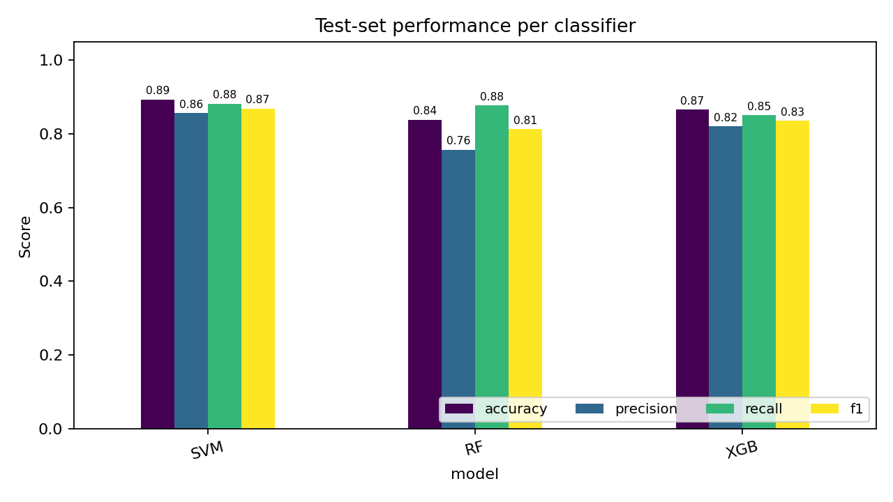
Results & Discussion
Performance Evaluation
Model Acc. F1 ROC-AUC
SVM-RBF 0.893 0.869 0.960
XGBoost 0.865 0.835 0.943
Random Forest 0.838 0.813 0.932
SVM-RBF is strongest overall: best accuracy, recall (0.882) and ROC-AUC.
XGBoost is the most balanced (precision 0.820 / recall 0.850), fastest inference.
Random Forest trades precision for recall, producing more false alarms.
Figure 5: Test-set performance per classifier.
Evaluated on the 1,500-prompt held-out test set. All three detectors exceed 0.93 ROC-AUC, confirming lexical features carry strong injection signal.

Slide 23
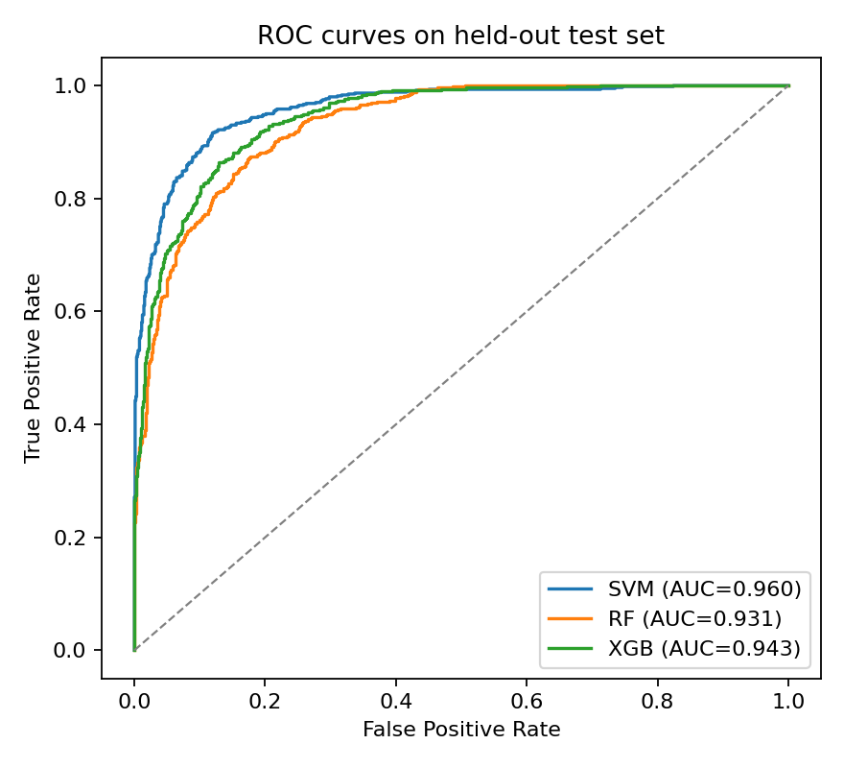
Benchmark Comparison
Performance Evaluation
Study
Best Technique
Acc.
AUC
Jain [5]
RNN + vectorizers
–
–
Ayub [11]
OpenAI embed. + RF
0.867
0.764
Rahman [12]
Multilingual BERT
0.965
0.965
Ivry [13]
ModernBERT (WB)
0.987
0.980
Hung [14]
Attention Tracker (WB)
–
1.000
Ours: SVM
SVM-RBF + TF-IDF
0.893
0.960
Figure 6: ROC curves on the held-out test set.
Comparability-tagged; WB = white-box. BERT-family and white-box detectors score higher but need model internals our threat model excludes.

Slide 24
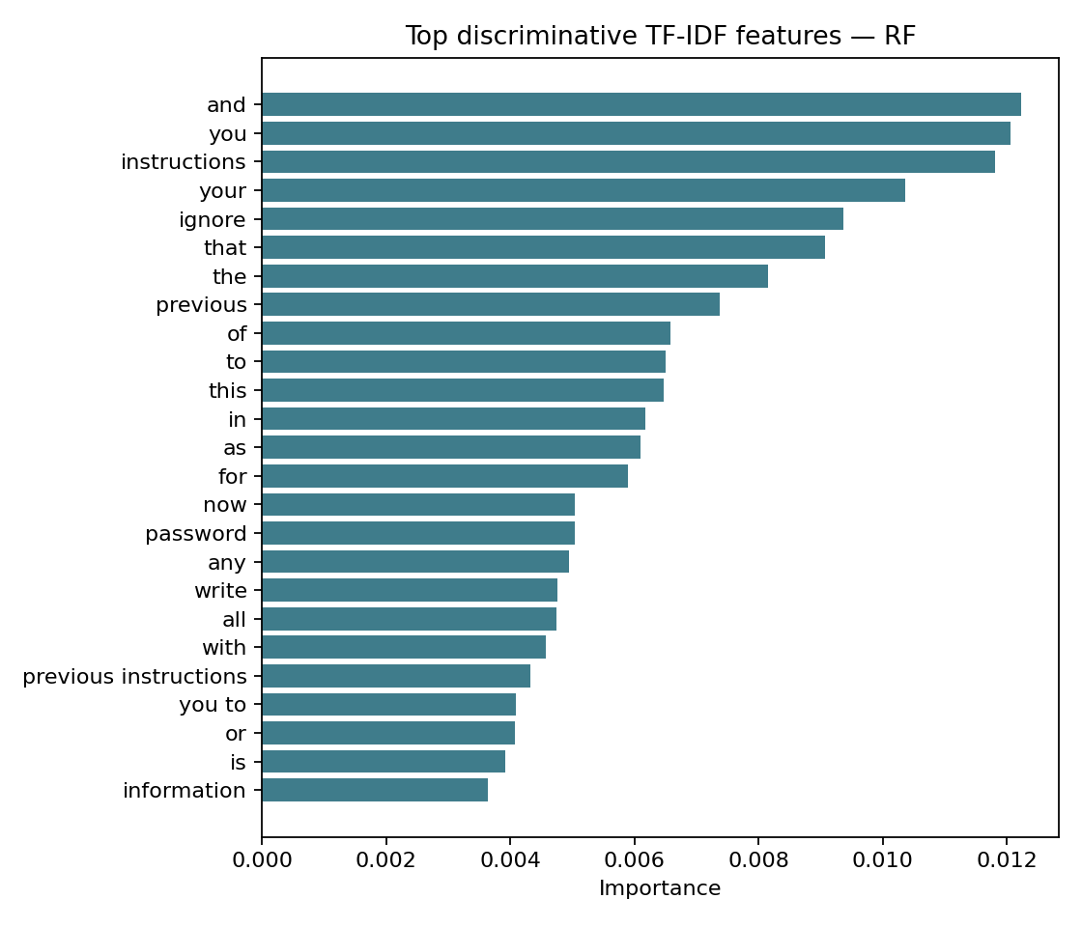
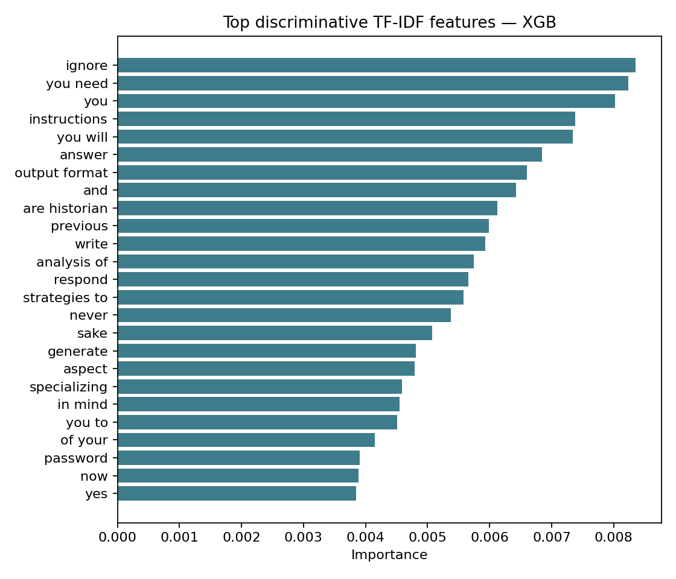
Explainability / Feature Importance
Performance Evaluation
Figure 4: Top features — Random Forest impurity.
Figure 8: Top features — XGBoost gain.
Key insight
Both detectors rely on linguistic injection markers (“ignore”, “previous”, “instructions”, “you need”). This validates low-order n-grams, but also explains residual errors: an adaptive adversary could paraphrase these cues to evade lexical detection.

Slide 25
Limitations
Performance Evaluation
Method & Data Limits
Scope Limits
Lexical (bag-of-n-grams) features: an adaptive adversary who paraphrases markers could evade detection
Single benchmark of 5,000 prompts (English + German); not externally validated on other languages or domains
Mild class imbalance limits how rare or sophisticated attack variants are represented
Limited to three classical classifiers and two feature representations
Contextual embeddings (BERT, ModernBERT) and deep architectures were not implemented
Only prompt-level detection: pipeline was not deployed inside a live IDE / code assistant
Real-world latency, integration cost, and developer false-positive impact remain unmeasured

Slide 26
05
Conclusion

Slide 27
Summary & Key Findings
Conclusion
Prompt injection is a critical threat to LLM code assistants. We framed detection as binary text classification at the assistant perimeter and compared three classical models on a 5,000-prompt benchmark. The SVM-RBF with TF-IDF was the strongest, reaching 89.3% accuracy, 0.869 injection-class F1, and 0.960 ROC-AUC.
SVM-RBF Wins
TF-IDF Best
Deployable Defence
Best overall: 89.3% accuracy, 0.869 F1, 0.960 ROC-AUC; beats RF and XGBoost on recall and discrimination
TF-IDF outperformed Bag-of-Words for the margin-based SVM (0.856 vs 0.803 F1)
Lightweight, transparent, white-box-free first line of defence for code assistants
The pipeline trades a few points of accuracy, versus embedding and white-box methods, for deployability, transparency, and very low computational cost.

Slide 28
Future Work
Conclusion
Our lexical detectors are a strong, deployable first line of defence. The natural next steps move from lexical cues toward semantic robustness, adversarial resilience, and real-world deployment inside developer tooling.
Semantic Models
Adversarial Robustness
Live Deployment
Add contextual embeddings (BERT, ModernBERT) and deep architectures to capture meaning beyond lexical cues
Apply adversarial data augmentation and evaluate against adaptive, paraphrasing adversaries
Deploy inside a live IDE / code assistant; expand to larger multilingual benchmarks for external validation
Goal: a semantically robust, externally validated detector proven in production developer workflows.

Slide 29
References
[1] Chen et al., "StruQ: Defending Against Prompt Injection," arXiv, 2024.
[2] Yi et al., "Benchmarking Indirect Prompt Injection Attacks on LLMs," KDD, 2024.
[3] Liu et al., "Prompt Injection Attack Against LLM-Integrated Apps," arXiv, 2023.
[4] Greshake et al., "Compromising LLM Apps with Indirect PI," AISec, 2023.
[5] Jain et al., "ML and DL Models on PI Classification," IRJMT, 2025.
[6] Yi et al., "Jailbreak Attacks and Defenses Against LLMs: A Survey," arXiv, 2024.
[7] Qi et al., "Safety Alignment Should Be More Than a Few Tokens Deep," arXiv, 2024.
[8] Bhatt et al., "CyberSecEval 2: Cybersecurity Evaluation for LLMs," arXiv, 2024.
[9] Mathew, "Security in LLMs: Review of PI Attacks and Defenses," J. AI, 2025.
[10] Fu et al., "PoisonBench: Assessing LLM Vulnerability to Data Poisoning," arXiv, 2024.
[11] Ayub & Majumdar, "Embedding-Based Classifiers for PI Detection," EMNLP, 2024.
[12] Rahman et al., "Multilingual BERT for PI Detection," AIBThings, 2024.
[13] Ivry & Nahum, "Sentinel: SOTA Model for PI Protection," arXiv, 2025.
[14] Hung et al., "Attention Tracker: Detecting PI Attacks in LLMs," EMNLP, 2024.
[15] Wen et al., "Defending Indirect PI by Instruction Detection," EMNLP Findings, 2025.
[16] Chen & Guestrin, "XGBoost: A Scalable Tree Boosting System," ACM SIGKDD, 2016.
[17] Breiman, "Random Forests," Machine Learning, vol. 45, 2001.
[18] Chawla et al., "SMOTE: Synthetic Minority Over-sampling Technique," JAIR, 2002.
[19] rogue-security/prompt-injections-benchmark, Hugging Face (accessed May 2026).
[20] PIShield, GitHub repository, github.com/0x00K1/PIShield (accessed May 2026).

Slide 30
Thank You
Any Questions?
CS 522 | Section 1 | Team 7
Imam Abdulrahman Bin Faisal University

