Slide 1




Alen SARSEN
Rayan OUERDANE
Ayrton LUDGER CROSNIER

Slide 2
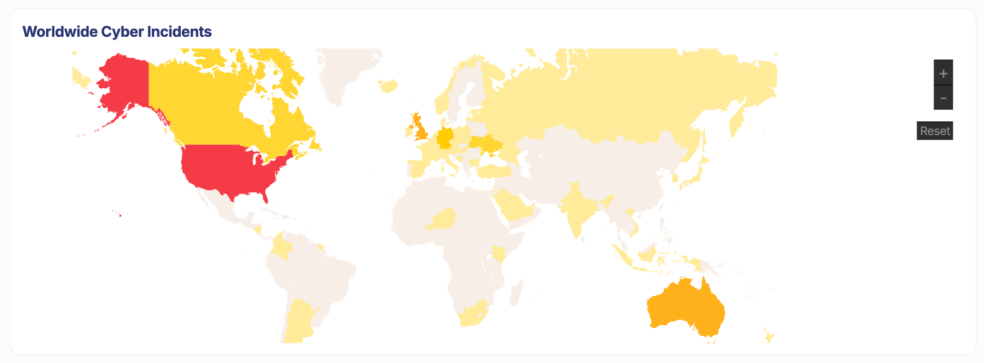

Slide 3
CONTEXT
  An interactive map
  Events displayed on interactive timeline
  Statistics about the countries displayed on the map
  Additional Informations (chart)

Slide 4


TECHNOLOGIE
Astro web framework for speed and flexibility
React for performance and usability

Slide 5


USED LIBRARIES
D3 library to display and manage the map
Shadcn library to display the statistics

Slide 6
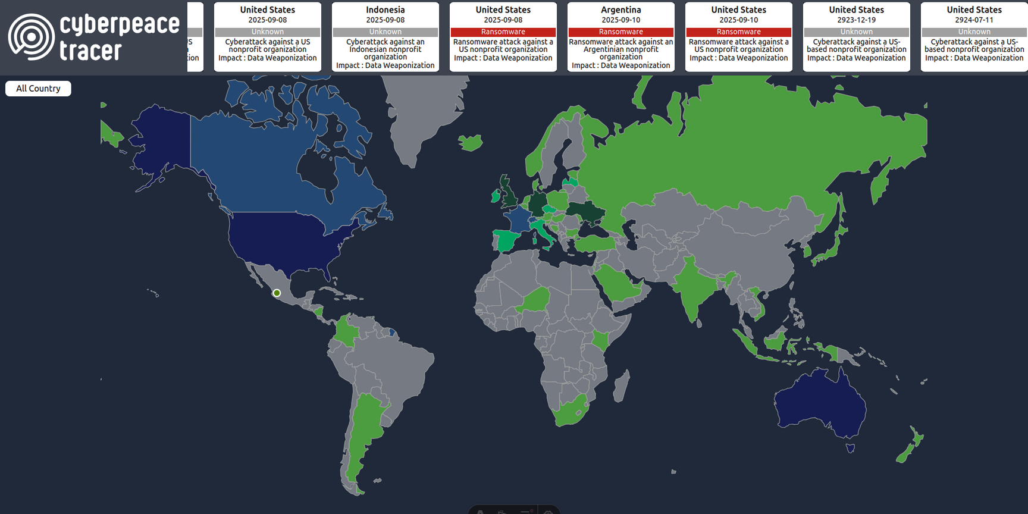
FEATURES AND NEW UI
BEFORE
AFTER

Slide 7
QUESTION ?

Slide 8
THANKS FOR LISTENING
alen.sarsen.epitech.eu
rayan.ouerdane.epitech.eu
ayrton.ludger-crosnier@epitech.eu

