Slide 1
AGDF-GenConViT
Adaptive Gated Decision Fusion for Deepfake Detection
Rayan Ahmed · Awwab Ahmed · Uwaid · Rana Zohaib
Dept. of Artificial Intelligence | FAST-NUCES, Islamabad
Computer Vision (Spring 2026)
Notes:
Welcome everyone. This presentation covers AGDF-GenConViT — our proposed improvement to the GenConViT deepfake detection framework by replacing its static 50/50 branch average with a lightweight learned gating module.

Slide 2
MOTIVATION
The Problem with Static Fusion
GenConViT Baseline
Our Approach: AGDF
Two complementary branches:
• GenConViT-ED — EfficientNet + Swin Transformer
• GenConViT-VAE — VAE reconstruction errors
Fixed 0.5 / 0.5 static average at inference
✗ Treats both branches as equally reliable
✗ Cannot adapt to per-sample uncertainty
✗ Probability [0.51, 0.49] ≡ [0.99, 0.01]
Adaptive Gated Decision Fusion module
• Inspired by AGFN (sentiment analysis)
Input: concatenated branch probabilities
+ Shannon entropy per branch
Output: per-sample weights (w_ed, w_vae)
✓ Up-weights the confident branch
✓ Only ~18.8K trainable parameters
✓ Trains on cached logits in minutes
→
Notes:
GenConViT is powerful but fuses its two branches with a hard-coded 50/50 average. This is suboptimal because branch reliability varies per sample — a branch that is very uncertain should contribute less. Our AGDF module learns to weight branches dynamically from the data.

Slide 3
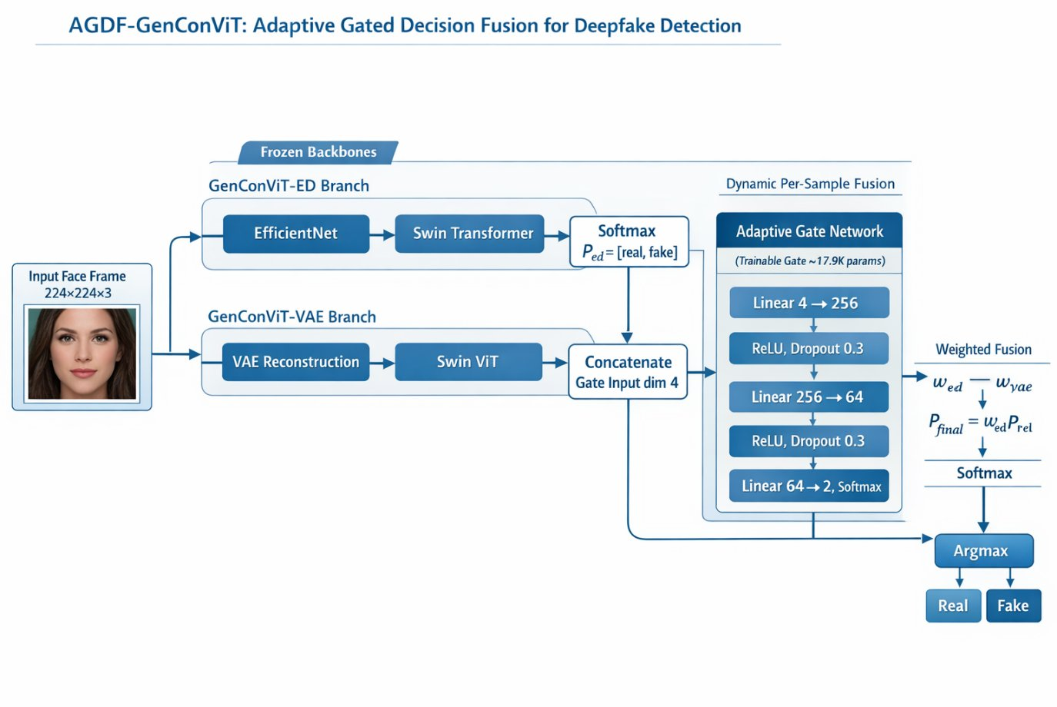
ARCHITECTURE
AGDF-GenConViT Pipeline
Frozen backbones feed 6-D gate input → Adaptive Gate Network → dynamic per-sample weights → final prediction
Notes:
The frozen GenConViT-ED and GenConViT-VAE branches produce 2D softmax probabilities. Their Shannon entropies are appended, forming a 6-dimensional gate input. The Adaptive Gate Network (3 linear layers, ~18.8K params) outputs (w_ed, w_vae) via Softmax, which blend the branch predictions into P_final.

Slide 4
METHOD
Gate Network & Training Details
Adaptive Gate MLP Architecture
Training Configuration
Layer | Operation | Dim | Params
Input | Concat [P_ed, P_vae, H_ed, H_vae] | 6 | 0
Block 1 | Linear → LayerNorm → ReLU → Drop(0.3) | 256 | ~2.1K
Block 2 | Linear → LayerNorm → ReLU → Drop(0.3) | 64 | ~16.6K
Output | Linear → Softmax | 2 | ~130
Total | Trainable parameters | ≈18.8K
Optimizer
AdamW | lr = 1e-3 | wd = 1e-4
Schedule
Cosine Annealing | 50 epochs
Gradient Clipping
max norm = 1.0
Batch Size
512 (cached logits)
Loss Functions
CE vs Focal (α=0.25, γ=2.0)
Compute
Kaggle 2× NVIDIA Tesla T4
Notes:
The gate is deliberately tiny — 18.8K params vs millions in the backbone — to avoid overfitting and preserve the frozen backbone representations. LayerNorm is used instead of BatchNorm for stability at large batch sizes. Two loss variants are compared: standard CE and Focal Loss to focus on hard examples.

Slide 5
EXPERIMENTS
Dataset & Evaluation Setup
FaceForensics++ Dataset
Evaluation Metrics
5 manipulation types:
Deepfakes · Face2Face · FaceSwap
NeuralTextures · FaceShifter
Balanced sampling:
Up to 5,000 frames per class → 10,000 total
Faces cropped & resized to 224×224 px
Random seed 42 | Stratified splits
Accuracy
Overall classification rate
F1-Score (Fake)
Binary F1 for Fake class
AUC-ROC
Discrimination ability
Model Selection
Best validation F1
LODO Protocol
Out-of-distribution generalization
Split | Fraction | Size | Purpose
Train | 70% | ~7,000 | Gate training
Validation | 15% | ~1,500 | Hyperparameter tuning
Test | 15% | ~1,500 | Final evaluation
Notes:
We use FaceForensics++ with balanced 50/50 real vs fake sampling. Backbone predictions are cached to disk once, then the gate is trained rapidly on top. The primary selection criterion is best validation F1 to ensure recall on the Fake class is strong.

Slide 6
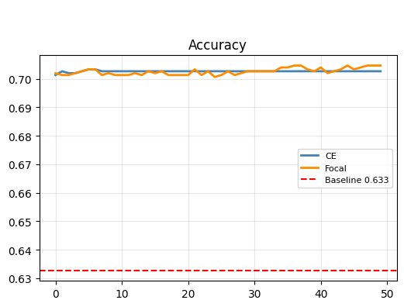
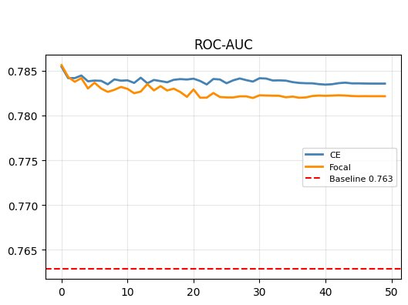
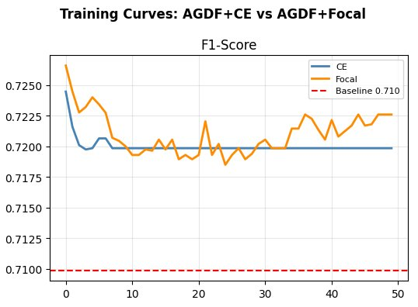
RESULTS
Training Curves: 50 Epochs
Key Observations
Rapid convergence in 5–10 epochs · CE achieves higher, more stable AUC ceiling · Both models consistently above static baseline throughout all 50 epochs
Notes:
All three metrics tell the same story: both AGDF variants converge quickly and stay well above the static baseline (dashed red lines) for all 50 epochs. CE is slightly more stable on AUC while Focal shows more variance early on due to hard-example focusing.

Slide 7
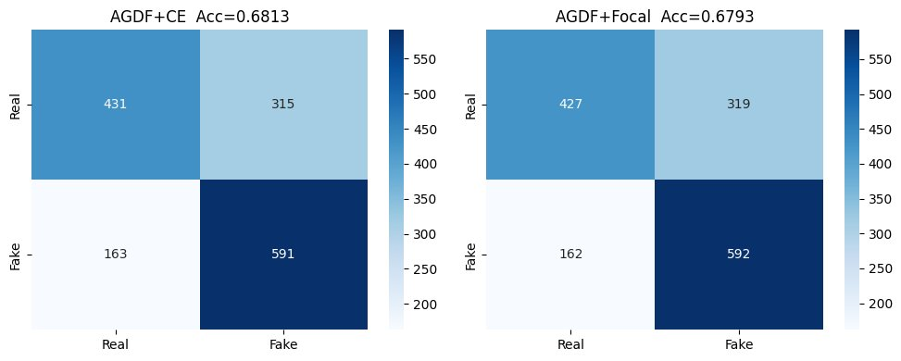
RESULTS
Confusion Matrices — Test Set (1,500 samples)
AGDF+CE: Recall(Fake) = 591/754 ≈ 78.4% | FP on Real = 315/746
AGDF+Focal: Recall(Fake) = 592/754 ≈ 78.5% | FP on Real = 319/746
Notes:
Both variants show an asymmetric error pattern: strong fake recall (~78.5%) but higher false positives on real frames. This likely reflects the pre-trained GenConViT backbone's bias toward predicting fake for uncertain inputs, which the gate inherits through cached predictions.

Slide 8
RESULTS
Quantitative Results
63.3%
68.1%
0.784
18.8K
Baseline Acc.
AGDF+CE Acc.
AGDF+CE AUC
Gate Params
Static 50/50 avg
+4.8 pp gain
vs baseline 0.763
vs millions in backbone
Method | Accuracy | F1 (Fake) | AUC-ROC | Δ Acc.
GenConViT Baseline (Static Avg.) | 63.3% | 0.710 | 0.763 | —
AGDF + CE (Ours) | 68.1% | 0.712 | 0.784 | +4.8 pp
AGDF + Focal (γ=2.0) (Ours) | 67.9% | 0.711 | 0.782 | +4.6 pp
Both AGDF variants consistently outperform the static baseline across all three metrics on 1,500 balanced test samples.
Notes:
The table shows clear gains across all metrics. CE achieves the best absolute accuracy (68.1%) and AUC (0.784). The modest CE vs Focal gap suggests hard-example focusing does not provide additional benefit in the gate-only training regime — the easy examples are already well-handled by the frozen backbones.

Slide 9
DISCUSSION
Gate Behavior & Key Insights
Gate Weight Behavior
Asymmetric Error Pattern
Deviates from static 0.5/0.5 in input-dependent manner
Higher weight to ED branch when branches disagree
Equal weights when both branches are confident
Emergent — no explicit branch-agreement supervision
Strong fake recall (~78.5%) at cost of real false positives
Inherits GenConViT backbone bias toward 'fake' on uncertain inputs
Fix: class-rebalanced gate training loss (future work)
Or: per-class threshold sweep at inference
Domain Transfer (AGFN → AGDF)
Parameter Efficiency
Gated fusion is modality-agnostic
Sentiment (audio/text/video) ↔ Deepfake (ED/VAE branches)
Core requirement: two signals of input-dependent reliability
Opens avenues for other dual-model detection systems
~18,800 trainable params vs multi-million backbone
Gate trains in minutes on cached logits
Backbone inference done only once (caching phase)
Practical for rapid deployment on pre-trained detectors
Notes:
The gate learns meaningful routing purely from entropy signals — no hand-engineering. The asymmetric error pattern is a known backbone bias issue that can be addressed with rebalanced training losses. The domain transfer principle is the most broadly applicable takeaway: gated fusion is a general pattern for combining two unreliable-but-complementary predictors.

Slide 10
Conclusion
What We Showed
Future Directions
AGDF replaces static 50/50 with per-sample learned weights
18.8K gate MLP trained on cached logits in minutes
+4.8 pp accuracy gain: 63.3% → 68.1% (CE variant)
AUC: 0.763 → 0.784 | F1: 0.710 → 0.712
CE and Focal both consistently beat baseline at every epoch
Gate learns ED-branch preference when branches disagree
Class-rebalanced gate loss (fix real/fake asymmetry)
Joint end-to-end fine-tuning + entropy regularization
Extend to 5-class manipulation-type identification
Audio-visual deepfake settings
Thank you · Questions welcome
Notes:
Wrap up: AGDF is a clean, lightweight solution to a real limitation of GenConViT. The gated fusion approach is general and could be applied to other dual-branch detectors. Our key future direction is addressing the real/fake asymmetry and exploring joint fine-tuning.

