Slide 1
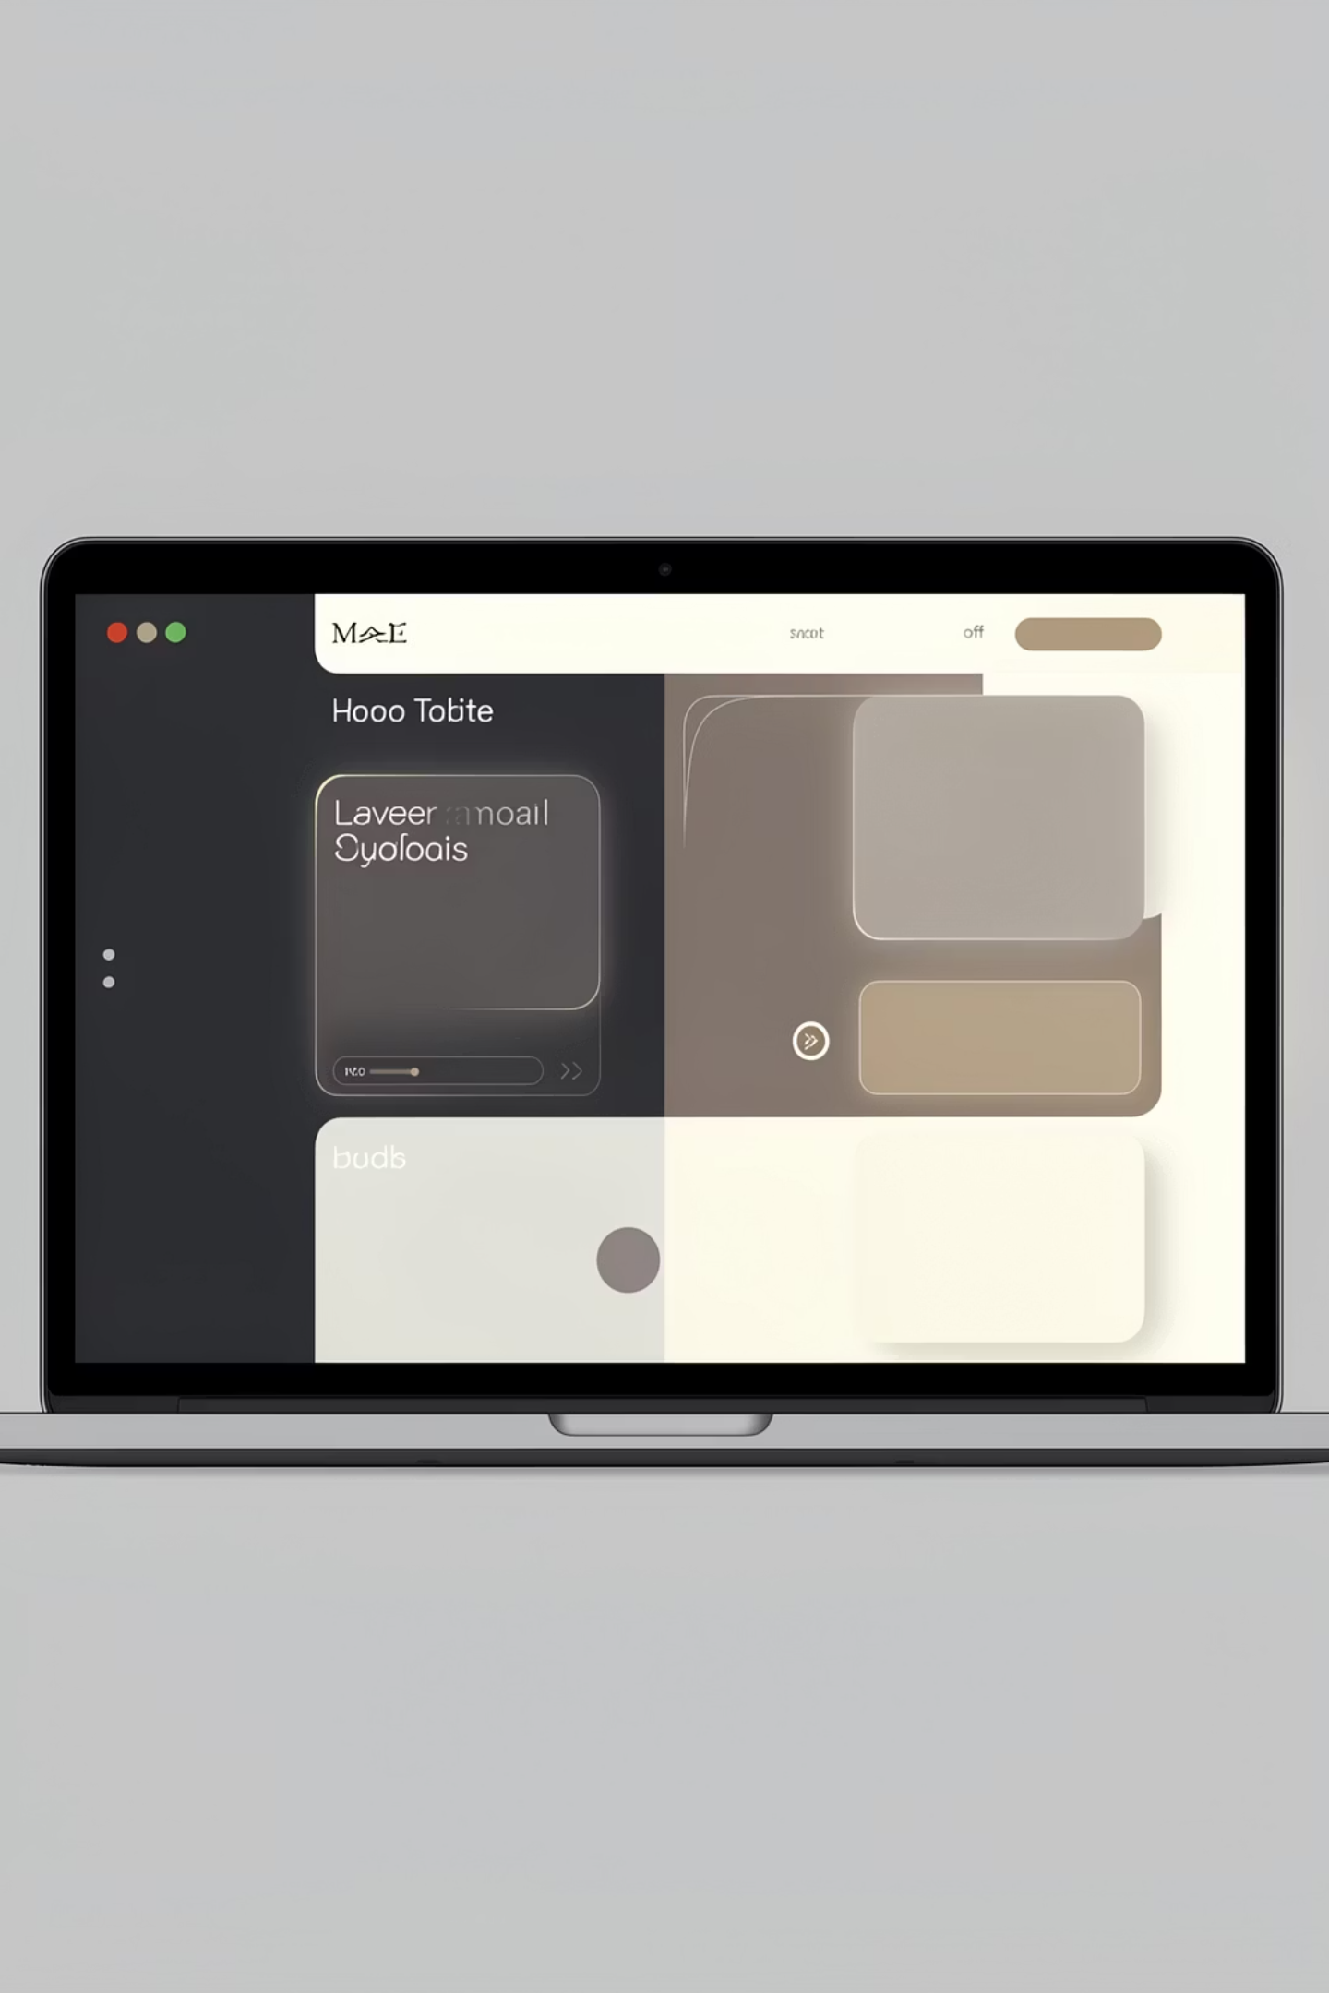
PERSONAL WEB APPLICATION
Assignment 4 Final Project · Rayan Mudhayiq
HTML · CSS · JAVASCRIPT
RESPONSIVE · API · STATE MANAGEMENT

Slide 2
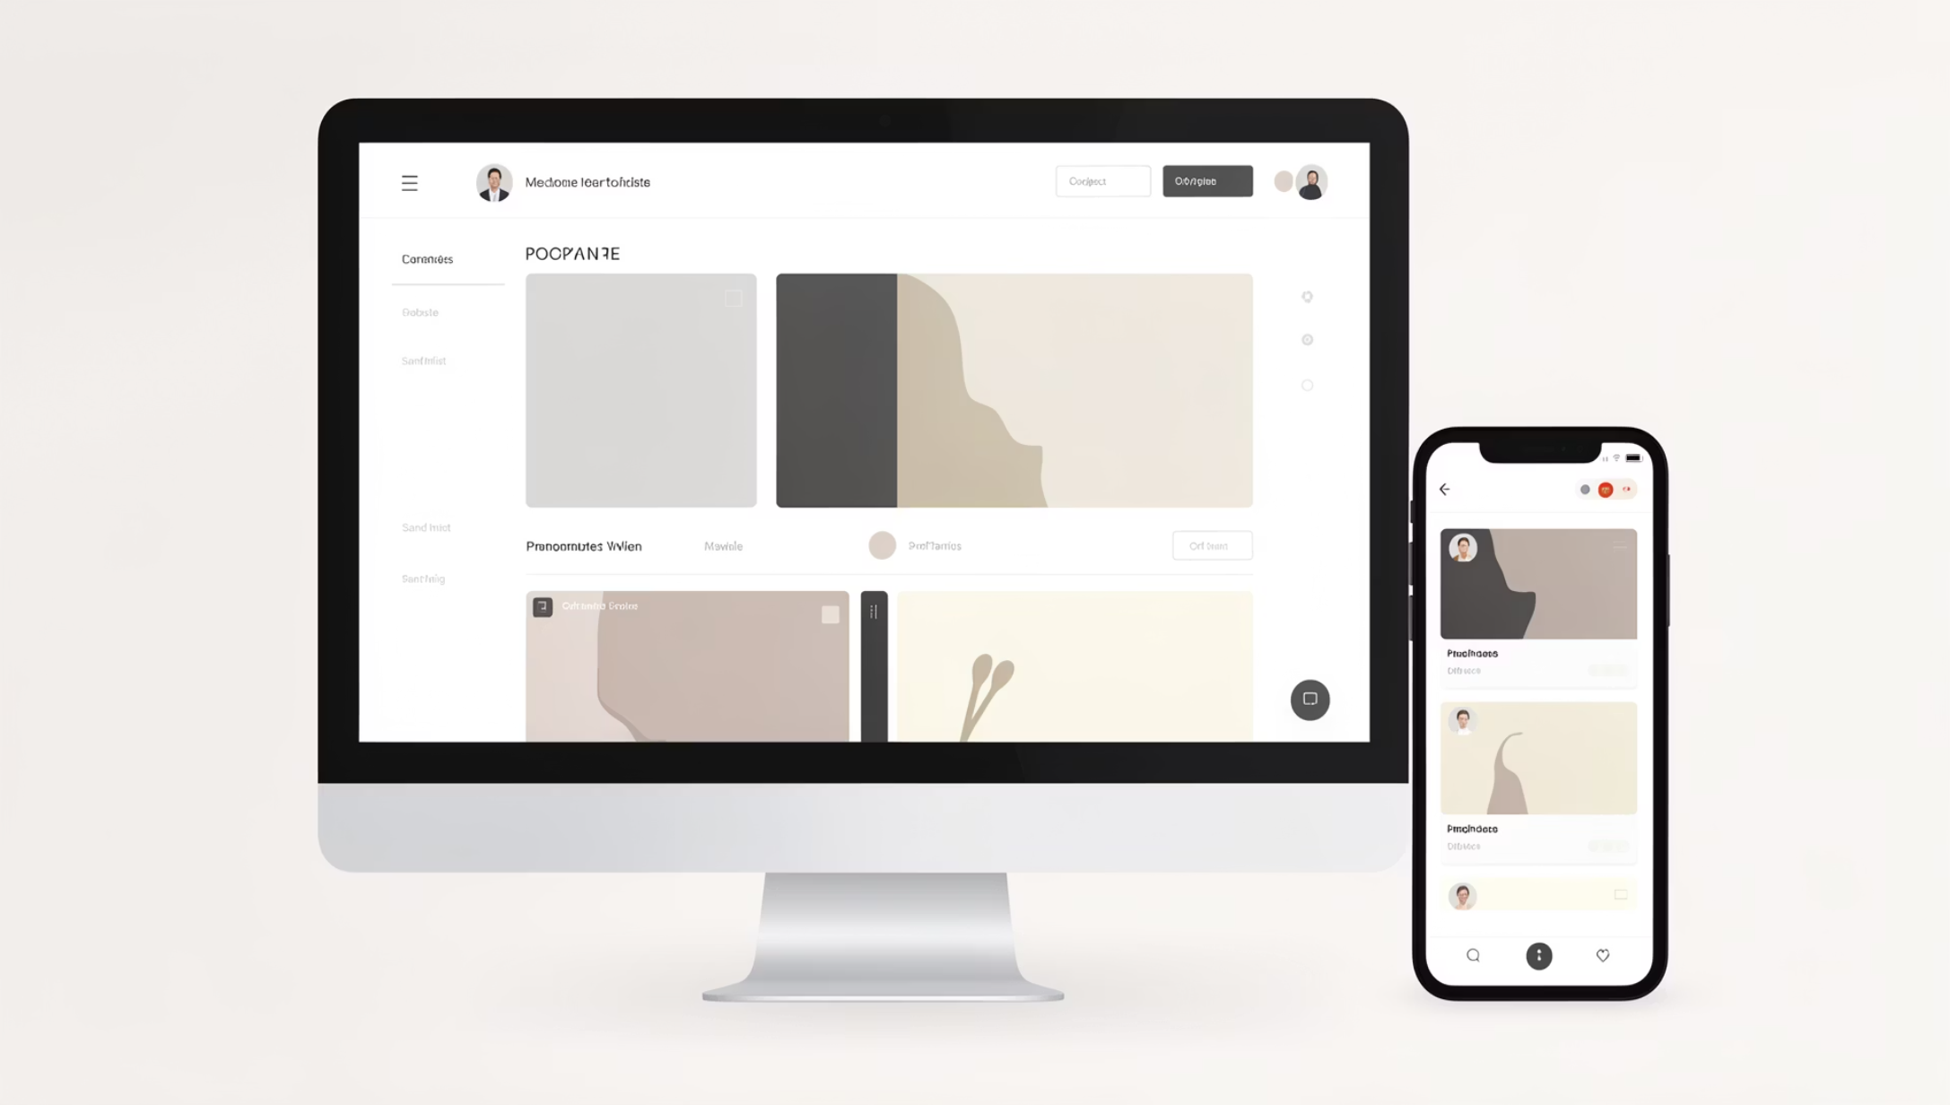

WHAT THIS PROJECT IS
RESPONSIVE PORTFOLIO
Desktop, tablet, and mobile ready
PROFILE + PROJECTS + CONTACT
Complete personal web presence
ADVANCED FRONTEND
API integration, state management, validation, performance

Slide 3
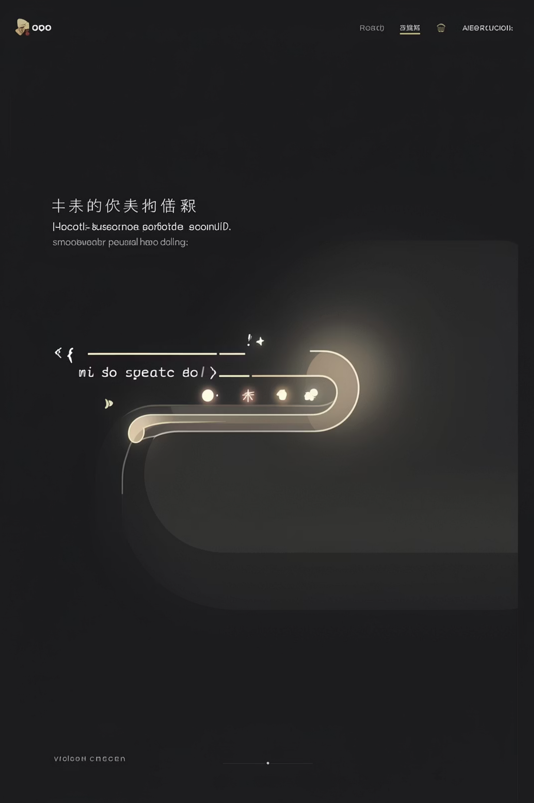
HERO & NAVIGATION
TYPING ANIMATION
Dynamic text reveal on load
SCROLL EFFECTS
Smooth section transitions
ACTIVE NAV
Highlights current section
FULLY RESPONSIVE
Adapts to all screen sizes

Slide 4
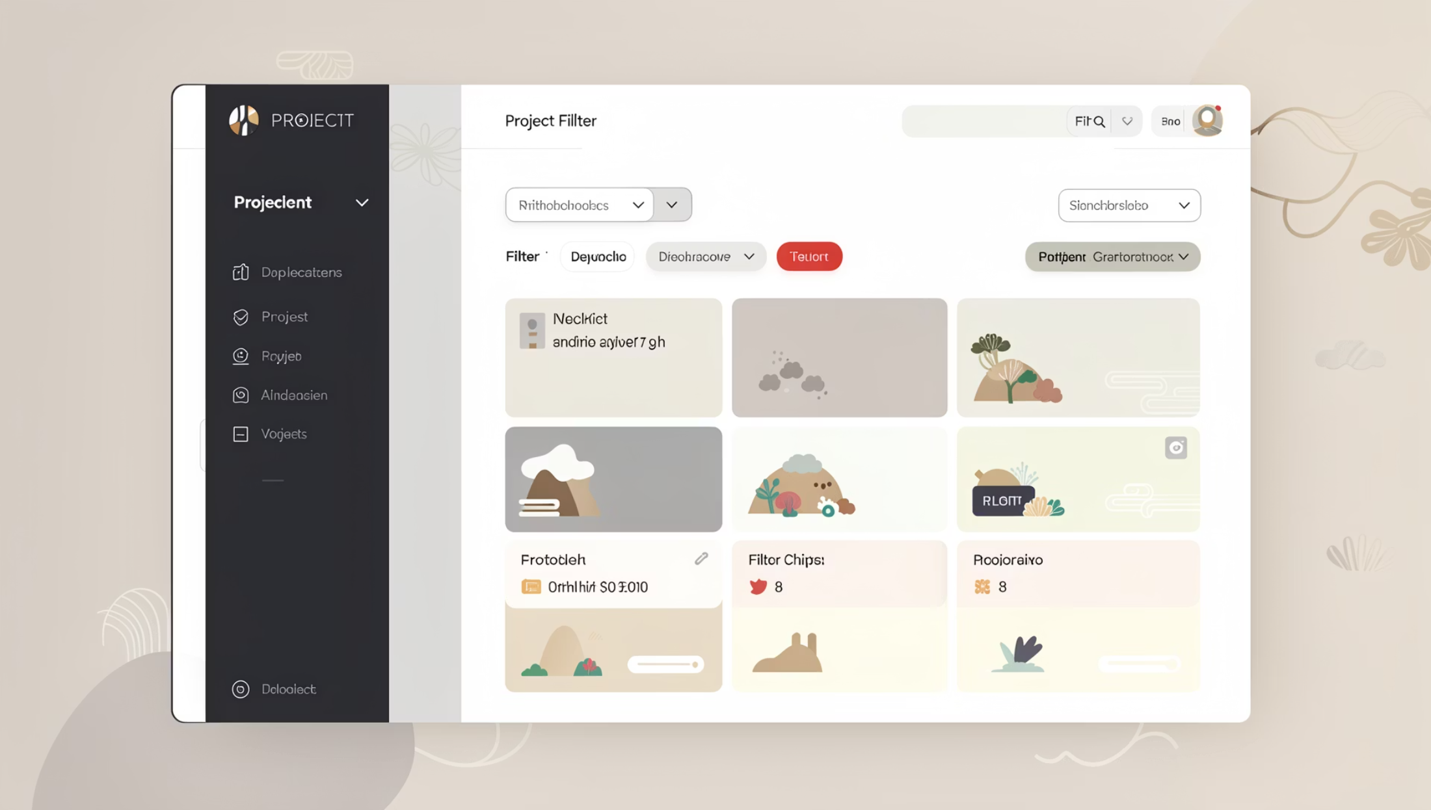

PROJECTS SECTION
FILTER BY PLATFORM
All · Web · Mobile
FILTER BY LEVEL
Beginner · Advanced
SORT BY YEAR
Newest · Oldest
Multiple conditions combined in one unified logic flow

Slide 5
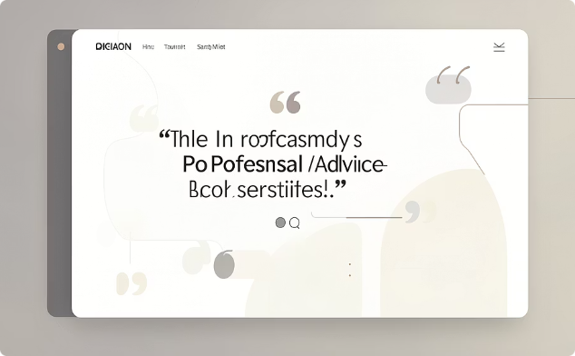
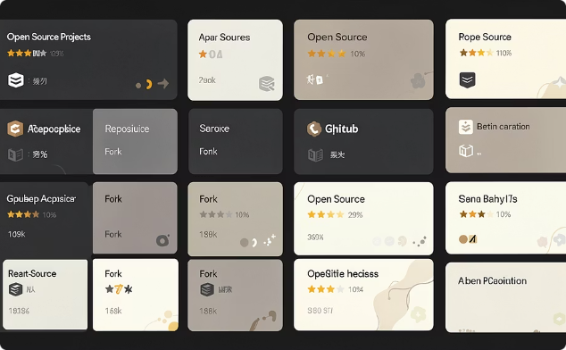
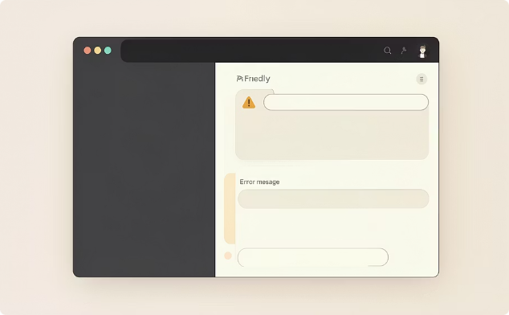
API INTEGRATION
ADVICE API
GITHUB API
FALLBACK HANDLING
Dynamic fun-fact block refreshed on demand
Loads latest public repos automatically
Graceful UI messages when API fails — never breaks

Slide 6
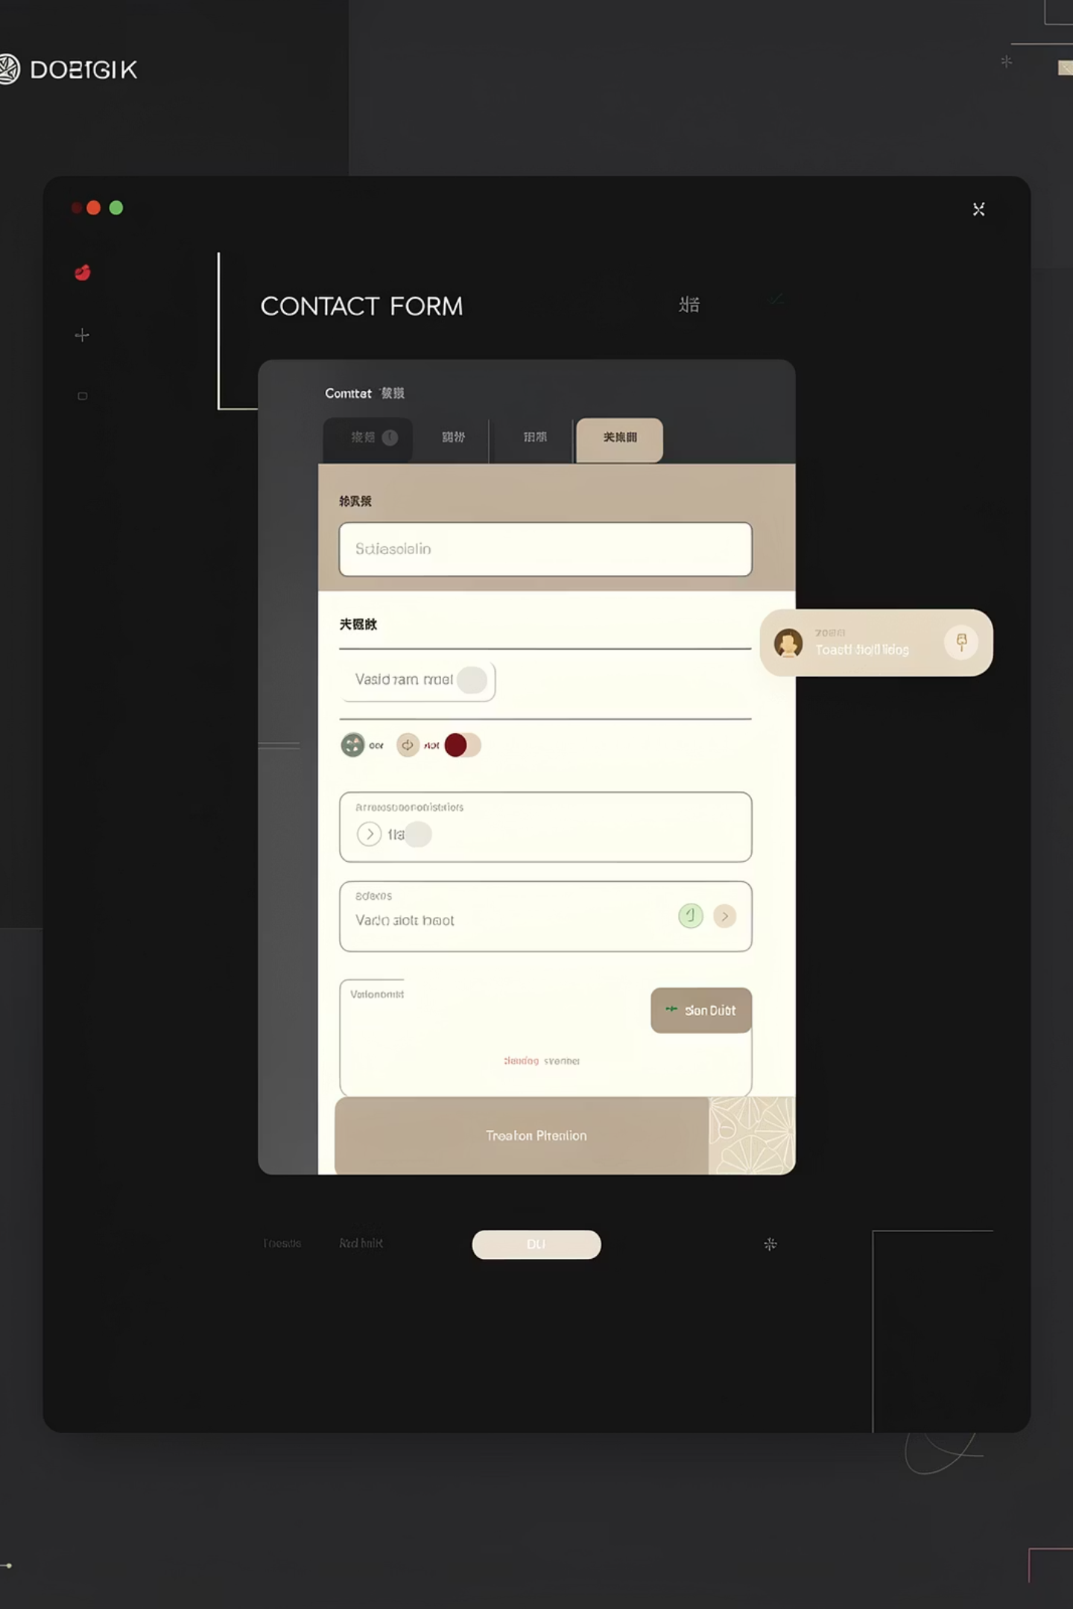
CONTACT SECTION
REAL-TIME VALIDATION
Name, email, and message checked inline
TOAST NOTIFICATIONS
Success or failure feedback on submit
AUTO-SAVE DRAFT
localStorage preserves input on refresh
THEME STATE
Persistent light/dark mode with session timer

Slide 7
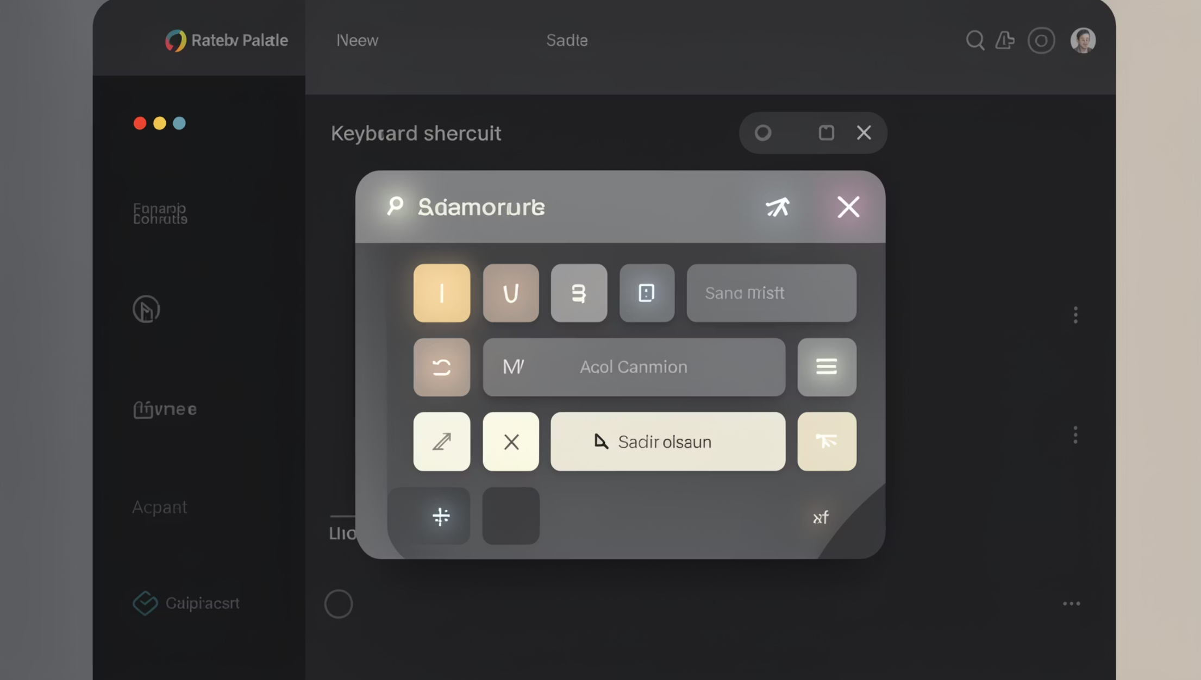
QUICK ACTIONS PALETTE
CTRL / CMD + K
POWER USER ACCESSIBILITY
01
JUMP TO ANY SECTION
Home, About, Projects, Contact
02
TOGGLE THEME
Switch light/dark from keyboard
03
ALWAYS ACCESSIBLE
Opens instantly, no mouse needed

Slide 8
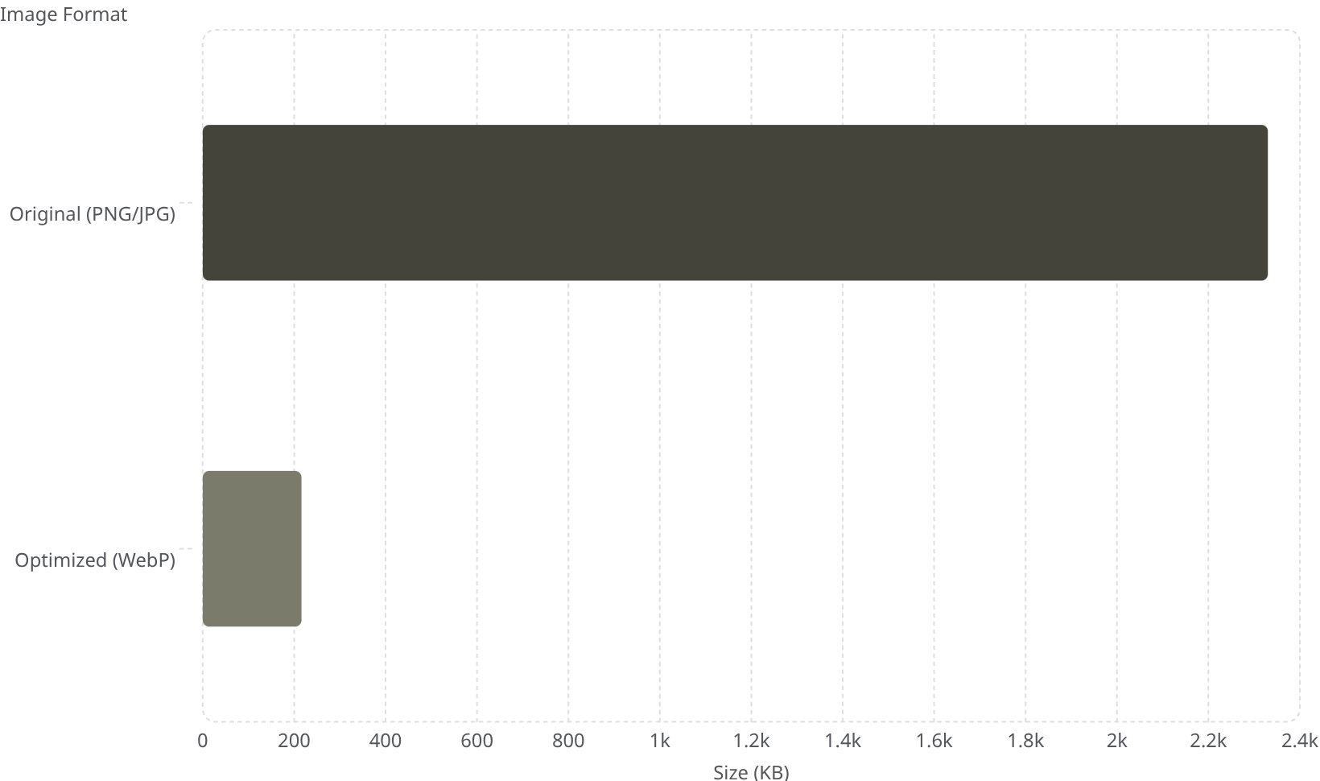
PERFORMANCE: WEBP OPTIMIZATION
91% REDUCTION
FASTER LOAD
2.33 MB → 216 KB total image payload
Significantly improved page performance

Slide 9
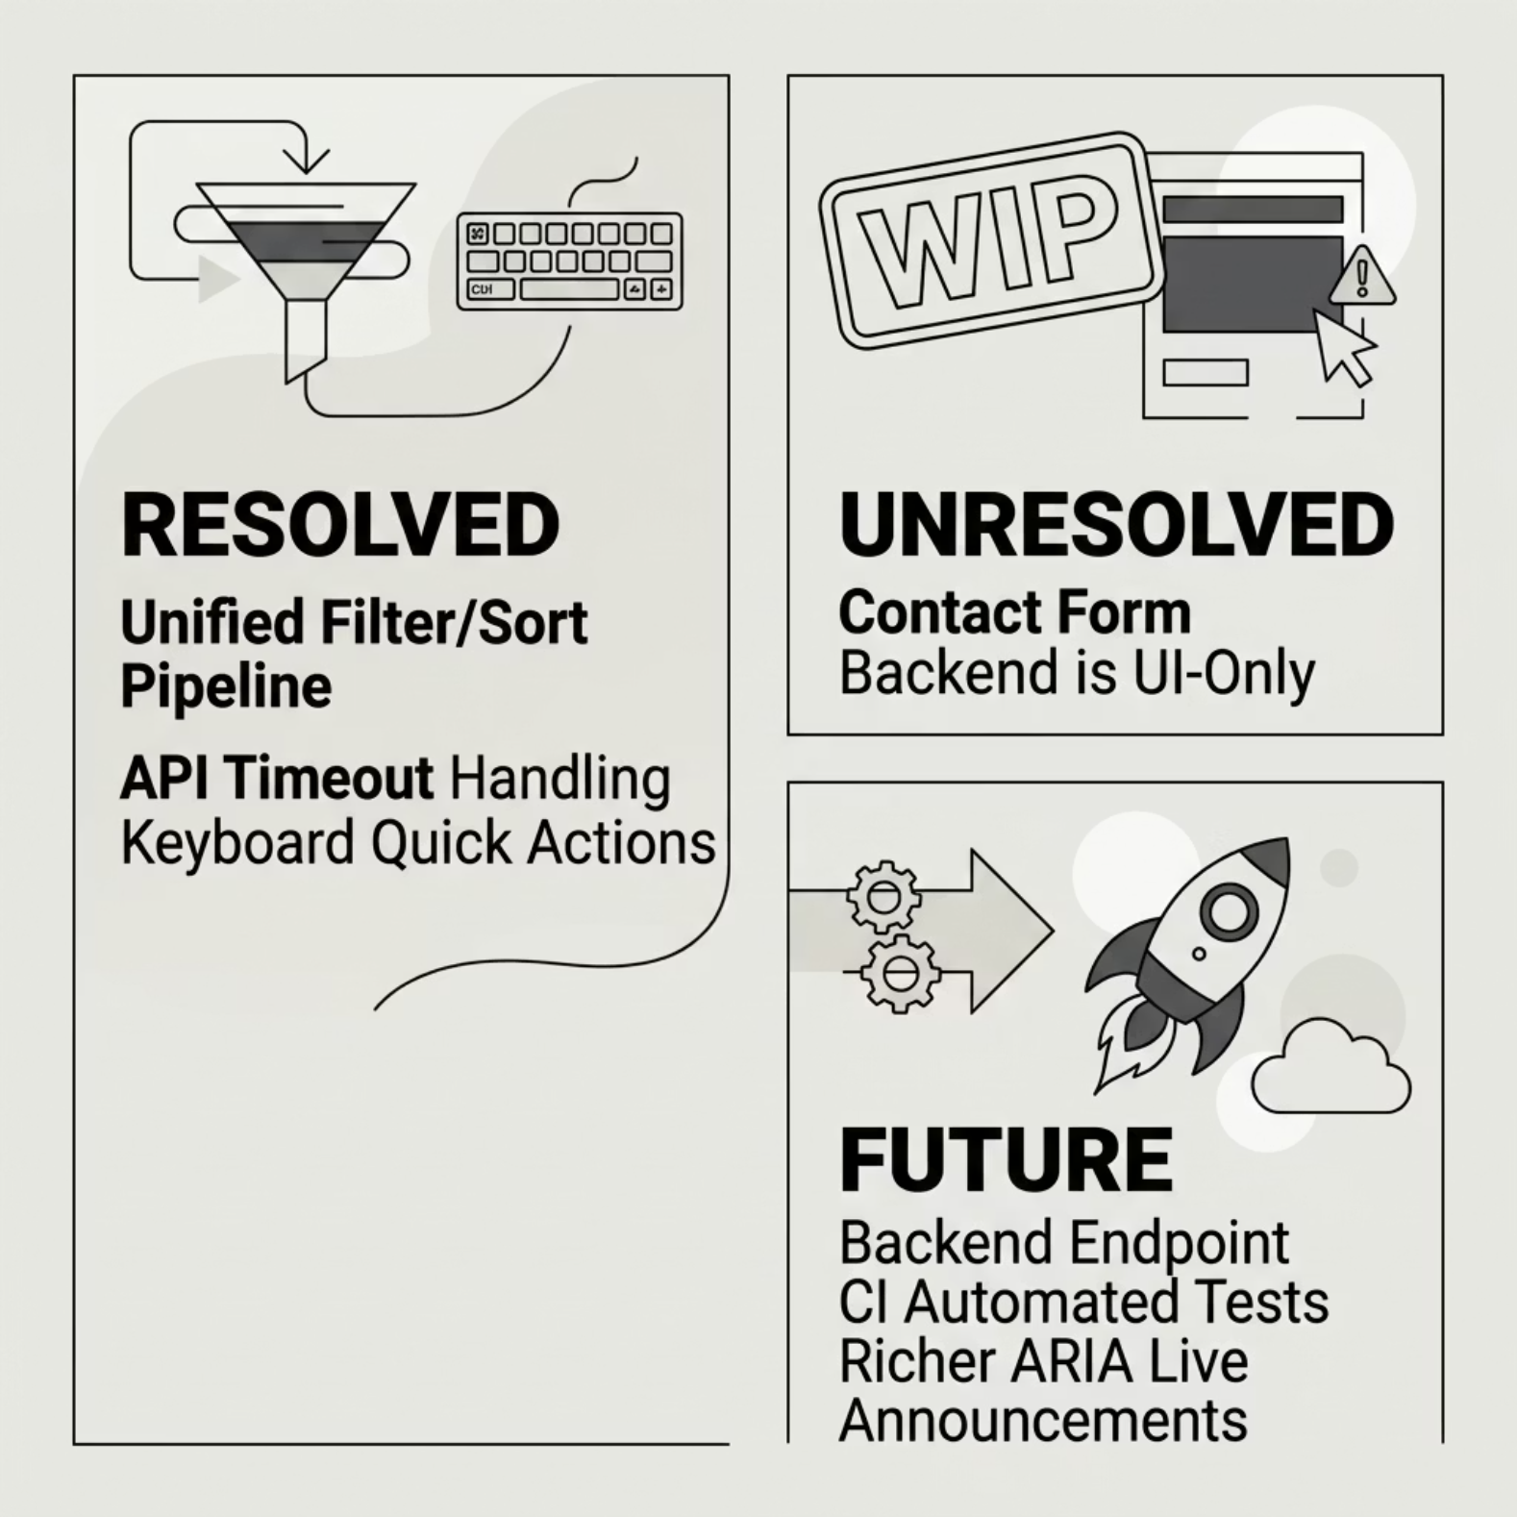


CHALLENGES & LEARNINGS
KEY TAKEAWAY
Designing frontend logic that is both interactive and maintainable — while keeping the final product professional.
Most challenging: combining category, level, and sort controls on one dataset cleanly

Slide 10
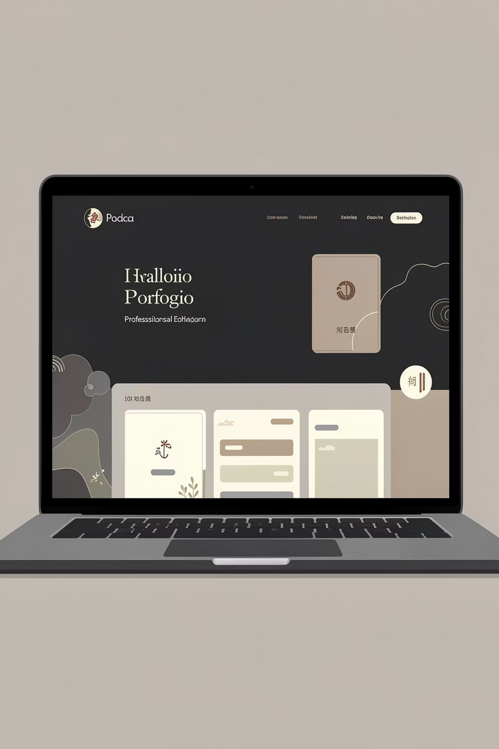
KEY OUTCOMES
STRONG FRONTEND
Responsive, animated, validated
MEANINGFUL API USE
Advice + GitHub with fallbacks
INNOVATION
Quick Actions keyboard palette
PERFORMANCE
91% image size reduction
Thank you — happy to demo any feature in more detail.

