Slide 1

DATA MINING
Artificial Intelligence Engineering Department
Dr.Rayan Abri

Slide 2

What is your expectation of this course?

Slide 3
Course Description?
Data Mining studies algorithms and computational paradigms that allow computers to find patterns and regularities in Dataset, perform prediction and forecasting, and generally improve their performance through interaction with data.
It is currently regarded as the key element of a more general process called Knowledge Discovery that deals with extracting useful knowledge from raw data.
The knowledge discovery process includes data selection, cleaning, coding, using different statistical and machine learning techniques, and visualization of the generated structures.
The course will cover all these issues and will illustrate the whole process by examples.

Slide 4

Course Objective?
Basic concepts of AI
Different methods for function approximation
Select the right learning scheme
Difference between shallow and Deep Learning
Verify the learning capability
Run and Evaluate experiments
Write a scientific paper

Slide 5
Grading Policies
It is expected that all students will conduct themselves in an honest manner and NEVER claim work which is not their own. Violating this policy will result in a substantial grade penalty or a final grade of F.
 | Task | Weight %
1 | Research | 0
2 | Quiz (2) | 10 Maybe
3 | Midterm | 30-40
4 | Final | 60
5 | Attendance | Mandatory

Slide 6
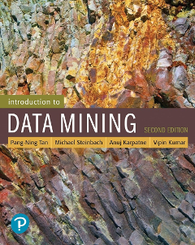
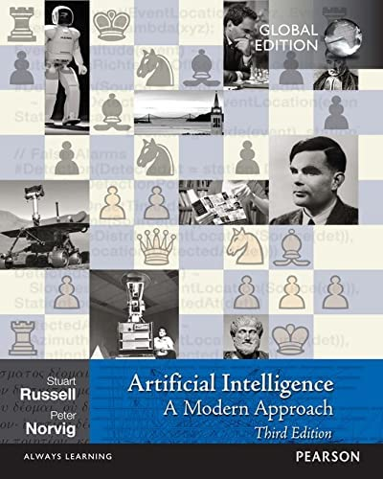
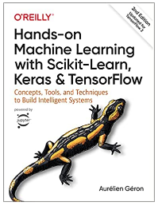
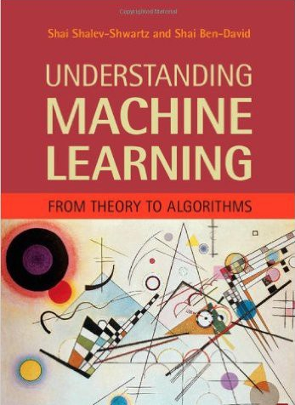
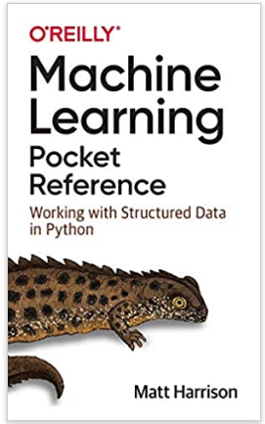

Books

Slide 7
Syllabus
# | Main Subject | Sub Groups
1 | Introduction to AI/Data Mining | General Concepts, History, Applications
2 | Data Preprocessing | Cleaning, Filtering, Normalization, Outlier Detection, Augmentation, Validations, K-fold CV
3 | Encoding/Embedding Data | Data Compression, PCA, LDA, T-SNE, Fisher Vector,VLAD,
4 | Supervised Learning/ Classification | Regressions, SVM, KNN, DT, Random Forests, Bayesian Learning, Naive Bayes
5 | Unsupervised Learning/ Clustering | K-Means, FCM, Cluster Validity, SOM
6 | Learning NN, CNN, AE’s | Perceptron, Back propagation, CNN, AEs
7 | Evolutionary Algorithms / Swarm Algorithms | GA,Opposition Based Learning, SA
8 | Fuzzy Logic | Concepts, Applications, FCM
9 | Reinforcement Learning | Q-Learning

