Slide 1
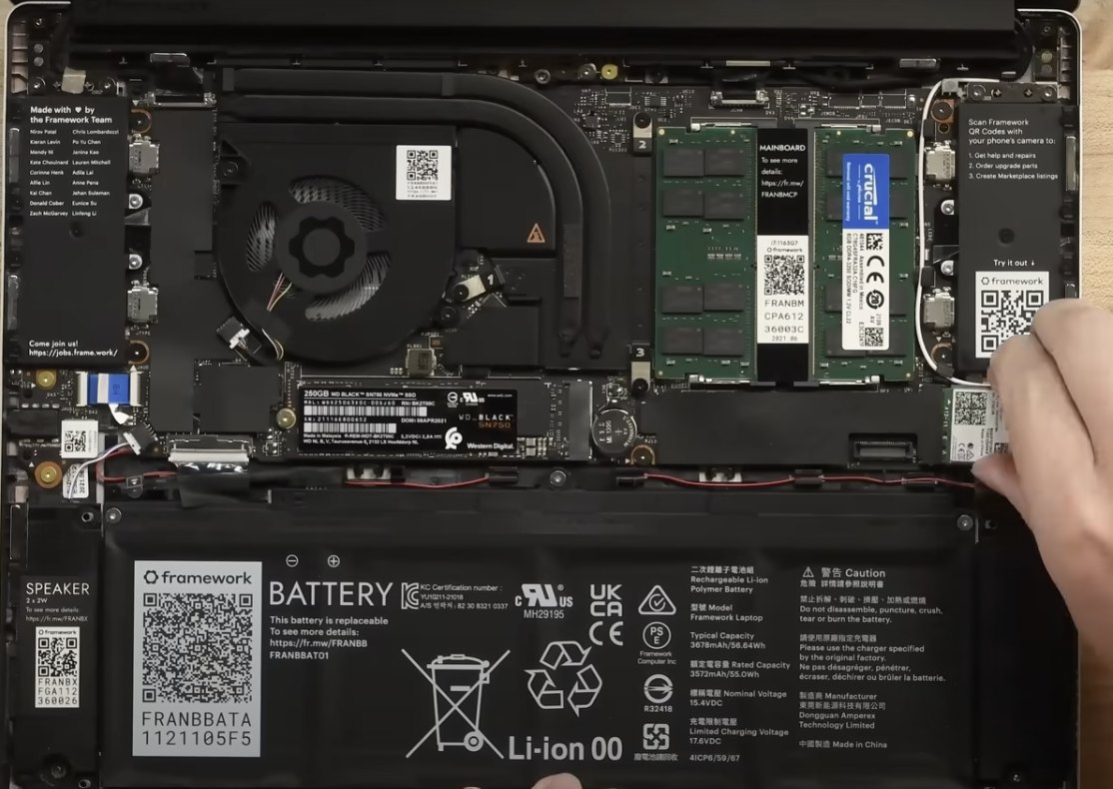



Device 1: Windows Laptop
Memory
Network adapter
SSD (storage)
Battery (power supply)

Slide 2
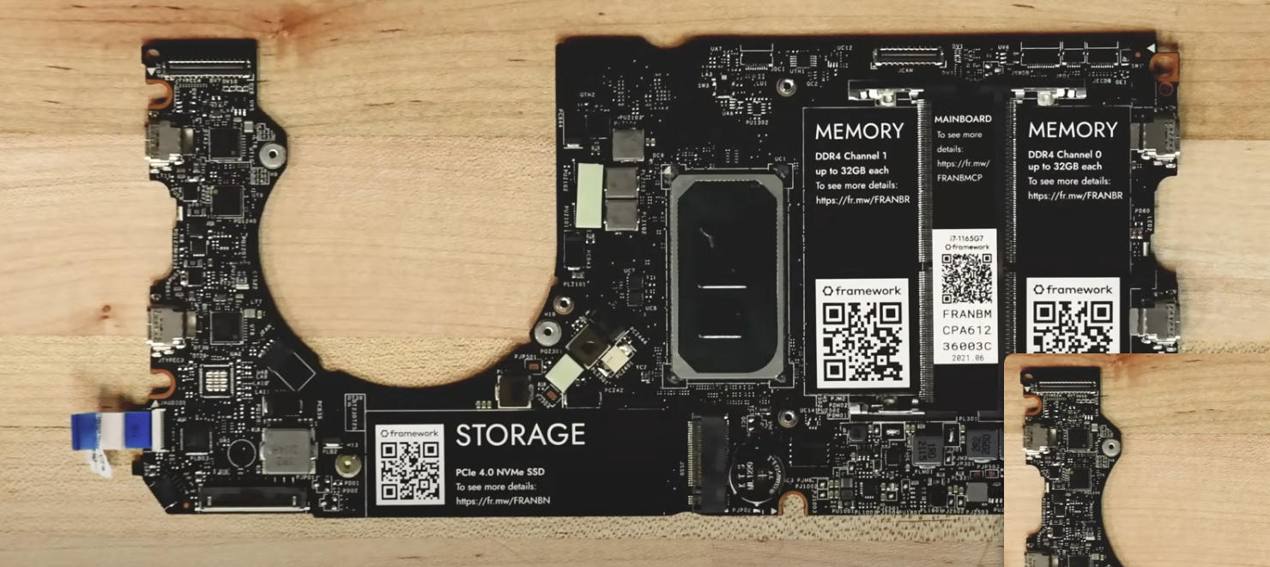


Device 1: Windows Laptop
CPU
Input and Output
Motherboard

Slide 3
Background Info
What I found very interesting is how the laptop uses a Solid State Drive instead of a traditional hard drive as these are significantly faster
I was also surprised by how large the battery really was. It takes up nearly 1/3 of the laptops size
It was also interesting to see how smaller the mother board really is. The essential components are all on the 2nd slide, most of the chasis is taken up by the battery and cooling systems

Slide 4
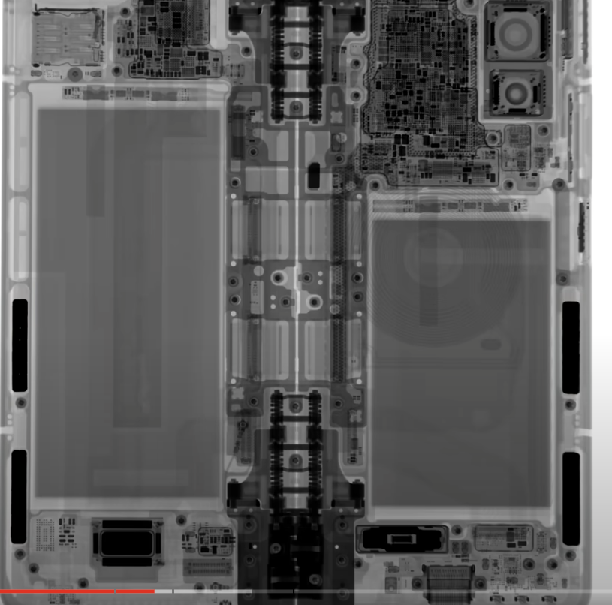
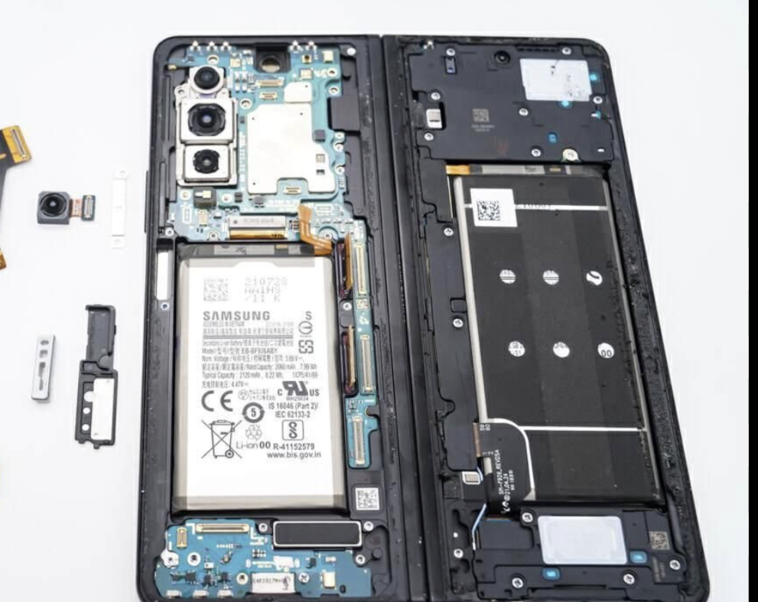




Device 2: Samsung Galaxy Z Fold 3
Motherboard
CPU & Memory
Network adapter
Battery
Storage
Input/Output (USB-C port, speakers)

Slide 5
Background Info
I was surprised to see how a folding phone is really laid out.
I originally imagined that it would be 2 identical halved merged together, but as we can see they do differ; one side has a larger battery while the other houses the camera, SoC, and USB-C port
I also found it interesting how it uses a System on a Chip where the CPU and RAM are integrated together saving space and increasing speed

Slide 6
Discussion
The devices did differ naturally as one is a laptop and the other is a smart phone; they have different sizes and use cases
The laptop was a bit easier to find the parts for as the video labeled everything with stickers and many laptops share the same general layout, so it followed what I expected
The phone was more difficult as it is a unique design due to being a folding phone and the SoC made it tricky as I had to do further research into the device, and it differed from what I expected
I picked these devices because I own a laptop, and while I don’t have this specific phone, I was intrigued into finding out how a folding phone looked like from the inside
This activity taught me how complex, yet thought out the design of common electronics is. Every single inch of space is optimized to house the internals of the device and the specific hardware specs are chosen because they are what best fits the needs of the device

