Slide 1
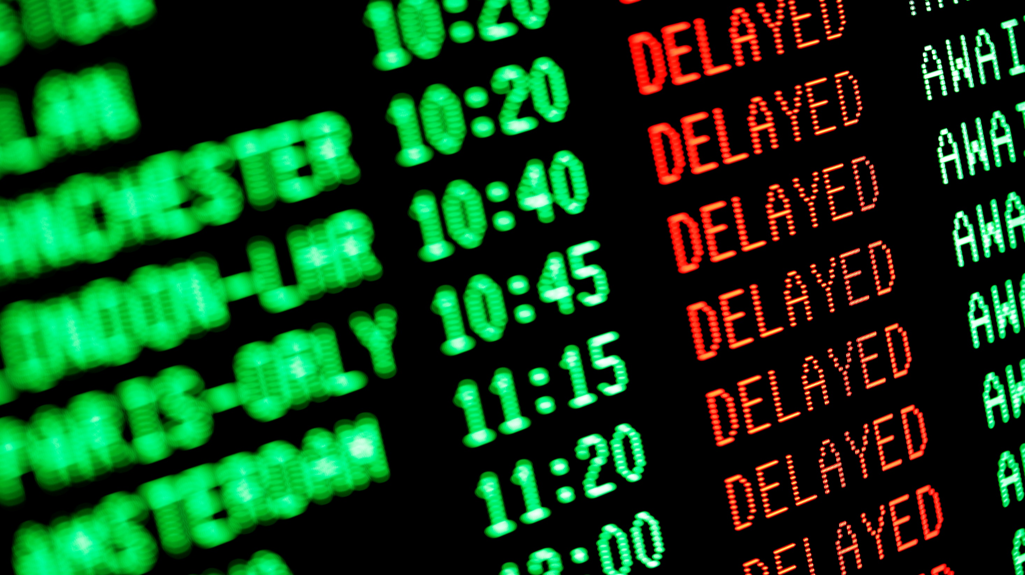
AirPlanes Delays !! ☹ ☹ ☹
By Rayan Nakouri

Slide 2
This is our problem :
Passengers wait airplanes
Airplanes don’t wait Passengers
Is that legal ☹ ??
Most of airplanes are delayed and most of passengers lived the moment which they were forced to wait for the plane for a vacation, a buisness meeting outside …
Delays are accused to lose time for passengers and they may be busy
Everyone knows how time is expensive !!

Slide 3
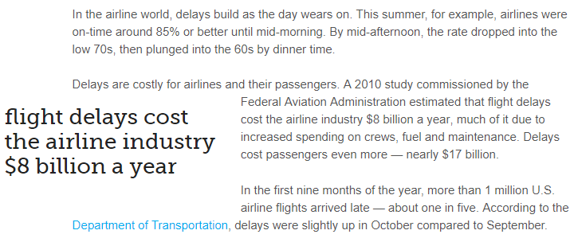
Statistics
WTF ??
Usually, delays are accused to lose money also for the AirLineCompany

Slide 4
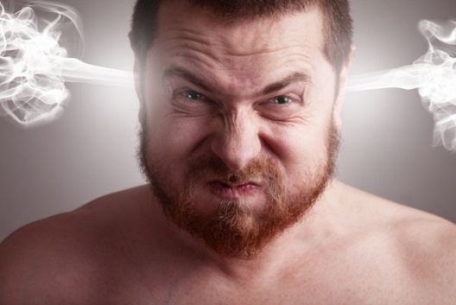
So my project tries to find a solution for « Delays »
How ??

